Slide 1



CEPC MDI Key issue studies in EDR
Sha Bai
On behalf of CEPC MDI group
IAS Program on High Energy Physics (HEP 2024)
Jan 22-25, 2024

Slide 2
Outline
Introduction
IR beam pipe structure
IR beam pipe plan in EDR
Radiative background in EDR
Masks
Shielding
Movable collimators
Remote Vacuum Connector
SC magnet supporting system
Integration and assembly
Fast luminosity tuning system
Summary

Slide 3
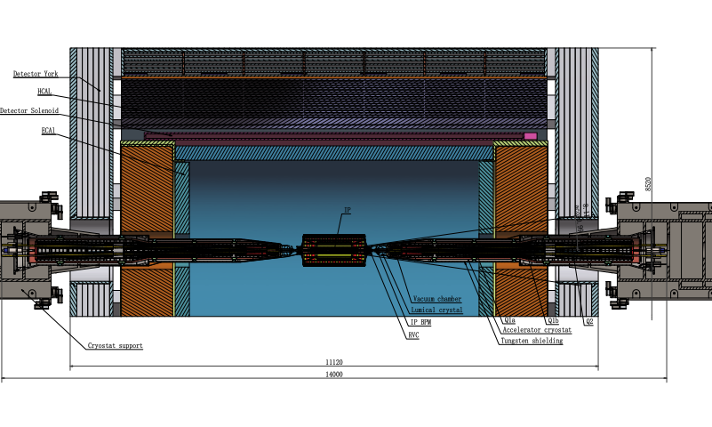
MDI layout and IR design
The Machine Detector Interface (MDI) of CEPC double ring scheme is about ±7m long from the IP.
MDI components and topics in EDR~ IR beam pipe including beryllium pipe and tungsten alloy beam pipe; radiative background especially consistent with experiment and software improvement; Masks; Shielding; collimators; RVC; SC magnet supporting system; integration and assembly; fast luminosity tuning system; etc on.

Slide 4
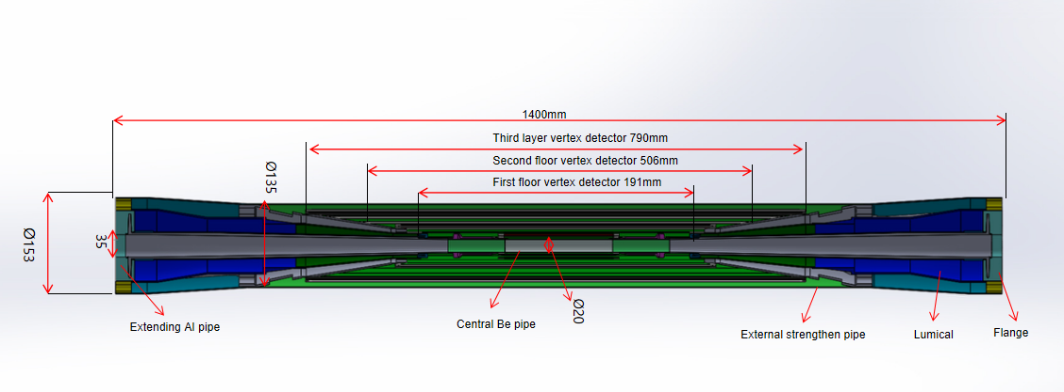
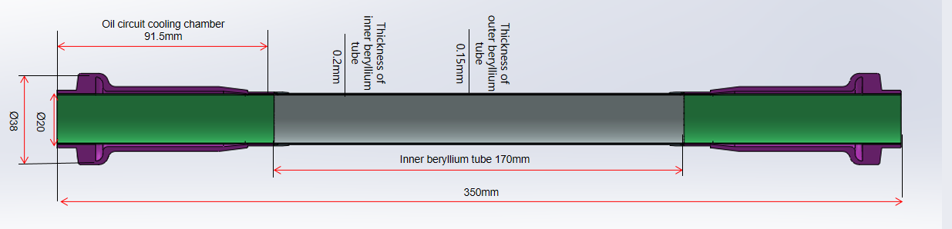
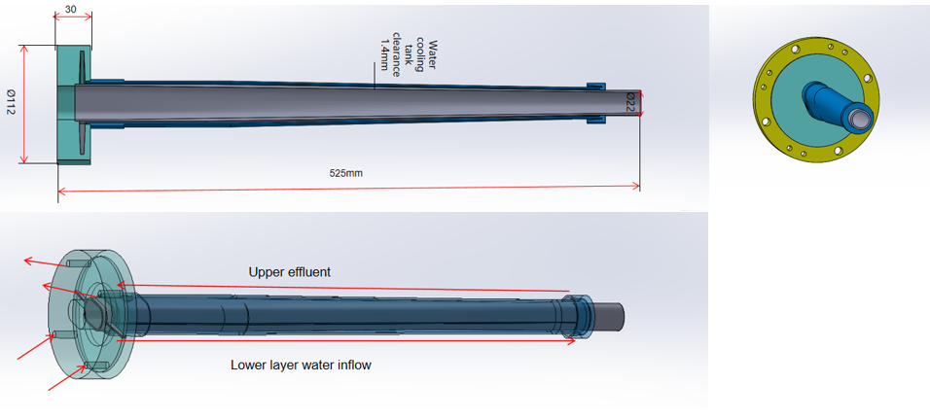
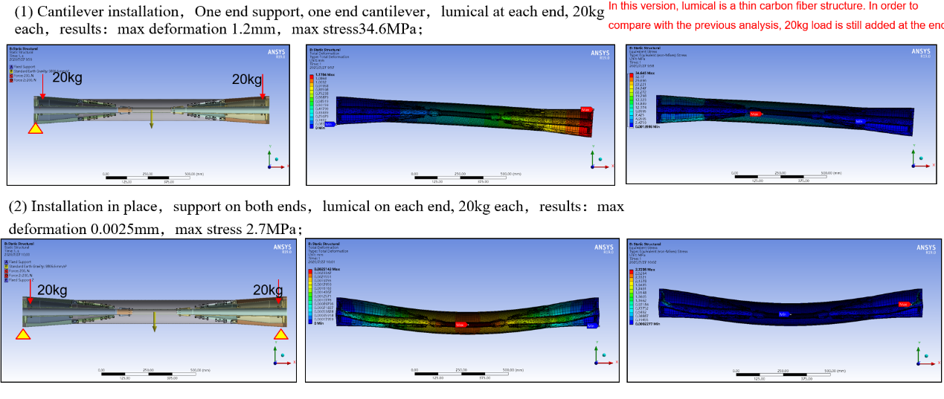
IR beam pipe structure
The center of the beam pipe adopts a double-layer beryllium pipe structure, with an overall length of 350mm.
The thickness of the inner beryllium pipe is 0.2mm, and the outer beryllium pipe is 0.15mm.
A 0.5mm cooling gap between the double layer beryllium tubes, which is filled with coolant.
The coolant enters through the left amplification chamber, passes through the gap between the double layer beryllium pipes, and finally is discharged through the right amplification chamber, taking away the HOM heat from the inner wall through cooling.
when both ends of the beam pipe are supported, the maximum sink at the center during the simulated installation is 0.0025 mm, and the maximum stress is 2.7 MPa, which meets the requirements and ensures the overall structural safety.
Central beryllium pipe
Epitaxial aluminum tube structure

Slide 5
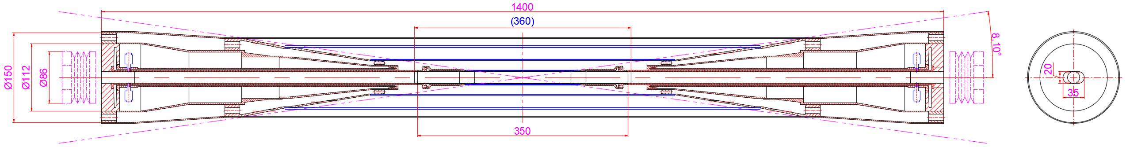
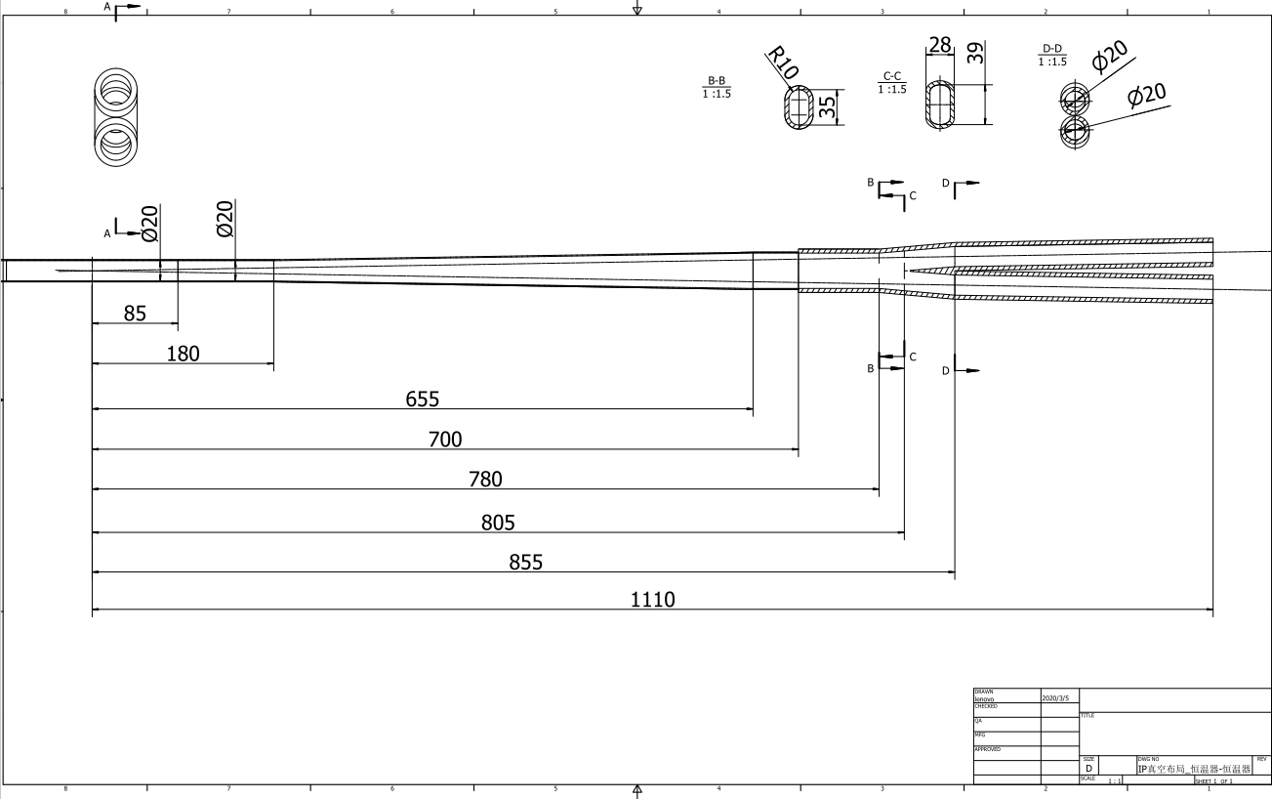
IR beam pipe design plan in EDR
Processing and manufacturing of IR beam pipes, including beryllium pipe and tungsten alloy beam pipe.
To make prototypes of the beryllium beam pipe, and to improve the key technology such as the manufacture of the pure berryllium pipe, the choice of the coolant, the estimation between the coolant and the pipe in radiation environments, the welding between berryllium and other materials like aluminum, the window to LumiCal, and so on.

Slide 6
Radiative background in EDR
Improve the efficiency and accuracy of background simulation to narrow the difference with future experiments, including the improve the quality of the all the generation tools, the interface between different tools, and also made the new version of the beam background simulation toolkit dedicated to CEPC simulation.
Apply and test the toolkit on existing machines like BEPCII and SuperKEKB, to validate the toolkit, and use the new toolkit to simulate CEPC beam backgrounds, to estimate the background level in whole interaction region, including the detector and also the accelerator components, and optimize the interaction region layout based on the estimation.
More simulations and experiments based on BEPCII can help understand the background and narrow the differences between data and simulation.
A. Natochii
Photon BG
Beam loss BG
Injection BG
A. Natochii
Background sources
  Photon backgrounds: SR, Pair production
  Beam loss backgrounds
    Radiative Bhabha scattering
    Beam Gas scattering
    Beam Thermal photon scattering
  Injection background

Slide 7
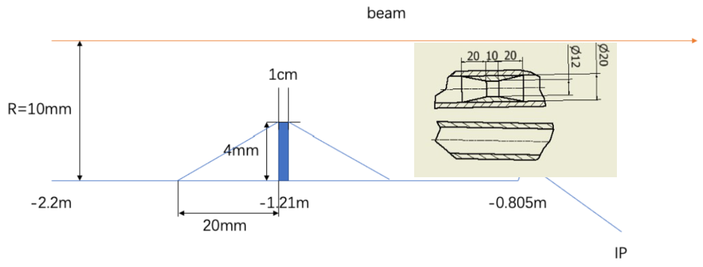
Masks
Methods | Photon hitting number on Be/BX | Deposition power on Be(W)
No mask | 39400.0 | 30.57*e-5
1.21-mask-Cu | 1736.0 | 1.45*e-5
1.21-mask-W | 1698.0 | 1.36*e-5
2.2-mask-Cu | 1147.0 | 0.94*e-5
1.21-mask-Cu-5㎛Au | 216.0 | 0.273*e-5
Masks design(two masks/IP/ring) :
  Tungsten
  One locates at -1.21m with 4mm height and 10mm long
  The other at -4.2m with 0.6mm height
Photons hitting number on Be/BX reduced by two orders of magnitude
Deposition power on Be pipe suppressed to acceptable level by vertex detector
Masks will be processed and manufactured along with Tungsten alloy IR beam pipe

Slide 8
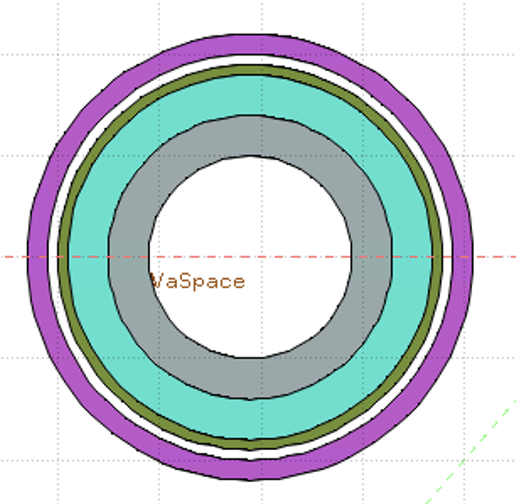
Shielding
Shielding in MDI including 4 parts:
Tungsten alloy IR beam pipe
Combined iron and tungsten yoke of SC magnet
Gold plating on beryllium pipe (~5µm)
Tungsten shielding outside of cryostat
Accelerator
Detector
White: Vacuum
Gray: Tungsten Pipe
Light Green: Helium
Heavy Green: Stainless Steel Vassel
Pink: Coil
Key Issues on Calculation and Simplification of Beam pipe model
Pure tungsten IR beam pipe with 4mm thickness without cooling taken into account, simulate the Absorbed Dose on Coil (Region)
The very tight space of thickness ~Tungsten IR beam pipe
Seek for better new shielding material
It is unlikely to use pure tungsten, which is too brittle.
WNiFe and WNiCu are two kinds of alloys that can be made. WNiCu is non-magnetic, but it is difficult to make this alloy too long. It must be welded in sections, with each section no more than 1m.
For the 6m long IR beam pipe, there will be many welds.
Tungsten alloy is made by powder pressing. It has certain machining performance and welding performance (brazing). The vacuum performance is unknown.

Slide 9
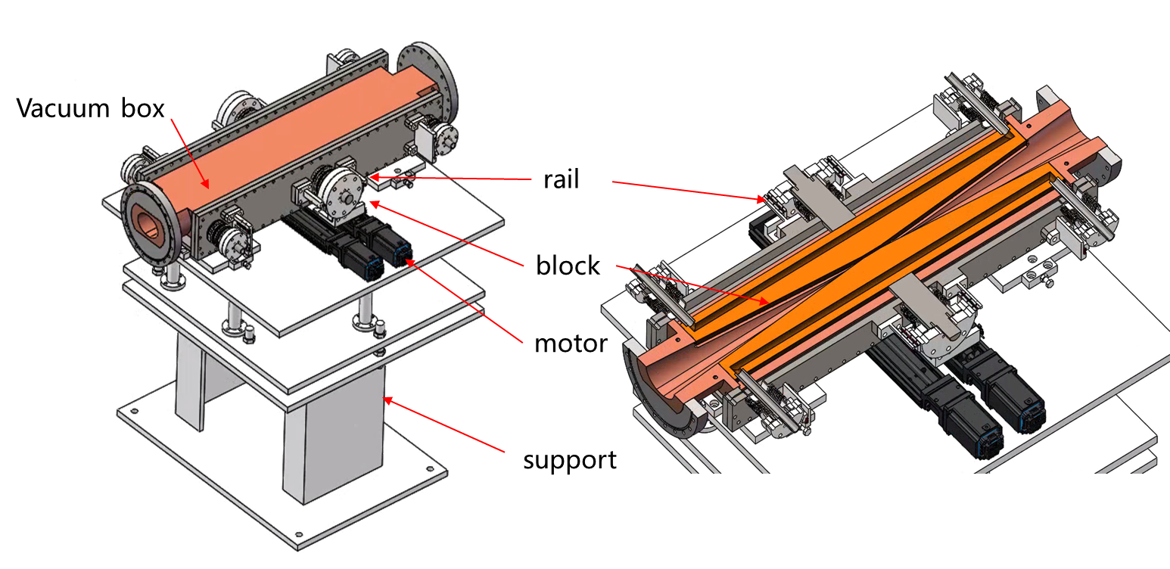
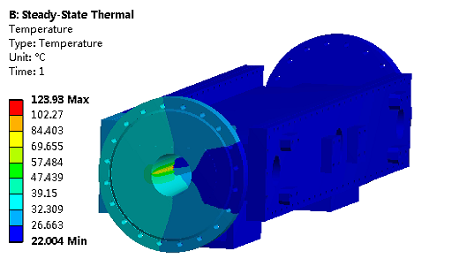
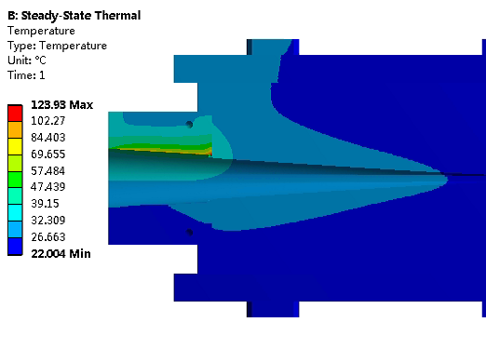
Movable collimators
  In TDR, we made a preliminary design of horizontal movable collimator for background decreasing.
  Jaw and vacuum vessel material: Glidcop Al-15, can endure the SR and HOM power in normal operation.
Plan in EDR:
  The structure design and detailed FEA, beam-material interaction and impedance.
  The necessary technique study if possible (eg. Tip material and connecting technique with jaw body. )
Aim:
  Collimators can work theoretically.
  Thermal conductivity of new material ≥600 W/(m.K）
  Connection strength higher than 90% strength of base material.
Highest temperature: 124 ℃

Slide 10
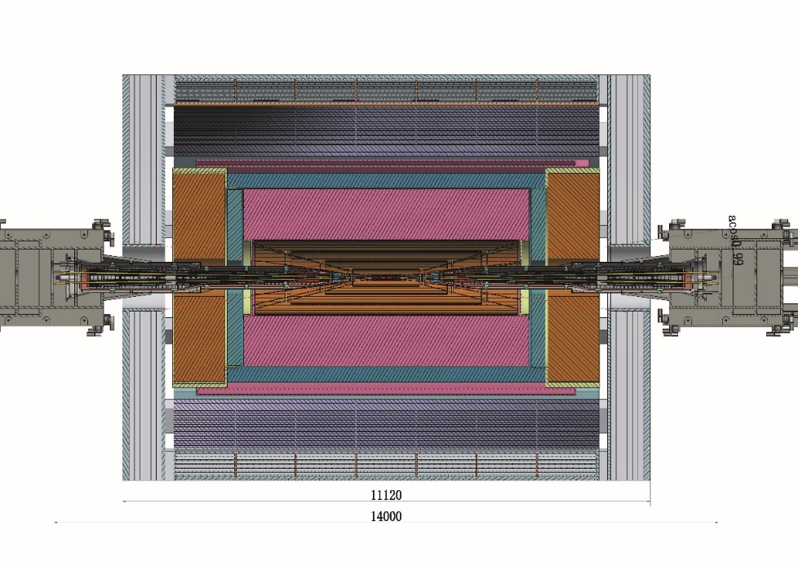
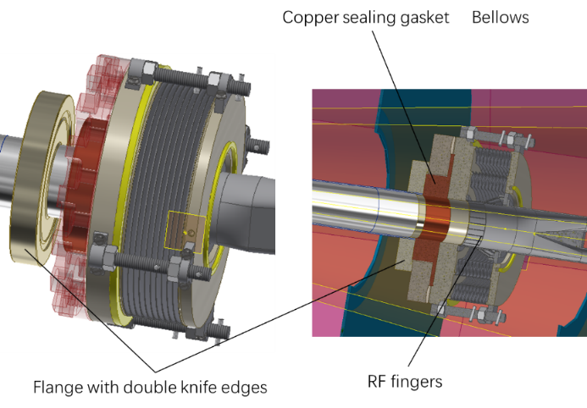
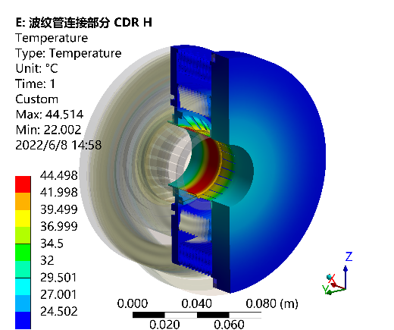
Remote Vacuum Connector plan in EDR
  Plan in EDR: further assessment and mechanical design of the RVC, and a prototype if possible.
  Aim: RVC leak rate~ 2.7 ×10^{–11} Pa·m³/s

Slide 11
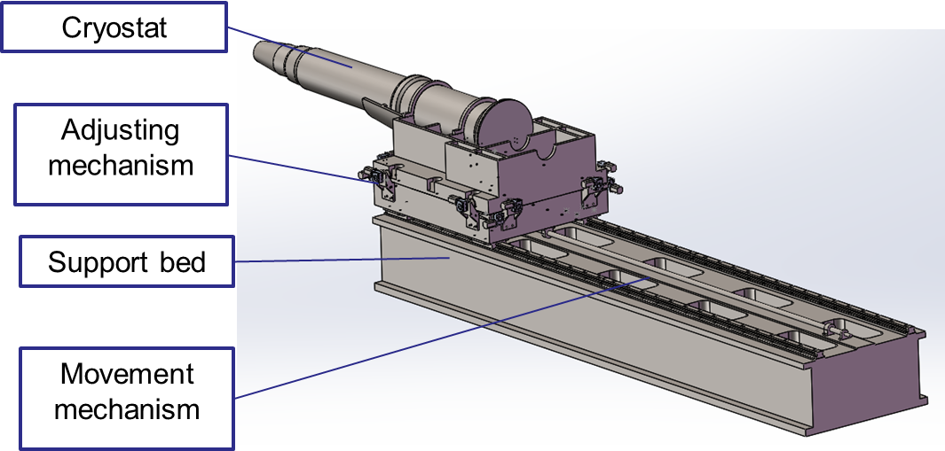
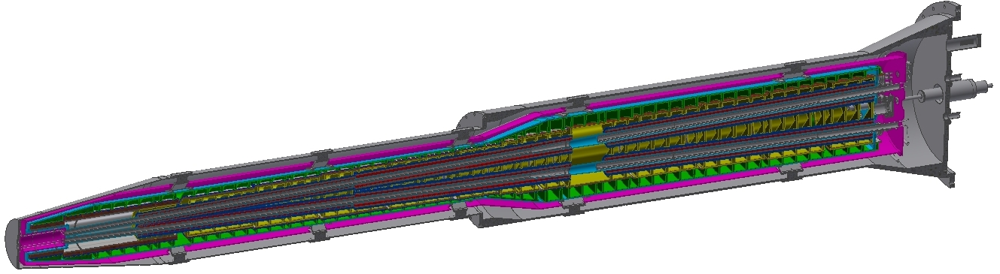
SC magnet support system
  Aim: Support resolution~5µm. Support can work theoretically.
Plan in EDR
  The basically determined structure design of the support for cryostat at MDI, the detailed FEA of structure and stability, including the rough assessment of Lorenz force, quench cases and temperature change.
  The necessary technique study if possible (eg. Vibration, movement and alignment related techniques).
Thermal shield
Helium vessel
Q2
Vacuum vessel
Q1b
Q1a
Anti-solenoid
Support rods

Slide 12
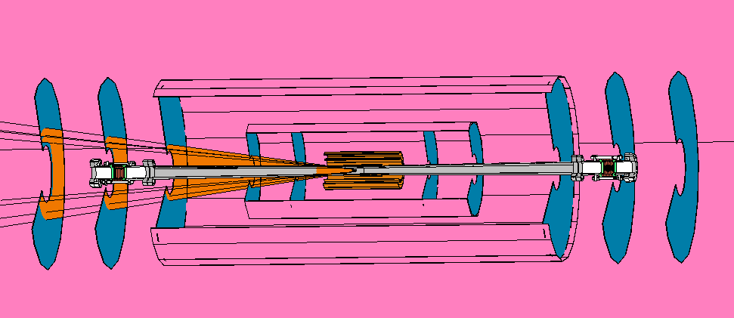
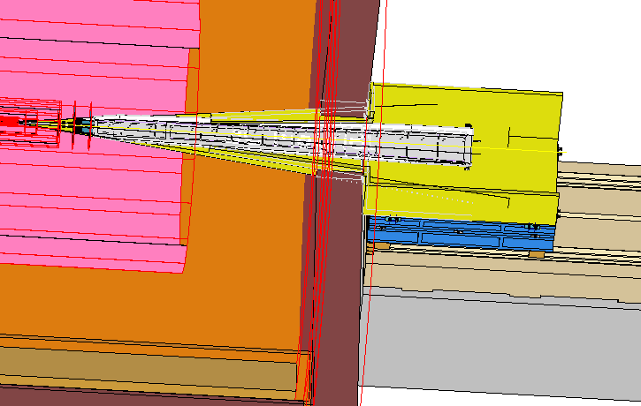
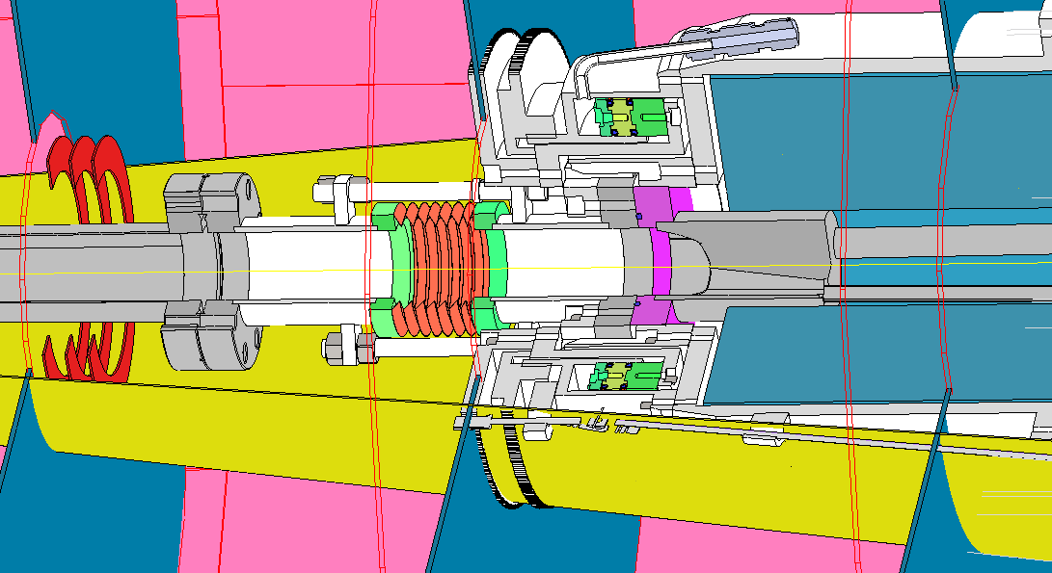
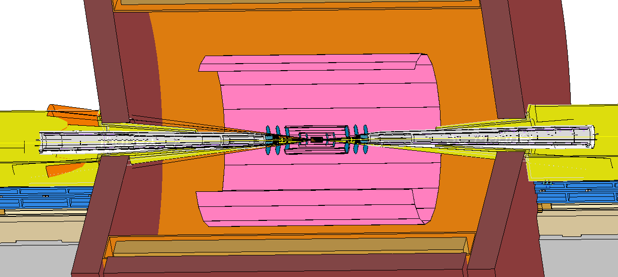
Integration and Assembly
Overall integration and installation for all components in the MDI.
Specific installation procedure.
Cryostat including Final doublet installation alignment.
Lumical and Berryllium pipe installation alignment.

Slide 13
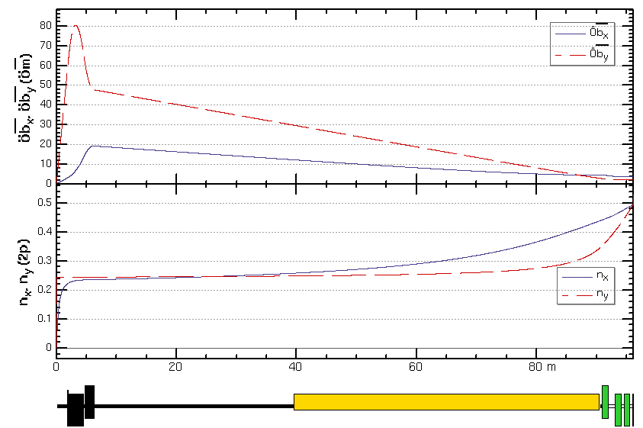
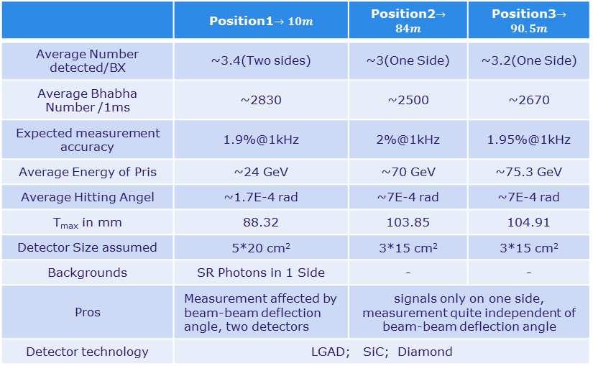
Fast luminosity tuning system
With very small beam sizes at IP and the presence of strong FFS quadrupoles in the CEPC, the luminosity is very sensitive to the mechanical vibrations, Fast Luminosity Tuning System, including fast BPMs and fast luminosity monitor, would be necessary for CEPC.
Currently,
Using 4 sets of BPMs each ring and located at or near the largest beta function can be used for vertical orbit feedback in principle.
The Fast Luminosity Monitor are needed as input to luminosity optimization and feedback. We already have some candidate positions and potential detector solutions.
IP
1
2
3
 | Position1$→10m$ | Position2$→84m$ | Position3$→90.5m$
Average Number detected/BX | ~3.4(Two sides) | ~3(One Side) | ~3.2(One Side)
Average Bhabha Number /1ms | ~2830 | ~2500 | ~2670
Expected measurement accuracy | 1.9%@1kHz | 2%@1kHz | 1.95%@1kHz
Average Energy of Pris | ~24 GeV | ~70 GeV | ~75.3 GeV
Average Hitting Angel | ~1.7E-4 rad | ~7E-4 rad | ~7E-4 rad
T_{max} in mm | 88.32 | 103.85 | 104.91
Detector Size assumed | 5*20 cm² | 3*15 cm² | 3*15 cm²
Backgrounds | SR Photons in 1 Side | - | -
Pros | Measurement affected by beam-beam deflection angle, two detectors | signals only on one side, measurement quite independent of beam-beam deflection angle
Detector technology | LGAD; SiC; Diamond
Plan in EDR
More detailed simulations to study, including determine the detailed location and quantity of BPMs and the reaction between the primary Bhabha scattering electrons and beam pipe, as well as the design of detectors and feedback .
The detailed design of the detectors.

Slide 14
Summary
MDI components and topics in EDR~ IR beam pipe including beryllium pipe and tungsten alloy beam pipe; radiative background especially consistent with experiment and software improvement; Masks; Shielding; collimators; RVC; SC magnet supporting system; integration and assembly; fast luminosity tuning system; etc on.
Processing and manufacturing of IR beam pipes. To make prototypes of the beryllium beam pipe, and to improve the key technology such as the manufacture of the pure berryllium pipe.
Improve the efficiency and accuracy of background simulation to narrow the difference with future experiments. Try to apply and test the toolkit on existing machines like BEPCII and SuperKEKB. More simulations and experiments based on BEPCII can help understand the background and narrow the differences between data and simulation.
Masks will be processed and manufactured along with Tungsten alloy IR beam pipe.
Shielding in MDI including 4 parts. The very tight space of tungsten IR beam pipe ~Seek for better new shielding material.
For collimators, the structure design and detailed FEA, beam-material interaction and impedance. The necessary technique study if possible (eg. Tip material and connecting technique with jaw body. )
Further assessment and mechanical design of the RVC, and a prototype if possible.
The basically determined structure design of the support for cryostat at MDI, the detailed FEA of structure and stability, including the rough assessment of Lorenz force, quench cases and temperature change. The necessary technique study if possible (eg. Vibration, movement and alignment related techniques).
Overall integration and installation for all components in the MDI. Specific installation procedure.
For the fast luminosity tuning system, more detailed simulations to study, including determine the detailed location and quantity of BPMs and the reaction between the primary Bhabha scattering electrons and beam pipe, as well as the design of detectors and feedback. The detailed design of the detectors.

Slide 15
Thanks

