Slide 1
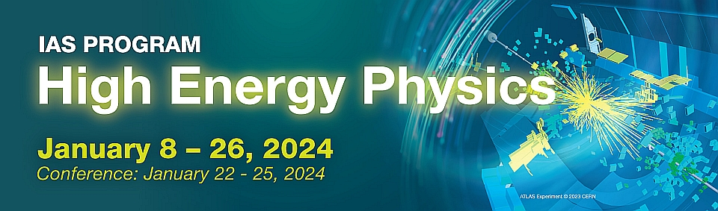

CEPC SRF Development in EDR
Jiyuan Zhai (IHEP)
IAS Program on High Energy Physics (HEP 2024)
HKUST, Hong Kong, Jan 22-24, 2024

Slide 2
Content
TDR design of CEPC SRF system
EDR plan of CEPC SRF system
Key component R&D consideration
Summary

Slide 3
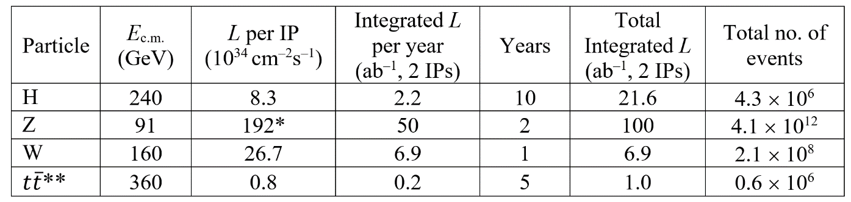
Design Requirement and Challenges of CEPC SRF System
CEPC collider 50 MW | Energy (GeV) | Current (mA) | RF voltage (GV)
Z | 45.5 | 1345 | 0.1
W | 80 | 140 | 0.7
H | 120 | 27.8 | 2.2
ttbar | 180 | 5.6 | 10
Higgs priority
- timeline and performance priority
Upgradable
- power (luminosity) and energy upgrade
Low cost (especially first stage)
- staged cost and in-kind contribution
Max luminosity for each mode
- up to 50 MW SR power per beam
Seamless mode switch
- switch among H/W/Z/(ttbar)
45.5-180 GeV double-ring collider with a full energy booster, RF system cost and reliability
6.6/30 GV total RF voltage, cavity G & Q, heat load
1.3 A beam current, 100 km large ring, low cavity RF voltage, beam-cavity interaction
60/100 MW SR power, coupler capacity and match
6 kW HOM power / cell, HOM damper, #CAV in CM

Slide 4
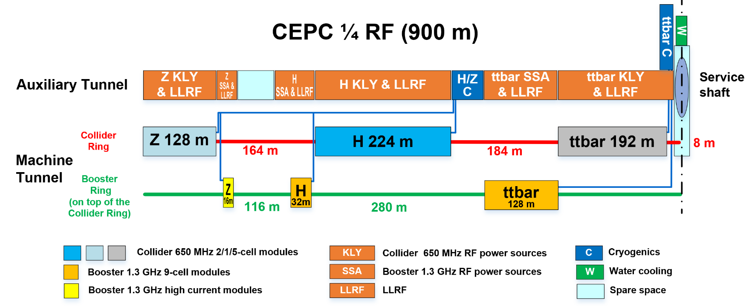
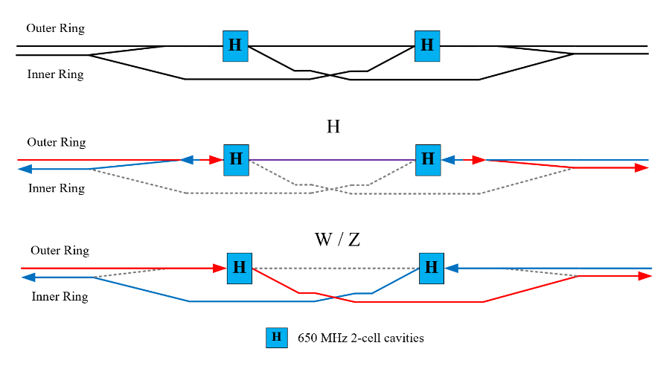
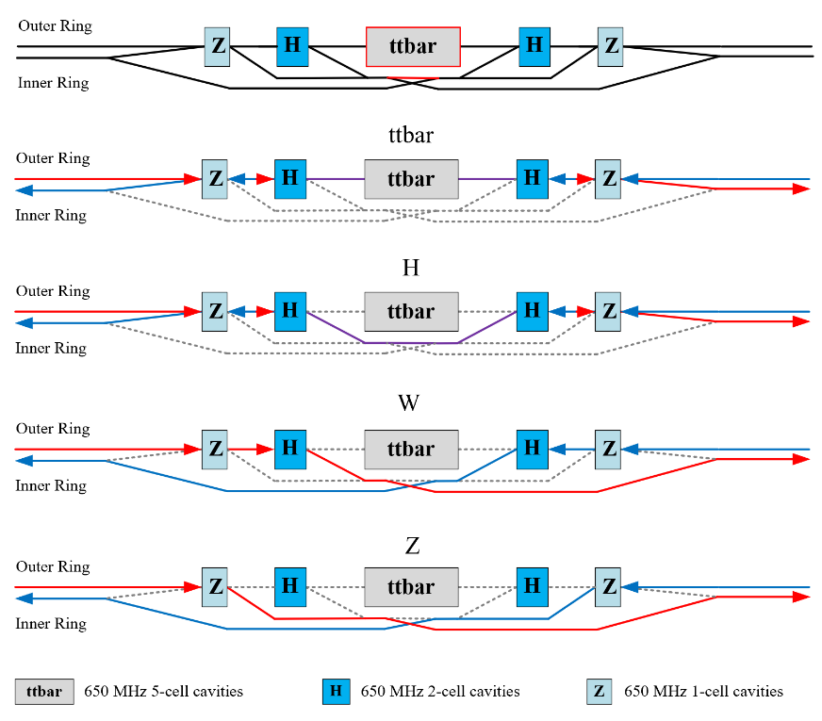
CEPC RF Layout
Collider RF Staging and Bypass Scheme
RF power transfer from H to Z to have less klystrons? Waveguide loss
Bypass booster H cavities for low luminosity Z (< 10 MW) operation.
2x3.7 km long straight section, 2x1.8 km RF section
3 km RF module footprint, 2 km RF module
628 650 MHz cavities, 352 1.3 GHz cav, total 980 cav, 4900 cells

Slide 5
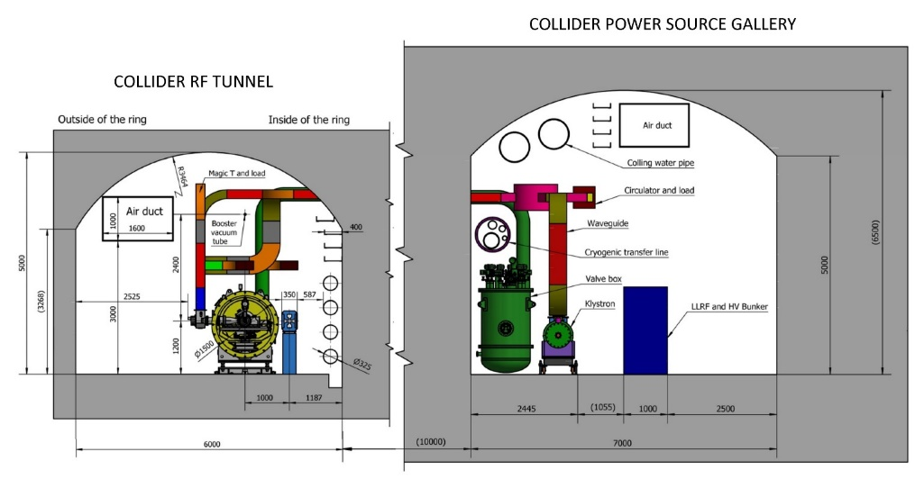
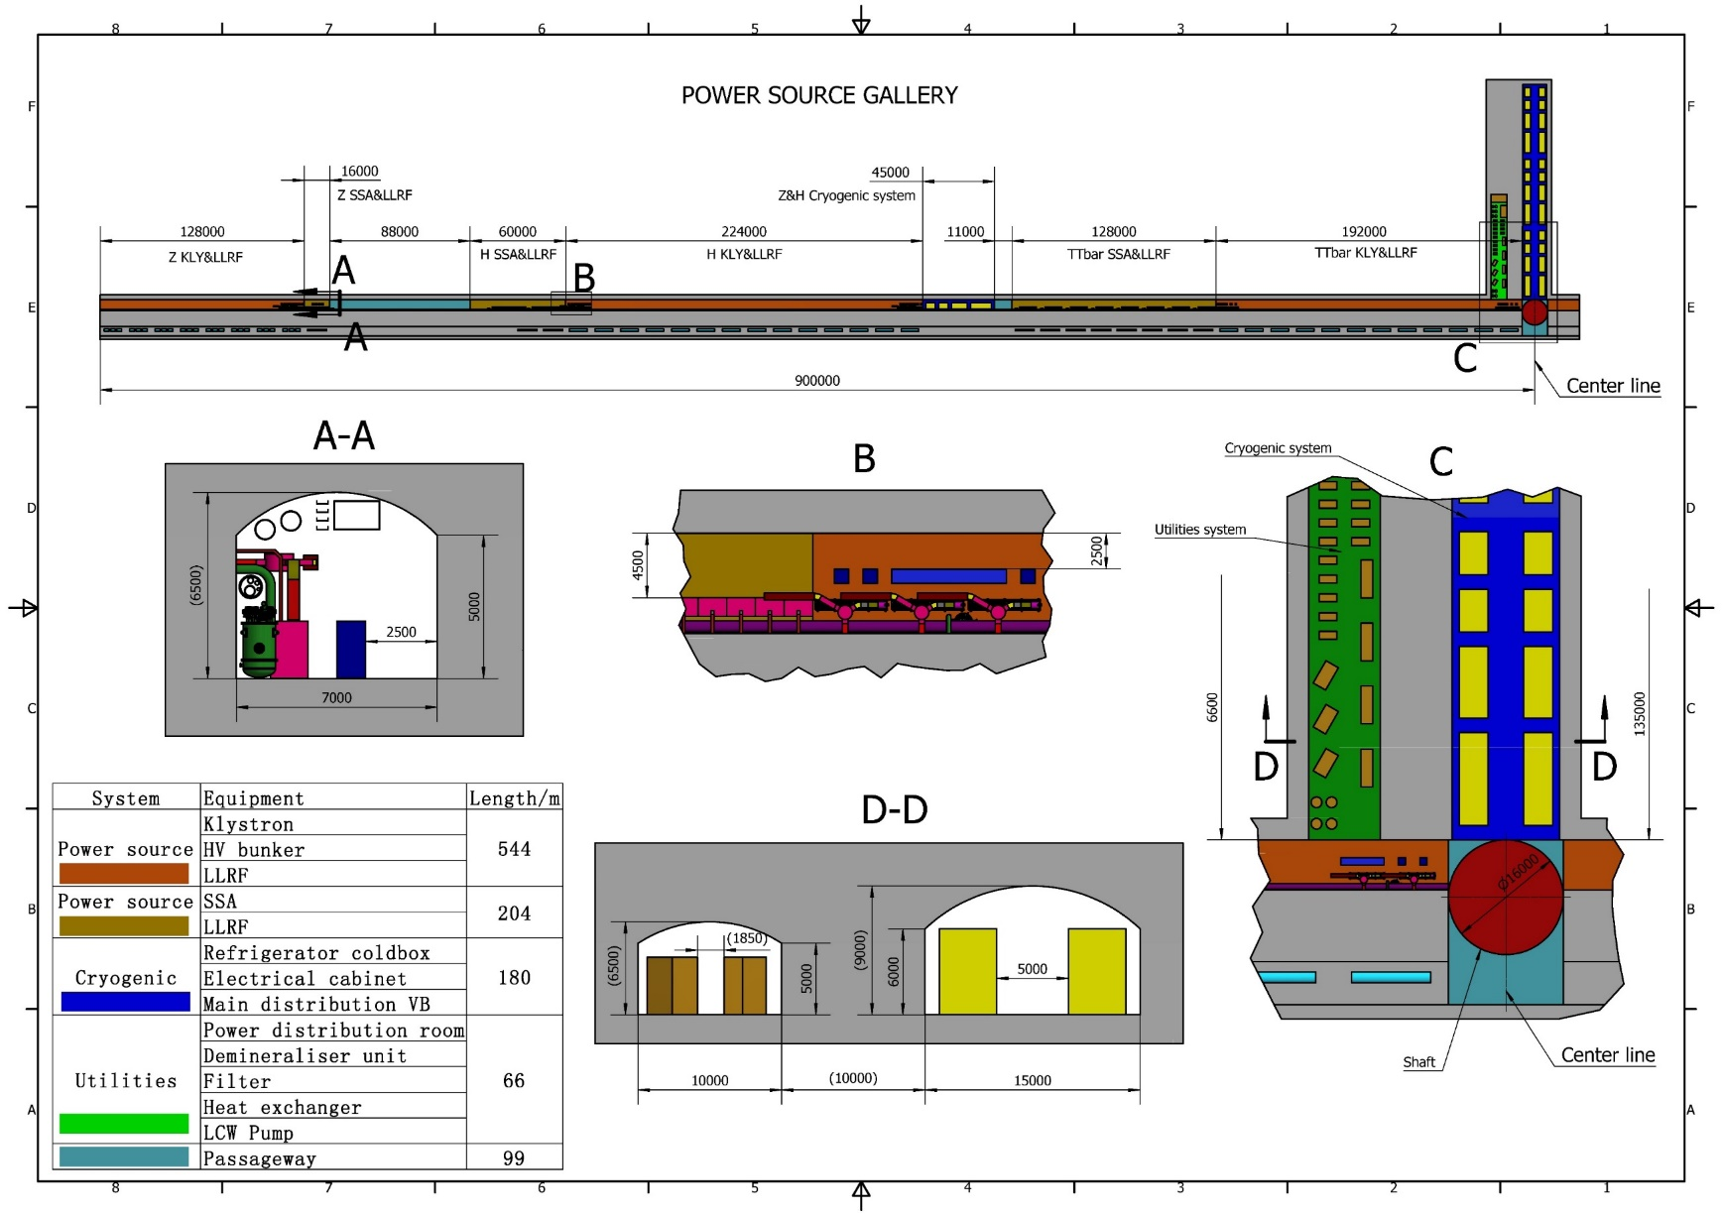
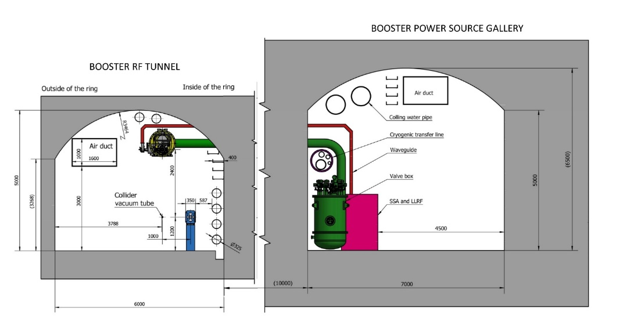
CEPC RF Tunnel
650 MHz cryomodules mounted on tunnel floor. Cavities operate in CW mode.
1.3 GHz cryomodules hung from ceiling at a different beamline height and in between collider cryomodule sections. Cavities operate in fast voltage ramp mode.

Slide 6
CEPC Collider Ring 650 MHz RF Parameters
30/50 MW SR power per beam for each mode. Higgs/ttbar shared cavities for the two rings. W/Z separate cavities. HL-Z cavities bypass. | ttbar 30/50 MW |  | Higgs 30/50 MW | W 30/50 MW | Z 10 MW | Z 30/50 MW
 | New cavities | Higgs cavities
Luminosity / IP [10³⁴ cm⁻²s⁻¹] | 0.5 / 0.8 |  | 5 / 8.3 | 16 / 26.7 | 38 | 115 / 192
RF voltage [GV] | 10 (6.1 + 3.9) |  | 2.2 | 0.7 | 0.12 | 0.12 / 0.1
Beam current / beam [mA] | 3.4 / 5.6 |  | 16.7 / 27.8 | 84 / 140 | 267 | 801 / 1345
Bunch charge [nC] | 32 |  | 21 | 21.6 | 22.4 | 22.4 / 34.2
Bunch length [mm] | 2.9 |  | 4.1 | 4.9 | 8.7 | 8.7 / 10.6
650 MHz cavity number | 192 | 336 | 192/336 | 96 / 168 / ring | 48 / ring | 30 / 50 / ring
Cell number / cavity | 5 | 2 | 2 | 2 | 2 | 1
Gradient [MV/m] | 27.6 | 25.2 | 24.9 / 14.2 | 15.9 / 9.1 | 5.4 | 17.4 / 8.7
Q₀ @ 2 K at operating gradient | 3E10 | 3E10 | 3E10 | 3E10 | 3E10 | 2E10
HOM power / cavity [kW] | 0.4 / 0.66 | 0.16 / 0.26 | 0.4 / 0.67 | 0.93 / 1.54 | 1.9 | 2.9 / 6.2
Input power / cavity [kW] | 188 / 315 | 71 / 118 | 313 / 298 | 313 / 298 | 206 | 1000
Optimal Q_{L} | 1E7 / 6E6 | 9E6 / 5.4E6 | 1.6E6 / 9.5E5 | 8E5 / 2.7E5 | 1.4E5 | 1.5E5 / 3.8E4
Optimal detuning [kHz] | 0.01 / 0.02 | 0.02 / 0.03 | 0.1 / 0.2 | 0.7 / 2 | 7 | 6.7 / 21.7
Cavity number / klystron | 4 / 2 | 2 | 2 | 2 | 2 | 1
Klystron power [kW] | 800 | 800 | 800 | 800 | 800 | 1200
Klystron number | 48 / 96 | 168 | 96 / 168 | 96 / 168 | 48 | 60 / 100
Cavity number / cryomodule | 4 | 6 | 6 | 6 | 6 | 1
Cryomodule number | 48 | 56 | 32 / 56 | 32 / 56 | 16 | 60 / 100
Total cavity wall loss @ 2 K [kW] | 12.1 | 7.1 | 3.9 / 2.3 | 1.6 / 0.9 | 0.1 | 0.45 / 0.2
ttbar and Higgs half filled with common cavities for two rings, W and Z with separate cavities for two rings.
High luminosity Z upgrade use high current 1-cell cavity with RF bypass.
Add more 2-cell cavities for Higgs 50 MW upgrade.
Add 5-cell cavities for ttbar while using the original 2-cell Higgs cavities.
Fundamental mode instability of Z-mode due to large detuning will be suppressed by RF & beam feedback.
No beam feedback needed for HL-Z because of deep damping 1-cell cavities.
High gradient, high Q, high current, high power 1-cell cavity and multi 1-cell cavities in one module as alternative design for H/W/Z operation.

Slide 7
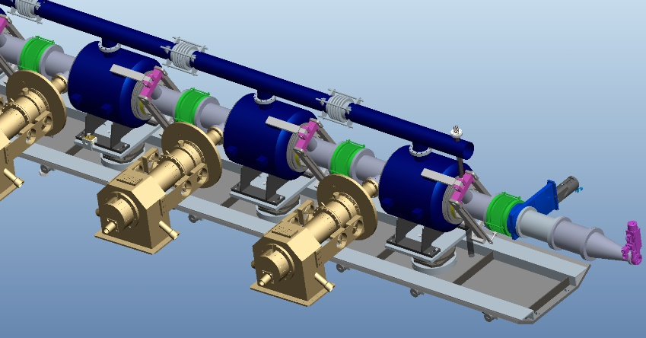
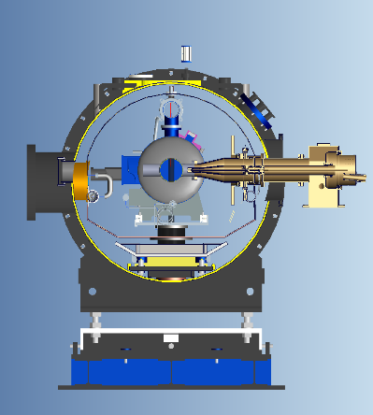
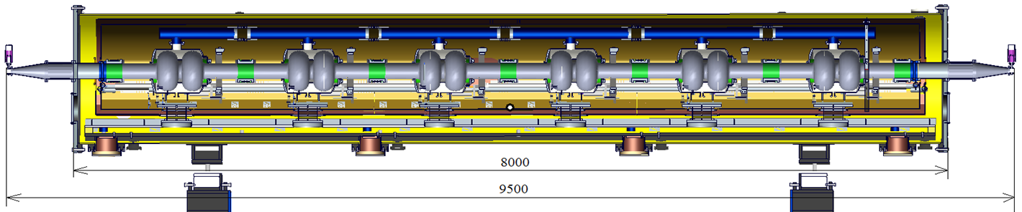
Collider 650 MHz Cryomodule
The collider Higgs mode will require 30 MW SR power per beam and will use a 650 MHz RF system with 192 2-cell cavities.
Each of the 11 m-long collider cryomodules will contain six 650 MHz 2-cell cavities.
Each cavity will have two detachable coaxial HOM couplers mounted on the cavity beam pipe with a HOM power handling capacity of 1 kW. Additionally, each cryomodule will have two beamline HOM absorbers at room temperature outside the vacuum vessel with a HOM power handling capacity of 5 kW each.

Slide 8
CEPC Booster Ring 1.3 GHz RF Parameters
30/50 MW Collider SR power per beam. 30 GeV injection. Higgs & ttbar half filled. Higgs on-axis injection with bunch swapping. Z injection from empty ring. | ttbar 30/50 MW |  | Higgs 30/50 MW on-axis | W 30/50 MW | Z 30/50 MW
 | New cavities | Higgs cavities
Extraction beam energy [GeV] | 180 |  | 120 | 80 | 45.5
Extraction average SR power [MW] | 0.05 |  | 0.5 / 0.67 | 0.02 / 0.04 | 0.05 / 0.1
Bunch charge [nC] | 1.1 |  | 0.78 (20.3)* | 0.73 | 0.81
Beam current [mA] | 0.12 / 0.19 |  | 1 / 1.4 | 3.1 / 5.3 | 16 / 30
Injection RF voltage [GV] | 0.761 |  | 0.346 | 0.3 | 0.3
Extraction RF voltage [GV] | 9.7 (7.53 + 2.17) |  | 2.17 | 0.87 | 0.46
Extraction bunch length [mm] | 1.8 |  | 1.86 | 1.3 | 0.75
Cavity number (1.3 GHz 9-cell) | 256 | 96 | 96 | 96 | 32
Module number (8 cavities / module) | 32 | 12 | 12 | 12 | 4
Extraction gradient [MV/m] | 28.3 | 21.8 | 21.8 | 8.7 | 13.8
Q₀ @ 2 K at operating gradient | 2E10 | 3E10 | 3E10 | 3E10 | 3E10
Q_{L} | 4E7 | 4E7 | 1.2E7 | 7.3E6 / 4.4E6 | 1.2E7 / 6.3E6
Cavity bandwidth [Hz] | 33 | 33 | 110 | 178 / 296 | 111 / 208
Peak HOM power per cavity [W] | 0.5 / 0.8 |  | ~ 75 / ~ 100 | 11.8 / 19.6 | 146 / 272
Average HOM power per cavity [W] | 0.2 / 0.32 |  | ~ 10 / ~ 15 | 3.8 / 6.3 | 80 / 150
Input peak power per cavity [kW] | 8.3 / 9.2 | 5.1 / 5.9 | 22 / 32 | 10.9 / 18.1 | 17 / 32
Input average power per cavity [kW] | 0.3 | 0.2 | 6.5 / 9.2 | 0.3 / 0.5 | 2.5 / 4.5
SSA power [kW] (1 cavity / SSA) | 10 | 10 | 25 / 30 | 25 / 30 | 25 / 40
Total cavity wall loss @ 2 K [kW] | 0.36 | 0.05 | 0.5 | 0.02 | 0.08
1.3 GHz 9-cell cavities
Higgs and ttbar booster are half filled for the injection timing with Collider ring.
Transient beam loading for Higgs on-axis injection tolerable (both at injection and extraction).
Increased average HOM power of HL-Z requires ERL-type 1.3 GHz cryomodule (HOM absorber at low temperature between cavities). Four cryomodules for Z with RF bypass, also to reduce impedance and increase current limit.
High gradient high Q 9-cell cavities for ttbar.
Narrow bandwidth high gradient cavity voltage ramping through the multipacting region to be studied. Counter-phasing ramp.
* The small bunch charge number before the parenthesis is for the bunches injected from the linac. The large bunch charge number in the parenthesis is for the bunches injected back from the Collider ring during the swap-out injection at Higgs energy.

Slide 9
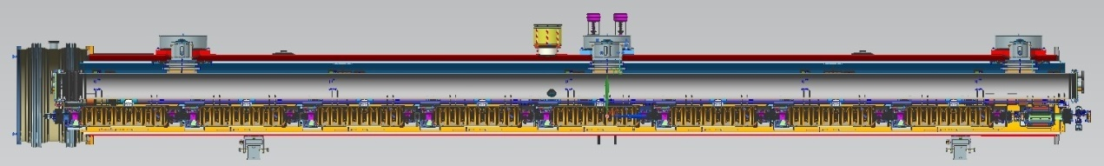
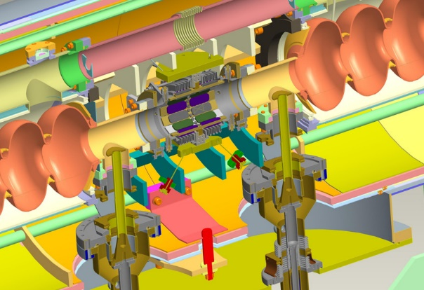
Booster 1.3 GHz Cryomodule
TESLA/TTF/Euro-XFEL/ILC/LCLS-II/SHINE type 1.3 GHz cryomodule will be used for the Booster. Each of the 12-meter-long cryomodules contains eight 1.3 GHz 9-cell cavities, with each cavity having two welded HOM couplers on the cavity beam pipe. No superconducting magnet and cold BPM in the module.
Due to the high beam current and high HOM power per cavity in the high luminosity Z mode (up to 30 mA for injection into the empty Collider ring), an ERL-type 1.3 GHz cryomodule with a HOM absorber at 100 K between cavities will be used instead of the low current TESLA cavities for Higgs, W and tt̄ mode. To reduce the impedance, the Z-mode beams will only go through Z-cavities and bypass the Higgs and tt̄ cavities.

Slide 10
CEPC Power and Energy Upgrade Plan
 | Baseline |  |  | Power Upgrade |  |  | Energy Upgrade
 | Higgs | W | Z | Higgs | W | Z | tt̄
Collider SR power / beam [MW] | 30 |  |  | 50 |  |  | 30 |  | 50
Beam energy [GeV] | 120 | 80 | 45.5 | 120 | 80 | 45.5 | 180
Luminosity / IP [10³⁴ cm⁻²s⁻¹] | 5 | 16 | 115 | 8.3 | 26.7 | 192 | 0.5 |  | 0.8
Collider 650 MHz cavities | 2-cell |  | 1-cell | 2-cell |  | 1-cell | Add 5-cell | Existing 2-cell | Add 5-cell | Existing 2-cell
RF voltage [GV] | 2.2 | 0.7 | 0.12 | 2.2 | 0.7 | 0.1 | 10 (6.1 + 3.9) |  | 10 (6.1 + 3.9)
Beam current / ring [mA] | 16.7 | 84 | 801 | 27.8 | 140 | 1345 | 3.4 |  | 5.6
Cavity number | 192 | 96×2 | 30×2 | 336 | 168×2 | 50×2 | 192 | 336 | 192 | 336
Cryomodule number | 32 | 32 | 60 | 56 | 56 | 100 | 48 | 56 | 48 | 56
Klystron number | 96 | 96 | 60 | 168 | 168 | 100 | 48 | 168 | 96 | 168
Klystron power [kW] | 800 | 800 | 1200 | 800 | 800 | 1200 | 800 | 800 | 800 | 800
Collider 4.5 K equiv. heat load [kW] | 44.4 | 28.1 | 15.2 | 41.9 | 20 | 20.1 | 128.3 |  | 128.3
Booster 1.3 GHz cavities | 9-cell |  |  | 9-cell |  |  | Add 9-cell | Existing 9-cell | Add 9-cell | Existing 9-cell
Extraction RF voltage [GV] | 2.17 | 0.87 | 0.46 | 2.17 | 0.87 | 0.46 | 9.7 (7.53 + 2.17) |  | 9.7 (7.53 + 2.17)
Beam current [mA] | 1 | 3.1 | 16 | 1.4 | 5.3 | 30 | 0.12 |  | 0.19
Cavity number | 96 | 96 | 32 | 96 | 96 | 32 | 256 | 96 | 256 | 96
Cryomodule number | 12 | 12 | 4 | 12 | 12 | 4 | 32 | 12 | 32 | 12
SSA number | 96 | 96 | 32 | 96 | 96 | 32 | 256 | 96 | 256 | 96
SSA power [kW] | 25 | 25 | 25 | 30 | 30 | 40 | 10 | 10 | 10 | 10
Booster 4.5 K equiv. heat load [kW] | 7.8 | 3.1 | 3.5 | 8.1 | 3.2 | 3.7 | 11.4 |  | 11.4
Total RF length [m] | 704 | 704 | 384 | 1088 | 1088 | 608 | 2368 |  | 2368
Total 4.5 K equiv. heat load [kW] | 52.2 | 31.2 | 18.7 | 50.0 | 23.2 | 23.8 | 139.7 |  | 139.7

Slide 11
Content
TDR design of CEPC SRF system
EDR plan of CEPC SRF system
Key component R&D consideration
Summary

Slide 12
EDR Plan for CEPC Superconducting RF System
 | 2023 | 2024 | 2025 | 2026 | 2027 | 2028 | 2029 | 2030 | 2031 | 2032 | 2033 | 2034-2035 | 2036-2045 | 2046-2047 | 2048 | 2049-2053
EDR
Civil construction
Acc. construction & installation
Commission & operation |  |  |  |  |  |  |  |  |  |  |  |  | H | Z | W | ttbar
SRF system engineering design | Layout, cost, module, beam-cavity, LLRF, interfaces …
650 MHz test module (2x2-cell) | TCM beam operation, install high Q cav & variable coupler
650 MHz H module (6x2-cell) |  | PCM design, fabrication and test |  | Improvement and prepare production | Prepare | Production of 32 CM / 192 2-cell CAV for 30 MW H |  |  |  | Installation, Commissioning |  |  | Op & +24 CM | Operation | Op | Op
1.3 GHz H module | High Q module | Production of modules with SCM and BPM |  | pCM fabrication | pCM fab | pCM test | Production of 12 CM / 96 9-cell CAV |  |  | Installation, Commissioning |  |  | Operation
1.3 GHz Z module (high current) |  | Design and R&D |  |  | pCM fabrication |  | pCM test |  | Production of 4 CM / 32 9-cell CAV |  | Installation, Commissioning |  | Operation | Op
650 MHz HL-Z module | Conceptual design. 500 MHz high current module production. |  |  |  | Design and R&D |  |  |  |  |  |  | Produce and Install 60+40 1-cell CM | Production | Op
ttbar cavity and module | Design and R&D of high gradient high Q and new material (Nb3Sn etc.) 650 MHz and 1.3 GHz cavities and module for ttbar Pulsed high gradient 1.3 GHz 8x9-cell cryomodule in 2024-2026 |  |  |  |  | High G & Q and new material cavities for ttbar Design and R&D |  |  | pCM fabrication and test |  |  |  | Production and Installation of 48 CM / 192 650 MHz 5-cell CAV 32 CM / 256 1.3 GHz 9-cell CAV |  |  | Op
CEPC EDR, construction, installation, commission, operation and upgrade. Push SRF technology frontiers in high gradient, high Q, high current, high power and new material in synergy with storage ring light sources, FELs and other SRF projects in China and the world.

Slide 13
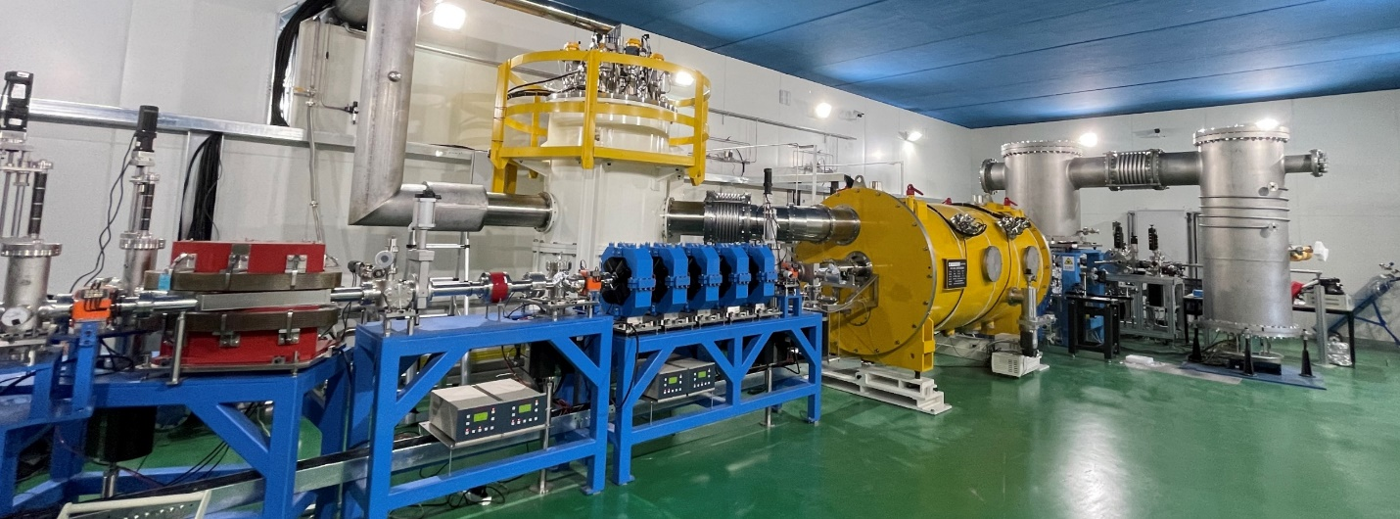
CEPC Collider 650 MHz Superconducting RF R&D in EDR
Higgs 650 MHz full-scale cryomodule prototyping (PCM) (2024-2025): Based on the experience of the 650 MHz 2x2-cell test module, complete engineering design of CEPC Higgs collider module in 2024, build one mid-T bake high Q 6x2-cell module prototype and complete horizontal test in 2025. Achieve CEPC TDR specification.
Higgs 650 MHz test module (TCM) beam test (2024).
Z-pole high current 1-cell and ttbar 4x5-cell 650 MHz cryomodule design (2025-2027).

Slide 14
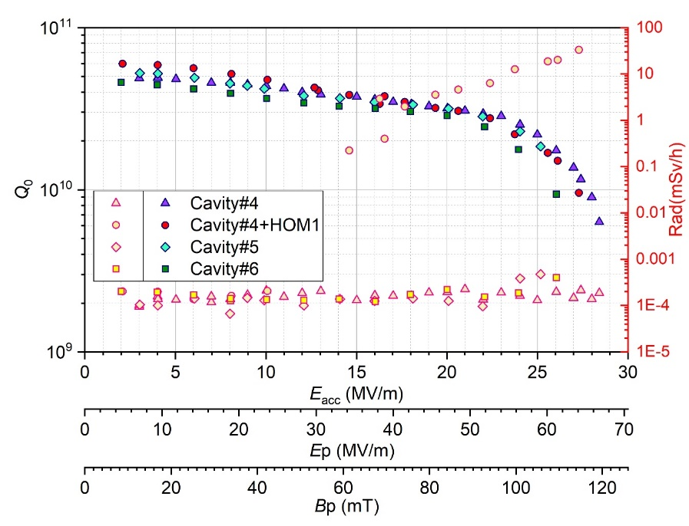
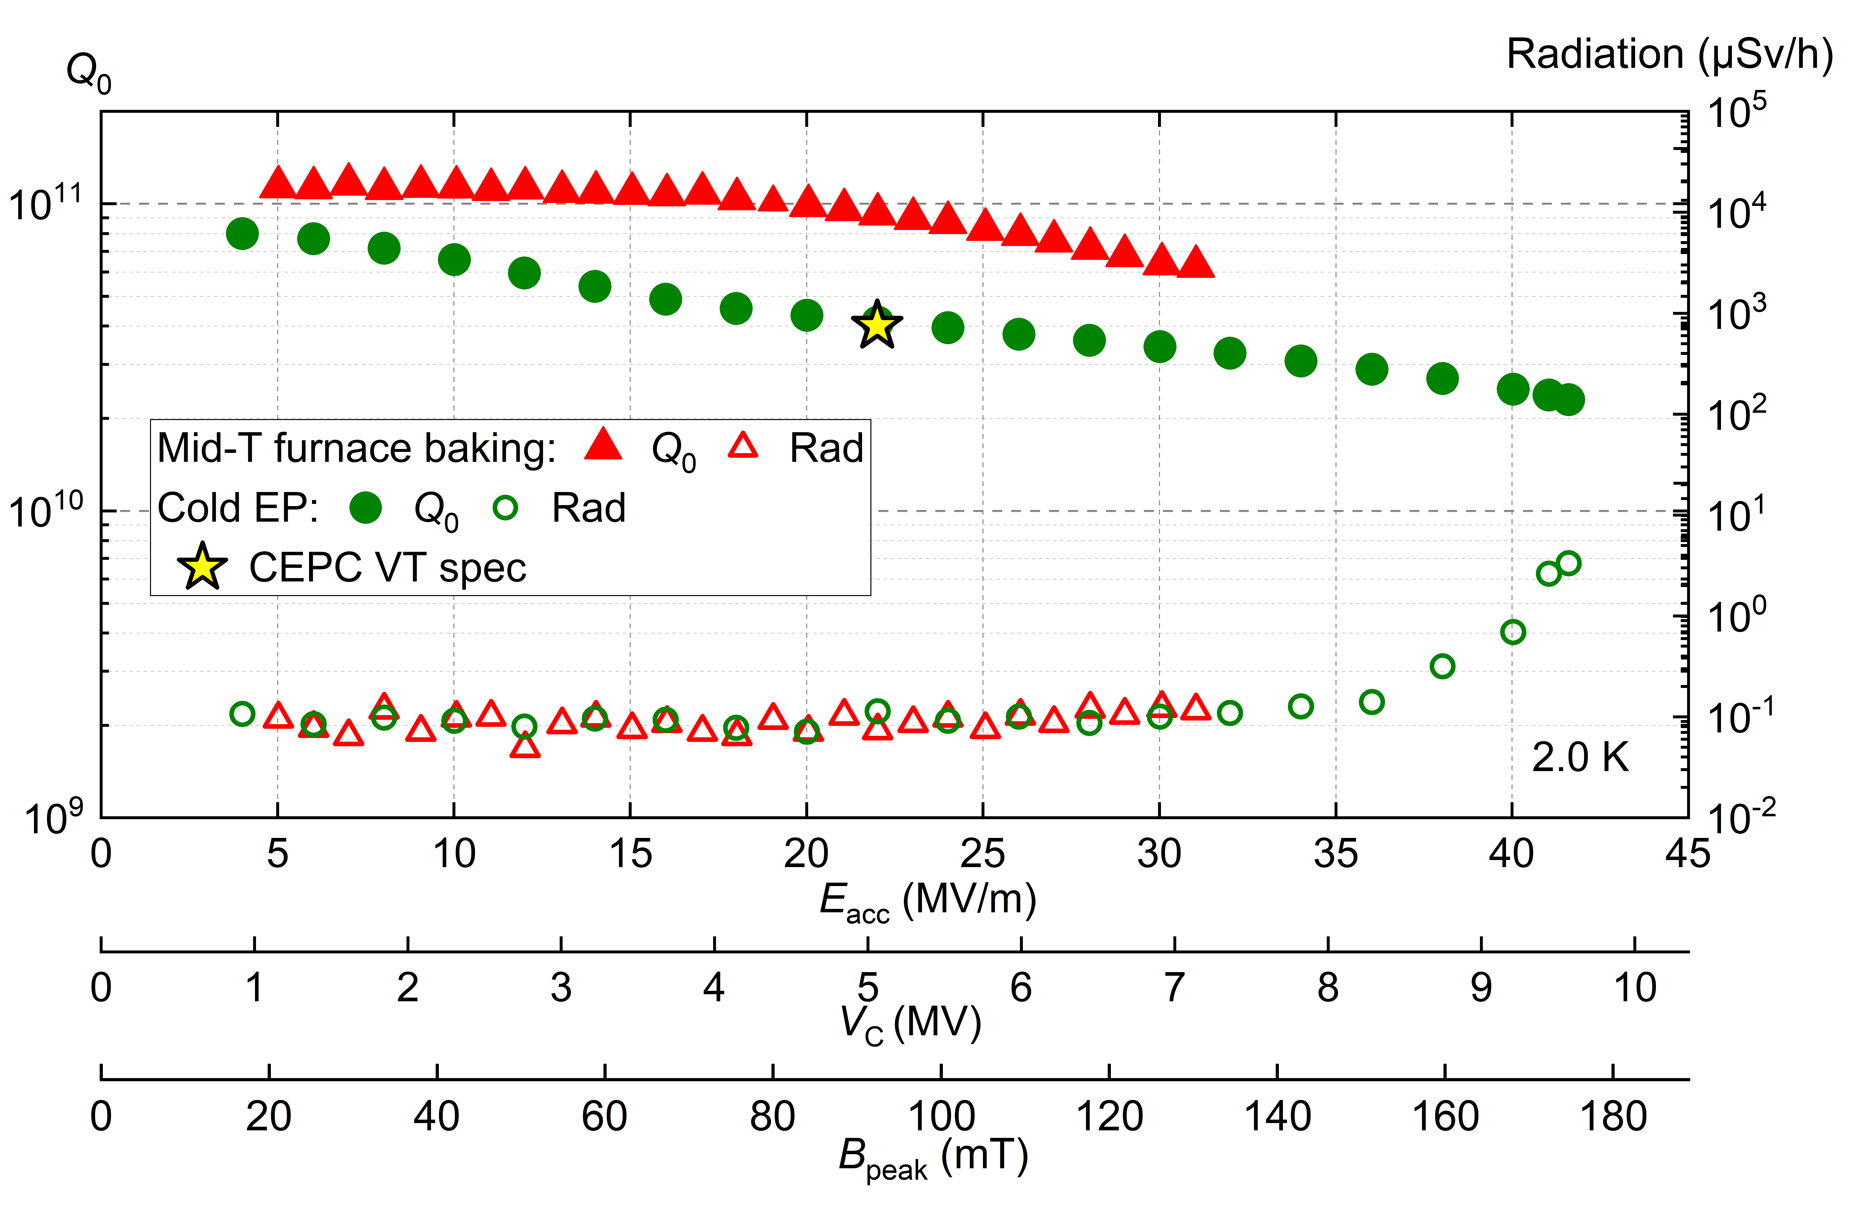
650 MHz Cavity EDR R&D
650 MHz 2-cell BCP
CEPC 650 MHz CM |  | EDR Specification
650 MHz 2-cell cavity vertical test | E_{acc.max} | 30 MV/m
 | Q₀ | 3.6E10 @ 25 MV/m
Module horizontal test acceptance | E_{acc.max} | 28 MV/m
 | Q₀ | 3.3E10 @ 25 MV/m
Module long term operation | E_{acc.max} | 28 MV/m
 | Q₀ | 3.0E10 @ 25 MV/m
20 % margin from vertical test to operation spec
650 MHz 1-cell EP / mid-T
  650 MHz 2x2-cell test cryomodule:
  Solve coupler GHe cooling issue of. Achieve 2E10@15 MV/m operation with beam.
  Replace with high Q cavity and variable coupler. Demonstrate 3E10@25 MV/m in the test module.
CEPC Higgs VT
Eacc spec
CEPC Higgs HT spec

Slide 15
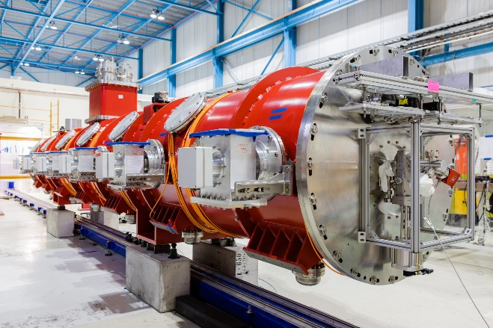
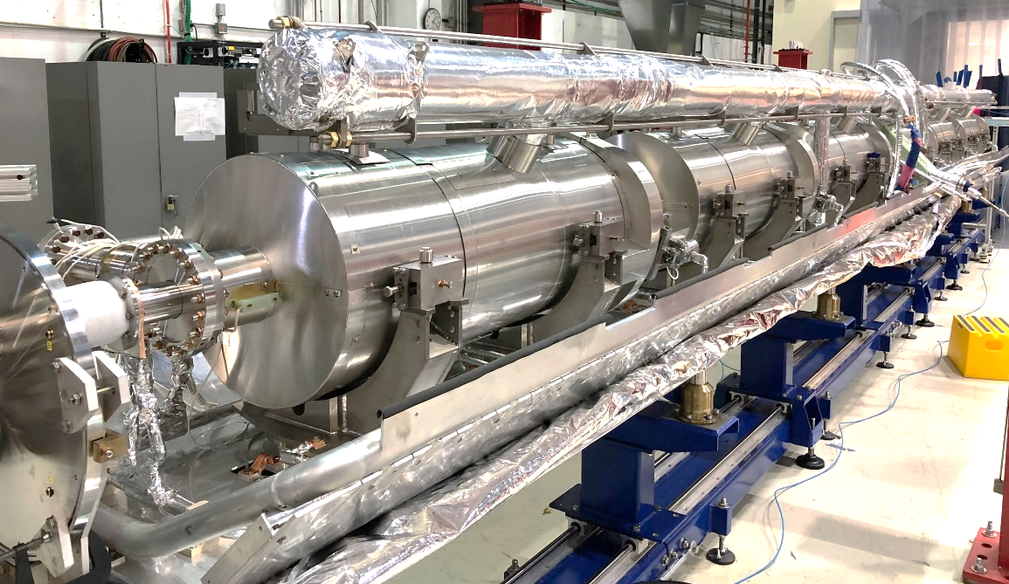
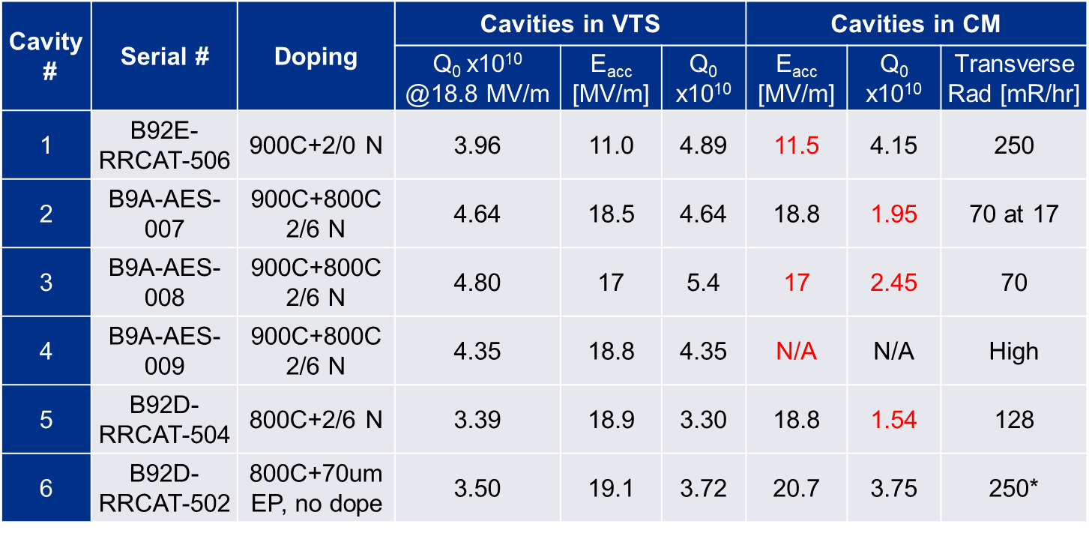
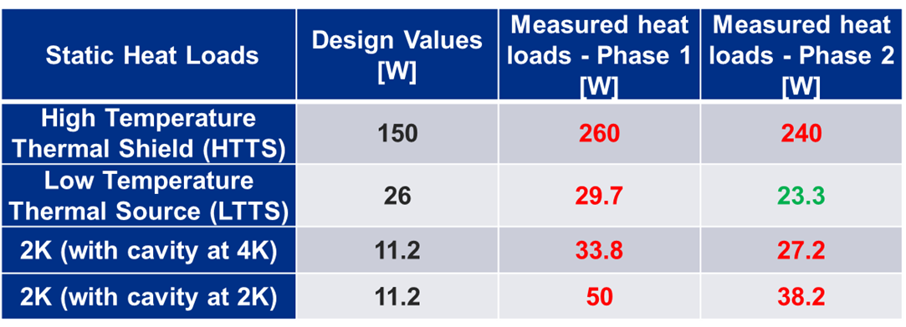
650 MHz SRF Cavity and Module in other Projects
FNAL PIP-II 650 MHz 6x5-cell Cryomodule
650 (648) MHz cavity application | CEPC Higgs 650 | PIP-II HB650 | CiADS HB650 | CSNS-II 648
 | CW ring | CW linac | CW linac | Pulse linac
Beam current (mA) | 5.6 ~ 267 | 2 | 10 | 40 / 0.6
β and cell number | 2-cell | 0.92 5-cell | 0.82 5-cell | 0.62 6-cell
Eacc (MV/m) | 25 | 18.8 | 14 | 14
Q₀ (horizontal test) | 3.6E10 | 3.3E10 | 2.8E10 | 1E10
Avg. input power (kW) | 313 | 45 | 120 | 7.2
HOM power (kW) | 2 | no | no | no
All six cavities experienced significantly increased FE during cryomodule (CM) operation.
Higher static heat loads than the design values were observed during the pCM cold testing.
D. Passarelli, TTC meeting, Dec 6, 2023

Slide 16
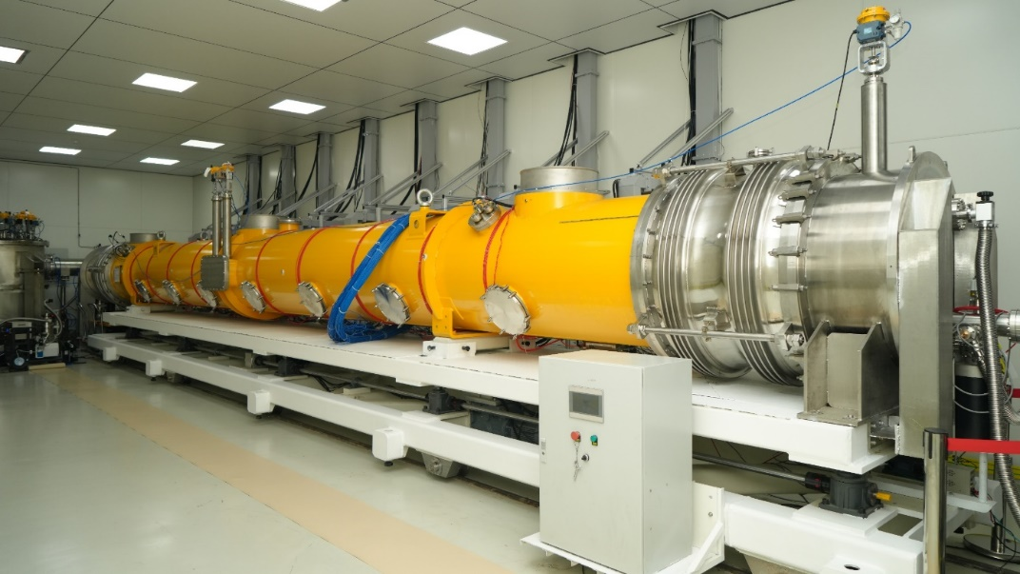
CEPC Booster 1.3 GHz Superconducting RF R&D in EDR
Higgs high Q 1.3 GHz cryomodule prototyping (QCM) (2025-2027): Complete engineering design of CEPC Higgs booster module (without cold BPM and quadrupole as in FEL module) in 2025. Based on the successful verification module, build two more mid-T bake high Q 8x9-cell module prototypes using CW FEL funding. Make improvements and increase module average CW gradient to > 25 MV/m with Q₀ > 3E10.
Z-pole high current 1.3 GHz cryomodule design (CCM) (2026-2027): conceptual design and component development, in collaboration with domestic ERL R&D.
ttbar high gradient 1.3 GHz cryomodule prototyping (GCM) (2024-2026): Build one ILC/XFEL type high gradient 8x9-cell module prototype using pulsed XFEL funding. Achieve module average gradient > 35 MV/m.
IHEP Mid-T bake high Q 1.3 GHz cryomodule

Slide 17
Mid-T Bake Cavity and Cryomodule Development
Fermilab: in-situ mid-T bake of assembled cavity (S. Posen, et al, SRF19 MOP043, Jul. 2019; PHYSICAL REVIEW APPLIED 13, 014024, 2020). Discovery of high Q by 250~400 C mid-T bake.
KEK: regular furnace mid-T bake of unassembled cavity (K. Umemori, TTC meeting at CERN, Feb. 2020; H. Ito, et al, Prog. Theor. Exp. Phys. 2021, 071G01). Simplified the implementation of mid-T bake.
IHEP:
  Further simplified furnace mid-T bake procedure (only one bulk EP, no light EP).
  Successfully applied mid-T bake to 1.3 GHz 9-cell cavities in Oct. 2020 (F. He, et al, Superconductor Science and Technology, 34, 2021, 095005). 14 mid-T 9- cell cavities tested in 2020-2022.
  Cryomodule with eight mid-T 9-cell cavities achieved world leading high Q and high gradient in June 2023 (https://arxiv.org/abs/2312.01175) for Dalian Advanced Light Source (DALS) R&D, based on the important experience gained in Euro-XFEL and LCLS-II (&HE) cryomodules.
  Advantages: mid-T 1 EP vs N-doping 3 EPs, no NbN precipitates, no careful EP after doping, stable and reliable performance … (H. Padamsee. Superconducting Radiofrequency Technology for Accelerators: State of the Art and Emerging Trends. Wiley-VCH, Feb. 2023)
  Application: PIP-II 650 MHz β=0.61 5-cell cavities will use mid-T bake. SHINE, S³FEL, DALS, CEPC, CW upgrade of Euro-XFEL and other projects are considering to use mid-T bake for large number of cavities.

Slide 18
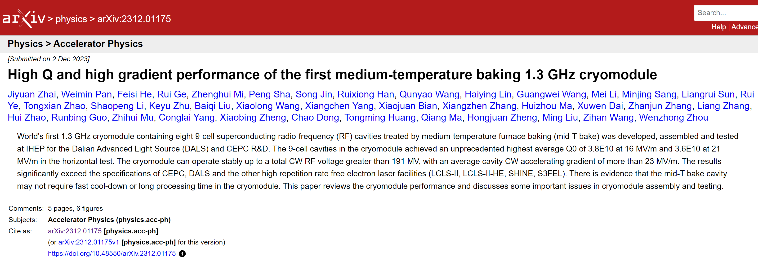
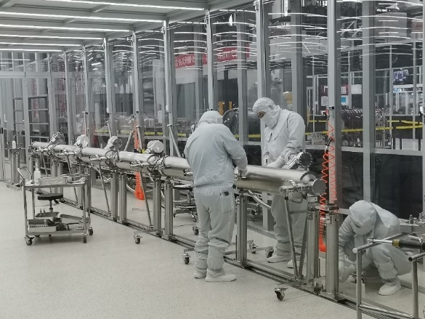
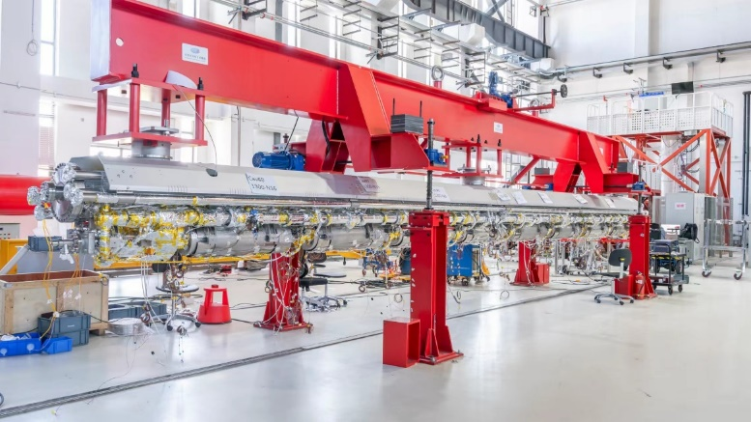
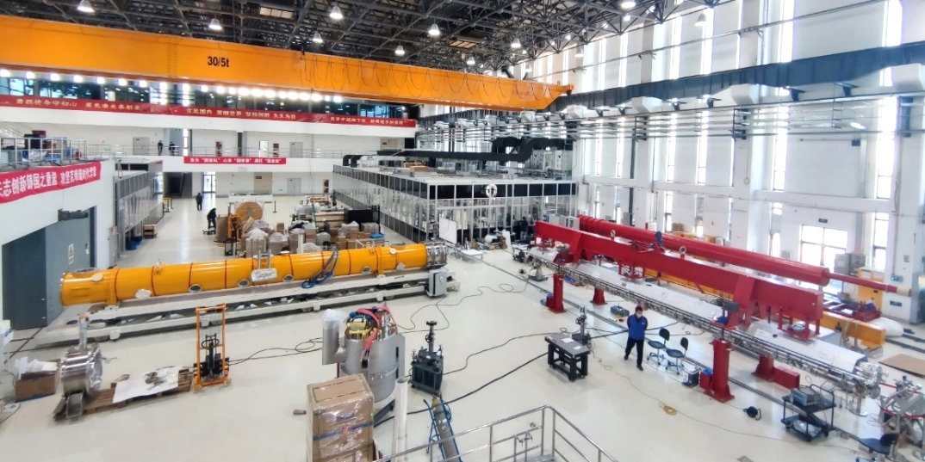
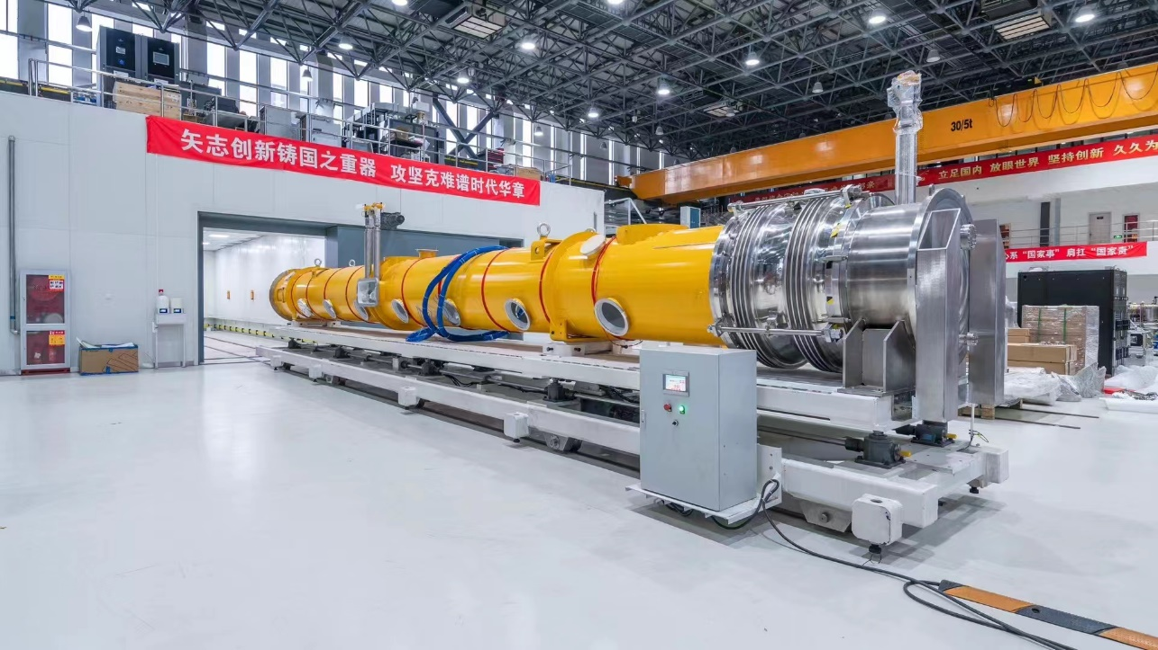
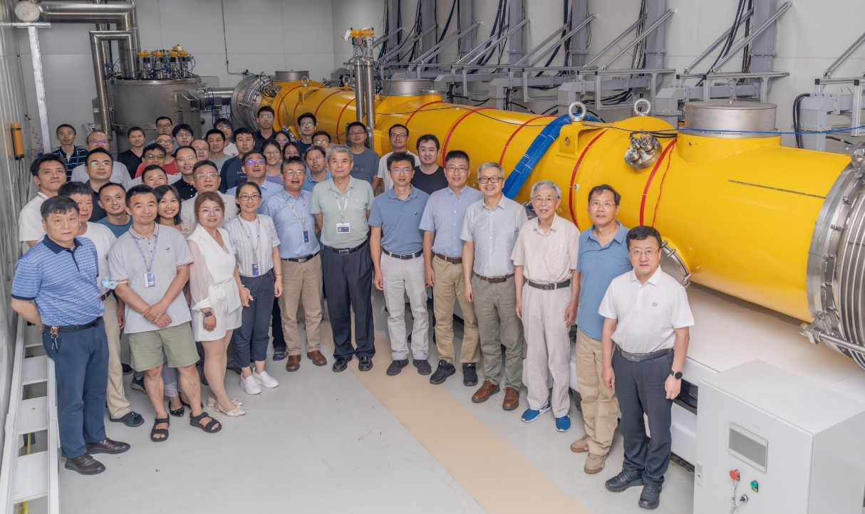
IHEP Mid-T Bake High Q 1.3 GHz Cryomodule
World’s first 1.3 GHz cryomodule with 8 mid-T (medium-temperature furnace bake) 9-cell cavities. Mid-T bake has distinct advantages over N-doping. Will be used in CEPC and other SRF projects.

Slide 19
IHEP Mid-T Bake High Q 1.3 GHz Cryomodule
Parameters | IHEP mid-T CM | LCLS-II, SHINE spec | LCLS-II -HE spec | LCLS-II 40 CMs | LCLS-II -HE 5 CMs | LCLS-II or-HE single best
Module usable RF voltage (MV) | 191.2 | 128 | 173 | 158 | 203 | 209
Average usable gradient E_{acc} (MV/m) | 23.1 | 16 | 20.8 | 19 | 24.4 | 25.1
2 K total heat load@ 128 MV (W) | 83.5 | 93 | / | - | / | -
Average Q₀ @ 16 MV/m | 3.8×10¹⁰ | 2.7×10¹⁰ | / | 2.8×10¹⁰ | / | 3.7×10¹⁰
Module 2 K heat load @ 173 MV (W) | 133 | / | 137 | / | - | 115
Average Q₀ @ 21 MV/m | 3.6×10¹⁰ | / | 2.7×10¹⁰ | / | 3.1×10¹⁰ | 3.27×10¹⁰
CEPC spec: long term operation 3.0E10 @ 21.8 MV/m with max 24 MV/m, horizontal test 3.3E10 @ 21.8 MV/m with max 24 MV/m, vertical test 3.6E10 @ 21.8 MV/m with max 26 MV/m.

Slide 20
Content
TDR design of CEPC SRF system
EDR plan of CEPC SRF system
Key component R&D consideration
Summary

Slide 21
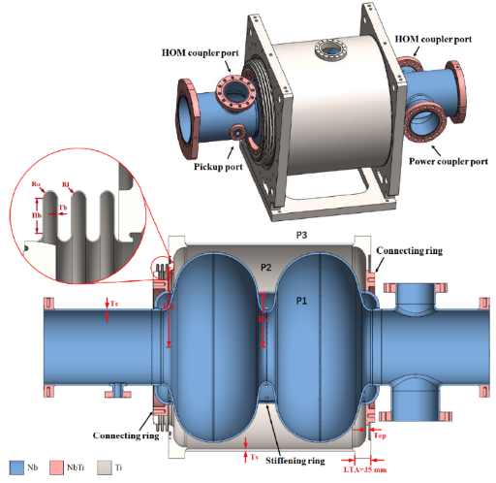
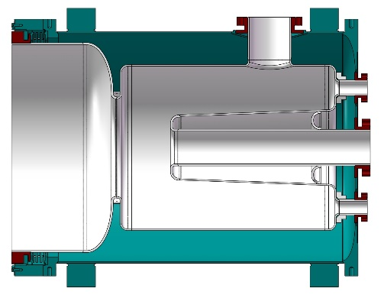
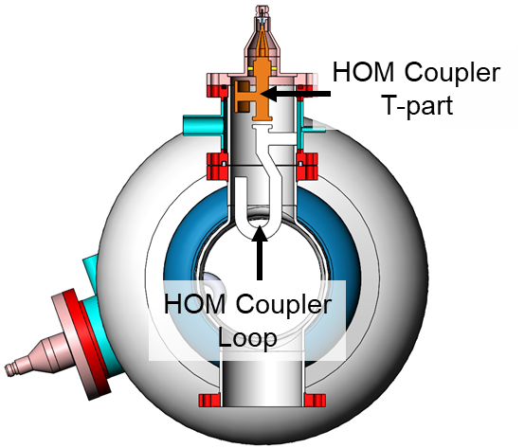
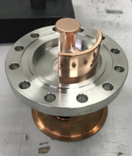
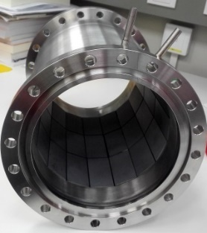
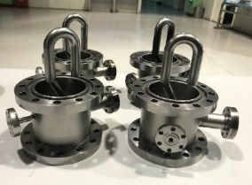
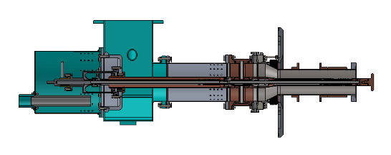
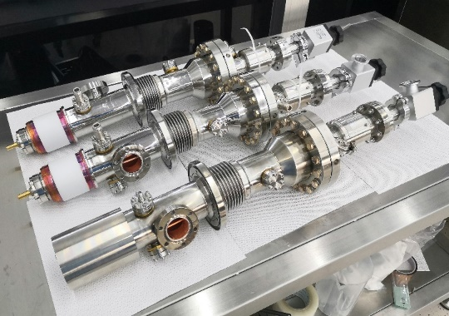
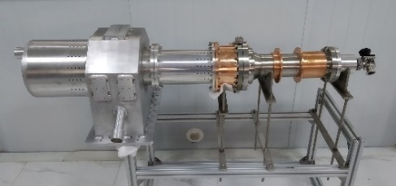
650 MHz Key Components R&D
650 MHz HOM coupler & HOM absorber
Double-notch wide-band
1 kW HOM coupler without FM tuning.
Broad band 5 kW absorber with SiC+AlN composite
HEPS 166 MHz cavity helium vessel
650 MHz input coupler
Variable, one-window, 300 kW CW
1.3 GHz input coupler
Variable, 2-window, 7 kW CW
EDR R&D (similar challenges with FCC-ee, HL-LHC, EIC):
Cavity helium vessel to cover the niobium ports to avoid overheating.
High power variable couplers. Cooling and heat load design optimization. Conditioning with 650 MHz klystron 640 kW TW, 320 kW SW. Six couplers in the pCM operation. Design and develop 1 MW variable input coupler for Z-pole.
HOM couplers. HOM power coaxial line design. 1 kW high power test at 2 K in the horizontal test stand (in vacuum, heating measurement).
Tested to CW TW 150 kW (SSA power limit), SW 100 kW (corresponding to 400 kW TW power at the window)
Tested to CW SW 7 kW

Slide 22
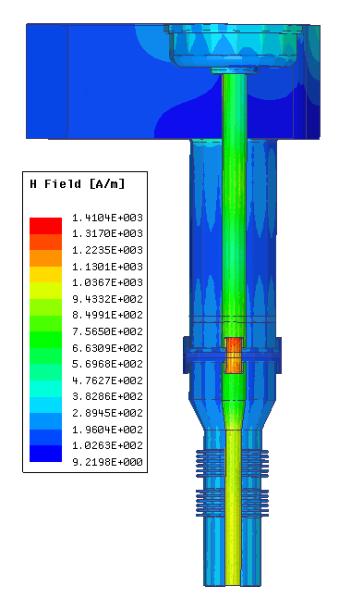
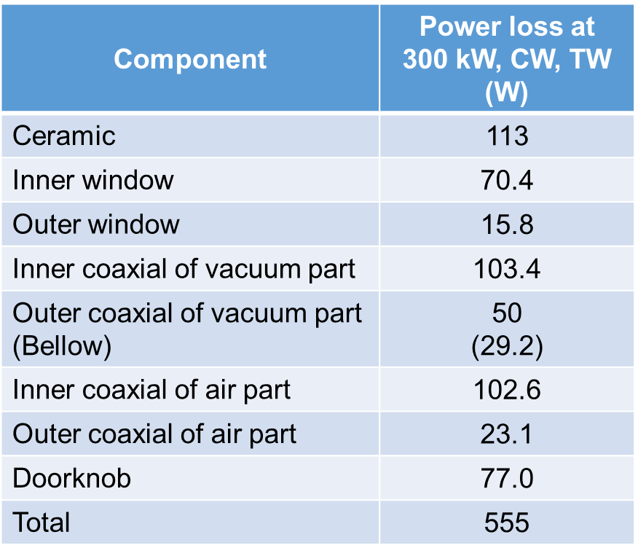
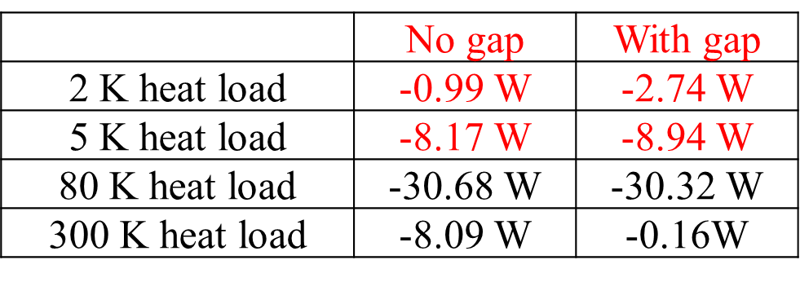
Low Heat Load Input Coupler
CEPC most critical RF component: 300 kW ~ 1 MW input coupler. High power, low heat load, high reliability, long lifetime. If fails, input power reduction, cavity number and cost increases, extra RF power, cavity contamination, RF trips...
Matching and coupling adjusting range (1E5-1E7): key issue of a green accelerator, same as klystron efficiency.
Low heat load input coupler is an important R&D item for EDR. 650 MHz coupler static/dynamic goal: 0.05 / 0.2 W @ 2 K, 0.5 / 1.2 W @ 5 K, 1 / 4.8 W (?) @ 40-80 K / 100 kW
RF shielding of the gap between the coupler and cavity connecting flange is very important, since which made great contributions to the 2K heat load

Slide 23
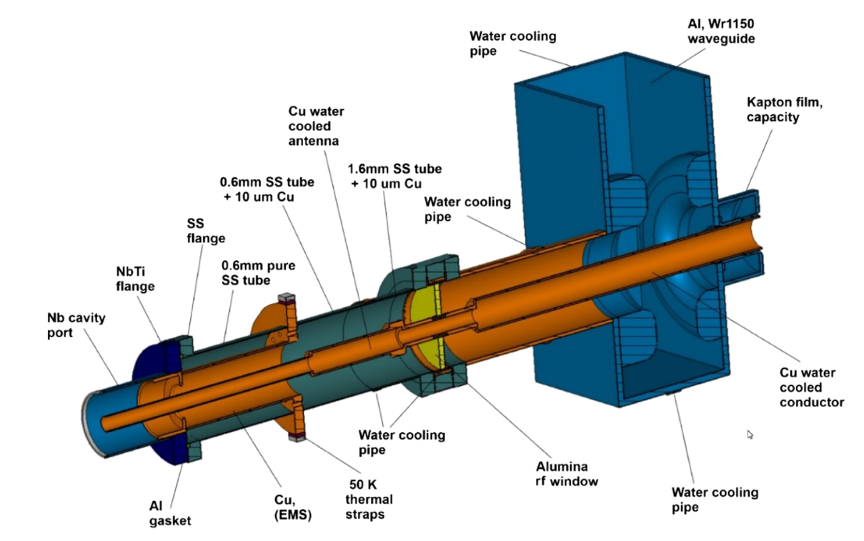
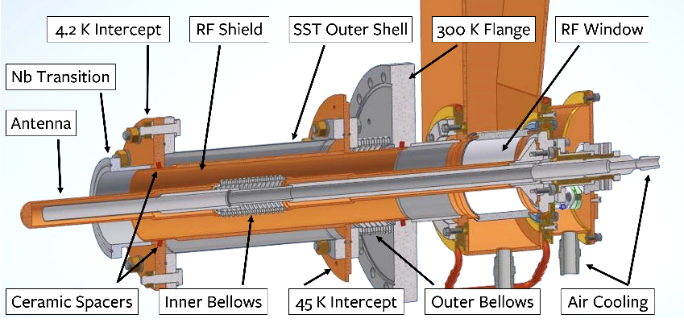
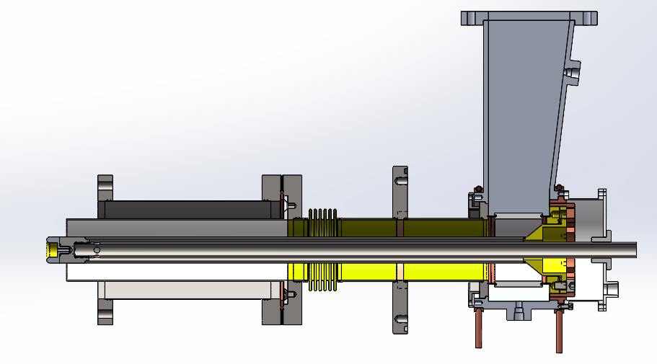
Low Heat Load Input Coupler for Conduction Cooled Cavity
Challenge with conduction cooling Nb₃Sn accelerator to reduce the number of cryocoolers (2 W @ 4.2 K each): 500 kW CW RF power through each input coupler.
Fermilab, Cornell and PKU are designing coupler with ~ 0.3 W @ 4.2 K for 100 kW forward power.
PRAB, 25, 041601 (2022)
F. Wang, 11th China accelerator microwave and RF technology workshop, 2023
N. Stilin, SRF2023 conference
Copper electromagnetic shield (EMS) heat sunk only at ∼50 K and no physical contact with the cavity.
The EMS screens the stainless-steel outer conductor, aluminum gasket, and stainless flange from the electromagnetic field, thereby reducing Ohmic losses in the outer conductor, gasket, and flange. All rf losses are mostly concentrated in EMS and are intercepted by the 50 K thermal intercept. Copper has a higher RRR than coated copper which helps reduce the total RF losses.
The EMS also includes an iris to reduce thermal radiation from room temperature.

Slide 24
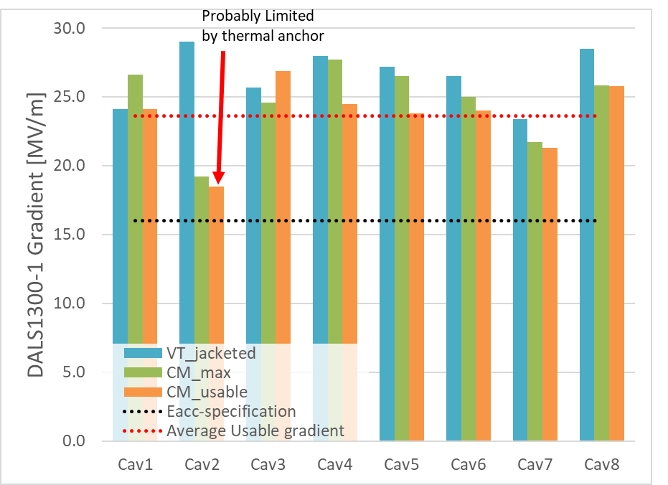
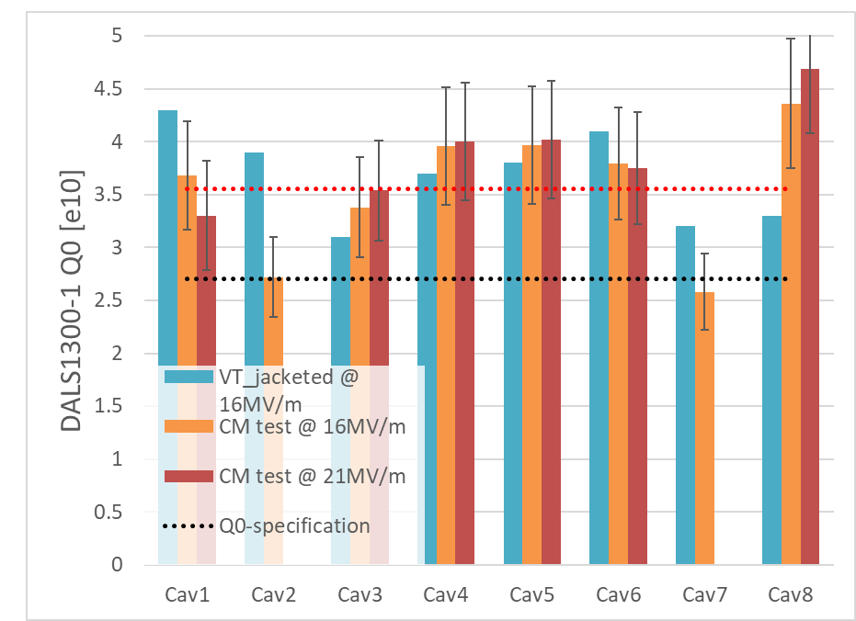
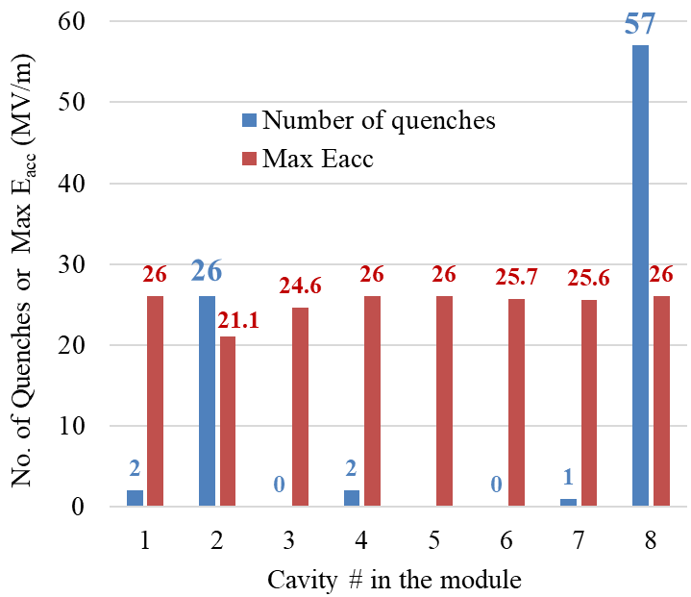
Improvement of High Q Cavity and Cryomodule
Optimize VT procedure of jacketed cavity to have similar Q₀ with bare cavity (for mass production without VT of bare cavities).
Reduce module static heat load.
Investigate the relation of mid-T cavity Q₀ with different cooldown speed, top to bottom cavity temperature difference at critical temperature, flux expulsion, remnant magnetic field and thermal current etc.
Investigate gradient drop of individual cavities and avoid systematic risk.
Investigate cavity processing and input coupler outgassing issues and reduce processing time.
Increase cavity gradient, reduce Q spread. Statistics with more mid-T cavities and cryomodules.

Slide 25
Summary
CEPC TDR SRF system design meets the physics run requirement (Higgs first, upgradable, low cost for first-stage, mode-switching) by staging and bypass with different SRF systems and by exploiting the most advanced technology.
During the five-year TDR phase, major SRF components and cryomodules developed with domestic industries reached good performances, but not all ready for construction.
EDR phase work planned for SRF system design optimization, components R&D, full-scale module prototyping and mass production preparation toward the construction stage.
We will continue to gain SRF experience by supporting other SRF projects in China and hope to collaborate with other labs world wide in the CEPC related SRF system design and technology development.

Slide 26
Thank you!

Slide 27
Design Features of SRF System
Share cavities for the two rings for H and ttbar (low cost)
  Shared cavities for H/ttbar, separate cavities for W/Z
  Save 2.2/10 GV, reduce by half cavities, klystrons, cryogenics construction and operation cost
  Cons: double coupler power, half filling of both collider and booster
RF system optimized for Higgs (Higgs priority)
  Coupler power, cavity and cell number, cavity gradient, HOM power, Qin match, beam-cavity interactions (FM/HOM CBI, RF transient), cavity material, operating temperature, Q₀, number of cavities in a module, module heat load, HOM damper, cavities per klystron, power overhead for LLRF... Balance all the parameters with technology maturity, reliability, performance degradation, operational margins, cost, risk and maintenance.
RF system for W, Z and ttbar (mode switch and max luminosity)
  Due to the wide range of machine parameters, it is impossible to have a single common SRF system for the highest possible luminosity in each mode. A staged SRF complex with bypass lines for both collider and booster is inevitable.
  W: fully share and use half of the Higgs cavities per ring due to similar beam parameters
  Z: only low power Z can use Higgs cavities (half parking cavities). 1-cell cavity for > 10 MW to 30 / 50 MW.
  ttbar: reuse Higgs (& Z) cavities, add new 5-cell cavities. Add more 9-cell cavities for the booster.
  Add new RF power sources for Z and ttbar
  Bypass the low current cavities for both collider and booster

Slide 28
Beam Cavity Interaction
CEPC large ring features:
  Large circumference and small revolution frequency (3 kHz, dense beam spectrum)
  W and Z low energy and small radiation damping
  Low injection energy of Booster
Beam cavity interaction issues:
  Transient beam loading of beam gaps for beam abort, ion-clearing or in bunch trains
  Fundamental mode (FM) induced coupled bunch instabilities (CBI), due to large cavity detuning (low RF voltage and high current) and the parked cavities
  Higher-order-modes (HOM) induced coupled bunch instabilities
Less cavities and cells are preferred to have high stored energy and low impedance.
Details in CEPC TDR

Slide 29
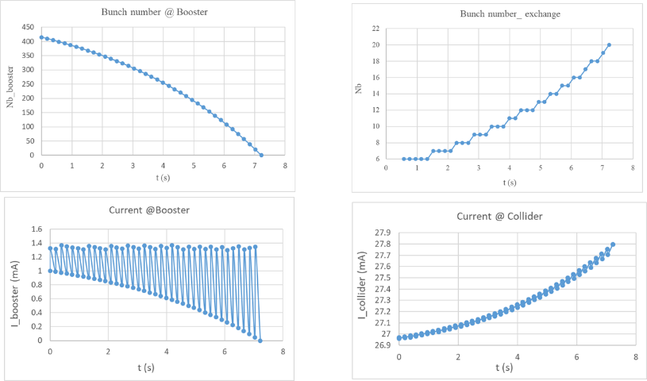
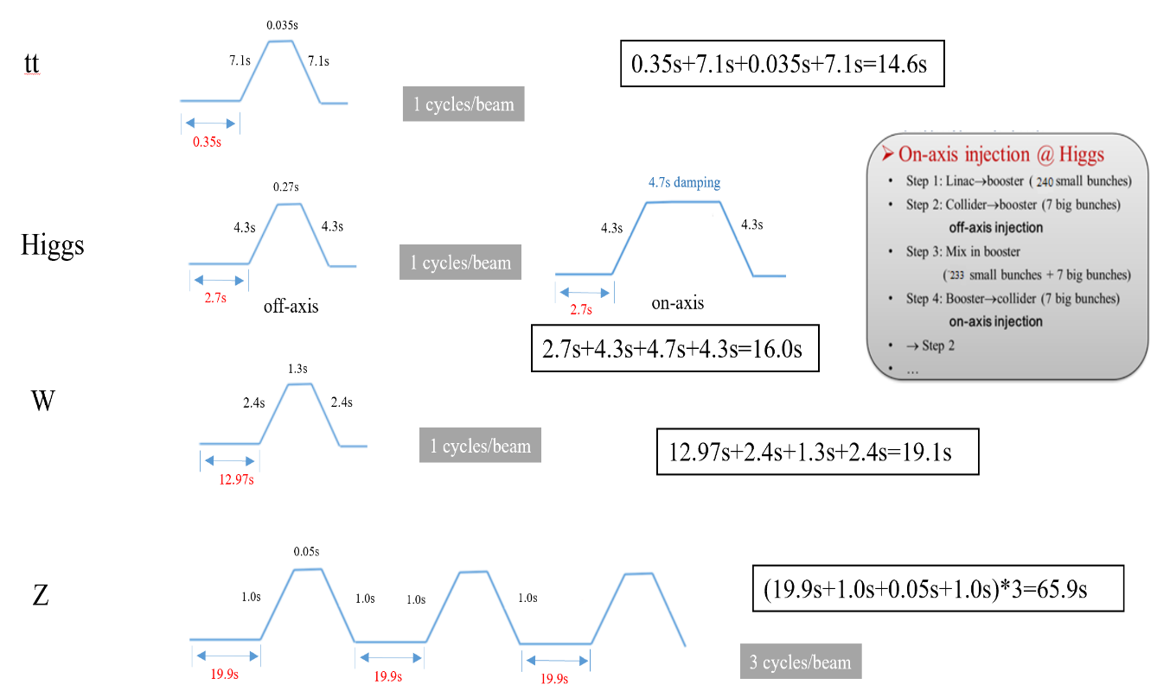
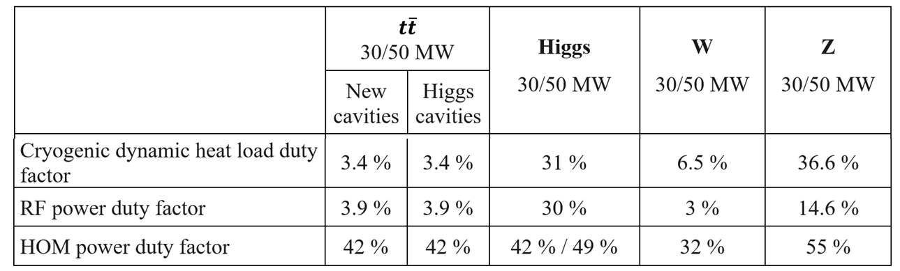
Booster Ramp and Duty Factors
Booster cavities operate in fast ramp mode, and the beam energy increases almost linearly with time. The total RF voltage must be increased during the energy ramp to keep the synchrotron tune constant.
Cryogenic, RF power and HOM power duty factor change with the cavity voltage, Q0, ramp time, circulating and swapping bunch charge, bunch length, beam current, etc. Big impact on Higgs on-axis injection.

