Slide 1




CEPC Collider Magnet Development in EDR
Mei Yang, Fusan Chen, Xianjing Sun, Wen Kang
On behalf of CEPC Magnet Group
22-25. Jan. 2024,HKUST, IAS Program on High Energy Physics (HEP 2024)

Slide 2
Content
Overview of CEPC Collider Ring magnets
Magnet prototypes in CEPC TDR
Magnet design and optimization in EDR
Plans on CEPC Collider magnets in EDR
Summary

Slide 3
Overview of CEPC Collider Ring Magnets
Over 80% of collider ring is covered by conventional magnets, except some in IR region. All these magnets work at DC mode at four E(H/Z/W/tt). (CEPC TDR)
The most important issues are Cost & Power Consumption.
  Make the magnets compact and simple.
  Aluminum wire is used for the excitation coils.
  Dual aperture magnets save nearly 50% power consumption.
  Increase the coil cross section and decrease the operating current.
 | Dipole | Quad. | Sext. | Corrector | Total
Dual aperture | 3008 | 3008 | - | - | 17562
Single aperture | 162 | 1120 | 3176 | 3544*2
Total length [km] | 68.71 | 9.95 | 2.17 | 3.1 | 83.9
Power[MW]@120GeV | 6 | 17.5 | 8.91 | 0.28 | 32.7

Slide 4
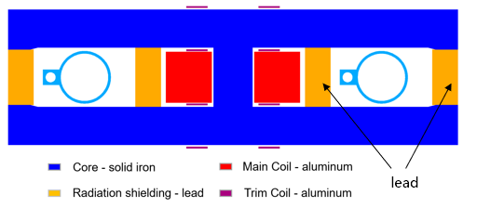
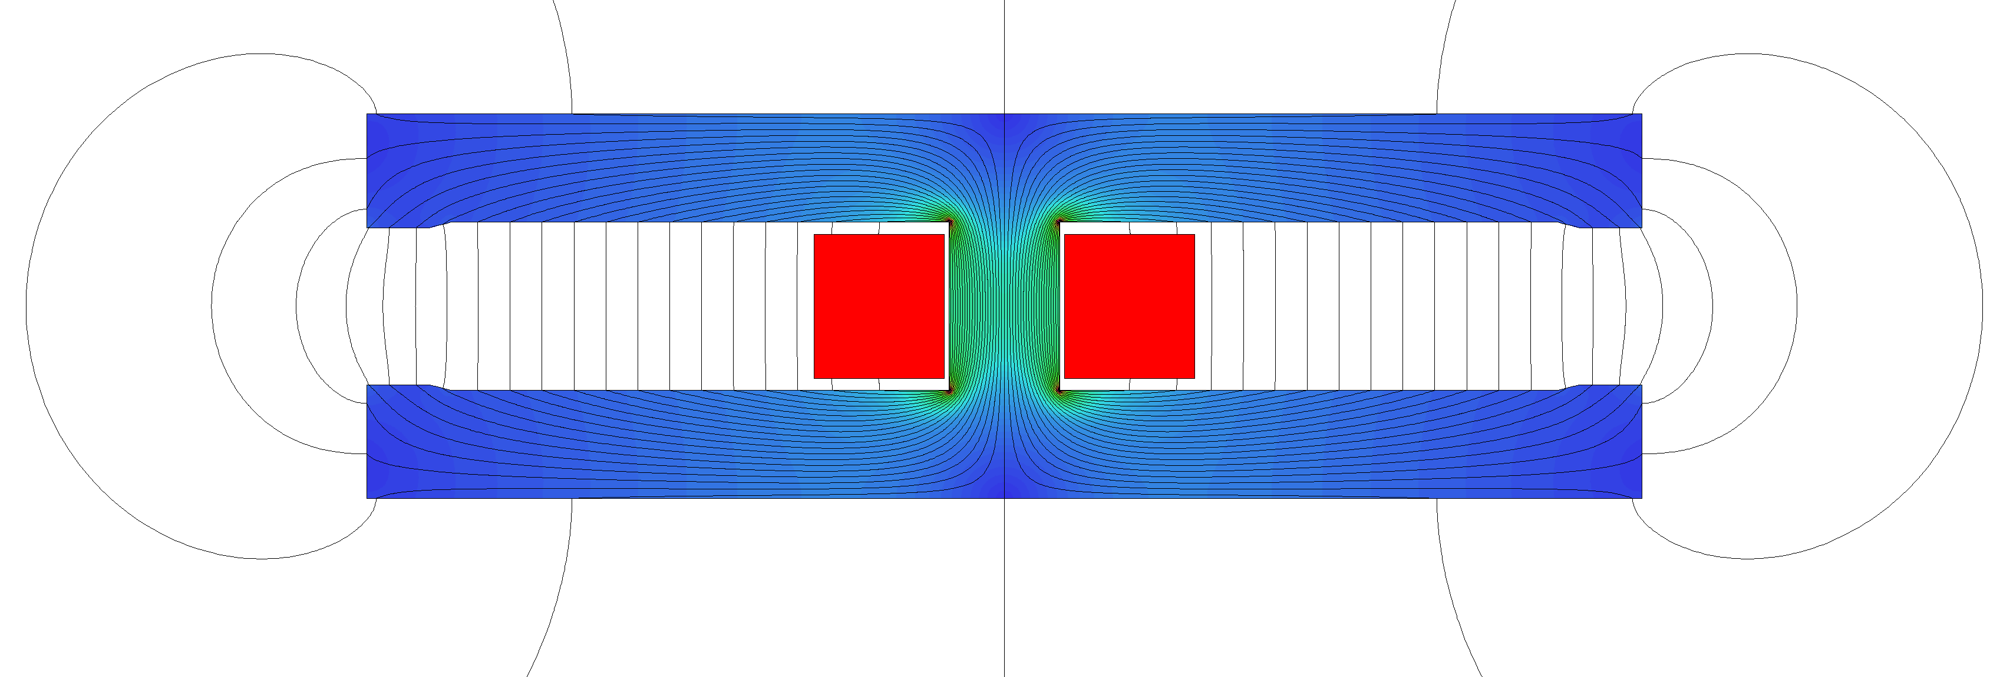
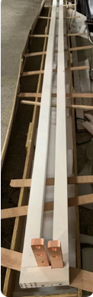
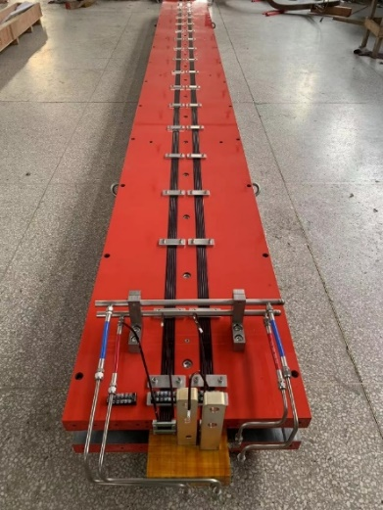
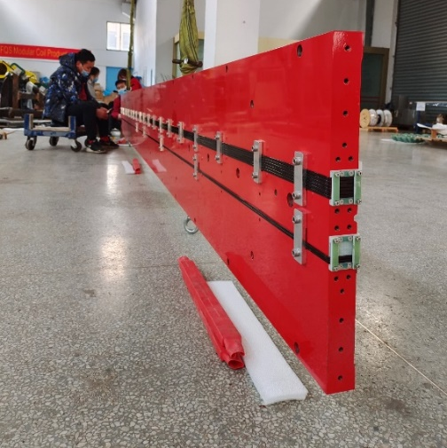
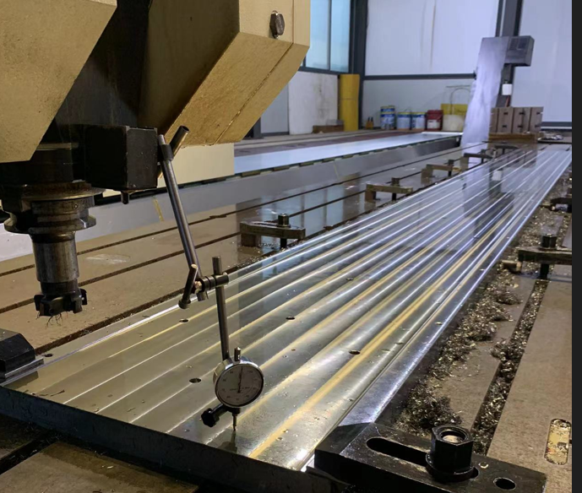
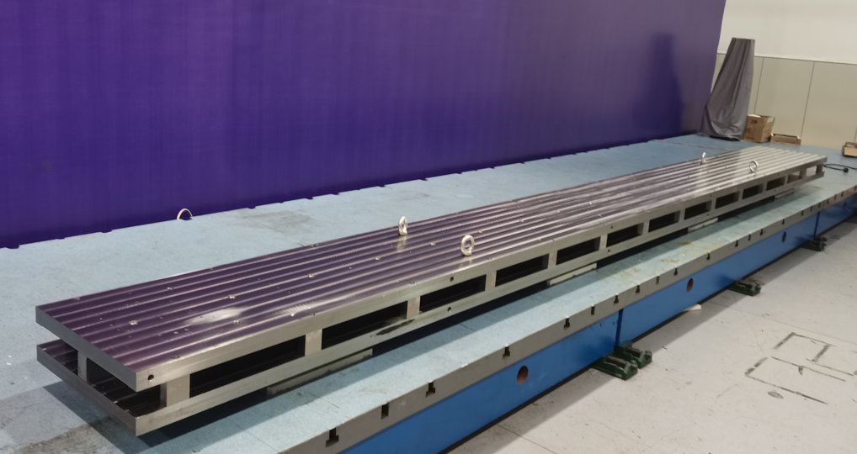
Full-scale Dual Aperture Dipole(DAD) prototype
Full-scale DAD prototype ( Liron=5.67m)
  B=140Gs ~570Gs, Gap=70mm, beam separation D=350mm
  Solid iron with three plates: up and down poles and center yoke
  Contour blocks at longitudinal intervals on the opening gap to ensure the gap height
  Two turns of aluminum busbar with a cooling hole. The busbars are extruded and with a surface insulation of ceramic insulation coating.

Slide 5
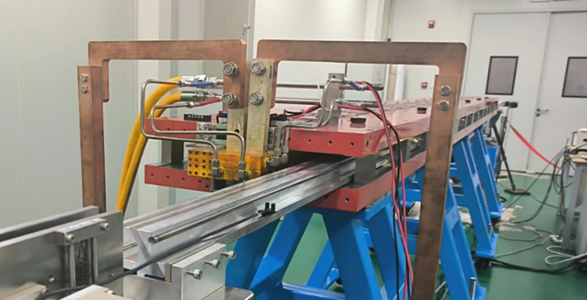
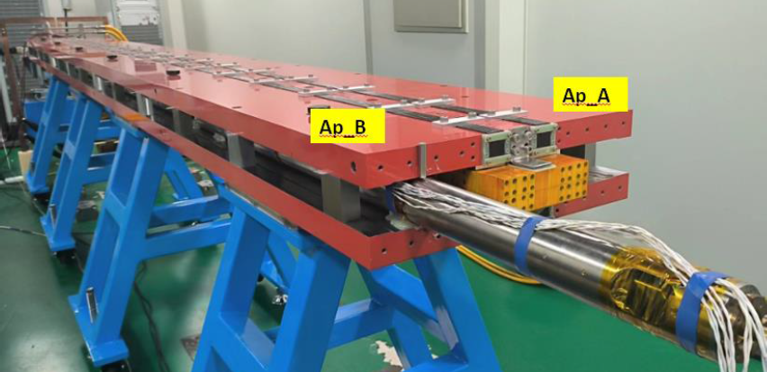
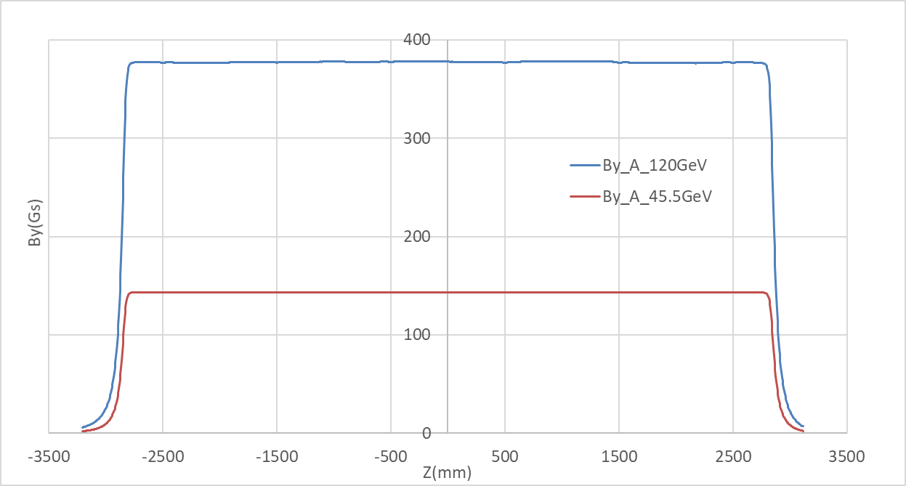
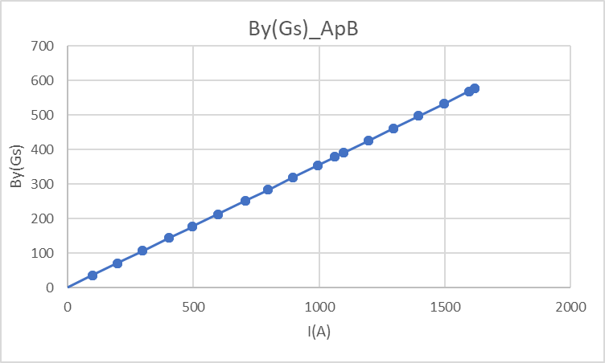
Full-scale DAD prototype-2
Field performance with a hall probe and rotating coil measurement system
  Integral field difference in two apertures <0.1%
  Excitation efficiency ~ 99.2%
  By=378.3Gs@120GeV, Leff= 5746.8mm
  Local field variation (~1Gs @373Gs)
    Local aperture gap difference

Slide 6
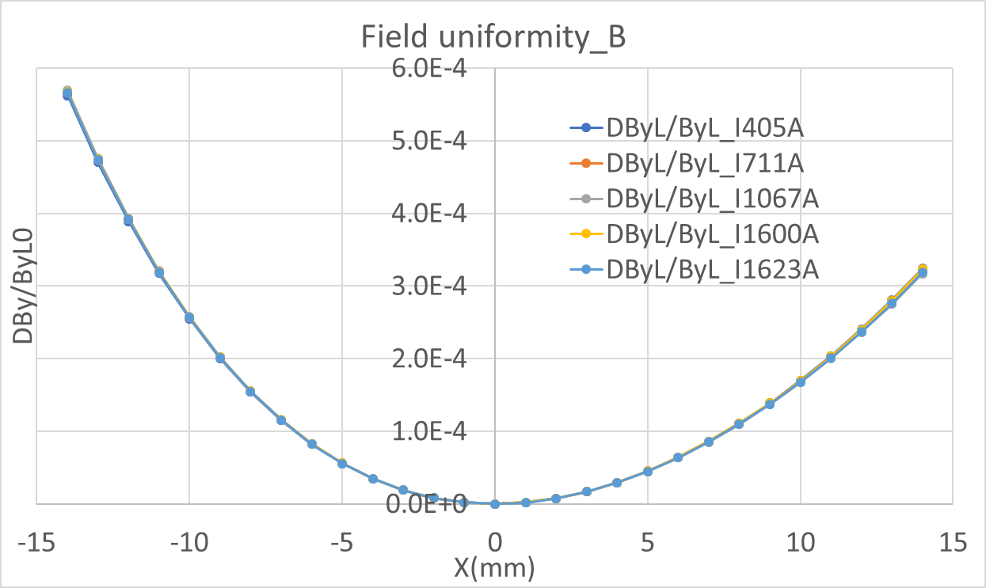
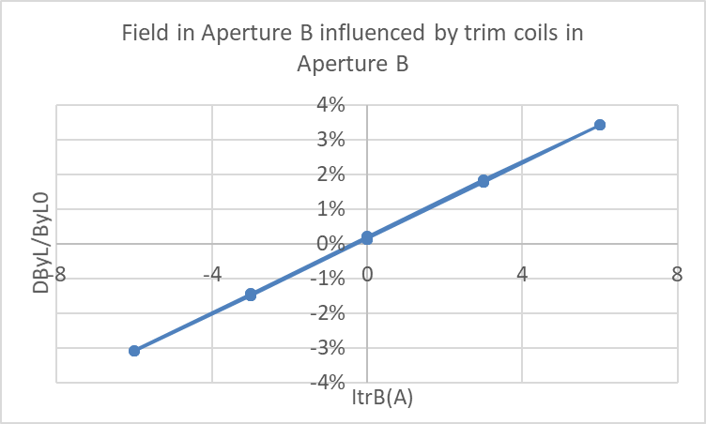
Full-scale DAD prototype-3
Integrated field
  Good uniformity of integral field without any end chamfer, consistent with simulation results as a long magnet.
  Field distribution at four energies is almost identical.
    No obvious remanence effect on the field uniformity, especially at 140 Gs
    Linear BH properties at work range (140~570Gs)
Impact of trim coils on main field
  Adjustability ~3%
  No harmonics introduced by trim coils
  Hysteresis on the main field with trim coils, reproducible
  More research needs to be done
High harmonics @four E (units:1e-4)
n | bn_A | bn_B
2 | 0 | 0
3 | 3.92 | 3.88
4 | 1.03 | -1.22
5 | 0.47 | 0.54
6 | 0.08 | -0.46

Slide 7
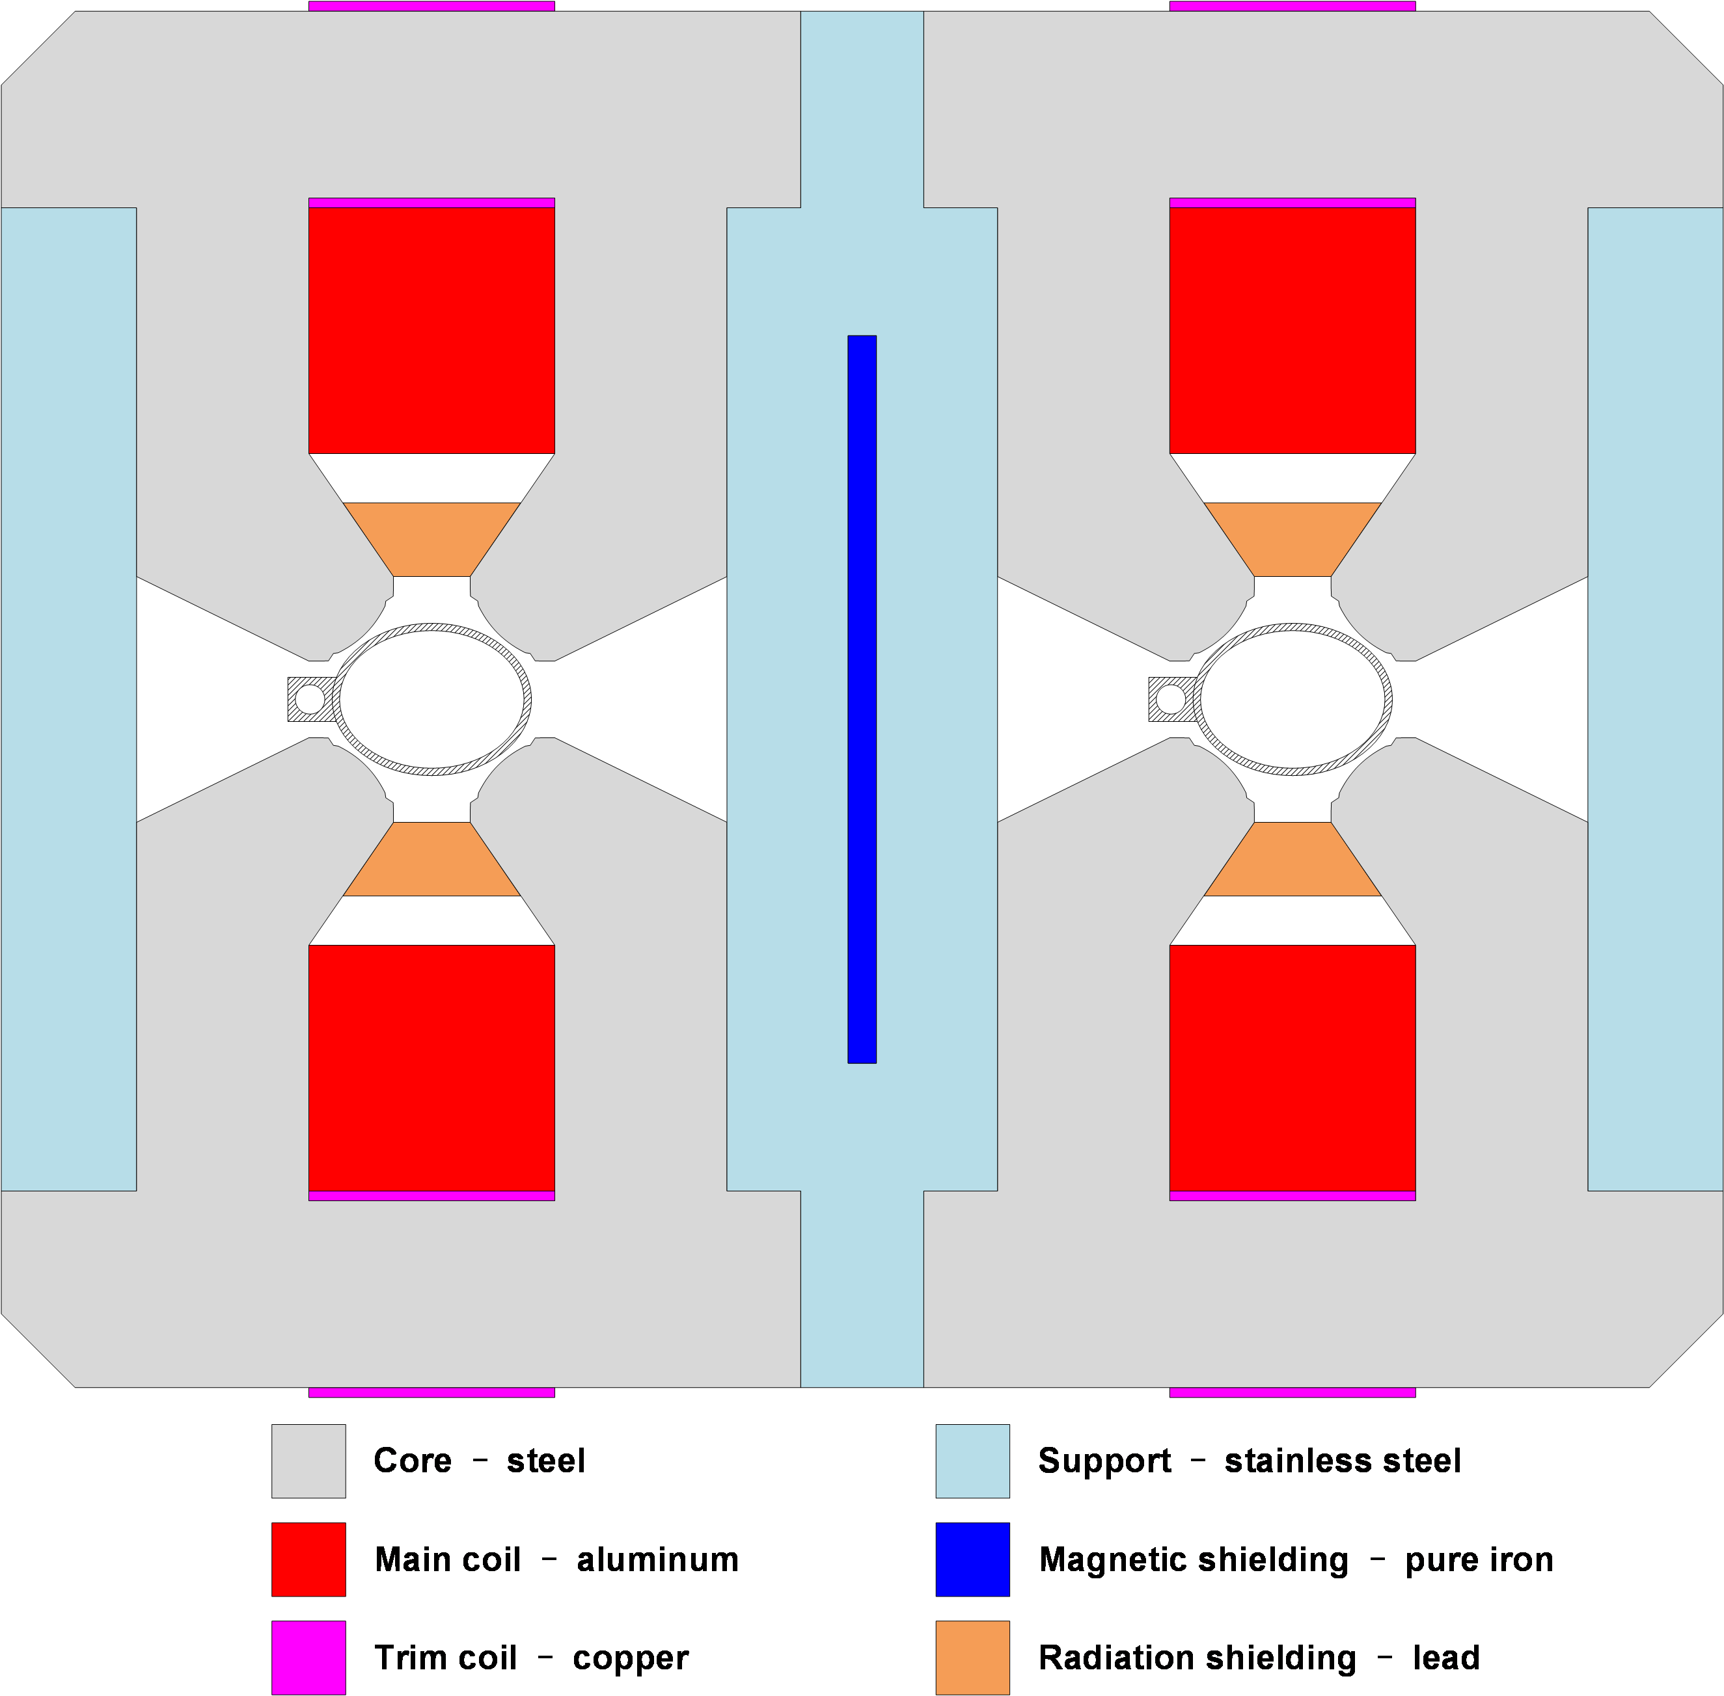
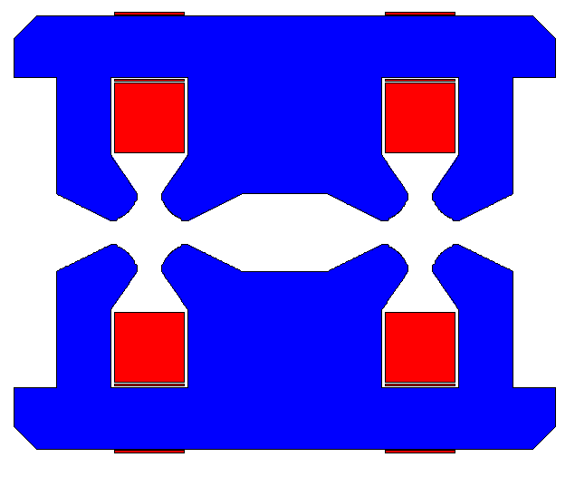
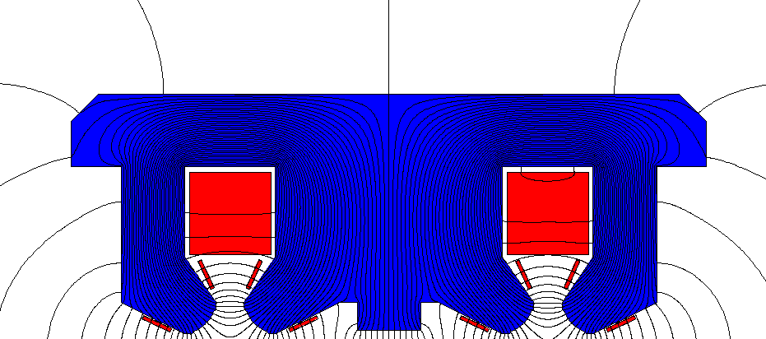
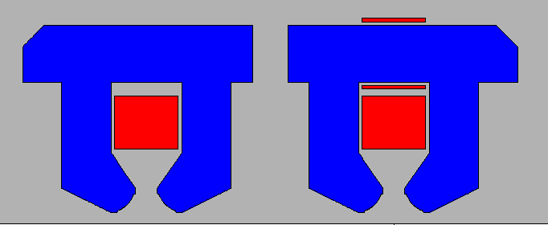
Short Dual Aperture Quadrupole(DAQ) prototype
First short DAQ prototype (1m)
  G=3.2T/m~12.4T/m, D=76mm, Liron=1m
  Laminated iron with complex mechanical structure
  A center bump compensation the horizontal asymmetric
  Stainless steel support at the center
  Hollow aluminum conductor is used for coils.
Design changes on DAQ
First F/D design in CDR
Modified I -separate irons
Constant and large b1 and b3,
no saturation
Trim coils work bad
Modified III- in TDR
Center shim balances the horizontal flux
whole iron, trim coils on poles
Small b1 and b3, no saturation
Trim coils work well
Modified II- whole iron
large b1 and b3, no saturation
Trim coils work bad

Slide 8
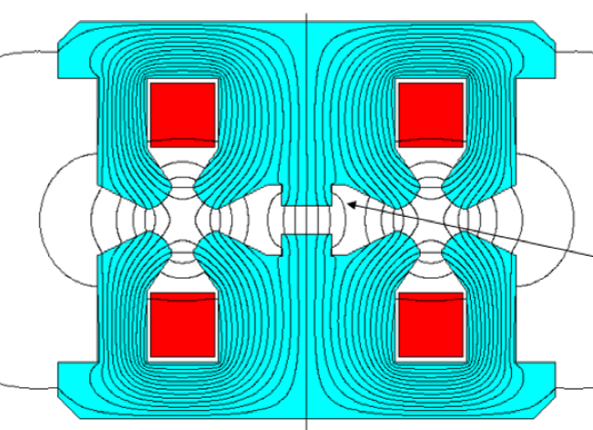
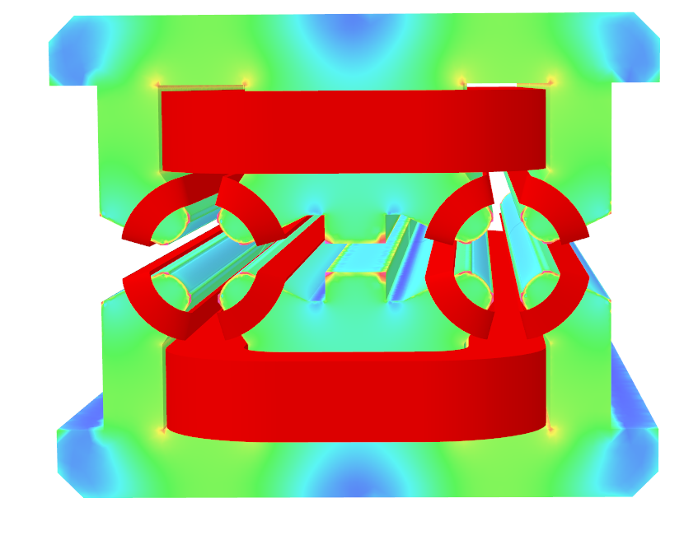
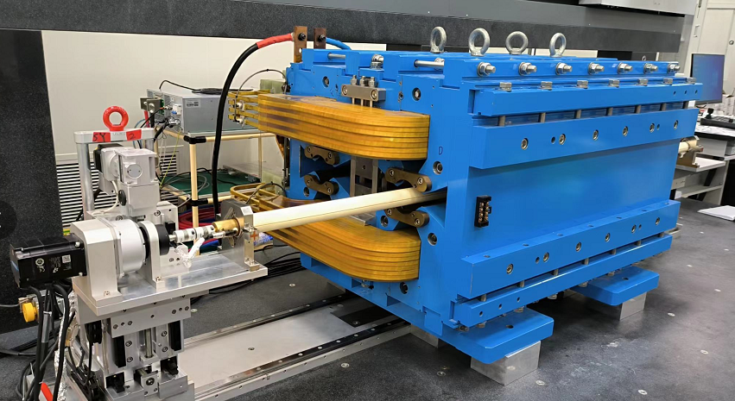
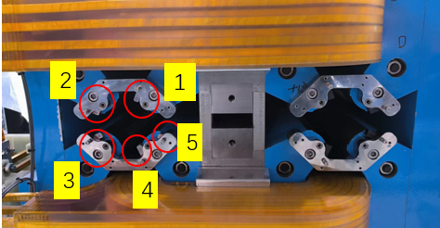
Short DAQ prototype-2
Field performance
  GL difference in two apertures <0.2%
  Similar transfer function in two apertures.
  The efficiency is about 97.8%, not saturated.
  Field harmonics< 5 units after compensation with magic fingers
    Origin higher harmonics <3 units, except sextupole component.
      Large mechanical assemble errors;
      Iron deformation
      Cross talk effect not canceled out completely

Slide 9
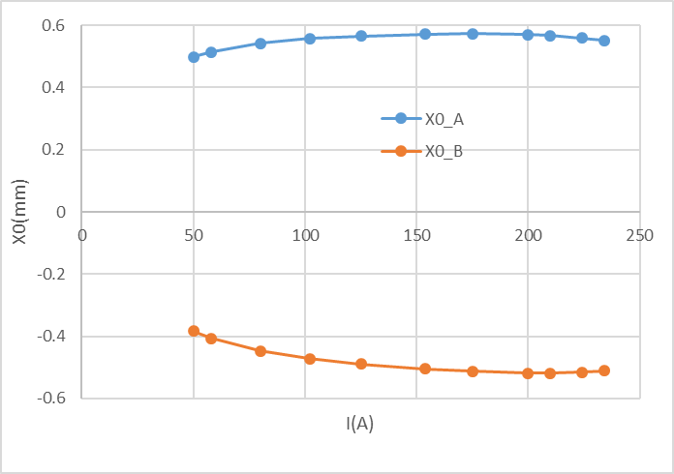
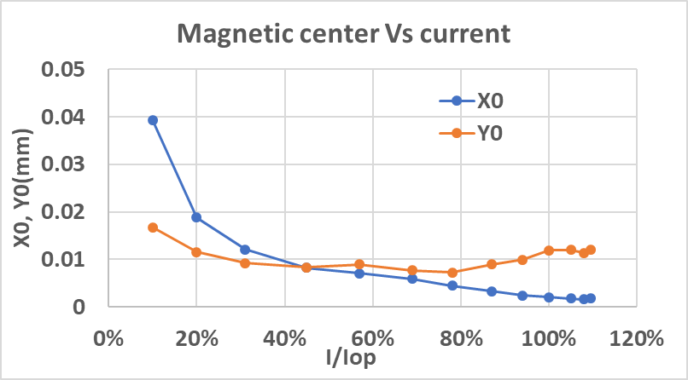
Short DAQ prototype-3
Magnetic center shift with energy
  X0_A varies 0.056mm，X0_B varies 0.105mm
  Y0_A varies 0.04mm
Possible reasons
  Mixed steel materials (J23 and DT4)
  Nonlinear BH curve at the field strength range
  Uneven distribution of magnetic materials
Magnetic center shift in single aperture quad.
High G: ~80T/m @I, R=13mm, L=245mm
I from 40%~100%, X0 varies 17μm, Y0 varies 5 μm.
The fixed x0 shift can be adjusted by the correctors or dipole magnet nearby.
More optimization is to be done to reduce the shift.

Slide 10
Magnet design and optimization in EDR
Magnet prototypes for the main dipole and quadrupole magnet are done in TDR. Field performance has been verified.
Some aspects are not so good and there maybe over design or drawbacks. Further optimization is still on to meet the new physical requirements and apply the latest technologies or materials.

Slide 11
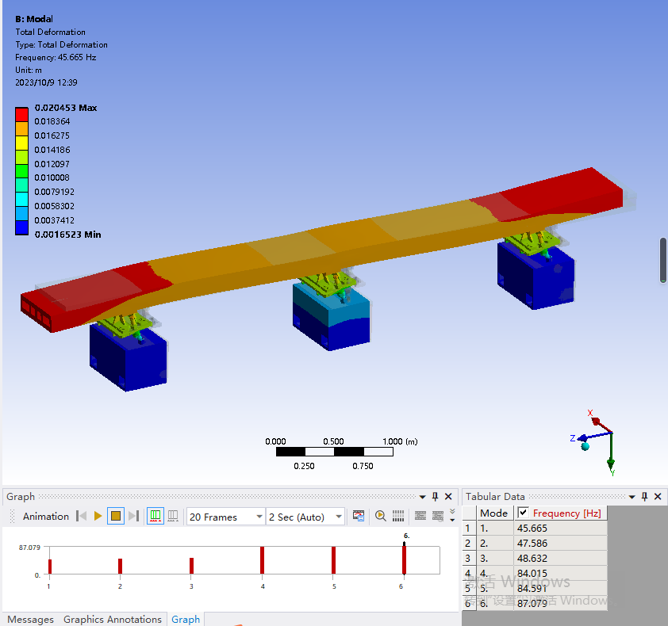
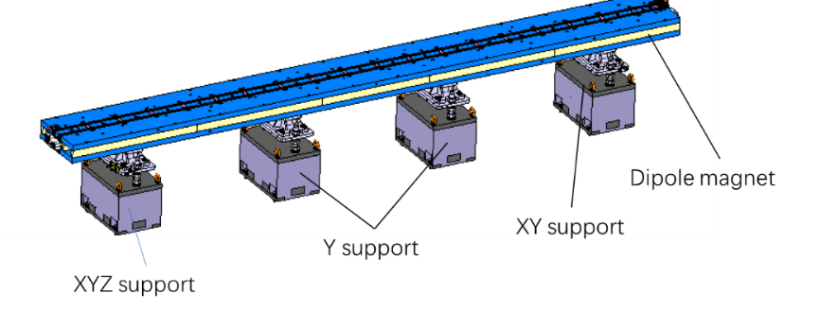
Magnet design and optimization in EDR-2
DAD design and optimization
  Core materials comparison: DT4(E), DT4, low carbon steel,…
    As the field is very low in DAD, high permeability of core material is not a key problem. Low carbon steel with lower performance can be used as the core which is very cheap.
  Magnetic optimization with uniform flux in the iron
    Less sensitive to the material
  Mechanical optimization and balance
    Core length selection
      Related to vacuum chamber and mechanics
    Mechanical tolerance distribution
    Radiation related design
    Supports number and yoke deformation
    Compromise field quality and production cost
      Machining errors
      Assembly tolerances
Dipole support in TDR
Ref: Haijing Wang’s talk

Slide 12
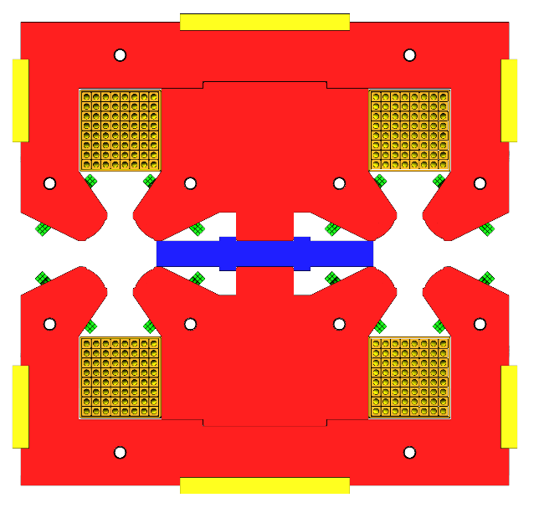
Magnet design and optimization in EDR-3
DAQ design and optimization
  Yoke shape optimization with equal magnetic reluctance on four poles of each aperture
  Magnetic center shift studies
  Mechanical structure design of 3m long laminated sheets
    With strong stiffness and rigidity
    Easy stacking and assembly
    Radiation shielding to be considered
  Field compensation method
    Tolerance control
    Batch magnets need easy field shimming method

Slide 13
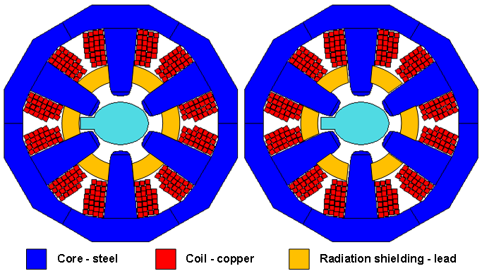
Magnet design and optimization in EDR-4
Sextupole design and optimization
  Two sextupoles are arranged side by side with narrow space in X direction.
  High gradient with long and slender figure
  Copper coils are used for space saving
  Mechanical design requires careful design
Other aspects should be considered
  Both DAD and DAQ with open sides where leakage field is existed, which affects the surrounding components, such as the vacuum, BMP, supports, etc. The field shielding or protection is of concern.
  Busbars interconnection experiment between different cores need to be welding in site.
  Power and energy saving technologies are crucial for CEPC. The selection of wire type (Cu or Al) is comprehensively evaluated based on the magnet construction cost, operating time, operating energy, and electricity price of the CEPC site location, especially for the quadrupoles.
  Field measurement method for convenient for long magnets

Slide 14
Plans on CEPC Collider Magnets in EDR
Magnet prototype construction plans in EDR
  After further optimization and iterative design, three kinds of full scale main magnets will be built for further verification
    DAD with more general or cheap steel materials
    Full scale DAQ
    Full scale sextupole magnet
Research on efficient batch production and field measurement
  Large scale manufacturing with more than 35000 magnet elements
  Allows the magnet components production on flow lines, including the stacking process, welding, assembly, size checking, coil winding, machining, etc.
  Field measurements are also hard tasks and time taking. Fixed measurement task and modular measurement process is very important.

Slide 15
Automatic production line on magnet
As such a large scale facility, every efficient strategy needs to be adopted to save time and reduce cost. Automatic control, AI and robot is on the way.
Accelerator magnets are nonstandard products. But there is a relatively standardized and fixed production process.
Key components of warm magnets and main process flows
  Core: laminated or solid
    Punching sheet, stacking process, machining, assembly, welding,…
  Coils: wire winding or busbar coils
    Insulation wrapping, winding, fixing, welding, …
  Connectors and support
  Painting and packing
  …

Slide 16
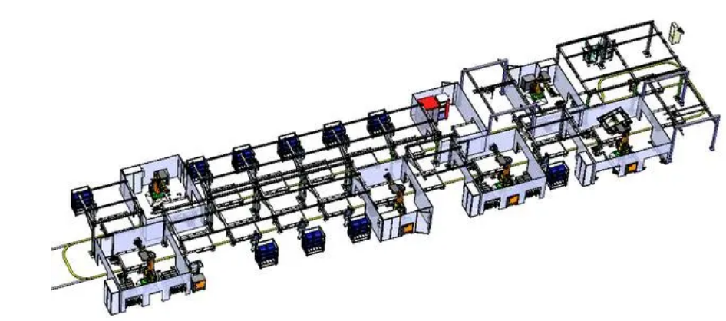
Automatic production line on magnet-2
Focus the automatic production line on multipole magnets whose quantity is very large. The baseline of multipoles is laminated core. Stacking the laminated sheets is the key step for automatic production.
Customized components can be ordered and produced by the manufacturer. Product oriented components and standardized components are preferred.
  Lamination sheets: punching, blending, deburring, trimming, weighing, etc.
  Insulated conductor wires with fiber glasses or kapton tapes.
  Standard water joints and cable terminals
  …
W. Kang

Slide 17
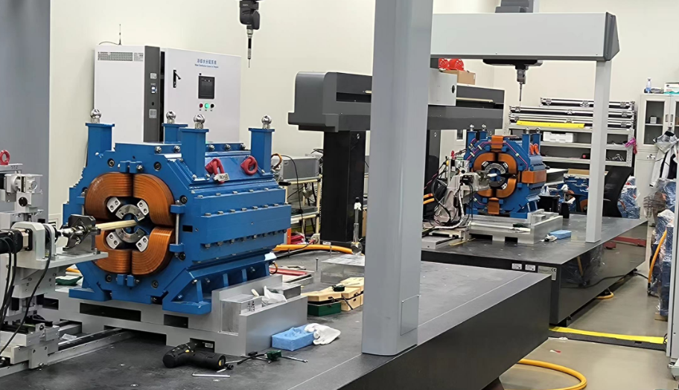
Automatic magnetic field measurement
Experiences in HEPS storage ring
  ~1800 magnets, including 240 DL, 672 HGQ, 294 Offset quad, 294 Sext,96 Oct and 192 FC.
  Field measurement systems in PAPS: 1 NMR,2 Hall probe, 2 RCS based on CMM and 1 SSW.
  1000 quads measurement finished in 2 RCS for one year, about 4~5 magnets/day.
Fixed field measurement process
  Magnet lifting
  Connecting water and electricity with fast connectors
  Automatic detecting and alignment by programmed CMM
  Inserting rotating coils and alignment (? Slide rails and robotic arms)
  Automatic measurement: integrating power supply control and field measurement program follows a certain process, adding the basic results judgement.
  Water and electricity dismantling
  magnet hoisting

Slide 18
Summary
Magnet prototypes for CEPC Collider ring have been studied and modified. The field quality can meet the requirements.
Further optimization on CEPC Collider magnets will be on going in CEPC EDR for energy saving, convenient and economical to construct.
Since the large quantities of magnets in CEPC, automatic or half automatic production lines are in research, especially in the quadrupole and sextupole and excitation coils, which are laminated ones and need much more manpower. Automatic field measurement are also need to implement.
Other materials or new technologies will be tried and studied.

Slide 19
Thanks for your attention!

