Slide 1




CEPC RF Power Source and Distribution System Development in EDR
Zusheng Zhou
On behalf of CEPC klystron R&D team
22-25. Jan. 2024, Conference, IAS Program on High Energy Physics

Slide 2
Content
RF power source
  Design consideration
  R&D Status
    650MHz/800kW klystron
    5720MHz/80MW
    Energy recovery klystron
    PPM klystron
RF power distribution system
  Collider ring
  Booster ring
  Linac injector/Damping ring

Slide 3
Design consideration for Collider RF sources
Considering klystron lifetime, power redundancy and cost, the 2 cavities will be powered with one CW klystron capable to deliver more than 800 kW.
High voltage DC power supply for high power and high efficiency klystron.
Distributions of RF power to the cavities, including waveguide, power divider, phase shifter, circulator and load.
Other Auxiliary PS, interlock and controls, LLRF, pre-amplifier are also included in RF power source system.

Slide 4
Design consideration for Collider RF sources
Requirement list:
Klystron | 96 | 650MHz/700kW
PSM Power Supply | 96 | 130kV/16A
Circulator | 96 | 650MHz/700kW
Load | 96 | 650MHz/700kW
Phase shift | 96 | 650MHz/700kW
Waveguide | 96 | Power divider/directional coupler
LLRF | 96 | Phase stabilization <0.1 degree, Amplitude stabilization <0.1%
Pre-amplifier | 96 | 650MHz/200W

Slide 5
Design consideration for Collider RF sources
Requirement list:
Klystron | 96 | 650MHz/700kW | Higher efficiency
PSM Power Supply | 96 | 130kV/16A | Mature product
Circulator | 96 | 650MHz/700kW | Mature product
Load | 96 | 650MHz/700kW | Mature product
Phase shift | 96 | 650MHz/700kW | Mature product
Waveguide | 96 | Power divider/directional coupler | Mature product
LLRF | 96 | Phase stabilization <0.1 degree, Amplitude stabilization <0.1% | Mature product
Pre-amplifier | 96 | 650MHz/200W | Mature product

Slide 6
Design consideration for Collider RF sources
Cost consumption
CEPC at 800 RMB/MWh and 6000 hours/year
Efficiency impact on operation cost (Only considering operation efficiency of klystrons)
Save Money
84M RMB
1 year
65 M RMB
Excessive electricity bill, M RMB
PAST
1st tube
62%
COMING
2nd tube
75%
Efficiency, %
FUTURE
3rd tube
80%

Slide 7
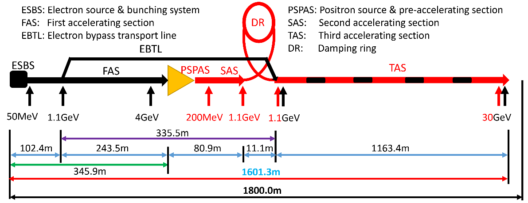
Design consideration for Linac RF sources
The main high power RF sources components are 33 units of 80MW S-band klystron, 236 units of 50MW C-band klystron and related modulators.
Type | QTY | Freq.(MHz) | Structure type
S-band klystron | 33 | 2860 | 1 1-to-1，standard-bunch 3 1-to-2，standard acc. structure. 8 1-to-2，large aperture acc. structure 21 1-to-4, standard acc. structure.
C-band klystron | 236 | 5720 | 1-to-2，standard acc. structure.

Slide 8
Design consideration for Linac RF sources
Requirement list:
S band klystron | 33 | 2860MHz/80MW
Modulator of S band klystron | 33 | 400kV/500A
C band klystron | 236 | 5720MHz/50MW
Modulator of C band klystron | 236 | 350kV/400A

Slide 9
Design consideration for Linac RF sources
Requirement list:
S band klystron | 33 | 2860MHz/80MW | Mature product
Modulator of S band klystron | 33 | 400kV/500A | Mature product
C band klystron | 236 | 5720MHz/50MW | Mature product
Modulator of C band klystron | 236 | 350kV/400A | Mature product

Slide 10
Design consideration for Linac RF sources
Why we do C band 80MW klystron?
  Only C band of 50MW klystron is mature product in the world.
  1 klystron only power to 2 accelerator structures (CEPC Linac baseline).
  QTY of C band klystron is very large (236 set).
IF output power of C band klystron is up to 80MW, the number of klystron will be reduced by half. (1 klystron power to 4 accelerator structures)

Slide 11
R&D Strategies
650MHz/800kW klystron with higher efficiency design for CEPC Collider.
5720MHz/80MW klystron for CEPC Linac cost reduction.
Energy recovery klystron for much higher efficiency.
PPM klystron for more simple auxiliary system.

Slide 12
R&D Status

Slide 13
650MHz klystron R&D strategy and plan
3 or more klystron prototypes for klystron efficiency improvement
2016 | 2017 | 2018 | 2019 | 2020 | 2021
2022
2023
2024
Prototypes
Step1
1st
Step2
2nd
Step3
3rd
more
Efficiency: 60%
70%
80%

Slide 14
Design scheme
Scheme 1: Traditional way for >60% efficiency
Scheme 2: With high voltage gun (110 kV/9.1 A), low perveance (HE, >75%)
Scheme 3: MBK, 54 kV/20A electron gun (8 beams) (HE, >80%)
Parameter | Scheme1(1st prototype) | Scheme2(2nd) | Scheme3(3rd)
Freq. (MHz) | 650 | 650 | 650
Voltage (kV) | 82 | 110 | 54
Current (A) | 16 | 9.1 | 20(2.5×8)
Beam No. | 1 | 1 | 8
Perveance (µP) | 0.65 | 0.25 | 1.6(0.2×8)
Efficiency (%) | 65 | ~80 | >80
Power(kW) | 800 | 800 | 800(100×8)

Slide 15
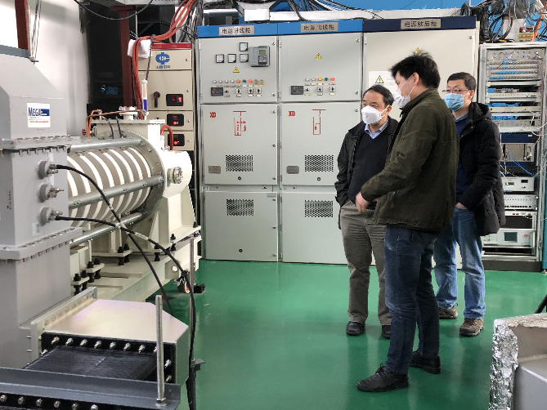
1st prototype milestone
Oct. 2017 Design report
Mar. 2020 High power test at IHEP
Parameters | Design | Test
Operating frequency (MHz) | 650 | 650
Beam Voltage (kV) | 81.5 | 80
Beam Perveance (μA/V^{3/2}) | 0.65 | 0.7
Efficiency(%) | 65 | 62
Saturation Gain(dB) | ≥45 | 47
Output power(kW) | 800 | 800
1 dB Bandwidth(MHz) | ≥1 | 1.8

Slide 16
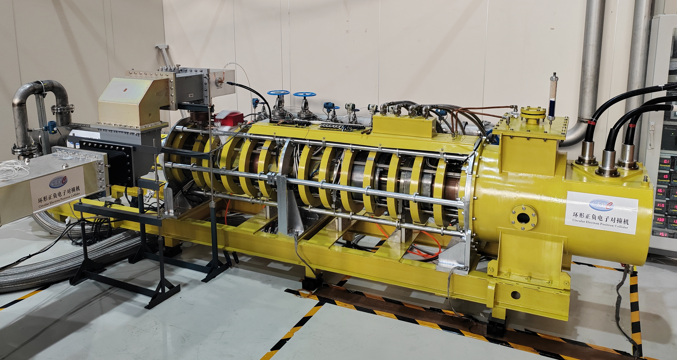
2nd prototype (HE design) milestone
Jan., 2021: Klystron manufacture started
Jul., 2022: CW 630kW with Eff. 70.5% (1st stage high power test)
Jan., 2024: 2nd stage high power test startup

Slide 17
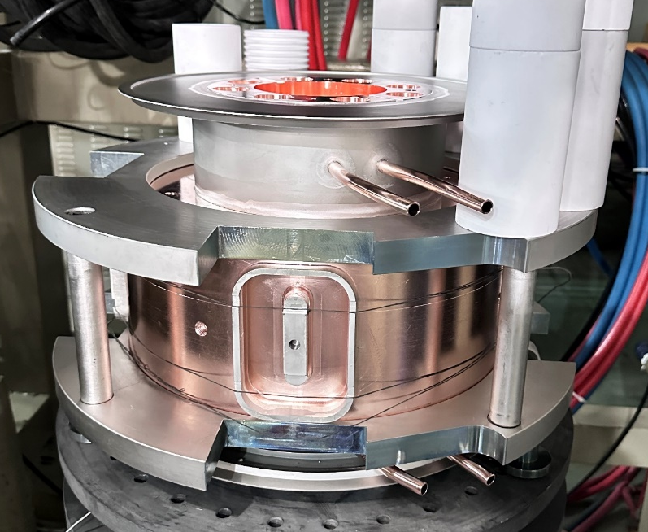
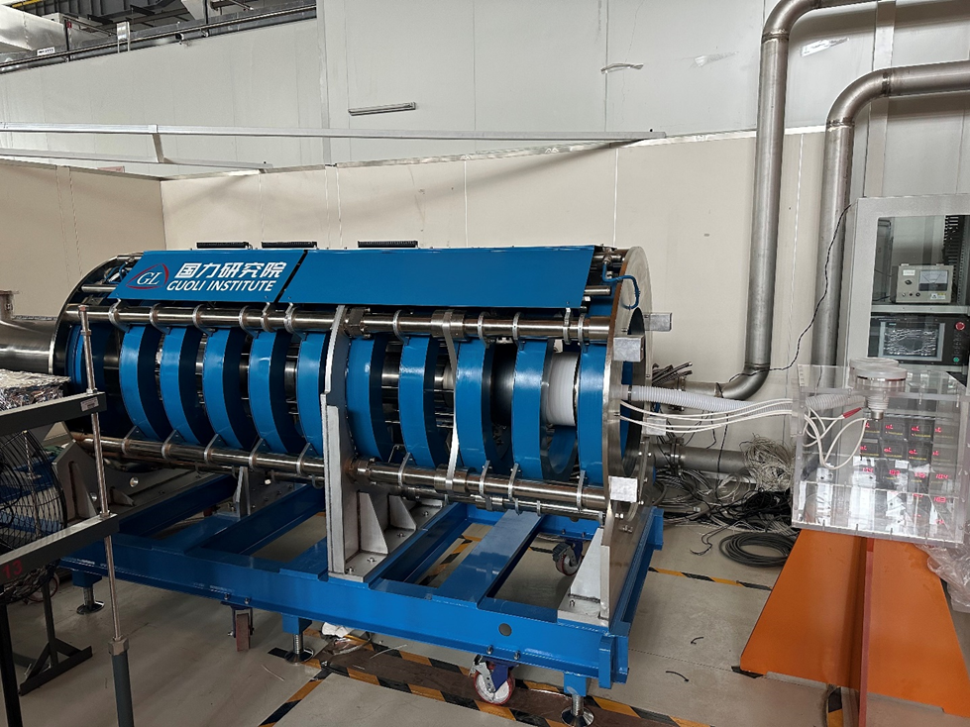
3rd prototype (Multi-beam design) milestone
Dec., 2021: Klystron beam tester manufacture started
Oct., 2023: Accomplishment of klystron beam tester high voltage conditioning and beam emission.
Jan. 2024: Klystron manufacture is in progress.

Slide 18
5720MHz klystron design

Slide 19
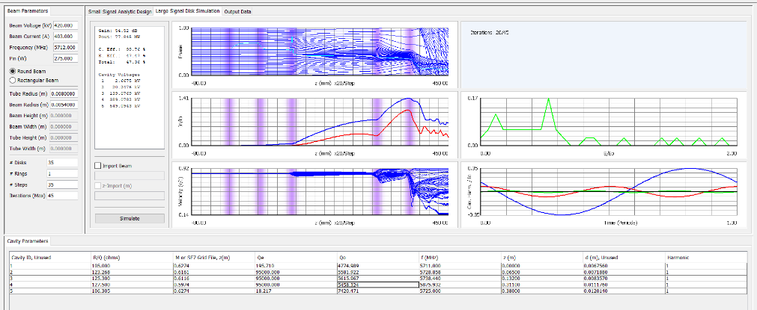
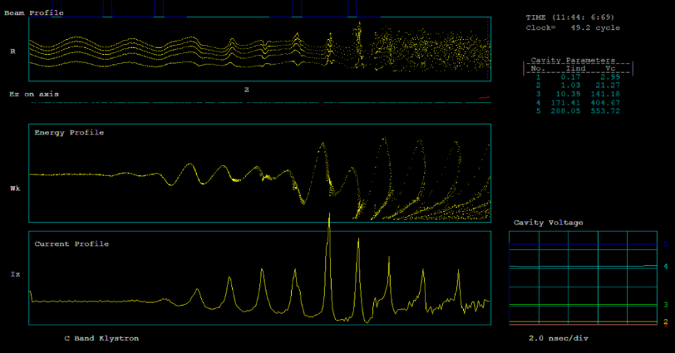
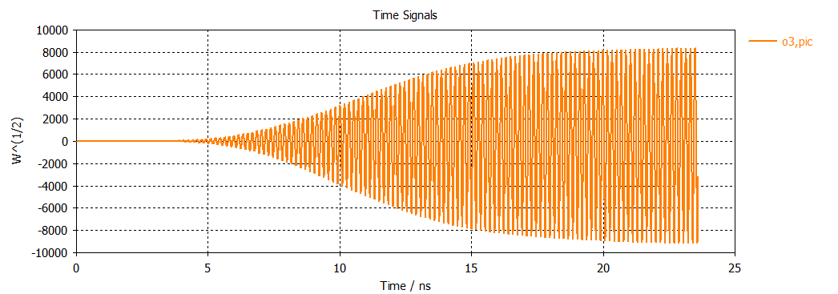
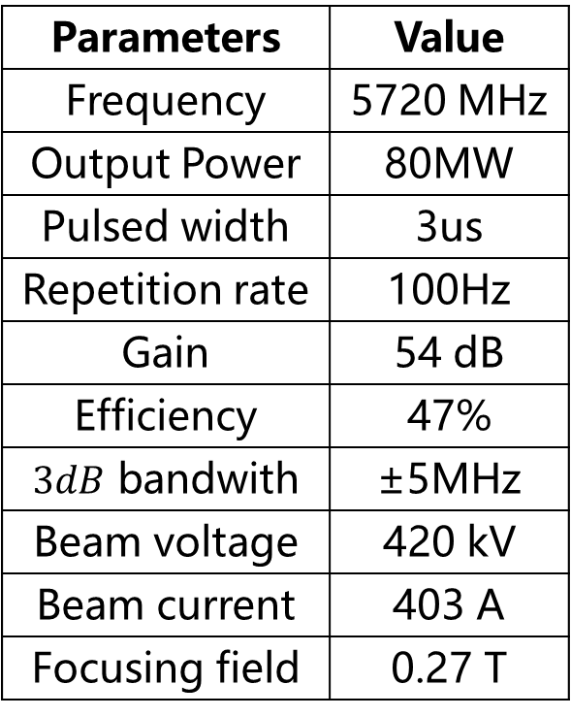
Design progress
Main parameters
Beam dynamics
Parameters | Value
Frequency | 5720 MHz
Output Power | 80MW
Pulsed width | 3us
Repetition rate | 100Hz
Gain | 54 dB
Efficiency | 47%
$3dB$ bandwith | ±5MHz
Beam voltage | 420 kV
Beam current | 403 A
Focusing field | 0.27 T

Slide 20
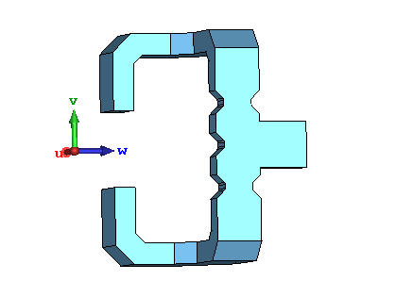
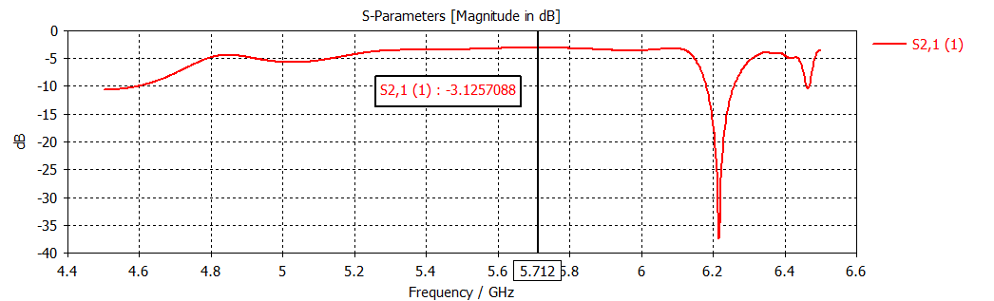
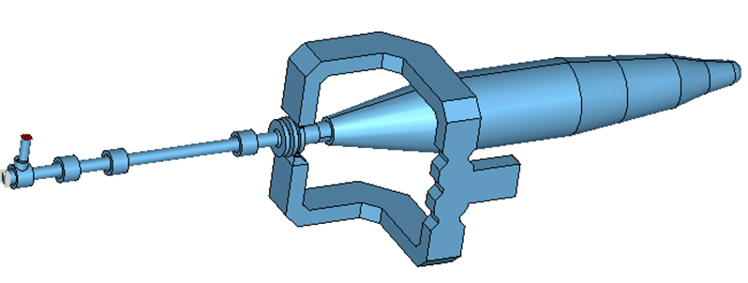

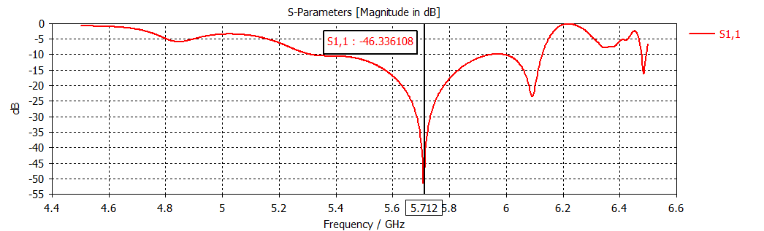
Design progress
RF Power Combiner & Collector Connected with
80 MW C-band Klystron
RF Power combiner

Slide 21
Energy recovery klystron

Slide 22
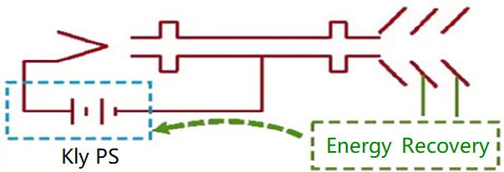
Energy recovery klystron
If 60MW SR power (e+&e-) of CEPC, RF power demands 109.5MW, waster power is still about 49.5MW. (Klystron efficiency~70% @linear region and ~80%@saturate region).
The energy recovery klystron recovers energy from the spent electron beam by multi-depressed collector, thereby reducing the power demand from the grid and significantly lowering operation.
RF OUT
Typical klystron
Energy recovery klystron

Slide 23
Roughly theoretical analysis
CEPC 1st klystron prototype
Coll. Qty | Coll. Eff. | Kly. Eff.
0 | 0.00% | 58.3%
1 | 31.4% | 71.4%
2 | 50.9% | 79.5%
3 | 59.2% | 83.0%
4 | 64.3% | 85.1%
5 | 67.9% | 86.6%
CEPC 2nd klystron prototype
Coll. Qty | Coll. Eff. | Kly. Eff.
0 | 0.0% | 68.0%
1 | 29.8% | 77.5%
2 | 47.7% | 83.3%
3 | 55.6% | 85.8%
4 | 61.4% | 87.7%
5 | 65.2% | 88.9%

Slide 24
PPM klystron

Slide 25
PPM advantage
Small volume, light weight, and does not require water cooling and power supply.
It saves the power consumption and cost of power supply, and on the other hand, it avoids the risk of power supply failure and water leakage.
 | E37212 | E37302A
Frequency(MHz) | 5712 | 2998
Output Power (MW) | 51 | 47
Beam Power (MW) | 118.3 | 123.5
Average Power (kW) | 35.5 | 24.7
Solenoid Power (kW) | 8.4 | 3.4
RF efficiency (%) | 43.1 | 38
Overall efficiency(%) | 34.9 | 33.5

Slide 26
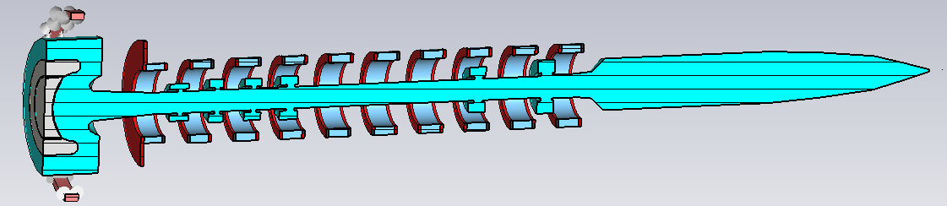
PPM klystron
On the basis of the S band klystron, the electromagnetic focusing is being changed to PPM focusing structure.

Slide 27
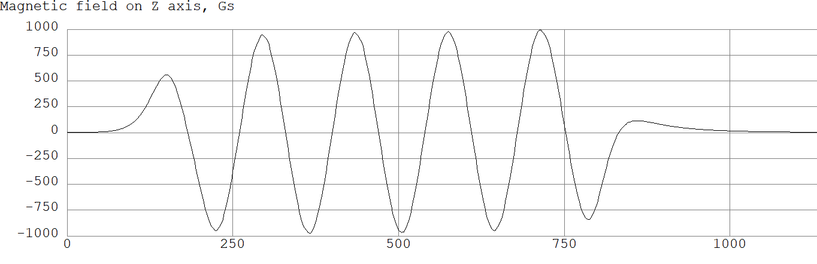
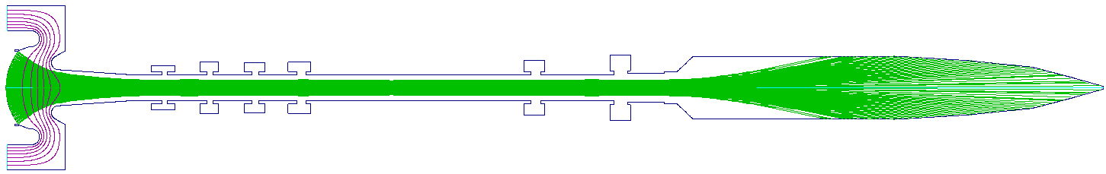
Beam optics

Slide 28
RF power sources distributions

Slide 29
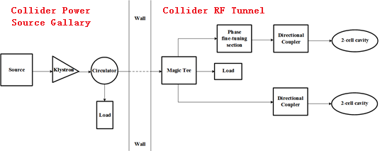
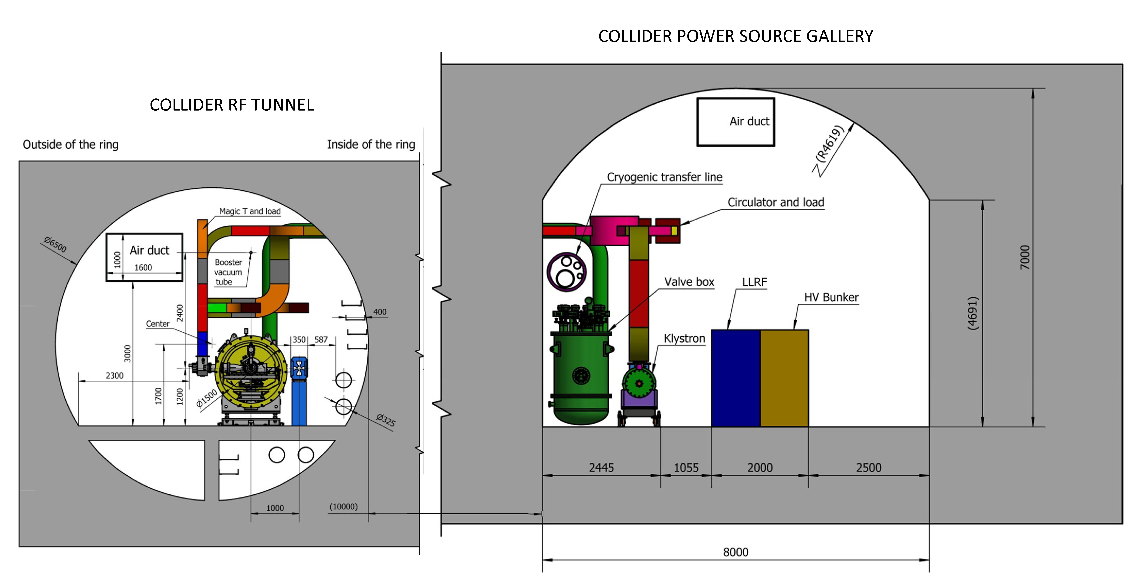
Collider power sources distributions
High voltage power supply are placed on the ground.
For space savings, transmission system in part are placed in RF tunnel.

Slide 30
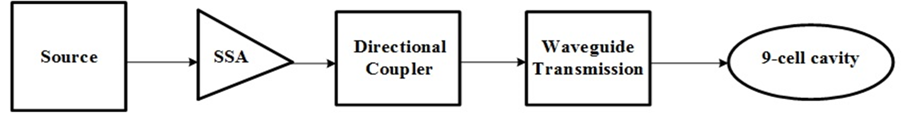
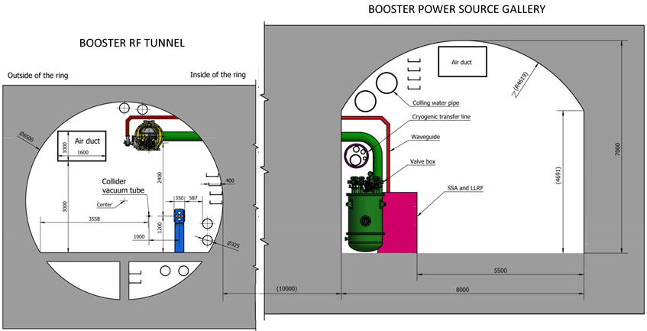
Booster power sources distributions
The Booster RF system consists of 1.3 GHz superconducting RF cavities. There are 12 cryo-modules for Higgs operation, each containing eight 9-cell superconducting cavities.
These cavities need 96 set 25kW power sources.

Slide 31
Damping ring power sources distributions
There are 2 RF stations, RF power is 650MHz/90kW/station.
650MHz/90kW SSA Specifications
Parameters | Values
Frequency | 650MHz
Power | 90 kW
Gain | ≥65 dB
Bandwidth (1dB) | ≥ 1 MHz
Amplitude stability | ≤0.1% RMS
Phase stability | ≤0.1°RMS
Phase Variation | ≤10°
Harmonic | < -30 dBc
Spurious | < -60 dBc

Slide 32
Linac power sources distributions
Type | Structure type
S-band klystron | 1 1-to-1，standard-bunch 3 1-to-2，standard acc. structure. 8 1-to-2，large aperture acc. structure 21 1-to-4, standard acc. structure.
C-band klystron | 1-to-2，standard acc. structure.

Slide 33
Summary
Much higher efficiency and much less power consumption and system cost.
The 2nd stage high power test of 650MHz high efficiency klystron is being done at IHEP PAPS test stand.
Energy recovery klystron and PPM klystron are also being developed at IHEP.
Design of C band 80MW klystron is almost accomplished design and will be manufactured in the near future.
RF power source distributions are also under consideration.

Slide 34
Thanks for your attention!

