Slide 1



CEPC Instrumentation Study in EDR
Yanfeng Sui
On behalf of CEPC BI group
22-26. Jan. 2024, Hongkong, IAS Program on High Energy Physics

Slide 2
Content
The introduction of CEPC beam instrumentation
  Booster and collider ring beam instrumentation
  Linac and damping ring beam instrumentation
Instrumentation study in EDR
  Beam position monitor （BPM）system
  Beam feedback system
  Synchrotron light based diagnostics
  Luminosity tuning system
  ……
Summary

Slide 3
Design parameters of Linac & damping ring
 | Item | Method | Parameter | Amounts
Linac | Beam position | Stripline BPM | Resolution ：30um | 150
 | Beam current | ICT | 2.5%@1nC-10nC | 63
 | Beam profile | YAG/OTR | Resolution: 30um | 30
 | Beam emittance | Q+PR | 10% | 3
 | Beam energy & spread | AM+PR | 0.1% | 3
Damping ring | Average current | DCCT | Resolution :50uA@0.1mA-30mA | 1
 | Beam position | Button BPM | Resolution : 20um @ 5mA TBT | 40
 | Tune measurement | Frequency sweeping | Resolution:0.001 | 1

Slide 4
Design parameters of the booster beam instrumentation
Item | Method | Parameter | Amounts
Beam position monitor | Button electrode BPM | Measurement area (x × y)：±20mm×±10mm Resolution：<20um(turn by turn) | 2408
Bunch current | BCM | Measurement range：10mA / per bunch Relatively precision：1/4095 | 2
Average current | DCCT | Dynamic measurement range：0.0~1A Resolution:50uA@0.6-8mA Linearity：0.1 % Zero drift: <0.05mA | 2
Beam size | Double slit interferometer x ray pin hole | Resolution:0.2 µm | 2
Bunch length | Streak camera Two photon intensity interferometer | Resolution:1 ps | 2
Tune measurement | Frequency sweeping method | Resolution:0.001 | 2
 | DDD | Resolution:0.001
Beam loss monitor | Optical fiber | Space resolution:0.6m | 670
Feedback system | TFB | Damping time<=3ms | 2
Feedback system | LFB | Damping time<=35ms（50ms） | 4

Slide 5
Design parameters of the collider beam instrumentation
Item |  | Method | Parameter | Amounts
Beam position monitor | Closed orbit | Button electrode BPM | Measurement area (x × y)：±20mm×±10mm Resolution：<1um Measurement time of COD：< 4 s | 4252
 | Bunch by bunch | Button electrode BPM | Measurement area (x × y)：±40mm×±20mm Resolution：0.1mm
Bunch current |  | BCM | Measurement range：10mA / per bunch Relatively precision：1/4095 | 2
Average current |  | DCCT | Dynamic measurement range：0.0~1A Linearity：0.1 % Zero drift: <0.05mA | 2
Beam size |  | Double slit interferometer x ray pin hole | Resolution:0.2 µm | 4
Bunch length |  | Streak camera Two photon intensity interferometer | Resolution:1ps@10ps | 2
Tune measurement |  | Frequency sweeping method | Resolution:0.001 | 2
 |  | DDD | Resolution:0.001
Beam loss monitor |  | PIN-diode | Dynamic range:120 dB Maximum counting rates≥10 MHz | 5800
Feedback system |  | TFB | Damping time<=1ms | 4
 |  | LFB | Damping time<=12ms | 4

Slide 6
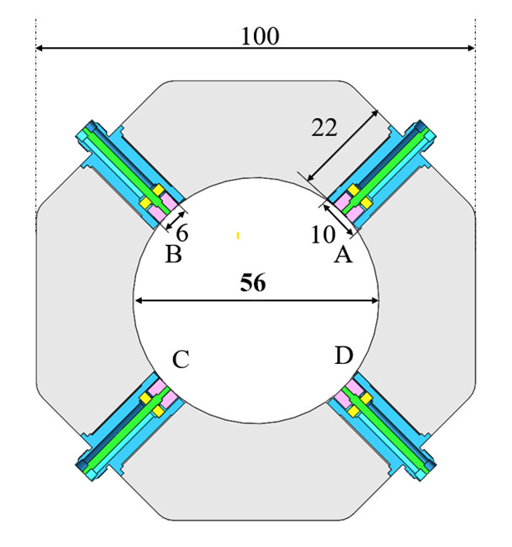
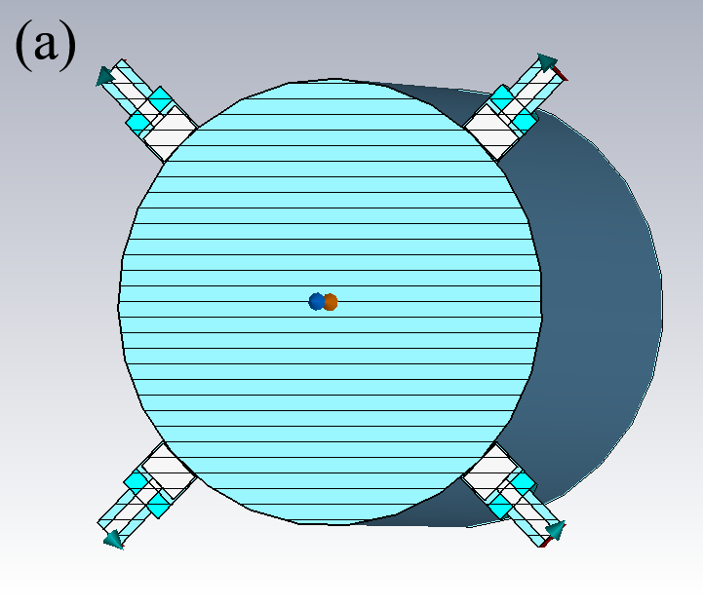
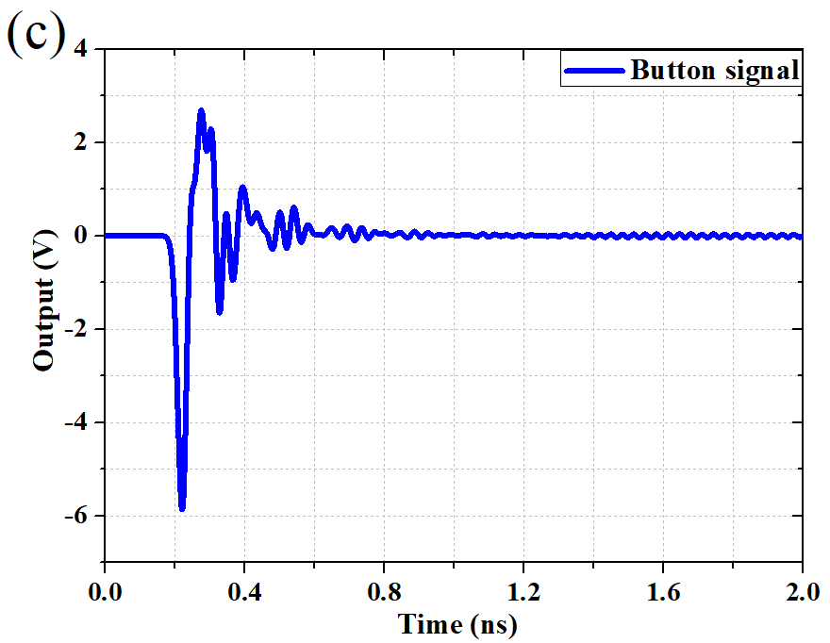
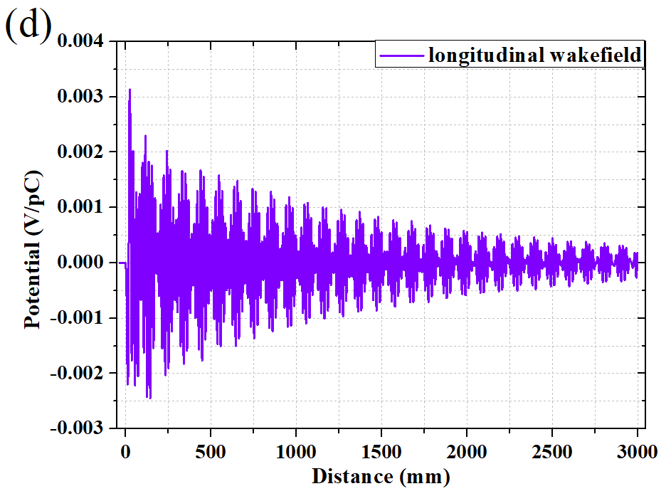
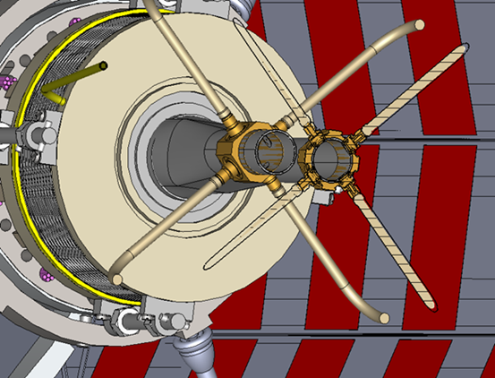
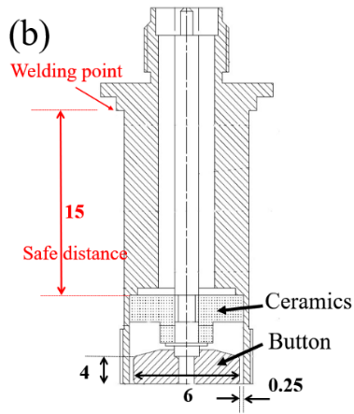
Beam position monitor
With one Beam Position Monitor (BPM) near each quadruple, there will be 4252 BPMs in collider ring and 2408 BPMs in the booster
The best solution is a capacitive monitor with a button-like electrode. The four buttons will be mounted on a machined block of stainless steel welded into vacuum chamber.
The booster beam position monitors are the same as those of collider.
 | ttbar |  | Higgs |  | W |  | Z
 | Real | CST | Real | CST | Real | CST | Real | CST
Charge | 20e10 | 32 nC | 14e10 | 22.4 nC | 13.5e10 | 21.6 nC | 14e10 | 22.4 nC
Bunch length | 2.2/2.9 | 3 mm | 2.3/3.9 | 4 mm | 2.5/4.9 | 5 mm | 2.5/8.7 | 8.7 mm
Vpp | 635V |  | 359V |  | 295V |  | 179V
Z_500M | 0.22Ω |  | 0.22Ω |  | 0.22Ω |  | 0.22Ω
P_500M | -7.3dBm/320mA |  | -12.8dBm/170mA |  | -10.6dBm/216mA |  | -10.4dBm/224mA
Kx=Ky | 19.9mm |  | 19.9mm |  | 19.9mm |  | 19.9mm
Parameters
Bunch | Length | 4.1 mm
 | Charge | 1 nC
Mechanical | r_{b} | 3 mm
 | t_{b} | 4 mm
 | g_{b} | 0.25 mm
 | b | 28 mm

Slide 7
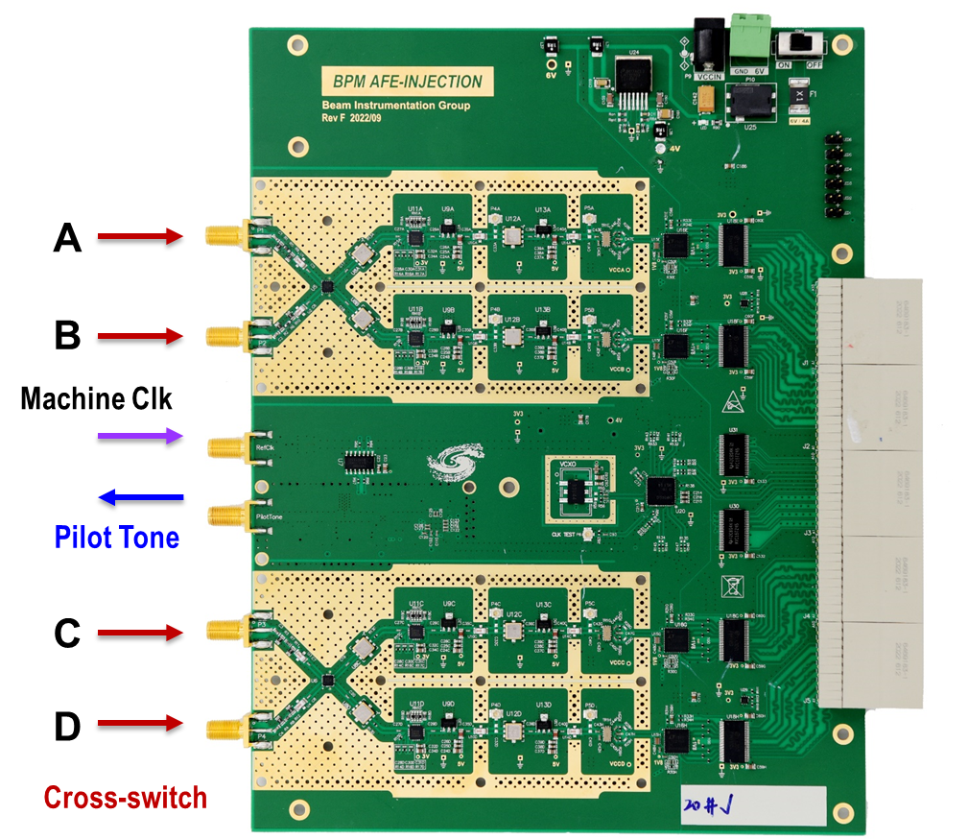
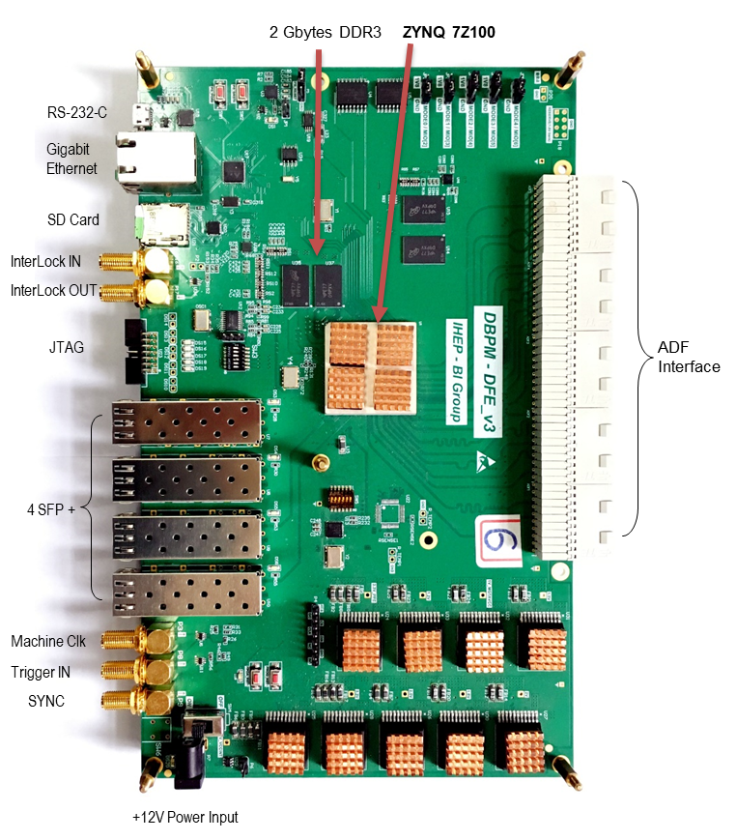
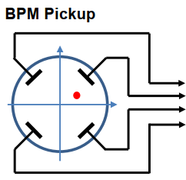
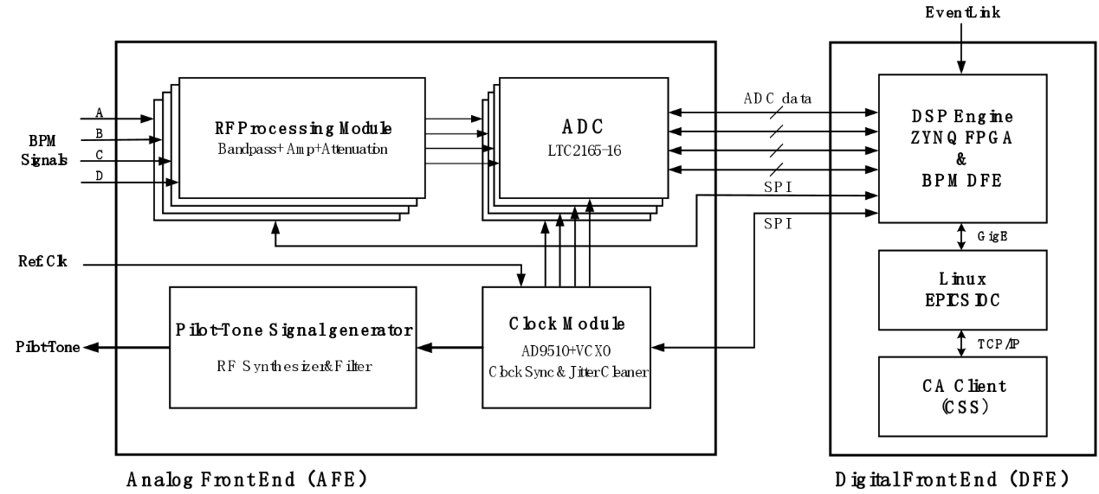
Beam position monitor
The BPM electronics can be categorized into two main parts: the Analog Front-End (AFE) for radio frequency signal conditioning and the Digital signal processing part (DFE).
The AFE consists of the RF signal conditioning module, ADC analog-to-digital conversion module, clock processing module, and pilot signal generation module. On the other hand, DFE includes the BPM signal acquisition module, signal conditioning module, data acquisition and transfer module, EPICS IOC module, and CSS control module.
About 6600 BPM electronics are required in CEPC and will installed in auxiliary tunnels.
Radiation-tolerant design of the electronics, the ADC and FPGA should be radiation resistant.

Slide 8
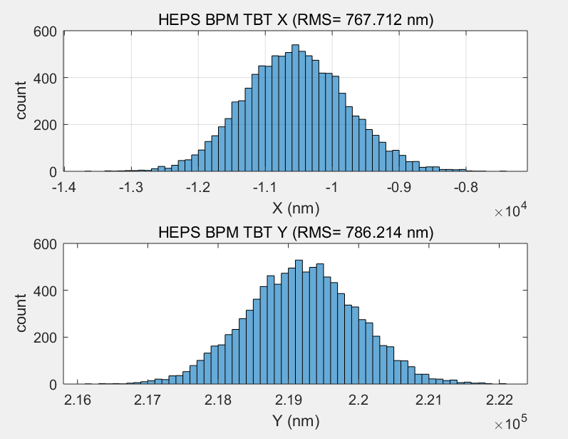
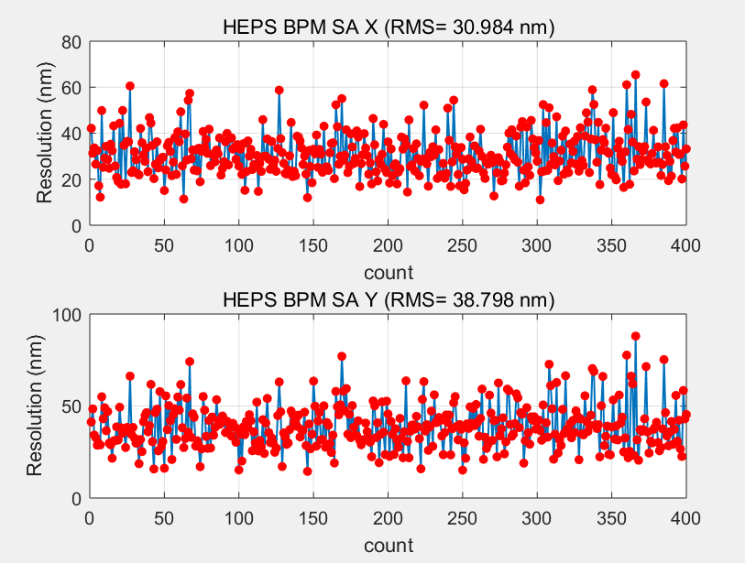
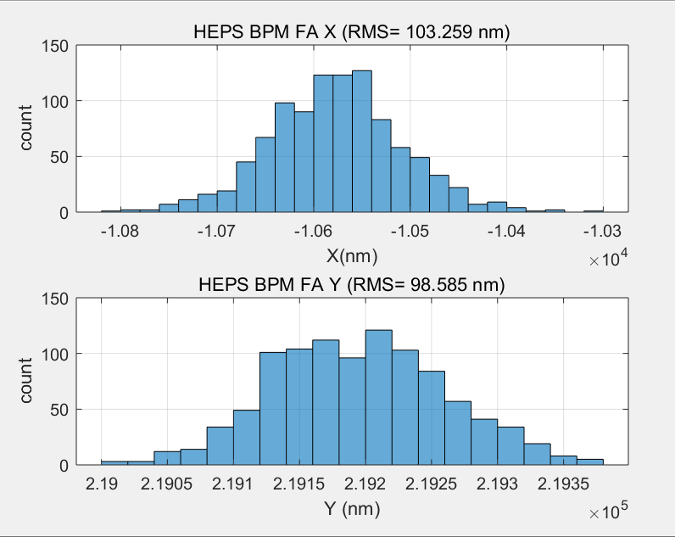
BPM electronics resolution test in lab
TBT RMS (X=767nm,y=786nm)
SA RMS(X=30nm,Y=38nm) 10points STD
We test the performance of DBPM in lab
RF frequency is 499.8MHz(-15dBm) from R&S SMA100
TBT data rms xpos ≈767nm, ypos ≈786nm;
FA data rms xpos ≈103nm, ypos ≈98nm;
SA data rms xpos ≈30nm, ypos ≈38nm;
Kx=Ky=8.26mm;
FA RMS (X=103nm,y=98nm)

Slide 9
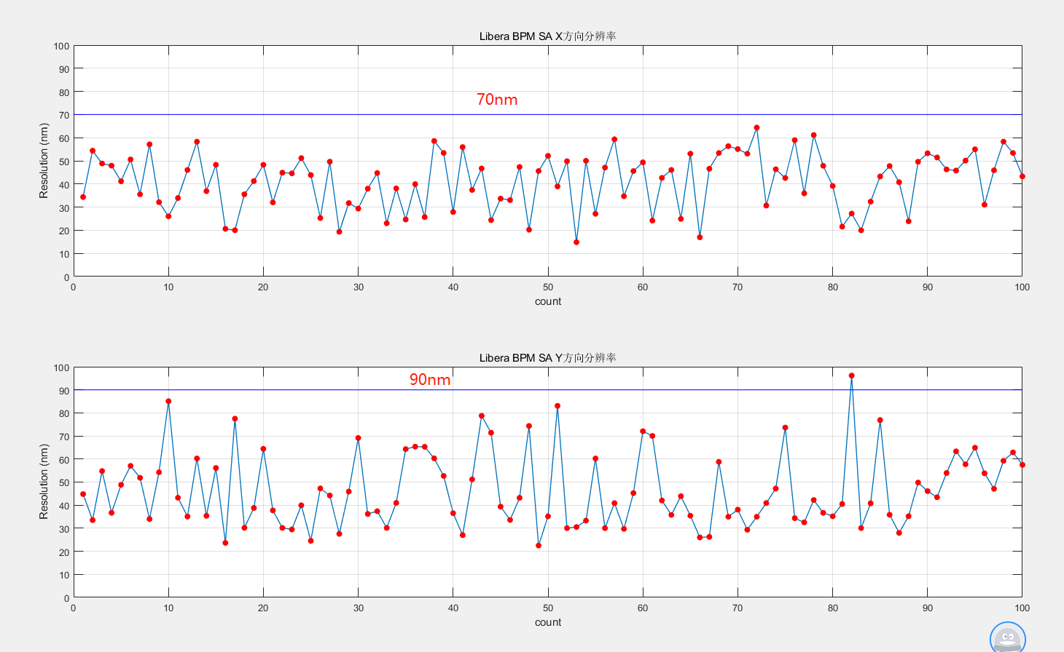
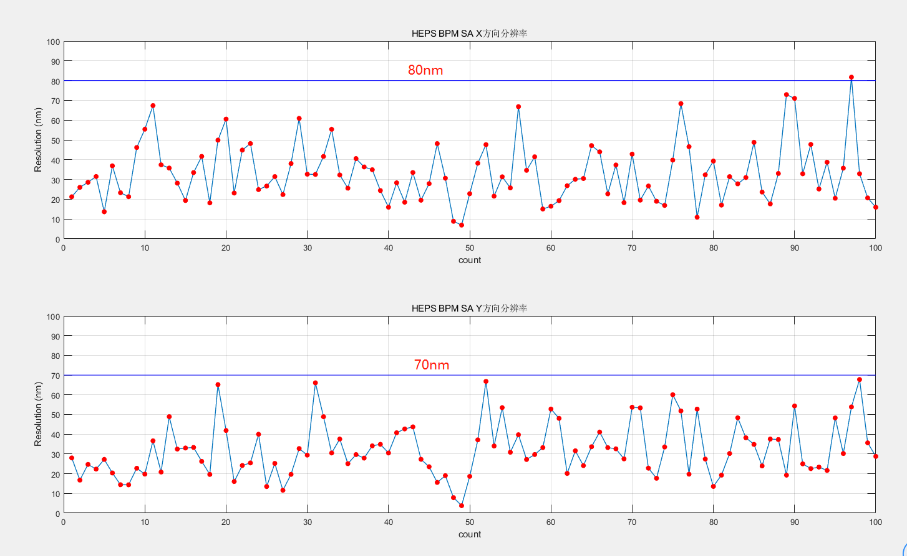
Real beam test in BEPCII
BPM 1O_03 (IHEP&&commercial products)
70nm
80nm
90nm
70nm
** BPM electronics
IHEP BPM electronics

Slide 10
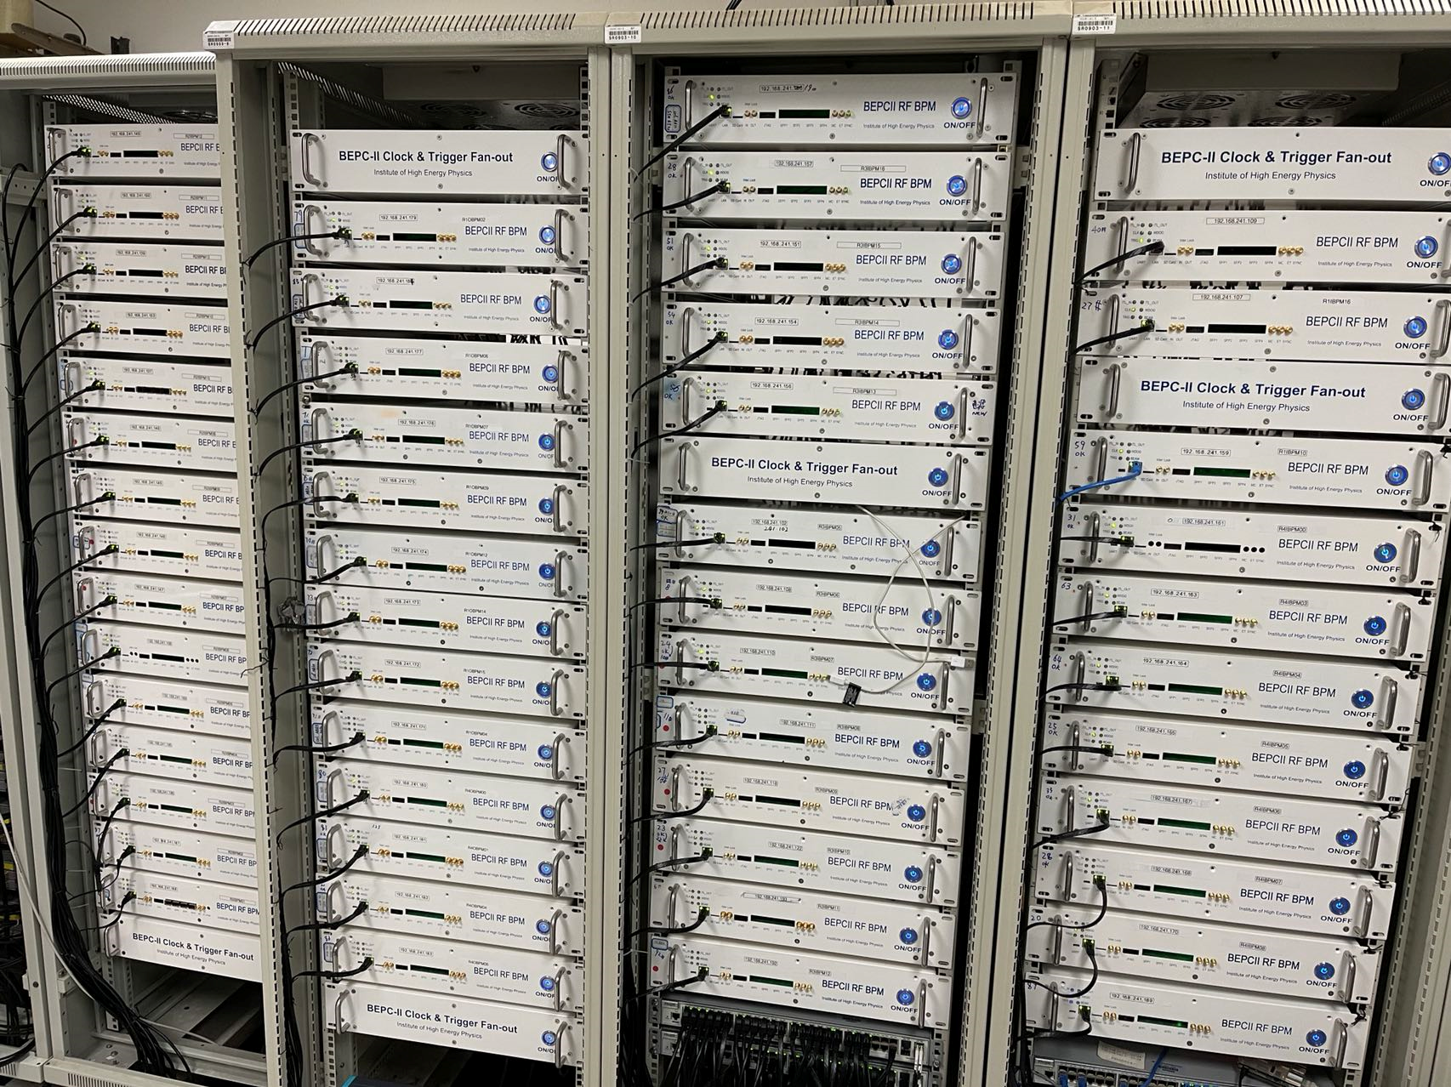
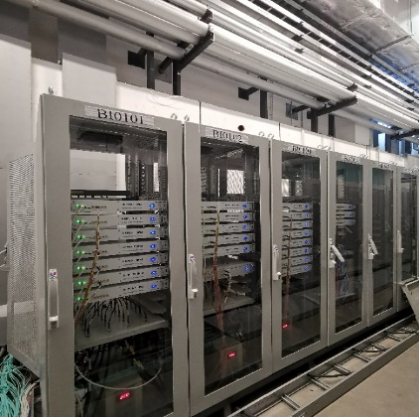
Beam position monitor electronics
We successfully solved the issue of mass production of BPM electronics and the BPM electronics were used in BEPCII collider ring operation and HEPS.
~700 BPM electronics in HEPS and 120 BPM electronics in BEPCII have been developed and test by our team.
These jobs will train personnel in preparation for CEPC construction.
BPM electronics for HEPS linac

Slide 11
The industrialization of BPM electronics
The industrialized production of BPM electronincs
  HEPS and BEPCII BPM electronics production is still in the laboratory, but for CEPC, there will be an order of magnitude increase. We can’t handle that.
  We need to seek assistance from CIPC member companies or other vendors to carry out batch production.
The automated testing of BPM electronics
  Improve BPM electronics testing efficiency
  Reduce the impact of human factors on test results
  The electronic and automated testing documents

Slide 12
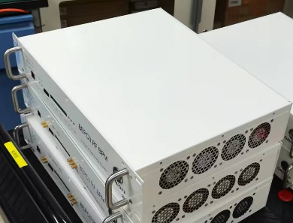
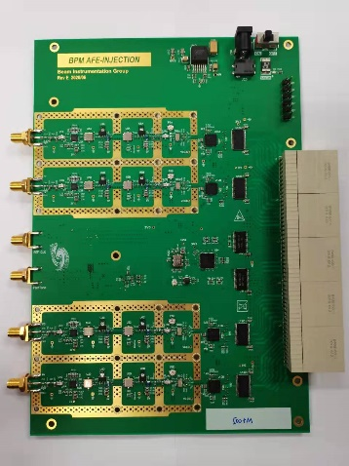
BPM electronics test requirements
AFE test content
  Voltage and resistance testing
  Channel amplitude and phase consistency testing
  Each channel S-parameter testing
  Channel linearity and saturation characteristic testing
  Channel isolation testing
  ……
The entire system test content
  Channel coefficient
  Current dependence
  ADC signal-to-noise ratio
  Attenuator performance
  Channel isolation
  ……

Slide 13
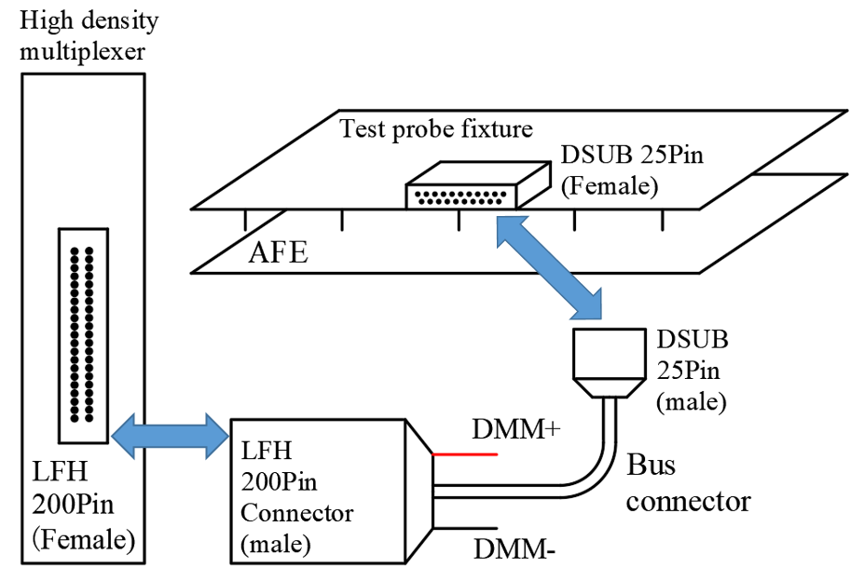
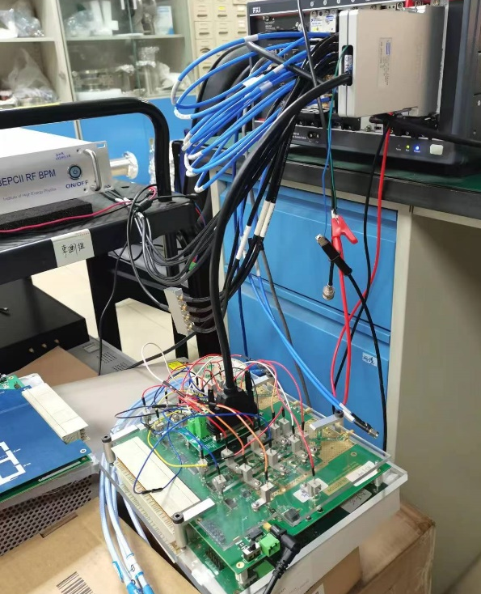
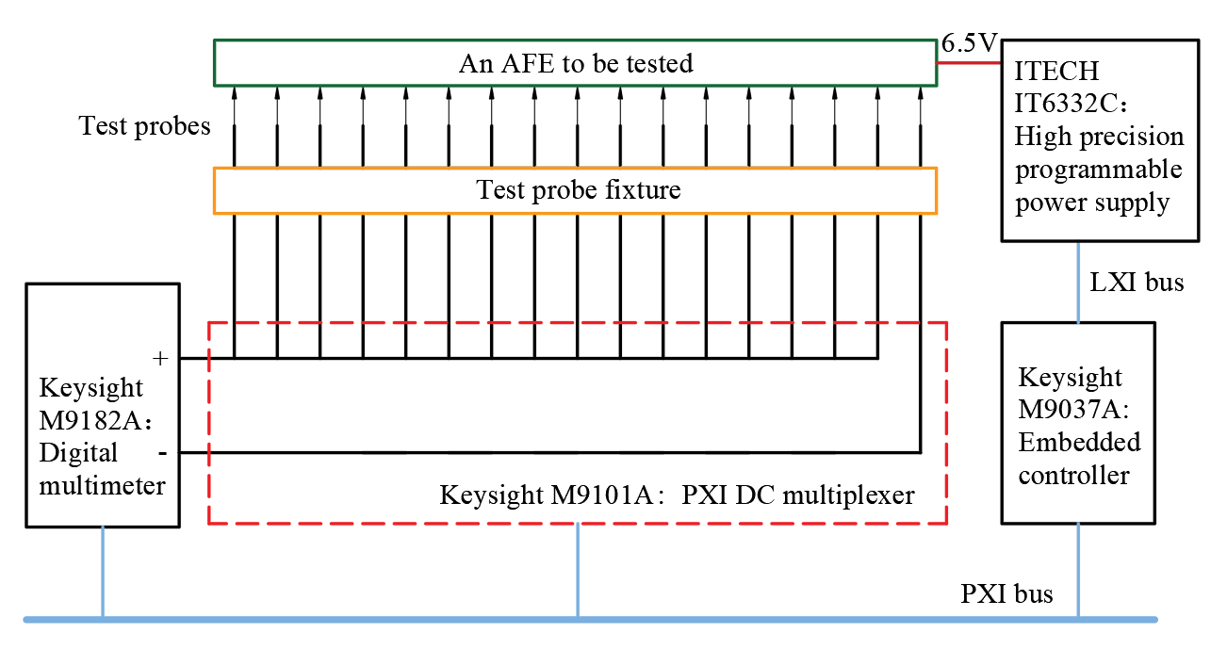
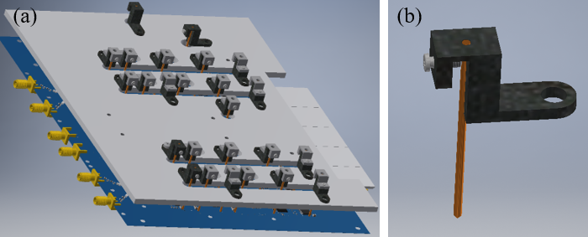
Automated test system for the AFE board
Testing of DC performance—hardware
To be tested：
Voltage and resistance of 23 key chips, with voltage values ranging from 1.8V to 6V.
Design of AFE fixture and probe module

Slide 14
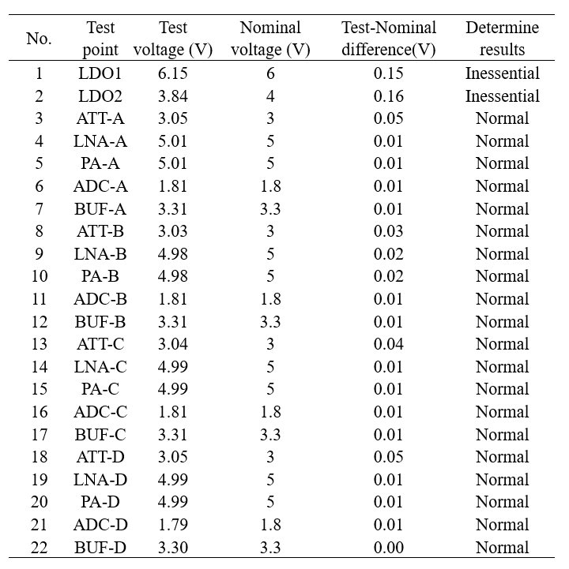
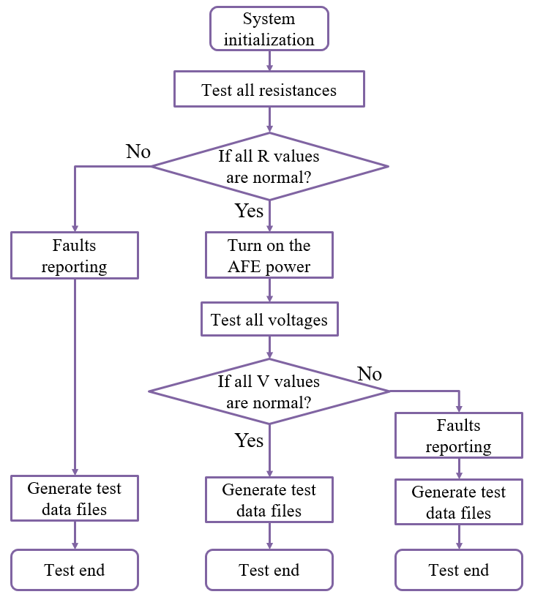
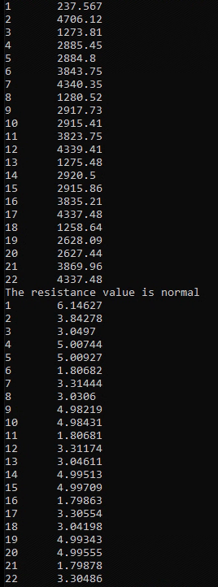
Automated test system for the AFE board
Testing of DC performance—software
software development tools：
1、Microsoft Visual Studio
2、Language：C++
3、 Driver library of instrument

Slide 15
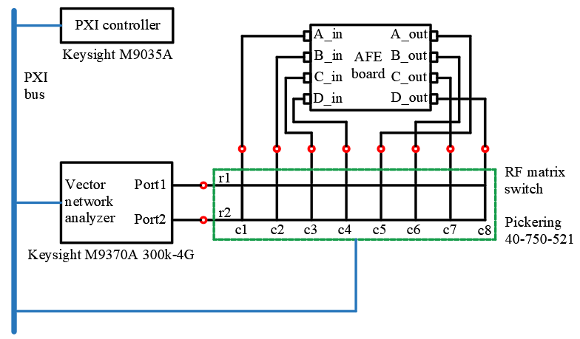
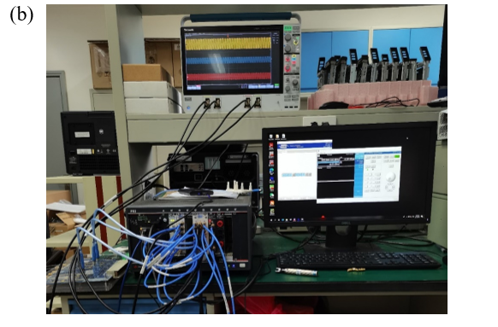
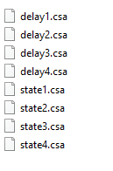
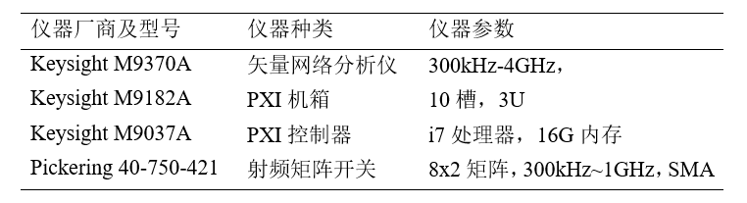
Automated test system for the AFE board
RF performance testing—system development
Calibration data
To be tested：
AFE channel filter performance (S21 parameter)
AFE saturation performance (power scan parameters)
AFE group delay
AFE voltage standing wave ratio
RF performance testing stand

Slide 16
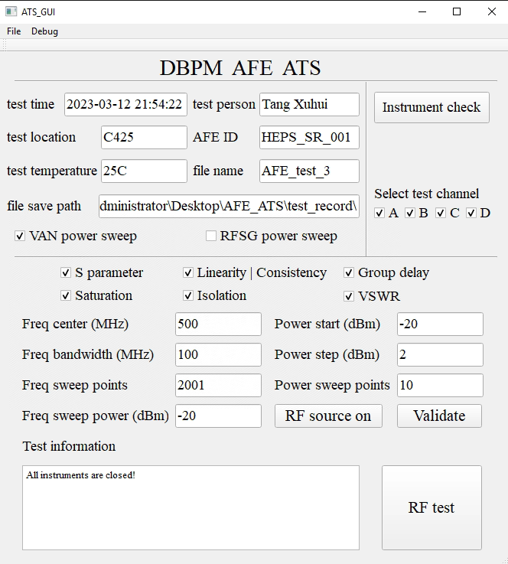
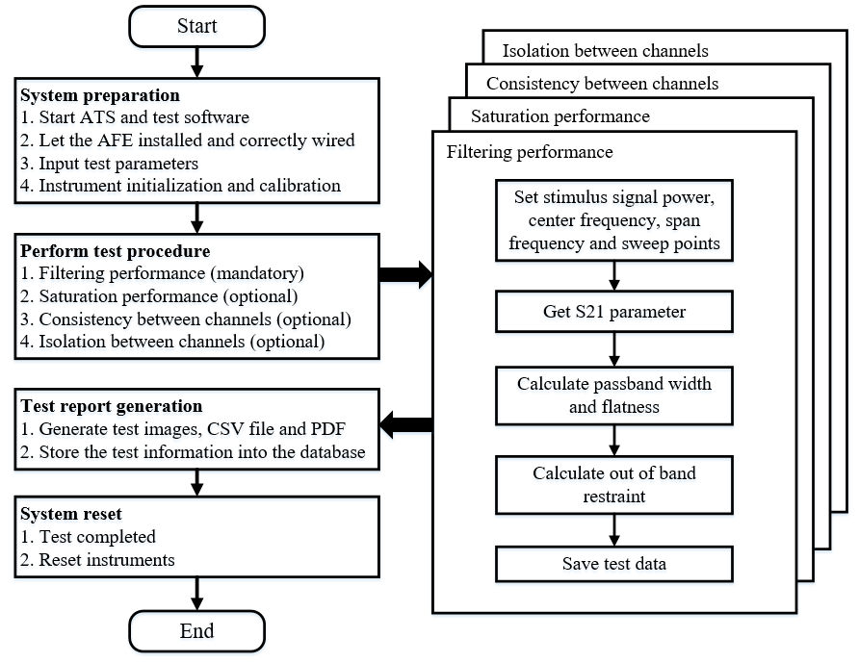
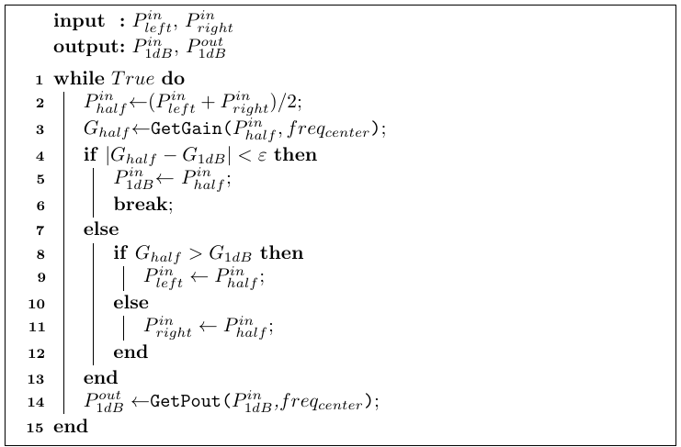
Automated test system for the AFE board
Testing of RF performance - software flow and algorithms
AFE automatic test software flowchart
User configuration interface of software
Measuring 1dB compression point

Slide 17
The wireless data transmission of BPM
Necessary modification in BPM electronics
  ADC and data process are placing close to the detector
  Add wireless transmission module
  The timing system needs to be improved according to the requirements
The issues should be addressed in the EDR
  Radiation-resistant components- ADCs and FPGAs
  Highly reliable wireless transmission protocol
  Necessary radiation shielding
  ……

Slide 18
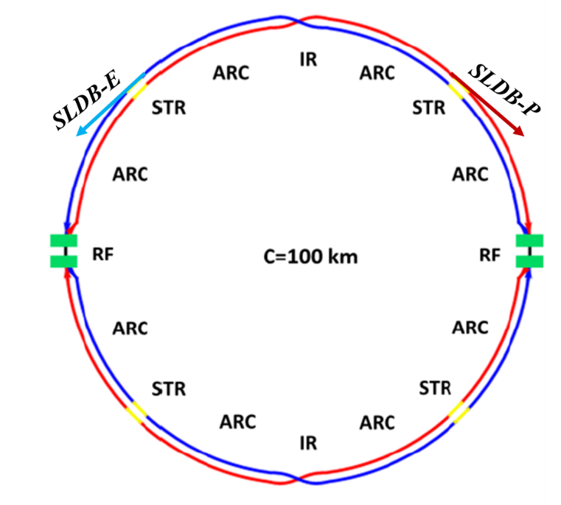
CEPC beam diagnostic with synchrotron light
Synchrotron light diagnostic beamlines (SLDB)
  SLDB-E is located at the northwest, while SLDB-P located at the northeast.
  Each beamline has two port for x-ray and visible light extraction.
  X-ray port is used for transverse beam sizes measurement.
  Visible light port is used for bunch length measurement.
Schematic of locations of the synchrotron light diagnostic beamlines

Slide 19
The study of synchrotron light based diagnostics in EDR
Visible light extraction mirror
  Visible light is used for bunch length measurement with streak camera.
  SR power from dipole is about 4.7kW/mrad. It’s a huge heat load if extract visible light directly with a mirror. Thermal distortion with current due to incident SR will cause measurement error.
  Mirror design and mount, distortion evaluate are key issues for research.
Beam sizes measurement
Vertical beam size is very small approximately several micrometers. Hard x-ray should be used in order to achieve enough resolution.
Bending angle of dipole is also small, considering the radius of beam pipe and the magnets geometry, the nearest optical elements should be placed about 50 meters away from the source point, making measurement more difficult. X ray interferometer is considered as measurement method.
Design of measurement system, fabrication of x-ray double slit, and design of high resolution x-ray camera are key issues for research.

Slide 20
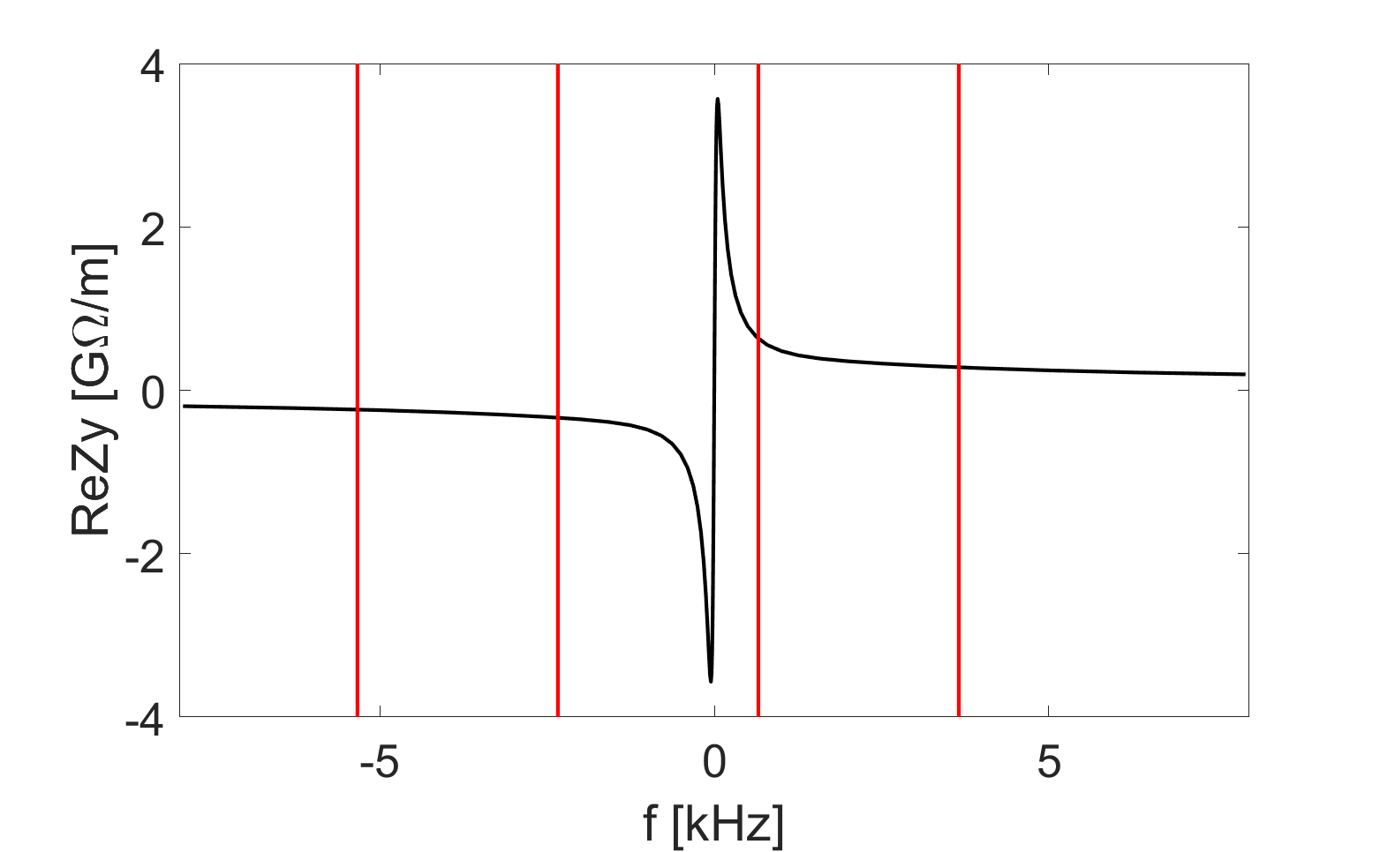
Conceptual solutions of TFB feedback
Narrow-band feedback + bunch by bunch feedback
Consider narrow-band feedback, in addition to bunch-by-bunch ones, for specific instabilities such as resistive wall coupled bunch. Mode No. 19650 & 19651
Mode frequency [kHz] | Mode number | Growth time [ms]
-2.338 | 19650 | 1.1 (3 turns)
-5.335 | 19651 | 1.6 (5 turns)
-8.332 | 19650 | 2.0 (6 turns)
-11.330 | 19649 | 2.3 (7 turns)
n=11252
n=11253
n=11251
n=11254

Slide 21
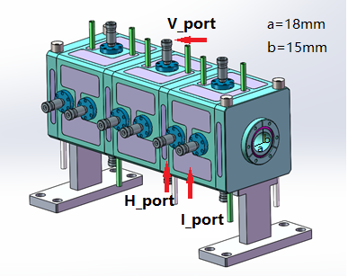
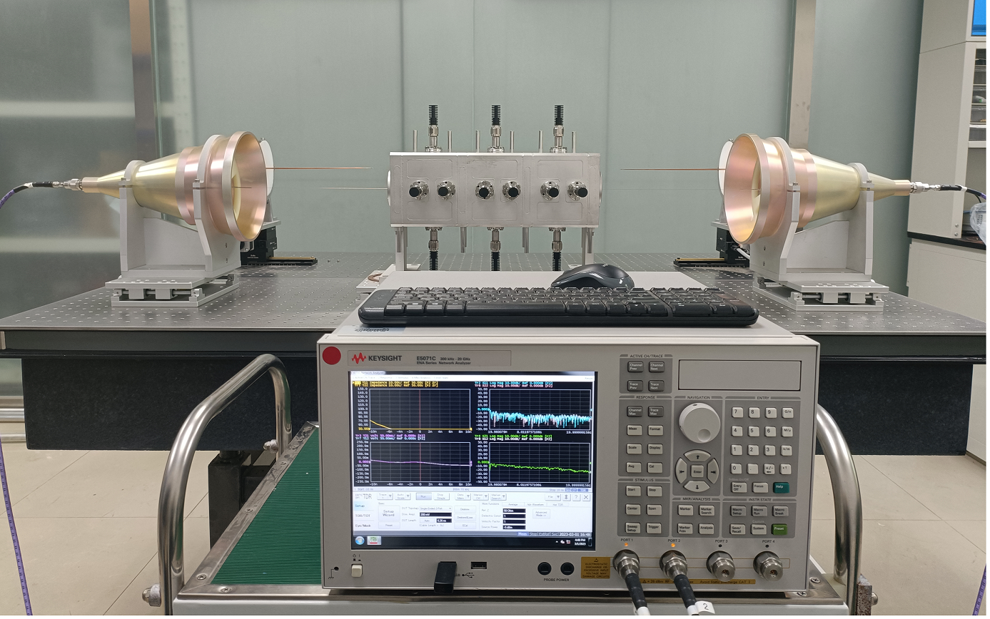
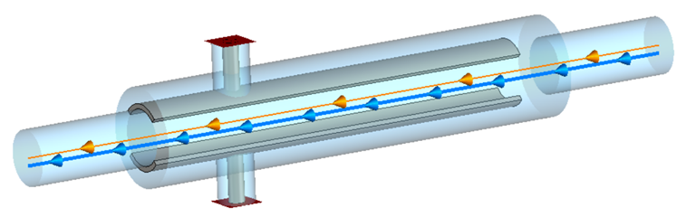
Beam feedback study in EDR
Study of feedback system kicker
Resonant strip-line type longitudinal kicker
130
121.5
108
Resonant strip-line type transverse kicker
85
Study of narrow-band feedback for specific instabilities

Slide 22
Luminosity tuning study in EDR
The fast luminosity monitor study(luminosity detector and data acquisition)
Local fast orbit feedback system at interaction point (IP)

Slide 23
Summary
We have thoroughly understood the measurement requirements of CEPC and conducted extensive research on key technologies, in the past five-year TDR phase.
In the EDR phase, studies will carry out in industrialization and testing of BPM electronics，beam feedback system，luminosity tuning system and components R&D of synchrotron light based diagnostics.
We hope the beam instrumentation system is mature enough to carry out engineering applications after EDR.
Thank you for attention！

