Slide 1


CEPC Linac Injector Development in EDR
High Energy Physics 2024 (HEP2024)
Jingru Zhang
2024.01.24
On behalf of linac group, Institute of High Energy Physics, CAS

Slide 2
Content
Introduction
Physical design of Linac
Source &RF system of Linac
R&D of 5 cell normal conducting cavity of DR
LLRF &Phase reference line of Linac
Summary

Slide 3
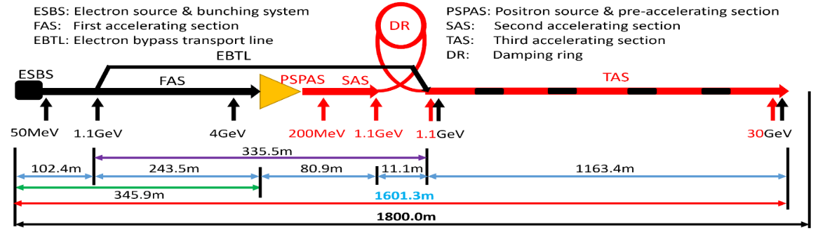
Introduction
The 30 GeV linac provides electron and positron beams for the booster, with 1.1GeV damping ring for the positron beam
  Electron gun: thermal cathode
  Positron source: Conventional scheme (fixed target)
  30 GeV normal conducting accelerating structures including bunching system
    S-band Linac: FAS: 4GeV + PSPAS: 200MeV + SAS: 1.1GeV
    C-band Linac: TAS：1.1GeV→30GeV
  1.1GeV damping ring with two 5 cell normal conducting cavities
The length of the linac tunnel 1.8km
  Linac is about 1.6 km
  200 m as reserved space
Parameter | Symbol | Unit | Baseline
Energy | E_{e-}/E_{e+} | GeV | 30
Repetition rate | f_{rep} | Hz | 100
Bunch charge |  | nC | 1.5 (3)
Energy spread | σ_{E} |  | 1.5×10⁻³
Emittance | ε_{r} | nm | 6.5

Slide 4
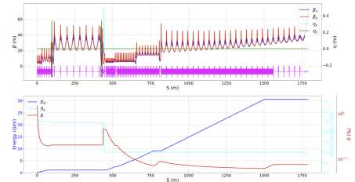
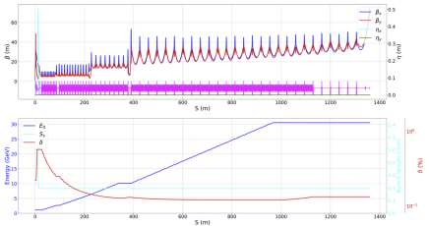
Physical design of LINAC in EDR
TDR finished: Start to end simulations with errors have been conducted for both electron and positron beams with qualities satisfying design requirements
In EDR:
  Optimization of the physics design, especially double-bunch acceleration simulation will be done
  Availability analysis of the Linac
    During the CDR phase, there is a preliminary analysis, which will be further analyzed
e- in linac
e+ in linac

Slide 5
Double-bunch-per-pulse experiment in EDR
This is the proposed operation modes of CEPC, the pulse repetition rate of the linac is 100Hz. For Z mode, double bunch per pulse is needed
double-bunch acceleration
  The accelerators that achieve double-bunch acceleration are KEKB (high bunch charge) and the Swiss FEL (low bunch charge)
  SuperKEKB is currently reattempting double-bunch acceleration operation mode. There are still significant challenges, especially with high bunch charge
 | tt(180GeV) | Higs(120GeV) | W(80GeV) | Z(45.5GeV)
Pulse repetition rate(Hz) | 100 | 100 | 100 | 100
Bunch number per pulse | 1 | 1 | 1 | 2

Slide 6
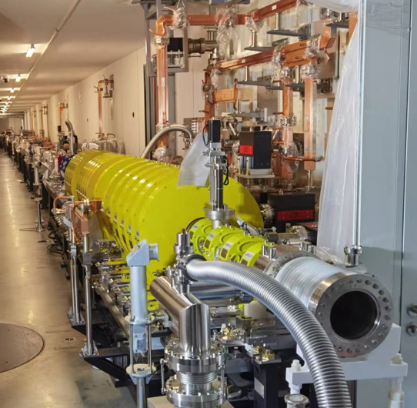
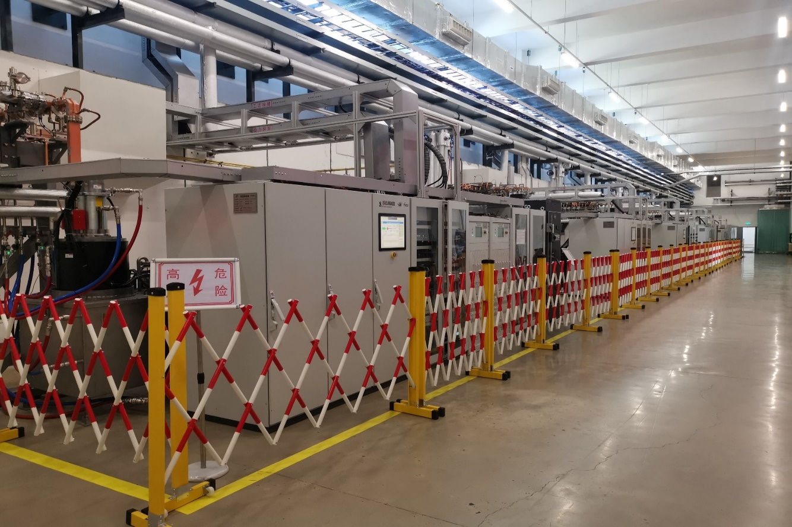
Double-bunch-per-pulse experiment on HEPS Linac
The HEPS linac is a 500-MeV S-band normal conducting linear accelerator
A maximum bunch charge of 8 nC at the exit of the Linac can be routinely achieved
There is still time for Linac based machine studies before commissioning the HEPS storage ring
With minor modification, the HEPS Linac could be used for double-bunch-per-pulse experiments

Slide 7
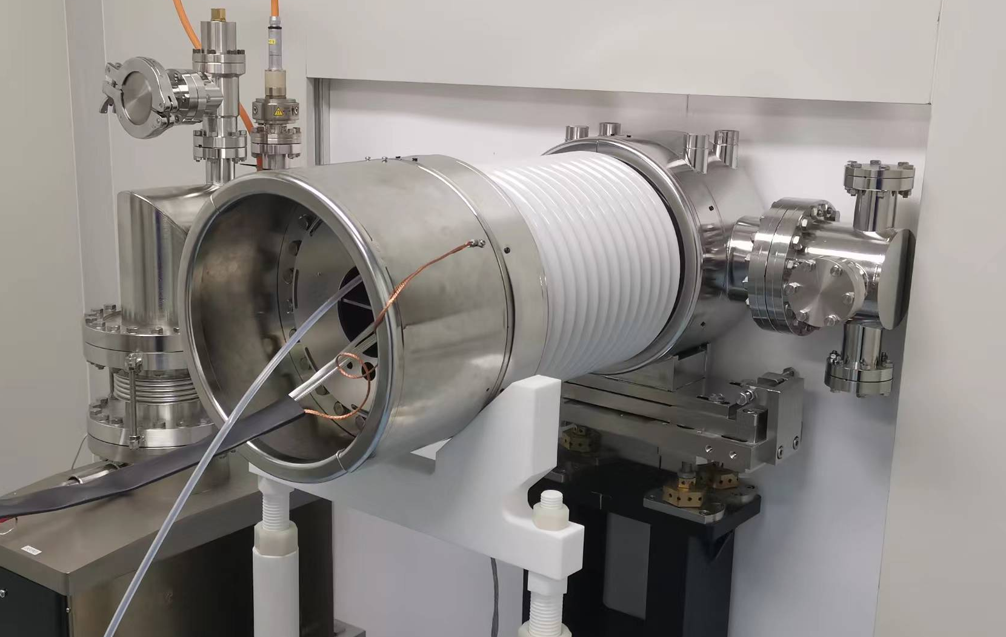
Double-bunch-per-pulse experiment on HEPS Linac
Modification and upgrade for the Double-bunch-per-pulse experiment
The e-Gun
  Only one pulser are currently installed
  Additional pulser is needed for the double-bunch experiment
Timing upgrade
  One additional high precision timing module is needed for
  the second pulser
Beam diagnostics
  Current beam diagnostics can only be used for single-pass
  long separation pulses
  A new system need to be developed for pulses with separation about 100 ns

Slide 8
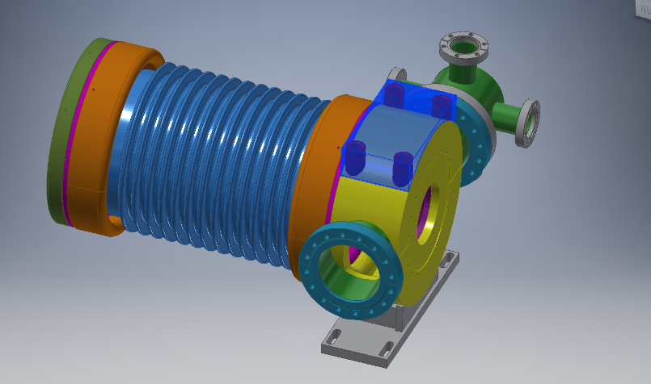
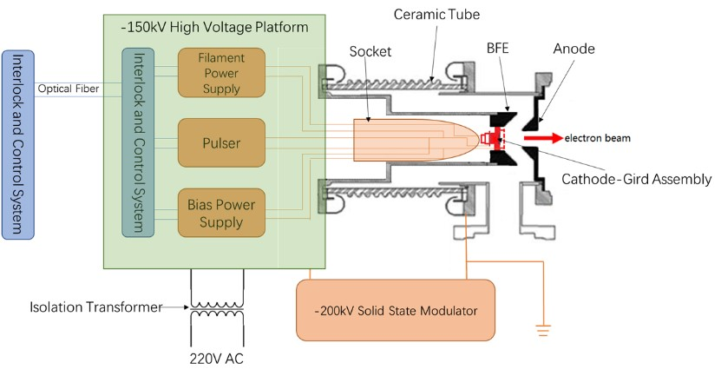
Sources-TDR finished
Electron source
  Traditional thermionic triode gun
  Mature technology
Design parameters of the TDR
  1.5 nC bunch charge for electron injection
  10 nC bunch charge for positron production
The HEPS and BEPCII design can meet our requirement
Parameter | Unit | Value
Type | - | Thermionic Triode Gun
Cathode | - | Dispenser cathode
Beam current | A | > 10
High voltage of anode | kV | 150
Bunch charge 1 | nC | 3.3 (e– injection)
Bunch charge 2 | nC | 11 (e⁺ production)
Repetition rate | Hz | 100
Pulse duration | ns | 1

Slide 9
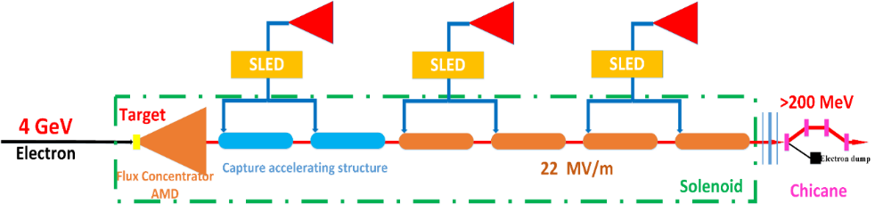
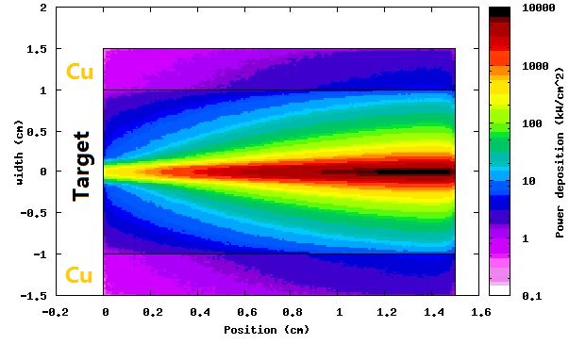
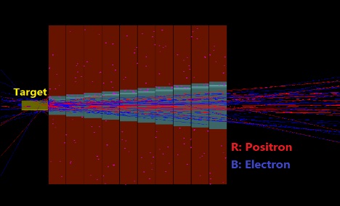
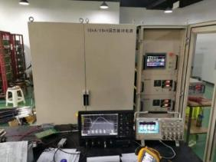
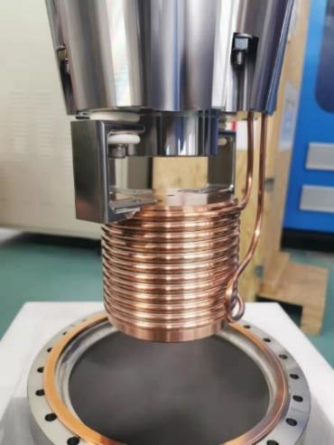
Sources-TDR finished
Positron source
  Incident electron beam:4GeV/10nC/100Hz, Beam power 4kW
  Fixed Target (tungsten,15mm thickness , Beam size: 0.5 mm)
  Energy deposition: 0.784 GeV/e- @ FLUKA, 784 W → water cooling
  We have made a prototype of the flux concentrator and it’s power supply and successfully high power tested
For the beam energy is high, under normal circumstances, there is no problem. We will research on the protection method of positron conversion target under extreme conditions
Solenoid
FLUX Concentrator
Target
e-
Vacuum chamber
The FLUX conentrator
The 15kA solid-state modulator
Test of the peak pulse magnetic field
Design of positron converter device

Slide 10

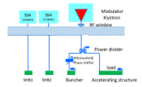
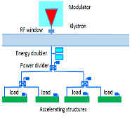
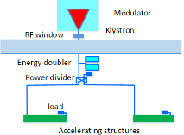
RF system
RF distribution of the 30 GeV linac
  S-band, 80 MW klystron, the number of S-band Acc. Structure is 93, big hole s-band structure after the positron source is 16. the number of pulse compressor is 33
    1-1(ESBS), 1 accelerating structure, 22MV/m
    1-4 (FAS), 21 sets, 84 standard accelerating structures, with pulse compressor, 22MV/m
    1-2(PSPAS), 8 sets, 16 big hole accelerating structures, 22MV/m, with pulse compressor
    1-2(SAS), 4 sets, 8 accelerating structures, 27MV/m , with pulse compressor
  C-band, 50 MW klystron, C-band structures: 470, with 235 pulse compressors
    1.1GeV-30GeV, 1-2(TAS), 235 sets, 470 accelerating structures, ~40MV/m,
Parameter | Unit | S-band |  | C-band
Frequency | MHz | 2860 |  | 5720
Length | m | 3.1 | 2.0 | 1.8
Cavity mode |  | 2π/3 |  | 3π/4
Aperture | mm | 19~26 | 25 | 12~16
Gradient | MV/m | 22/27 | 22 | 40~45
Cells (include coupler cells) |  | 86 | 55 | 89
Number of Acc. Stru. |  | 93 | 16 | 470
Number of Klystron |  | 33 |  | 236
Klystron Power | MW | 80 |  | 50
S-band
C-band

Slide 11
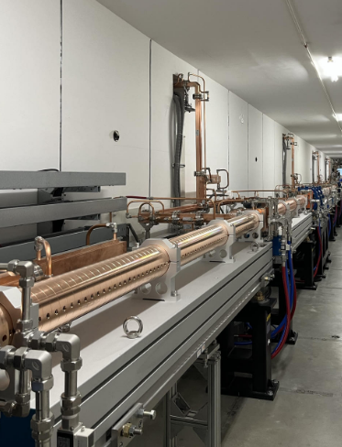
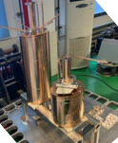
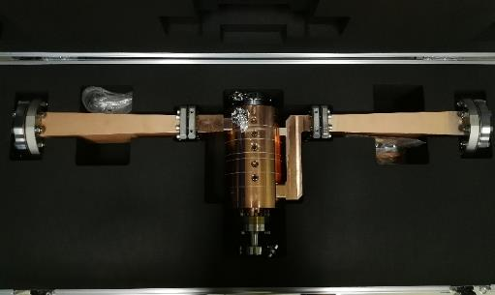
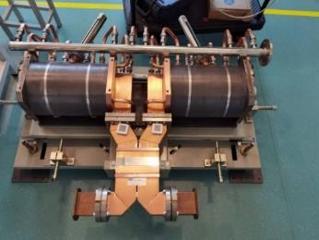
Bunching cavities and S-band RF system-TDR finished
The SHBs & buncher
  Traditional cavity structure
    Re-entrant SW for SHBs
    TW/CI for buncher
The same as HEPS only the frequency is a little deference
S-band RF system
  The prototype for CEPC was tested and the average gradient has reached 33 MV/m at high power test (with SLED)
The S-band RF system successfully used in HEPS project and the gradient with beam reached 26MV/m
Buncher for HEPS
SHBs for HEPS
HEPS pulse compressor

Slide 12
C-band RF system-TDR finished
The situation of other labs
  The maximum average gradient with beam is about 40MV/m
 | IHEP | SARI | RIKEN | INFN | PSI
Frequency(MHz) | 5712 | 5712 | 5712 | 5712 | 5712
Mode | 3π/4 | 4π/5 | 2π/3 | 2π/3 | 2π/3
Length (m) | 1.8 | 1.8 | 2 | 1.4 | 2
Gradient at high power test bench(MV/m) | - | 50^{[1]} | 50.1^{[2]} | 36^{[3]} | 52^{[4]}
Operating gradient with beam (MV/m) | - | 41.7(maximum, private talk) | 41.4 | 36 | 28
W. Fang, et al. THE C-BAND TRAVELING-WAVE ACCELERATING STRUCTURE FOR COMPACT XFEL AT SINAP . NIMA 2016
T. Sakurai, et al. C-band disk-loaded-type accelerating structure for a high acceleration gradient and high-repetition-rate operation.
PHYSICAL REVIEW ACCELERATORS AND BEAMS 20, 042003 (2017)
3. D. Alesini, et al. HIGH POWER TEST RESULTS OF THE SPARC C-BAND ACCELERATING STRUCTURES. IPAC 2014
4. F. Loehl, et al. STATUS OF THE SWISSFEL C-BAND LINEAR ACCELERATOR. FEL 2013

Slide 13
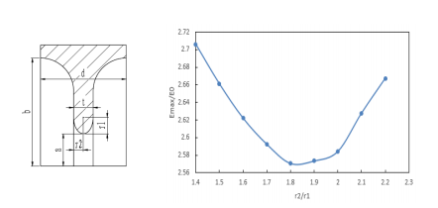
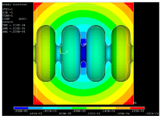
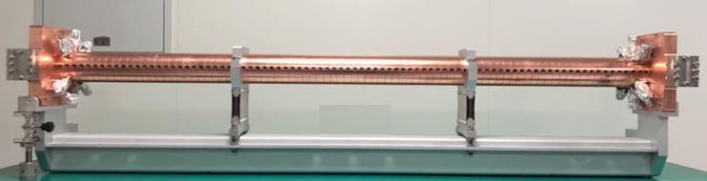
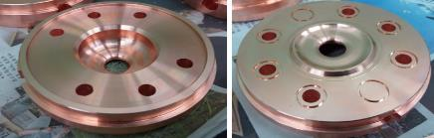
C-band accelerating structure
The R&D of C-band accelerating structure at IHEP
  The beam dynamics of linac based on this design
  Constant gradient, 3π/4 mode, 1.8 meters long (Including mechanical length, Effective length is about 1.7m)
    Round cavity shape
    Racetrack symmetrical magnetic coupling
No high power test and beam testing
Cavity shape
The deformation caused by temperature variation

Slide 14
C-band accelerating structure
The design parameters between different lab
  Mode :3π/4, 2π/3, 4π/5
  Length
  Disc thickness
Though the phase advance is deferent, the other key parameters is similar
 | IHEP | Spring8 | SINAP¹
Frequency: f（MHz） | 5712 | 5712 | 5712
No. of Cells | 87+2 | 100 regular cells +2 coupler | 89+2
Phase advance | 3π/4 | 2π/3 | 4π/5
Total length(m) | 1.8 | 2 | 1.784
Length of cell : d (mm) | 19.675 | 17.495 | 20.994
Disk thickness: t (mm) | 4.5 | 4 | 5
Average aperture: 2a (mm) | 14.04 | 15.938~12.107 | 15
Average diameter : 2b (mm) | 45.6 | 43.196~41.869 | -
Shunt impedance(average) : Rs (MΩ/m) | 66.05 | 66 | 62
Quality factor : Q | 11358~11186 | 9300/8900(measured) | 10470
Group velocity: Vg/c (%) | 2.8% ~ 0.96% | 2.3%(average) | 1.7%(average)
Filling time : t_{f} (ns) | 350 | 290 | 330
Attenuation factor : τ | 0.56 | 0.59 | 0.585
Epeak/E0 | 2.57 | 2.6 | 2.6
1. W. Fang, et al. THE C-BAND TRAVELING-WAVE ACCELERATING STRUCTURE FOR COMPACT XFEL AT SINAP

Slide 15
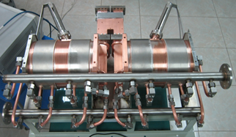
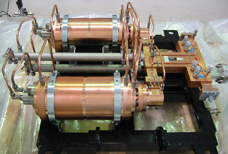
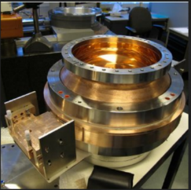
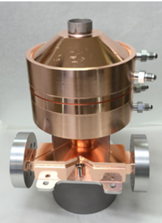
C-band RF system-what EDR can do
The model selection of the pulse compressor(PC)
  SLAC type (Two cavities)
  BOC type
  Spherical type
No direct experience for us
Two cavities PC
SACLA C-band PC
PSI BOC type PC
Spherical PC（Xband of SLAC）

Slide 16
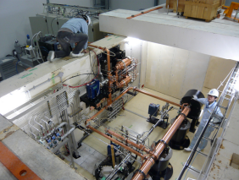
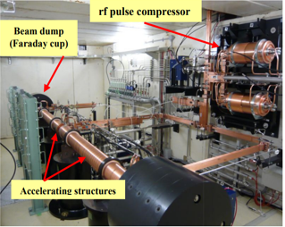
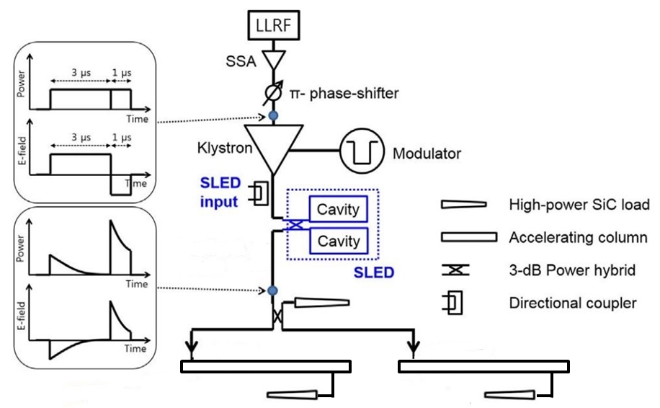
C-band RF system-what EDR can do
This is a high power test bench of Spring-8 before their mass-production
We hope we can establish the C-band test bench and test the components. With pulsed compressor, waveguides, directional couplers, loads, bend and straight waveguides, etc.
It is a complete unit and should cooperation with C-band power source

Slide 17
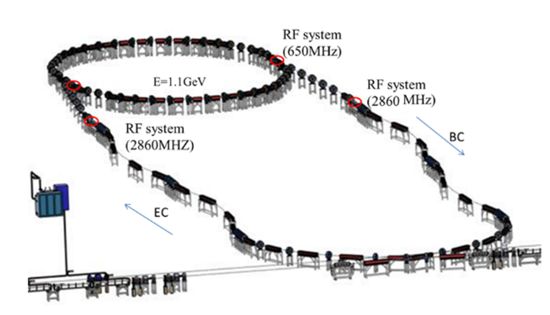
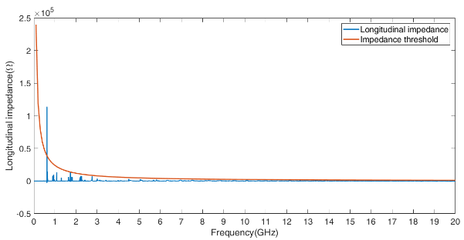
Damping Ring RF cavity-TDR completed
D. Wang, Y.D. Liu, X.H. Cui
The total cavity voltage requirement is 2.5MV
5 cell cavity aperture is decided by impedance、HOM and instability threshold
  Taking into account the simulation results for impedance threshold and HOM power, the 5-cell cavity with a 90 mm aperture is considered the best choice

Slide 18
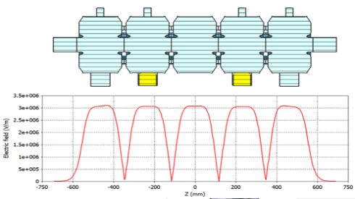
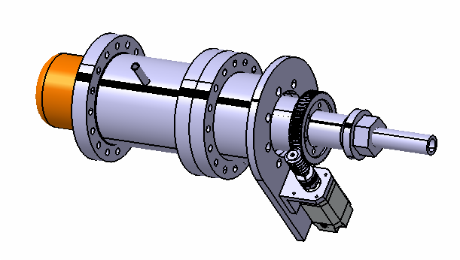
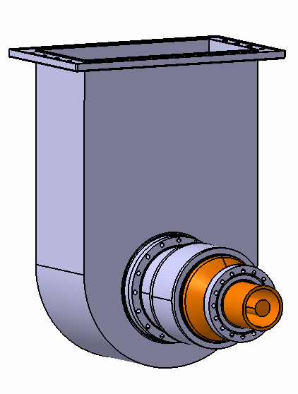
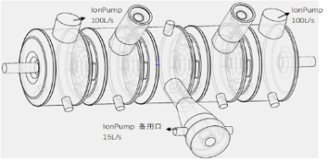
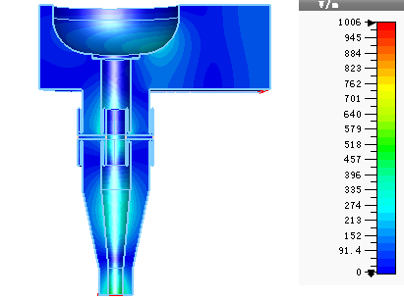
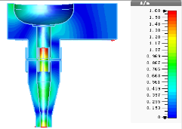
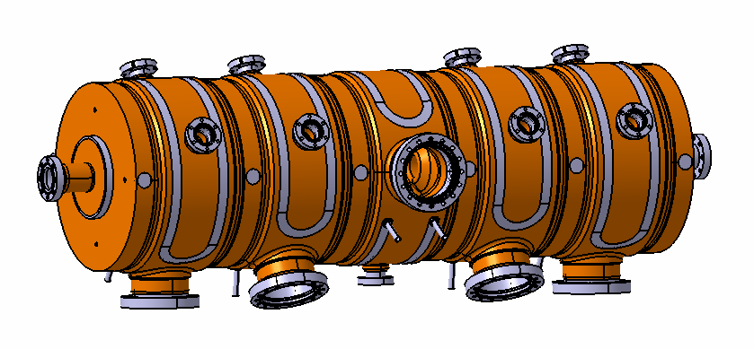
Damping Ring RF cavity-TDR completed
The design of the 650MHz 5 cell cavity finished
  RF cavity design
  Input coupler and doorknob design
  Vacuum design
  Mechanical design
 | Unit | Value
Beam tube aperture | mm | 90
Cell length | mm | 5*230.61
π-mode frequency | MHz | 650.0
Q0 |  | 31633
Shunt impedance | MΩ | 32.4
R/Q | Ω | 1023
Accelerating voltage per cavity | MV | 1.25
Accelerating gradient E0 | MV/m | 1.08
Esmax/E0 | - | 4.62
Dissipated cavity power (20% margin) | kW | 58 (84*)
Tunner
Coupler
Cavity
  Mechanical design
Ion pump distribution
Electromagnetic field distribution

Slide 19
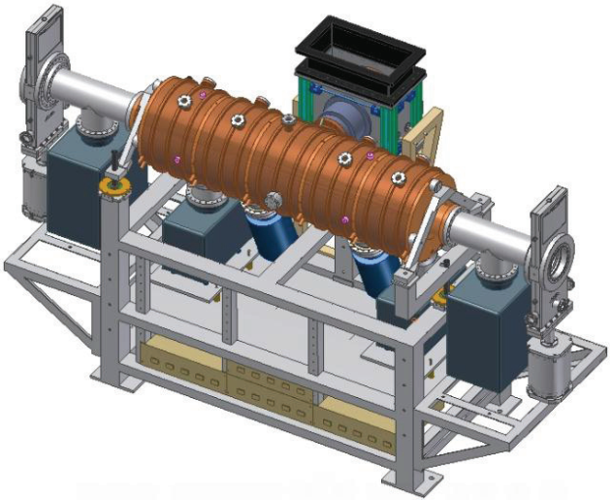
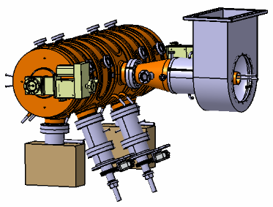
Damping Ring RF cavity-what EDR can do
Further optimize the 5 cell cavity design
If possible, we hope have fund to process the DR normal conducting 5 cell cavity. And finished the cold test of the cavity
After the machining of the cavity completed, use PAPS (a test bench of IHEP at Huairou) test bench to do the high-power test of the DR normal conducting 5 cell cavity
  Mechanical design

Slide 20
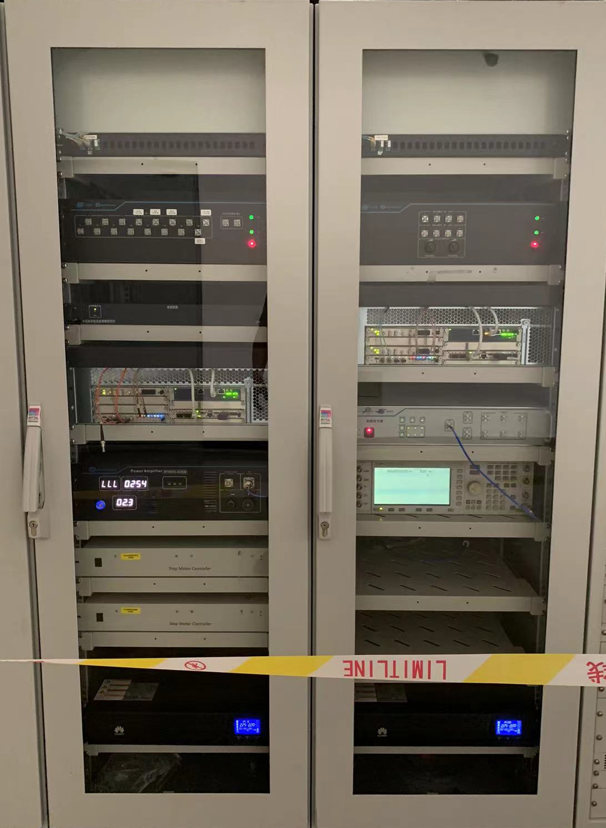
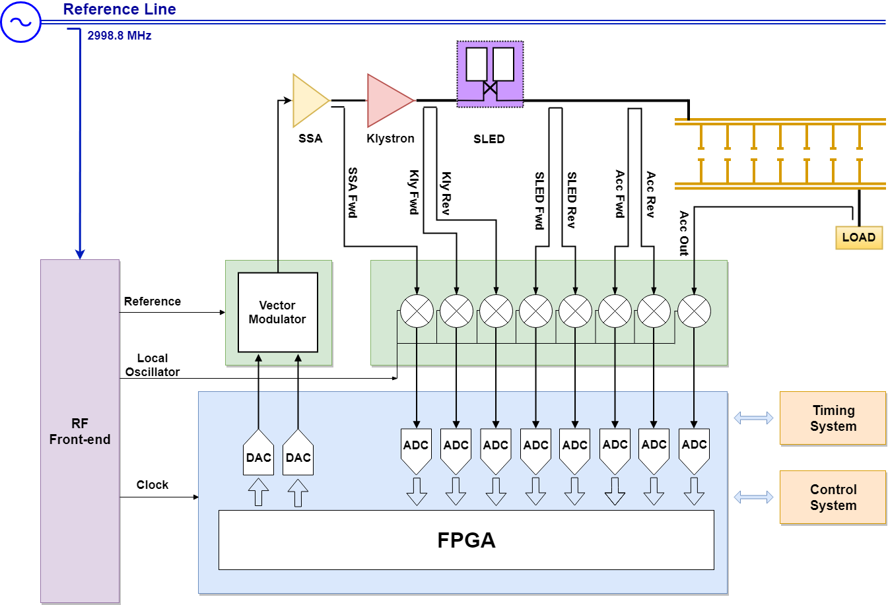
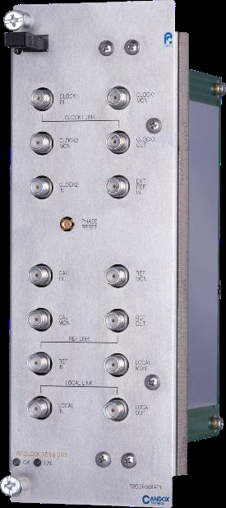
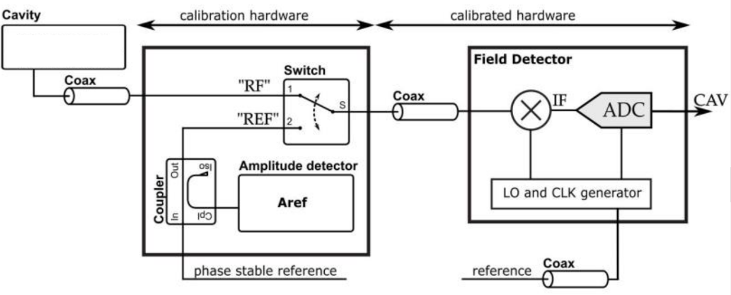
Low Level RF for linac
The MTCA LLRF system with a down-conversion architecture covering a frequency range of 500MHz to 6GHz has been successfully developed and applied to HEPS LINAC and BEPCII LINAC
Further research is required to enhance control precision of the S-band and C-band LLRF system
  Develop the low noise frequency synthesizer covering the S-band and C-band. The module is designed to be integrated into the MTCA chassis, make system more compact, improves reliability
  Develop a phase drift compensation system to deal with the component temperature related phase drift of RF signals, technologies such as time-division multiplexing and pilot tone will be used
S-band LLRF System
LO&Clock Generator
Phase drift compensation system

Slide 21
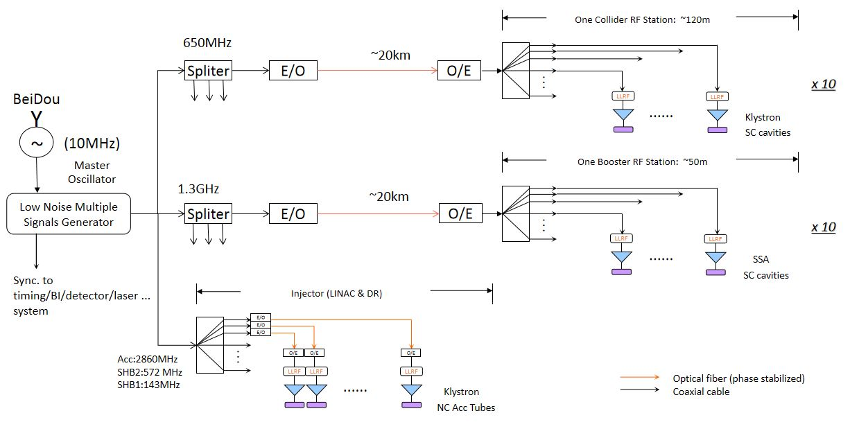
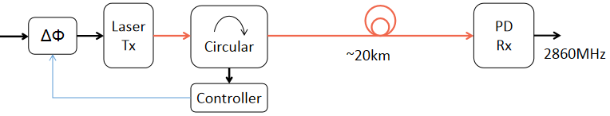
Phase reference line for CEPC Linac
Phase reference line of whole CEPC
CEPC Linac's phase reference line;
Master oscillator will located at Linac to reduce cable length;
~1.6km

Slide 22
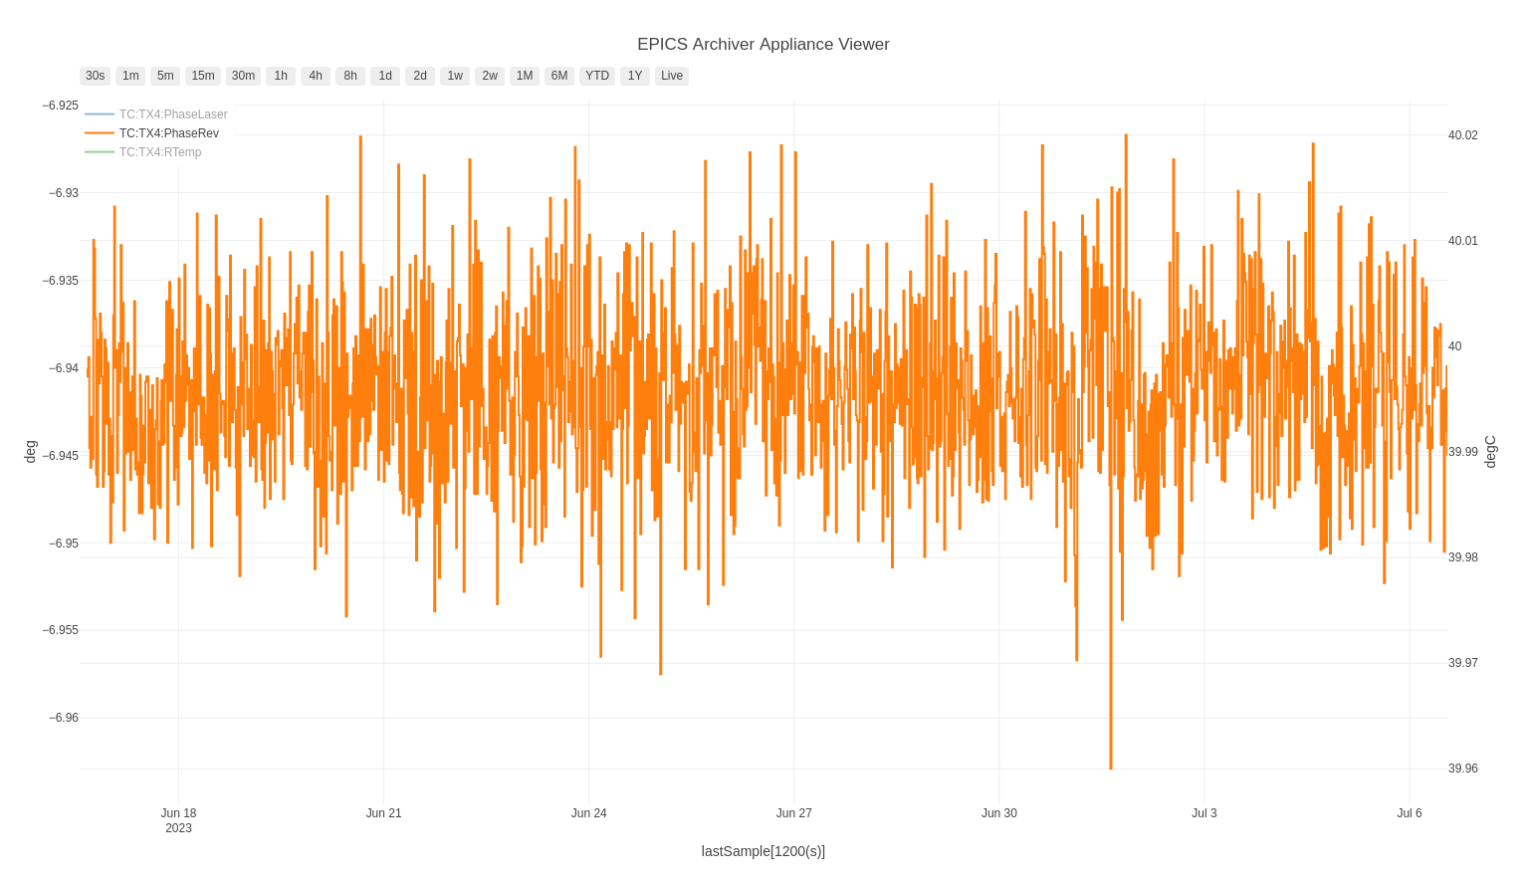
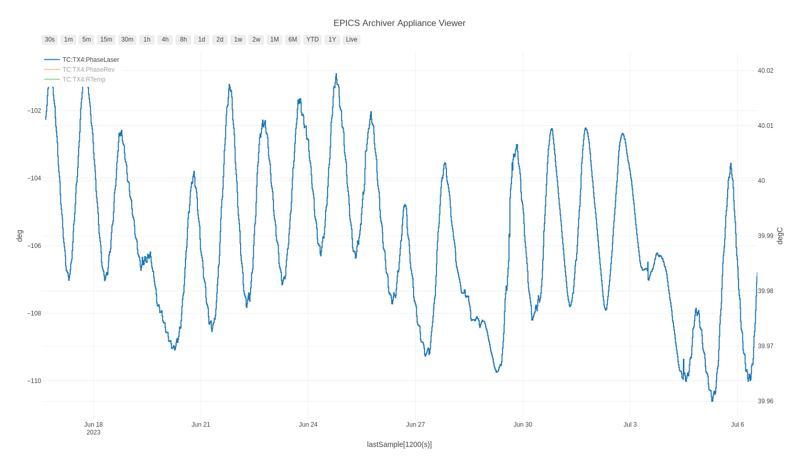
Phase reference line for CEPC Linac
（close loop and open loop stability,
21days，image: 2023.6.17-7.7）
HEPS operation
Success example of RF phase reference on HEPS
  420m phase-stabilized optical fiber was used transfering MO 499.8MHz to Linac and booster RF
  Stable Running >7 month ±0.02°(±110fs) phase drift was measured
New 2856MHz phase reference line planned:
  New S-band(covering 2860MHz) Tx-Rx module under developed with modifications of HEPS 499.8MHz version
  This 2856MHz version will be used for PWFA accelerator based on BEPCII Linac as a CEPC new acceleration principle demo facility
The corresponding internal design needs to be done for the newly 2860M frequency and consideration rematch circuit
0.04°
6.5°

Slide 23
Summary
The physical design of linac need more optimization especially its availability analysis
The technology of electron source, SHBs, buncher and S-band RF system is relatively mature
The positron source needs to be consider the protection of positron conversion target under extreme conditions
The C-band RF system needs to establish high power test bench and verify high-power performance
The 5 cell cavity in damping ring needs to be machining and high power test
Further research is required to enhance control precision of the S&C-band LLRF and reference line

Slide 24
Thank you for your attention!

