Slide 1


SppC Lattice Design and Compatibility Study with CEPC
Haocheng Xu, Yiwei Wang, Jie Gao, Yukai Chen, Jingyu Tang
for the SppC Study Group
The Institute of High Energy Physics, Chinese Academy of Sciences
HKUST - IAS HEP Conference
Jan. 24, 2024, Hong Kong
Email: xuhaocheng@ihep.ac.cn

Slide 2


Content
SppC lattice design and nonlinearity optimization
Error correction scheme
Geometric compatibility between CEPC and SppC

Slide 3
SppC parameters
Parameter | Value | Unit
General design parameters
Circumference | 100 | km
Beam energy | 62.5 | TeV
Lorentz gamma | 66631
Dipole field | 20 | T
Dipole curvature radius | 10415.4 | m
Arc filling factor | 0.78
Total dipole magnet length | 65.442 | km
Arc length | 83.9 | km
Number of long straight sections | 8
Total straight section length | 16.1 | km
Energy gain factor in collider rings | 19.53
Injection energy | 3.2 | TeV
Number of IPs | 2
Revolution frequency | 3.00 | kHz
Physics performance and beam parameters
Initial luminosity per IP | 4.3´10³⁴ | cm⁻²s⁻¹
Beta function at collision | 0.50 | m
Circulating beam current | 0.19 | A
Nominal beam-beam tune shift limit per IP | 0.015
Bunch separation | 25 | ns
Number of bunches | 10080
Bunch population | 4.0´10¹¹
Accumulated particles per beam | 4.0´10¹⁵
Normalized rms transverse emittance | 1.2 | mm
Beam life time due to burn-off | 8.1 | hours
Total inelastic cross section | 161 | mb
Reduction factor in luminosity | 0.81
Full crossing angle | 73 | mrad
rms bunch length | 60 | mm
rms IP spot size | 3.0 | mm
Beta at the first parasitic encounter | 28.6 | m
rms spot size at the first parasitic encounter | 22.7 | mm
Stored energy per beam | 4.0 | GJ
SR power per beam | 2.2 | MW
SR heat load at arc per aperture | 26.3 | W/m
Energy loss per turn | 11.4 | MeV
*CEPC TDR

Slide 4
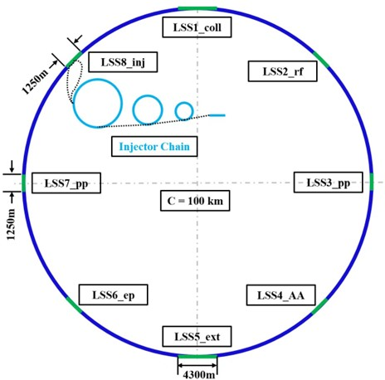
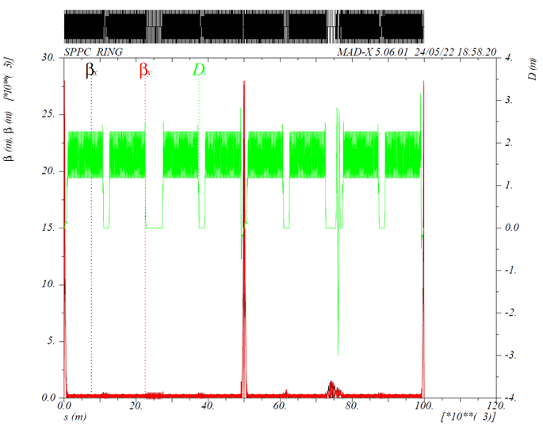
SppC lattice design
Compatible with CEPC, 100km, 2 IPs
8 arc sections
  2-in-1 yoke-sharing magnets
  both interleaved and non-interleaved sextupoles studied
4 short straight sections
  RF region, dual-harmonic RF system (800 and 400 MHz)
  injection section after injection chain
  Space reserved for e-p collision
2 long straight sections
  collimation section for both betatron and momentum
  extraction section
2 interaction regions
  anti-symmetric interaction region
  chromaticity corrected with arc sextupoles

Slide 5
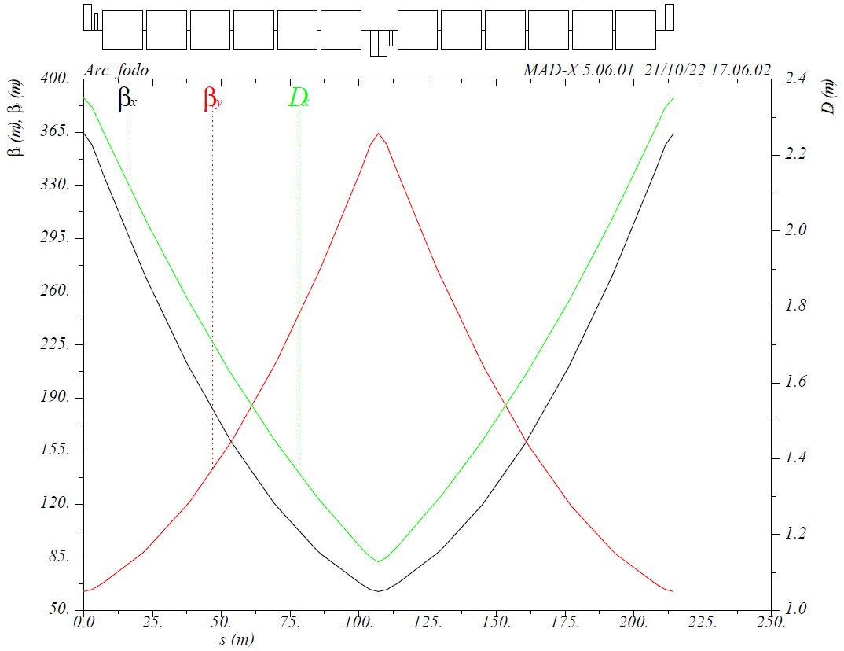
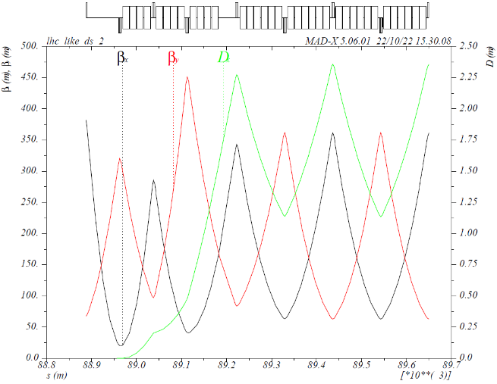
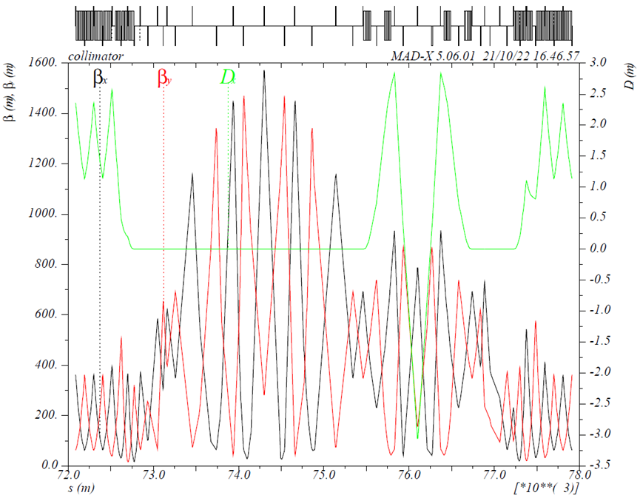
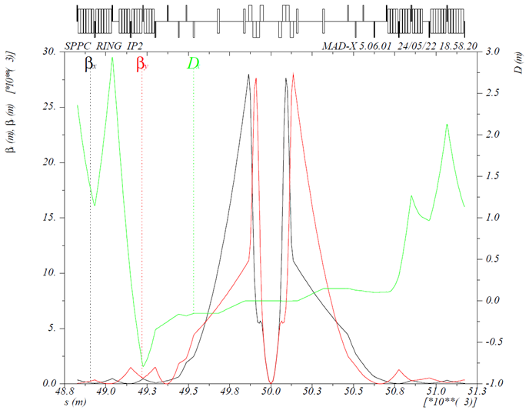
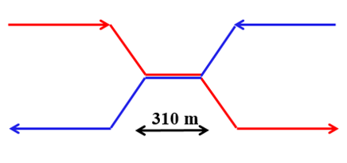

Lattice optics
Arc FODO cell
Dispersion suppressor
betatron and momentum collimation
$$β^{∗}=0.5m$$
30 cm
Collimation section
Interaction region

Slide 6

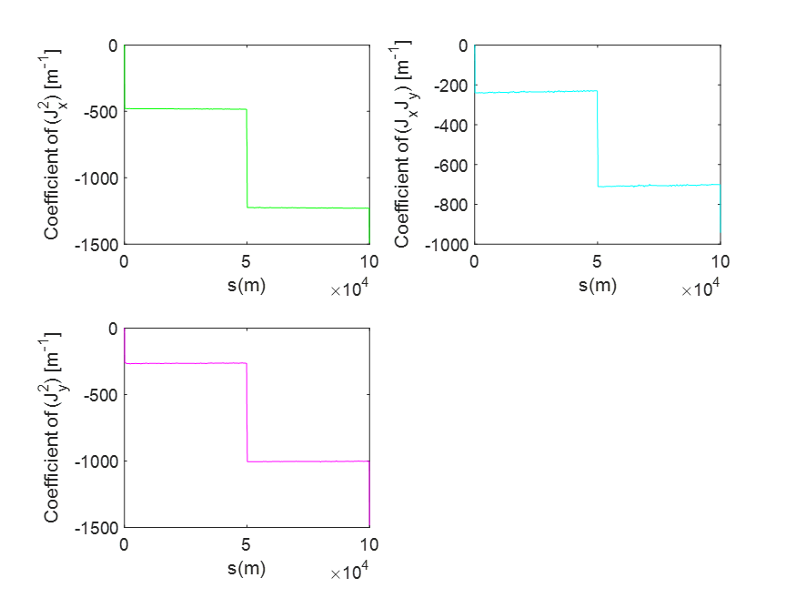
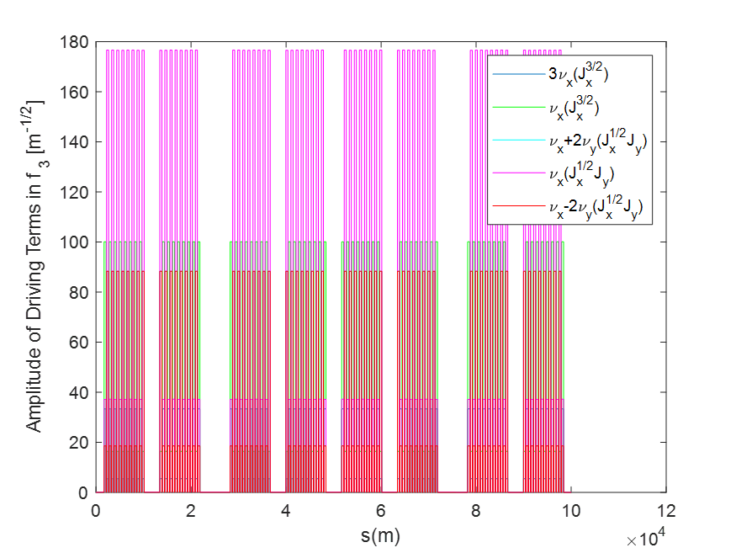
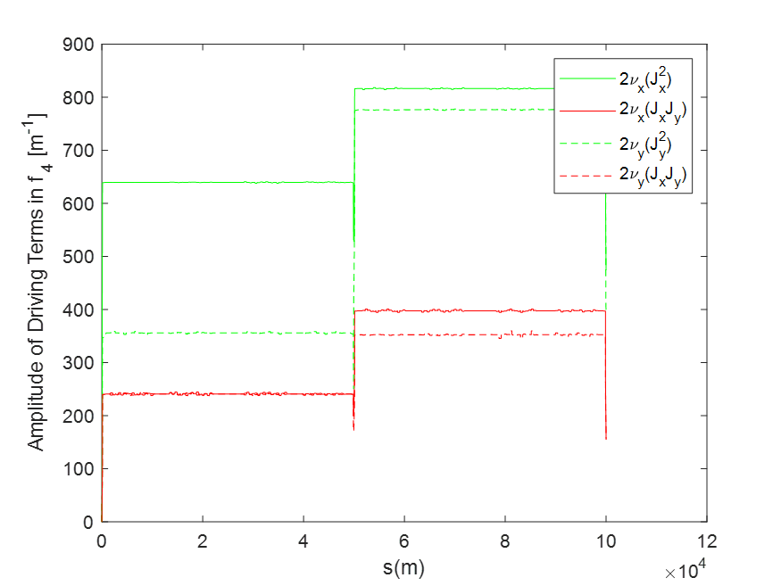
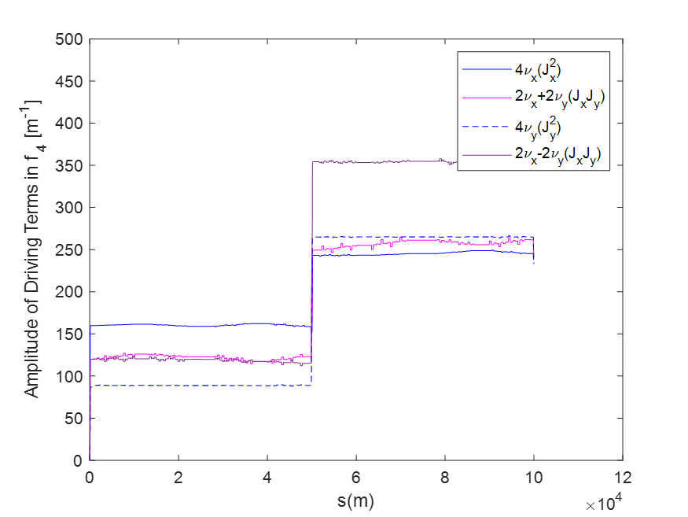
Nonlinearity optimization
5 FODO cells per period. Most nonlinearities are cancelled in 4 periods and the tune shifts are significantly reduced compared with the interleaved scheme.
Since the number of sextupoles is less than interleaved scheme, the sextupoles in arc will be stronger, thus the length of sextupoles is doubled to 1m to weaken the sextupoles.
Tune shift coefficients and RDTs

Slide 7
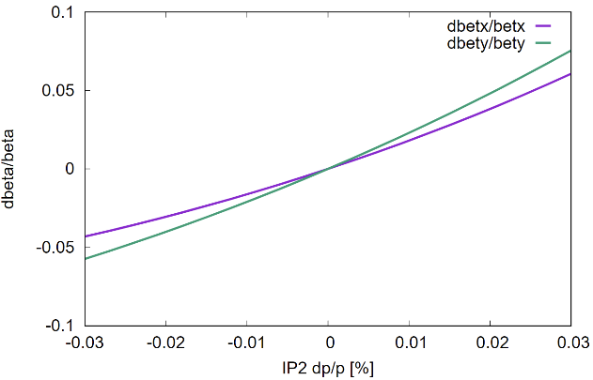
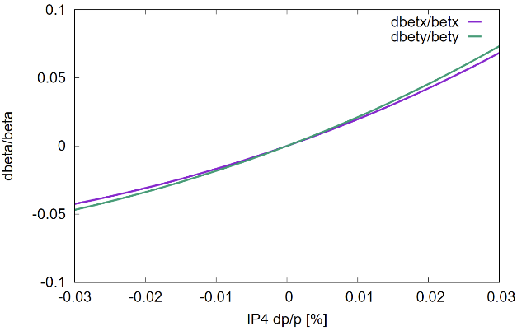
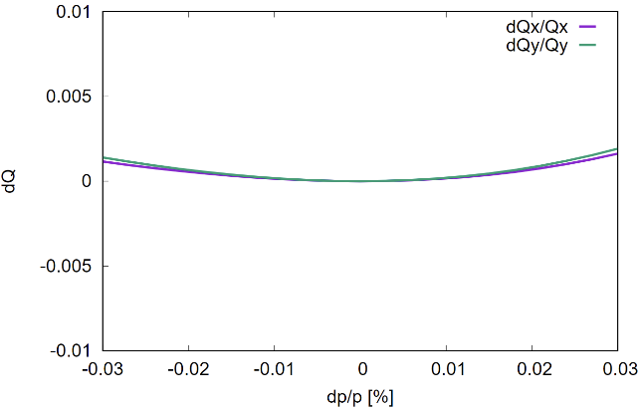
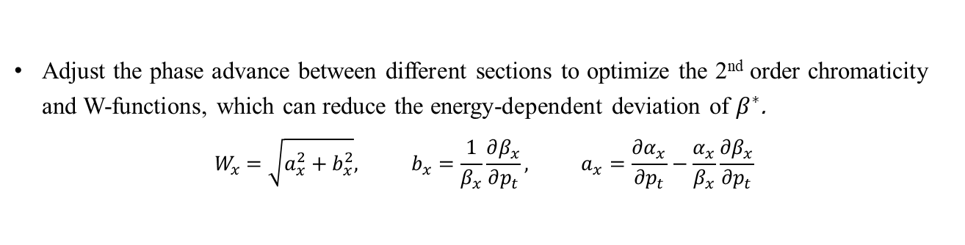
Chromatic function optimization
Adjust the phase advance between different sections to optimize the 2nd order chromaticity and W-functions, which can reduce the energy-dependent deviation of $β^{∗}$.
$$W_{x}=\sqrt{a_{x}^{2}+b_{x}^{2}}, b_{x}=\frac{1}{β_{x}}\frac{∂β_{x}}{∂p_{t}}, a_{x}=\frac{∂α_{x}}{∂p_{t}}−\frac{α_{x}}{β_{x}}\frac{∂β_{x}}{∂p_{t}}$$

Slide 8
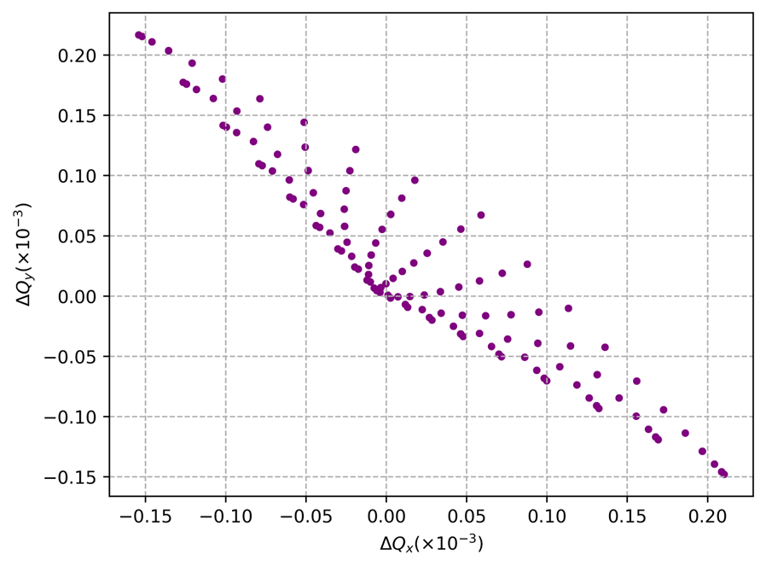

Consideration of Landau octupoles
Landau damping
Octupoles are installed adjacent to arc quadrupoles, providing a tune spread of about $0.2×{10}^{−3}$ on both planes with a footprint of $J_{x}+J_{y}<6ε_{x,y}$, to replicate similar Landau damping as in FCC-hh.
Octupolar Hamiltonian*：
$V\left(I, φ;s\right)=V_{0}(I;s)+\frac{B^{′′′}}{48Bρ}\left[β_{x}^{2}J_{x}^{2}\left(\cos{4φ_{x}}+4\cos{2φ_{x}}\right)−6β_{x}β_{y}J_{x}J_{y}\left\{\cos{2\left(φ_{x}+φ_{y}\right)}+\cos{2\left(φ_{x}−φ_{y}\right)}+2\cos{2φ_{x}}+2\cos{2φ_{y}}\right\}+β_{y}^{2}J_{y}^{2}\left(\cos{4φ_{y}}+4\cos{2φ_{y}}\right)\right].$
Mainly care about 2nd order RDTs as the working point (0.12, 0.13) is far from 4th order resonances.
Pairs of octupoles with equal strength and phase advance $∆φ_{x}=∆φ_{y}=90°$ works.
*Moohyun Yoon 1998 Jpn. J. Appl. Phys. 37 3626
Tune shift provided by Landau octupoles
Changes to tune shifts and 2nd order resonance

Slide 9
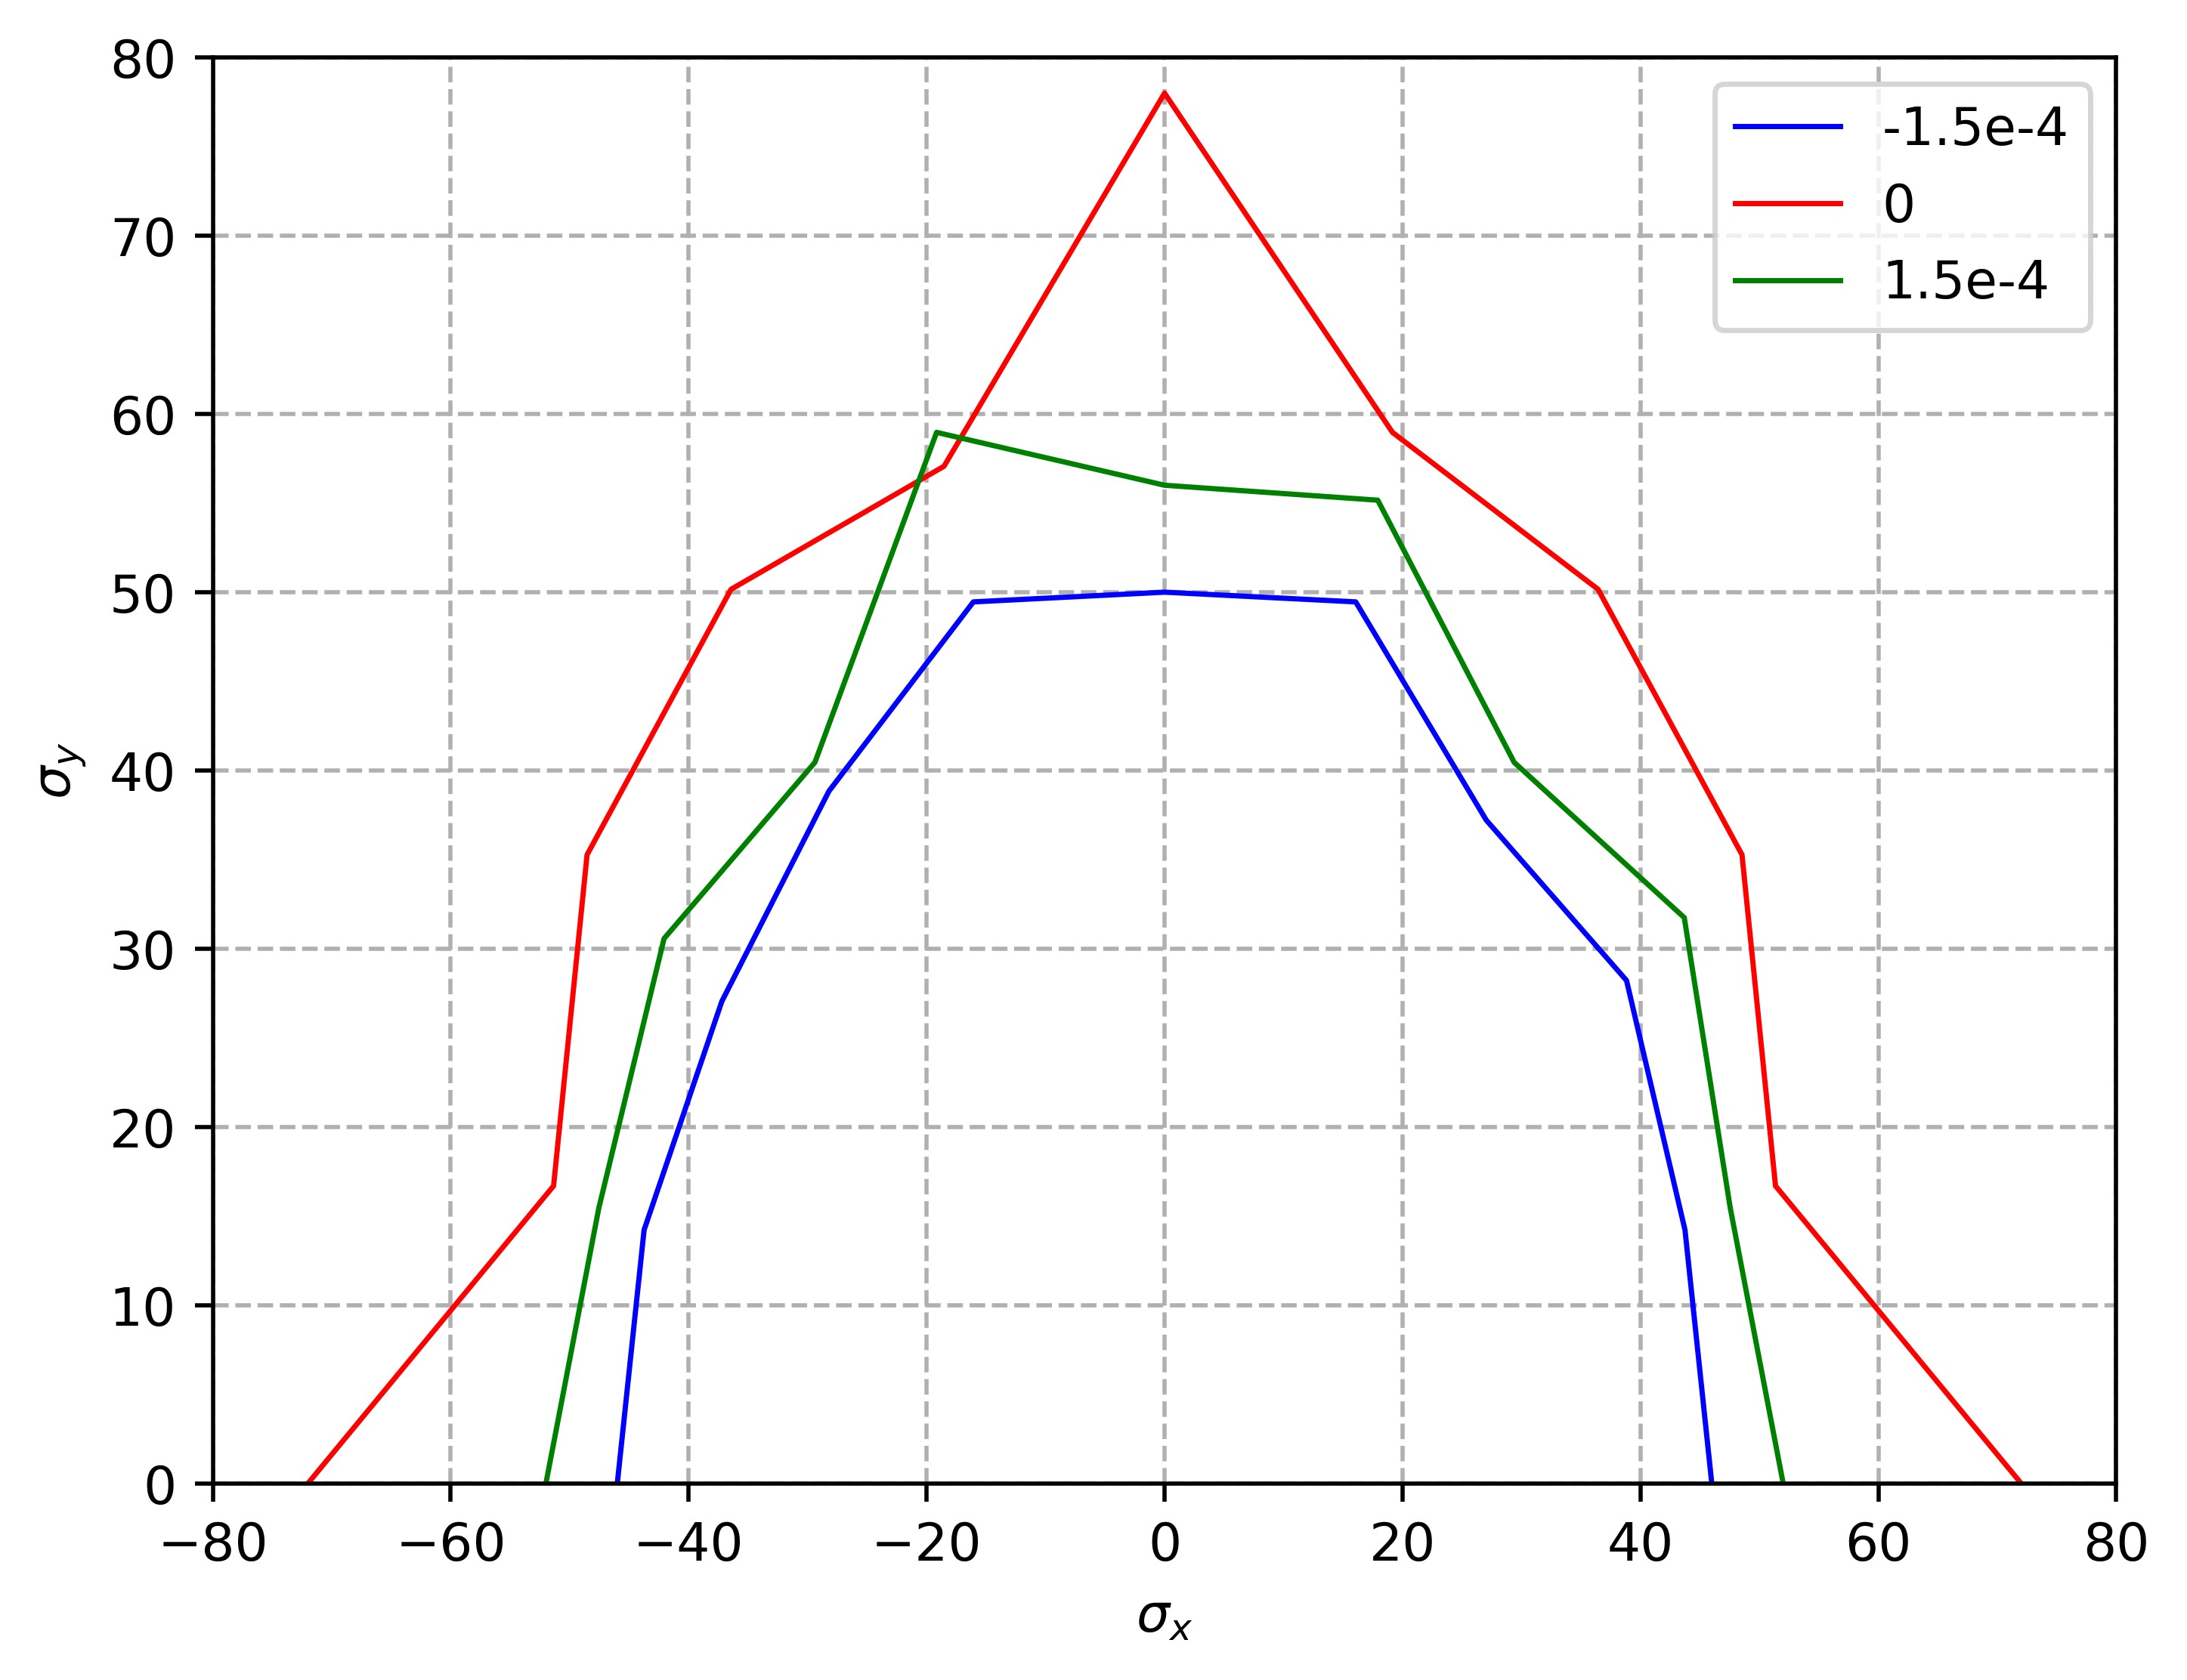
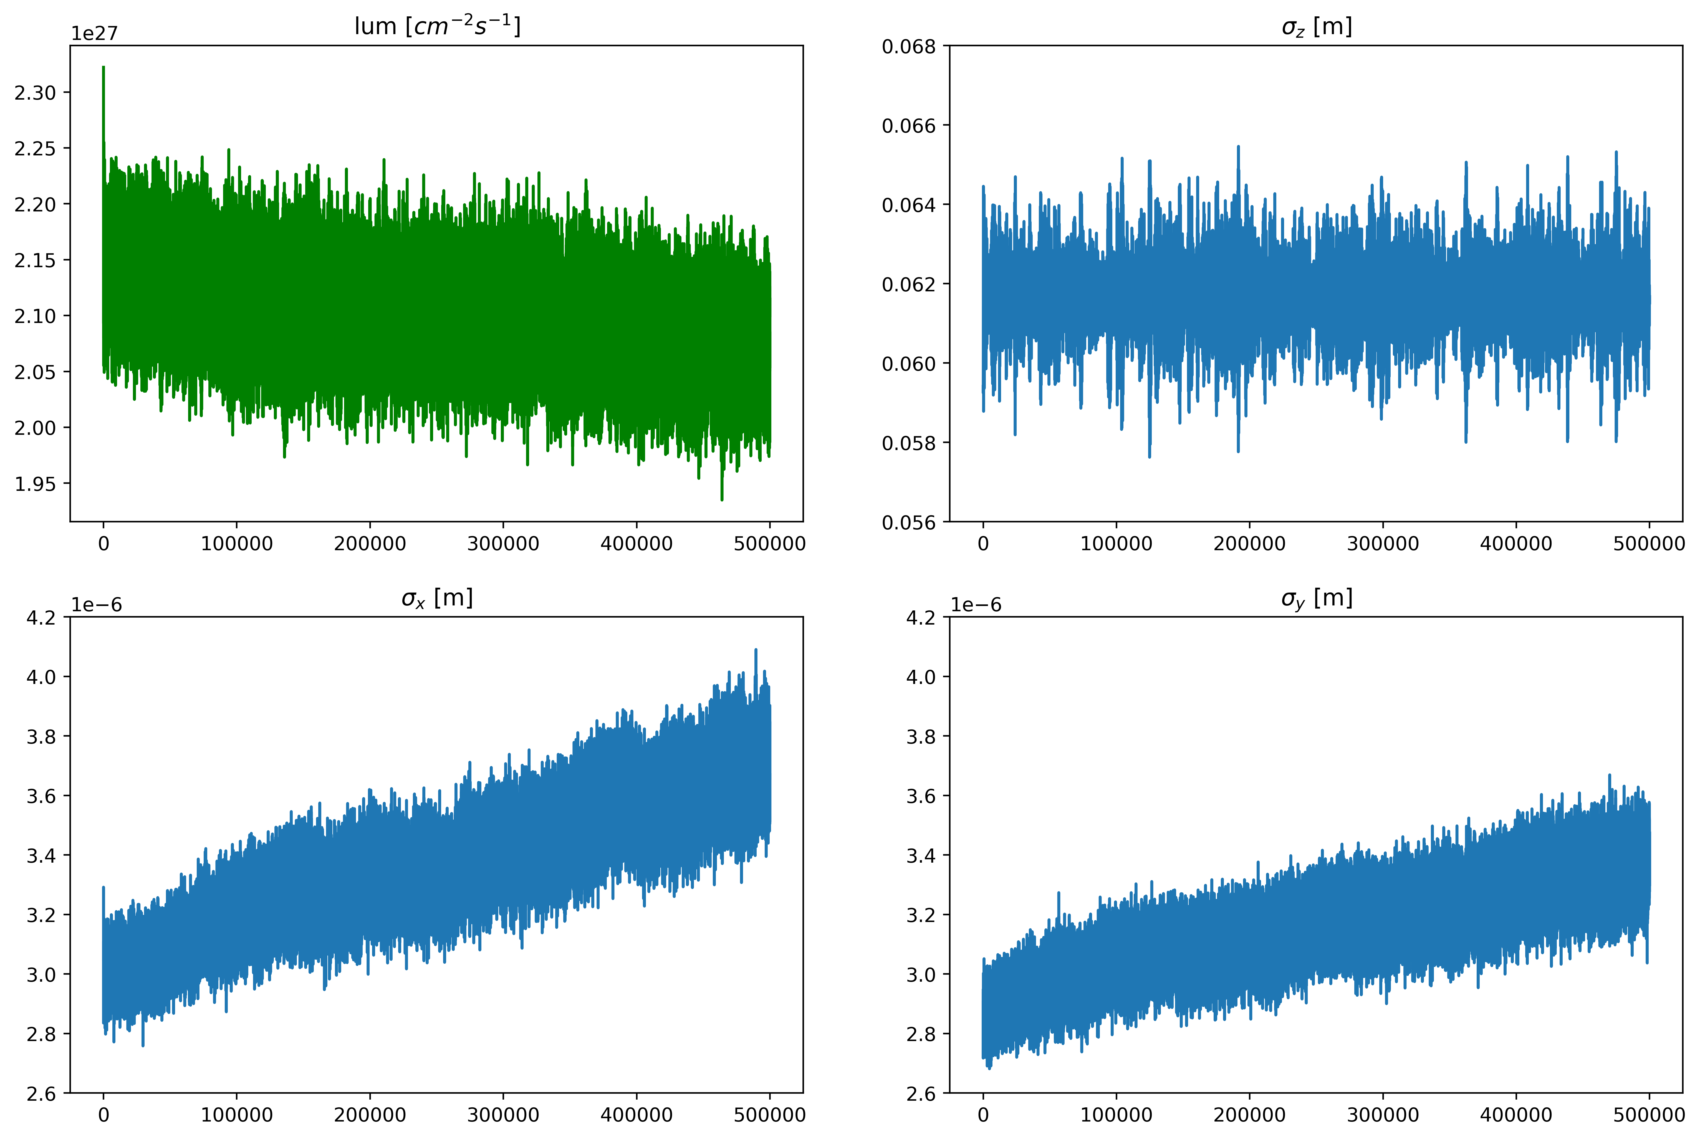
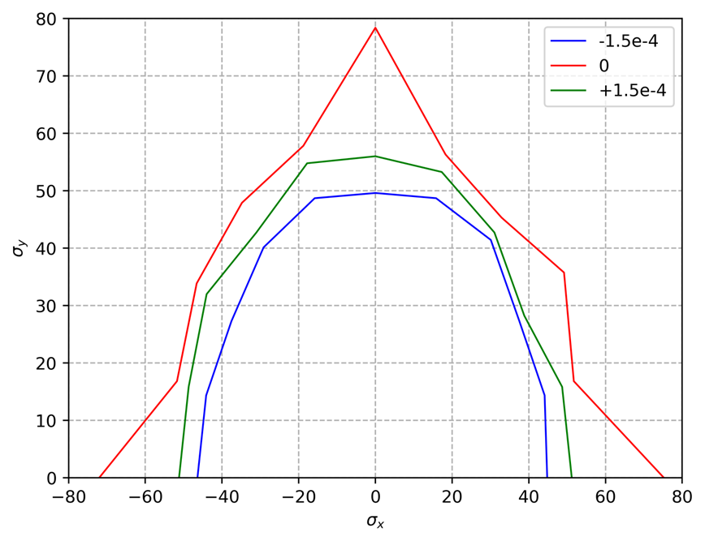
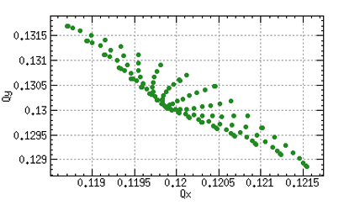
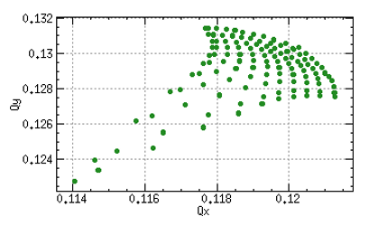

Consideration of beam-beam effect
Weak-strong beam-beam effect simulation is performed by SAD. The calculated luminosity can fit with that in parameter table:
  $$L = L_{per}N_{b}f=2.2×{10}^{27}×10080×3000 {cm}^{−2}s^{−1}=6.7×{10}^{34}{cm}^{−2}s^{−1}$$
Bare lattice
Luminosity, bunch length and bunch size
Bare lattice + beam-beam
FMA results with amplitude of lower than 10σ
Notes:
Np改成负的

Slide 10
Content
SppC lattice design and nonlinearity optimization
Error correction scheme
Geometric compatibility between CEPC and SppC

Slide 11
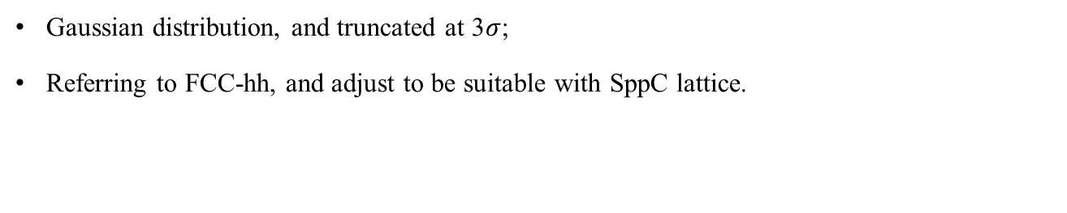
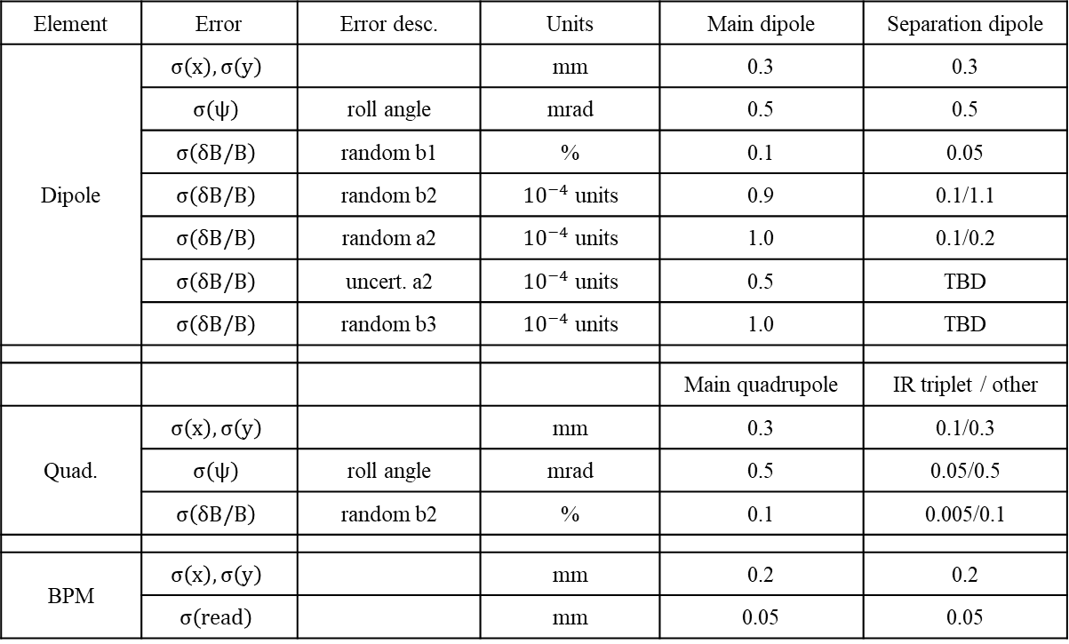
SppC lattice error table
Gaussian distribution, and truncated at 3$σ$;
Referring to FCC-hh, and adjust to be suitable with SppC lattice.
Element | Error | Error desc. | Units | Main dipole | Separation dipole
Dipole | $$σ\left(x\right),σ\left(y\right)$$ |  | mm | 0.3 | 0.3
 | $$σ\left(ψ\right)$$ | roll angle | mrad | 0.5 | 0.5
 | $$σ\left(δB/B\right)$$ | random b1 | % | 0.1 | 0.05
 | $$σ\left(δB/B\right)$$ | random b2 | ${10}^{−4}$ units | 0.9 | 0.1/1.1
 | $$σ\left(δB/B\right)$$ | random a2 | ${10}^{−4}$ units | 1.0 | 0.1/0.2
 | $$σ\left(δB/B\right)$$ | uncert. a2 | ${10}^{−4}$ units | 0.5 | TBD
 | $$σ\left(δB/B\right)$$ | random b3 | ${10}^{−4}$ units | 1.0 | TBD
 |  |  |  | Main quadrupole | IR triplet / other
Quad. | $$σ\left(x\right),σ\left(y\right)$$ |  | mm | 0.3 | 0.1/0.3
 | $$σ\left(ψ\right)$$ | roll angle | mrad | 0.5 | 0.05/0.5
 | $$σ\left(δB/B\right)$$ | random b2 | % | 0.1 | 0.005/0.1
BPM | $$σ\left(x\right),σ\left(y\right)$$ |  | mm | 0.2 | 0.2
 | $$σ\left(read\right)$$ |  | mm | 0.05 | 0.05
*Reference radius of field error is 17 mm.
Ref: D.Boutin et al, optic corrections for Fcc-hh, IPAC2019

Slide 12
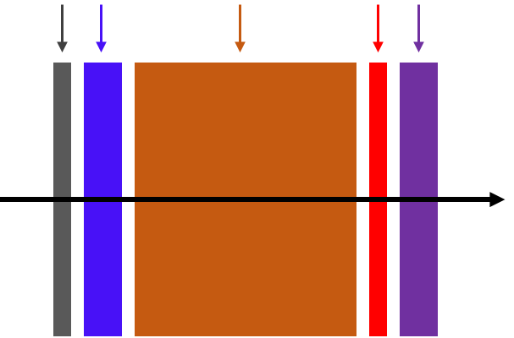
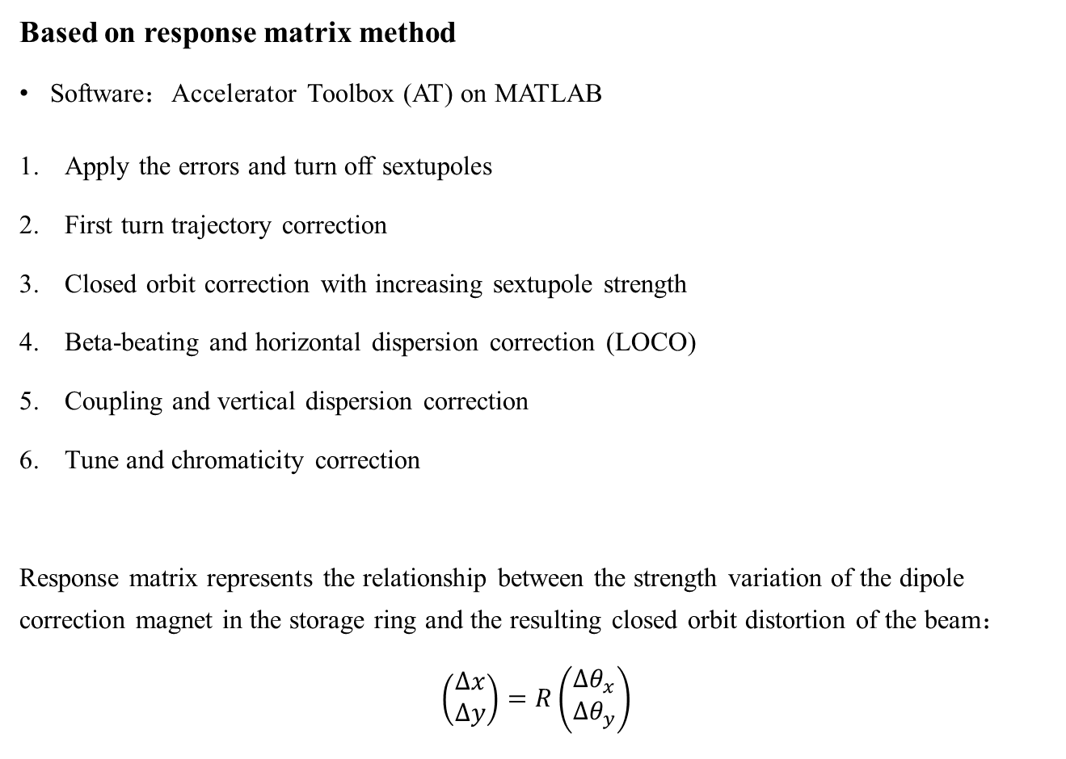
SppC lattice correction scheme
Based on response matrix method
Software：Accelerator Toolbox (AT) on MATLAB
Apply the errors and turn off sextupoles
First turn trajectory correction
Closed orbit correction with increasing sextupole strength
Beta-beating and horizontal dispersion correction (LOCO)
Coupling and vertical dispersion correction
Tune and chromaticity correction
Response matrix represents the relationship between the strength variation of the dipole correction magnet in the storage ring and the resulting closed orbit distortion of the beam：
$$\left(\begin{matrix}∆x \\ ∆y\end{matrix}\right)=R\left(\begin{matrix}∆θ_{x} \\ ∆θ_{y}\end{matrix}\right)$$
BPM
SKEW
COR
SX
QUAD
Iterate for several times

Slide 13


SppC lattice correction scheme
938 BPMs and 477 dipole correctors installed near the quadrupoles in the ring.
First turn trajectory correction：
Use BPMs and dipole correctors to find the closed orbit, 85% of the machines with errors can be corrected successfully in this step.
Closed orbit correction：
Solve the equation with the response matrix of lattice：$\vec{u}+A\vec{θ}=0$
$\vec{u}$: vector of orbit at BPM, A: response matrix, $\vec{θ}$: vector of corrector strength
Sextupole off, then after each 10% increase, the closed orbit is corrected once until the set value is reached.
$${COD}_{x,y,rms}<0.4 mm$$
Comparison of closed orbit before and after correction
Corrector strength less than 5 T*m

Slide 14

SppC lattice correction scheme
Beta-beating and horizontal dispersion correction：
Use the LOCO program to fit the response matrix itself.
Minimize the difference between measured and theoretical response matrix by varying the quadrupole strength to correct the beam envelope function：
$$χ^{2}=\sum_{i,j}{\frac{{\left(M_{meas,ij}−M_{model,ij}\right)}^{2}}{σ^{2}}}$$
$σ$: BPM noise given by multiple measurements of BPMs。
Beta-beating
before and after correction
Dispersion deviation
before and after correction
Quadrupole variation less than 3%

Slide 15

SppC lattice correction scheme
Coupling and vertical dispersion correction：
Correct the linear coupling RDTs by the skew quadrupoles in lattice：
$${\left(\begin{matrix}\vec{f_{1001}} \\ \vec{f_{1010}} \\ \vec{D_{y}}\end{matrix}\right)}_{meas}+M\vec{K_{s}}=0$$
$f_{1001}$ and $f_{1010}$: RDTs of difference and sum resonance, respectively; $K_{s}$: Skew quadrupole strength.
Focus more on the correction of $f_{1001}$since the tune is close to difference resonance.
Linear coupling RDTs
before and after correction
Skew quadrupole strength less than 150T/m

Slide 16
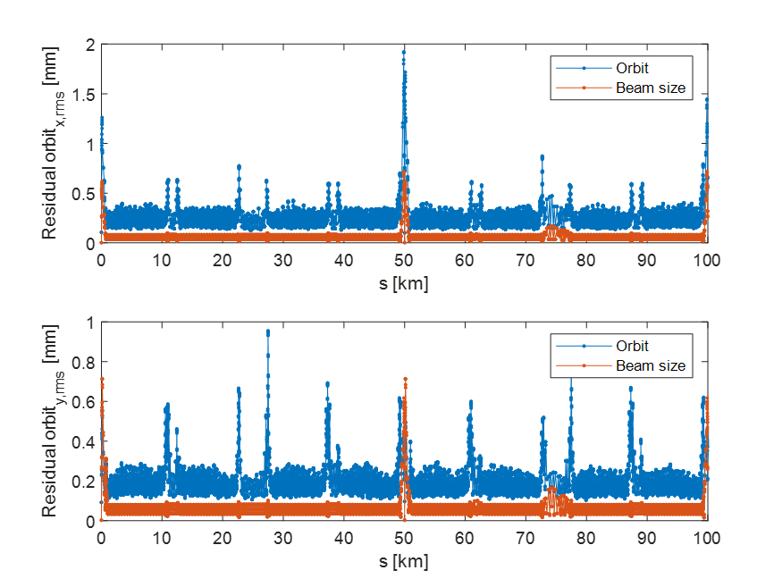
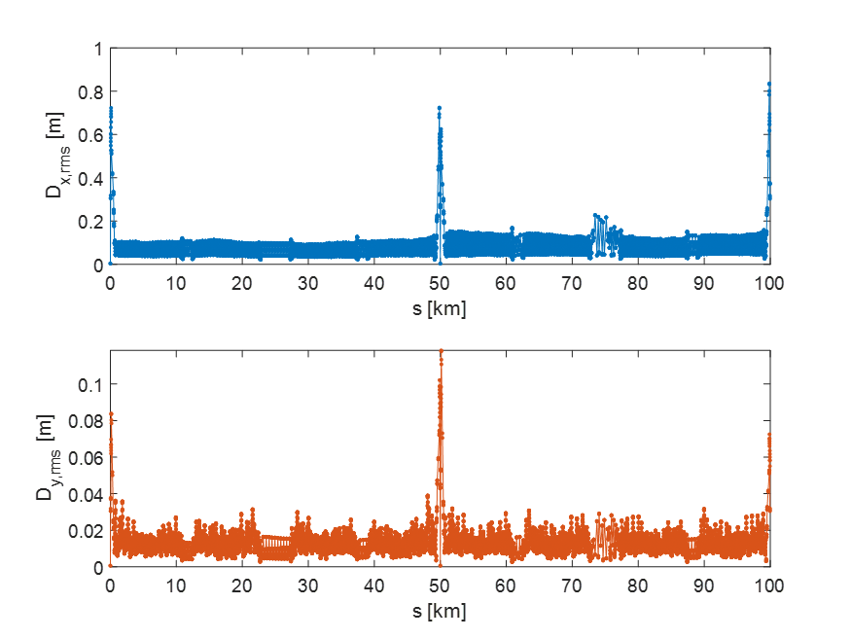
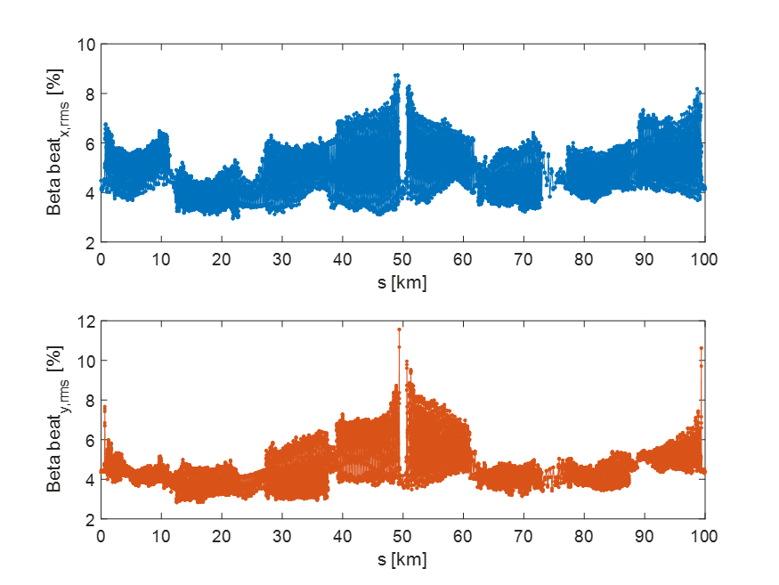
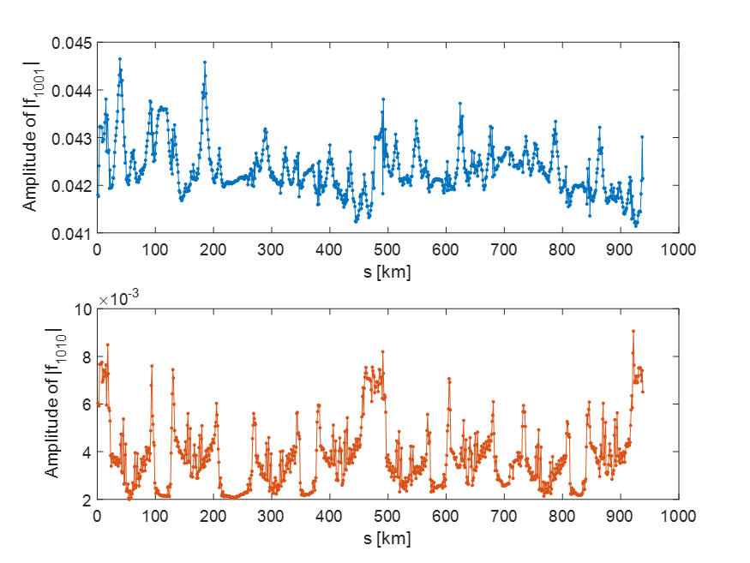

SppC lattice correction results
For collision
90 of 100 machines successfully corrected. Figures show the RMS results of those machines.
Hor. RMS：0.27 mm
Hor. RMS：0.09 m
Residual orbit and beam size：
Dispersion deviation：
Ver. RMS：0.21 mm
Ver. RMS：0.02 m
Beta-beating：
Linear coupling：
Hor. RMS：5.0 %
Ver. RMS：4.8 %
$f_{1001}$ RMS：0.042
$f_{1010}$ RMS：0.004

Slide 17
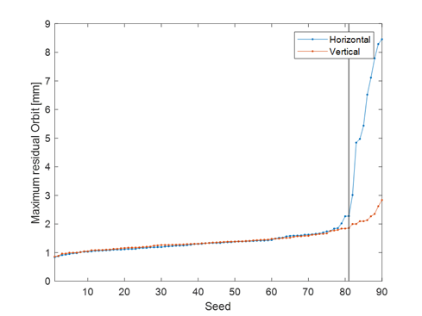
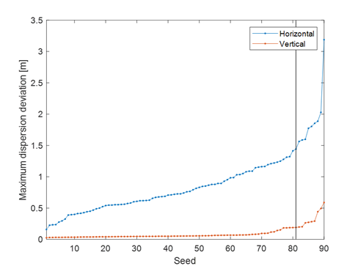
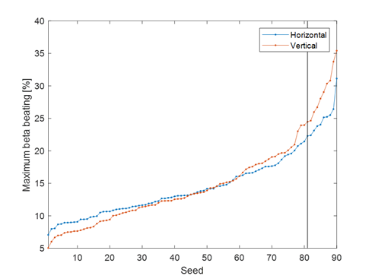
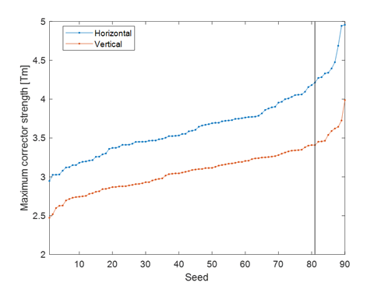
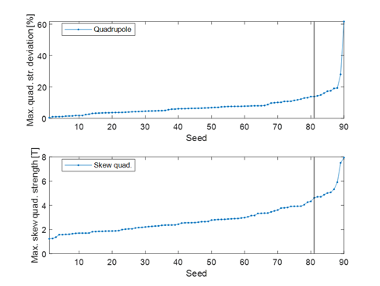
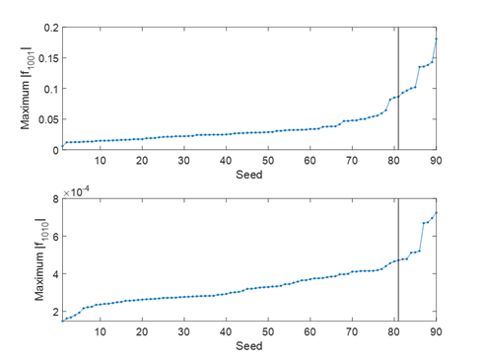

SppC lattice correction results
For collision
From the maximum values distribution the 90-percentile is calculated over all 84 machines.
Hor. ：2.3 mm
Ver. ：1.9 mm
Hor. ：1.44 m
Ver. ：0.19 m
Hor. ：22.3 %
Ver. ：24.5 %
Residual orbit
Dispersion deviation
Beta-beating
Quad. ：13.9 %
$f_{1001}$：0.09
Hor. ：4.2 T*m
Ver. ：3.4 T*m
Skew Q：4.6 T (45mm)
$f_{1010}$：0.02
Corrector strength
Quadrupole deviation and skew quadrupole strength
Linear coupling RDTs

Slide 18
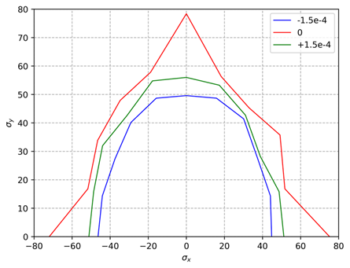
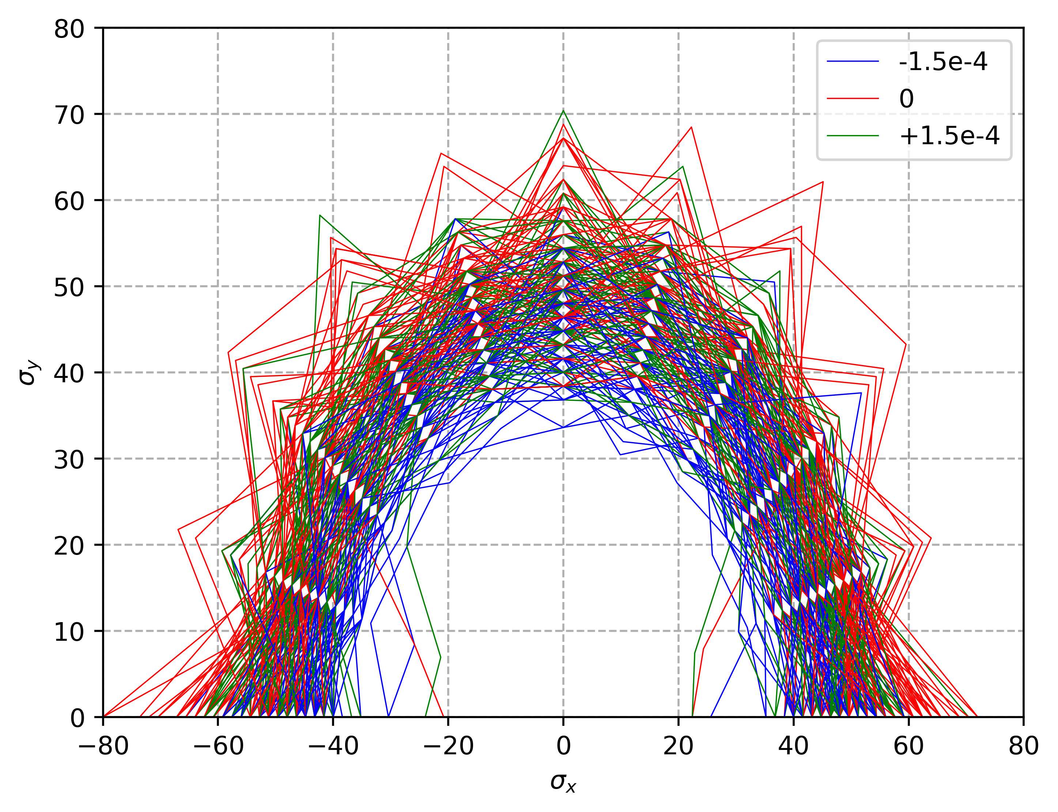
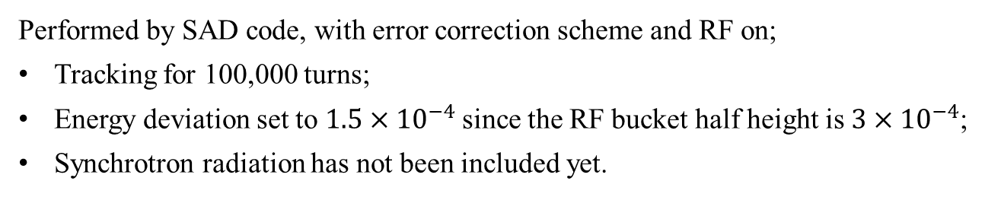
Dynamic aperture
Performed by SAD code, with error correction scheme and RF on;
Tracking for 100,000 turns;
Energy deviation set to $1.5×{10}^{−4}$since the RF bucket half height is $3×{10}^{−4}$;
Synchrotron radiation has not been included yet.
90 cases
Bare lattice
Bare lattice + beam-beam
Bare lattice + beam-beam + error correction

Slide 19
Content
SppC lattice design and nonlinearity optimization
Error correction scheme
Geometric compatibility between CEPC and SppC

Slide 20
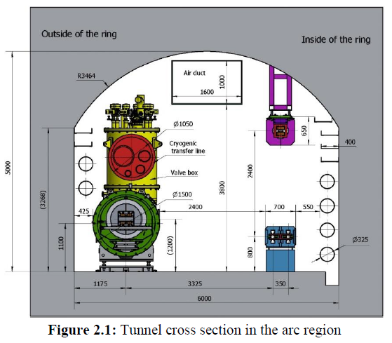
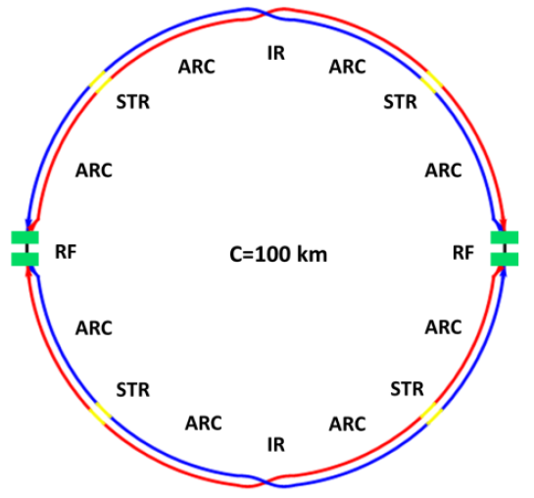
CEPC-SppC compatibility
Geometry compatibility of the CEPC and SPPC
  The SPPC will share the tunnel of CEPC as much as possible.
  The SPPC locates outside of CEPC
  In the 8 arc regions and 4 short straight sections, two machines share the tunnel (distance of machine centers=3.5m)
  In the 4 long straight sections, the SPPC will bypass the CEPC (distance of machine centers at IPs=23m as the big size of CEPC and SPPC detectors)
    IP1 and IP3 for CEPC interaction and SPPC collimation, IP2 and IP4 for CEPC RF and SPPC interaction
Tunnel in the ARC
CEPC Layout
SPPC Layout
IP1
IP1
IP4
IP2
IP4
IP2
IP3
IP3

Slide 21
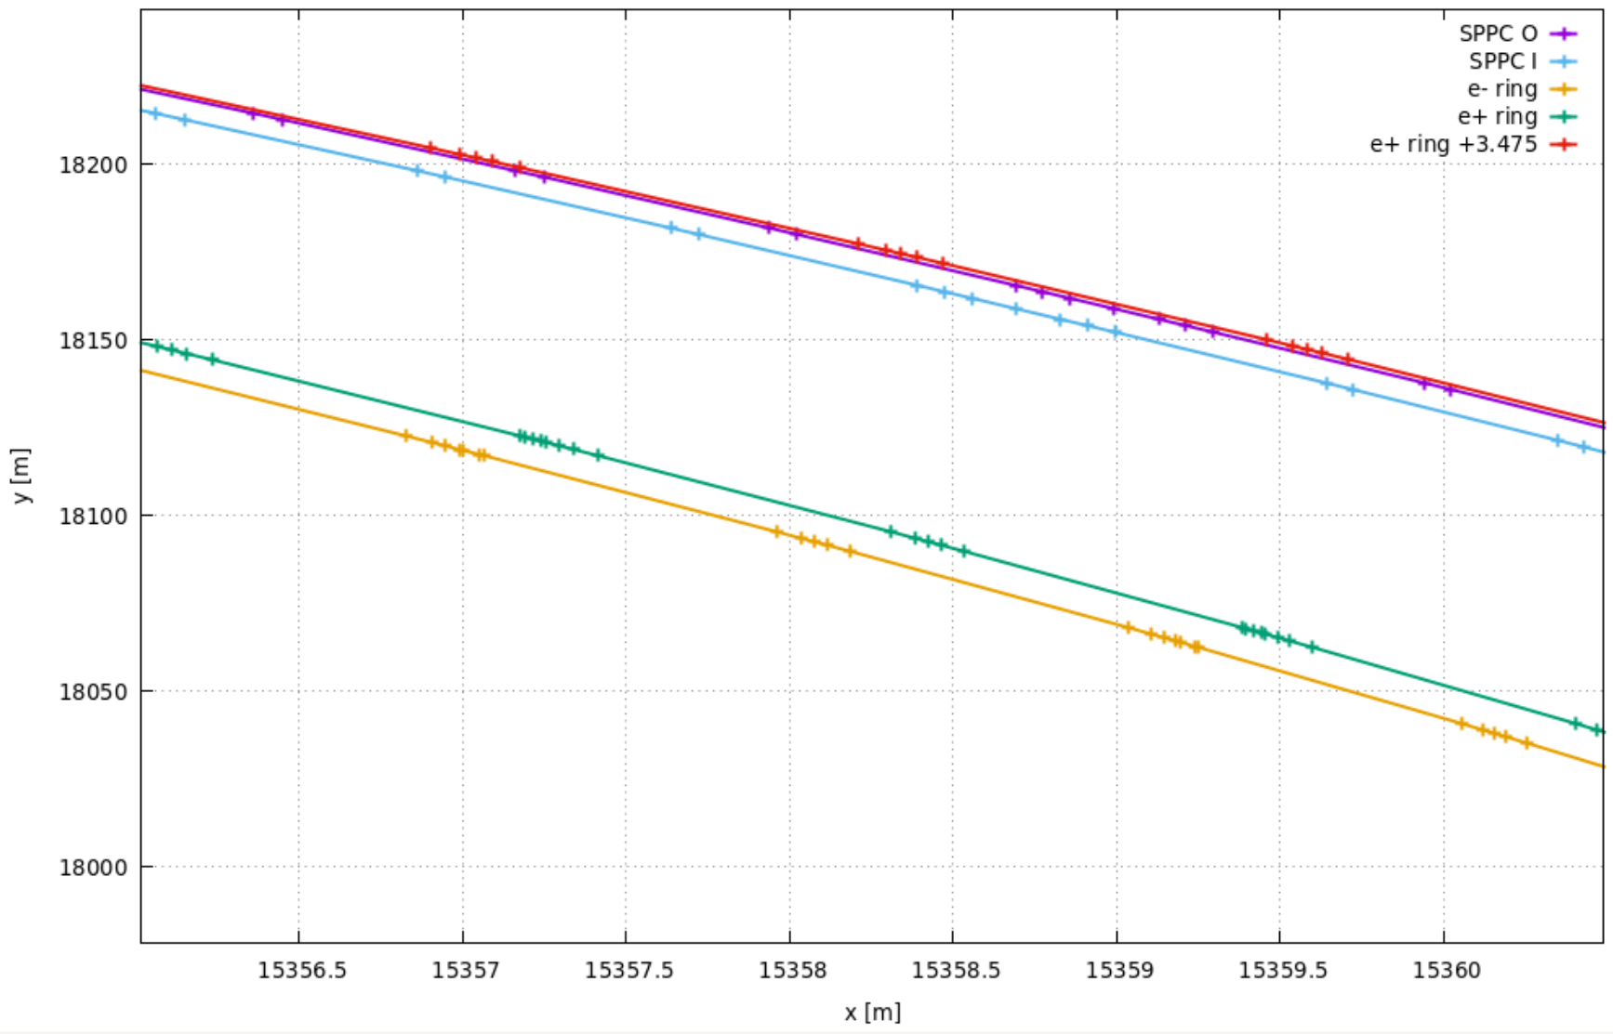
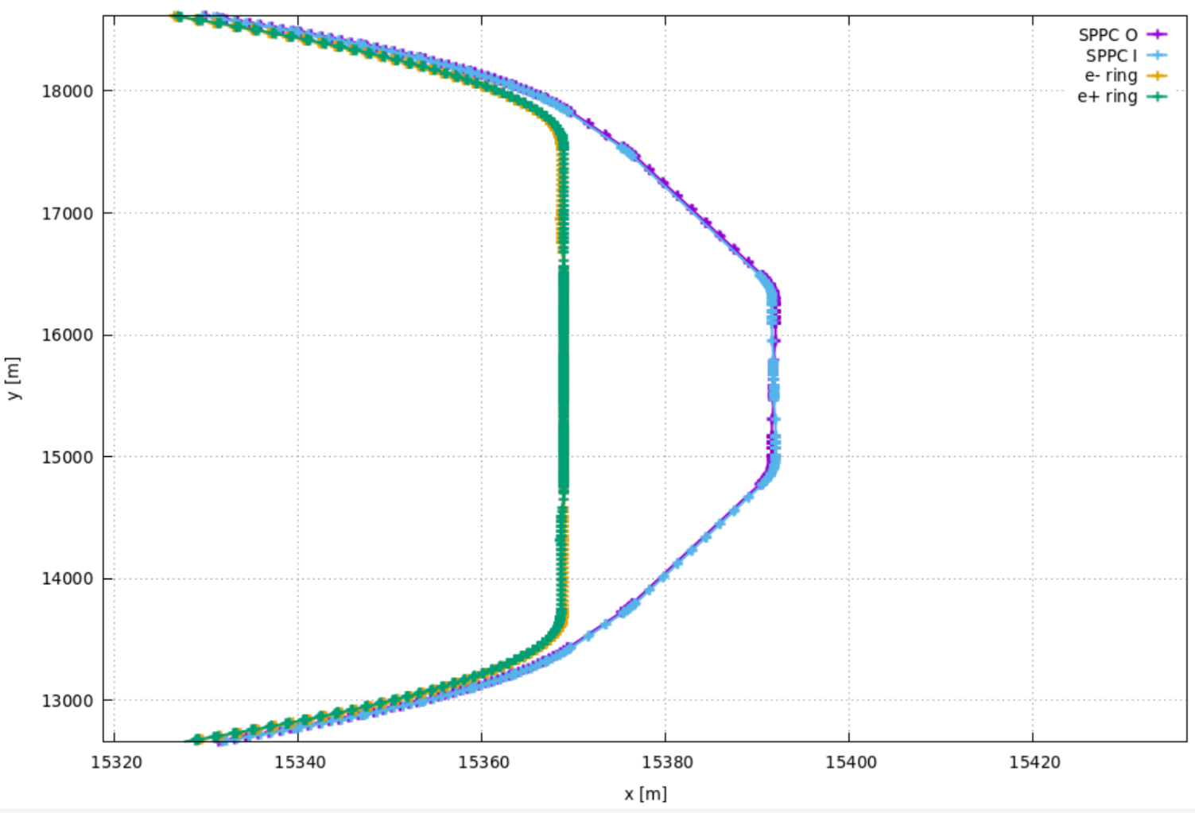
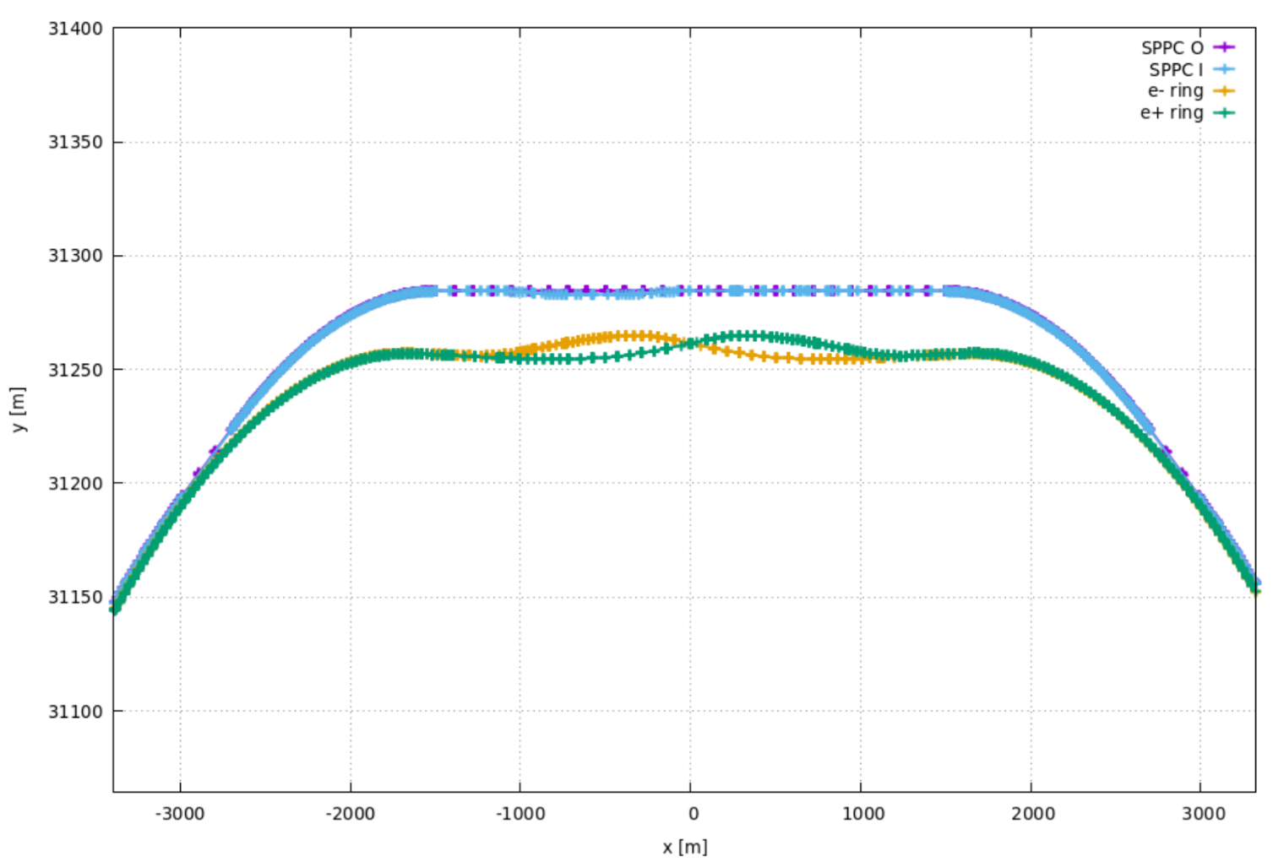
With bypass
SPPC updated to double ring:
Strength of dipole (arc and bypass): 20.31 T
Swap at IP2 and IP4
Double ring separation: 30 cm
Distance of two machine’s centers:
Separation with CEPC at ARC: 3.5 m
Separation with CEPC at IPs: 23 m
Geometry of arc section
Geometry of bypass at IP2
with a total length of 4399 m
Geometry of bypass at IP3
with a total length of 5985.34 m

Slide 22
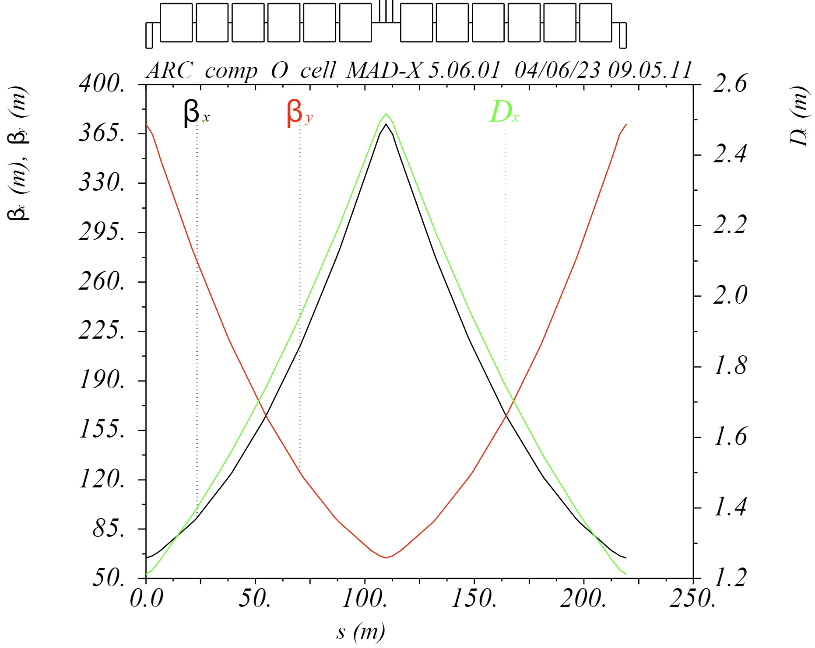
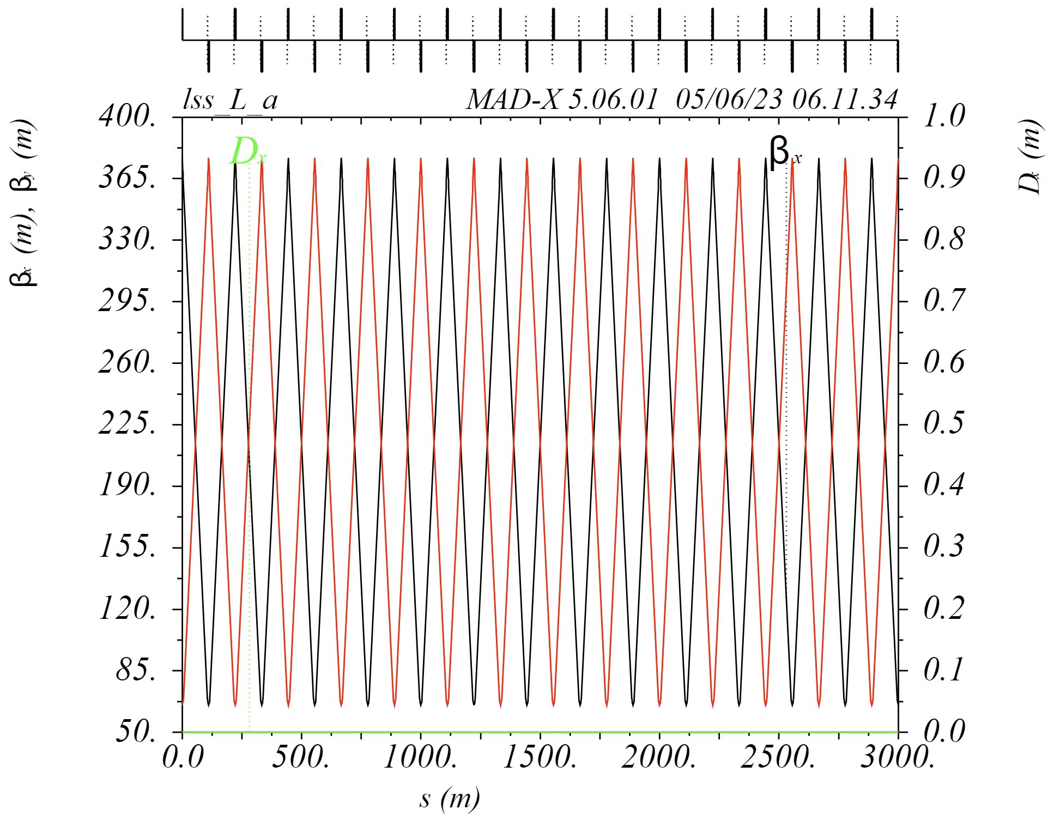


Almost the same as the former design
New Arc cell
3 km long straight section
Shortened for the
matching of bypass
3 km collimation section
986.84 m short straight section

Slide 23



Without bypass for the absence of CEPC detectors
SPPC updated to double ring:
Strength of dipole (arc and bypass): 20.31 T
Swap at IP2 and IP4
Double ring separation: 30 cm
Distance of two machine’s centers: 3.5 m
IP1 / IP3
Arc section
IP2 / IP4

Slide 24


Almost the same as the former design
New Arc cell
3337.13 m long straight section
3337.13 m collimation section
986.84 m short straight section

Slide 25
Geometric parameters of SPPC and CEPC
 | SPPC before | SPPC after | CEPC
Arc between SSS and final focus | 10487.52 m | 9962.31 m | 10270.44 m
Arc between SSS and collimation/extraction | 10487.52 m | 8865.69 m | 10185.70 m
Arc cell | 213.42 m | 219.32 m | 54.63 m
Linear section at IP1/IP3 | 4300 m | 3000 m | 3337.13 m
Linear section at IP2/IP4 | 1250 m | 1250 m | 3776.90 m
Short straight section | 1250 m | 986.84 m | 986.84 m
Bypass at IP1/IP3 | / | 5985.34 m | /
Bypass at IP2/IP4 | / | 4399 m | /
Circumference | 100000 m | 100027.44 m | 100000.0 m
With bypass:
*Arc including DIS sections
 | SPPC before | SPPC after | CEPC
Arc between SSS and final focus | 10487.52 m | 10273.29 m | 10270.44 m
Arc between SSS and collimation/extraction | 10487.52 m | 10188.55 m | 10185.70 m
Arc cell | 213.42 m | 219.32 m | 54.63 m
Linear section at IP1/IP3 | 4300 m | 3337.13 m | 3337.13 m
Linear section at IP2/IP4 | 1250 m | 3776.90 m | 3776.90 m
Short straight section | 1250 m | 986.84 m | 986.84 m
Circumference | 100000 m | 100021.84 m | 100000.0 m
Without bypass:
*Arc including DIS sections

Slide 26
Summary
A global correction scheme based on response matrix method is presented. Lattices at collision energy with errors have been corrected.
For the compatibility of CEPC and SppC, two kinds of SppC lattice design are presented for the presence or absence of bypass respectively.
Further improve the global correction results to get a more relaxed tolerance.
Thanks for your attention!

