Slide 1



High Field Magnet R&D
for the Next-generation Accelerators
Qingjin XU
for the Superconducting Magnet Group
Accelerator Division, IHEP-CAS
Jan 24 2024

Slide 2


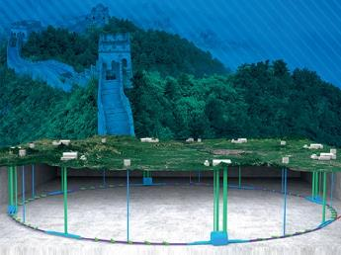
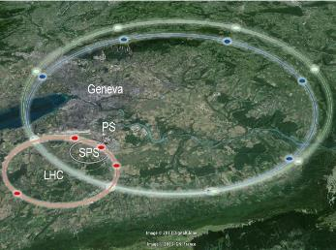
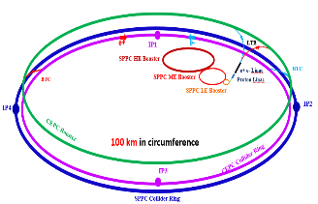
Design Scope for the Next-generation Accelerators
High Energy Circular Colliders for next decades | SPPC | FCC
Proposed institution | IHEP-CAS, China | CERN, Europe
Proposed dates | 2012 | 2013
Site of the project | China | Europe
Baseline technology | IBS 20~24 T to reach 125-150 TeV, Nb₃Sn etc as options | Nb₃Sn 16 T to reach 100 TeV
Timeline | Construction at 2040s | Construction at 2050-60s
Cost | * | **
2

Slide 3
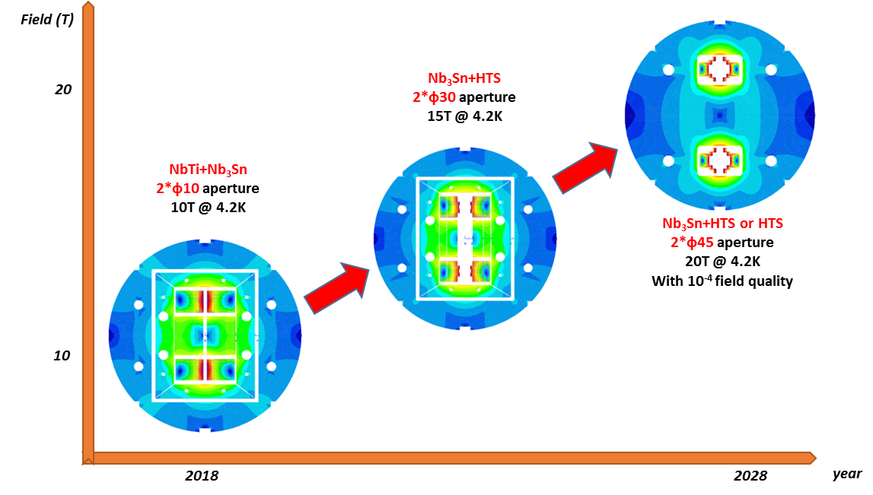
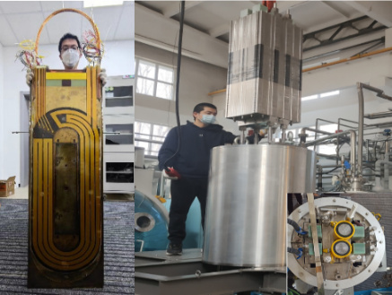
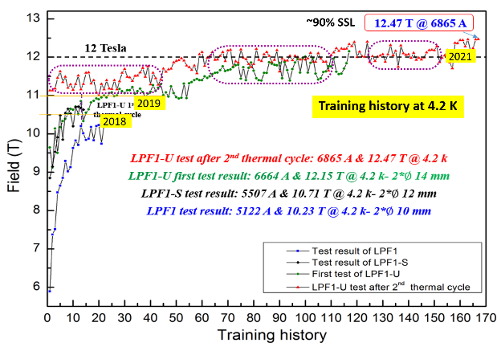
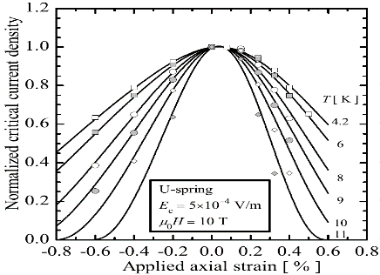
Roadmap of the High Field Magnet R&D at IHEP
2021-2023 16T @ 4.2K
Nb₃Sn + HTS
2018-2021, 12.47T @4.2K
NbTi + Nb₃Sn
Challenges: Stress control, quench protection, field quality control,……
3

Slide 4
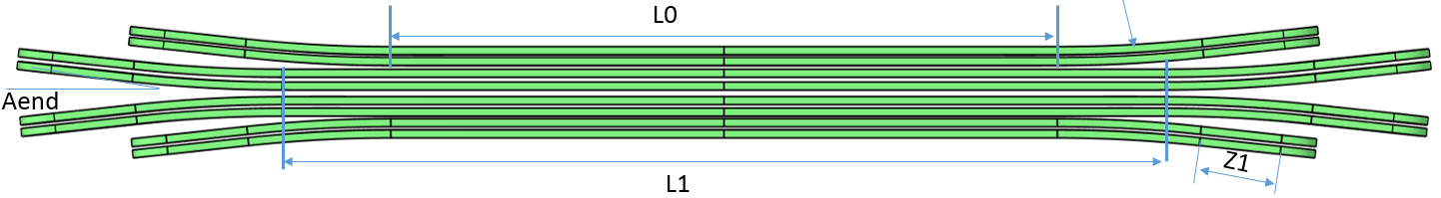
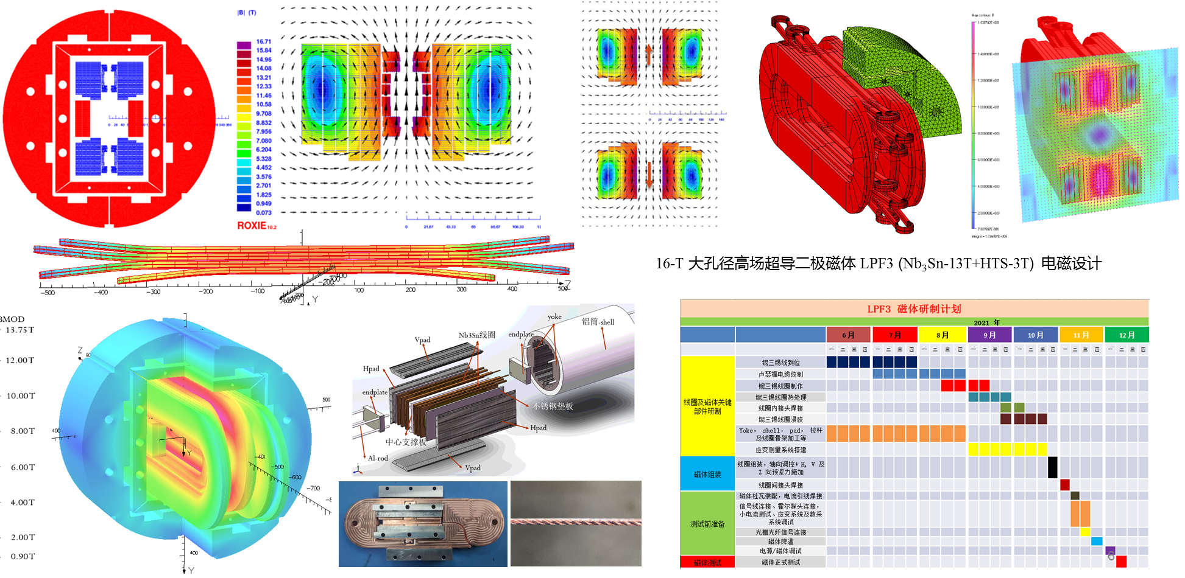
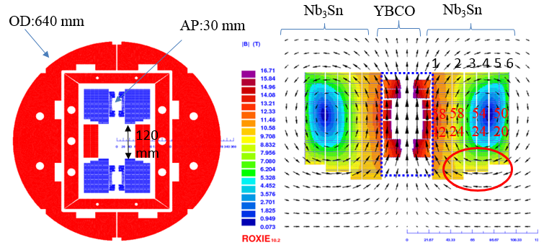
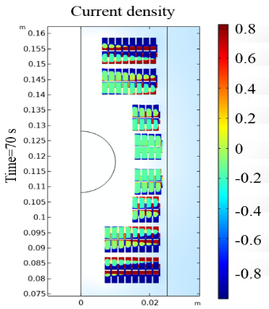
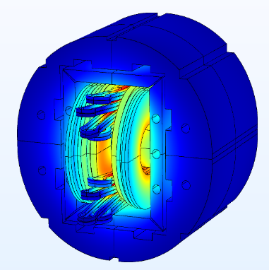
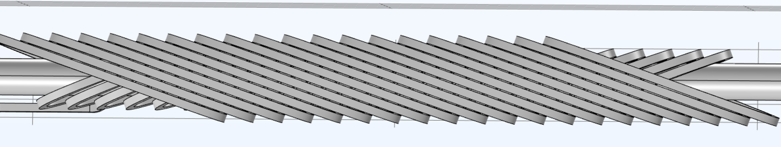
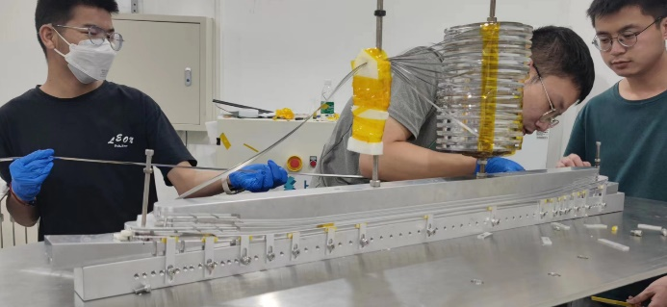
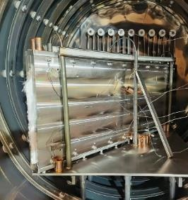
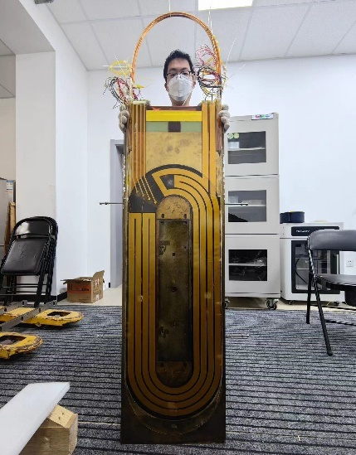
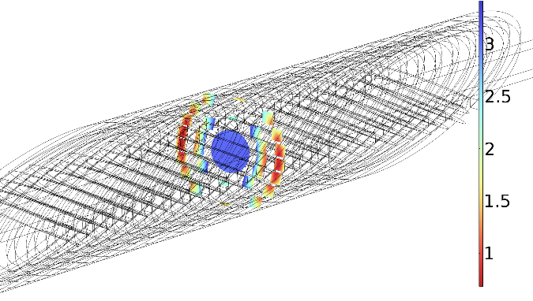
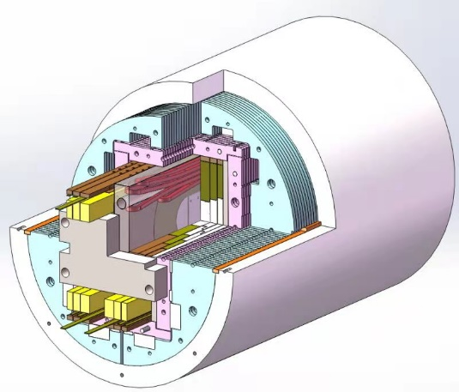
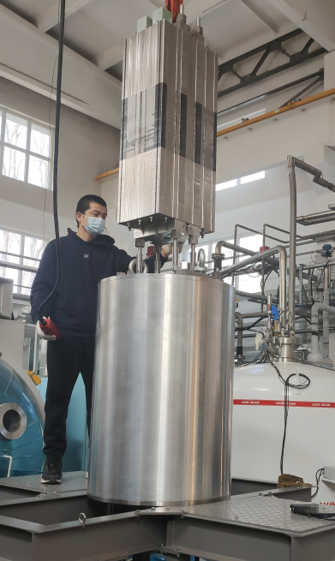
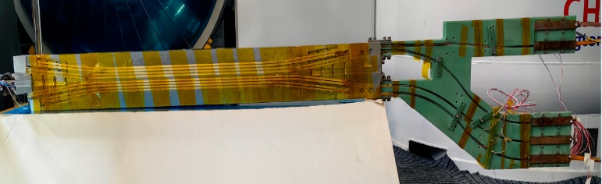
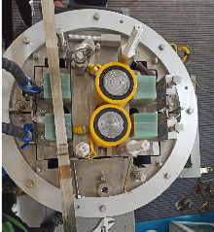
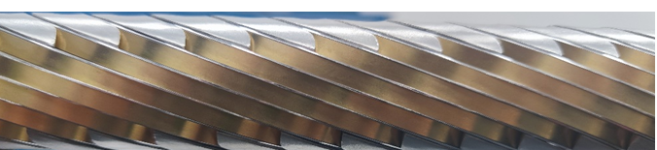
Development of the 16-T Model Dipole LPF3
16 T Model Dipole LPF3: Nb₃Sn 13 T (Common Coil with 55 mm gap) + HTS 3 T inserts (Block & CCT with ∅20 mm)
4

Slide 5
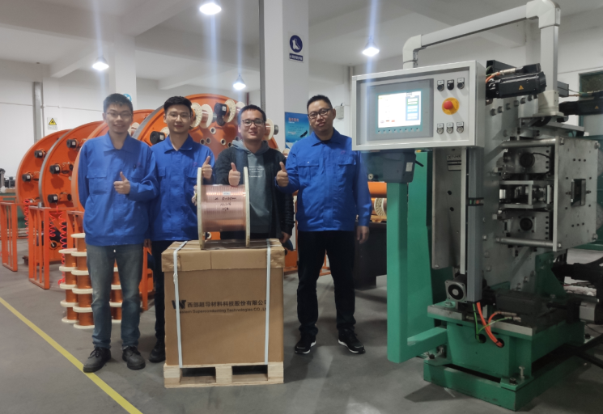

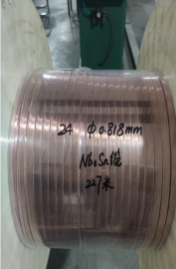
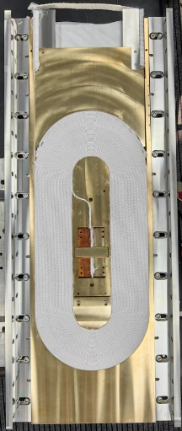
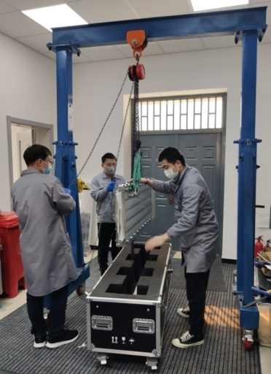
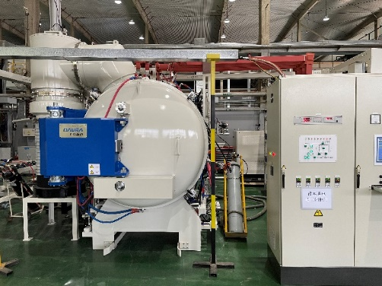
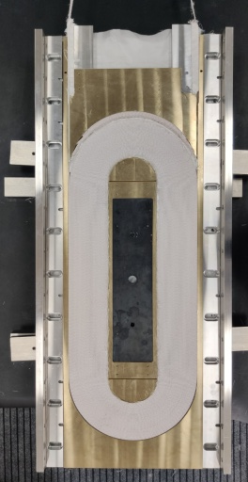
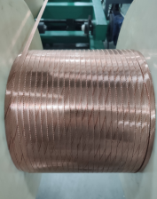
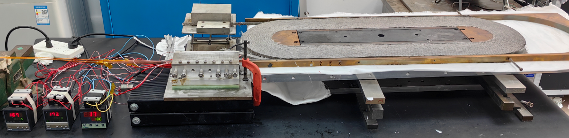
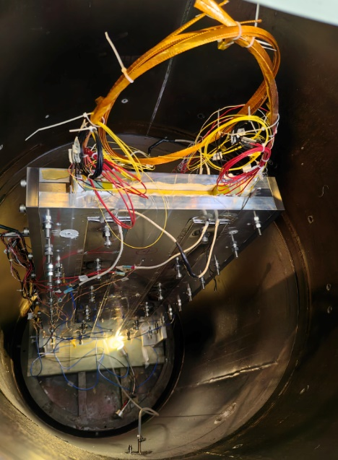
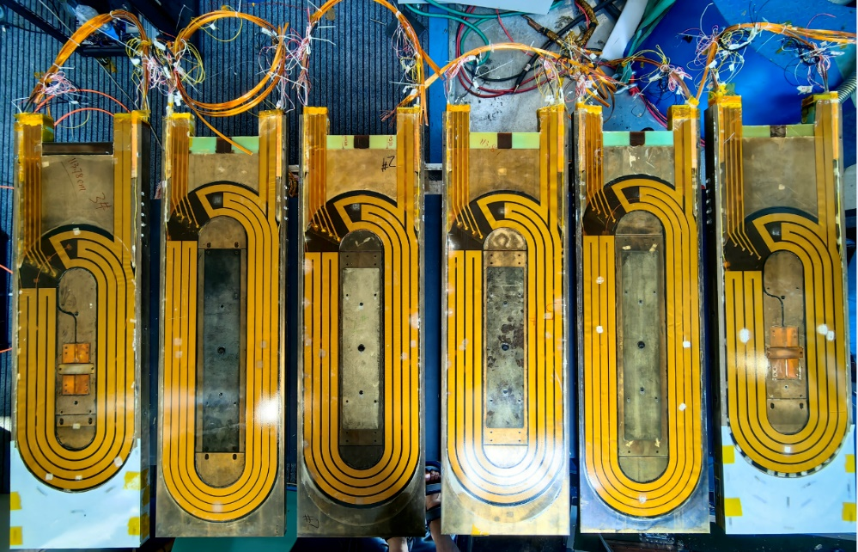
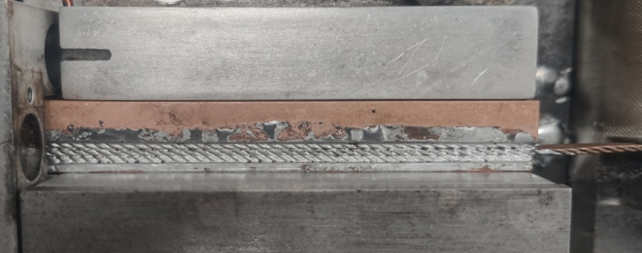
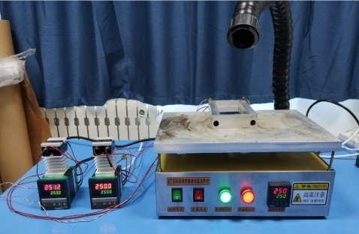
Development of the 16-T Model Dipole LPF3
The Nb₃Sn coils for LPF3
Chengtao Wang et al
5

Slide 6
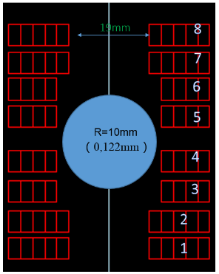
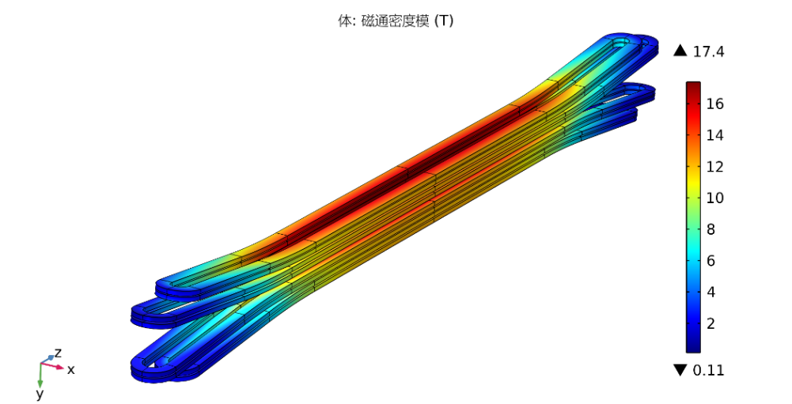
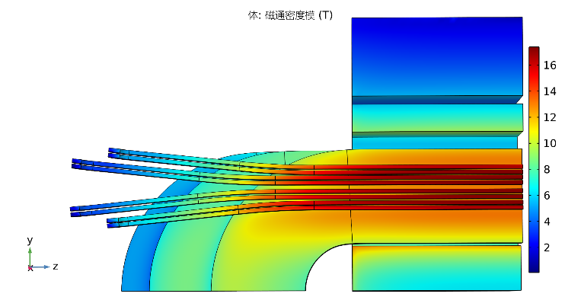

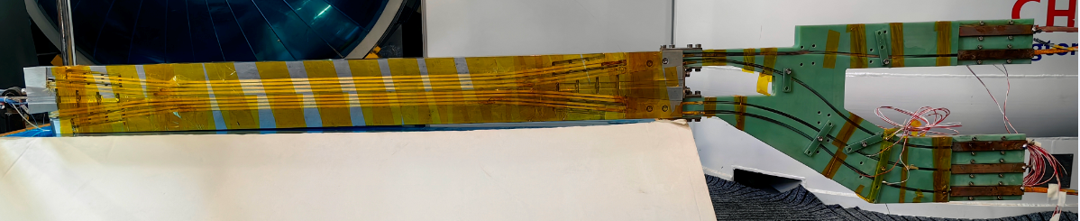
Development of the 16-T Model Dipole LPF3
The ReBCO block insert coils for LPF3
Ze Feng et al
Parameters | Values
L0 | 409.6 mm
L1 | 540.2 mm
Rhard | 800 mm
Aend | 6 °
R1 | 9.5 mm
Z1 | 120 mm
6

Slide 7

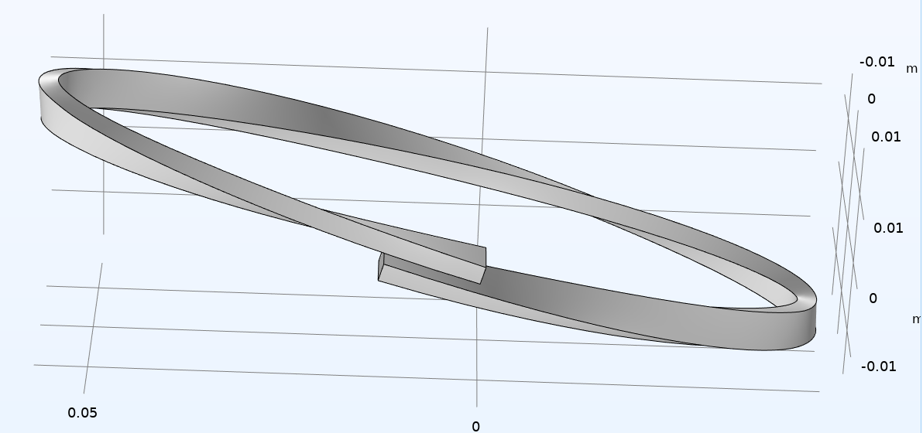
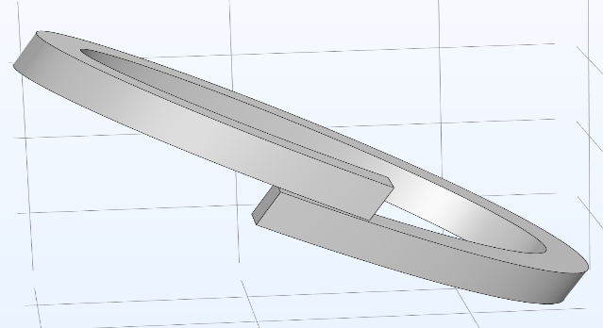
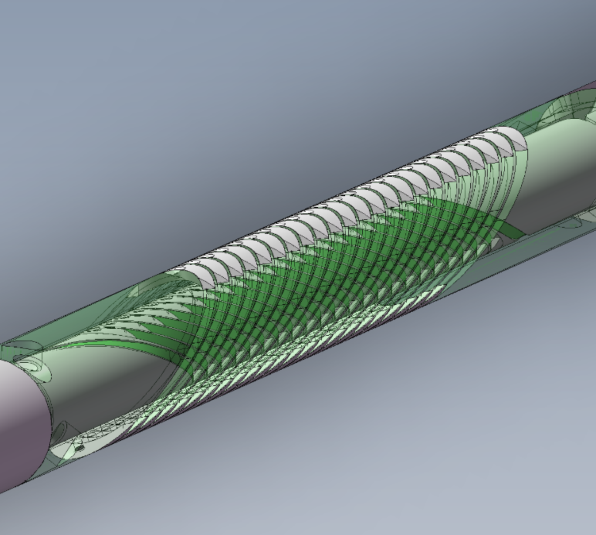
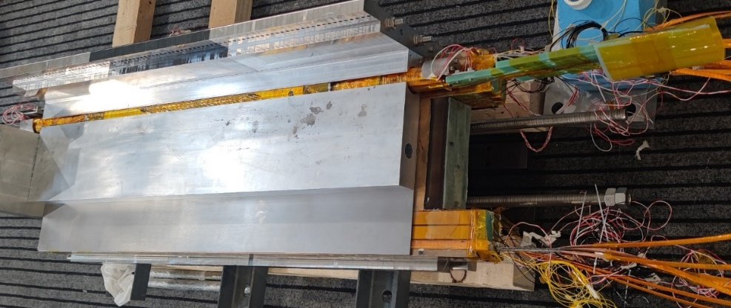
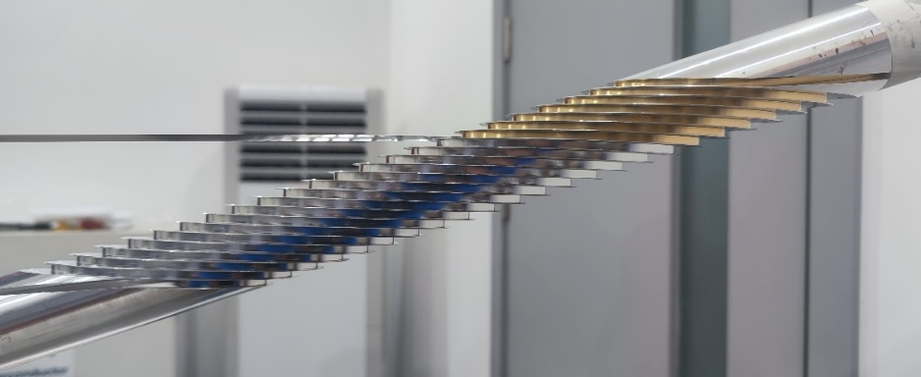
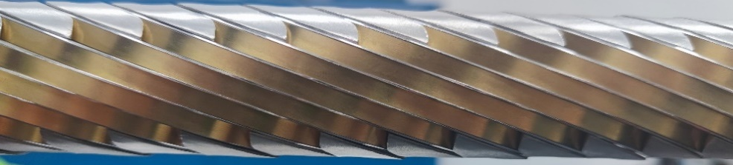
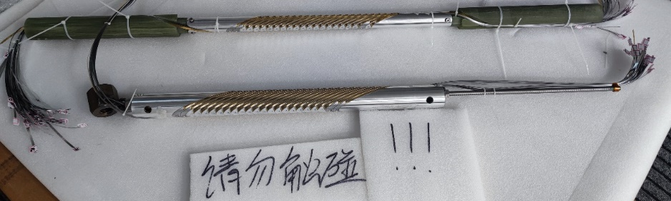
Development of the 16-T Model Dipole LPF3
The ReBCO CCT instert coils for LPF3
Rui Kang et al
典型CCT线圈结构示意
“斜螺线管”型CCT线圈结构示意
7

Slide 8
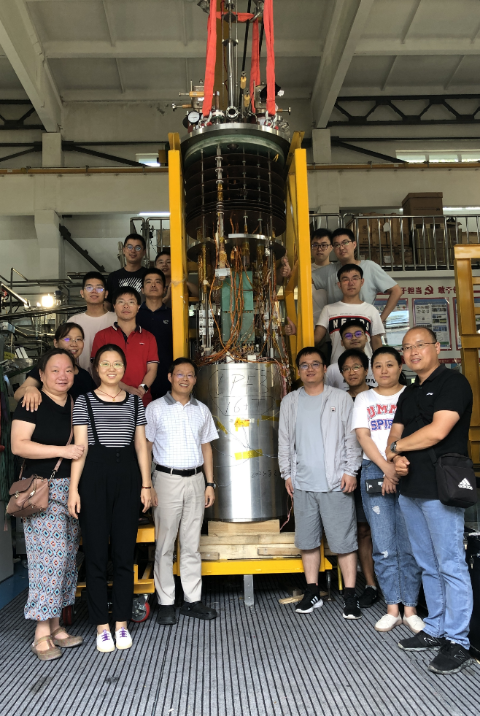
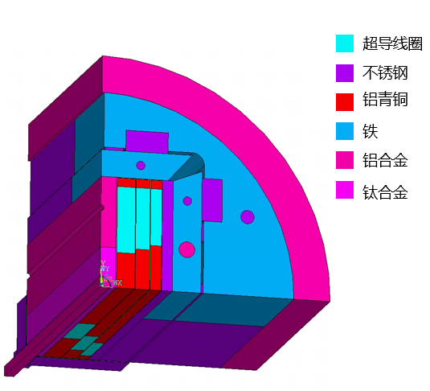
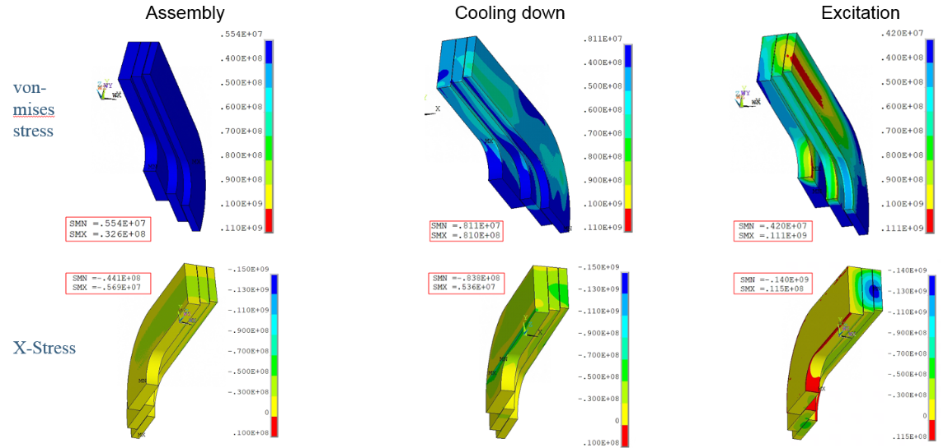
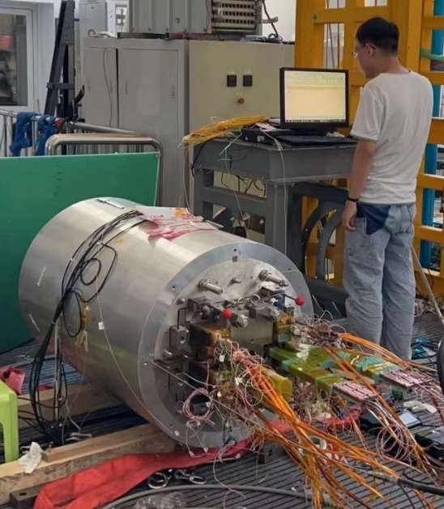
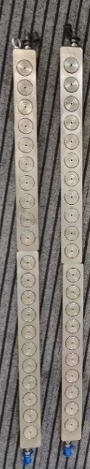


Development of the 16-T Model Dipole LPF3
Pre-stress and assembly of LPF3
Yingzhe Wang et al
Stress monitoring during
assembly with FBG
Pre-stress applied with commercial hydraulic jack
8
8
2023.8.29 Assembly completed

Slide 9




Development of the 16-T Model Dipole LPF3
Quench protection of LPF3
Jinrui Shi et al
Varistor plus CLIQ to protect the Nb₃Sn coils. The maximum hot spot is ~ 230 K
NI configuration plus dump resistor to protect the 2 HTS insert coils
Feasibility study of applying the no-insulation coil on accelerator magnets
Current decay curve at the operating current
Rui Kang, Hongjun Zhang et al
9

Slide 10




Development of the 16-T Model Dipole LPF3
Performance test ongoing from Sep 2023
Wei Li et al
The Nb₃Sn coils were trained firstly, maximum current reached ~85% of I_{op} in Dec 2023.
HTS block coil was ramped independently to 100% of I_{op} with negligible terminal voltage
Present test results indicate the promising performance of the LTS and HTS coils. Test to be continued in Feb 2024
10

Slide 11


IBS Technology: Status and Outlook
90% Stainless-steel & 10% Sliver stabilized IBS tape achieved the highest J_{e} in 2022!
Significantly reduced the cost and raised the
mechanical properties.
IBS 2025
IBS 2022
IBS 2019
IBS 2016
11

Slide 12


IBS Technology: Status and Outlook
The First IBS Solenoid Coil at 32 T background field
Chunyan Li et al
I_{c} of Φ34mm-17 turns-DPC reached 60 A at 4.2 K and 32 T, world’s highest record up to now.
Successfully fabricated a double pancake coil and
a series-connected coil consisting of six DP coils
12
2024 Supercond. Sci. Technol. 37 015001

Slide 13




IBS Technology: Status and Outlook
Quench propagation study of the IBS tapes and coils
Chunyan Li et al
Poster: WP-P-12
Experimental data shows significant quench propagation in the IBS tape! More testing will be carried out.
13

Slide 14






IBS Technology: Status and Outlook
IBS solenoid at 32 T
Racetrack at 10 T
1.3 kA transposed cable
J_{e} > 450 A/mm²
@ 10 T, 4.2 K
100-m 7-core IBS tape fabricated
J_{e}= 100 A/mm²
@ 10 T, 4.2 K
Z. Zhao
IBS (T_{c} 55K)
2008.02
2008.04
2008.09
2016
2018
2020
2022
Discovery of IBS
Discovery of
122 phase IBS
IBS solenoid at 24 T
Racetrack at 8 T
J_{e}= 300 A/mm²
@ 10 T, 4.2 K
H. Hosono
IBS (T_{c} 26K)
J_{e} of IBS expected to be similar as ReBCO in 5 years with better mechanical properties and lower cost
14

Slide 15





Development of CCT Magnets for HL-LHC
Milestone of the HL-LHC CCT Magnet Project
Agreement signed
btw IHEP and CERN
The CCT magnet from China under test at CERN
Installation to tunnel
The qualified prototype delivered to CERN
All the 12 series CCT magnets delivered to CERN
HL-LHC commissioning
15

Slide 16





Development of CCT Magnets for HL-LHC
Successful design upgrade to solve the “long training problem”, significantly reduced the times of quench during training, ensured the project progress “on track”.
16

Slide 17







Training of MCBRD02 & MCBRD03
Development of CCT Magnets for HL-LHC
AP1(CB12，25 quenches 526A) reached ±422A after 11 quenches.
AP2(CB09, 33 quenches 530A; after thermal cycle ＞500A) reached ±422A without any quenches.
17

Slide 18


Training of MCBRD04
Development of CCT Magnets for HL-LHC
Satisfying performance at 4 K for both apertures, tested at IMP-CAS
18

Slide 19
Development of CCT Magnets for HL-LHC
4 series CCT magnets have been fabricated, successfully reached the design target and delivered to CERN
Components for 2 series magnets being shipped to CERN
Production rate for the rest of series magnets: every 3 month per magnet; to be completed by mid 2025
 | Coil name | Winding method | Location | Coil stand-alone performance (4.2 K) | Magnet performance at 4.2 K
MCBRD01 | MCBRD_CB01 | Wet wind | CERN | 530 A | Both apertures reached ultimate current 422 A, and passed 4-hour stability test at 4.2 K
 | MCBRD_CB03 | Direct wind |  | 410 A (training stopped due to the availability of the test station)
 | MCBRD_CB02 | Direct wind | CERN | Failed to reach the design current
MCBRD02 | MCBRD_CB04 | Wet wind | CERN | 422 A (training stopped due to the availability of the test station) | Both apertures reached ultimate current 422 A, and passed 4*1 hour stability test at 4.2 K
 | MCBRD_CB06 | Wet wind |  | 530 A
MCBRD03 | MCBRD_CB09 | Direct wind with new channel size | CERN | 530 A | Both apertures reached ultimate current 422 A, and passed stability test at 4.2 K
 | MCBRD_CB12 | Direct wind with new channel size |  | 526 A (25 quenches)
 | MCBRD_CB14 | Direct wind with new channel size | BAMA | 530 A (30+34 quenches), put in quarantine
MCBRD04 | MCBRD_CB13 | Direct wind with new channel size | IMP | 530 A (20+33 quenches) | Both apertures reached ultimate current 422 A, and passed stability test at 4.2 K
 | MCBRD_CB17 | Direct wind with new channel size | IHEP | 524 A (47 quenches) | -
MCBRD05 | MCBRD_CB18 | Direct wind with new channel size | IHEP | 530 A (43 quenches) | To be assembled
 | MCBRD_CB19 | Direct wind with new channel size | IHEP | 530 A (63 quenches) | -
 | MCBRD_CB20 | Direct wind with new channel size | IHEP | To be stand-alone tested
MCBRD_CB10, 11, 15, 16 |  | Shipped to CERN for fabrication

Slide 20
Summary
Long-term advanced superconducting magnet R&D for future high-energy accelerators is ongoing at IHEP-CAS
16 T (Nb₃Sn+HTS) model dipole has been fabricated at IHEP-CAS and under performance test at 4.2 K. Present results show very promising and encouraging performance
Strong domestic collaboration for the advanced superconductor R&D (HTS & Nb₃Sn): Stainless-steel-Silver stabilized IBS tape achieved the highest J_{e} in 2022! Significantly reduced the cost and raised the mechanical properties
HL-LHC CCT magnets going well, to be installed in the tunnel in 2026
Thanks for your attention!
20

