Slide 1



CEPC industrial preparation and procurement strategy study
Song Jin （IHEP)
（For CEPC study group）
IAS Program on High Energy Physics (HEP) 2024, 22-25, Jan., 2024, HKUST, Hongkong

Slide 2
Content
Introduction
Industrial preparation
Procurement strategy study
Summary and plan in EDR

Slide 3
1. Introduction
CEPC is one of the most advanced future colliders, featuring a large-scale accelerator complex comprising
  A 1.8 km linear accelerator
  Two 100 km circular accelerators
This endeavour necessitates large-volume components for various accelerator systems. For example:
  ~37,000 magnets,
  ~ 200 km of copper with NEG film, 100 km of aluminium and 6 km of stainless-steel vacuum pipes
  about 192 650 MHz two-cell SRF cavities, and 96 1.3-GHz nine-cell SRF cavities
  around 96 high efficient klystrons, to name a few
  over 80,000 mechanical supports
more than 20,000 magnet power supplies
Industrial preparation and procurement strategy study became important.

Slide 4
Components types and strategies
In order to make study clear, we can categorize the components into three parts.
Non-standard Products-Industrial production
  Custom production based on specific requirements with low Technology Readiness Level（TRL）
Standard Products - Procurement
  Standardized components or products that can be purchased directly from suppliers.
Integration and Testing Category - Workforce training
  installation and testing during the entire system integration and testing process.

Slide 5
Various types versus different strategies
Following is a table for various types of components versus different strategies
 | Strategies | Non-standard components | Standard components | Integration preparation
Industrial preparation | Work with industry and technology transfer | Yes
 | TRL assessment and improvement | Yes
 | Logistics and infrastructure consideration | Yes
 | Efficiency, economical production and workforce training | Yes |  | Yes
Procurement | Policy | Yes | Yes | Yes
 | Sourcing | Yes | Yes | Yes
 | Other procurement strategies | Yes | Yes | Yes
Tools to follow-up（Digital twin) | DeepC | Yes | Yes | Yes

Slide 6
Various types versus different strategies
Following is a table for various types of components versus different strategies
 | Strategies | Non-standard components | Standard components | Integration preparation
Industrial preparation | Work with industry and technology transfer | Yes
 | TRL assessment and improvement | Yes
 | Logistics and infrastructure consideration | Yes
 | Efficiency, economical production and workforce training | Yes |  | Yes
Procurement | Policy | Yes | Yes | Yes
 | Sourcing | Yes | Yes | Yes
 | Other procurement strategies | Yes | Yes | Yes
Tools to follow-up（Digital twin) | DeepC | Yes | Yes | Yes

Slide 7
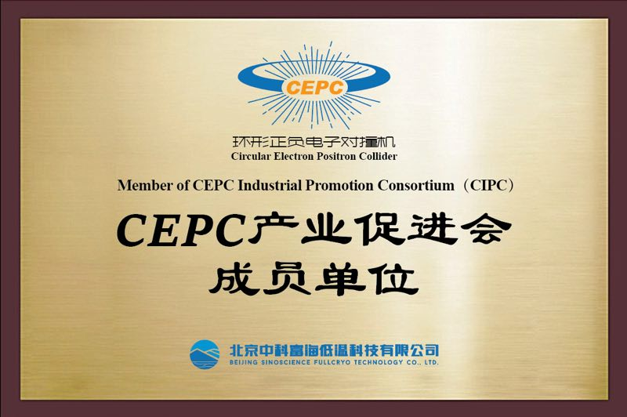
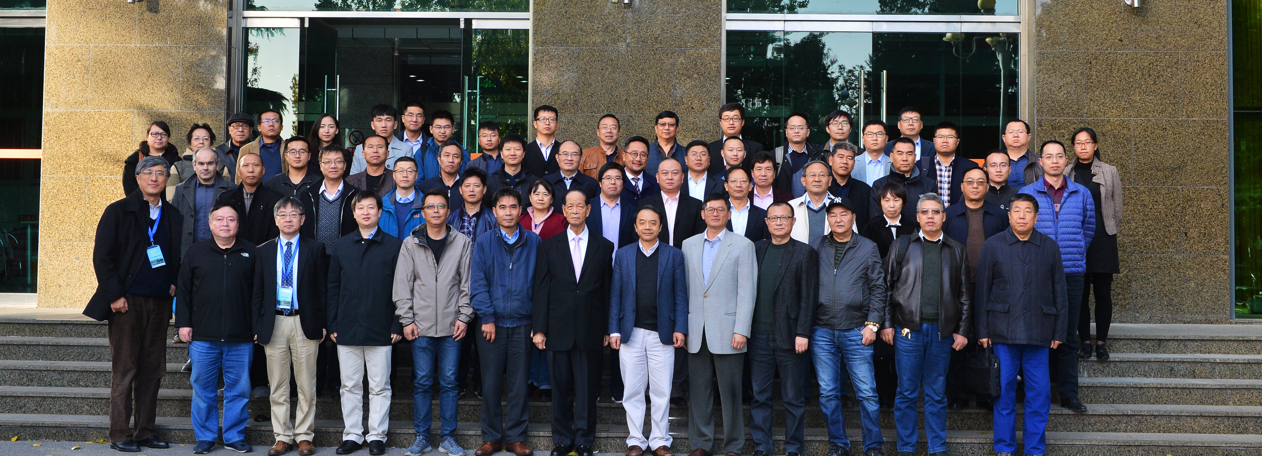
2. CEPC industrial preparation
CEPC industrial preparation began very early before the CDR period.
The establish of CEPC Industrial Promotion Consortium (CIPC) one of the most milestones for industrial preparation. It was established in the Nov. 2017.
The CIPC give the industrial preparation a great support.
The plate for CIPC member
CIPC established in Nov. 7 , 2017
Notes:
In the later progress of CEPC, it gave a greatly support to CEPC R&D.

Slide 8
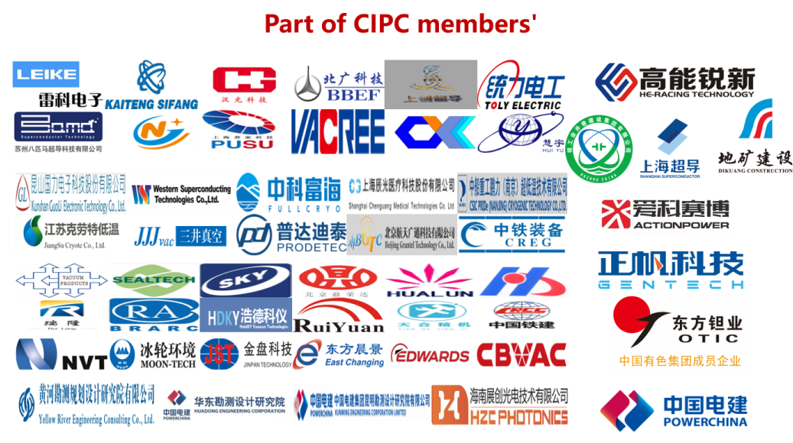
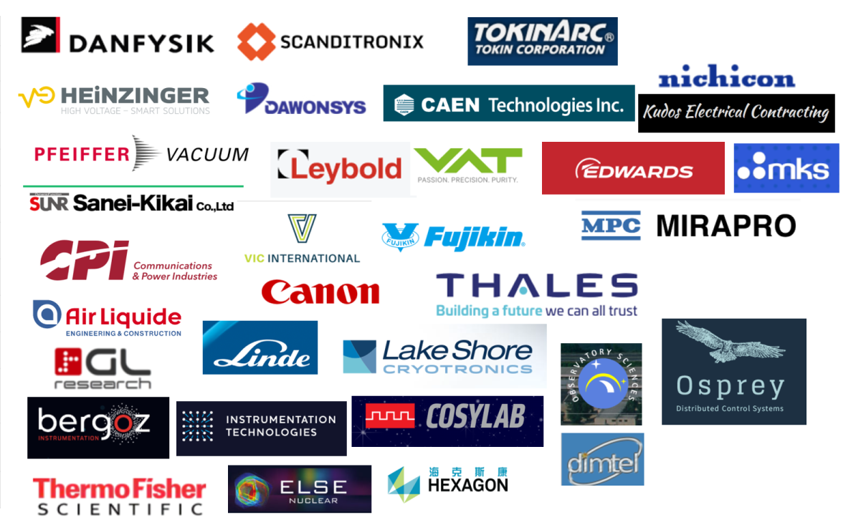
      Sourcing
Sourcing here is to prevent the over-reliance on too few suppliers and stimulate vendor interest in participating in CEPC procurement.
Most members of CIPC are recommended by experts of the related fields from experience projects at IHEP such as BEPC II and HEPS.
Up to now, the CIPC membership exceeded 70. Survey for international vendors was underway.
Potential international collaborating suppliers and partners worldwide
Notes:
In the establishment and development process of CIPC, the sourcing was always one of key points for industrial preparation. It is crutial to prevent the over-reliance on too

Slide 9
Work with industries
Working with companies is specially important for the industrialization
Several accelerator systems deeply collaborated with industry, for example
  The high efficient klystron R&D
  High performance SRF cavity cryomodule was assembled
  The new automatic magnet production line is under studied
  Magnets of project HPES were fabricated
In those processes, several crucial factors for industrialization are improved, like technology transfer, workforce training, and preparation for economical production
Notes:
Following sourcing, work with industries is specially important for the industrialization.

Slide 10
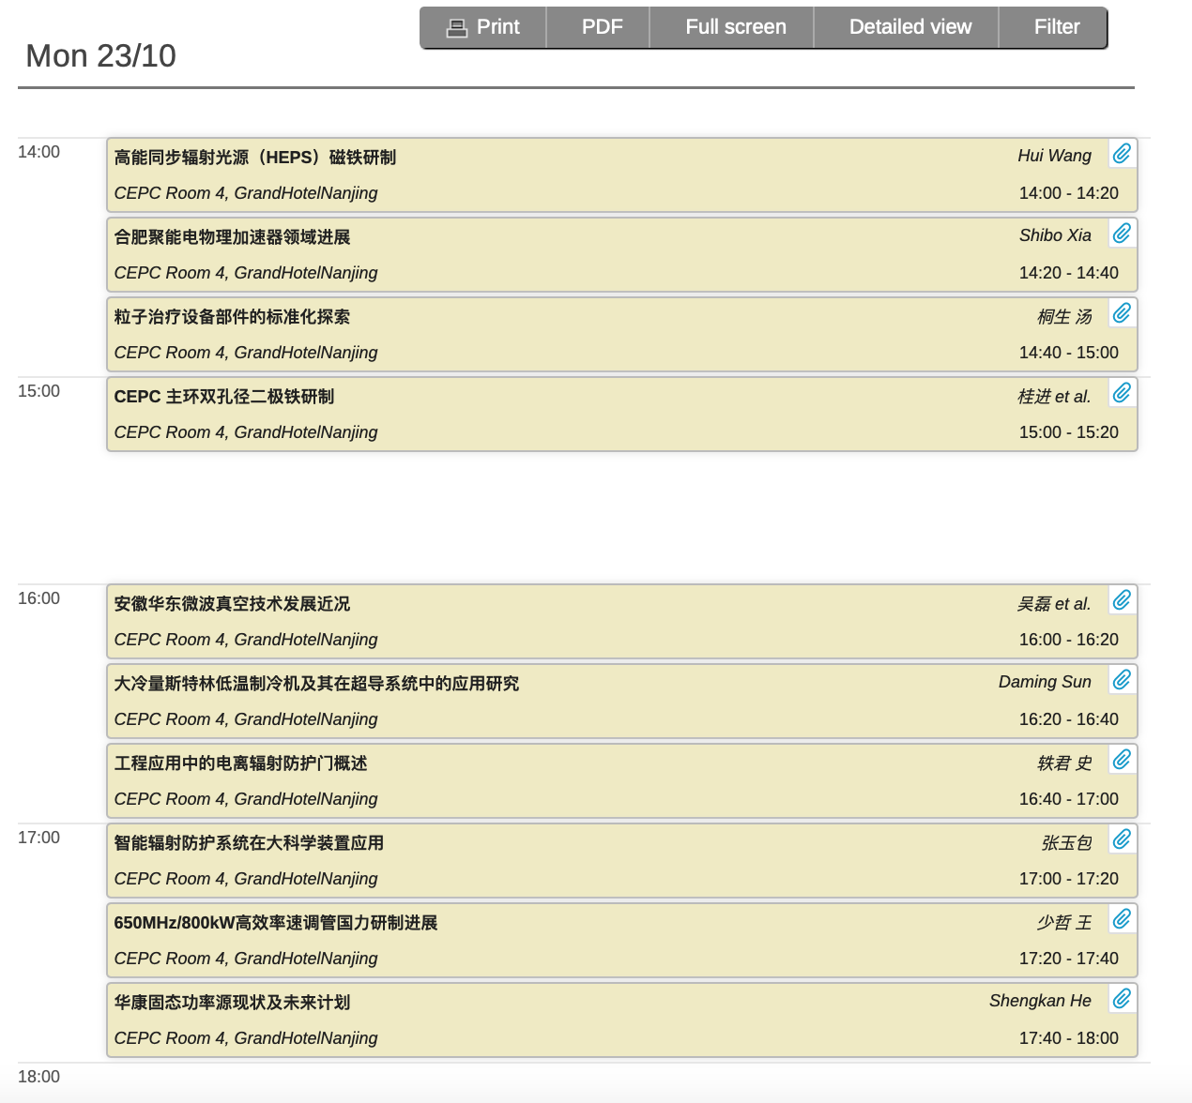
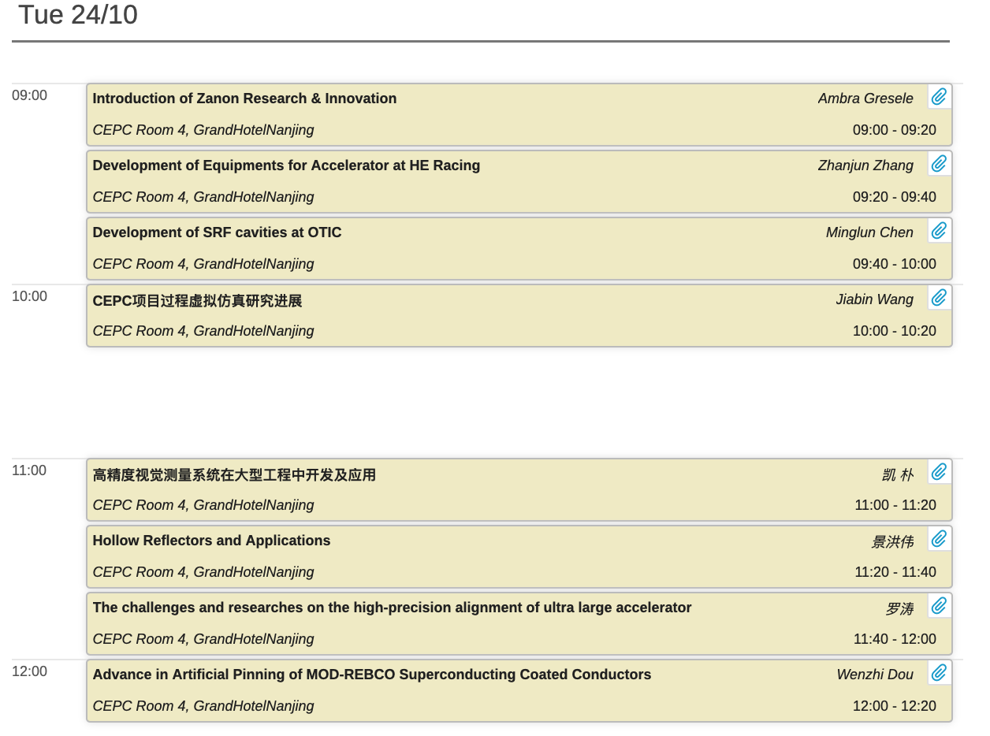
Work with industries
Based on CIPC, over 20 company partners actively participate in CEPC's R&D efforts during both the CDR and TDR phases.
In annual CEPC workshop，there was a CIPC session to report the progress.
For example, in CECP2023 in Nanjing, there are 4 sessions and about 20 talks reported.

Slide 11
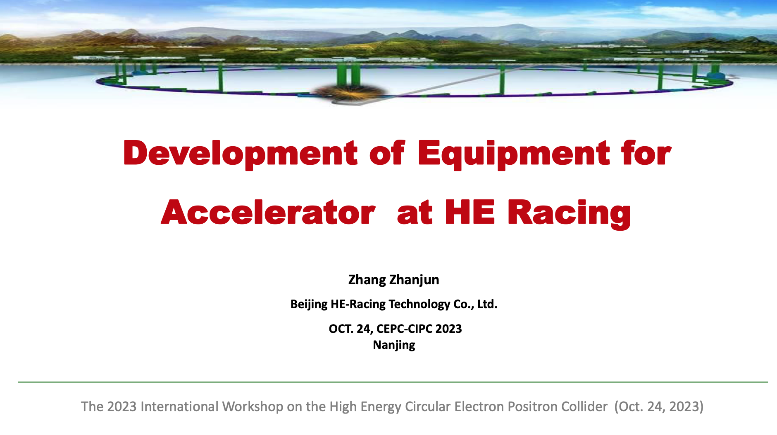
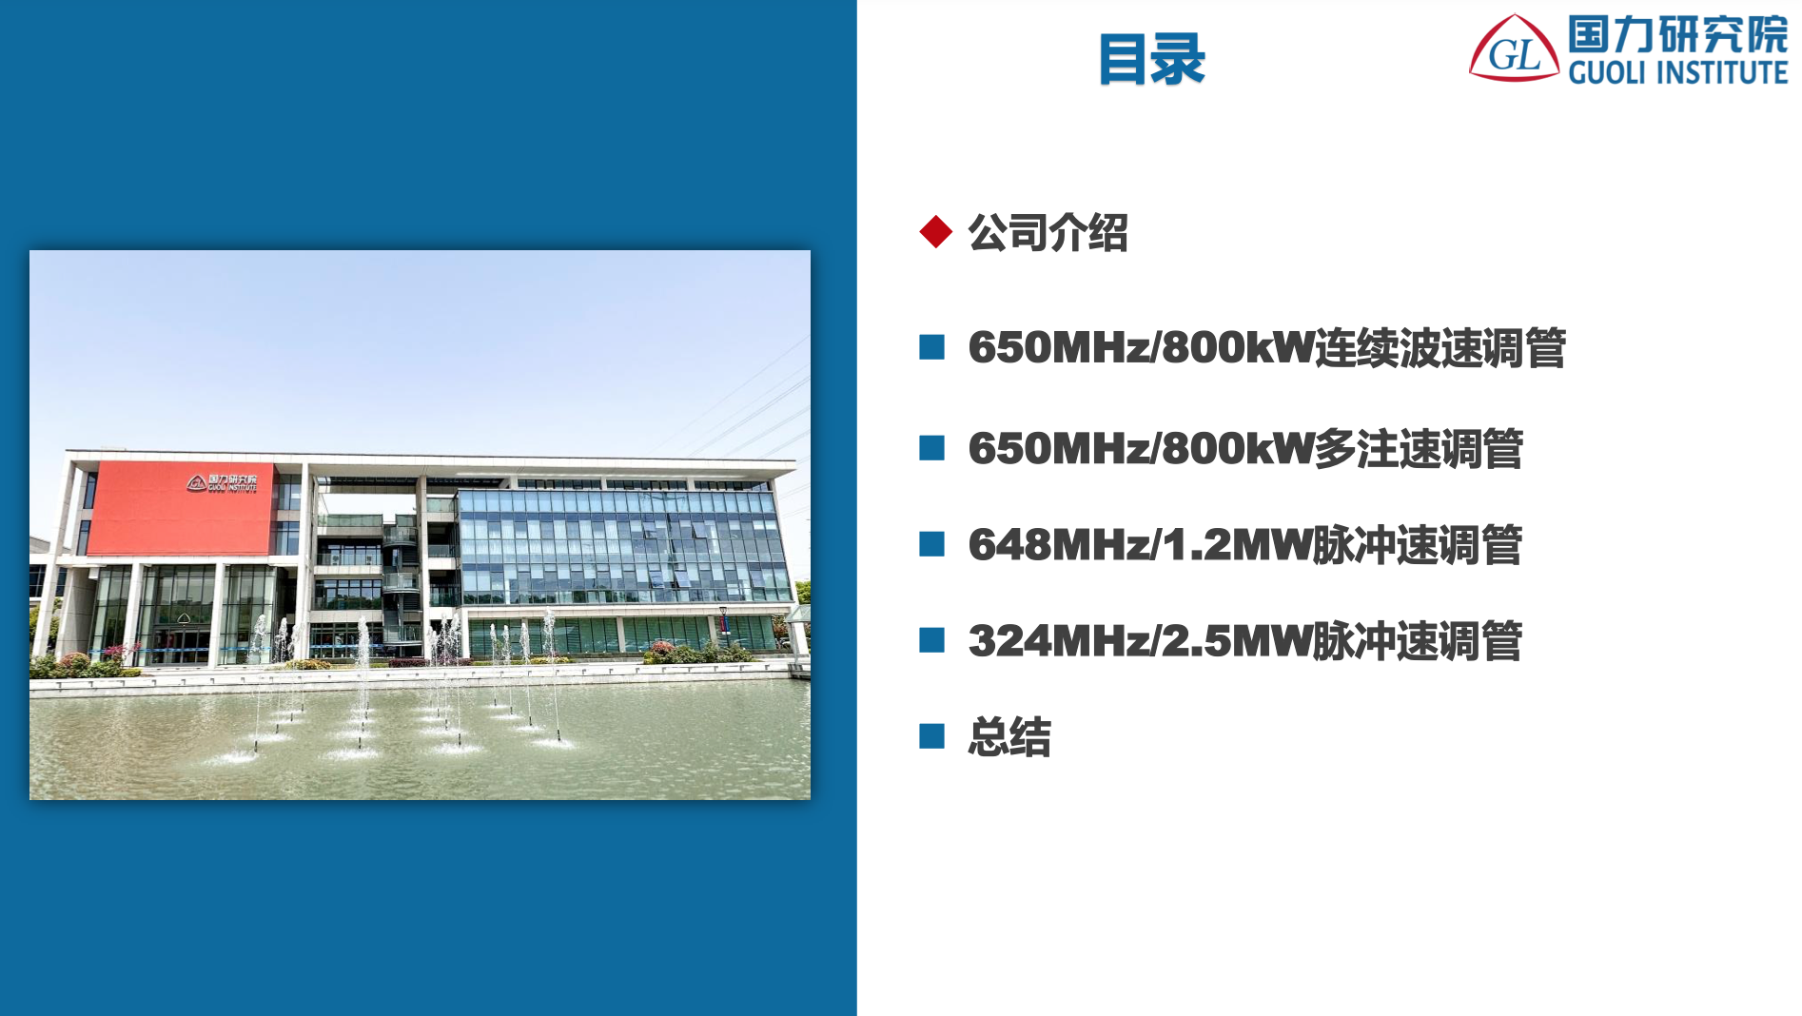

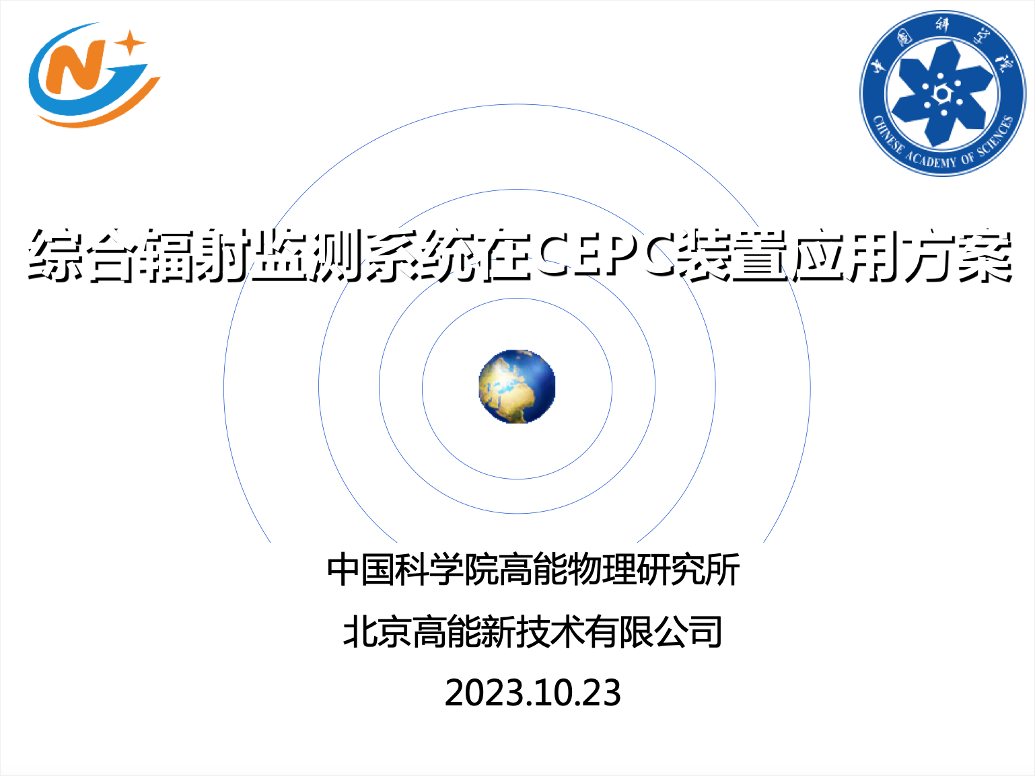
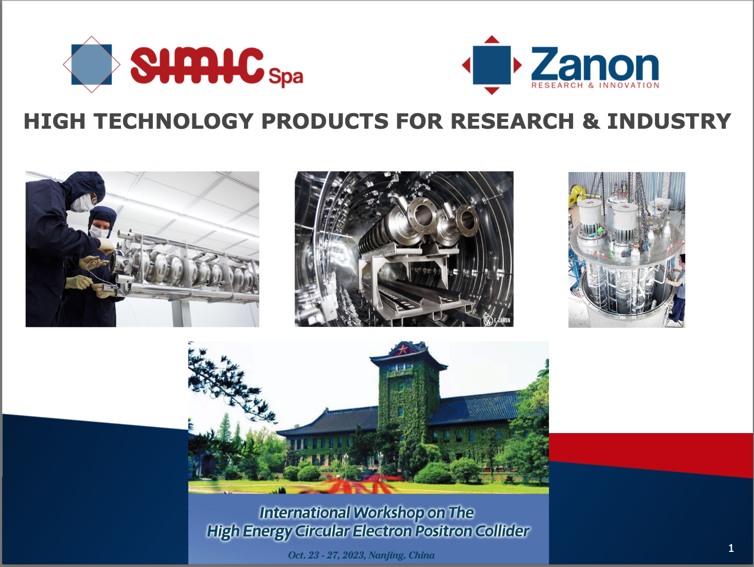
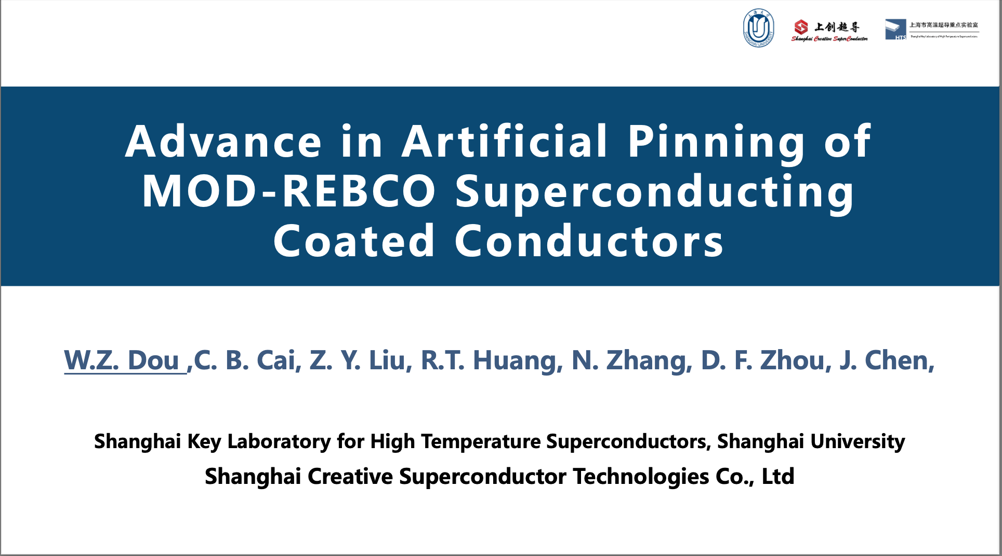
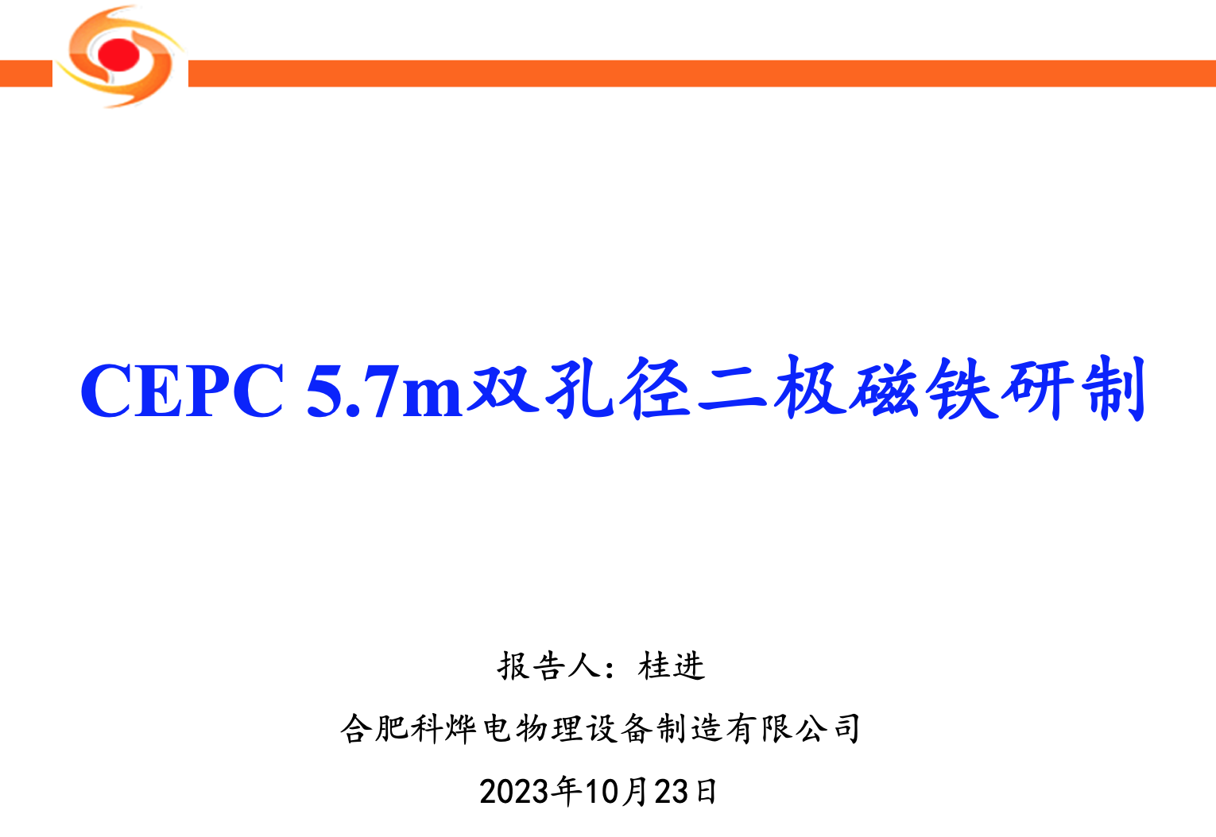
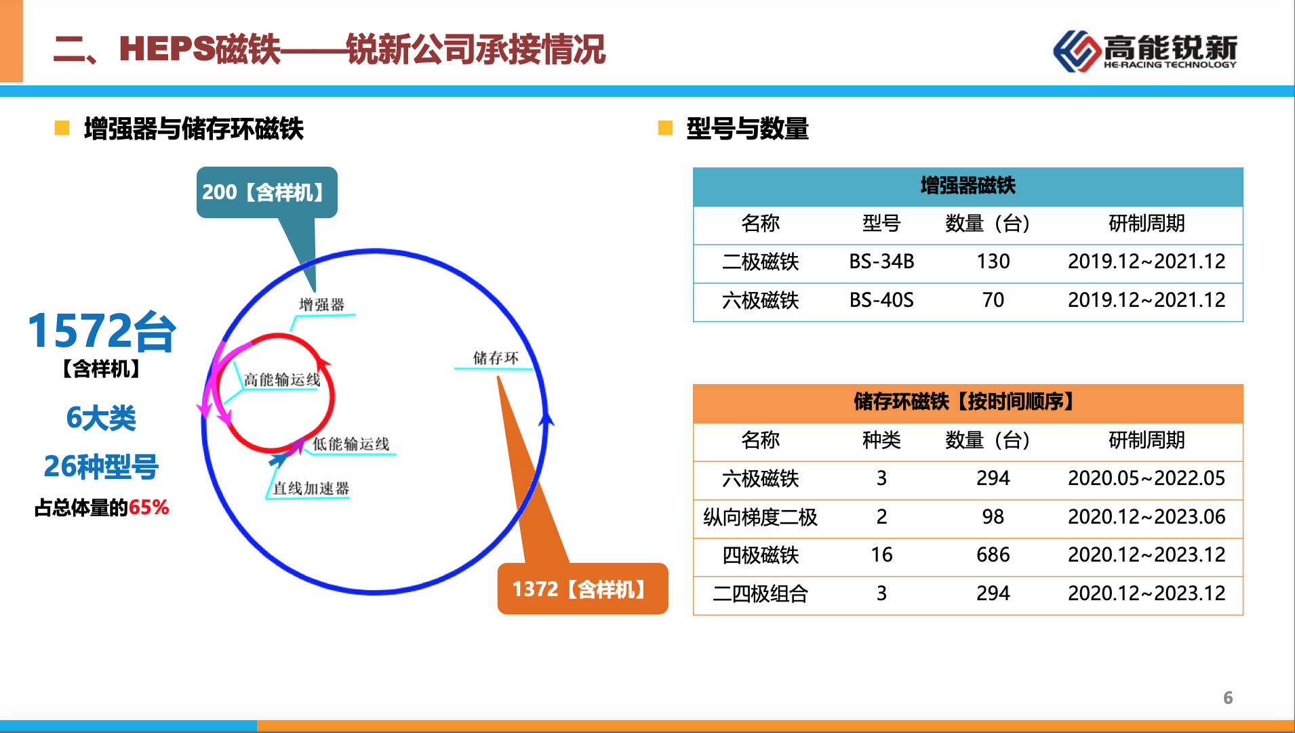
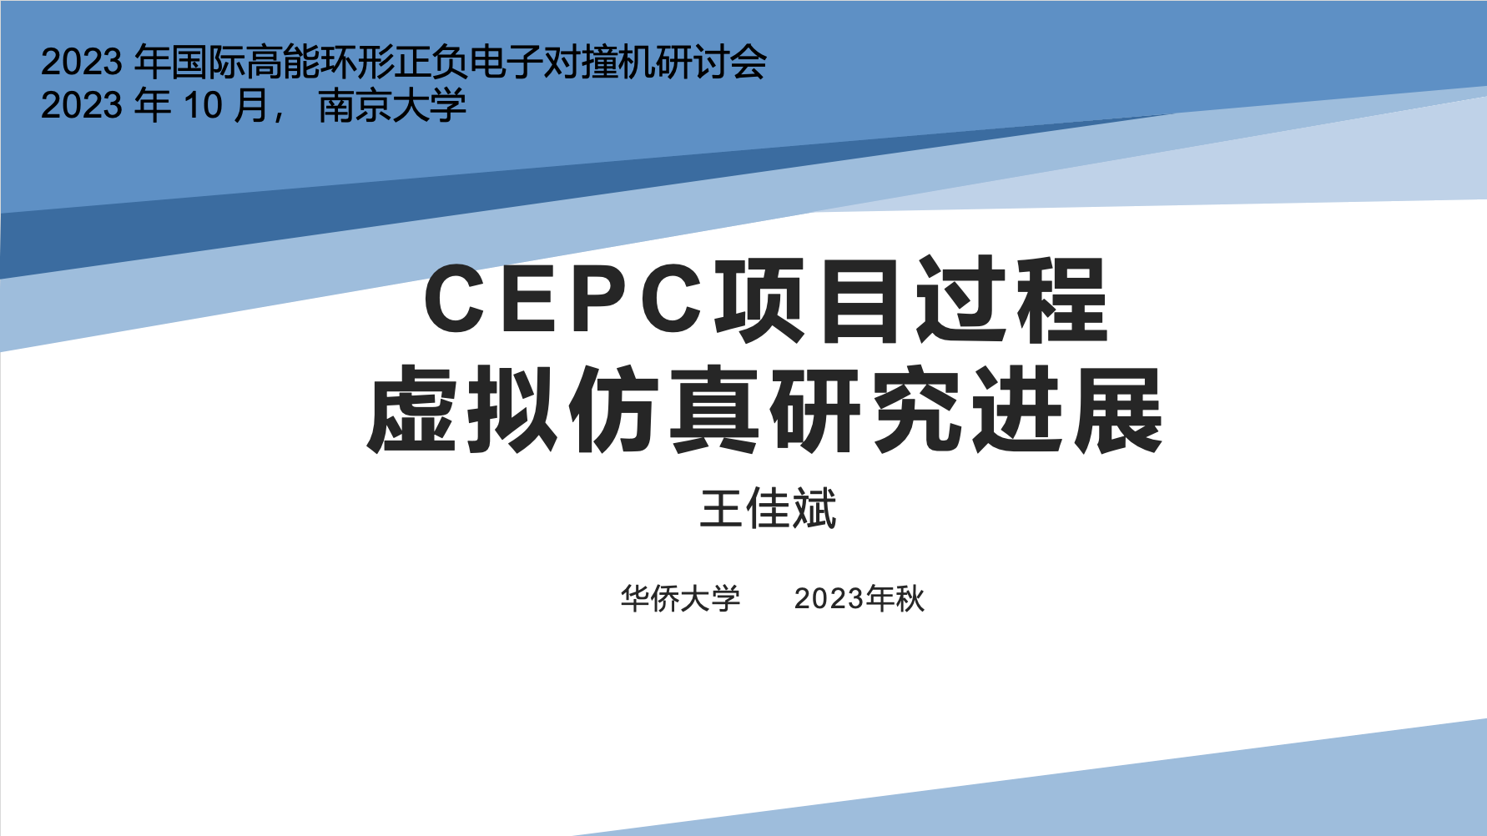
Parts of CIPC talks in CEPC 2023
Klystron
Radiation Protection
SRF
Alignment and Survey
Magnet fabrication
Logistics
HTS magnet

Slide 12
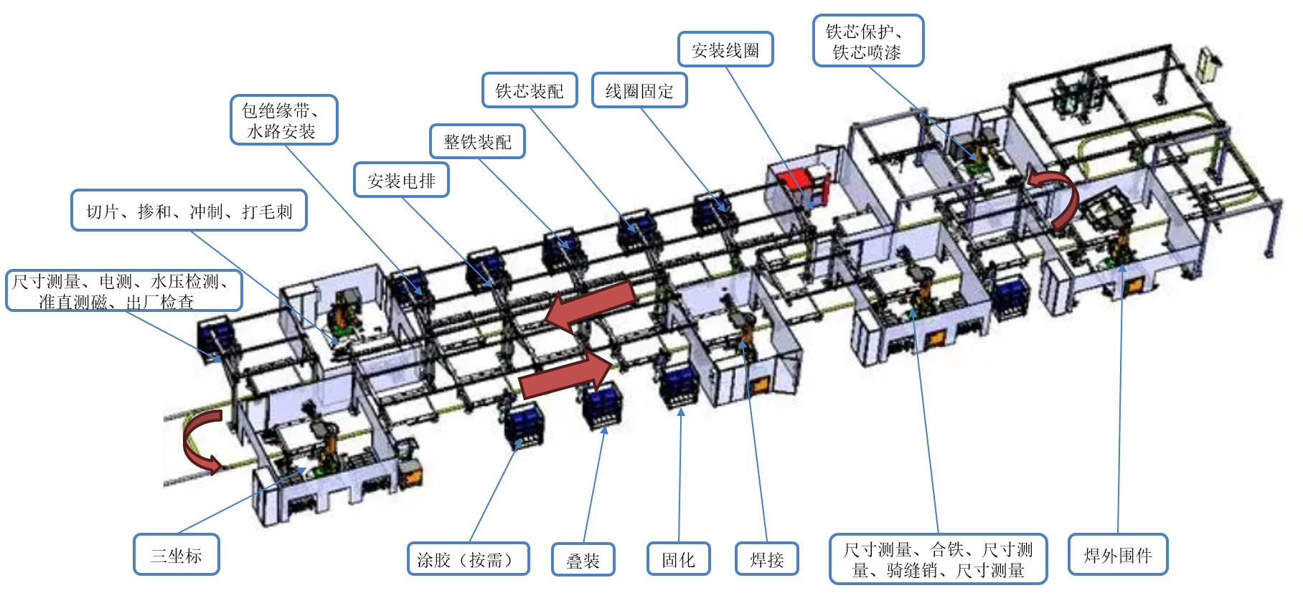
Equipment for efficiency industrial production
The Magnets’ automatic fabrication line is under study with collaboration of one of CIPC members，Herace company.
Main factors of initial cost, benefits, efficiency were assessed.
The concept design was finished and will be demonstrated in EDR and used during construction .

Slide 13


      Development of digital tools for follow-up
New home-developed intelligent big data engineering management solution was developed by one of CIPC partner Huadong Engineering Company
a low-code development platform to create an application
intelligent data governance services

Slide 14
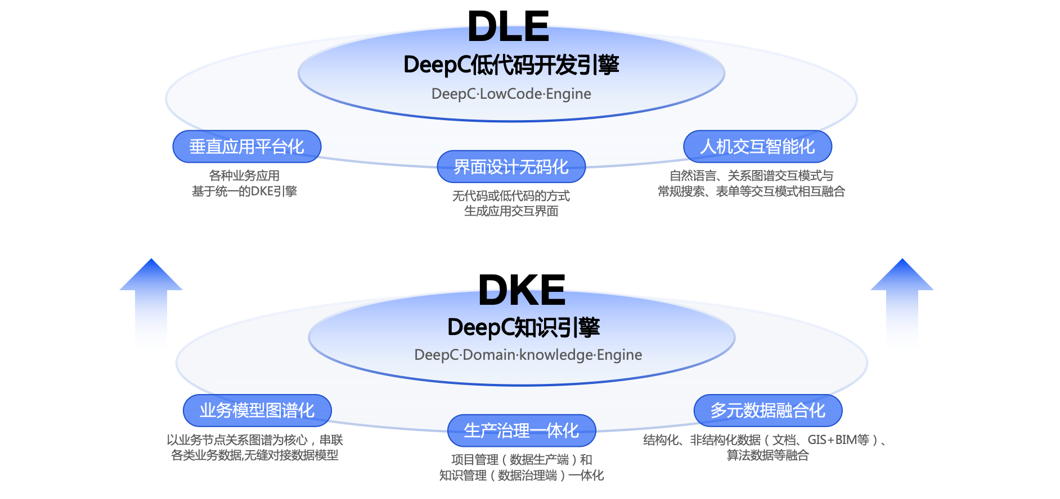
Short introduction
DLE: Low-code-engine. The ability to develop no-code applications for complex business scenarios throughout the entire engineering lifecycle.
DKE: DeepC domain knowledge engine.
  using knowledge graph to unify business models and data models;
  the ability to integrate engineering multi-source data;
  the knowledge service capability based on graph reasoning, generate AI question-answer service.

Slide 15

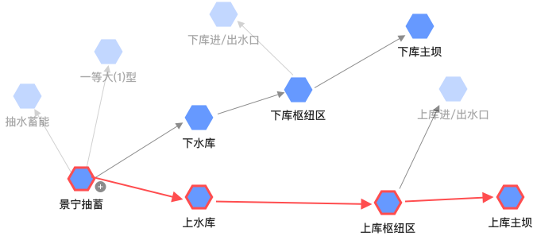
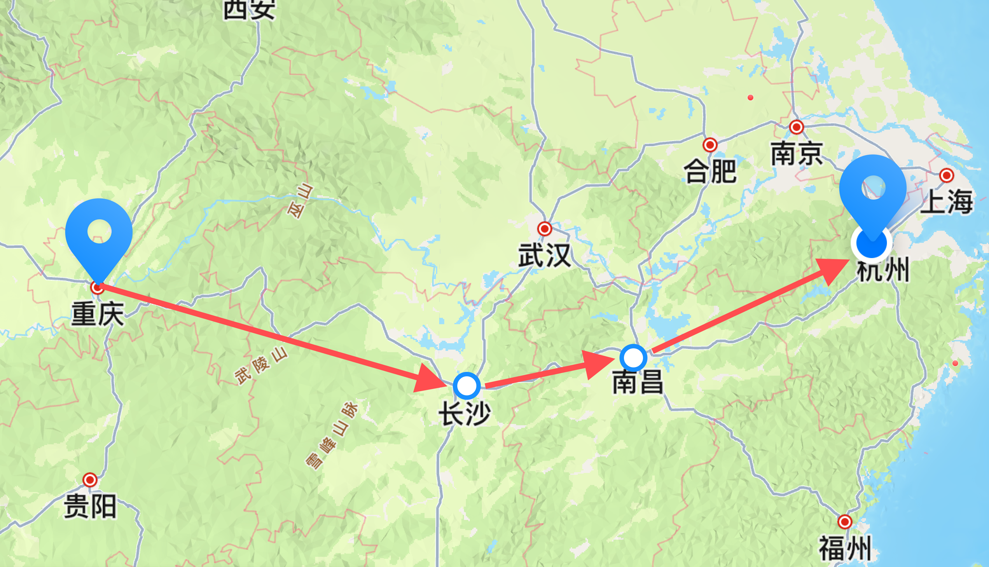


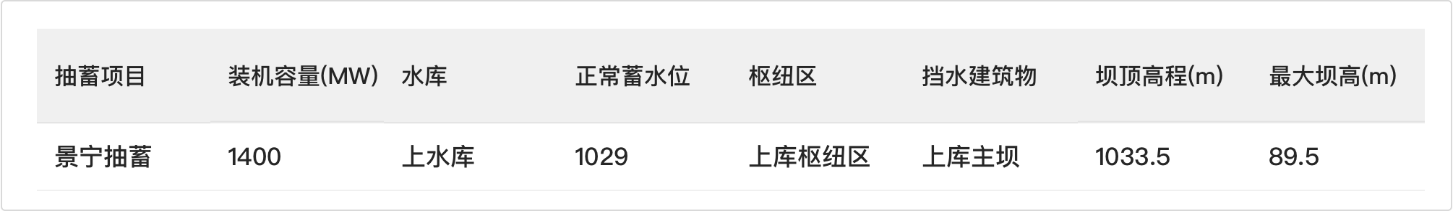
DKE Engine Example
Using knowledge graph, it can connect business models, data models, and interaction patterns.
Ask: what maximum heigh of a hydropower Dam?
AI-powered interaction mode: natural language questioning and graph display
The exploration of business model paths like exploring map routes
Logic expression based on knowledge graph.
hydropower station
Upstream
reservoir
Upstream
hub
Upstream
Dam
Quickly obtain the desired information through the table structure: maximum dam height 89.5m
Use graph database to convert graph database into table structure.

Slide 16

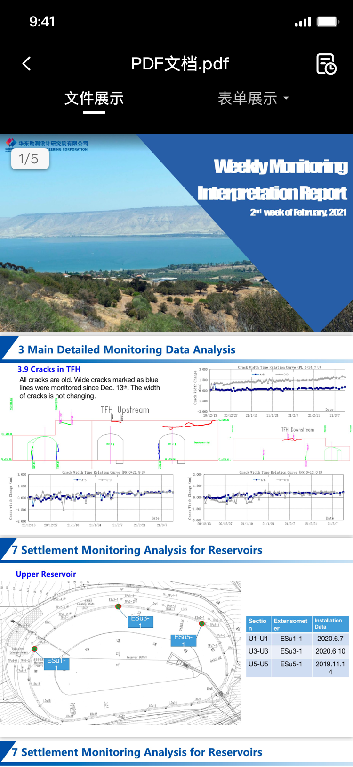

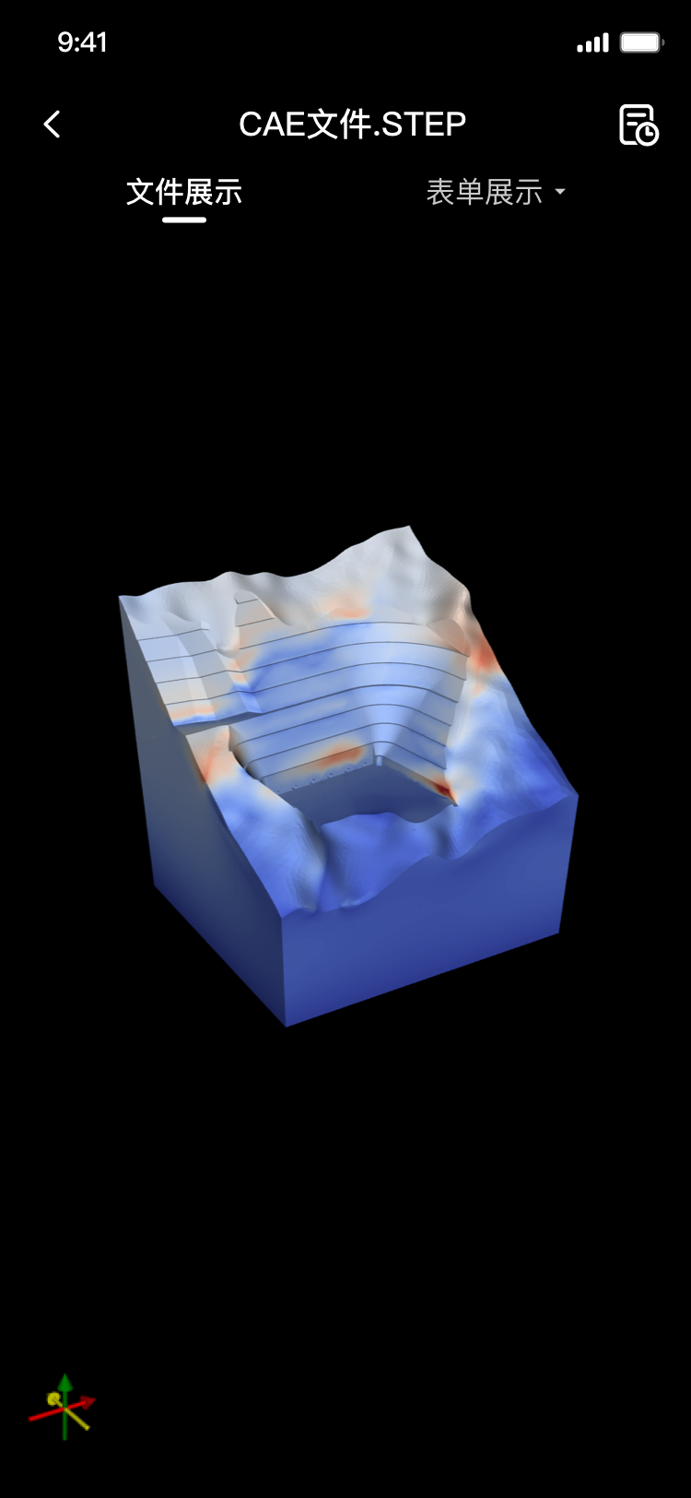
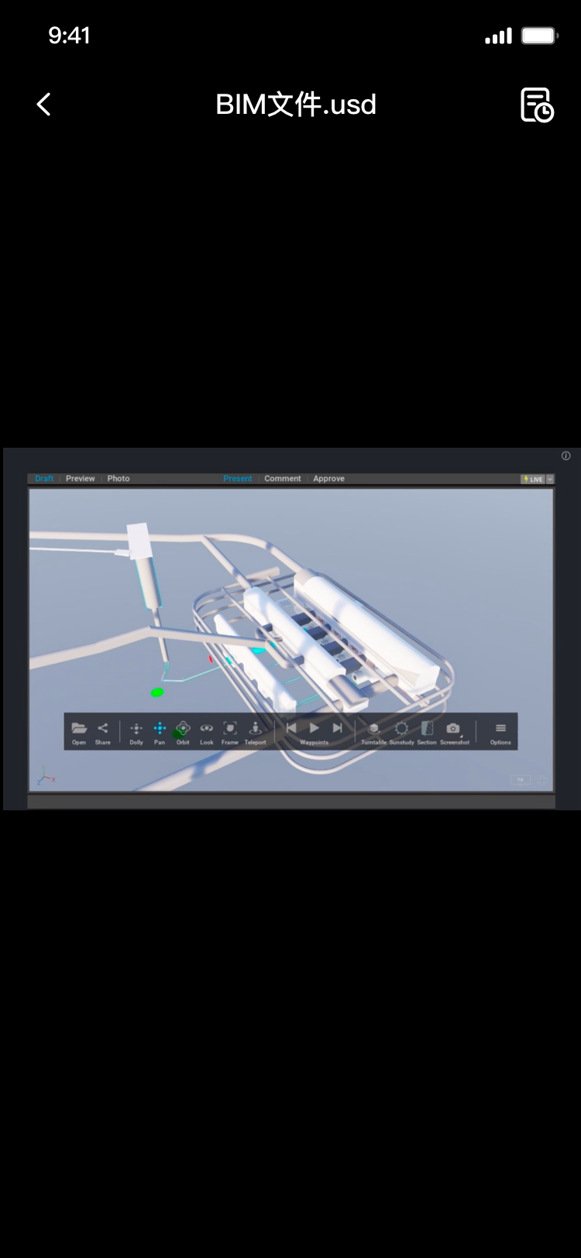






Through this engine, multiple file formats can be browsed.
PDF / office
Video or pictures
CAE
BIM

Slide 17
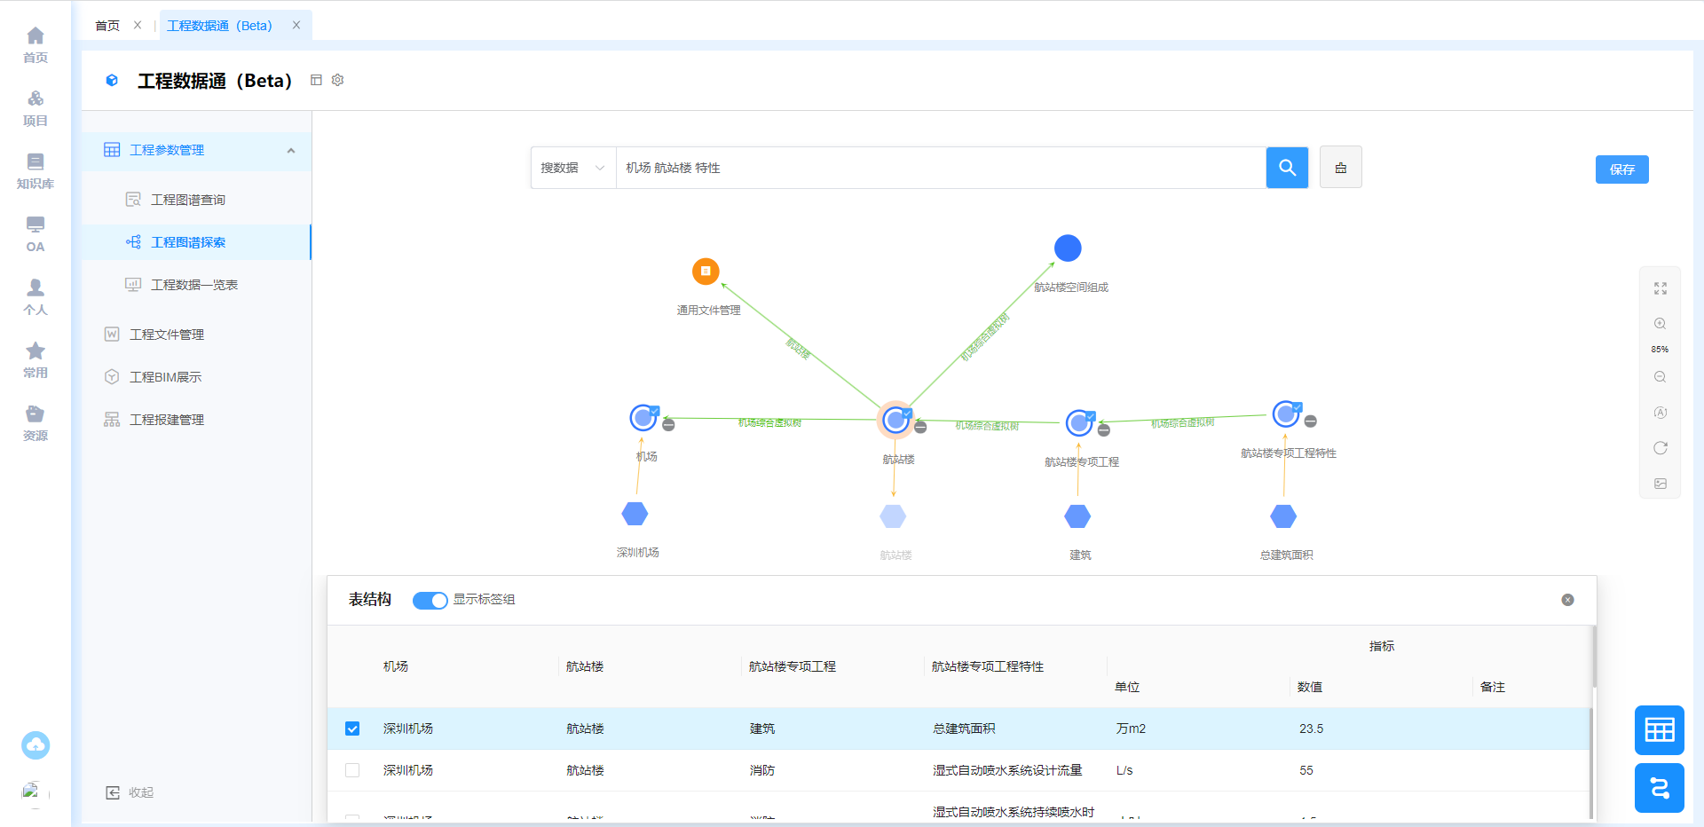
Application example: Engineer Parameters management
Graphical display of key engineering parameters

Slide 18
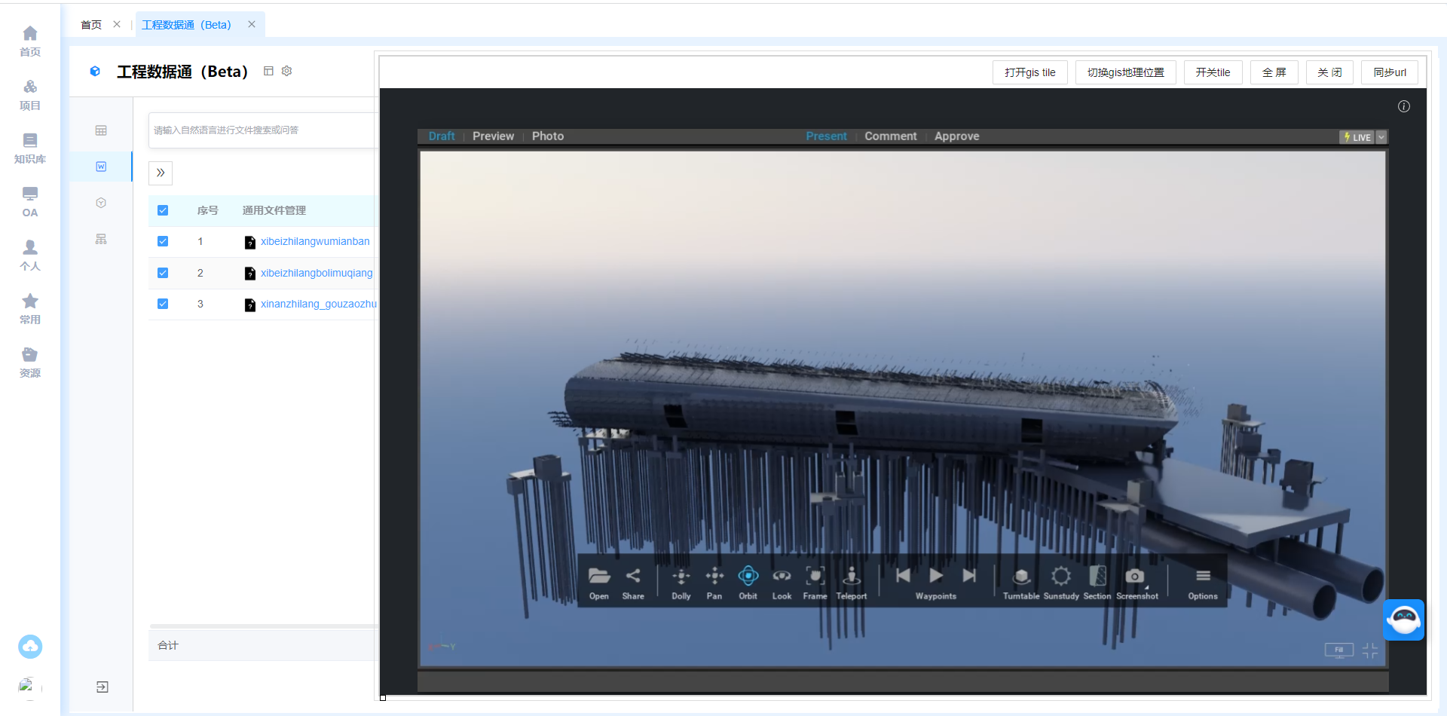
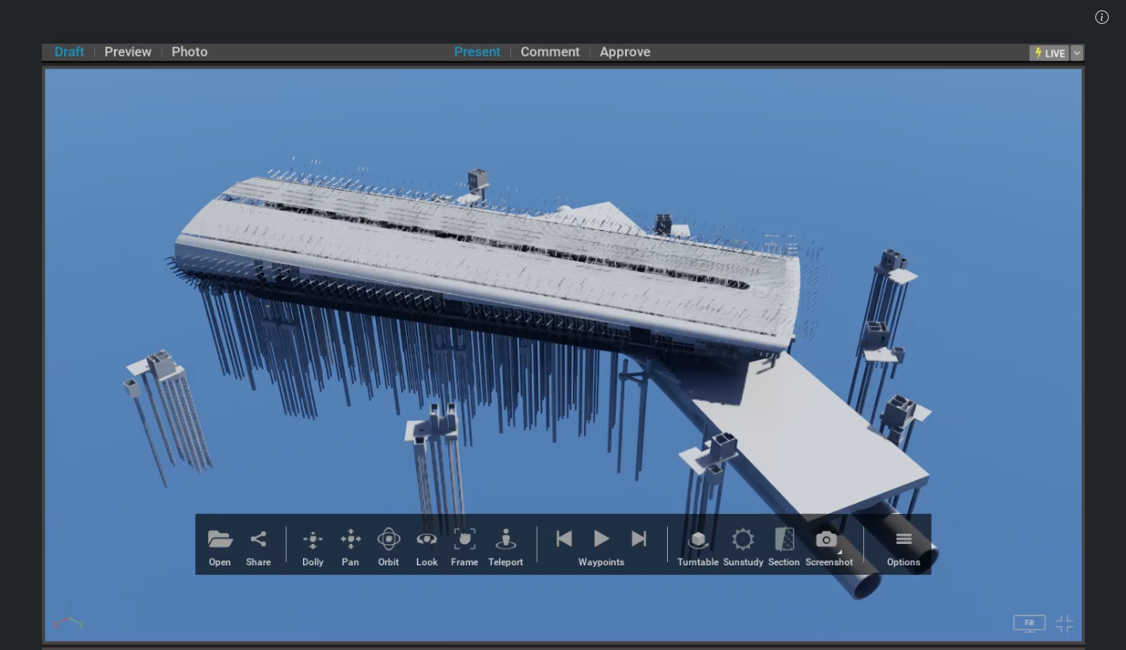
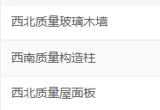
Building Information Modeling（BIM) Display
  Management of parameters and model separation
  Consistent management of models and files
  Automatic location update of components

Slide 19

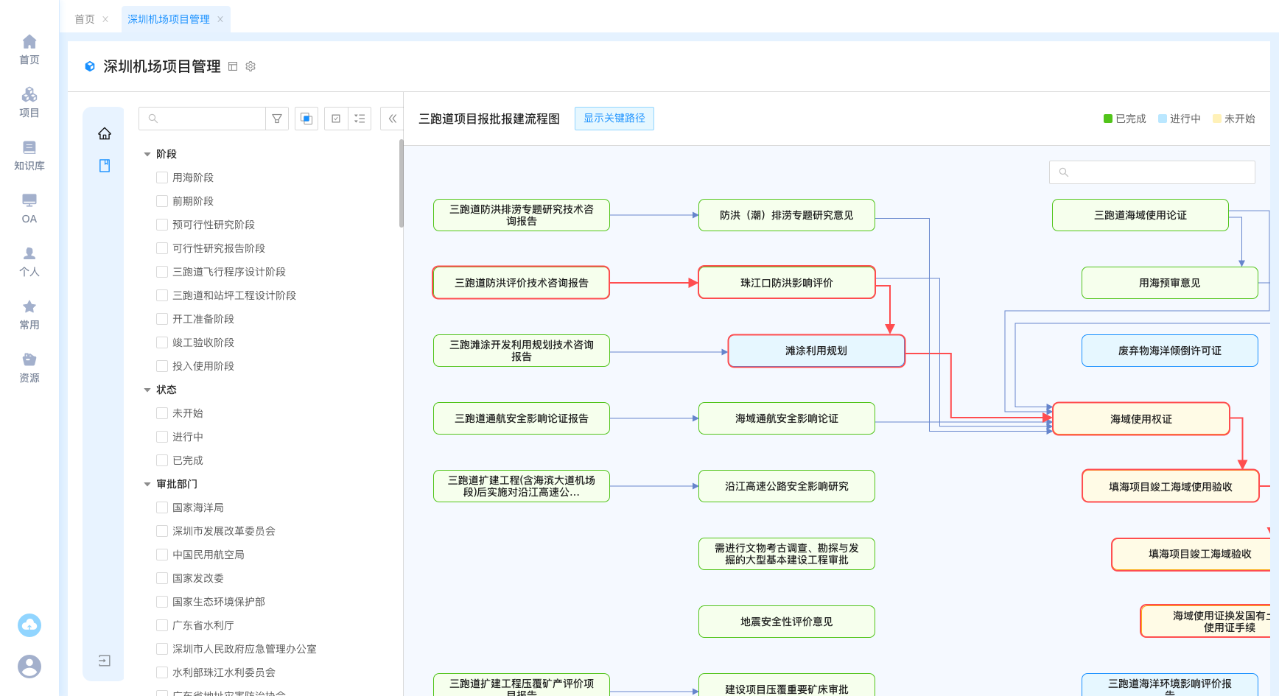
The progress flow management: automatedly created from multiple WBS processes.
The critical path can be clearly visible
Complete
On going
Will begin
Notes:
WBS work breakdown structure

Slide 20
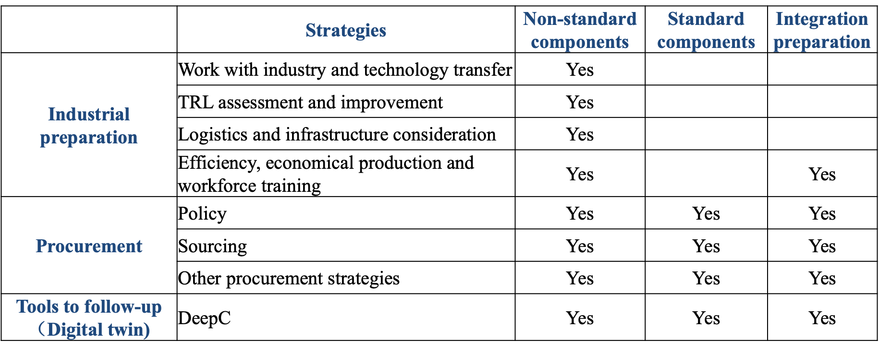
3. Procurement strategy study
Procurement plays a crucial role in the establishment and ongoing operation of large research infrastructure.

Slide 21
What is a Procurement Strategy
A procurement strategy could be defined as a long-term plan to acquire the necessary resources and supplies for production.
It depends on several factors, including purchase timeline, budget, the risk associated, cost of ownership, and so on.
Besides，policies including monitor and key indicators are necessary，
  Use KPIs (Key Performance Indicators) to measure the success of operations related to costs, processing time, amount of stock, etc.
  With these critical indicators, you can know about your perfection, understand the deviations and take corrective steps to overcome them.

Slide 22
Purpose and types of Procurement Strategies
For the purpose, the direct reasons for the implementation of these strategies include:
  Making sources available for production
  Minimizing the cost of production
  Evaluating the performances and effectiveness
  Maximizing quality of goods produced
  Automating the process through tools and software
  Build connections with the stakeholders associated with the process
  Ensuring products are delivered on time
  Enabling growth mutually

Slide 23
Methods for cost reduction
For the cost reduction, there are some key points：
  Cost Reduction: involves cost savings in the overall production process that includes negotiation of terms, administrative and operational expenses, automated tools, and intelligent use of data. And, the competitive method is the main means.
  Risk and Supply Chain Management： Risks can be both businesses as well as environmental risks.
  Green Purchasing： It highlights the use of recycled and purchasing products for a balanced environment.
  Global Sourcing
  Total Quality Management

Slide 24
Sourcing methods
However, many accelerator components are often highly specialized, which would limit the number of available industrial producers. Sourcing with various ways will be necessary.
One potential solution involves breaking down components into more common design sub-components to expand the pool of potential vendors. Identifying subcontractors, categorizing these sub-components, and issuing project-level bids can also increase the number of vendors and help reduce costs.
Organizing industrial gatherings with global presentations and engaging in discussions with project engineers is another effective approach.
The transfer of technology and knowledge represents one of the project's most valuable assets.

Slide 25
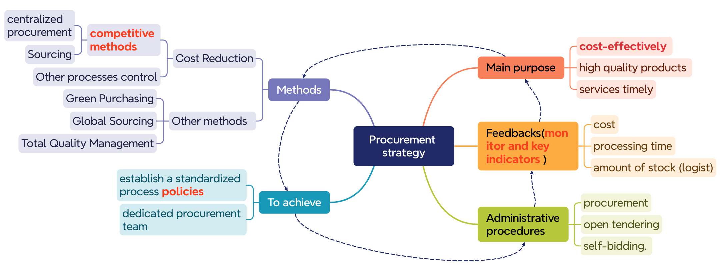
Multiple-dimension view for procurement strategy

Slide 26
4. Summary and plan in EDR
The industrial preparation have been well going on, and the procurement strategy is discussed.
But many works are still needed in EDR, including:
  Continue involvement of the industry with sourcing campaigns.
  Assess and continue improve Technology Readiness Levels.
  Improve the application of the software platform DeepC
  Well-defined industrial production schedule and cost baselines.
  A robust industrial Product Breakdown Structure (PBS).
  Rigorous procurement strategy is still needed to improved.

Slide 27
Thanks for your attention!

