Slide 1
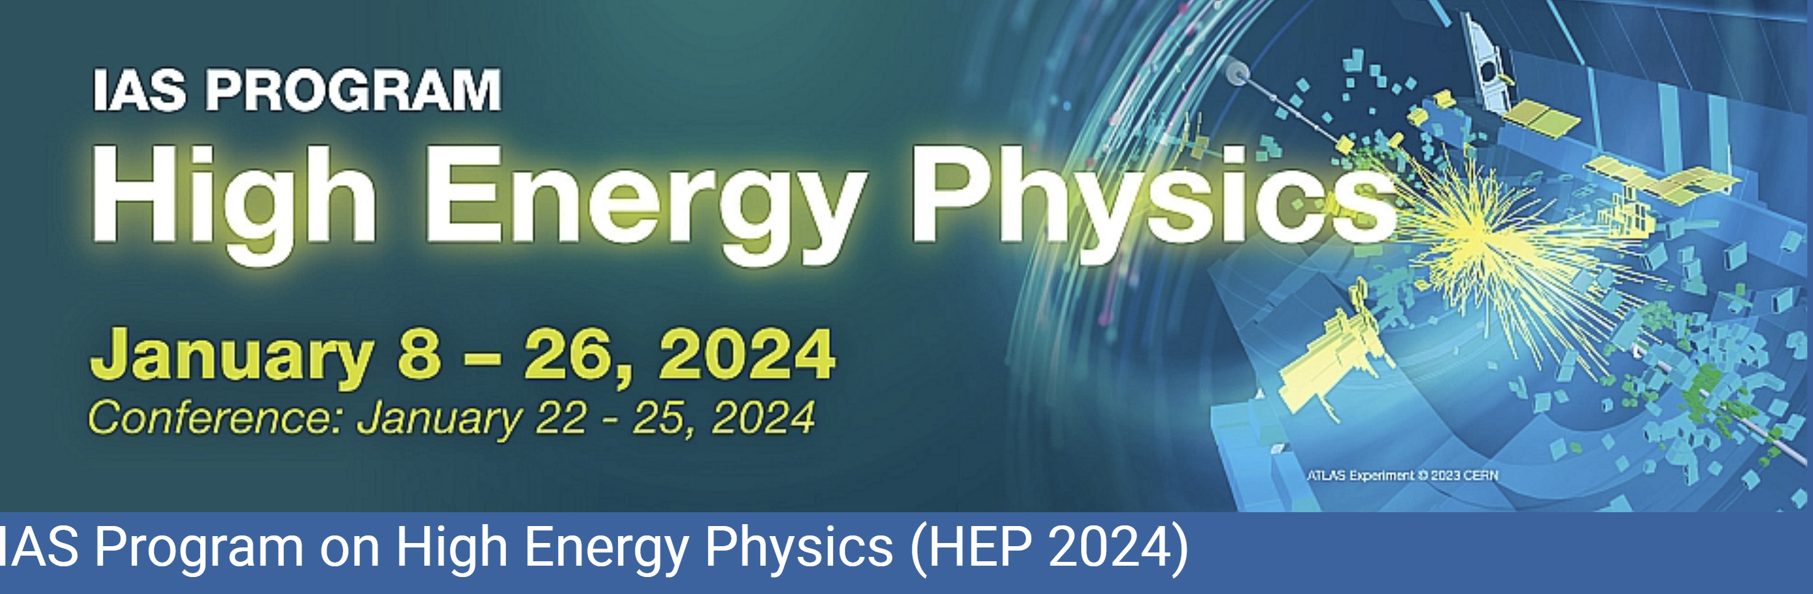
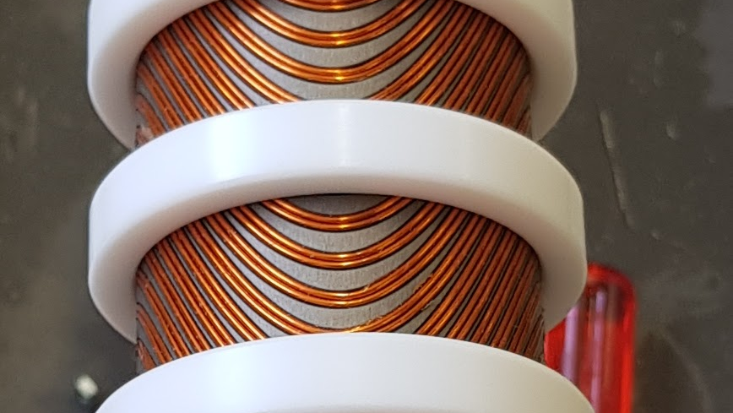


SC Final Focus quadrupoles
M. Koratzinos
23/1/2024

Slide 2
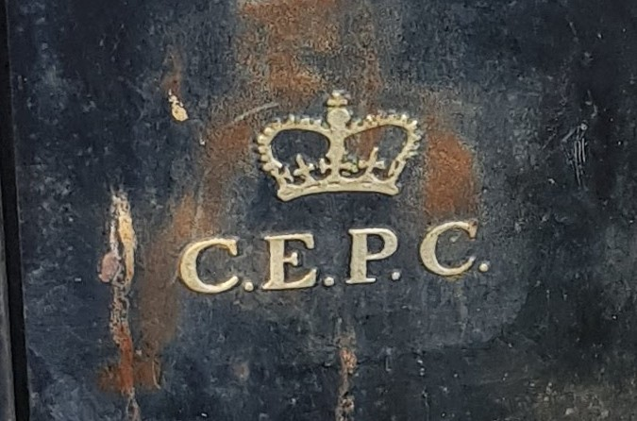
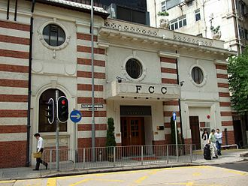

A tale of two projects
CEPC and FCC-ee are the two circular collider future flagship projects with a lot in common and very few differences!

Slide 3
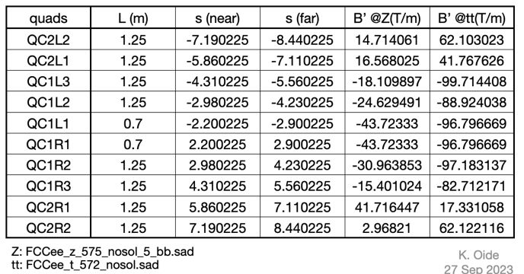
The final focus system of FCC
Three quadrupoles in a cryostat inside the detector (QC1)
Two more (QC2) outside the detector
QC1L1, closest to the IP, is the toughest challenge
  Distance at tip from the other beam is 66mm
  Distance at the other tip is 87mm
There are packaging and integration issues – very little space!

Slide 4
QC1L1
The quad closest to the IP (and closest to its neighbour)
Length 700mm
Strength 100T/m
Inner diameter of the beam pipe: 30mm
A CCT prototype was constructed in 2019
  Length 420mm
  Aperture 40mm
  Strength 100T/m
  Conductor: NbTi (8X0.825mm LHC strand)
  Temperature: 1.9K (superfluid He)

Slide 5
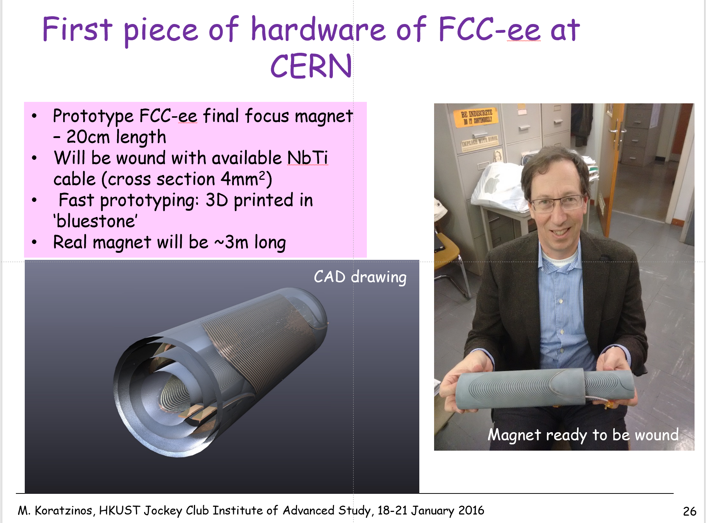
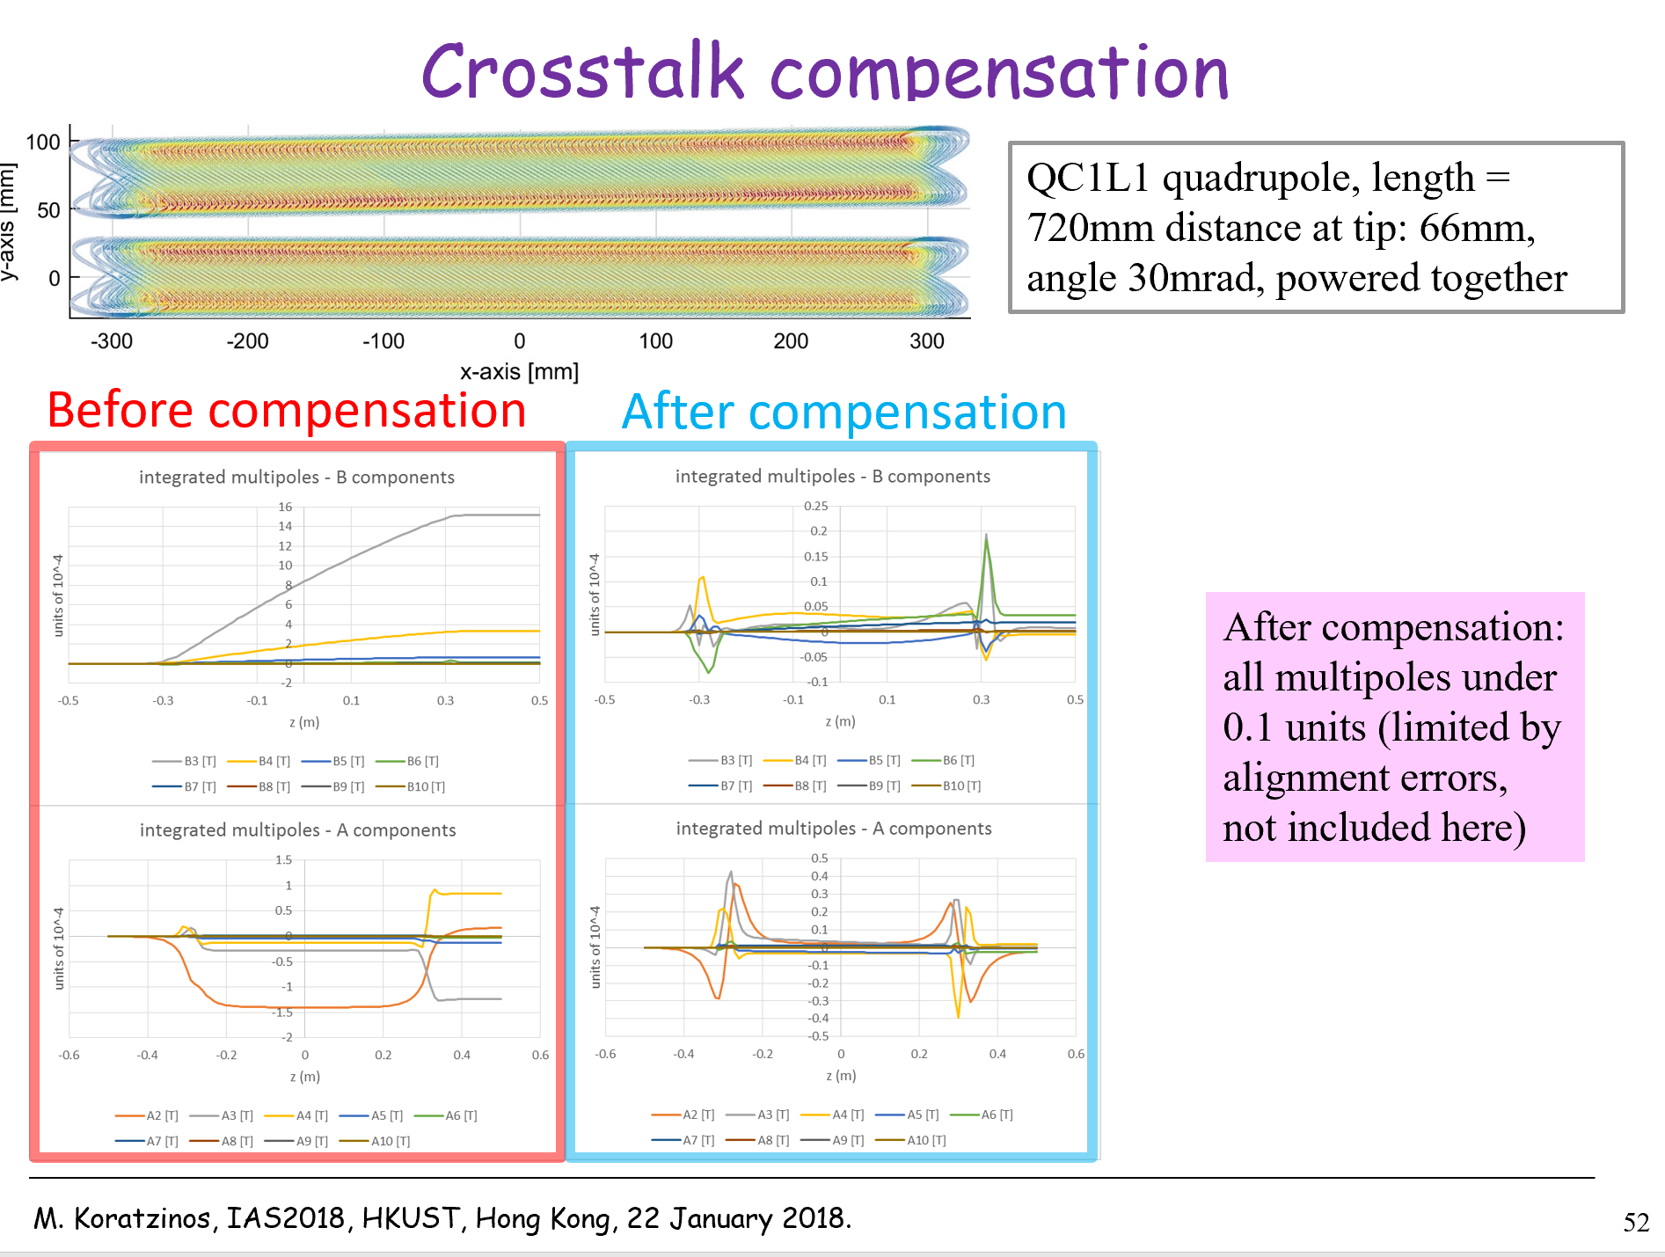
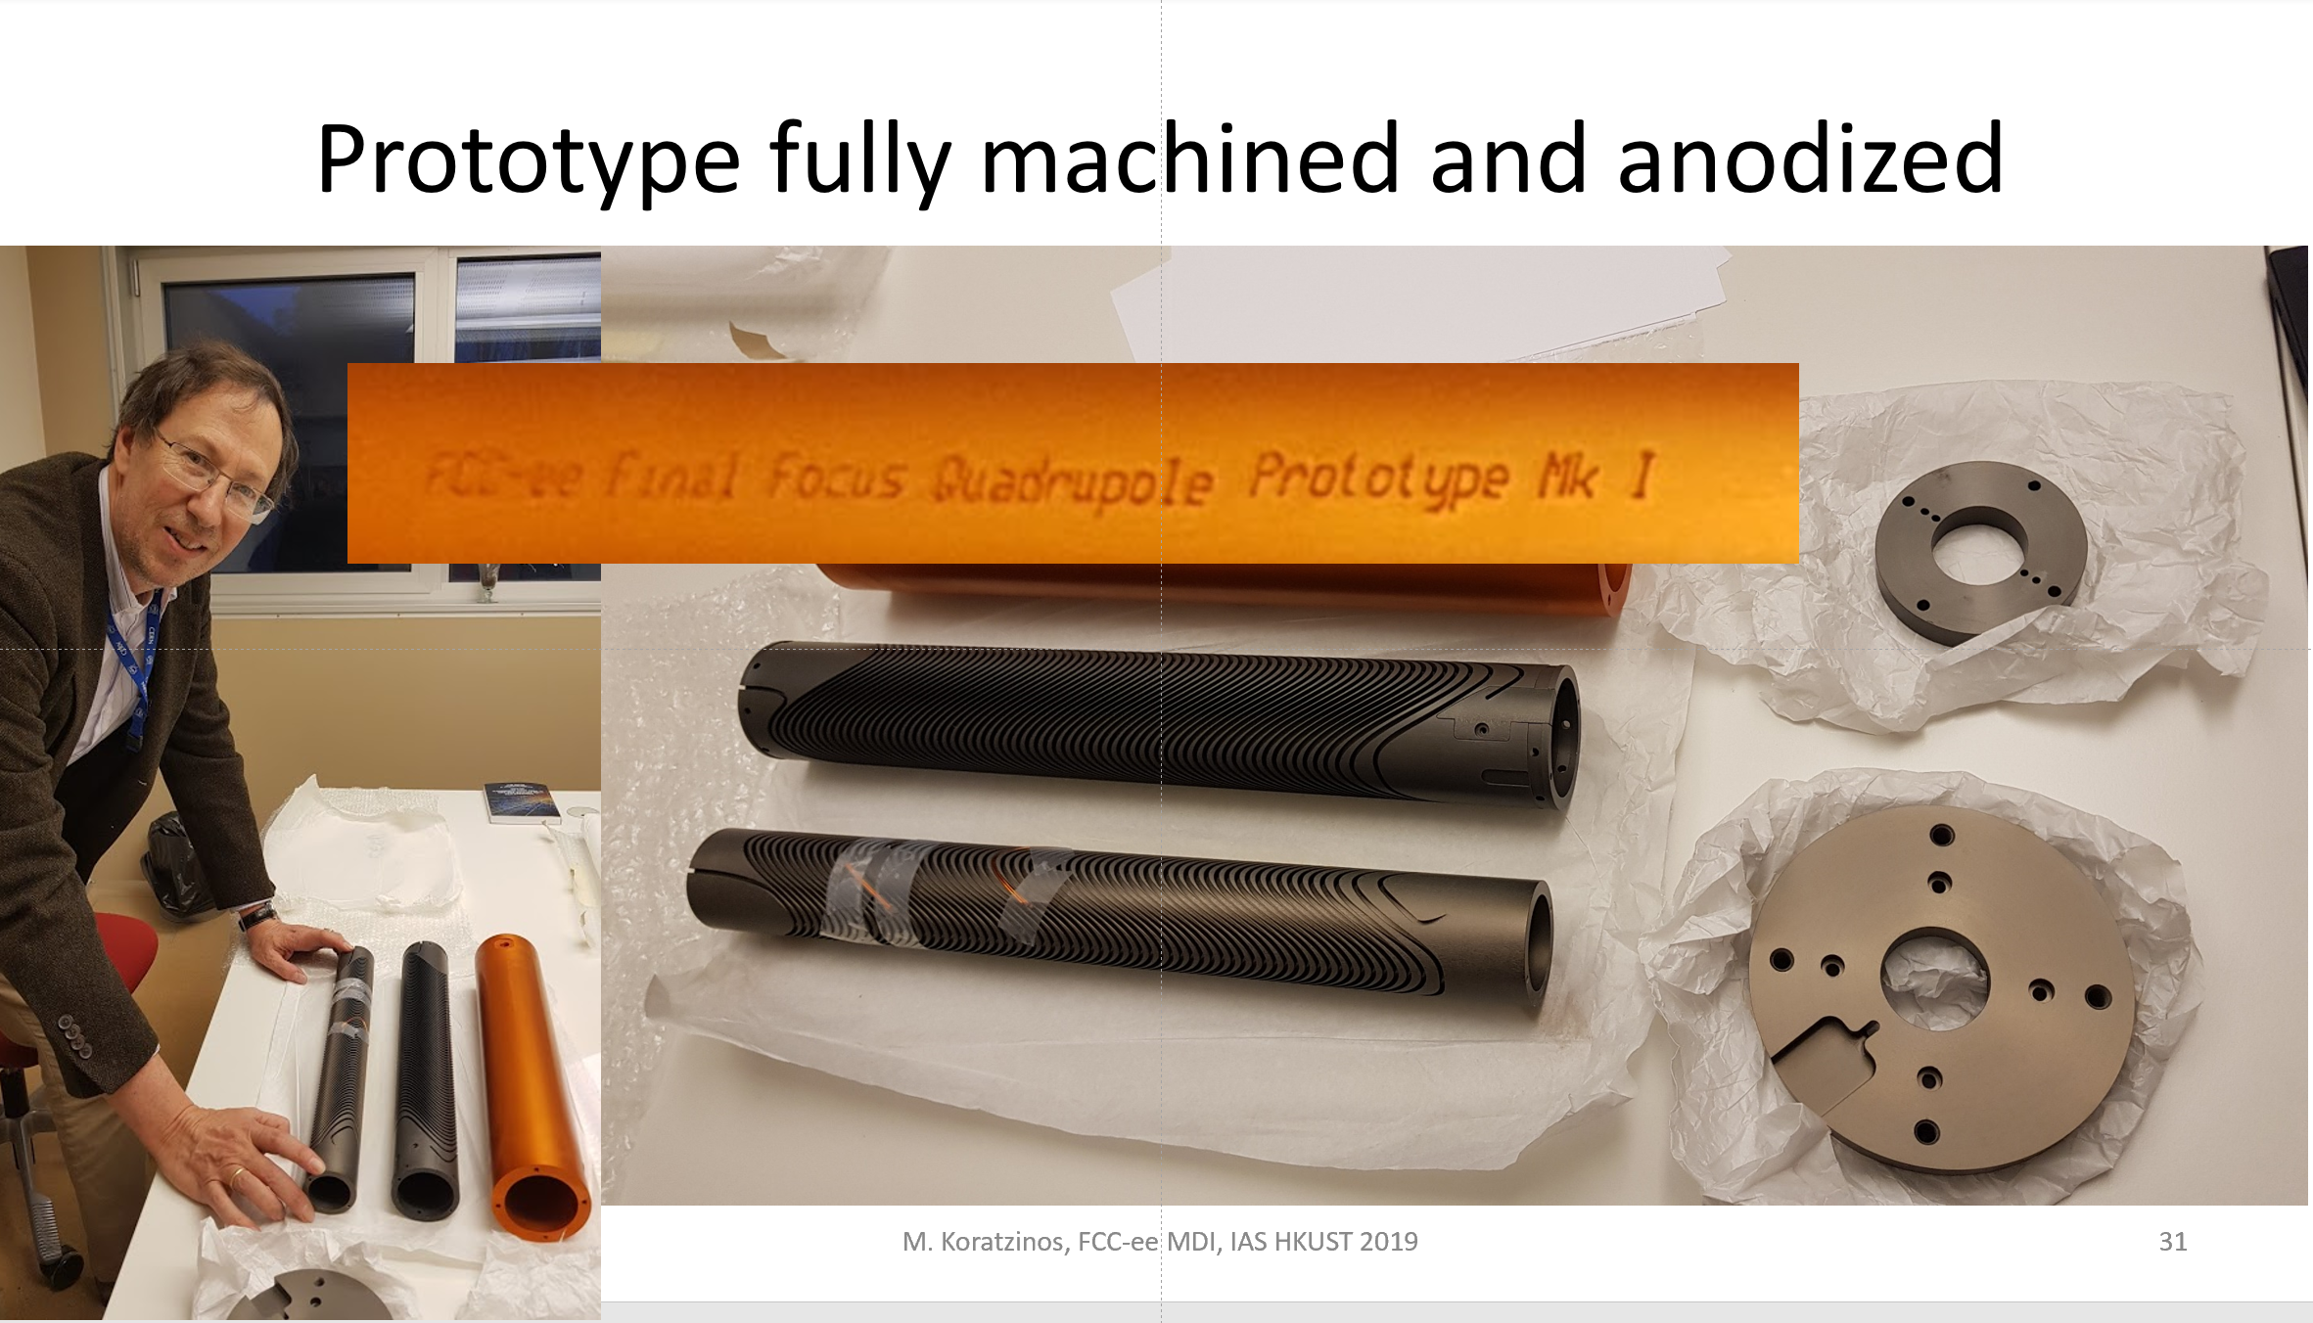
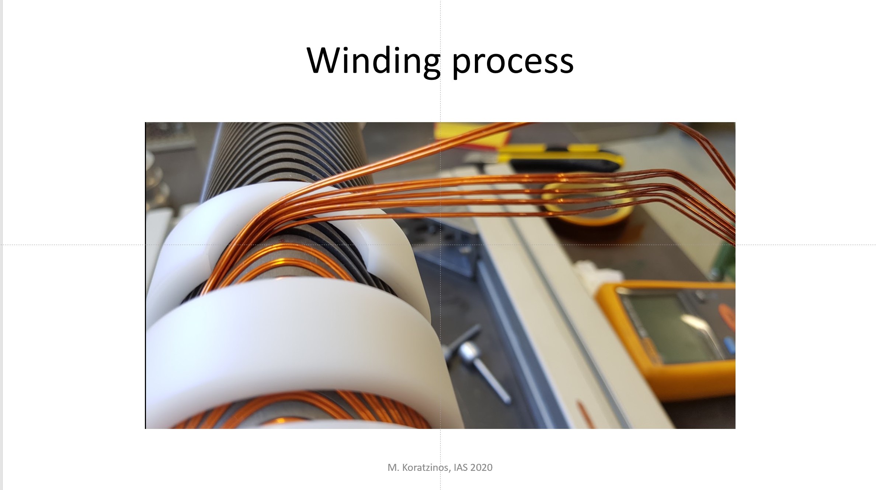
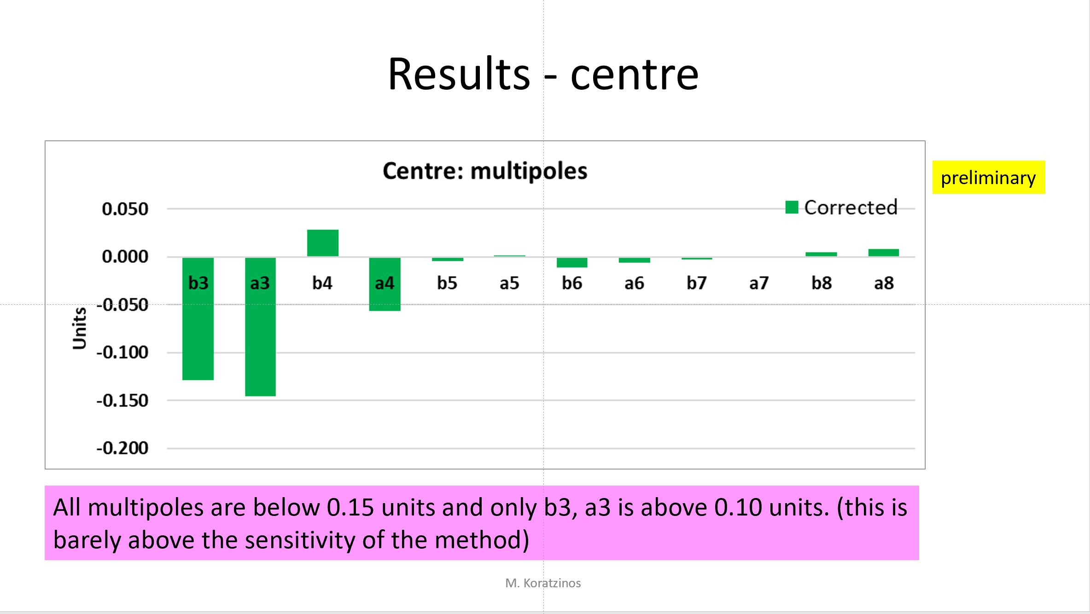
Final Focus quads in IAS conferences
2016
2018
2019
2020
2021
Progress has been reported every year: interesting to see the project from the concept stage to fruition

Slide 6
How to eliminate crosstalk?
Especially for QC1L1, there is very little space between the e+ and e- quadrupoles.
One possible strategy would be to use iron to shield one quad from the other
Is this good enough?
[In this talk I will be talking about “units”. A unit is a multipole that has a magnitude of 1/10,000 of the main multipole (quadrupole in our case)
The briefing we were given by the Optics people is that we should limit ourselves to imperfections of less than 1 unit.
These multipoles are measured at a specific reference radius, traditionally taken to be 2/3 of the aperture. FCC uses 10mm CEPC 7.5mm]

Slide 7
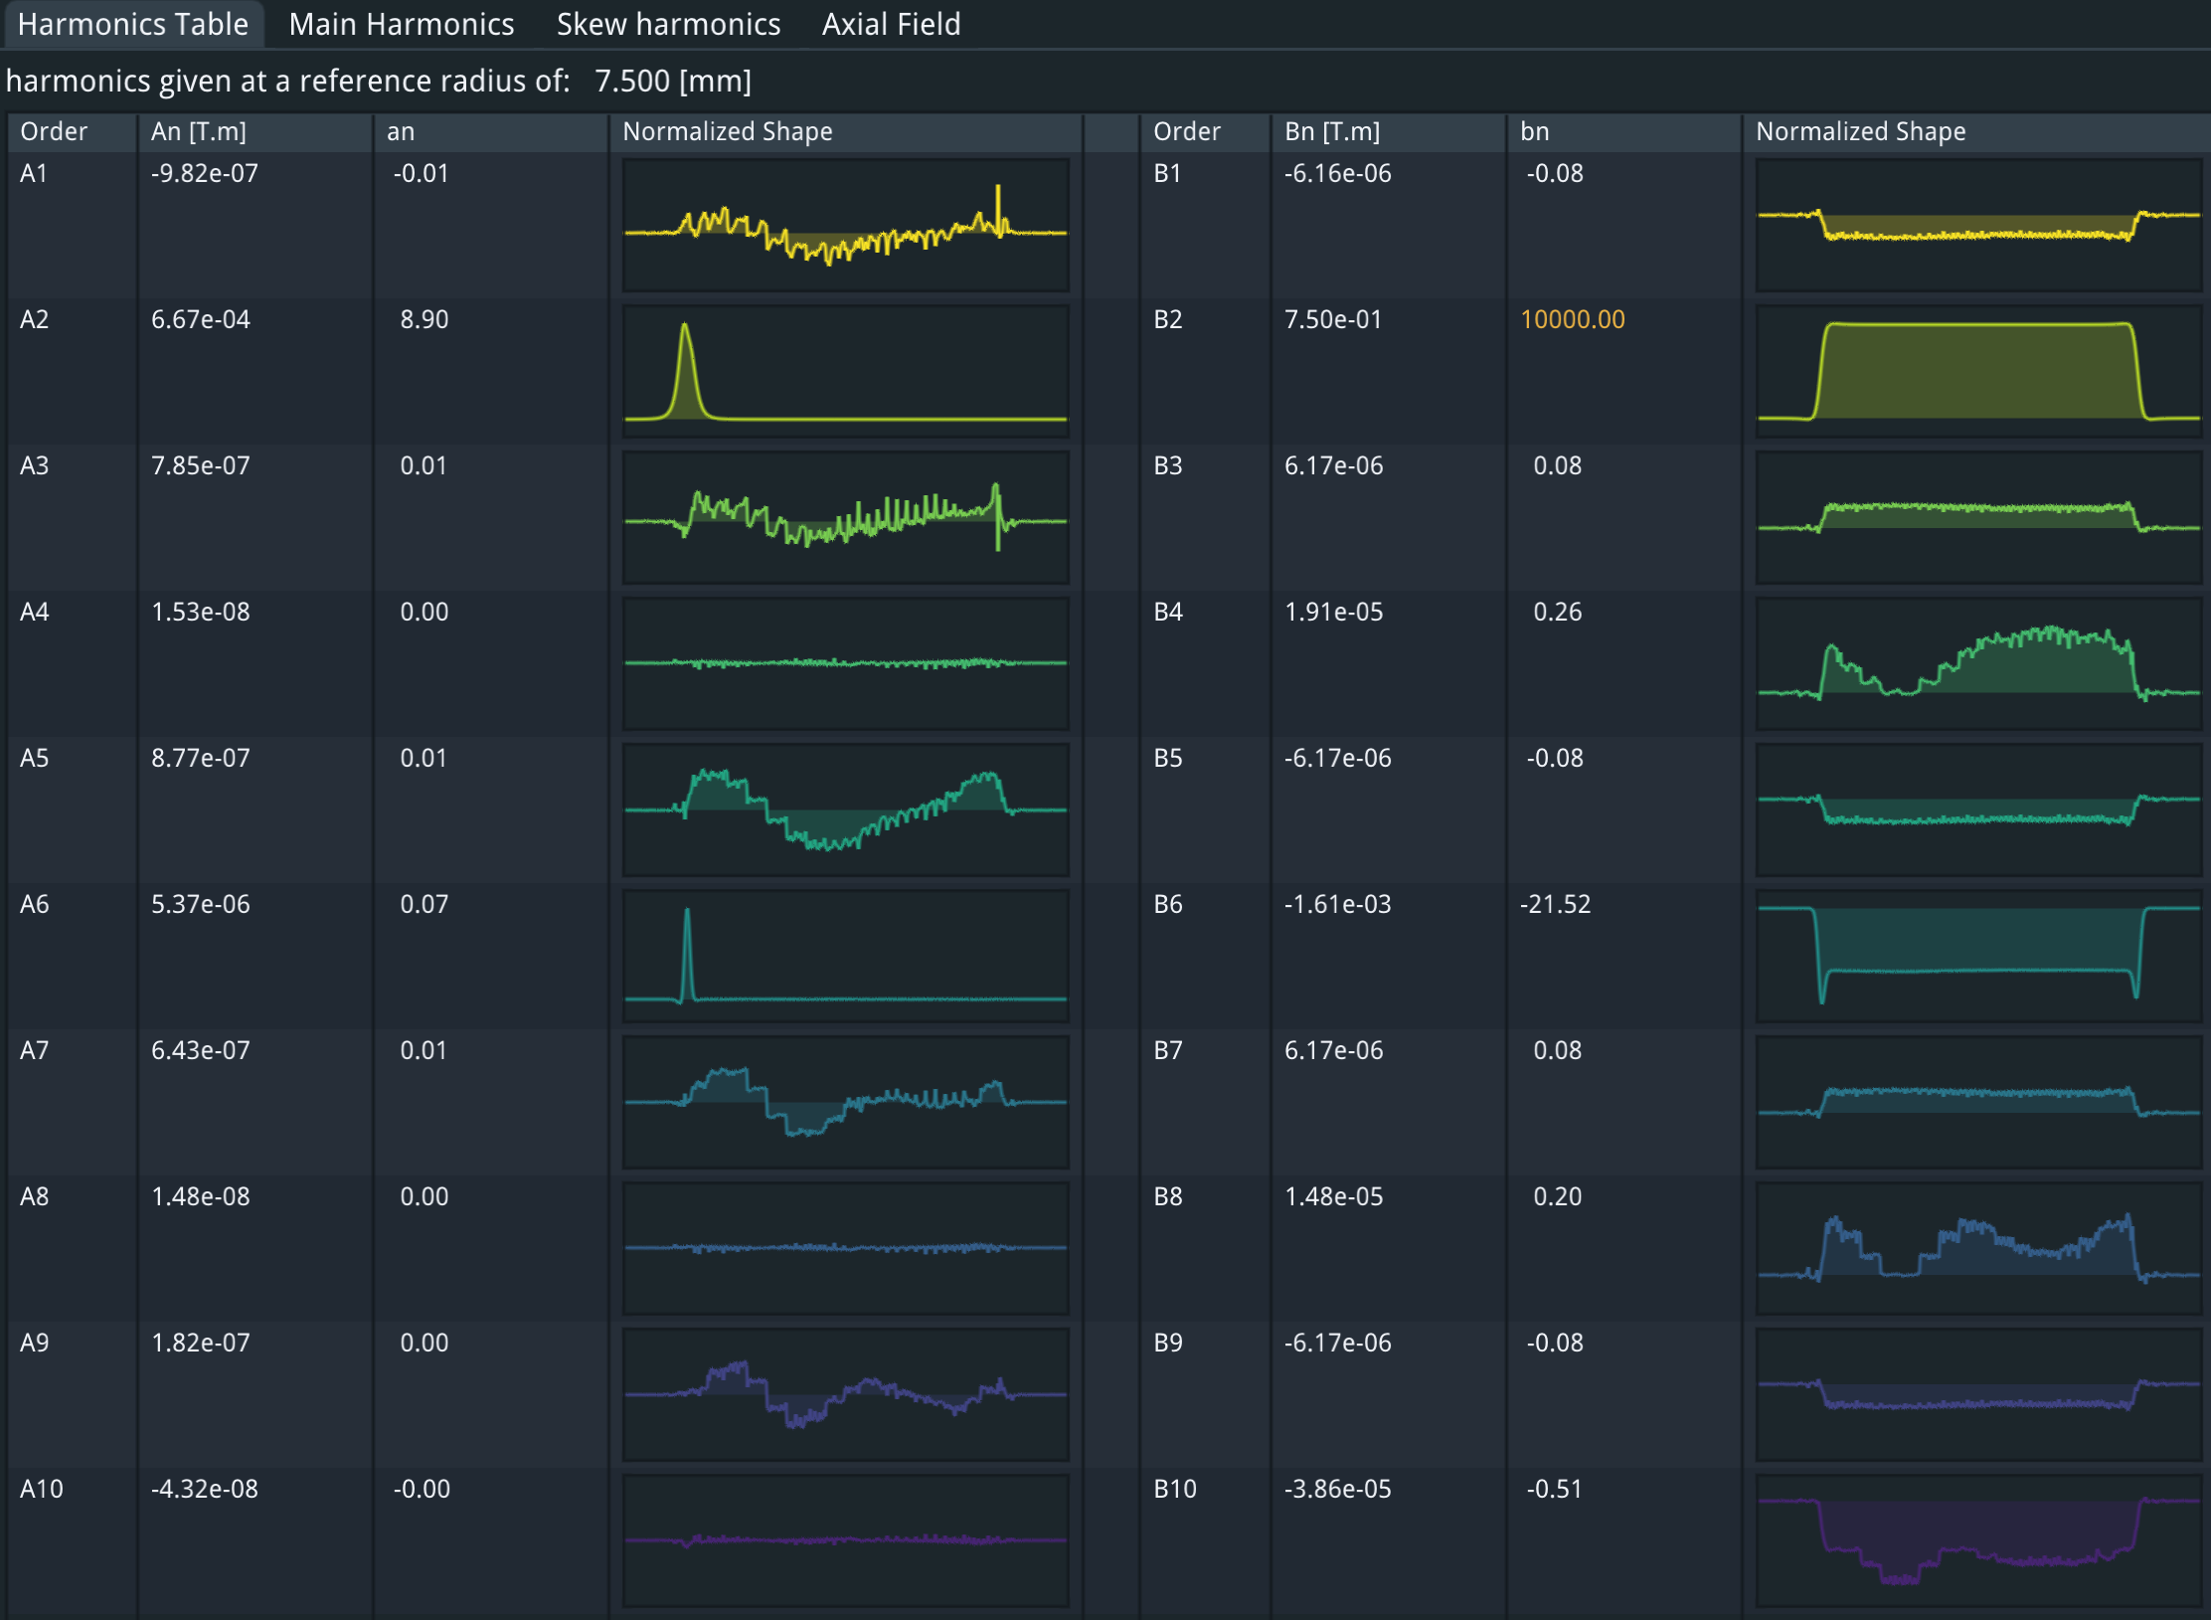
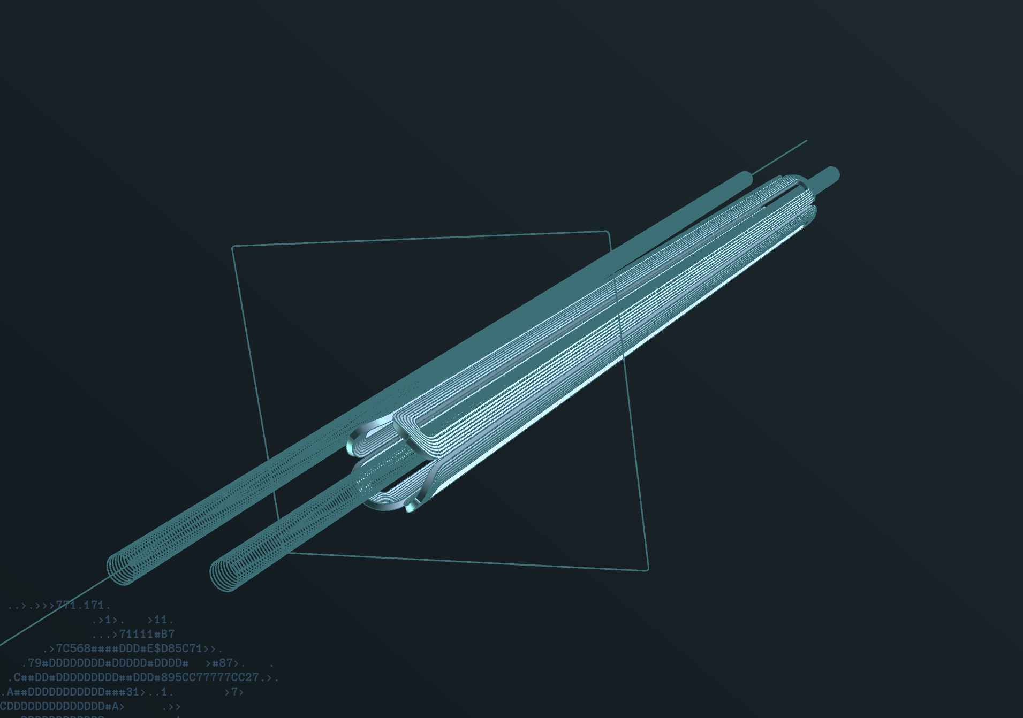
Single cosine-theta quad
@7.5mm reference radius!
(FCC-ee reference radius: 10mm)

Slide 8
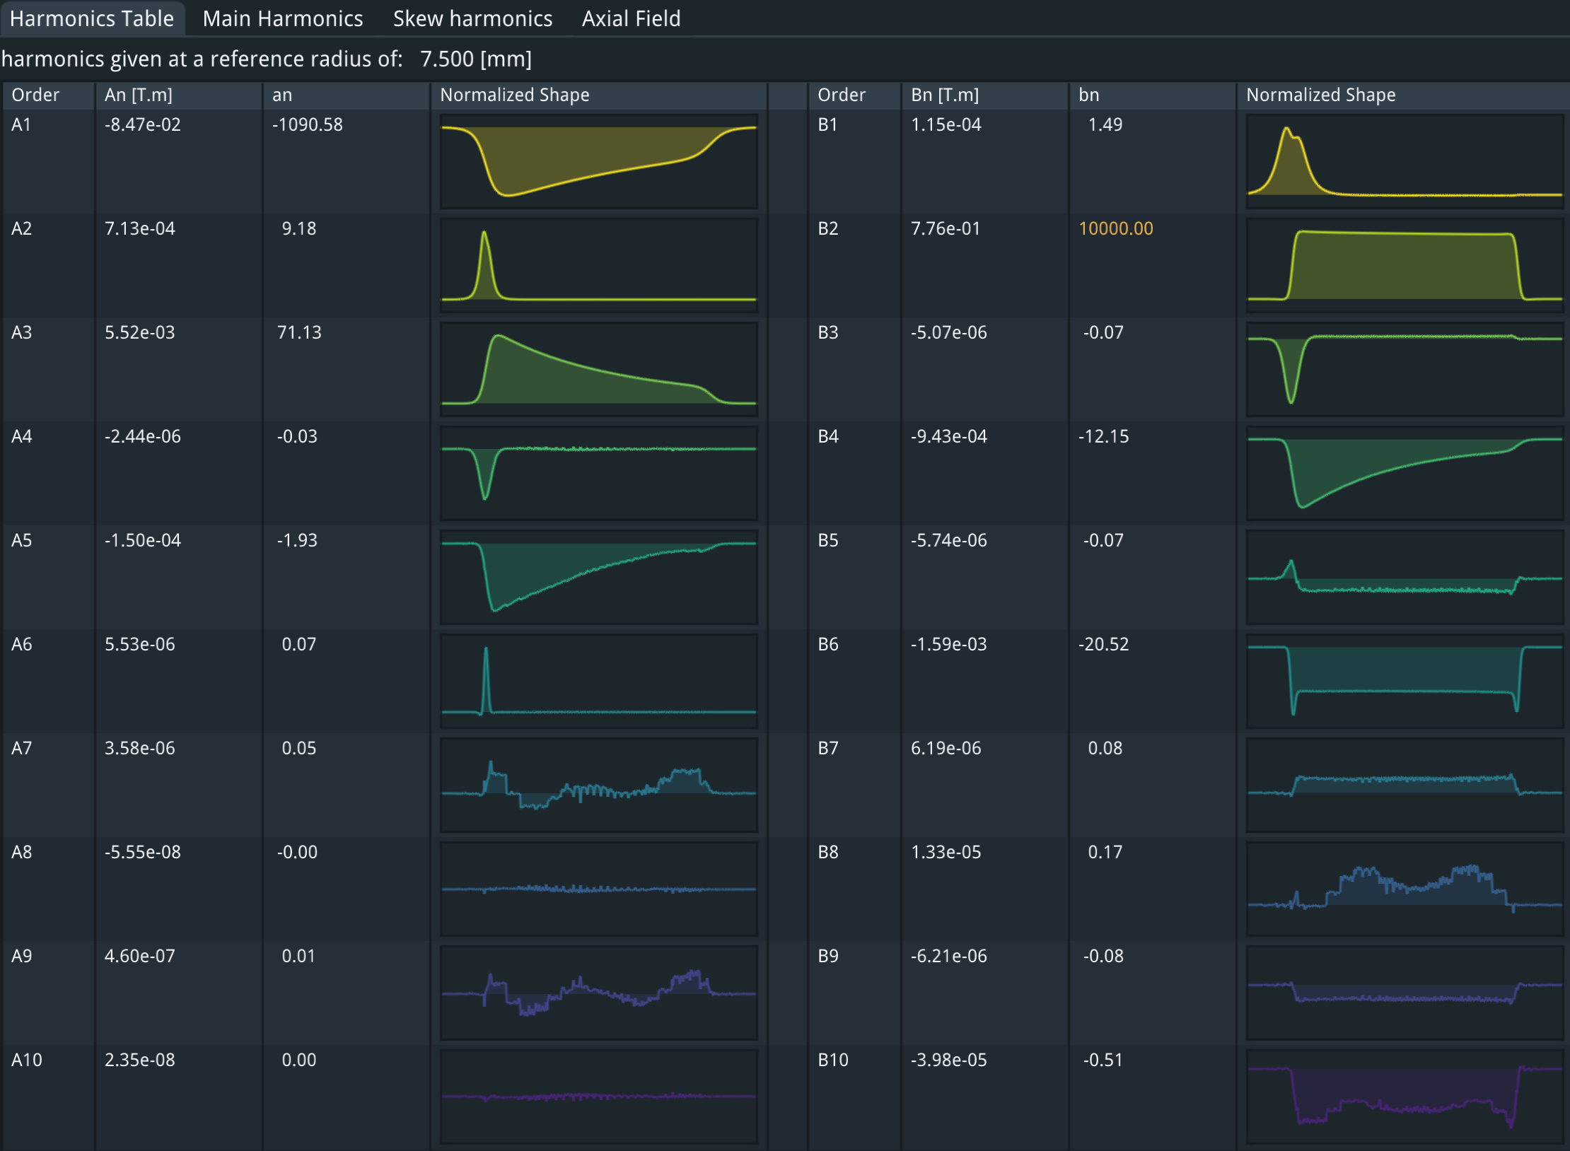
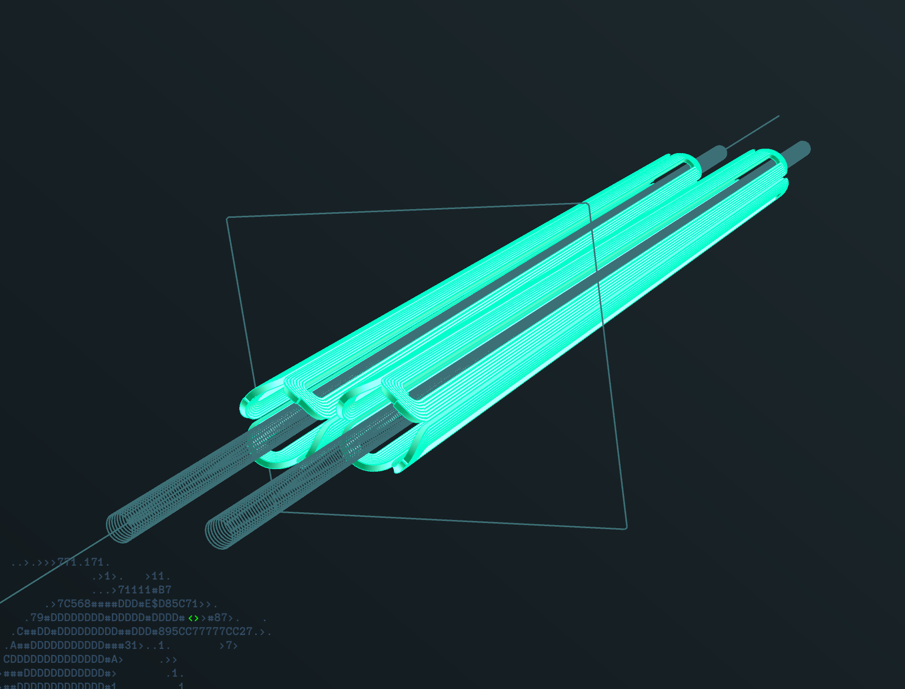
Double quad no iron

Slide 9
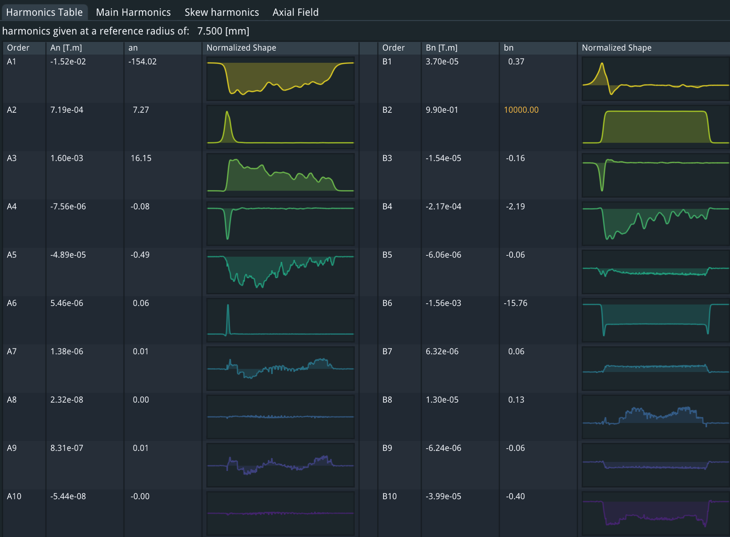
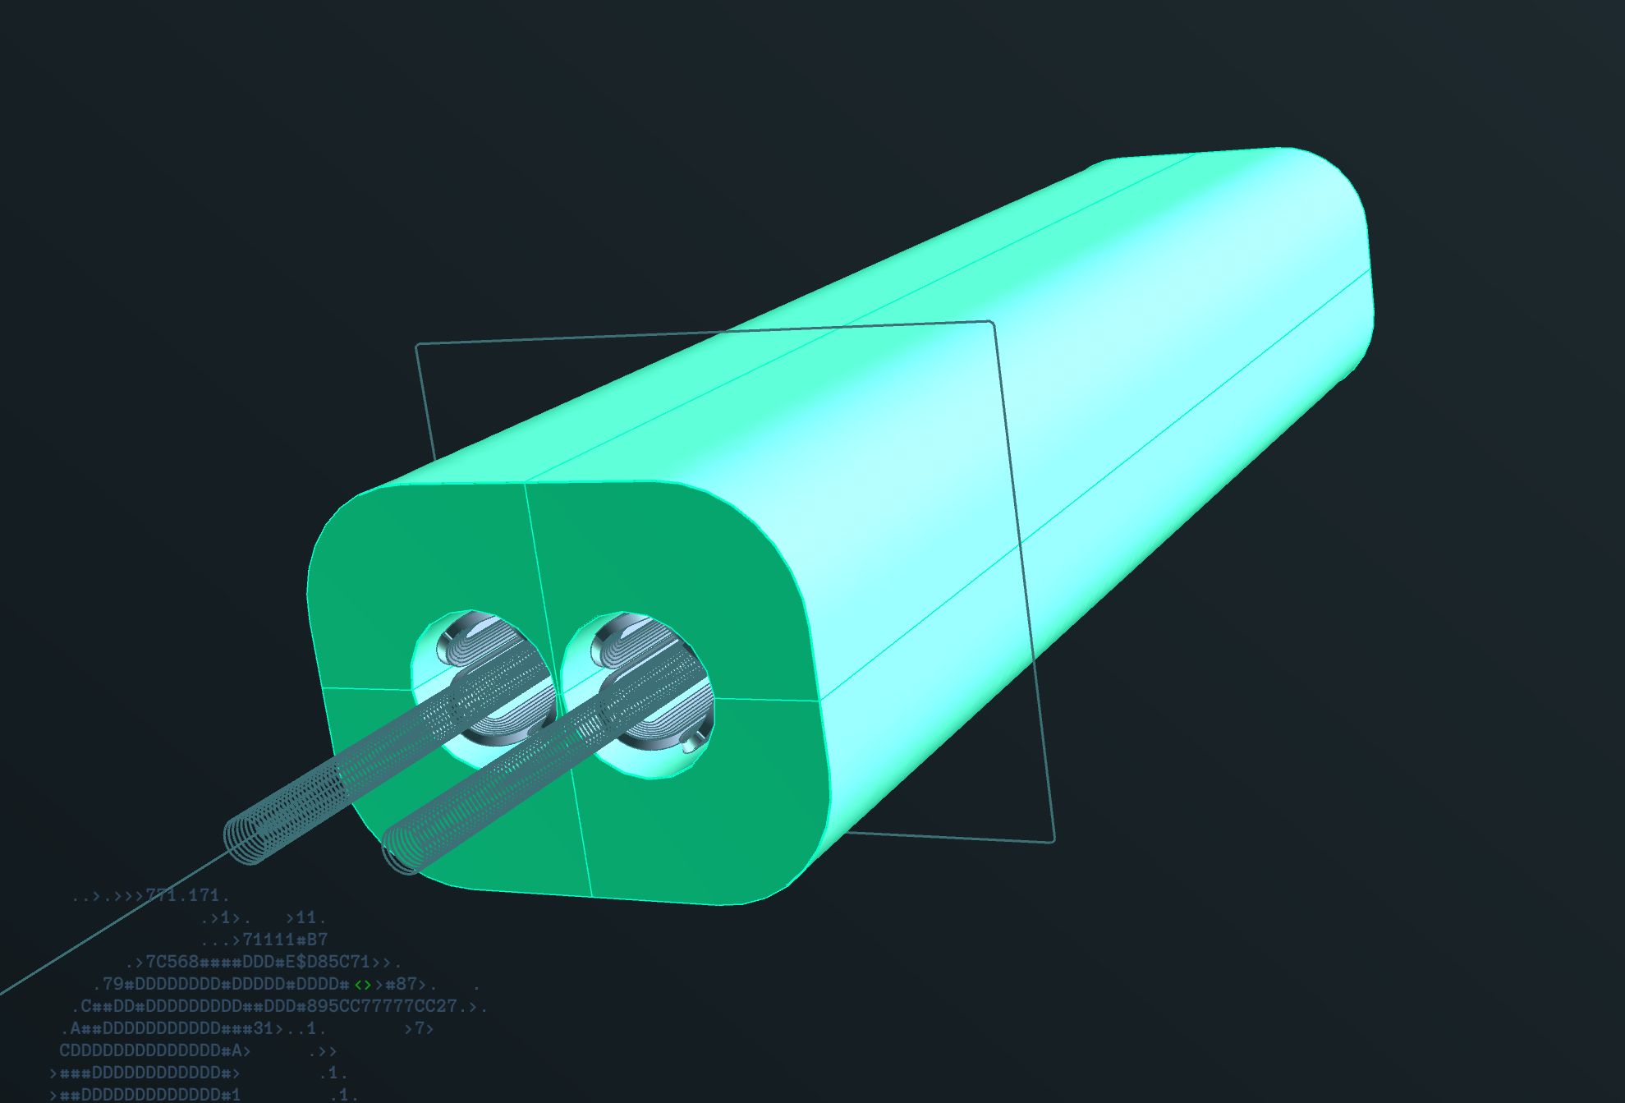
Double quad plus iron

Slide 10
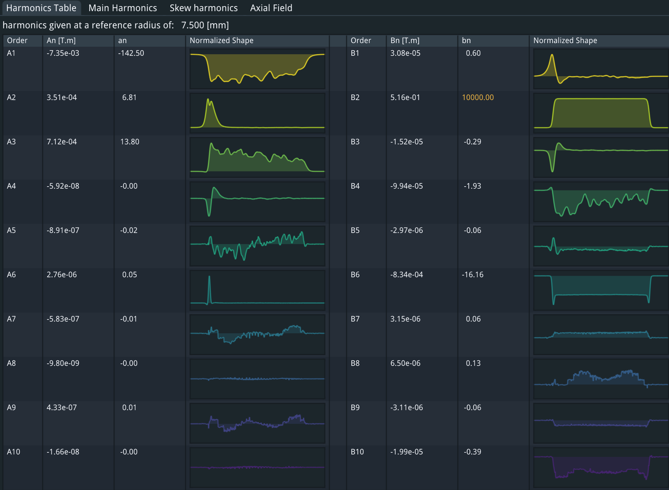
Double quad with iron, half strength
Non-linearity from half to full strength:
A3: 2 units

Slide 11
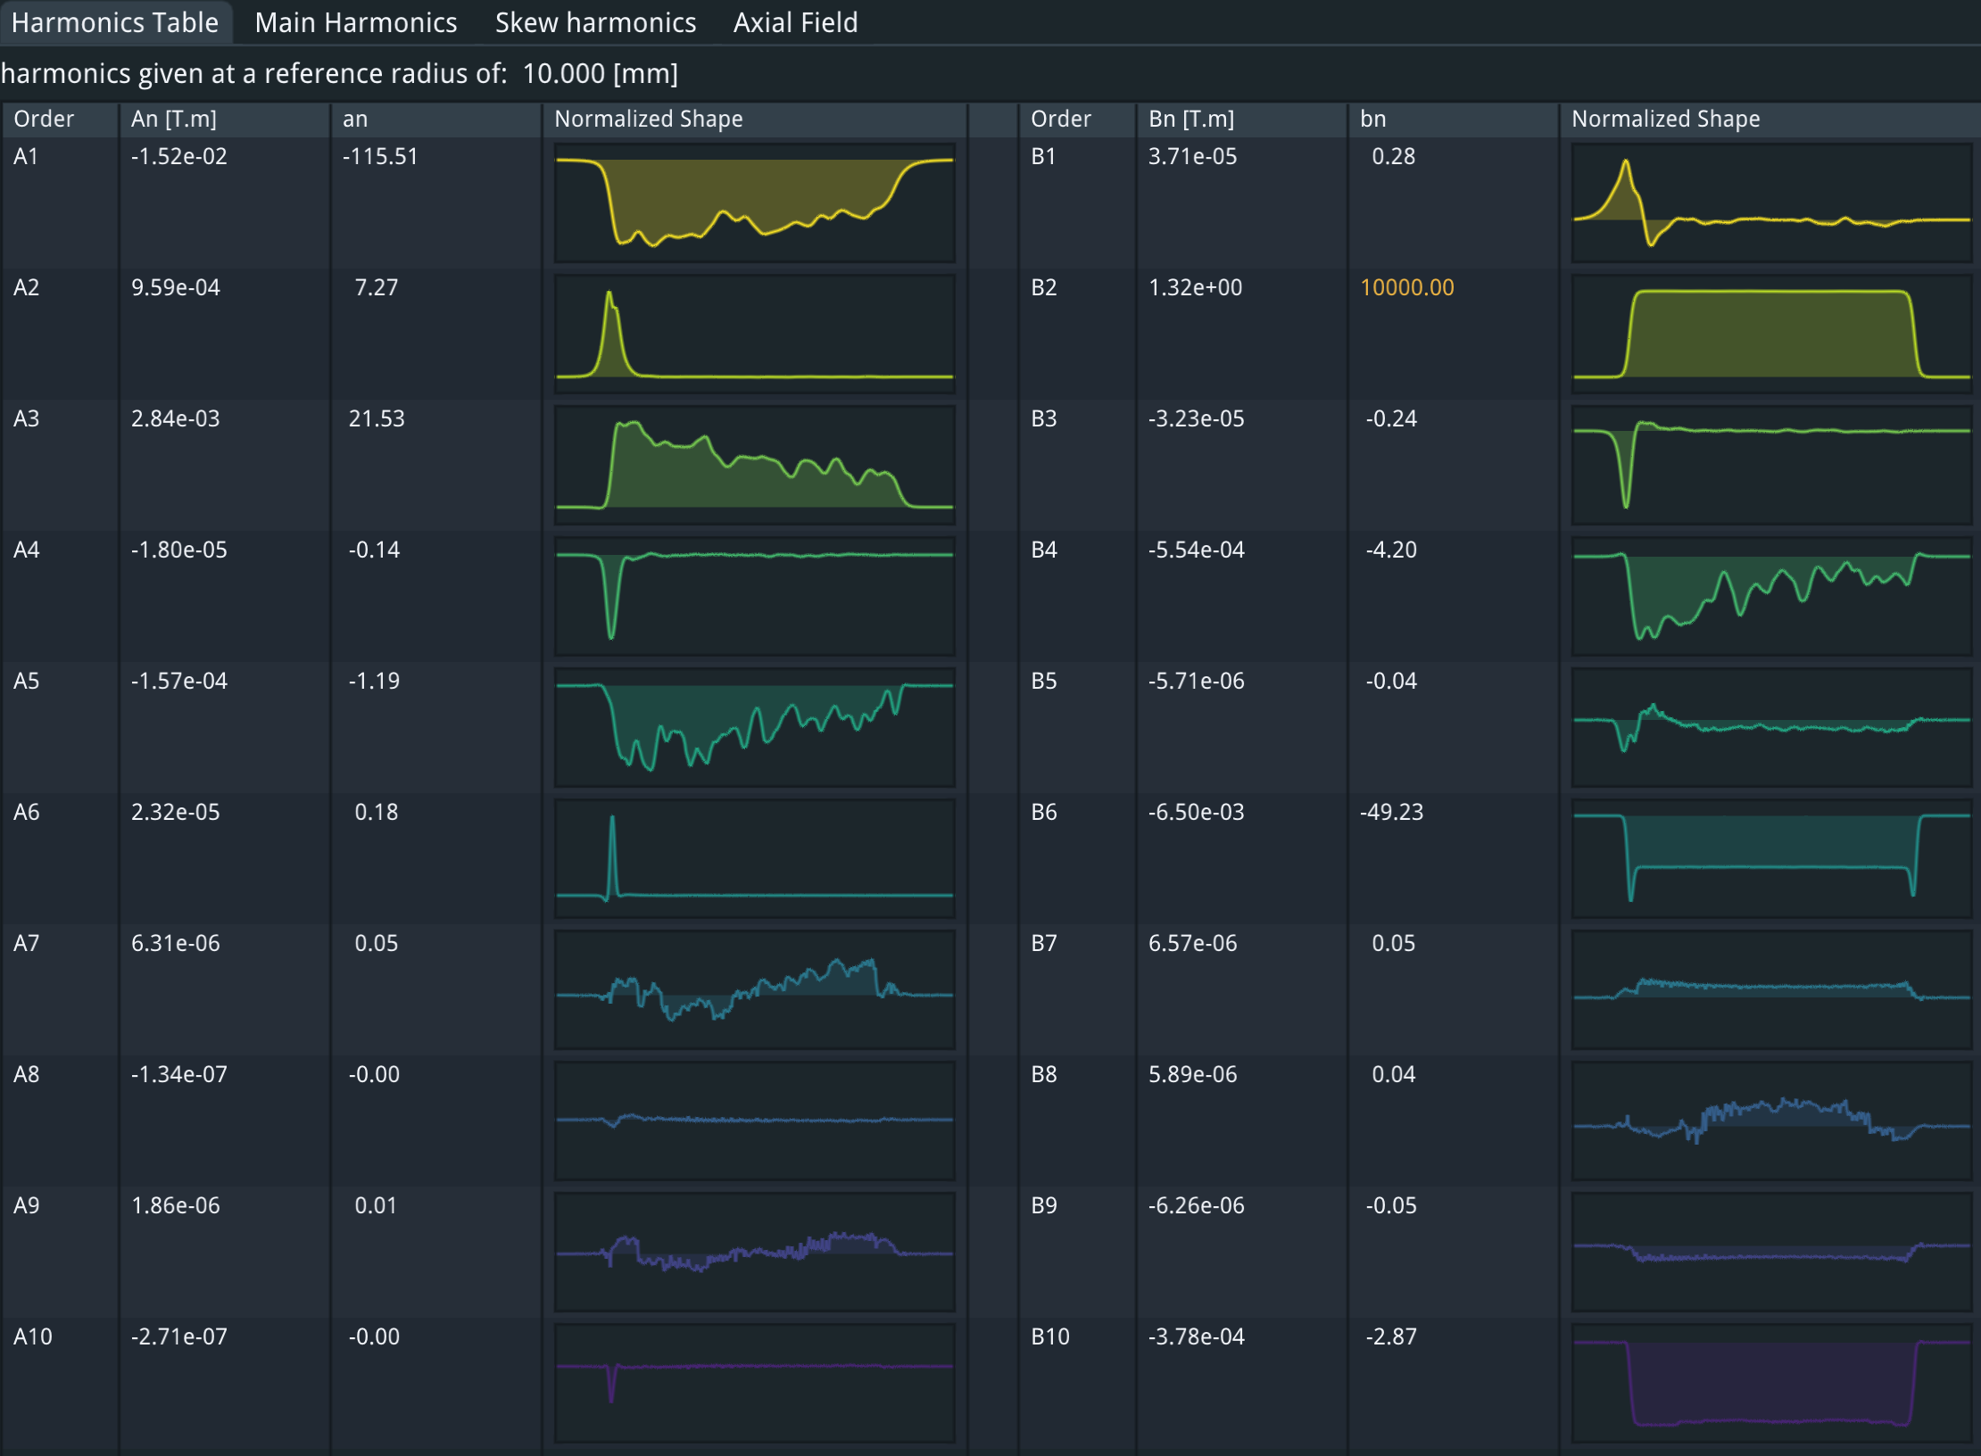
(Double quad, iron, 10mm reference radius)
Multipoles larger than 1 unit:
A3: 22 units
A5: 1 unit
B4: 4 units

Slide 12
Iron vs non-iron
Using iron to shield the two apertures gives significant field imperfections (larger than 10 units @7.5mm)
Non-linearities are ~2 units
Using a different method to correct for the fringe fields of adjacent magnets seems preferable
This is the approach of FCC.
We are using a CCT quadrupole which has offending multipoles removed by design.
This is an iron-free design with the added benefit of having no non-linearities.

Slide 13
The FCC-ee CDR solution
Use CCT technology and NbTi conductor
CCT was used as it can eliminate crosstalk
NbTi was used as it was proven technology at the time
To get the 100T/m gradient needed, we need to operate at 1.9K (superfluid helium)

Slide 14
The FF quad prototype
A final focus quad prototype was built in 2019 and tested at warm.
The prototype was impregnated with wax at PSI (August 2023)
During October 2023 it was tested at CERN’s SM18 facility at 1.9K and 4.5K

Slide 15
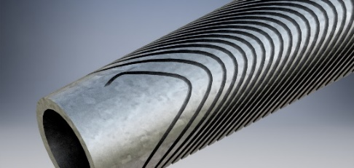
Design
Was done in-house using the FIELD suite of programs
Mechanical design done in Autodesk Inventor

Slide 16
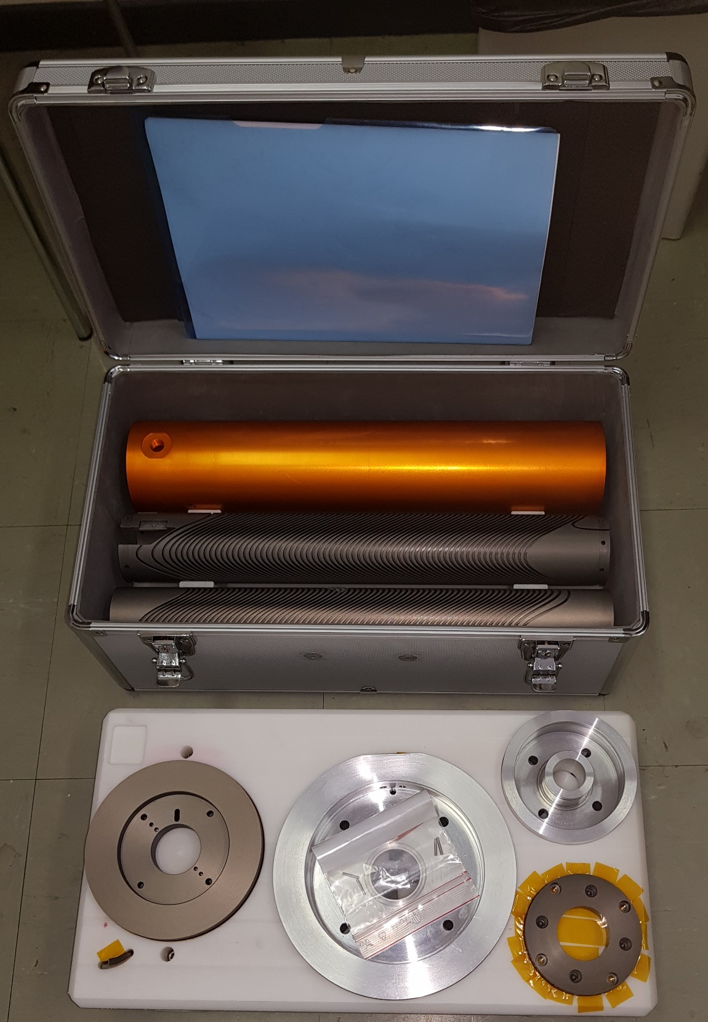
Manufacturing
Was done at the main CERN workshop. Material: Aluminium 6082-T6, hard-anodized

Slide 17
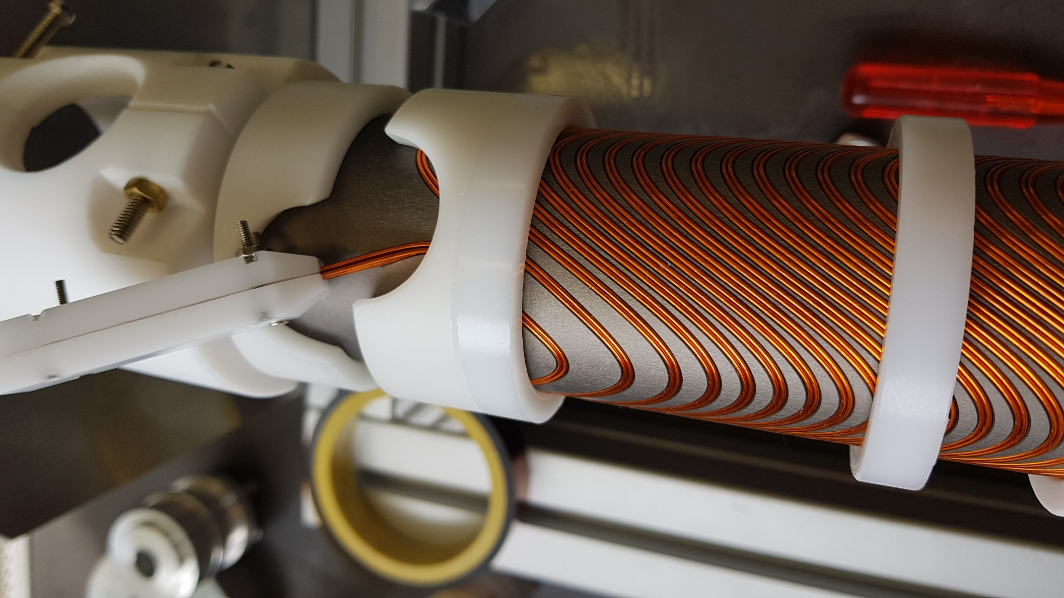
winding
Done in-house using standard LHC 0.825 NbTi strand

Slide 18
Impregnation
Wax was chosen for its (expected) performance during quench training
Wax contracts by 15% when it crystalizes creating voids if no measure is taken
Voids can be avoided if crystallization occurs in a controlled manner (inner to outer and bottom to top)
Using the experience gathered by different experts on wax impregnation, a new method was tried: The magnet was impregnated and cooled in a controlled manner at PSI

Slide 19
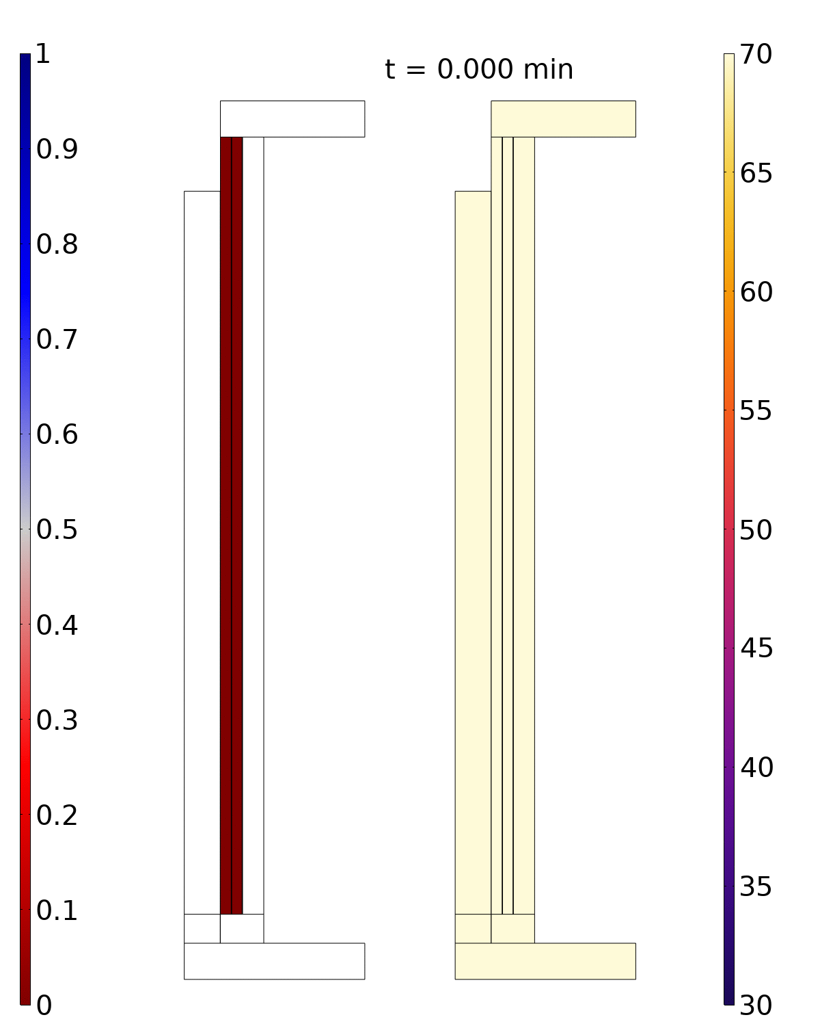
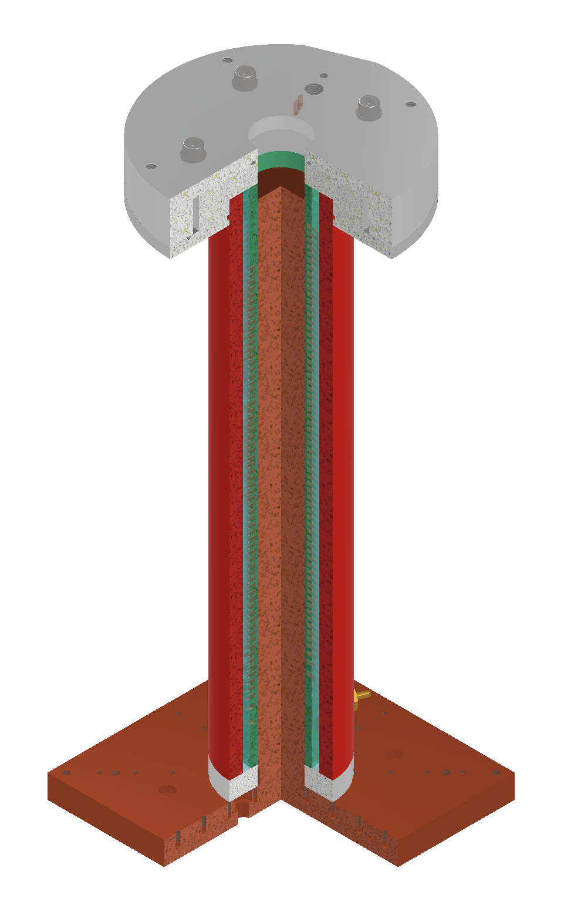
Simulation
Simulation plane
Crystallization range [51.5,54.5] Celsius
Solid fraction
Temperature [degC]
Jaap Kosse

Slide 20
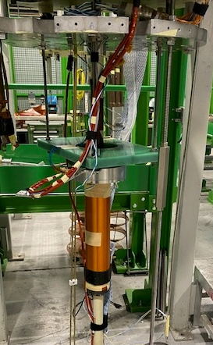
The test at SM18
Testing at cold at SM18 (CERN)
Cryostat supporting 1.9K superfluid helium
Training campaign
Measurement of splice resistance
Measurement of quenchback
Measurement of RRR

Slide 21
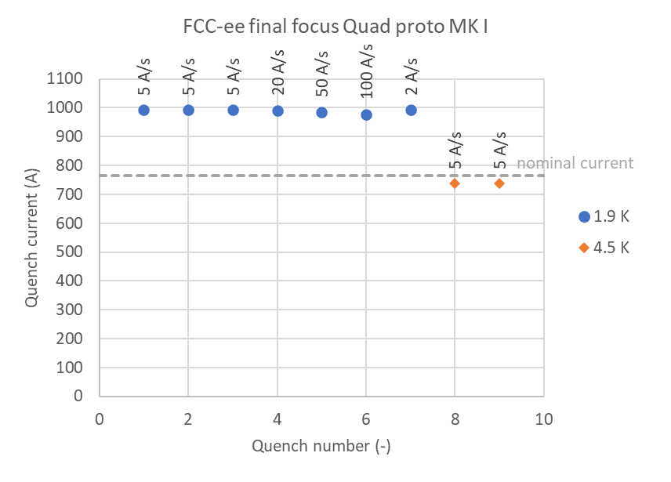
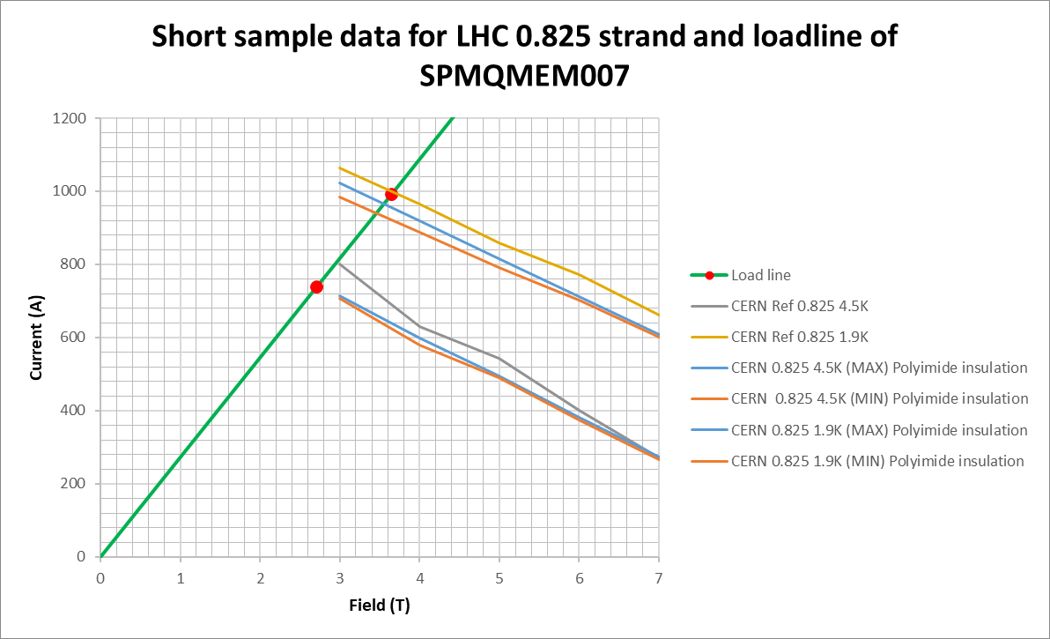
SM18 Test results Oct 27-31 - Training
No training quenches were seen up to short sample limit
No degradation was seen for quenches at short sample limit
1.9 K: reached 991 A, peak field on conductor is 3.65 T
4.5 K: reached 738 A, peak field on conductor is 2.71 T
Short sample limit 1.9K
Gradients:
Nominal: 100T/m
Maximum at 1.9K: 130T/m
Maximum at 4.5T: 96T/m

Slide 22
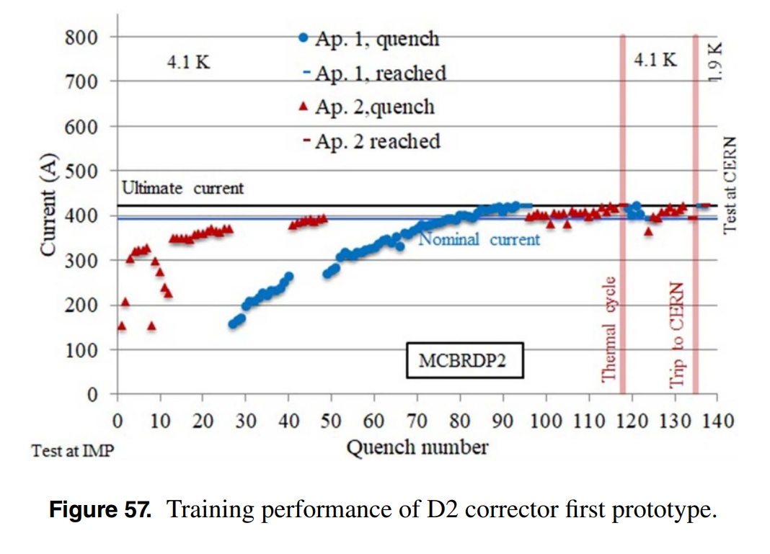
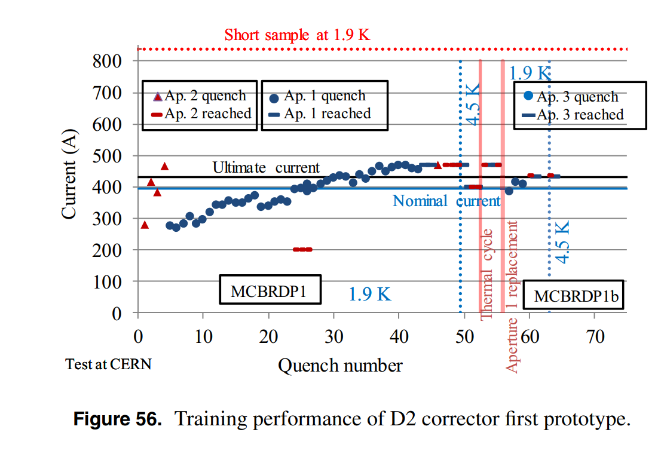
Comparison to similar projects
https://iopscience.iop.org/article/10.1088/1361-6668/abdba4/pdf
1000
This project
900
Chinese-made MCBRD HiLumi dipole corrector
CERN-made MCBRD HiLumi dipole corrector

Slide 23
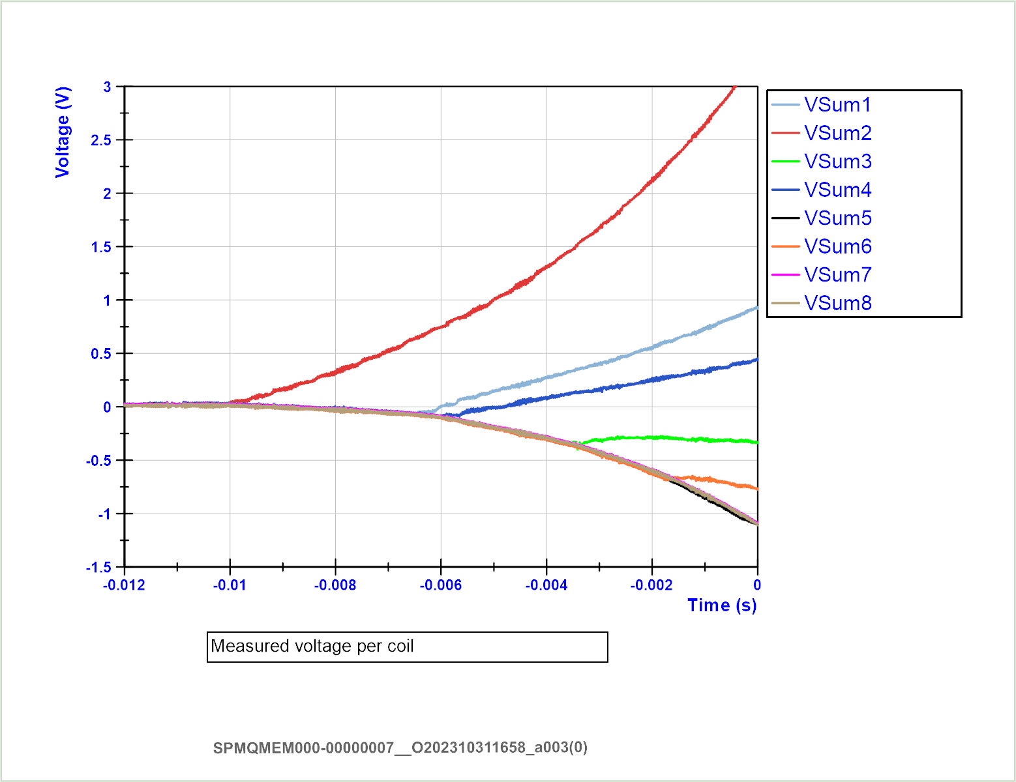
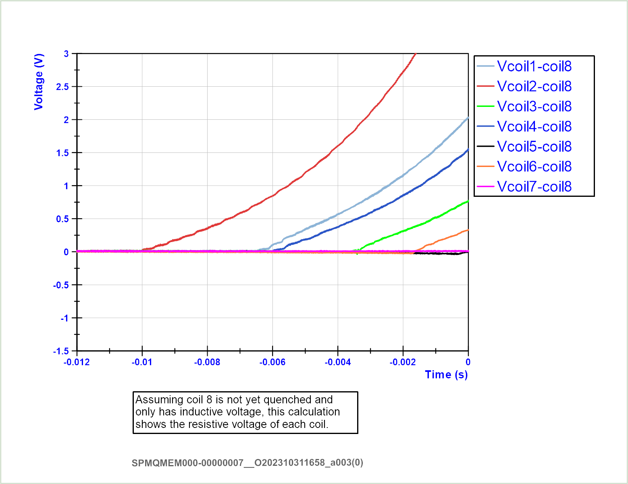
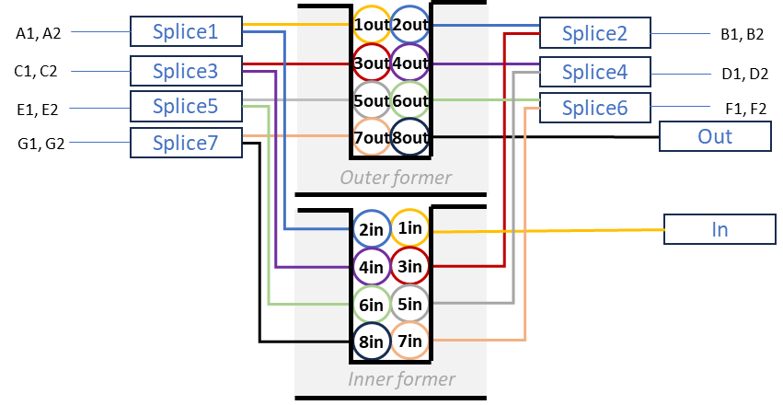
Quench analysis at short sample limit, 1.9 K at 991 A.
2
1
4
3
6
Negative (inductive) component due to dI/dt

Slide 24
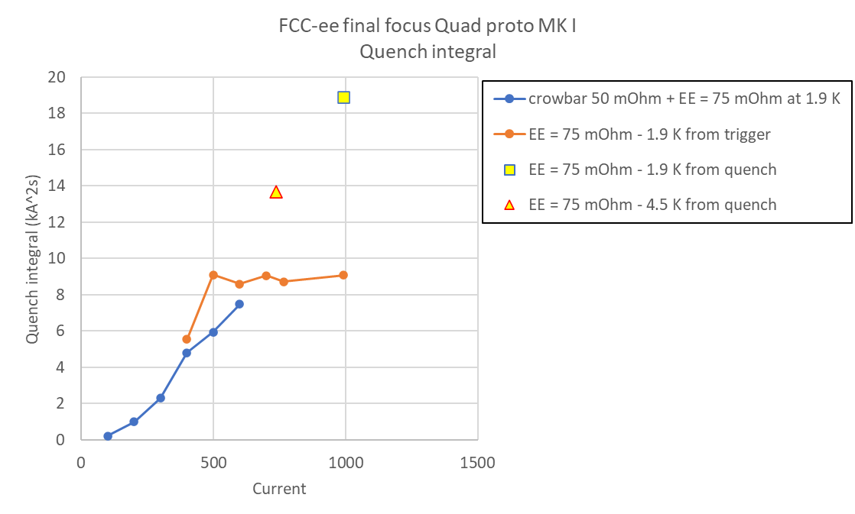
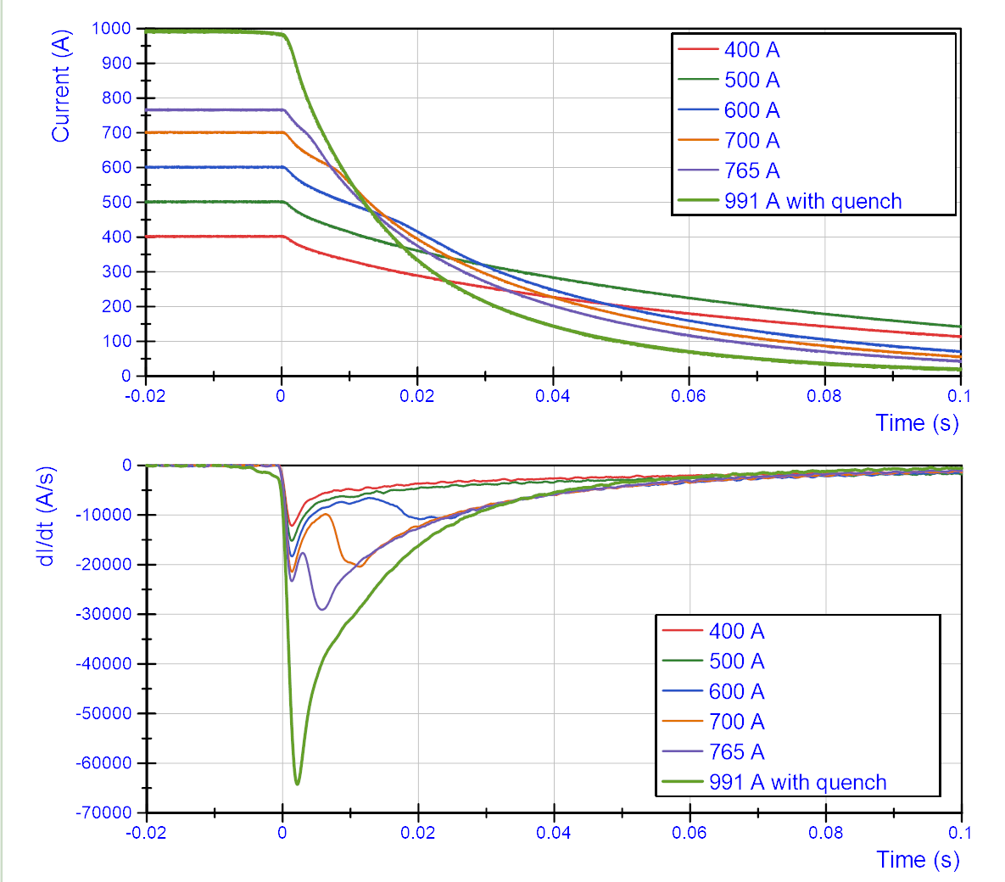
Quench integral and Quenchback
Above ~600A, the former absorbs some of the energy, so quench integral is about half of what simulation without former predicts
Effects to take into account:
Quench back starts between 400 and 500 A with 50 mOhm crowbar + 75 mOhm EE.
Quench back starts between 500 and 600 A for 75 mOhm EE.
The contribution of the former becomes more important at higher dI/dt. This could explain why the curve is flat above 500 A.

Slide 25
Field quality – measurements at warm
Mysterious ‘environment’ component extracted after repeating warm measurement with a 42 degree tilt of the magnet

Slide 26
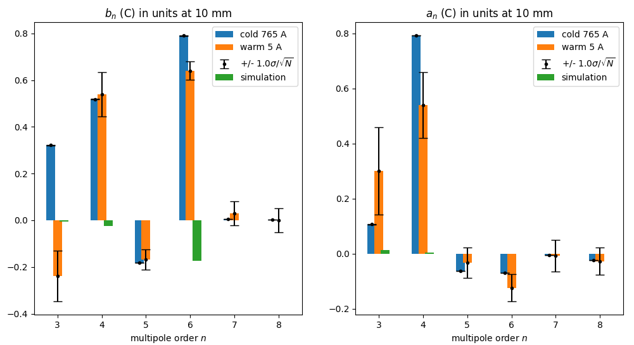
Field quality - cold
Work under way, but already <1unit for all multipoles
We did not do the same trick during cold measurements
The ‘warm’ measurements below come from the unrotated data

Slide 27
Next steps
Last remaining question is the radiation resistance of wax.
The plan would be to irradiate and re-measure.
I have requested for this irradiation to be done at Dafne in Frascati.

Slide 28
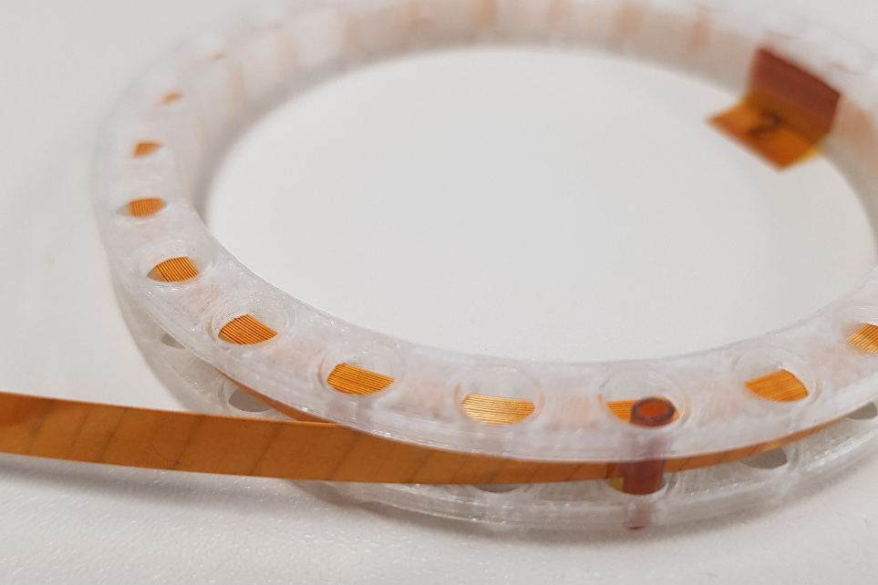
Upgrade to HTS
Changing the technology from NbTi to HTS would mean that we can operate at 30K instead of 2K.
BUT, HTS comes in form of tapes, not trivial to design a quadrupole with crosstalk compensation.
Earlier attempts resulted in large B6 (dodecapole) component which needed a dedicated corrector…
I am happy to report that I think I have solved all these technical problems.

Slide 29
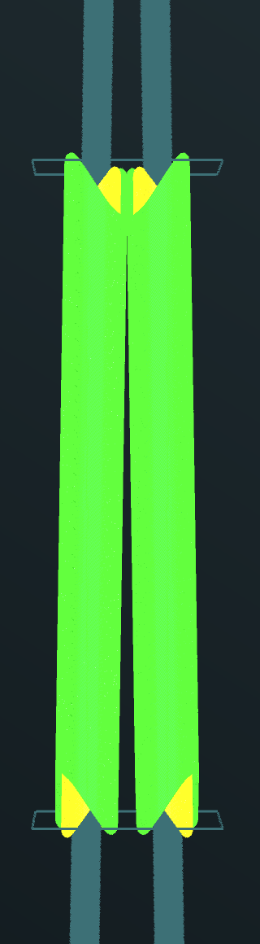
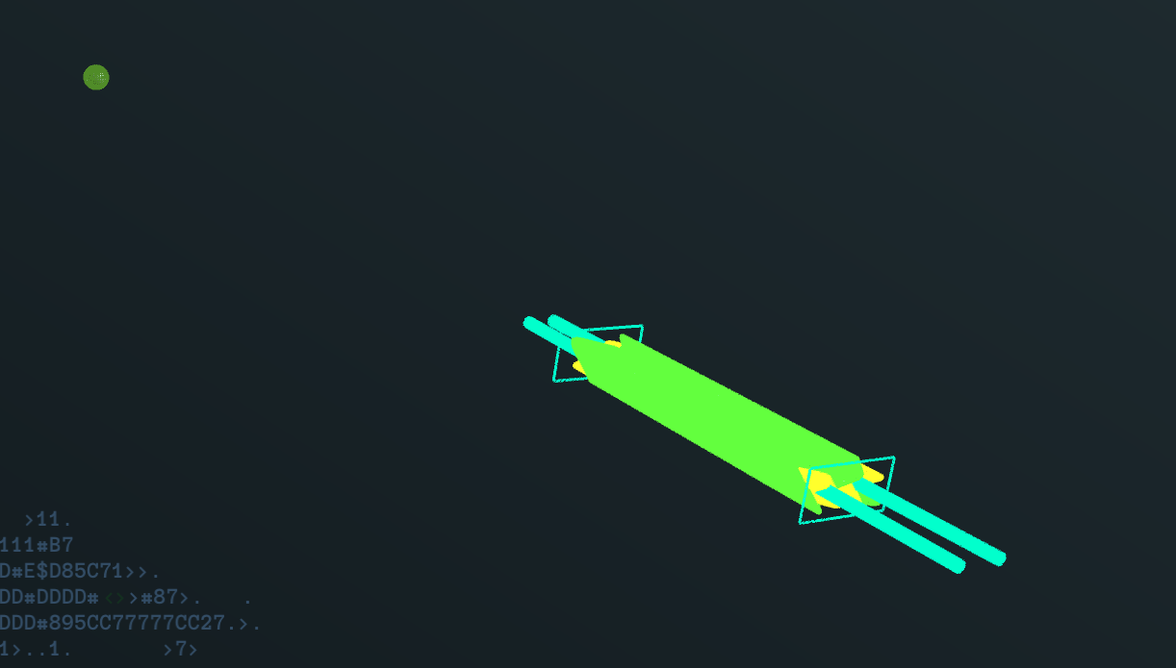
The new HTS design
View from the top
IP
QC1L1E, QC1L1P

Slide 30
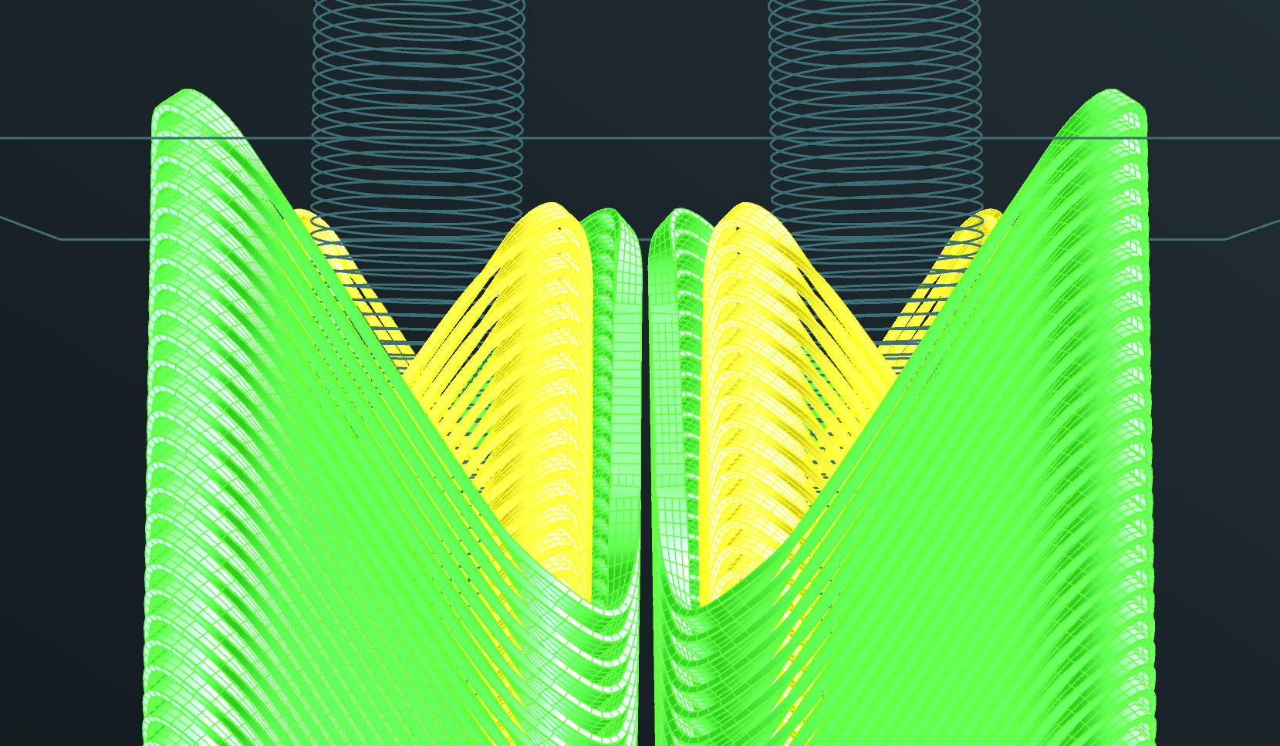
Detail at 2200mm from the IP
beampipe

Slide 31
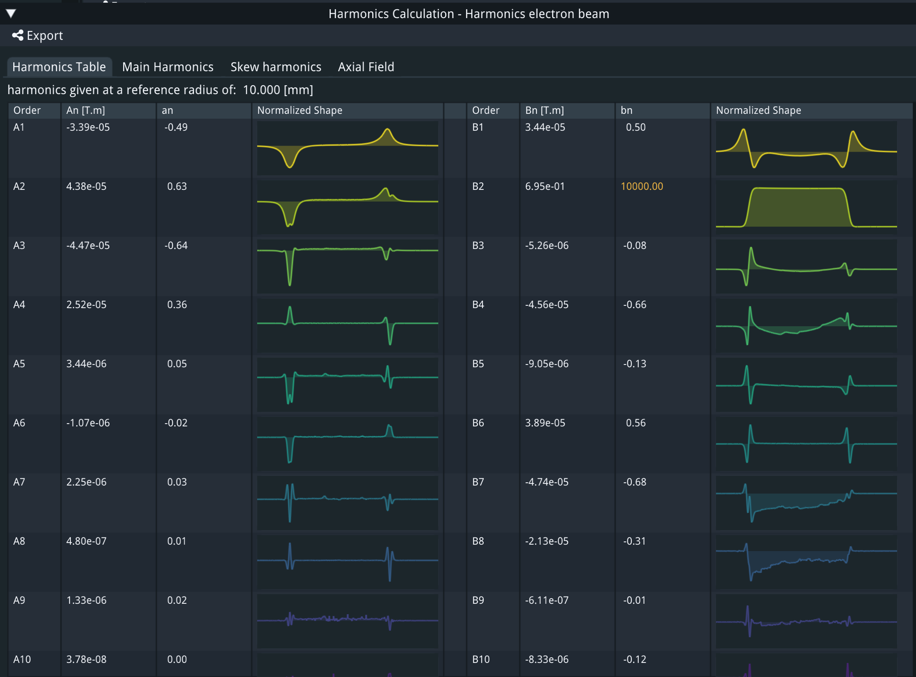
Crosstalk compensation e+ beam
All multipoles below 10⁻⁴. I stopped the optimization when I reached this level, but further improvement is possible and easy, up to the manufacturing tolerances (10⁻⁵??).

Slide 32
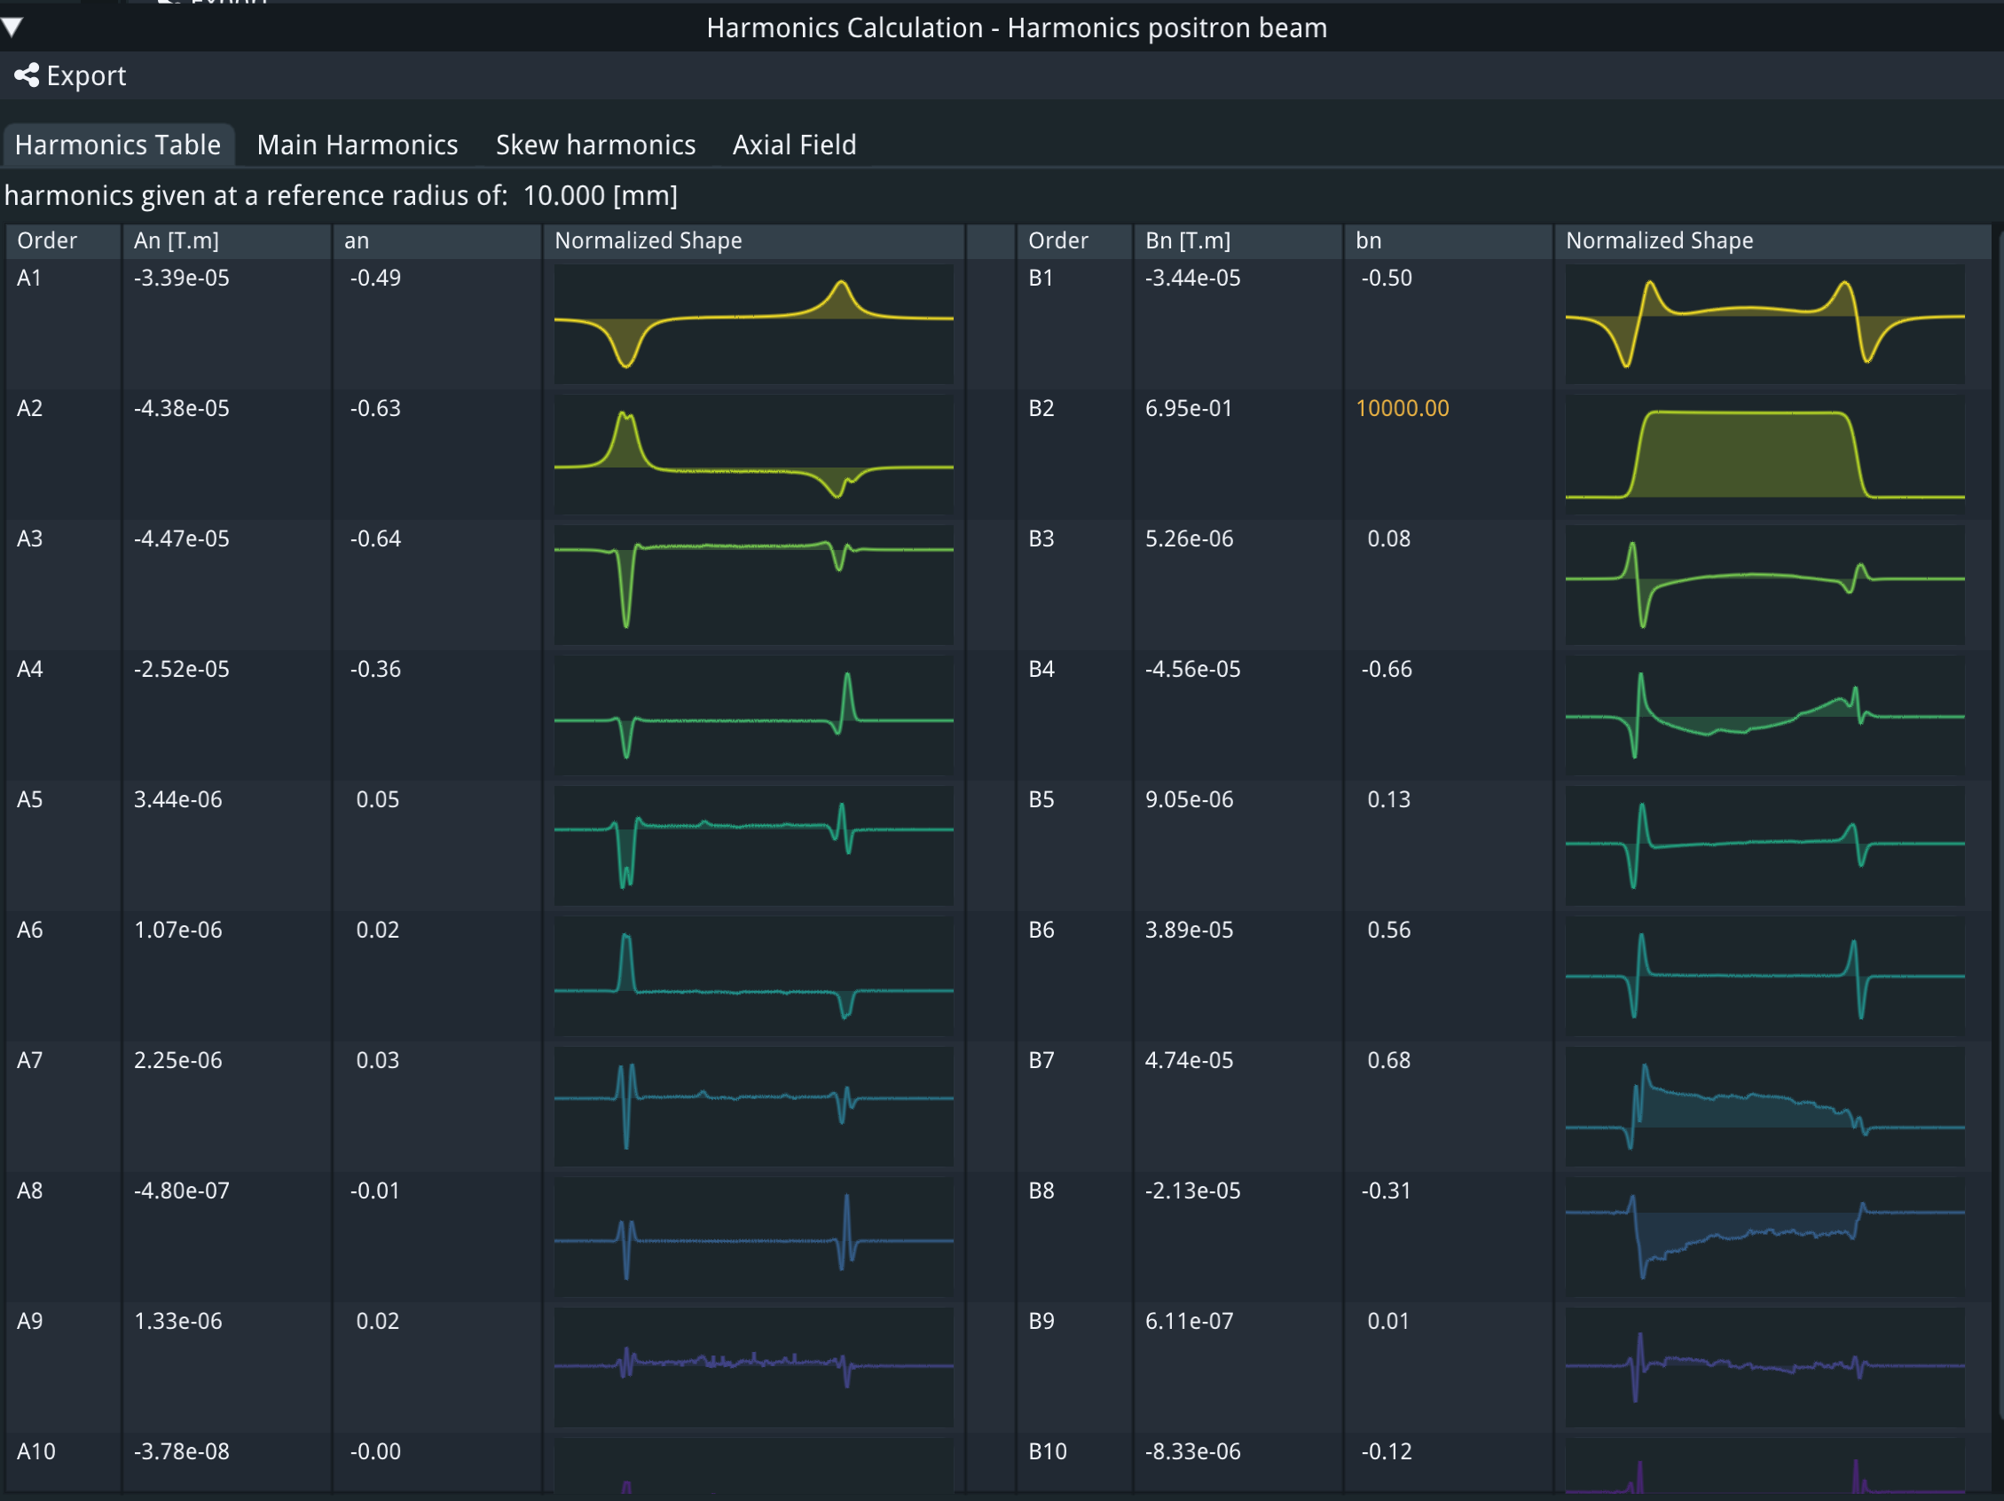
Crosstalk compensation e- beam
(System is symmetric)

Slide 33
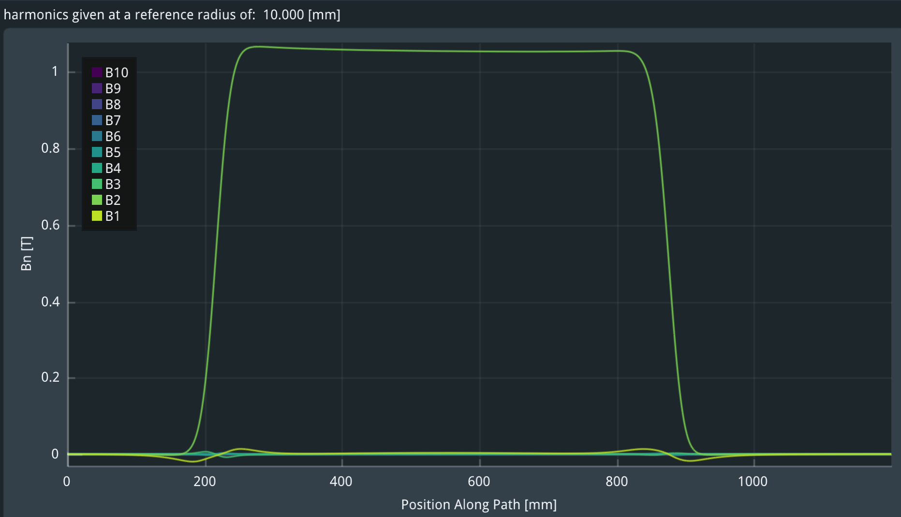
Field gradient
(7% higher than 100T/m since the magnetic length is 7% smaller)

Slide 34
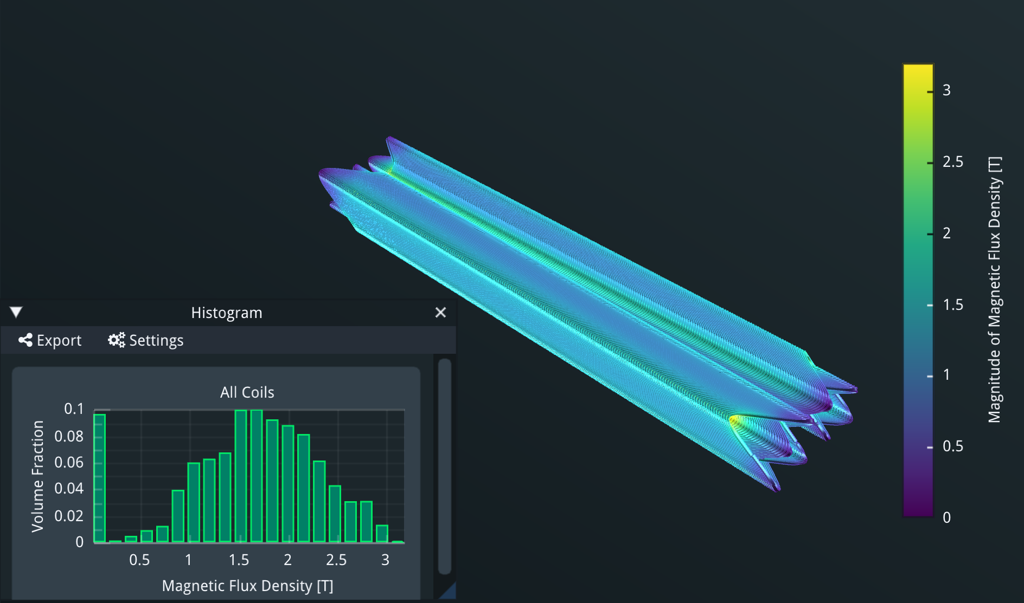
Magnetic field for 100T/m gradient

Slide 35
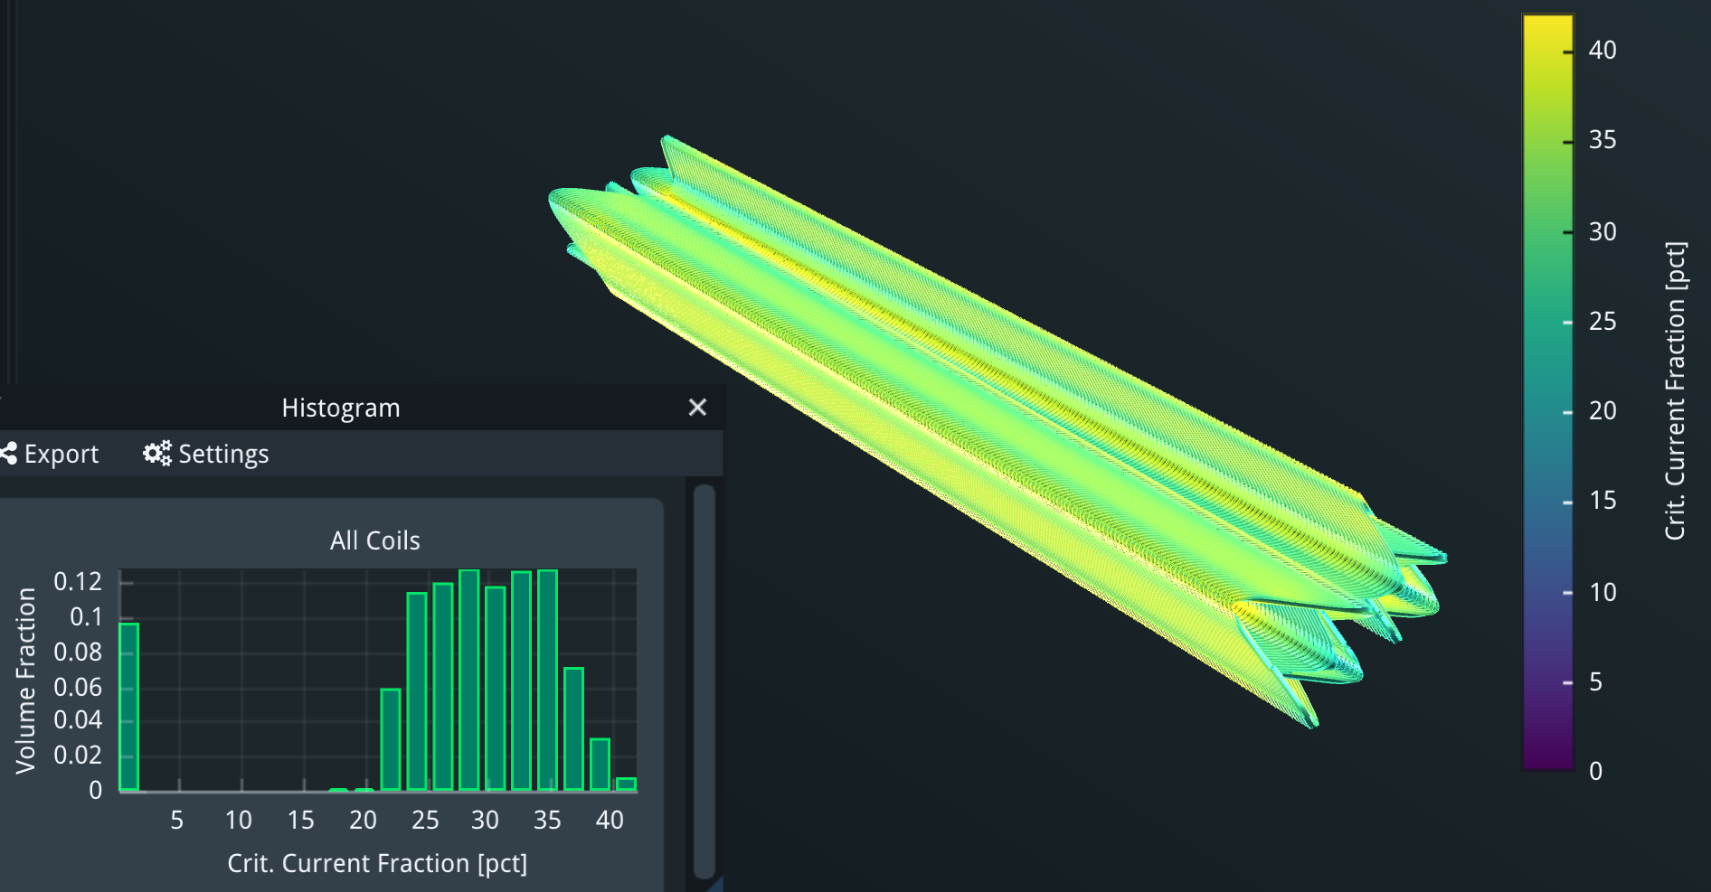
Critical current
10 turns of 400A per turn:
42% of critical current at 20K

Slide 36
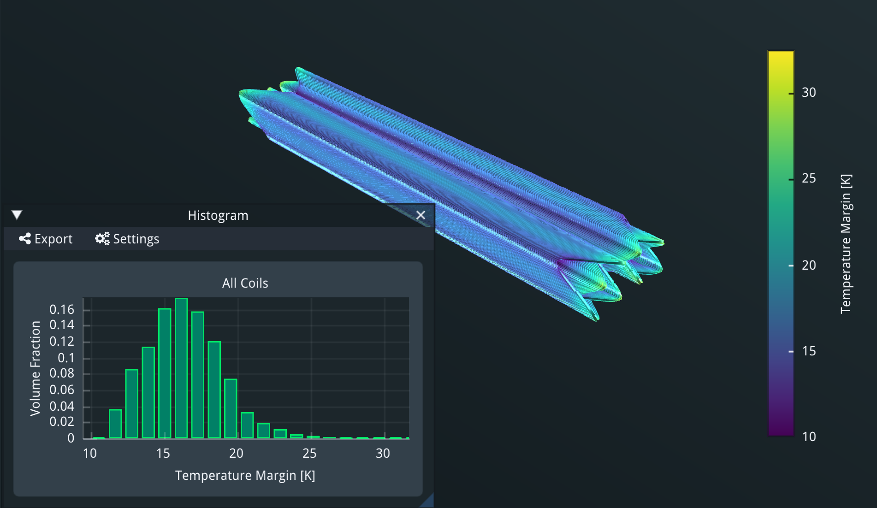
Temperature margin
If operating at 30K we have a margin of 10K

Slide 37
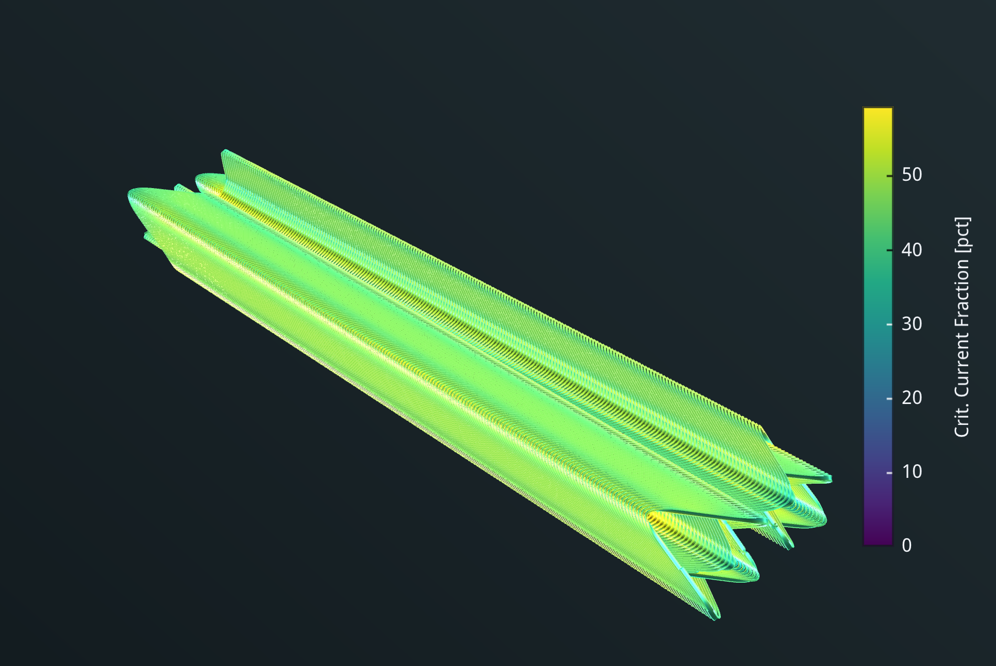
Running at 1.9K
Number of turns reduced to 4 (from 10) and current increased to 1000A
Critical current fraction ~60%

Slide 38
Parasitic currents
A potential problem of HTS tapes is parasitic currents when running well below the critical current that could introduce multipole errors
The real answer of how important these are will be given when we measure the HTS arc sextupole, currently under manufacture for the FCCee-HTS4 project.
Simulations show that the problem for the HTS4 sextupole is well below 1 unit of 10⁻⁴
Need to measure!

Slide 39
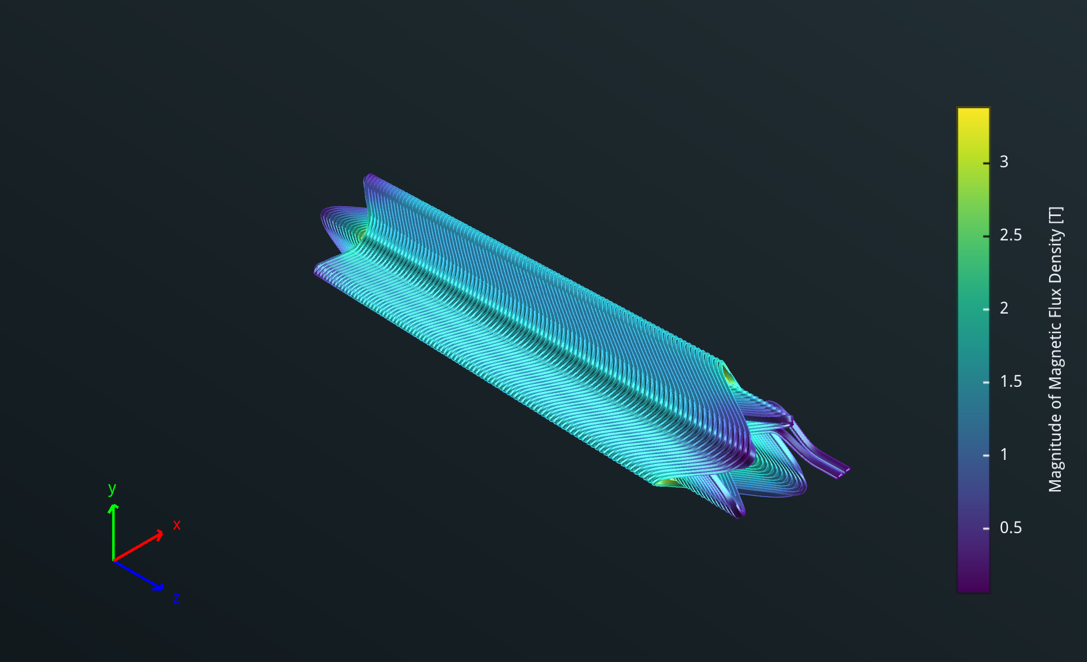
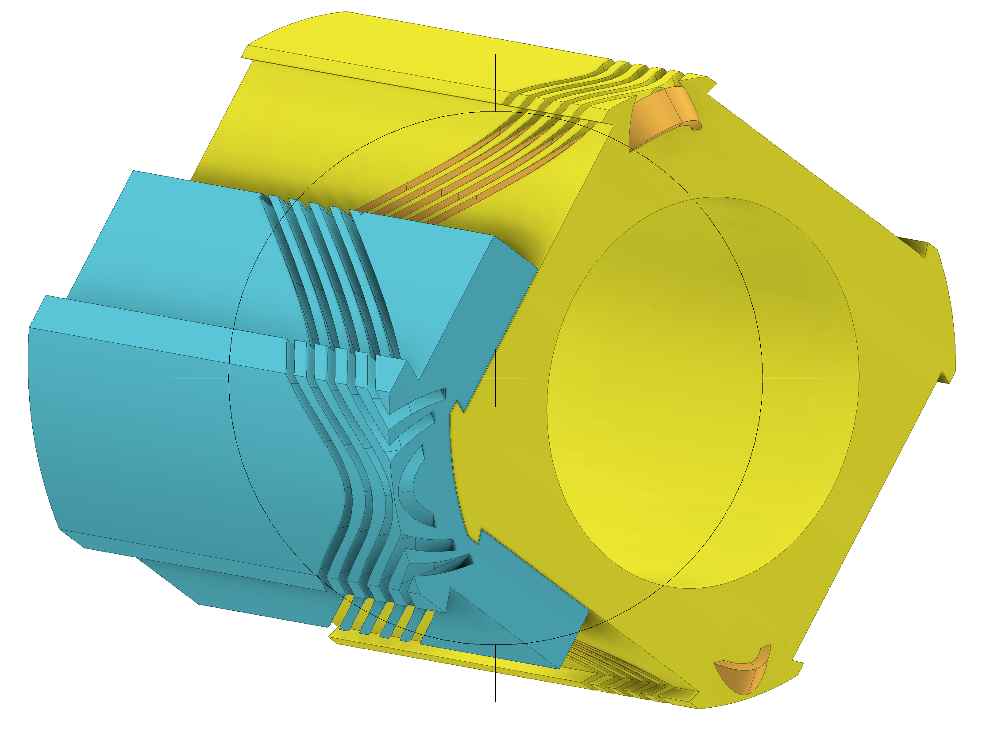
Magnetic and mechanical design of single aperture prototype
Similar in size to NbTi prototype

Slide 40
Conclusions
The first FCC-ee FF quad prototype was tested at cold with excellent results.
The choice of CCT iron-free technology seems justified.
Making the FF quads of FCC using HTS tape conductors now appears possible.
This will give sizable advantages and a proposal to build a prototype has been put forward.

Slide 41

Thank you

Slide 42
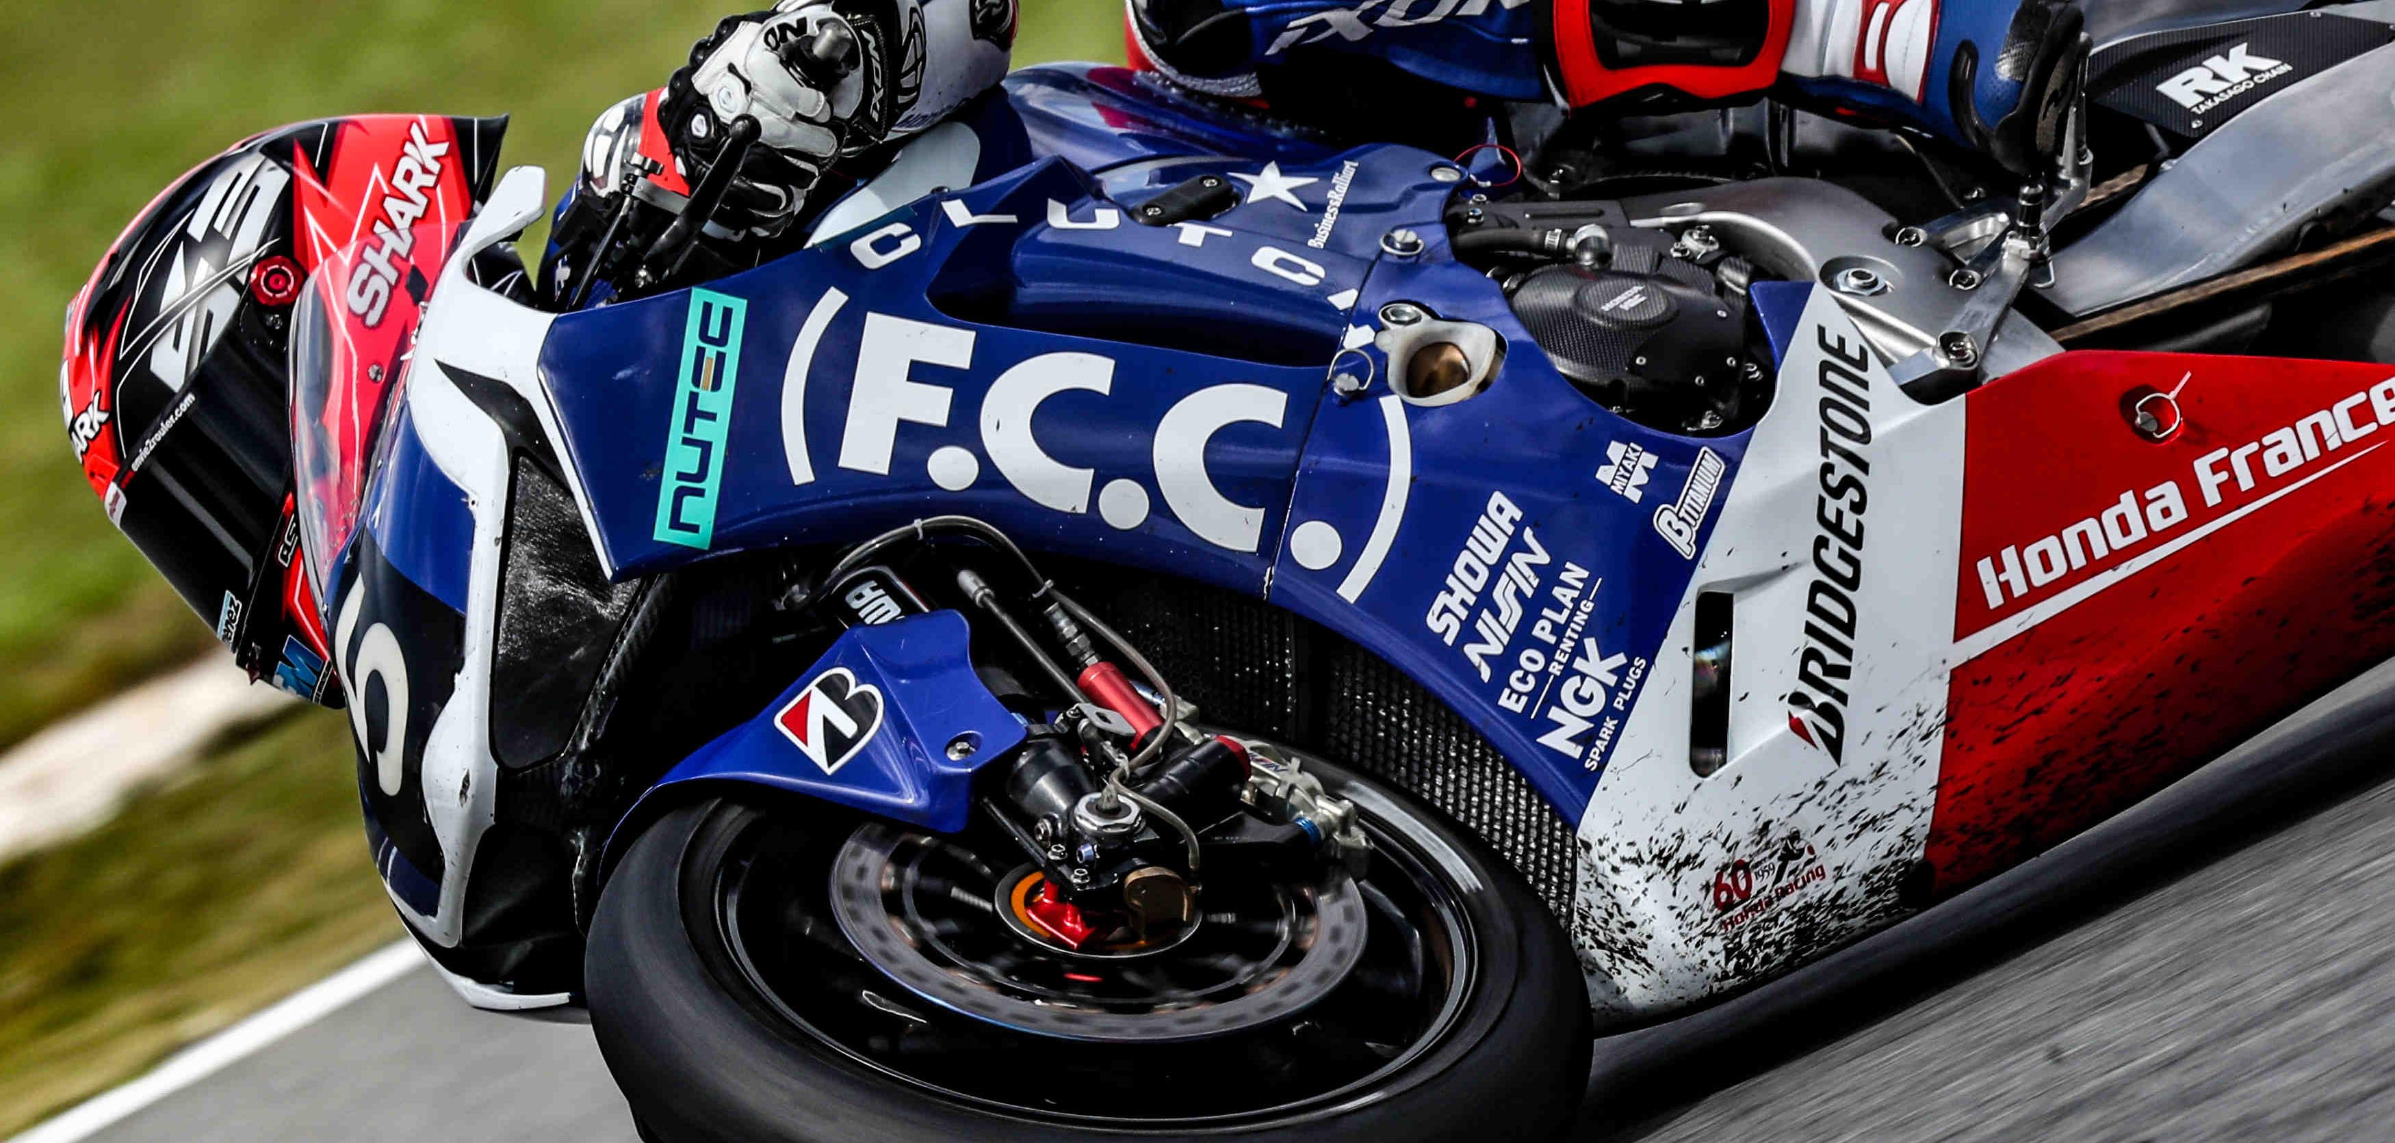
GO, FCC!

