Slide 1
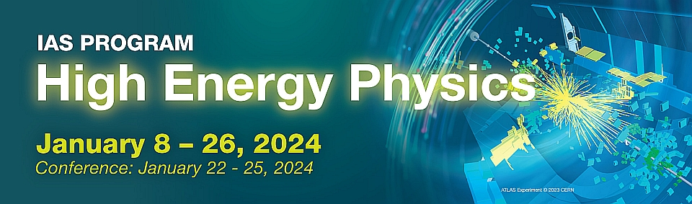
Summary - Accelerator
Dou Wang (IHEP)
IAS Program of High Energy Physics,
Hong Kong University of Science and Technology
January 24, 2024
Notes:
全部列上“极大”、“极小”。用不同颜色标注，标注出跟我们密切相关的问题。
修改：补充了科学问题，但没有列全，一方面有些问题不好界定（我整理了列表，2005年和2021年一共包含47个问题），另一方面版面排不下，要不字体太小看不清

Slide 2
Program Schedule
Mini-workshop: Green Accelerator and Colliders (Jan 18 - 19, 2024)
Carbon footprint
Efficiency of electricity consumptions
Waste heat recovery
Green energy applications, etc.
Conference: Jan 22 - 25, 2024

Slide 3
IAS-HEP 2024 Mini-Workshop: Accelerator
Future Accelerator Projects in Asia/Australia--Jie GAO (IHEP)
EAJADE Sustainability Activities for Future Large Accelerators and Colliders--Maxim TITOV (CEA Saclay, Irfu)
CEPC Towards a Green Collider--Yuhui LI (IHEP)
Green ILC--Masakazu YOSHIOKA (KEK)
CO2 Reduction Optimization with Future Colliders Design, Construction and Operation--Dou WANG (IHEP)
Energy Recover and Reuse Technology Studies for Large Green Accelerators--Rui GE (IHEP)
High Q and High Field SC Cavity Studies and Applications in Green Accelerators--Jiyuan ZHAI (IHEP)
High Efficiency Klystron Studies and Development for Green Colliders--Zusheng ZHOU (IHEP)
Overview of the Xsuite Accelerator Simulation Framework--Giovanni IADAROLA (CERN)
IHEP C3 Technology Studies--Jingru ZHANG (IHEP)
Beam Drived Plasma Accelerator and Efficiency Study--Dazhang LI (IHEP)
SC Magnets for FCCee Collider Ring--Michael KORATZINOS (CERN)
Permanent Magnets Applications in Accelerators--Mei YANG (IHEP)
Applications of High Field Superconducticity Technology--Qingjin XU (IHEP)
HEPS Green Energy Applications--Jinshu HUANG (IHEP)
Economical and High Efficiency Industrial Production of Accelerator Components--Song JIN (IHEP)
Accelerator parallel, hybrid on-line and in-person meeting
Tuesday-Friday, 2 days, 6 sessions, 16 talks
  2 Switzerland (CERN)
  1 France (CEA, irfu)
  1 Japan (KEK)
  12 China (IHEP)
Notes:
全部列上“极大”、“极小”。用不同颜色标注，标注出跟我们密切相关的问题。
修改：补充了科学问题，但没有列全，一方面有些问题不好界定（我整理了列表，2005年和2021年一共包含47个问题），另一方面版面排不下，要不字体太小看不清

Slide 4

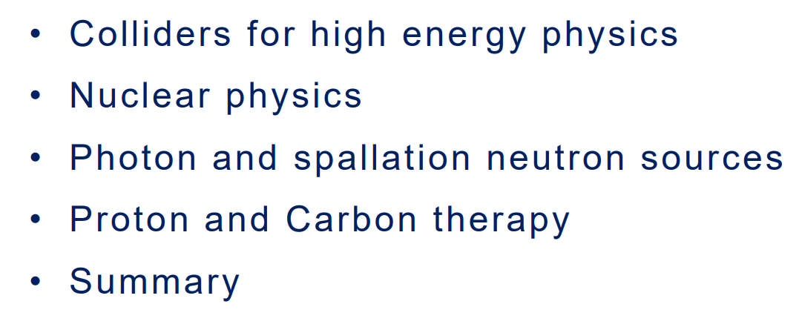
Notes:
全部列上“极大”、“极小”。用不同颜色标注，标注出跟我们密切相关的问题。
修改：补充了科学问题，但没有列全，一方面有些问题不好界定（我整理了列表，2005年和2021年一共包含47个问题），另一方面版面排不下，要不字体太小看不清

Slide 5
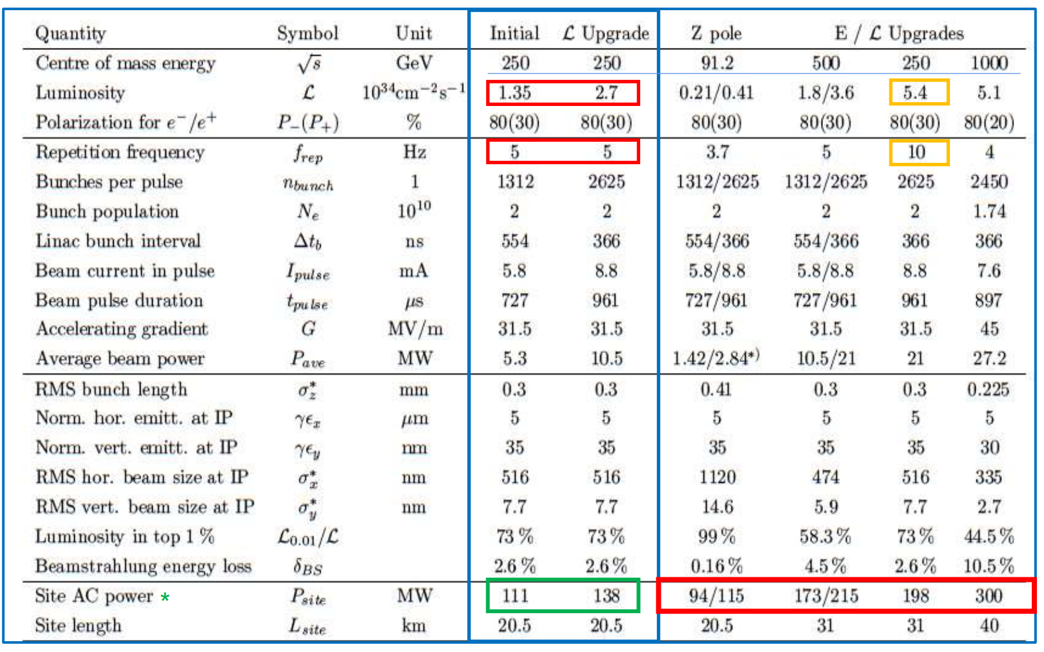
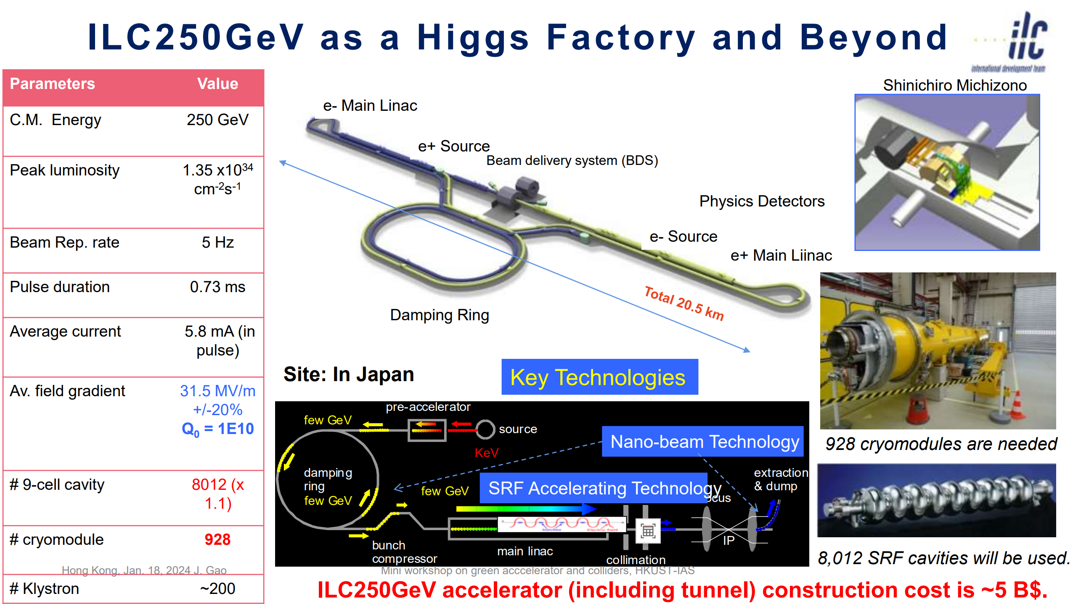
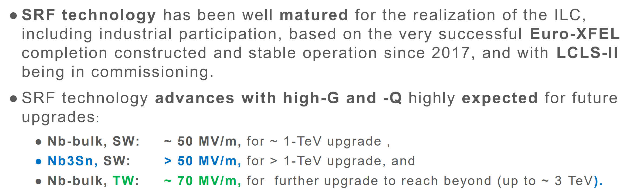
Future accelerator facilities in Asia and Australia: ILC250 GeV
Notes:
全部列上“极大”、“极小”。用不同颜色标注，标注出跟我们密切相关的问题。
修改：补充了科学问题，但没有列全，一方面有些问题不好界定（我整理了列表，2005年和2021年一共包含47个问题），另一方面版面排不下，要不字体太小看不清

Slide 6
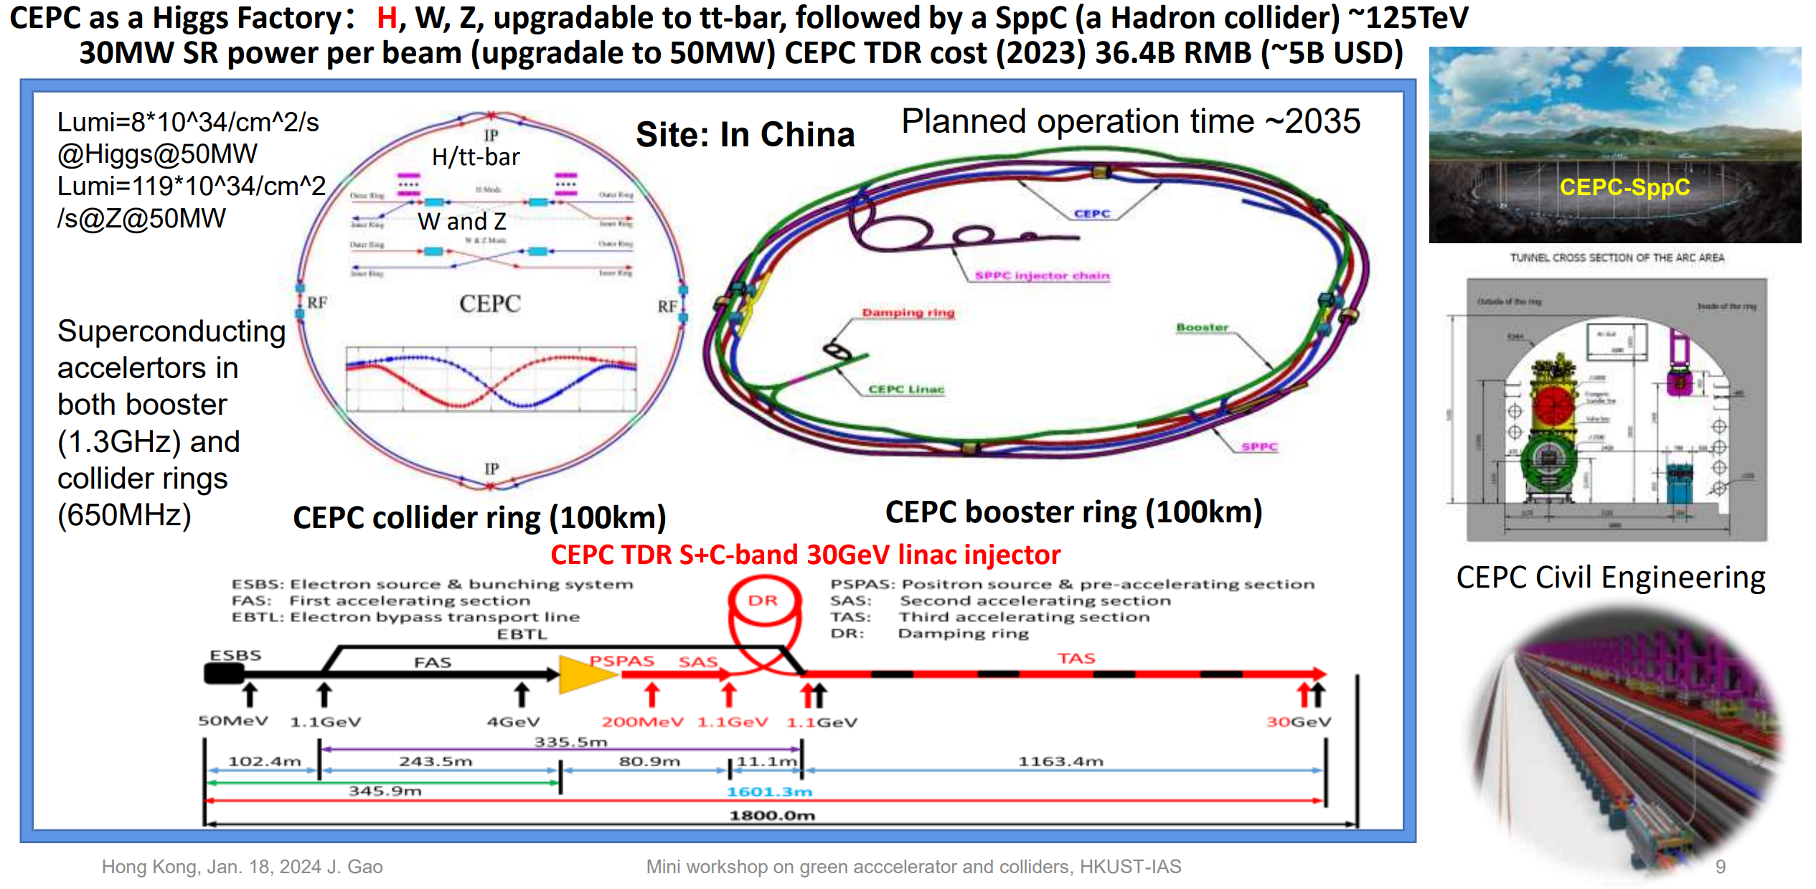
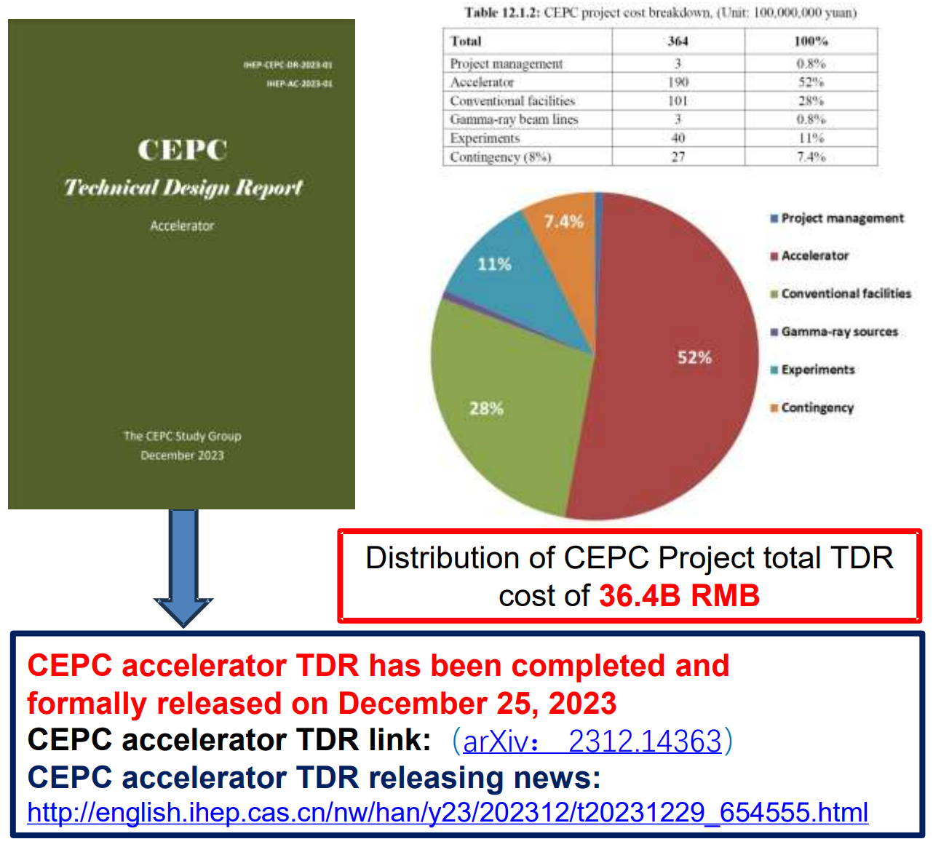
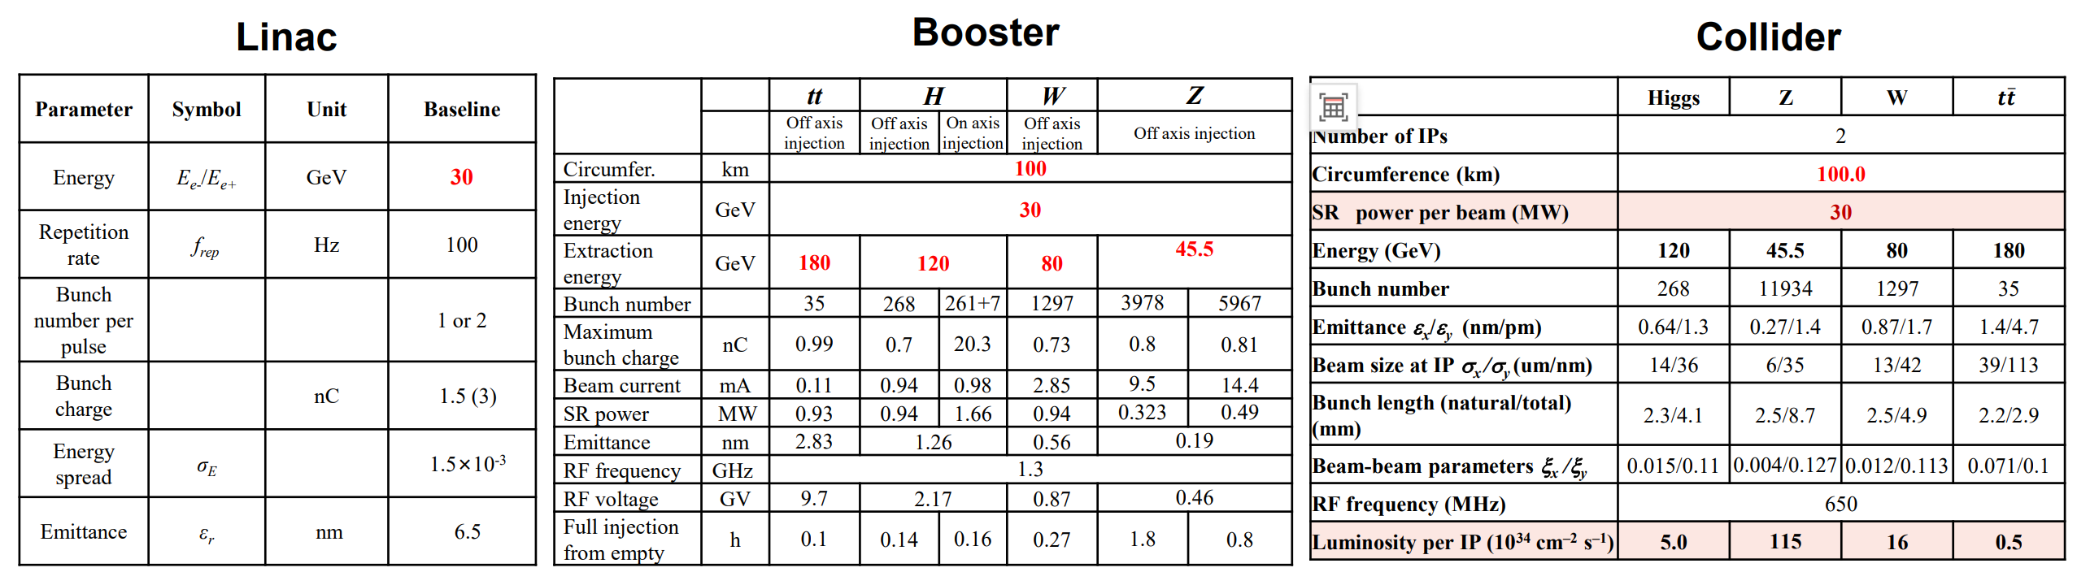
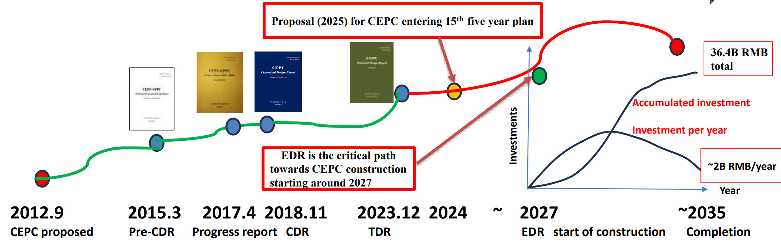
Future accelerator facilities in Asia and Australia: CEPC
Notes:
全部列上“极大”、“极小”。用不同颜色标注，标注出跟我们密切相关的问题。
修改：补充了科学问题，但没有列全，一方面有些问题不好界定（我整理了列表，2005年和2021年一共包含47个问题），另一方面版面排不下，要不字体太小看不清

Slide 7
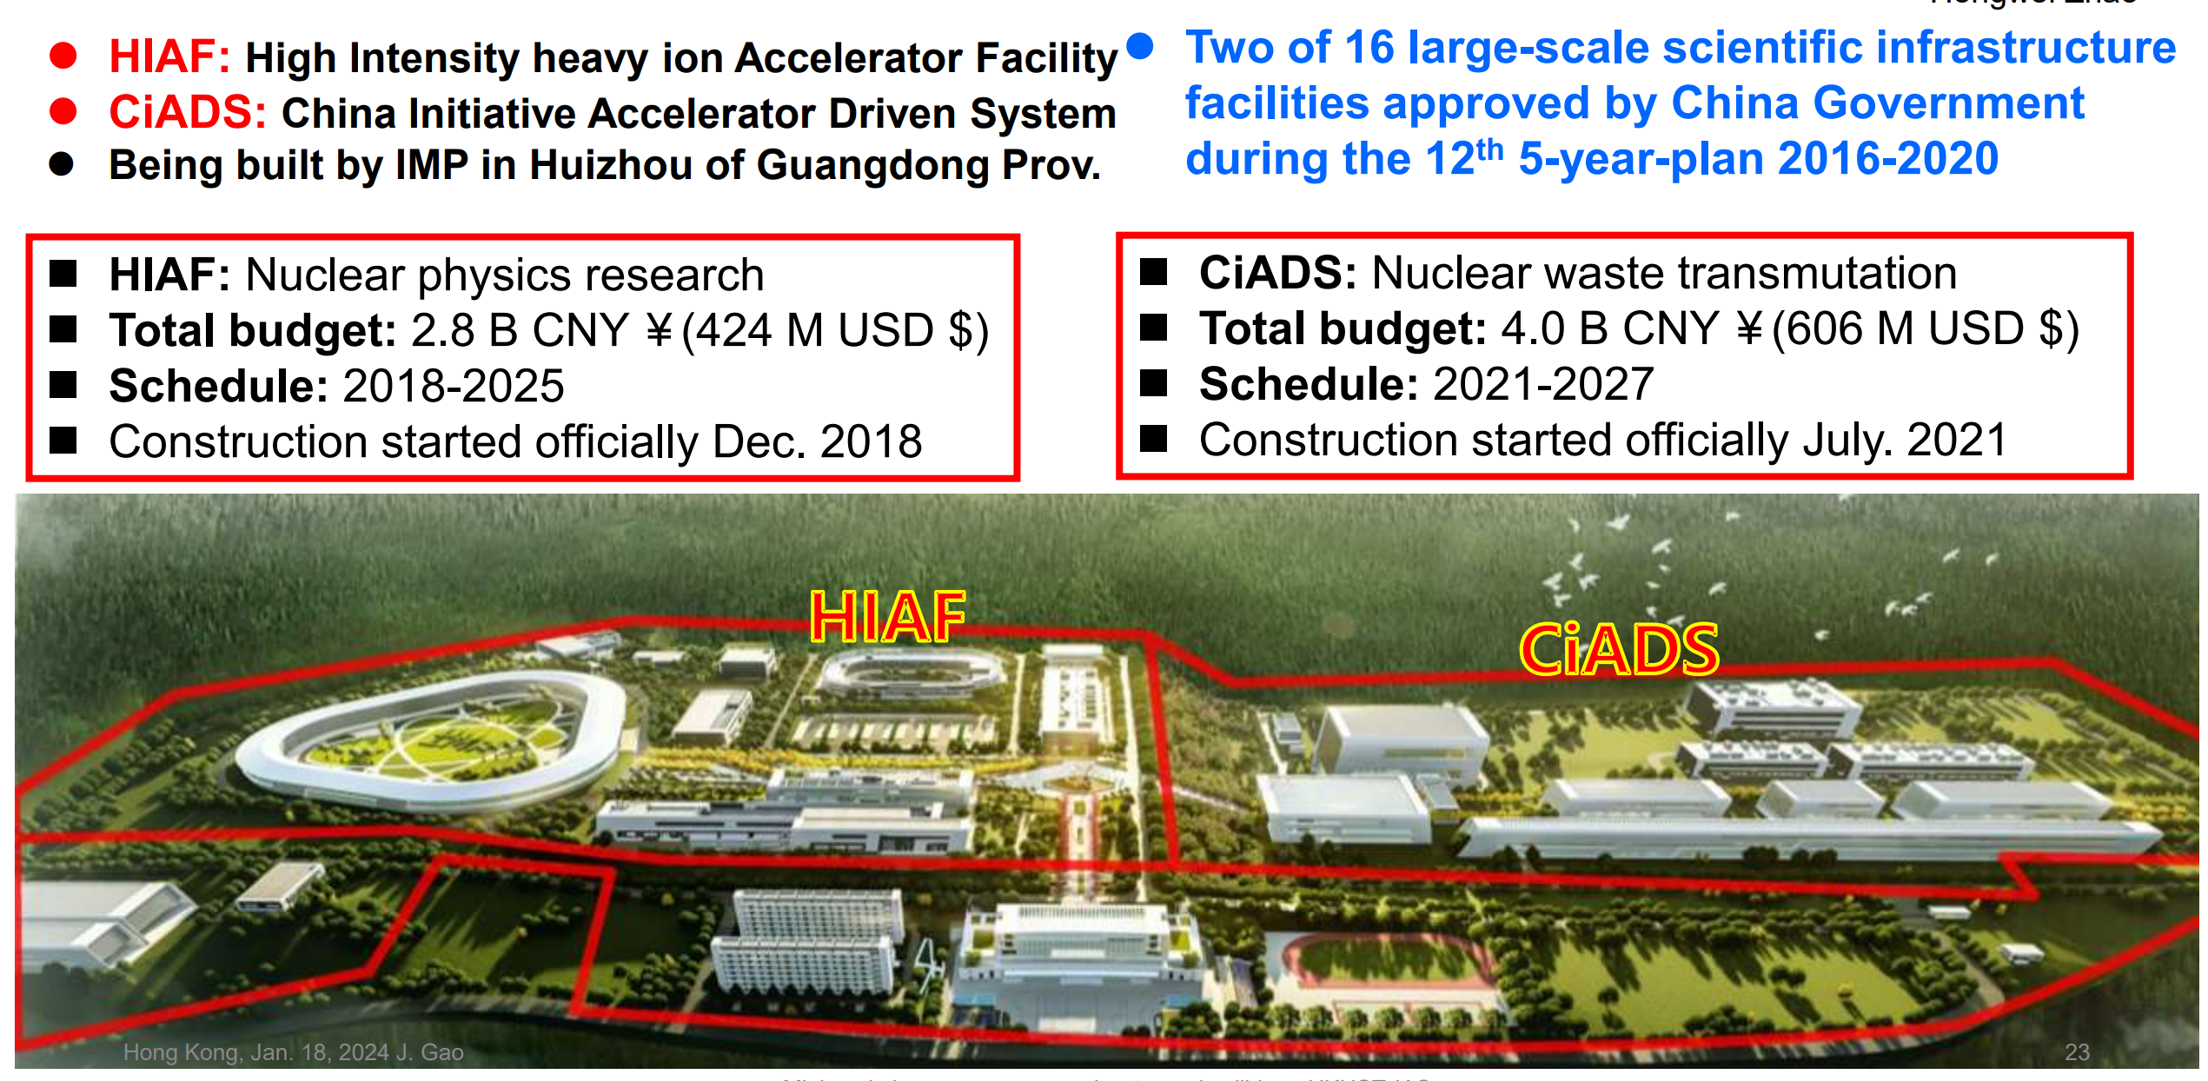
Future accelerator facilities in Asia and Australia: HIAF & CiADS
Notes:
全部列上“极大”、“极小”。用不同颜色标注，标注出跟我们密切相关的问题。
修改：补充了科学问题，但没有列全，一方面有些问题不好界定（我整理了列表，2005年和2021年一共包含47个问题），另一方面版面排不下，要不字体太小看不清

Slide 8
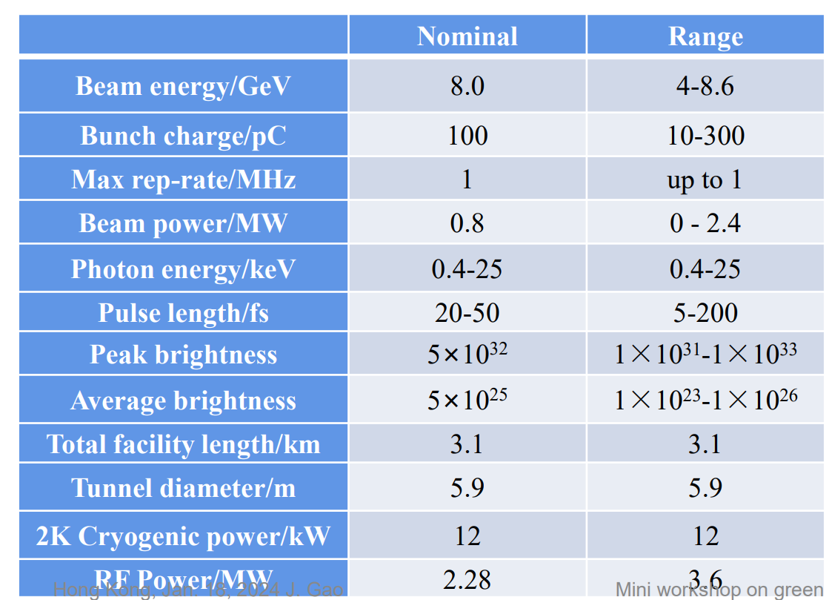
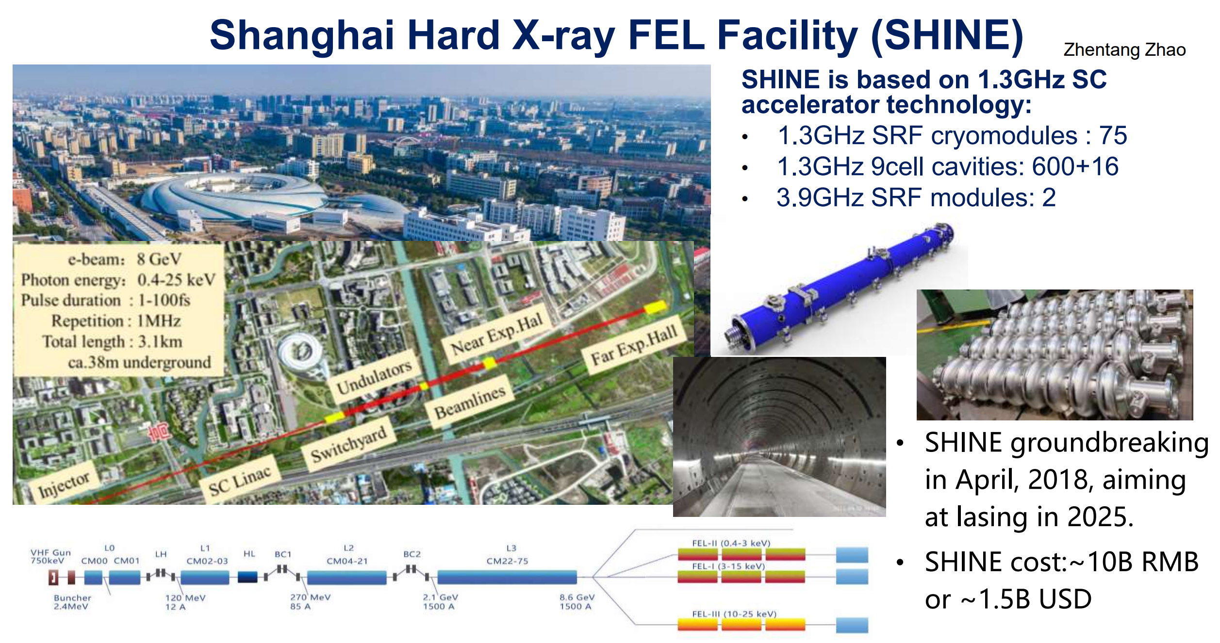
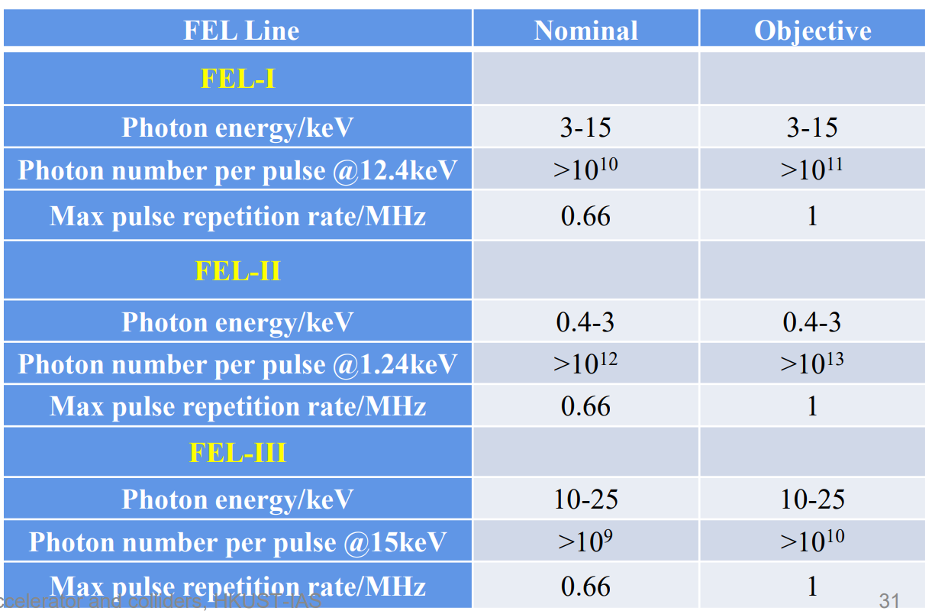
Future accelerator facilities in Asia and Australia: SHINE-FEL
Notes:
全部列上“极大”、“极小”。用不同颜色标注，标注出跟我们密切相关的问题。
修改：补充了科学问题，但没有列全，一方面有些问题不好界定（我整理了列表，2005年和2021年一共包含47个问题），另一方面版面排不下，要不字体太小看不清

Slide 9
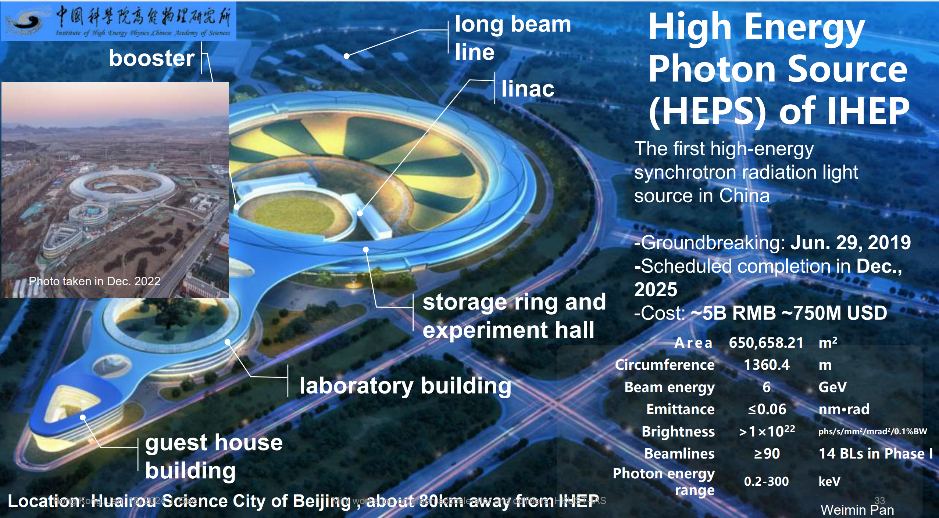
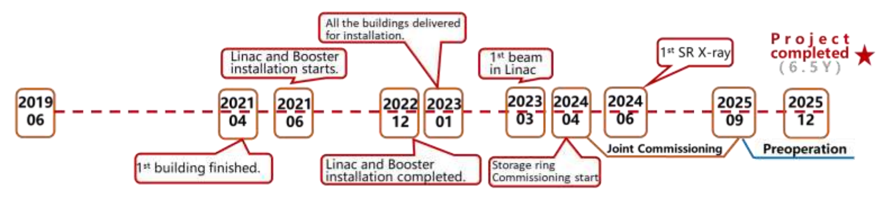
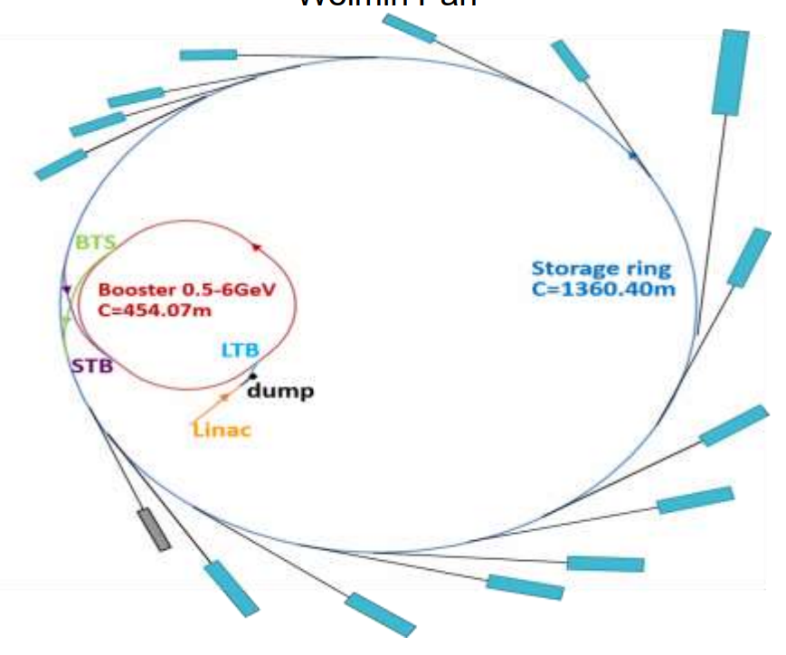
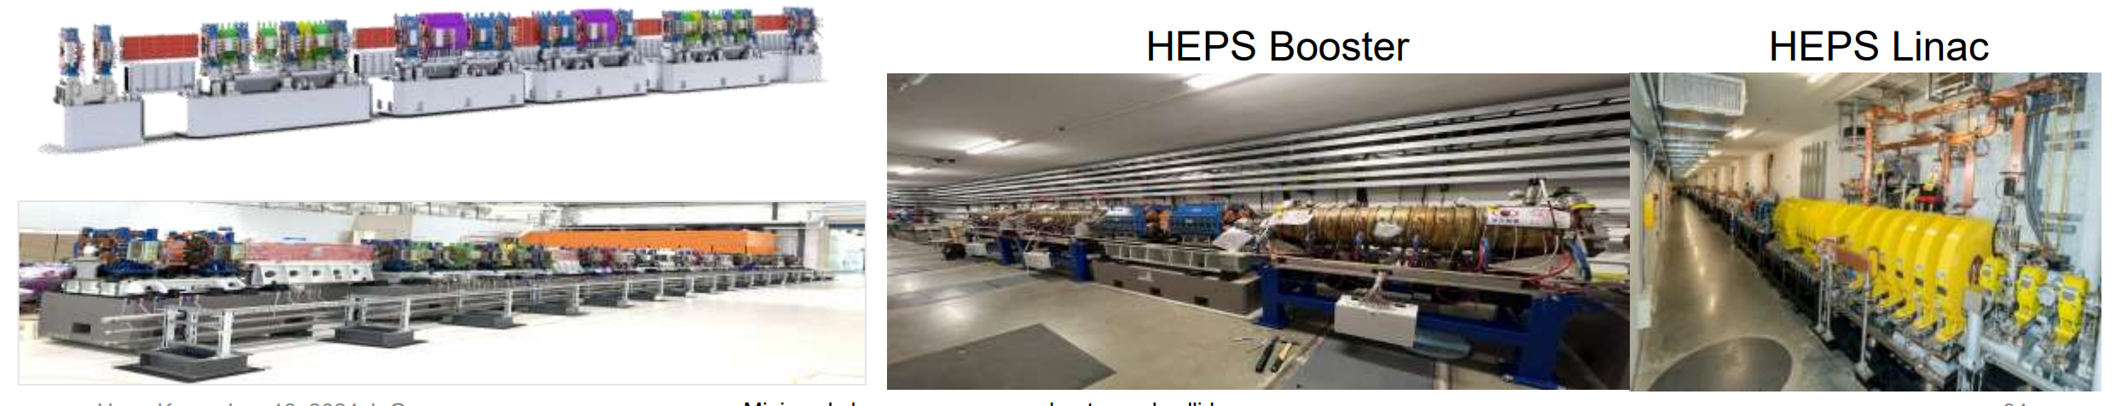
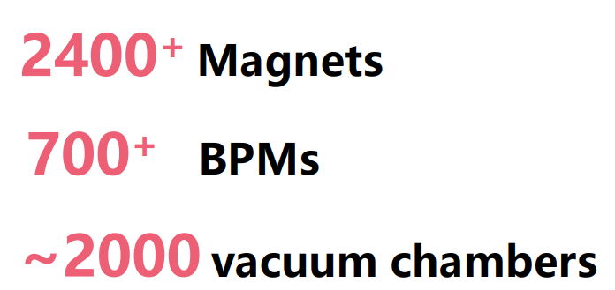
Future accelerator facilities in Asia and Australia: HEPS
Notes:
全部列上“极大”、“极小”。用不同颜色标注，标注出跟我们密切相关的问题。
修改：补充了科学问题，但没有列全，一方面有些问题不好界定（我整理了列表，2005年和2021年一共包含47个问题），另一方面版面排不下，要不字体太小看不清

Slide 10

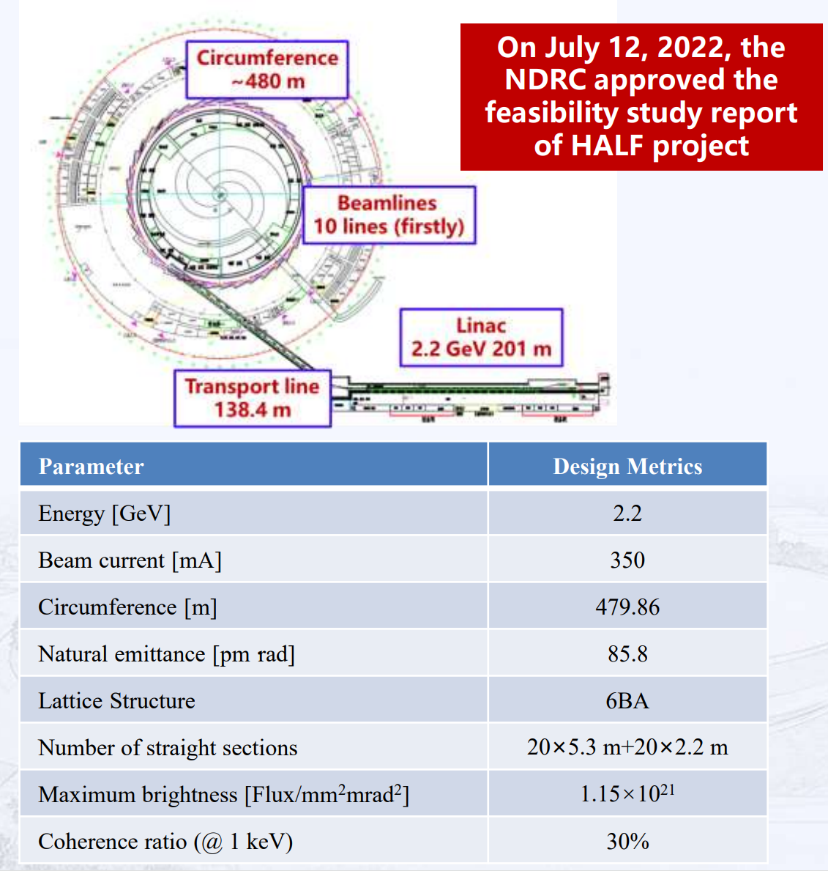
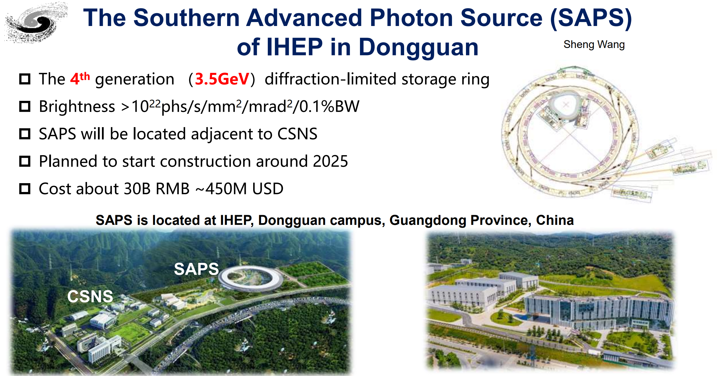
Future accelerator facilities in Asia and Australia: HALF & SAPS
Notes:
全部列上“极大”、“极小”。用不同颜色标注，标注出跟我们密切相关的问题。
修改：补充了科学问题，但没有列全，一方面有些问题不好界定（我整理了列表，2005年和2021年一共包含47个问题），另一方面版面排不下，要不字体太小看不清

Slide 11
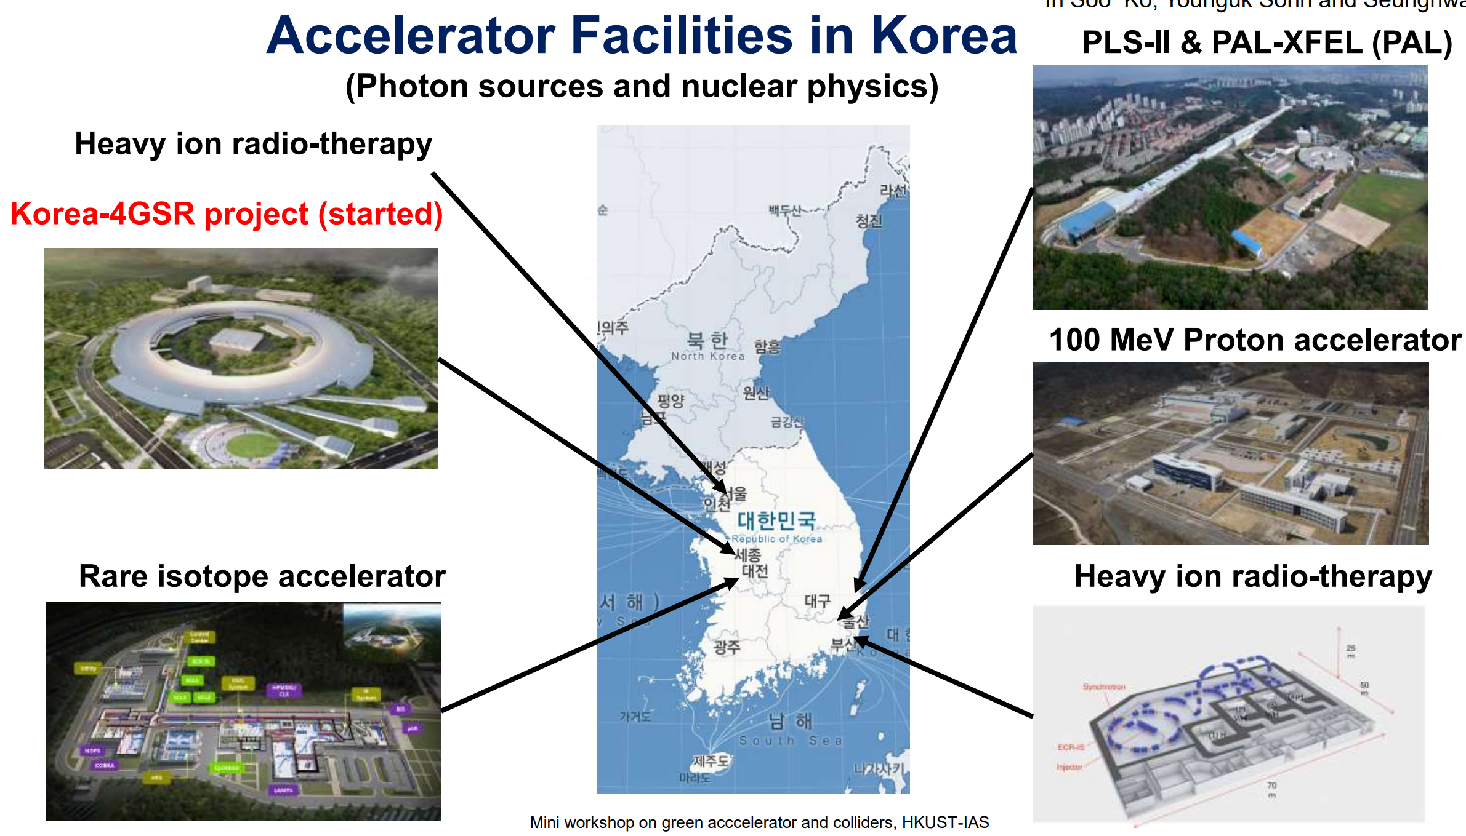
Future accelerator facilities in Asia and Australia: Korea
Notes:
全部列上“极大”、“极小”。用不同颜色标注，标注出跟我们密切相关的问题。
修改：补充了科学问题，但没有列全，一方面有些问题不好界定（我整理了列表，2005年和2021年一共包含47个问题），另一方面版面排不下，要不字体太小看不清

Slide 12
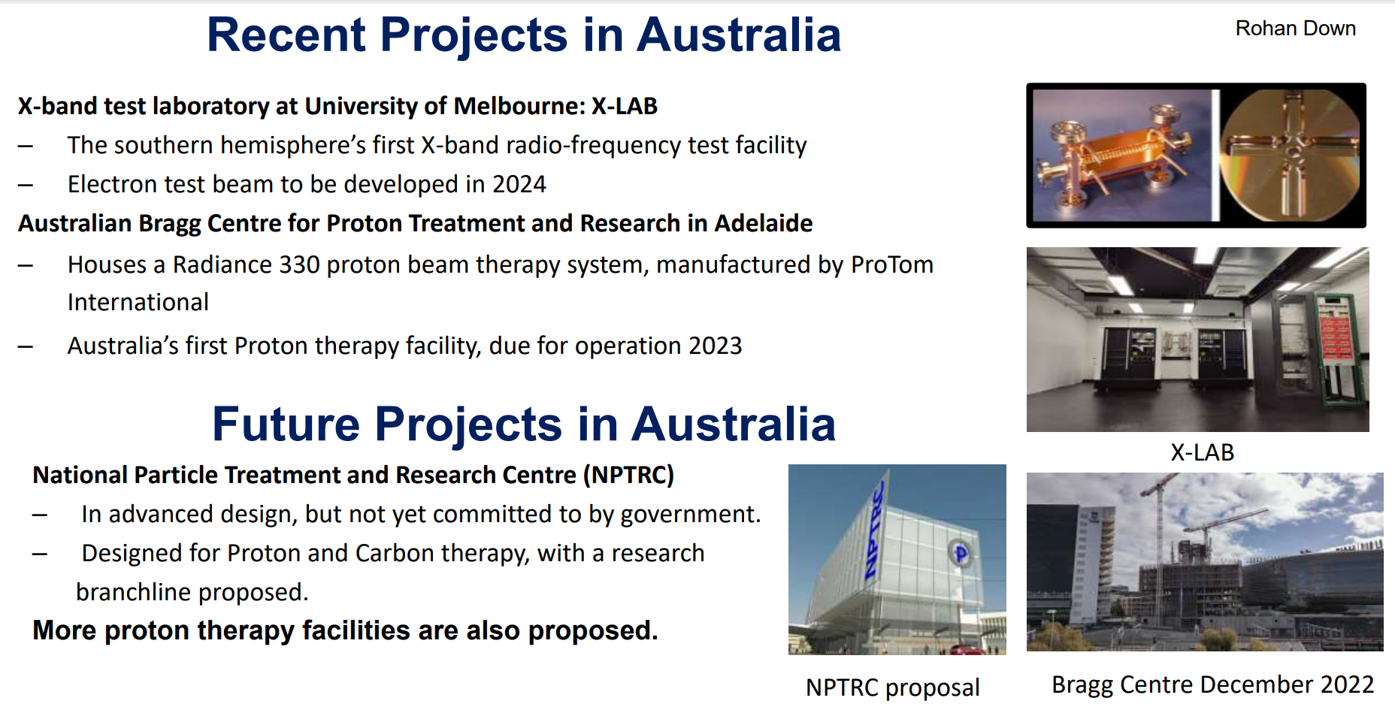
Future accelerator facilities in Asia and Australia: Australia
Notes:
全部列上“极大”、“极小”。用不同颜色标注，标注出跟我们密切相关的问题。
修改：补充了科学问题，但没有列全，一方面有些问题不好界定（我整理了列表，2005年和2021年一共包含47个问题），另一方面版面排不下，要不字体太小看不清

Slide 13
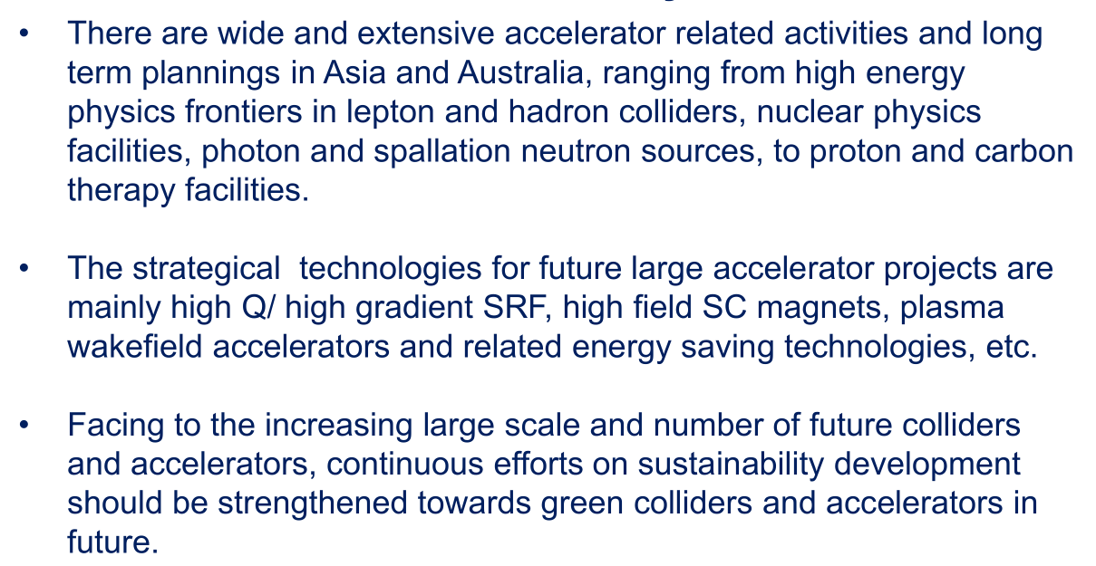
Summary

Slide 14
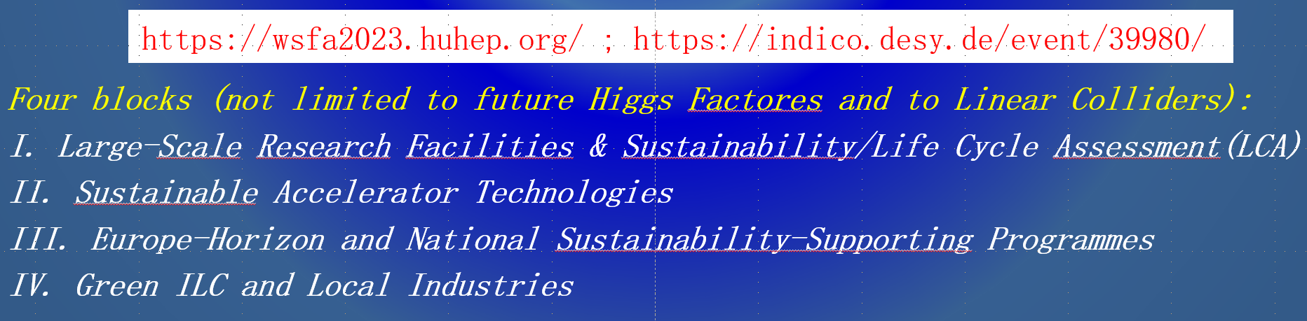
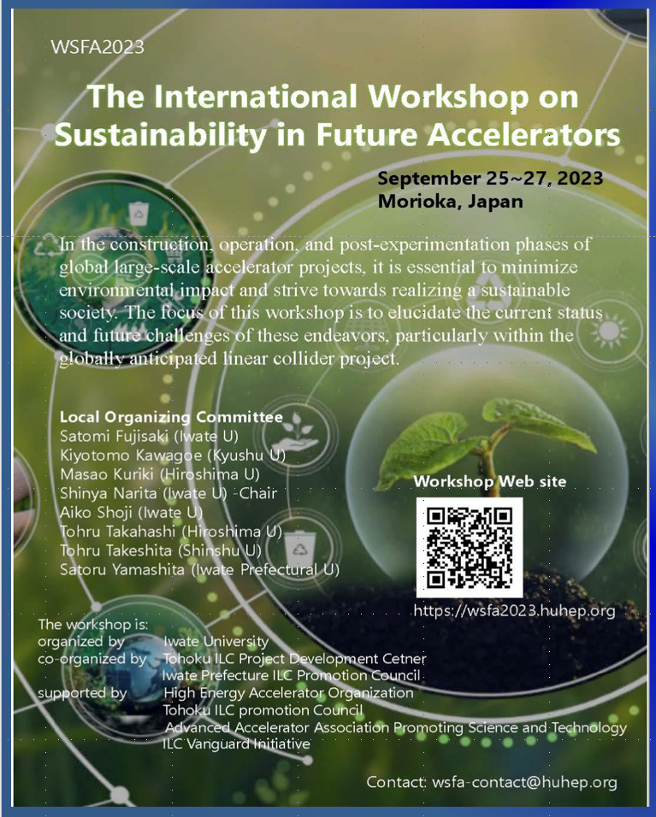
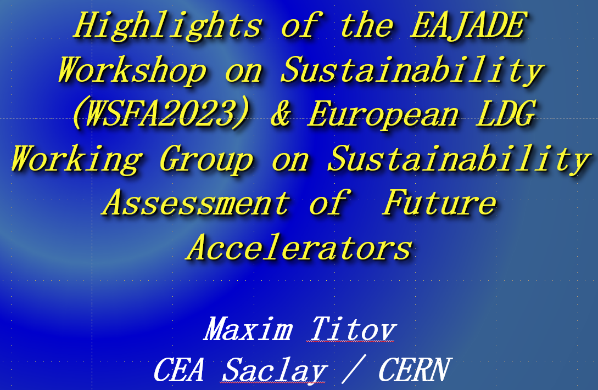
EAJADE Sustainability Activities for Future Large Accelerators and Colliders
Notes:
全部列上“极大”、“极小”。用不同颜色标注，标注出跟我们密切相关的问题。
修改：补充了科学问题，但没有列全，一方面有些问题不好界定（我整理了列表，2005年和2021年一共包含47个问题），另一方面版面排不下，要不字体太小看不清

Slide 15

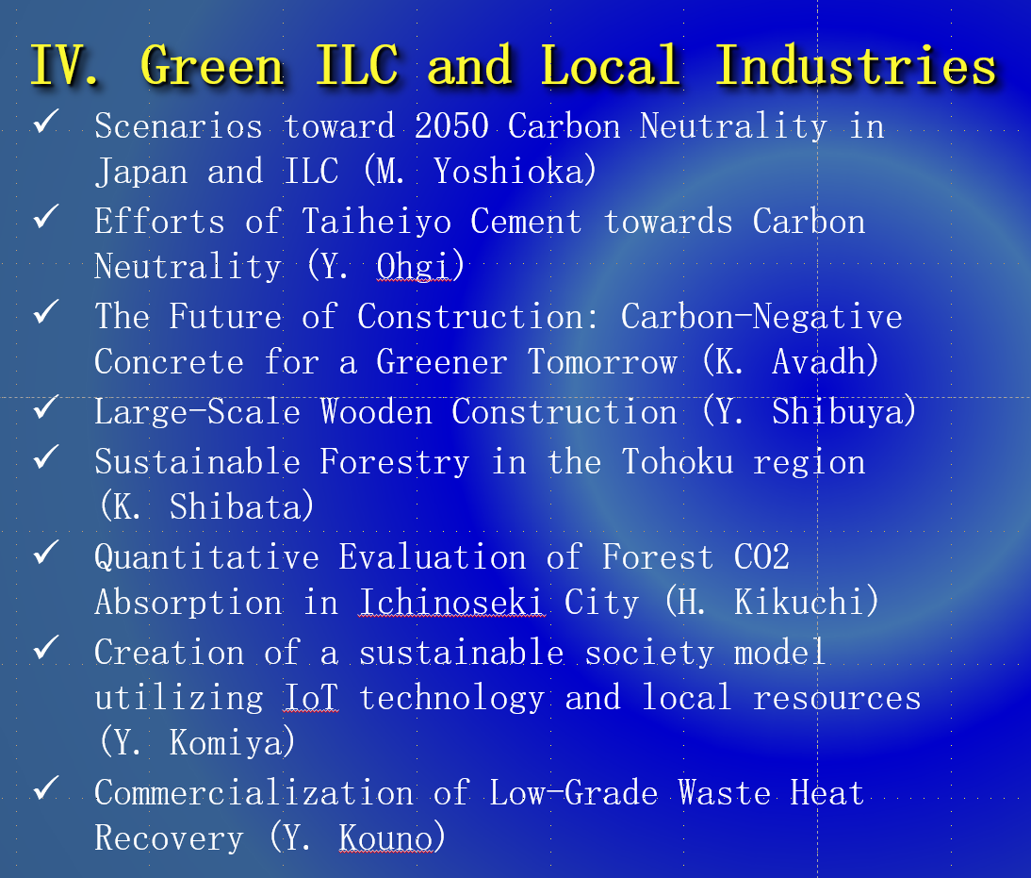
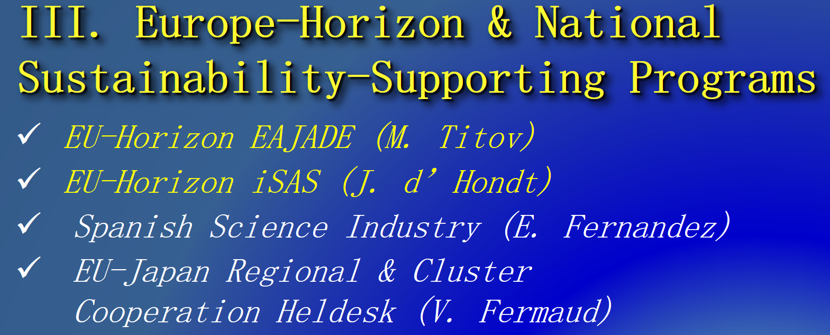
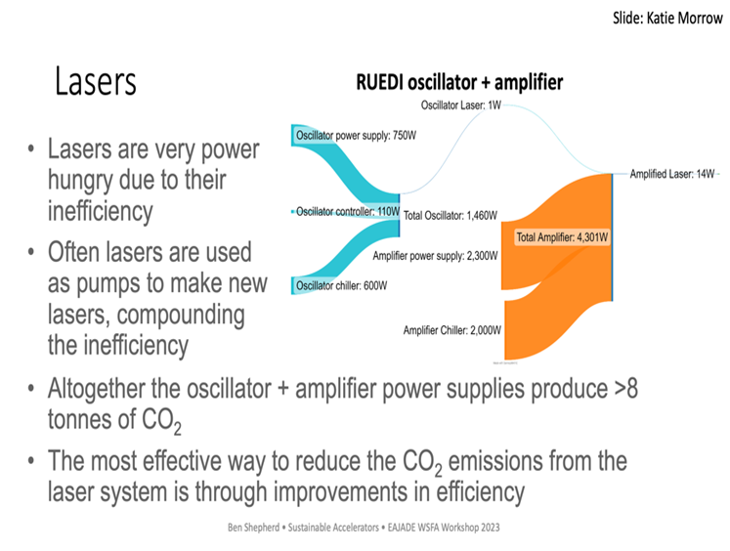
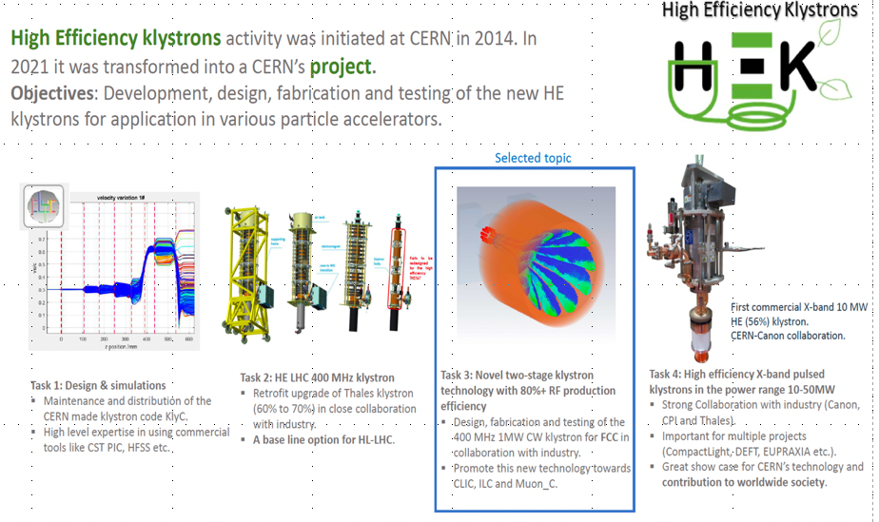
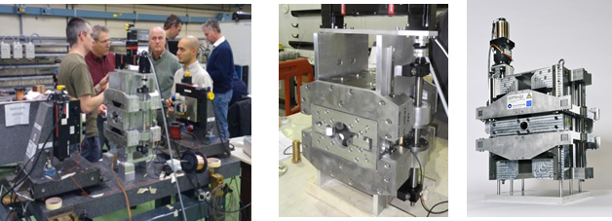
EAJADE workshop on sustainability & assessment of future Acc.
Notes:
全部列上“极大”、“极小”。用不同颜色标注，标注出跟我们密切相关的问题。
修改：补充了科学问题，但没有列全，一方面有些问题不好界定（我整理了列表，2005年和2021年一共包含47个问题），另一方面版面排不下，要不字体太小看不清

Slide 16
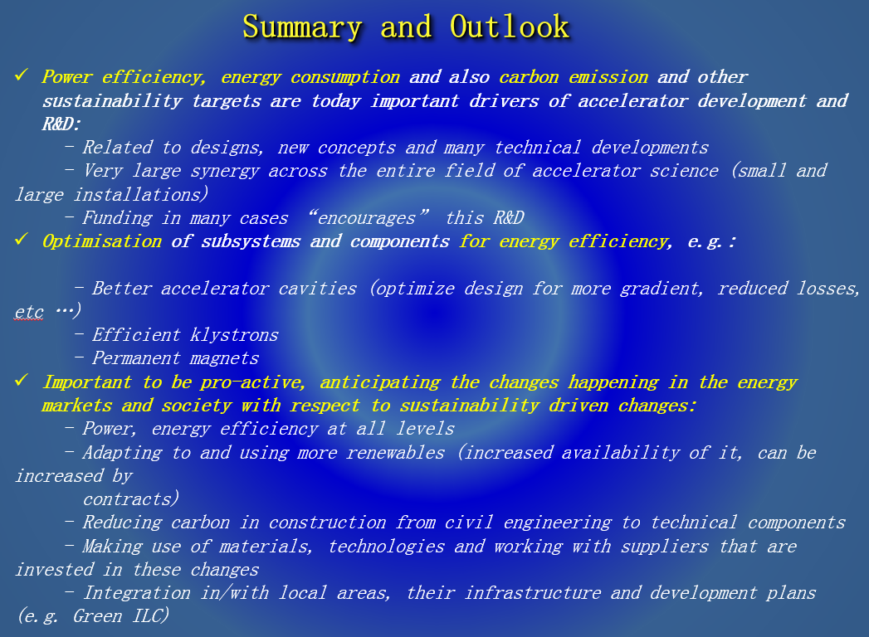
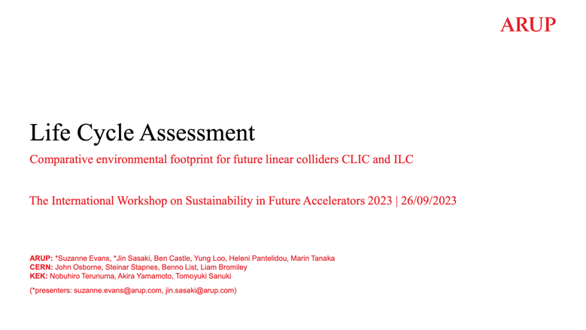

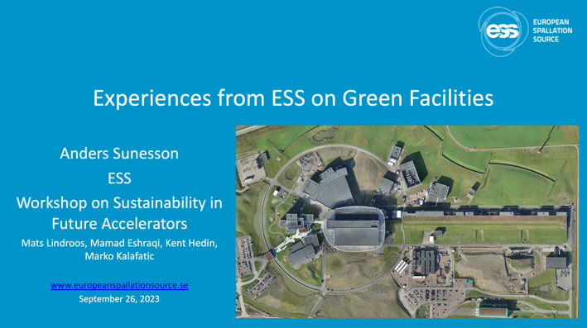
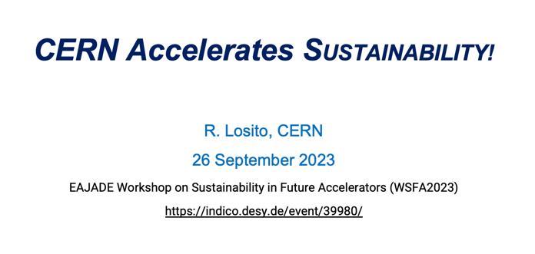

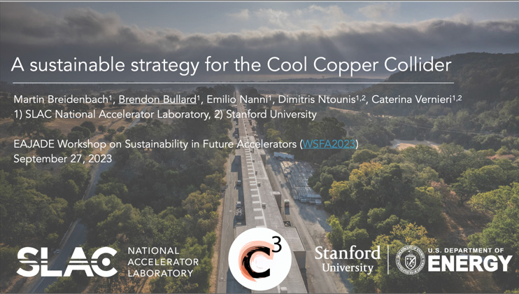

EAJADE workshop on sustainability & assessment of future Acc.
Notes:
全部列上“极大”、“极小”。用不同颜色标注，标注出跟我们密切相关的问题。
修改：补充了科学问题，但没有列全，一方面有些问题不好界定（我整理了列表，2005年和2021年一共包含47个问题），另一方面版面排不下，要不字体太小看不清

Slide 17
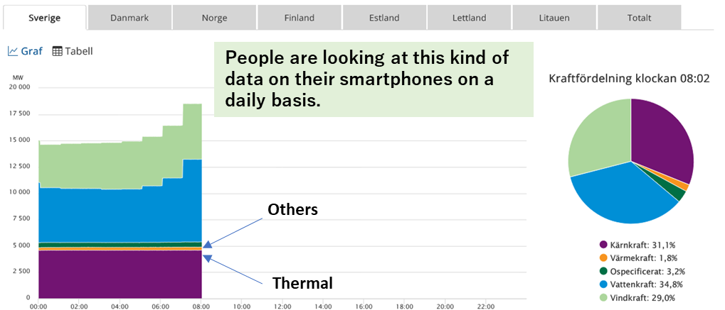
Green ILC
Accelerator researchers are making following four efforts to achieve sustainable accelerator facilities
Increasing the power efficiency and performance of accelerator components.
Electricity used by accelerators should be provided by sustainable power sources instead of fossil fuels, and effective local use of the waste heat energy emitted from the accelerator.
To this end, we will help to increase the amount of sustainable electricity in the region and create regional energy management business using waste heat.
Cooperate to increase Green Carbon (from forests), Blue Carbon (from seaweed), and White Carbon (CO₂ fixation by increasing wooden buildings) in the region to increase CO₂ absorption.
Sweden and Europe have liberalized their electricity markets and electricity is traded under free competition.
Electricity networks are interconnected and power is transmitted and distributed across borders.
The objective of the electricity market is to use integrated resources as efficiently as possible to meet the demands of electricity users.
The public can view the following electricity statuses at any time in real time (https://www.svk.se/om-kraftsystemet/kontrollrummet/)
Notes:
全部列上“极大”、“极小”。用不同颜色标注，标注出跟我们密切相关的问题。
修改：补充了科学问题，但没有列全，一方面有些问题不好界定（我整理了列表，2005年和2021年一共包含47个问题），另一方面版面排不下，要不字体太小看不清

Slide 18
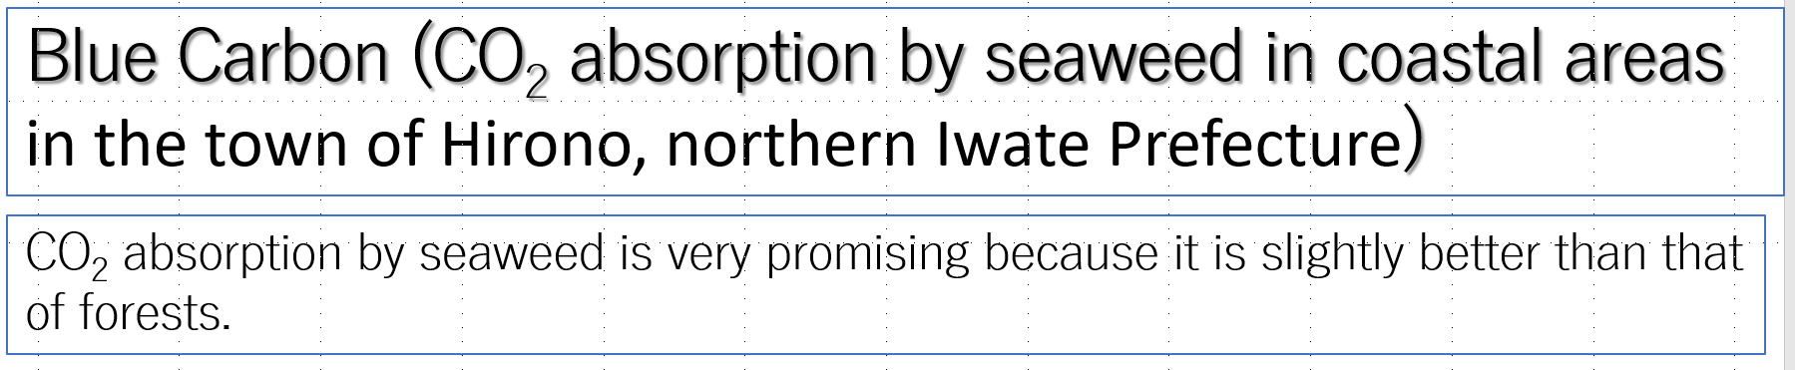
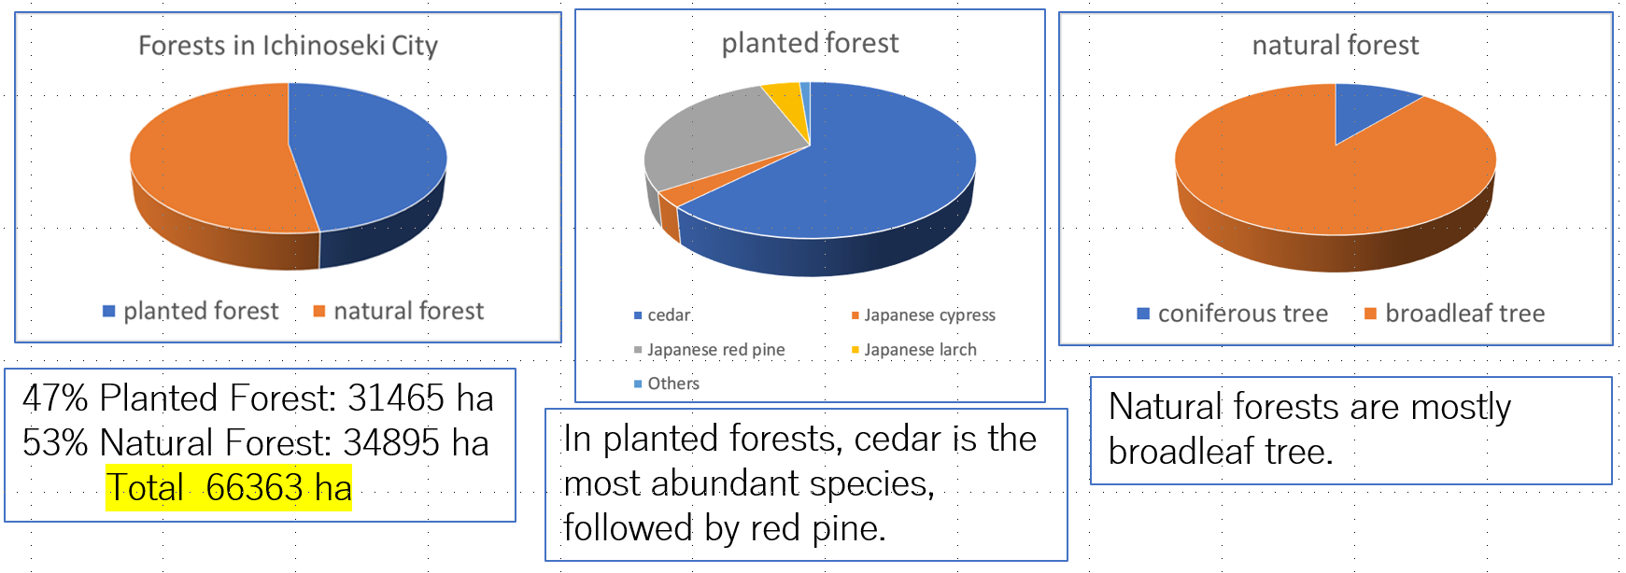
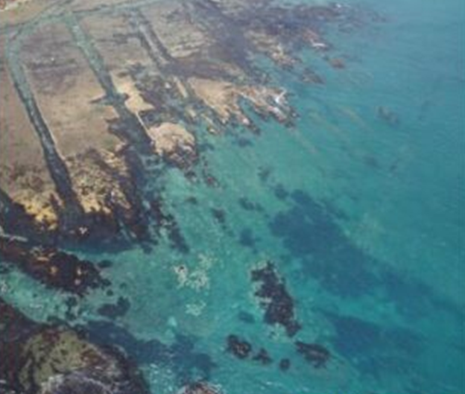
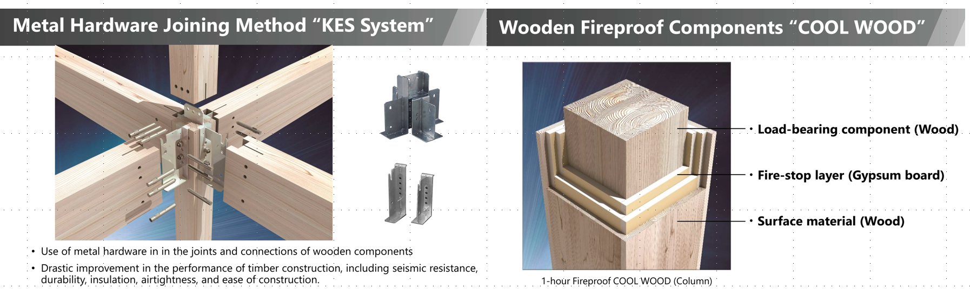
Green ILC
Green Carbon
White Carbon
Notes:
全部列上“极大”、“极小”。用不同颜色标注，标注出跟我们密切相关的问题。
修改：补充了科学问题，但没有列全，一方面有些问题不好界定（我整理了列表，2005年和2021年一共包含47个问题），另一方面版面排不下，要不字体太小看不清

Slide 19

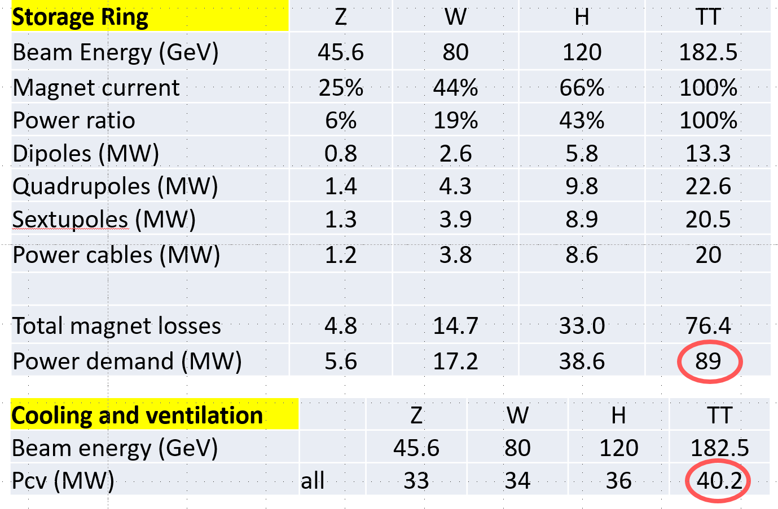
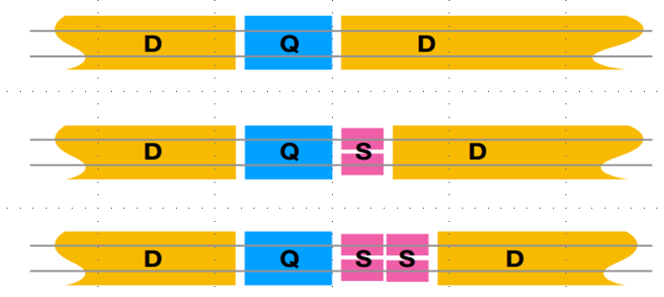
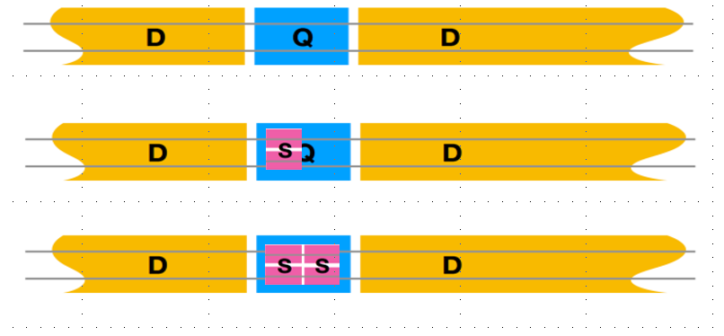
Future accelerator facilities in Asia and Australia
Magnet is the major electricity consumer after SRF, and we pay twice for normal conducting magnets: one through ohmic losses, and again for removing the heat with our cooling and ventilation (CV) system.
Total contribution of the collider ring magnets is therefore ~100MW at the top, 76% of which comes from the quads and sextupoles
Replace the NC Q+S. by HTS Mag.: zero Ohmic loss + higher packing factor
Potential additional benefit: More space (~7%) for dipole and reduction of the RF power
Notes:
全部列上“极大”、“极小”。用不同颜色标注，标注出跟我们密切相关的问题。
修改：补充了科学问题，但没有列全，一方面有些问题不好界定（我整理了列表，2005年和2021年一共包含47个问题），另一方面版面排不下，要不字体太小看不清

Slide 20
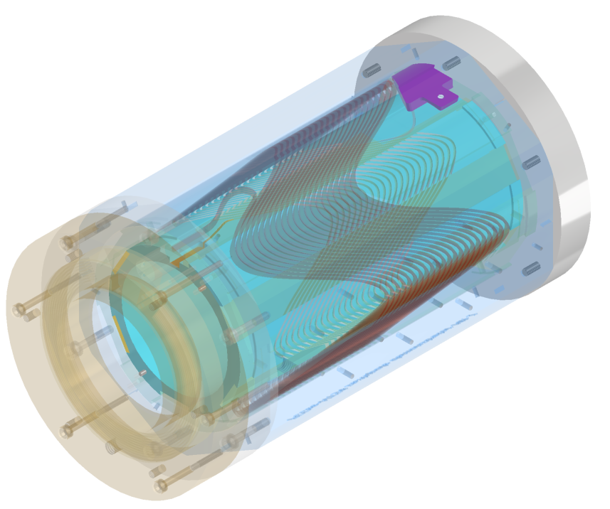
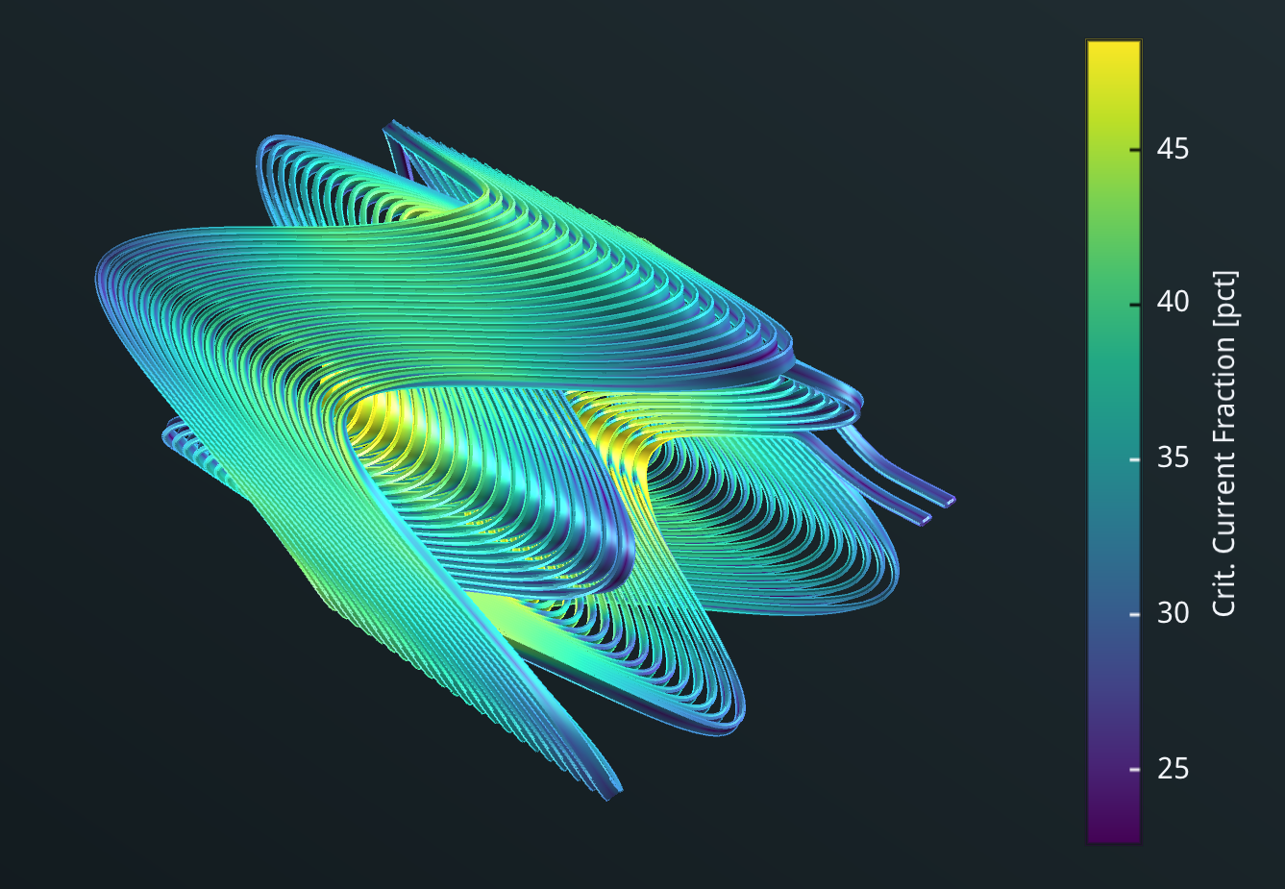
sextupole demonstrator
SC for the FCCee collider
Choose a CCT magnet layout due to
  Ease of construction
  Good field quality
  Quick design cycle
Other approaches (i.e. standard cosine-theta) will also be pursued
Demonstration of the HTS tape CCT magnet
Specifications:
Aperture: 90mm
Current: 260A
Temperature: 40K
Field gradient: 1000T/m2
Max. field @conductor:1.5T
Crit. Current fraction: 49%
Temp. margin: 14K
Notes:
全部列上“极大”、“极小”。用不同颜色标注，标注出跟我们密切相关的问题。
修改：补充了科学问题，但没有列全，一方面有些问题不好界定（我整理了列表，2005年和2021年一共包含47个问题），另一方面版面排不下，要不字体太小看不清

Slide 21
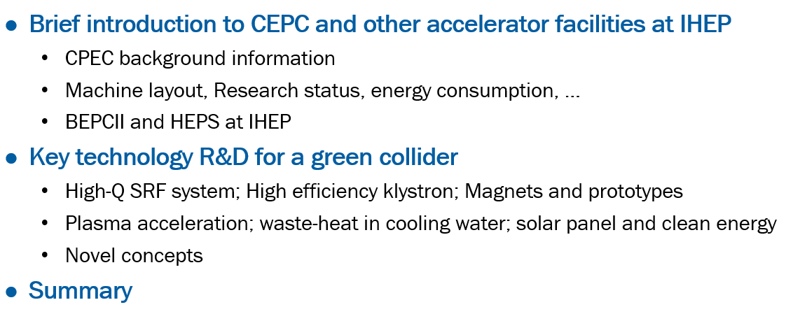
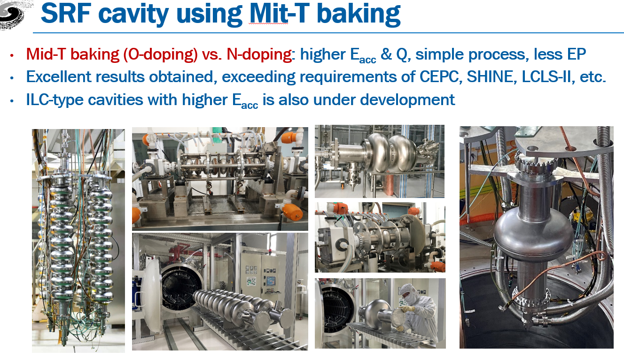
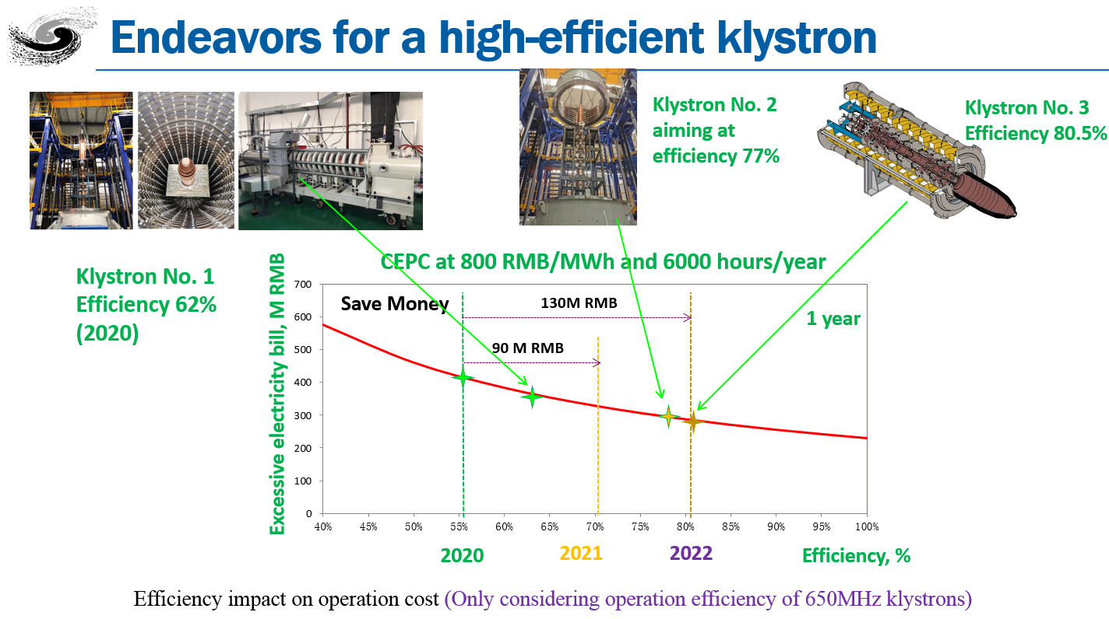
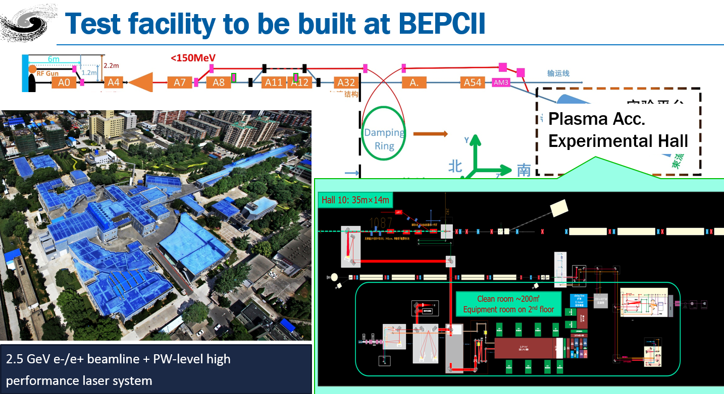

CEPC Efforts Towards a Green Collider
Yuhui Li

Slide 22


Cryogenic power decrease with high Q Niobium cavities
- CEPC 650 MHz 2-cell cavity Q₀ at 2 K vs cryogenic AC power of total cavity wall loss: 1E10 ~ 9 MW, 3E10 ~ 3 MW, 6E10 ~ 1.5 MW, 1E11 ~ 1 MW
Gain from further-increasing Q is marginal!
Cryogenic power decrease with high Q SRF Nb₃Sn cavities
  650 MHz Nb₃Sn 2 K Q₀ at ~ 20 MV/m lower than Nb (no-doping or N/O doping)
  ~ 20 MV/ m Nb₃Sn 4.2 K cryo efficiency similar to Nb at 2 K, lower than high Q Nb at 2 K
  650 MHz Nb cavity at 4.2 K Q₀ ~ 2E9. If use cryocooler at 4.2 K for industry application (~ 10 MV/m), Nb₃Sn is the only choice. COP of cryocooler not efficient for large accelerators.
Notes:
全部列上“极大”、“极小”。用不同颜色标注，标注出跟我们密切相关的问题。
修改：补充了科学问题，但没有列全，一方面有些问题不好界定（我整理了列表，2005年和2021年一共包含47个问题），另一方面版面排不下，要不字体太小看不清

Slide 23



High-Q, high-gradient SRF application for a green accelerator
Notes:
全部列上“极大”、“极小”。用不同颜色标注，标注出跟我们密切相关的问题。
修改：补充了科学问题，但没有列全，一方面有些问题不好界定（我整理了列表，2005年和2021年一共包含47个问题），另一方面版面排不下，要不字体太小看不清

Slide 24






High-efficiency klystrons R&D status for CEPC
Notes:
全部列上“极大”、“极小”。用不同颜色标注，标注出跟我们密切相关的问题。
修改：补充了科学问题，但没有列全，一方面有些问题不好界定（我整理了列表，2005年和2021年一共包含47个问题），另一方面版面排不下，要不字体太小看不清

Slide 25

Increasing efficiency by decelerating the used beams at collector
Notes:
全部列上“极大”、“极小”。用不同颜色标注，标注出跟我们密切相关的问题。
修改：补充了科学问题，但没有列全，一方面有些问题不好界定（我整理了列表，2005年和2021年一共包含47个问题），另一方面版面排不下，要不字体太小看不清

Slide 26



Permanent Magnet R&D at IHEP
Mei Yang
Notes:
全部列上“极大”、“极小”。用不同颜色标注，标注出跟我们密切相关的问题。
修改：补充了科学问题，但没有列全，一方面有些问题不好界定（我整理了列表，2005年和2021年一共包含47个问题），另一方面版面排不下，要不字体太小看不清

Slide 27



Plasma acceleration technology to improve the efficiency
Dazhang Li
Notes:
全部列上“极大”、“极小”。用不同颜色标注，标注出跟我们密切相关的问题。
修改：补充了科学问题，但没有列全，一方面有些问题不好界定（我整理了列表，2005年和2021年一共包含47个问题），另一方面版面排不下，要不字体太小看不清

Slide 28



HEPS Green Energy Applications
Jinshu Huang
Photovoltaic (PV) power generation systems are installed on the roofs of HEPS building complex
Adopting 465Wp/550Wp monocrystalline silicon photovoltaic modules, the first phase has a total installed capacity of 9,950.92 kWp. The average annual power generation is expected to be 10.31 million kWh, and the equivalent average annual utilization hours will be 10,035.85h.
Phase I was connected to the grid on 2023.10.30.
The second phase is planned to lay PV modules on the ground inside the storage ring with an installed capacity of 7314.45kWp
Notes:
全部列上“极大”、“极小”。用不同颜色标注，标注出跟我们密切相关的问题。
修改：补充了科学问题，但没有列全，一方面有些问题不好界定（我整理了列表，2005年和2021年一共包含47个问题），另一方面版面排不下，要不字体太小看不清

Slide 29
Energy Recover and Reuse Technology Studies
Rui Ge
As the rapid development of photovoltaic and heat storage technology, absorption heat pumps (AHP) can be served the new possible scheme to recover the waste heat.
Notes:
全部列上“极大”、“极小”。用不同颜色标注，标注出跟我们密切相关的问题。
修改：补充了科学问题，但没有列全，一方面有些问题不好界定（我整理了列表，2005年和2021年一共包含47个问题），另一方面版面排不下，要不字体太小看不清

Slide 30


IAS-HEP 2024 Conference: Jan 22 - 25, 2024
Plenary session - (5 talks)
“CEPC‐SppC Progress”, by Jie GAO (IHEP)
“FCC Progress”, by Michelangelo MANGANO (CERN)
“A Realistic and Evolutionary Approach to a Linear e+e‐ Higgs Factory”, by Tatsuya NAKADA (EPFL)
“Status, Challenges and Plans for the ILC and CLIC Accelerator Projects”, by Angeles FAUS‐GOLFE (IJClab)
“Overview on C3”, by Caterina VERNIERI (SLAC)
Parallel Session: Accelerator Physics – (15 talks)
3 sessions
11 talks from CEPC
2 talks from FCC
1 General talk

Slide 31





CEPC-SppC Progress

Slide 32






CEPC Accelerator International TDR Review and Cost Review
June 12-16, and Sept. 11-15, 2023, in HKUST-IAS, Hong Kong
CEPC Accelerator TDR Review
June 12-16, 2023, Hong Kong
CEPC Accelerator TDR Cost Review
Sept. 11-15, 2023, Hong Kong
Domestic Civil Engineering
Cost Review, June 26, 2023, IHEP
9th CEPC IAC 2023 Meeting
Oct. 30-31, 2023, IHEP

Slide 33




Status of the FCC
Michelangelo Mangano
FCC-ee optics baseline & further evolution(s)
FCC-hh layout, optics work, geom. integration

Slide 34

FCC Feasibility Study (2021-2025): high-level objectives
The mid-term report of the feasibility study will be reviewed next week by Council, following the positive assessment and constructive feedback from Scientific Advisory Committee and Cost Review Panel
The feasibility of the FCC project is getting closer and closer to the real axis

Slide 35

PERLE Status at IJCLab
Walid Kaabi

Slide 36
Challenges toward PERLE realization
Development of high current electron sources:
DC gun: high charge production at high repetition rate, high cathode field & high vacuum
New photocathode materials with high quantum efficiency and long life time
Beam dynamics & instrumentation:
Specific simulation tools for ERL adapted to high-power beams at different energies and currents
Development of high dynamic range instrumentation allowing high beam control at different functioning phases (commissioning, ramping-up and operation), and also to decern beams from “undesired” one (halo):
  Non-invasive diagnostics: optical system for beam imaging
  BPMs and BAMs adapted to multi-turn
  Sensitive BLMs for the monitoring of beam loss and beam halo
SRF Cavity and High Order Mode (HOM) damping:
For operation in CW mode with the minimum dynamic loss, cavity should have the highest Q₀: Thermal treatment (Doping, infusion, medium temperature annealing) or R&D on SRF material for 4,2K operation (Nb3Sn or others…)
Development of Fast Reactive Tuners (FRTs) adapted to cavity and cryomodule to mitigate cavity detuning by microphonics.
Efficient HOM extraction w/o increasing cryoload, to preserve beam quality & avoid its disruption by wakefields
  Cavity design choices should integrate the HOM extraction issue: frequency optimisation, large aperture, few cells, optimised end group)
  Design of specific HOM couplers & optimisation of the damping scheme
  Study the need of additional absorber in the beam line

Slide 37

Status, Challenges and Plans for ILC and CLIC
A. Faus-Golfe
Two e+e- linear collider designs, starting as a Higgs factory

Slide 38

Time-critical WPs at the ILC Technology Network (ITN)

Slide 39

IDT Scope for ILC Realization

Slide 40







ILC possible upgrades

Slide 41







CLIC accelerator challenges/technologies
CLIC baseline – a drive-beam based machine with an initial stage at 380 GeV. The main challenges:
  High-current drive beam bunched at 12 GHz
  Power transfer and main-beam acceleration, efficient RF power
  Towards 100 MV/m gradient in main-beam X-band cavities
  Alignment and stability (“nano-beams”)
CLIC 380 GeV with X-band klystrons (larger tunnel, klystron design not optimized…)
The CLIC Test Facility at CERN (CTF3) programme addressed all drive-beam production issues
Other critical technical systems (alignment, damping rings, beam delivery, etc.) addressed via design and/or test-facility demonstrations
X-band technology developed and verified with prototyping, test-stands, and use in smaller systems and linacs
XBox facility
Target and achieved emittance in existing and planned machines
more info in CLIC Mini Week (11-13 December 2023)

Slide 42






CLIC studies towards next ESPP update
Project Readiness Report as a step toward a TDR
Assuming ESPP in ~ 2026, Project Approval ~ 2028, Project (tunnel) construction can start in ~ 2030.
The X-band technology readiness for the 380 GeV CLIC initial phase - more and more driven by use in small compact accelerators.
Optimizing the luminosity at 380 GeV – already implemented for Snowmass paper, further work to provide margins will continue. Luminosity margins and increases:
    Initial estimates of static and dynamic degradations from damping ring to IP gave: 1.5 x 10³⁴ cm⁻² s⁻¹
    Simulations taking into accord static and dynamic effects with corrective algorithms give 2.8 on average, and 90% of the machines above 2.3 x 10³⁴ cm⁻² s⁻¹ (this is the value currently used)
    Common LC studies in ATF3 part of this, and also on positron, sources, DRs and beam-dynamics.
Improving the power efficiency for both the initial phase and at high energies, including more general sustainability studies
Power estimate bottom up (concentrating on 380 GeV systems)
Very large reductions since the CDR, better estimates of nominal settings, much more optimised drivebeam complex and more efficient klystrons, injectors more optimized, main target damping ring RF significantly reduced, recent L-band klystron studies
Energy consumption ~0.6 TWh yearly, CERN is currently (when running at 1.2 TWh.
More work needed on LCA (carbon and other issues).

Slide 43







Overview on C3
Caterina Vernieri
The Cool Copper Collider

Slide 44




Synergies with Future Colliders

Slide 45

Mechanical Model of the FCCee MDI
Francesco Fransesini

Slide 46

Assembly procedure

Slide 47






SC Final Focus quadrupoles
Michael Koratzinos
CCT quadrupole (iron-free)
Manufacturing
winding
Design
Testing at cold at SM18 (CERN)
Training
The first FCC-ee FF quad prototype was tested at cold with excellent results.

Slide 48




Upgrade to HTS
Operate at 30K instead of 2K
Redesign the SC quadrupole using HTS tape conductors.
A proposal to build a prototype has been put forward.
Magnetic field for 100T/m gradient

Slide 49



From CEPC Lattice Design to Hardware Requirements in EDR
Yiwei Wang
The collider ring lattice design, progress and related hardware requirements for EDR to give starting points were presented.
  Lattice design, beam lifetime study with strong-strong beam-beam and lattice
  solenoid configuration optimization, geometry, IR quadrupoles, NC magnets, Power supply, SC RF, mechanics, alignment, wiggler for gamma source et al.
Work progress and plans toward the EDR were proposed.
The lattice design will also evolve with the iteration between beam physics simulation and hardware engineering design.
SS4
SS1
Lattice+strong strong beam-beam
Geometry of RF region for 3 stages
SS3
SS2

Slide 50



CEPC Lattice Studies with Various Machine Errors in EDR
Bin Wang
Component | Δx (mm) | Δy (mm) | Δθ_{z} (mrad) | Field error
Dipole | 0.10 | 0.10 | 0.10 | 0.01%
Arc Quadrupole | 0.10 | 0.10 | 0.10 | 0.02%
IR Quadrupole | 0.10 | 0.10 | 0.10 | 0.02%
Sextupole | 0.10* | 0.10* | 0.10 | 0.02%
*implement beam-based alignment techniques to reach rms offsets in the order of 10 μm with respect to the beam.
with a large beta* lattice
with quadrupole coils in the sextupoles
10 μm is possible as O(BPM resolution)=1μm
The DA with error correction decreases as the BBA resolution increase, the success rates, DA satisfies with the injection requirement, are 86%, 80%, 60%, 10% and 3%.
The BPM noise (10 μm) and BPM shift (10 μm) are considered in the correction, preliminary results of the close orbit correction is reported.
Preliminary results of waist position tuning, dispersion tuning and coupling tuning are presented in this conference.
BBA of main magnets, effect of multi-filed errors and the long range alignment errors are ongoing.

Slide 51




MDI key issue studies in EDR
Sha Bai
MDI components and topics in EDR: IR beam pipe including beryllium pipe and tungsten alloy beam pipe; radiative background especially consistent with experiment and software improvement; Masks; Shielding; collimators; RVC; SC magnet supporting system; integration and assembly; fast luminosity tuning system; etc on.
Processing and manufacturing of IR beam pipes.
Improve the efficiency and accuracy of background simulation to narrow the difference with future experiments.
Masks will be processed and manufactured along with Tungsten alloy IR beam pipe
  The structure design and detailed FEA, beam-material interaction and impedance.
  The necessary technique study if possible (eg. Tip material and connecting technique with jaw body. )
Shielding in MDI including 4 parts. The very tight space of tungsten IR beam pipe ~Seek for better new shielding material.

Slide 52




MDI key issue studies in EDR
Sha Bai
The basically determined structure design of the support for cryostat at MDI, the detailed FEA of structure and stability, including the rough assessment of Lorenz force, quench cases and temperature change. The necessary technique study if possible (eg. Vibration, movement and alignment related techniques).
Further assessment and mechanical design of the RVC, and a prototype if possible. RVC leak rate~ 2.7 ×10^{–11} Pa·m³/s.
Fast Luminosity Tuning System, including fast BPMs and fast luminosity monitor, would be necessary for CEPC.
IP
1
2
3
More detailed simulations to study, including determine the detailed location and quantity of BPMs and the reaction between the primary Bhabha scattering electrons and beam pipe, as well as the design of detectors and feedback .
The detailed design of the detectors.
Overall integration and installation for all components in the MDI.

Slide 53



CEPC SRF Development in EDR
Jiyuan Zhai
Higgs collider and booster module prototyping: Build one mid-T bake high Q 650 MHz 6x2-cell full-scale module prototype to meet CEPC spec. 650 MHz test module beam test. Build two more mid-T bake high Q 1.3 GHz 8x9-cell module prototypes to get more statistics and increase gradient.
High gradient R&D for ttbar. Build one high gradient 1.3 GHz 8x9-cell module prototype.
Z-pole and ttbar collider and booster module design.

Slide 54






IHEP Mid-T Bake High Q 1.3 GHz Module
https://arxiv.org/abs/2312.01175 World’s first 1.3 GHz cryomodule with 8 mid-T (medium-temperature furnace bake) 9-cell cavities, achieved unprecedented high Q and meet CEPC booster specification. Mid-T bake has distinct advantages over Nitrogen-doping and will be used in CEPC, PIP-II, SHINE, S3FEL, EXFEL upgrade …
54

Slide 55






CEPC RF Power Source and Distribution System Development in EDR
Zusheng Zhou
Collider power sources distributions
Booster power sources distributions

Slide 56




CEPC Collider magnet development in EDR
Mei Yang
A full-scale dual aperture dipole and a short dual aperture quadrupole prototype magnets are built and tested in CEPC TDR. Basic field requirements are met.
Physical and mechanical design optimizations of magnets will be done on increasing the field quality and saving the construction cost and operation power in EDR.
For large scale manufacturing, automatic production lines and automatic field measurement processes are been studied in collaboration with factories, especially on critical steps like lamination stacking and coil winding processes where much more manpower is needed. Other aspects of customized products and standard components are also preferred.

Slide 57


CEPC Advanced Instrumentation Study in EDR
Yanfeng Sui
We have thoroughly understood the measurement requirements of CEPC and conducted extensive research on key technologies, in the past five-year TDR phase.
The design of beam instrumentation can meet the requirements of CEPC.
In the EDR phase, Studies will carry out in industrialization and testing of BPM electronics，beam feedback system，luminosity tuning system and components R&D of synchrotron light based diagnostics.
We hope to make the beam measurement system mature enough to carry out engineering applications after EDR.

Slide 58
CEPC Large Scale and Precision Control System Study in EDR
Dapeng Jin
Optical fibers as backbone for timing, clock, LAN…
Radiation to electronics to be investigated thoroughly. Locations, radiation test, design…
Redundant fast loop machine protection for safety
Real-time high precision correlated data acquisition for post-mortem and health monitoring
Design automation, application of artificial intelligence
Control of vacuum, power supplies…

Slide 59
Interested Talks in This Afternoon Session
“Beam Transport Line and Beam Injection Systems of SuperKEKB”, by Mori TAKASHI (KEK)
“CEPC Linac Injector Development in EDR”, by Jingru ZHANG (IHEP)
“Beam drived plasma accelerator development in China”, by Dazhang LI (IHEP)
“CEPC Machine Protection and Collimation Studies in EDR”, by Yuting WANG (IHEP)
“CEPC Large Scale Measurement, Precision Alignment and Efficient Installation Studies in EDR”, by Xiaolong WANG (IHEP)
“Monochromatisation Scheme Study Status for FCCee”, by Angeles FAUS-GOLFE (IJCLab)
“SppC Lattice Design and Compatibility Study with CEPC”, by Haocheng XU (IHEP)
“Progress of the High Field Magnet R&D for the Next-generation Accelerators”, by Qingjin XU (IHEP)
“CEPC Industrial preparation and Procurement Strategy Study”, by Song JIN (IHEP)
“Green CEPC Technology Development in EDR”, by Jinshu HUANG (IHEP)

Slide 60
Summary
This conference documents an enormous amount of progress in a large number of projects: PERLE, SuperKEKB, ILC, CLIC, C3, LHC, FCCee, FCChh, CEPC, SPPC…
Green and sustainable machines are today important drivers of accelerator development and R&D. Substantial collaborations should provide many benefits.
CEPC acc. has successfully finished the TDR and is on the path to the EDR.
Finally, thanks to our host (IAS) for organizing this highly stimulating and enjoyable conference and mini-workshop.
Thanks for your attention!
Notes:
全部列上“极大”、“极小”。用不同颜色标注，标注出跟我们密切相关的问题。
修改：补充了科学问题，但没有列全，一方面有些问题不好界定（我整理了列表，2005年和2021年一共包含47个问题），另一方面版面排不下，要不字体太小看不清

