Slide 1
Perspectives for TPCs at Higgs/Electroweak/top Factories
Paul Colas, CEA Saclay
Thanks to my LCTPC and ILD colleagues, and especially Daniel Jeans, Serguei Ganjour, Keisuke Fujii

Slide 2
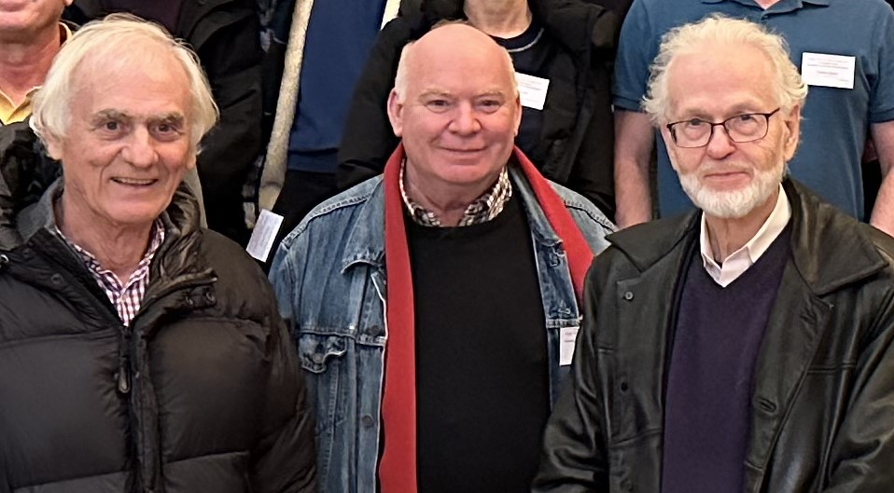
50 years
In a few weeks, we celebrate the 50 years of the TPC idea, by Dave Nygren.
We celebrated this event 2 months in advance at the TPC Paris conference, in the presence of Dave.
Let us discuss the advantages and conditions for using a TPC at an e+e- collider
Ioannis Giomataris
Dave Nygren

Slide 3
A TPC is essential for PID using dE/dx, though a TOF with 10 ps or less resolution can help for moderate momenta (<20 GeV)
However, at Z pole (we assume lumi of 2.10³⁶ cm⁻² s⁻¹ for circular colliders) there is a huge production of (slow) positive ions, plus possibly a feed-back from the multiplication space.
A drift chamber can also use dE/dx (by cluster counting), but has certain difficulties (more matter, high mechanical tension, possible lack of robustness for 40,000 wires). As the drift distance is O(few cm), it is less sensitive to distortions from space charge than a TPC – but the study has not been made so far. The z coordinate measurement is much poorer than for a TPC.
Gaseous detectors are more transparent than solid-state (unless extremely thinned sensors can be made)
On a circular collider, to reach the maximum lumi at the Z pole, the B field has to be lowered to 2T (possibly 3T with a reduction of lumi). This also has consequences on the point resolution (higher diffusion because of lower ωτ, larger radius of curvature).

Slide 4
E. Perez

Slide 5
Gas detector R&D in Europe (European strategy)
New organization or detector R&D in several collaborations DRD1, 2, 3,.. for gaseous, liquid, solid state,… detectors.
New committee DRDC to review these R&D : structure in Working Groups (knowledge) and Work Packages (actions)

Slide 6
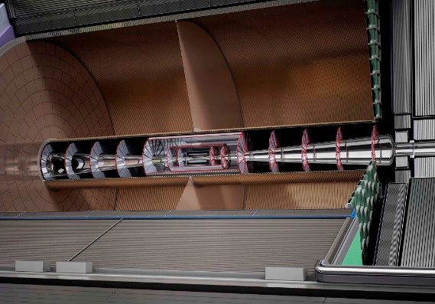
ILD strategy
The ILD detector has been designed in detail and costed (including cooling, services) for construction and operation at the ILC.
Central Tracking is entrusted to a TPC
However it is not clear so far that the ILC will be built. Thus in October 2022 it was decided to revise the strategy and study if and how ILD could be adapted to other colliders, in particular circular colliders.
It was recognized that several points had to be revised
  The calorimeter cooling
  The forward region
  Can a TPC run in the conditions of a circular collider : continuous beam, high lumi at Z pole?

Slide 7
Distortions in a TPC : space charge corrections
Ions drifting in the gas are very slow (typically ~m/s)
Primary ions from ionization in the gas (from event tracks of from machine background) or secondary ions created during amplification and back-flowing in the drift region, drift very slowly, producing space charge which distorts the trajectories of the electrons drifting from the tracks by creating a component transverse to the electric drift field
This effect is common to all the amplification devices
Calculated in 2011 by D. Arai and K. Fujii
2023 : New calculation in progress, adapt to Z pole
(K. Fujii, D. Jeans, S. Ganjour, Mingrui Zhao…)

Slide 8
Positive ion density at the Z peak
From hadronic Z decays (Toy MC by K.Fujii, full simulation by Daniel Jeans)
60 KHz of Z decays : 26 000 ion disks created in the amplification pile-up in the 0.44 s of flushing time of the ions (assuming 5 m/s ion drift velocity)
In case of IBF=1, maximal distortions (at small radius) are 330 µm and they are stable enough to be corrected for

Slide 9
Similar situation in ALICE at LHC Run3. IBF~1%, gain=2000.
200 ms ion drift
50 kHz lead-lead collisions.
-> the ions of 10 000 collisions pile-up in a TPC length.
Space-charge density cause distortions up to several cm, varying with instantaneous luminosity and fluctuating.
Measurement of the space charge (from integrated currents) necessary.
ALICE, Jens Wiechula, LCTPC collaboration meeting, Jan 18, 2023.

Slide 10
Calculation of the distortions (K. Fujii)
The ion charge density creates a potential at each point of the field cage volume :
From which one derives the transverse field (with I, K modified Bessel functions)
In practice one needs ~n=500 first terms

Slide 11
Calculation of the distortions II (K. Fujii)
The Langevin equation gives the modification of the drift velocity :

Slide 12
Positive ion density at the Z peak
From hadronic Z decays (Tox MC by K.Fujii, full simulation by Daniel Jeans)
60 KHz of Z decays : 26 000 ion disks created in the amplification pile-up in the 0.44 s of flushing time of the ions (assuming 5 m/s ion drift velocity)

Slide 13
Case of FCC or CEPC at Z pole : almost continuous set of disks.
https://agenda.linearcollider.org/event/5504/contributions/24543/attachments/20144/31818/PositiveionEffects-kf.pdf

Slide 14
K. Fujii
IBF*Gain=1
ωτ = 5.7 (B=2T)

Slide 15
D. Jeans

Slide 16
Resulting distortions at Z pole for IBF*gain=5 ~800 µm (preliminary)
(330 µm if IBF can be fully suppressed…). But recent calculations by Daniel Jeans show that the machine background with the FCC-designed interaction region yields ~200 times more ionization that the Z itself.
Can it be corrected for?
Only on average, or the charge must be locally measured. This is difficult, as the micro-curlers saturate the amplifiers.
Maybe only way, in Gridpix, using the segmented mesh of the chips : monitor the mesh current of each chip.

Slide 19
Time-dependent corrections are more difficult (work in progress)

Slide 20
Summary and Conclusions
A TPC is an irreplaceable tool for 3D track reconstruction and for particle identification with almost no matter.
However distortions can be caused by a space charge due to produced ions in the drift or in the amplification region.
In the TeraZ conditions, these are typically of several hundred microns per point to a mm, and even centimeters if one consider the charge created by the machine background.
In the HZ conditions at a high-luminosity circular collider, the secondary ions back-flowing need to be strongly suppressed, and corrections have to be dynamically applied.
The Alice TPC already encounters this problem at RUN 3 in heavy ion collisions and pionneers various ways to attack this problem, but with less stringent needs of accuratcy.
An intense R&D program has to be started on
designing the interaction region to suppress the beam background
supressing the ion backflow
applying dynamic corrections to the coordinates.

Slide 21
Summary and Conclusions (2)
In fact, a linear collider and a circular collider are complementary. A Circular is suited to do the Z and EW studies at very high luminosity, and a Linear is better suited for higher energies from HZ to ttbar and above.
They require very different detector optimization.
We should aim at a Global project with 2 international accelerators : a circular (FCC/CEPC) and a linear (ILC/CLIC/C3) seeking synergies between them.

Slide 22
