Slide 1



Possible time-dependent Z mass from the model of the instantaneous symmetrical breaking and the expansion of the universe
IAS Program on High Energy Physics 2024
Yaquan Fang
Institute of High Energy Physics
https://arxiv.org/abs/2308.16412
Jan 22-25 , 2024

Slide 2
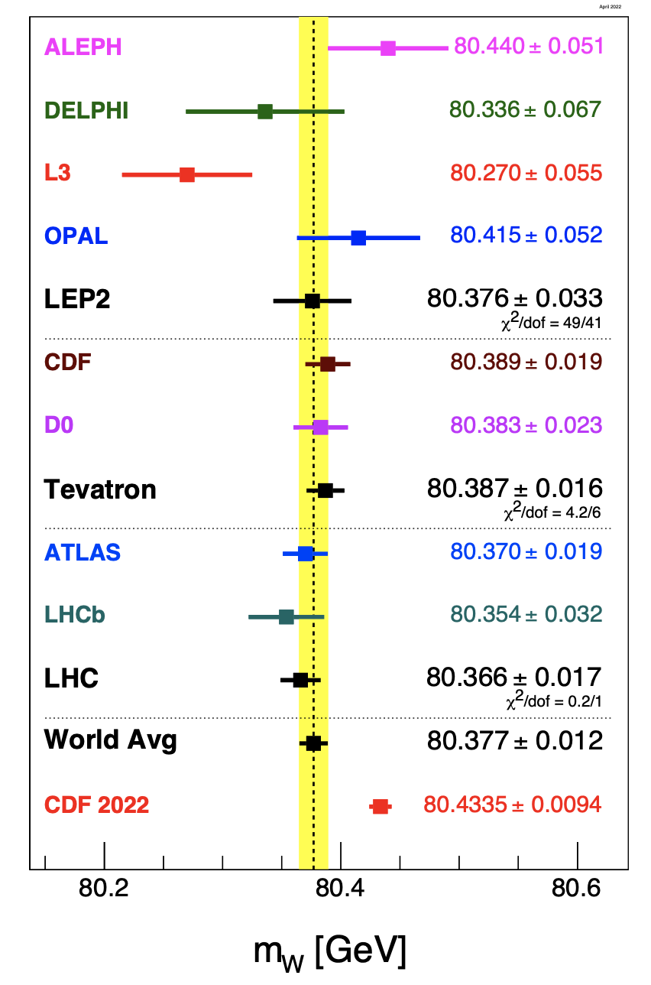
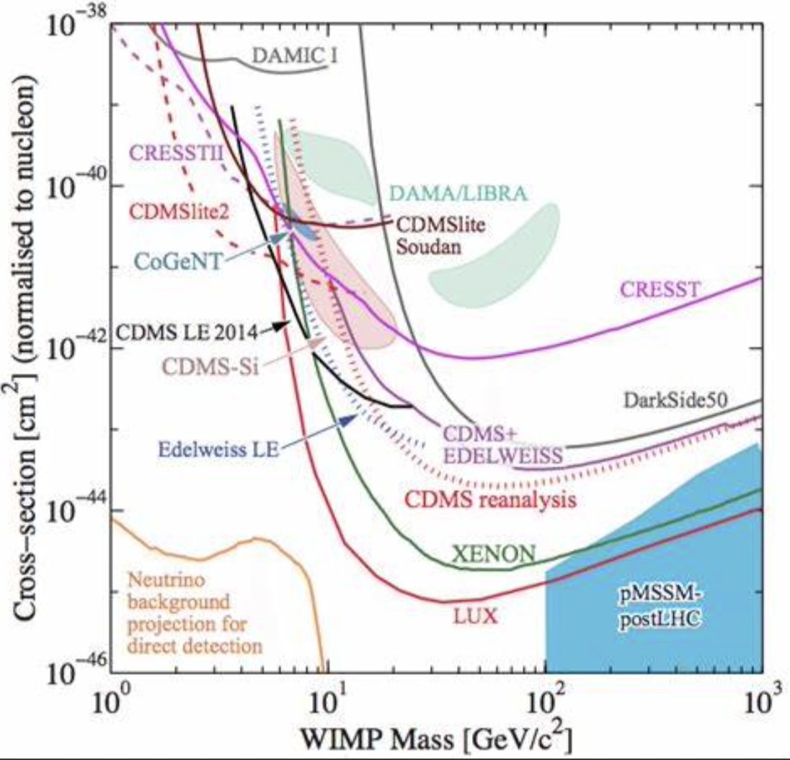
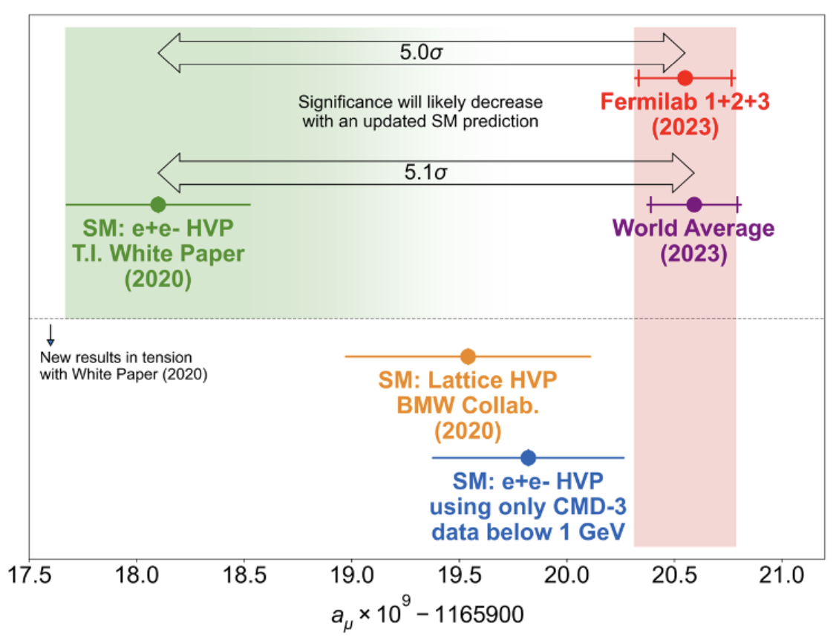
Motivation
The mechanism of electroweak symmetry breaking has been verified with the ATLAS and CMS experiment at the LHC in 2012
  Higgs discovery & the Standard Model success
However, issues or questions are still in puzzle:
  Why cannot observe the dark matter while it is demanded in the Astrophysics?
  Excess at Muon g-2
  Incompatibility of the W-mass measurements from CDF

Slide 3

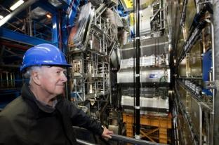
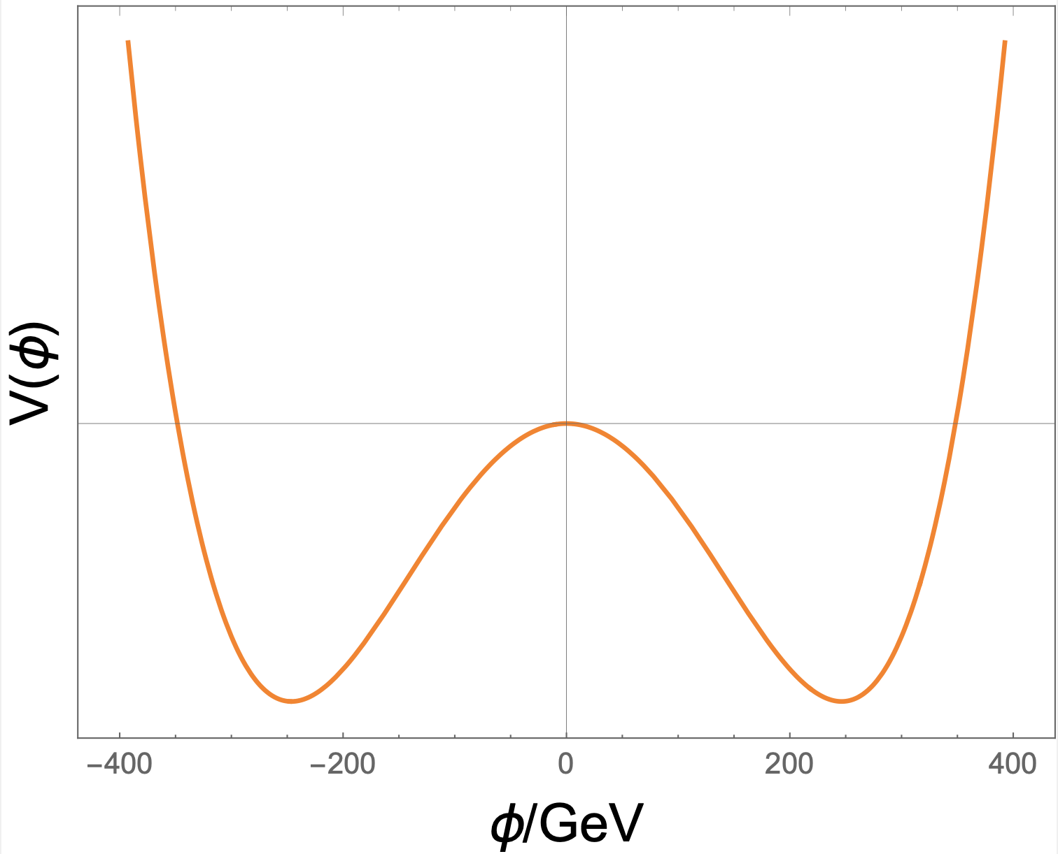
Higgs Potential: Stable Symmetry Breaking (SSB)
Symmetry breaking leads to mass
Proposed by Peter Higgs et al.
The vacuum expectation value (VEV)~246 GeV
  Stable Symmetry breaking (SSB)
  Lead to observable mass for fundamental particles.
However,
  could not find the experimental evidence of the dark matter coupling with the fundamental particles.
Mysterious term:
(Where μ²<0,λ²>0)

Slide 4
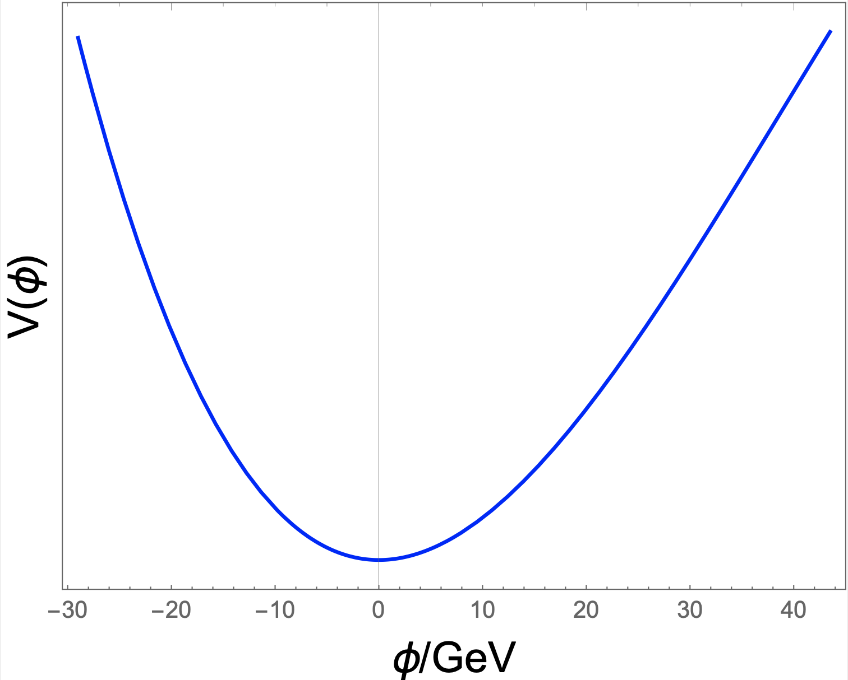
What is the Instantaneous Symmetry Breaking (ISB) ?
Assume there is an asymmetrical potential:
For a symmetry breaking with the above asymmetrical potential (left plot), the “ball” will go to the center, yielding a VEV=0.
Now assume the Symmetry breaking with very high frequency (right plot):
  Instantaneously, (the balls show) asymmetrical behavior due to asymmetrical potential, → has mass effect, involves the gravitational force.
  but since VEV = 0 for each breaking, it cannot interact with any fundamental particle (non-observable)
  Does not need to follow QFT.

Slide 5
Asymmetrical Potential: Instantaneous Symmetry Breaking (ISB)
Asymmetry leads to mass effect
The potential here just a way showing
how the symmetry breaks.
The double Gaussian centered at zero is used as an model to represent the asymmetrical potential.
  VEV = 0 and non-observable mass.
When W_{L}=W_{R}, it degenerates into a single Gaussian and symmetrical.
When W_{R} goes higher and higher, the potential is more and more asymmetrical.
  So W_{R}-W_{L} can serve an indicator qualifying the asymmetry.
Imagine the vacuum with this potential vibrates with very high frequency f_{d},
  f_{d}*(W_{R}-W_{L}) can be used to describe the effect of mass for the non-observable matter (i.e. dark matter).
  It characterizes the asymmetry of ISB.
Unfortunately, this potential is not renormalizable.
w_{L}
w_{R}

Slide 6
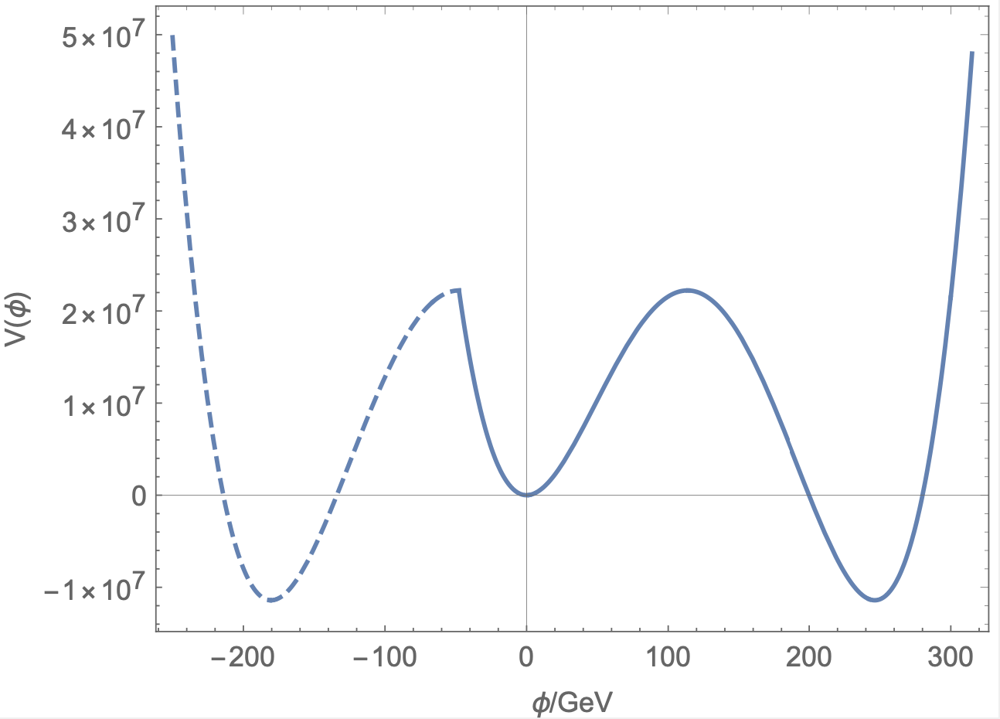
Combination of Different Potentials
Combined Potential Proposed
Higgs Potential
Asymmetrical Potential
+
=》
The vacuum with the potential shown in the right plot vibrates.
  The frequency is very high
  Only few vibrations with strong strength can break through the central pitfall, end up with SSB.
  The ISB at the central potential with high frequency will render the effect of the mass, but no coupling with fundamental particles ( can not be observed, <VEV>=0)
If the central potential is absorbed to one point, the model can be simplified as the Higgs potential.

Slide 7

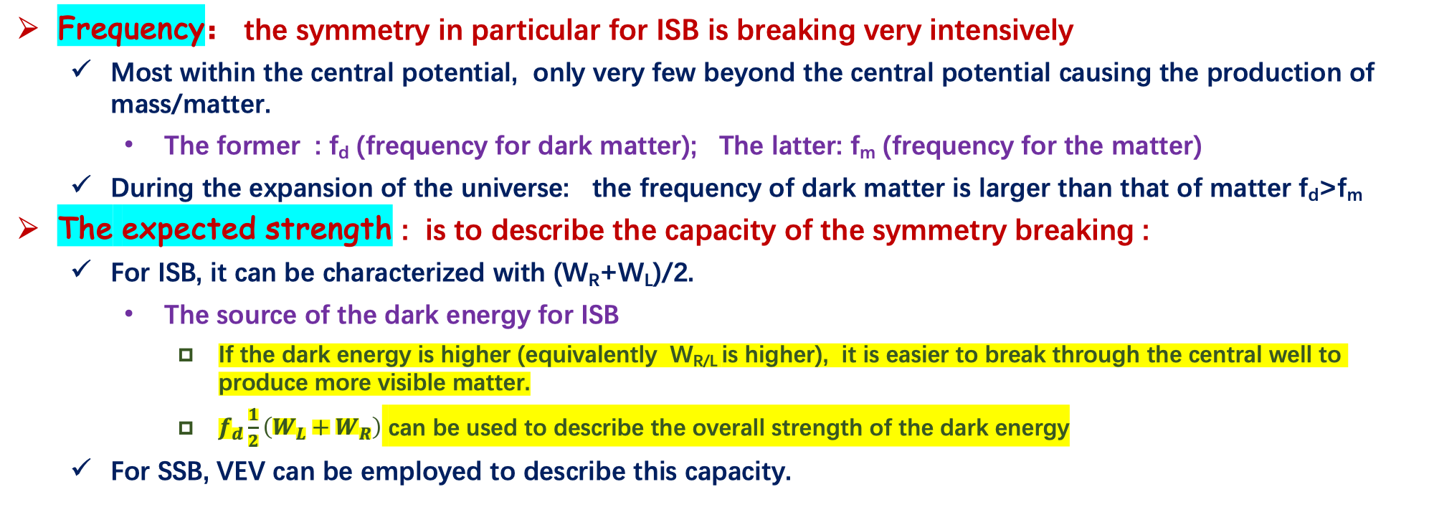
Two Parameters for ISB/the Relation with the Dark Matter and Dark Energy
w_{L}
w_{R}
Frequency： the symmetry in particular for ISB is breaking very intensively
  Most within the central potential, only very few beyond the central potential causing the production of mass/matter.
    The former : f_{d} (frequency for dark matter); The latter: f_{m} (frequency for the matter)
  During the expansion of the universe: the frequency of dark matter is larger than that of matter f_{d}>f_{m}
The expected strength : is to describe the capacity of the symmetry breaking :
  For ISB, it can be characterized with (W_{R}+W_{L})/2.
    The source of the dark energy for ISB
      If the dark energy is higher (equivalently W_{R/L} is higher), it is easier to break through the central well to produce more visible matter.
      $f_{d}\frac{1}{2}\left(W_{L}+W_{R}\right)$ can be used to describe the overall strength of the dark energy
  For SSB, VEV can be employed to describe this capacity.

Slide 8
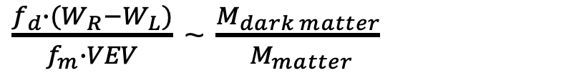
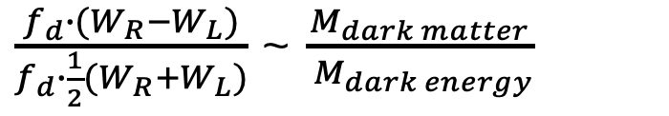
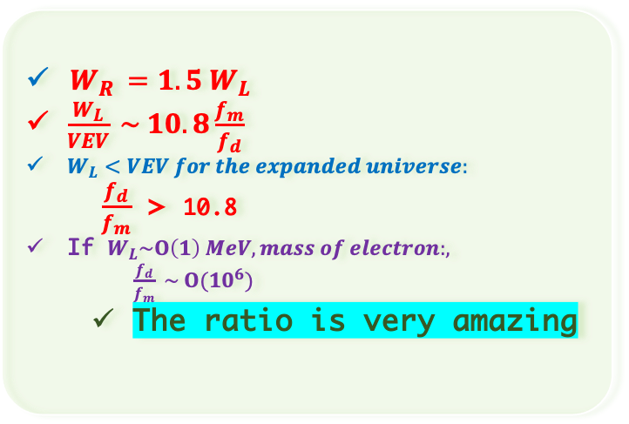
Some Derivations
Input of current ratios:
Dark matter : 27%
Dark Energy : 68%
Matter : 5%
w_{R}
w_{L}
VEV
$W_{R }=1.5 W_{L}$
$\frac{W_{L}}{VEV} \sim 10.8\frac{f_{m}}{f_{d}}$
$W_{L}<VEV for the expanded universe:$
$\frac{f_{d}}{f_{m}}$ > 10.8
If $W_{L}\sim Ο\left(1\right) MeV, mass of electron:, \frac{f_{d}}{f_{m}} \sim Ο({10}^{6})$
  The ratio is very amazing
$\frac{f_{d}∙(W_{R}−W_{L})}{f_{d}∙\frac{1}{2}(W_{R}+W_{L})}$ ~ $\frac{M_{dark matter}}{ M_{dark energy}}$
Dark matter vs Dark energy :
$\frac{f_{d}∙(W_{R}−W_{L})}{f_{m}∙VEV}$ ~ $\frac{M_{dark matter}}{ M_{matter}}$
Dark matter vs matter :

Slide 9
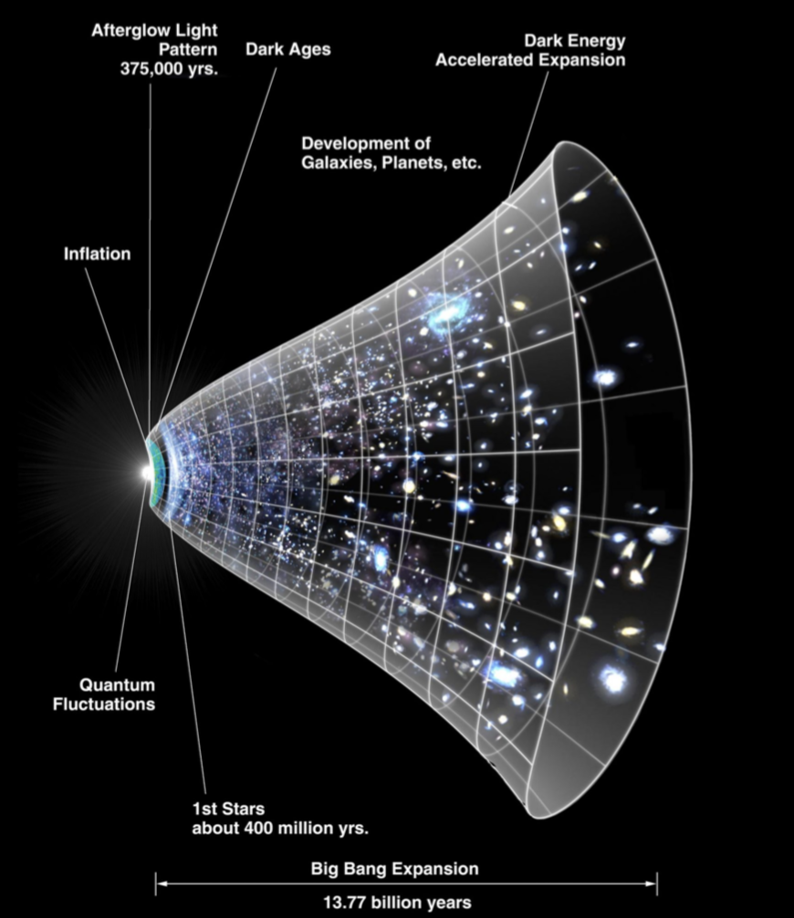

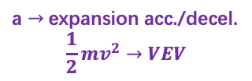
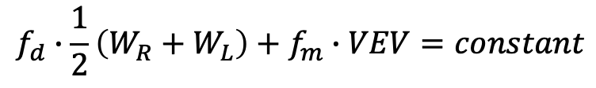
Universe Model： Expansion and Contraction
Conservation law :
$$f_{d}∙\frac{1}{2}\left(W_{R}+W_{L}\right)+f_{m}∙VEV=constant$$
a $→$expansion acc./decel.
$$\frac{1}{2}mv^{2}→VEV$$
Dark energy
(dark matter)
w_{R}
Matter
w_{L}
VEV
Dark
matter/energy
matter/energy
From the conservation law： the overall capacity of symmetry breaking for the matter increases/decreases, the one for the dark energy decreases/increases.
The universe has four phases :
  Expanding acceleratively：more ISB can go beyond the central potential, VEV goes higher, f_{d/m} goes lowers.
    More and more energetic in Symmetry breaking resulting in higher SSB.
  Expanding deceleratively：Less ISB can go beyond the central potential, VEV goes lower, f_{d/m} higher
  Contracting acceleratively : SSB absorbed into ISB, W_{L}/W_{R} decreases & f_{d} increases.
  Contracting deceleratively： W_{L}/W_{R} increases, SSB show up & f_{d} decreases.
Not discussed

Slide 10
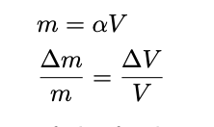
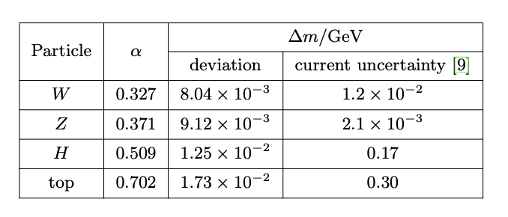
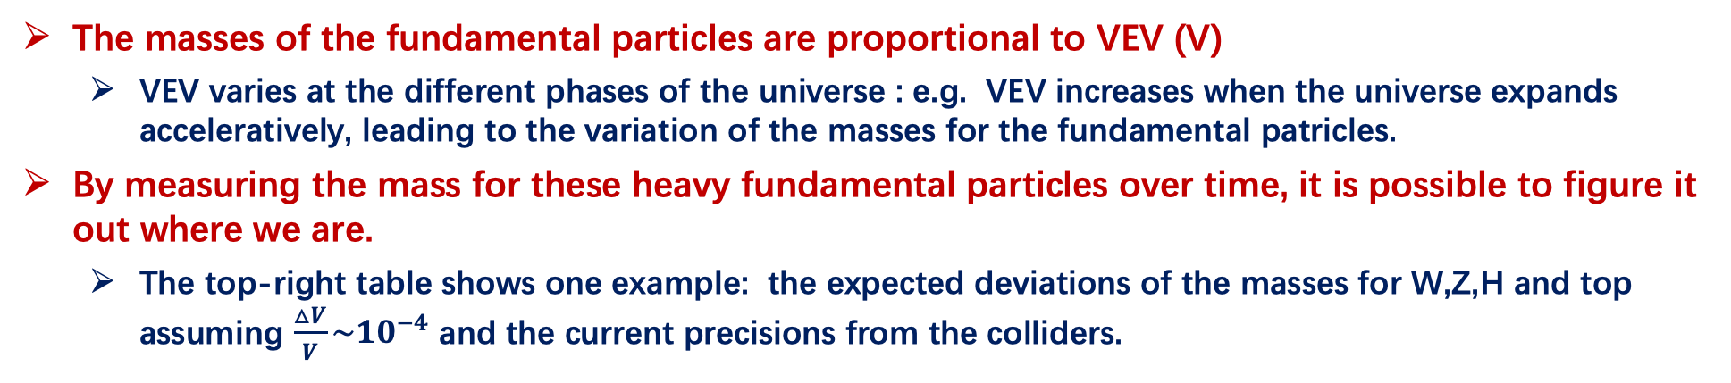
Where are we now and how to verify it ?
Z is the best choice
Dark energy
(dark matter)
Matter
w_{R}
w_{L}
VEV
The masses of the fundamental particles are proportional to VEV (V)
  VEV varies at the different phases of the universe : e.g. VEV increases when the universe expands acceleratively, leading to the variation of the masses for the fundamental patricles.
By measuring the mass for these heavy fundamental particles over time, it is possible to figure it out where we are.
  The top-right table shows one example: the expected deviations of the masses for W,Z,H and top assuming $\frac{△V}{V}\sim {10}^{−4}$ and the current precisions from the colliders.

Slide 11

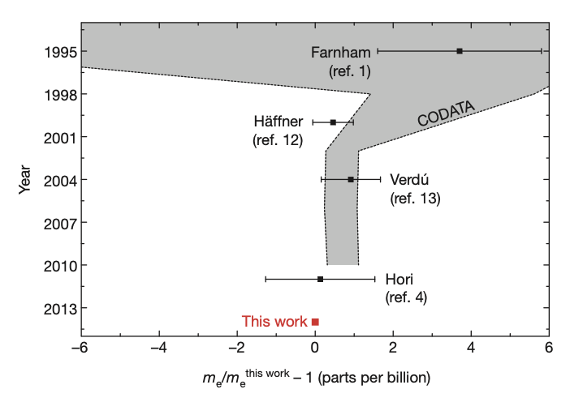
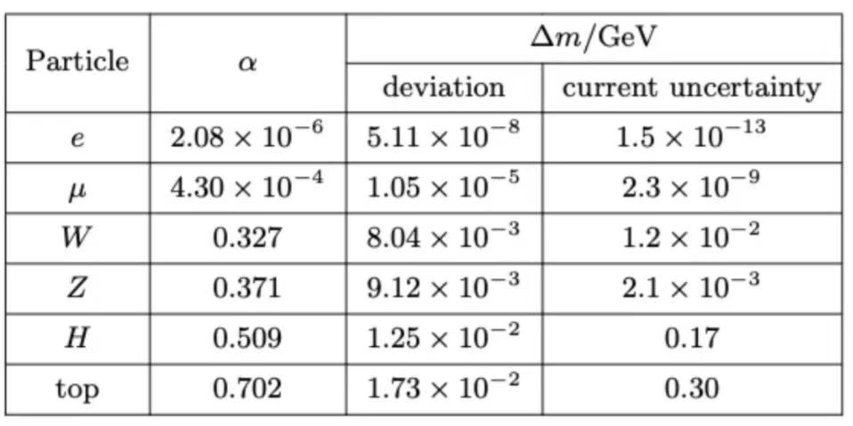
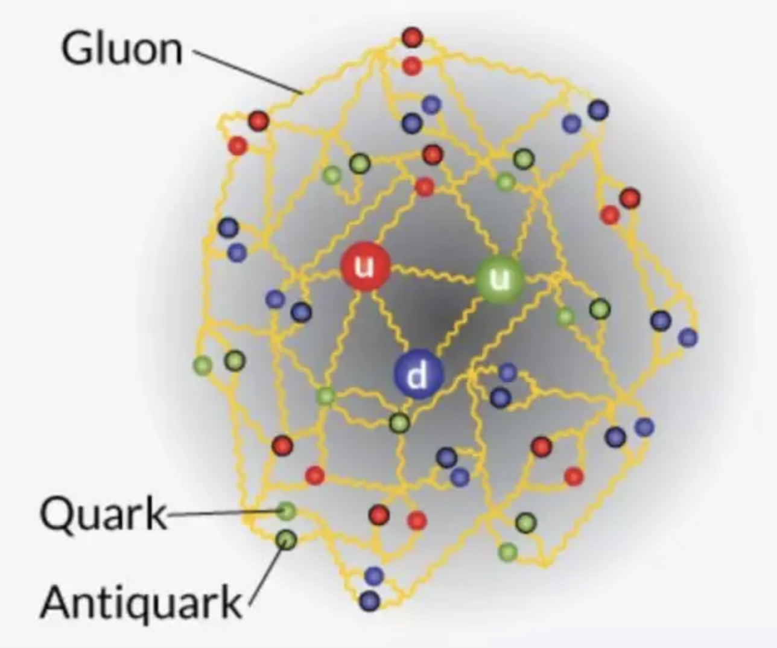
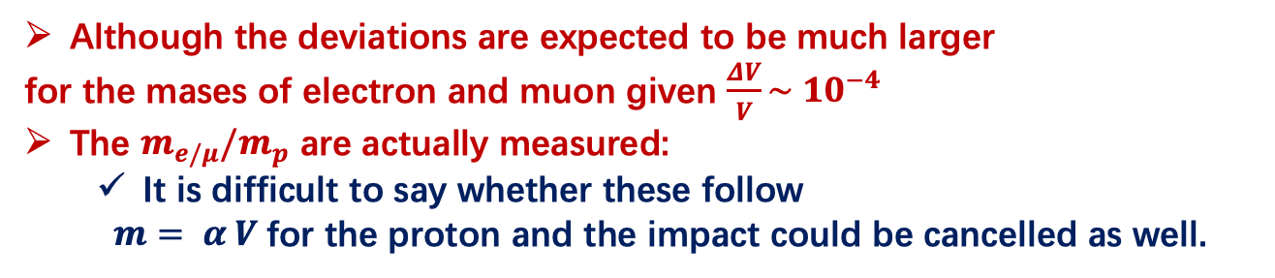
Why don’t we consider electron and muon?
Doi:10.1038/nature13026
Although the deviations are expected to be much larger
for the mases of electron and muon given $\frac{ΔV}{V}\sim {10}^{−4}$
The $m_{e/μ}/m_{p}$ are actually measured:
  It is difficult to say whether these follow
  $m= α V$for the proton and the impact could be cancelled as well.

Slide 12
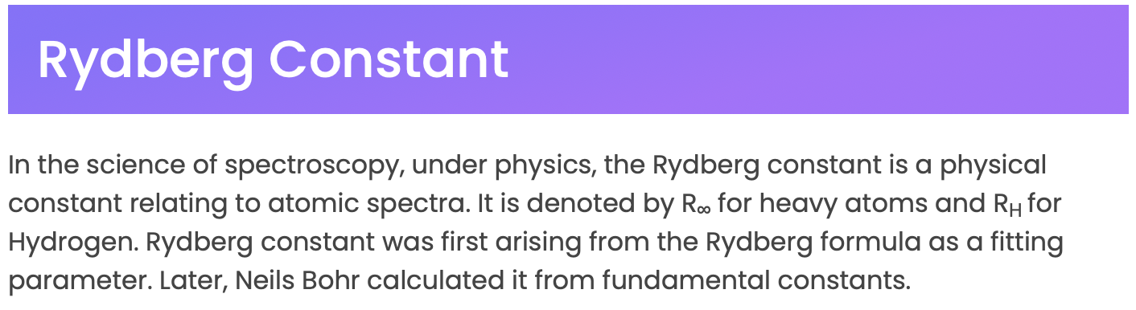
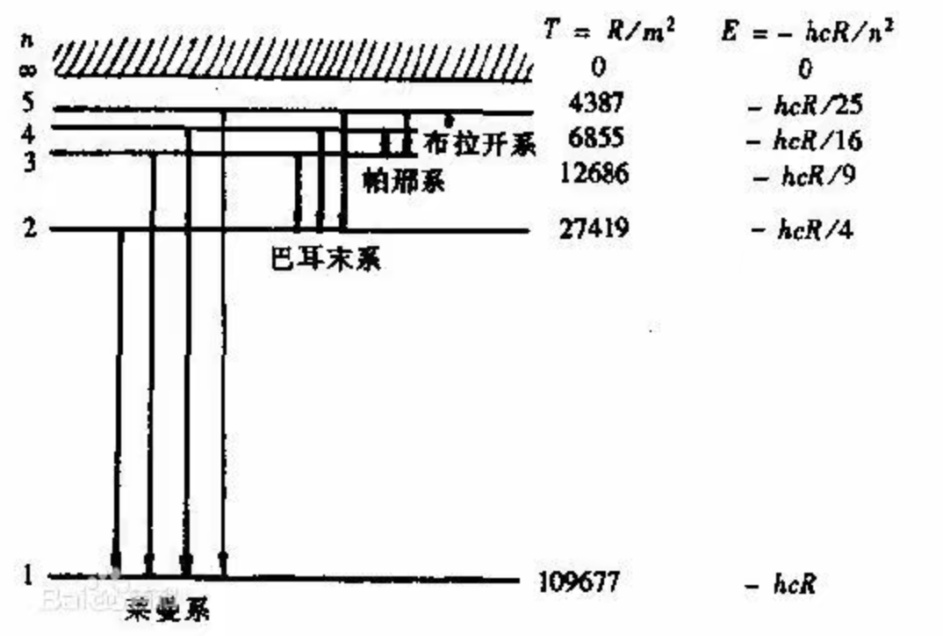
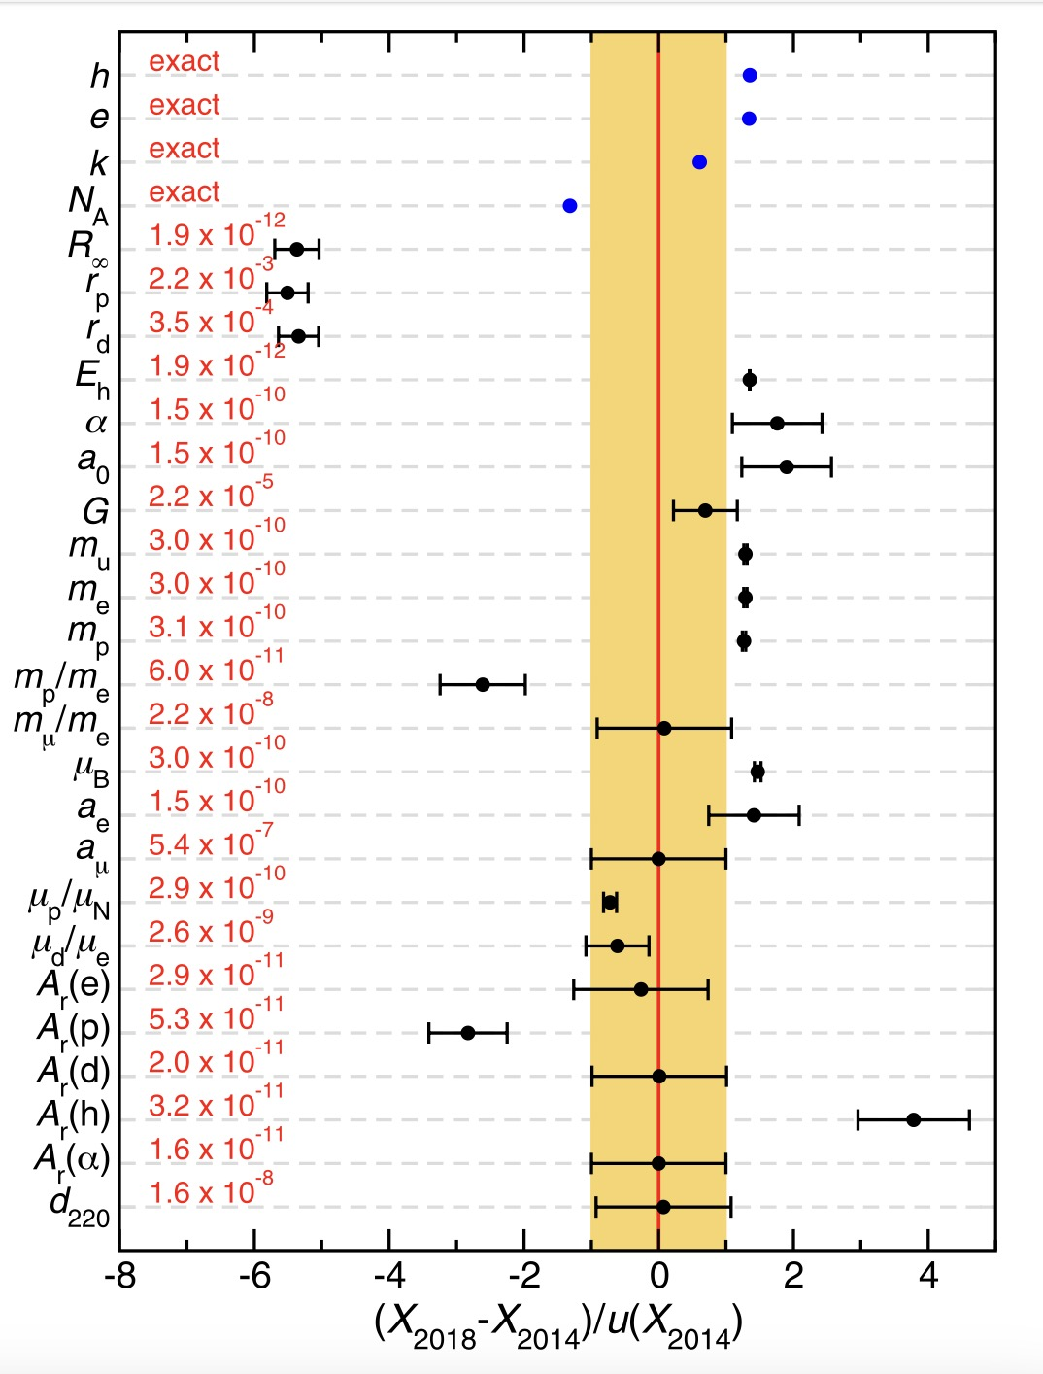
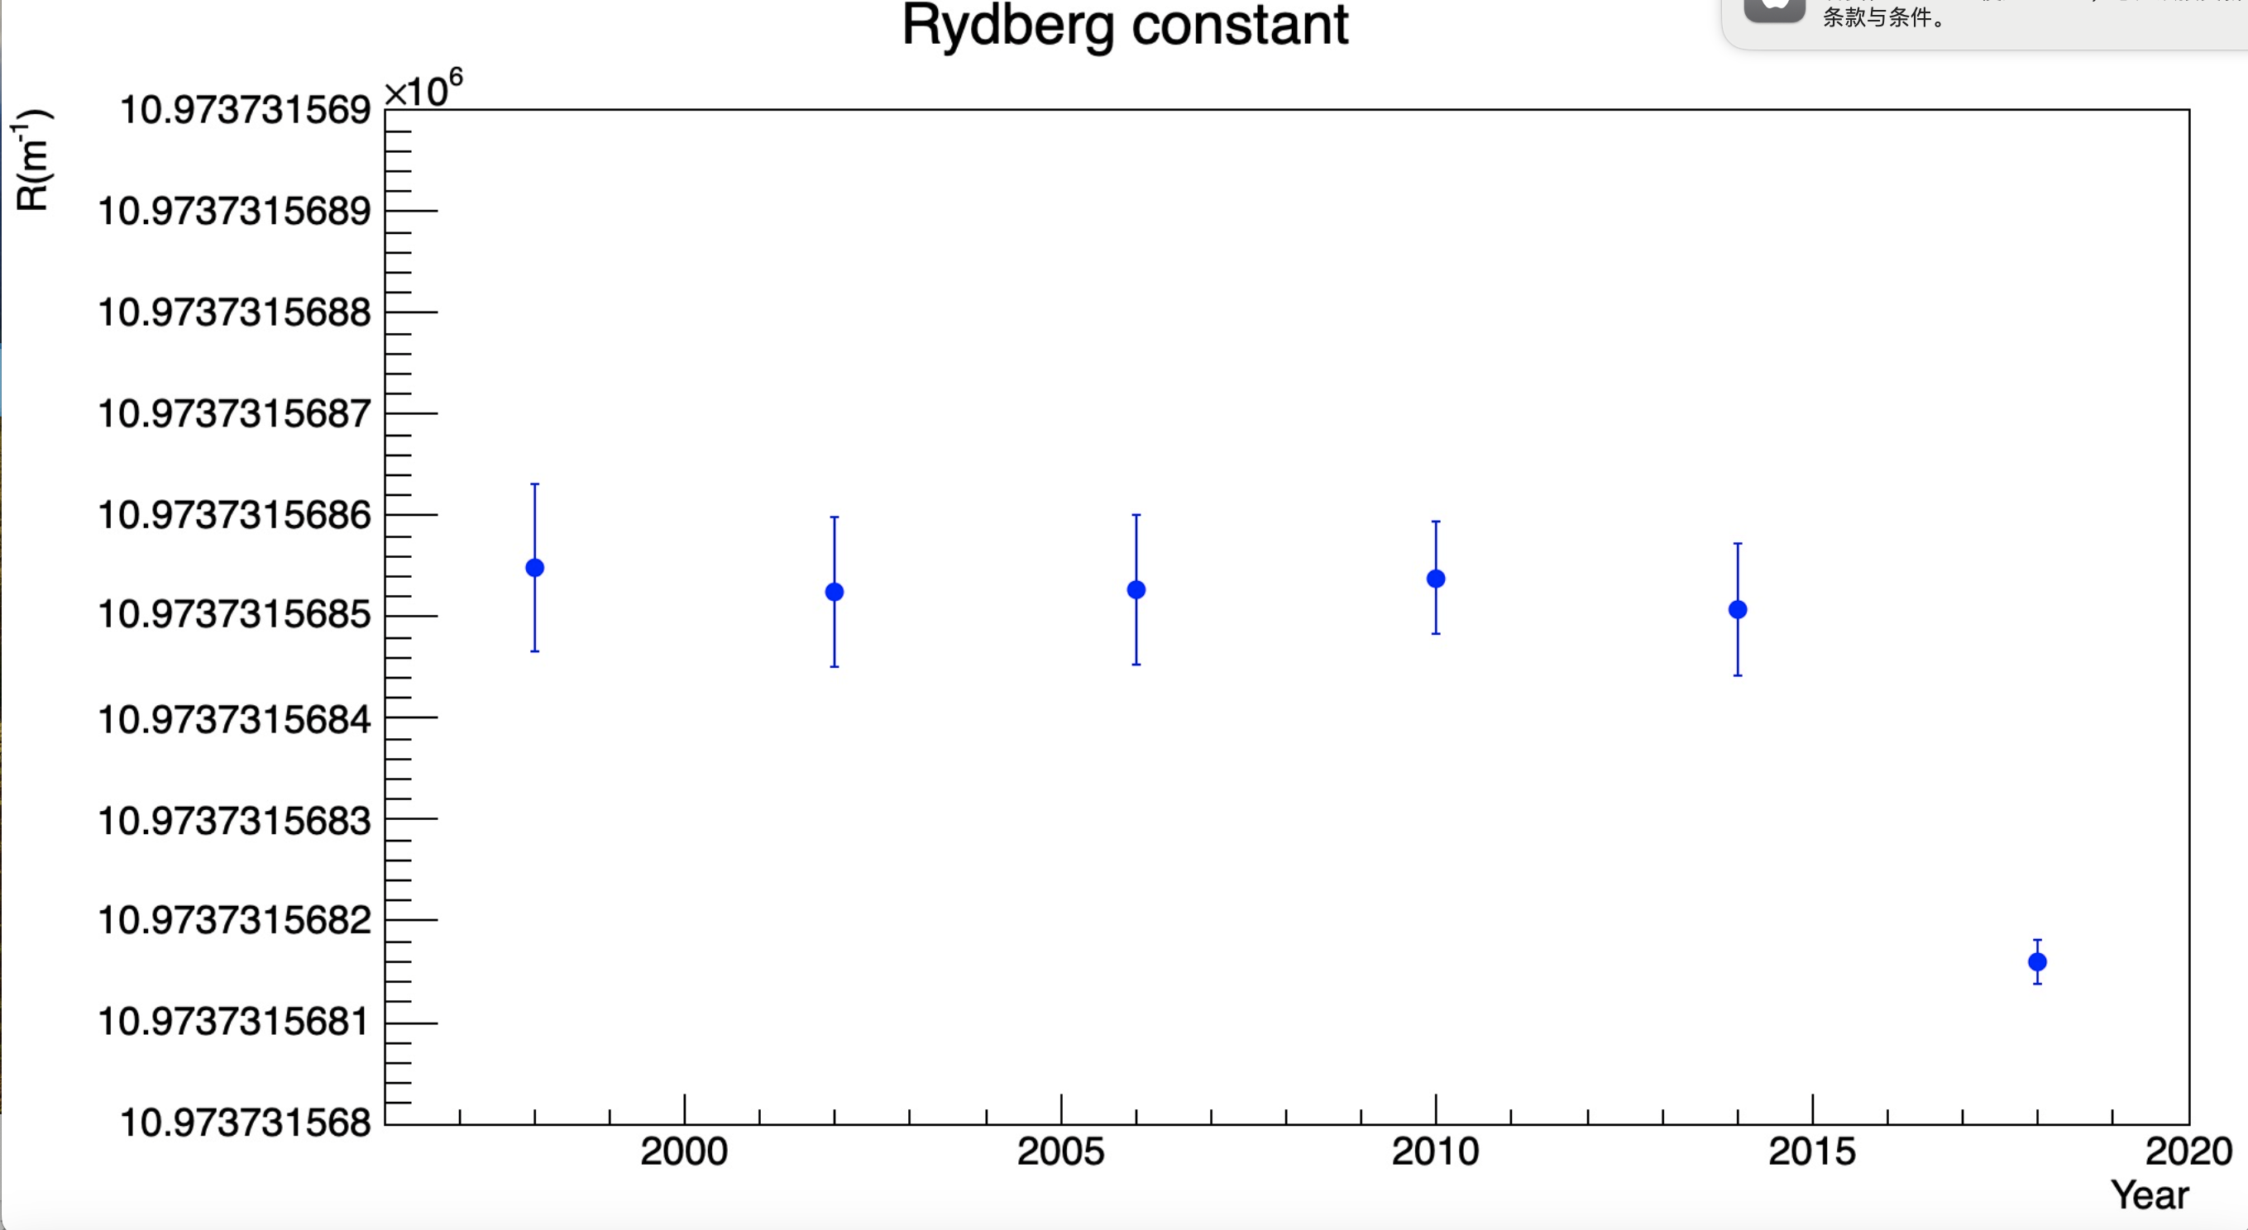

But the measurements of Rydberg constant hint ……
$R_{∞} =\frac{m_{e}e^{4}}{8ε_{0}^{2}h^{3}c}$
J. Phys. Chem. Ref. Data 50, 033105 (2021)
https://doi.org/10.1063/5.0064853
Balmer series
PDG book:
$$R_{∞}=10973731.568508（65） m^{−1} \left(2018\right)$$
Raman series
From the formula, Rydberg constant is proportional to the mass of the electron.
If the Rydberg constants varies with time, it perhaps indicates that the mass of the electron varies as well.
The Rydberg constant measured in 2018 deviate from that in 2014 with 5.3σ

Slide 13
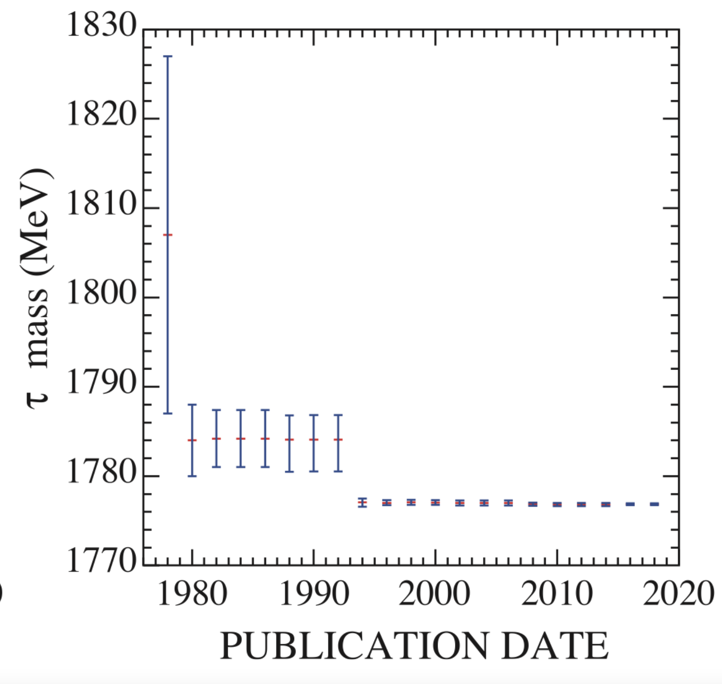
Tau mass measurements
PDG book

Slide 14
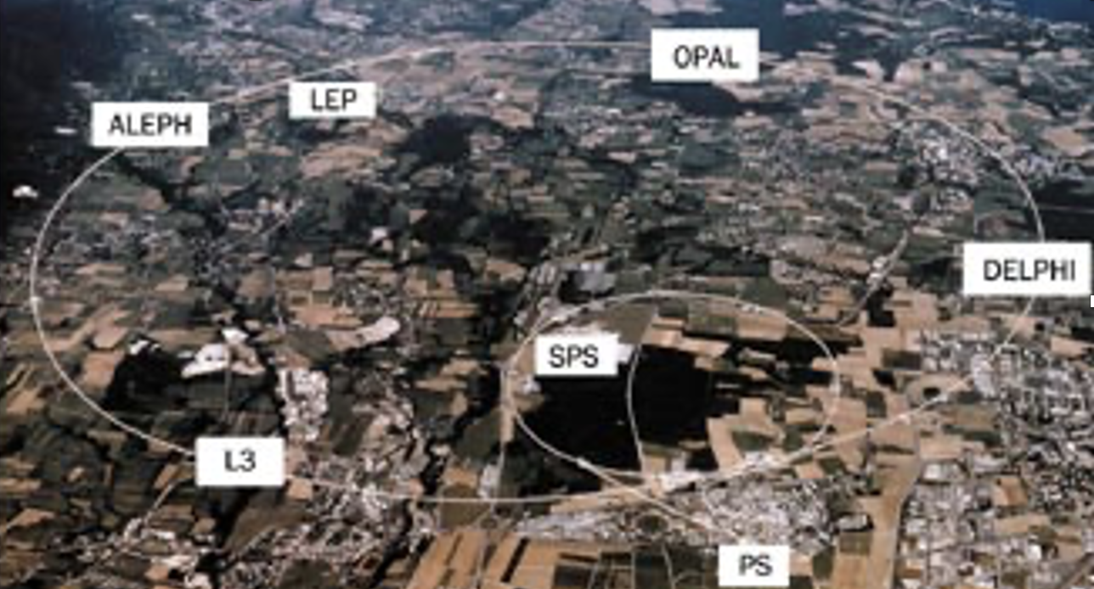
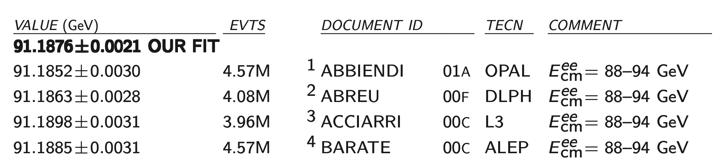
LEP : the Precise Measurement of Z Mass
LEP ran in 1990s, around 30 years from now :
  Four experiments located at the ring : ALEPH, OPAL, DELPHI and L3.
  With the energy scan, 2 MeV precision can be reached on the measurement of Z mass by combining 4 experiments.
PDG from LEP experiments:

Slide 15
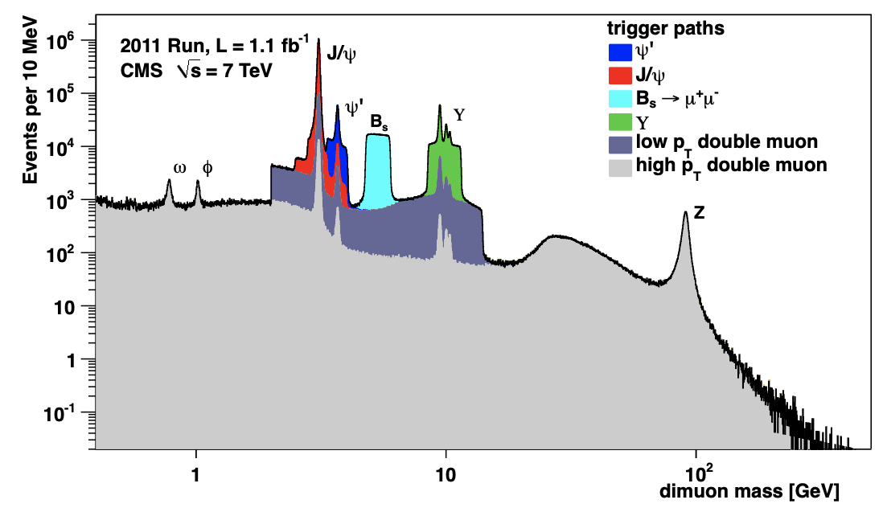
LHC : Measurement of Z Mass with ATLAS/CMS
Can’t perform the energy scan to measure the Z mass at the LHC.
No official precise measurements of the Z mass available have been done at ATLAS/CMS.
  Perhaps can not exceed the LEP measurements and no much interest.
It is not easy to treat the calibrations and systematics.

Slide 16
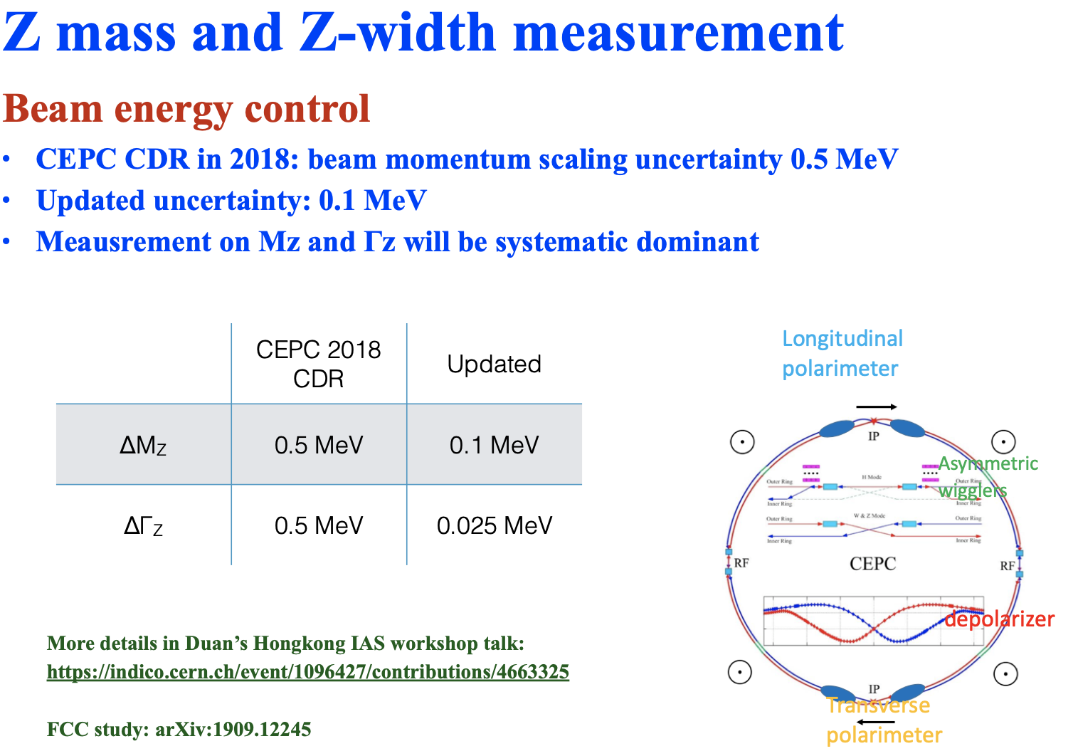
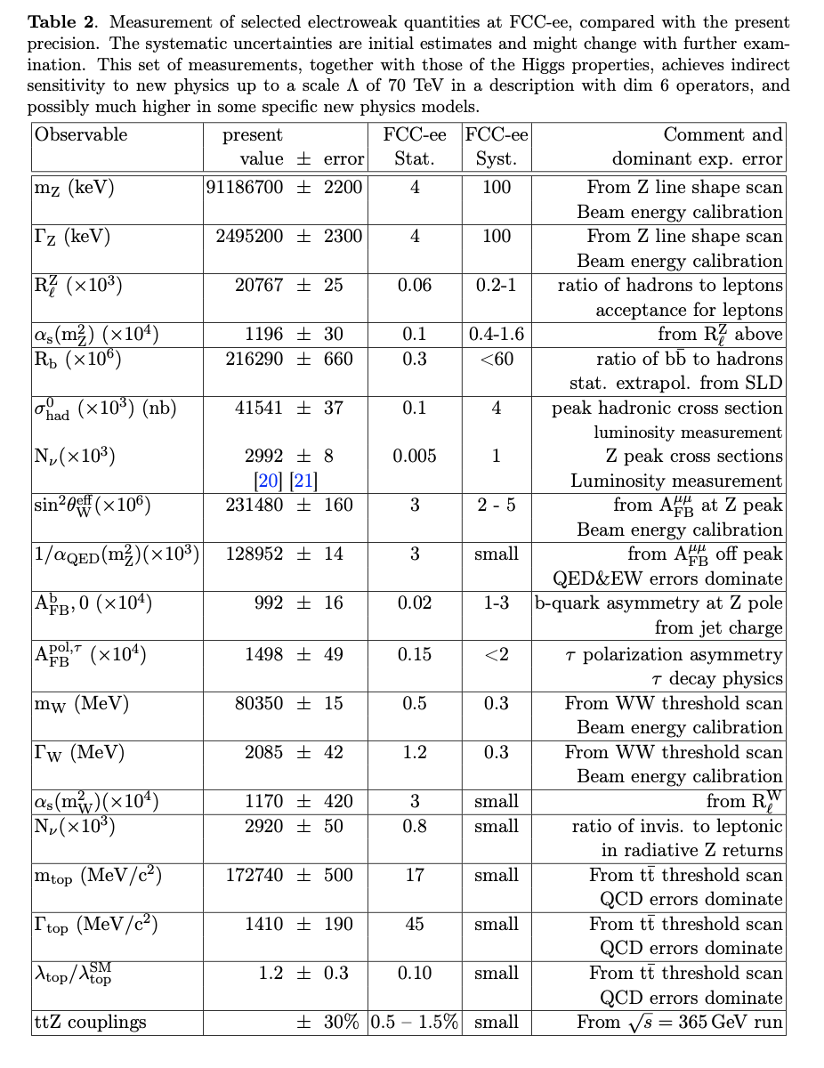
CEPC/Fcc-ee : Measurements of Z Mass with unprecedent precisions
CEPC
Fcc-ee
Siqi Yang (USTC)
The precision of O(0.1) MeV is expected at CEPC/Fcc-ee
  One order of magnitude better than LEP.

Slide 17
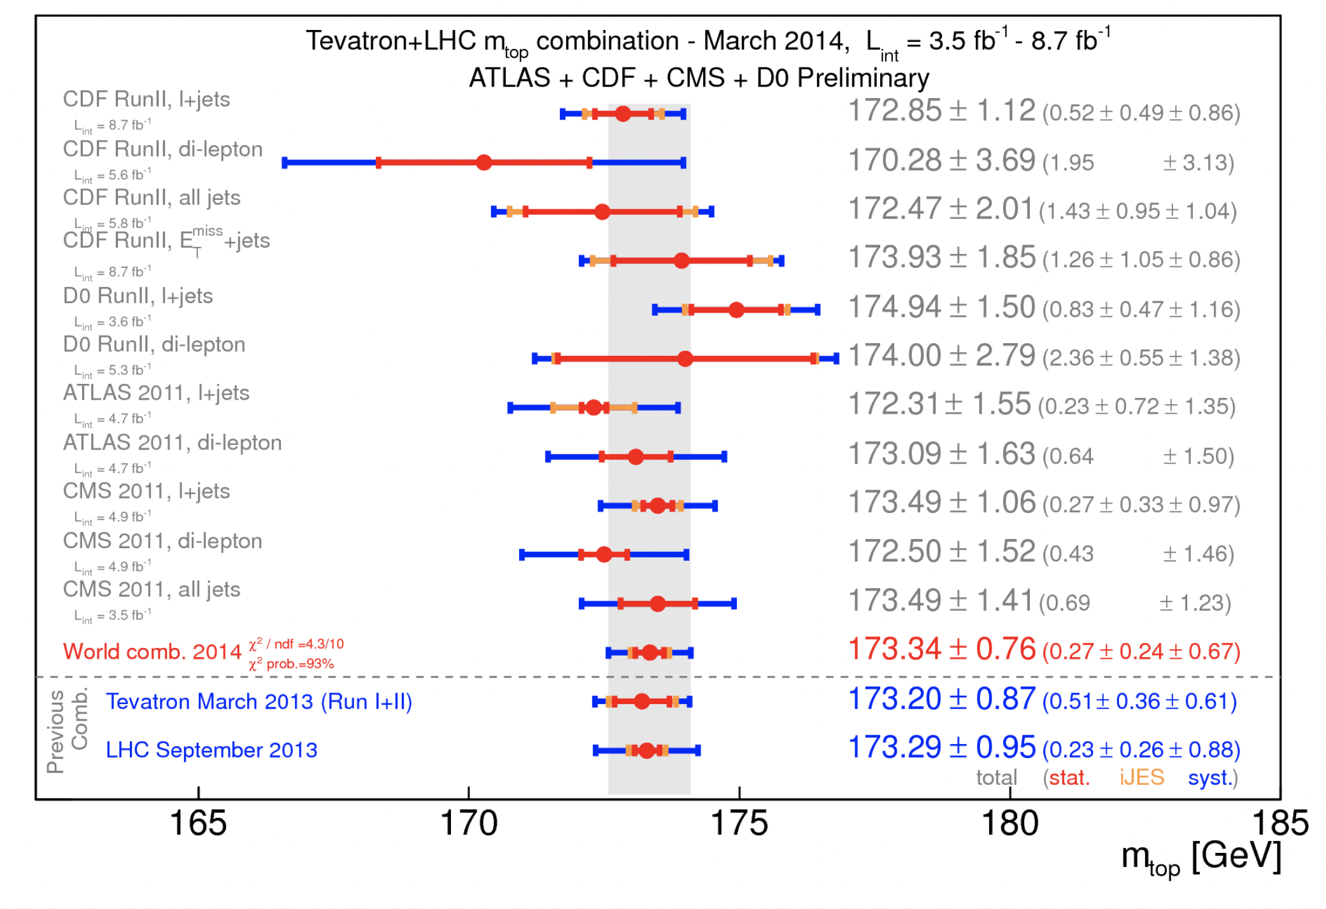
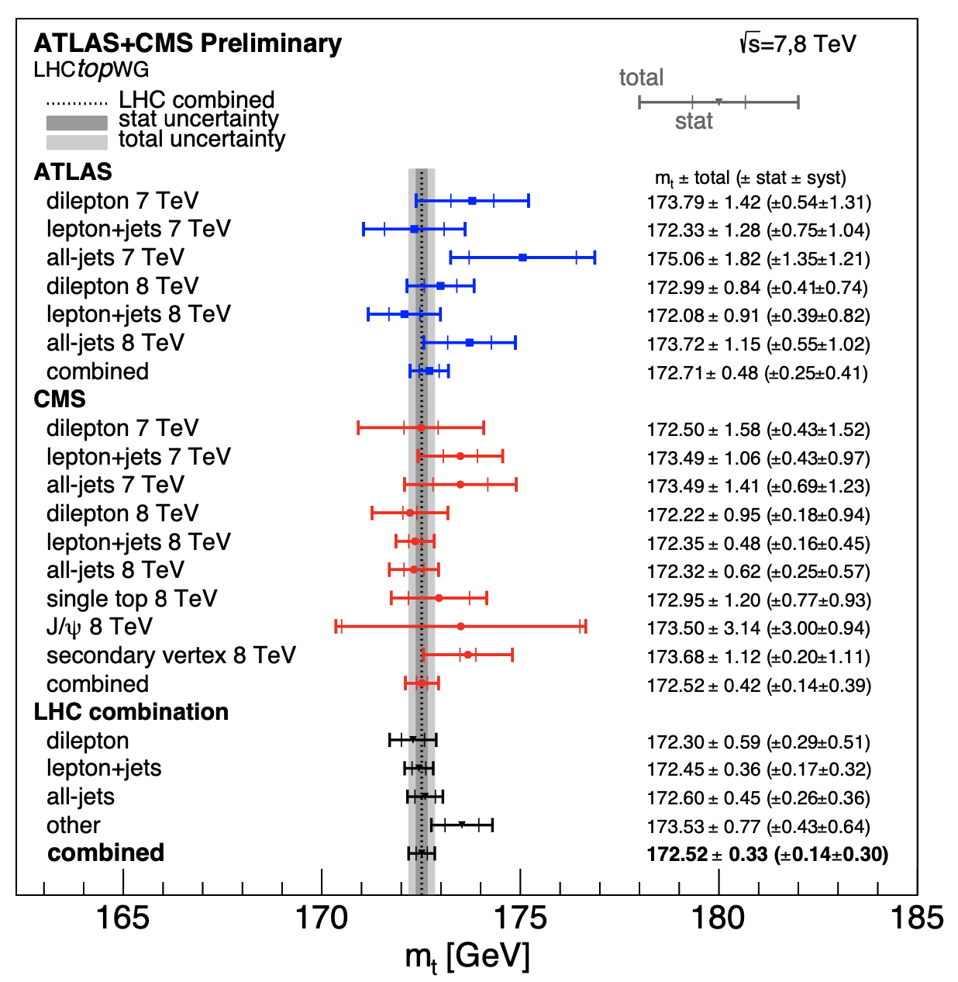
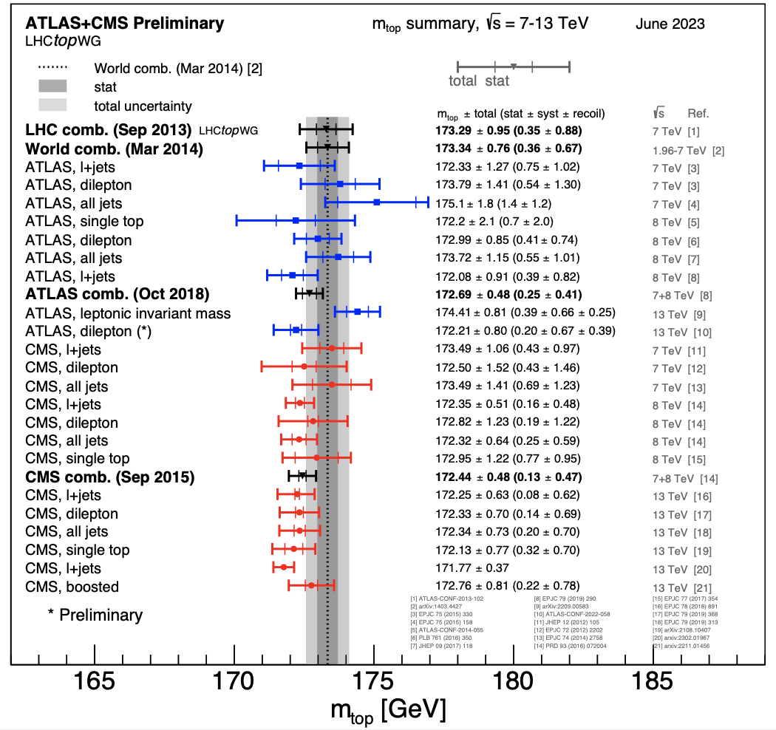
Top Mass Measurements at Tevatron/LHC
Experiment | Year | Mean (GeV) | Total Sys. (GeV) | Stat. (GeV) | Syst. (GeV)
Tevatron (1407.2682) | 1.96 TeV（1986/92- 2011） | 174.34 | 0.64
ATLAS | 7/8TeV (2011-2012) | 172.69 | 0.48 | 0.25 | 0.41
CMS | 7/8TeV (2011-2012) | 172.44 | 0.48 | 0.13 | 0.47
ATLAS+CMS ATLAS-CONF-2023-066 | 7/8TeV (2011-2012) | 172.52 | 0.33 | 0.14 | 0.30
ATLAS （by hand) | 13 TeV (2013-2018) | 173.32 | 0.65 | 0.18 | 0.59
CMS | 13 TeV (2013-2018) | 172.17 | 0.24 | 0.07 | 0.23
ATLAS+CMS (by hand) | 13 TeV (2013-2018) | 172.31 | 0.23 | 0.06 | 0.22
ATLAS-CONF-2023-066
To some extent, measured top quark also has a trend of the reduced mass as a function of time.
However, the uncertainty is significant.

Slide 18
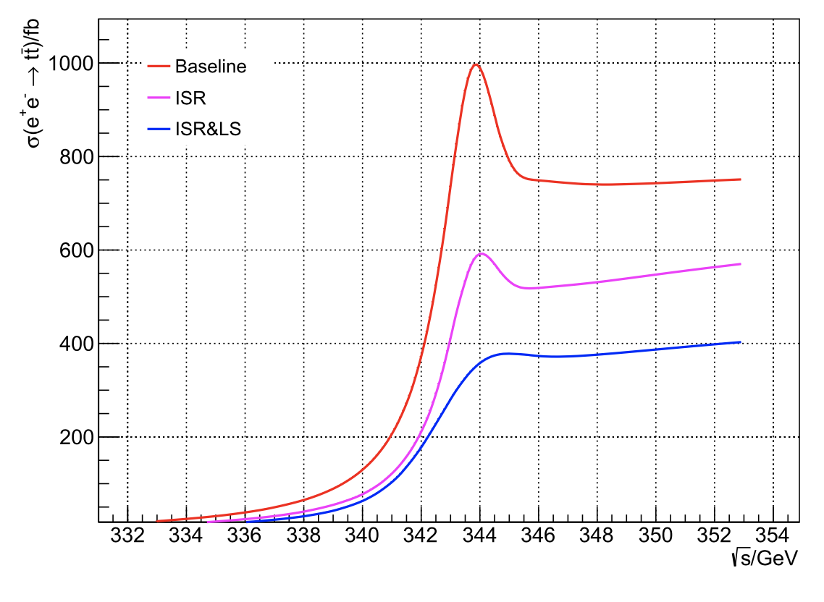
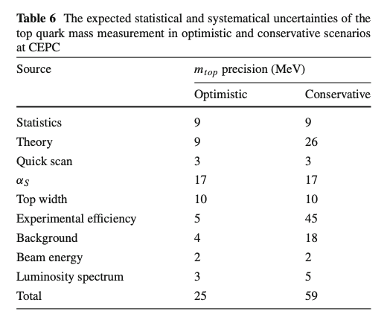
CEPC/ILC/CLIC/Fcc-ee : Measurements of top Mass
EPJC 83, 269 (2023)
Xiaohu Sun (PKU)
Zhan Li (IHEP) et al.
CEPC
The precision of O(10) MeV can be reached at e⁺e⁻ colliders.
  One order of magnitude better than LHC.

Slide 19
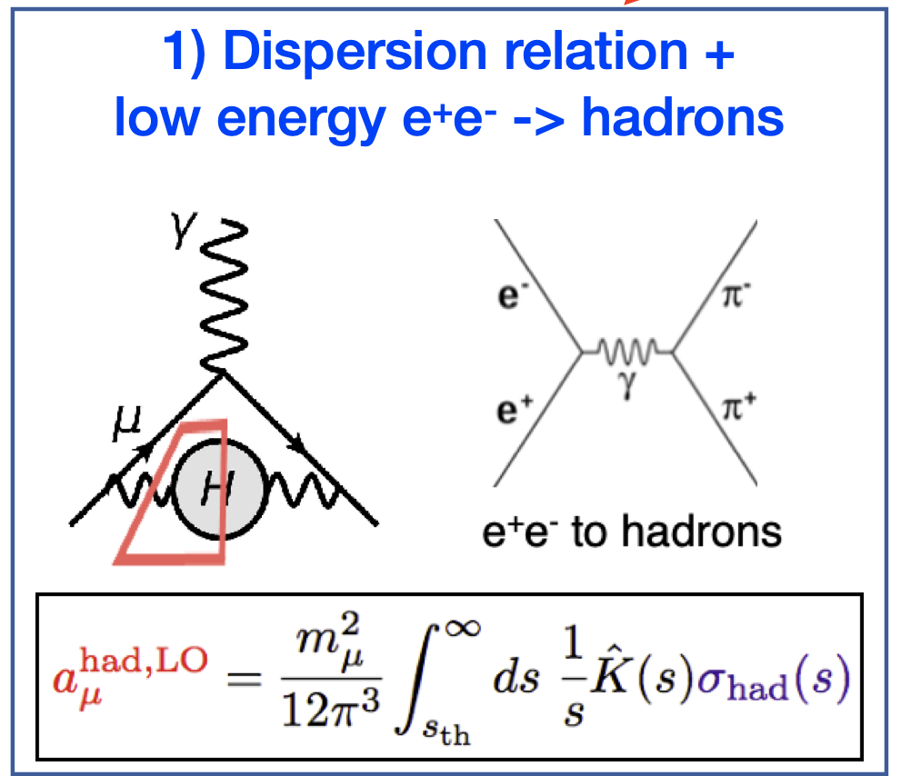
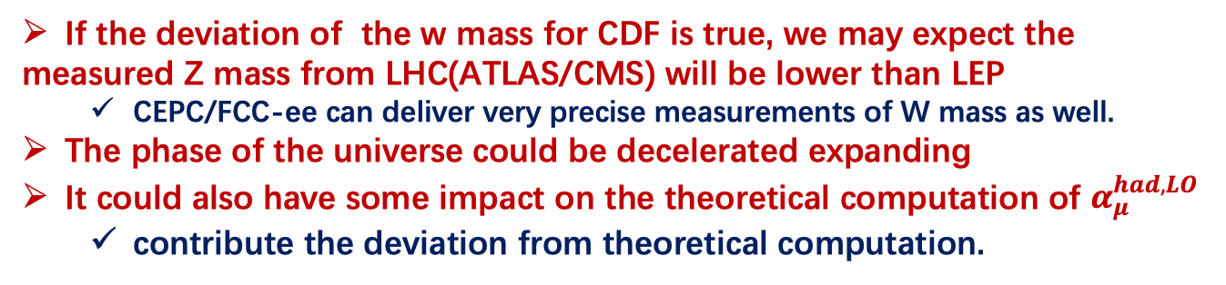
Hints from W mass measurements and muon g-2
If the deviation of the w mass for CDF is true, we may expect the
measured Z mass from LHC(ATLAS/CMS) will be lower than LEP
  CEPC/FCC-ee can deliver very precise measurements of W mass as well.
The phase of the universe could be decelerated expanding
It could also have some impact on the theoretical computation of $α_{μ}^{had,LO}$
  contribute the deviation from theoretical computation.
Two deviation of W-mass supports the excess of muon g-2

Slide 20
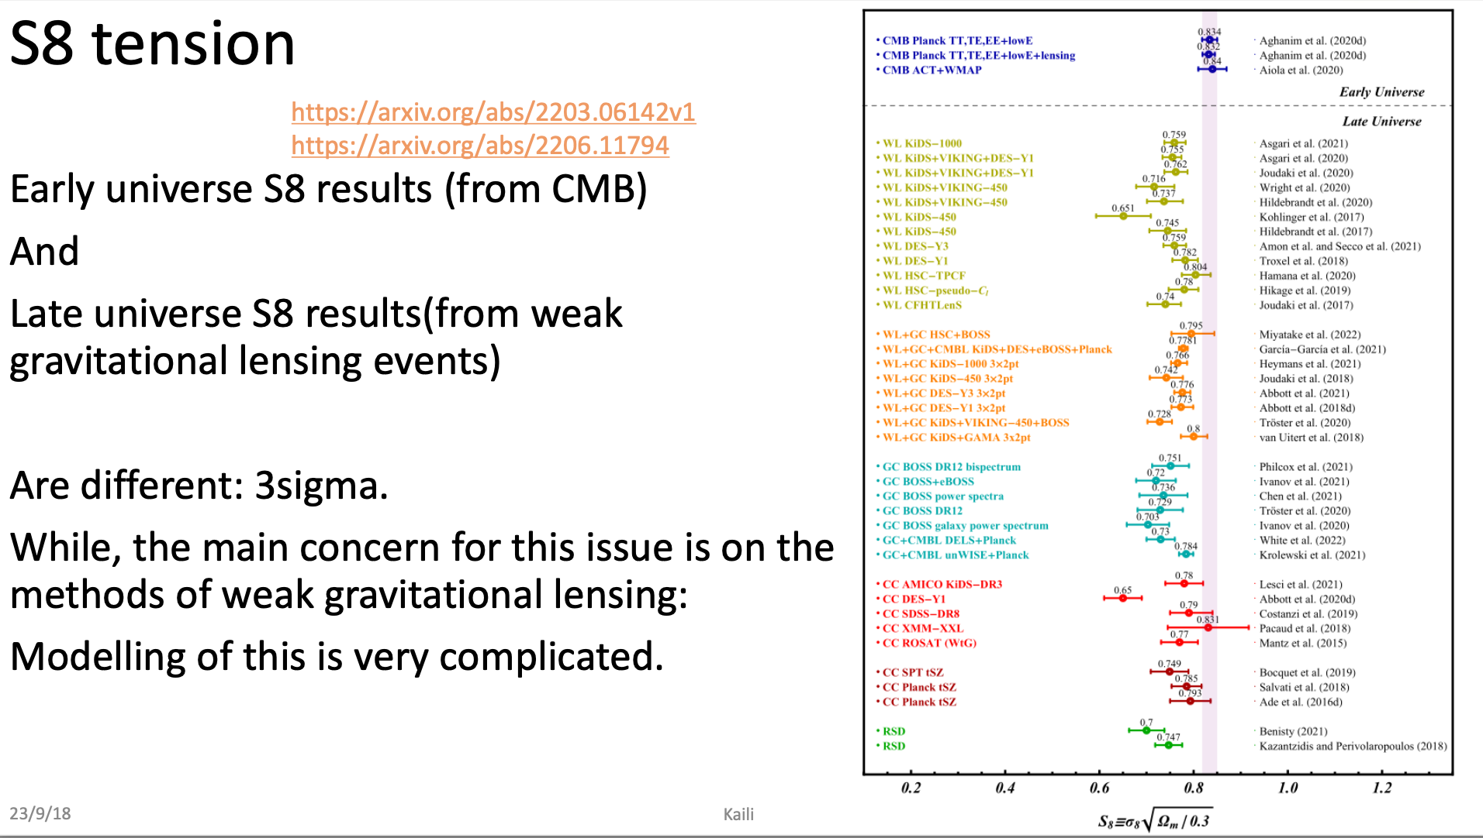
S8 from Astrophysics
Is it possible that Early Universe and/or Late Universe experience
expansions both acceleratively and deceleratively ?

Slide 21
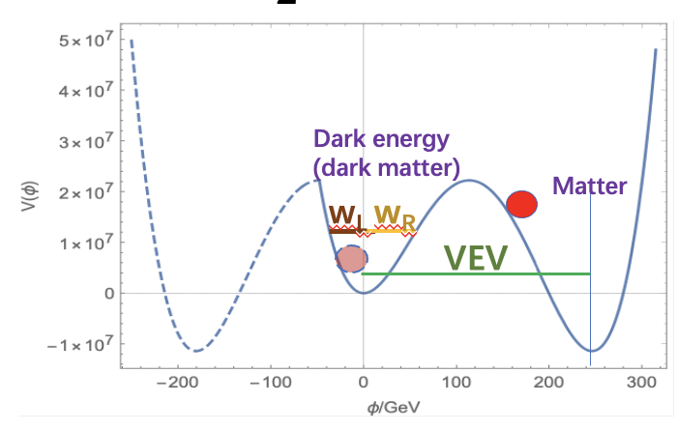
Conclusion
A model combing Higgs potential and asymmetrical potential is proposed to
  Try to explain the non-existence of the observed dark matter and source of dark energy
    Dark matter describes the extent of the ISB.
      ISB and VEV = 0 lead to the mass effect involving gravitational force but not observable.
        no couplings with fundamental particles.
    The strength of the symmetry breaking (ISB) of the vacuum is the source
    of the dark energy
      Beyond the central potential is energy/matter
      Within the central potential is called dark energy
      The frequency of ISB is at least 10⁶ larger than SSB
Predict :
  the possible mass changes of the fundamental particles over time.
  Variation of dark matter/dark energy over time.
All the evidences point to reduced masses ⟶ decelerative expansion of the current Universe;
Propose to check:
  Possible variation of the measured Z mass at the ATLAS/CMS and compare it with the previous LEP measurements.
    More precise measurement will be delivered at the CEPC/Fcc-ee in the future.
  Check the possible variations of ratio of dark matter, dark energy and matter from experimental astrophysics.

Slide 22
backup slides

Slide 23
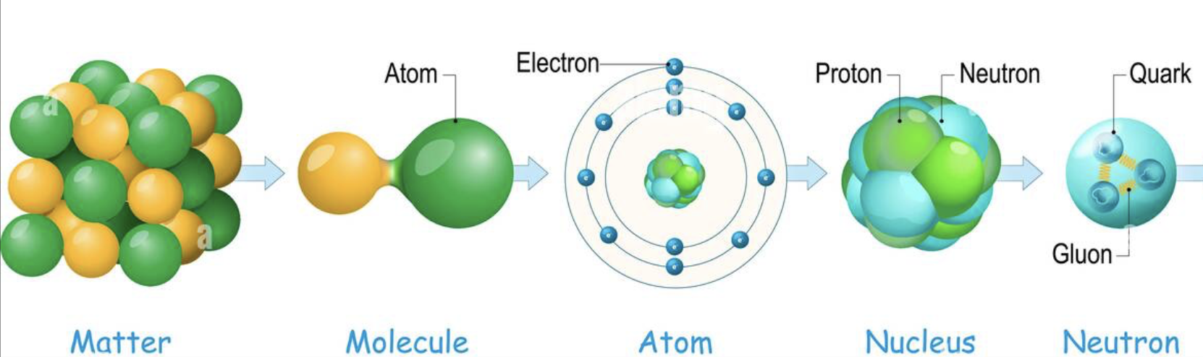
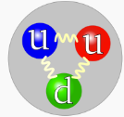
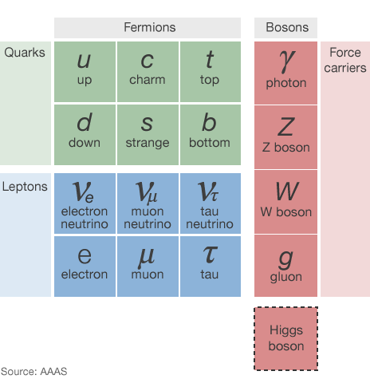
Background: Standard Model
What ?
e.g. proton ：up-up-down
How ?
quark, lepton
force carrier
quark, lepton
力(Force) | 载体(Carrier)
强（Strong） | 胶子Gluons (g)
电磁(EM) | Photon 光子
弱（Electro-Weak) | 玻色子bosons W/Z
引力（Gravitation） | ?
Is the mass of the fundamental particles are fixed ?

Slide 24
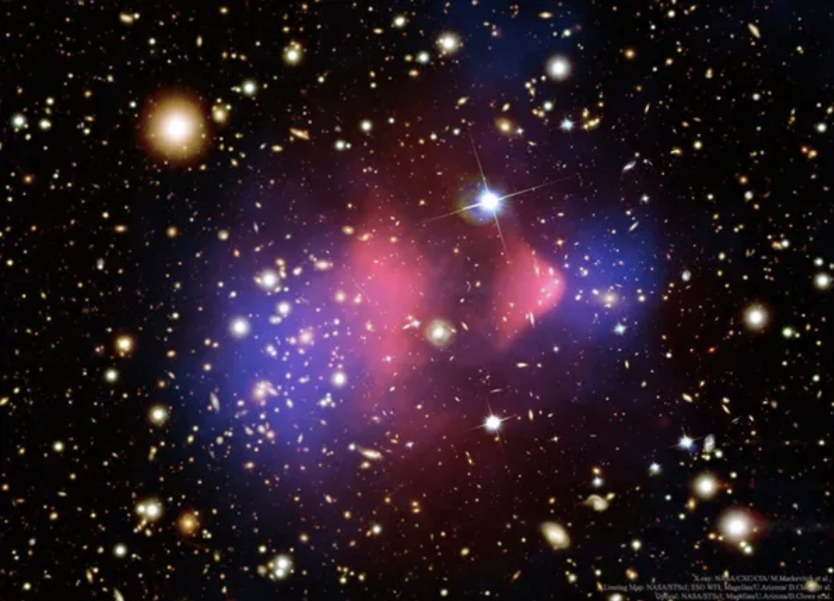
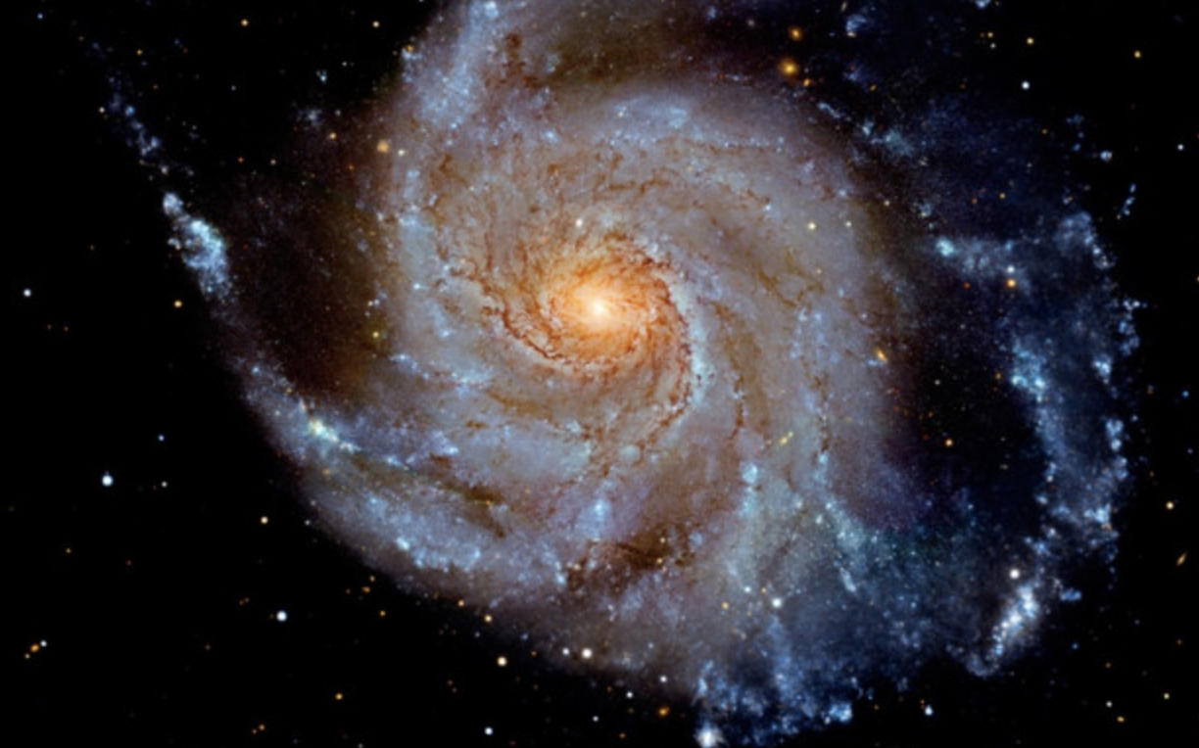
Background: Dark Matter and Dark Energy
Dark Matter : In order to hold the Universe,
more matter than observed is needed to provide
attractive force.
Dark Energy : In order to keep the expansion of the Universe, more energy is needed to provide source energy.
Dark Matter : 27%
Dark Energy : 68%
Matter : 5%
But neither of them has been observed !

Slide 25




Introduction : Symmetry
Symmetry happens everywhere in our world
It means the invariance
Notes:
雪花来解释对称性

Slide 26

How mass is generated : massless or massive ？
Gauge Symmetry：
Lagrangian is invariant under some phase transition
  EM force :
    Massless photon A_{μ}
  Strong interaction:
    8 massless gluons
  EW interaction:
    However massive W/Z (1983 at CERN).
U(1)
SU(3)
SU(2)

