Slide 1
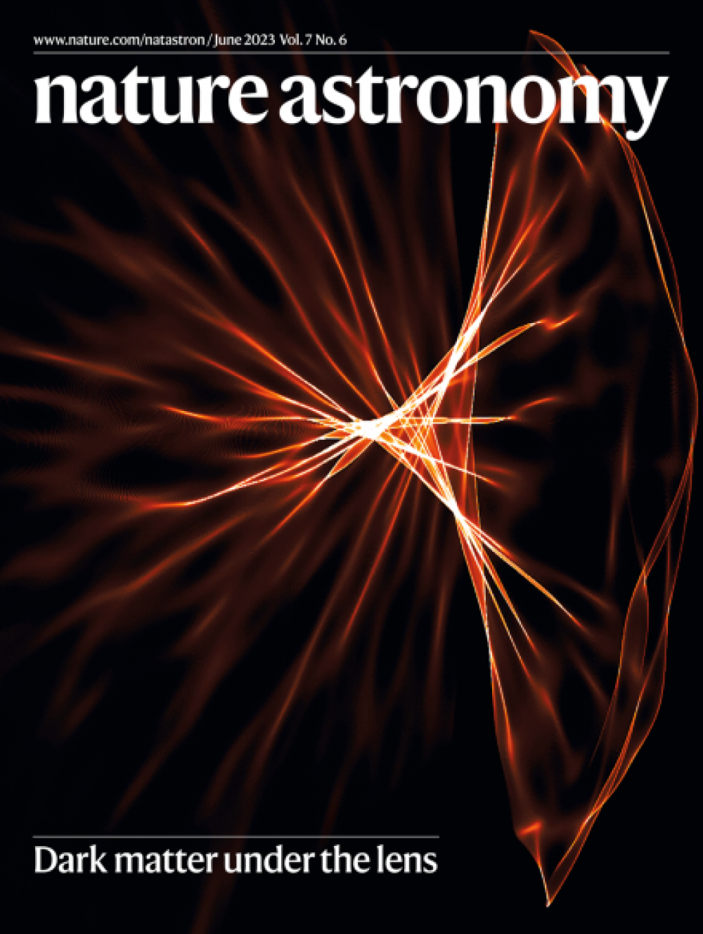
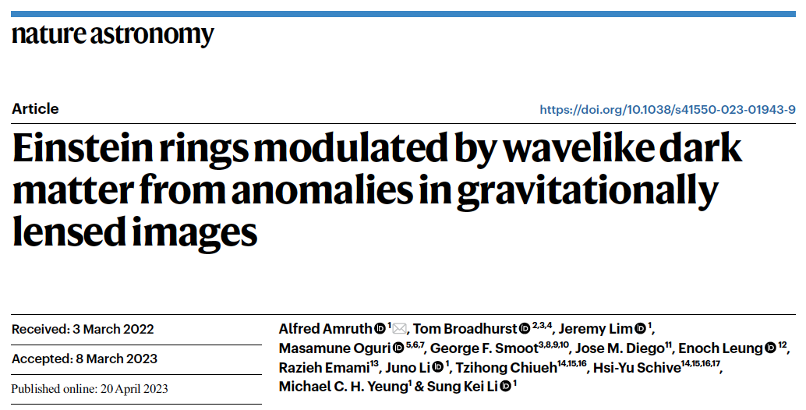

Dark Matter under the Gravitational Lens
2023 HK Young Scientist Award in Physical and Mathematical Sciences: Amruth Alfred

Slide 2
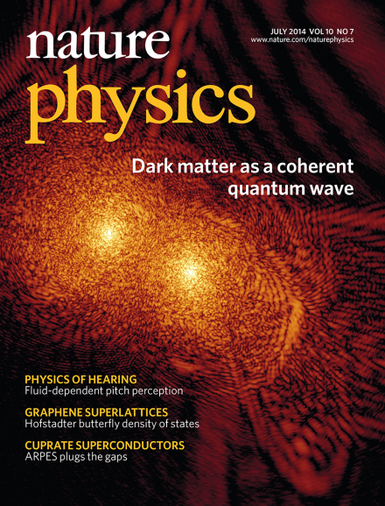
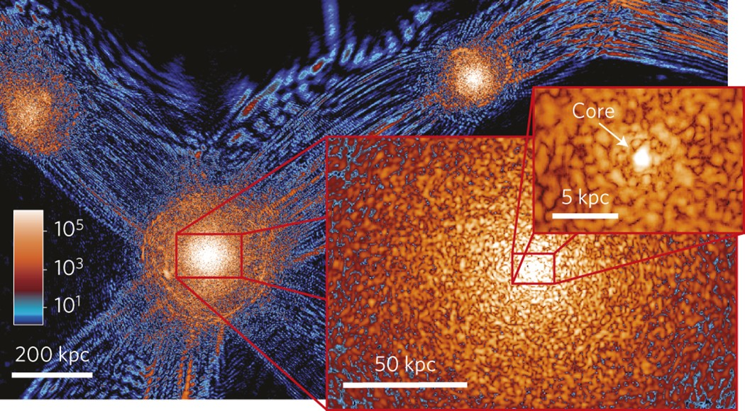
Dark Matter under the Gravitational Lens
Unique macro properties of Ultralight Cold Particles as Dark Matter: - solitonic cores - pervasive density modulations

Slide 3
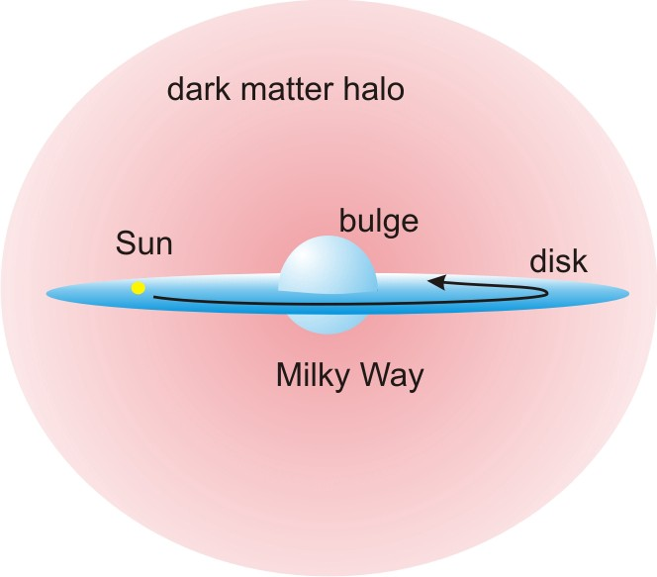
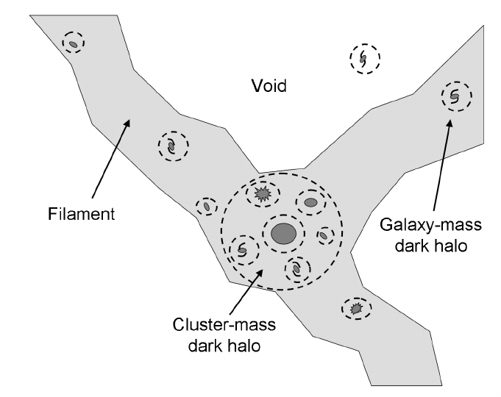
Nature of Dark Matter
Dark Matter: - does not absorb or emit light - interacts with ordinary particles, including light, only through gravity

Slide 4
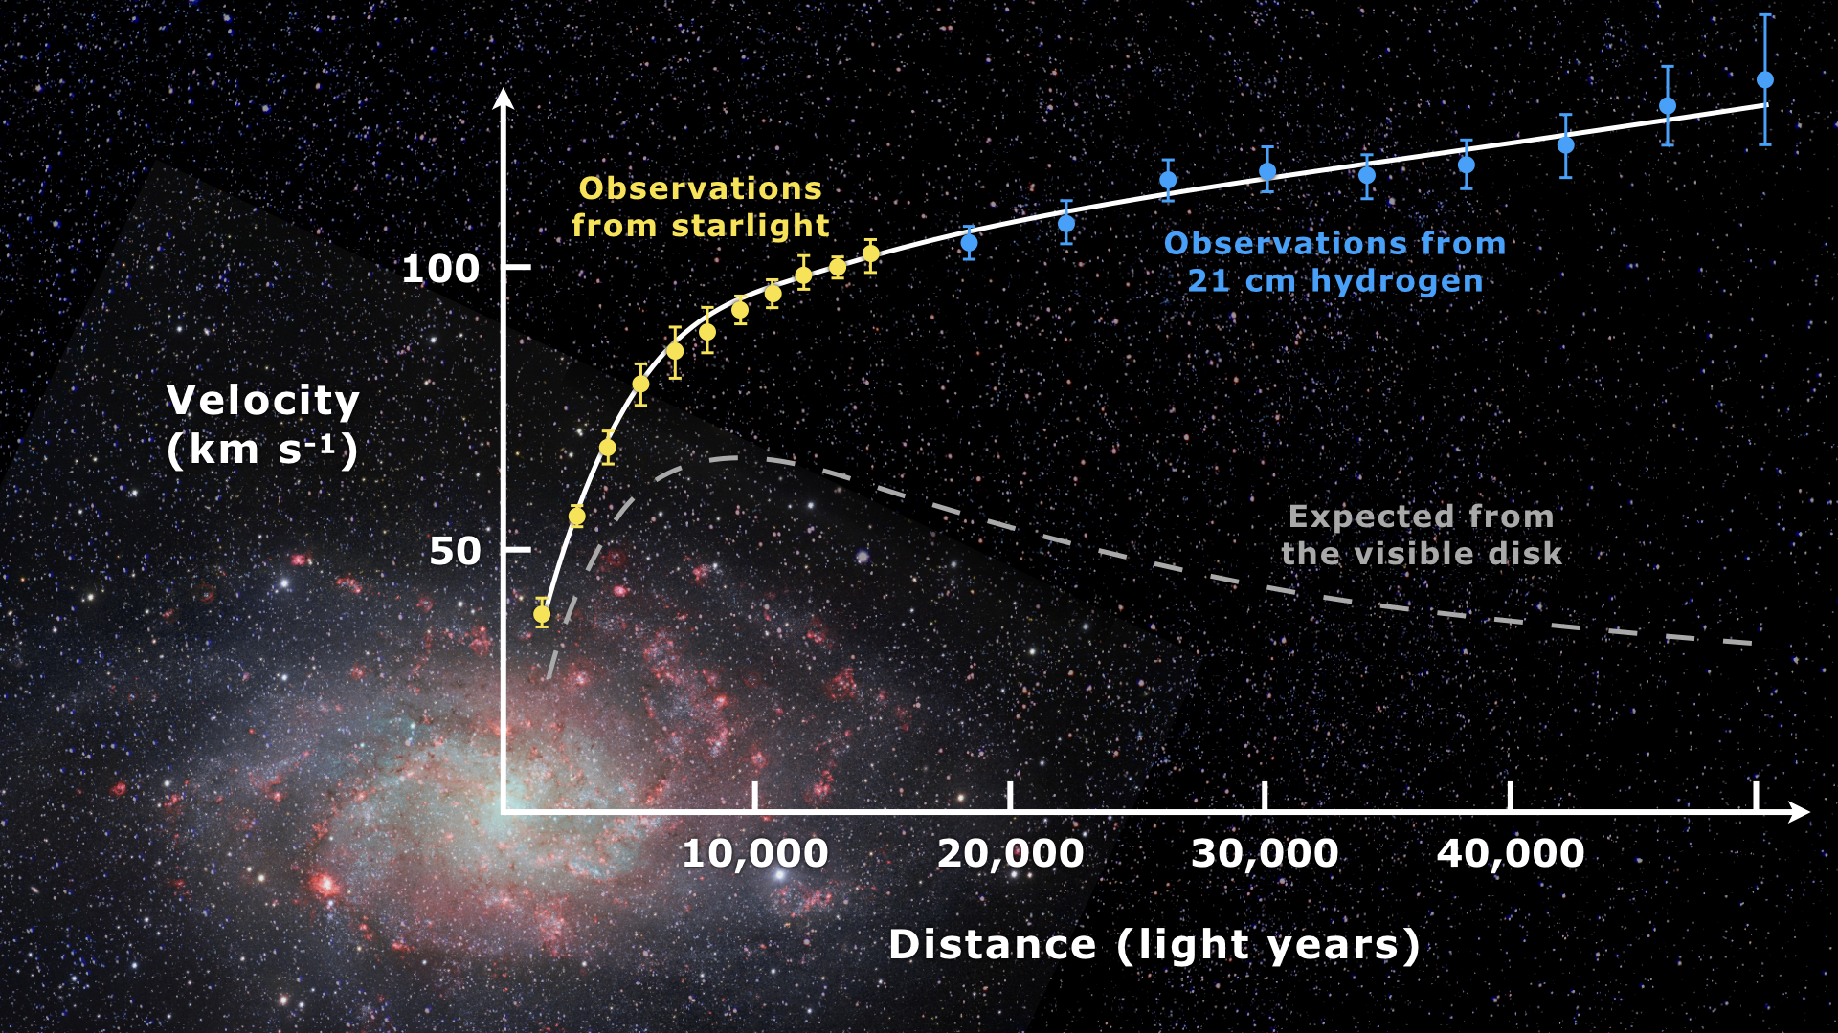
Nature of Dark Matter
Dark Matter: - does not absorb or emit light - interacts with ordinary particles, including light, only through gravity
Rotation curve of M33

Slide 5
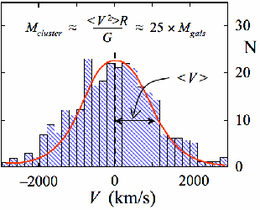
Nature of Dark Matter
Dark Matter: - does not absorb or emit light - interacts with ordinary particles, including light, only through gravity
Rotation curve of M33
Velocity dispersion of galaxies in Coma Cluster

Slide 6
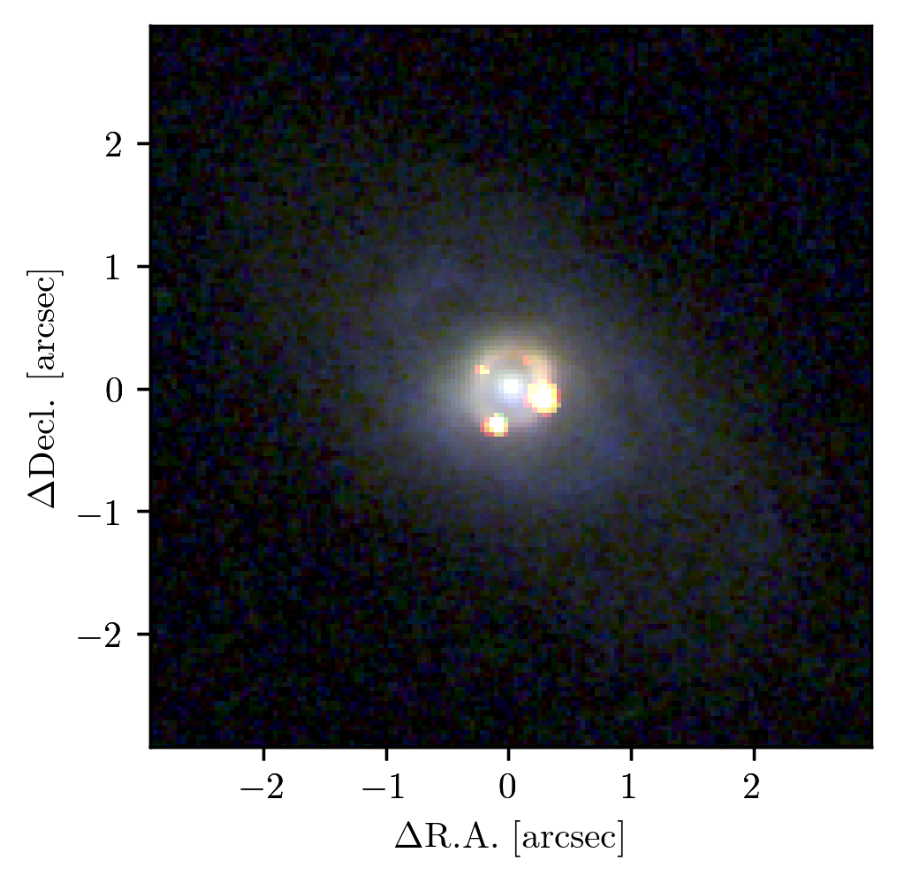
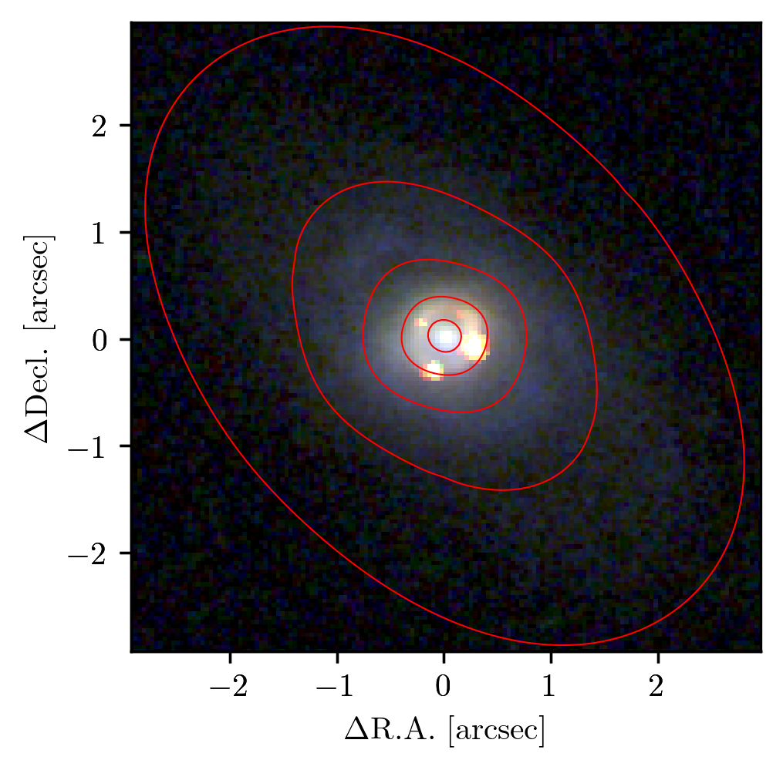
Nature of Dark Matter
Dark Matter: - does not absorb or emit light - interacts with ordinary particles, including light, only through gravity
SNIa iPTF16geu
Velocities of galaxies in Coma Custers
Chow+

Slide 7
Nature of Dark Matter
Dark Matter: - does not absorb or emit light - interacts with ordinary particles, including light, only through gravity
SNIa iPTF16geu
Galaxy cluster SMACS J0723.3–7327
Chow+
Chow+23

Slide 8
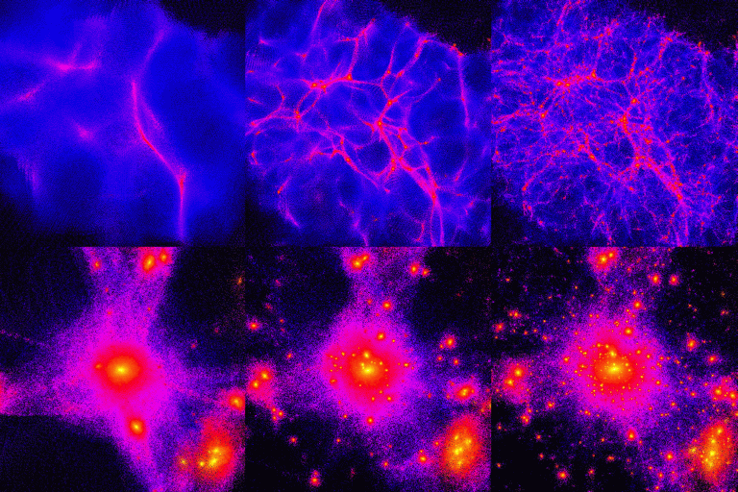
Nature of Dark Matter
Dark Matter: - does not absorb or emit light - interacts with ordinary particles, including light, only through gravity - favored to be cold, perhaps (some fraction) warm, but not predominantly hot
Cosmological Simulations of Structure Formation for:
Hot Dark Matter
Warm Dark Matter
Cold Dark Matter

Slide 9
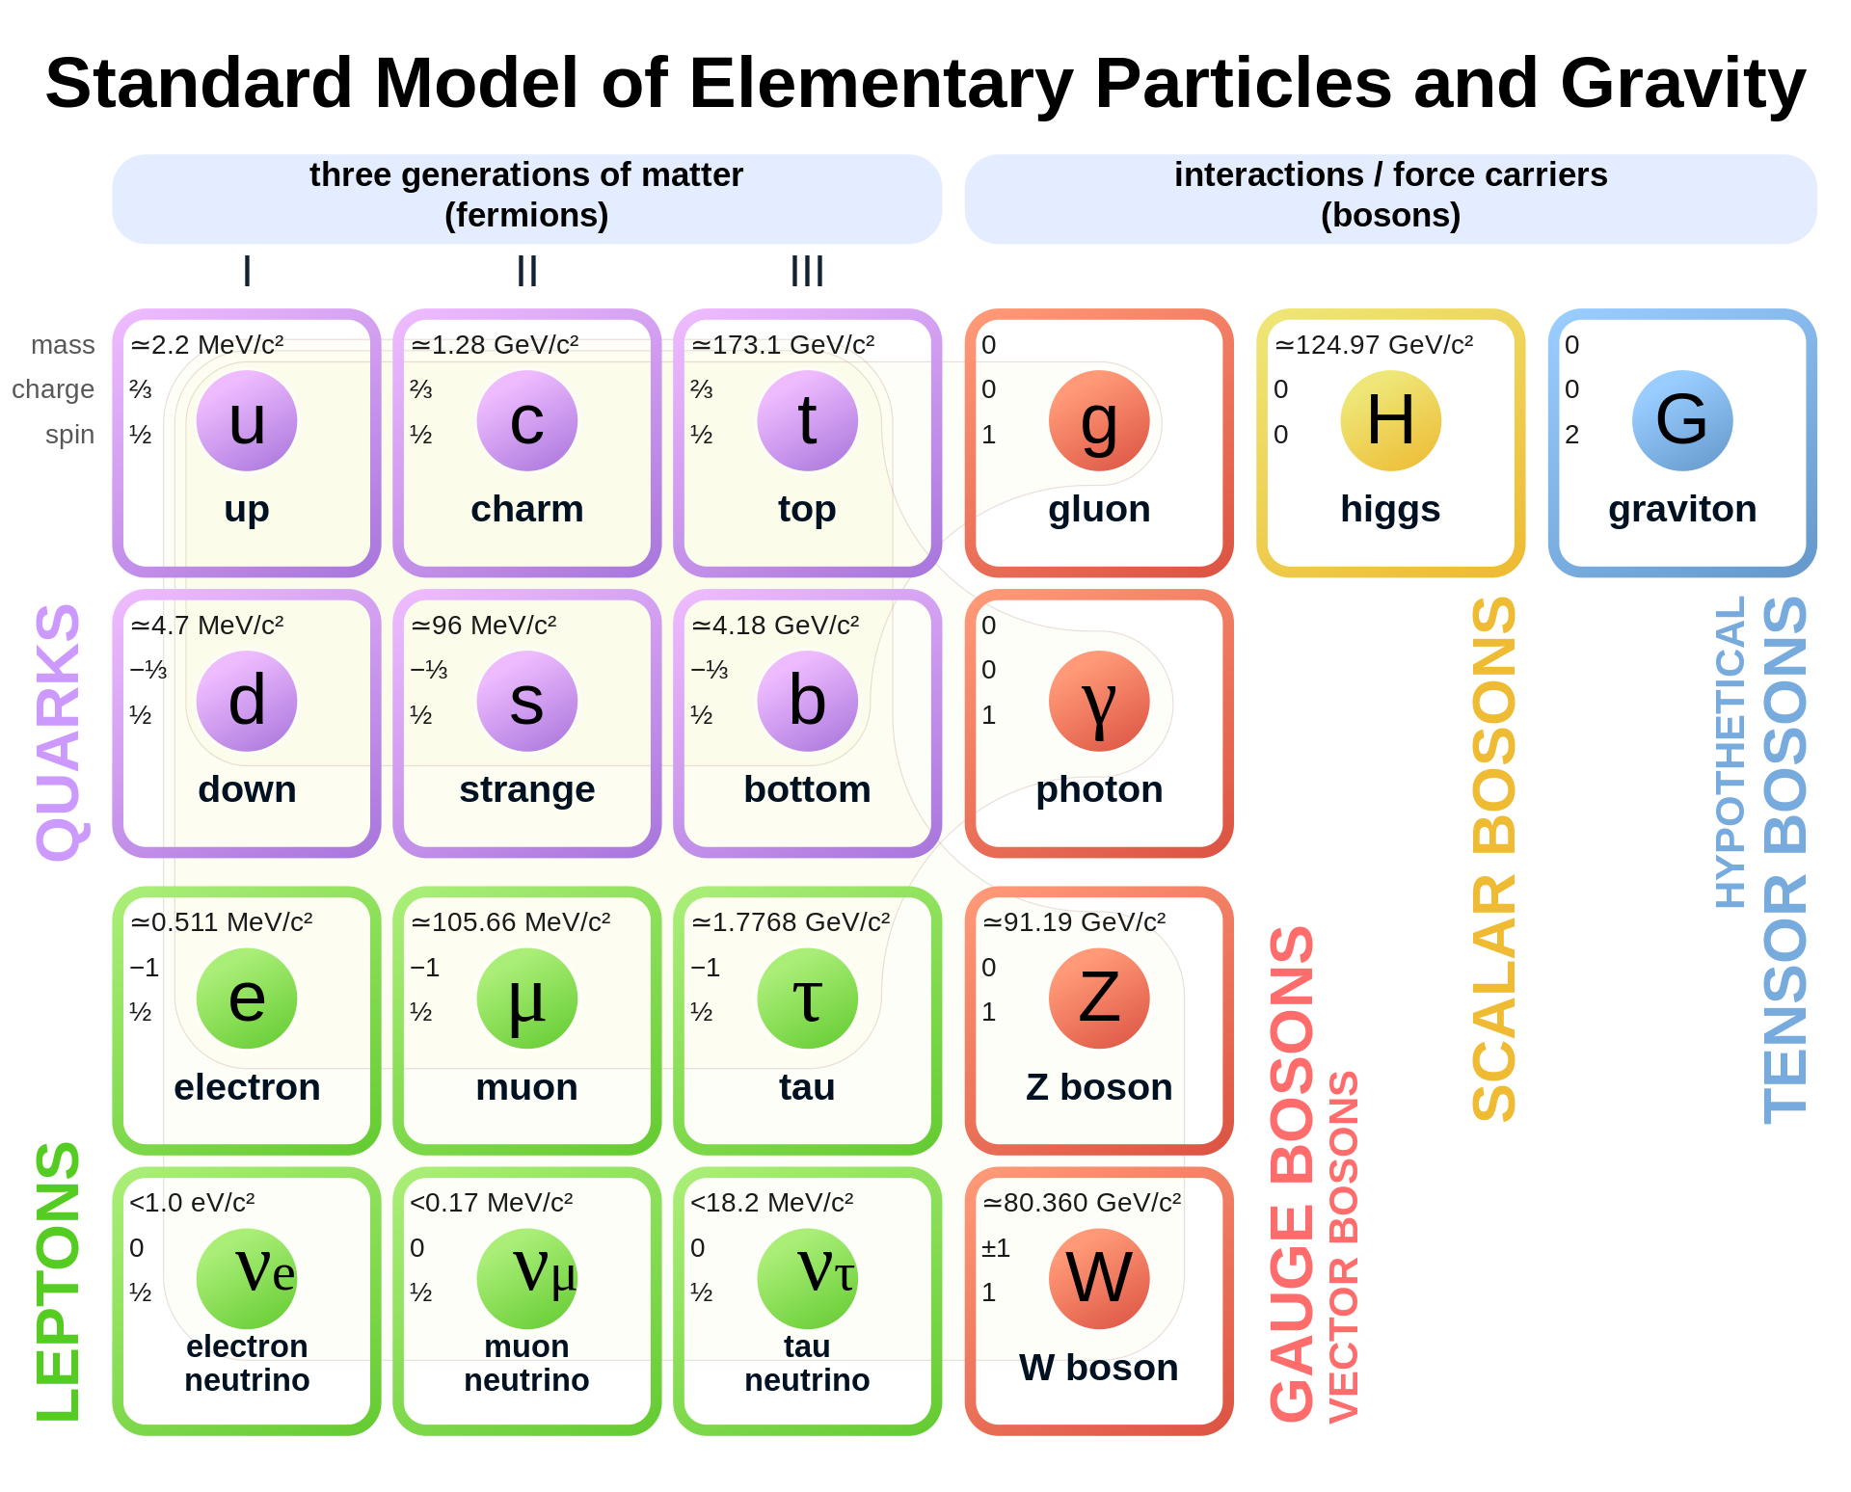
Standard Model of Particle Physics
The Standard Model of Particle Physics – a pillar of modern physics – is incomplete: - ad hoc assumptions - predicts neutrinos to be massless, in contradiction to neutrino oscillations - no explanation for matter-antimatter asymmetry - no explanation for gravity - no explanation for Dark Energy - no particle for Dark Matter (manifested through gravity)

Slide 10
Standard Model of Particle Physics
The Standard Model of Particle Physics – a pillar of modern physics – is incomplete: - ad hoc assumptions - predicts neutrinos to be massless, in contradiction to neutrino oscillations - no explanation for matter-antimatter asymmetry - no explanation for gravity - no explanation for Dark Energy - no particle for Dark Matter (manifested through gravity)
Theoretical extension to the Standard Model to address ad hoc assumptions predict hypothetical particles with masses of ~10⁻²² eV to ~10⁹ eV
These hypothetical particles have been proposed as candidates for Dark Matter: identification of the Dark Matter particle mass will therefore eliminate whole classes of theories, and point to the correct class of theory for New Physics

Slide 11
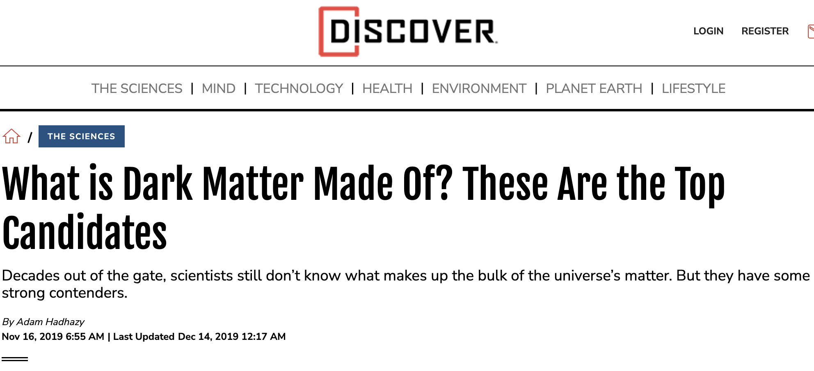
Candidates for Dark Matter
In descending order of favoritism (according to a popular article in 2019): - Weakly Interacting Massive Particles (WIMPs), 1⎯1000 GeV (1985) - Axions, ≪1 eV (1977)
  - Sterile neutrinos, ~1 GeV (late 1970s) - Strongly Interacting Massive Particles (SIMPs), ~0.1 GeV (2014) - MAssive Compact Halo Object (MACHOs), astronomical bodies - Gravitationally Interacting Massive Particles (GIMPs)
Notes:
SIMPs are massive composites of ordinary particles

Slide 12
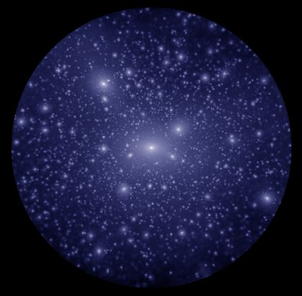
Candidates for Dark Matter
In descending order of favoritism (according to a popular article in 2019): - Weakly Interacting Massive Particles (WIMPs), 1⎯1000 GeV (1985) - Axions, ≪1 eV (1977)
Focus on ultra-massive (WIMPs) versus ultra-light (Axions) Cold Dark Matter
Ultra-massive cold particles (WIMPs)
Ultra-light cold particles (Axions)
Notes:
SIMPs are massive composites of ordinary particles

Slide 13
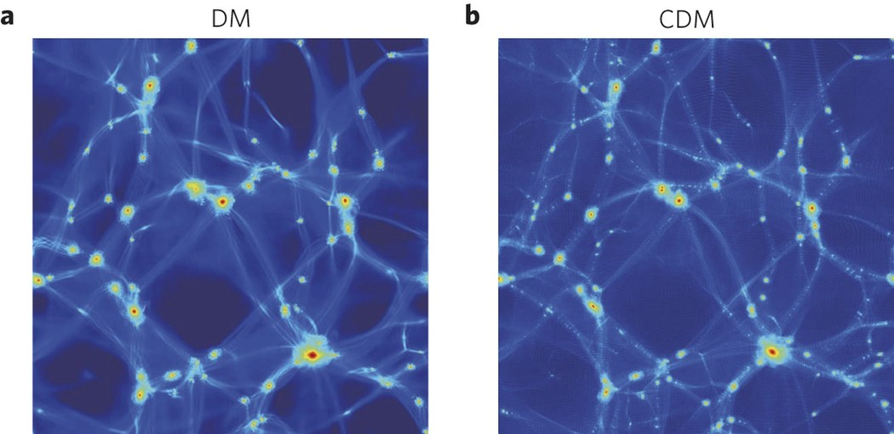
Structures formed by WIMPs vs Axions
WIMP vs. Axion Dark Matter: - form same large-scale structure - form halos with same global density profiles - differ in low-mass halos and therefore also sub-halos
Ultra-massive cold particles (WIMPs)
Ultra-light cold particles (Axions)
Schive+16
Notes:
Einstein’s theory of GR published in 1915

Slide 14
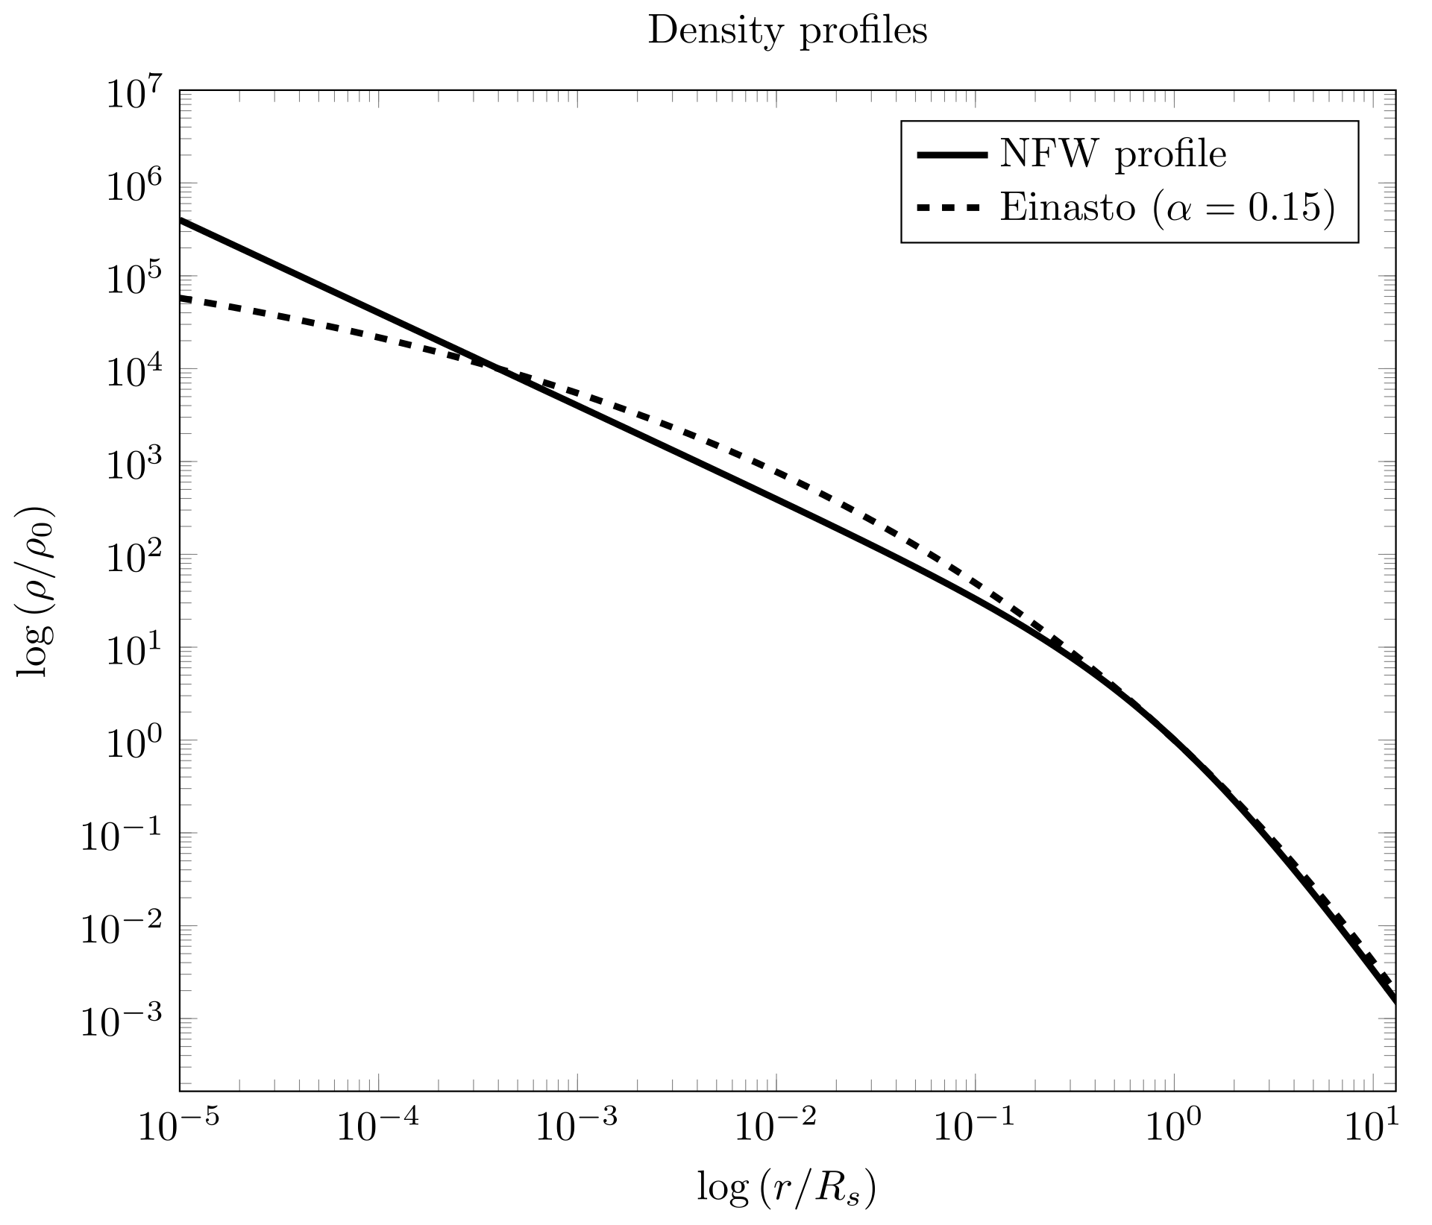
Structures formed by WIMPs vs Axions
WIMP DM halos characterized by: - smoothly decreasing density outwards - abundance of sub-halos (satellite galaxies) around massive halos
Ultra-massive particles (WIMPs)
Radial density profile of DM halo
Notes:
Einstein’s theory of GR published in 1915

Slide 15
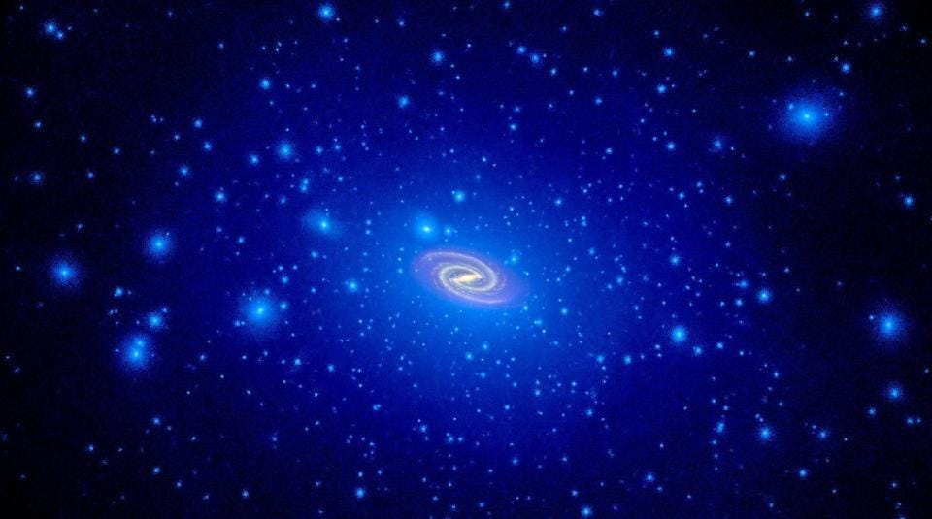
Structures formed by WIMPs vs Axions
WIMP DM halos characterized by: - smoothly decreasing density outwards - abundance of sub-halos (satellite galaxies) around massive halos
Ultra-massive particles (WIMPs)
Sub-halos around Massive Halos
Notes:
Einstein’s theory of GR published in 1915

Slide 16
Structures formed by WIMPs vs Axions
Axion DM halos characterized by: - solitonic core (larger towards lower-mass halos) - pervasive density modulations on de-Broglie scale (~100 pc massive halos) - (fewer sub-halos)
Ultra-light particles (axions)
Schive+16
Notes:
Einstein’s theory of GR published in 1915

Slide 17
Structures formed by WIMPs vs Axions
Different “substructures” of WIMP vs Axion DM permit their distinction
Ultra-massive cold particles (WIMPs)
Ultra-light cold particles (Axions)
Schive+16
Notes:
SIMPs are massive composites of ordinary particles

Slide 18
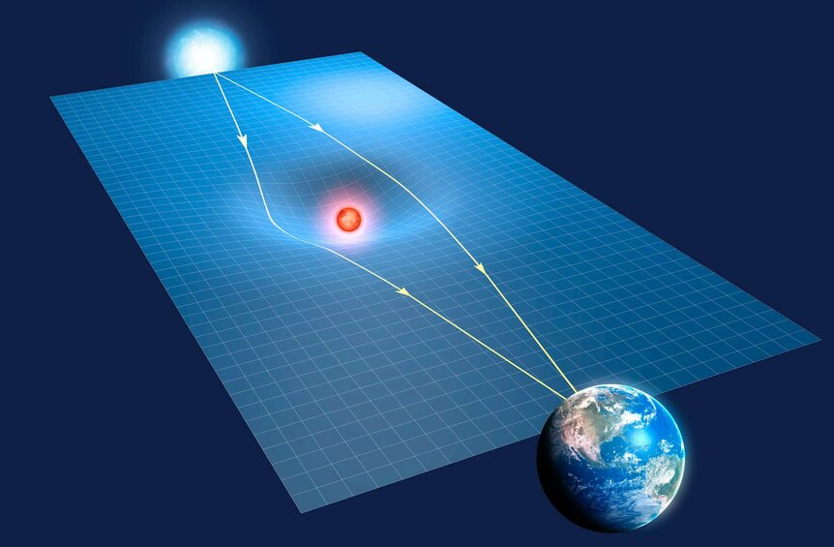
Revealing Dark Matter “substructure” through Gravitational Lensing
Deflection (focusing) of light from background galaxy by foreground massive object (galaxy or galaxy cluster) results in multiply-lensed images
Notes:
Einstein’s theory of GR published in 1915

Slide 19
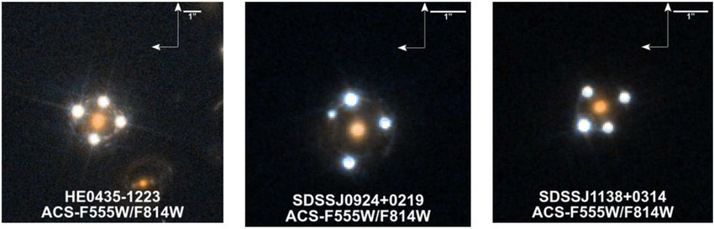
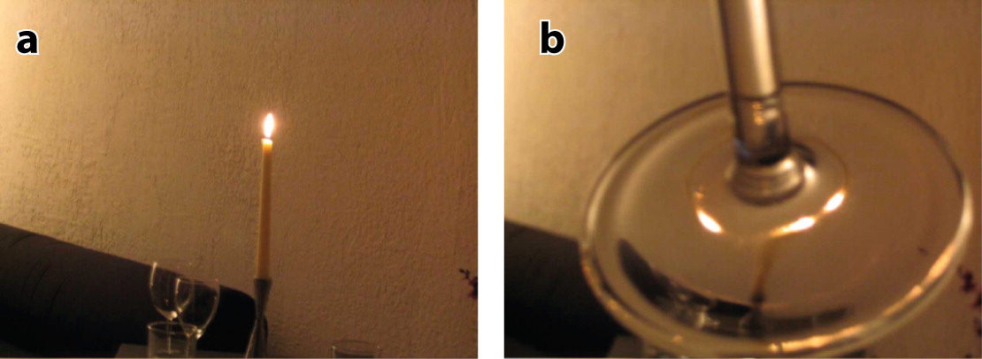
Revealing Dark Matter “substructure” through Gravitational Lensing
Deflection (focusing) of light from background galaxy by foreground massive object (galaxy or galaxy cluster) results in multiply-lensed images
Treu+10
Notes:
Einstein’s theory of GR published in 1915

Slide 20
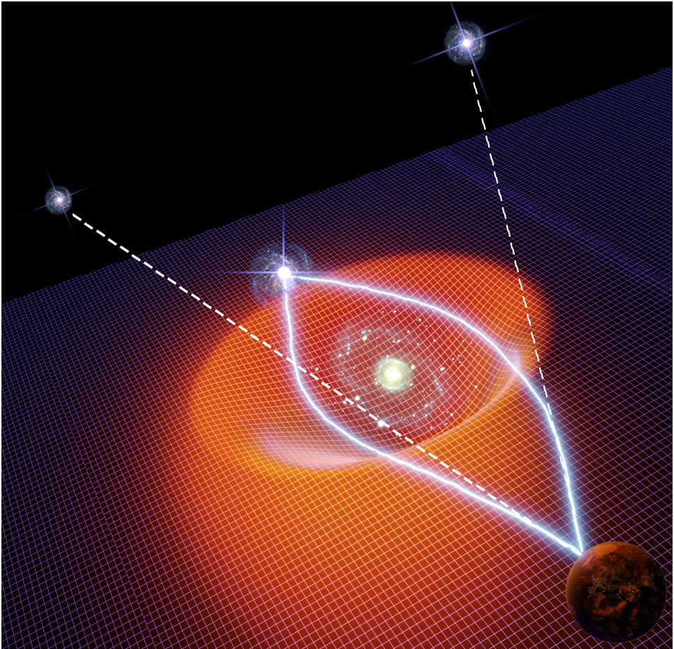
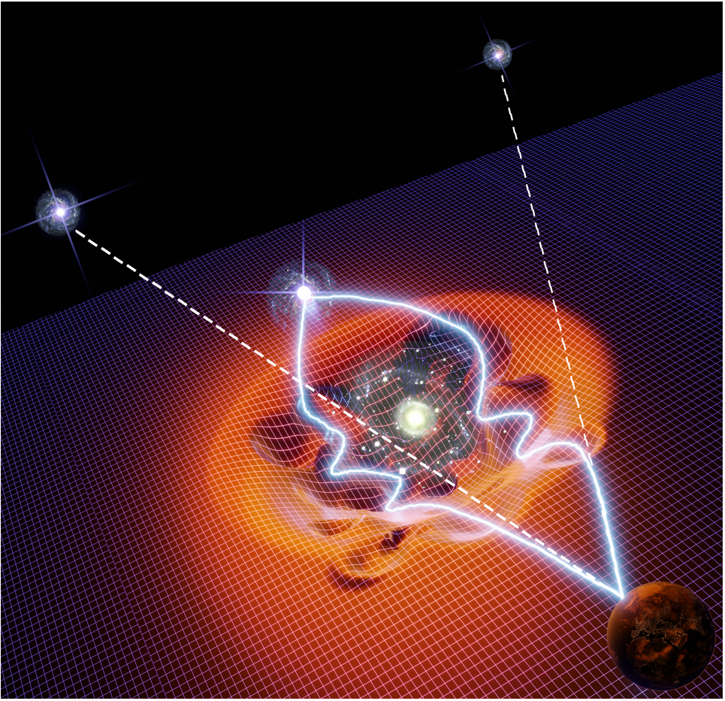
Revealing Dark Matter “substructure” through Gravitational Lensing
WIMP vs Axion DM halo predict different positions and brightnesses of multiply-lensed images
WIMP halo gravitational lensing
Axion halo gravitational lensing
Notes:
Einstein’s theory of GR published in 1915

Slide 21
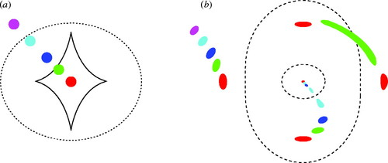
Gravitational Lensing of WIMP vs Axion Halos
Galaxy or galaxy cluster DM halos are triaxial ellipsoids: - positions and brightnesses of multiply-lensed images depend upon alignment between foreground lensing and background lensed objects
Source Plane
Image Plane
(Tangential) Critical curve
(Tangential) Caustic
Narayan & Bartlemann95
Notes:
Einstein’s theory of GR published in 1915

Slide 22
Gravitational Lensing of WIMP vs Axion Halos
Galaxy or galaxy cluster DM halos are triaxial ellipsoids: - positions and brightnesses of multiply-lensed images depend upon alignment between foreground lensing and background lensed objects
Source Plane
Image Plane
(Tangential) Critical curve
(Tangential) Caustic
Narayan & Bartlemann95
Notes:
Einstein’s theory of GR published in 1915

Slide 23
Gravitational Lensing of WIMP vs Axion Halos
Galaxy or galaxy cluster DM halos are triaxial ellipsoids: - positions and brightnesses of multiply-lensed images depend upon alignment between foreground lensing and background lensed objects
Source Plane
Image Plane
(Tangential) Critical curve
(Tangential) Caustic
Narayan & Bartlemann95
Notes:
Einstein’s theory of GR published in 1915

Slide 24
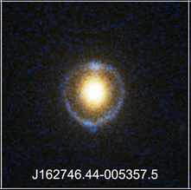
Gravitational Lensing of WIMP vs Axion Halos
Galaxy or galaxy cluster DM halos are triaxial ellipsoids: - positions and brightnesses of multiply-lensed images depend upon alignment between foreground lensing and background lensed objects
Source Plane
Image Plane
(Tangential) Critical curve
(Tangential) Caustic
Narayan & Bartlemann95
Notes:
Einstein’s theory of GR published in 1915

Slide 25
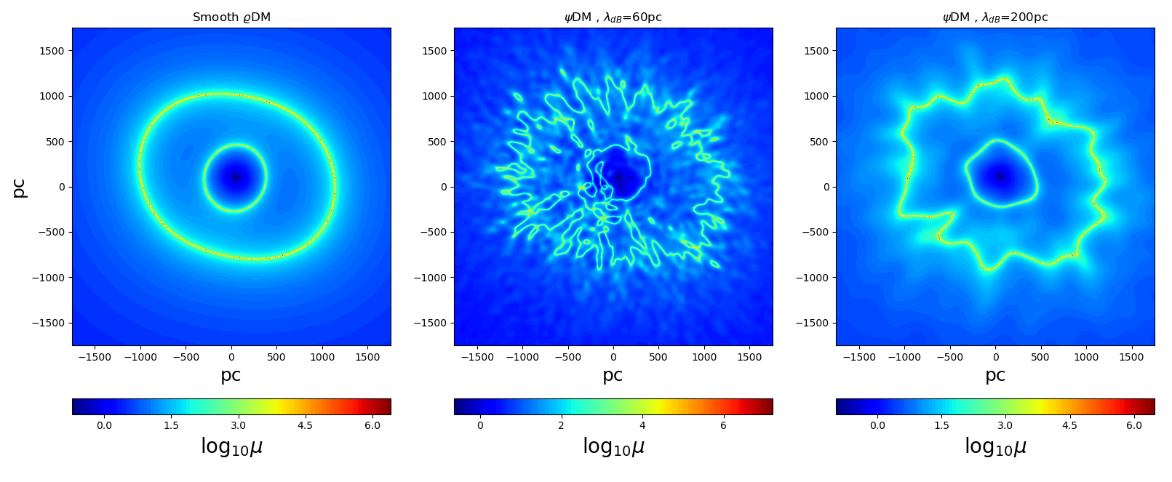
Gravitational Lensing of WIMP vs Axion Halos
Smooth vs perturbed critical curves for WIMP vs Axion DM halos
WIMP halo
Axion halo
(Tangential) Critical curve
(Tangential) Critical curve
Axion halo
Notes:
Einstein’s theory of GR published in 1915

Slide 26
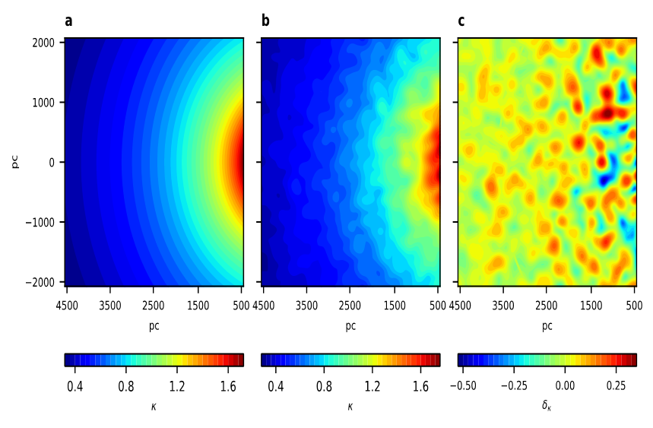
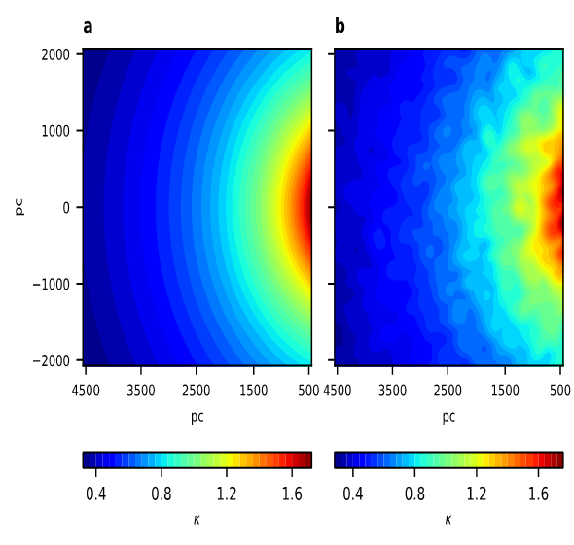
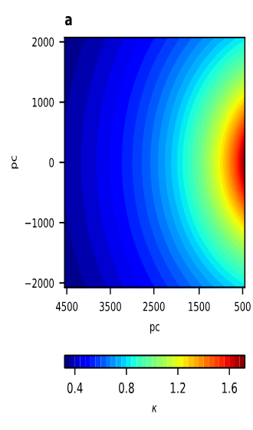
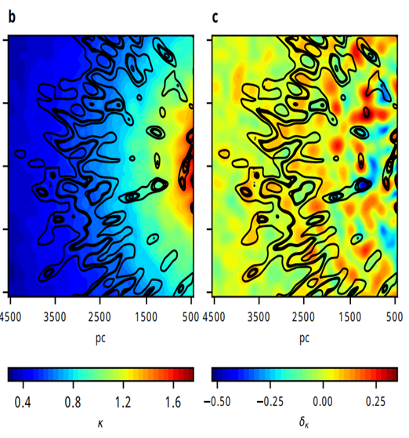
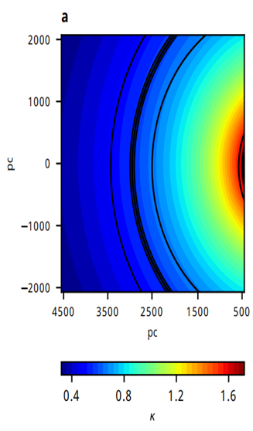
Gravitational Lensing of WIMP vs Axion Halos
Smooth vs perturbed critical curves for WIMP vs Axion DM halos
WIMP halo
Axion halo
Axion halo
Amruth+23

Slide 27
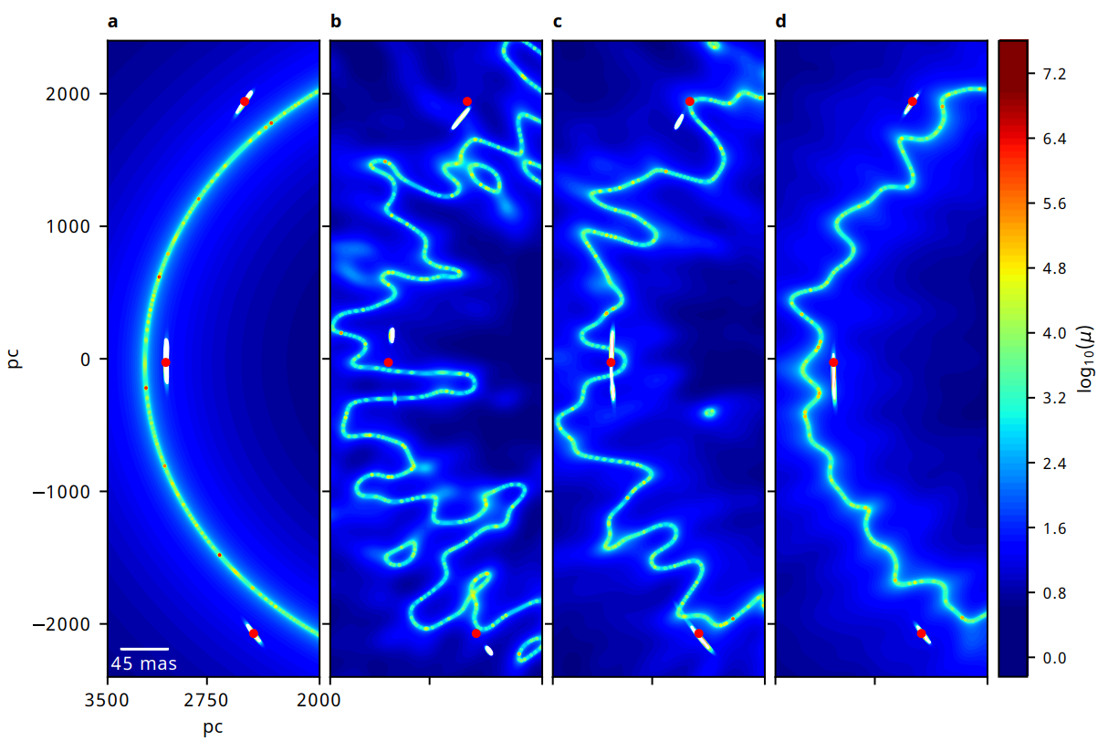
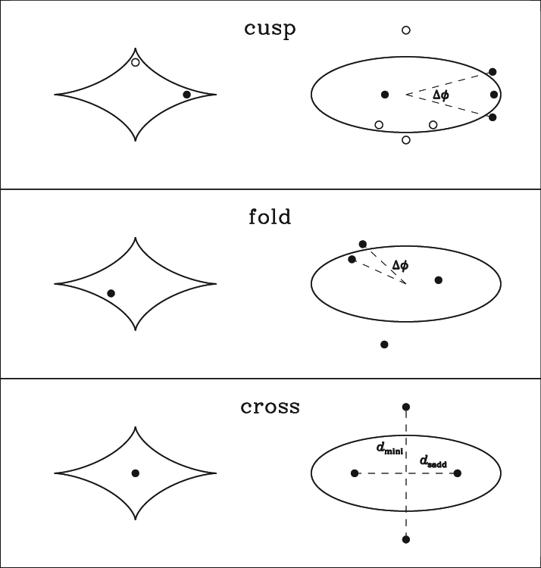
Gravitational Lensing of WIMP vs Axion Halos
Positions and brightnesses of multiply-lensed images generated by WIMP vs Axion DM halos
WIMP halo
Axion halo
Source Plane
Image Plane
Amruth+23

Slide 28
Gravitational Lensing of WIMP vs Axion Halos
Positions and brightnesses of multiply-lensed images generated by WIMP vs Axion DM halos
WIMP halo
Axion halo
Axion halo + some stars
Amruth+23

Slide 29
Gravitational Lensing of WIMP vs Axion Halos
Positions and brightnesses of multiply-lensed images generated by WIMP vs Axion DM halos
WIMP halo
Axion halo
Axion halo + some stars
Axion halo + more stars
Amruth+23

Slide 30
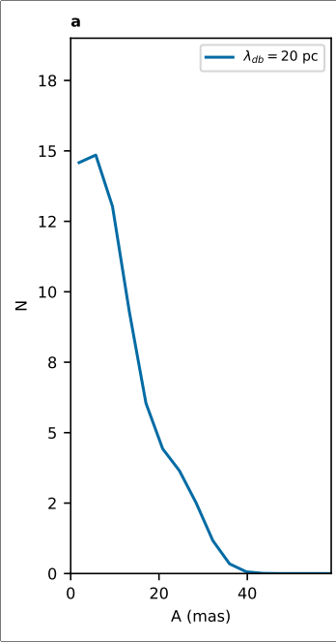
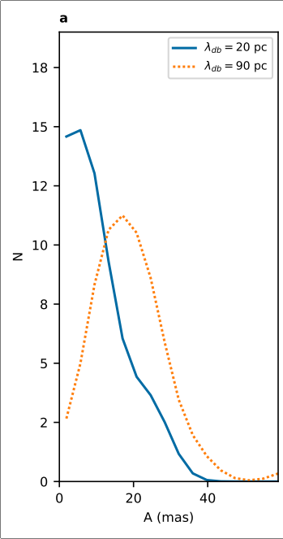
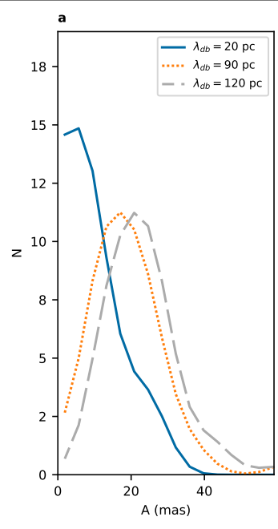
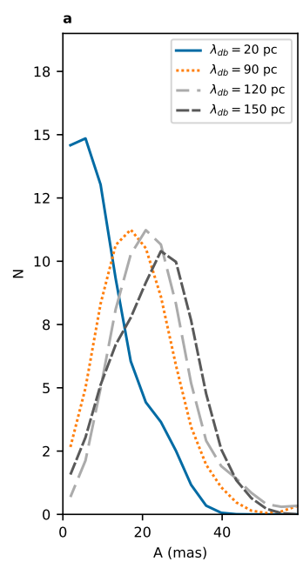
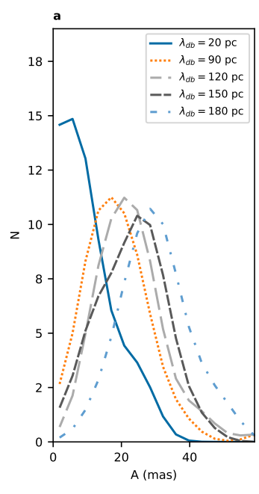
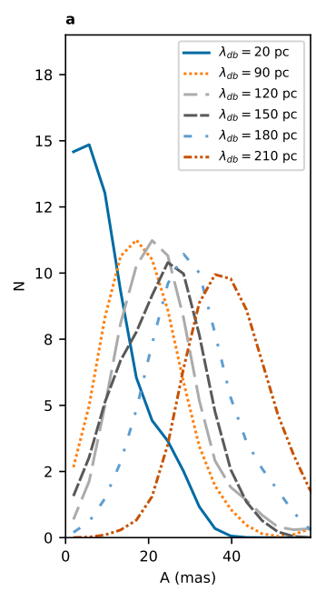
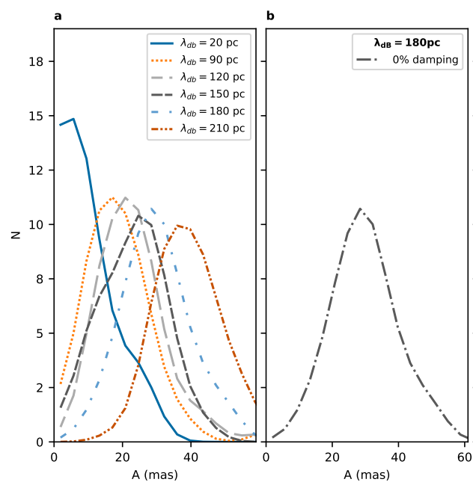
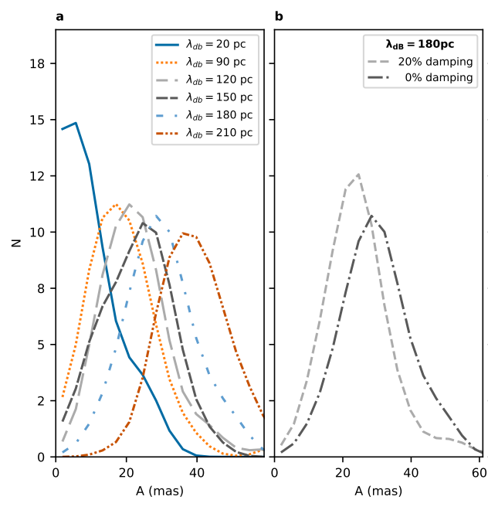
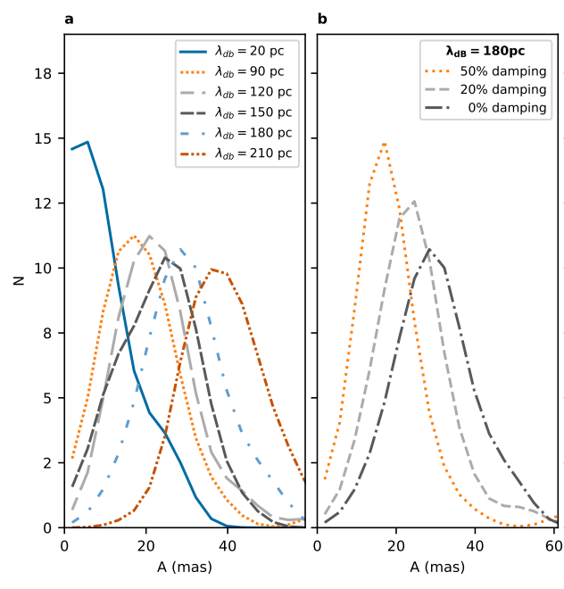
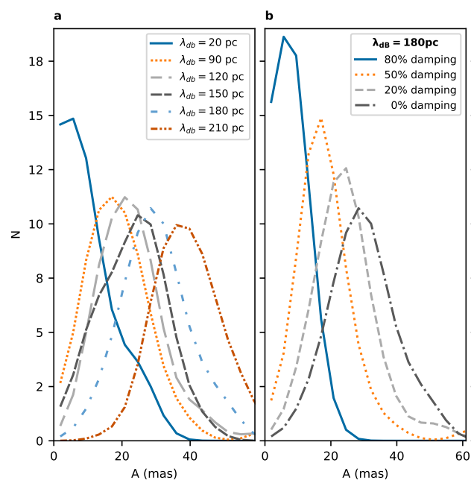
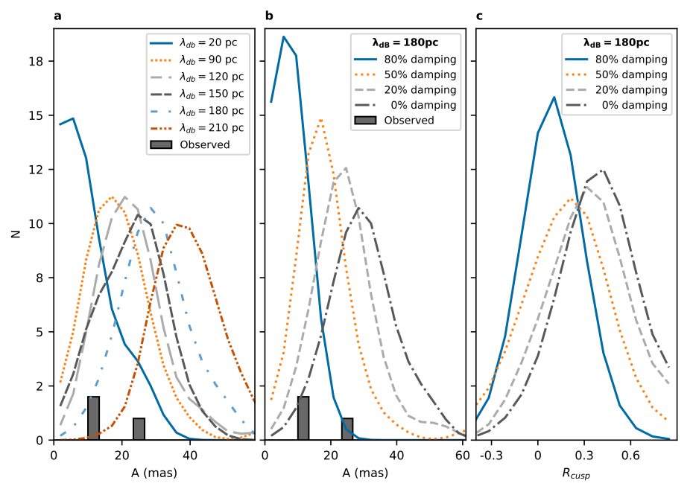
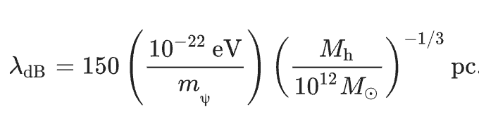

Lensing Anomalies
Predicted position anomalies left by Axion DM halo.
(m_{ψ} = 8 × 10⁻²² eV)
(m_{ψ} = 0.8 × 10⁻²² eV)
M_{h} = 7 × 10¹¹ M☉
$$A{= [\frac{1}{3}\sum_{i=1}^{3}{{\left(x_{i}^{pert}−x_{i}^{smooth}\right)}^{2}]}}^{1/2}$$
Amruth+23

Slide 31
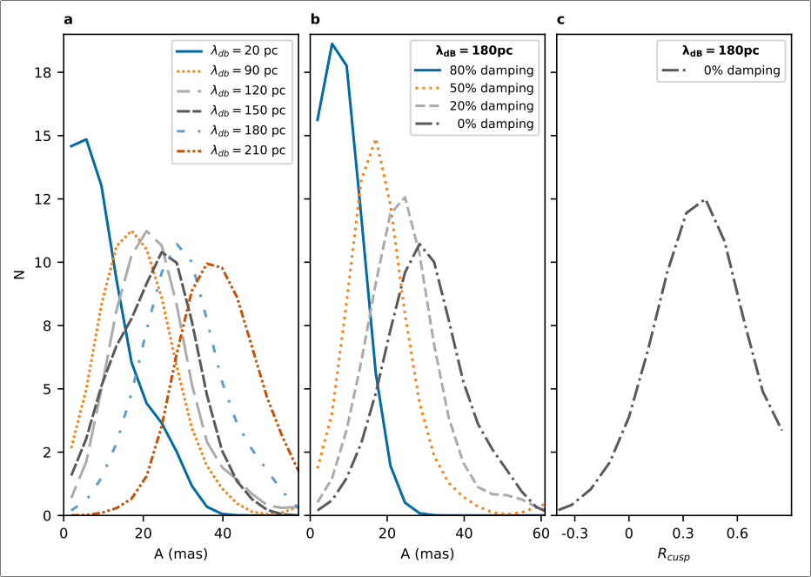
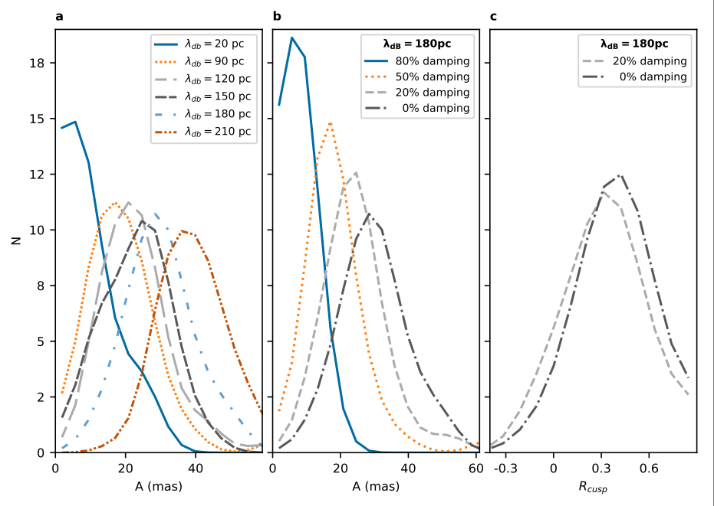
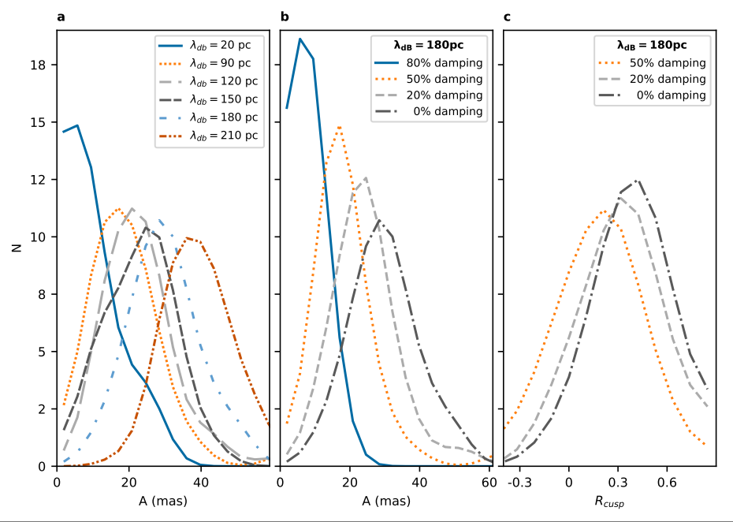
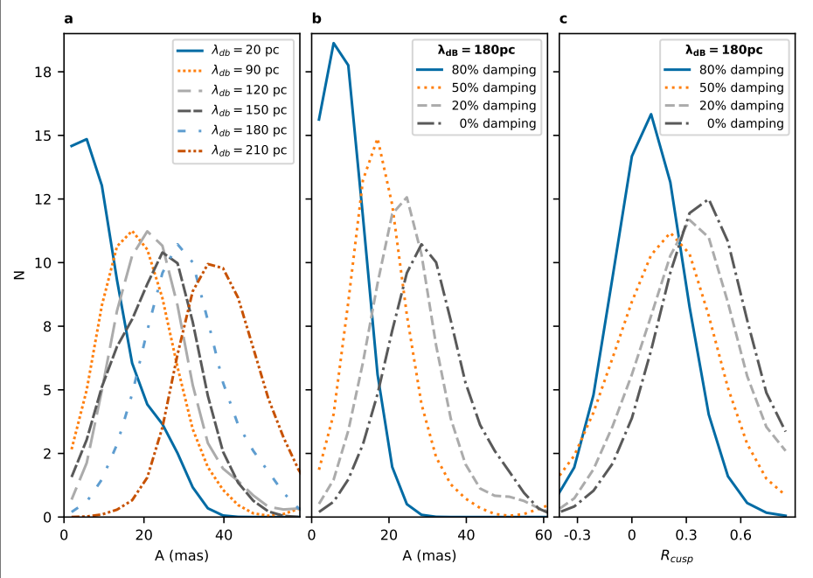
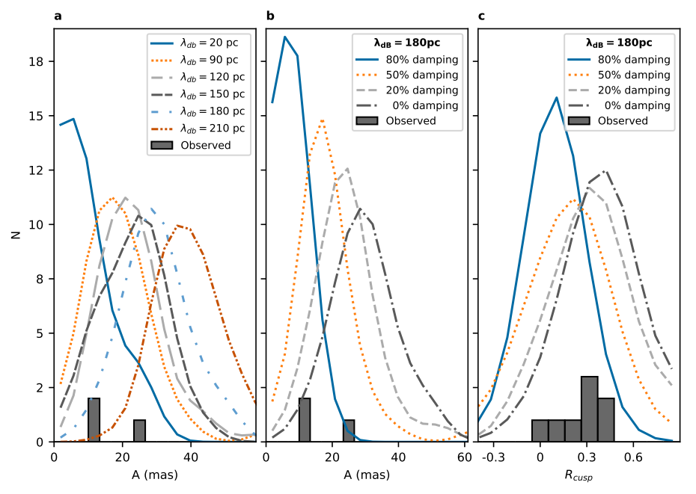

Lensing Anomalies
Predicted brightness (magnification) anomalies left by Axion DM halo.
μ₁
μ₂
μ₃
$$R_{cusp}=\frac{μ_{1}+μ_{2}+μ_{3}}{\left(\left|μ_{1}\right|+ | μ_{2}|+|μ_{3}|\right)}$$
Amruth+23

Slide 32
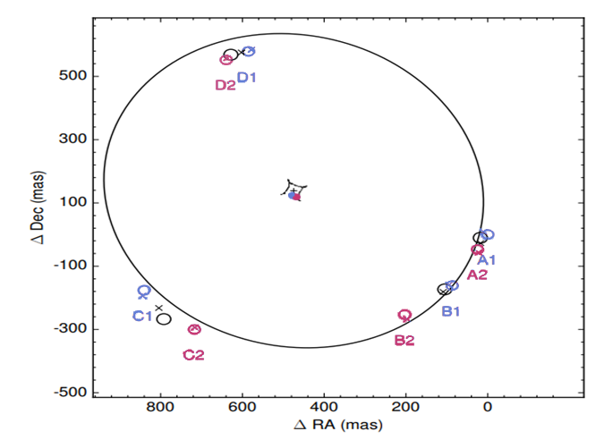


Lensing Anomalies
WIMP lens models leave both position and brightness anomalies in the multiply-lensed quasar HS0810+2554 as observed with HST and Very Long Baseline Interferometry (VLBI)
X - Predicted position
Hartley+19

Slide 33



Lensing Anomalies
Axion lens models able to reproduce observed positions of multiply-lensed quasar HS0810+2554 as observed with HST and Very Long Baseline Interferometry (VLBI)
180 pc
Amruth+23
Hartley+19
Notes:
75 GRF realisations
180 pc is 23 mas

Slide 34



Lensing Anomalies
Axion lens models able to reproduce observed positions of multiply-lensed quasar HS0810+2554 as observed with HST and Very Long Baseline Interferometry (VLBI)
Amruth+23
Hartley+19

Slide 35



Lensing Anomalies
Axion lens models able to reproduce observed positions of multiply-lensed quasar HS0810+2554 as observed with HST and Very Long Baseline Interferometry (VLBI)
Amruth+23
Hartley+19

Slide 36



Lensing Anomalies
Axion lens models able to reproduce observed positions of multiply-lensed quasar HS0810+2554 as observed with HST and Very Long Baseline Interferometry (VLBI)
Amruth+23
Hartley+19

Slide 37

Lensing Anomalies
Axion lens models able to reproduce observed brightness ratios of multiply- lensed quasar HS0810+2554 as observed with Very Long Baseline Interferometry (VLBI)

Slide 38


Conclusions
Scales tilting towards ultra-light particles for Cold Dark Matter: - resolution of lensing anomalies (Amruth+23) - mitigates problem of missing satellites - evidence for solitonic cores in dwarf galaxies (Broadhurst+20, Pozo+21, Pozo+22)

Slide 39

Future Work
Extend work by Amruth+23 to: - lensing galaxies with different masses - multiply-lensed SNIa - galaxy clusters
SNIa iPTF16geu

