Slide 1



Economical and high efficiency
industrial production of accelerator components
Song Jin
（For CEPC study group）
Mini-workshop of IAS Program on High Energy Physics (HEP) 2024, 18-19. Jan., 2024, HKUST, Hongkong

Slide 2
Content
Introduction
Main factors affecting the industrial production
Virtual factory
Summary

Slide 3
1. Introduction
CEPC project represents one of the most advanced future colliders, featuring a large-scale accelerator complex comprising
  A 1.8 km linear accelerator
  two 100 km circular accelerators, including a booster and a collider.
This endeavour necessitates large-volume components for various accelerator systems. For example:
  ~37,000 magnets, more than 20,000 magnet power supplies
  ~ 200 km of copper with NEG film, 100 km of aluminium and 6 km of stainless-steel vacuum pipes
  over 80,000 mechanical supports
  about 192 650 MHz two-cell SRF cavities, and 96 1.3-GHz nine-cell SRF cavities
  around 96 high efficient klystrons, to name a few

Slide 4
Relationship between economical efficiency and high efficiency
So, economical and high efficiency of the production became important:
  For a so large project, economical strategy should have high priority to control cost
  High efficiency: it is highly related to project schedule, and normally could reduce cost
    However, in special cases, it is possible that high efficiency may increase the cost . For example, for high efficiency, additional manufacture machines or human resource may be needed and then increase cost in a short period of the project construction
    But in a view of long term, the improvement of efficiency will be helpful. R&D and a good assessment will be necessary for a target of high efficiency .
In the talk, some of considerations are presented for the further discussion.

Slide 5
Types of components
Standard Products
  Usually do not require customization or special processing
  Those components or products that can be purchased directly from suppliers.
  Typically common standard specification products, such as screws, nuts, bearings, etc.
  Procurement strategies are needed
Non-standard Products
  They require custom production based on specific requirements.
  Involve special dimensions, materials, or functional requirements, necessitating customized communication with suppliers.
  Most accelerator components are belong to this type, and we need to focus on this type of components for industrial production
Integration and Testing Category
  These components may include various sensors, actuators, controllers, etc., and require installation and testing during the entire system integration and testing process.

Slide 6
2. Main factors affecting the industrial production
Main process control of the economical and high efficiency production
  Engineer design
  Product process flow control
  Supply chain management
  Quality and cost control
Some of critical points need to take care of in above processes
  Material
  Automated manufacture equipment
  Manufacture processing
  Collaboration between companies

Slide 7
The main process: Engineer design for manufacture
In engineer design phase, manufacturability and reliability will be crucial. Actually, reliability is one of factors which can lower the cost. Several aspects are important as following:
  reasonably design
  Selection of the product's functions
  structure
  materials
  Besides, some ideas for increasing efficiency also need to be considered and combined to the design, which are discussed in following.

Slide 8
The main process : Product process flow control
Develop a reasonable production process flow, including control measures for raw material procurement, processing, and assembly to ensure product quality and production efficiency.
We had a preliminary construction schedule for each system in TDR process. The further consideration for special points likes milestones or deadlines and so on might be needed to go to details.
Besides, the interfaces of various systems in the schedule sometimes are complicated. Some detailed planned may need to make further more.

Slide 9

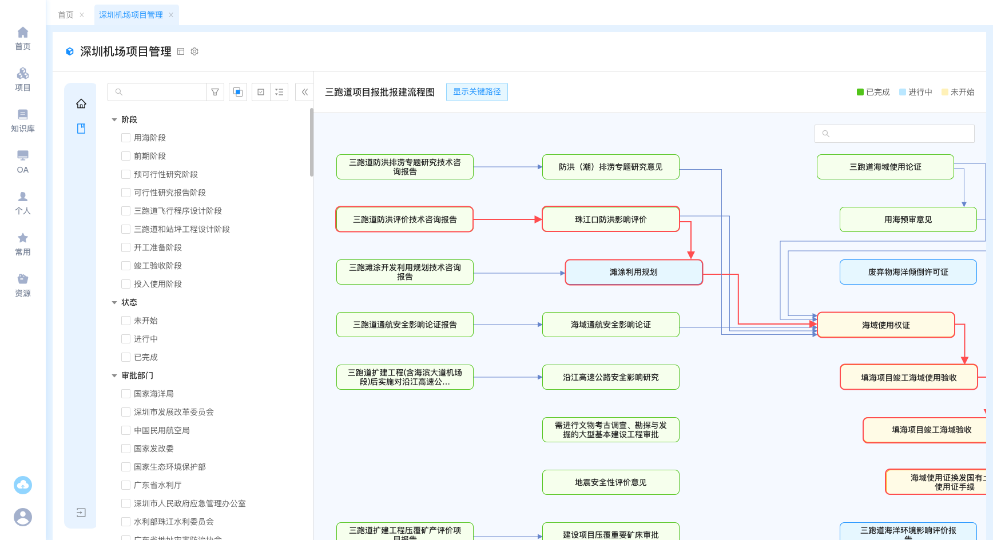
An example from software called DeepC
The progress flow could be automatedly created from multiple WBS processes in the file like Excel. The critical path in red color can be clearly visible
Complete
On going
Will begin

Slide 10
The main process: Supply chain management
Effectively manage the supply chain, including
  raw material suppliers
  processing plants: Production equipment, Processing, Plants
  logistics
  labors for assembly or integration
  To ensure the stability and efficiency of the supply chain.
  For a large project, management strategies will need for the economical benefit.
  For example, traditionally, the procurement or processing is done separately by various sub-systems. But for a large project, the centralized procurement, resources coordinate of processing plant and logistics may have more advantages for economical purpose.

Slide 11
The main process: Quality and cost control
Quality control: a sound quality management system, including measures for
  raw material inspection,
  production process control,
  finished product inspection.
Cost control: Reasonably control production costs, including
  raw material costs,
  labor costs,
  equipment depreciation, etc.

Slide 12
Key points: Raw Material
The cost of raw material could be more than 1/3 of the total cost of production. So, it is one of the main factors affects economical production.
For a large project, the centralized procurement should be considered to lower the cost.
And if possible, the project also can work with the material industries to see whether some process can be optimized and even using new technology to lower the cost.
  For example, several years ago, there was no so high RRR niobium for SRF cavities. The SRF committee help to improve the material.

Slide 13
Key points: Automation for high efficiency production
For mass production, the highly automated production equipment is the key to ensuring high efficiency.
We are currently in the era of AI, and intelligent production become the mainstream trend for the industrial sector. CEPC also made some effort.
However, there will also be some challenges we need to be carefully assessed. Following table shows some of comparison *.
Benefits | Increased productivity | Consistency | Cost-effective | Safety | Improved quality control | Increased flexibility | Better use of time and resources
Challenges | High initial cost | Maintenance and repair | Lack of flexibility | Integration with existing systems | Safety concerns | Workforce training | Resistance to change
*https://www.wevolver.com/article/how-assembly-line-automation-is-revolutionizing-manufacturing-types-benefits-and-challenges

Slide 14
A few explanation about benefits
Increased productivity: Automation can increase productivity by reducing manual labor, eliminating human error, and increasing the speed of production. Businesses can cut down the time to market for new products which ultimately improves profitability.
Consistency: Automated systems can perform tasks with a high level of accuracy and consistency, ensuring that each product is identical in quality.
Cost-effective: Automation reduces production costs by eliminating the need for manual labor and offering high-performance and high-quality output. Machines and robots can perform tasks 24/7 with minimal human intervention, leading to reduced labor costs. Automation also reduces the risk of errors and defects, leading to reduced waste and rework costs.
Safety: Automation improves workplace safety by eliminating the need for humans to perform dangerous and repetitive tasks. Machines and robots can perform tasks in hazardous environments, reducing the rImproved quality control: Automation technologies such as sensors and data analytics can monitor production processes and identify defects and errors in real time. This allows manufacturers to improve product quality and reduce waste. They perform inspections, and quality control checks much faster and more consistently than humans, reducing the likelihood of defective products.
Increased flexibility: Flexible automation systems can be easily modified to accommodate changes in product design and production requirements.
Better use of time and risk of workplace accidents and injuries.
resources: Automation allows workers to focus on more complex tasks, improving the production line's overall efficiency.

Slide 15
Some of explanation about challenges
High initial cost: One of the main challenges of robotic assembly and automation is the high upfront costs. The cost of purchasing and installing automation equipment can be significant, especially for small and medium-sized enterprises. However, the long-term benefits of automation, such as increased productivity and reduced costs, often outweigh the initial investment.
Maintenance and repair: Automation equipment requires regular maintenance and repair to ensure smooth and efficient operation. This can be a significant challenge for some companies, especially those with limited technical expertise.
Lack of flexibility: Some types of automation systems are designed for specific tasks and cannot be easily modified. This lack of flexibility can be a challenge for companies that need to adapt to changing production requirements.
Integration with existing systems: Retrofitting new automation systems with existing production processes can be challenging. This can require substantial redesign and reconfiguration of the production line, which can be time-consuming and expensive.
Safety concerns: Automation equipment can be dangerous if not properly designed, installed, and maintained. Companies must take steps to ensure that their workers are trained on safety procedures and that the equipment is properly safeguarded to prevent accidents.
Risk of Job Displacement: Automation can lead to job displacement as machines and robots replace human labor. This can lead to social and economic challenges in communities that rely on manufacturing jobs. However, automation can also create new job opportunities in areas such as programming, maintenance, and repair of automation equipment.
Workforce training: Assembly systems often require specialized skills and knowledge that may not be readily available in the workforce. Companies may need to invest in employee training and development to ensure that their workers are able to operate and maintain the new systems.
Resistance to change: Implementing assembly machines can be a significant change for workers and management alike. Some employees may resist the changes, which can lead to morale and productivity issues. It is important to communicate clearly and effectively with employees about the reasons for the changes and how they will benefit the company and the workforce.

Slide 16
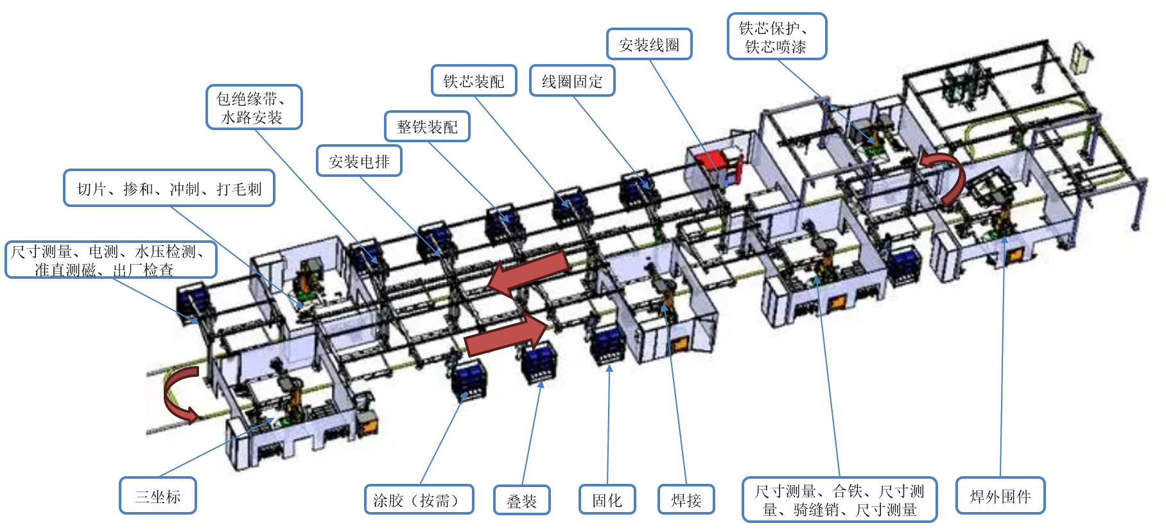
An example of R&D on CEPC magnet automation production

Slide 17
Key points: Manufacture processing control
Usually, for non-standard products, the maturity is not as high as standard products.
Effective processing control helps in managing variations, identifying defects, ensuring consistency, and meets the required quality standards and performance criteria.
Beyond, the manufacturing processing optimization can also help the lower the cost of non-standard products.
Work with industrial will become necessary. And there are several considerations for the manufacture processing as discuss in following items*.
*https://www.mckinsey.com/capabilities/operations/our-insights/more-from-less-making-resources-more-productive

Slide 18
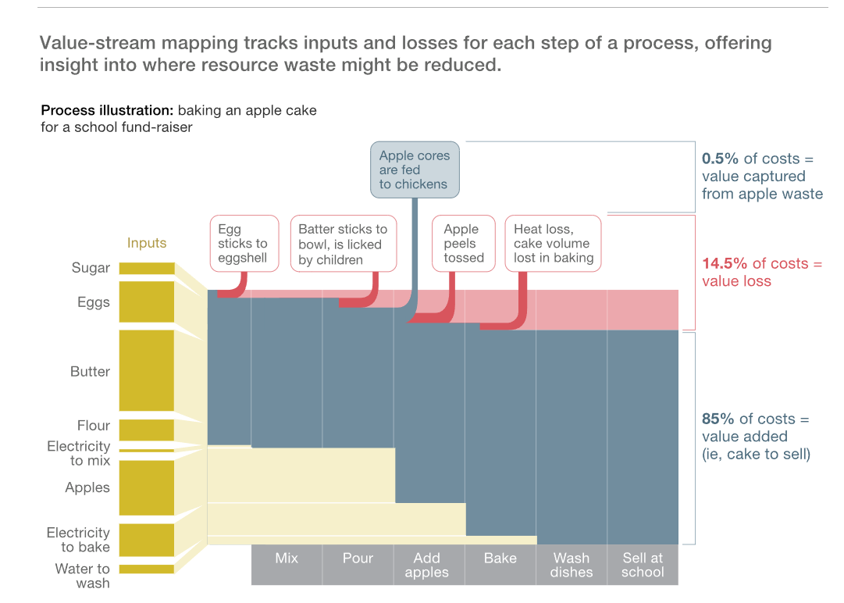
Think lean for the process
  The lean ideas first advanced in the Toyota production system gave organizations a new way to recognize and root out waste
  That’s known as value-stream mapping, which can be illustrated by a Sankey diagram that highlights streams of resource waste
  In practice, these methods often involve a product through a factory or service operation.
Input
Processing
Notes:
招标的时候，请厂商分析

Slide 19
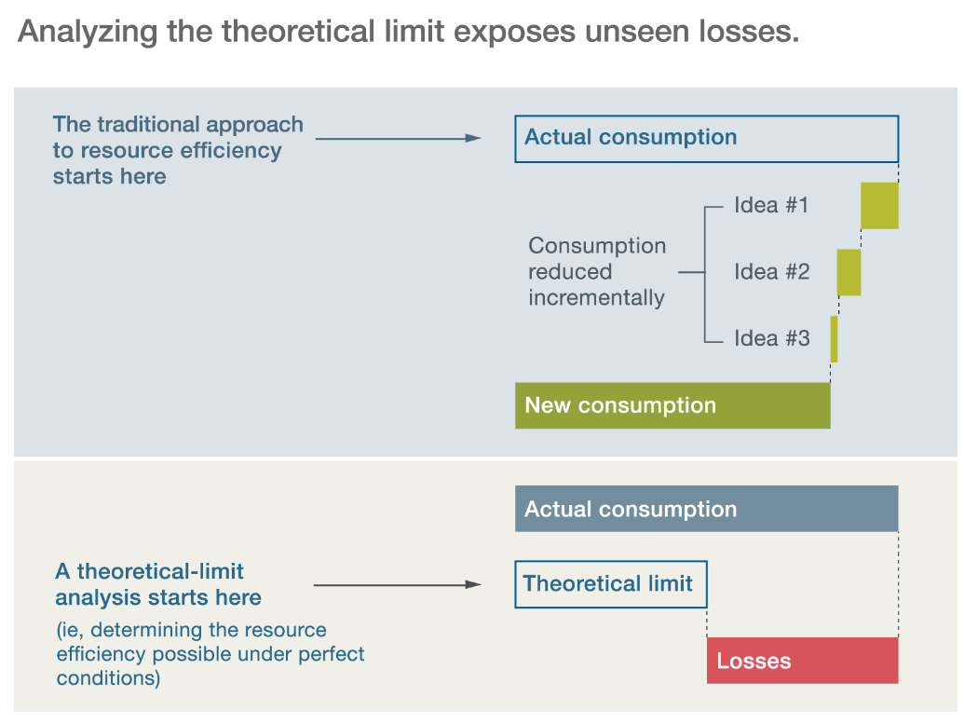
Think limits
The starting point for most operational-improvement efforts is incremental change: taking an existing process as a baseline and seeing what improvements are possible from that point.
For any process, the baseline is the theoretical limit: the level of resource efficiency that the process could achieve under perfect conditions, such as a hypothetical state in which it produces zero emissions or if the heat it generates can be recovered.
For example, an organization might begin with actual consumption and identify ideas to reduce it. As right Exhibit suggests, an aggressive approach to resource productivity makes almost the opposite assumption.

Slide 20
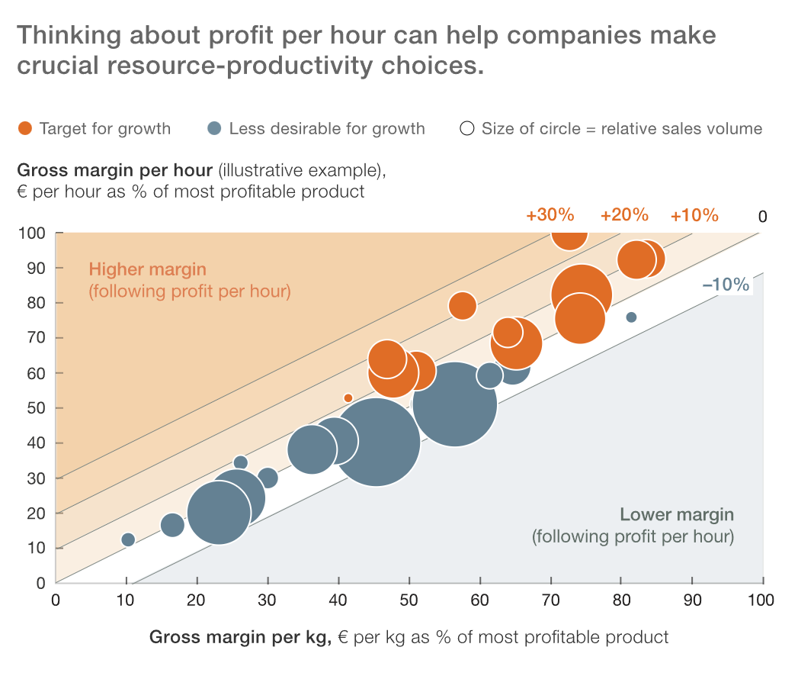
Think profits per hour
To choose among competing resource-productivity initiatives，a common language for evaluating each idea’s impact is needed and the trade-offs involved.
Right exhibit shows a model including the essential resource: time that tracks a typical portfolio of products by profitability as a percentage of a company’s highest-margin offering.
It sometimes can be easy to help make decision. For example, increasing a product’s yield usually reduces cost, but requires longer times and leaves less capacity for other products. In this case, the factor of time should be taken into account.

Slide 21
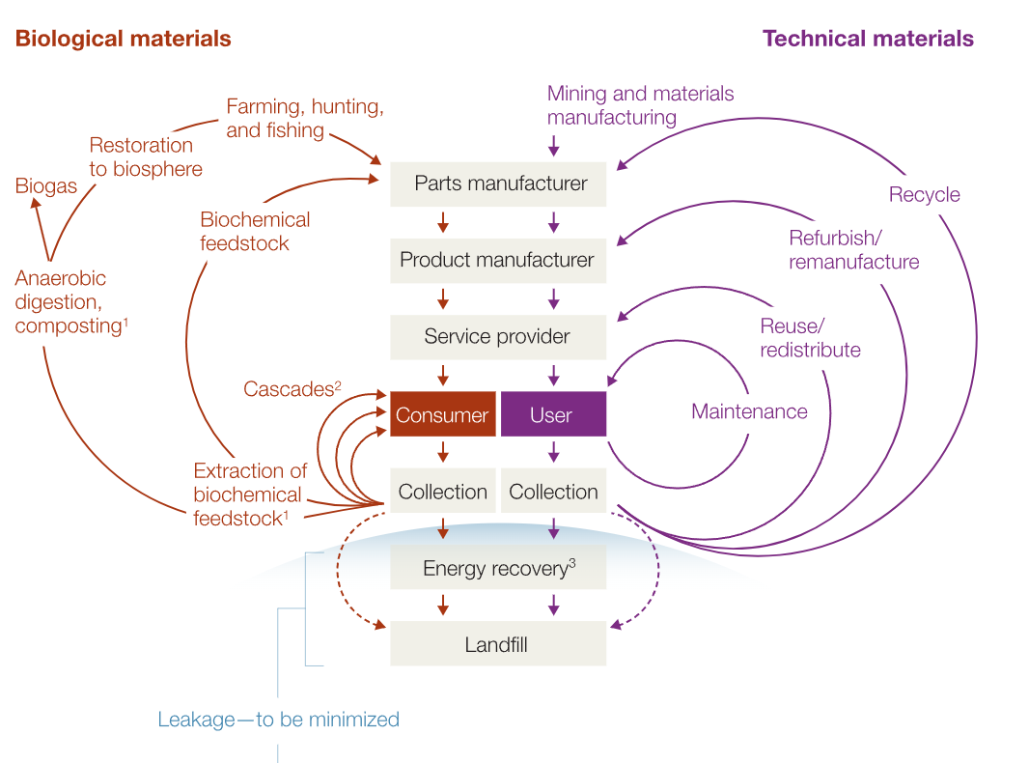
Remaking the industrial economy in the progress control
Accelerator components
A regenerative economic model—the circular economy—is starting to help lower cost while reducing their dependence on scarce resources.
In a circular economy, ideas are needed to enable cycles of disassembly and reuse, thus reducing or eliminating waste.
Loss of materials, energy, and labor when products, components and row material cannot be reused, refurbished or recycled.
*https://www.mckinsey.com/capabilities/operations/our-insights/more-from-less-making-resources-more-productive

Slide 22
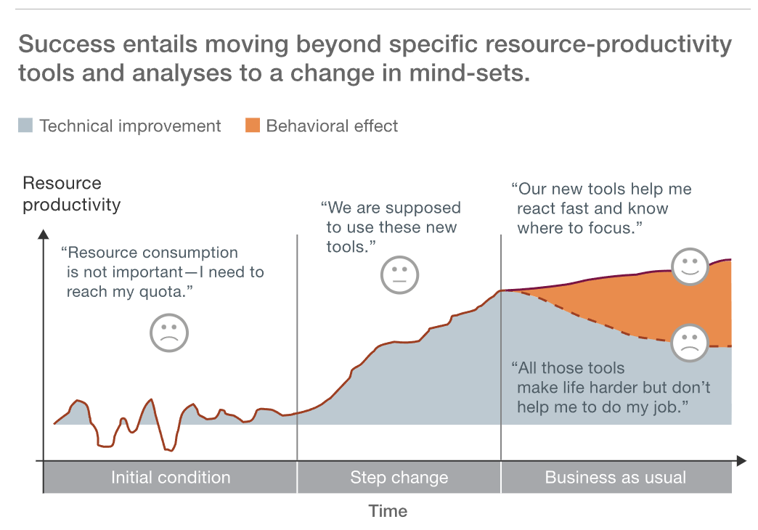
Beyond tools
Resource productivity also requires a comprehensive change-management effort.
Generally, we rely on teaching workers specific resource-productivity tools and analyses. However, changing people’s underlying mind-sets is equally important to support the new mind-sets with revised. So, resource productivity informs almost every aspect of operations, ensuring that people keep finding new opportunities to create more value from less.
Traditional take–make–dispose logic: take raw materials out of the ground, assemble them into finished products, and then throw them away. A more sustainable logic is to “think circular,” creating new value for companies and society by looping products, components, and materials back into the production process after they have fulfilled their initial use.
*https://www.mckinsey.com/capabilities/operations/our-insights/more-from-less-making-resources-more-productive

Slide 23
Key points: collaboration between companies
For the components of the scientific projects as accelerator complex, multiple processes are required to complete them.
However, usually each company has different areas of technical expertise. For a given product, they may not excellent in every aspect.
So, a manufactory model may be possible that we can processing the product or component to various to companies according the technologies they are good at. That means several companies to manufacture one type of component in collaboration with each other.
In this case, a good organization will be one of critical challenges.

Slide 24
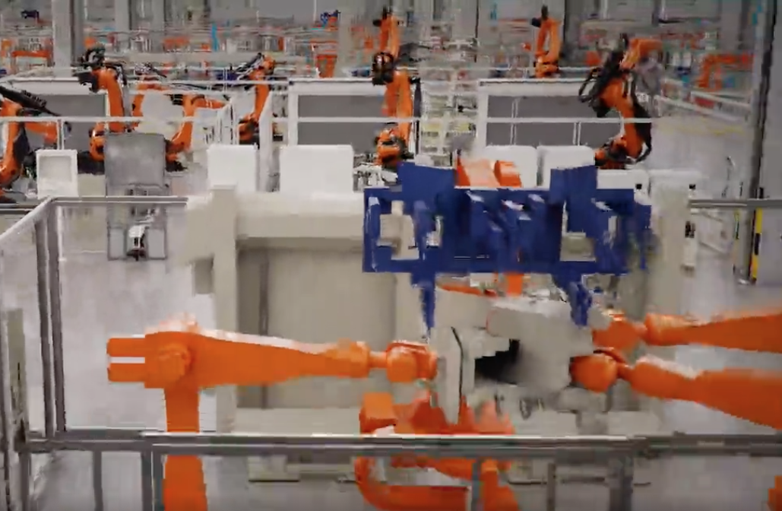
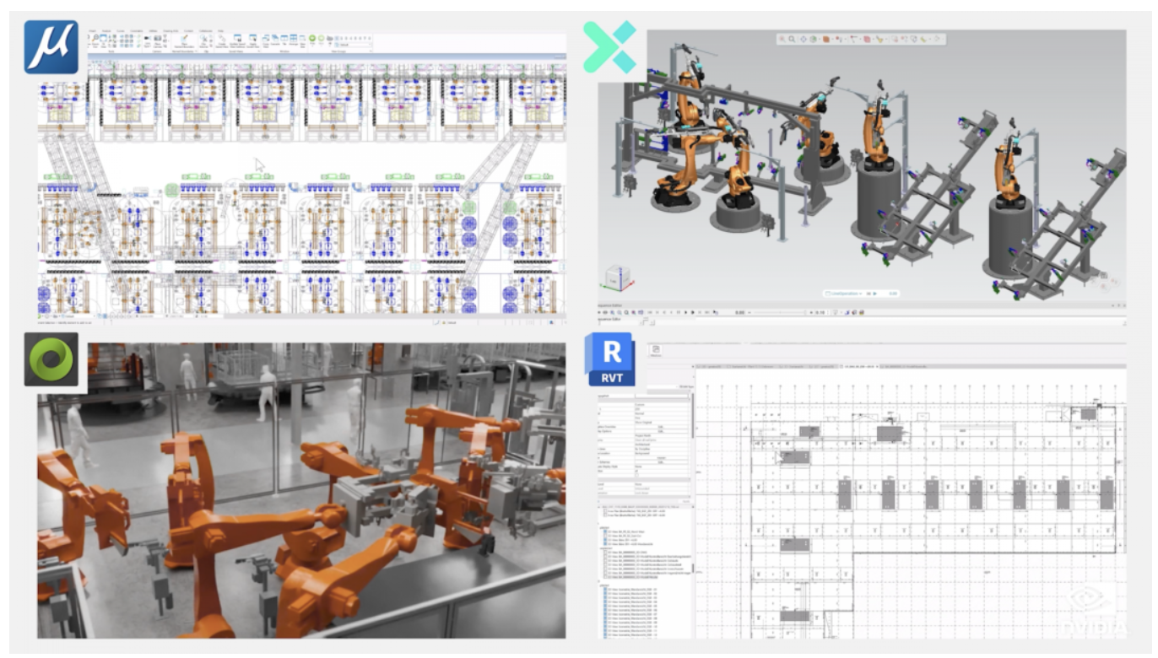
3. Virtual factory
Virtual factory can help to optimize several layout, automation technology, process and logistics systems.
According to BMW company data, by optimizing facility planning and implementing efficient processes, an estimated cost savings of 30% is expected.
Building Information Modeling (BIM) system can involve various related files like drawings, layout and so on together. It bring greatly convenient for designers.
Besides in the virtual factory, teams can engage in real-time remote collaboration with multiple users and diverse data from different fields in large-scale scenarios, without the need for in-person meetings.
Virtual factory by BMW
(https://mp.weixin.qq.com/s/4GpZGGwRKqxR-dFcKkfsPA)

Slide 25
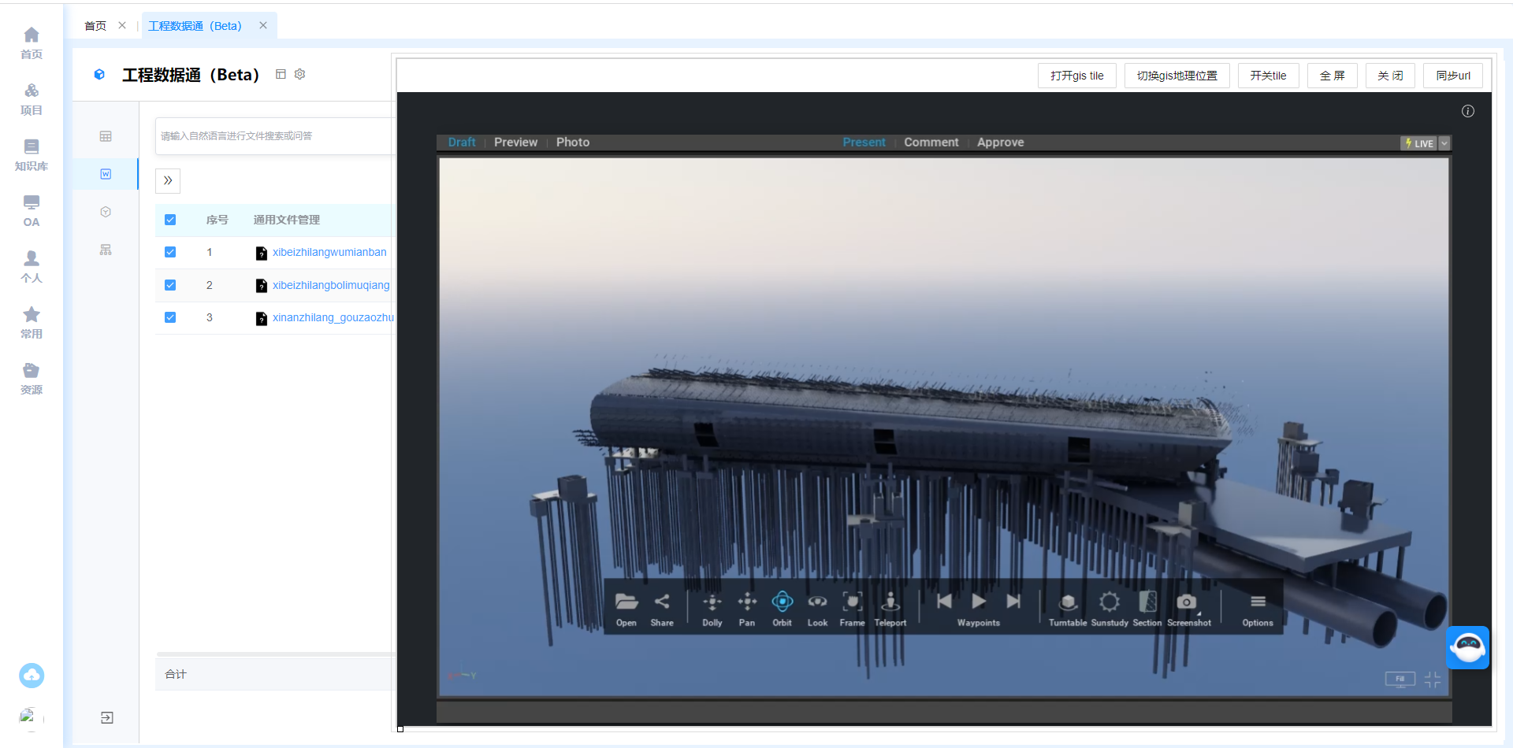
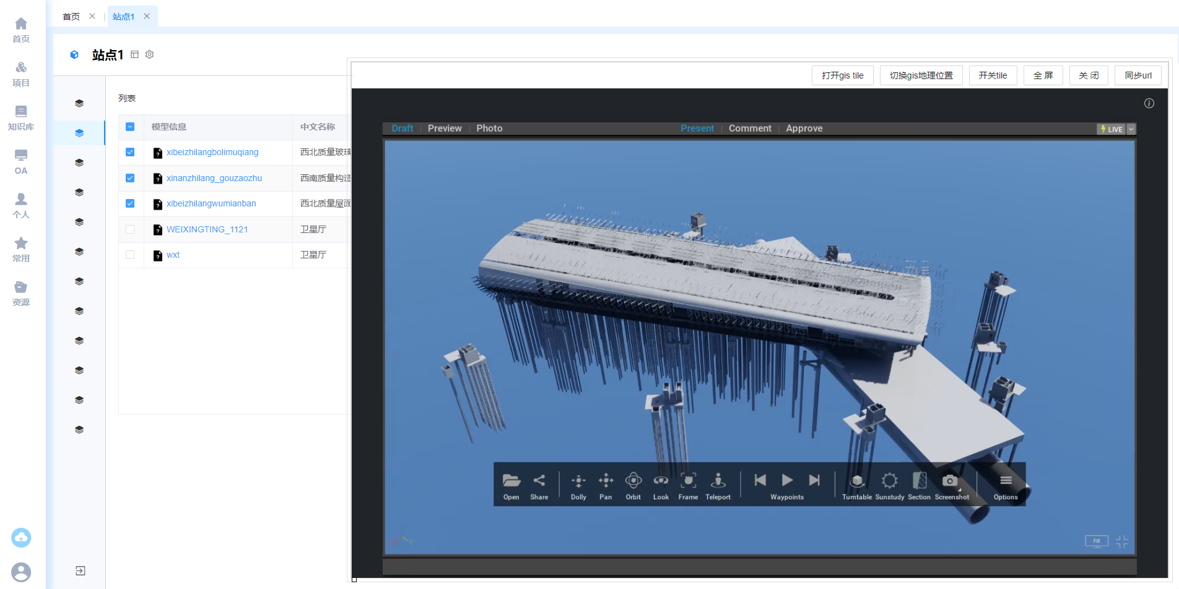
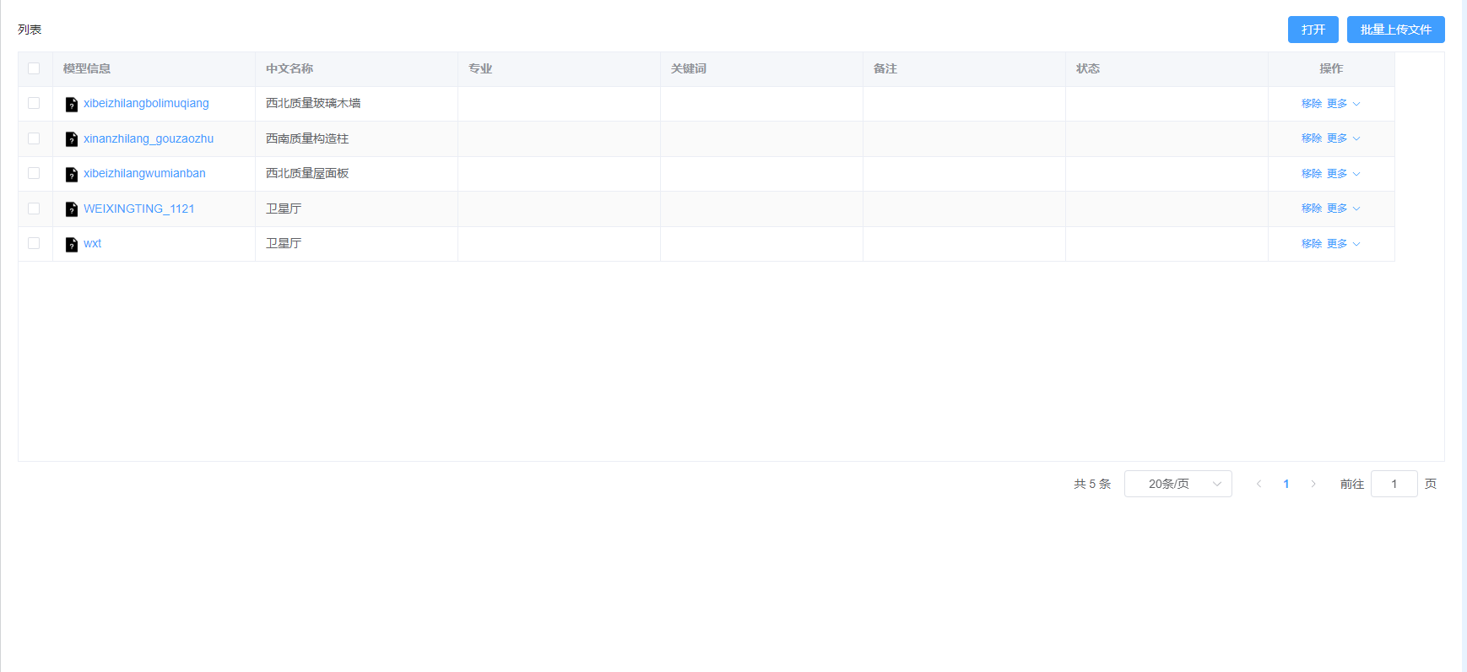
An example from CEPC
At present, several functions has achieved in DeepC
  Management of parameter and model separation
  Consistent management of models and files
  Automatic location update of components

Slide 26
Summary
Nowadays, accelerator projects are getting bigger and more numerous. Economical and high efficiency industrial production becomes important for the accelerator components or devices.
For a scientific facility, a considerable parts of components are non-standard products. Work with industry for the optimization process is important. The automation device will be active for high efficiency, but fine assessment is still needed.
There were several aspects we can optimize. It is believed that through efforts the product efficiency will have a great improvement and cost will be lower and lower.
Thanks for your attention!

