Slide 1

Progress of the
HL-LHC CCT Magnets
Qingjin Xu
IHEP- CAS
On behalf of the CCT Chinese Team
Jan 2024
Notes:
重点报告内容：（1）未来5年拟开展的研究工作，包括主要研究方向、关键科学问题与研究内容；（2）研究方案，包括骨干成员之间的分工及合作方式、学科交叉融合研究计划、年度工作计划与目标等；（3）五年预期目标和可能取得的重大突破等。

Slide 2
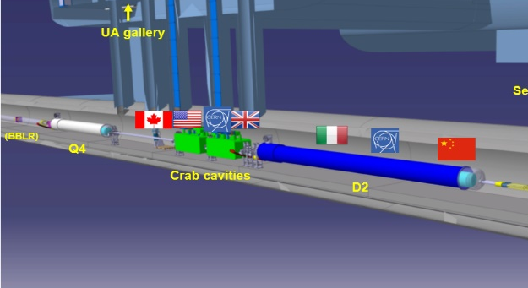
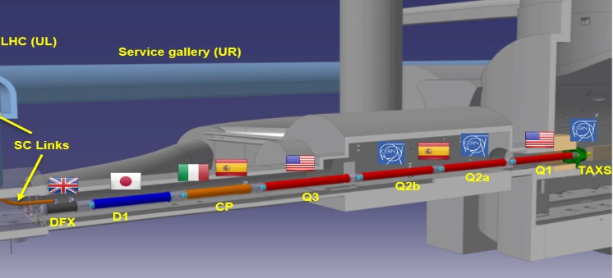
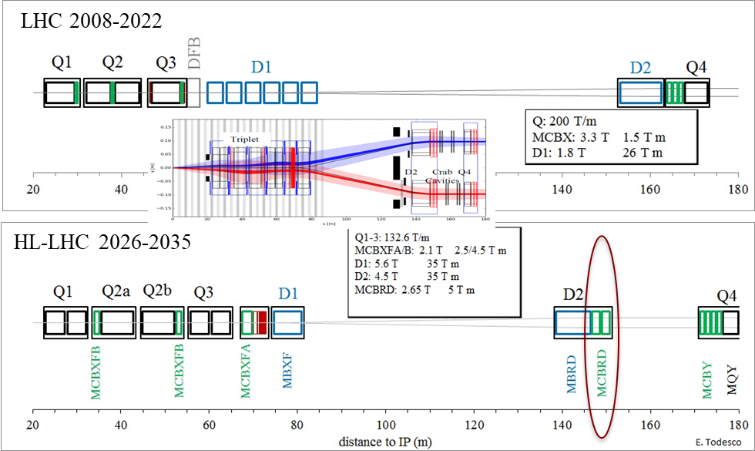
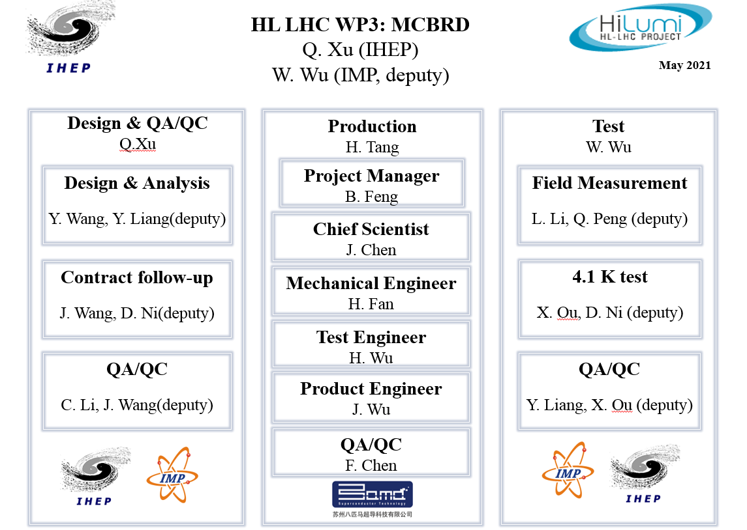
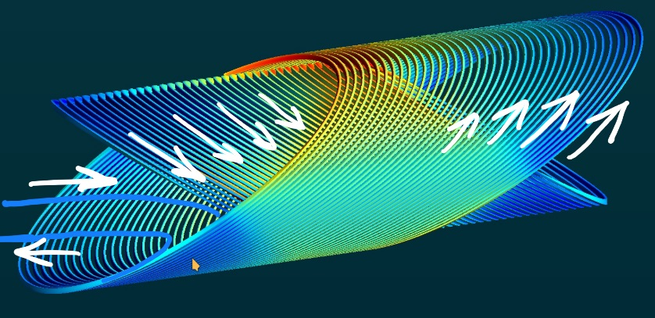

CCT Magnets- Key Components of HL-LHC
Together with other magnets, to increase Luminosity by 5 times
  Chinese team develop 12+1 set CCT
  Superconducting magnets for HL-LHC
  For the first time CCT-type magnets
  being used in particle accelerator

Slide 3
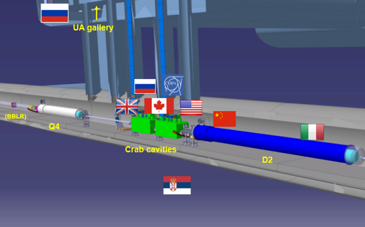
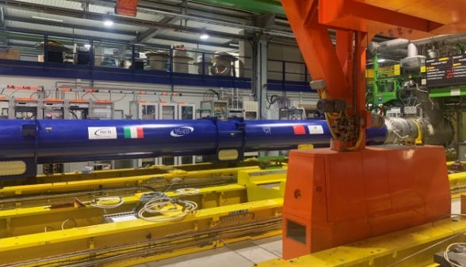
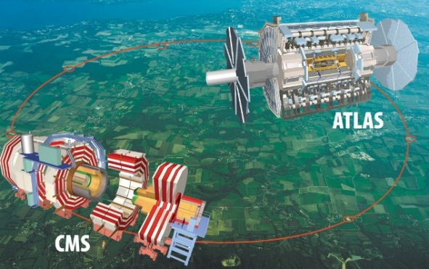
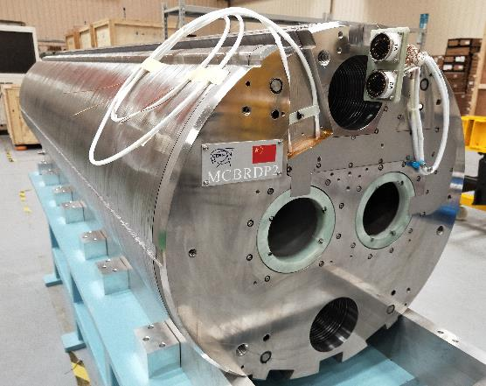
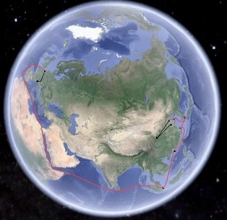
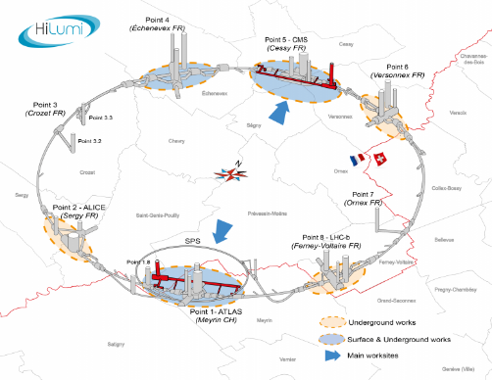
Roadmap of the HL-LHC CCT Magnets
Contribution to HL-LHC from China
合作协议签订
首套正式磁体发往CERN
与其他磁体集成后水平性能测试
磁体隧道安装及调试
2018
2020
2022
2024
2026
2027
全尺寸样机通过测试后
发往CERN
完成全部12套正式磁体
参加LHC束流调控
HL-LHC束流调试

Slide 4
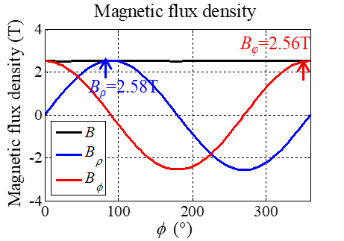
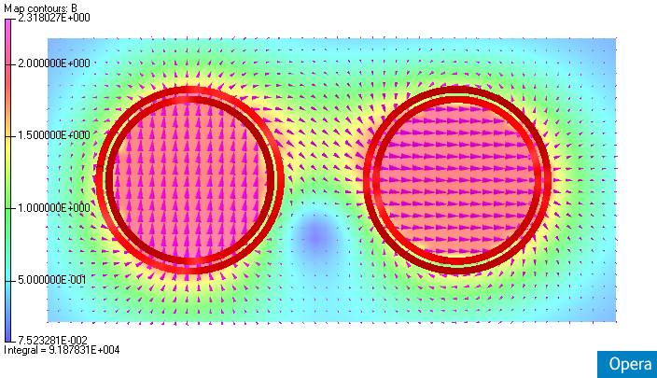
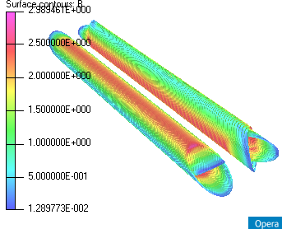
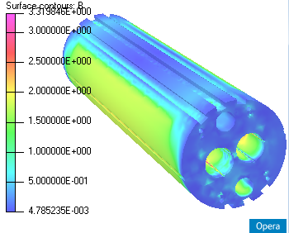
Electromagnetic Design of the CCT Magnets
新型斜螺线管型线圈结构：双孔径二极磁场，实现束流对撞前轨道校正
B_{y} = 2.59
B_{y} = 1.69

Slide 5
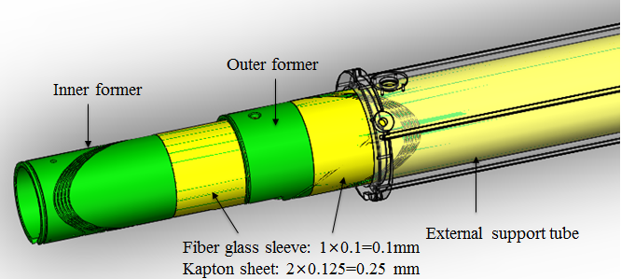
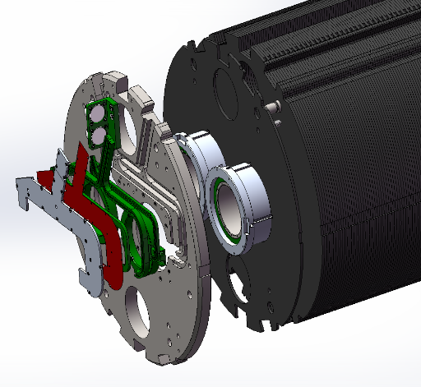
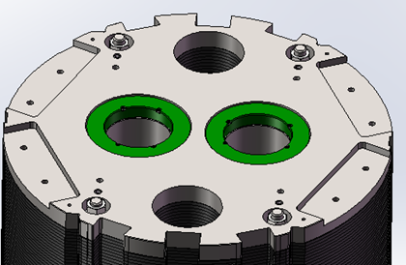
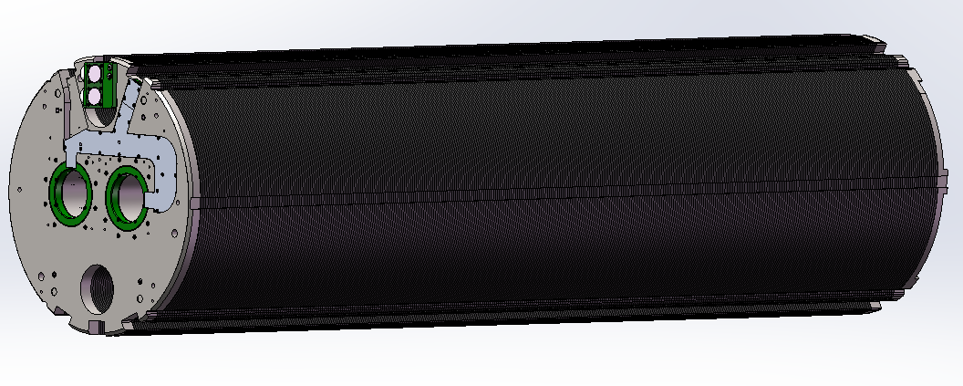
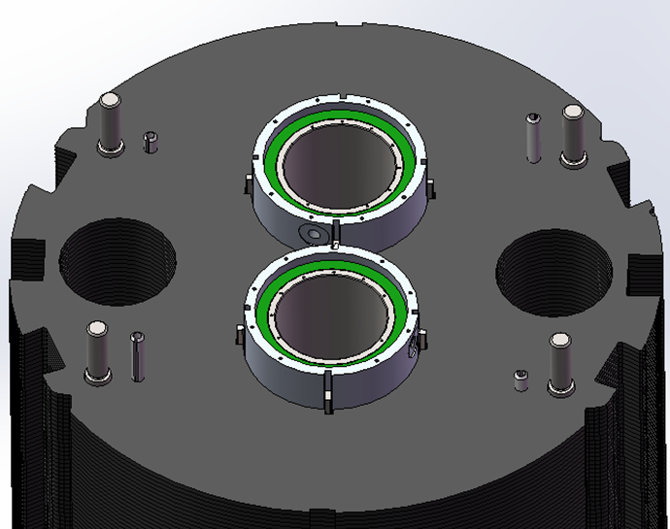
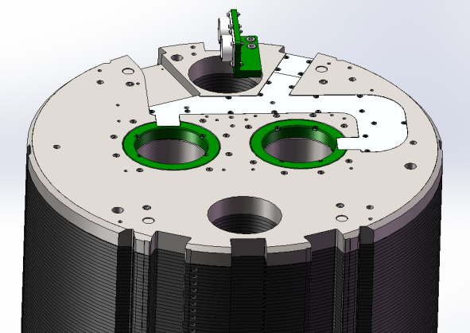
Mechanical Structure
双层超导线圈+外支撑筒，共用轭铁结构
CCT线圈组装
后端板
CCT铁轭组装
前端板

Slide 6
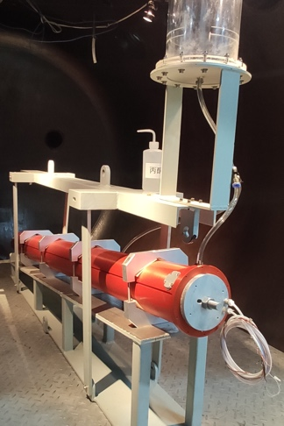
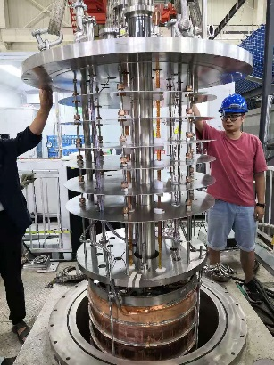
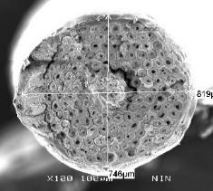
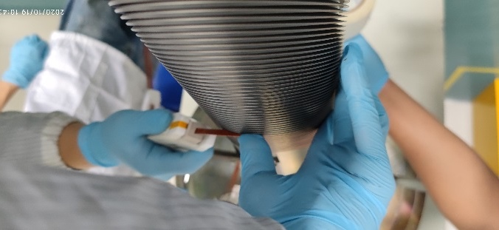
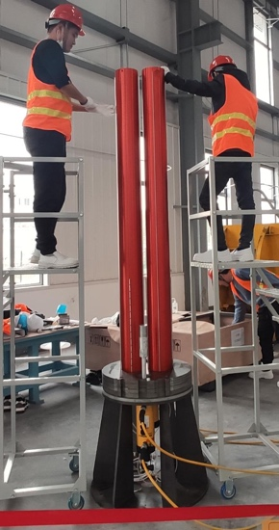
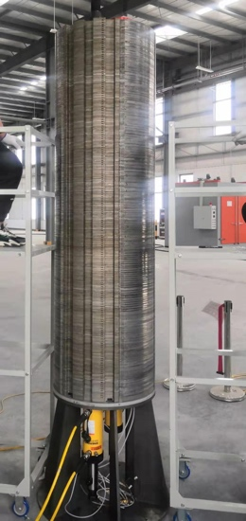
Development Scheme
HL-LHC CCT磁体：从超导线材到线圈、磁体，实现核心部件完全国产化
Material,
Cross section, Processing,…
Stress control,
Dimension control,
Electrical insulation
Impregnation quality control:
epoxy material, filling procedures,
Temperature control,
Thermal stress control
Mechanical strength and stability
超导线材性能分析
CCT线圈制作
CCT线圈环氧固化
磁体组装
性能测试
Quench protection
Training,
Strain of coils,
Hot spot,…
J_{c,} RRR, Cu ratio,
Filament size,
Flux jump,…
J_{c} and Field quality
degradation,
Electrical short…
Dimension control,
Alignment,
Stress control,…

Slide 7
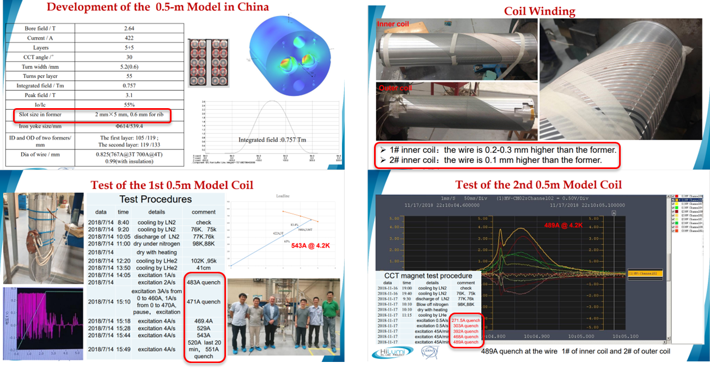
Development of Subscale CCT Coils
2018年完成两台缩尺线圈样机研制，性能远超设计指标

Slide 8
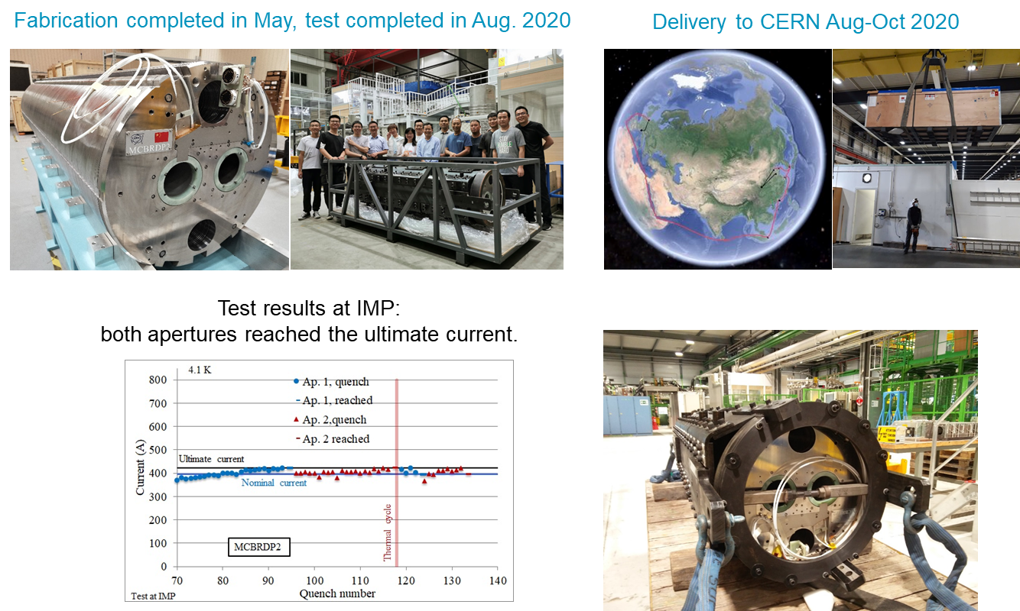
Development of Full-scale Prototype
2020年完成国内首台全尺寸磁体样机研制，性能达到设计指标

Slide 9
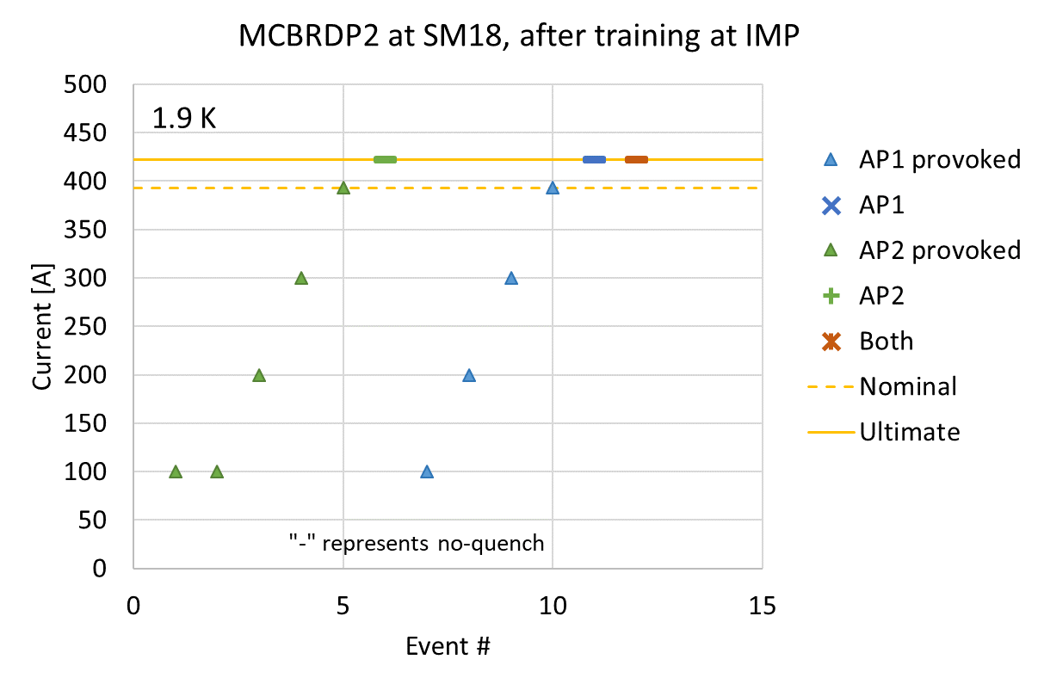
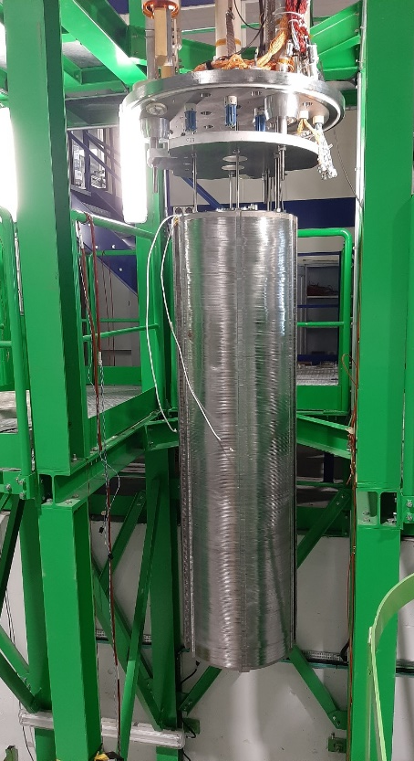
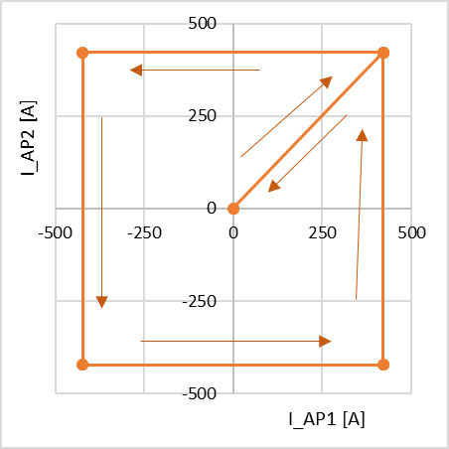
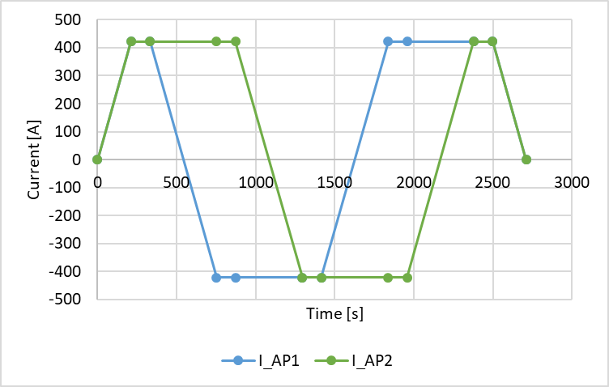
Development of Full-scale Prototype
国内首台全尺寸磁体样机，CERN确认性能达到设计指标
CERN性能复测：场强、场质量及长时间运行稳定性均达到要求
“Each aperture, individually and combined, arrived to ultimate current without quench”
“Operation range test checked without quench”
”Inductance and magnetic measurements done simultaneously”

Slide 10

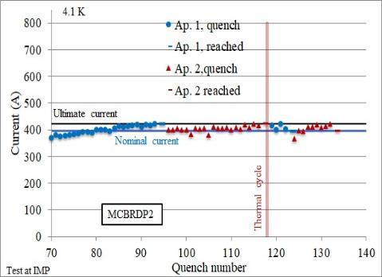
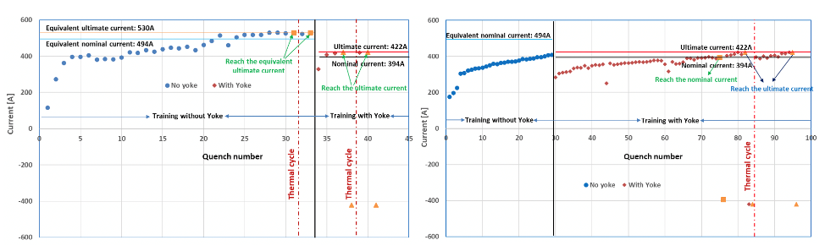
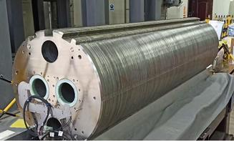
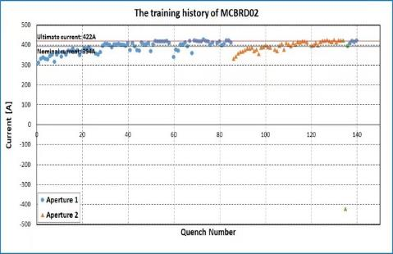
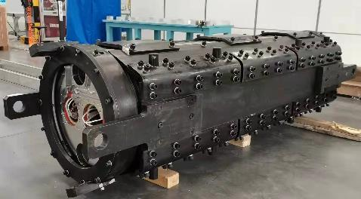
Mass Production
全尺寸样机2020年5月完成
性能达到设计指标
2020年8月运往CERN
MCBRDP2
MCBRD01
首套量产CCT磁体性能达标 2021年10月运往欧洲
第二套CCT磁体性能达标2022年6月运往欧洲
MCBRD02

Slide 11
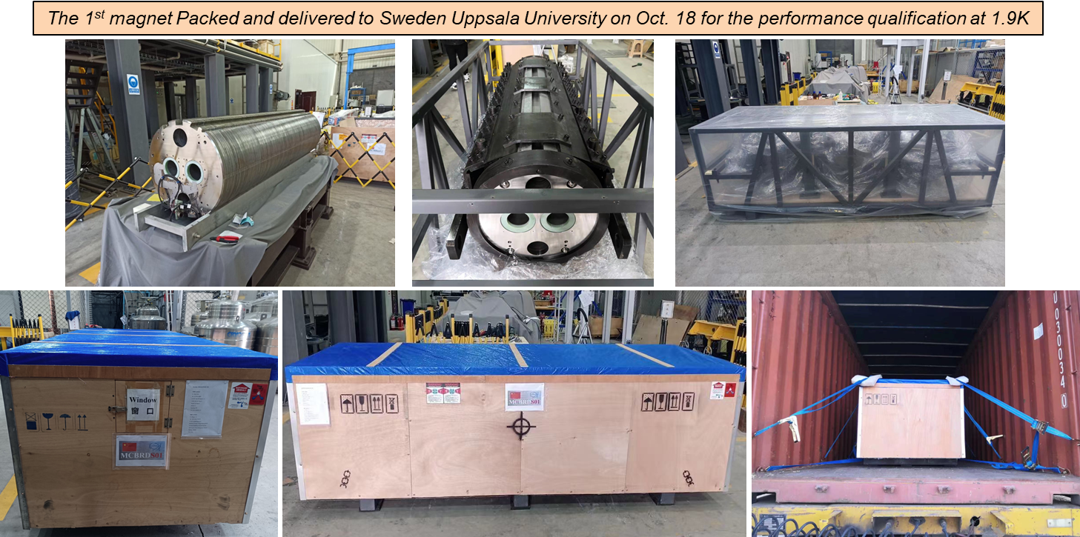
Delivery to CERN
首套正式磁体国内性能测试达标后，2021年10月发往欧洲

Slide 12
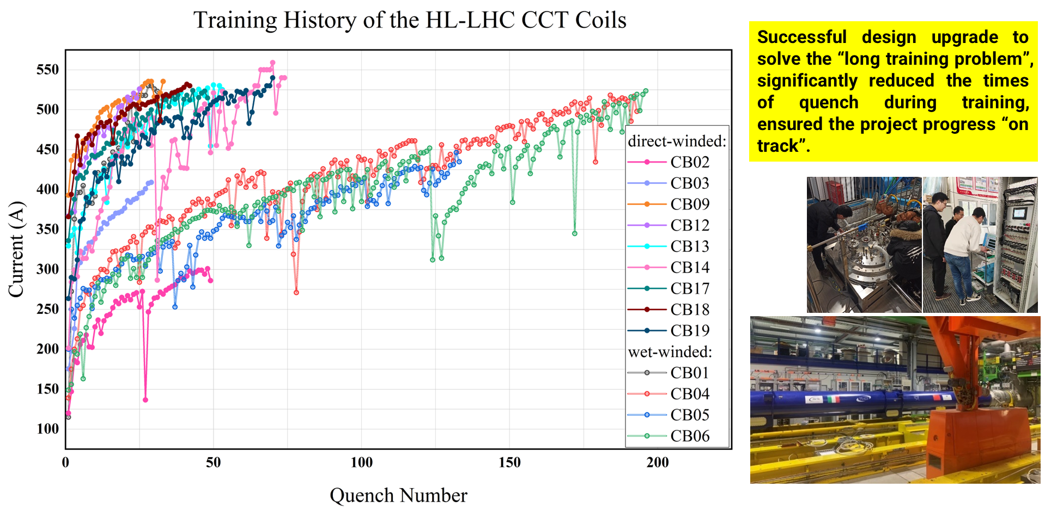
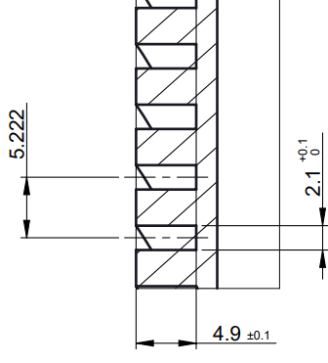
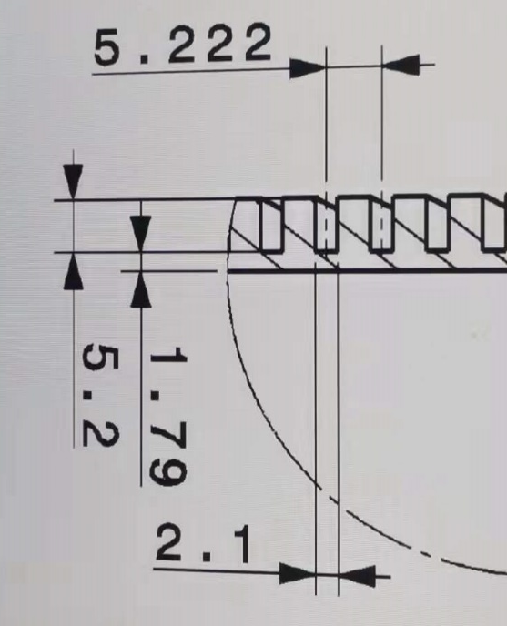
Problems and Solutions During Mass Production
批量制作过程中，解决了CCT超导线圈结构存在多年的“long training”问题
保证了HL-LHC项目的整体进度不受我们的影响

Slide 13
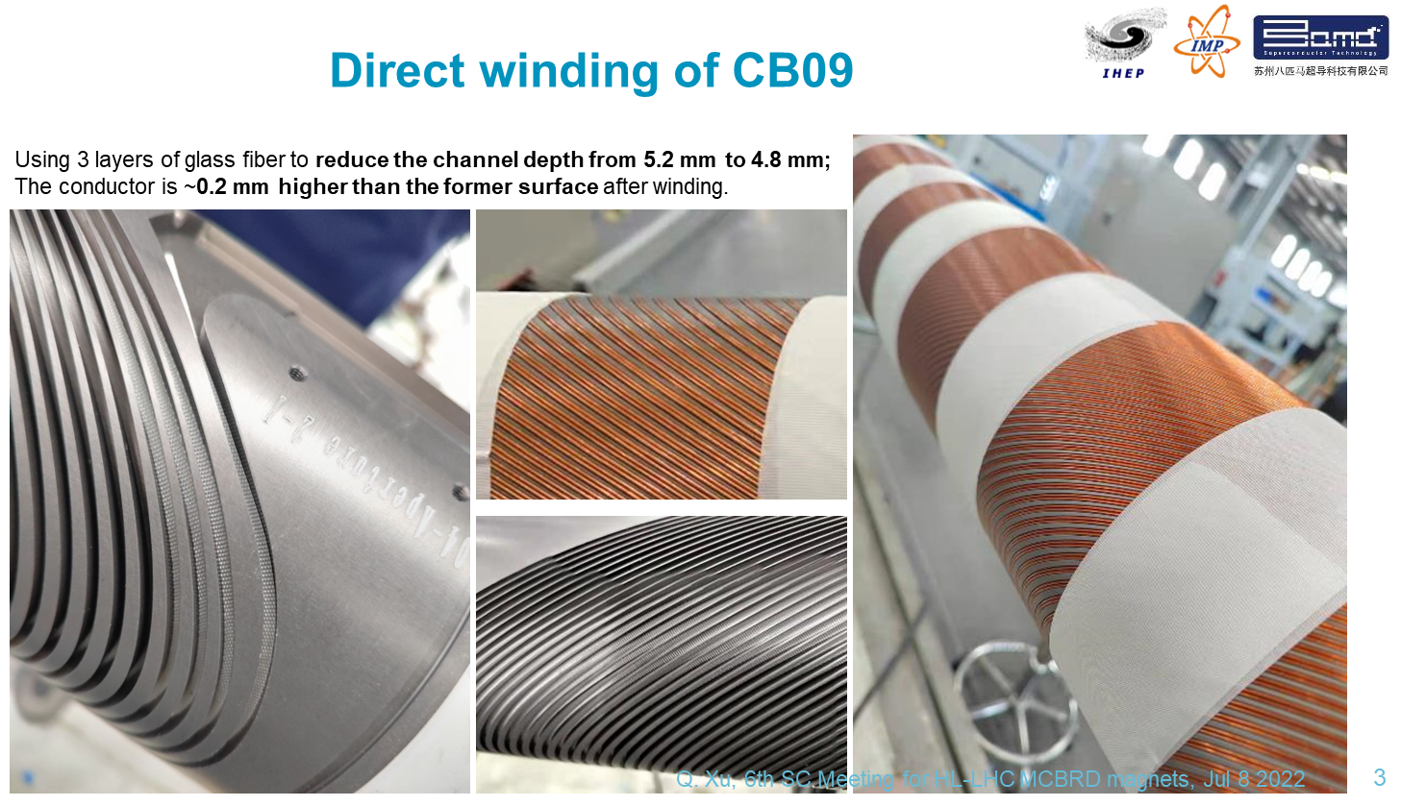
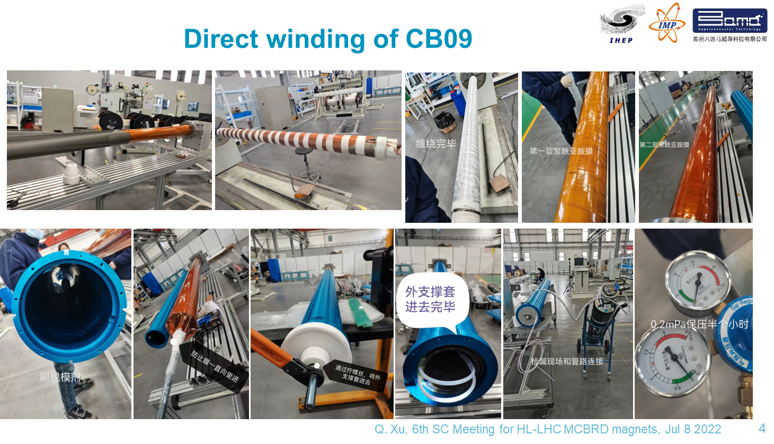
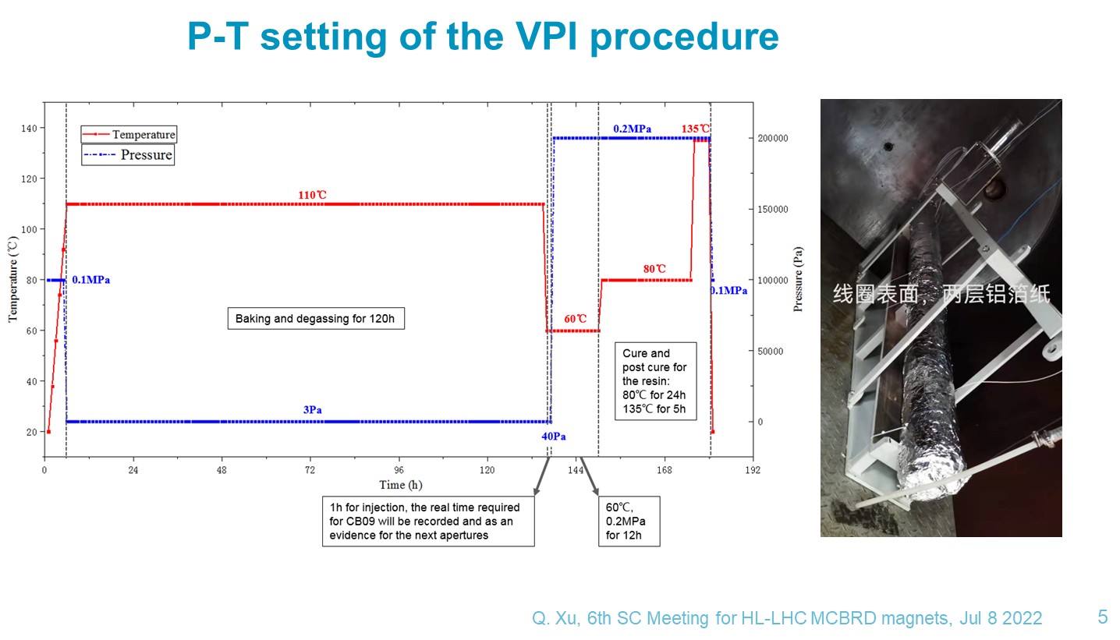
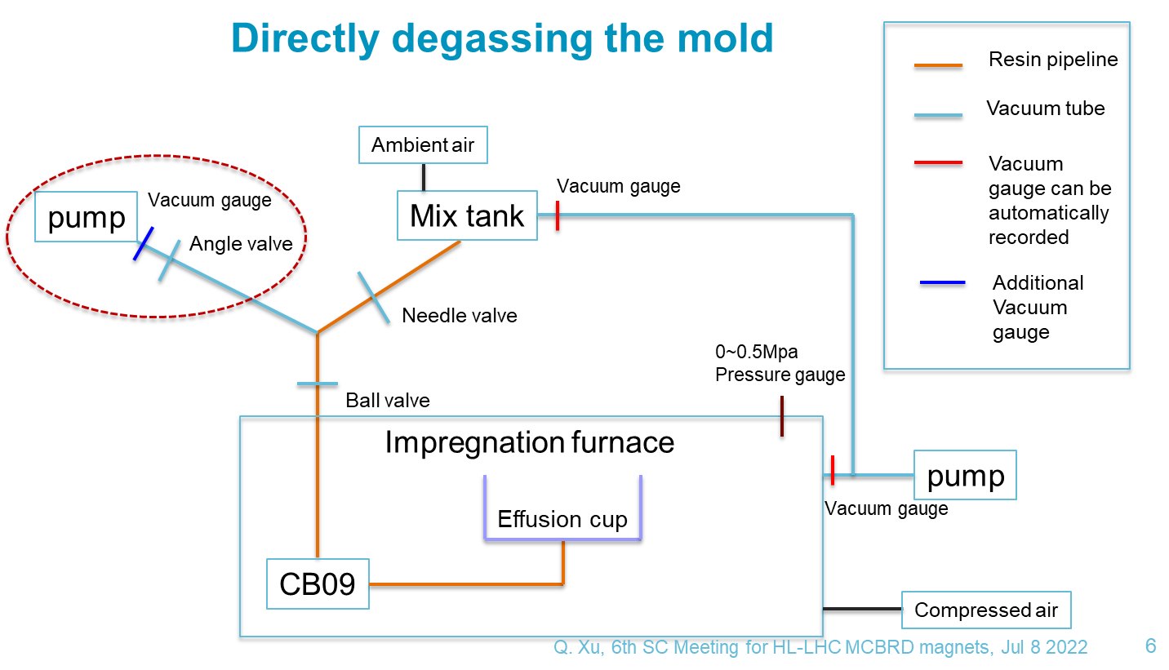
Problems and Solutions During Mass Production

Slide 14
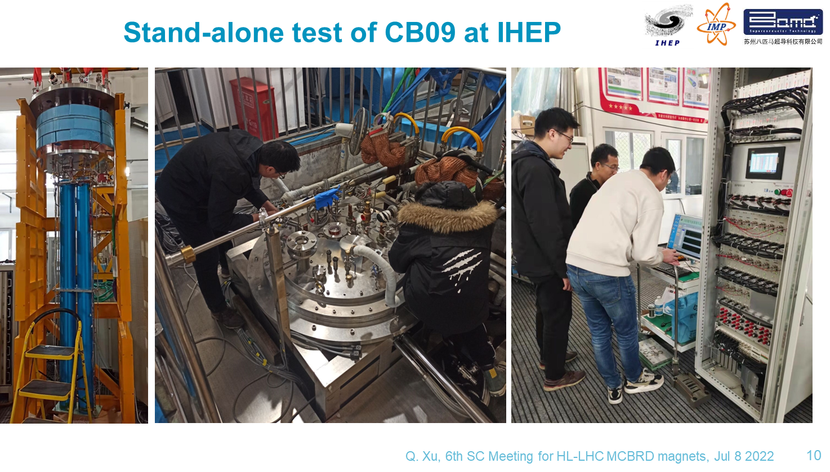
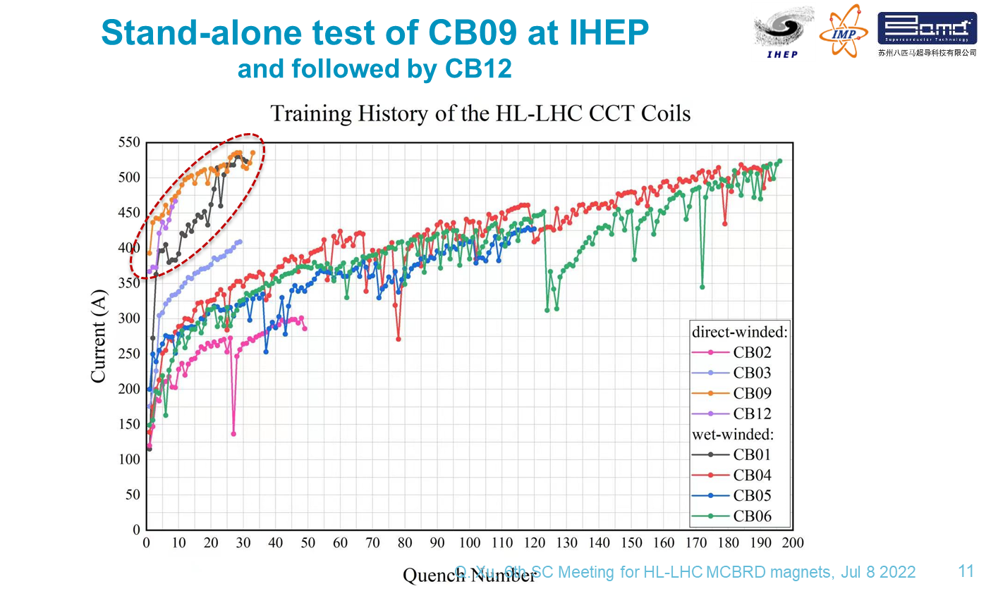
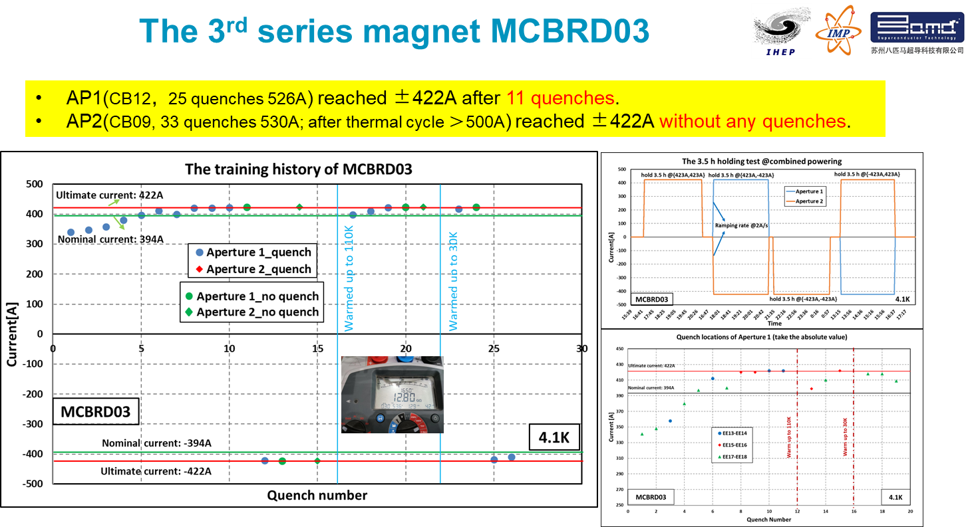
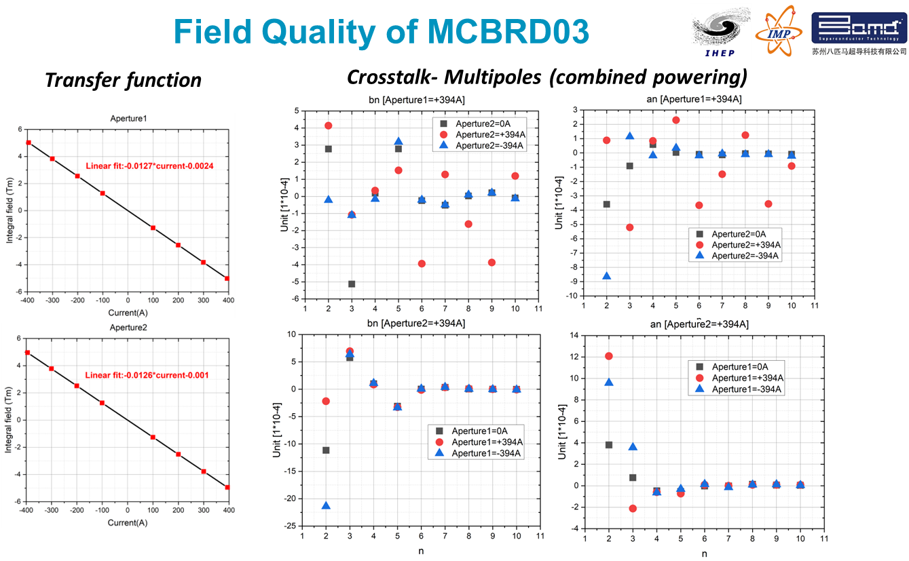
Problems and Solutions During Mass Production

Slide 15



Problems and Solutions During Mass Production
“long training”问题解决方案CCT四极线圈验证
确认了解决方案的有效性及普适性
Performance of SCQ-CCT coils
Well impregnated magnet SCQ-1 experienced long training
With the modified channel size, the training performance of SCQ-2 significantly improved.

Slide 16


Problems and Solutions During Mass Production
解决了CCT超导线圈“detraining”问题
参照高能所高场超导磁体VPI经验，全面升级八马VPI系统
注胶速度、温度控制；质量管控等

Slide 17

Latest Progress
目前已经完成一半批量磁体的研制：约每3月交付一套磁体
2025年年中前完成所有磁体的交付，2026年开始隧道安装

Slide 18
Summary
China provides 12+1 sets of CCT superconducting magnets for the HL-LHC project, helping to increase the luminosity by 5 times
For the first time the CCT superconducting magnets are adopted for an operating accelerator
During mass production, effective and universal solutions have been developed to solve the serious problem of "long training", which make possible large-scale application of CCT magnets in future while ensuring the progress of the HL-LHC project
Half of the series magnets have been developed presently. Delivery of all magnets is expected to be completed by mid-2025, and tunnel installation will begin in 2026
Thanks for your attention!

