Slide 1



Permanent magnets applications
in accelerators
Mei Yang, Fusan Chen, Wen Kang, Qing Li
On behalf of CEPC Magnet Group
Mini workshop on Green Accelerator and Colliders, HKUST-IAS, Jan 18-19, 2024

Slide 2
Content
Introduction
Permanent magnet materials
Current research status of permanent magnets
Permanent magnets in IHEP
Possible proposal of PM in CEPC
Conclusion

Slide 3
Introduction
Permanent magnet (PM)
  Insertion Devices (IDs)
    Used in accelerators for more than 30 years
    Most being IDs in 3rd generation light source, recently in LINAC based Free Electron Lasers(FELs) and 4th generation light source.
  Normal PM dipole and quadrupole magnets
    Light source
      Longitudinal gradient dipole magnet in 4th Generation light source (ESRF-EBS, HEPS)
      Permanent high gradient quadrupole magnets (being designed and studied)
    Fermilab Recycler Ring^{[1]}
      Entirely on magnets energized with Strontium ferrites
      low field requirements, low cost and proven stability of the PM material
    Collider
      Multipoles in Final focus lens: compact and high gradient without heating
[1] Fermilab Recycler Ring Technical Design Report. https:/lss.fnal.gov/archive/test-tm/1000/fermilab-tm-1991.pdf.

Slide 4
Comparation with PM and electromagnet
Advantages and drawbacks of PM and Electromagnet
Type | Advantages | Drawbacks | Solvers
Electro magnet | Easy to adjust field strength or gradient Super high field can be gotten in SC magnet Field performance can be increased by shimming and end chamfer | Need Power supply and water cooling system Large power loss and heat | Optimization Low current density with high voltage Dual aperture magnet Combined magnet
PM | No operation cost and heat load in the tunnel Compact structure, especially in narrow space No utilities( power supply, water cooling) No vibration | Not easy to adjust field strength Large disperse in materials results in bad field performance High temperature coefficients, field not stable Demagnetization in high temperature and radiation | Hybrid PM with soft iron Temperature compensation(FeNi) Far from heat and radiation
[1] J. Chavanne et al. Prospects for the use of permanent magnets in future accelerator facilities, IPAC2014

Slide 5
Permanent magnet materials
Combine at room temperature a spontaneous magnetization and coercivity
  Spontaneous magnetization is a property of 3rd transition metals, such as iron, cobalt or nickel.
  Coercivity is linked to the anisotropy of the material
  Rare earth elements(Sm or Nd) provide strong uniaxial magneto-crystalline anisotropy
Main permanent magnet materials
Materials | Br(T) | u0Hcj(T) | Features | Working Temperature (℃) | Temp coefficient (%/℃)
Strontium Ferrite | 0.2~0.42 | 0.2 to 0.4 | Low magnetic properties, ceramic material and hard to machine | Very high | Very low
NdFeB | 1.42 to 1.15 | 1.4 to 3.3 | High remanence with moderate coercivity | <100 | 0.126
Sm₂Co₁₇ | 1.05 to 1.15 | >2 | High coercivity and high temperature resistance, Low temperature coefficient High radiation resistance Brittle | <350 | -0.04

Slide 6
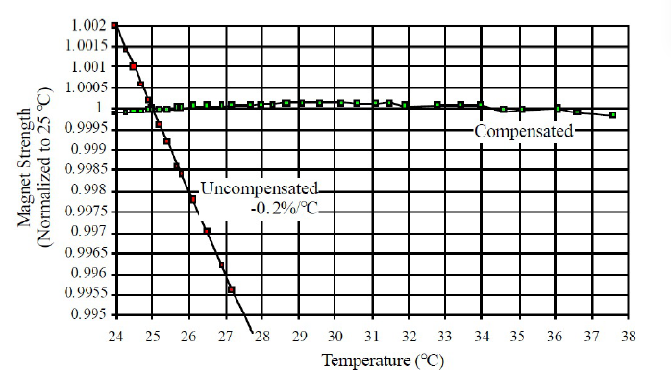
Challenges of Permanent magnet materials
PM is sensitivity on ambient environment. (Ref to experience of Fermilab PM magnets)
  Temperature variation[1-2]
    Br varies with temperature
    FeNi alloy (30% nickel and 70% Fe) as flux shunt
    Reduced 20 times
  Radiation demagnetization[1]
    Irradiated by a source with a dose of 0.3 Mrad/hour for about 100 Mrads, field reduced by 0.5 Gs over 1465Gs, about 0.03% and acceptable by Fermilab Recycler Ring.
  Shock and vibrations
    mechanical disturbance such as dropping the magnet, change <0.3Gs.
  Time dependence
    Over 6 operation years, less than 0.04% of field strength is lost.
[1] James T. Volk, Experiences with permanent magnets at the Fermilab recycler ring,2011, Jinst.
[2] B. C. Brown et al., Time Dependence and Temperature Stability of the Permanent Magnets for the Fermilab Antiproton Recycler Ring,1999.

Slide 7
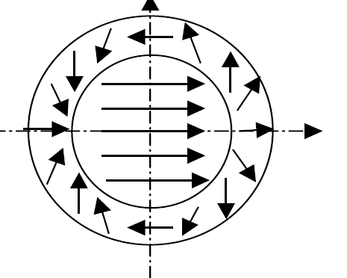
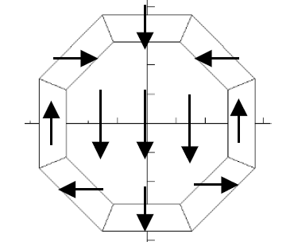
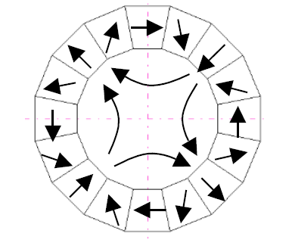
Current research status of permanent magnet
Pure permanent magnet
  Halbach type-> linear superposition with a typical field quality of ~0.5%
  Field quality dependence
    Remanent magnetization dispersion(~2%)
    Paramagnetic axis deviation (<0.3°)
    Spatial positional deviation
    Assembly errors
Hybrid permanent magnet
  Plus soft iron or excited coils
  With good field quality
Idea dipole magnet
PM dipole with 8 pieces
PM quadrupole with 16 pieces

Slide 8
Current research status of permanent magnet
Permanent Magnet achieve a high gradient or strength with compactness and with the absence of power supplies, letting them to be a solution for future sustainable green society.
Many PM magnets are used in transport lines, DTL, LINAC based Free Electron Lasers(FELs), where loose field quality is required, such as 0.1% or even 1%.
Most PM have fixed field strength or gradient, which is easy to implement. Hybrid PM with better field quality is used in light source and Fermilab Recycler Ring.
Adjustable PM are with complex mechanics which need motion and occupy large space with even bad field quality.
Many attempts have been made, especially in 4th generation light source and future large scale facilities.

Slide 9
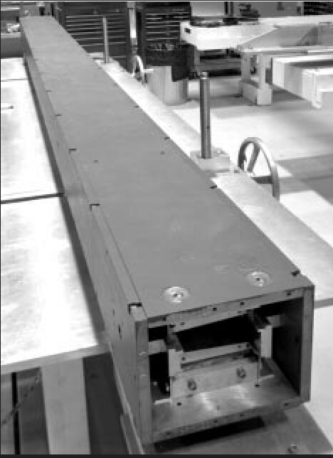
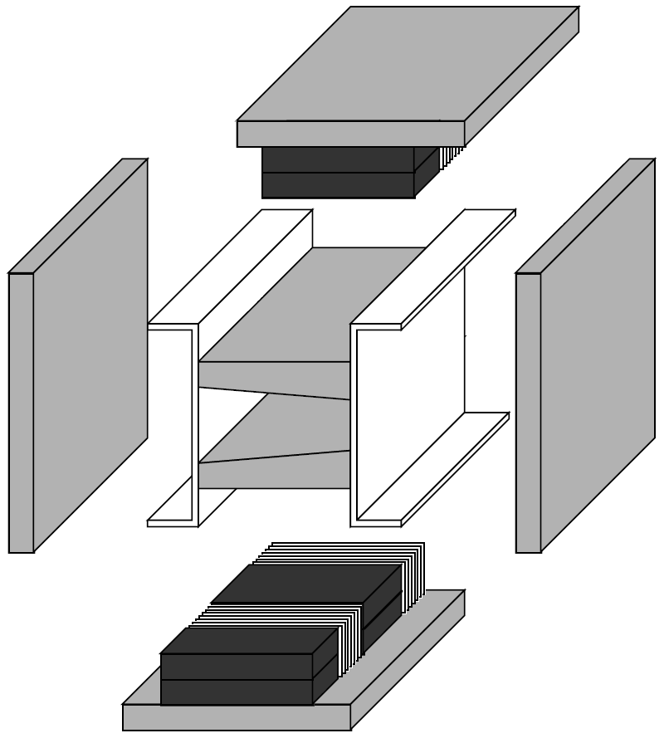
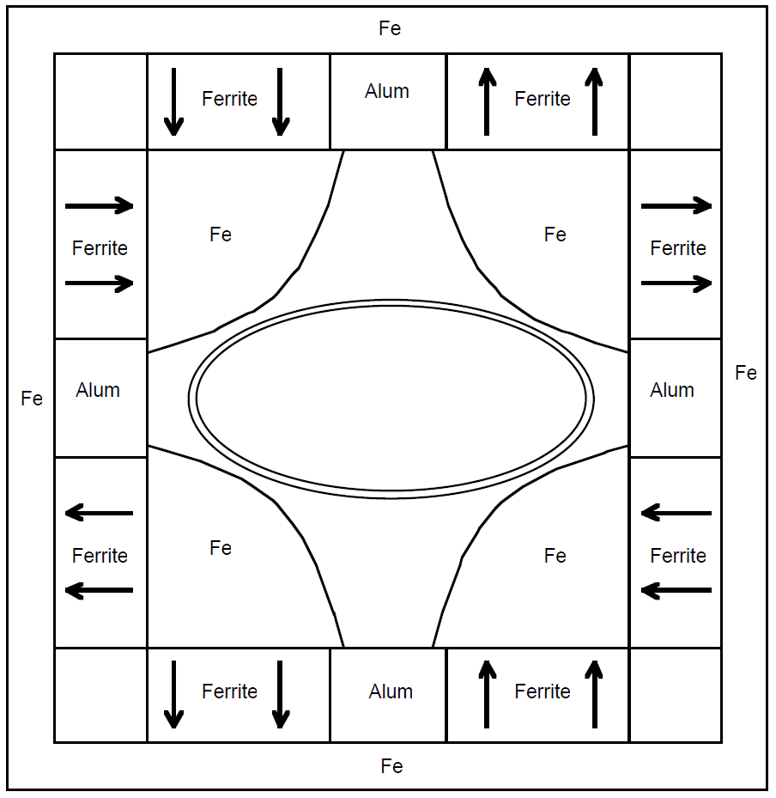
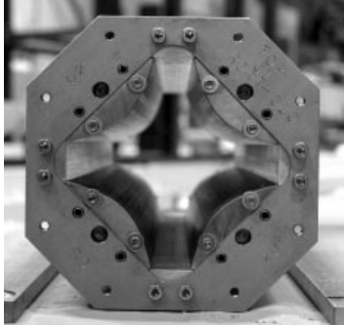
PM with fixed field or gradient
Fermilab Recycler Ring^{[1]} 2001
  First accelerator to use permanent magnets in large quantities
  9 kinds of 467 magnets
  Hybrid PM with constant field strength (Strength is controlled by sorting bricks on PM strength and adjusting the total volume of PM)
Strontium Ferrite
12 holes to adjust the field strength and field performance
Gradient dipole
Quadrupole
[1] Fermilab Recycler Ring Technical Design Report. https:/lss.fnal.gov/archive/test-tm/1000/fermilab-tm-1991.pdf.

Slide 10
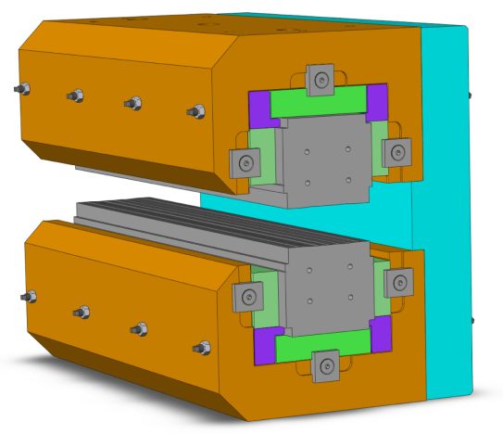
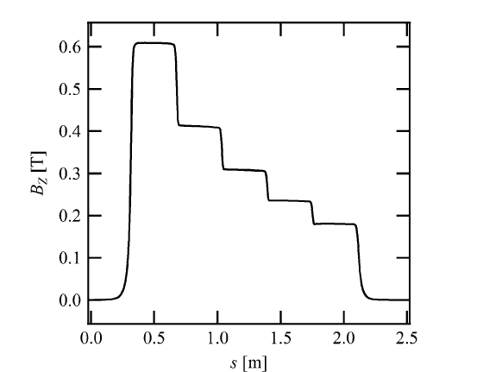
PM with fixed field or gradient-2
ESRF-EBS^{[1]} 2020
  PM first used in bulk on an electron synchrotron
  128 longitudinal gradient dipole magnets in storage ring
  Fine tuning of integrated field by end chamfer about ~2%^{[2]}
Sm2Co17
[1] Gail Le Bec, et al., Magnets for the ESRF Diffraction-Limited Light Source Project. IEEE Transactions on Applied Superconductivity, Vol. 26, No. 4, June 2016.
[2] C. Benabderrahmane, et al., Status of the ESRF-EBS Magnets. Proceedings of IPAC2018.

Slide 11
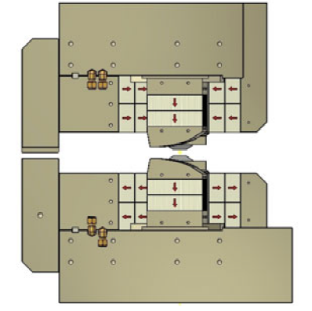
PM with fixed field or gradient-3
Superbend in Sirius 2018
  High field and small aperture : B0=3.2T
  Field quality: DBL/BL<0.05%, DGL/GL<0.1%, higher harmonics<6*10⁻⁴
[1] James Citadini, et al., Sirius-Details of the New 3.2 T Permanent Magnet Superbend. IEEE Transactionson Applied Superconductivity, Vol. 28, No. 3, April 2018.

Slide 12
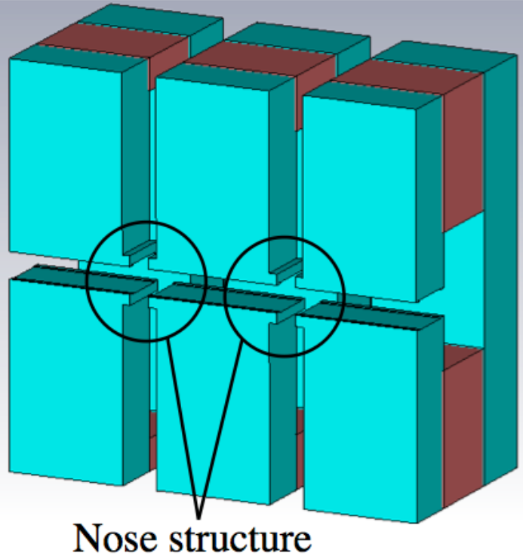
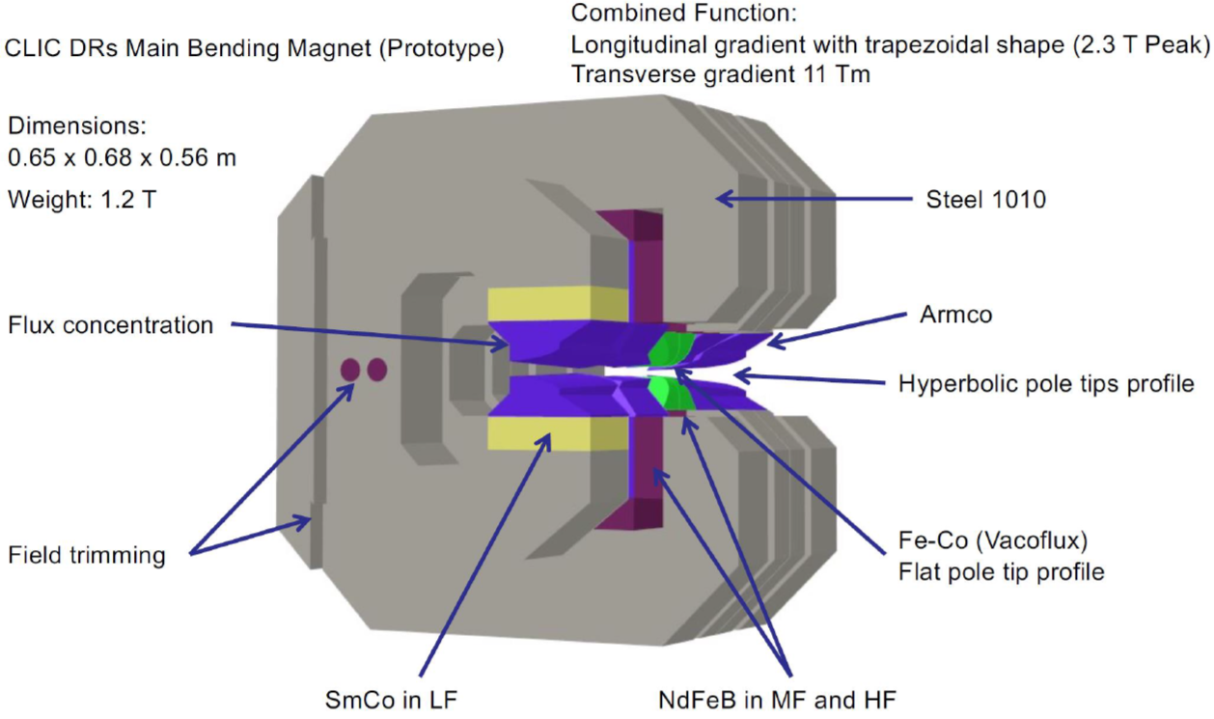
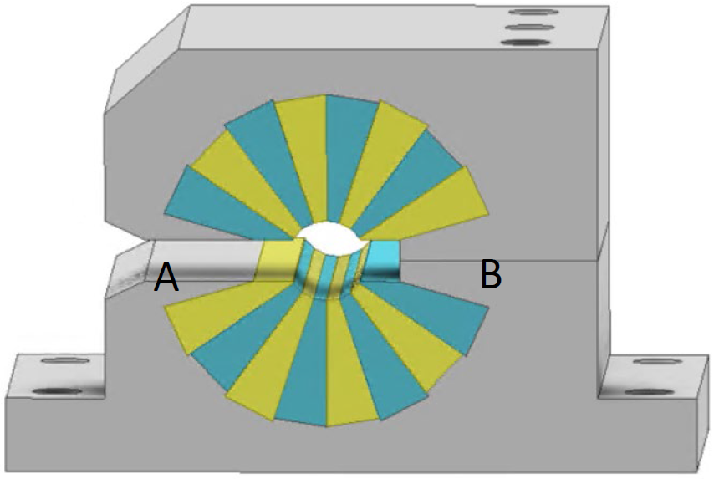
PM with fixed field or gradient-4
Longitudinal combined dipole and quadrupole for CLIC damping ring in ALBA
Magnet section activities at ALBA, Jordi Marcos, IMMW22.
DL in Spring-8-II
Magnet Development for SPring-8 Upgrade. T. Watanabe, et al. Proceedings of IPAC2016.
Prototype of longitudinal dipople and quadrupole in Desy
Magnet Design for the PETRA IV Storage Ring. I. Agapov, et al. DOI:10.18429/JACoW-IPAC2022-THPOTK002.
Symmetric Halbach PMQ
Complex PM bend quadrupole in NSLSII-U
Development of Advanced Magnets for Modern and Future Synchrotron Light Sources. S.K. Sharma. IPAC22.

Slide 13
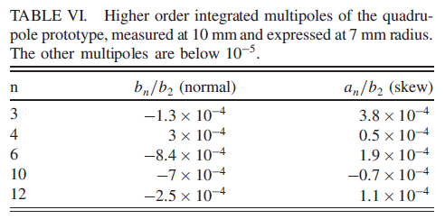
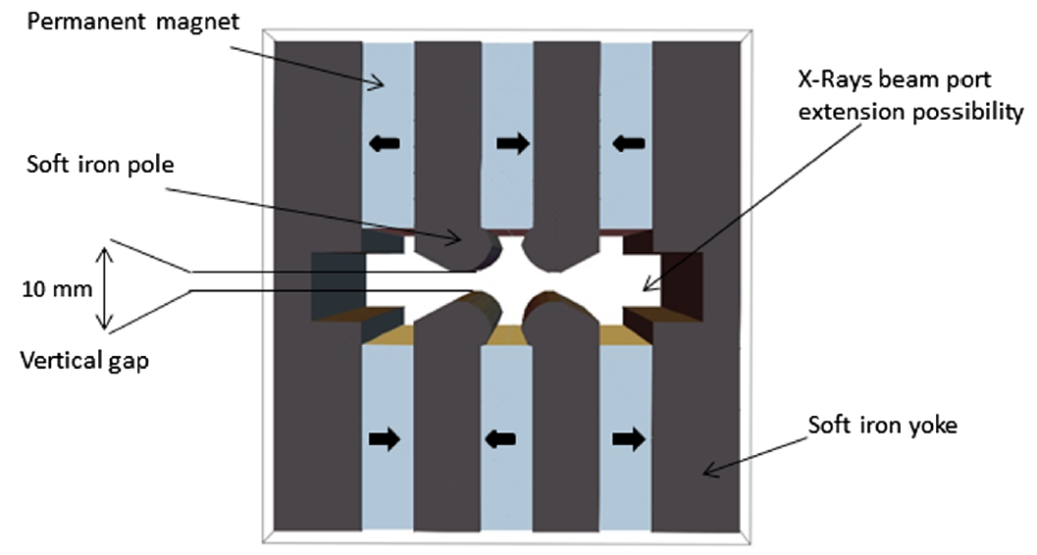
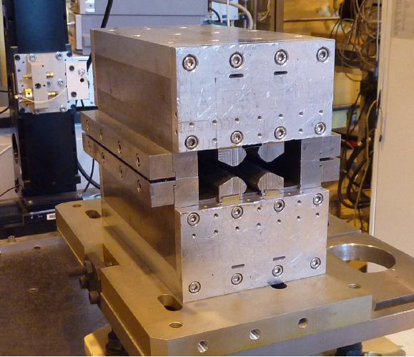
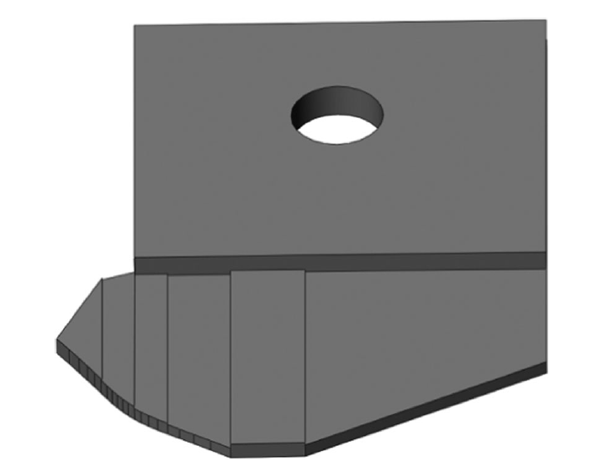
Hybrid Permanent quadrupoles
Hybrid high gradient PMQ design
  Strong gradient for potential use in future light source lattices: G=82T/m, D=24mm
  Simple mechanical parts, rectangular PM blocks and soft iron poles
  Gradient inhomogeneities <0.1% after special shims.
Special end shims
Soft iron
Prototype of PMQ in ESRF-EBS
[1] P. N’ gotta, et al., Hybrid high gradient permanent magnet quadrupole, PRAB,2016.

Slide 14
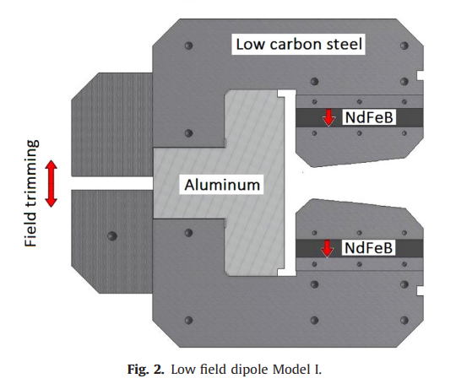
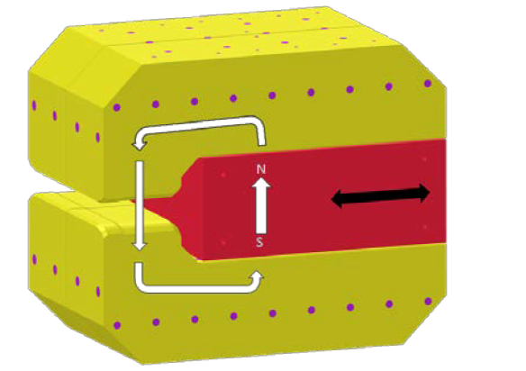
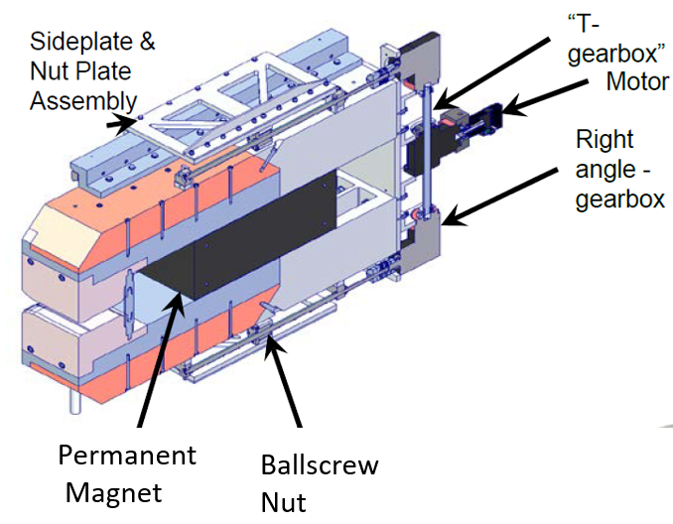
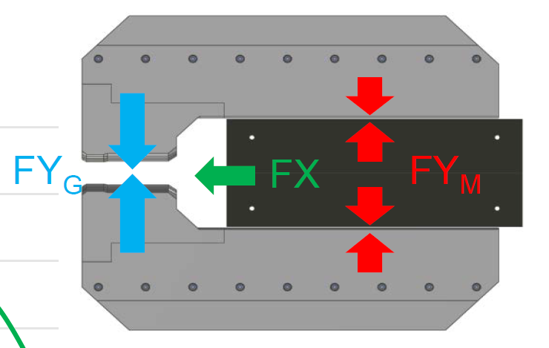
Tunable PM dipole magnet
PM dipole magnet
  Aluminum bracket support
  Low carbon steel pole
  NdFeB for excitation
  Field trimming is by the backlag
ZEPTO (Zero Power Tunable Optics)
  Tunes without changing gap!
  PM moves perpendicular to largest forces
The ZEPTO Dipole: Zero Power Tuneable Optics for CLIC. A. R. Bainbridge, et al. Proceedings of IPAC2017, pp. 4338-4341. DOI: 10.18429/JACoW-IPAC2017-THPIK105.

Slide 15
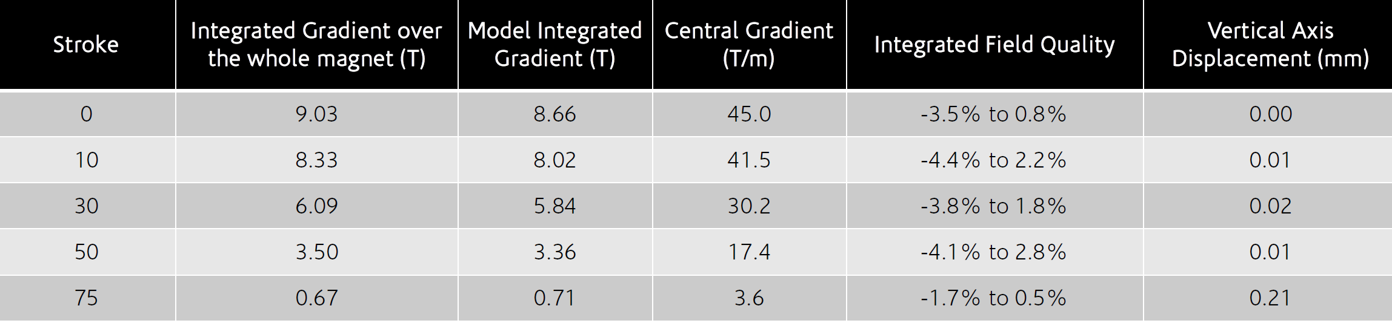
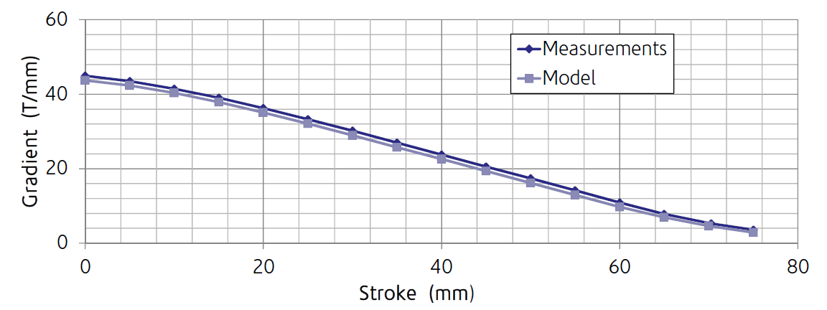

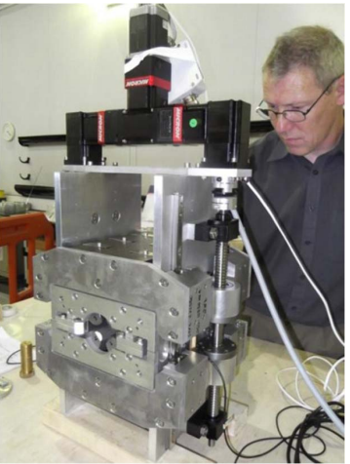
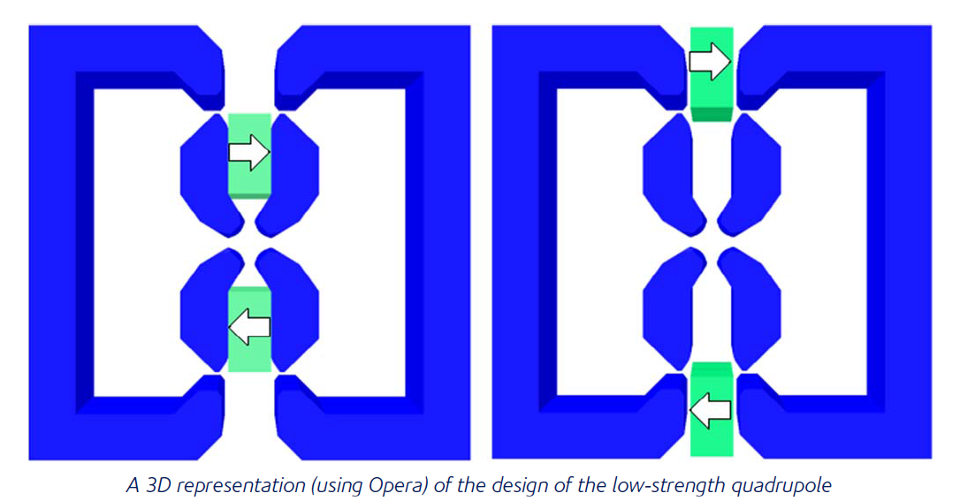
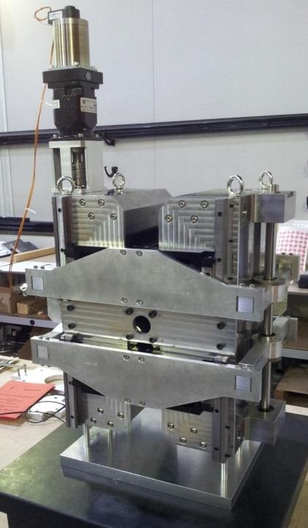
Adjustable quadrupole magnet-1
ZEPTO-Q2 :continuously adjustable hybrid PM quadrupole (STFC-CERN collaboration )
  NdFeB with VACODYM 764 TP
  Q1: 15T/m~60T/m; single axis motion with one motor
  and two ballscrews; max force is 16.4kN.
  Q2: 3.5T/m~43T/m; single axis motion with one motor
  and one ballscrews; max force is only 0.7kN.
Q1
[1] Tuneable High-Gradient Permanent Magnet Quadrupoles. B. J. A. Shepherd, et al. Journal of Instrumentation, vol. 9, T11006, 2014. DOI: 10.1088/1748-0221/9/11/T11006.
[2] Design and Measurement of a Low-energy Tunable Permanent Magnet Quadrupole Prototype. B. J. A. Shepherd, et al. Proceedings of IPAC2014, pp. 1316-1318. DOI: 10.18429/JACoW-IPAC2014-TUPRO113.
Q2

Slide 16
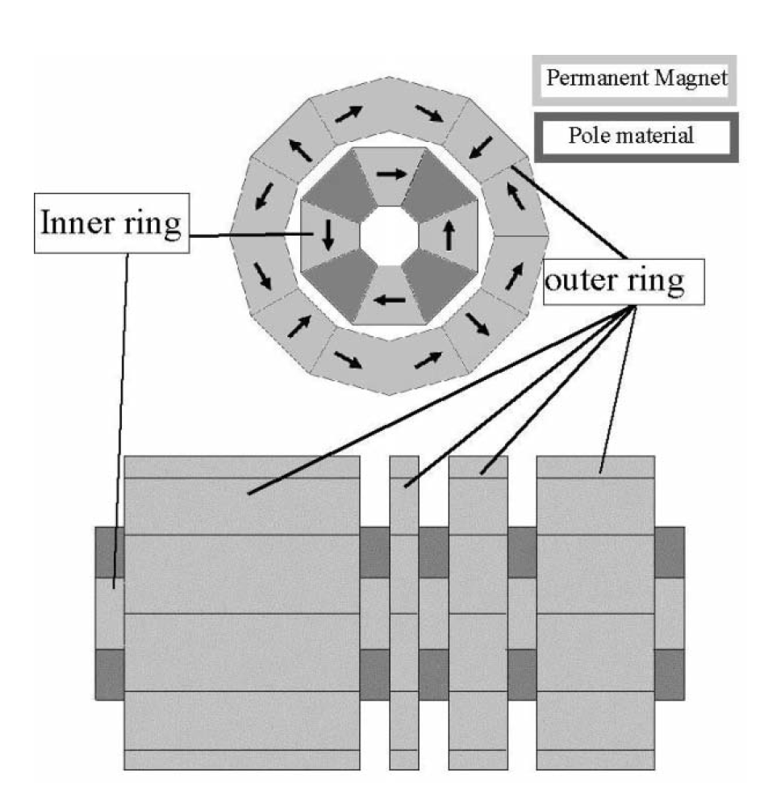
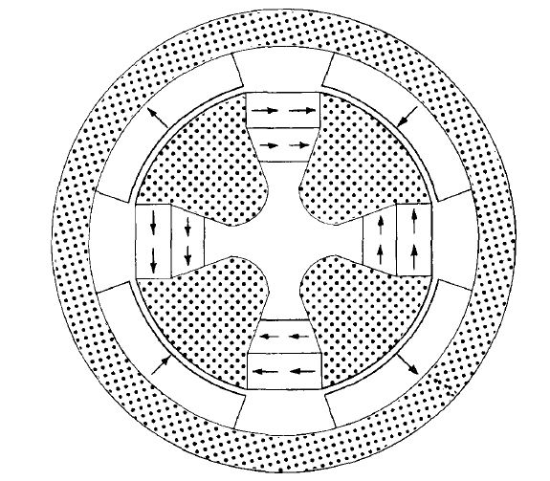
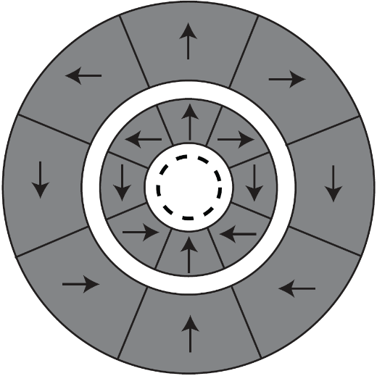
Adjustable quadrupole magnet-2
Double ring structure
  Scheme 1: two Halbach array rings with pure PM
  Scheme 2: the outer ring with PM rotating around the center, the inner four steel poles with the pm blocks are fixed.[1][2]
[1] K. Halback, CONCEPTUAL DESIGN OF A PERMANENT QUADRUPOLE MAGNET WITH ADJUSTABLE STRENGTH, NIMA,1983
[2] T. Mihara, et al., A Super Strong Adjustable Permanent Magnet for the Final Focus Quadrupole in a Linear Collider. Proceedings of EPAC2004.

Slide 17
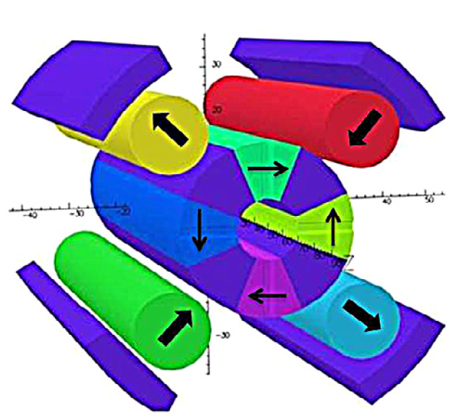
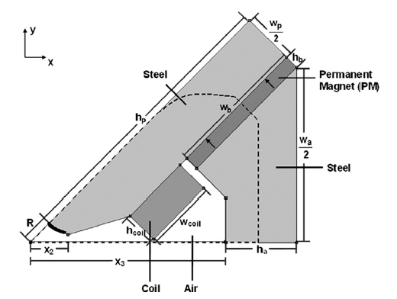
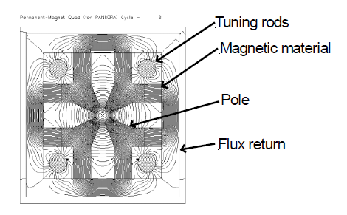
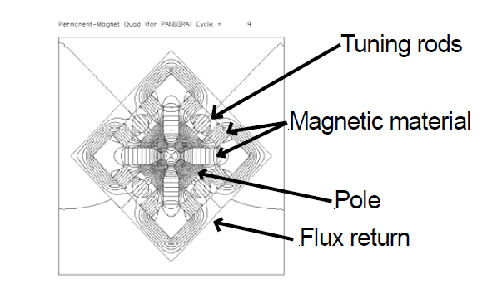
Adjustable quadrupole magnet-3
Tunable high gradient quadrupoles （installed in transport line)
Next Linear Collider
Sirius Quadrupole
[1] Variable high gradient permanent magnet quadrupole
[2] Giancarlo Tosin, et al., Super hybrid quadrupoles,NIMA, 2012

Slide 18
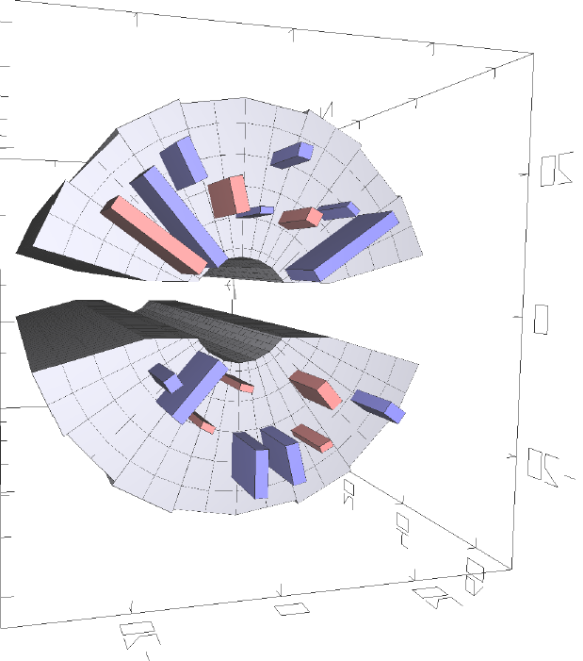
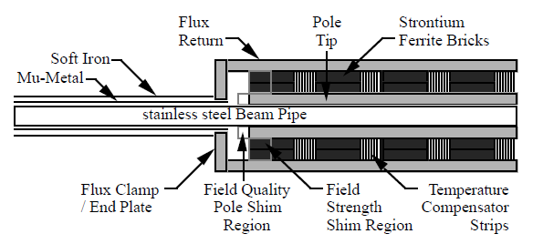
Field correction in PM
Harmonics correction by alignment and magic fingers
  With iron or end magic fingers to adjust the field harmonics.
Field strength modification
  At the end of the magnet with PM Pieces are used.
  Side soft iron bolts.

Slide 19
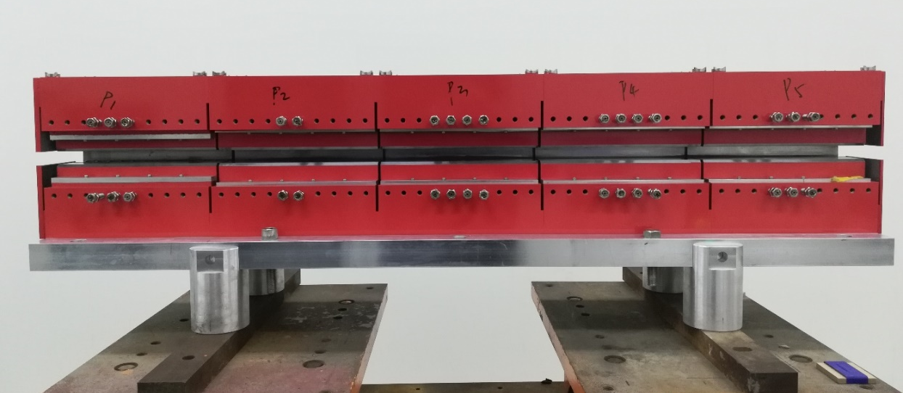
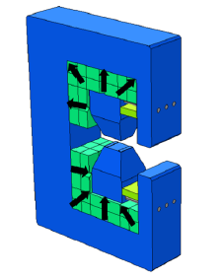
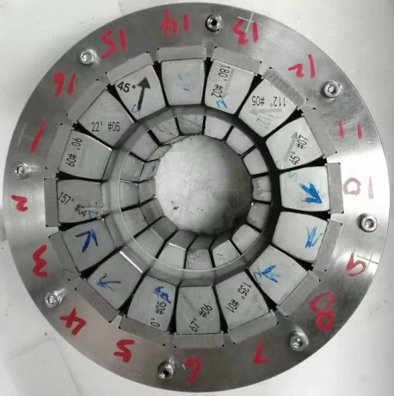
Permanent magnets in IHEP
Longitudinal gradient dipole magnet in HEPS 2022
  Batch production: 240 PM in HEPS storage ring, installed in the SR tunnel.
  Saved 480kW for EM, which is 16% power of the SR magnets（EM Dipole:~3.5MKWh/year)
IDs in IHEP: IVU, CPMU,IAU in HEPS, SC wiggler(3W1) in BEPCII, etc.
Combined quadrupole and sextupole PM (By Quanling Peng,2023)
  Halbach arrays of quadrupole and sextupole arranged longitudinal
Longitudinal gradient dipole in HEPS (BLG1&BLG5,96)
Combined Q and S PM
Module p3 in BLG3 (48)
Bm~1T

Slide 20
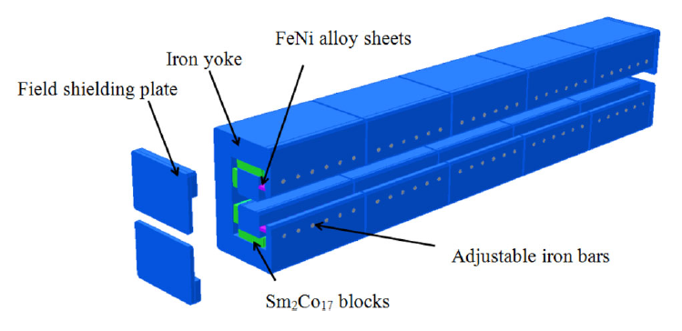
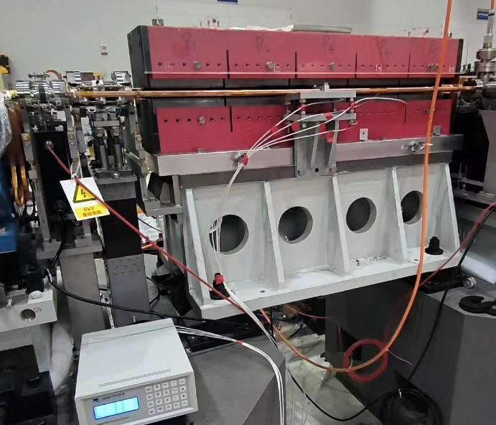
Batch production of BLG in HEPS
Temperature effect
  FeNi alloy is used for temperature compensation, Temp coefficient is reduced from 3×10⁻⁴ /℃ to 0.5×10⁻⁴/℃. Experiment shows the field changes 50ppm/℃, around 25±1℃ in our lab.
  Vacuum chamber baking for NEG coating, the copper vacuum chamber should be heated to about 200℃, which is inserted in the gap aperture of dipole magnet. For more than 24 hours test, the field is not demagnetized after temperature is recovered to 25 ℃. (PM blocks is fixed outside the iron pole and far from the vacuum chamber, and temp rise in PM is far less 200℃）

Slide 21
Permanent dipole magnets in IHEP
Heat treatment
  PM is easy demagnetized by heating and radiation
  By preheating treatment, heat resistance of pm material is improved.
Ref to pure PM in Fermilab Recycler Ring
1.1st , down to -10℃ and back，Br reduced by 0.05%.
2. 2nd, down to -10℃ and back, Br remains the same.
Φ change of SmCo after several Heat treatments

Slide 22
Batch production of BLG in HEPS
Good integral field dispersion in all the magnets
  DBL/BL<±0.5×10⁻⁴
  The integral field is shimmed by iron bolt in the yoke.

Slide 23
Magnet system in CEPC
Over 80% of collider ring is covered by conventional magnets, except some in IR region. All these magnets work at DC mode at four energies.
For CEPC Booster worked a ramped mode, 19624 magnets cover 74 km of the tunnel. Laminated magnets are the first option in TDR.
Other DC magnets are in damping ring, transport lines and linac regions.
The most important issues are Cost & Power Consumption.
 | Dipole | Quad. | Sext. | Corrector | Total
Dual aperture | 3008 | 3008 | - | - | 17562
Single aperture | 162 | 1120 | 3176 | 3544*2
Total length [km] | 68.71 | 9.95 | 2.17 | 3.1 | 83.9
Power[MW]@120GeV | 6 | 17.5 | 8.91 | 0.28 | 32.7

Slide 24
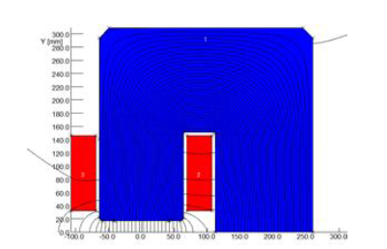
Possible proposal of PM in CEPC
Fixed field strength or gradient magnet
  PM magnets can be used in Damping ring and transport lines.
    In DR：C=147m, E=1.1GeV
    Dipoles：B0=1.3T, Leff =0.5m, Gap=38mm
    PM dipole and gradient dipole magnet can be used.
DC magnets worked at four energies
  Energy ranging from 45.5GeV to 180GeV, the magnets have field strength/gradient with a large variation.
  Dual aperture magnets are designed for the main dipole and quadrupole magnets.
  Trim coils are added for energy sawtooth effect.
  Conceptual design of tunable magnet for the dual aperture magnet are proposed.

Slide 25

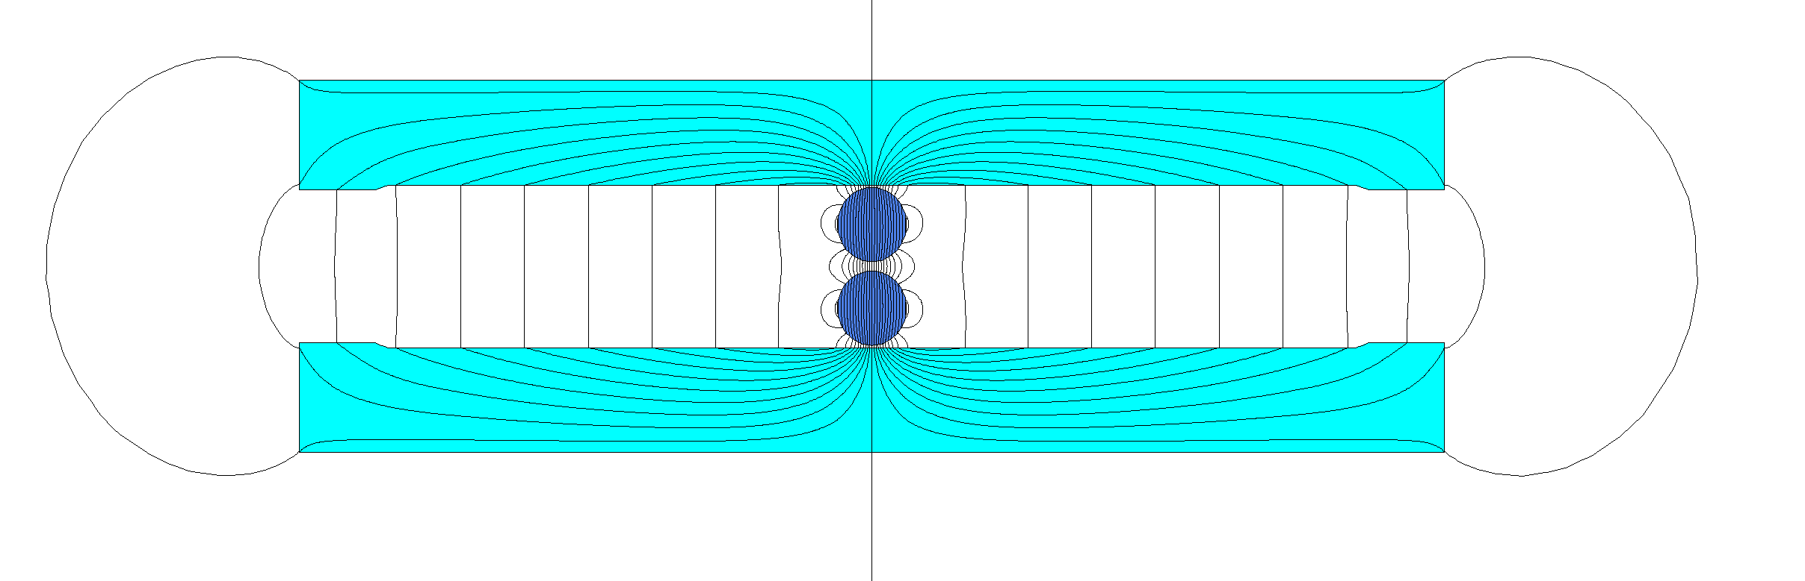
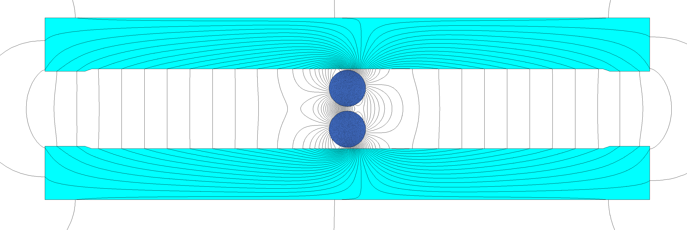
Conceptual PM design on CEPC Collider
DAD design schemes
  Two PM cylinder in the middle
  Three PM: one PM block + two PM cylinders
    B=B₁±2B₂*cosθ
  Trim coils are needed to tamper field strength.
PM2
PM1
PM2
Bmax=B₁+2B₂
Bmin=B₁-2B₂

Slide 26
Conceptual PM design on CEPC Collider
From the simulation on DAD PM schemes, the magnetic remanence Br and easy axis θ should be adjusted and sorted carefully. Two cylinder blocks should be rotated at the same angle, otherwise, the skew field cannot be canceled out completely.
Besides the errors in PM materials, the field harmonics are also determined by the pole shape and gap, which is same to normal conducting magnet.
The PM blocks should be protected from the beam radiation by lead blocks.
The PM scheme for dual aperture quadrupole magnet will be tried later.

Slide 27
Conclusions
PM magnets are of more concerns in nowadays since the green environment is more and more important, especially in large scale facilities.
Hybrid PM dipoles with fixed field are now common in the light source, followed ESRF-EBS which has strict requirements and is currently in operation.
PM in used and to be used in accelerators are summarized. The stability of PM materials requires sustained and high attention.
Technical challenges in the PM technical is large field adjustability.
The possibility of permanent magnet applications is studied in CEPC for power saving.

Slide 28
Thanks for your attention!

