Slide 1
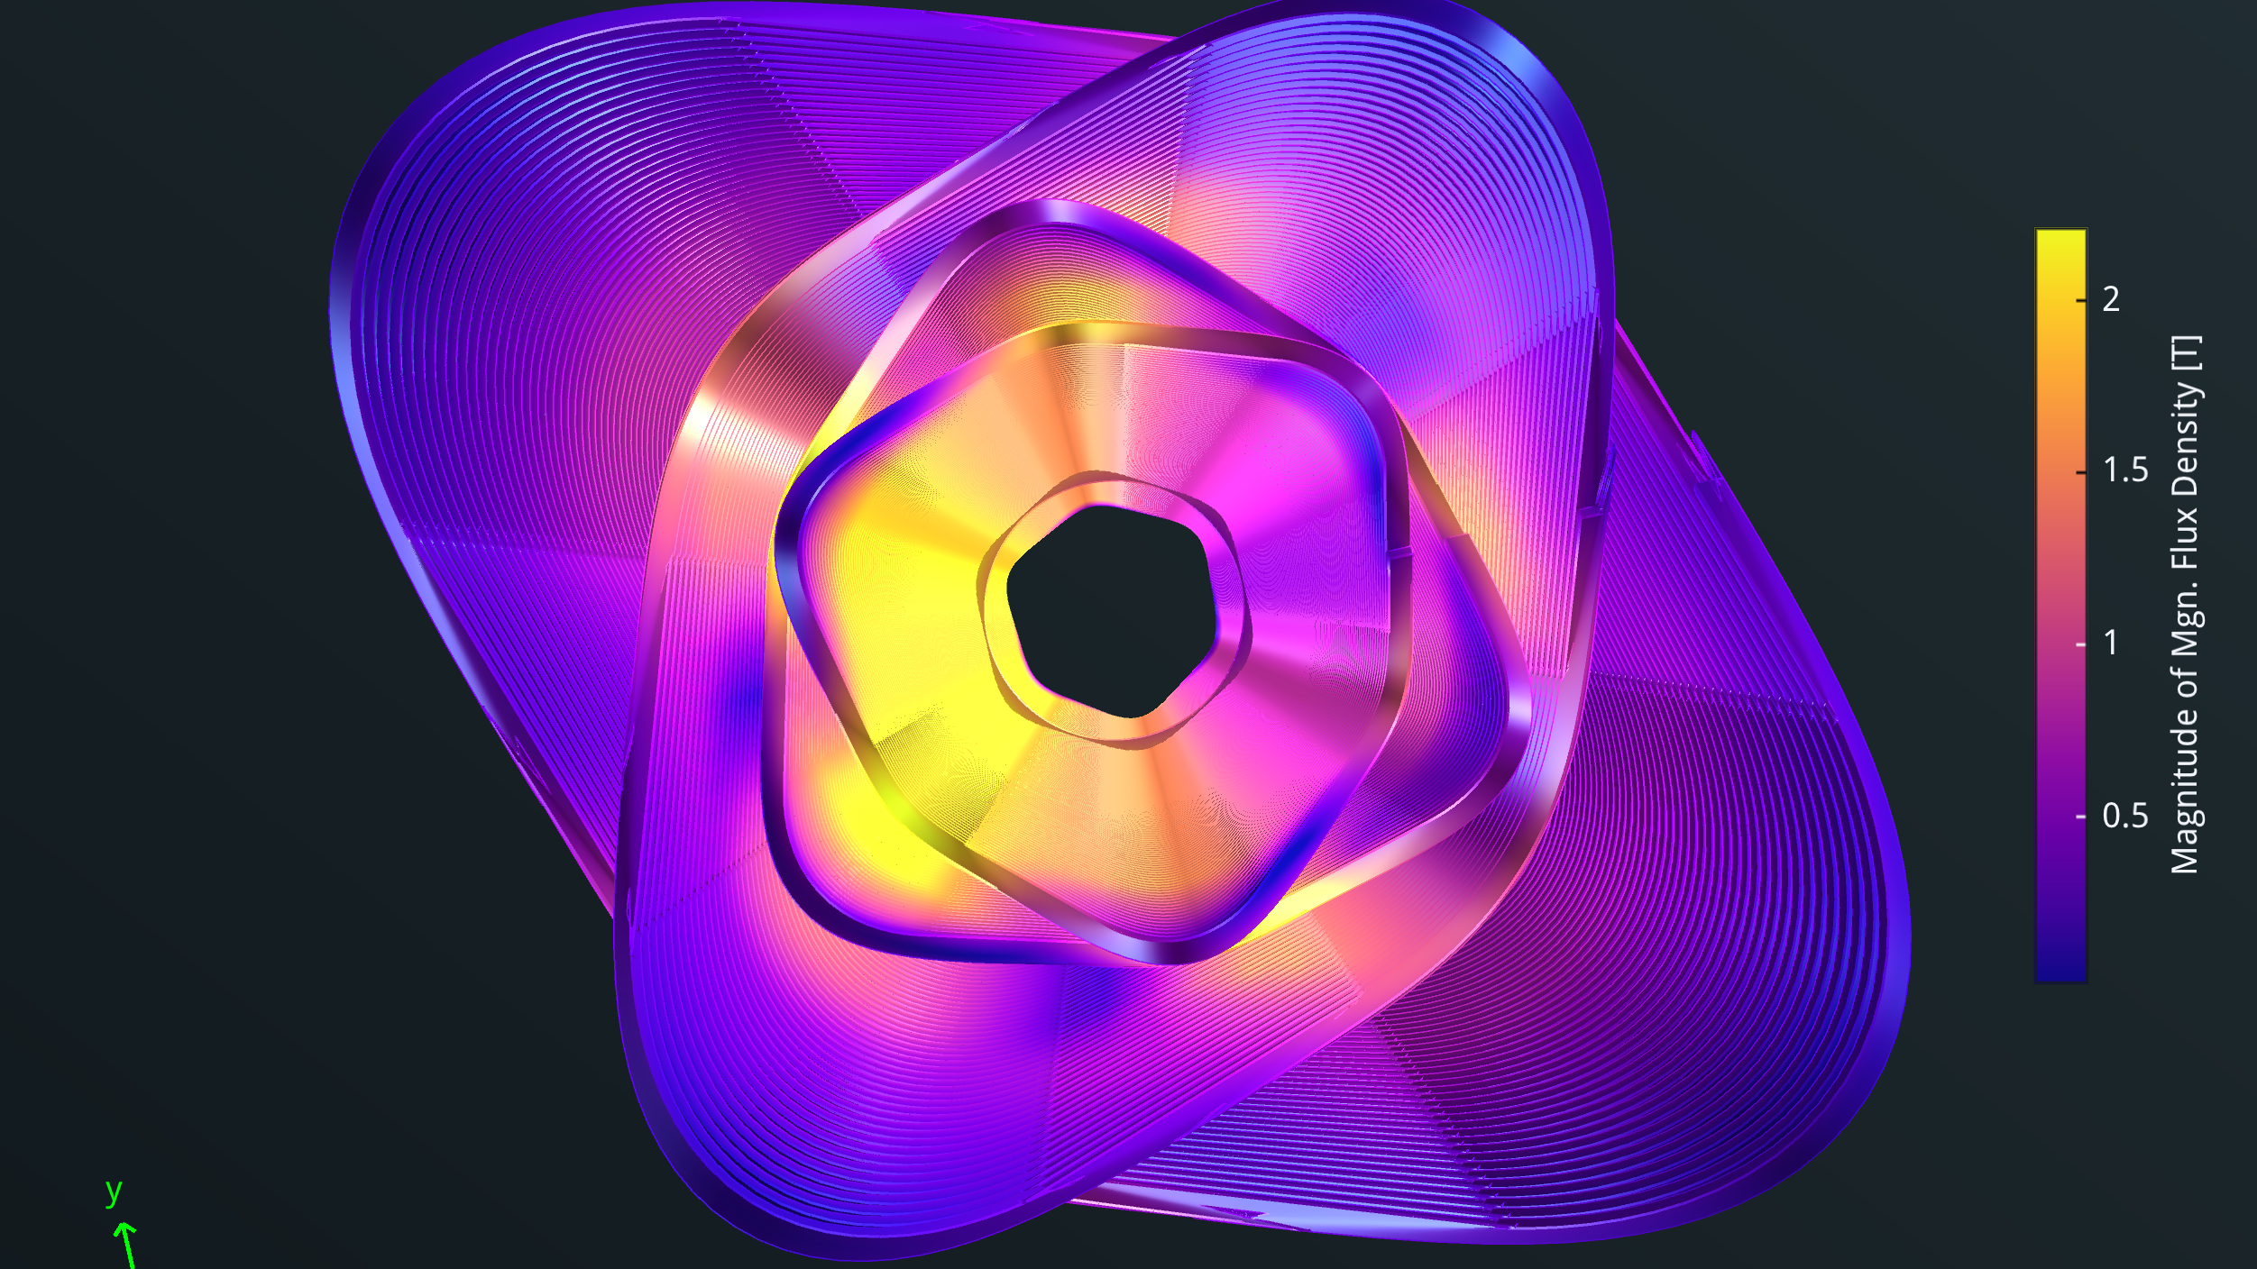





SC Magnets for the FCCee Collider Ring
M. Koratzinos
Mini-workshop on Green Accelerator and Colliders
18/1/2024
This work is performed under the auspices and with support from the Swiss Accelerator Research and Technology (CHART) program (www.chart.ch).

Slide 2
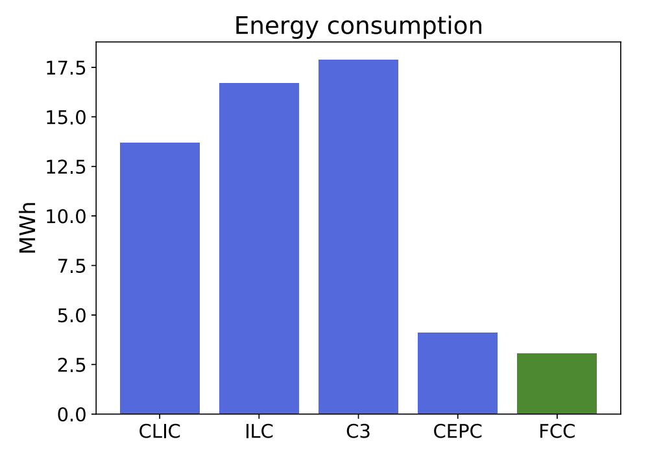
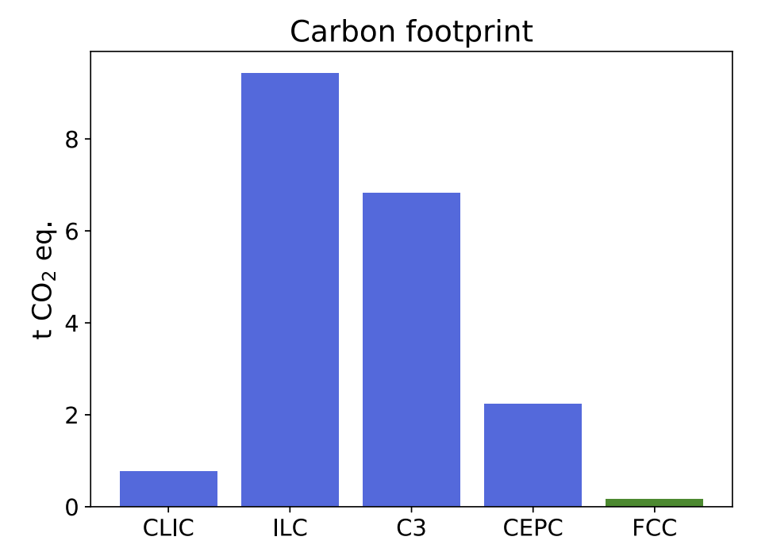
The big picture
Energy consumption per Higgs produced
FCC-ee is the most energy-efficient accelerator proposed (and the one with the smallest CO2 footprint (see “the carbon footprint of proposed e+e- factories”, Janot and Blondel, https://link.springer.com/article/10.1140/epjp/s13360-022-03319-w
But we do not stop here! I will present our work to make FCC-ee even more sustainable and at the same time increase performance by focusing on the main magnet systems of FCC-ee
We re also looking into increasing the relevance of FCC to society by adopting state-of-the-art technologies and trying to play a leading role in our respective fields
Carbon footprint per Higgs produced

Slide 3
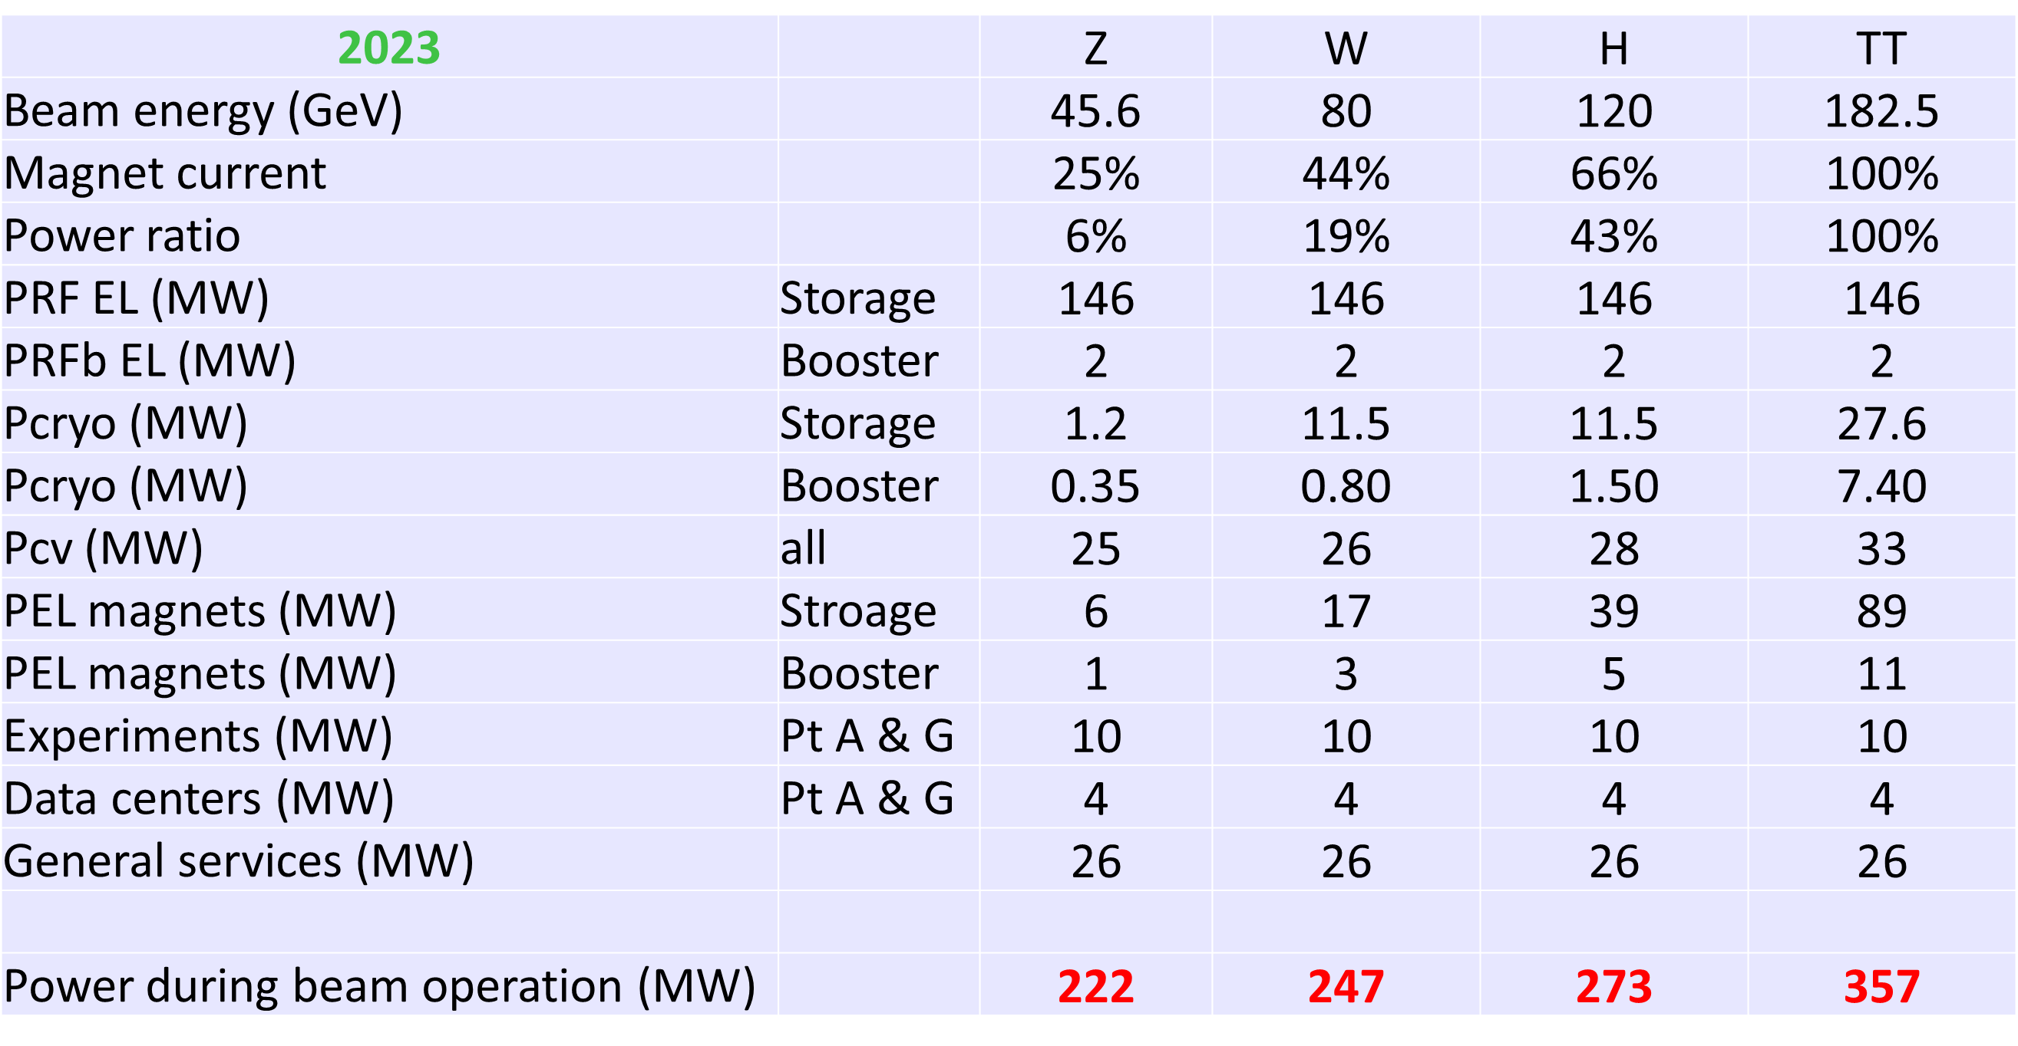
Power demand of FCC at all energies
Main consumers: RF, magnets, CV (cooling and ventilation)

Slide 4
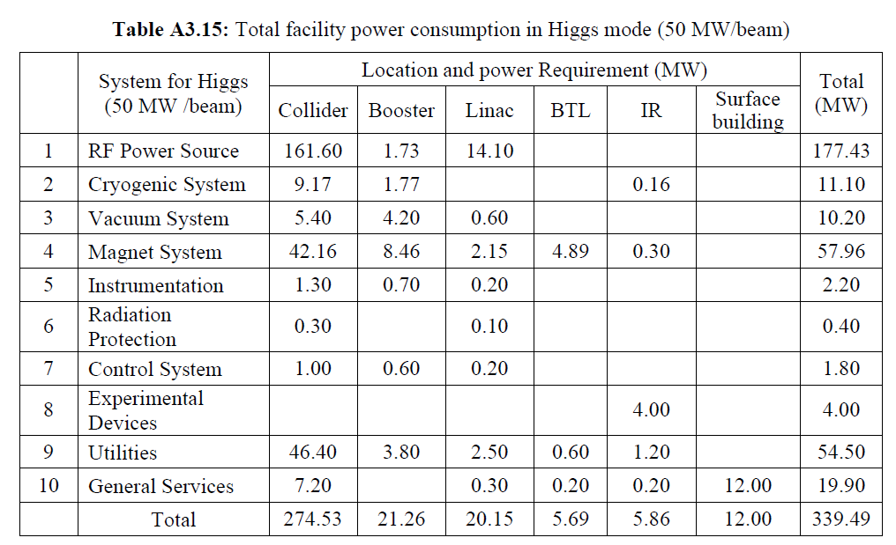
Comparison to the CEPC
Presented on 18/1/2024 from the 2023 TDR:
Numbers are a bit more pessimistic, resulting in 25% more energy consumed.
CV does not appear as a separate item
But the magnet power consumption increases more than a factor 2 at the top!
Going from 30 to 50MW beam power increases efficiency per Higgs produced by 30%!

Slide 5
Power consumption – collider main magnet systems
We pay twice for normal conducting magnets: one through ohmic losses, and again for removing the heat with our cooling and ventilation (CV) system.
Storage Ring | Z | W | H | TT
Beam Energy (GeV) | 45.6 | 80 | 120 | 182.5
Magnet current | 25% | 44% | 66% | 100%
Power ratio | 6% | 19% | 43% | 100%
Dipoles (MW) | 0.8 | 2.6 | 5.8 | 13.3
Quadrupoles (MW) | 1.4 | 4.3 | 9.8 | 22.6
Sextupoles (MW) | 1.3 | 3.9 | 8.9 | 20.5
Power cables (MW) | 1.2 | 3.8 | 8.6 | 20
Total magnet losses | 4.8 | 14.7 | 33.0 | 76.4
Power demand (MW) | 5.6 | 17.2 | 38.6 | 89
CV needs to remove the heat of the storage and booster magnets (100MW at top), storage and booster RF (148 at top) and experiments (8MW). Total is 256MW
The share of storage ring magnets on CV is 35%, or 14MW
Cooling and ventilation |  | Z | W | H | TT
Beam energy (GeV) |  | 45.6 | 80 | 120 | 182.5
Pcv (MW) | all | 33 | 34 | 36 | 40.2
Total contribution of the collider ring magnets is therefore ~100MW at the top, 76% of which comes from the quads and sextupoles
Jean-Paul Burnet (CERN) 2022

Slide 6
Arc magnets
Power consumed at the top is ~76MW for the quadrupole and sextupole system and “only” ~24MW in the dipole system
Quads and sextupoles reduce the packing factor
Start from reducing power consumption/footprint to the quad/sext system (this presentation)
…then move to the dipoles.

Slide 7
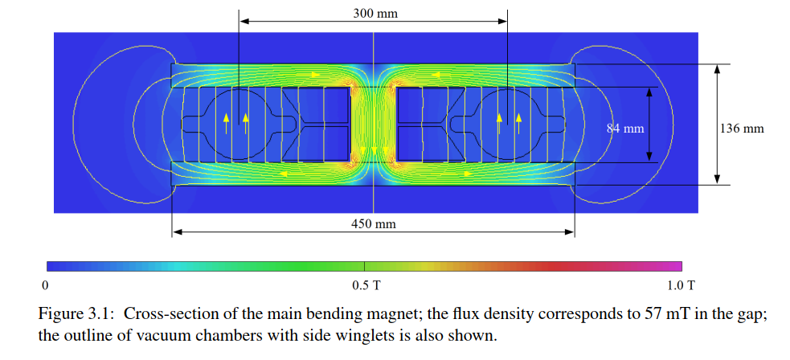
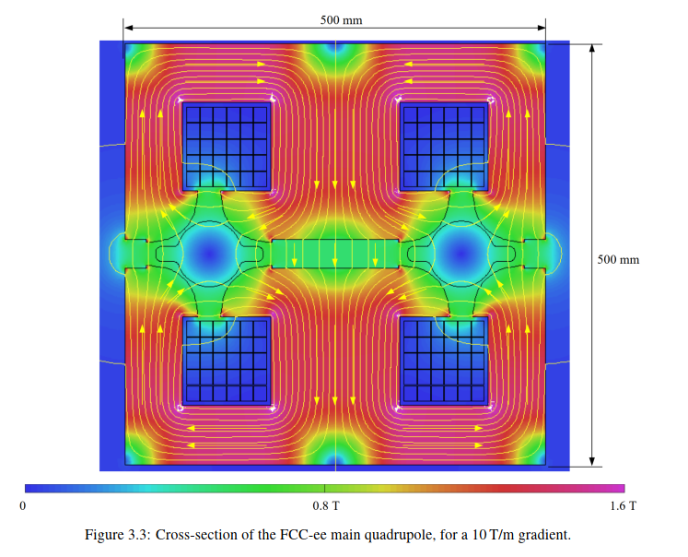
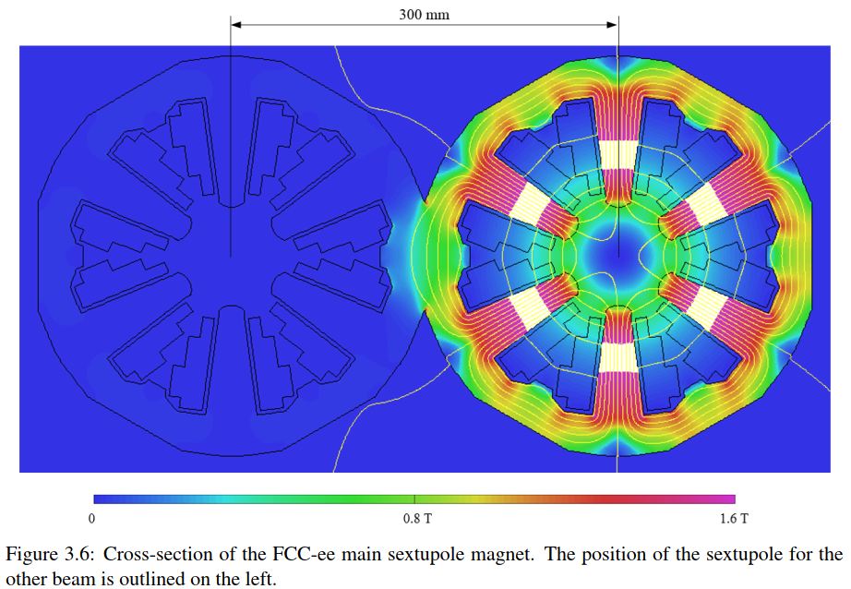
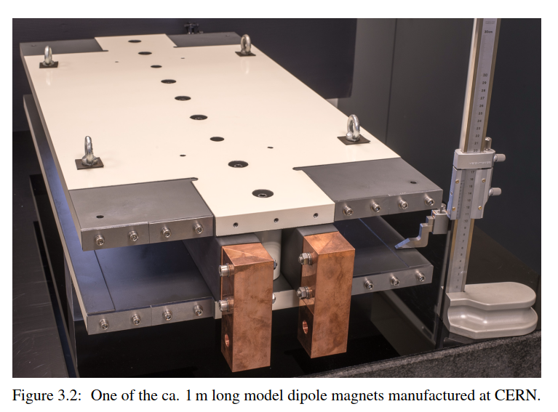
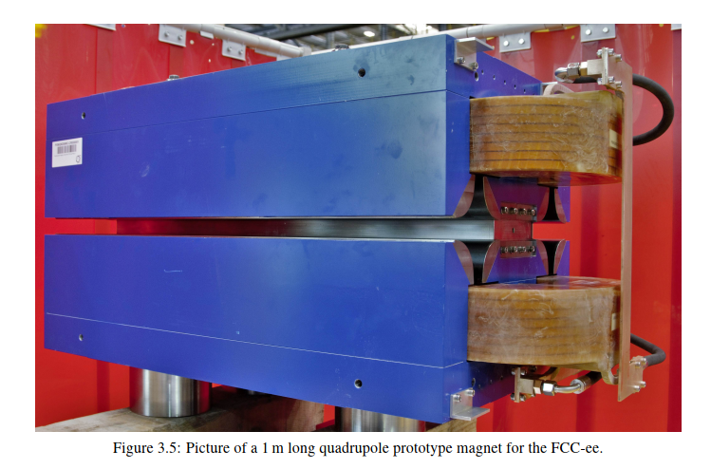
FCC-ee: baseline arc magnet system
CDR: FCC-ee is a conventional (warm) accelerator, much like LEP (CERN, 1989-2002)
The FCC-ee CDR has 2900 (20m-long) dipole, 2900 quadrupole and 4704 sextupole magnets, all normal conducting
Every effort was made to have a “power saving” design for the quads (50% saving, but with some compromises)
This power loss is dominated by the quadrupole and sextupole magnets.
CDR
CDR
CDR - prototype
CDR - prototype
(no prototype exists yet)
Big, heavy quads and sextupoles

Slide 8
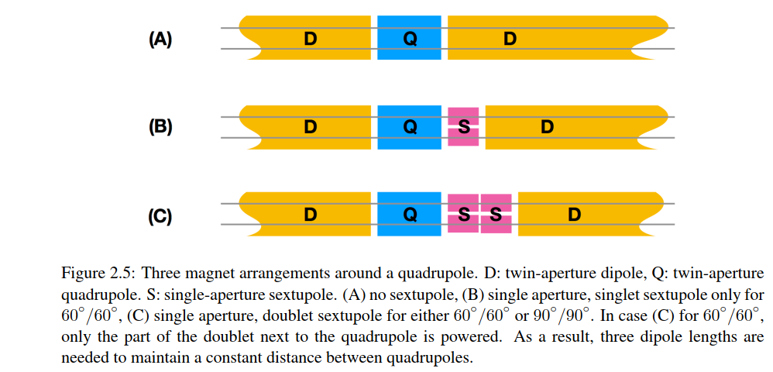
FCC-ee: The cold SSS proposal
How can we improve in this design?
1/ Make the magnets superconducting. Then, energy is only spent cooling the magnets (zero Ohmic losses).
2/ Also, we can “nest” the magnets, so that they take less space
This means that there is more space available for bending, so performance of the accelerator also increases.
Potential power reduction for these systems: ~90%
2900 cryostats, 3.5m long each
CDR
CDR
This proposal
Half cell length: 27.9 m
Half cell length: 27.9 m

Slide 9
Other potential gains
Apart from the power consumption reduction, the gains of a nested system are:
The packing factor increases by 7%, so, for the same luminosity, RF power can be reduced by 7%
The higher packing factor also reduces the total voltage needed by the RF by 7%
Total gain ~14% in the price of the RF system (which is O(1BnCHF). If the price of the magnet systems concerned is ~25% of the price of the total RF system, then ~40% of the cost of the cold SSSs is compensated by the reduction in the RF costs alone!
We aim to produce the superconducting SSSs in the same price envelope as in the CDR.
The optics design is much more flexible:
  No requirement for fixed polarity electron/positron quadrupoles
  Sextupoles available in all SSSs
  Opens the path for 100% filling factor and tapering management (see next slide)
It should be made clear that this is a big change in the design of FCC-ee and many systems are affected, for instance photon stopper design, radiation environment in the tunnel, BPM design, girder design, optics, etc.

Slide 10
Can we do even better?
Move the power supply inside the cryostat instead of the traditional cold magnet/warm power supply (FCCee-CPES project)
This system can naturally be adapted to also have a nested dipole covering the entire length of the SSS (another potential gain of 7% in packing factor, reaching almost 100%).
A nested dipole system (which will be individually powered) will also solve all our tapering needs (maximum dipole strength needed at the top is ~30%).

Slide 11
FCCee-HTS4 project
Investigate the replacement of all FCC-ee short straight sections (SSSs) that contain arc quads, arc sextupoles and assorted correctors by superconducting ones.
Nest the sextupoles and quadrupoles in the same unit.
Use HTS conductors (ReBCO tapes)
Operate at around 40K
Investigate all integration issues
Produce a ~1m prototype
Funded by CHART
FCCee-HTS4 are: B. Auchmann, J. Kosse, J. Schmidt, V. Batsari, A. Thabuis, A. Habsburg, M.K.

Slide 12
SSS main parameters
The FCC-ee optics design layout has the following specifications:
Length of quads is 2.9m. Quads should not be shorter, due to SR issues
Strength of quads is 11.84 T/m at tt.
Length of sextupoles is 1.5m. Sextupoles can be made stronger and shorter at will.
Strength of sextupoles is 812 T/m^2 at tt.
Together with necessary gaps and with all services, the length of the SSS will be 3.5m

Slide 13
Choice of HTS as conductor (ReBCO tapes)
ReBCO tapes are quickly becoming the industry standard, used by most Fusion (and other) projects
The biggest disadvantage is the high cost (around 100$/kA/m).
This cost is not due to the material cost of the tape (which is ~1$/kA/m)
Neither is it due to the manufacturing process (which is also ~1$/kA/m)
Expect for the cost to go down as demand increases

Slide 14
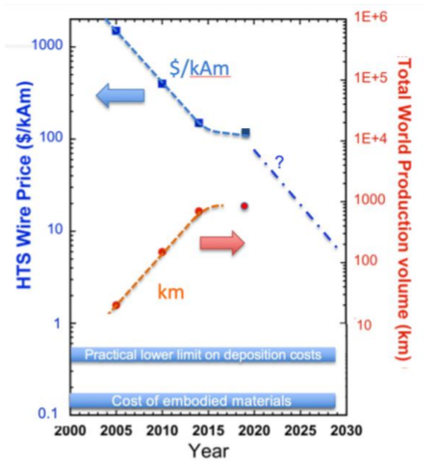
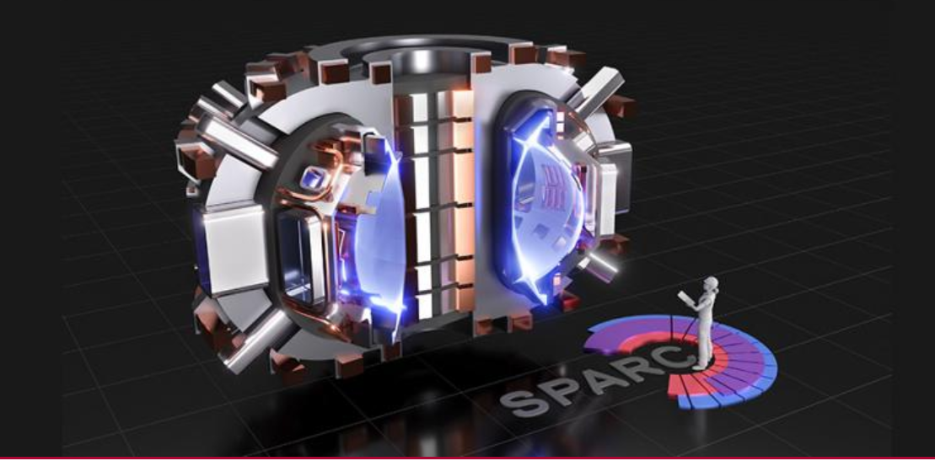
HTS cost
https://www.snowmass21.org/docs/files/summaries/AF/SNOWMASS21-AF7_AF0_Vladimir_Matias-251.pdf
The cold SSS idea cannot cost more than the price of the normal conducting system. The major cost driver today is the HTS conductor
For the above to be the case, we need a reduction in price of HTS tapes of about 3-4 compared to now in 20 years.
We believe that the advent of fusion projects will help reduce the price of HTS by a factor 10 in 20 years, so we think we are competitive.
Synergies with Fusion projects
Cf: SPARC fusion project needs 10,000 kms of HTS cable ~today
Nature, Scientific Reports | (2021) 11:2084 | https://doi.org/10.1038/s41598-021-81559-z

Slide 15
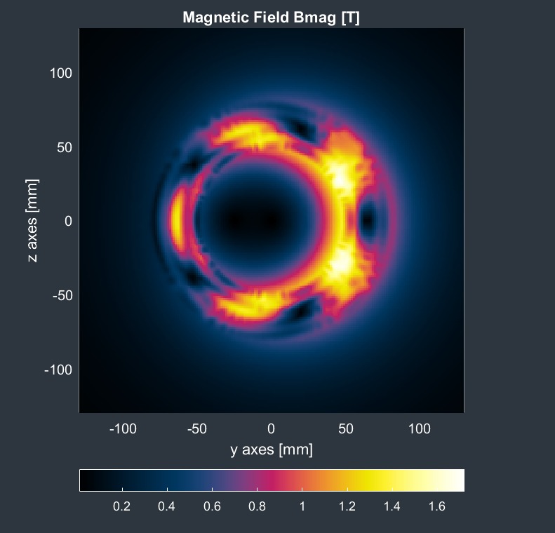
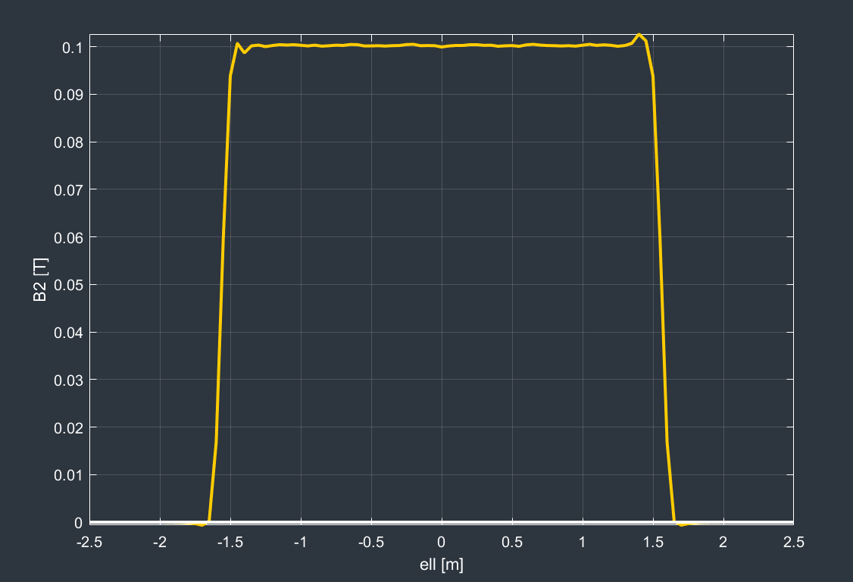
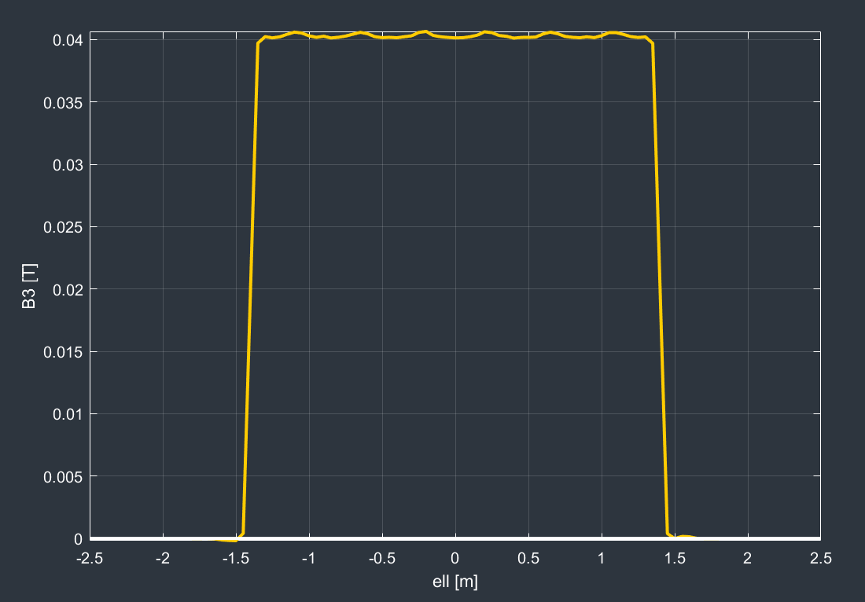
Magnetic analysis
Quad and sextupole at full strength
This is a low field application (1.7T max) gradients: 12T/m; 1000T/m²
There is no problem attaining the performance with today’s HTS tapes
B2 @10mm: 0.1T; B3 @10mm: 0.04T

Slide 16
Demonstrator
Since we are dealing with a new technology (quads and sextupoles using HTS conductor) one (or more) short-length demonstrators are needed to prove that our technology choices are correct.
A sextupole demonstrator has been designed and is being manufactured
The sextupole was chosen since in a nested (quad/sextupole) system, the higher order multipole goes closer to the beam pipe
Progress:
  Magnetic design finished using the RAT GUI from Little Beast Engineering (https://rat-gui.ch/)
  CAD design finished
  Material ordered
  Manufactured in the CERN main workshop

Slide 17
Demonstrator – choice of technology
We have chosen a CCT magnet layout due to
  Ease of construction
  Good field quality
  Quick design cycle
Other approaches (i.e. standard cosine-theta) will also be pursued
The use of HTS tape makes the design non-trivial compared to a round-conductor CCT, like the final focus prototype quadrupole already constructed and tested at warm. Proprietary IP is used

Slide 18
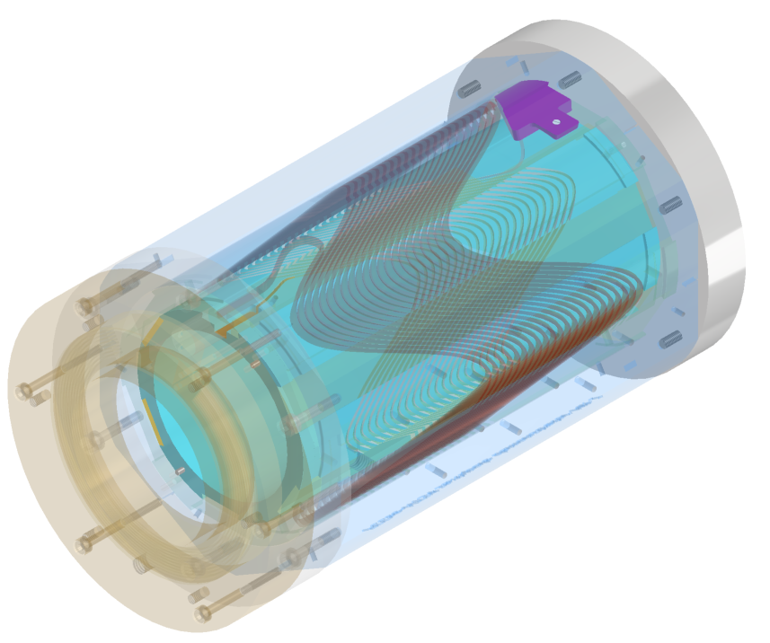
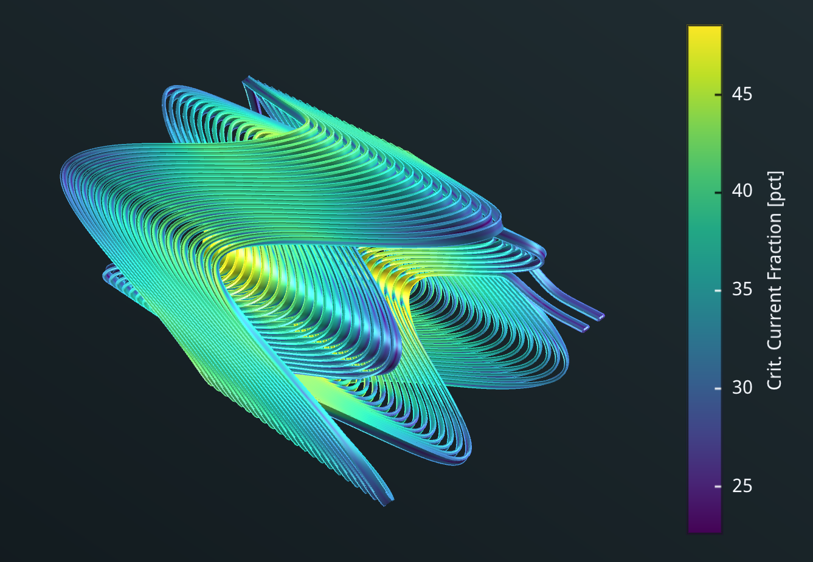
CAD design of sextupole demonstrator
Specifications:
Aperture: 90mm
Current: 260A
Temperature: 40K
Field gradient: 1000T/m2
Max. field @conductor:1.5T
Crit. Current fraction: 49%
Temp. margin: 14K

Slide 19
Manufacturing
For the prototype stage, there are two main manufacturing techniques:
Additive manufacturing (metal 3D printing)
  Advantages: any geometry is realizable
  Disadvantages: surface roughness, a lot of post-processing
Subtractive manufacturing (CNC machine milling)
  Advantages: mirror-like finish
  Disadvantages: not all geometries realizable
  Our choice for the first demonstrator
We are actively looking at both techniques

Slide 20
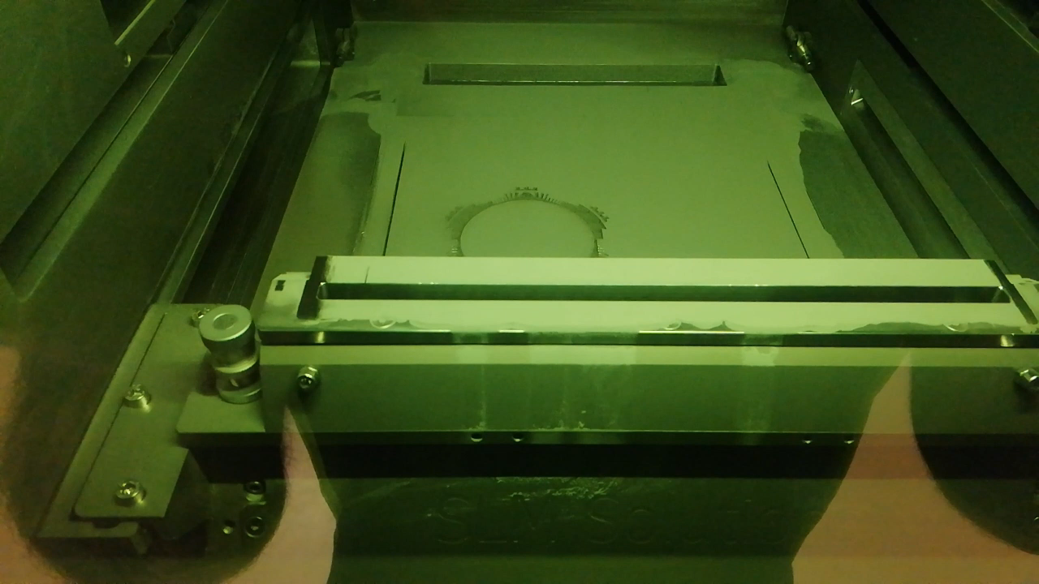
Metal 3D printing
Romain Gerard, Numan Ghazali (EN-MME-FW)

Slide 21
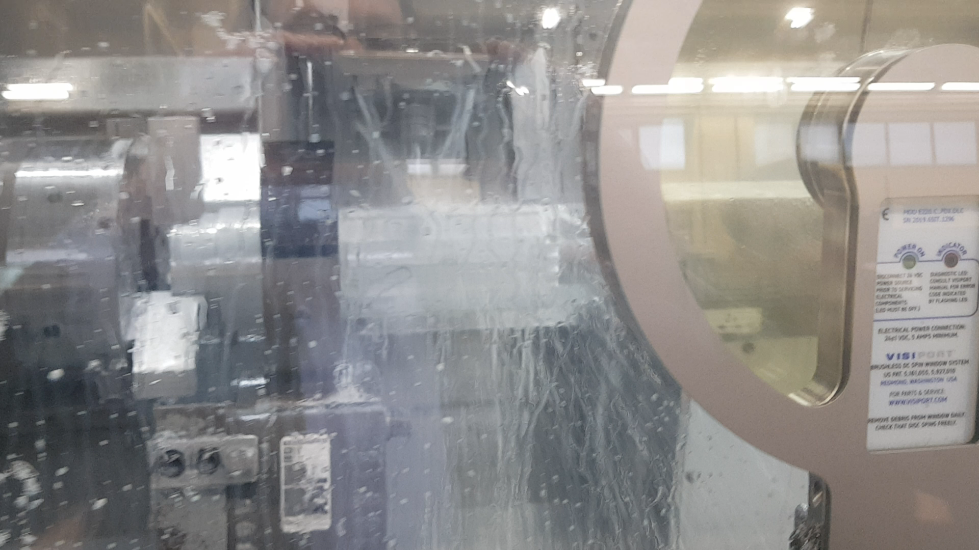
CNC milling

Slide 22
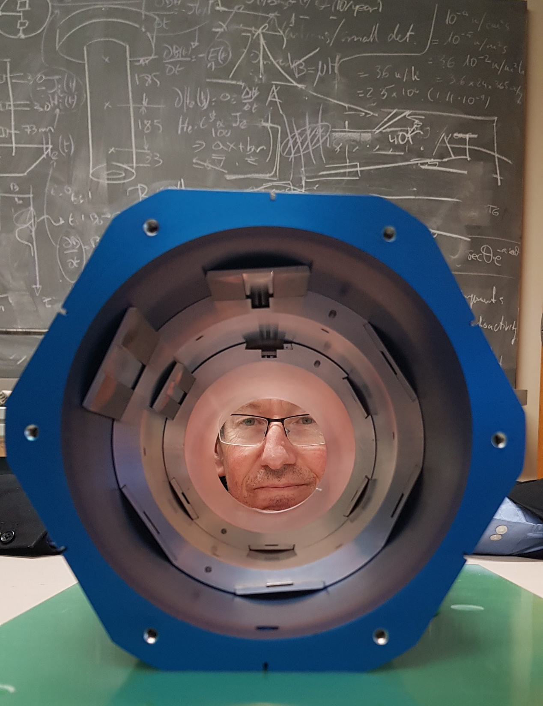
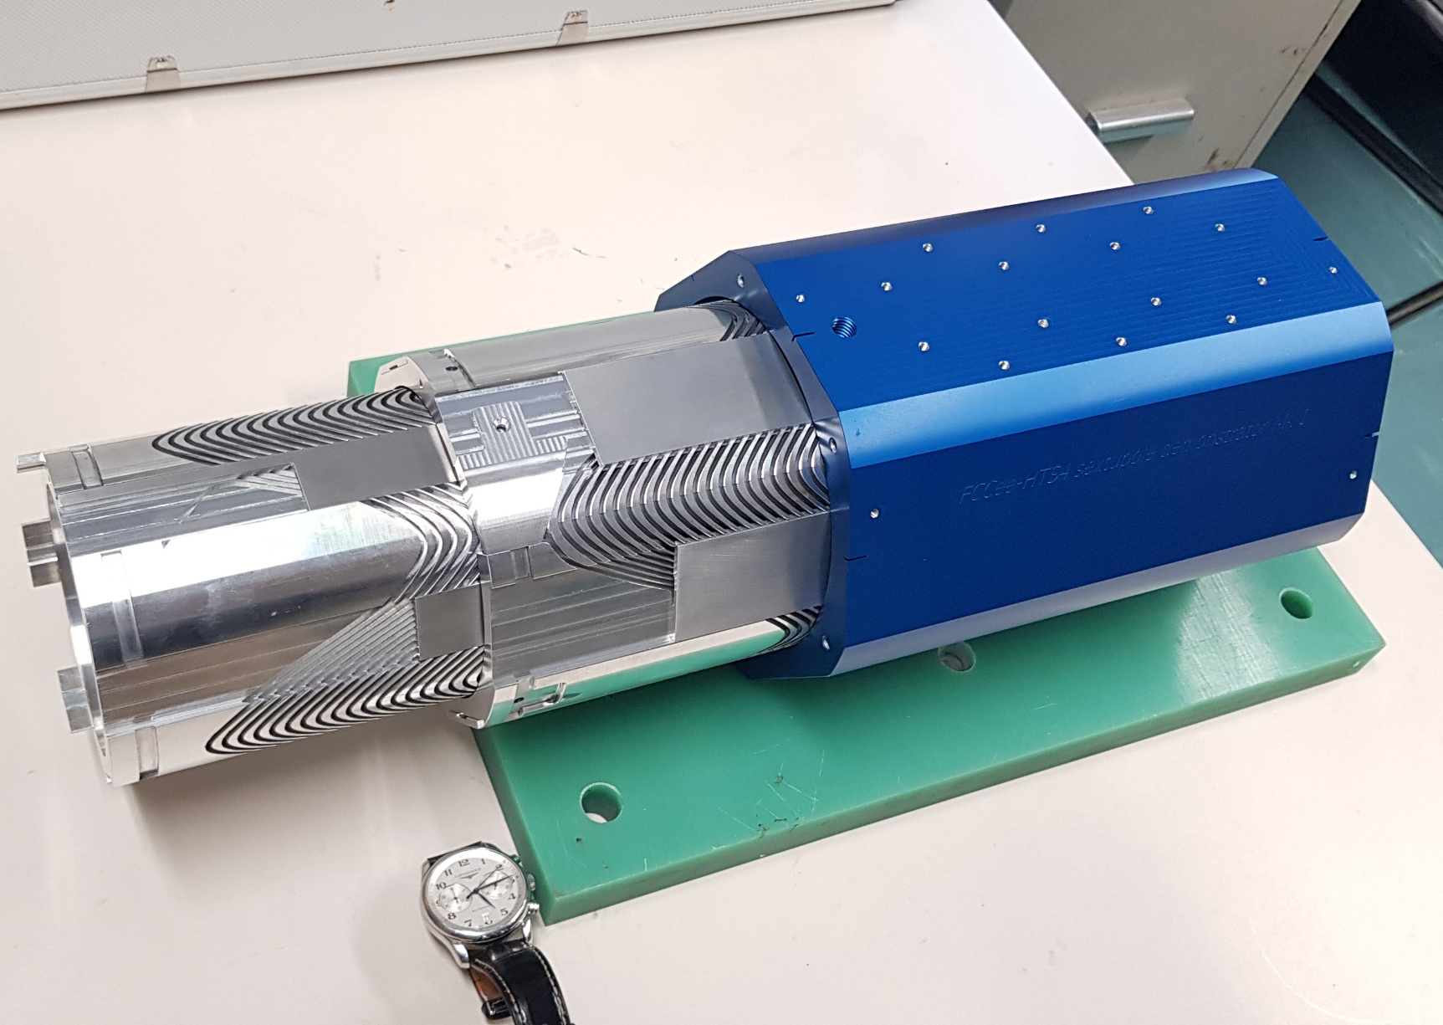
Demonstrator news
Formers manufactured
HTS tape purchased

Slide 23
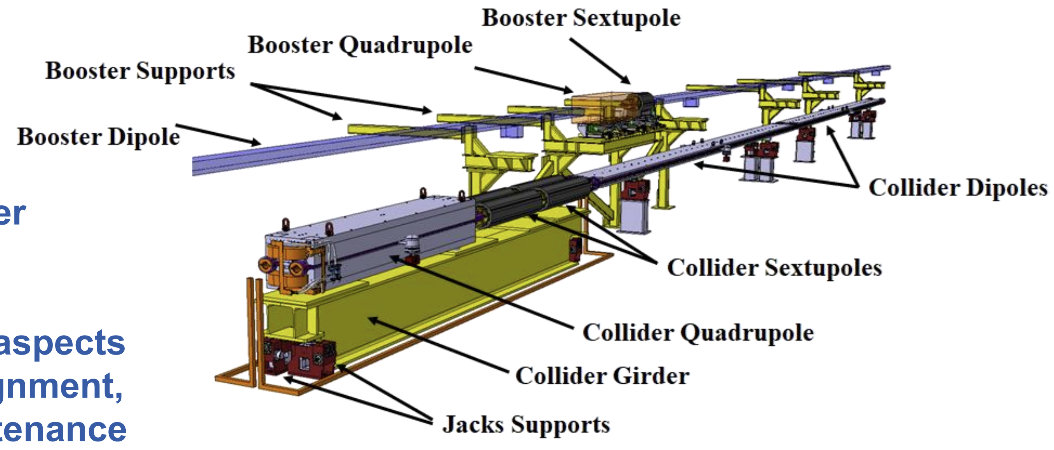
The girder and alignment
For the CDR, the quad and sextupole magnets will be mounted on a girder (in yellow, below), alignment presumably done before transportation to the tunnel.
Then the girder, as a whole, will be aligned in situ.
In the case of HTS4, the weight of the SSS is substantially reduced
Having a much lighter and nested (therefore shorter) system would greatly reduce the cost of the girder and alignment uncertainties.
The new girder will be a very simple object – an SSS cryostat mechanical support
Weights: Quad ~4T, Sext: ~1T, total weight with girder: ~10T
Tor Raubenheimer

Slide 24
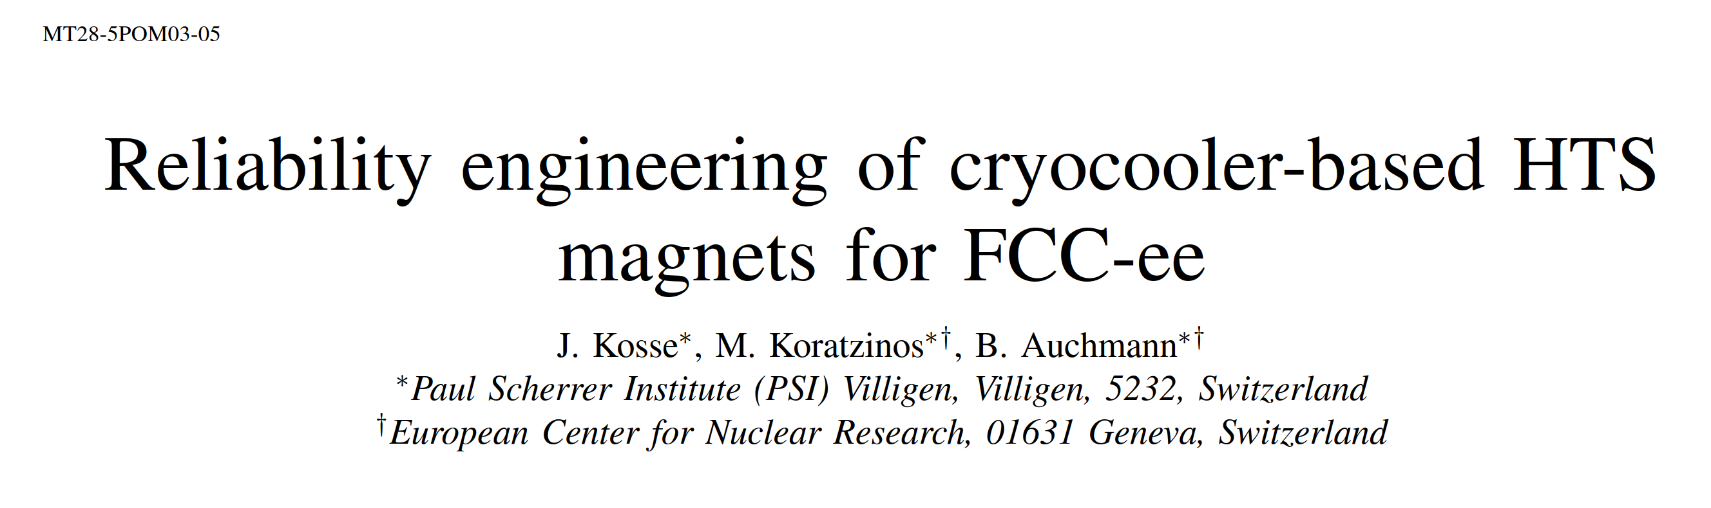
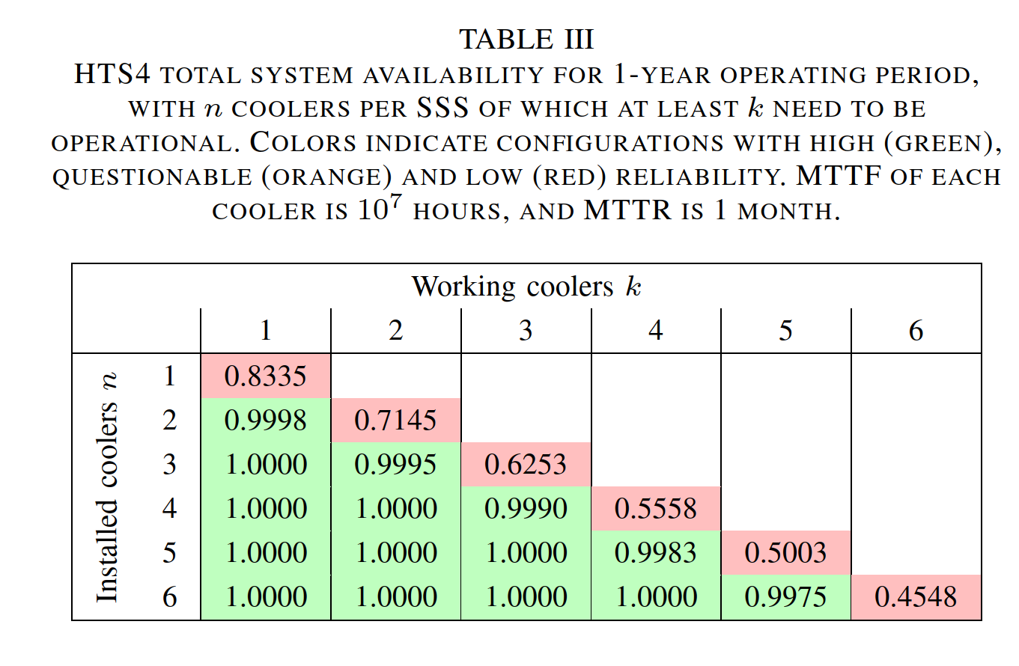
HTS4 in MT28
We are proposing a large, distributed, cryogenic system.
Availability of such a system is paramount.
(a centralized cryogenic system will also be considered)

Slide 25
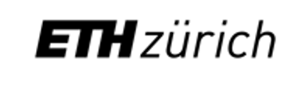

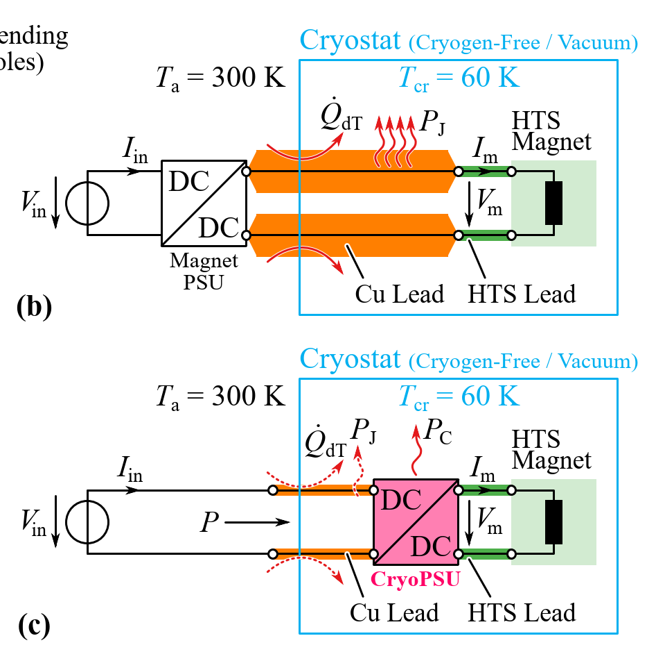
Our sister project: The idea behind FCCee-CPES
Traditional systems have a heat loss due to the copper power supply leads of ~90W/kA (two leads) see https://arxiv.org/abs/1501.07166.
Although we have pushed the current down to 250A (at the expense of more coil windings), this still corresponds to a heat budget of 45W for four current leads for the traditional approach.
By comparison, the heat load due to radiation and conduction through the feet of the cryostat are expected to be ~12W
By moving the power supply inside the cryostat and operating it at 60-70K, we need only very thin wires to the outside word (this is a DC application with long charging times).
the aim of the project is to decrease power consumption roughly five-fold.
Traditional system:
This proposal:
FCCee CPES (PES, ETHZ) Jonas Huber, Danqing Cao, Daifei Zhang

Slide 26
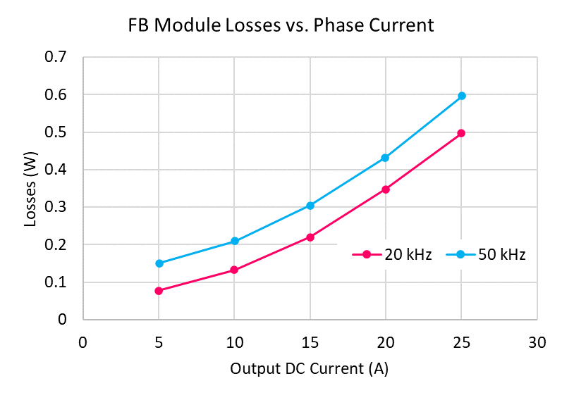
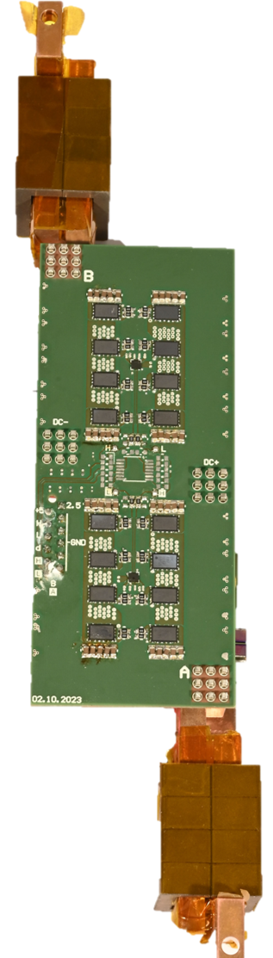
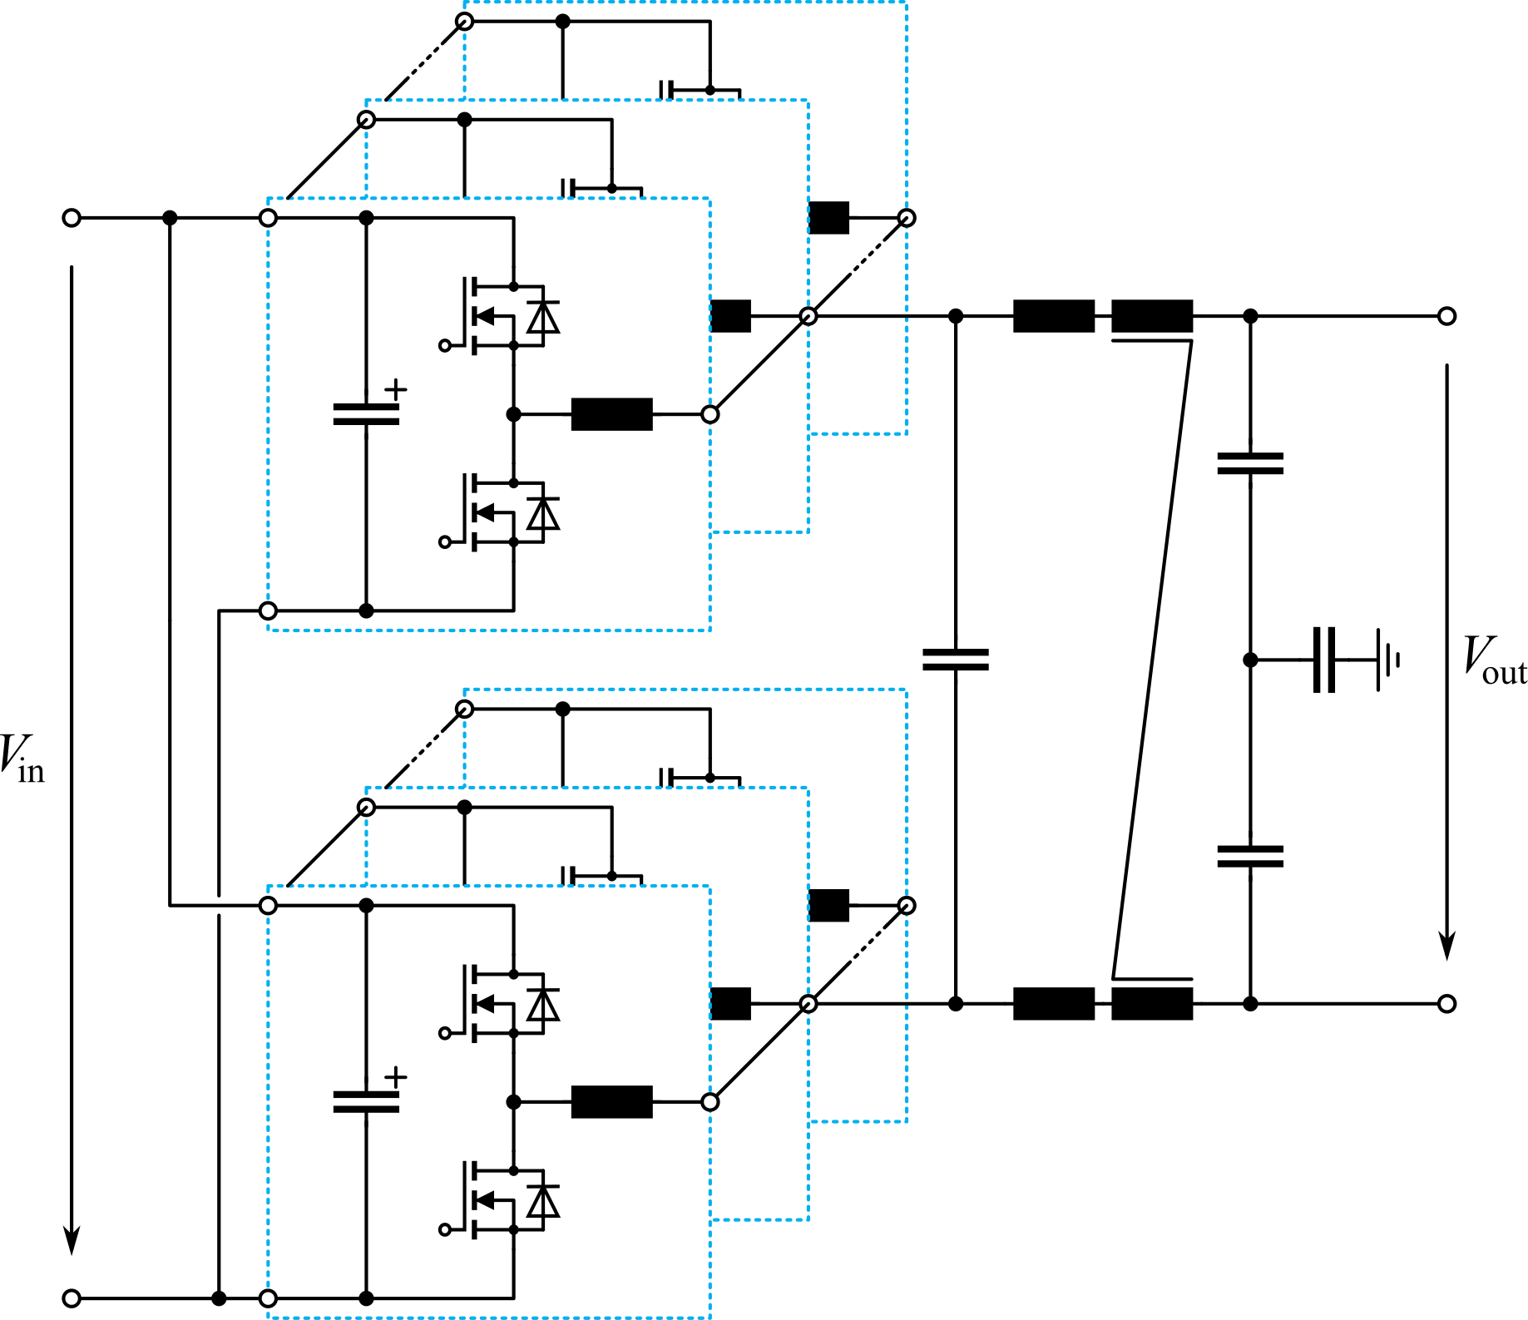
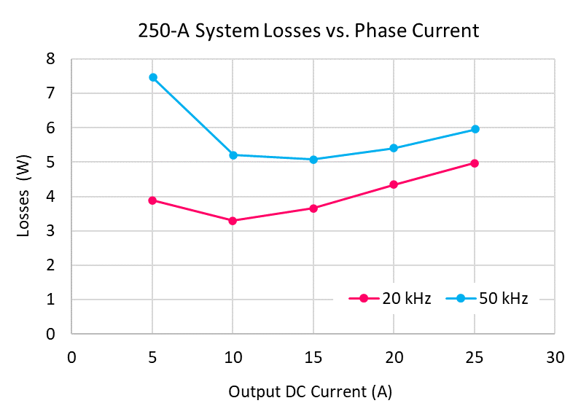
Feasibility of Cryogenic 250-A HTS Magnet PSU
First prototype results
Very encouraging first prototype measurements:
4.5W of losses in a 250A system.
Cf: the traditional approach has losses of 22.5W. This is a reduction of a factor 5
Full-bridge phase module measured in LN₂ @ 77 K
    Including gate driver and phase inductor losses, 1 V dc input
    4 parallel EPC 2302 GaN transistors (100 V, 1.8 mΩ @ RT) per position
    Optimizations of PCB losses, etc. ongoing
20 A:
347 mW
± 4.2 mW
Full-Bridge
Phase Module
12 Phases
4.46 W
25 Phases
3.29 W
250-A system: 4.46 W ± 0.05 W
    Estimated based on 12 phase modules @ 21 A each
    6 W loss budget leaves 1.5 W for residual leak-in losses,
    EMI filter, and control electronics
    Benchmark: 22 W leak-in losses for external (warm) PSU and 60 K cryostat temp.

Slide 27
Conclusions
The idea of cold Short Straight Sections has substantial benefits in reducing power consumption and cost, while increasing the performance and flexibility of the accelerator.
The FCCee-HTS4 project aims at demonstrating that this idea is feasible using HTS ReBCO conductors.
Our sister project FCCee CPES goes a step further and aims to reduce cooling costs by developing a power supply that will operate at cryogenic temperatures – first results encouraging.
These projects will increase the sustainability credentials of FCC-ee and increase its performance and relevance to society.

Slide 28
Thank you

