Slide 1
HEP Cool Copper Technology Studies
High Energy Physics 2024 (HEP2024)，Mini workshop
Jingru Zhang
On behalf of linac group, Institute of High Energy Physics, CAS
2024.01.18

Slide 2
Outline
1
Introduction
2
R&D of the C-band cryogenic copper structure
3
R&D of the cryostat and high power test bench
4
Summary

Slide 3
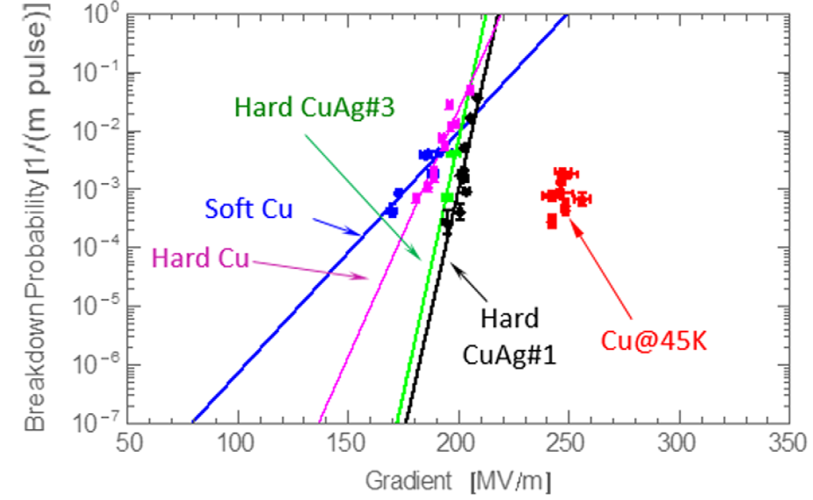
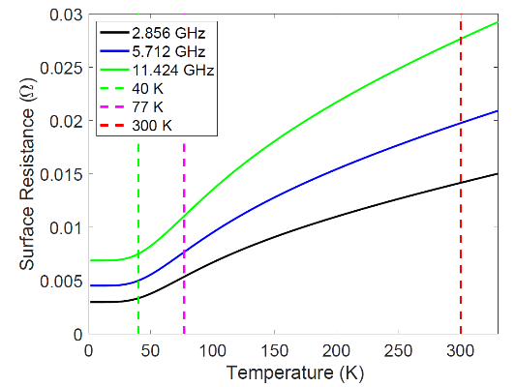
Introduction
High accelerating gradient operation is the forefront of research on accelerators
  For large scientific installations, reducing costs, such as high-energy colliders, FELs, etc.
  For functional devices, saving space, miniaturizing equipment, and diversifying functions, such as medical accelerators, etc.
One limiting factor for high accelerating gradient operation is RF breakdown
  The usual method is to use harder materials for the acceleration structure, and another method is to operate at low temperatures
Low temperature operation
  That can increase the hardness of the material, thereby reducing surface deformation and reducing the number of breakdowns
  At the same time reduce surface resistance, thereby increasing Q value and shunt impedance
A. D. Cahill, et al., PRAB 21, 102002 (2018)
A. Cahill, et al, IPAC MOPMW038 (2016)
Mei Bai, et al., SLAC-PUB-17629, 2021

Slide 4
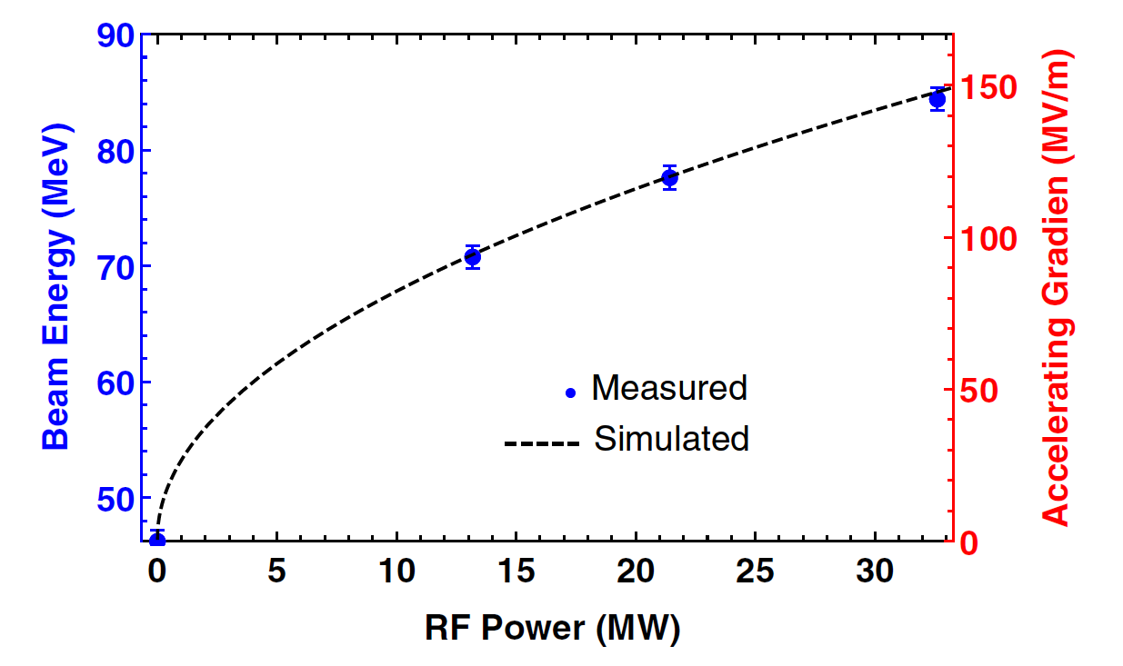
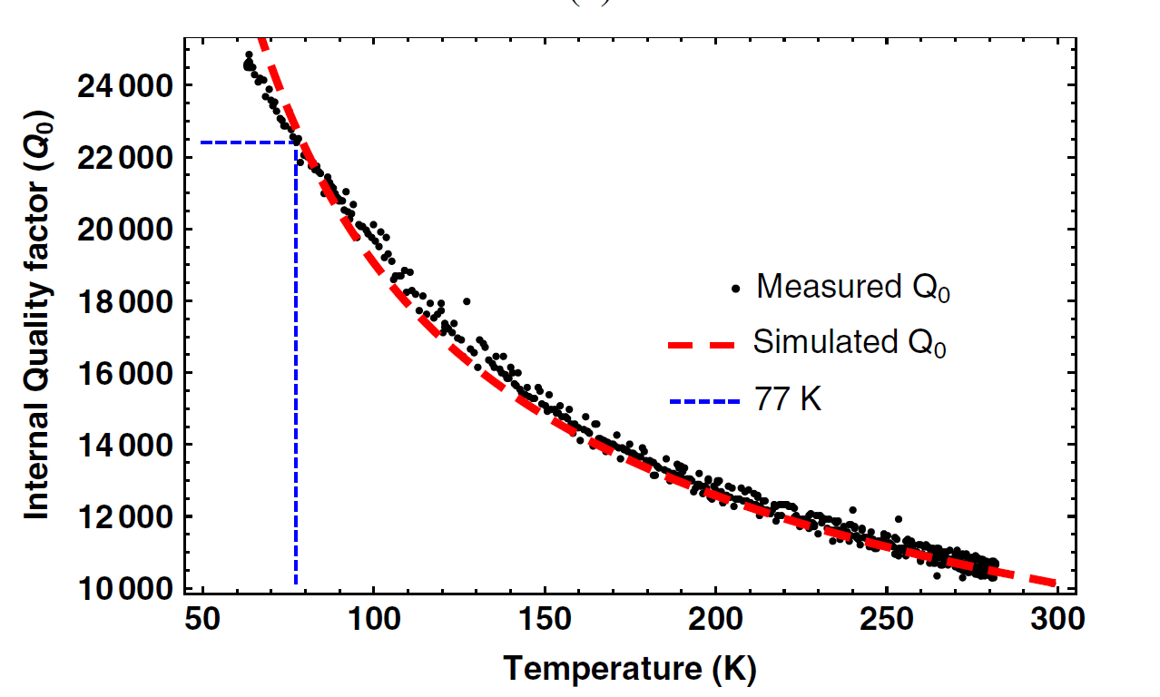
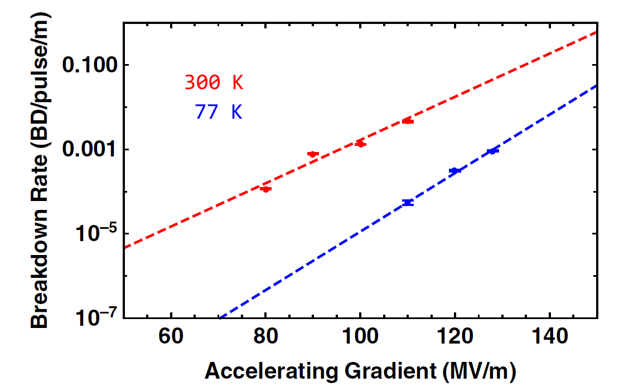
Research history of cold copper structure
Verified Q value improvement and lower breakdown rate of the structure
1985
1993
2016
2017
2020
2021
Varian
Russia，MEPI
Japan, SOKENDAI
USA, UCLA, SLAC
USA，SLAC
USA，SLAC
S-band, 77K, 1 cell, Q~2.7
  X-band, 77K, 1 cell, Q~2.5, 50MV/m
C-band, 20K, High power, 1.3m, 30.9MV/m@1μs
  X-band, 45K, 1 cell, 250MV/m, Low BDR, Q₀ ↘@>150MV/m
  X-band, New Structure, 300K, 20 cell, beam test 140MV/m
  X-band, 77K, 20 cell, beam test 150MV/m，Q~2.25, 2 order of BDR lower
Mamdouh Nasr ,et al., PHYSICAL REVIEW ACCELERATORS AND BEAMS 24, 093201 (2021)

Slide 5
High energy XFEL
C. Meng
A new high energy XFEL scheme based on a low-temperature accelerator physics has been studied
High energy XFEL | High energy XFEL | RF gun | RF frequency | Electron energy | Repetition rate | temperature | Average Bunch Repetition rate | Max. Bunch Repetition rate | Accelerating gradient | length | Light time
 |  |  |  | GeV | Hz |  | Hz | Hz | MV/m | km
US | LCLS | Cu RF | S-band | 14.3 | 30 | NC | 120 | 120 | 20 | 1.0 | 2009
 | LCLSII(HE) | VHF Gun | L-band | 4~8 | 120 | SC | 0.93 M | 0.93M | 16 | 0.7 | 2023
DE | EuroXFEL | Cs2Te L-band gun | L-band | 17.5 | 10 | SC | 27 k | 5M | 20 | 1.7 | 2017
CH | SwissFEL | Cs2Te-Cu photo RF | C-band | 5.8 | 100 | NC | 100 | 100 | 28 | 0.4 | 2017
JR | SACLA | Thermionic | C-band | 8 | 60 | NC | 60 | 60 | 38 | 0.4 | 2011
KP | PAL-XFEL | Cu photo RF | S-band | 10 | 60 | NC | 60 | 60 | 27 | 0.7 | 2016
CN | SHINE | VHF Gun | L-band | 8 | CW | SC | 1 M | 1M | 16 | 1.4 | Cons.
 | CryoXFEL | Cu photo RF | C-band | 20 | 100 | LC | 20 k | 119M | 90 | 0.4 | /

Slide 6
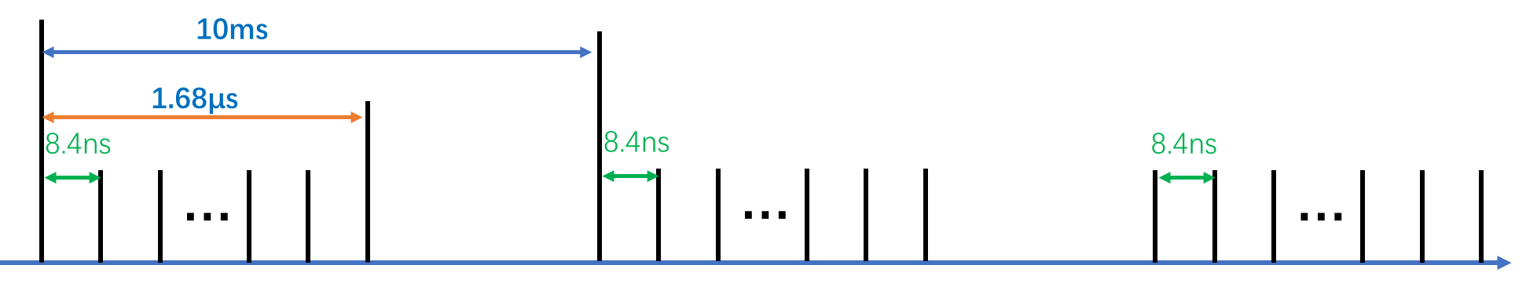
High energy XFEL based on a low-temperature accelerator
Advantage of the design
  High energy: the highest acceleration gradient, most compact
  High repetition rate: The average repetition rate is much higher than that of room-temperature structures, comparable to the European XFEL
  Burst Mode:
    the highest bunch repetition rate (reaching hundreds of MHz), about 25 times that of existing facilities like the European XFEL
    it can reduce the average power and avoid thermal accumulation effects
  Bunch charge: 100pC ~250pC

Slide 7
High energy XFEL based on a low-temperature accelerator
RF power saving
  For collider case, more severe beam loading, the advantages become more pronounced
C-band CCA
C-band NCA
One klystron(80MW) drive two accelerating structure
  Accelerating gradient is 90 MV/m
  Accelerating length is 1 m
  Energy gain is 180MeV
20GeV Linac (with 10% backup)
  125 klystrons
  Accelerating length 250m
One klystron drive two accelerating structure
  Accelerating gradient is 25 MV/m
  Accelerating length is 1.8 m
  Energy gain is 90 MeV
20GeV Linac (with 10% backup)
  250 klystrons
  Accelerating length 900m

Slide 8
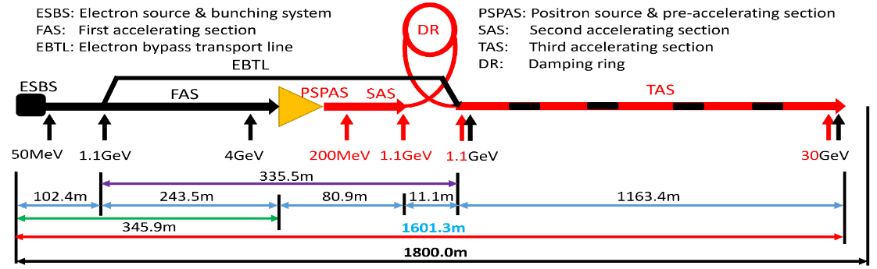
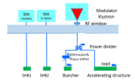
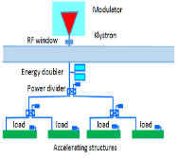
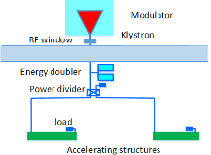
The CEPC linac RF system TDR baseline design
The gradient of the 30 GeV linac normal conducting structures
  S-band, 80 MW klystron
    1-1(ESBS), 1 accelerating structure, 22MV/m
    1-4 (FAS), 21 sets(6+15), 84 standard accelerating structures, 22MV/m
    1-2(PSPAS), 8 sets, 16 big hole accelerating structures, 22MV/m
    1-2(SAS), 4 sets, 8 accelerating structures, 27MV/m
  C-band, 50 MW klystron
    1.1GeV-30GeV, 1-2(TAS), 235 sets, 470 accelerating structures, 40MV/m
Parameter | Unit | S-band |  | C-band
Frequency | MHz | 2860 |  | 5720
Length | m | 3.1 | 2.0 | 1.8
Cavity mode |  | 2π/3 |  | 3π/4
Aperture | mm | 19~26 | 25 | 12~16
Gradient | MV/m | 22/27 | 22 | 40
Cells (include coupler cells) |  | 86 | 55 | 89
Number of Acc. Stru. |  | 93 | 16 | 470
Number of Klystron |  | 33 |  | 236
Klystron Power | MW | 80 |  | 50
S-band
C-band
High gradient will reduce the length of the linac

Slide 9
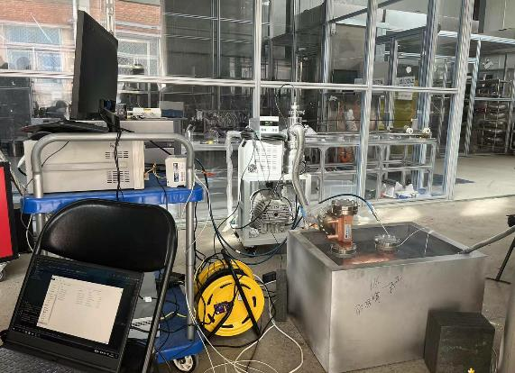
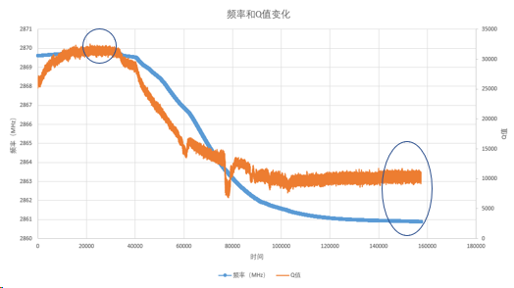
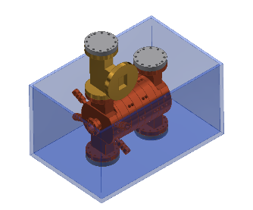
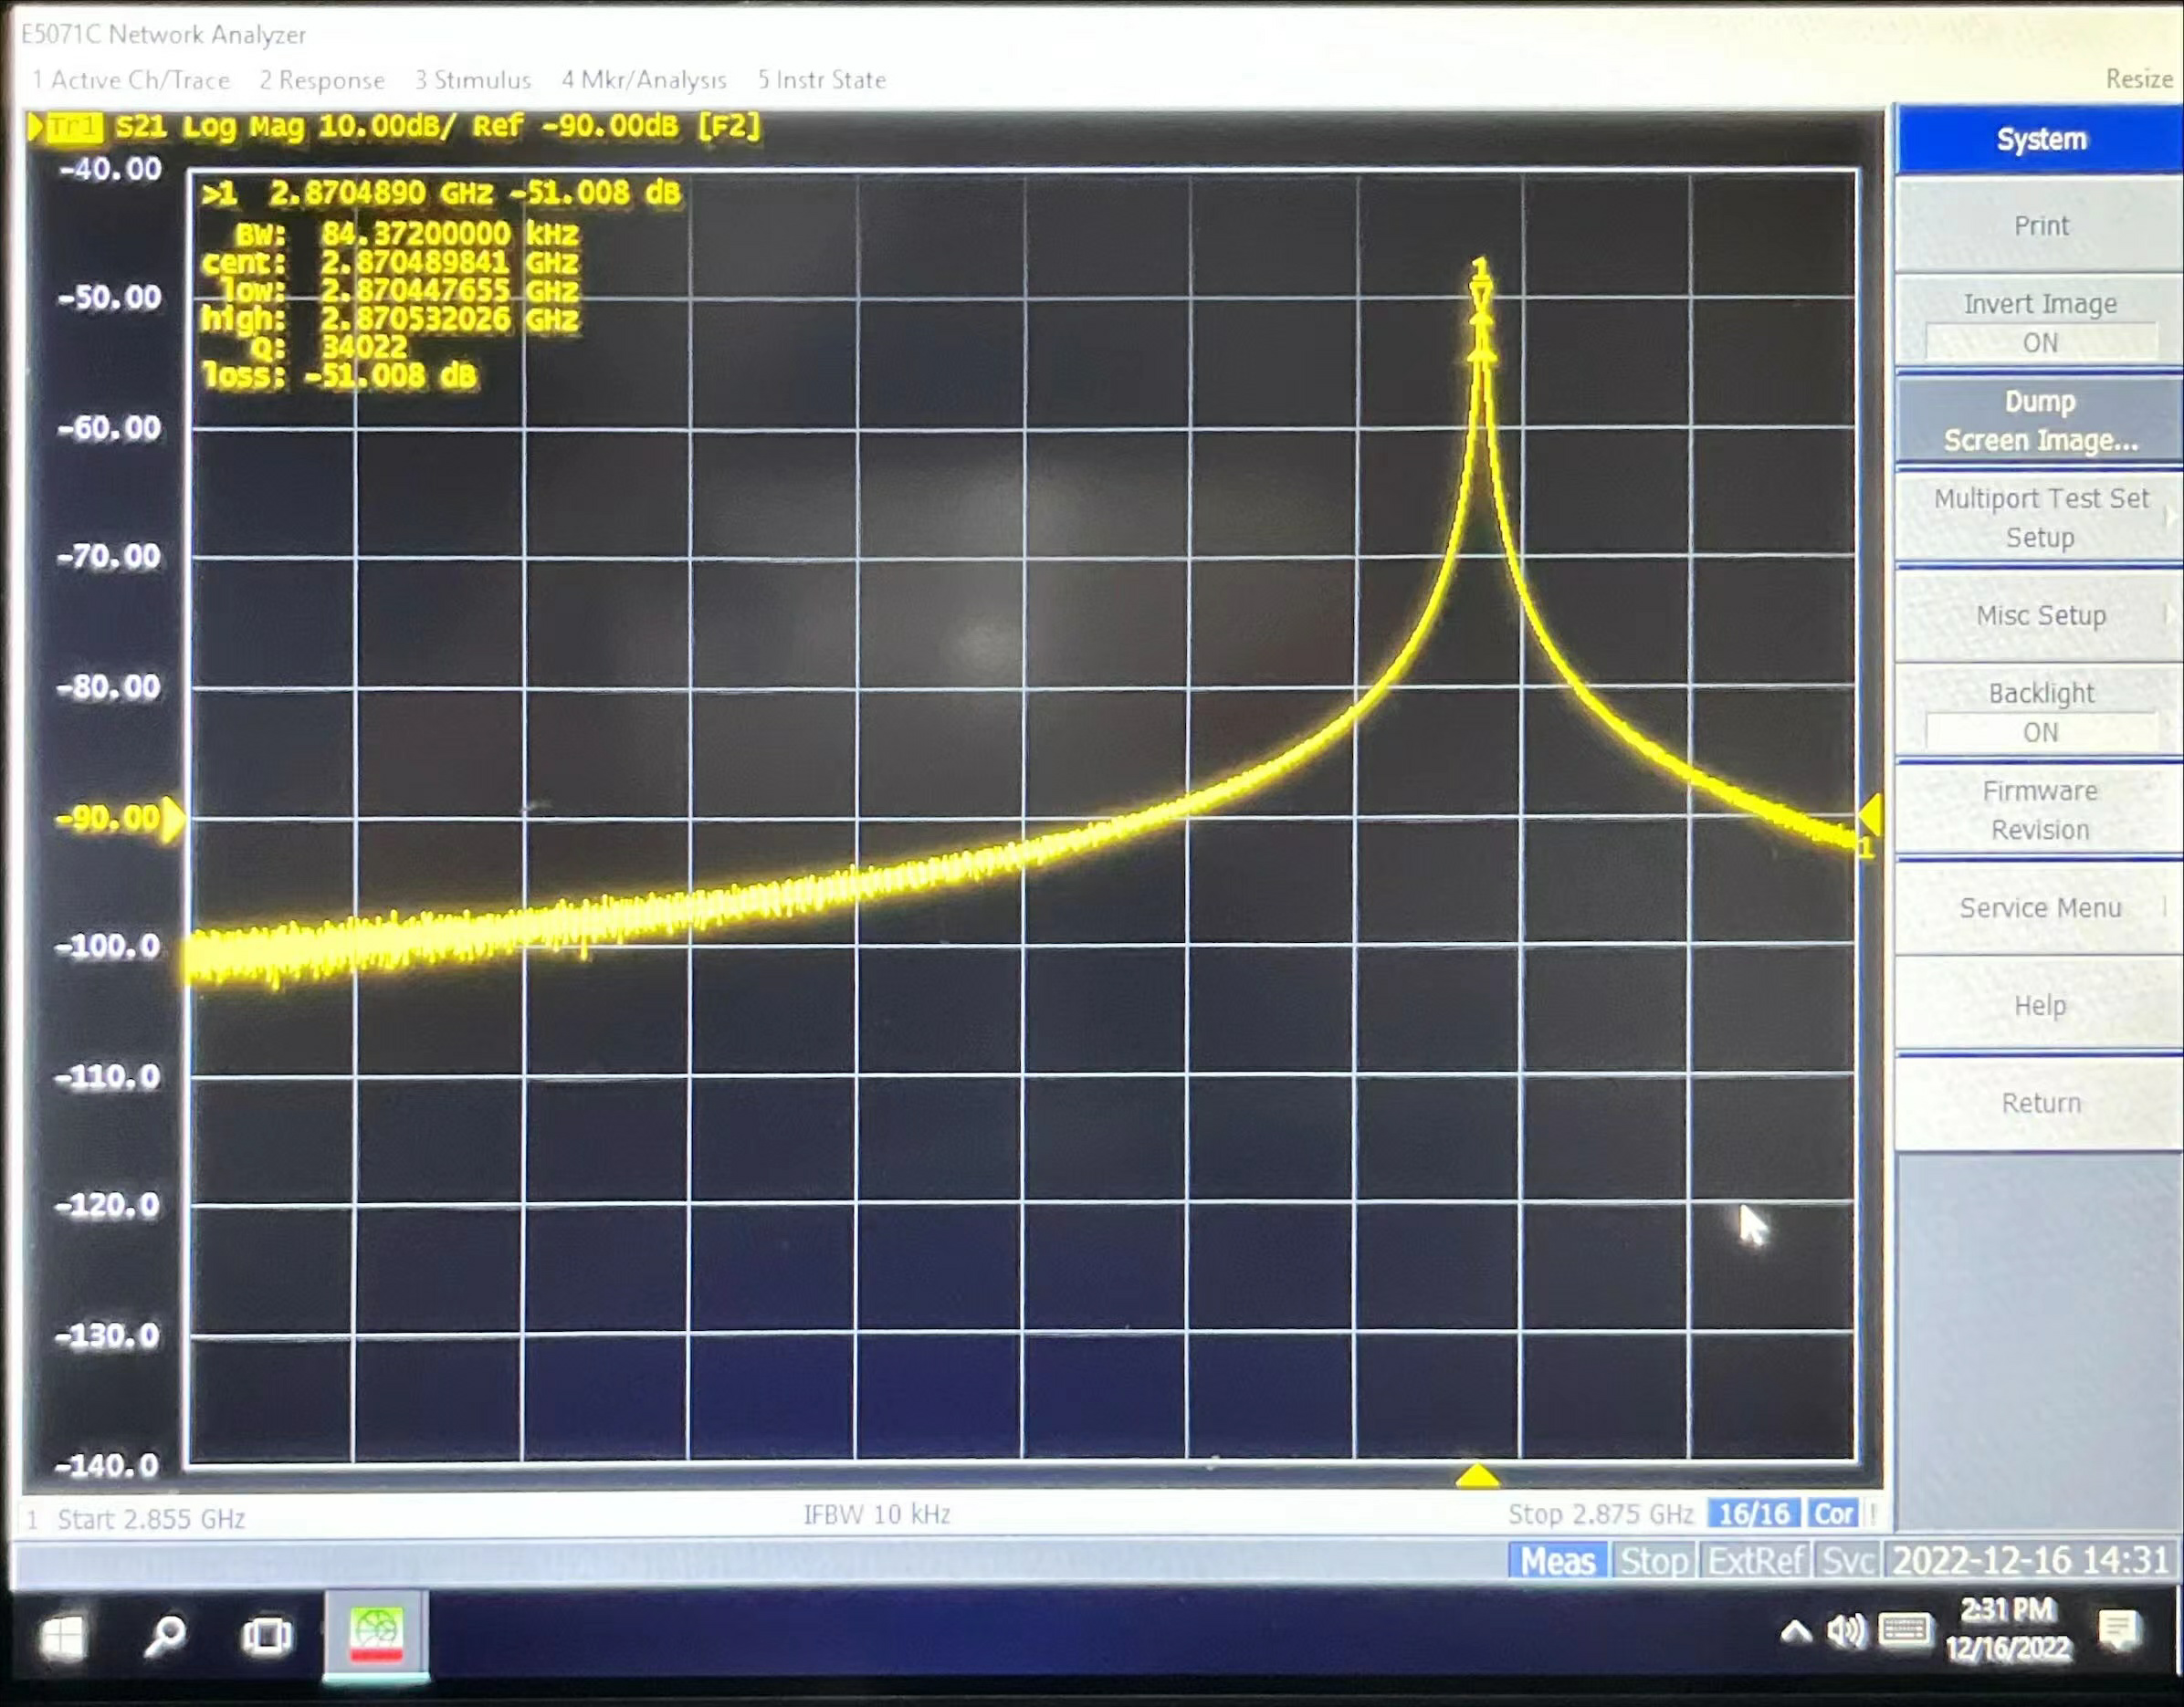
Low temperature test of an S-band structure
It is an S-band traveling wave structure with six cavities already existing in our lab
Let the temperature from 287.17k to 77.36K liquid nitrogen and naturally back to room temperature
  The frequency change is 8.478MHz (theoretical value: 8.452MHz, with a difference of 26KHz)
  Q value increases 3 times

Slide 10
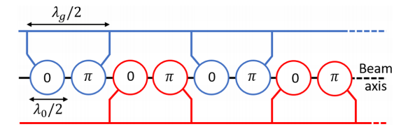
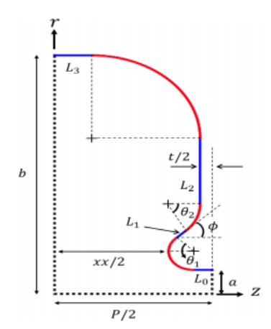
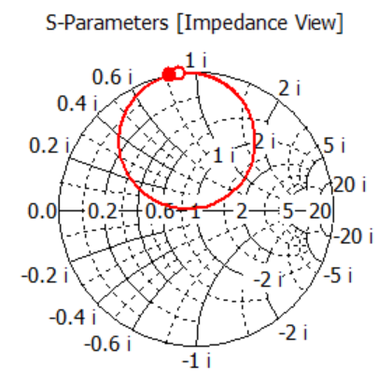
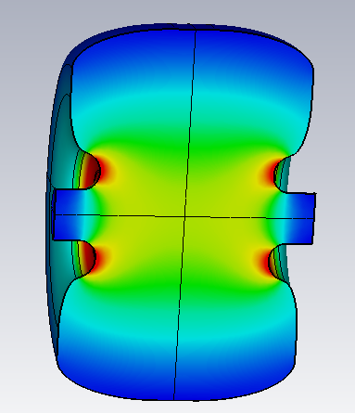
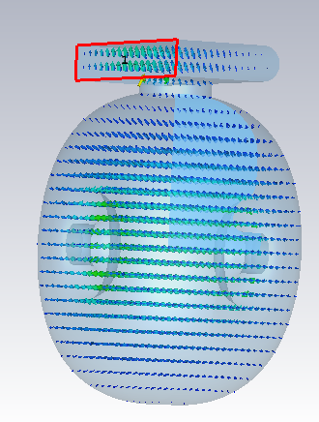
C-band parallel coupling cold accelerating structure design
The beam diameter: a=0.05*λ₀
Coupling coefficient
  β=1
Cavity optimization

Slide 11
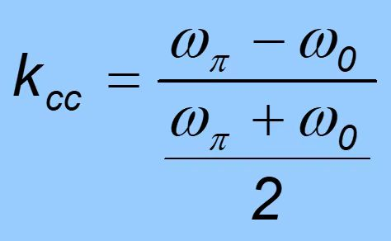
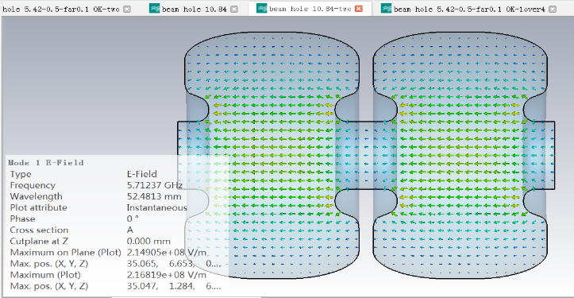
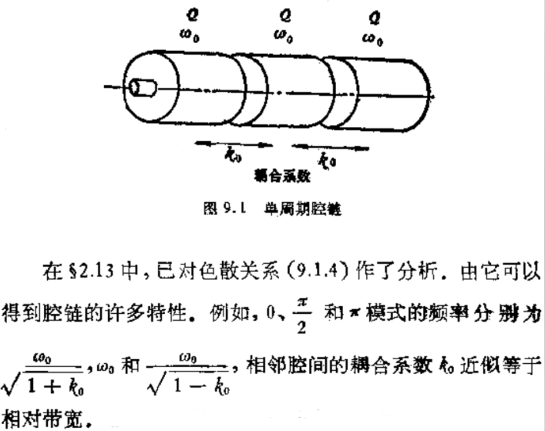
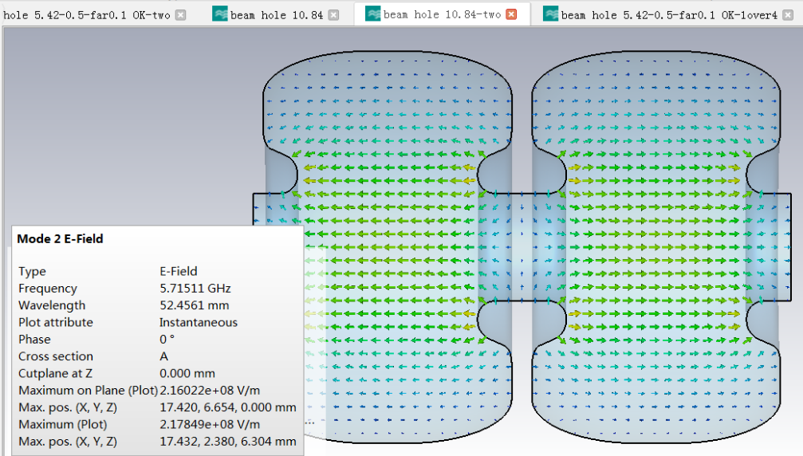

C-band parallel coupling cold accelerating structure design
Coupling between cavities
  Super conducting cavity (~2%)
  k₀$=\frac{ωπ2−ω02}{ωπ2+ω02}$ （~1.1%-3%）
  The calculation results of the two definitions are consistent
0 mode
Pi mode
 | f0 | fpi | formula1 （%） | formula2 (%)
a=0.05*λ₀ | 5712.3 | 5712.31 | 0.000245 | 0.000245
a=0.1*λ₀ | 5712.37 | 5715.11 | 0.048 | 0.048

Slide 12
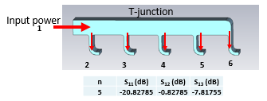
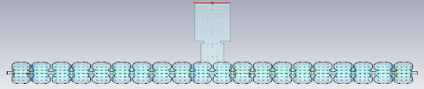
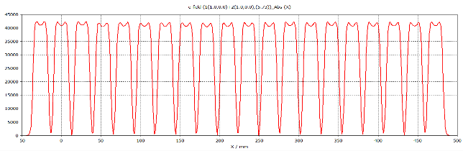
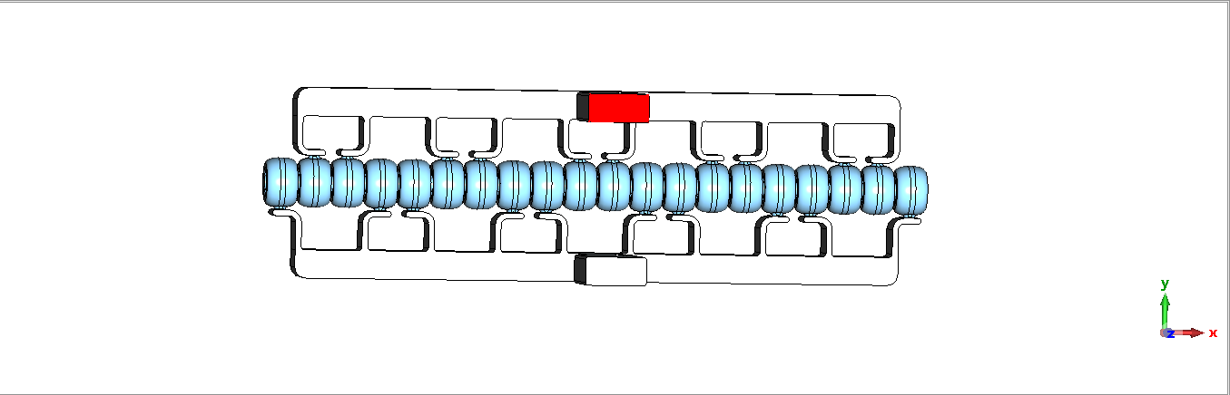
C-band parallel coupling cold accelerating structure design
Parallel coupling design for 20 cavities
Each manifold input power to one cavity
Field distribution along axis

Slide 13
The compare with the normal temperature structure
40MW C-band power source high power test bench is built, 2MW for each cavity at the test bench
The gradient can reach 156MV/m for 20 cells cavity theoretically
Parameters | Value
Type | standing wave | travelling wave
Temperature | 77K | 30°C
Frequency (MHz)@77K | 5712 | 5712
Mode | π | 3π/4
Cavity numbers | 20 | 89
Shunt impedance (MΩ/m) | 303 | 66
E₀/Es | 2.42 | 2.57
Q₀ | 31905 | 11500
Filling time(us) @90% | 2.2 | 0.35
Gradient (MV/m)@40MW | 156 (20 cavities) | 31 (89 cavities)

Slide 14
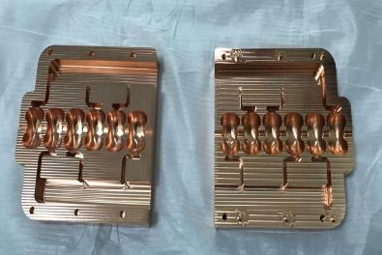
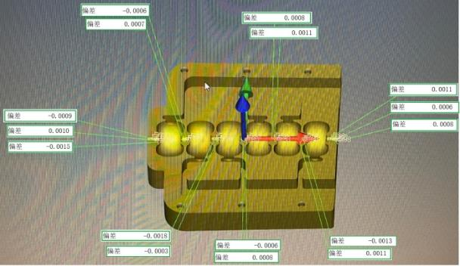
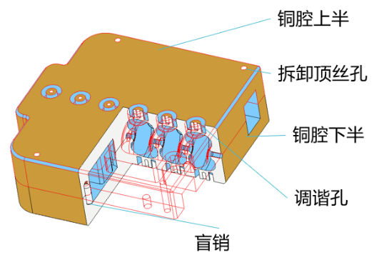
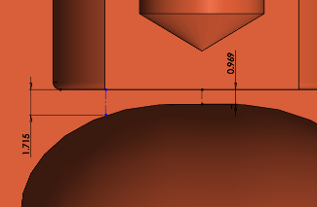
Progress of cavity manufacture
Before the whole structure machining, 6 cells test cavity is manufactured to verify machining accuracy and check the tuning range of the tuner
The maximum profile tolerance error is about 5um
Tuning range:-7MHz-2.5MHz
1
6
6
1

Slide 15
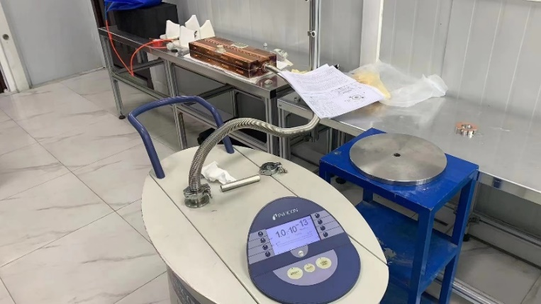
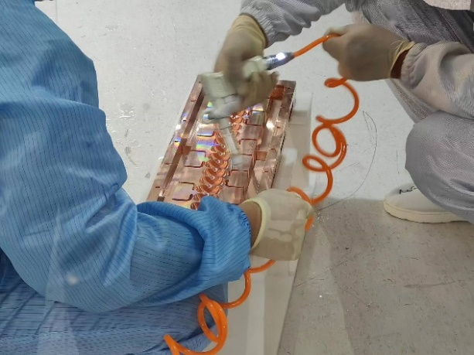
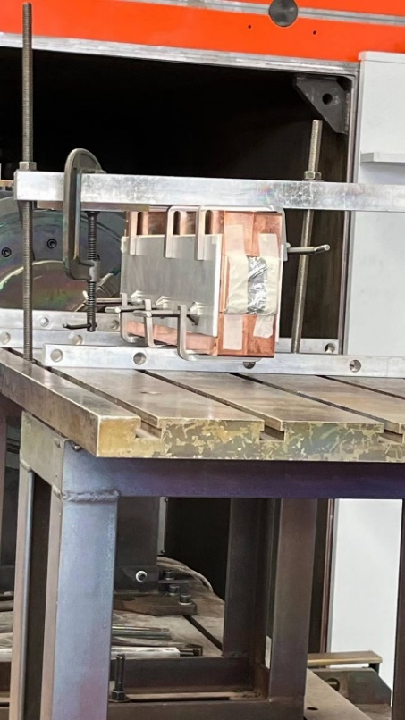
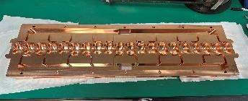
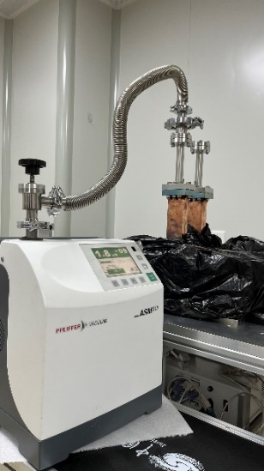
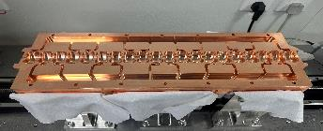
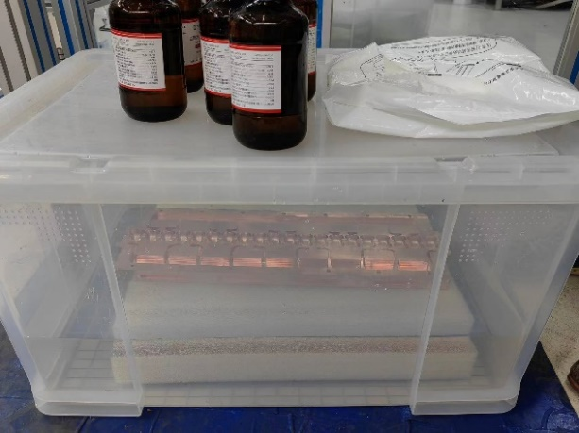
Progress of cavity manufacture
The cavity cleaning, EBW, vacuum leak detection for the first prototype (Cold Copper Accelerating Structure-I)
Two half of the structure
Cleaning
Electron Beam Welding
Leakage rate：3.5*10⁻¹¹Torr*l/s

Slide 16
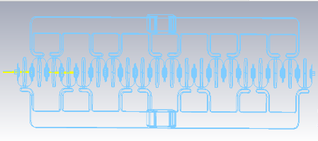
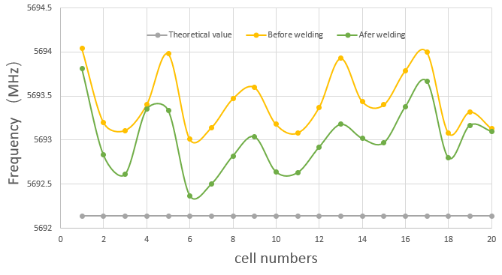
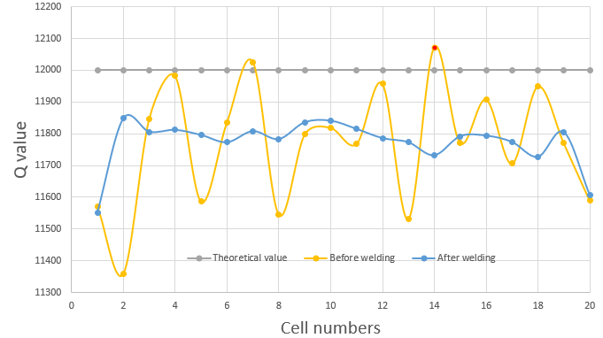
Frequencies before and after EBW
Using probes to measure the frequency of each cell
After welding the frequency is a little decrease but in the tuning range

Slide 17
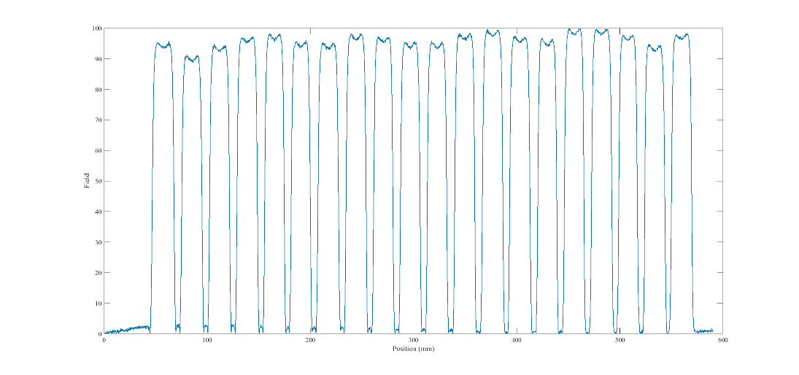
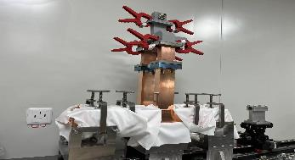
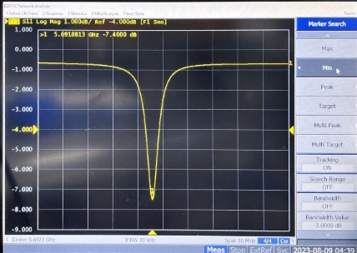
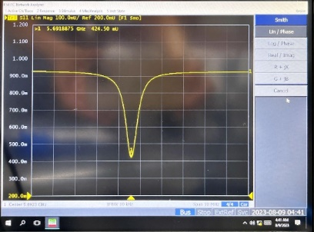
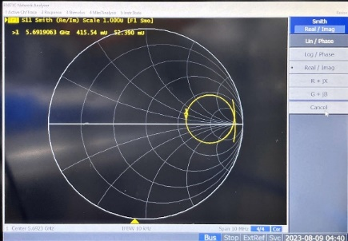
Cold test results after tuning
Each cell frequency error is in ±15kHz
The flatness of the field distribution is more than 90%
Field distribution
Room temperature measured S-parameters

Slide 18
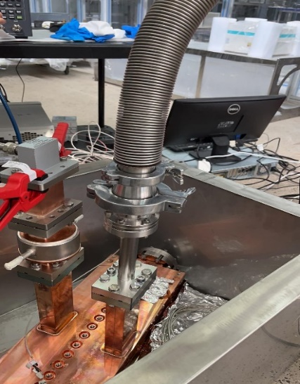
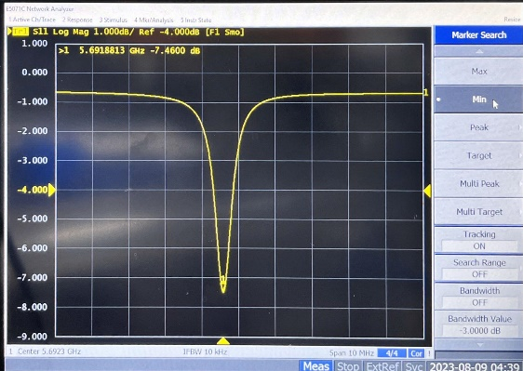
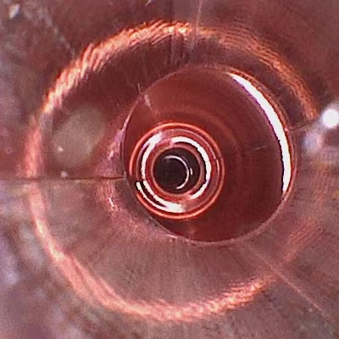


The problems we have encountered in CCAS-I
Vacuuming and cold temperature experiment
  It is connected to a network analyzer and measurement S11 while vacuuming
  We found that the waveform was deformed after vacuuming. That means the 20 cells frequency deference is out of 15kHz and largely changed
Judging that there is little gap between the upper and lower cavities due to welding stress (although it does not affect the Q value of the measurement)
√
×
We stopped the work and waited for further research
Exploring the inner of a cavity using an endoscope

Slide 19











Measurement for the CCAS-II
RF parameters measurement of before brazing
  Half1: 5691.7553MHz,-5.6dB,0.524,3.2
  Half2: 5691.7298MHz,-5.22dB,0.548,3.42
Half1
Half2

Slide 20



Brazing for the cold structure CCAS-II
In order to figure out why the Q-value test of the cavity was correct but when vacuumed the cells deformed uneven
Use stress paper to detect the surface contact between the upper and lower cavities
  Used a micrometer to create a color chart
Discovered that the maximum and minimum points of contact between the two cavities is about 13um

Slide 21




Brazing for the cold structure CCAS-II
After comprehensive consideration, we chose the brazing method for the CCAS-II
And in this morning, the brazing is finished in a hydrogen furnace. The cavity vacuum leak rate and preliminary RF measurement are OK. The next step of brazing will be carried out （Flanges and waveguides）
Further research will continue on the two parallel coupling cold accelerating structures

Slide 22


Design of the cryostat
X.C. Yang, R. Ge
The structure is immersed in liquid nitrogen for cooling
Connected to the normal and low temperature environments through a waveguide system
The power fed into the cavity by the waveguide is mostly converted into thermal power, which is absorbed by the vaporization of liquid nitrogen
The average RF power is 5kW（40MW*2.5uS*50Hz)
The gas flow has a maximum value of 8.1L/s. The maximum pressure drop of 0.59kPa.
The liquid flow rate at the delivery junction is 168 L/h.
Vacuum Insulated Cryostat
RF Input
nitrogen vessel
Accelerating Structure
The nitrogen vessel has a 30 cm radius. The liquid depth is 20 cm. The pressure of the gas is ~1 bar .

Slide 23









Design of the cryostat
The heat load for each component
部件 | 热负荷/W
液氮池吊扣 | 0.4
液氮池支撑 | 3.6
低温接管 | 3.4
低温阀杆 | 0.9
波导过度波纹管 | 2.8
热辐射 | 0.7
信号线 | 不计
总计 | 11.8

Slide 24


Cryostat for the cold cooper accelerating structure
The cryostat is ready and waiting the structure to assemble
An aluminum materials prototype has been pre installed
Pre-installed of the cavity prototype

Slide 25





Test bench in progress
The C-band test bench located in Dongguan branch of IHEP
Modulator and klystron is in place and has been preliminary testing
Completed the debugging of low-level RF and interlocking protection system
High power test bench
Waveguide layout design
waveguides

Slide 26
Summary and future work
Higher gradient and shunt impedance will make the accelerator more efficiency. Parallel coupling cold copper structure is a good choice and new technology
C-band high power test bench, cryostat and cold copper accelerating structure are under development
The structure will be complete low-temperature experiment in liquid nitrogen. Then assembly with the cryostat
We plan to complete the installation and high-power test in June 2024

Slide 27
Thanks for your attention！

