Slide 1



CEPC Efforts Towards a Green Collider
Yuhui Li
Institute of High Energy Physics
Sep. 21, 2023
Yuhui Li
On behalf of CEPC accelerator team
IAS Program on High Energy Physics (IAS-HEP 2024)
Hong Kong, China, Jan. 8-26 (2024)

Slide 2
Content
Brief introduction to CEPC and other accelerator facilities at IHEP
  CPEC background information
  Machine layout, Research status, energy consumption, …
  BEPCII and HEPS at IHEP
Key technology R&D for a green collider
  High-Q SRF system; High efficiency klystron; Magnets and prototypes
  Plasma acceleration; waste-heat in cooling water; solar panel and clean energy
  Novel concepts
Summary

Slide 3
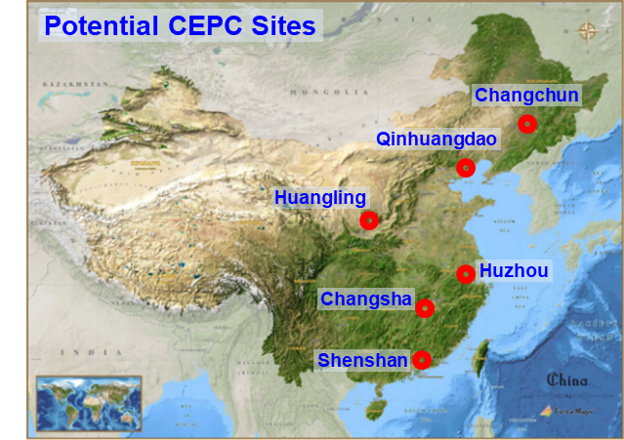
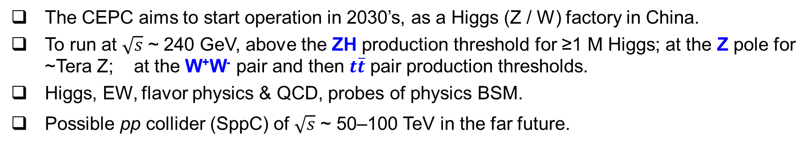

A brief introduction to CEPC
The CEPC aims to start operation in 2030’s, as a Higgs (Z / W) factory in China.
To run at $\sqrt{s}$ ~ 240 GeV, above the ZH production threshold for ≥1 M Higgs; at the Z pole for ~Tera Z; at the W⁺W⁻ pair and then $t\overline{t}$ pair production thresholds.
Higgs, EW, flavor physics & QCD, probes of physics BSM.
Possible pp collider (SppC) of $\sqrt{s}$ ~ 50–100 TeV in the far future.
IP 2
$e^{+}e^{−}$ Higgs (Z) factory
Ring length ~ 100 km
IP 1

Slide 4
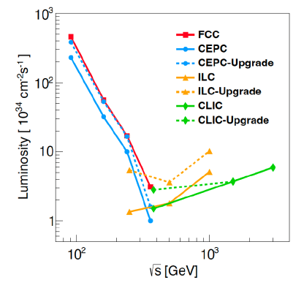
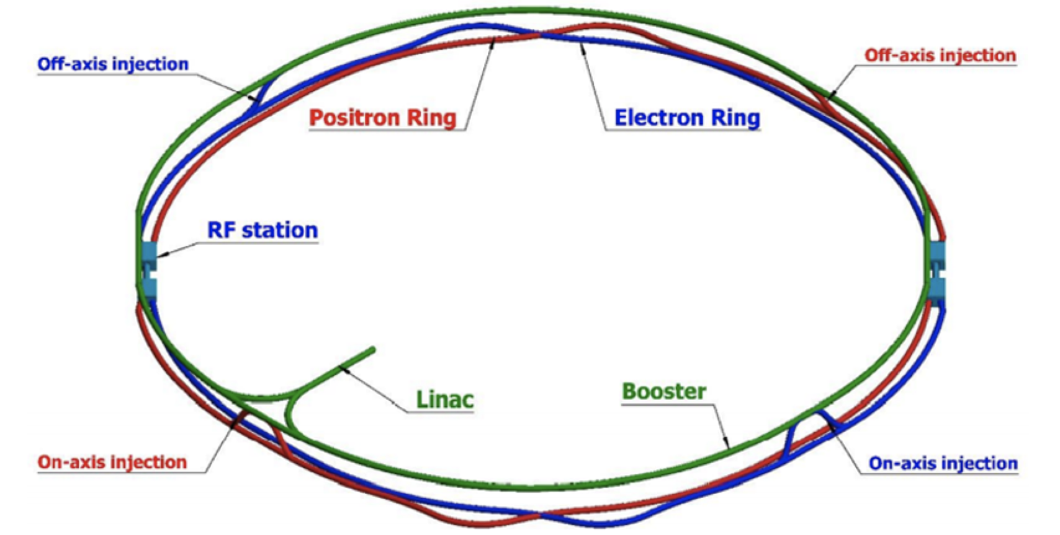
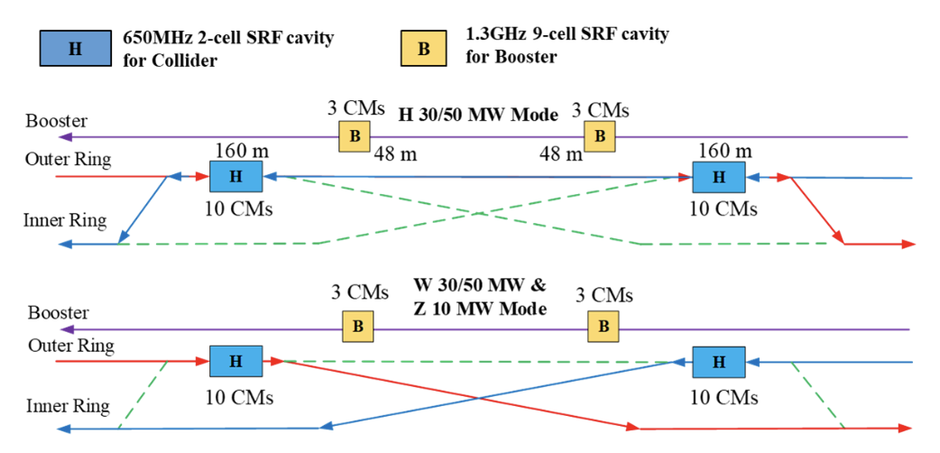
CEPC TDR design
Circular collider: Higher luminosity than a linear collider
100km circumference: Optimum total cost, good also for SppC
Shared tunnel: Accommodate CEPC booster &collider and SppC
Switchable operation: Higgs, W/Z, top
Luminosity comparison
Main Parameters: High luminosity as a Higgs Factory
 | Higgs | W | Z | ttbar
Number of IPs | 2
Circumference [km] | 100.0
SR power per beam [MW] | 50
Energy [GeV] | 120 | 80 | 45.5 | 180
Bunch number | 415 | 2161 | 19918 | 59
Emittance (εx/εy) [nm/pm] | 0.64/1.3 | 0.87/1.7 | 0.27/1.4 | 1.4/4.7
Beam size at IP (σx/σy) [um/nm] | 15/36 | 13/42 | 6/35 | 39/113
Bunch length (SR/total) [mm] | 2.3/3.9 | 2.5/4.9 | 2.5/8.7 | 2.2/2.9
Beam-beam parameters (ξx/ξy) | 0.015/0.11 | 0.012/0.113 | 0.004/0.127 | 0.071/0.1
RF frequency [MHz] | 650
Luminosity per IP[10³⁴/cm²/s] | 8.3 | 27 | 192 | 0.83
Common tunnel for booster/collider & SppC
Compatible Operation for Higgs W and Z
4

Slide 5
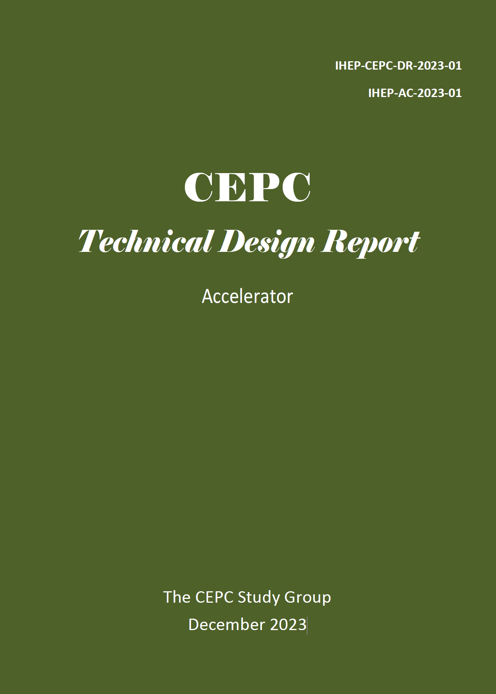
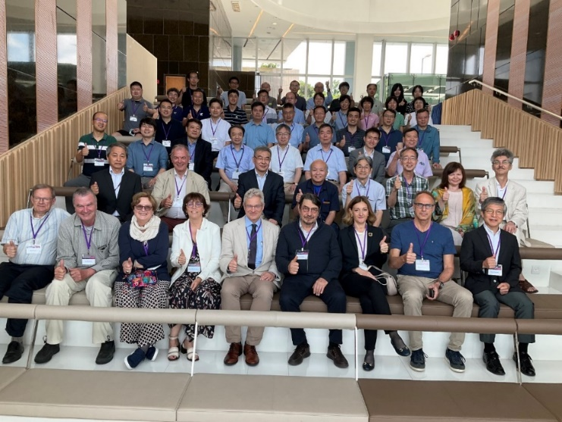
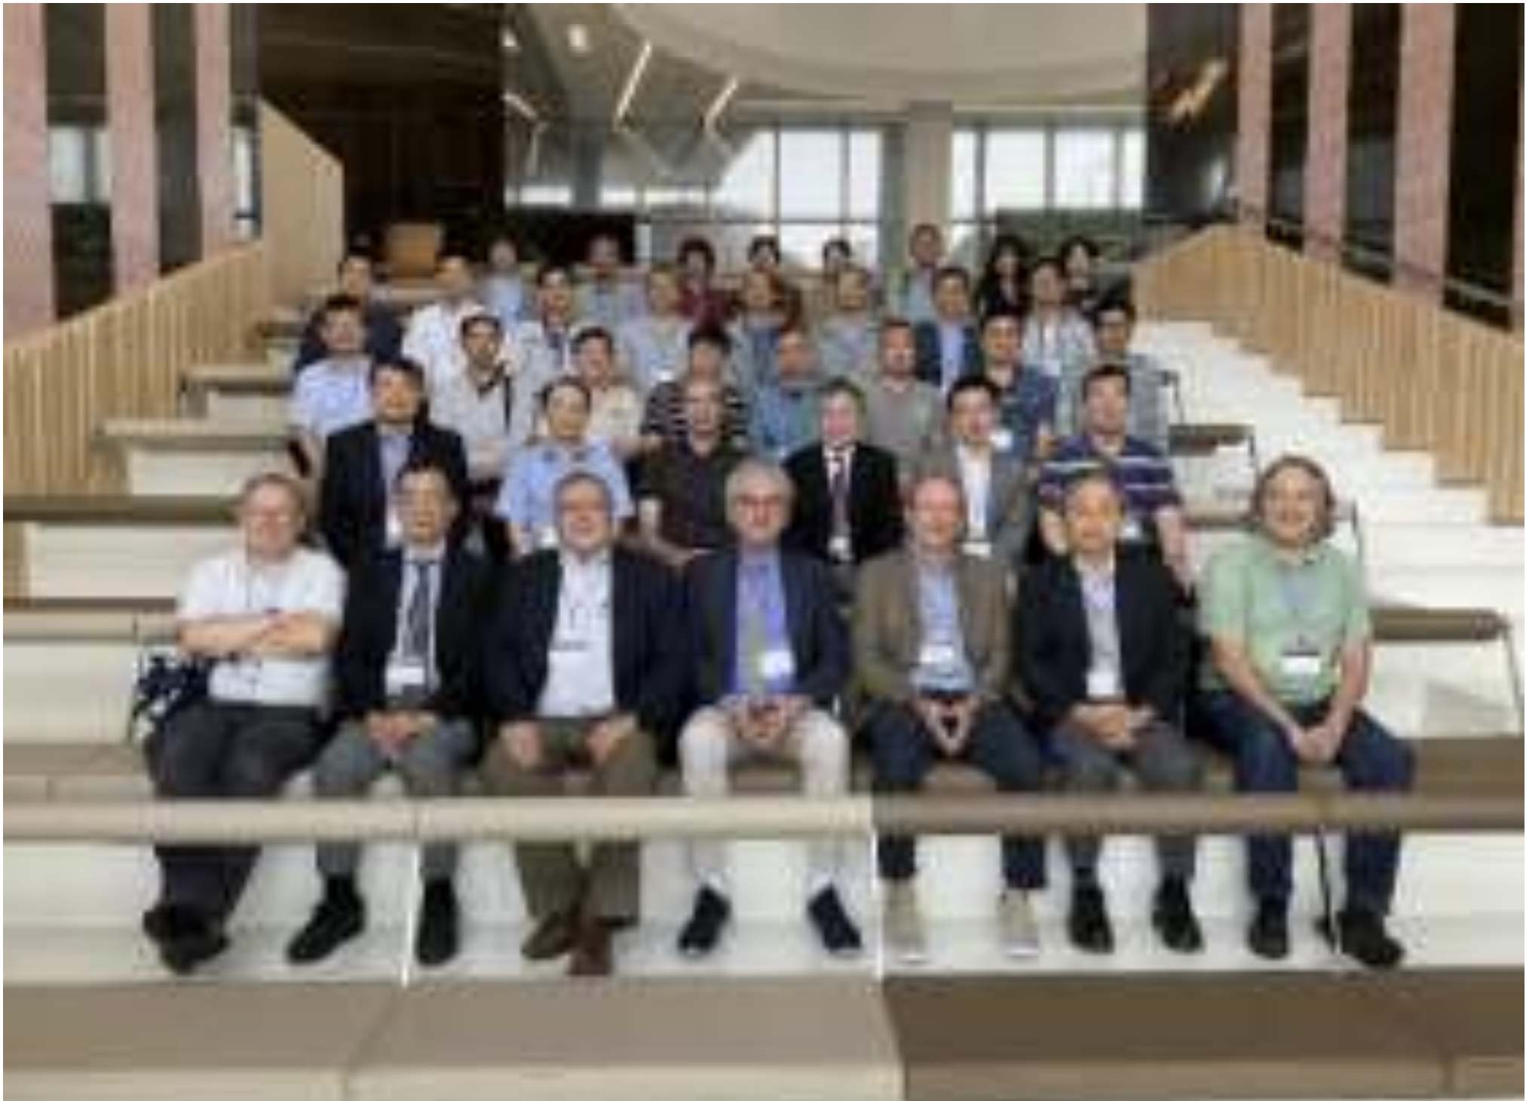
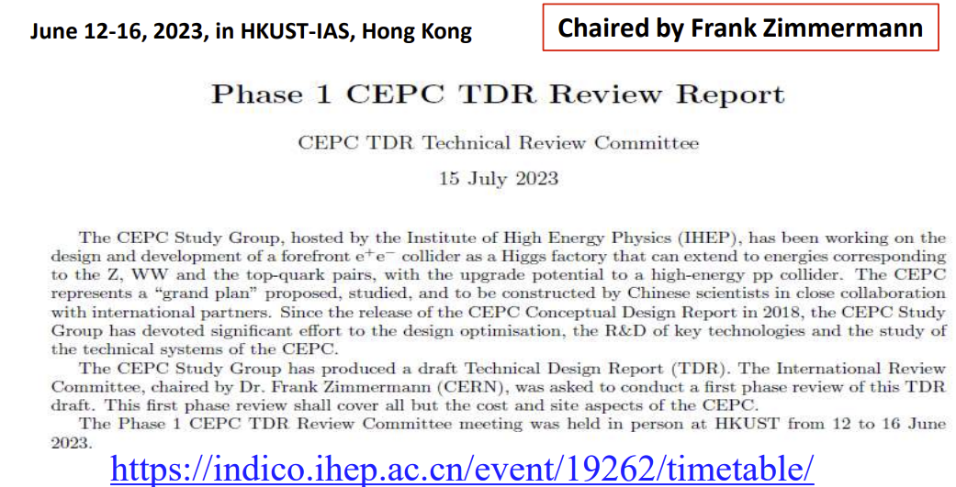
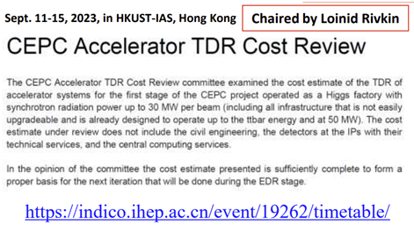
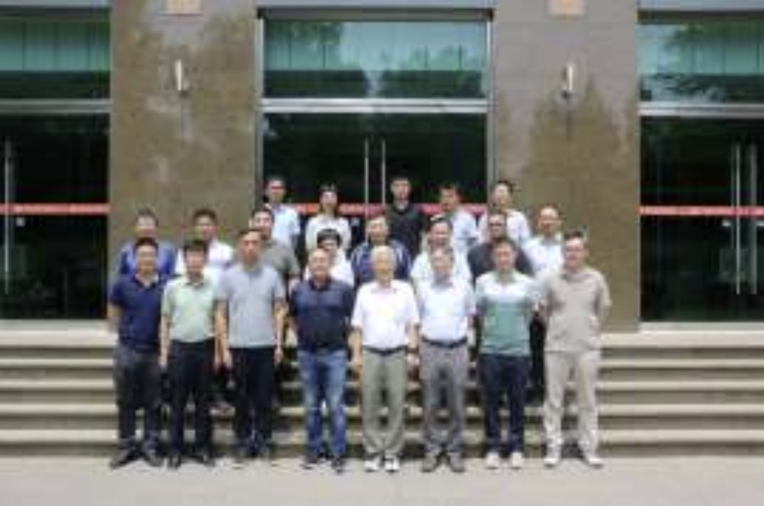
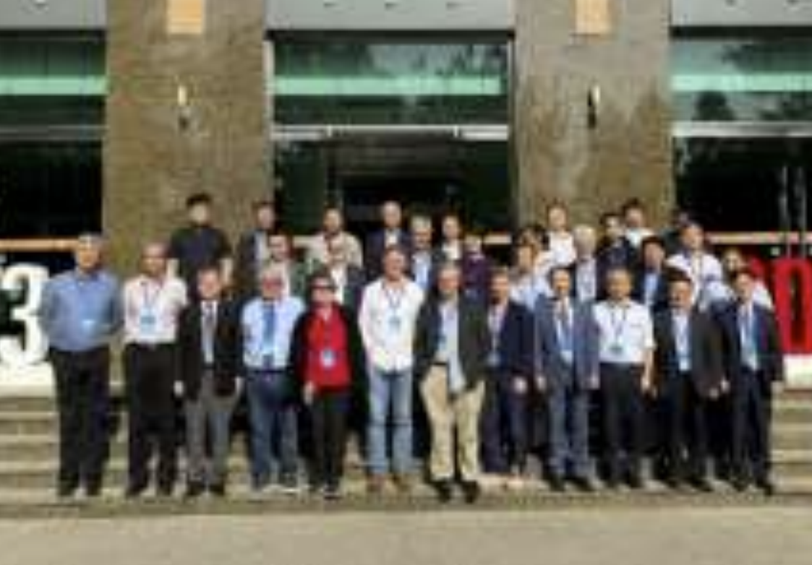
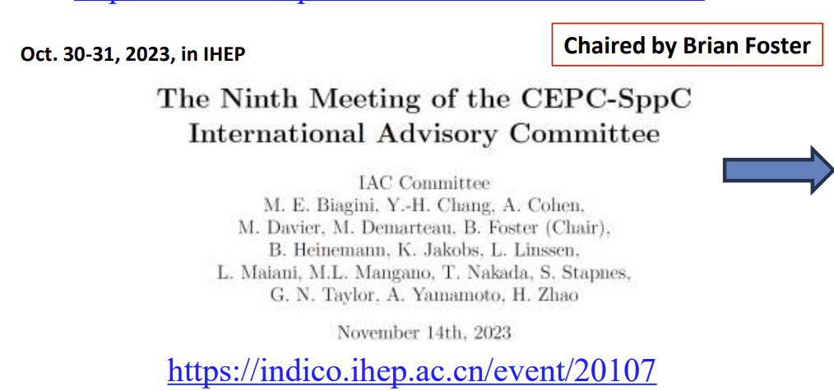
CEPC TDR international review and formal release
International TDR reviews
2023 June 12-16 ：technical review； June 26: civil cost domestic review； September 11-15 ：cost review
2023 October: CEPC International Advisory Committee meeting
Technical review
Cost review
arXiv: 2312.14363
Civil construction review
IAC meeting
基建国际评审
CEPC TDR -Accelerator formally released on 25. Dec. 2023

Slide 6
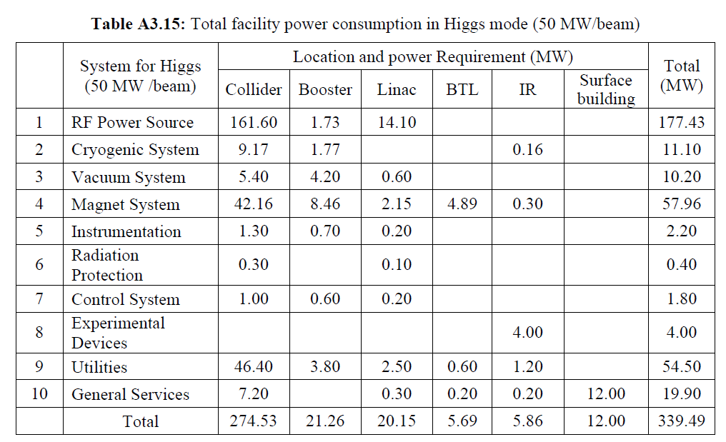
Energy consumption breakdown @ 50MW SR power
CEPC-TDR p967
The total power at other operation modes are listed in TDR
The total electricity consumption is 340MW for the operation of Higgs, SR power 50MW
The major energy consumer systems:
  RF power (177MW) ➢Magnet (58MW) ➢ Cryogenics (11 MW)
  Auxiliary power:
    Instrumentation(2.2) + Radiation Protection(0.4) + Control(1.8) + Experimental device (4) + Utility(54.5) + General Service(19.9) = 78 MW

Slide 7
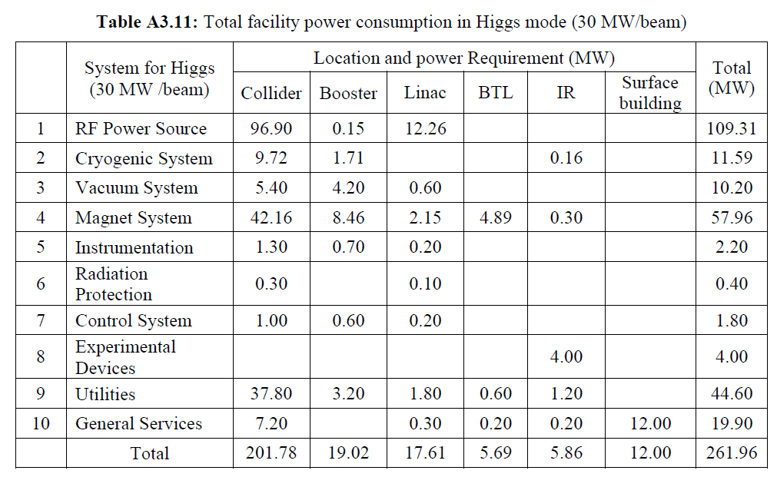
Energy consumption breakdown @ 30MW SR power
CEPC-TDR p965
The total electricity consumption is 262MW for the operation of SR power 30MW
The major energy consumer systems:
  RF power (109 MW) ➢Magnet (58 MW) ➢ Cryogenics (11.6 MW)
  Auxiliary power:
    Instrumentation(2.2) + Radiation Protection (0.4) + Control (1.8) + Experimental device (4) +Utility(44.6) +General Service(19.9) = 73 MW

Slide 8
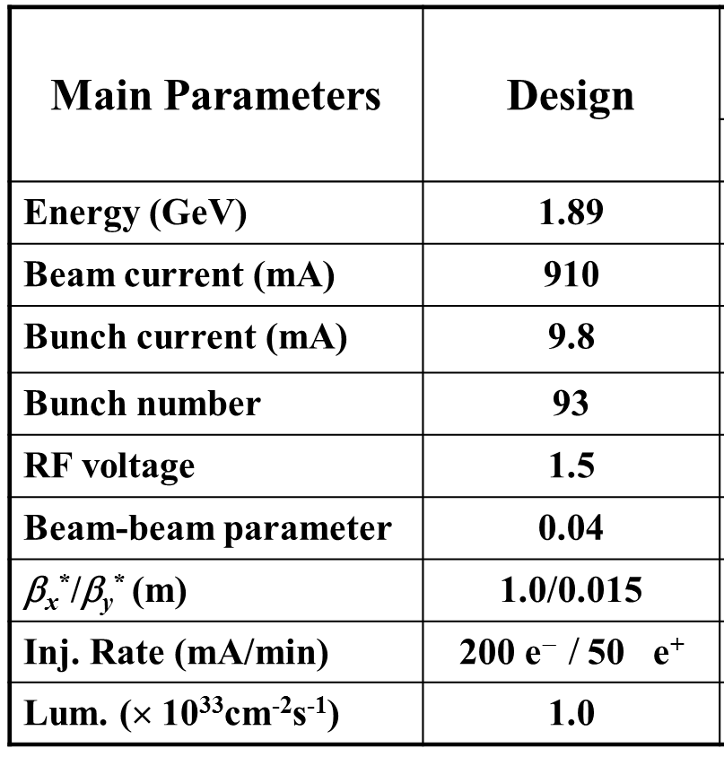
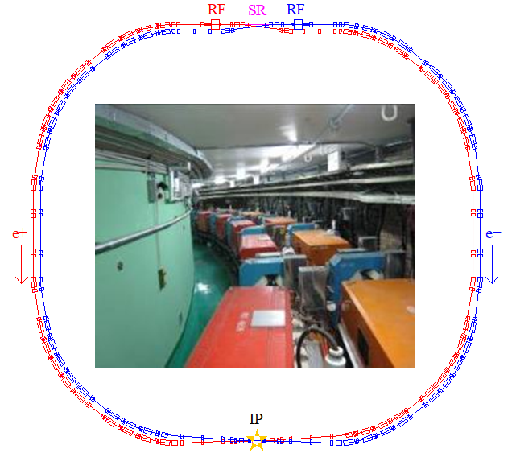
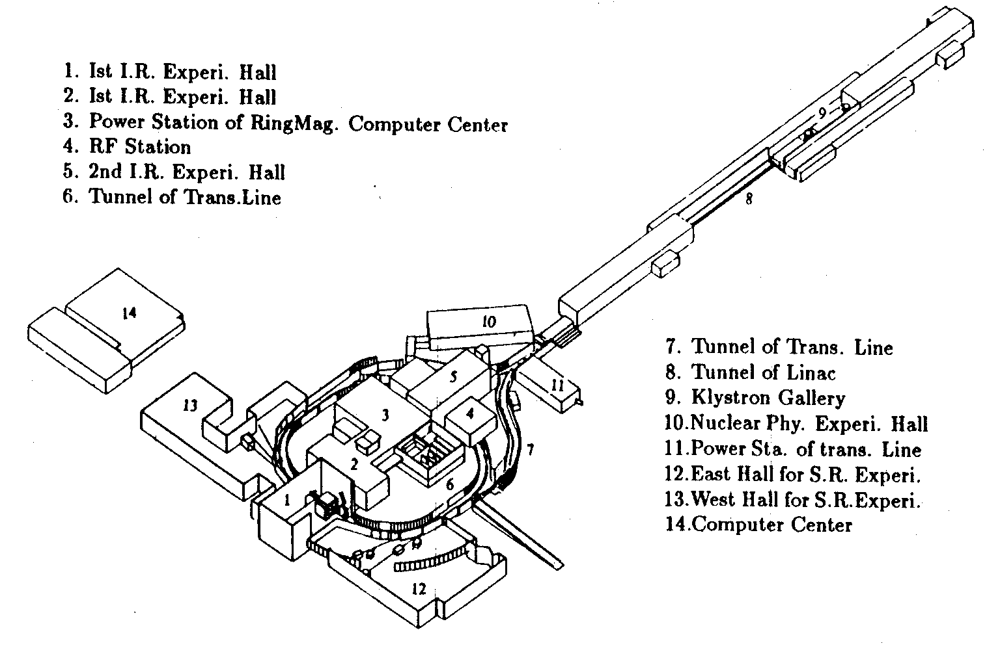
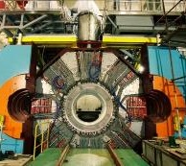
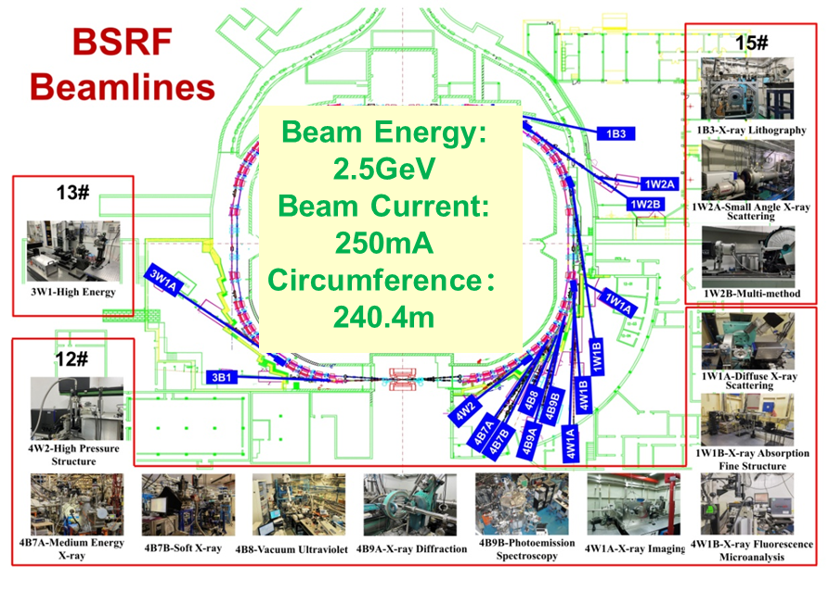
Operation of BEPCII and performance enhancement
BEPCII
- Upgrade project of BEPC, operated since 2009
- A double-ring factory-like collider
- Collider & SR operation modes
BEPCII
BESIII
BSRF

Slide 9
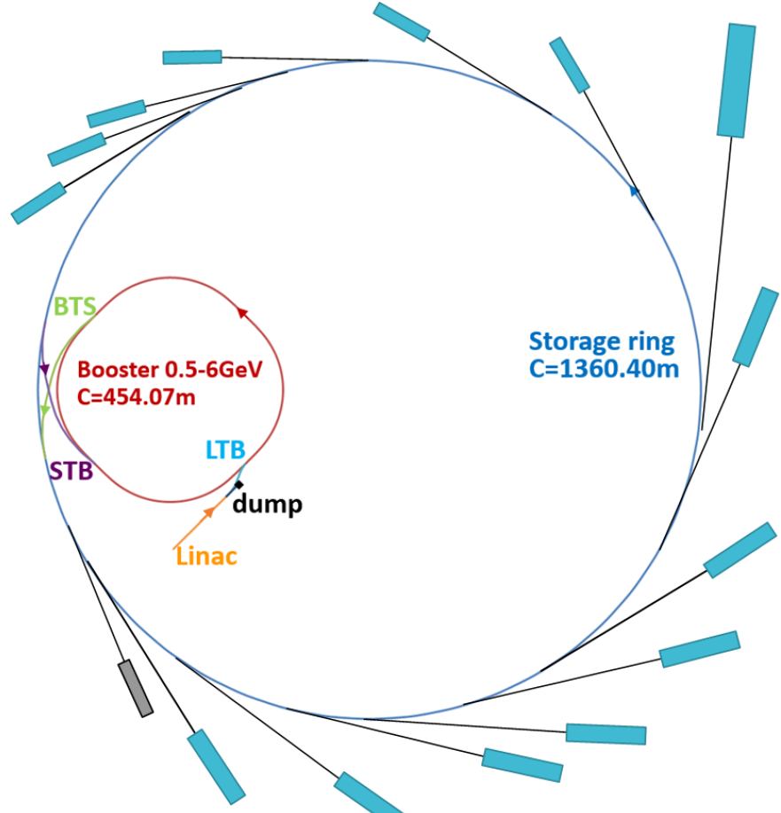
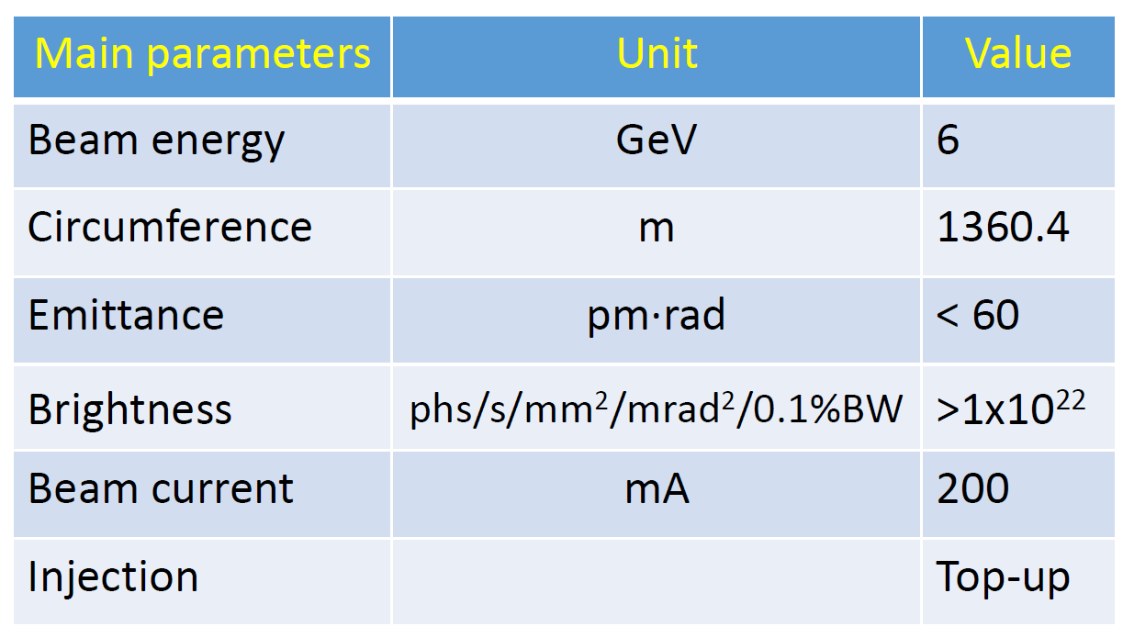
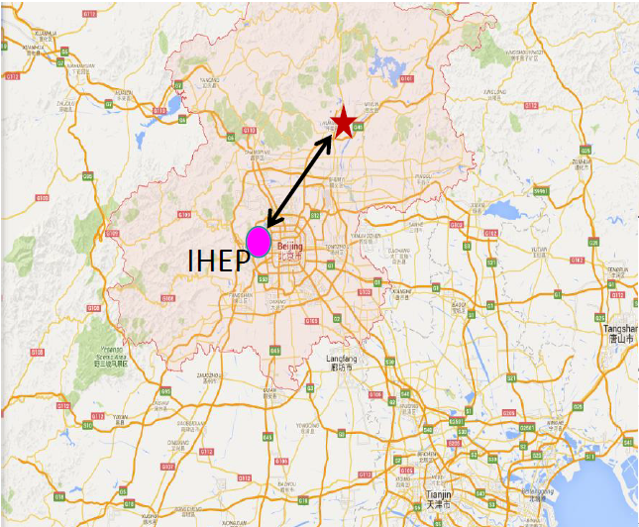
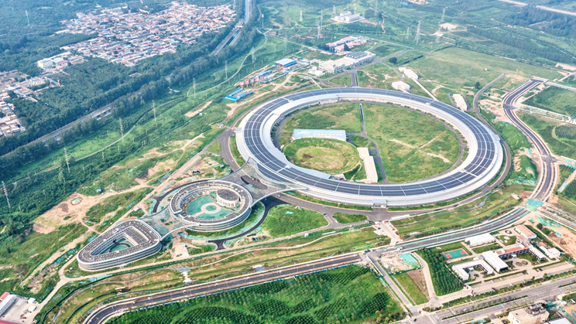
HEPS construction
Advanced 4th generation light source, promoting multi-disciplinary researches
Accumulate conventional key technologies for CEPC
- Magnet - Vacuum - Power supply - Beam instrumentation
- Alignment - Control - Mechanical system - Linac complex
- RF - Cryogenics - Utilities

Slide 10
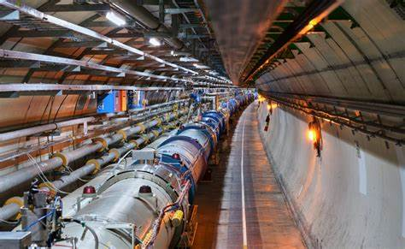
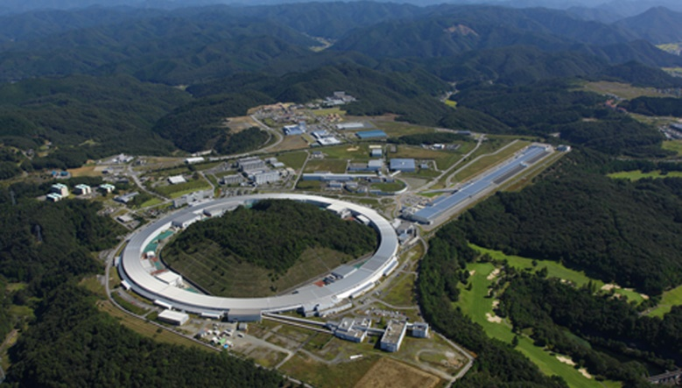
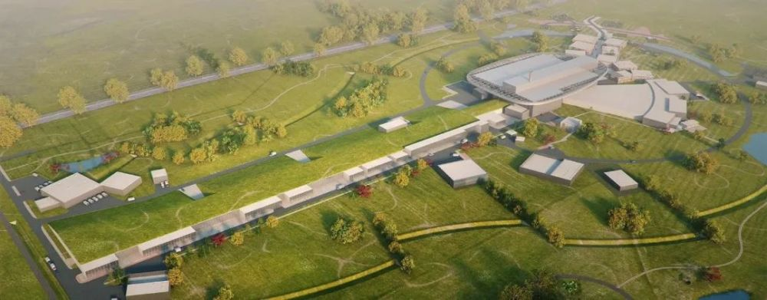
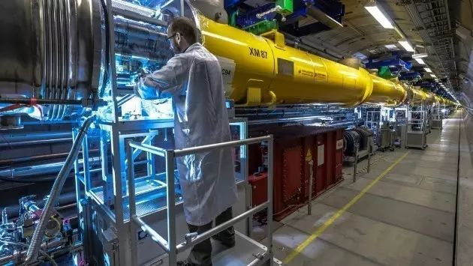
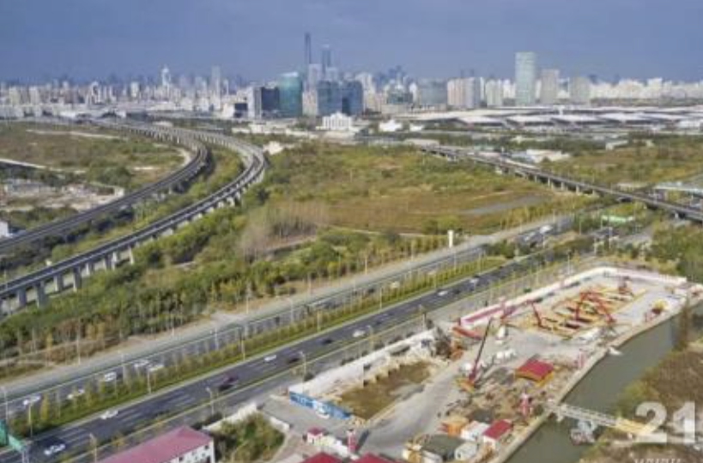
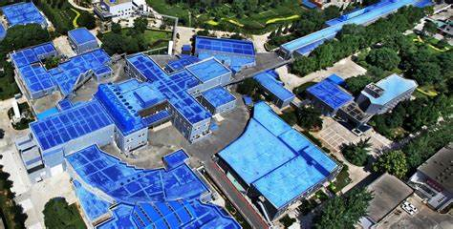
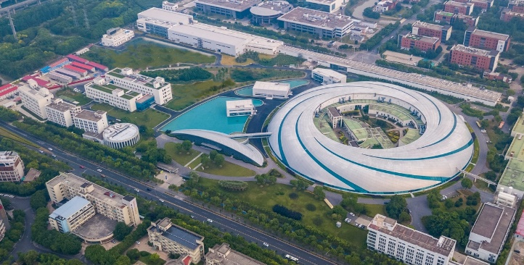
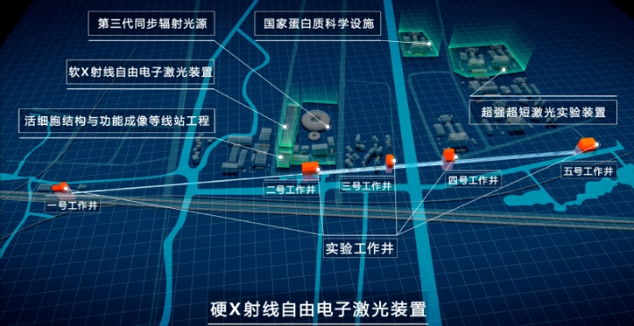
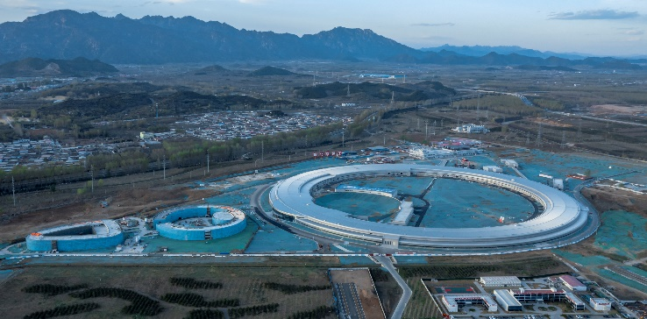
Motivation and obligations to pursue a green machine
China national dual-carbon strategy: CO2 emission peak before 2030 and carbon neutrality before 2060)
The modern high-performance accelerator complex consumes a significant amount of energy: LHC, ILC, CEPC…
LHC 照片
功率 200MW
LHC
200MW
Spring 8
25MW
ESS
33.75MW
EuropeanXFEL
17.76MW
BEPCII 照片
功率 ？MW
上海光源 照片
功率 ？？W
SSRF
10MW
SHINE
20MW
HEPS 照片
功率 ？MW
BEPCII
7MW
HEPS
30MW

Slide 11
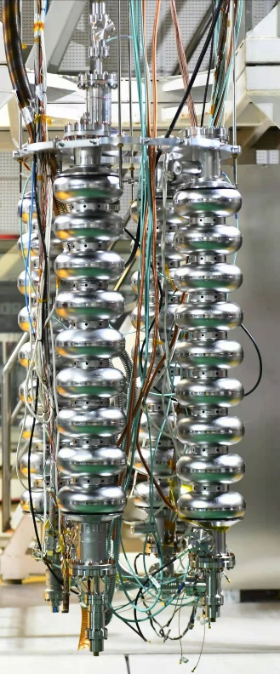
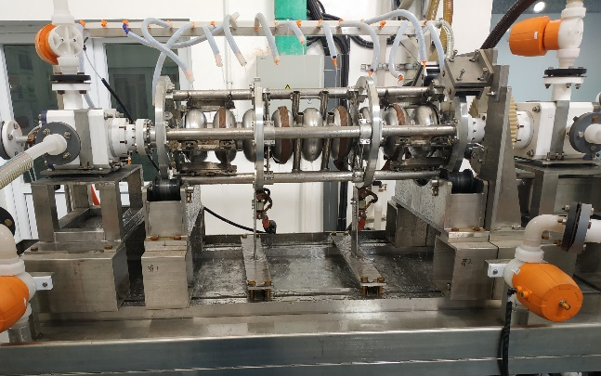
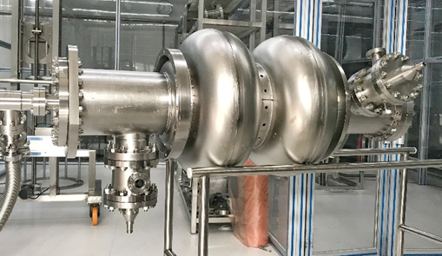
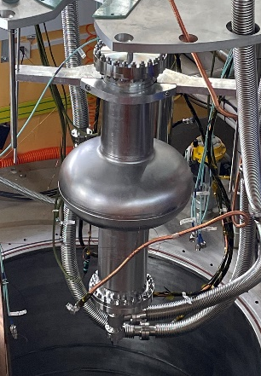
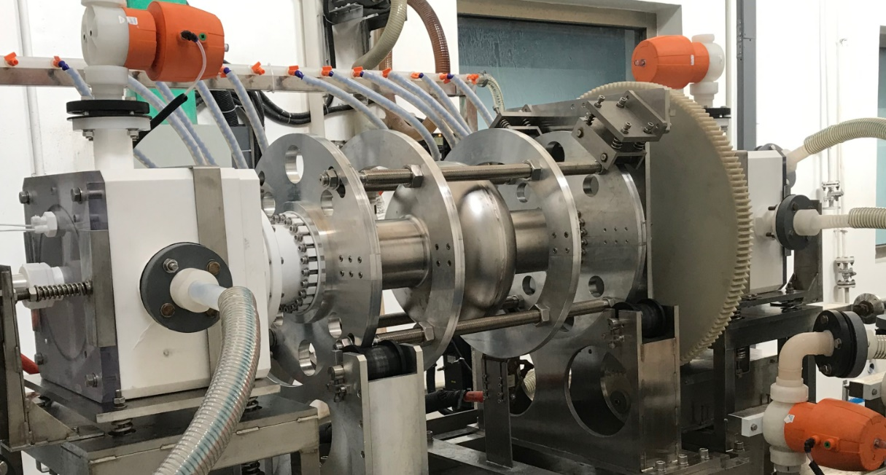
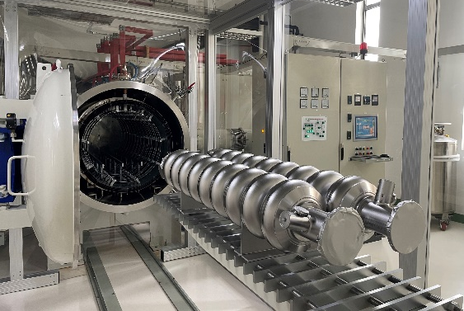
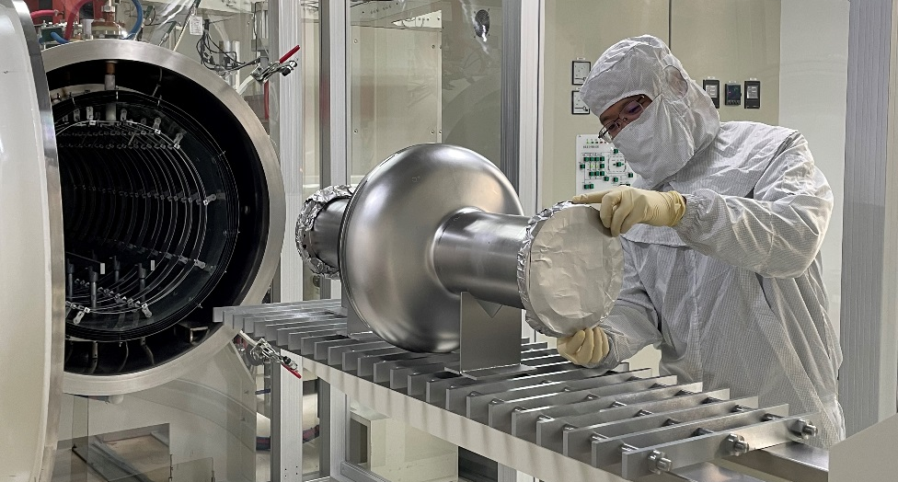
SRF cavity using Mit-T baking
Mid-T baking (O-doping) vs. N-doping: higher E_{acc} & Q, simple process, less EP
Excellent results obtained, exceeding requirements of CEPC, SHINE, LCLS-II, etc.
ILC-type cavities with higher E_{acc} is also under development

Slide 12
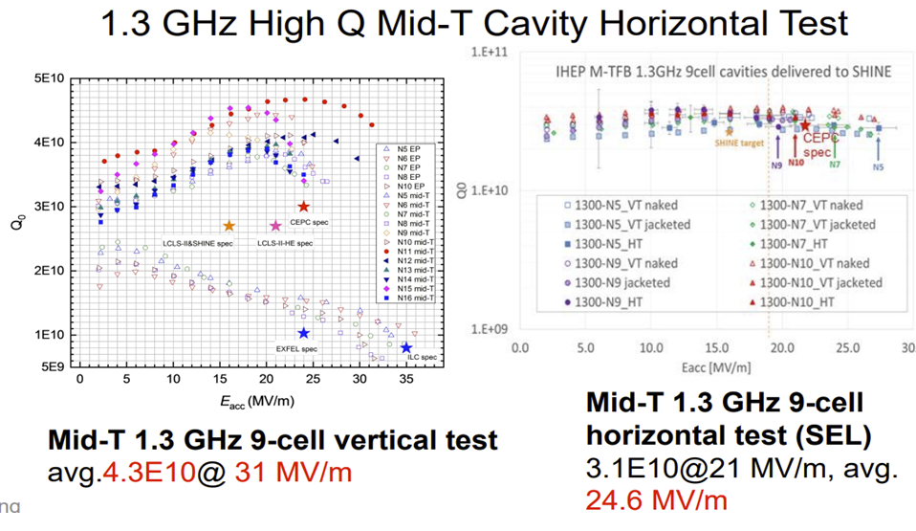
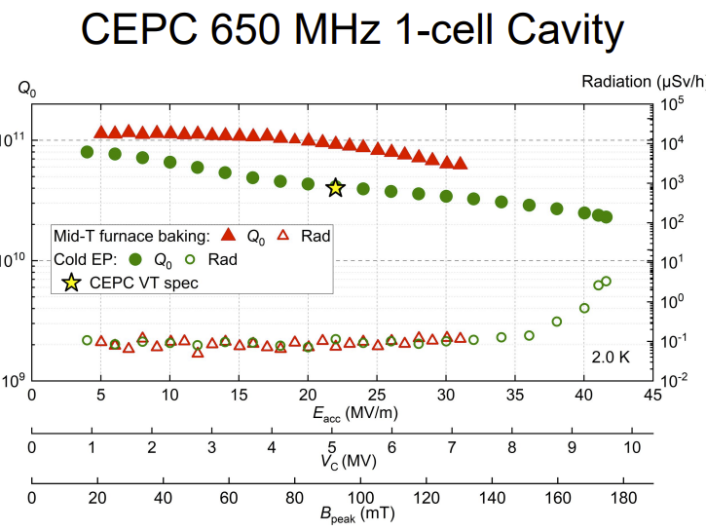
Mid-temp baking SRF cavity test results
6.4E10@30MV/m, 2.3E10@41.6MV/m
Mid-T baking applied to 1.3GHz/650MHz cavities, resulting in High Q SRF cavity that meets the CEPC specification;
Completed SRF modules for both 1.3GHz and 650MHz cavities were assembled;

Slide 13
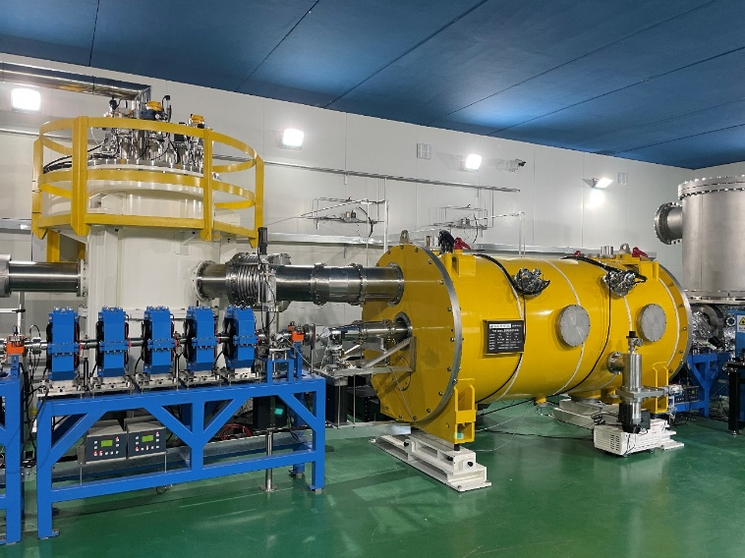
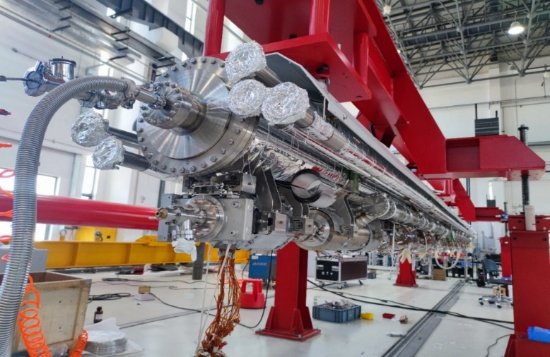
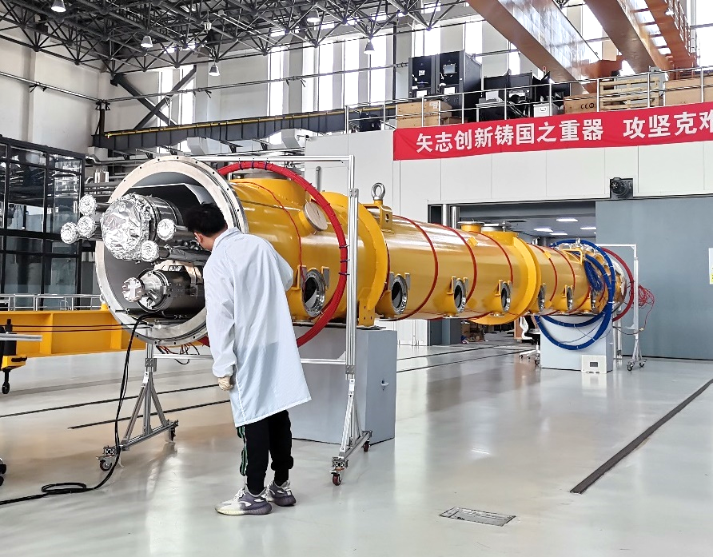
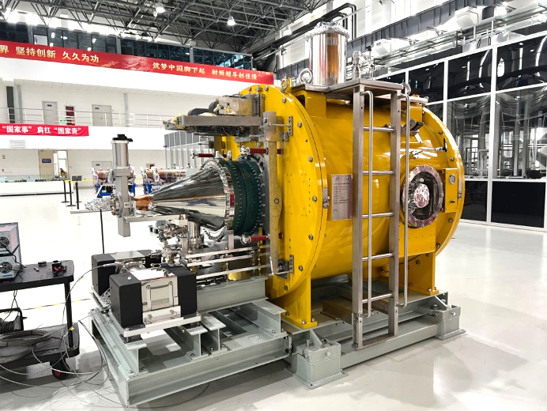
SRF cryo-module horizontal test results
650 MHz test cryomodules including cavities, couplers, HOM absorbers, tuners..., was built and tested OK
A full eight 1.3 GHz 9-cell cavities with input couplers, tuners, SC magnet, BPM, cryostat, module cart, feed/end-cap, volve-box … was built and tested OK
Parameters | Horizontal test results | CEPC Booster Higgs | LCLS-II, SHINE | LCLS-II-HE
Average Q₀ @ 21.8 MV/m | 3.6×10¹⁰ | 3.0×10¹⁰ @ 21.8 MV/m | 2.7×10¹⁰ @ 16 MV/m | 2.7×10¹⁰ @ 20.8 MV/m
Average CW E_{acc} (MV/m) | 23.1
650MHz 2-cell
1.3GHz 9-cell
1.3GHz 9-cell
166MHz QW

Slide 14
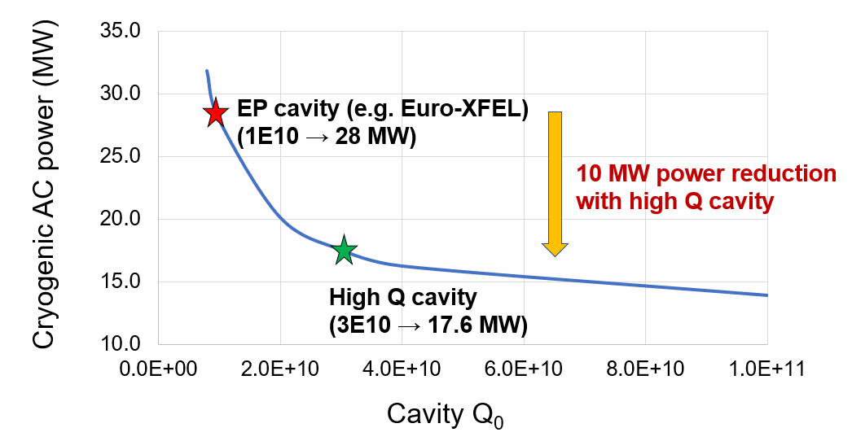
High Q SRF significance for a green machine
The SRF system, along with its cryogenic auxiliaries, is one of the major electricity consumers. High Q-factor SRF cryo-modules effectively reduce the heat load, resulting in lower energy consumption
The CEPC 1.3GHz SRF cavities adopt the mid-temp baking technology, which enhances the Q factor by 5 times compared to the EP technique.
Using the high-Q SRF in CEPC may reduce the operational power by 10MW, which could result in an electricity savings of approximately 60M kWh per year.
Power consumption with respect to the cavity Q-factor
CEPC 50MW Higgs operation

Slide 15
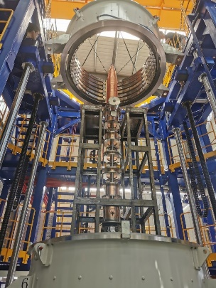
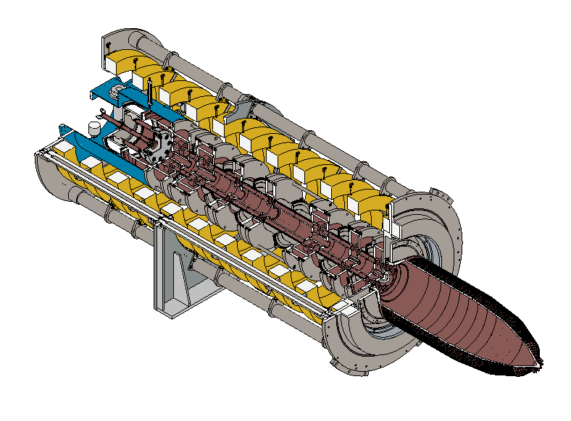
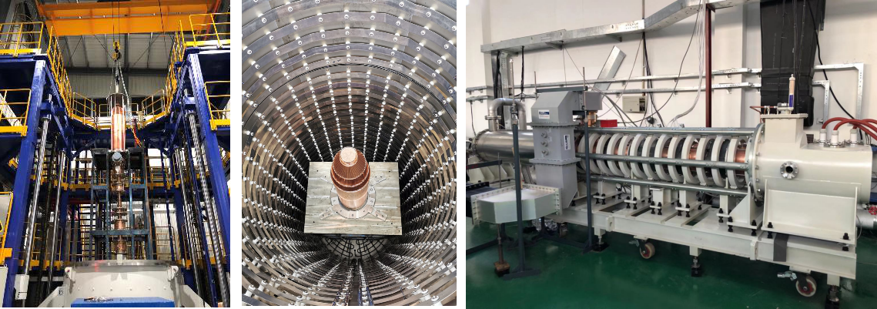
Endeavors for a high-efficient klystron
Klystron No. 2
aiming at efficiency 77%
Klystron No. 3
Efficiency 80.5%
CEPC at 800 RMB/MWh and 6000 hours/year
Klystron No. 1
Efficiency 62%
(2020)
Save Money
130M RMB
1 year
90 M RMB
Excessive electricity bill, M RMB
2020
2021
2022
Efficiency, %
Efficiency impact on operation cost (Only considering operation efficiency of 650MHz klystrons)

Slide 16

Research status of the klystron

Slide 17


Energy recovery by decelerating the used beams
CPI (USA) has developed multiple models of multi-stages decelerating collector klystrons
Many research institutes in Japan, UK and so on has conducted similar efforts.
CEPC will carry out the researches as well
  Theoretical studies of efficiency v.s. collection stages for normal and high-efficient klystrons
CEPC high efficiency klystron prototype H.V. 113kV Cur. 9.5A
Coll. Qty | Coll. Eff. | Kly. Eff.
0 | 0.0% | 68.0%
1 | 29.8% | 77.5%
2 | 47.7% | 83.3%
3 | 55.6% | 85.8%
4 | 61.4% | 87.7%
5 | 65.2% | 88.9%
CEPC first prototype H.V. 81.5kV Cur. 15.3A
Coll. Qty | Coll. Eff. | Kly. Eff.
0 | 0.00% | 58.3%
1 | 31.4% | 71.4%
2 | 50.9% | 79.5%
3 | 59.2% | 83.0%
4 | 64.3% | 85.1%
5 | 67.9% | 86.6%
The electric field distribution inside the three-stage depressed collector

Slide 18



Novel design and prototypes for the room-temperature magnet
Dual aperture magnets prototypes for the CEPC Collider
  Following the proposal of dual-aperture magnets with common coils from CERN, the CEPC team has developed prototypes for dipoles and quadrupoles. Both prototypes meet the specified requirements.
  Large amount of dual-aperture magnets will be used in CEPC: 7574 sets of magnets cover about 84.67 km
  Compare to the conventional separated-aperture magnets, the dual-aperture magnets will save 50% electricity, roughly 40 MW
Combine-function dipole- sextuple design for the CEPC Booster, eliminating a lot of sextuples and resducing their energy consumption

Slide 19




HEPS employs permanent dipole magnets
Longitudinal-gradient dipole takes use of the permanent magnet at HEPS, which consumes zero electricity
Equivalent single excitation energy consumption of about 1.62kW.
Equivalent cooling, power efficiency additional energy consumption of about 1.3kW
240 magnets in the whole ring
Annual running time of 8000 hours
Annual saving electricity about 5.6 million kWh
20

Slide 20

R&D for Halbach type quadrupole with tunable field
Dual-rings magnets enable field tenability in a large range
Challenges:
  Movement synchronizing for ceaselessly field cancellation
  Shimming technology for good field quality at all operation modes
  Radiation shielding
The CEPC uses permanent magnets (dipole, quadruple) for
  Damping ring • Transport line

Slide 21



Plasma wake field acceleration
High gradient: ~10-100GV/m, ~1000times higher than conventional Acc.
High energy conversion rate
High repetition rate possibility
Focus on PWFA acceleration
Plasma wake field
Driver beam
Trailer beam
Conventional linac
1GeV accelerator in hand

Slide 22

Conventional collider Vs. plasma collider
Size:
  LWFA LC << PWFA LC << LC
  But NOT 1000 times smaller due to beam deliver section
Power consumption
  Plasma LC < LC, smaller size means smaller vacuum, magnet, SC ……
  PWFA LC < LWFA LC, due to higher η_{wall plug→driver} and η_{driver→trailer}
  Plasma acclerator estimation is not as accurate as conventional LC, and should be overestimated / based on future technology
Construction
  Plasma accelerator cost is in a big range due to technique uncertainty
  May not be ready in the next 20 yrs
59 km
50 km
1.3 km
14 km

Slide 23



Single stage plasma acceleration efficiency
Hosing instability
AC → Driver, Driver → Wakefield, Wakefield → Trailer
Right now < 10 or even < 1
High rep. rate plasma source and lasers (for LWFA)
50-60% for PWFA
~ 10% for LWFA
50% (exp.)
90% (sim.)
40% (exp.)
90% (sim.)

Slide 24


CEPC drives PWFA study @ IHEP
  Backup solution for CEPC linac, conceptual design based on simulation shows that the scheme is feasible
  Conventional technology as the baseline design:
  PWFA backup design:
  Main linac: 10GeV S-band
  L-band (10+ nC) and S-band (≤5nC) RF guns
  Compression and combination
  Different e+ acc. scheme
  e+ PWFA need to be cascaded
  e- PWFA with TR ~ 3.5

Slide 25



Test facility to be built at BEPCII
Plasma Acc. Experimental Hall
束流中心
2.5 GeV e-/e+ beamline + PW-level high performance laser system

Slide 26


HEPS Waste Heat Sources Utilization
Installation the heat recovery condenser
A heat recovery chiller unit is used to recover waste heat.
HEPS installs four heat recovery chiller units: 2 * 5500 kW and 2 * 2800 kW. In the normal operation, maximum of about 13 MW waste heat can be recovered in the form of 42°C water
The heat load of HEPS is about 10,413 kW in winter and 4,117 kW in summer. When the system is running, the recovered heat source can fully replace municipal heat sources

Slide 27
Advanced heat-pump technology applications for CEPC
As the rapid development of photovoltaic and heat storage technology, AHP can be served the new possible scheme to recover the waste heat.

Slide 28



Solar panels on-top of the roof at HEPS
Photovoltaic (PV) power generation systems are installed on the roofs of HEPS building complex
Adopting 465Wp/550Wp monocrystalline silicon photovoltaic modules, the first phase has a total installed capacity of 9,950.92 kWp. The average annual power generation is expected to be 10.30766 million kWh, and the equivalent average annual utilization hours will be 10,035.85h.
Phase I was connected to the grid on 2023.10.30.
The second phase is planned to lay PV modules on the ground inside the storage ring with an installed capacity of 7314.45kWp.

Slide 29


Slide 30






Full recovery/recycling of helium for sustainability operation
Helium gas is a non-renewable resource. Therefore, helium recycling is essential for sustainable operations.
IHEP has implemented a helium gas recovery system, specifically the liquid helium recovery and purification system of BEPCII(ADS)/PAPS, many years ago. This system has been operating stably.
Recovery capacity ≥210NM³/h; purification capacity ≥105NM³/h;
PAPS helium purification
and recycling system
ADS helium purification
and recycling system
BEPCII cryogenic system

Slide 31



R&D for Iron-based HTS magnets
Iron-based superconducting materials are very promising for high-field magnets
  Isotropic
  May go to very high field
  Raw materials are cheap
  Metal, easy for production
Technology spin-off can be enormous
Major R&D goals
  High Jc: > 1000A/mm²@4.2K
  Long cable: > 1000 m
  Low cost: < 5$/kA⋅m
A collaboration formed in 2016 by IHEP, IOP, IOEE, SJTU, etc., and supported by CAS
World first: 1000m IBS cable, IBS coil, ➔ magnet
1st Iron-based Superconducting solenoid Coil at 24T
12.5T dipole with Nb3Sn and NbTi coil

Slide 32


Novel concept of power supply based on 10kV SST
Numerous media/small magnet power supplies are needed: Quadrupole, Sextupole, corrector, … Lots of cables are needed, resulting in energy lost
SST can eliminate the need for 10kV transformer and SVG, which directly converts the AC power from 10kV to DC 200V – 1000V DC200V~1kV, with voltage tenability
Rectifier is not needed in the power supplies, reducing the cost, space occupation and power consumption

Slide 33
Wireless data transmission for BPM signal
Necessary modification in BPM electronics
  ADC and data process close to the detector
  Add wireless transmission module
  Improved timing system according to specific requirements
The issues should be addressed in the EDR
  Radiation-resistant components- ADCs and FPGAs
  Highly reliable wireless transmission protocol
  Necessary radiation shielding
  ……

Slide 34
Summary
CEPC has released its TDR for the accelerator
Prototypes have been developed and key technology breakthrough has been achieved, with many of them addressing green collider technologies
Power efficiency, energy recycling, and clean energy generation are addressed as comprehensive measures for sustainable operation.

