Slide 1
Experimental hall and detector installation design for CEPC
Junsong zhang，Quan ji，Chang su, Yangshan shi
2023.2.15

Slide 2
outline
1、Overview
2、Experimental hall design
3、Detector installation scheme
4、summry

Slide 3
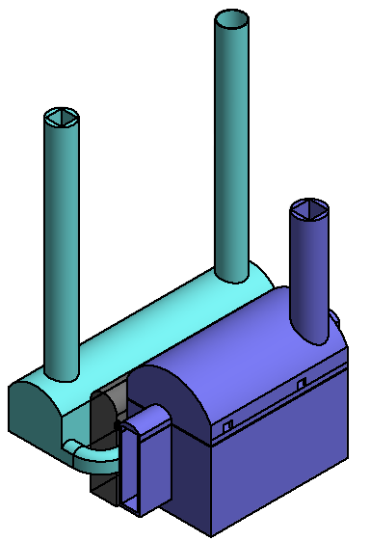
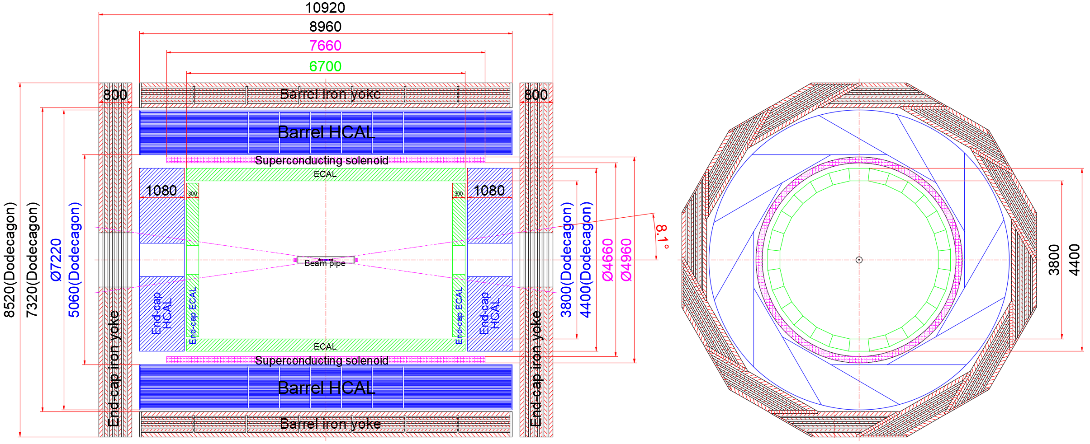
1、Overview
The overall scheme design of the experimental hall for CEPC
Yoke iron, HCAL, superconducting magnet, ECAL

Slide 4
2、CEPC Experimental hall design
Transport channel
Three transport channels
The depth of the experimental hall is about 100 meters underground
Distribution hall
Experimental hall
Visiting floor
Lift
Distribution hall
Shielding layer
Experimental hall
Visiting floor

Slide 5
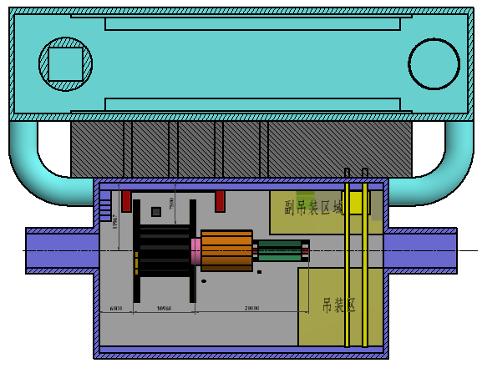
2、Experimental hall design
lift port
Lifting port
Distribution hall
Used for supporting control system, power supply system, cooling system
shielding
Ensure the radiation protection of distribution hall
Experimental hall
Install detector and beam line equipment
staff passage
device channel

Slide 6
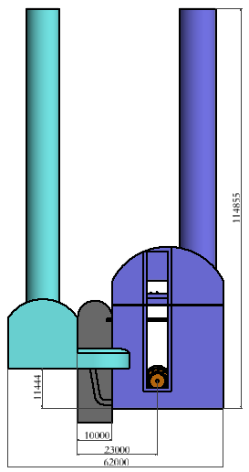
2、Experimental hall design
Visiting floor entrance/exit
The visiting floor can be opened to the public for Tours, from the top of the experimental hall . Pepole can see the tunnel and the whole detector

Slide 7
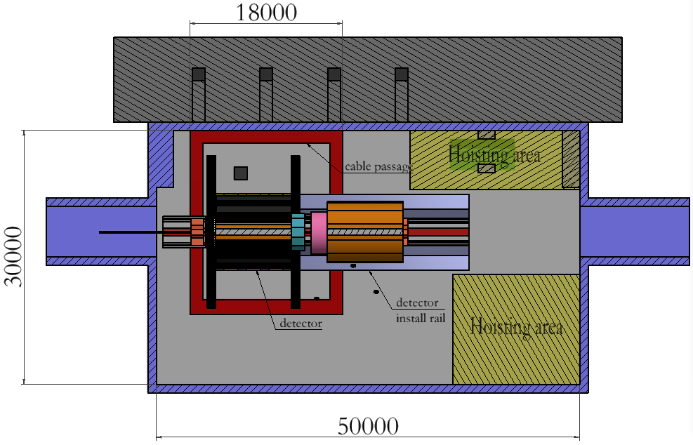
2、Experimental hall design
设备摆放区
The experimental hall is divided into detector installation area, two hoisting area, and equipment storage area
In this design. The detector is fixed in the colliding point directly .

Slide 8
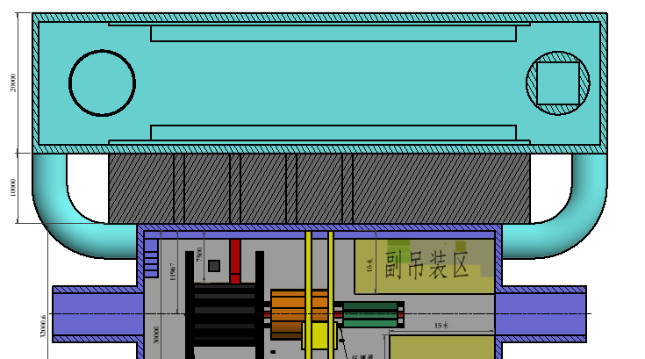
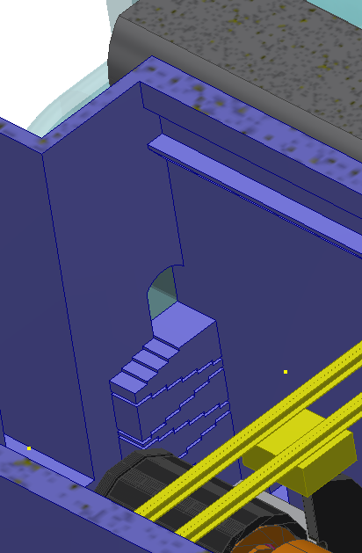
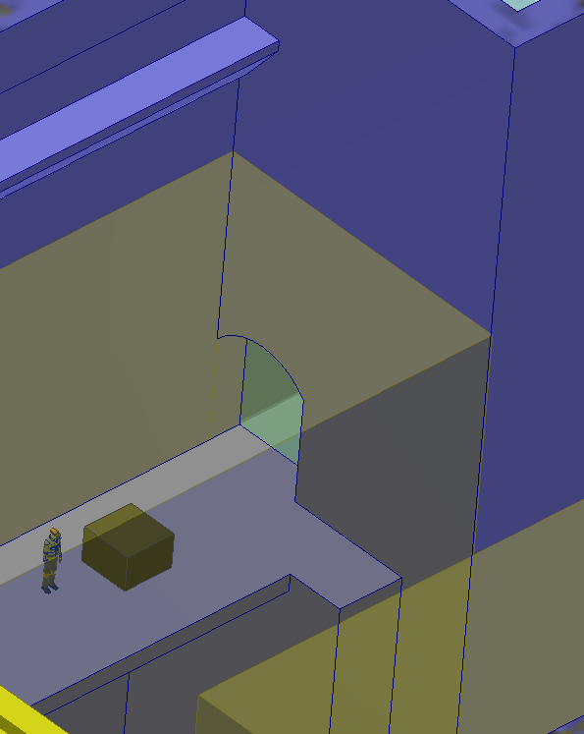
2、Experimental hall design
There are two channels from the distribution hall to the experimental hall, which can realize the passage of personnel and the transportation of small equipment

Slide 9
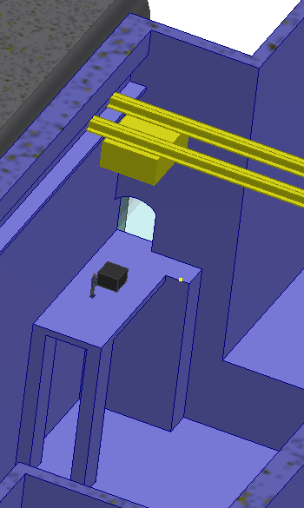
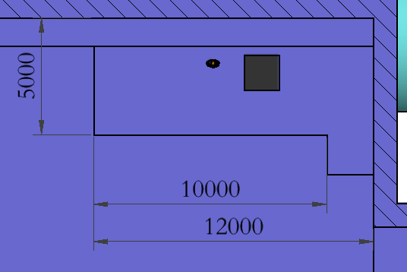
2、Experimental hall design
The purpose of the sub-hoisting area is to lift the small equipment transported from the distribution hall to the first floor. Improve the hoisting efficiency.

Slide 10
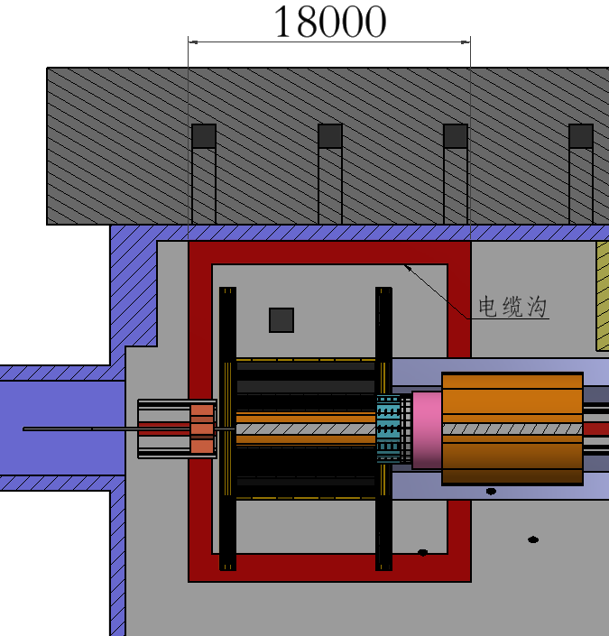
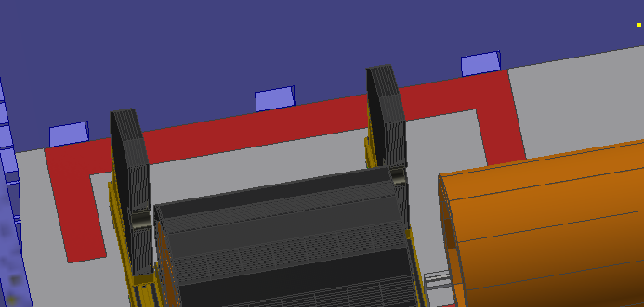
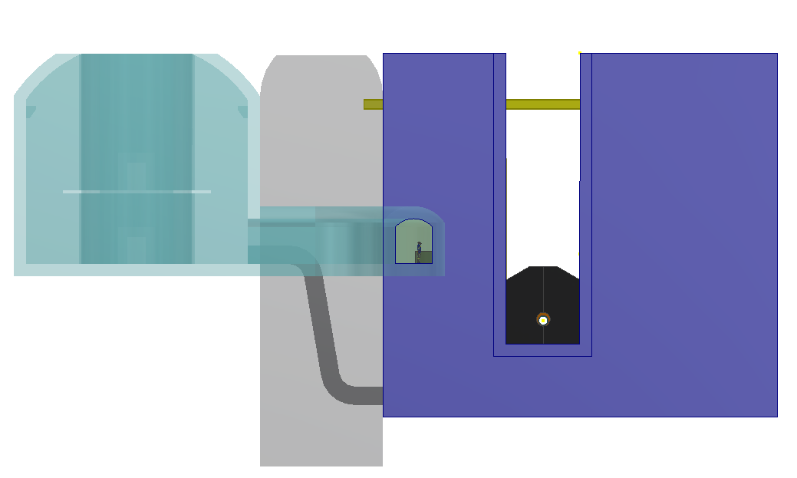
2、Experimental hall design
Detector process design scheme
In the experimental hall cable tunnel is designed around the detector. The cable tunnel is connected to the distrutional hall. It provide channels for the detector cooling system cable, control cable, power cable and other cable .

Slide 11
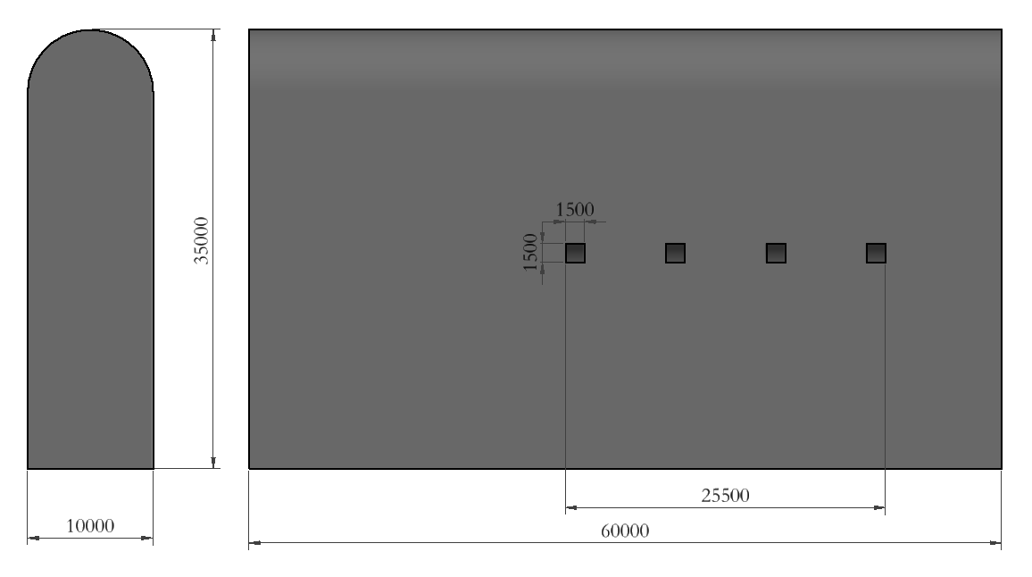
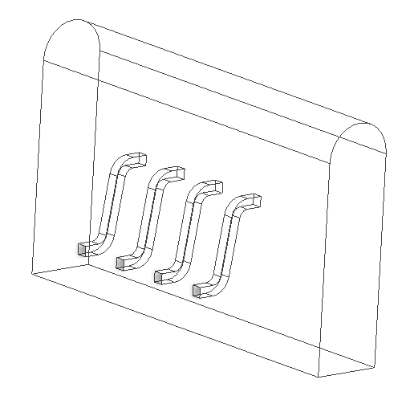
2、Experimental hall design
Shielding
The shielding wall has a thickness of 60 meters and a height of 35 meters. There are some channels inside to realize cables connetion.

Slide 12
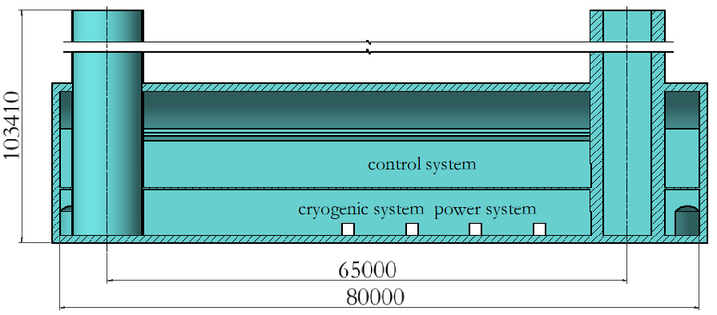
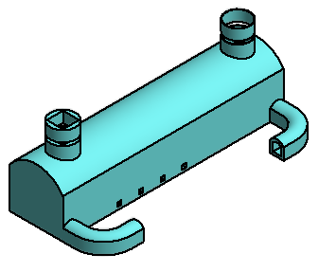
2、Experimental hall design
Distribution hall
The distribution hall is 80 meters long and 20 meters wide. It is divided into two layers. The lower layer is connected with the main hall and is used for laying out cables.

Slide 13
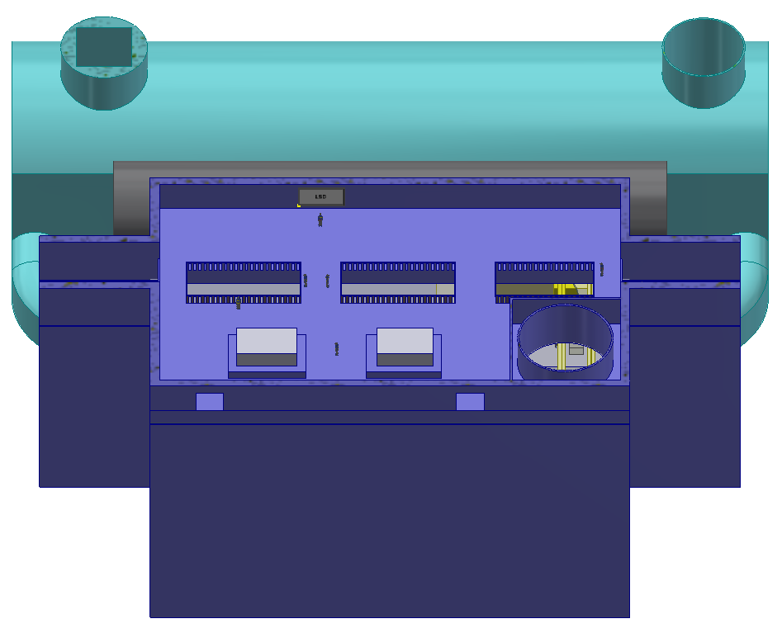
2、Experimental hall design
Visiting floor
Visiting floor
1、The visiting floor is used for external visits to the experimental hall
2、The entrance and exit of visitors and detector staff are separated;
3、Radiation protection requirements, the visiting hall in the running state can be entered.

Slide 14
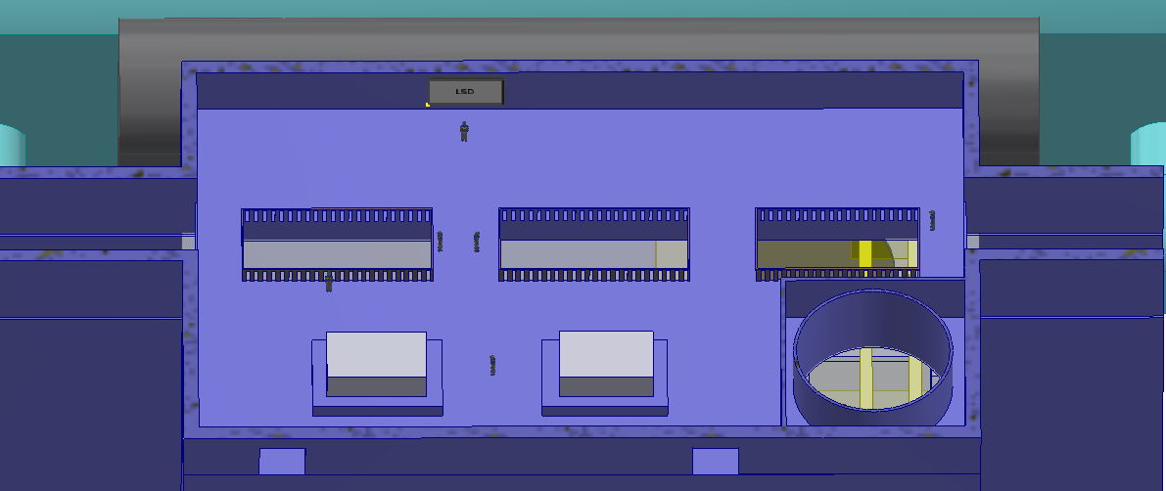
2、Experimental hall design
Visiting floor
large screen
Viewing area
Popular science model area
The visiting floor is 38 meters long, 31 meters wide and covers an area of 1,178 square meters

Slide 15
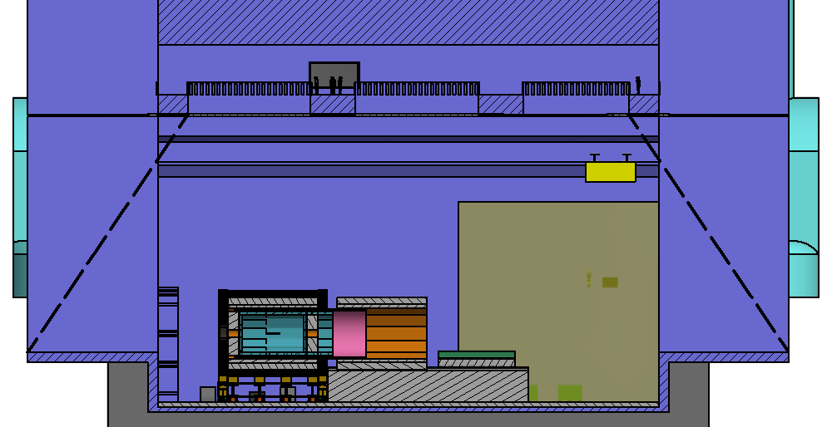
2、Experimental hall design
Visiting floor
The floor offers access to the laboratory hall and tunnels on both sides through the lead glass windows
The size and shape of the visiting area of the visiting floor need to be further optimized according to cost and practicability.
Visit area： tunnels and detectors

Slide 16
3、Detector installation scheme
General requirements for detector installation
Yoke iron, HCAL, superconducting magnet, ECAL
The current design is the superconducting magnet inside the HCAL

Slide 17
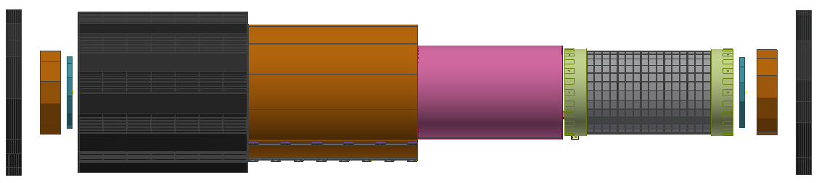
3、Detector installation scheme
General requirements for detector installation
superconducting magnet
30Tons
York Iron 850Tons
HCAL1200Tons
ECAL 180 Tons
1. The yoke of the detector is directly installed on the detector base;
2. Hadron calorimeter, superconducting magnet and electromagnetic calorimeter are respectively installed in the center of yoke iron in the axial direction
3. The end yoke shall be installed finally. The installation of the end yoke shall be coordinated with the installation of other detectors to avoid interference and obstruction

Slide 18
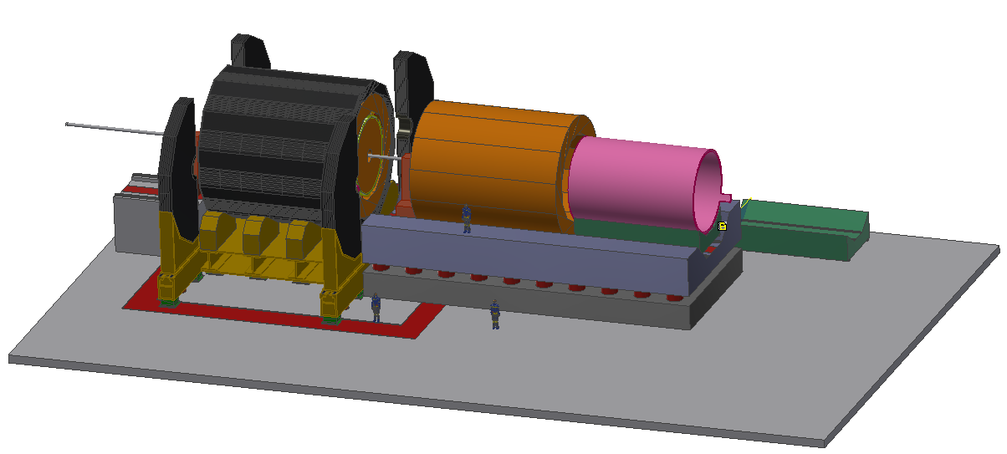
3、Detector installation scheme
General requirements for detector installation
Yoke
End yoke (open)
HCAL
Superconducting magnet
ECAL
End derctors
End yoke (closed)
Yoke iron
detector
detector
base
Install common guide supports
Superconducting coil and detector base

Slide 19
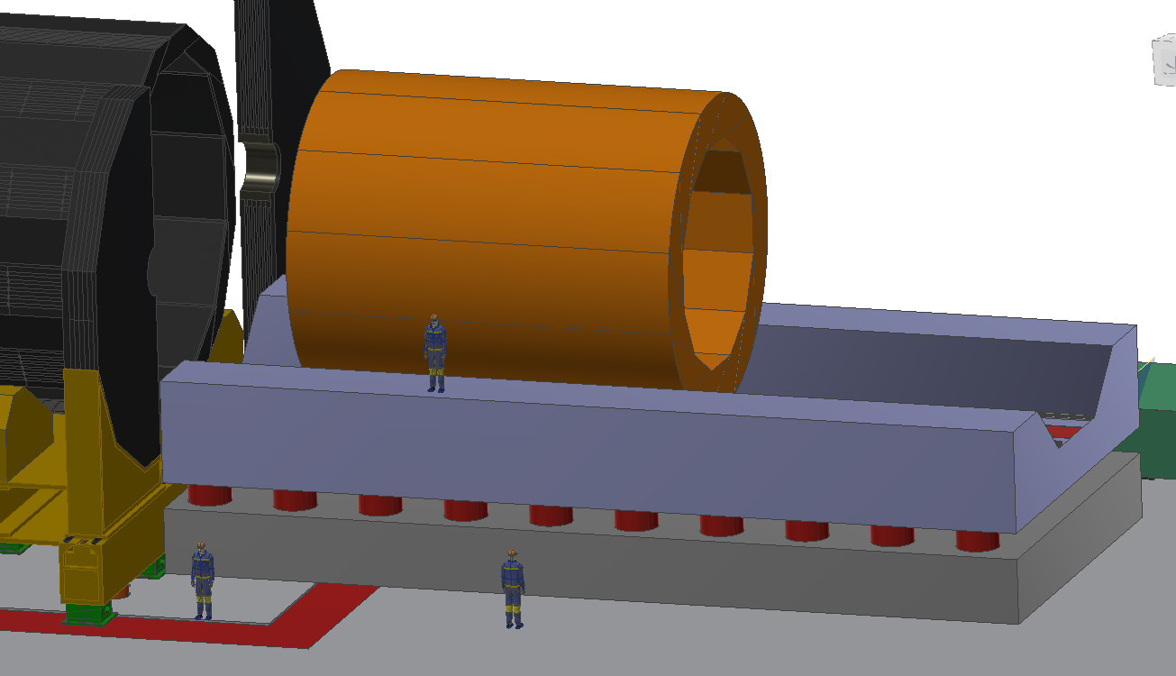
3、Detector installation scheme
Common guide scheme:
Common guide rail installation scheme:
1. HCAL, superconducting magnet and ECAL are installed in the axial direction through the common guide rail;
2. The common guide rail is divided into two layers, and the hydraulic mechanism is used to adjust between the two layers to realize the alignment of the guide rail;
3. The upper common guide rail is equipped with air float guide rail pair and rolling guide rail pair to meet movement of different equipment;
4. The axial propulsion is realized by hydraulic structure

Slide 20
3、Detector installation scheme
Common guide scheme:
Advantages of common rail installation scheme:
Save space; Save time; Improve maintenance efficiency and save cost.
Key technical difficulties:
1. Whether the supporting guide rail with different bearing capacity can be realized.
2. how to realize the different sub-detector support tooling
3. Realize the air floating guide rail in a small vertical space.
In the same guide rail structure, the axial transportation of each detector, superconducting magnet and end detectors is realized

Slide 21
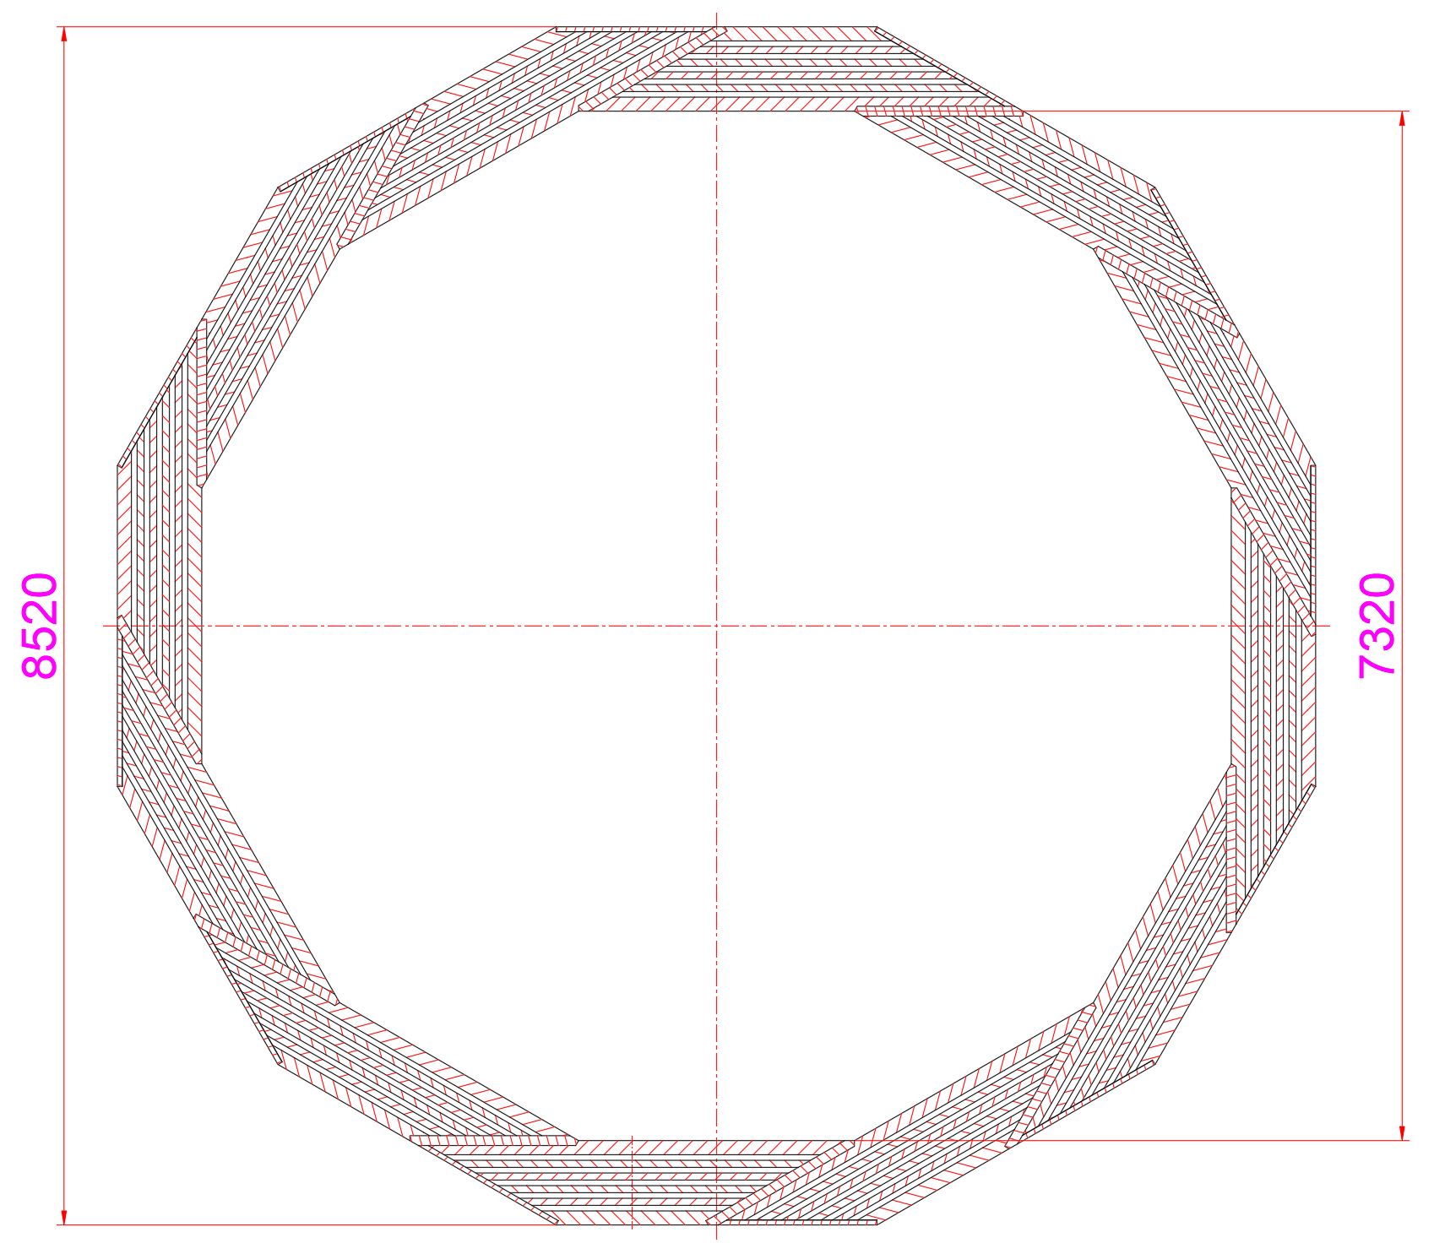
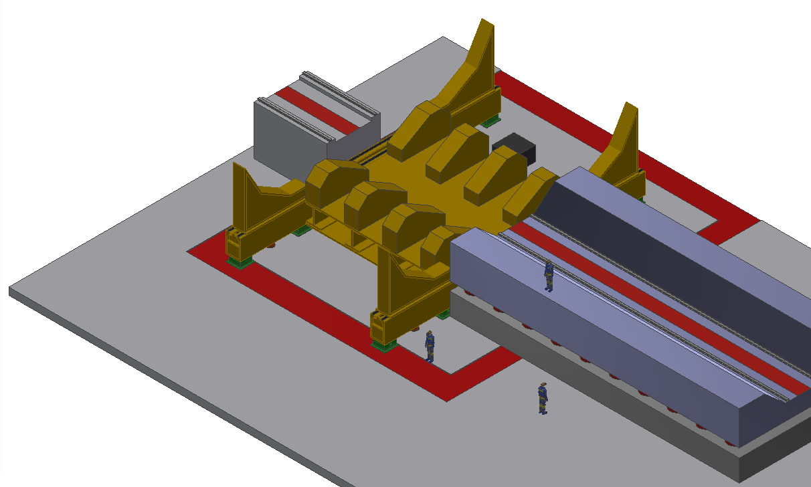
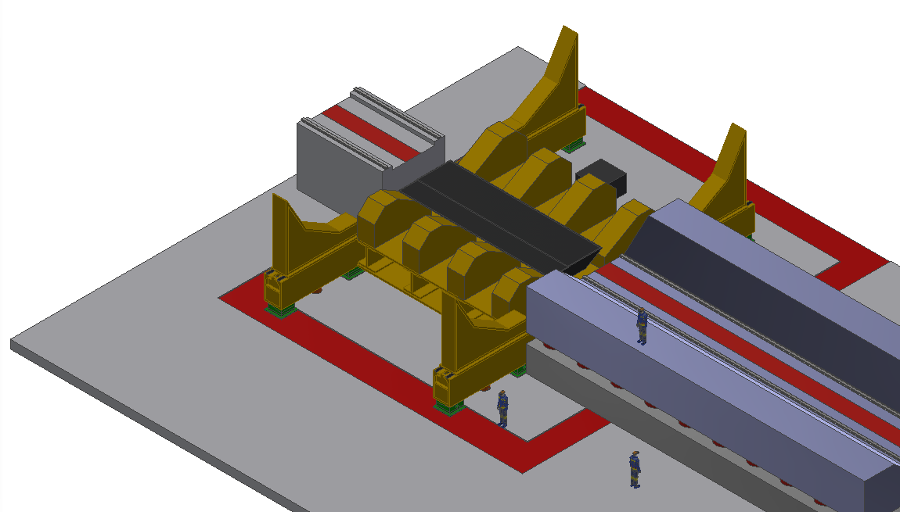
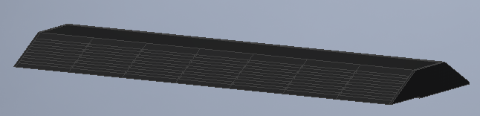
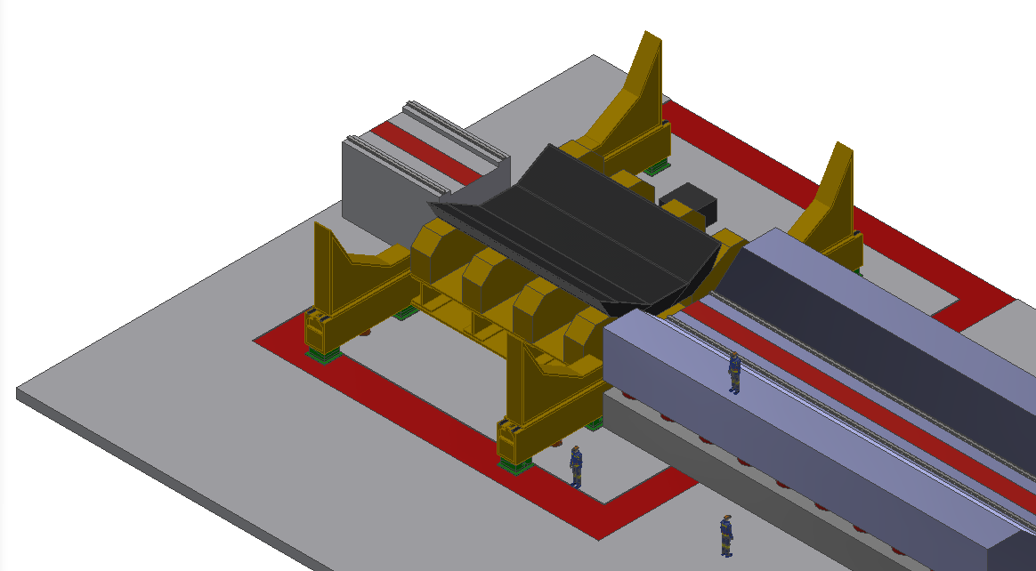
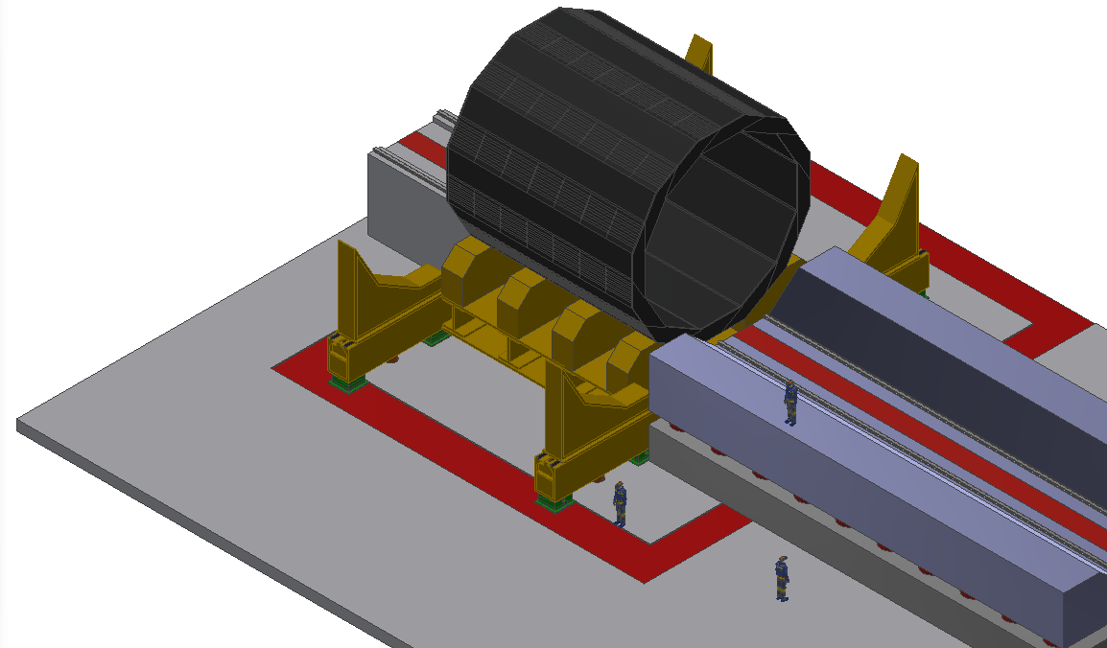
3、Detector installation scheme
The installation of yoke iron
8960mm
The yoke consists of 12 units, each of which weighs about 100 tons
Yoke is hoisted and transported to the experimental hall in units and assembled on the base piece by piece

Slide 22
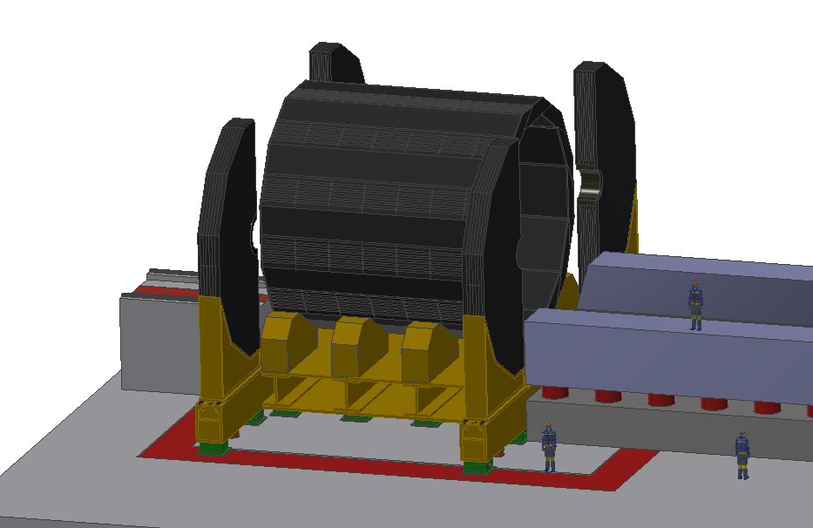
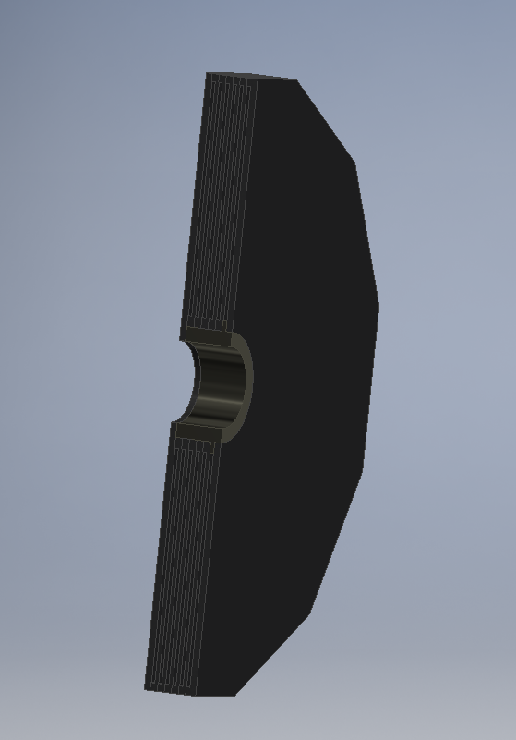
3、Detector installation scheme
Installation of detector base and end yoke
Half-end yoke
The total weight of the end yoke is 500t and there are 4 yoke elements in total. Each end yoke is about 125t.
The end yoke is supported with ball guide rails
The end yoke can be driven by hydraulic system to realize opening and closing, adjustment and so on
detector base
The bottom layer of detector base adopts hydraulic pressure and inclined iron mechanism to support and adjust the whole yoke.
The detector base can realize the opening and closing of the end yoke and the centering adjustment

Slide 23
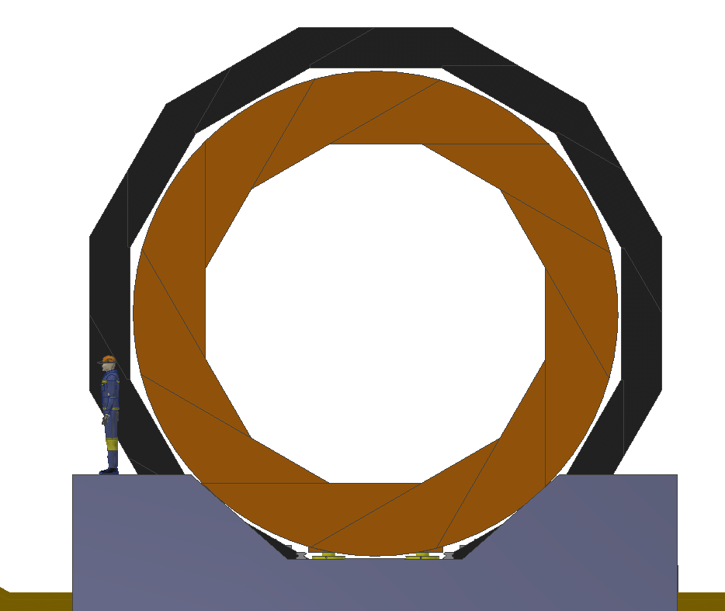
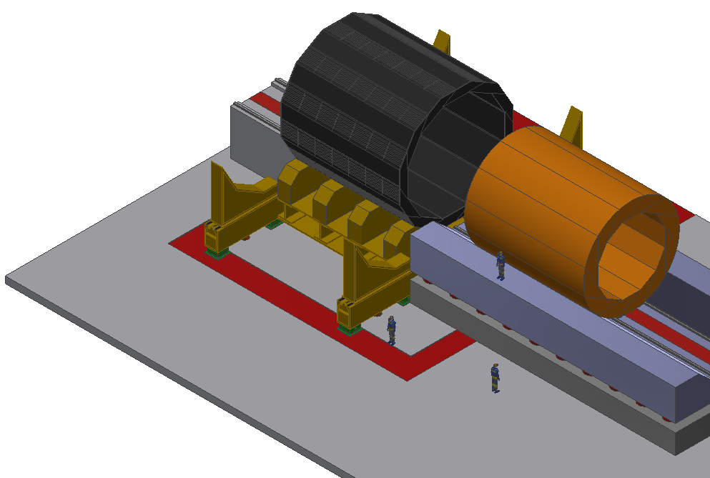
3、Detector installation scheme
Assembly of hadron calorimeter
HCAL has a total weight of 1200 tons and is divided into 12 units, which are assembled by unit on a common guide rail
Each unit is about 100 tons and assembled from the bottom up on the common guide rail.

Slide 24
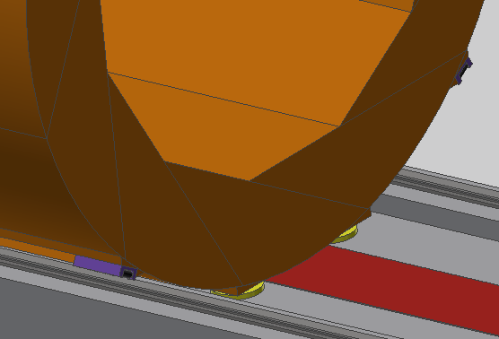
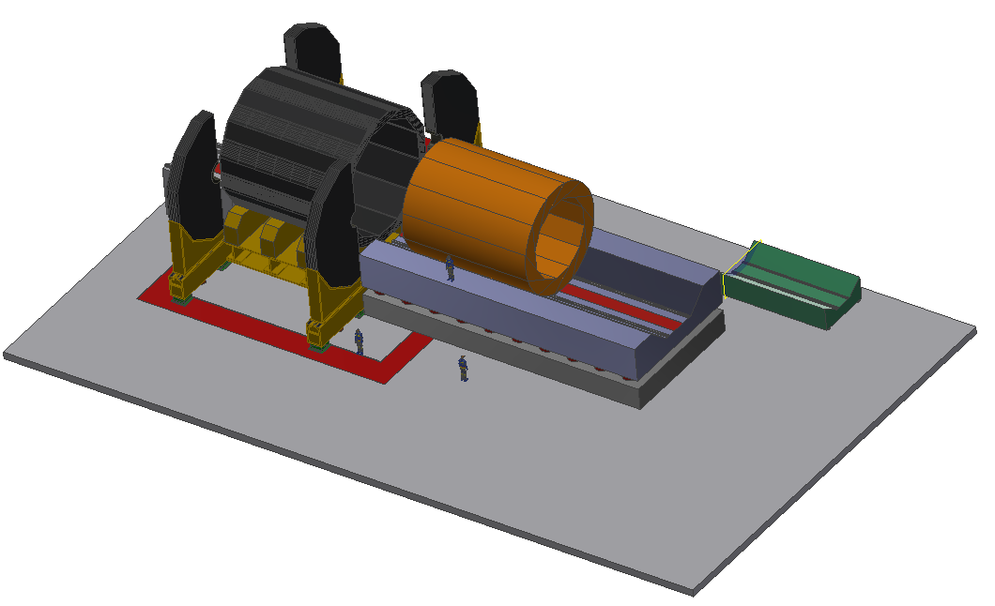
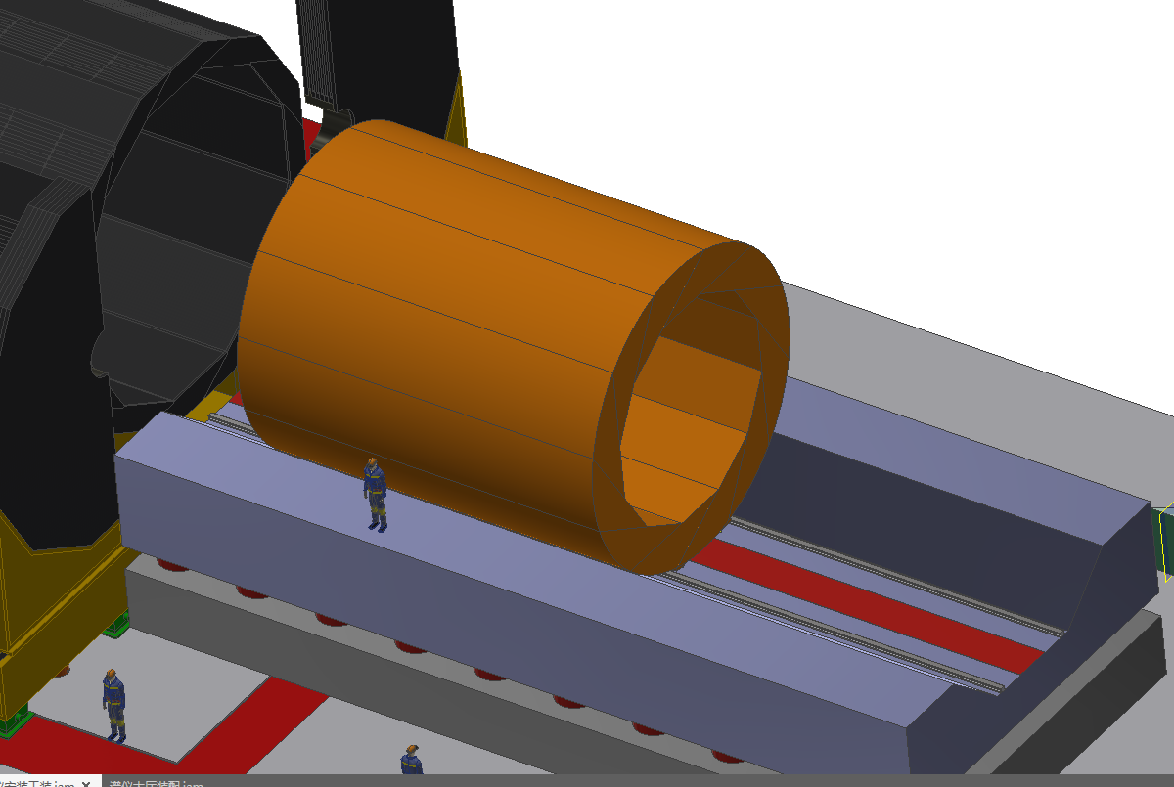
3、Detector installation scheme
Assembly of hadron calorimeter
Air float guide
Anti-tip roller
Air float guide
After the assembly is complete, HCAL is pushed into installation by hydraulic power system
Air float guide pair is used to realize the bearing and movement , and anti-overturning guide rail is used on the side
the vertical space is 50mm,It is hard for realize the air float guide.

Slide 25
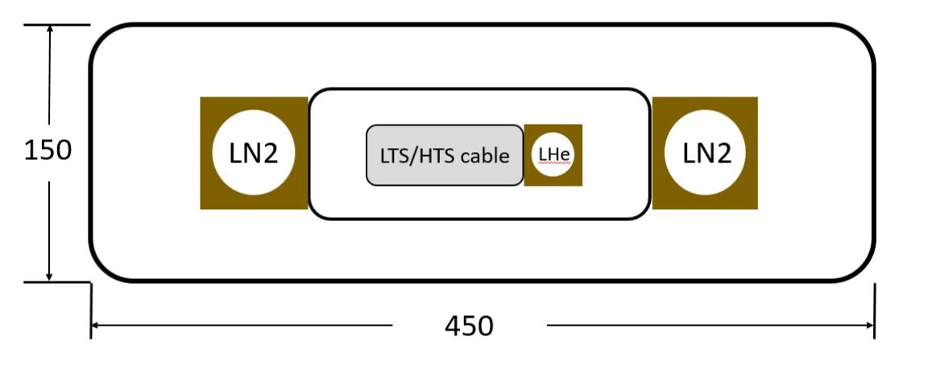
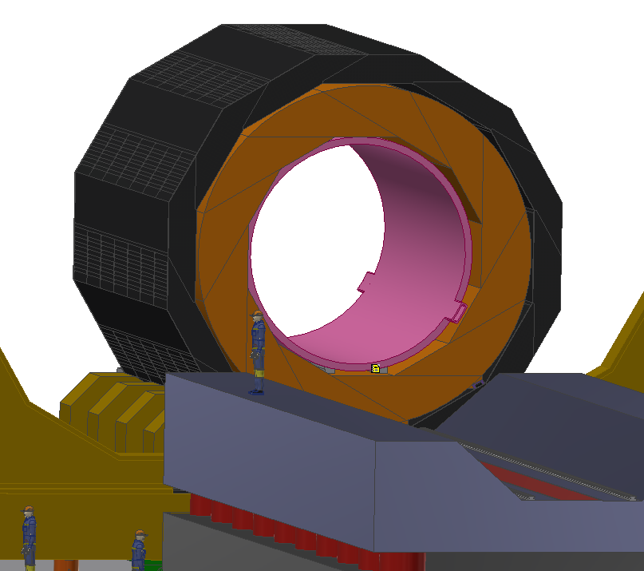
3、Detector installation scheme
Superconducting magnet installation
Size of socket of superconducting magnet
The leading interface of the superconducting magnet is one in and one out, which leads out in the axial direction
A connect structure is required for the outlet

Slide 26
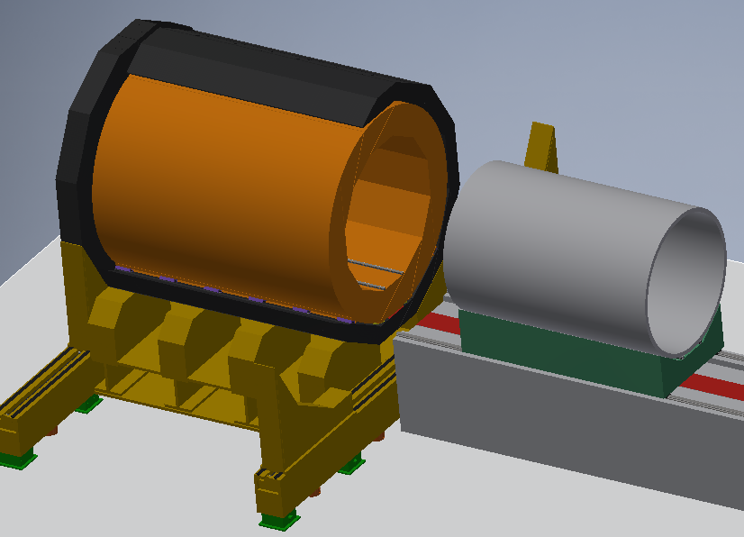
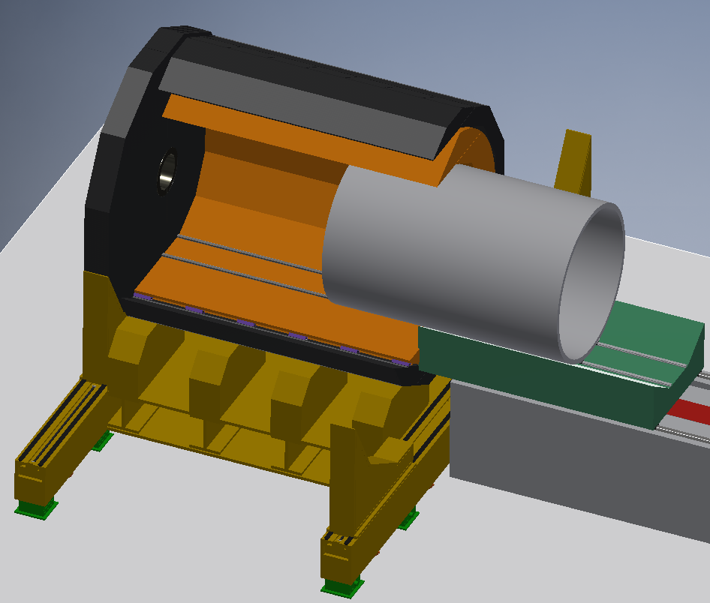
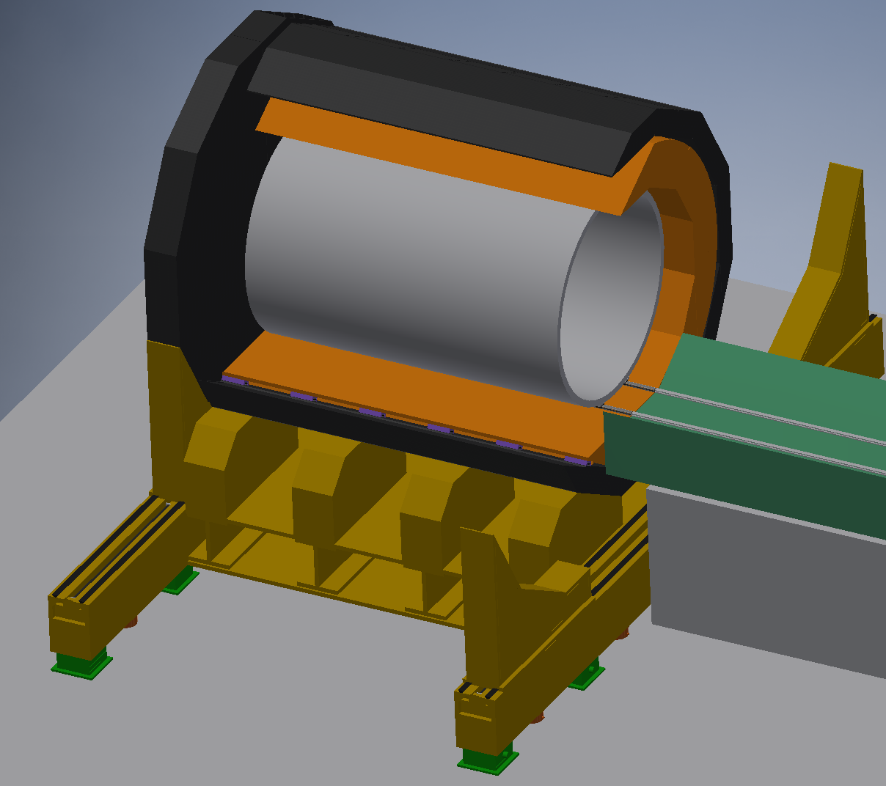
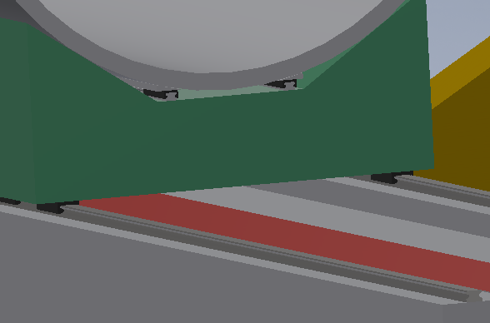
3、Detector installation scheme
Superconducting magnet installation
1. assemble the superconducting magnet
2.Push in the superconducting magnet
3. Assemble superconducting magnets
The superconducting magnet is about 7 meters long, 5 meters in height and weighs about 30 tons
Due to the height, the superconducting magnet adopts a roller guide rail pair as a motion support, and a hydraulic system to push
Linear rolling guide

Slide 27
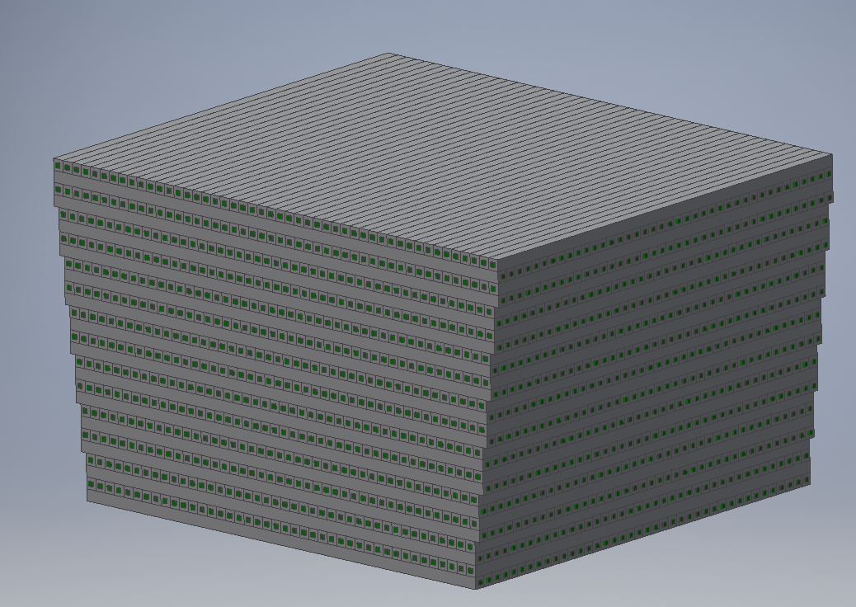
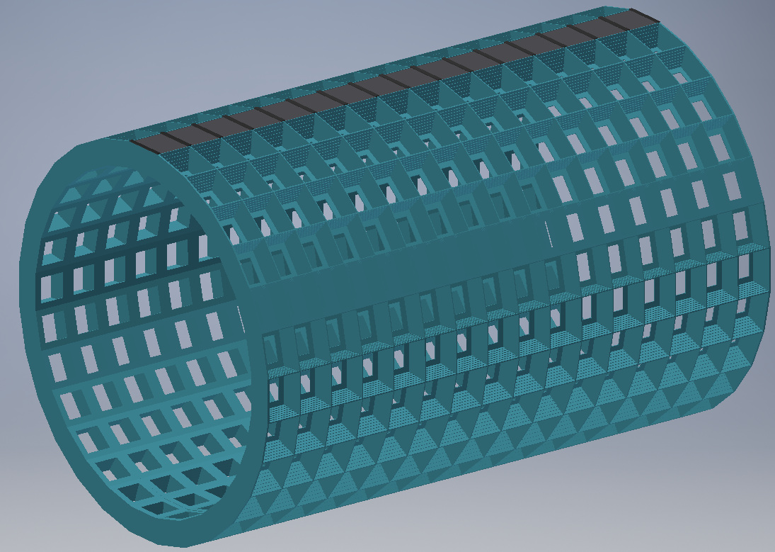
3、Detector installation scheme
The ECAL installation
280mm
400mm
ECAL adopts carbon fiber structure processing frame, The detector block is nearly square
When installing the detector units, install the detector unit in the top column, and then rotate the fixed angle to install the next column.
ECAL total weight is 180 tons;
There are 448 units;
There are 533,120 crystal bars in total.
The installation of ECAL requires the movement of an axially rotating structure.

Slide 28
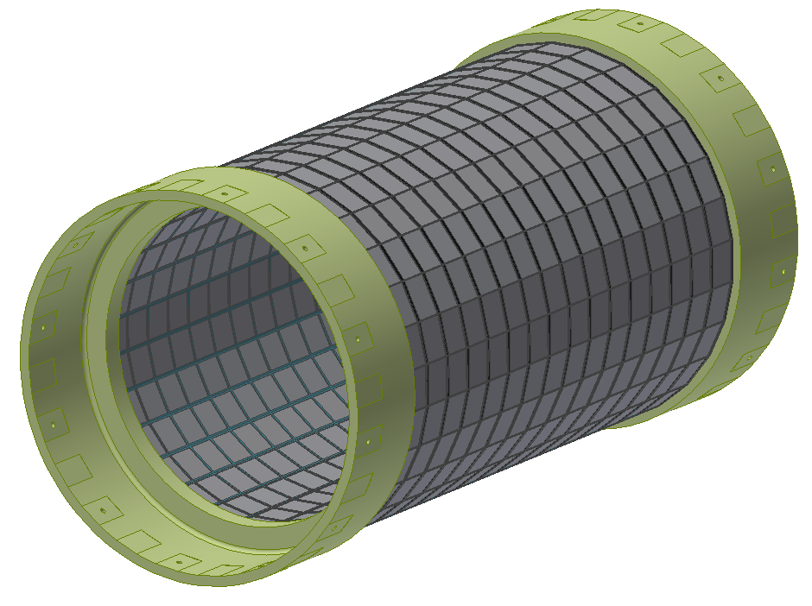
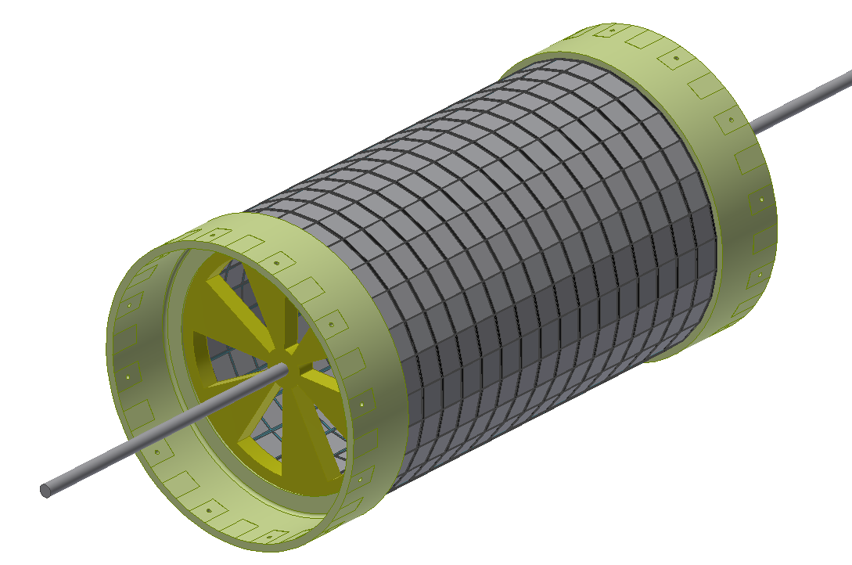
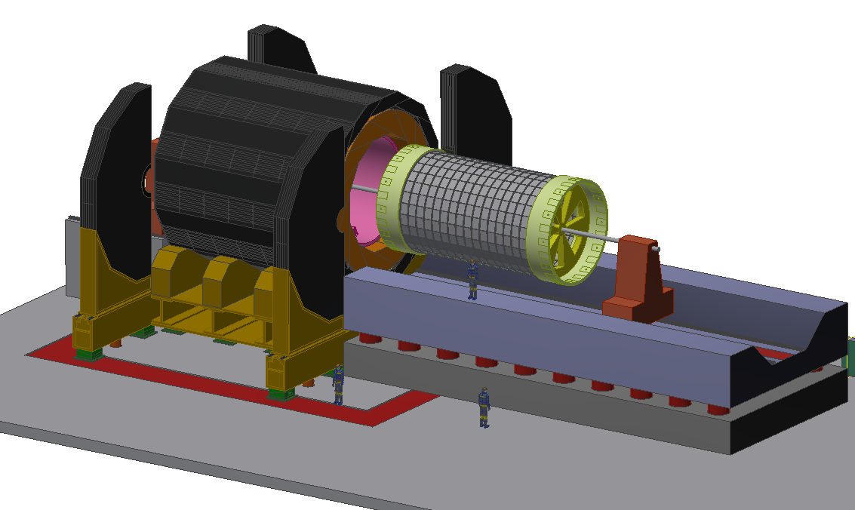
3、Detector installation scheme
ECAL structure and installation scheme
mandrel structure
flanges
In order to increase the structural strength of the ECAL and realize installation, both ends of the ECAL are fixed with flanges.
The ECAL is fixed on the mandrel structure for rotating assembly and installation.。
The total weight of the electromagnetic calorimeter is about 180 tons. The total length (with flange) is about 8890 meters.

Slide 29
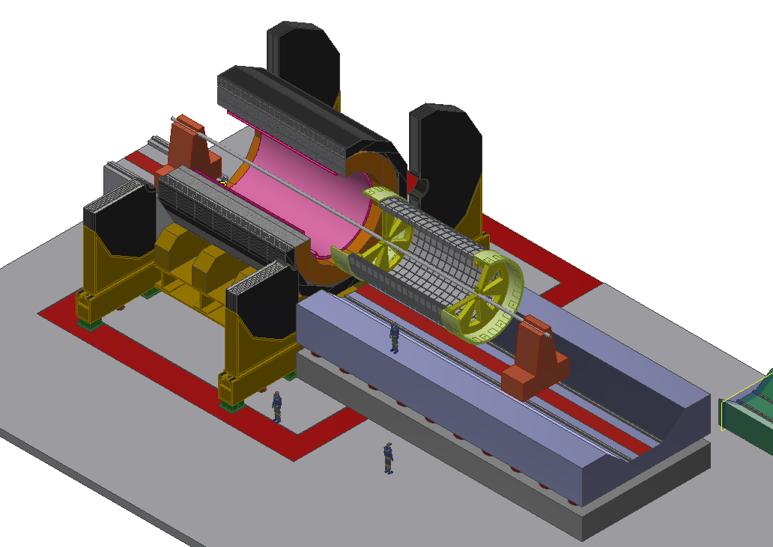
3、Detector installation scheme
ECAL structure and installation scheme
The installation of mandrel can realize the rotational motion for assembly.
After assembly, the ECAL is pushed into the detector in an axial direction
The alignment of ECAL cannot be adjusted during installation.

Slide 30
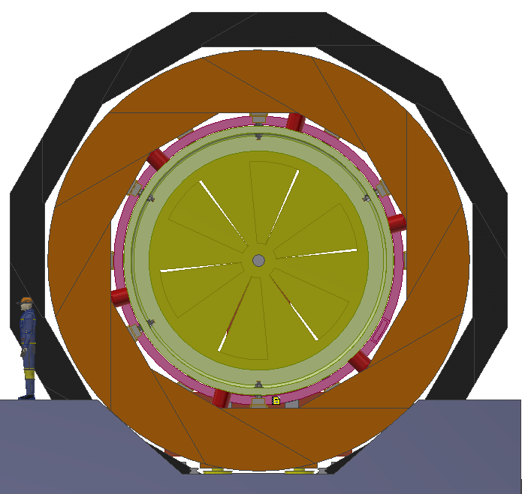
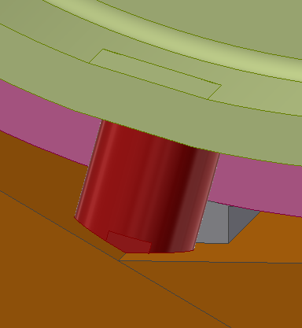


3、Detector installation scheme
ECAL structure and installation scheme
Before the mandrel is removed, 12 hydraulic mechanisms and 10 locking support mechanisms are installed to fix the ECAL.
Finally, hydraulic mechanisms are used to realize the alignment of the derctor, and supporting locking structure are used to fix it

Slide 31
4、summry
1. Completed the overall design of the experiment hall, and realized the transportation, placement and installation of all parts of the detector;
2. Visiting hall has economic value and publicity value. But it needs further optimization from various aspects;
3. The installation scheme of common guide rails can improve installation efficiency and easily maintain;

Slide 32
4、summry
Future plan:
1. Improve the overall model and the installation scheme of all sub-detectors
2. Conduct detailed design and research on key technical issues. Air float guide, hydraulic propulsion technology, the design and research of rotating structure.

Slide 33


4、summry
Design another yoke and HCAL assembly scheme. Yoke and HCAL will be fixed together。
3.The next plan is to design another yoke and HCAL assembly scheme.
Advantage：
1.The scheme eliminates the need to push the HCAL axially。Air float guide is not required for installation.
2.There is no gap between the yoke and HCAL.

Slide 34
Thank you for your attention

