Slide 1
IR Design Issues for High Luminosity and Low Backgrounds
for the
Hong Kong University of Science and Technology
Institute of Advanced Studies
High Energy Physics (2023)
M. Sullivan
Feb. 12-16, 2023

Slide 2
Outline
Very brief e+e- collider history
Some new designs
High currents
Beam halos/tails
High luminosity
Backgrounds
Summary
Conclusions

Slide 3
Very brief history
e+e- colliders at the energy frontier of new particle production
  AdA, Doris, SPEAR, PEP, PETRA, Tristan, LEP
PP colliders at the energy frontier
  Only possible because the proton contains some anti-matter
  RHIC, SPS, LHC
Tevatron PPbar collider
e+e- colliders moved to the luminosity frontier with the B-factories, Tau-Charm factories and Phi factories
  First high current (> 1 A) colliders
New designs now have high currents (EIC, STCF…) and some also have high energies (FCCee, CEPC)
  LHC is still at the energy frontier

Slide 4
New Designs
SuperKEKB
  This accelerator is already running and gradually improving performance
  It has the highest design currents
    3.6 A for the 4 GeV e+
    2.6 A for the 7 GeV e−
  Smallest diameter IR beam pipe
    20 mm
  Largest crossing angle
    83 mrad
  Design luminosity
    5-6x10³⁵
    Nano-beam collision scheme

Slide 5
CEPC and FCCee
Multiple beam energies
  CEPC FCCee
  45.5, 80, 120, 180 GeV 45, 80, 120, 182.5 GeV
Currents are:
  0.8035, 0.0841, 0.0167, 0.0033 A 1.4, 0.135, 0.0267, 0.005 A
Luminosities are:
  11.5, 1.6, 0.5, 0.05x10³⁵ 18.1, 1.73, 0.72, 0.125x10³⁵
The lowest beam energy (Z-Factory) design has high beam currents and a very high luminosity making these machines very similar to the SuperKEB but with a much higher beam energy

Slide 6
EIC
Also a multiple energy machine
  Proton beam energy range is 40 – 275 GeV
The electron beam also has several energies
  The electron beam energies are 5, 10, 18 GeV
  The electron beam currents are 2.5, 2.5, 0.27 A
  Luminosity of 1x10³⁴
The EIC has the highest design current for a 10 GeV electron beam
  The PEP-II B-factory achieved 2.07 A at 9 GeV and 3.21 A at 3.1 GeV
  KEKB achieved 1.2 A at 8 GeV and 1.6 A at 3.5 GeV
  The SuperKEKB design currents are 2.6 A at 7 GeV and 3.6 A at 4 GeV

Slide 7
High Current Issues
SR critical energy values for the main bend magnets of various machines
The PEP-II B-factory HER had a bend magnet critical energy of 9.8 keV
SuperKEKB bend magnet critical energy for the HER is 2.6 keV
CEPC and FCCee bend magnet critical energy for the high current Z running is about 20 keV
The EIC bend magnet critical energy for the 10 GeV beam is about 6.2 keV and 36 keV at 18 GeV
The new machines (FCCee, CEPC and EIC) will need to go through significant beam pipe “scrubbing” time before being able to achieve their design high current values
  The superKEKB has been scrubbing the beam pipe (especially in the new LER beampipe) for more than 2 years. They now are reaching beam currents above 1 A.

Slide 8
More on High Currents
The higher SR critical energies for the FCCee and CEPC at the Z pole running could mean that the beampipe scrubbing time may be longer
  The higher energy photons can penetrate more deeply into the beam pipe wall thereby dislodging more gas molecules located farther inside the material
As more current is stored in the ring more gas molecules are dug out of the wall and the dynamic gas pressure increases which shortens the beam lifetime
The beam develops non-gaussian tail distributions in X and in Y from scattering off gas molecules
Collimator settings or actual beam pipe apertures or the dynamic aperture of the ring will cause beam particles in these tails to be lost
If the perturbations generated by the gas pressure is often enough (the gas pressure is too high) the size of the core of the beam can increase lowering the expected luminosity

Slide 9
Beam tail distributions
ANY perturbation of the particles in a stored beam will populate a non-gaussian tail
Because the non-gaussian beam tails are generated by a large number of possible sources it is difficult to calculate an overall tail distribution
  The source terms also vary with time – some are more important when the vacuum pressure is high while others can become important if the bunch charge is large
A beam tail distribution coming from a particular source can be calculated but it is difficult to get all of the source terms correct at the same time
  Source terms can come from the beam being near instability thresholds
I use a second, wider gaussian beam tail distribution to model a real tail distribution
  A second gaussian distribution is a reasonable approximation as the tail distribution is semi-stable
The second gaussian has two unknowns in each transverse dimension
  The width which is given by a factor times the core sigma
  The height as compared to the core gaussian
This is done separately in both dimensions (X and Y)
  But I ask that the horizontal height and the vertical height of the tails be the same – reducing our 4 unknowns to 3
This model can then be used to calculate SR backgrounds, and the entire beam transverse distribution is the sum of these four gaussians

Slide 10
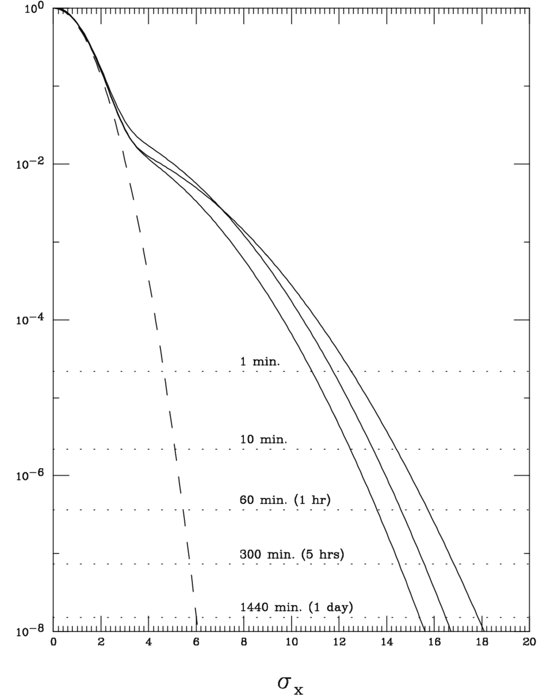
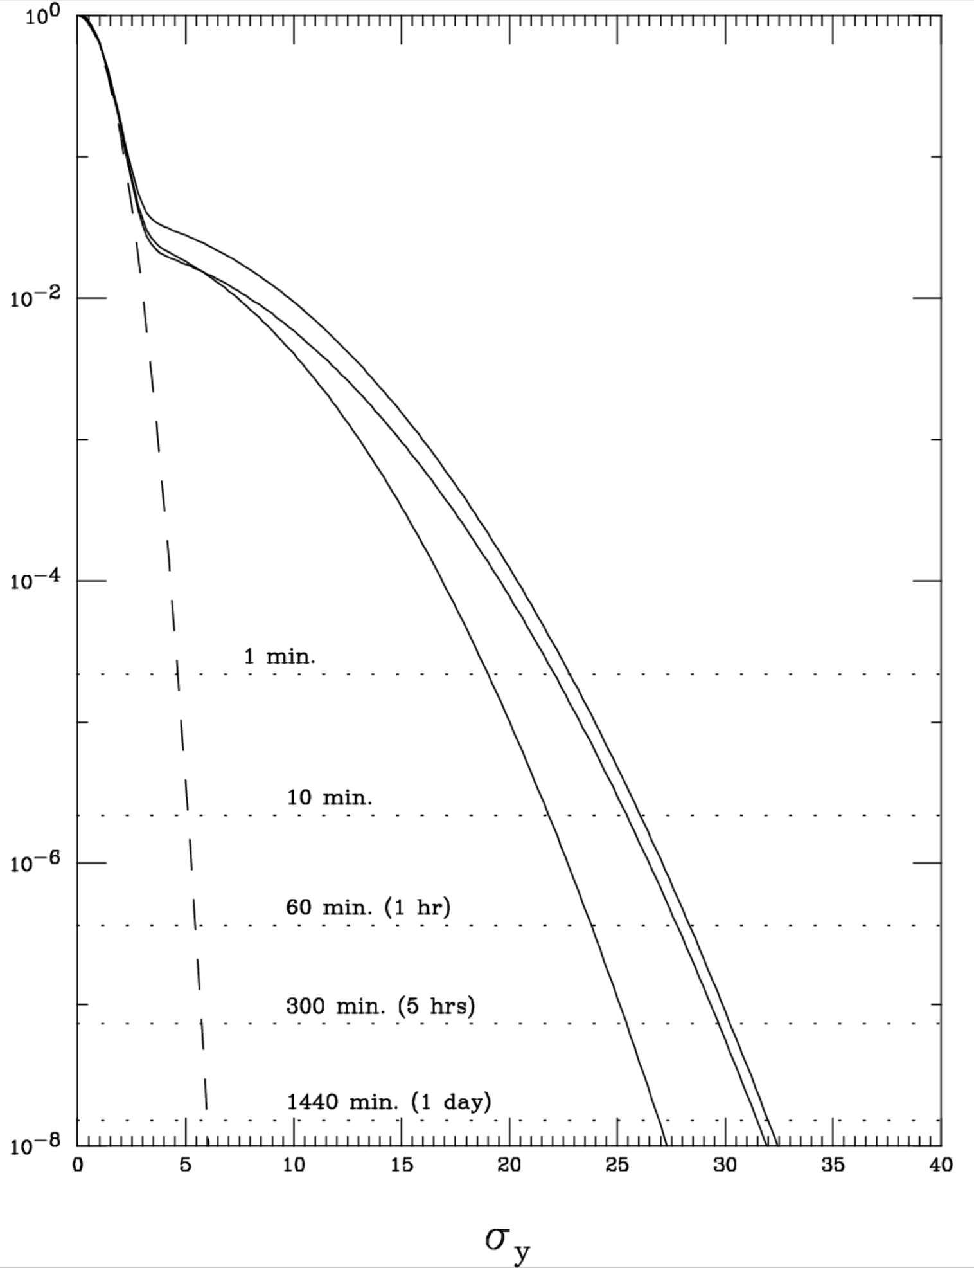
Beam transverse distribution plots for superKEKB
Tail distributions that can generate the background level seen in the superKEKB pixel detector (PXD) during early running.
They also approximately agree with the measured beam lifetime.
The one-day lifetime is derived by Matt Sands, “The Physics of Electron Storage Rings an Introduction”, 1970, SLAC-121
2
1
1
2
core
3
core
3

Slide 11
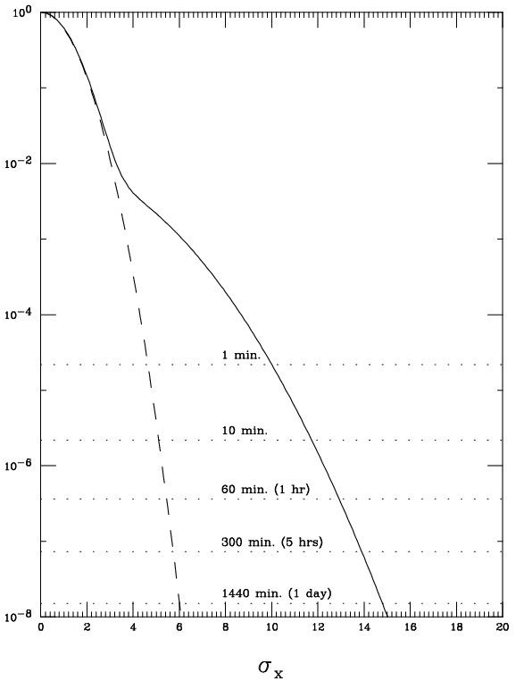
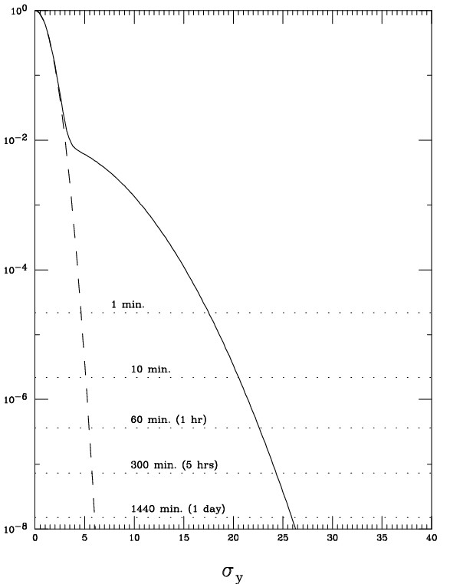
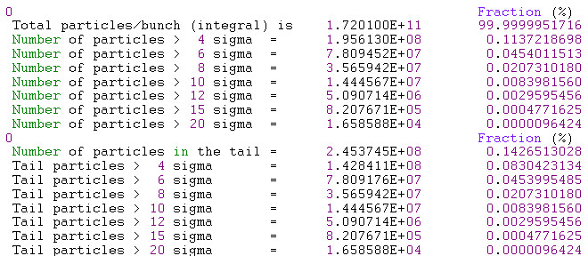
EIC beam tail model
With 1.7x10¹¹ particles/bunch we have about 1.7x10⁴ particles at the blue lines
This is the beam tail I used for an EIC study
It is what I call a “mid-range” tail
With collimators set at the BSC, the beam lifetime is about 2-3 hrs (red lines)
The fraction of the core that is in the tail is 0.14 %
Estimated lifetime for this beam tail is 3-4 hrs (red lines)

Slide 12
High Luminosity Issues
When the design luminosity is 1x10³⁴ or higher for e⁺e⁻ machines the collision begins to affect the detector through additional background sources
  Radiative Bhabhas
  Two-photon → e+e− (low energy pair)
  Tune shifts
  Beamsstrahlung
    First studied in Linear Collider designs
    Is now important in the FCCee and CEPC as a collision background while running at the Z pole and as a source of an intense photon beam exiting the IR
The high luminosity machines (superKEKB, FCCee and CEPC at the Z) have beam lifetimes that are dominated by the collision itself (less than 30 min)

Slide 13
Luminosity backgrounds
Radiative Bhabhas
  This background was first appreciated by the B-factories (PEP-II and KEKB) when the luminosity got up to 1x10³⁴
  This interaction produces high energy gammas that travel along the beam axis and off-energy beam particles that get over-focused in the final focus quads and crash into the local beam pipe producing shower debris in the detector
  It was recognized that the gammas traveling along the exit beam axis would be an excellent signal of the luminosity of the collision
    The high rate can produce a rapidly updating signal that can be applied to feedback programs as well as give the operators a signal to use to tune the machine
    The rate is also high enough to give a measurement of the luminosity of each bunch

Slide 14
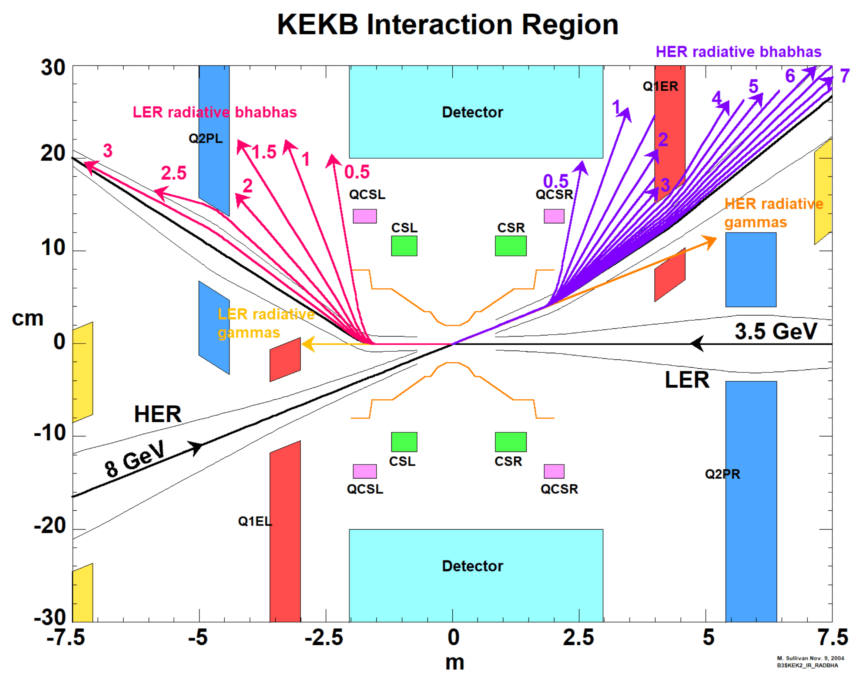
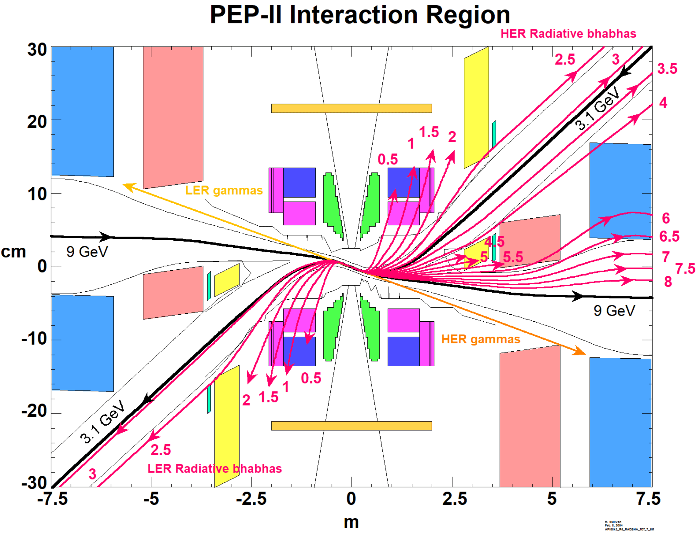
Radiative Bhabha tracks from the B-factories

Slide 15
Radiative Bhabhas Cont.
Both B-factory designs had strong bending fields on the outgoing beam lines which made the backgrounds from this source worse
SuperKEKB and all future ee designs now make sure that the outgoing and incoming beamlines have no nearby bending fields
  Bending magnets are now much farther away from the detector
Even so, this background source still ends up being the dominate detector background for Belle II at design luminosity
  The final focus quads overfocus these off-energy beam particles

Slide 16
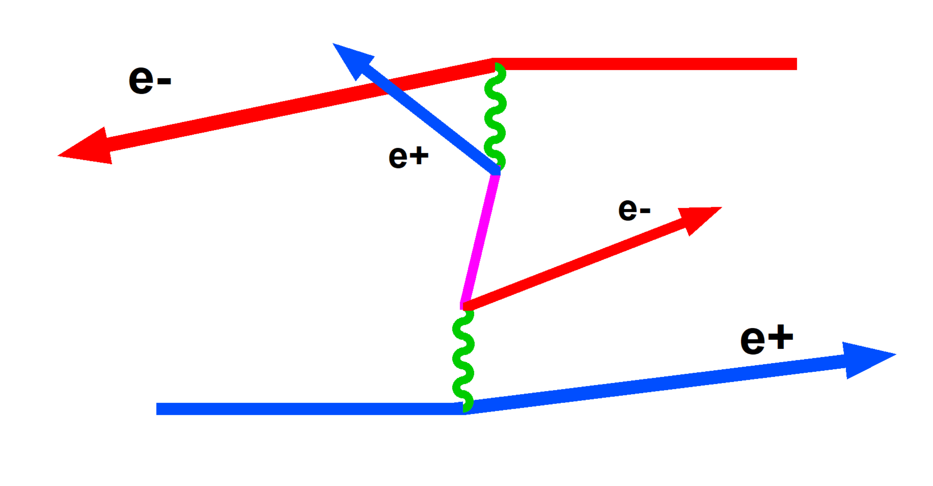
Low energy e+e- pair production
This interaction produces low energy e+e- pairs and these particles can cause a large increase in background hits in the vertex detector very close to the beam pipe
The particles spiral in the detector magnetic field and circle around the vertex detector components closest to the beam pipe thereby generating an enormous number of hits
This background can set a lower limit on the radius of the IR beam pipe
A higher detector magnetic field can help to reduce this background source

Slide 17
General Background Issues
Background levels are a continuing source of concern for the detectors of all new and present machines
When an accelerator starts up and while the accelerator team is working on finding the optimum working point and ironing out initial difficulties the background level in the detector can be uncomfortably high
  Many (almost all?) times the detector will stay offline during the initial startup and commissioning period
This is also the time when instability thresholds are discovered and when the “scrubbing” of the beam pipe around the ring is generating a lot of gas molecules which increases the pressure in the beam pipe throughout most of the ring

Slide 18
Background Issues (2)
High backgrounds from high dynamic gas pressure
As the rings become scrubbed and the dynamic pressure decreases then more current can be stored which will again increase the dynamic pressure
  The background levels in the detector will remain high during this period
  The acceptable background level set by the detector tends to limit the rate of current increase
  But if the beam lifetime becomes too short, then the injection capability may be the limiting factor
The luminosity remains low initially but as more current is added and as the machine gets tuned up the detector can begin to take data
The backgrounds are still high but as the dynamic pressure improves the backgrounds do diminish and the lower ring pressure also tends to raise other beam instability thresholds allowing the accelerator team to improve the performance of the collider

Slide 19
Background Issues (3)
The downstream photon beam
The high energy gammas from the radiative Bhabhas and from the Beamsstrahlung interaction as well as most of the quadrupole SR all travel down the axis of the outgoing beam line
  This includes some remnant of SR from the last upstream bend magnet as well as whatever SR is generated by the detector magnetic field
The high beam currents and the high luminosity of the collision together generate a significantly intense outgoing photon beam
The energy from this photon beam will begin to strike the beam pipe at the first bend magnet after the collision
The strike point must be carefully studied as the energy density can be high enough to melt most metals as well as create a significant source of neutrons
  In the case of the FCCee the effort to control this photon beam is leading to a design of a beam dump for this intense beam
These are all good reasons to move the downstream bend magnet as far as possible from the collision point

Slide 20
Summary
The new and current e+e− accelerators are using the experience gained from the B-factories to push beam currents up into the multi-Ampere regime
These high beam currents lead to extended beam pipe vacuum scrubbing and in turn large non-gaussian beam tail distributions which can influence the stored beam lifetime
The high luminosity of these designs lead to increased detector background levels from the collision itself and the perturbations of the collision also populate the beam tails

Slide 21
Conclusions
I have tried to touch on some of the important issues of high beam current, high luminosity machines and designs
I have left out many topics that merit further discussions (apologies!)
  HOM power issues is one in particular
The future of e+e- colliders shows promise of being a very exciting time with the upcoming Higgs factories (CEPC, FCCee) and with possible other factories (STCF…)
The EIC promises to be an equally exciting accelerator and will give us a much more detailed insight into how the proton is put together
Thank You

