Slide 1
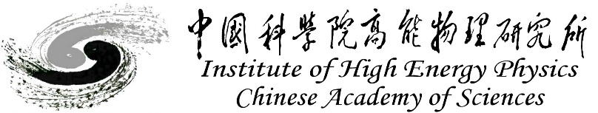
Development of CEPC Drift Chamber Software
Weidong Li (IHEP)
on behalf of the CEPC DC software working group
IAS workshop, Feb-13-2023

Slide 2
Contents
Introduction
  Detector design
  Event data model
Software implementations
  Data processing flow
  Detector simulation
  Track reconstruction
Summary

Slide 3
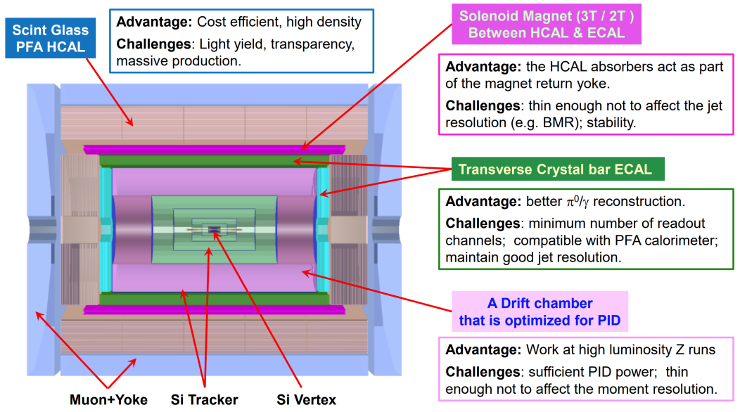
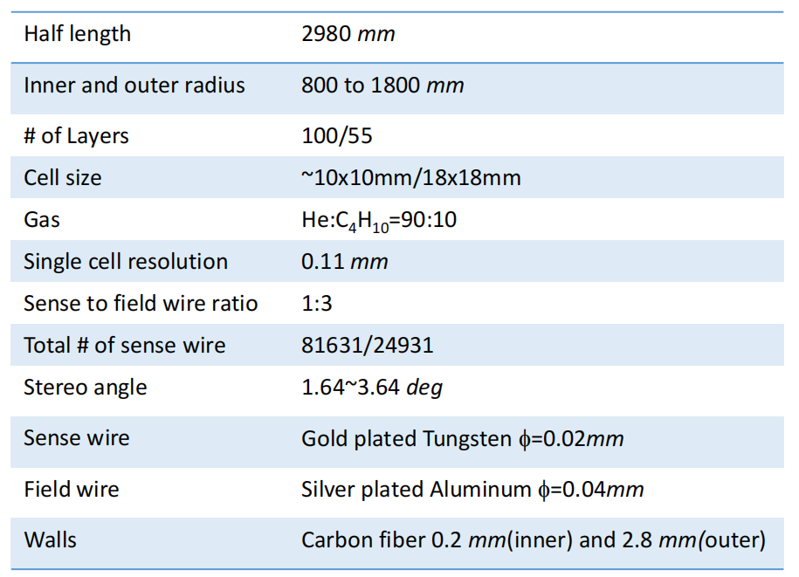
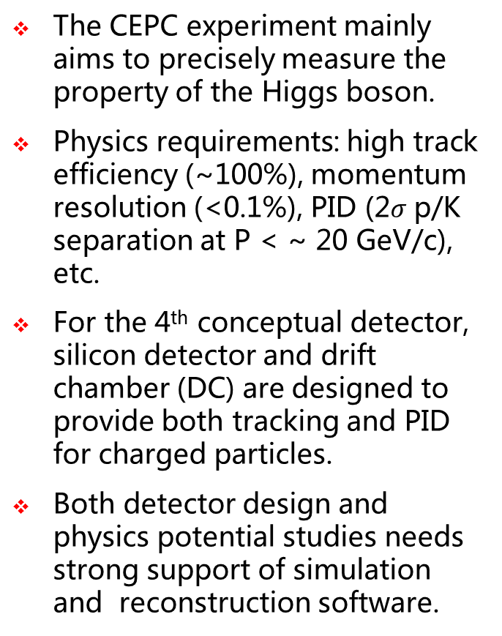
Detector Design
The CEPC experiment mainly aims to precisely measure the property of the Higgs boson.
Physics requirements: high track efficiency (~100%), momentum resolution (<0.1%), PID (2$σ$ p/K separation at P < ~ 20 GeV/c), etc.
For the 4th conceptual detector, silicon detector and drift chamber (DC) are designed to provide both tracking and PID for charged particles.
Both detector design and physics potential studies needs strong support of simulation and reconstruction software.
Notes:
It gives precise results with small uncertainty
The DC is quite important here, as it responsible for track rec…
So the performance of the DC needs to…

Slide 4
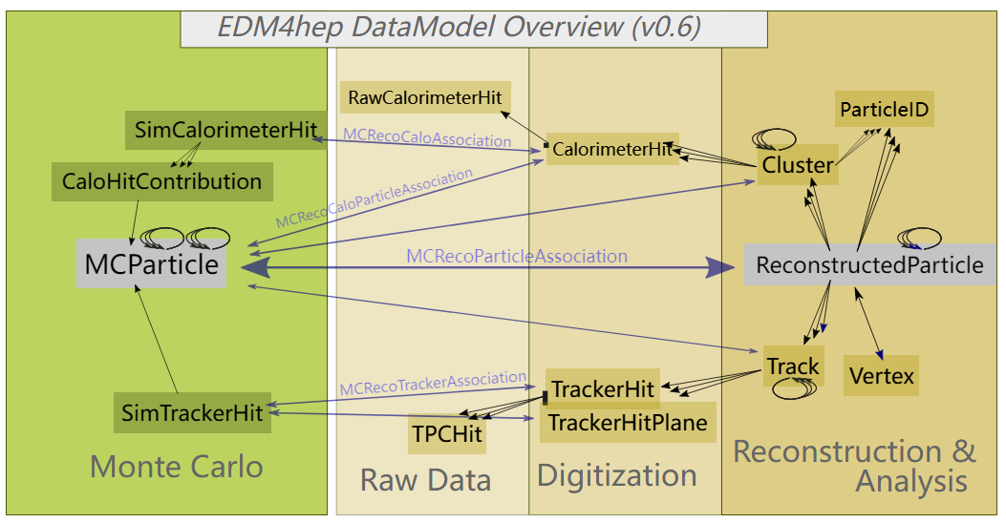
Event Data Model (1)
EDM4hep is the common event data model (EDM) being developed for the future experiments like CEPC, CLIC, FCC, ILC, etc.
EDM4hep describes event objects created at different data processing stages and also reflects the relationship between them.
For the drift chamber, MCParticle, SimTrackerHit, TrackHit, Track have been used since the begin of the software project.

Slide 5
Event Data Model (2)
As the development progressed, the previous versions of EDM appeared not able to fit all the requirements brought by newly added detector like the CEPC’s drift chamber.
Due to the strong flexibility of EDM4hep, TPCHit was extended to accommodate the new needs:
  Discussions inside EDM4hep group and also with the IDEA-CEPC drift chamber working group
  By using the upstream mechanism of PODIO, a common EDM was implemented for both TPC and drift chamber
Monte Carlo
Digitization
Reconstruction
EDM4dc:TrackerPulse
EDM4dc:RecIonizationCluster
EDM4hep:MCParticle
Rec Pulse
Rec ionization cluster
Cluster, ionization, pulse simulation
Pulse reconstruction
Cluster reconstruction
EDM4hep:Track
EDM4dc:SimPrimary
IonizationCluster
EDM4dc:TrackerData
dN/dx reconstruction
Waveform
EDM4dc:RecDndx
Sim ionization and pulse
Waveform Simulation
Rec dN/dx

Slide 6
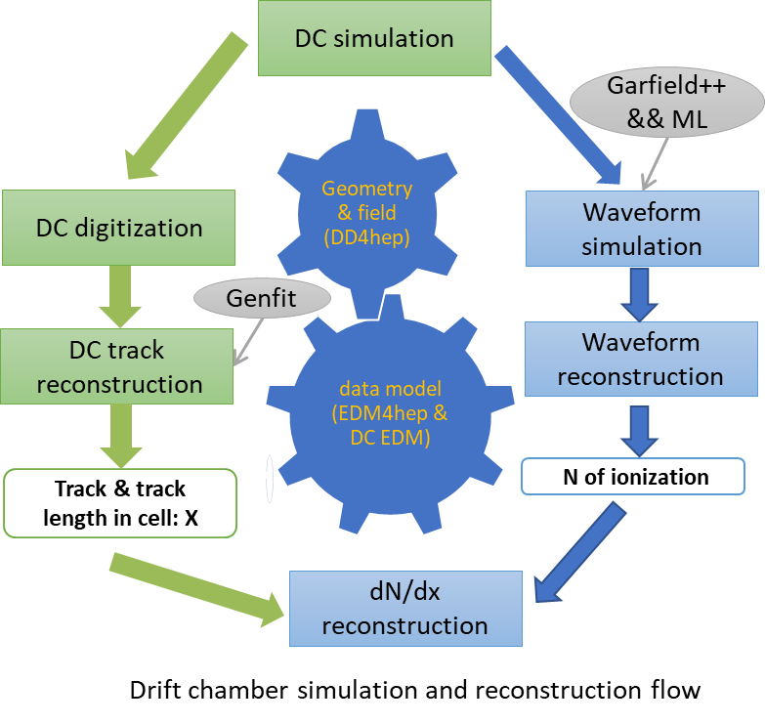
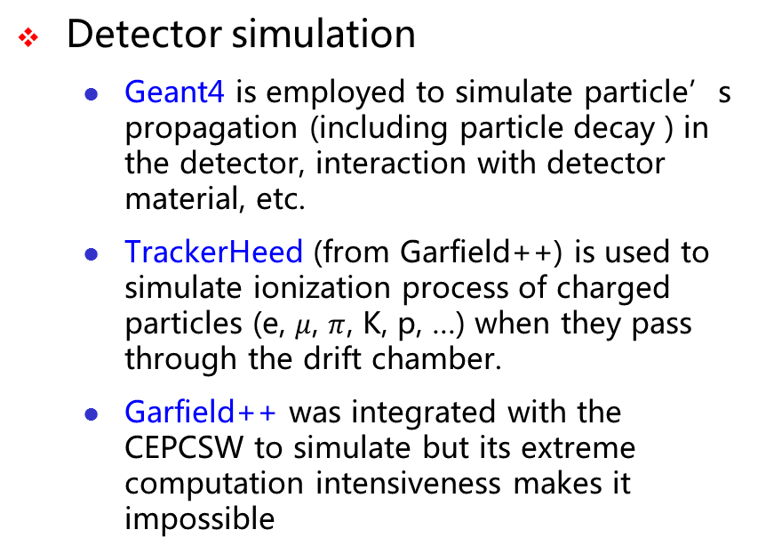
Data Processing Flow
Detector simulation
  Geant4 is employed to simulate particle’s propagation (including particle decay ) in the detector, interaction with detector material, etc.
  TrackerHeed (from Garfield++) is used to simulate ionization process of charged particles (e, $μ$, $π$, K, p, …) when they pass through the drift chamber.
  Garfield++ was integrated with the CEPCSW to simulate but its extreme computation intensiveness makes it impossible
  Machine learning (ML) based simulation: training data is created by Garfield++ and ML model is be executed to replace Garfield++ in the detector simulation.
Reconstruction
  Extrapolating the track segment found in the inner silicon detector to drift chamber, collecting the hits on the path, and applying a Kalman Fit to the found track .
  dN/dx reconstruction: waveform reconstruction + path length calculation

Slide 7
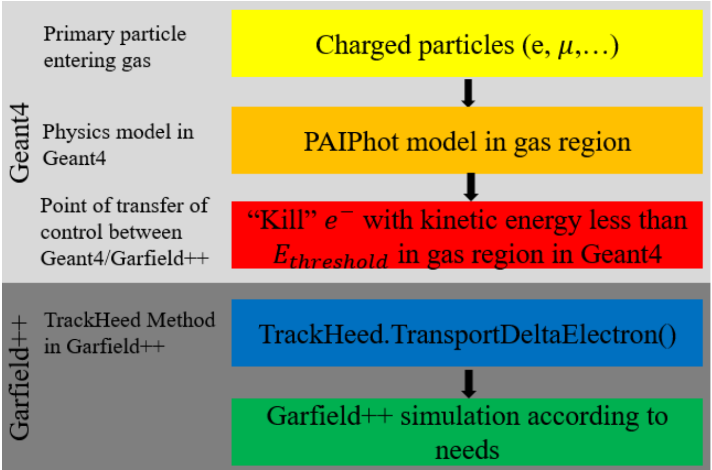
Simulation of Gaseous Detector (1)
Since Geant4 can not be used to simulate the ionization process properly (arXiv:2105.07064), Garfield++ becomes a common tool for precise ionization simulation.
“Interfacing Geant4, Garfield++ and Degrad for the Simulation of Gaseous Detectors” studied how to combine Geant4 and Garfield++ to get correct energy deposition or total number of ionized electrons (adopted by COMET experiment)
Method:
  Geant4 PAI (Photo Absorption Ionization) model to simulate primary or secondary ionization
  TrackHeed (from Garfield++) to simulate ionization from residual delta electron

Slide 8
Simulation of Gaseous Detector (2)
TrackHeedSimTool (Gaudi tool) was implemented for using TrackHeed to do ionization simulation
  Input: G4Step information (particle type, initial position and momenta, ionization path length)
  Use TrackHeed (used by Garfield++) to simulate one step length (or multi-step length for speed up) ionization (new API contributed to Garfield++ PR)
  Output: primary and total ionization information (contains position, time, cell id), saved in EDM
  The kinetic energy of G4Track will be updated according to the energy loss in the ionization
  Non-uniform magnetic field can be handled easily
SimPrimaryIonizationCluster
G4Step
TrackHeedSimTool
SimIonization
Garfield++ is precise but extremely time consuming, it takes $𝒪(1)$ to $𝒪(10)$ seconds to simulate an electron (a few hours for one track)
Notes:
So we proposed to combined Geant4 and Garfield directly in Geant4 simulation
We created a Gaudi Tool for this task
Two problems needs to be solved:
1, simulating desired step ionization length
2, time consuming

Slide 9
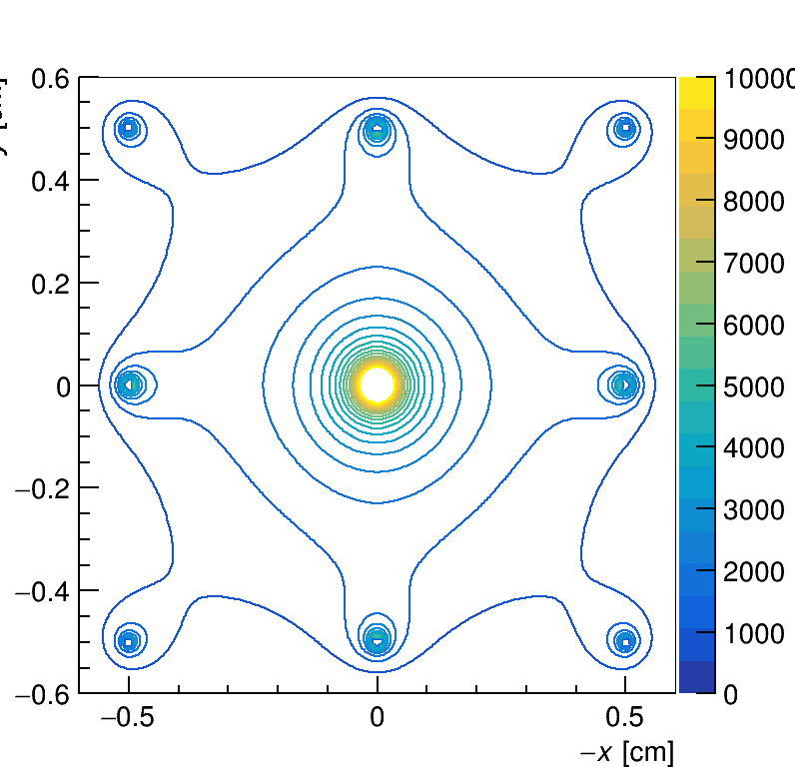
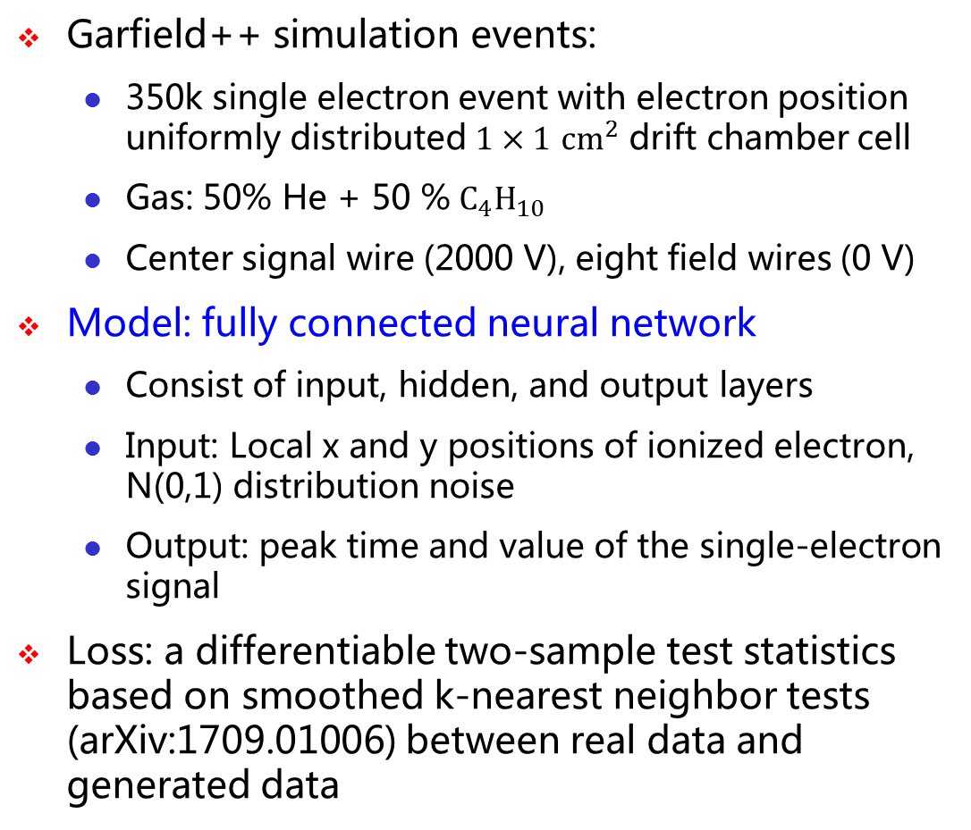
ML-based dN/dx Simulation
Garfield++ simulation events:
  350k single electron event with electron position uniformly distributed $1×1$ ${cm}^{2}$ drift chamber cell
  Gas: 50% He + 50 %$C_{4}H_{10}$
  Center signal wire (2000 V), eight field wires (0 V)
Model: fully connected neural network
  Consist of input, hidden, and output layers
  Input: Local x and y positions of ionized electron, N(0,1) distribution noise
  Output: peak time and value of the single-electron signal
Loss: a differentiable two-sample test statistics based on smoothed k-nearest neighbor tests (arXiv:1709.01006) between real data and generated data
Electric field contour plot
Input = x, y, noise ~ N(0, 1)
Dense(3, 814, activation=‘relu')
gen(time, value)=Dense(814,2)
Dense(814, 814, activation=‘relu')
Mini-batch training: using Faiss (fast similar search) to get a batch (1024) of closet data (L2 distance)
Notes:
This diagram gives the detailed configuring of our generative model
Last but not least, the fast similar search tool faiss is used in our mini-batch training, which can quickly get a batch of closet data for training
2000 volt
Zero volt

Slide 10
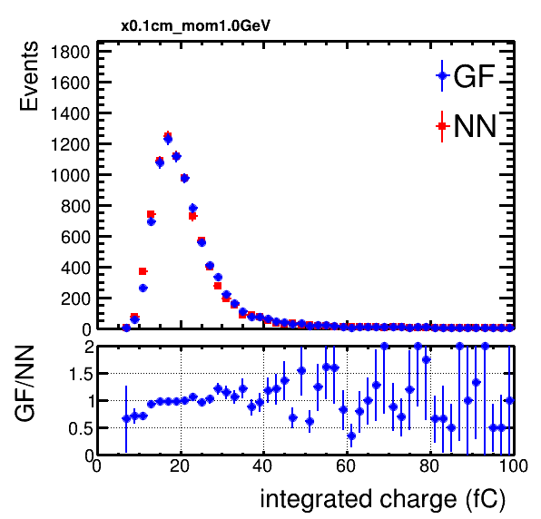
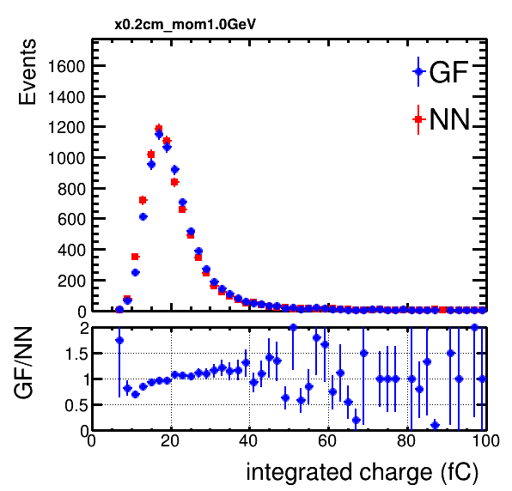
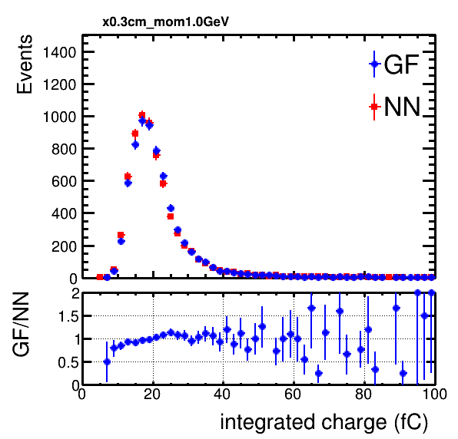
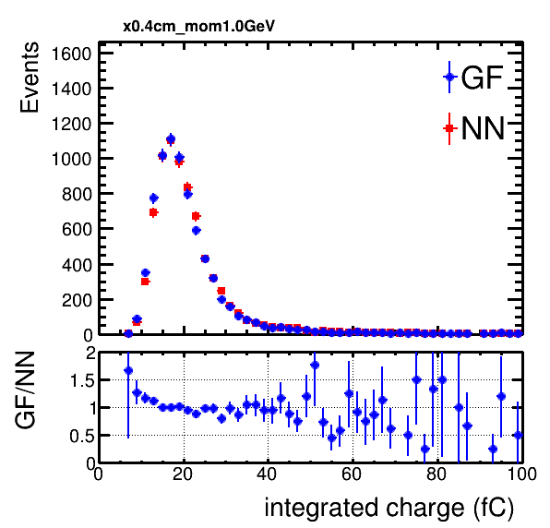
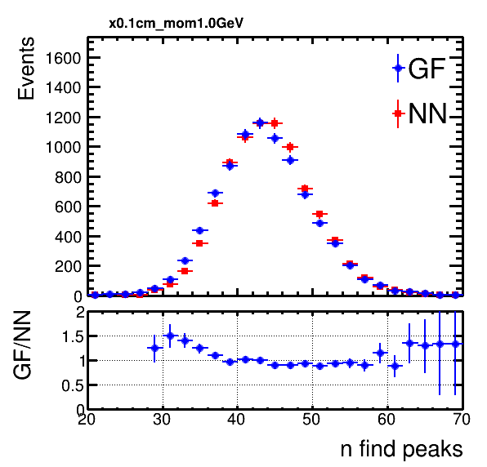
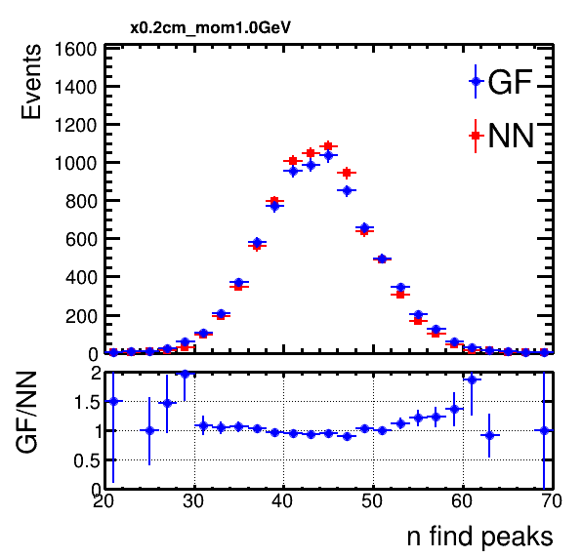
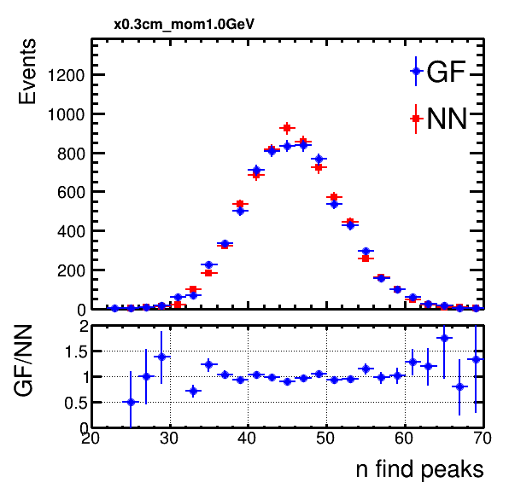
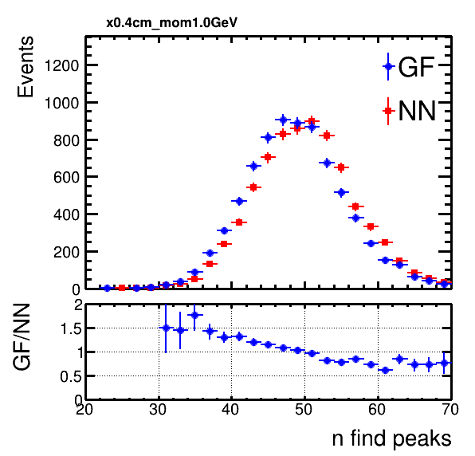
dN/dx Simulation Performance (1 GeV e- )
x=0.1 cm
x=0.2 cm
x=0.3 cm
x=0.4 cm
Checked total integrated charge and number of found peaks(using scipy.signal.find_peaks)
Good agreement in general (a little bias for the number of found peaks for x=0.4 cm. Could be improved in future), Similar results for other energy points (0.5, 5, and 10 GeV)
Notes:
Test the simulation results for 1 GeV electron when it pass different positions of the drift chamber cell, first column is for x = 0.1 cm, second column is ..

Slide 11
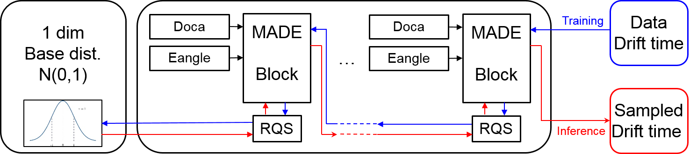
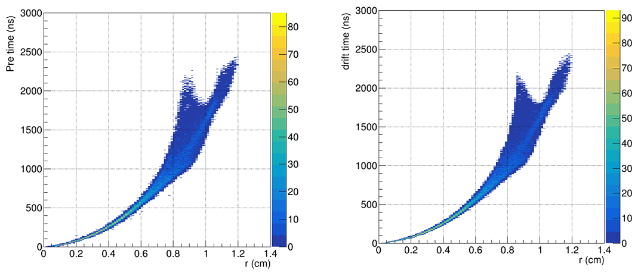
Simulation of Drift Time (3)
Normalizing Flow network was adopted
  A similar model to CaloFlow is used, RQS (for transformation)+MADE block (for the parameters of RQS)
By using the NN model, the drift time can be simulated as well:
  Drift time versus distance of closest approach (Doca) between a track and the signal wire

Slide 12
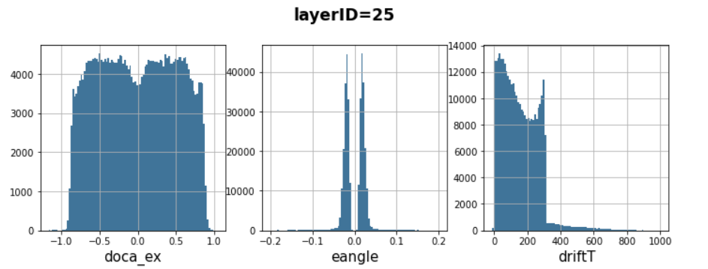
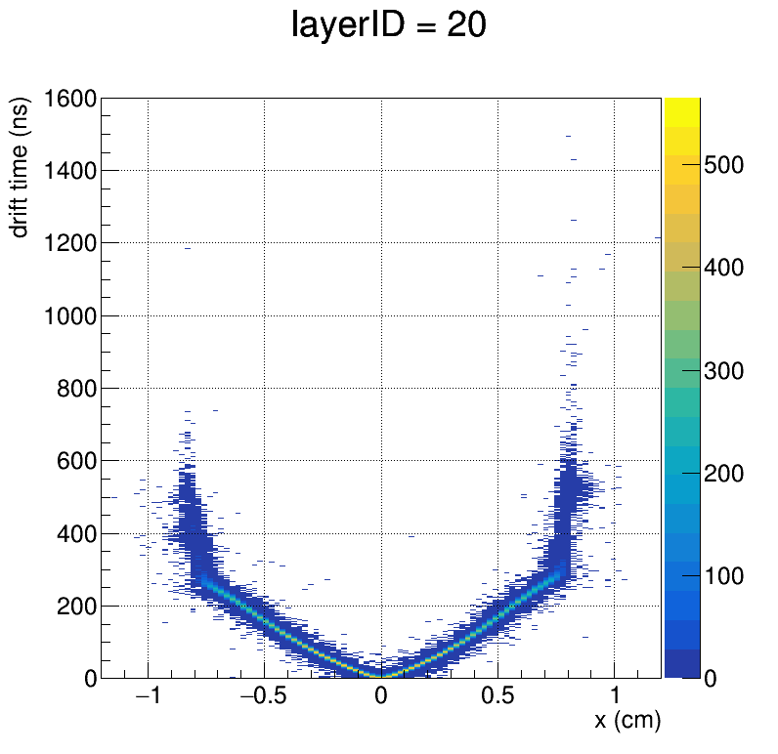
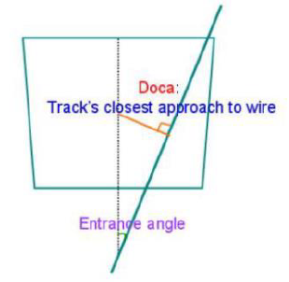




Performance Validation with BESIII Data (1)
To investigate the possibility of applying ML to simulation, the real data from the BESIII experiment was used evaluate the performance of the chosen neural network.
Radiative bhabha events were selected to study the simulation of drift time in the chamber cell
  X-T relation: the Doca versus drift time
Prepare experimental
data for training
Learn drift time distribution:
$$D_{drift time}=f(doca,eangle,layer)$$
Check $D_{drift time}^{data}$, $D_{drift time}^{NN sim.}$
check the X-T cure:
$C_{X−T}^{data}$, $C_{X−T}^{NN sim.}$
check spatial resolution:
using $C_{X−T}^{data}$, $C_{X−T}^{NN sim.}$
drift time vs doca

Slide 13
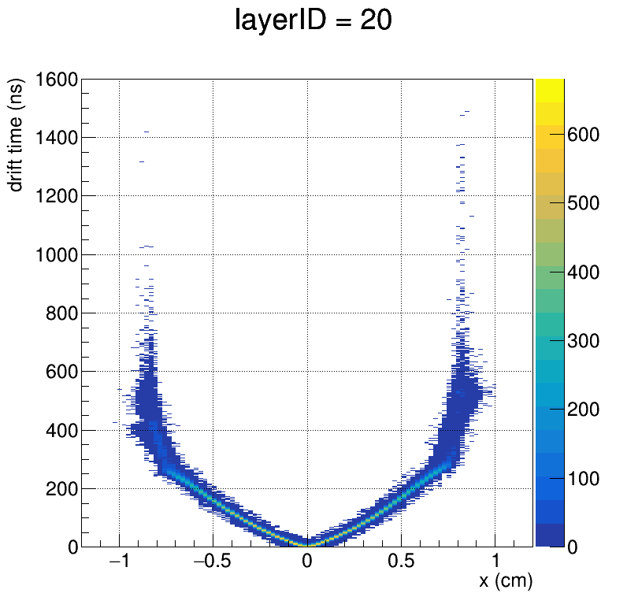
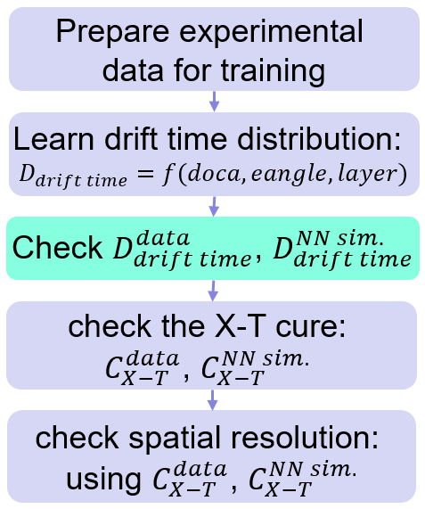
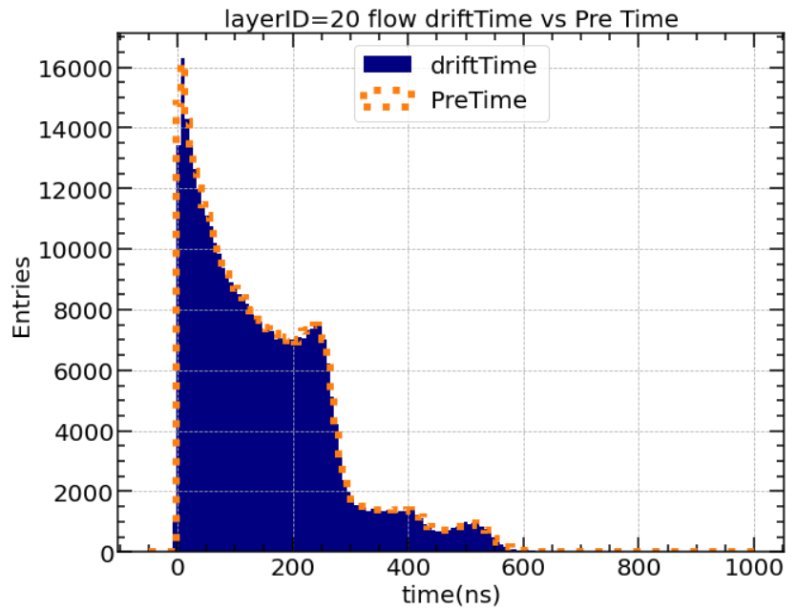



Performance Validation with BESIII Data (2)
Comparison of drift time distributions between real data and ML-based simulation
$D_{drift time}^{data}$ vs doca
$D_{drift time}^{NN sim.}$ vs doca
Good agreement was found

Slide 14
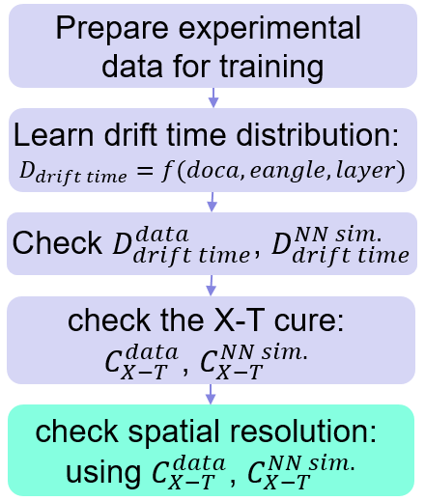
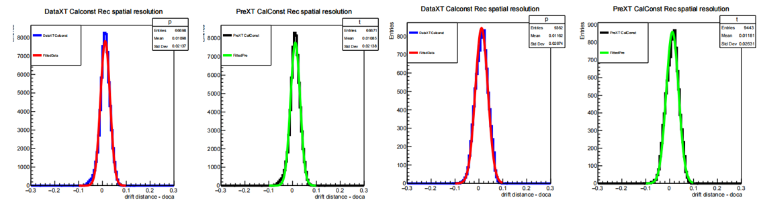
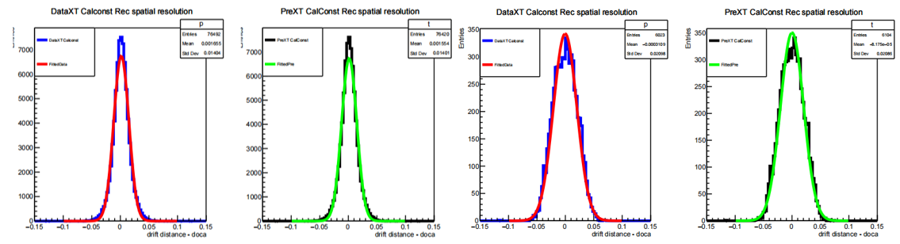
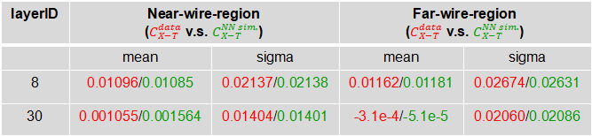
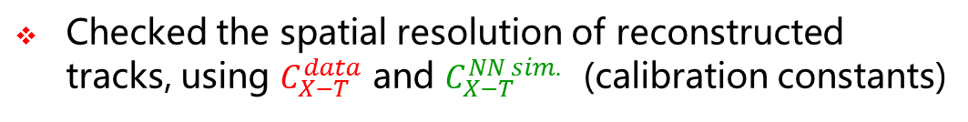
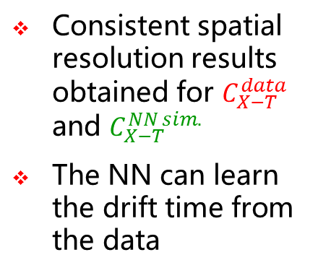
Performance Validation with BESIII Data (3)
Checked the spatial resolution of reconstructed tracks, using $C_{X−T}^{data}$ and $C_{X−T}^{NN sim.}$ (calibration constants)
layerID=8
layerID=30
Consistent spatial resolution results obtained for $C_{X−T}^{data}$ and $C_{X−T}^{NN sim.}$
The NN can learn the drift time from the data
Near-wire-region
Far-wire-region
layerID | Near-wire-region ($C_{X−T}^{data}$ v.s. $C_{X−T}^{NN sim.}$) |  | Far-wire-region ($C_{X−T}^{data}$ v.s. $C_{X−T}^{NN sim.}$)
 | mean | sigma | mean | sigma
8 | 0.01096/0.01085 | 0.02137/0.02138 | 0.01162/0.01181 | 0.02674/0.02631
30 | 0.001055/0.001564 | 0.01404/0.01401 | -3.1e-4/-5.1e-5 | 0.02060/0.02086

Slide 15
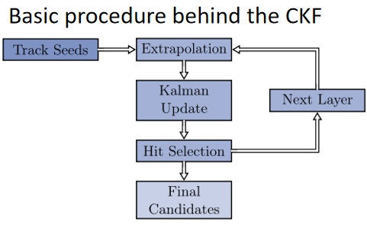
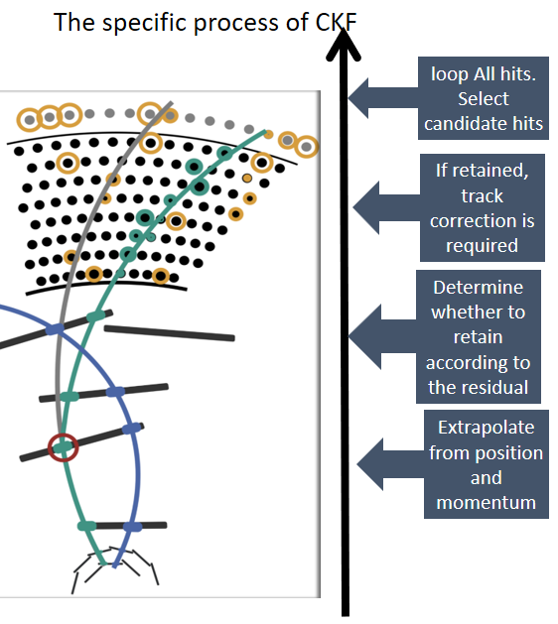
Track Reconstruction
Tracking with Combinatorial Kalman Filter (CKF) method
  Combining track recognition and track fitting
  Used by many high energy physics experiments
Track finding with CKF in the drift chamber
  Implementation: track segments reconstructed in the silicon dectctor, called seeds, are extrapolated to the DC and all the DC hits belonging to the track are collected
Current progress:
  Managed to port the Belle II code to the CEPCSW
  Performance validation is ongoing

Slide 16
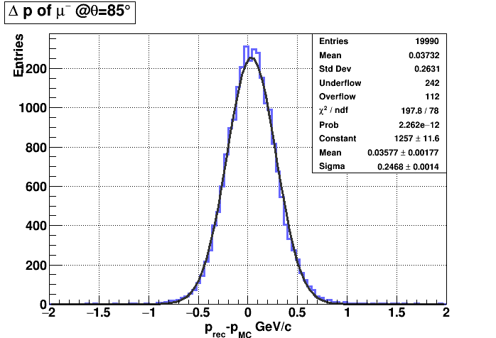
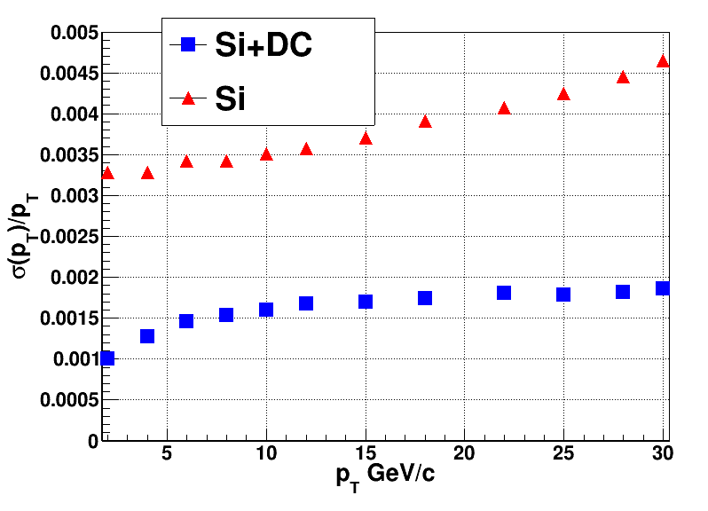
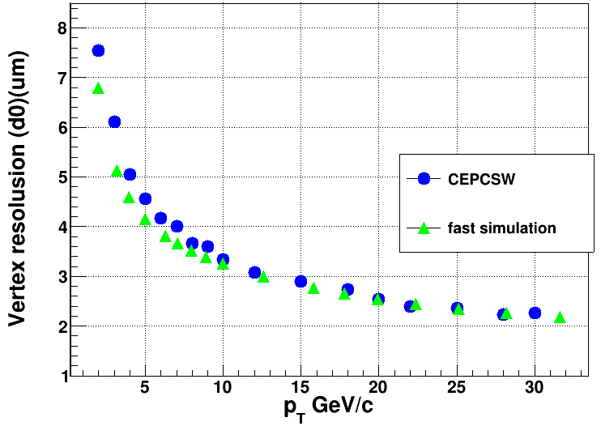
Tracking Performance (1)
  Tack recognition using the MC truth information was also implemented
Genfit is adopted as the track fitter
  using kalman filter method
  non-uniform magnetic field field and material effects are taken into account
Momentum/vertex resolution
  Particle gun：mu-，100 GeV@85°

Slide 17
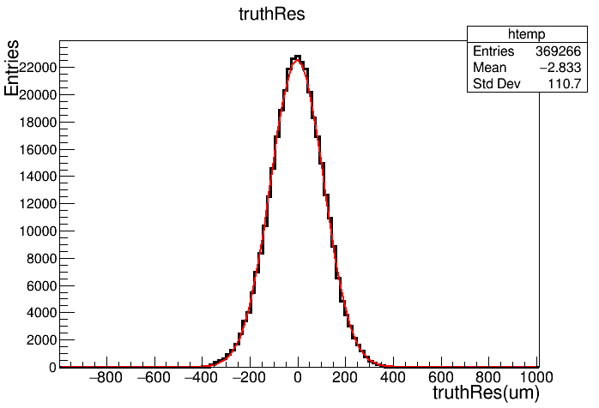
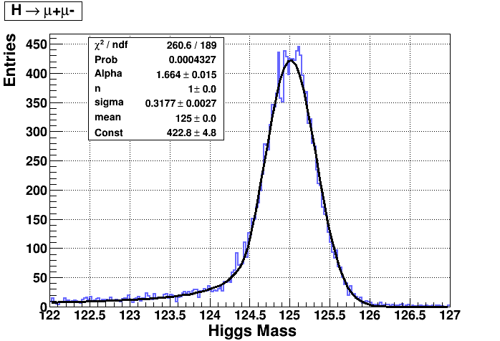
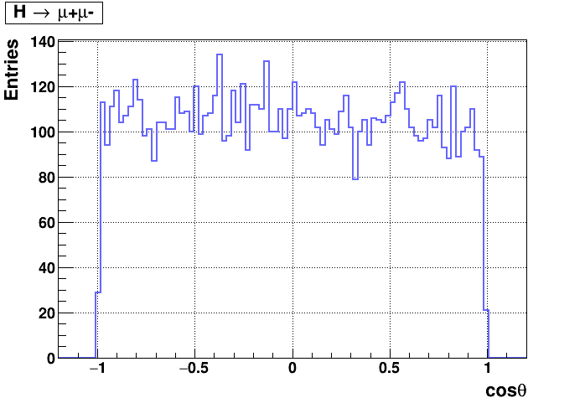
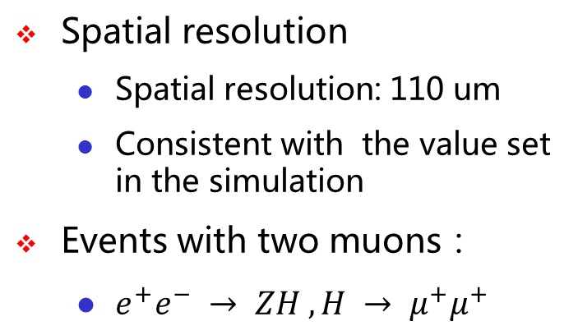
Tracking Performance (2)
Spatial resolution
  Spatial resolution: 110 um
  Consistent with the value set in the simulation
Events with two muons：
  $e^{+}e^{−} → ZH , H → μ^{+}μ^{+}$

Slide 18
Summary
As part of the Key4hep project, event data model of TPC detector was extended to accommodate the requirements from cluster counting studies.
In CEPCSW, Garfield++ was integrated with the Geant4 to perform a precise simulation for the drift chamber.
Machine learning based simulation was developed to model the response of the chamber cell.
Tracking algorithm was implemented by reusing the code of Belle II and performance validation is still in progress.
Thank You !
谢谢

