Slide 1
TPC R&D and operability at circular colliders
Physics and Detector Mini-workshop IAS HEP Program
HKUST, Hongkong, February 12, 2023
Paul Colas (CEA/Irfu Université Paris Saclay)
Thanks for contribution from LCTPC colleagues. Special thanks to K. Fujii, S. Ganjour, D. Jeans, P. Kluit

Slide 2
Tracking at an EW/Higgs/top factory
At the Z pole and beyond, particle ID is an essential ingredient, for tagging and studies of Heavy Flavours (together with an excellent vertex detection)
A TPC ideally combines dE/dx measurement and low material budget, allowing a continuous measurement of the tracks. A strong magnetic field aligned with the TPC drift field limits diffusion and allows charged track momentum measurement.
Together with silicon (vertex) detectors, it allows the excellent performance in resolution needed to extract the Z recoil peak to tag Higgses in a model-independent and unbiased way
TPC is the main tracker for the ILD detector concept. At ILC, it profits from a beam time structure allowing power switching and gating. ILD is considering adapting the concept in case a circular collider is built first.

Slide 3
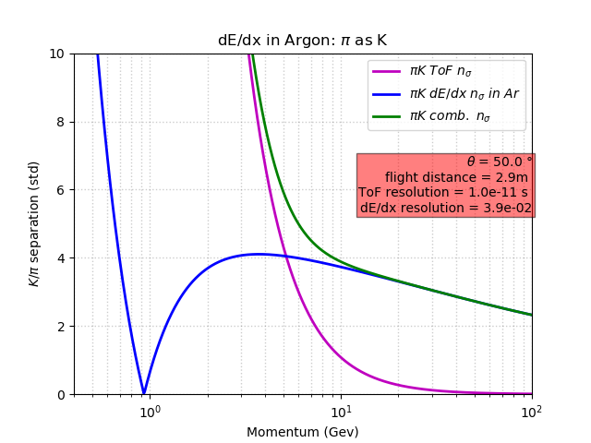
Particle Identification
SEPARATION POWER
dE/dx and TOF (10 ps) Combined
(see also Manqi Ruan)
R. Aleksan

Slide 4
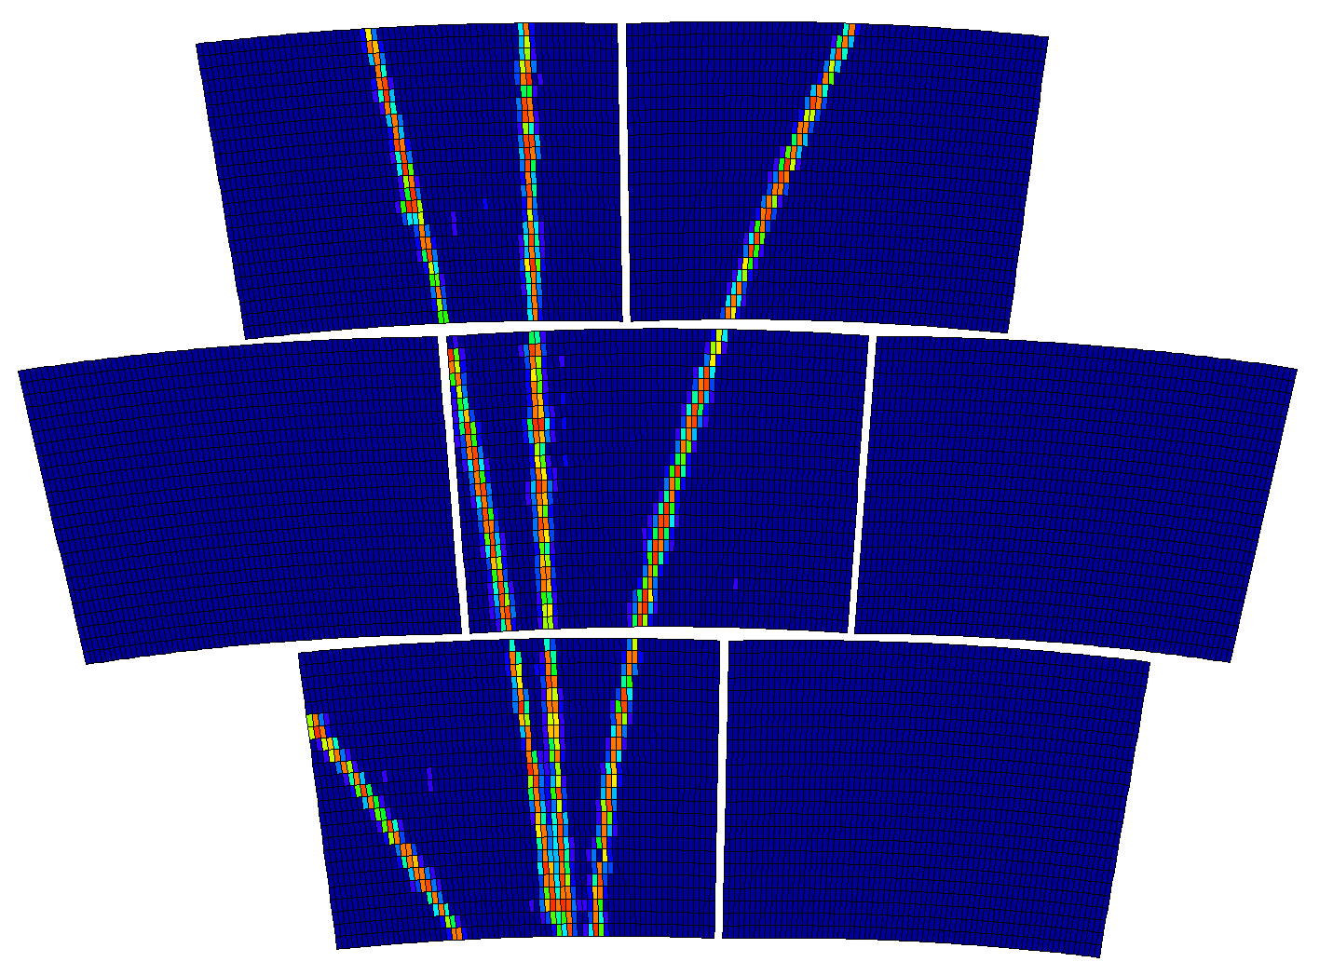
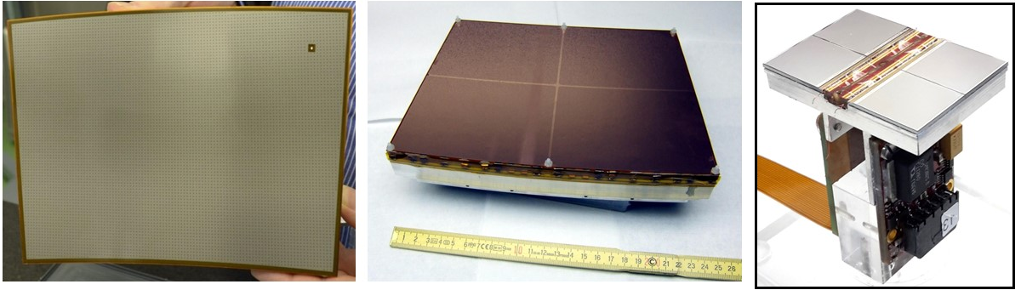
TPC R&D
The TPC R&D is carried out within the LCTPC collaboration (spokesperson Jochen Kaminski). There are 3 main options for the readout : Micromegas with a resistive anode (ERAM), GEM, and Gridpix.
Beside this dedicated R&D, lessons are learned from experiments in progress, using TPCs with similar techniques issued from e+e- collider studies : ALICE at LHC (GEMs), T2K/ND280 at J-PARC (resistive Micromegas)
Feasibility and performance has been demonstrated in ILC conditions. New ILD strategic goal is to adapt to conditions at a high lumi circular collider.
Micromegas
GEM
Gridpix

Slide 5
Gas choice
Base gas :
  Ar for largest ionization : 97 e-ion pairs in ~35-40 clusters
  He for well-separated clusters easing dN/dx (but cannot set field to the maximum drift velocity over 2 m)
Additional gases
  Isobutane : quencher, cuts UVs to avoid avalanche propagation
  CF₄ : increases electron drift velocity and reduces diffusion in magnetic field by a factor of ~10 at 3.5 T and ~5 at 2T.
  Low e attachment (keep O₂ and H₂O below ~10 ppm to drift over 2m) velocity)
T2K gas Ar:CF4:Isobutane 95:3:2 satisfies all requirements for a TPC
Note that the optimal gas is not the same for cluster counting (He) and for space resolution (large ωτ for low diffusion: ‘fast gas’)

Slide 6
Distortions from positive ions
Ions drifting in the gas are very slow (typically a few m/s)
Primary ions from ionization in the gas (from event tracks of from machine background) or secondary ions created during amplification and back-flowing in the drift region, drift very slowly, producing space charge which distorts the trajectories of the electrons drifting from the tracks by creating a component transverse to the drift field
This effect is common to all the amplification devices
Calculated in 2011 by D. Arai and K. Fujii
2022-2023 : New calculation in progress, adapt to Z pole
(K. Fujii, D. Jeans, S. Ganjour, Mingrui Zhao…)
Simulation by M. Killenberg (2009)

Slide 7
Calculation of the distortions (K. Fujii)
The ion charge density creates a potential at each point of the field cage volume :
From which one derives the transverse field (with I, K modified Bessel functions)
In practice one needs ~n=500 first terms

Slide 8
Calculation of the distortions II (K. Fujii)
The Langevin equation gives the modification of the drift velocity :

Slide 9
Positive ion density at the Z peak
From hadronic Z decays (Tox MC by K.Fujii, full simulation by Daniel Jeans)
60 KHz of Z decays : 26 000 ion disks created in the amplification pile-up in the 0.44 s of flushing time of the ions (assuming 5 m/s ion drift velocity)

Slide 10
Case of FCC or CEPC at Z pole : almost continuous set of disks.
https://agenda.linearcollider.org/event/5504/contributions/24543/attachments/20144/31818/PositiveionEffects-kf.pdf

Slide 11
K. Fujii
IBF*Gain=1
ωτ = 5.7 (B=2T)

Slide 12
D. Jeans

Slide 13
Resulting distortions at Z pole for IBF*gain=5 ~800 µm (preliminary)
(330 µm if IBF can be fully suppressed…)
Can it be corrected for?
Only on average, or the charge must be locally measured. This is difficult, as the micro-curlers saturate the amplifiers.
Maybe only way, in Gridpix, using the segmented mesh of the chips : monitor the mesh current of each chip.

Slide 14
Similar situation in ALICE at LHC Run3. IBF~1%, gain=2000.
200 ms ion drift
50 kHz lead-lead collisions.
-> the ions of 10 000 collisions pile-up in a TPC length.
Space-charge density cause distortions up to several cm, varying with instantaneous luminosity and fluctuating.
Measurement of the space charge (from integrated currents) necessary.
ALICE, Jens Wiechula, LCTPC collaboration meeting, Jan 18, 2023.

Slide 15
Pair production background
Studied with GUINEA-PIG MC (ILC, D. Schulte 2003, A. Vogel 2007) and GUINEA PIG++ (FCC, E. Perez 2019, A. Ciarma 2022)
ILC 250 GeV
B=3.5 T
FCC 91.2 GeV
B=2 T

Slide 16
Beamstrahlung photons at FCC
A. Ciarma
Enormous power radiated and copious photon production with energy of a few MeV: will produce e+e- pairs in the TPC gas if not extracted
Copious production of few-MeV photons
Also beam-gas background is being assessed

Slide 17
SUMMARY
Running a TPC @ Z pole @ 2. 10³⁶ cm⁻² s⁻¹ is not trivial
65 kHz of Z decays means 1 decay every 1.2 mm on average
The positive ions of 22 000 Zs will accumulate in the TPC volume before drifting out, causing distorsion of several 100 µm at least
The ion backflow has to be suppressed drastically
A continuous DAQ and tracking will be necessary, with real-time corrections for space point distortions
The experience from ALICE at LHC (50 kHz of Pb-Pb collisions) will be crucial
Control of beam-induced BGs will be crucial, not only at the Z but also at HZ.

