Slide 1
Review of Vertex/Silicon detector Technology
Zhijun Liang
Institute of High Energy Physics, CAS

Slide 2
Outline
Overview of vertex detector
CEPC vertex detector R & D
More Future prospect

Slide 3
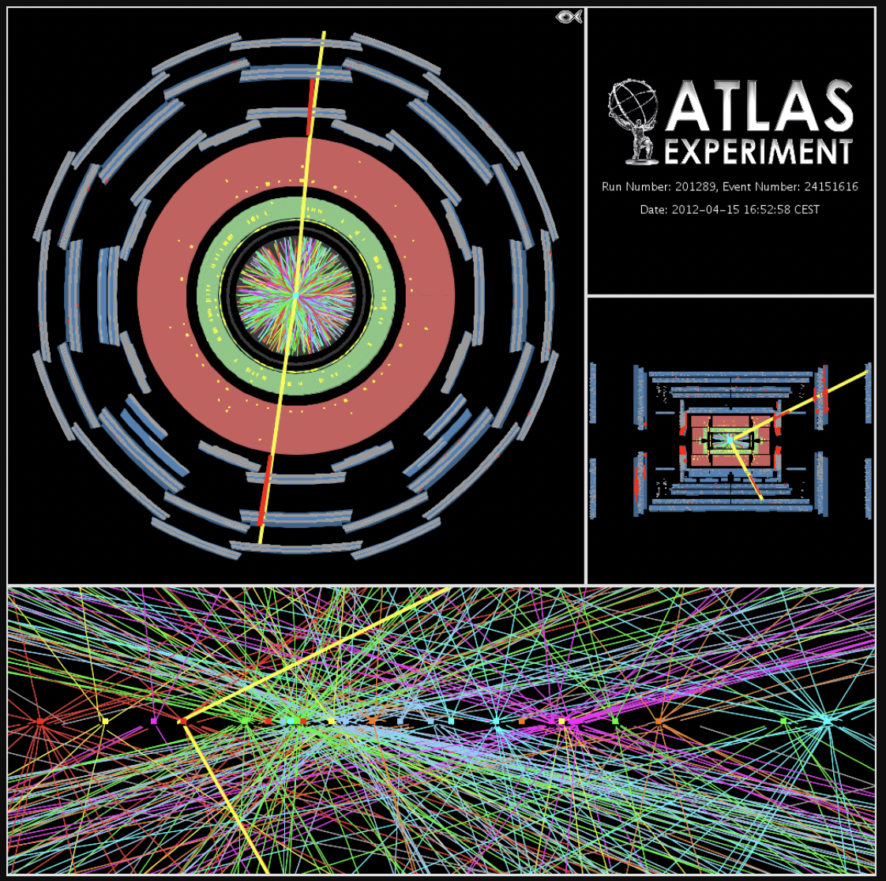
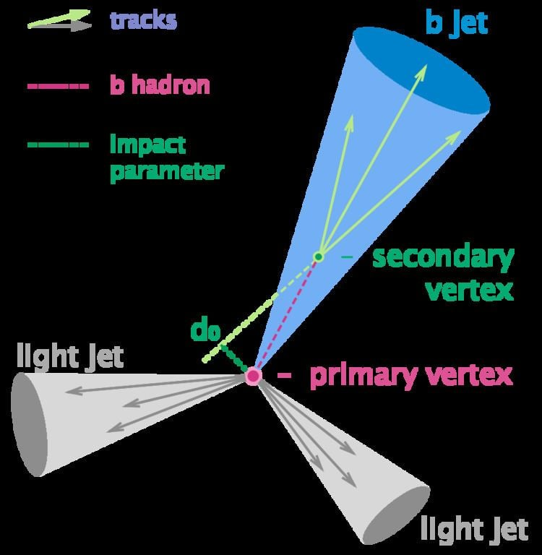
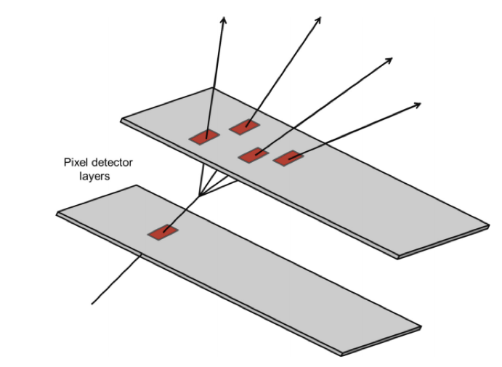
Why we need Vertex detector ?
  High precision vertex detector essential
    Flavor physics
    Higgs physics (H→bb/cc/gg and H→ττ)
    Pileup vertex rejection for hadron collider
11 Pileup vertex in Z->μμ events at ATLAS

Slide 4
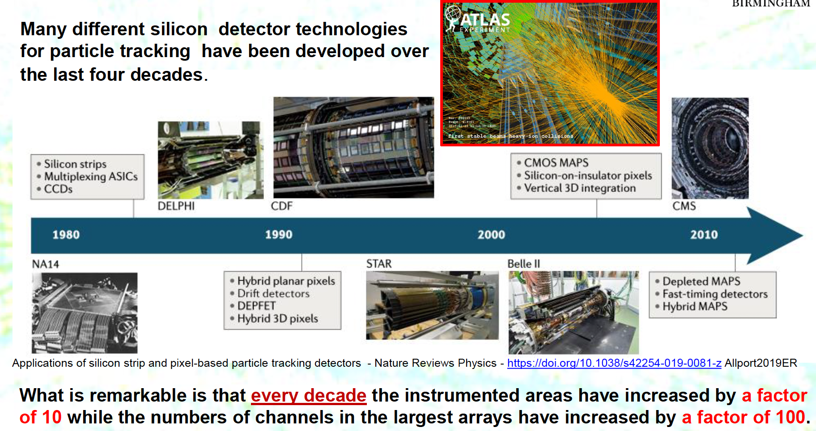
Silicon detector development
P.Allport, CERN detector seminar,
https://indico.cern.ch/event/960851
CERN, Oct.8 2020

Slide 5
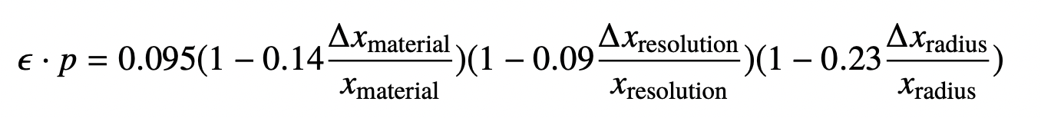
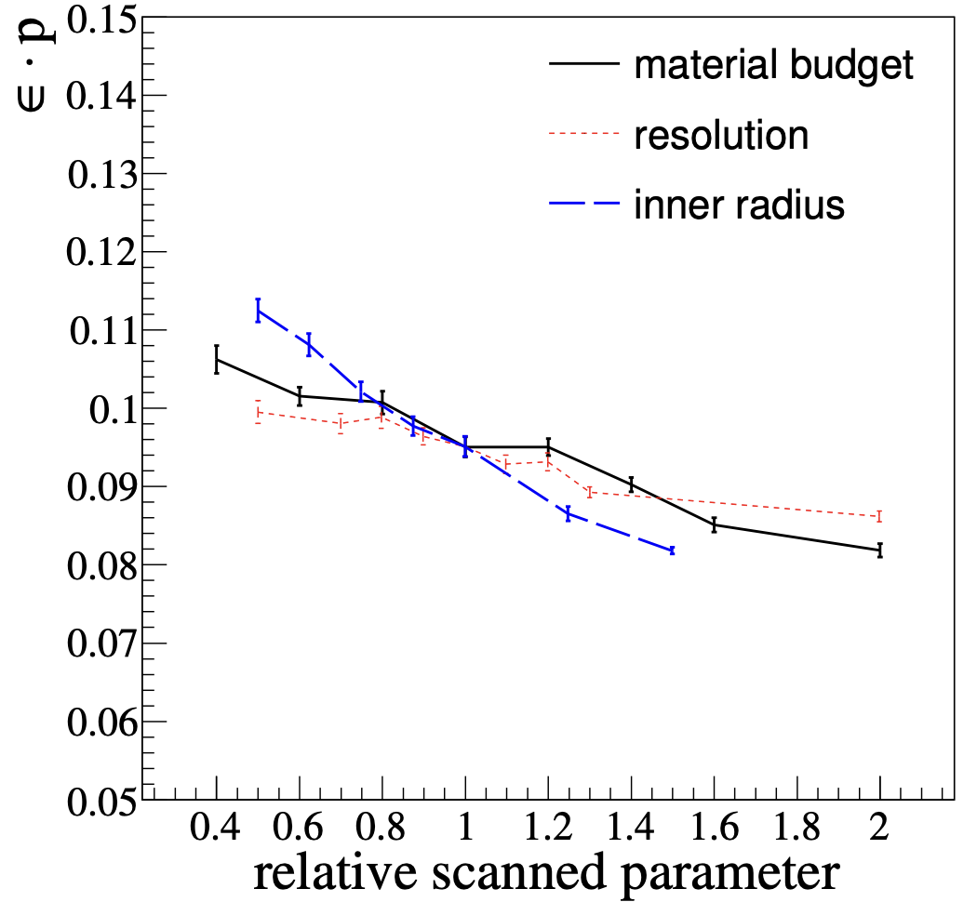
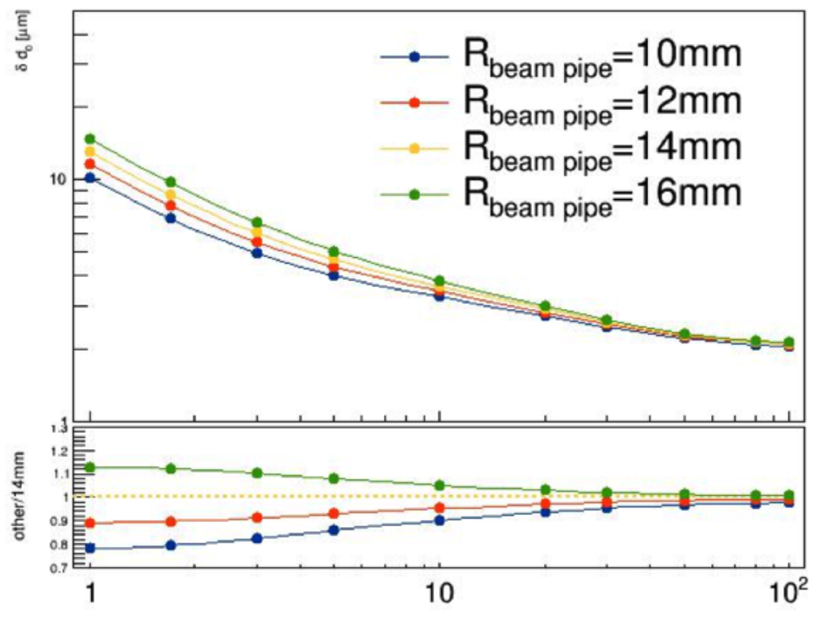
Vertex detector for future collider: general wishlist
Wishlist for vertex detector
  Closer to beam pipe (most important!)
  Minimum material
  High resolution pixel sensor
ZG Wu, MQ Ruan et al., Study of vertex optimization at the CEPC, 2018 JINST 13 T09002

Slide 6
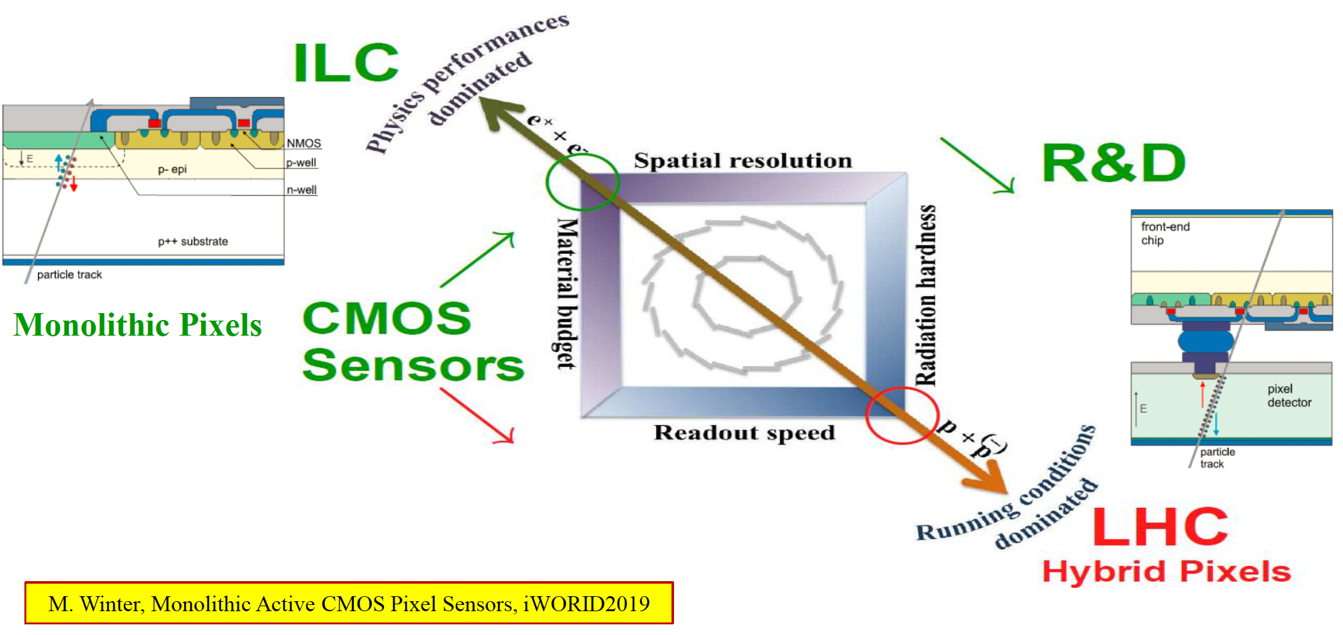
Silicon detector development

Slide 7
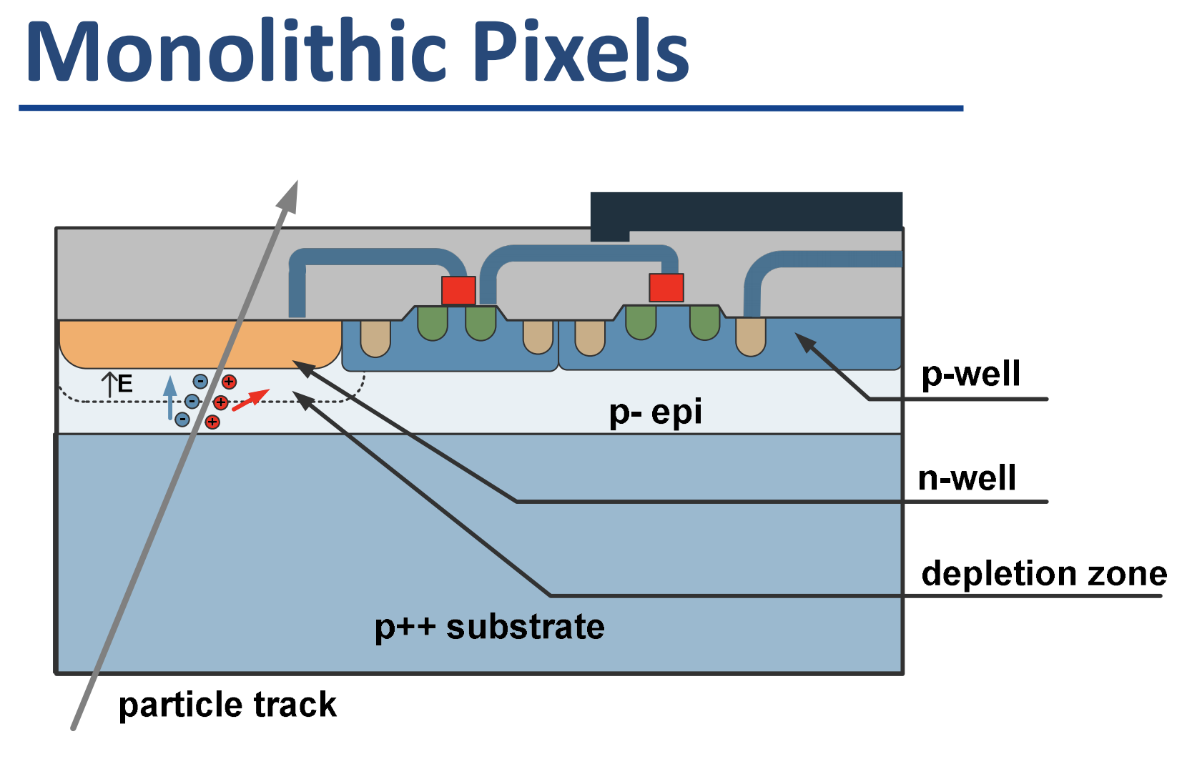
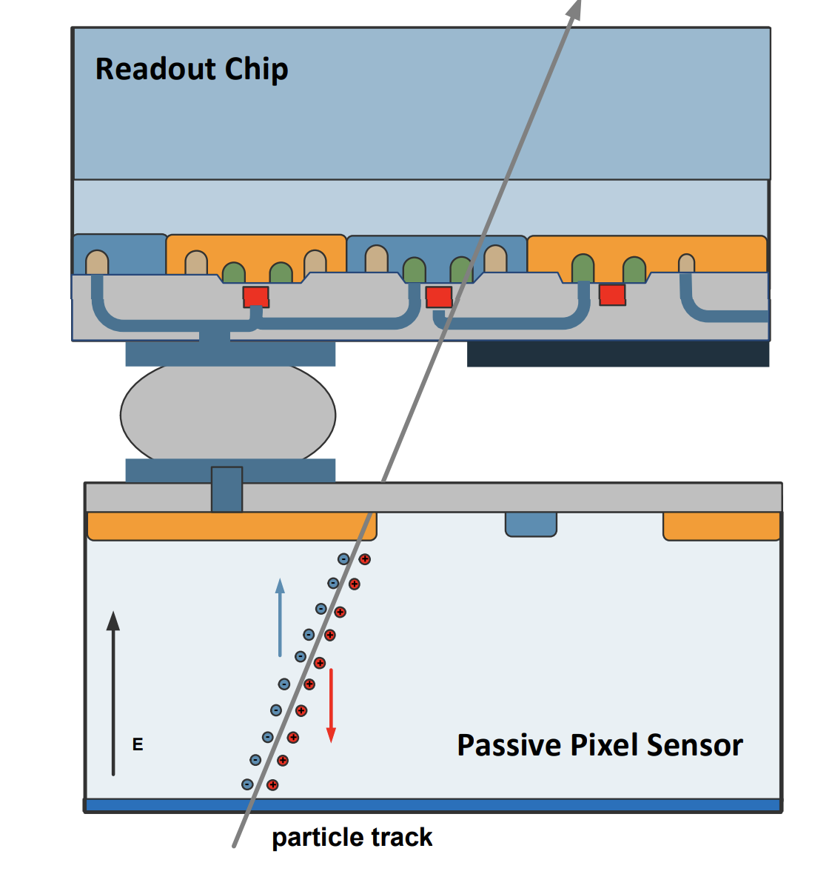
Vertex sensor development
Hybrid pixel technology (example: ATLAS and CMS, LHCb )
  Sensor and ASIC are designed separately, integrated by bump bonding
  Advantage: Radiation hard, advanced in spin off application (Timepix, …)
  Drawback: material budget (sensors and ASIC are both about 300um thick)
Monolithic pixel (example: Star, BELLE2, ALICE ITS2 , Mu3e….)
    Advantage: low material budget (can be thin down to 50μm)
    Drawback: radiation hardness is not as good compared to hybrid pixel sensor
Hybrid pixel

Slide 8
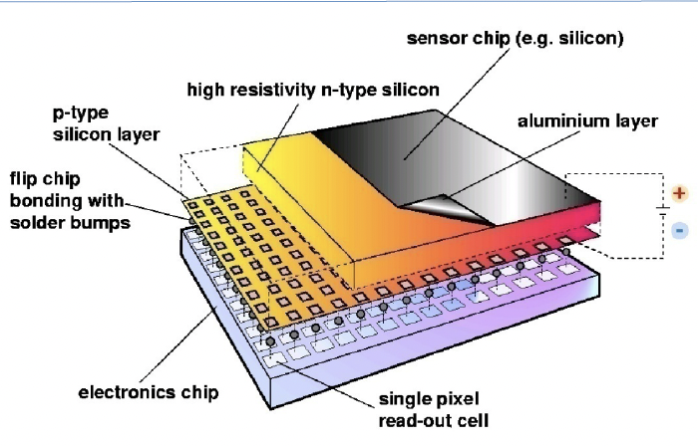
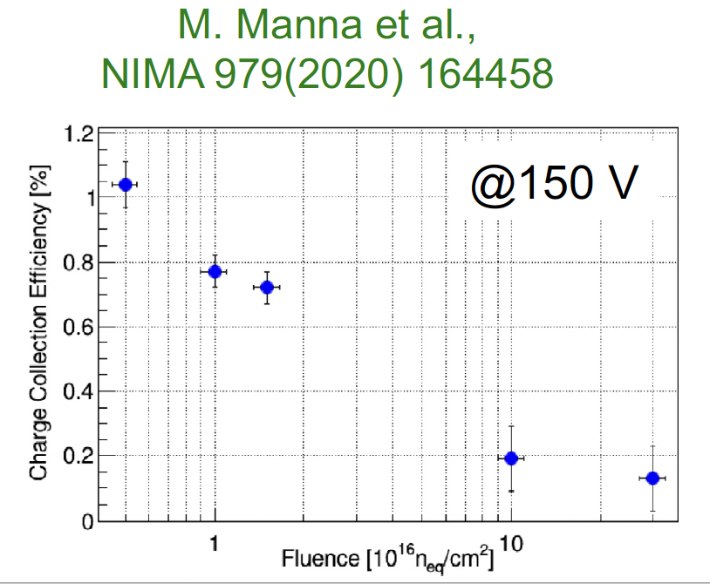
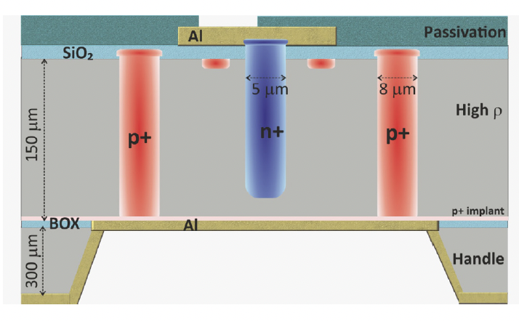
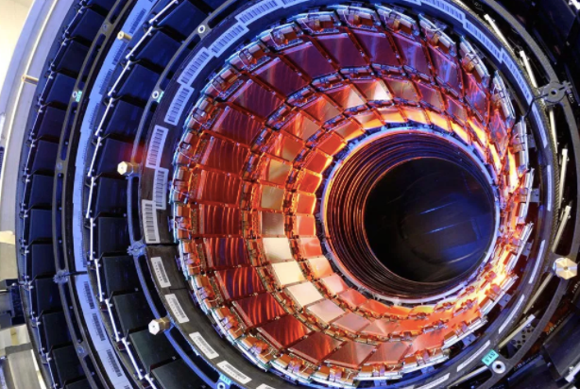
Hybrid pixel technology
Radiation sensor
  Current LHC operation showed pixel can work @ 10¹⁵ Neq/cm2 fluence
  LHC upgrade (3D pixel sensor) → work up to 2*10¹⁶ N_{eq}/cm² fluence
  Future Fcc-hh or Sppc: how to suffer 10¹⁷ N_{eq}/cm² fluence ?
Fast ASIC
  RD53 chip: fast readout chip for HL-LHC ATLAS and CMS vertex detectors
3D pixel sensor performance
LHC upgrade: 3D pixel sensor
Current LHC: CMS silicon tracker

Slide 9
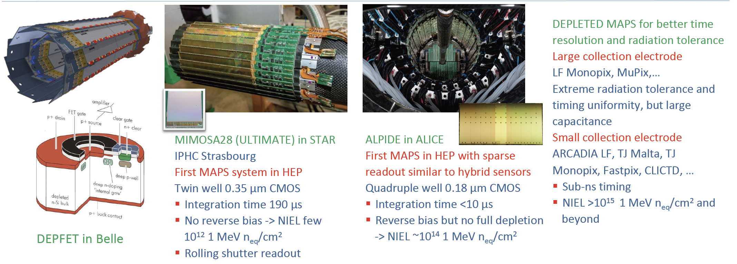
Monolithic sensors in HEP
W. Snoeys, CEPC workshop 2022

Slide 10
Outline
Overview of vertex detector
CEPC vertex detector R & D
More Future prospect

Slide 11
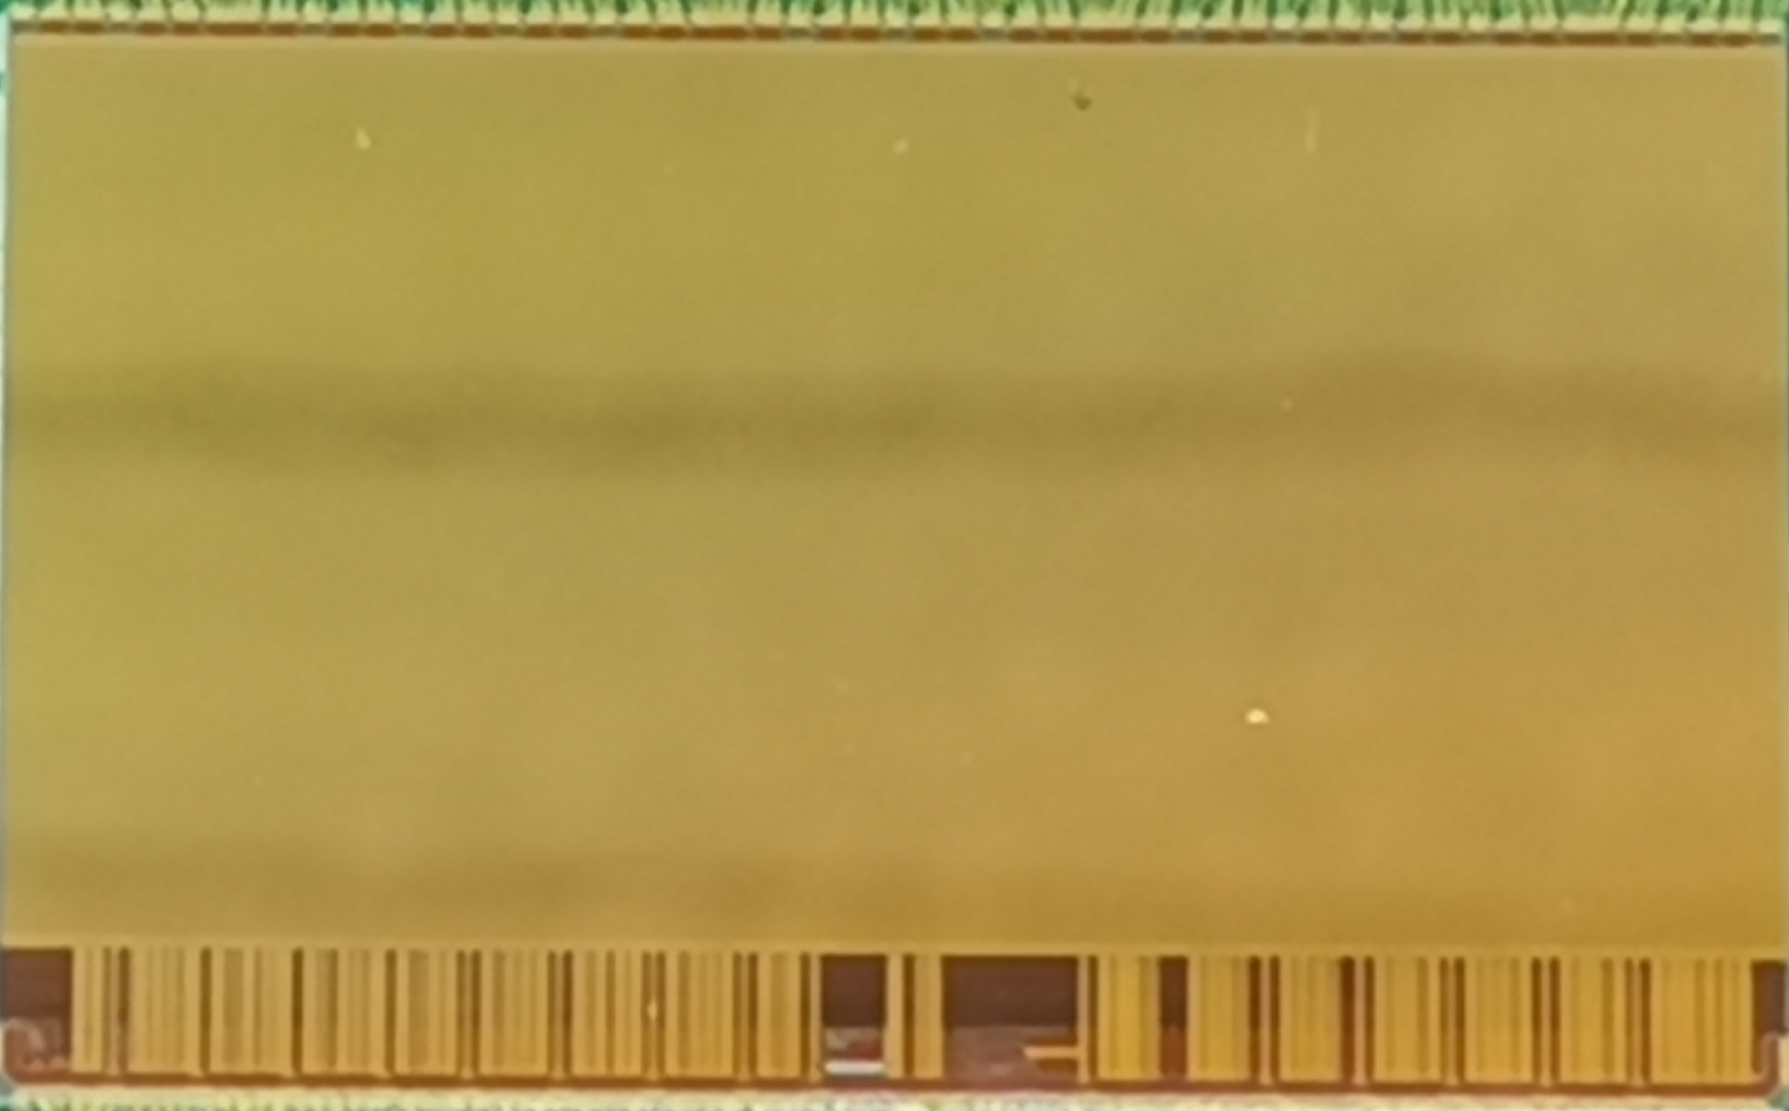
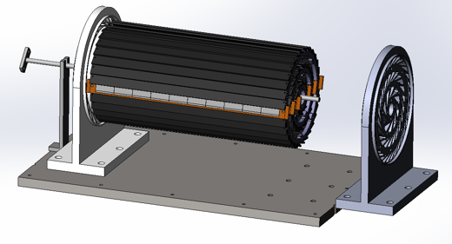
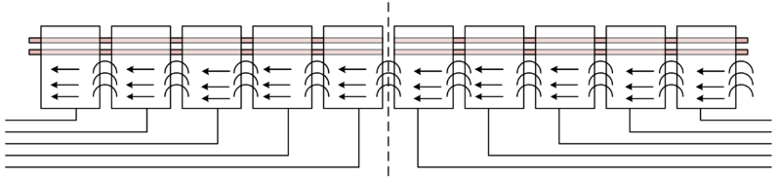
Overview of CEPC vertex detector prototyping
Vertex prototype R & D
  CMOS Pixel Sensor chip R&D
  Detector module prototyping
  Detector assembly
Detector module (ladder) prototyping
Full size vertex detector prototype
CMOS pixel sensor prototyping
TaichuPix-3
Electron beam
Double sided ladder
10 sensors/ladder side, read out from both ends

Slide 12
CMOS monolithic pixel sensor
The existing CMOS monolithic pixel sensors can’t fully satisfy the requirement
Major constraints for the CMOS sensor
  Pixel size: Single point resolution < 3 μm
  <500ns deadtime @40MHz clock at Z pole
  Radiation tolerance (per year): 1 MRad &2×10¹² 1 MeV n_{eq}/cm²
experiment | Chip | Resolution | Readout Speed | TID
ALICE | ALPIDE | ✔ | X | X (?)
ATLAS | Malta Monopix ATLASpix… | X | ✔ | ✔
Star | MIMOSA | ✔ | X | X (?)

Slide 13
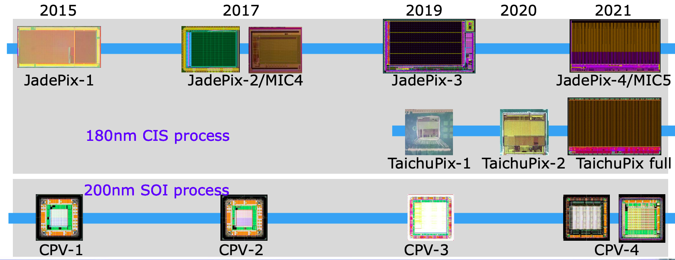
CEPC vertex sensor R & D
CEPC Vertex detector sensor R & D timeline
  Monolithic Pixel sensor design
    Based on Tower Jazz CIS 180nm process (Jadepix , TaichuPix)
    Based SOI 200nm process (CPV chip)
By Yunpeng

Slide 14
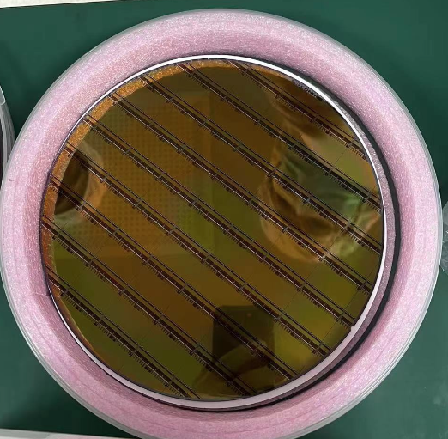
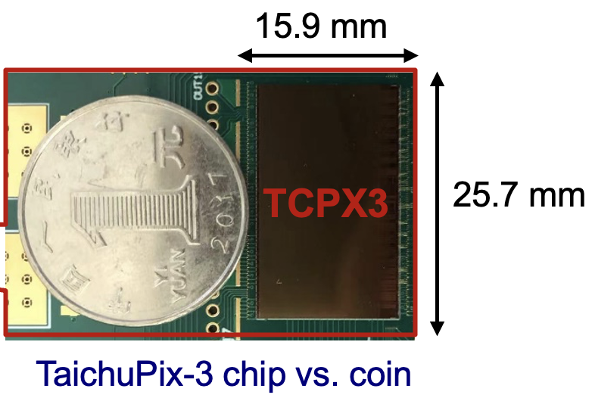
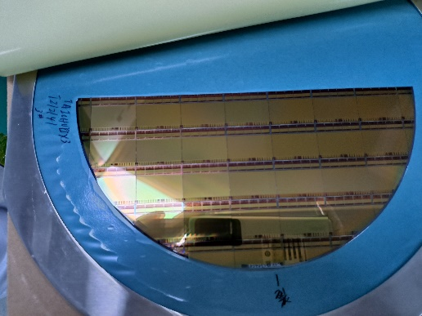
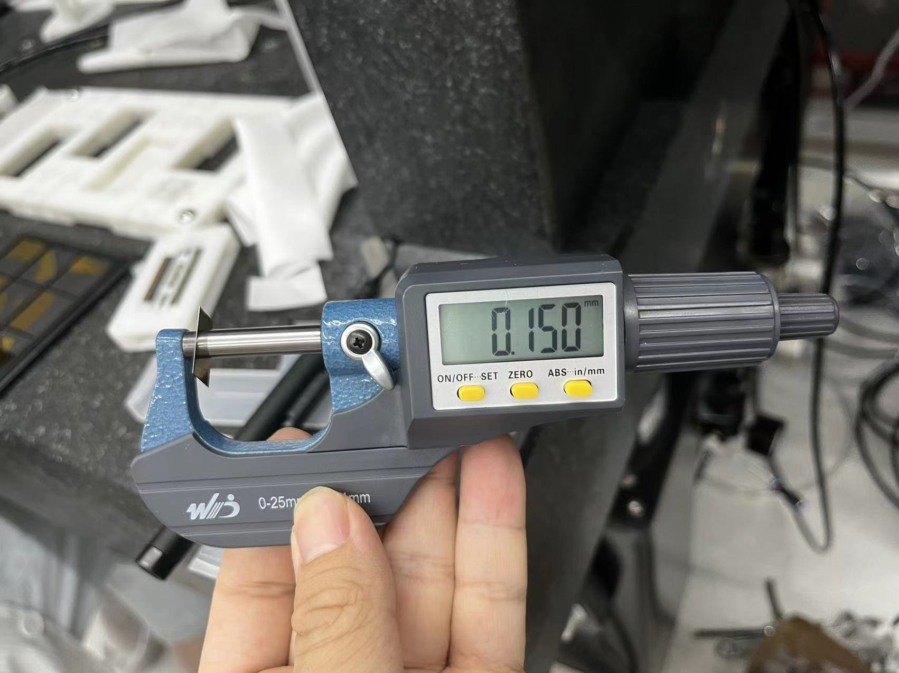
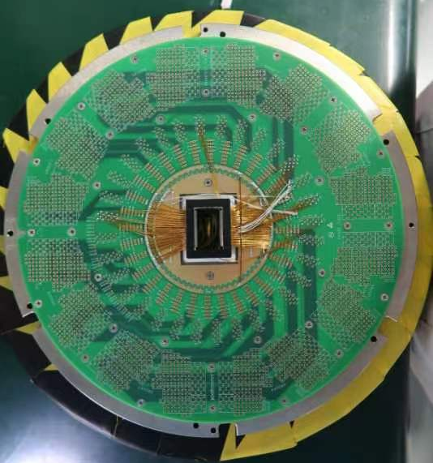
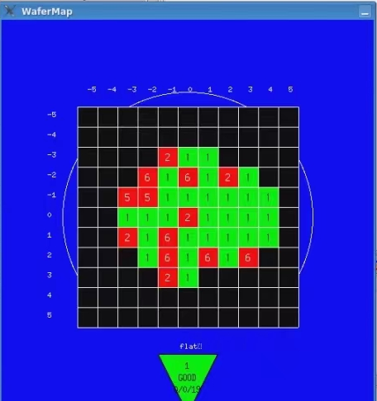
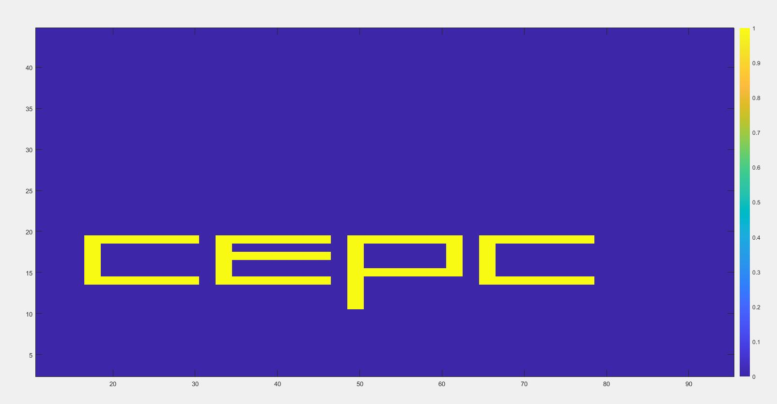
Large-scale MAPS sensor for CEPC: TaichuPix-3
6 TaichuPix-3 wafers (thinned down to 150 μm and diced)
Chip size：26 ×16 mm
Pixel size：25μm × 25μm
8-inch wafer
Wafer after thinning and dicing
Thickness after thinning
  wafer test on probe-station → 70-80% yield
Functional tests of the chip
Wafer T212141-02E3
8-inch wafer
An example of wafer test result
Probe card for wafer test

Slide 15
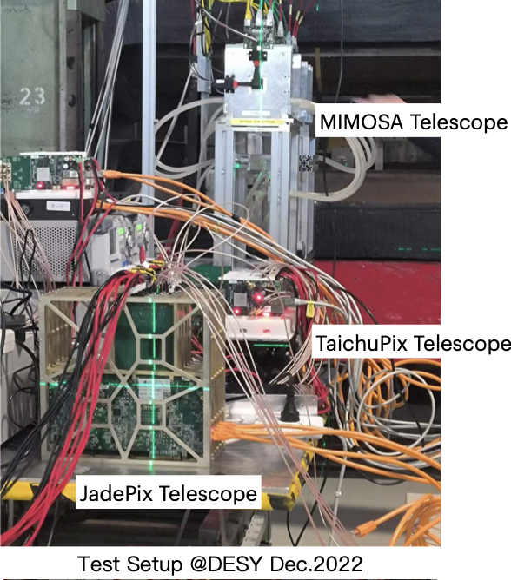
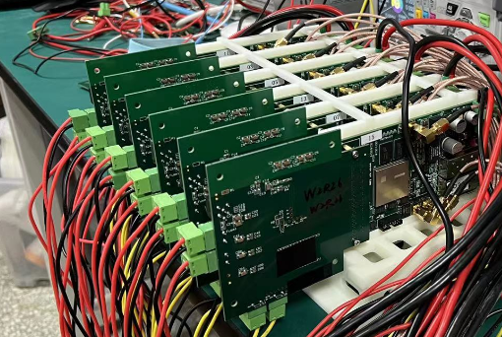
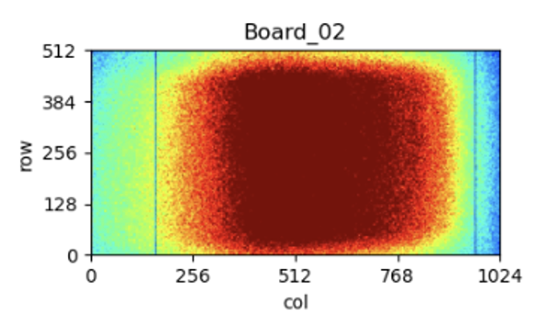
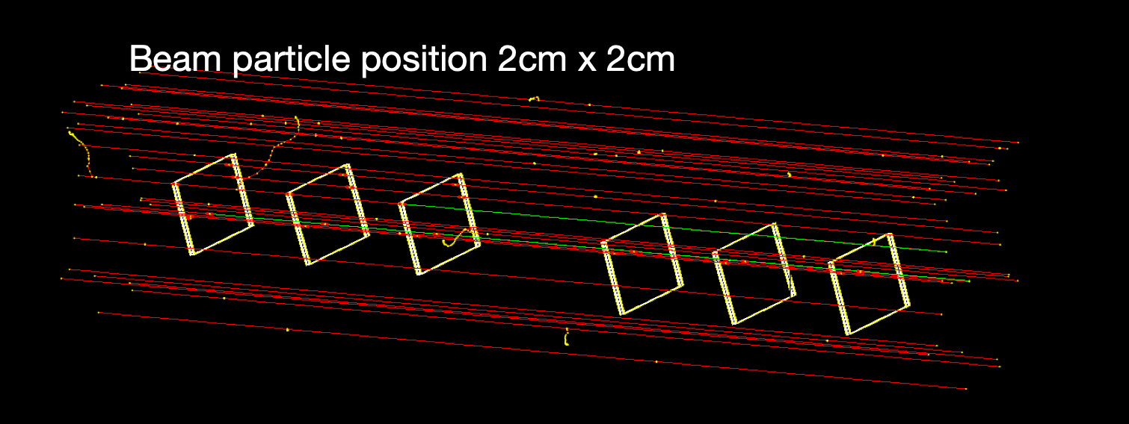
CEPC vertex detector : DESY Testbeam
The 6-layer of TaichuPix3 telescope
4-layer JadePix telescope.
Hit maps
Event display

Slide 16
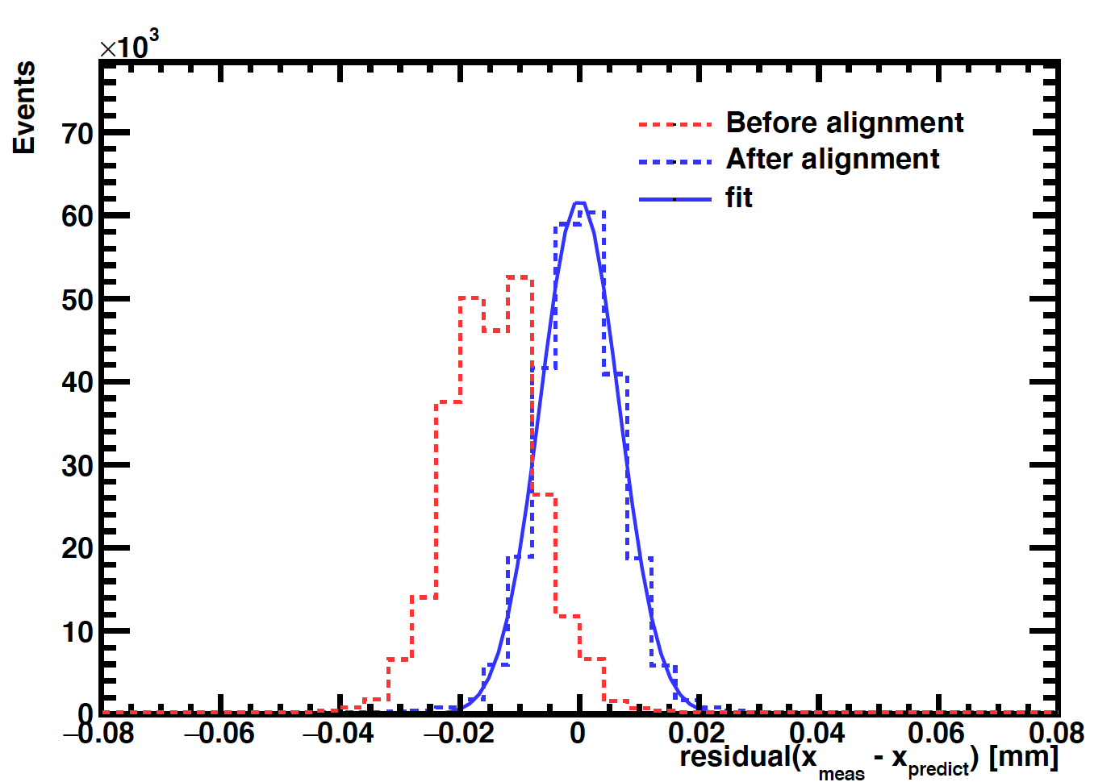
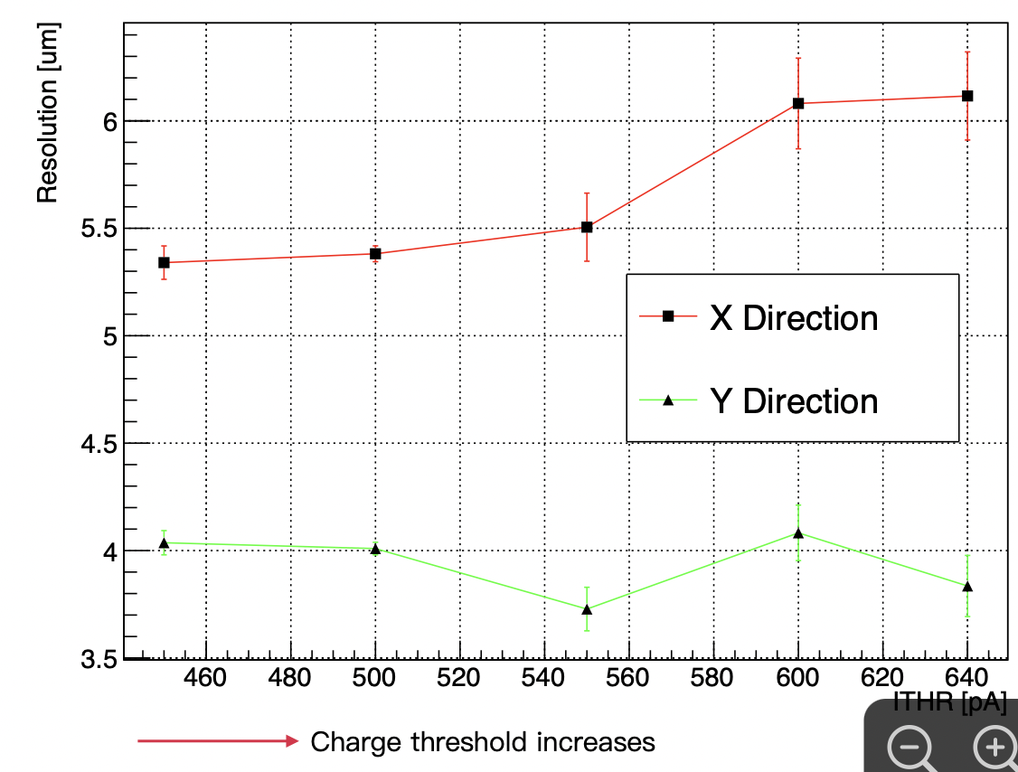
CEPC vertex detector : DESY Testbeam
Both CEPC pixel sensor prototype(Taichu and Jadepix) reach 3~5μm resolution
Efficiency can reach ~ 99%
  Taichu can work at 20Mhz clock with high efficiency.
Jadepix resolution
Taichupix resolution w/wo alignment

Slide 17
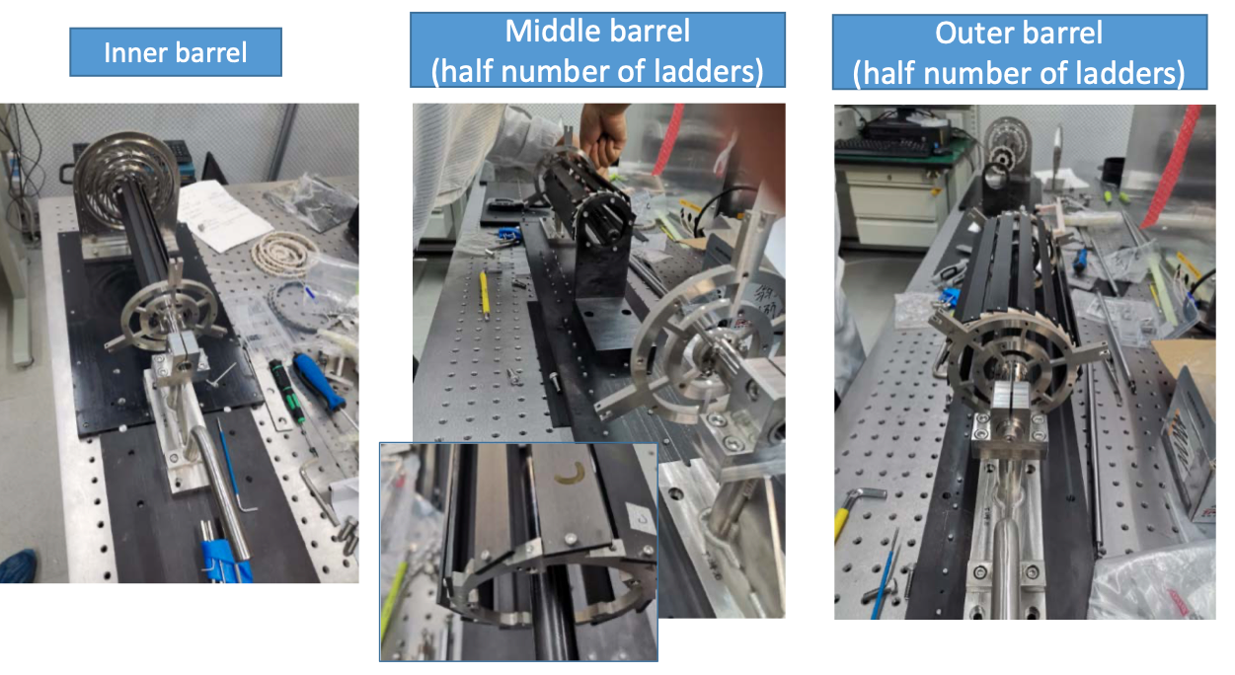
Vertex detector prototype assembly
Installation procedure of 3 double layer of vertex detector

Slide 18
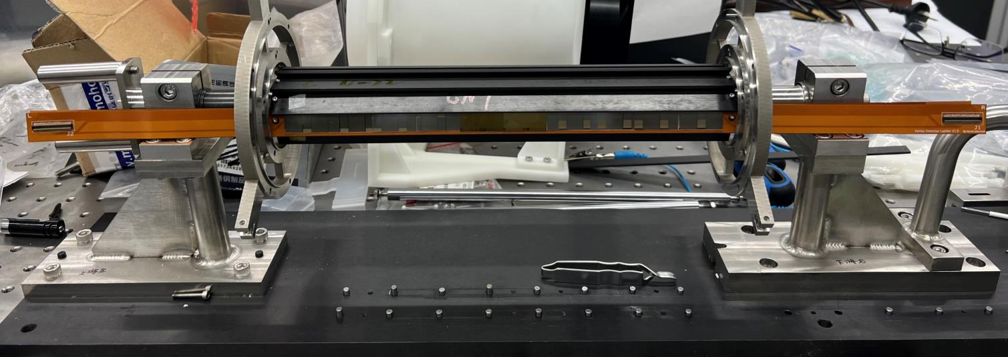
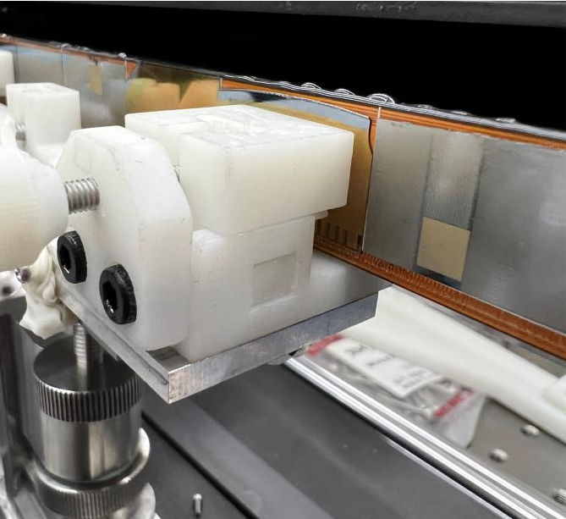

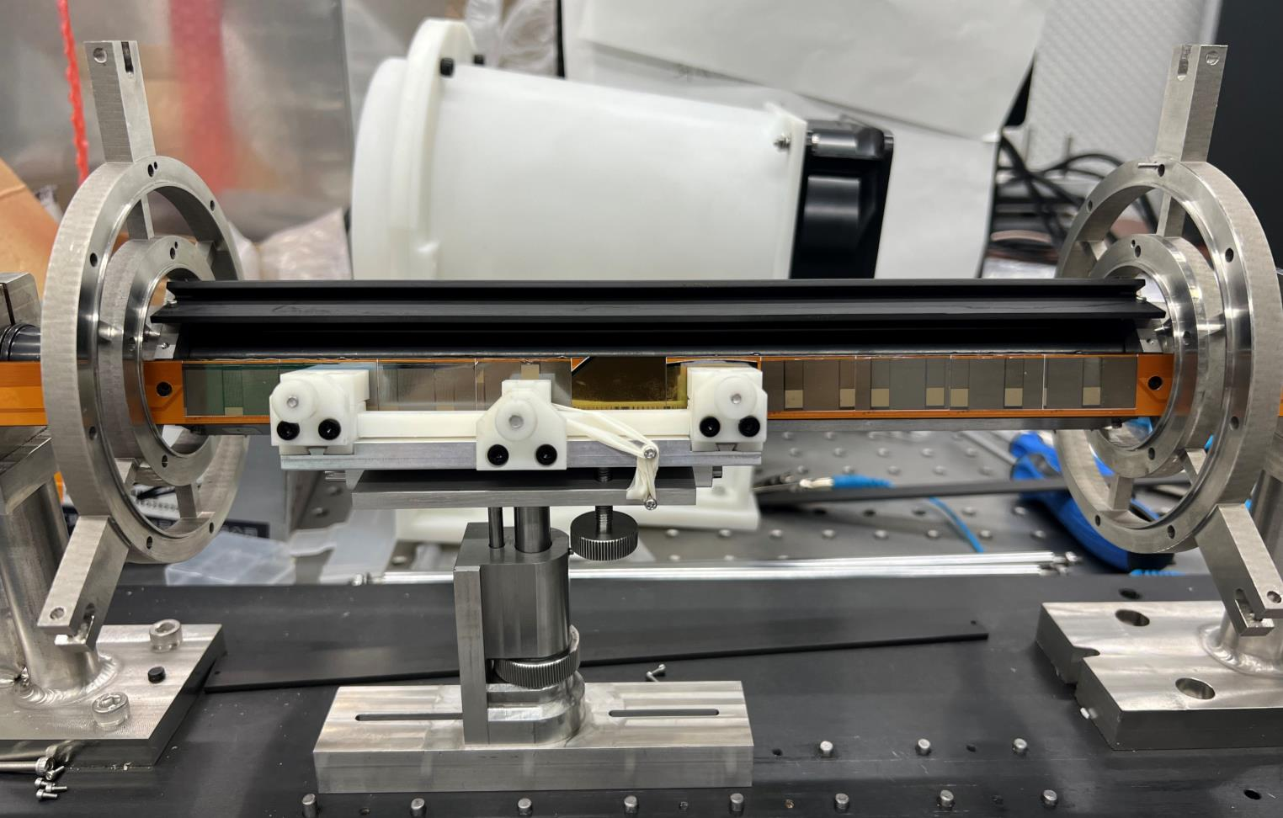
CEPC vertex detector: Ladder loading
Loading procedure of ladder on vertex detector has been tested
Another testbeam with full prototype expected in April 2023.
Wire-bonding
Ladder support tools
Ladder loaded on vertex detector

Slide 19
Outline
Overview of vertex detector
CEPC vertex detector R & D
More Future prospect
  Alice upgrade
  Timing detector

Slide 20
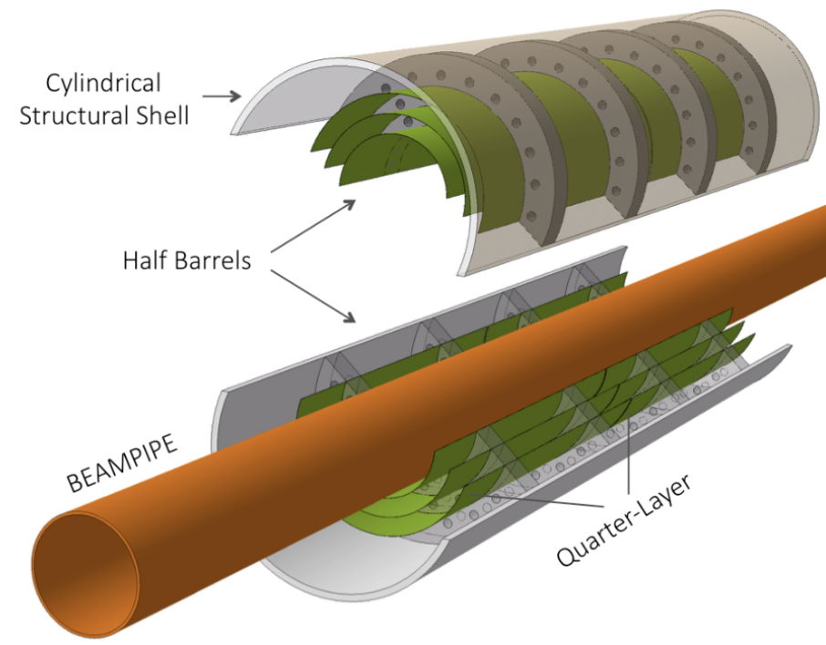
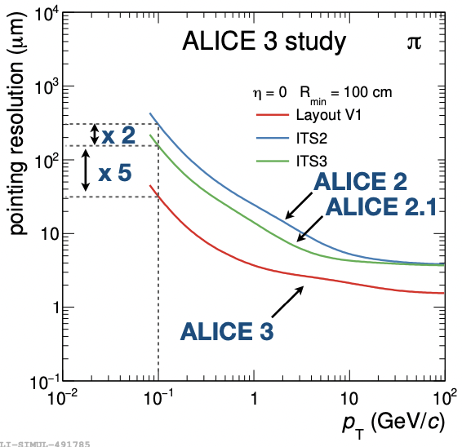
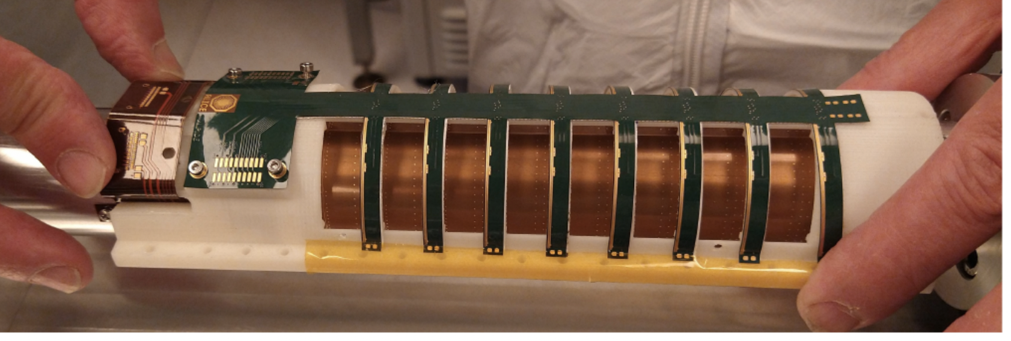
Alice ITS3 upgrade: MAPS
Cylindrical inner tracker with curved MAPS wafer
  5 times better performance expected that ITS2
From Magnus Mager & Nicolò Jacazio (Alice collobration)， ICHEP2022

Slide 21
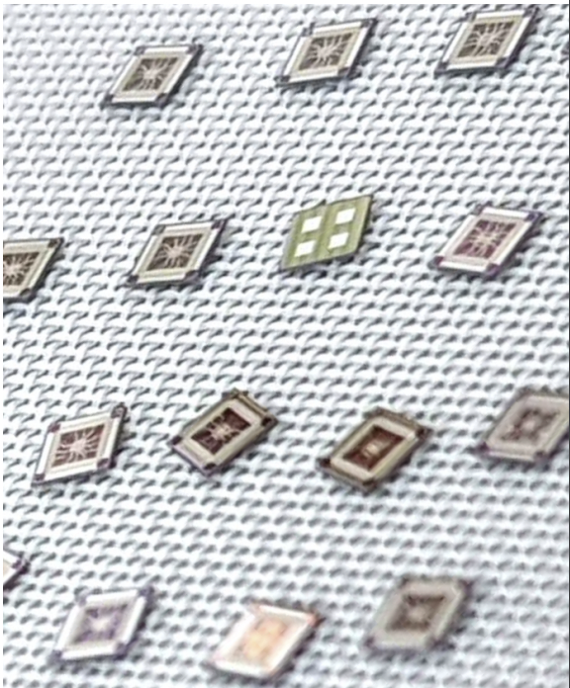
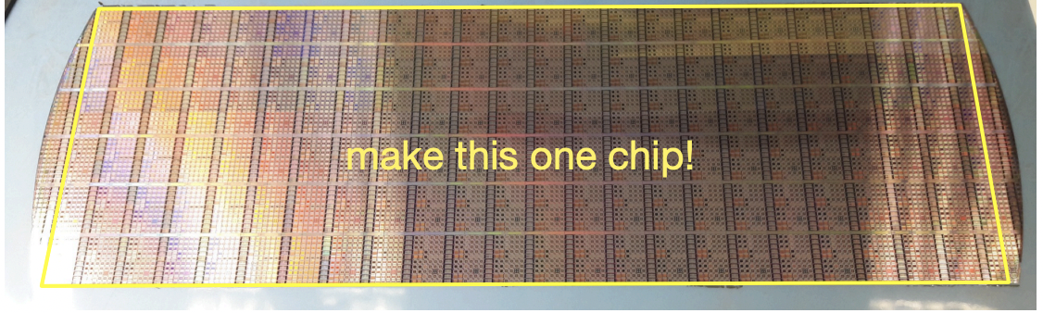
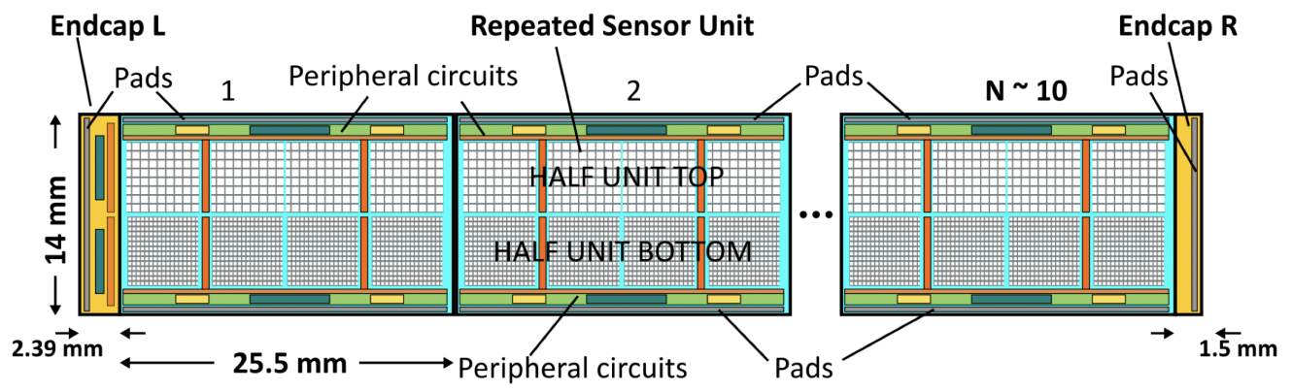
Alice ITS3 upgrade: 65nm technology & Stitching
First submission of TPSCo 65 nm CMOS Imaging Technology successful
next submission by Alice ITS3 community focus on stitching
From Magnus Mager (Alice collobration)， ICHEP2022

Slide 22
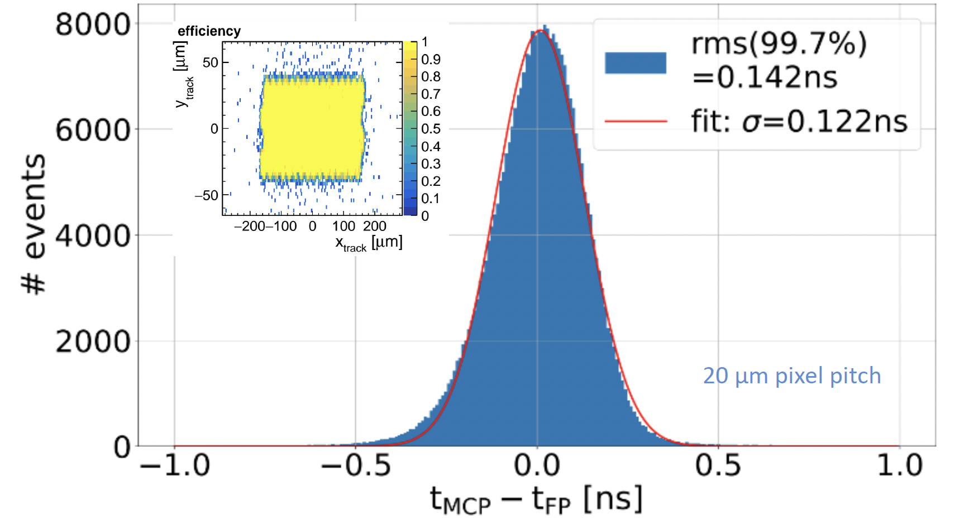
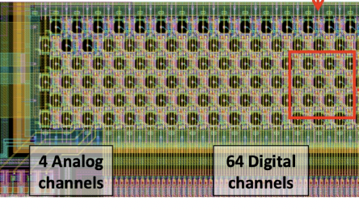
FastPix development
Future vertex with 4D precision: space resolution + timing
  8.6, 10, 15 and 20 μm pixel pitch
  Time resolution better than 150 ps at full efficiency
  Si-Ge fast readout
https://www.mdpi.com/2410-390X/6/1/13
J. Braach, E. Buschmann, D. Dannheim, K. Dort, T. Kugathasan, M. Munker, M. Vicente

Slide 23
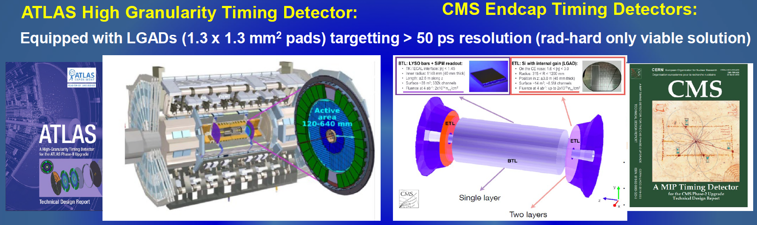
Silicon timing detector development
Both ATLAS and CMS is aiming for silicon timing detector
  with Low Gain Avalanche Detectors
  1.3mm² pad, with 30-50 ps resolution for single charge particle
  Mainly for pileup vertex rejection
  Also useful for search long-live particles search

Slide 24
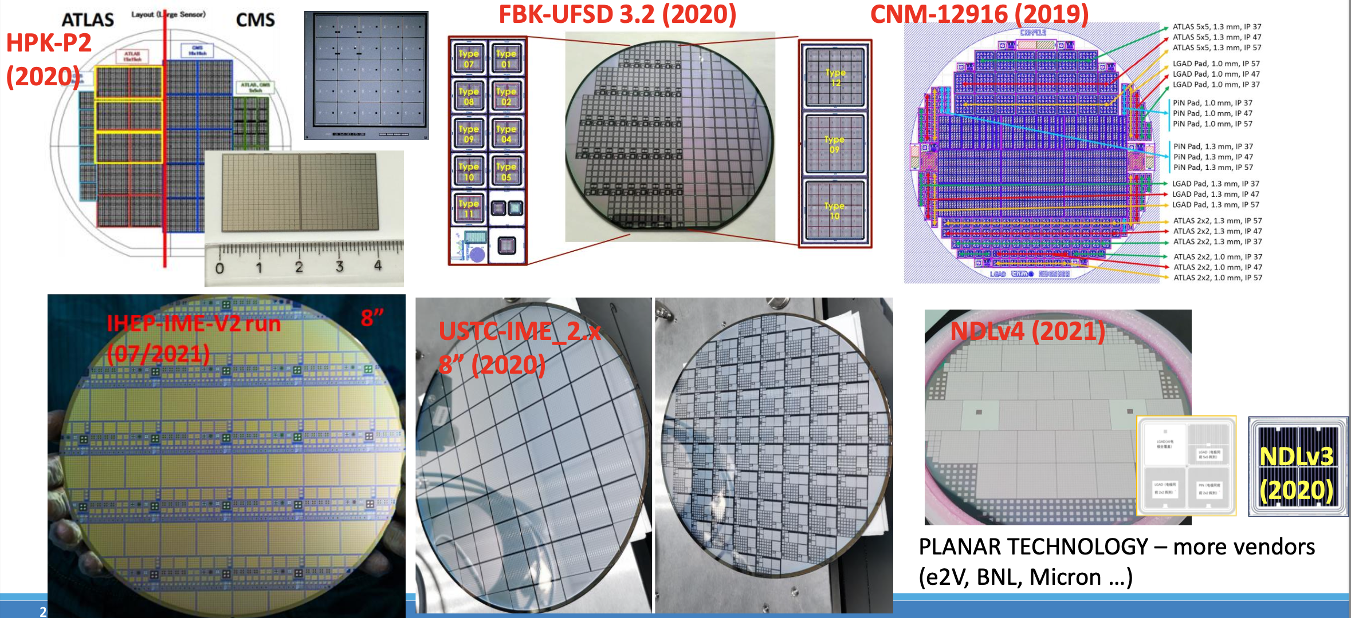
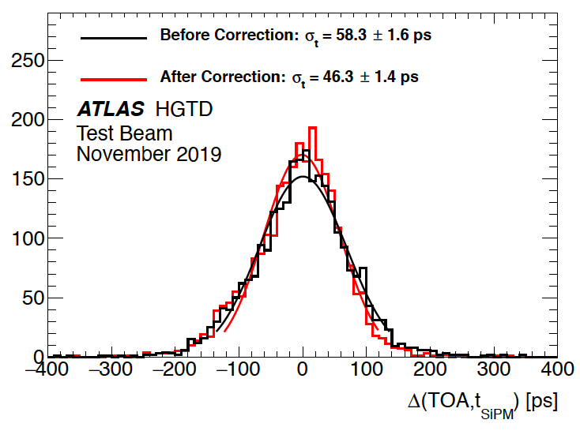
Silicon timing detector development
Both ATLAS and CMS is aiming for silicon timing detector
  with Low Gain Avalanche Detectors (LGAD)
  30-50 ps resolution for single charge particle
  Lots of foundries are doing R & D for LGAD around the world
  LGAD based 4D silicon tracker proposed for future EIC

Slide 25
Summary
CMOS Monolithic pixel is very promising for future lepton collider
  CPEC MAPS based vertex prototype is in good progress
    3 double layer prototype will be built and tested this year
  ALICE ITS3 Cylindrical tracker has excellent potential in future colliders
Fast time (<150ps time resolution) 4D pixel detector becoming feasible
  LGAD based fast sensor
  MAPS based technology

