Slide 1
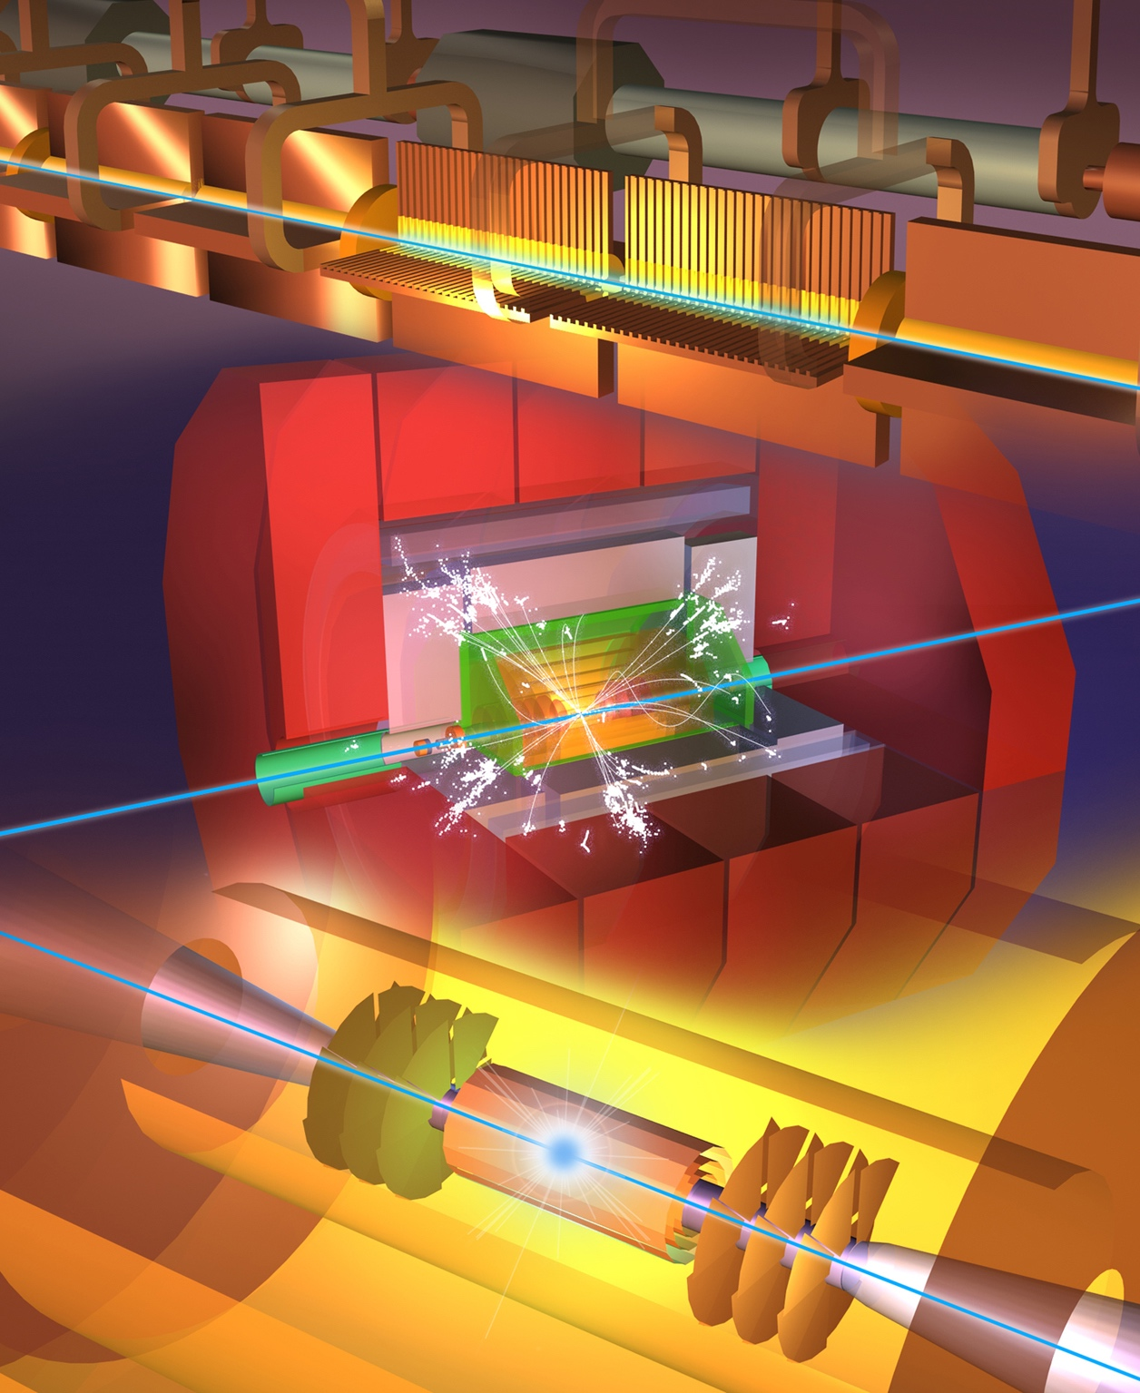
Andrea Latina (CERN)
on behalf of CLIC
The Compact Linear Collider (CLIC)
Outline
CLIC project overview
CLIC at 380 GeV
Optimisation studies
Applications
Summary
IAS HKUST
14-16 Feb 2023

Slide 2
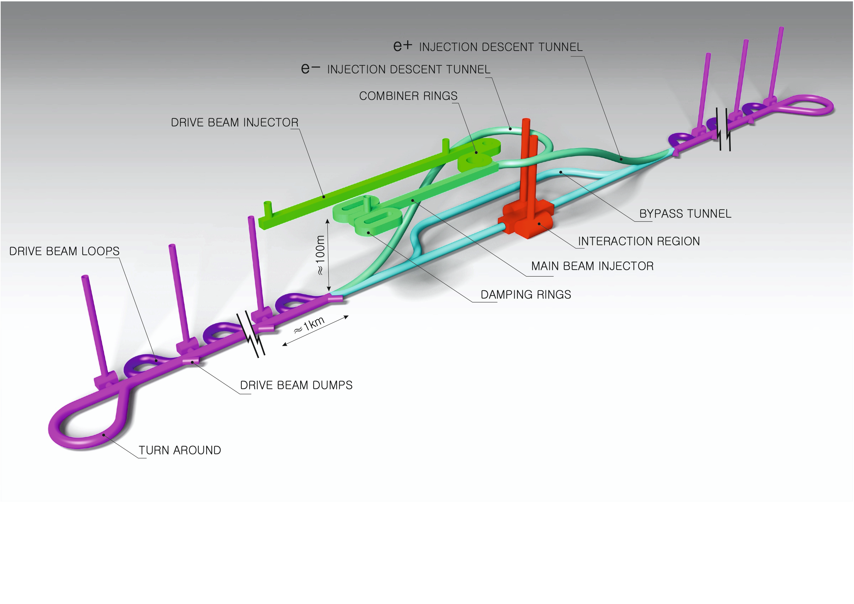
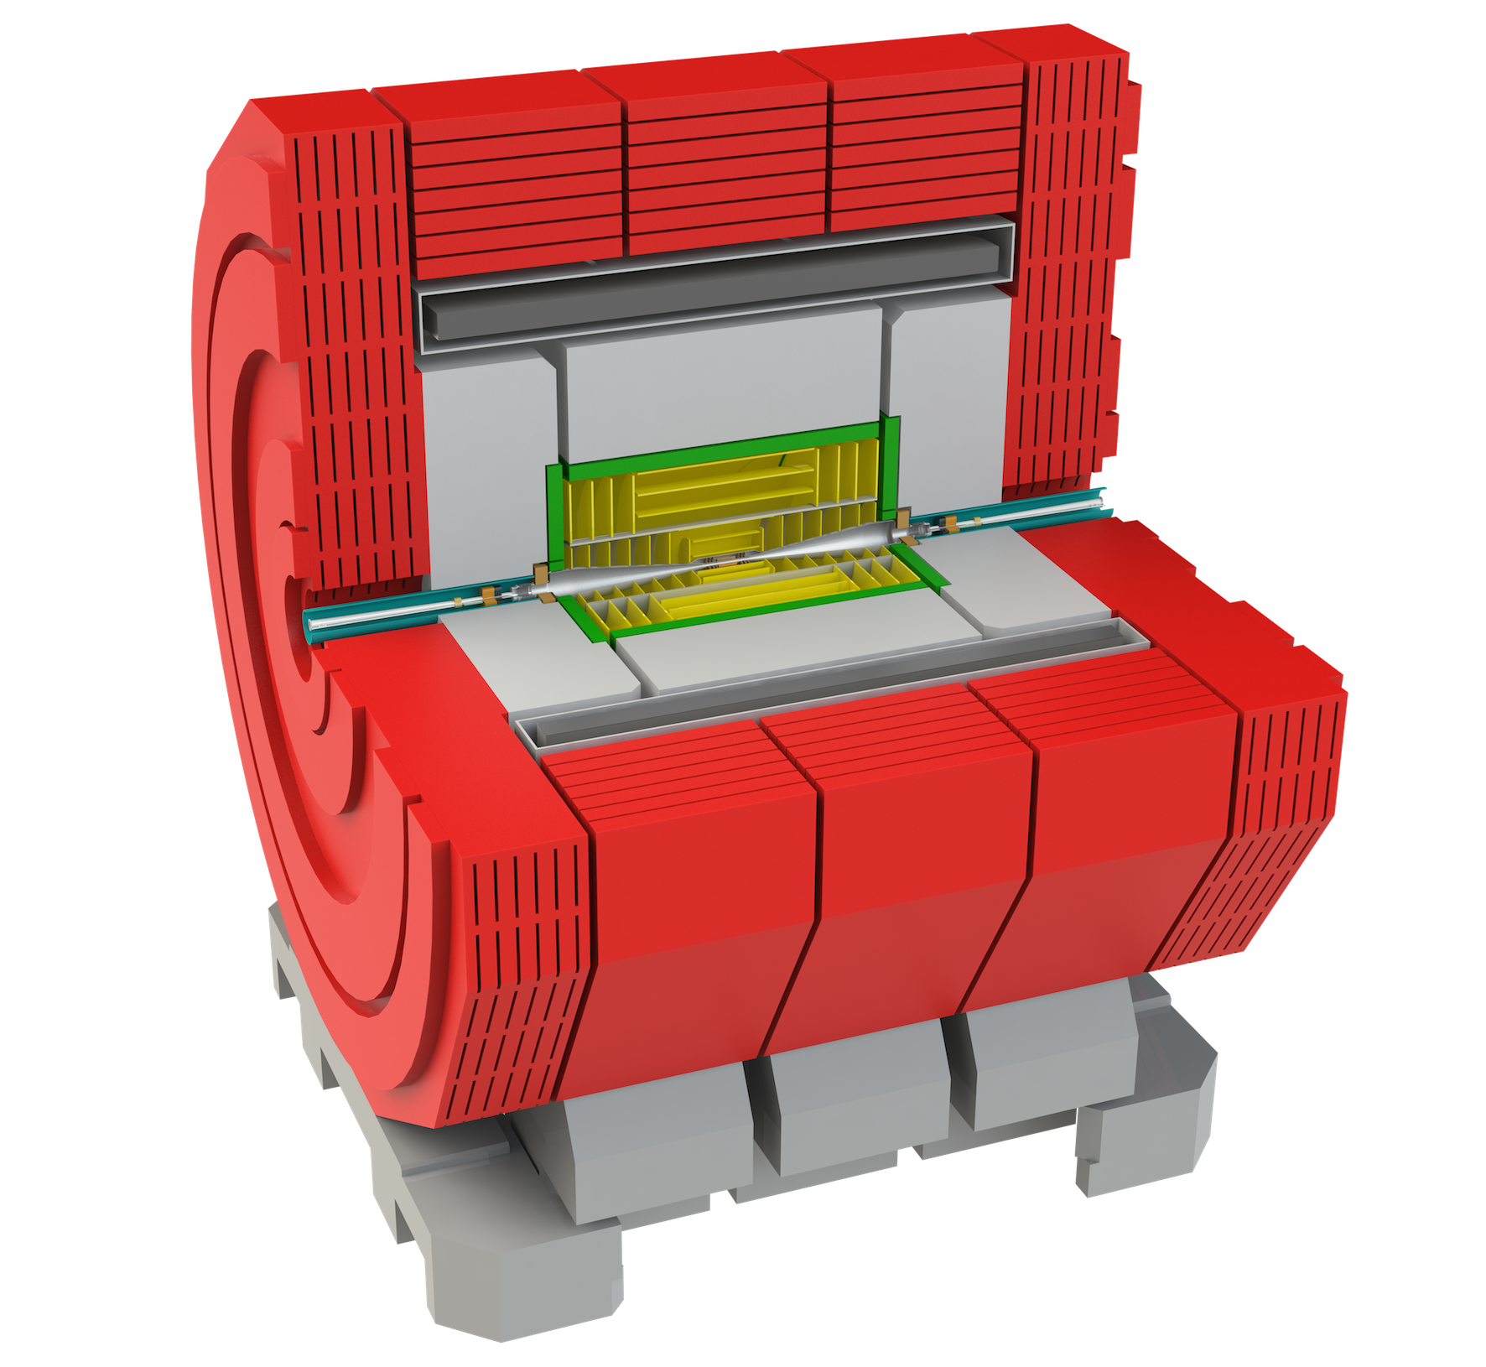
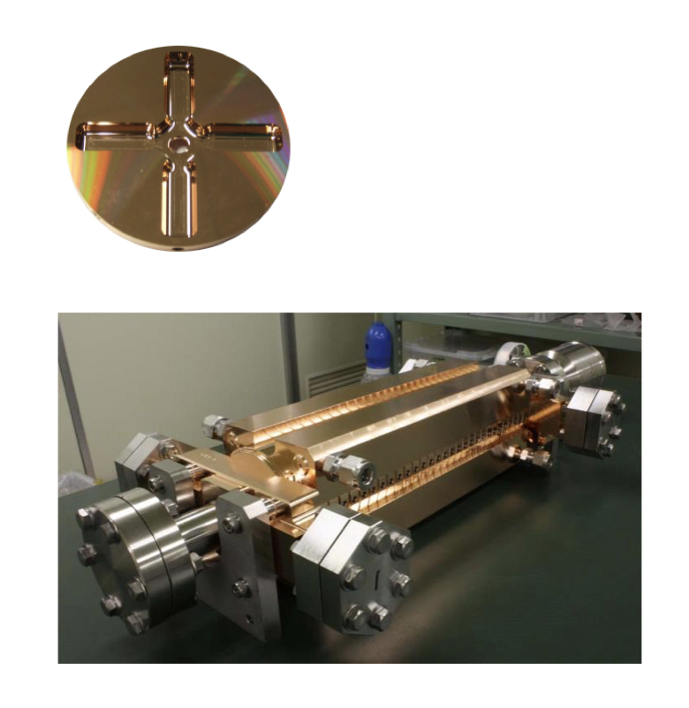
The Compact Linear Collider (CLIC)
  Timeline: Electron-positron linear collider at CERN for the era beyond HL-LHC
  Compact: Novel and unique two-beam accelerating technique with high-gradient room temperature RF cavities (~20’500 structures at 380 GeV), ~11km in its initial phase
  Expandable: Staged programme with collision energies from 380 GeV (Higgs/top) up to 3 TeV (Energy Frontier)
  CDR in 2012 with focus on 3 TeV. Updated project overview documents in 2018 (Project Implementation Plan) with focus 380 GeV for Higgs and top.
  Cost: 5.9 BCHF for 380 GeV (stable wrt 2012)
  Power: 168 MW at 380 GeV (reduced wrt 2012),
  corresponding to 60% of CERN’s energy consumption today
  Comprehensive Detector and Physics studies
Accelerating structure prototype for CLIC:
12 GHz (L~25 cm)

Slide 3
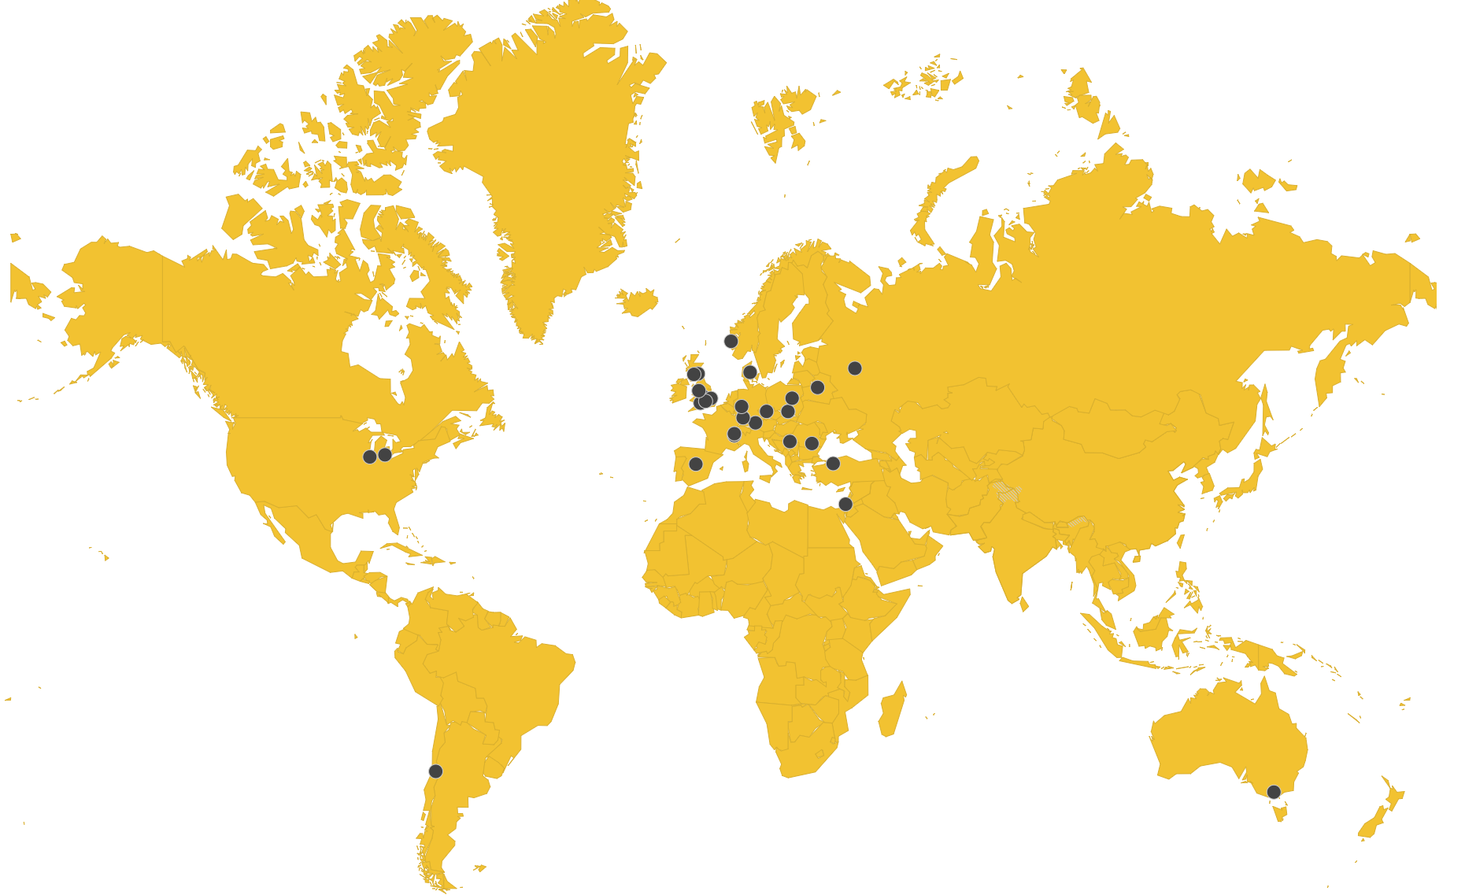
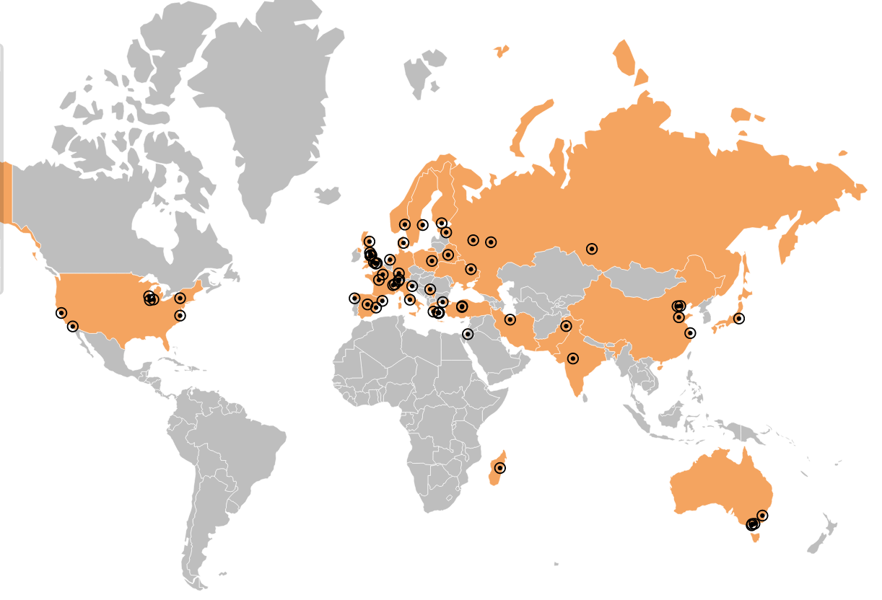
Collaborations
CLIC accelerator
  ~50 institutes from 28 countries*
  CLIC accelerator studies
  CLIC accelerator design and development
  Construction and operation of CLIC Test Facility, CTF3
CLIC detector and physics (CLICdp)
  30 institutes from 18 countries
  Physics prospects & simulations studies
  Detector optimisation + R&D for CLIC
+ strong participation in the CALICE and FCAL Collaborations and in AIDA-2020/AIDAinnova
*Canada missing on map
Notes:
Chec AIDA – Canada missing

Slide 4
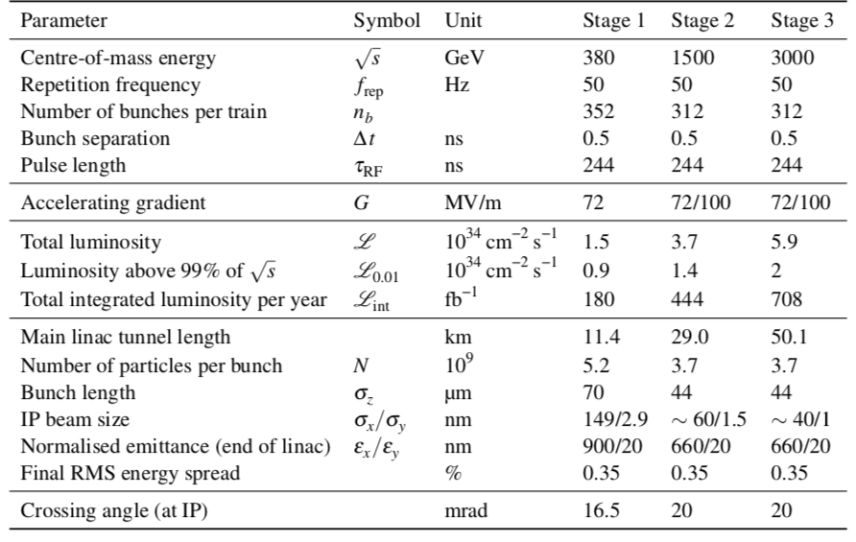
CLIC parameters

Slide 5
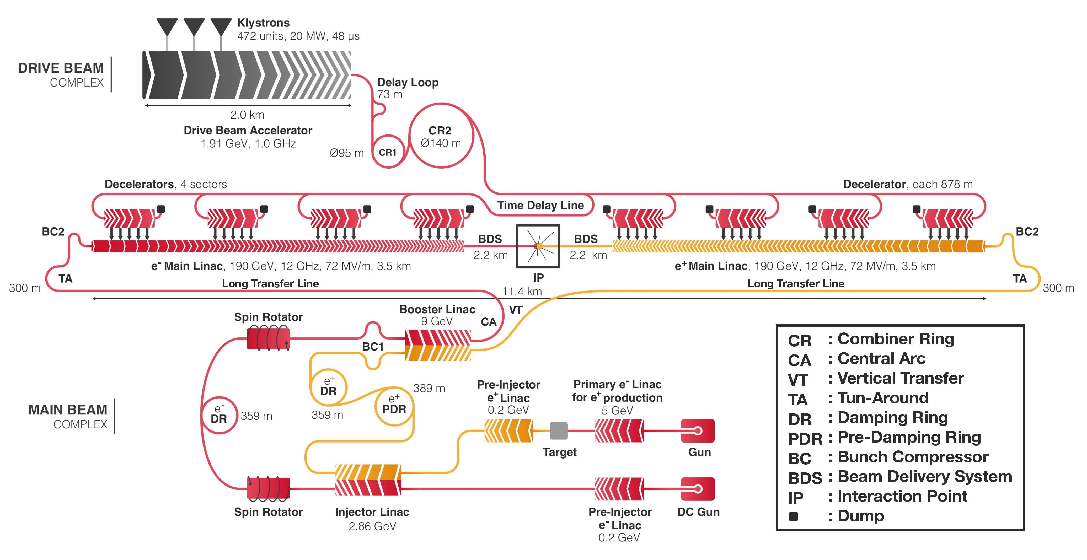
CLIC Layout 380 GeV

Slide 6
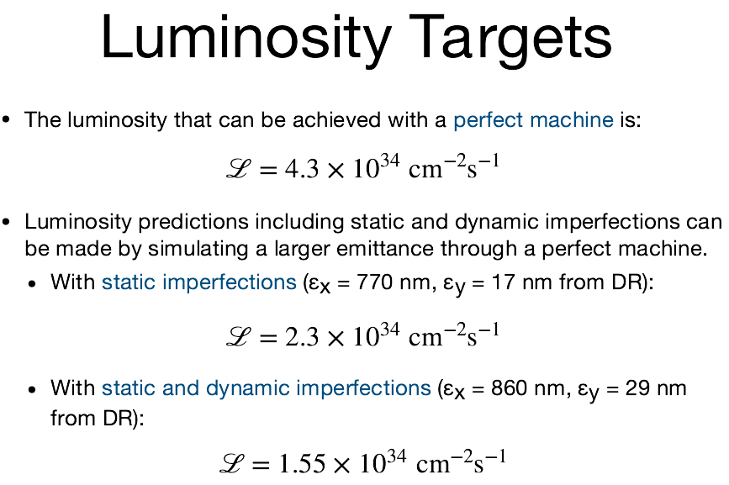
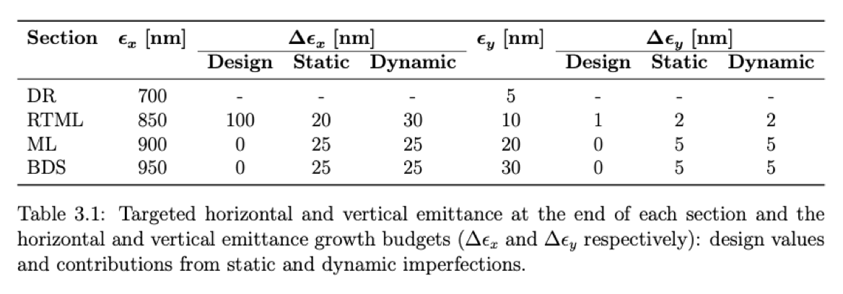
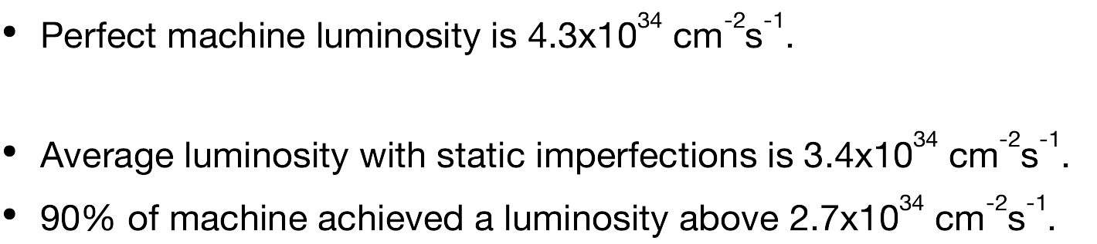
CLIC Luminosity Performance
Result of detailed simulations

Slide 7
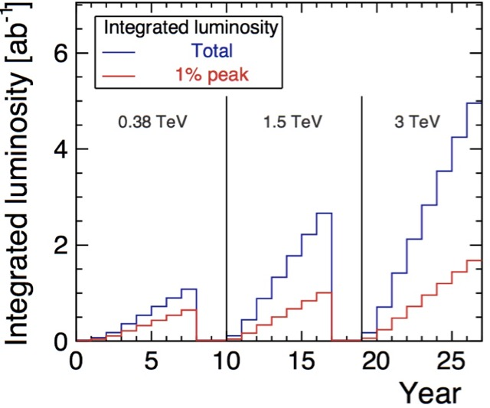
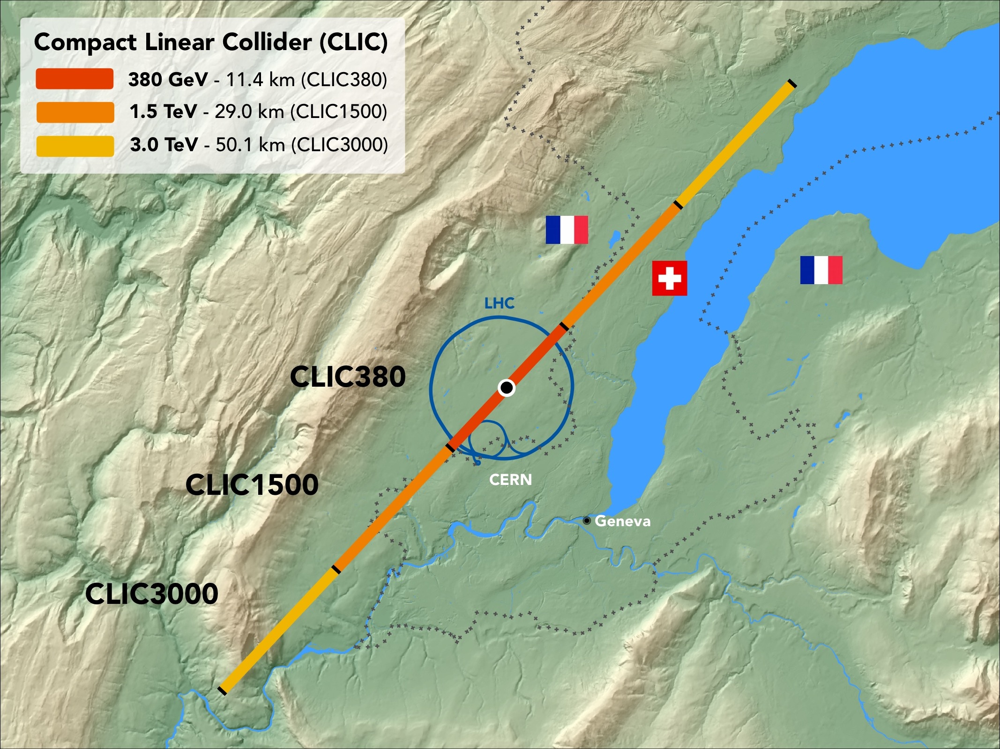
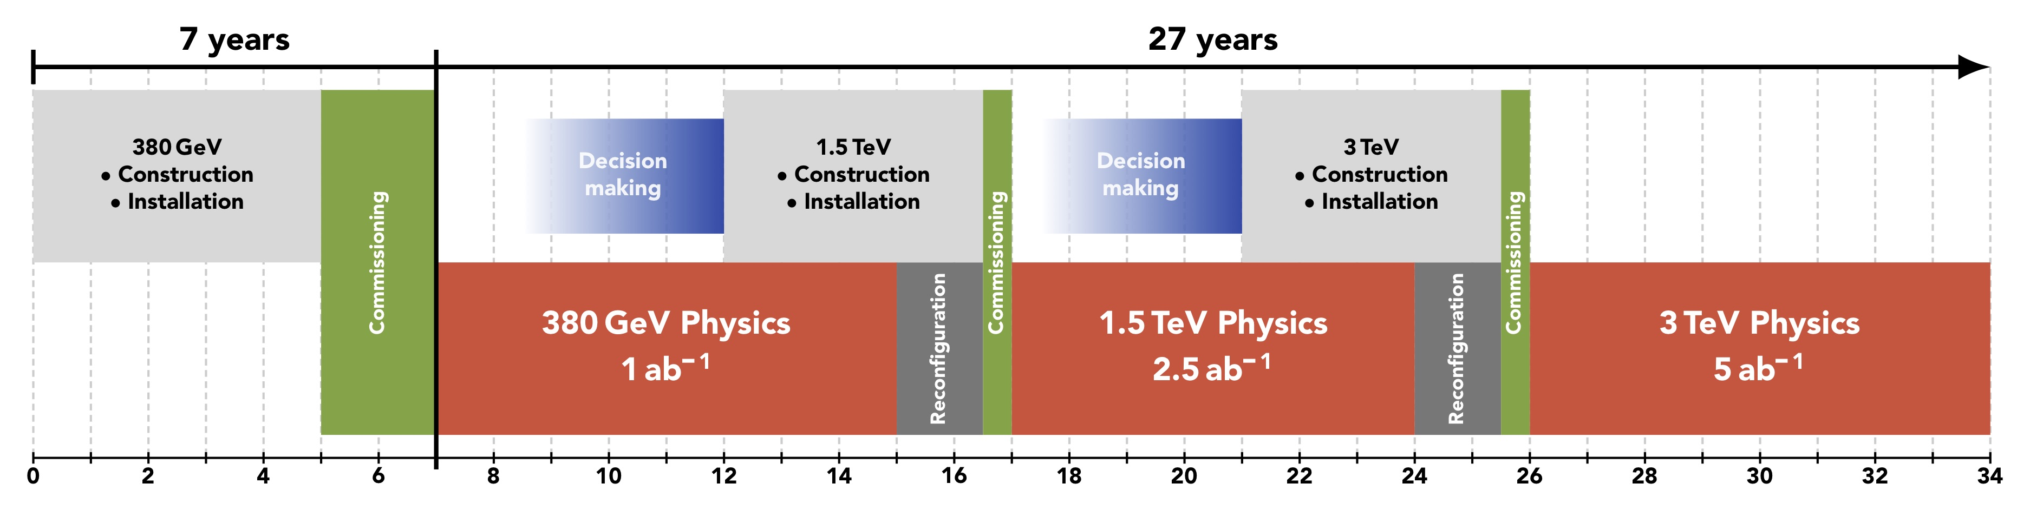
CLIC timeline
Ramp-up and up-time assumptions: arXiv:1810.13022, Bordry et al.
Technology Driven Schedule from start of construction shown above.
A preparation phase of ~5 years is needed before (estimated resource need for this phase is ~4% of overall project costs)

Slide 8
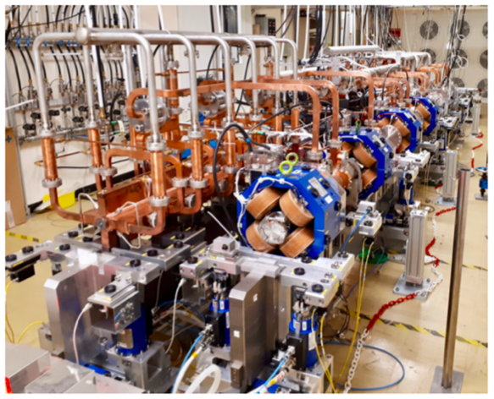
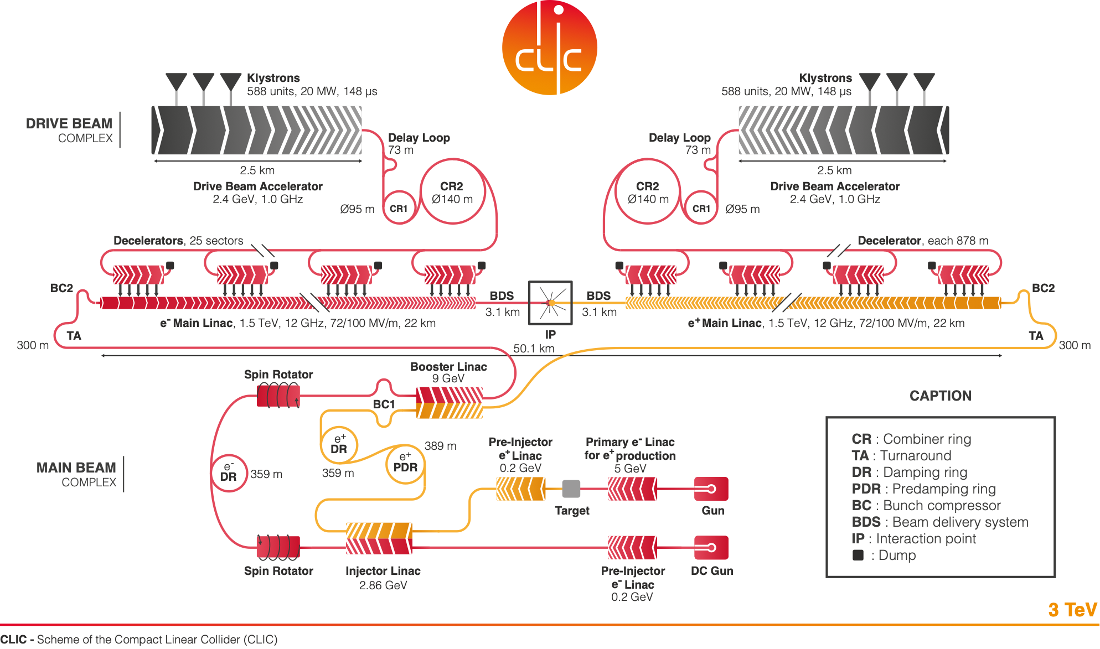
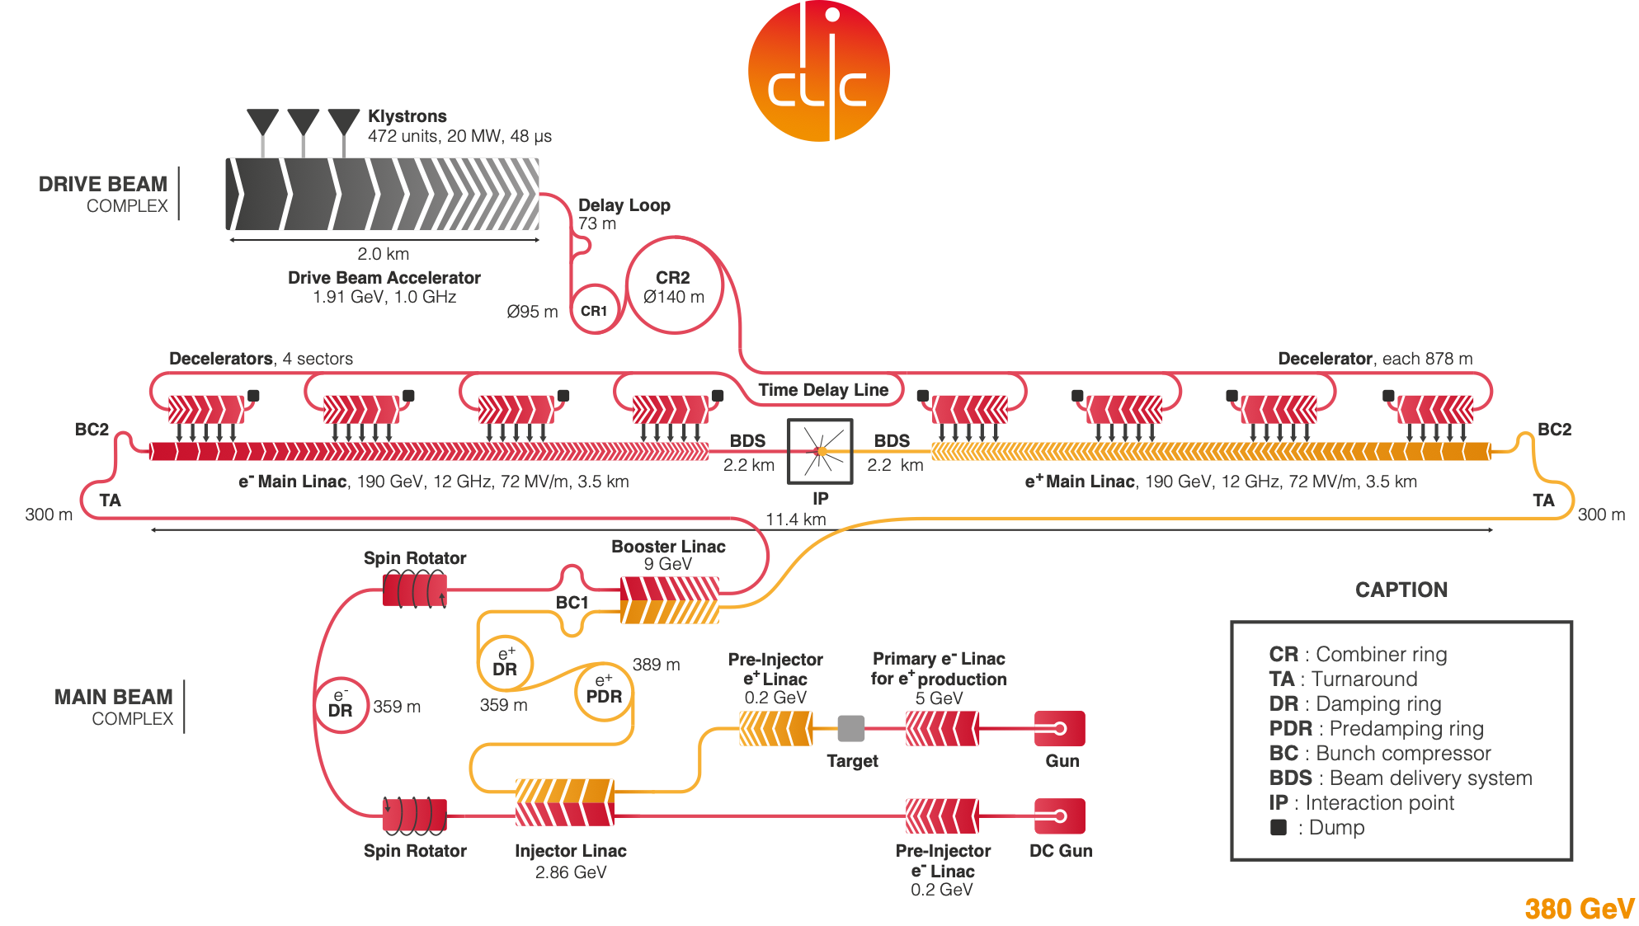
CLIC can easily be extended
  What are the critical elements:
    Physics
    Gradient and power efficiency
    Costs
  Drive beam accelerated to ~2 GeV using conventional klystrons
  Intensity increased using a series of delay loops and combiner rings
  Drive beam decelerated and produces high-RF
  Feed high-RF to the less intense main beam using waveguides
  Extend by extending main linacs, increase drivebeam pulse-length and power, and a second drivebeam to get to 3 TeV

Slide 9
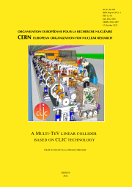
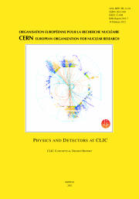
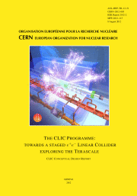
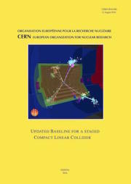
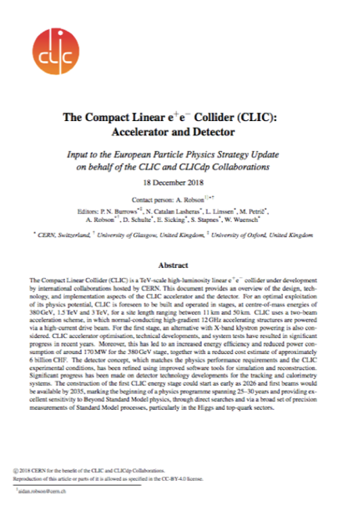
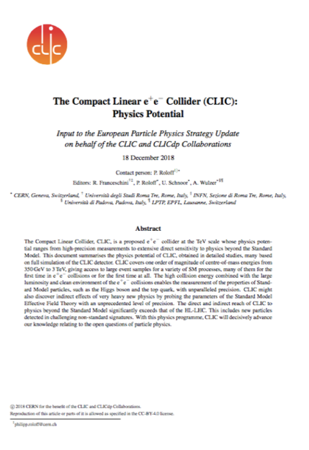
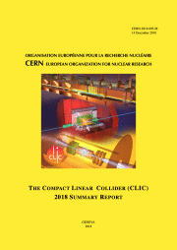
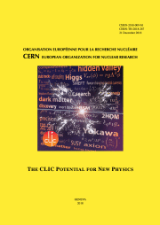
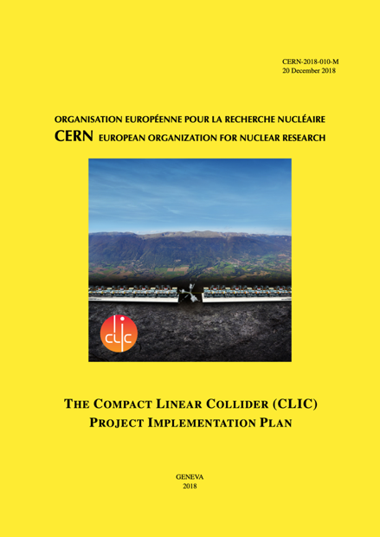
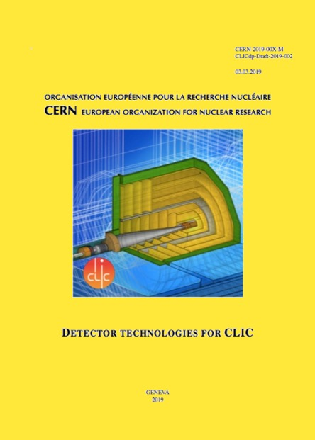
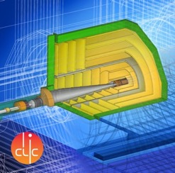
Resources
Available at:
clic.cern/european-strategy
3-volume CDR 2012
Updated Staging Baseline 2016
Two formal submissions to the ESPPU 2018
4 CERN Yellow Reports 2018
Several LoIs have been submitted on behalf of CLIC and CLICdp to the Snowmass process:
The CLIC accelerator study: Link
Beam-dynamics focused on very high energies: Link
The physics potential: Link
The detector: Link
Details about the accelerator, detector R&D, physics studies for Higgs/top and BSM

Slide 10
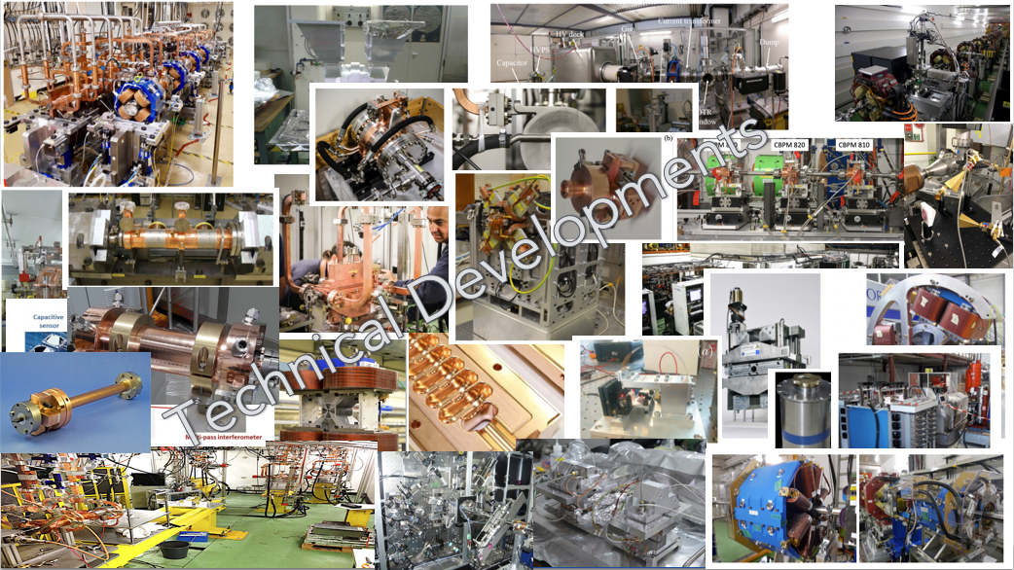
CLIC is a mature design/study
The CLIC accelerator studies are mature:
Optimised design for cost and power
Many tests in CTF3, FELs, lightsources and test-stands
Technical developments of “all” key elements

Slide 11
Recent updates
After the European Strategy for Particle Physics Update (ESPPU)
  Immediate study of luminosity performance margins, gamma-gamma and Z-pole operation
  Timeline for further studies changed (slower implementation)
  Accelerator
  Resources too limited to move into TDR “proper”
  External projects using X-band technology very important and much increased
  Prioritize R&D type of studies and development of core technologies (will show later)
Physics and Detector:
  Less resources for dedicated CLIC studies, more “Higgs-factory” approach (i.e., CLIC, ILC, FCC-ee, CEPC) and continue linking to detector R&D collaborations

Slide 12
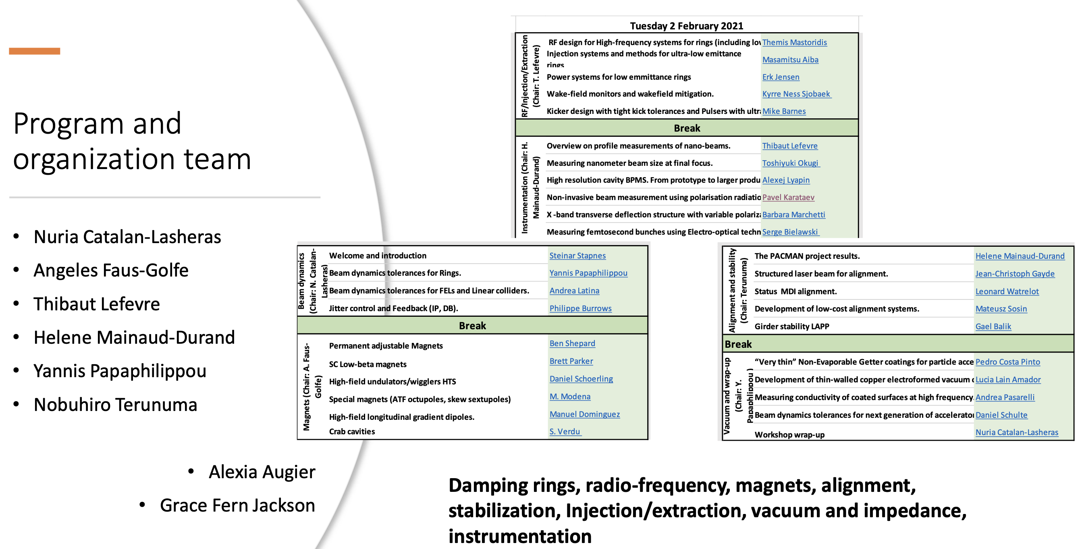
CLIC acc. studies – luminosities
Further work on luminosity performance, possible improvements and margins, operation at the Z-pole and gamma-gamma
      Luminosity margins and increases:
    Z pole performance, 2.3x10³² – 0.4x10³⁴ cm⁻² s⁻¹
    The latter number when accelerator configured for Z running (e.g., early or end of first stage)
    Baseline includes estimates static and dynamic degradations from damping ring to IP: 1.5 x 10³⁴ cm⁻² s⁻¹, a “perfect” machine will give : 4.3 x 10³⁴ cm⁻² s⁻¹, so significant upside
    In addition: doubling the frequency (50 Hz to 100 Hz) would double the luminosity, at a cost of +50 MW and ~5% cost increase
    CLIC note and paper about all these studies
Nanobeam workshop (summary by Nuria Catalan): LINK
Notes:
Is this the last version of this slide, now published

Slide 13
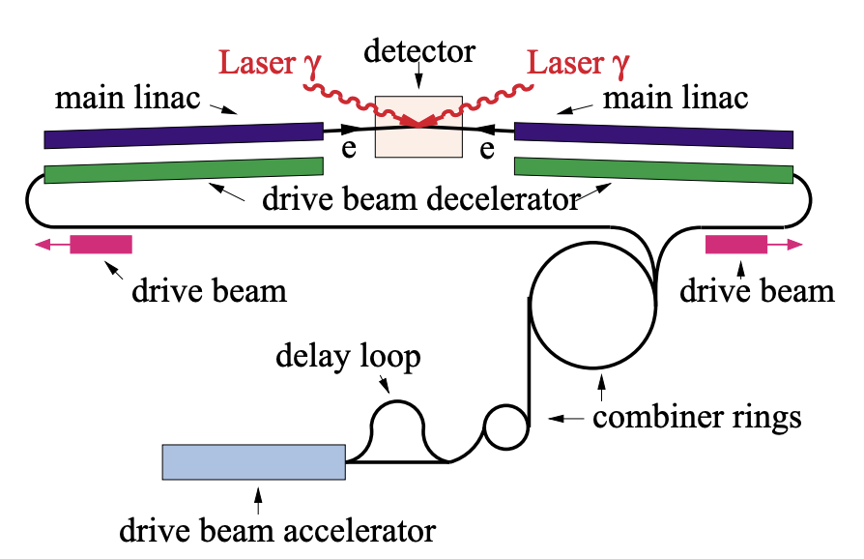
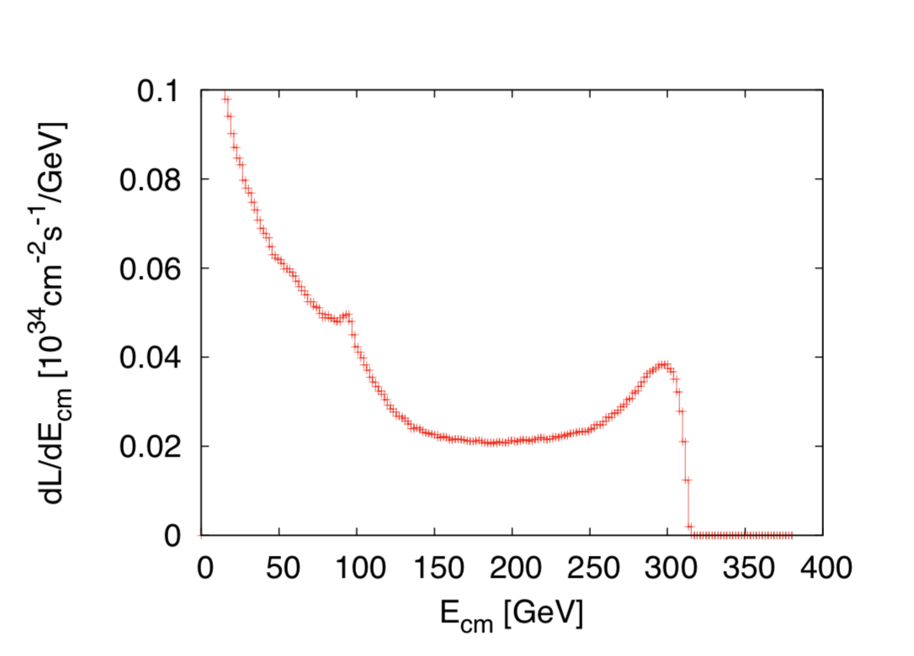
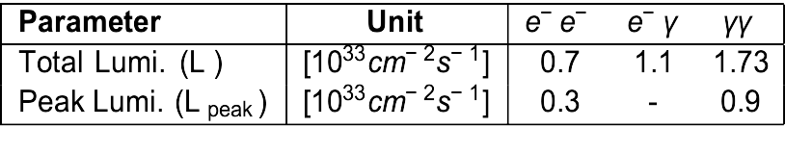
CLIC acc. studies – luminosities
Further work on luminosity performance, possible improvements and margins, gamma-gamma collider
      Gamma – Gamma spectrum (example)
Notes:
Is this the last version of this slide, now published

Slide 14
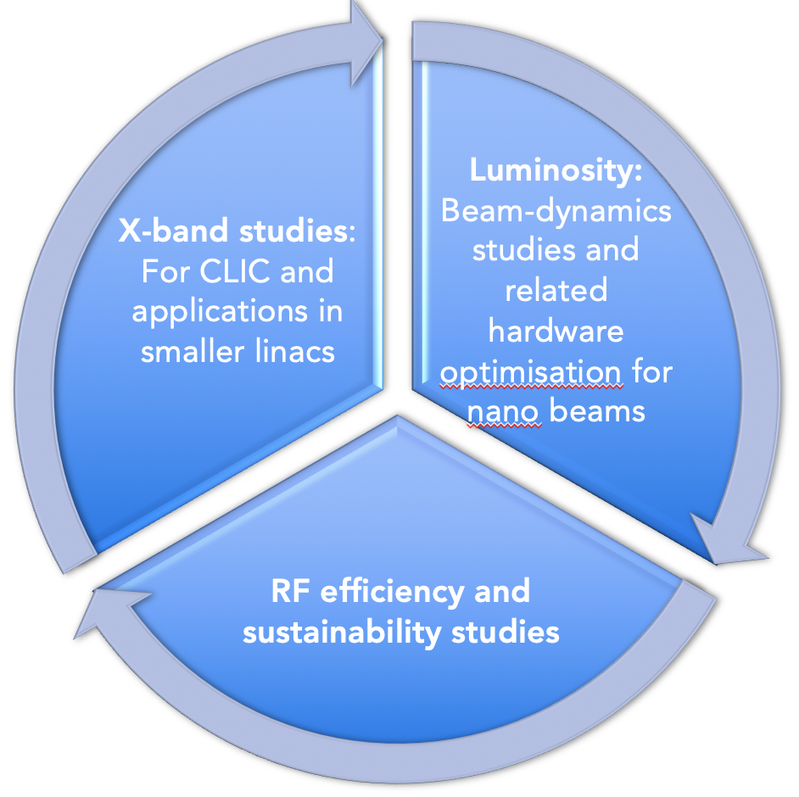
CLIC Project Readiness 2025-26
Project Readiness Report as a step toward a TDR – for next ESPP
Assuming ESPP in 2026, Project Approval ~ 2028, Project (tunnel) construction can start in ~ 2030.
Focusing on:
The X-band technology readiness for the 380 GeV CLIC initial phase
Optimizing the luminosity at 380 GeV
Improving the power efficiency for both the initial phase and at high energies
Goals for these studies by ~2025:
Improved 380 GeV parameters/performance/project plan
Push multi-TeV options/parameters

Slide 15
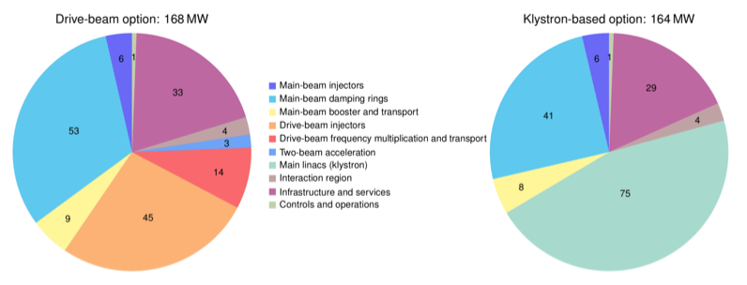
Power and Energy
Design Optimisation:
The designs of CLIC, including key performance parameters as accelerating gradients, pulse lengths, bunch-charges and luminosities, have been optimised for cost but also increasingly focussing on reducing power consumption.
Technical Developments:
Technical developments targeting reduced power consumptions at system level high efficiency klystrons, and super conducting and permanents magnets for damping rings and linacs.
Running when energy is cheap:
CLIC is normal conduction, single pass, can change off-on-off quickly, at low power when not pulsed. Specify state-change (off-standby-on) times and power uses for each – see if clever scheduling using low-cost periods, can reduce the energy bill
Renewable energy (carbon footprint):
Is it possible to fully supply the annual electricity demand of the CLIC-380 by installing local wind and PV generators (this could be e.g., achieved by 330 MW-peak PV and 220 MW-peak wind generators, at a cost of slightly more than 10% of the CLIC 380 GeV cost)
Power estimate bottom up (concentrating on 380 GeV systems)
Very large reductions since CDR, better estimates of nominal settings, much more optimised drivebeam complex and more efficient klystrons, injectors more optimized, etc
Further savings possible, main target damping ring RF significantly reduced, L-band klystrons (target 110-130 MW)
Energy consumption ~0.8 TWh yearly (target 0.6)
CERN is currently (when) running at 1.2 TWh (~90% in accelerators)

Slide 16
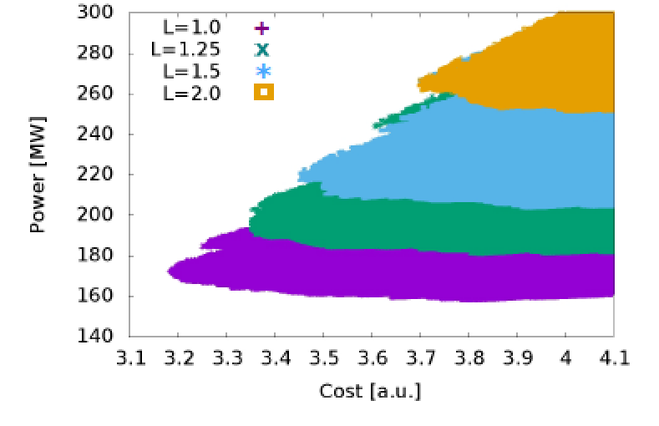
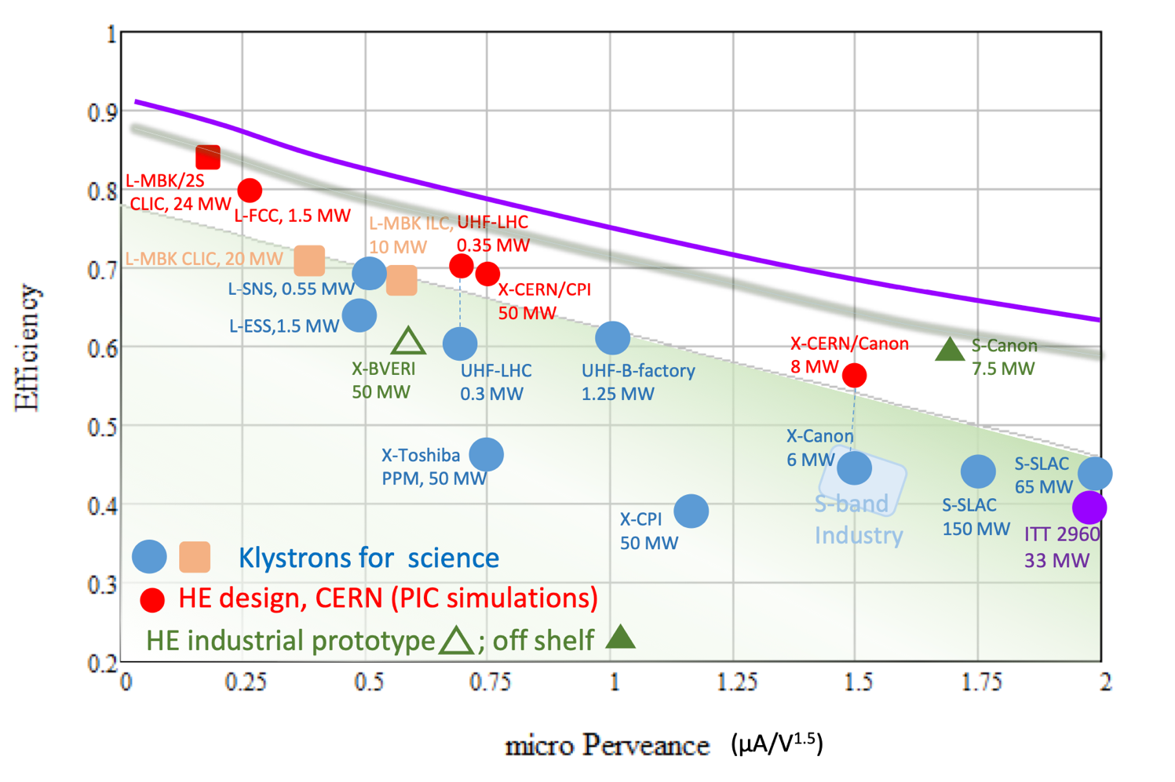
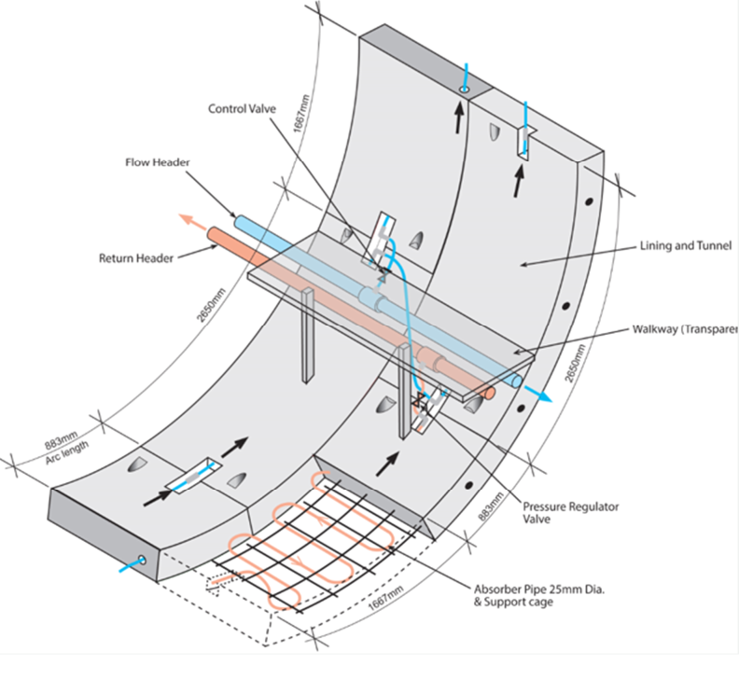
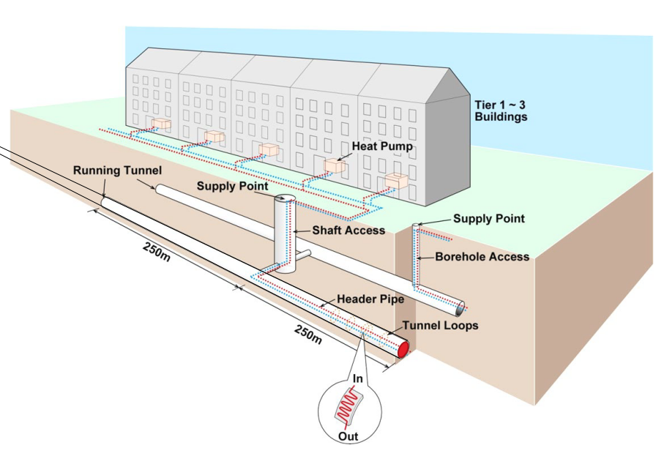
Optimisations – examples
Design Optimisation:
All projects aim to optimize – most often energy reach, luminosities and cost. Examples from all Higgs factories mentioned above.
Power is becoming at least as important, maybe even compromising ultimate performance for power saving.
Technical Developments:
Technical developments targeting reduced power consumptions at system level high efficiency klystrons and RF systems generally, and super conducting (traditional SC, and HTS in particular) including cryo, and permanents magnets.
Heat recovery:
Already implemented in point 8 for LHC
Tunnel heat recovery study by ARUP in 2022
The designs of CLIC, including key performance parameters as accelerating gradients, pulse lengths, bunch-charges and luminosities, have been optimised for cost and power

Slide 17
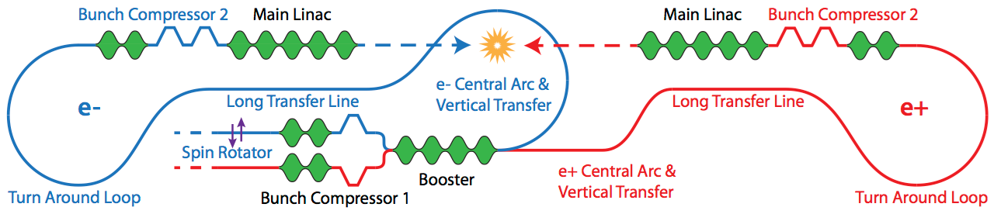
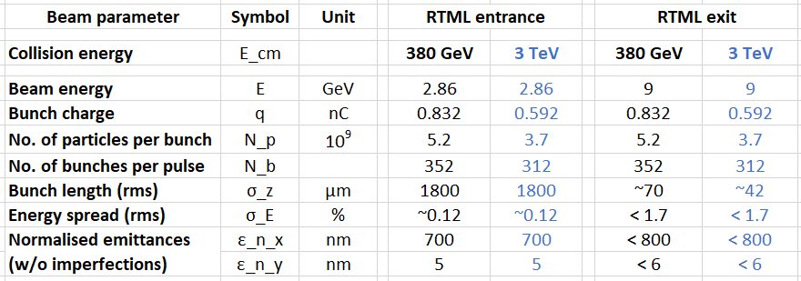
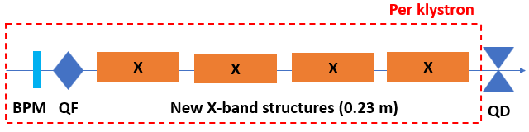
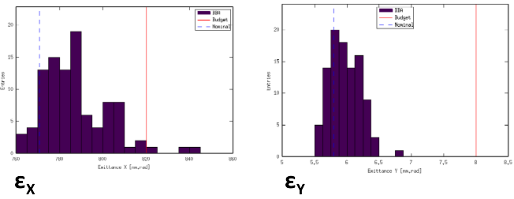
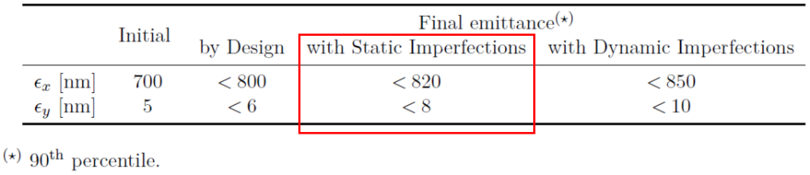
Rings to Main Linac optimisation
BC2 RF new optimisation for cost and power consumption

Slide 18
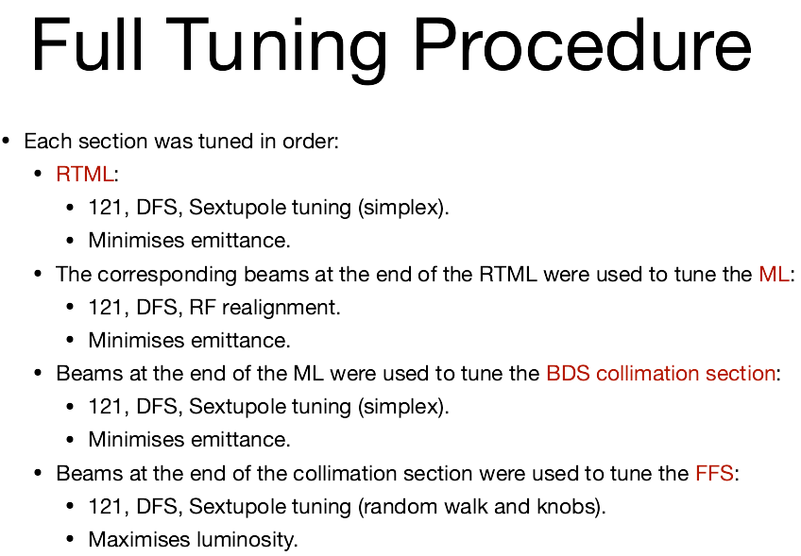
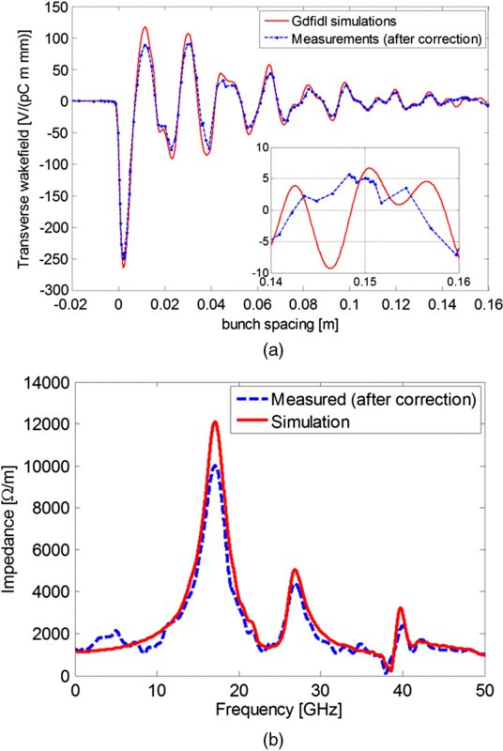
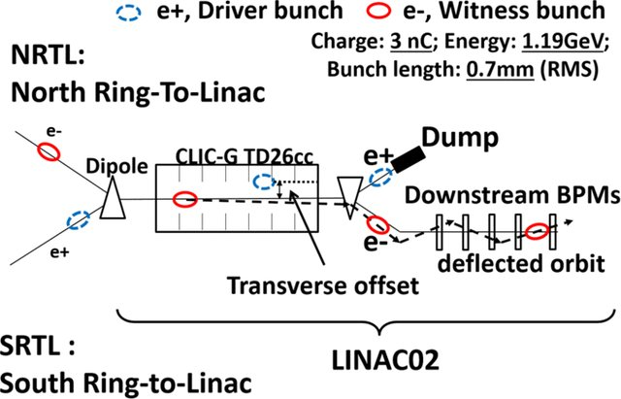
Main Linac
Long-range wakefields suppression
Experiment at FACET (SLAC)
Tests of Beam-based orbit correction at FACET

Slide 19
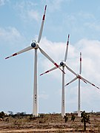
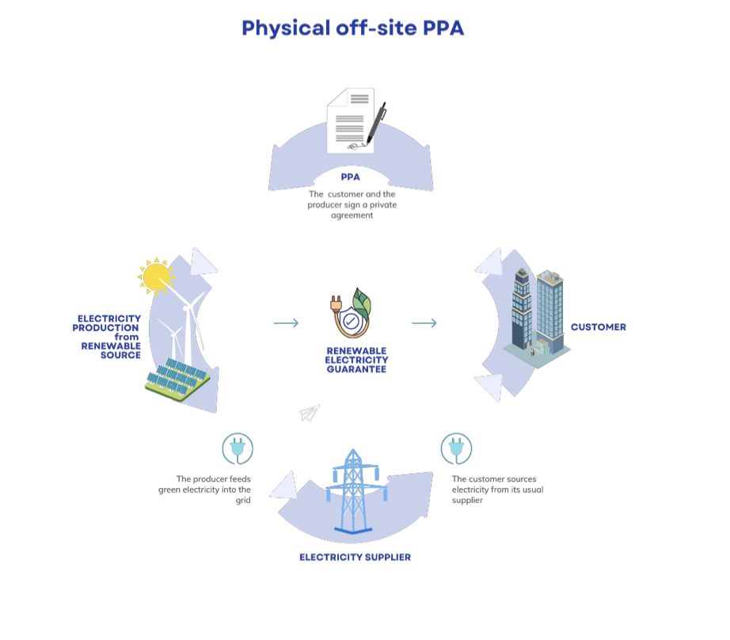
Running on renewables and when electricity is cheap
Two studies in 2017:
Supply the annual electricity demand of the CLIC-380 by installing local wind and PV generators (this could be e.g. achieved by 330 MW-peak PV and 220 MW-peak wind generators) at a cost of slightly more than 10% of the CLIC 380 GeV cost.
  Study done for 200 MW, in reality only ~110 MW are needed
Self-sufficiency during all times can not be reached but 54% of the time CLIC could run independently from public electricity supply with the portfolio simulated.
Can one run an accelerator as CLIC in a mode where one turn “on” and “off” depending prices (fluctuating with weather, demand, etc) ?
Specify transition times (relatively fast for a LC) and the annual luminosity goal
Significant savings – but the largest saving is the obvious one, not running in the winter.
Flexibility to adjust the power demand is expected to become increasingly important and in demand by energy companies.
More information (link)
Victor Gleim CC-BY-SA-4.0
A real implementation:
A physical power purchase agreement (PPA) is a long-term contract for the supply of electricity at a defined, fixed price at the start and then indexed every year, negotiated between a producer of renewable electricity and a consumer for a defined period (generally 15 to 20 years).
Being considered for CERN initially at limited scale.
Advantages: price, price stability, green, renewable.
Nuclear energy remains very important, on the timescale of a future CERN facility: SMEs
Must be a goal to run future accelerator at CERN primarily on green and more renewable energy with very low carbon footprint. However, energy costs will remain a concern

Slide 20
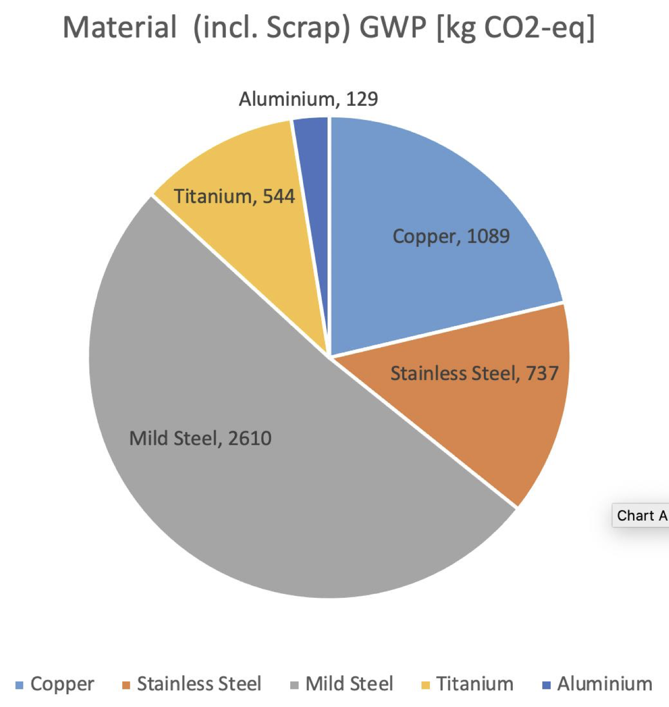



Sustainable Construction – some elements
Talk by B.List (link)
Carbon Cost/Life Cycle Assessment LCA study 2023
Two final comments:
The work on-going for the FCC to “integrate” into the areas near CERN, including getting rid of spoil, is obviously also a crucial element on the way to a environmentally integrated collider.
Responsible purchasing – and understanding the impact on our supply chain, costs and potential for changes – will be essentials for future projects (information from E.Cennini)
Similar CO2 estimates made for the FCC tunnel in the framework of Snowmass.
Assume a small tunnel (~5.6m diameter) and that the equipment in the tunnel has the same carbon footprint as the tunnel itself, 20km acc. incl. tunnel corresponds to 240 kton. This is equivalent to 50-60 TWh of nuclear power.

Slide 21



Cost - I
Machine has been re-costed bottom-up in 2017-18
Methods and costings validated at review on 7 November 2018 – similar to LHC, ILC, CLIC CDR
Technical uncertainty and commercial uncertainty estimated

Slide 22

Cost - II
Other cost estimates:
Construction:
From 380 GeV to 1.5 TeV, add 5.1 BCHF (drive-beam RF upgrade and lengthening of ML)
From 1.5 TeV to 3 TeV, add 7.3 BCHF (second drive-beam complex and lengthening of ML)
Labour estimate: ~11500 FTE for the 380 GeV construction
Operation:
116 MCHF (see assumptions in box below)
Energy costs

Slide 23




X-band tests
Industrial questionnaire:
Based on the companies feedback, the preparation phase to the mass production could take about five years. Capacity clearly available.
Structures and components production programme to study designs, operation/conditioning, manufacturing, industry qualification/experience
EU projects: ARIES, I-FAST, new TNA

Slide 24




Use in smaller linacs (C- and X-band)
SwissFEL: C-band linac
Photo: SwissFEL/PSI
104 x 2 m-long C-band (5.7 GHz) structures (beam up to 6 GeV at 100 Hz)
Similar μm-level tolerance
Length ~ 800 CLIC structures
Being commissioned
X-band structures from PSI perform well
26 academic and industrial partners: http://www.compactlight.eu/Main/HomePage
CompactLight Design Study 2018-21 (link)
Compact FEL based on X-band technologies
CERN: eSPS study (3.5 GeV X-band linac)

Slide 25







Applications – injector, X-band modules, RF
CompactLight Design Studies 2018-21 (right)
INFN 1 GeV linac
Flash RT, at CHUV
“Design Studies” for ICS
AERES, IFAST and TNA project
Overview at LINK
X-band accelerating modules
Notes:
Size of investments

Slide 26




Beam Facilities using X-band technology
TU Eindhoven: SMART*LIGHT, ICS
Tsinghua: VIGAS, ICS
CERN: AWAKE electron injector
INFN Frascati: EuPRAXIA@SPARC_LAB, accelerator
DESY: SINBAD/ARES, deflector
CHUV/CERN: DEFT, medical accelerator
Daresbury: CLARA, linearizer
Trieste: FERMI energy upgrade
VIGAS

Slide 27



High Eff. Klystrons
L-band, X-band (for applications/collaborators and test-stands
High Efficiency implementations:
New small X-band klystron, ordered
Large with CPI, work with INFN
L-band two stage, design done, prototyping for FCC
Also important, redesign of damping ring RF system (well underway) – no klystron development foreseen
Drivebeam klystron: The klystron efficiency (circles) and the peak RF power (squares) simulated for the CLIC TS MBK (solid lines) and measured for the Canon MBK E37503 (dashed lines) vs total beam power.
Publication: https://ieeexplore.ieee.org/document/9115885

Slide 28



I-FAST – CompactLight Structure
X-band linac
10 MW, 1.5 μs @1 KHz
50 MW, 1.5 μs @100 Hz
High-energy module

Slide 29

Accelerating structure RF operating parameters
Two structures being manufactured
Courtesy M. Diomede

Slide 30



CLIC Detector
CLICdet:
◆ High-performing detector optimized for CLIC beam environment
◆ Full GEANT-based simulation, including beam-induced backgrounds,
available for optimization and physics studies
◆ Mature reconstruction chain allows detailed performance characterisation
– e.g. for tracking: effect of busy environment; displaced track reconstruction
NIM A956 (2020) 163304
Software framework:
◆ Originally in iLCSoft, the simulation/reconstruction is now fully embedded in the Key4HEP ecosystem –> a common target for all future collider options
– existing reconstruction algorithms “wrappered” for the new framework

Slide 31




Detector R&D for CLICdet
Calorimeter R&D => within CALICE and FCAL
Silicon vertex/tracker R&D:
Working Group within CLICdp and strong collaboration with DESY + AIDAinnova
Now integrated in the CERN EP detector R&D programme
A few examples:
CLICTD monolithic tracking sensor:
Hybrid assemblies:
Monolithic sensors:
◆ Development of bump bonding process for CLICpix2 hybrid assemblies with 25 μm pitch
https://cds.cern.ch/record/2766510
◆ Exploring sub-nanosecond pixel timing with ATTRACT FASTPIX demonstrator in 180 nm monolithic CMOS
https://agenda.linearcollider.org/event/9211/contributions/49445/
◆ Now performing qualification of modified 65 nm CMOS imaging process for further improved performance
ACF conductor ball
Detailed simulations, Allpix² transient Monte Carlo combined with electrostatic 3D TCAD.
Beam tests at DESY, e.g. 5.8 ns CLICTD time resolution achieved
https://agenda.linearcollider.org/event/9211/contributions/49443/
◆ Successful sensor+ASIC bonding using Anisotropic Conductive Film (ACF), e.g., with CLICpix2, Timepix3 ASICs.
ACF now also used for module integration with monolithic sensors.
https://agenda.linearcollider.org/event/9211/contributions/49469/

Slide 32



Physics Potential recent highlights 1:
Initial energy stage
◆ Ongoing studies on Higgs and top-quark precision physics potential
Higgs coupling sensitivity:
◆ Sensitivities under different integrated luminosity scenarios to complement accelerator luminosity studies
Increased integrated luminosity at 380 GeV
(4ab^{–1})
Baseline: 380 GeV (1ab^{–1}) + 1.5 TeV
Top-quark threshold scan
◆ Optimisation of scan points including beam spectrum; here optimising on mass and Yukawa coupling.
◆ Expected top-quark mass precision of 25MeV can be improved by 25% without losing precision on width or Yukawa.
https://arxiv.org/abs/2103.00522
https://arxiv.org/abs/2001.05278
other sensitivities from Briefing Book https://arxiv.org/abs/1910.11775

Slide 33



Physics Potential recent highlights 2:
Multi-TeV stages
◆ Ongoing studies on new physics searches
Search for heavy neutrinos
◆ e+e- -> Nν -> qqlν signature allows full reconstruction of N
◆ BDT separates signal from SM; beam backgrounds included.
◆ cross-section limits converted to mass (m_{N}) coupling (V_{IN}) plane
Dark matter using mono-photon signature at 3TeV, e+e- -> XXγ
◆ New study using ratio of electron beam polarisations to reduce systematics
◆ Exclusions for simplified model with mediator Y and DM particle X
◆ For benchmark mediator of 3.5TeV, photon energy spectrum discriminates different DM mediators & allows 1TeV DM particle mass measurement to ~1%
https://arxiv.org/abs/2103.06006
CLIC 3TeV, geY=1
LHC analysis: [1812.08750],
different assumption V_{eN} = V_{mN} ≠ V_{τN} = 0

Slide 34
Summary and thanks
CLIC studies focused on core technologies, X-band and nanobeam, for next ESU, well underway.
Keep focus on both 380 GeV and multi-TeV performance and R&D
Greatly helped by studies of smaller linacs and systems using X-band technology
Detector and physics studies continue at lower pace, also in many areas integrated or connected with ”Higgs-factory” studies, and wider Detector R&D efforts
Thanks to Steinar Stapnes and to many CLIC accelerator colleagues for slides and inputs, and to Aidan Robson for the CLICdp slides

Slide 35


Luminosity of future colliders
Per IP, from Snowmass

Slide 36


Personnel estimate and cost – and Higgs factories
One FTEy estimated to 200kUS$

Slide 37

Higher energy projects – and costs

Slide 38


Timelines in Snowmass Energy Frontier summary
Comments:
Timelines are technologically limited – except the CERN projects that are linked to completion of the HL-LHC
CEPC and ILC schedules are mature, but the projects need to pass approval processes in the near future to maintain these schedules
CCC and MC are less well defined but R&D and project development on the shown timescales is reasonable, CCC can also upgrade ILC
A clear wish to develop options for future US-sited EF colliders
US put emphasis on “fast” access to a Higgs factory
From Meenakshi Narain EF summary Snowmass

Slide 39
Pushing the acc. technology – R&D
CLIC core studies:
Normal conducting accelerating structures are limited in gradient by three main effects (setting aside input power):
Field emission
Vacuum arcing (breakdown)
Fatigue due to pulsed surface heating
Studying these processes gives important input into:
RF design – Optimizing structures also coupled with beam dynamics
Technology – Material choice, process optimization
Operation – Conditioning and recovery from breakdown
Designs for CLIC steadily improving, but also RFQ, Muon collider, XFEL, ICS, etc
Important experimental support
Multi-TeV energies:
High gradient, high wall-plug to beam efficiency, nanobeam parameters increasingly demanding

