Slide 1

CEPC collective instability study status
Na Wang, Yuan Zhang, Haisheng Xu, Saike Tian , Yudong Liu, Yuting Wang
IHEP
IAS workshop, Feb. 12th-16th, 2023, Hong Kong

Slide 2
Outline
Impedance modeling
  Resistive wall & geometrical impedance
Collective instabilities
  Bunch lengthening and microwave instability
  Transverse mode coupling instability
  Coupled bunch instabilities
  Beam ion effects
Summary and outlooks

Slide 3
Impedance modeling
Impedance modeling of the key vacuum components has been performed since the beginning of the project.
Resistive wall impedance
  Generated from finite conductivity of the vacuum chambers
  Calculated with theoretical formulas considering the NEG coating
Geometrical impedance
  Generated by the discontinuity of the vacuum chambers
  Calculated individually with 2D/3D simulation codes

Slide 4
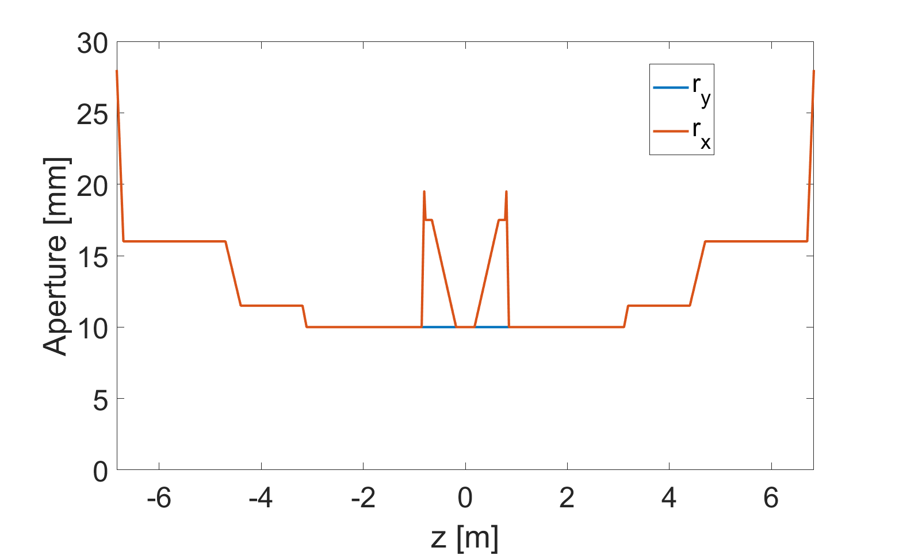
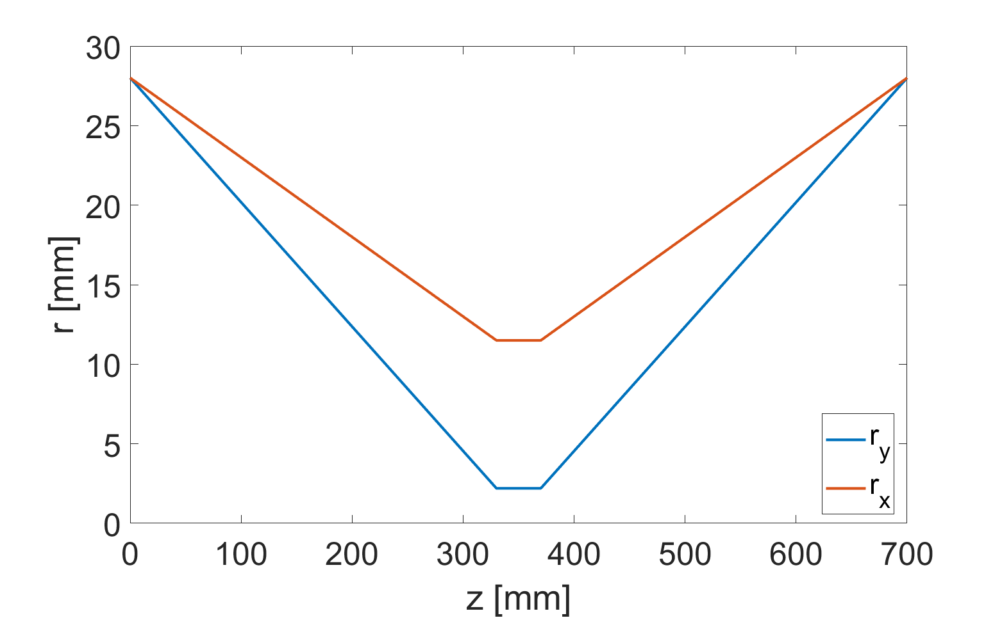
Resistive wall impedance
Including main chamber, MDI chamber, collimators in the IR region and stainless steel chamber (flanges, bellows, BPMs)
MDI chamber:
Main chamber:
(L=97km)
28mm
3mm copper
0.2um NEG coating
Collimator:
10 hori.+8 vert.
SS chamber:
(L=3km)
28mm
3mm stainless steel

Slide 5
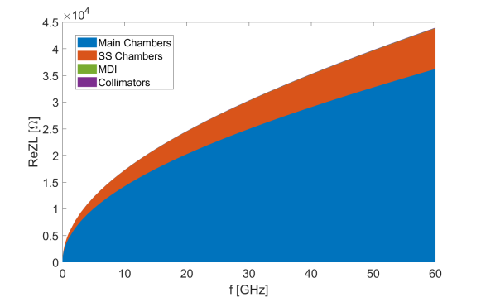
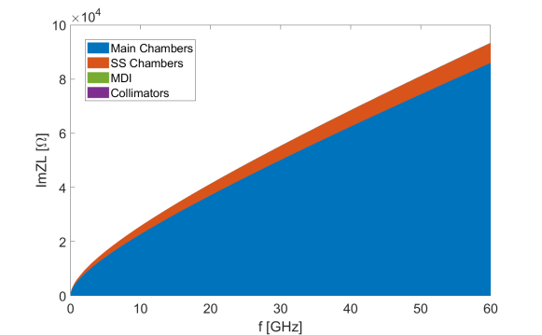
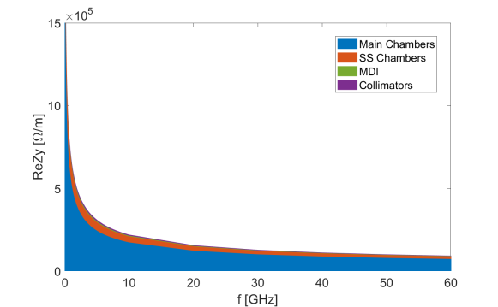
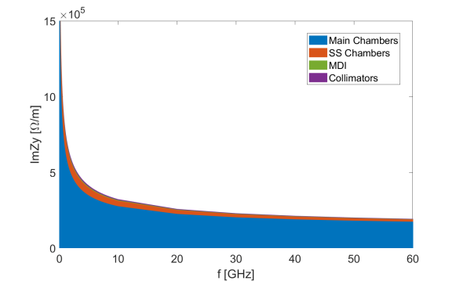
Resistive wall impedance
The impedance contributed by the main vacuum chamber dominates both the longitudinal and transverse RW impedance. The impedance from stainless steel chambers also shows nontrivial contributions.
Broadband effective impedance @σ_{z}=3mm
ReZL
ImZL
Components | Z||/n, mΩ | k_{loss}, V/pC | k_{y}, kV/pC/m
Main chamber | 6.0 | 350.7 | 10.9
SS chamber | 0.7 | 73.4 | 1.6
MDI chamber | 6.9E-3 | 0.7 | 0.2
Collimators | 8.9E-3 | 0.9 | 0.3
RW Total | 6.7 | 425.6 | 13.8
Ring Total | 15.9 | 741.4 | 33.8
ReZy
ImZy

Slide 6
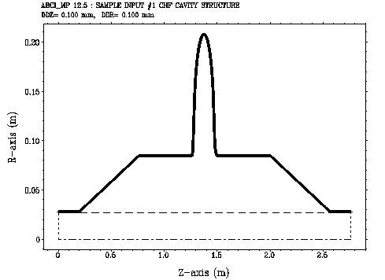
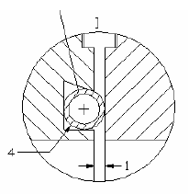
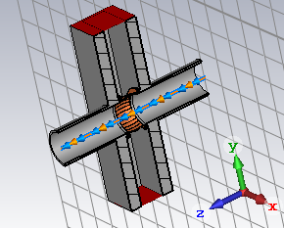
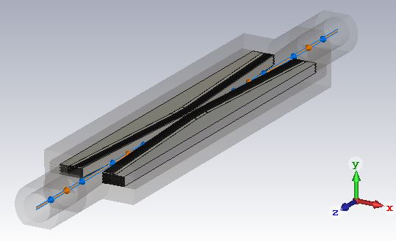
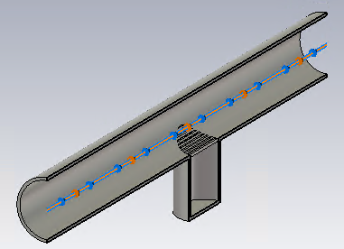
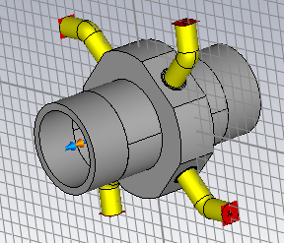
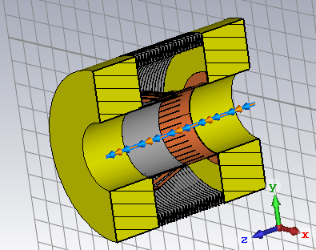
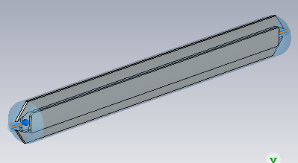
Geometrical impedance
Main vacuum components considered in the impedance model
Flange
Gate Valve
Collimator
RF cavity
BPM
Bellows
Electro separator
Pumping port

Slide 7
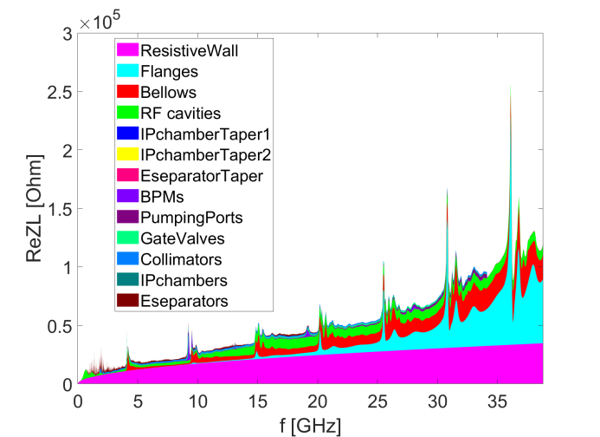
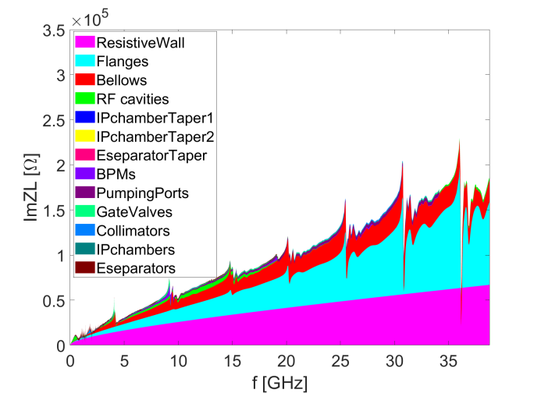
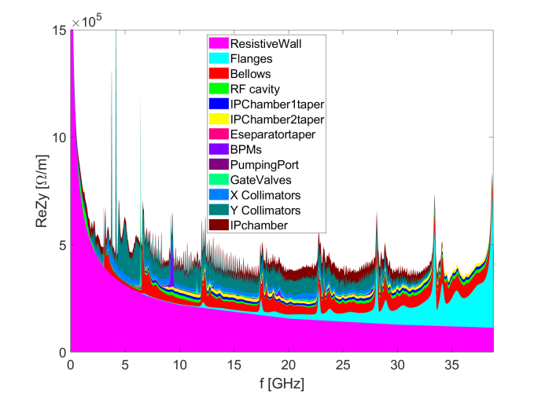
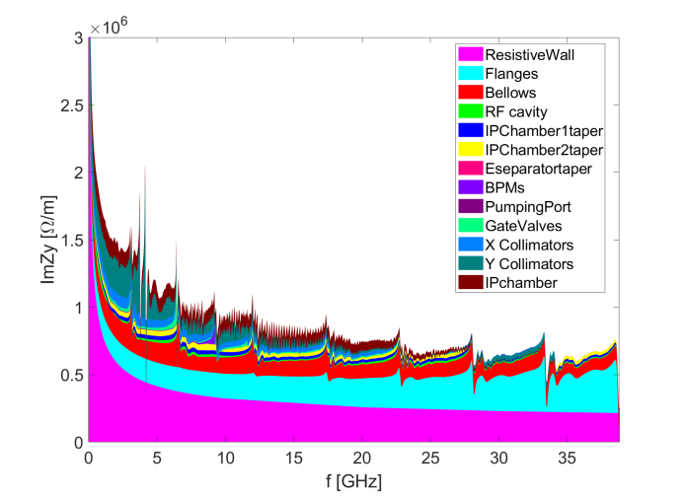
Impedance model
The longitudinal broadband impedance is dominated by the RW, flanges and bellows.
The transverse impedance is dominated by the RW, flanges, bellows and collimators.
Inj./ext. elements, feedback kickers, absorbers, masks and collimators outside the IR region are still missing.
ReZL
ImZL
ReZy
ImZy

Slide 8
Impedance budget @σ_{z}=3mm
Components | Number | Z||/n, mΩ | L, nH | k_{loss}, V/pC | k_{y}, kV/pC/m
Resistive wall | - | 6.7 | 355.7 | 425.6 | 13.8
RF cavities | 60 | 0.5 | 24.8 | 101.2 | 0.5
Flanges | 37714 | 5.2 | 276.1 | 37.3 | 5.2
BPMs | 1808 | 0.04 | 2.0 | 9.5 | 0.2
Bellows | 15949 | 2.9 | 154.6 | 87.4 | 3.9
Gate Valves | 500 | 0.2 | 11.4 | 14.5 | 0.4
Pumping ports | 5316 | 0.3 | 18.4 | 2.3 | 0.2
Collimators | 16 | 0.04 | 1.8 | 26.4 | 4.8
IP chambers | 2 | 0.004 | 0.2 | 0.3 | 2.9
Electro-separators | 20 | -0.1 | -5.4 | 34.5 | 0.1
Taper transitions | 48 | 0.04 | 2.3 | 2.5 | 1.8
Total |  | 15.9 | 842.0 | 741.4 | 33.8

Slide 9
Impedance evolution
The impedance model will be continuously updated along with the development of the hardware designs.
  The effective impedances varies along with the development of the impedance model => apparent increases on both Z/n and ky are shown.
CDR-2018
Elliptical cross section
IARC-2021
Circular cross section
More contributors included
More detailed chamber material, collimator updated and betatron function weighing is considered.
2023
Evaluate with rms bunch length of 3mm

Slide 10
Main beam parameters for the collider rings
Parameter [unit] | Higgs | W | Z | tt-bar
Beam energy [GeV] | 120 | 80 | 45.5 | 180
L_{max}/IP (10³⁴cm⁻²s⁻¹) | 5 | 16 | 115 | 0.5
Emittance (H/V) [nm] | 0.64/0.0013 | 0.87/0.0017 | 0.27/0.0014 | 1.4/0.0047
Beam current [mA] | 16.7 | 84.1 | 803.5 | 3.3
Bunch number | 249 | 1297 | 11934 | 35
Bunch Population [10¹⁰] | 13 | 13.5 | 14 | 20
Momentum compaction [10⁻⁵] | 0.71 | 1.43 | 1.43 | 0.71
Bunch length σ_{z} (natural/total) [mm] | 2.3/4.1 | 2.5/4.9 | 2.5/8.7 | 2.2/2.9
Energy spread (natural/total) [10⁻⁴] | 10/17 | 7/14 | 4/13 | 15/20
Betatron tune ν_{x}/ν_{y} | 445.10/445.22 | 317.10/317.22 | 317.10/317.22 | 445.10/445.22
Synchrotron tune | 0.049 | 0.062 | 0.035 | 0.078
Radiation damping [ms] | 44/44/22 | 156/156/78 | 850/850/425 | 14/14/7

Slide 11
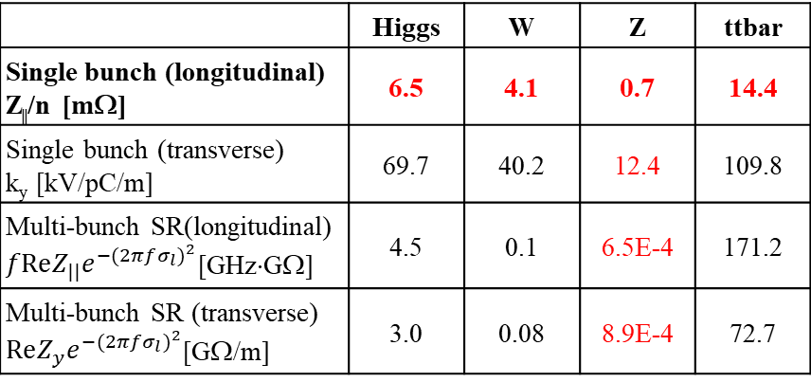
Collective instabilities in the collider rings
Rough estimations of the instability threshold based on analytical criterions.
 | Higgs | W | Z | ttbar
Single bunch (longitudinal) Z||/n [mΩ] | 6.5 | 4.1 | 0.7 | 14.4
Single bunch (transverse) k_{y} [kV/pC/m] | 69.7 | 40.2 | 12.4 | 109.8
Multi-bunch SR(longitudinal) $fReZ_{||}e^{−{(2πfσ_{l})}^{2}}$[GHz⋅GΩ] | 4.5 | 0.1 | 6.5E-4 | 171.2
Multi-bunch SR (transverse) $ReZ_{y}e^{−{(2πfσ_{l})}^{2}}$[GΩ/m] | 3.0 | 0.08 | 8.9E-4 | 72.7
Although the criterion usually underestimates the threshold, we do observed its influence on the beam-beam interaction ^{[PRAB 23, 104402 (2020);} ^{PRAB 25, 011001 (2022)]}.
TMCI unstable
Impedance budget
Z||/n, mΩ | 15.9
k_{y}, kV/pC/m | 33.8
Tight narrowband impedance requirements for Z (at least ~two orders higher for the other energies)

Slide 12
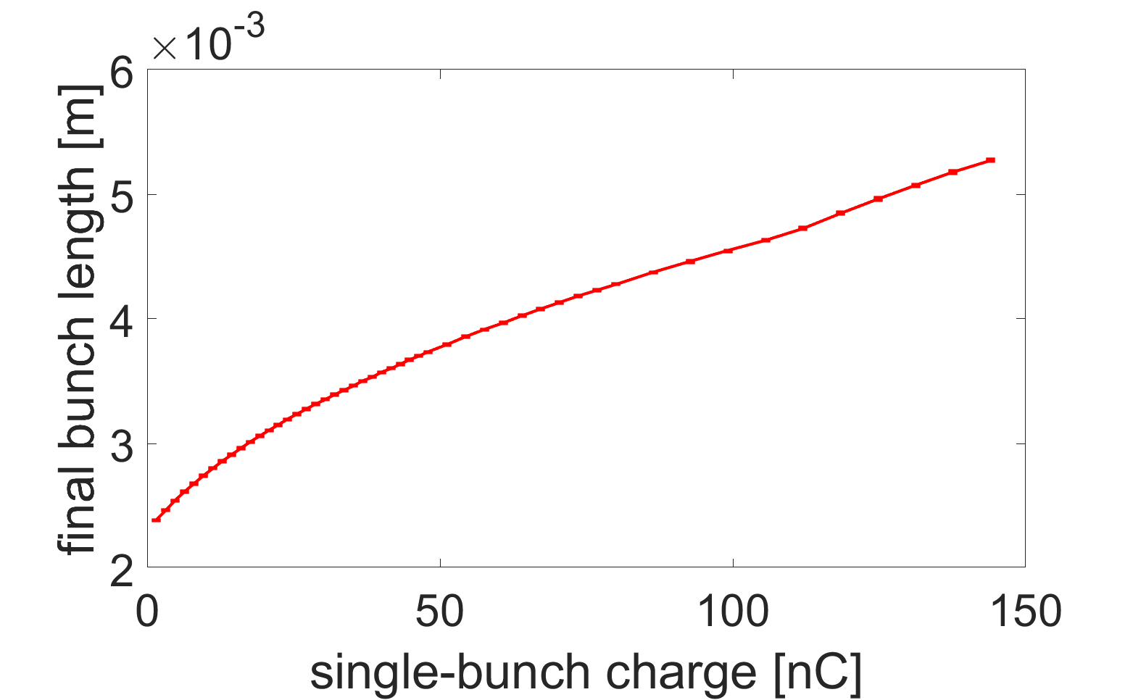
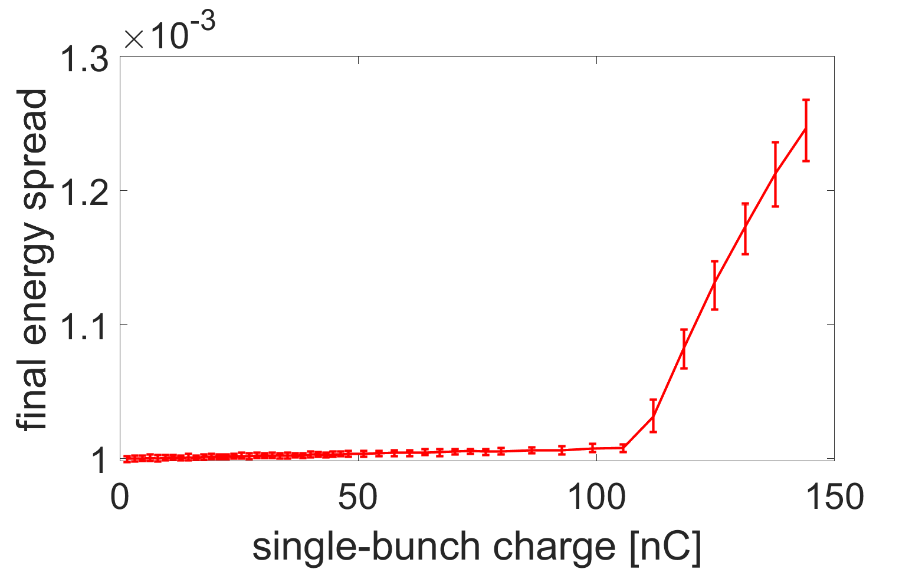
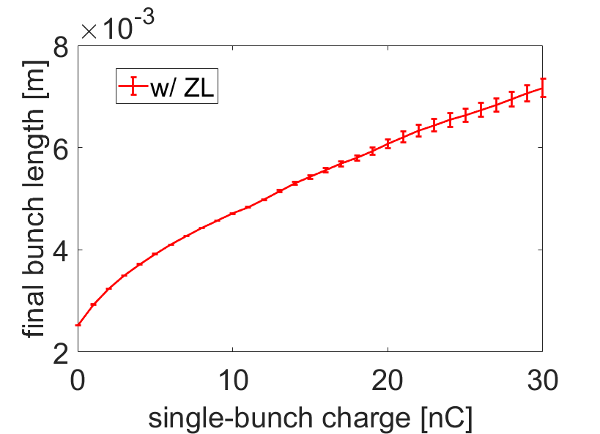
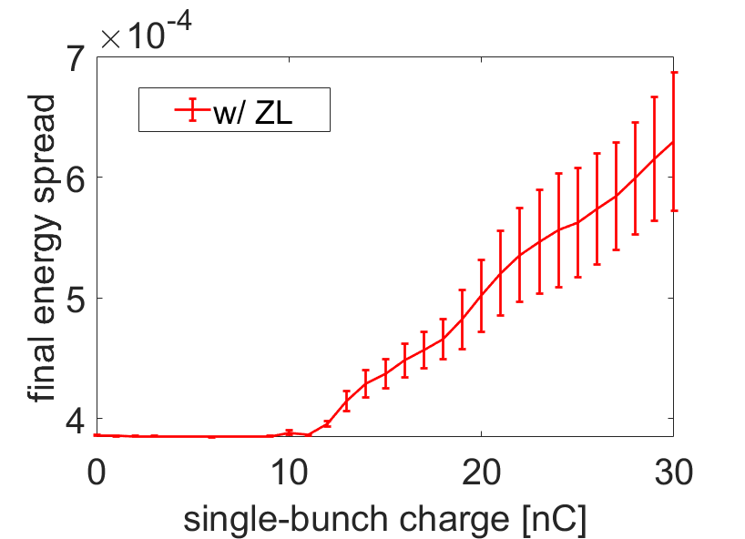
Bunch lengthening and microwave instability
Considering single beam, variations of bunch length and beam energy spread with bunch intensity are calculated by particle tracking simulations.
Higgs
Higgs
Z
Z
Higgs:
Instability threshold is around 100 nC ⇒ far above the design bunch current.
At the design bunch intensity, the bunch will be lengthened by ~30% due to the impedance.
Z:
Instability threshold is about half of the design bunch intensity.
At the design bunch current, the bunch length and the beam energy spread are increased by ~140% and ~35%, respectively.

Slide 13
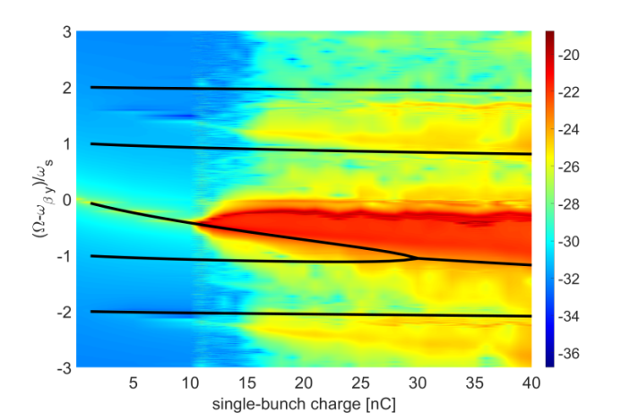
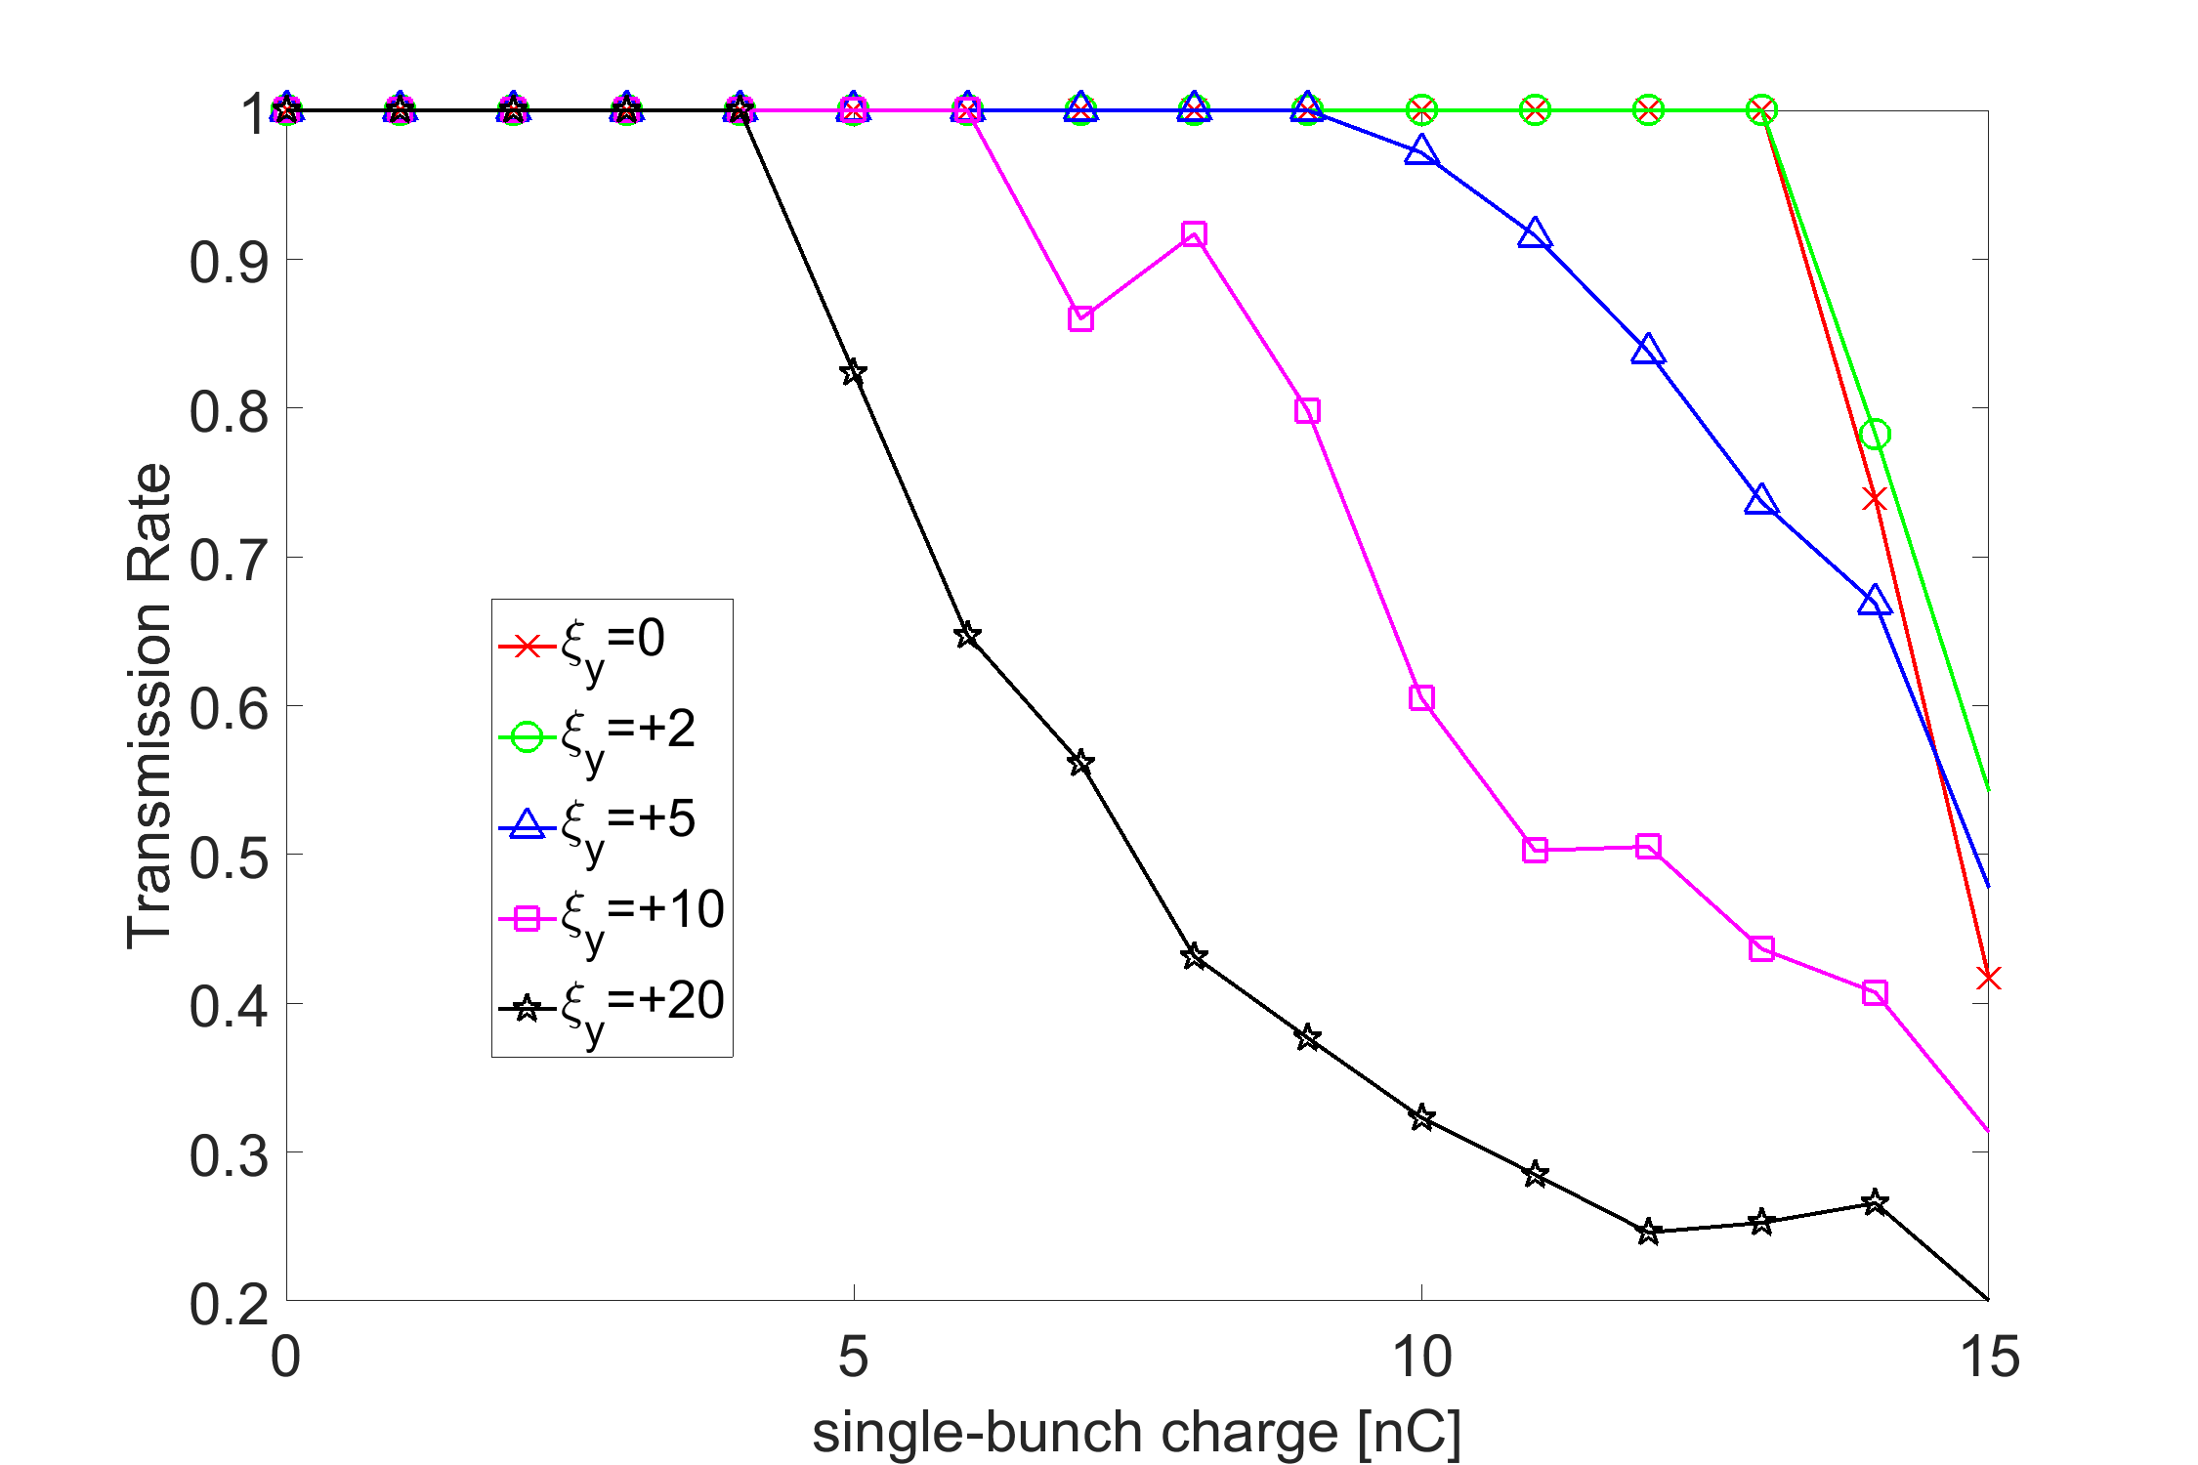

Transverse mode coupling instability (TMCI)
Main constraint on the single bunch current for Z.
For the single beam, consistent studies with both transverse and longitudinal impedance show reduction of the instability from longitudinal impedance.
  TMCI threshold at ξ=0 →10nC (design value: 22.4nC, Impedance: IARC-2021)
  Threshold beam current decreases with increase of chromaticity
Head-tail phase shift over the bunch:
$$k_{ξ}σ_{z}=\frac{ξω_{0}}{α_{c}c}σ_{z}<1$$
High order modes maybe excited with large chromaticity

Slide 14
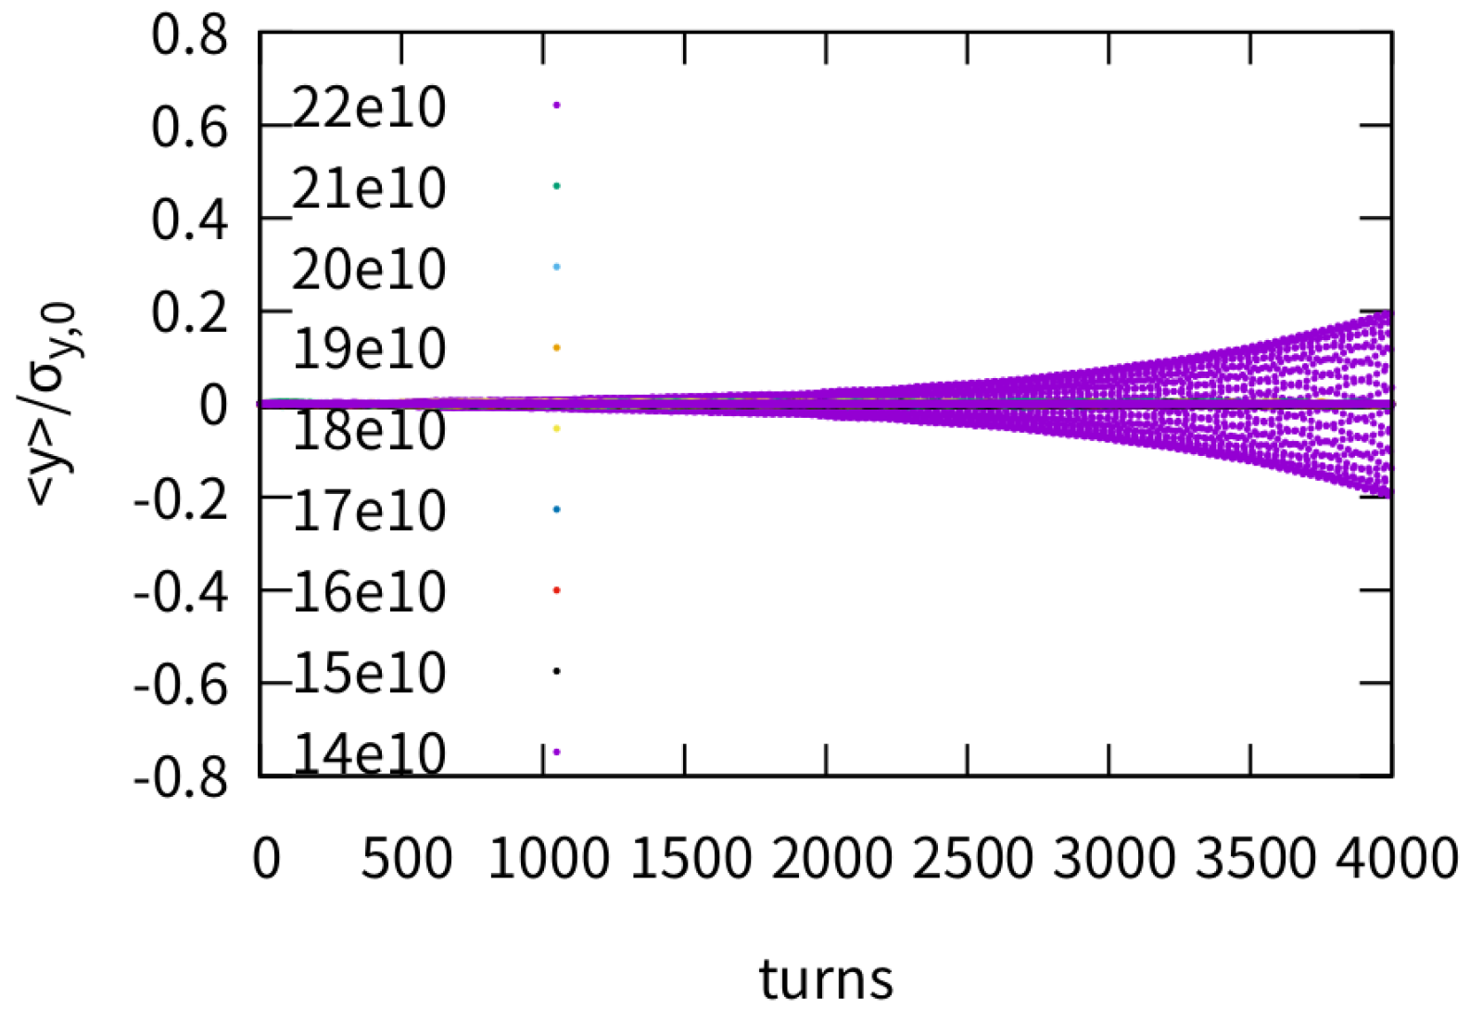
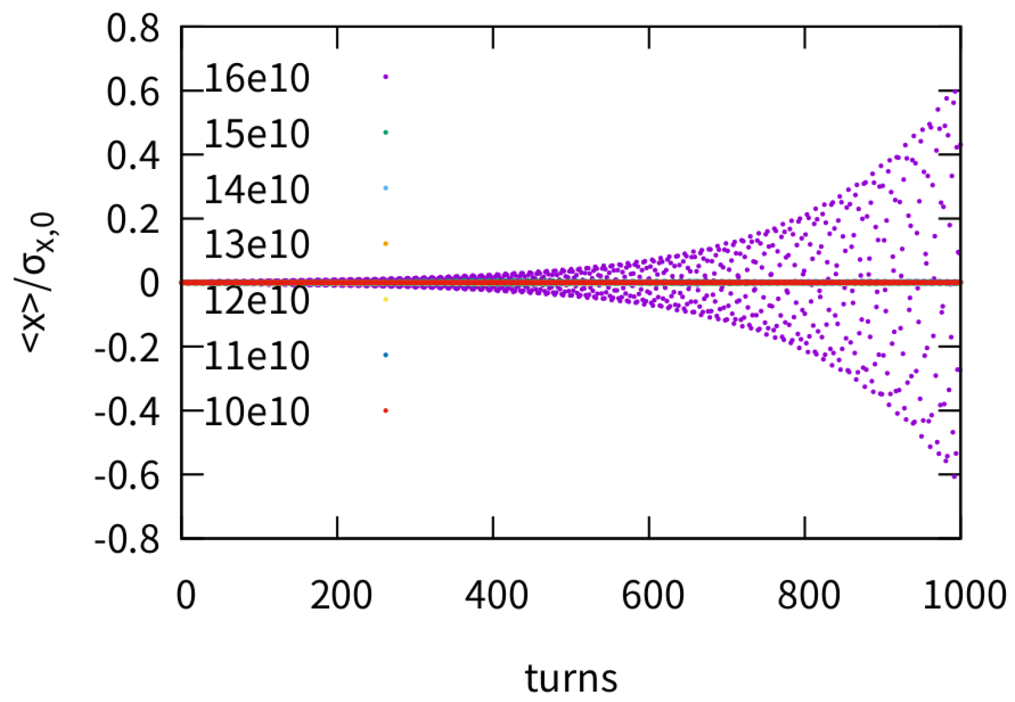
TMCI with lengthened bunch from BS and ZL
Yuan Zhang’talk for detail
Simulations are performed, considering bunch lengthening and energy spread increase @14e10, with the beam-beam code developed by Yuan Zhang.
⇒ Increase of the TMCI threshold due to the reduction of bunch density
⇒ Threshold decreases dramatically due to the increase of impedance
TMCI threshold: 21e10 (33.6nC)
TMCI threshold: 15e10 (24nC)
2021-ZT
2023-ZT

Slide 15
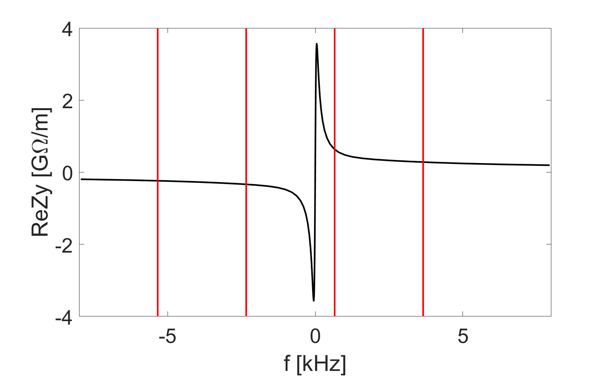
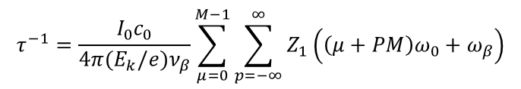
Transverse resistive wall instability
Assuming the whole ring is made of copper with coating, the instability growth rate is much faster than the synchrotron radiation damping (τ=850ms).
n=11615
$$τ^{−1}=\frac{I_{0}c_{0}}{4π(E_{k}/e)ν_{β}}\sum_{μ=0}^{M−1}{\sum_{p=−∞}^{∞}{Z_{1}\left(\left(μ+PM\right)ω_{0}+ω_{β}\right)}}$$
n=11616
n=11617
n=11618
f [kHz] | Mode index | Growth t [ms]
-2.338 | 11616 | 2.2 (7 turns)
-5.335 | 11615 | 3.2 (10 turns)
-8.332 | 11614 | 4.0 (12 turns)
-11.330 | 11613 | 4.6 (14 turns)
Tough requirement on feedback damping (broadband feedback + mode feedback)

Slide 16
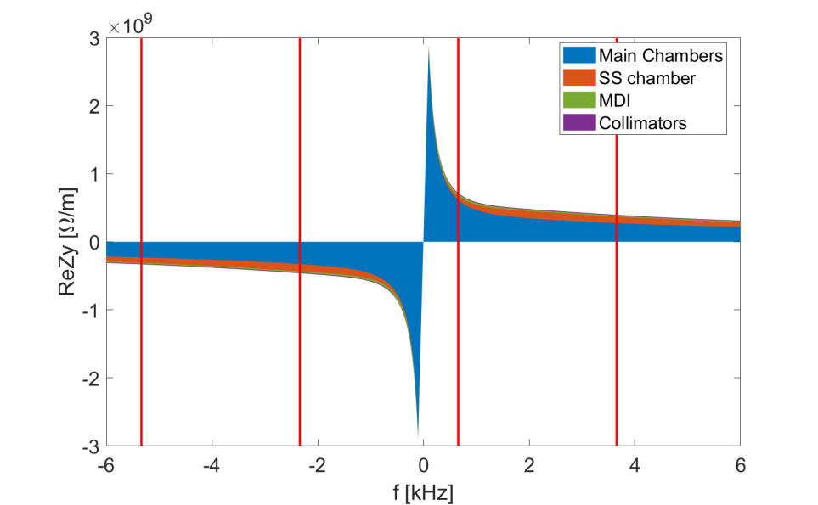
Transverse resistive wall instability (cont.)
With more detailed RW impedance model, the instability growth time can be further reduced by the stainless steel components. Contributions from the MDI and collimators are limited.
n=11615
$$τ^{−1}=\frac{I_{0}c_{0}}{4π(E_{k}/e)ν_{β}}\sum_{μ=0}^{M−1}{\sum_{p=−∞}^{∞}{Z_{1}\left(\left(μ+PM\right)ω_{0}+ω_{β}\right)}}$$
n=11616
n=11617
n=11618
f [kHz] | Mode index | Growth t [ms]
-2.338 | 11616 | 2.2 (7 turns)
-5.335 | 11615 | 3.2 (10 turns)
-8.332 | 11614 | 4.0 (12 turns)
-11.330 | 11613 | 4.6 (14 turns)
1.7ms
Tough requirement on feedback damping (broadband feedback + mode feedback)

Slide 17
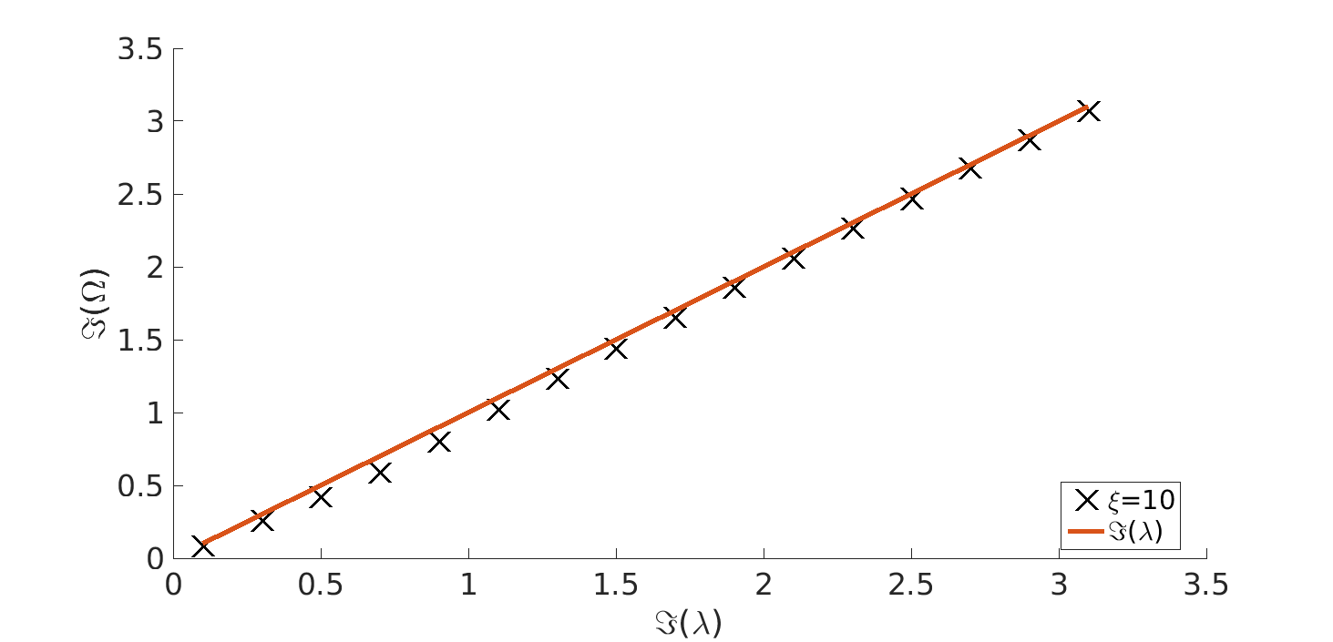

Transverse resistive wall instability (cont.)
Stabilizing effect of chromaticity is checked according to the theory developed in [PRAB 24, 024402 (2021)]
⇒ Limited damping from ξ for Z
$$k_{ξ}σ_{z}=\frac{ξω_{0}}{α_{c}c}σ_{z}$$
Head-tail phase shift over the bunch:
Natural bunch length or energy spread
σ_{z}=2.5mm, σ_{δ}=4×10⁻⁴, k_{ξ}σ_{z}=0.1
With impact of ZL and beamstrahlung
σ_{z}=8.7mm, σ_{δ}=13×10⁻⁴, k_{ξ}σ_{z}=0.4
τ = 2ms
τ = 2ms
ℑ(Ω)/(α_{c}σ_{δ}/σ_{t})
× ξ=10
− ξ=0
ℑ(Ω)/(α_{c}σ_{δ}/σ_{t})
× ξ=10
− ξ=0
ℑ(λ)/(α_{c}σ_{δ}/σ_{t})
ℑ(λ)/(α_{c}σ_{δ}/σ_{t})
Complex growth rate in terms of zero chromaticity growth rate

Slide 18
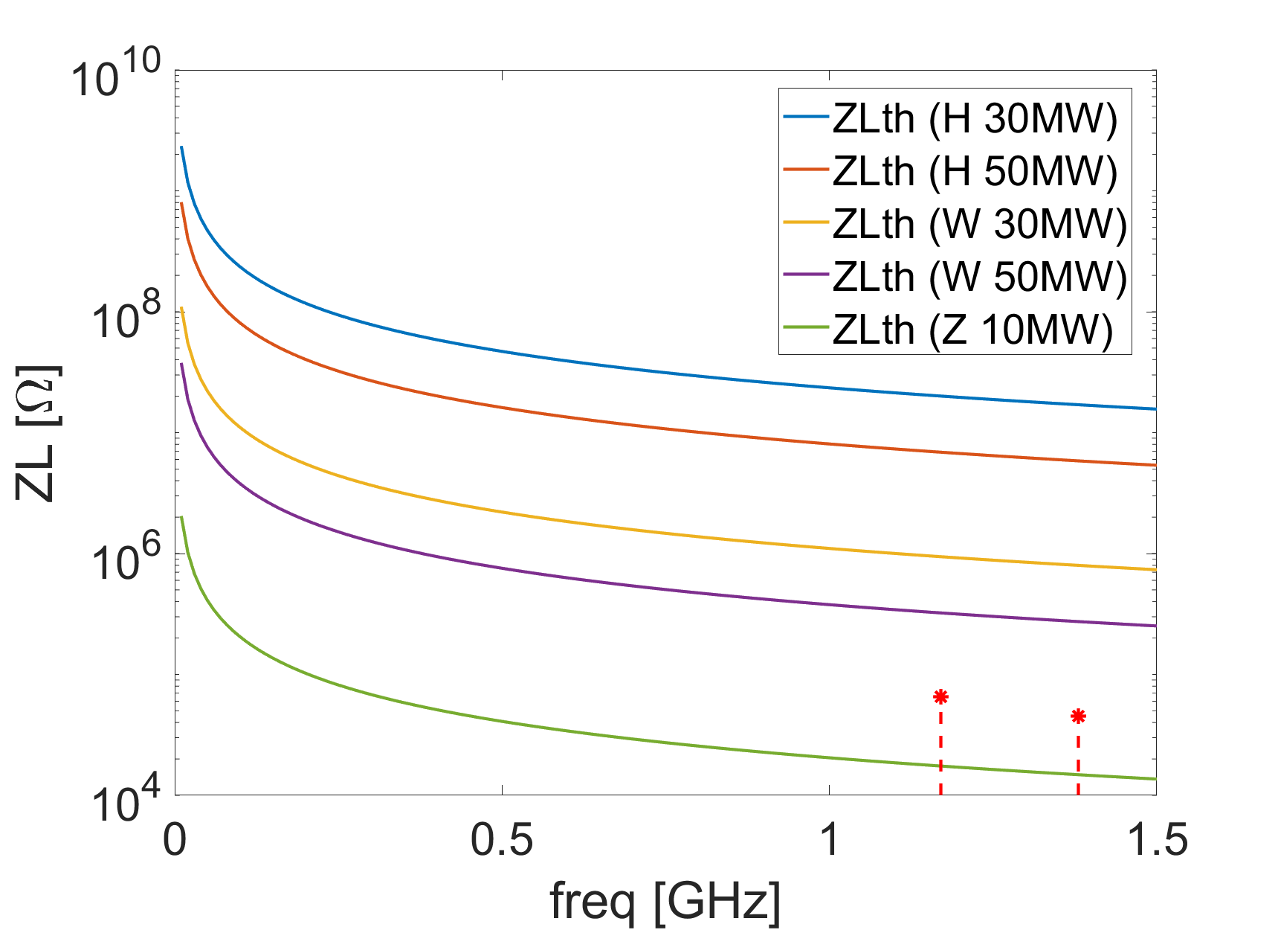
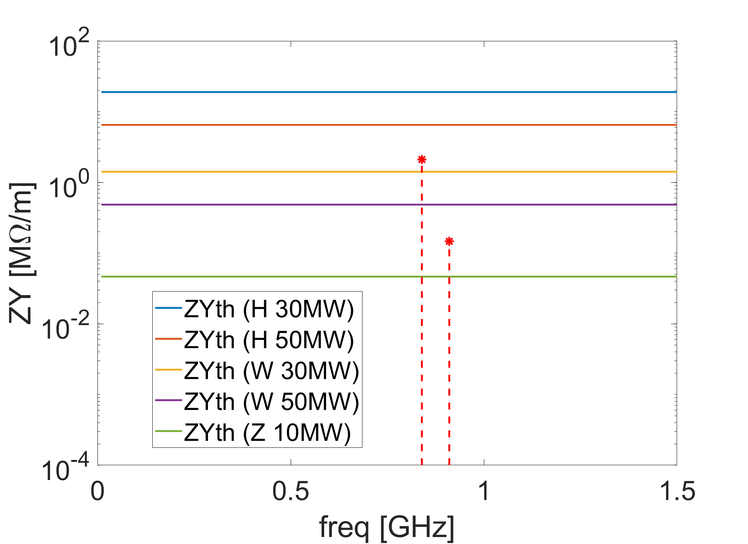
RF HOMs
Courtesy of JiYuan Zhai
For the operation mode of Higgs, W and low luminosity Z (with total beam power of 10 MW), the 2-cell 650MHz RF cavities will be adopted.
  The longitudinal and transverse HOMs below the cutoff frequency are measured.
  The impedance is above the SR threshold for Z in both longitudinal and transverse planes. In the resonant case, the instability has a growth rate of 114 ms and 19 ms, respectively.
  The W operation mode will also be unstable in transverse when consider only SR damping. In the resonant case, the instability has a growth rate of 105 ms.

Slide 19
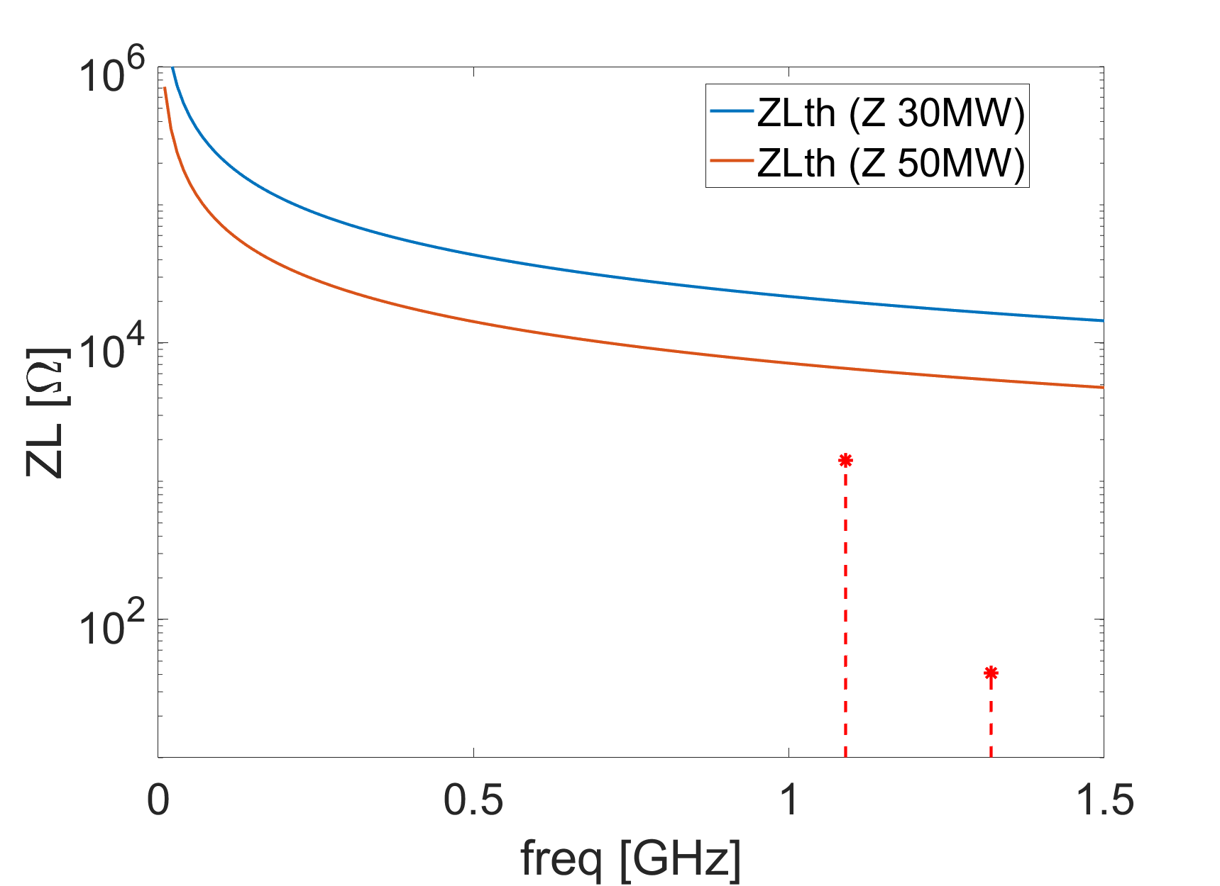
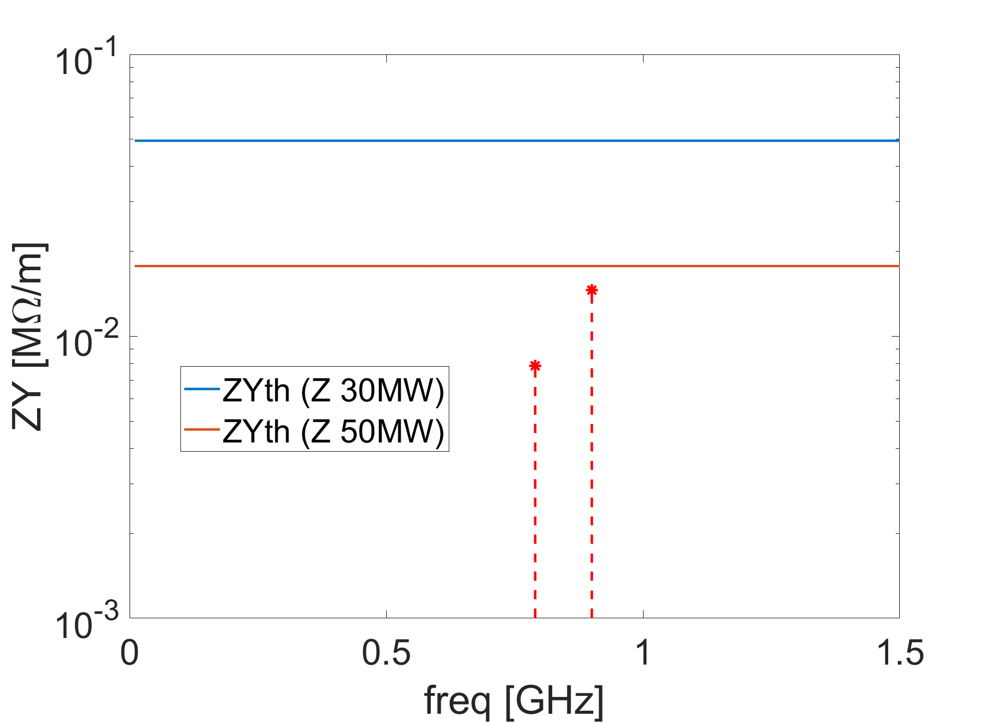
RF HOMs (cont.)
Courtesy of JiYuan Zhai
For the high luminosity Z, the RF cavities will be replaced by the 1-cell cavities.
  HOMs can be well damped (loaded Q of 100 has been considered) below the threshold that determined by the SR damping.

Slide 20
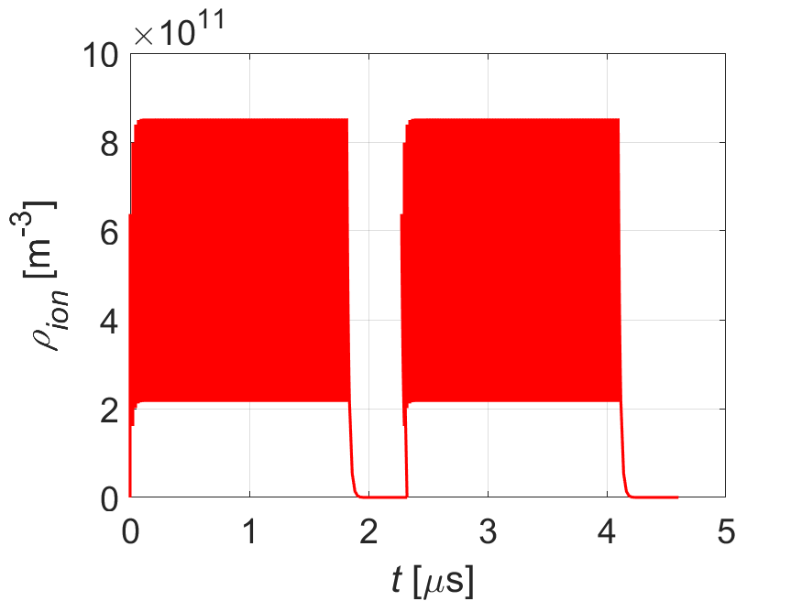
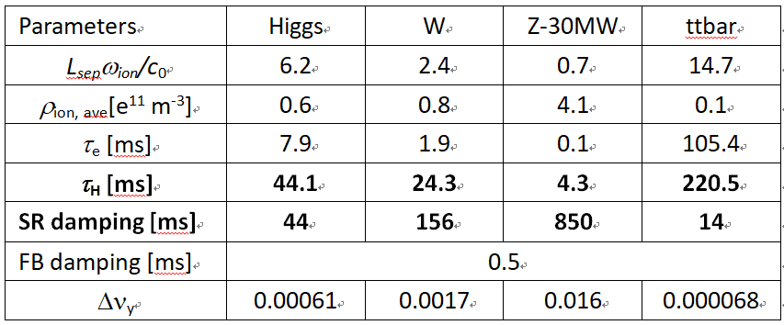
Beam ion effects
Trapped ions can induce bunch centroid oscillation and emittance growth.
The possibility of ion trapping and fast beam ion instability are investigated.
With vacuum pressure of 1nTorr, and CO has been considered as the only ion species
Consider multi bunch train filling pattern, the instability growth calculated by the analytical theory for W and Z are faster than SR damping.
Build-up of ions along the bunch train

Slide 21
Macro-particle simulations for Z
Filling pattern: 144 bunch trains, each train contains 83 bunches with spacing of 23ns
Multi-train filling is effective in mitigating the beam ion instability. However, beam emittance growth is still foreseen ⇒bunch by bunch feedback is needed.
Horizontal
Vertical
β_{x}/β_{y}=69/96m

Slide 22
Summary and outlooks
Main constraints from the beam collective effects are mainly focused on Z
  Transverse impedance restrict the single bunch current for single beam, as well as the stability of the beam-beam interaction.
  Tough requirement on feedback from TRWI ⇒ effective damping should be demonstrated.
Comprehensive or consistent studies considering coupling among different factors are needed for accurate estimate of the machine performance:
  impedance-beam beam, longitudinal-transverse, collective effect - feedback
Impedance model needs to be further evolved or optimized
  Constraint on the luminosity for the high performance Z.
  Kickers and machine protection collimators (or mask) can give nontrivial contributions, which are not included yet.
  HOM should be further checked for some key element, e.g. electro-separators.
Further investigation of the two-stream instability is still needed.

Slide 23
Thank you for your attention!

