Slide 1
Beam-Beam Effects at CEPC
Yuan Zhang, Na Wang, Dou Wang, Huiping Geng
IAS Program on High Energy Physics (HEP 2023)
2023, Feb

Slide 2
Beam-Beam Related Issues
Beamstrahlung Effect (Luminosity, Lifetime)
Coherent head-tail instability (X-Z instability)
  Influenced by Potential Well Distortion due to longitudinal impedance (ZL)
TMCI-like instability in vertical(horizontal) direction with transverse impedance (ZT)
Combined effect of Beam-Beam Interaction and realistic lattice
…

Slide 3
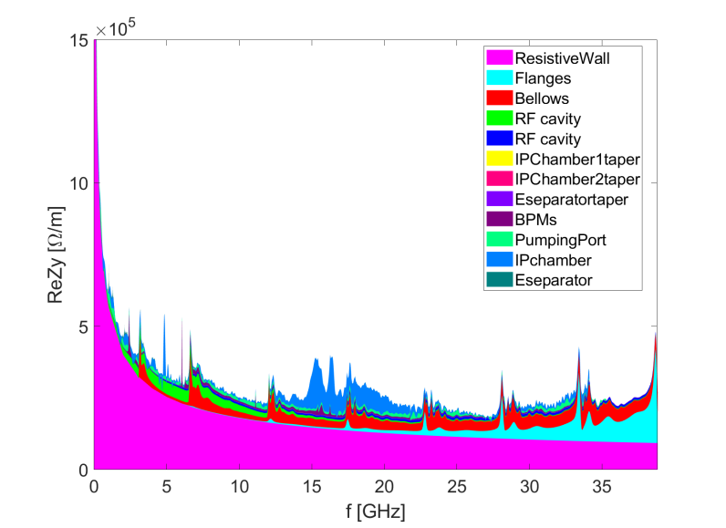
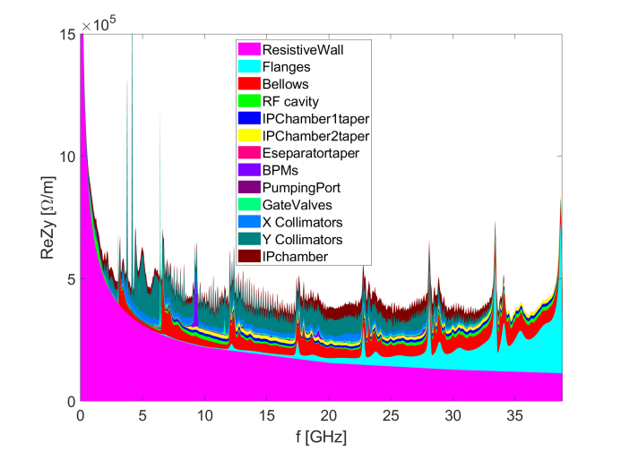
Impedance development
Na Wang
Continuously updating along with the development of the hardware designs
Naturally increase with more elements included.

Slide 4
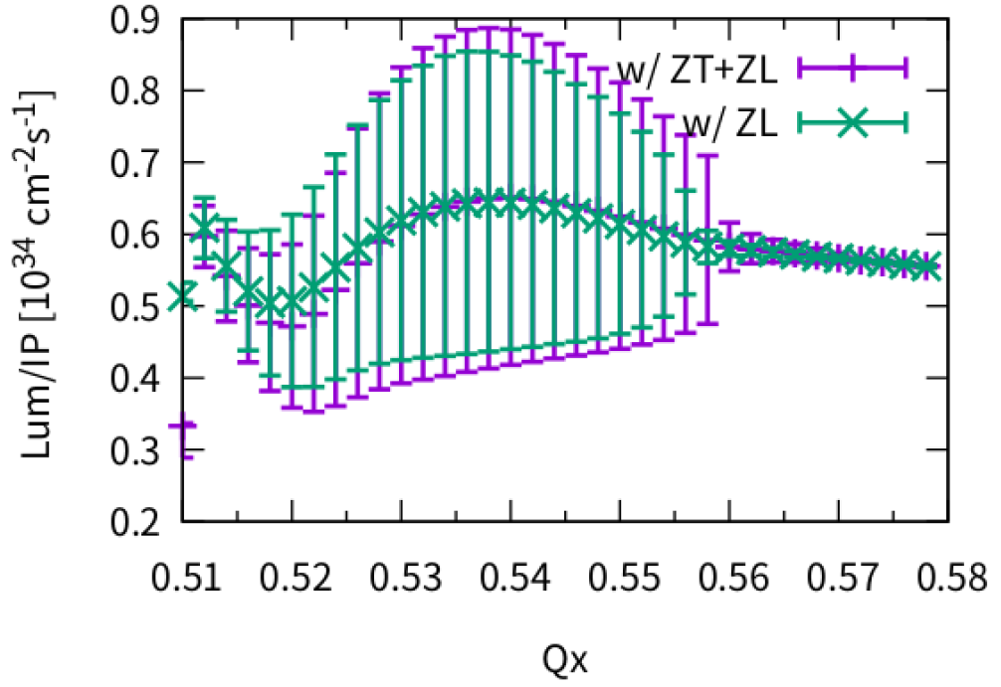
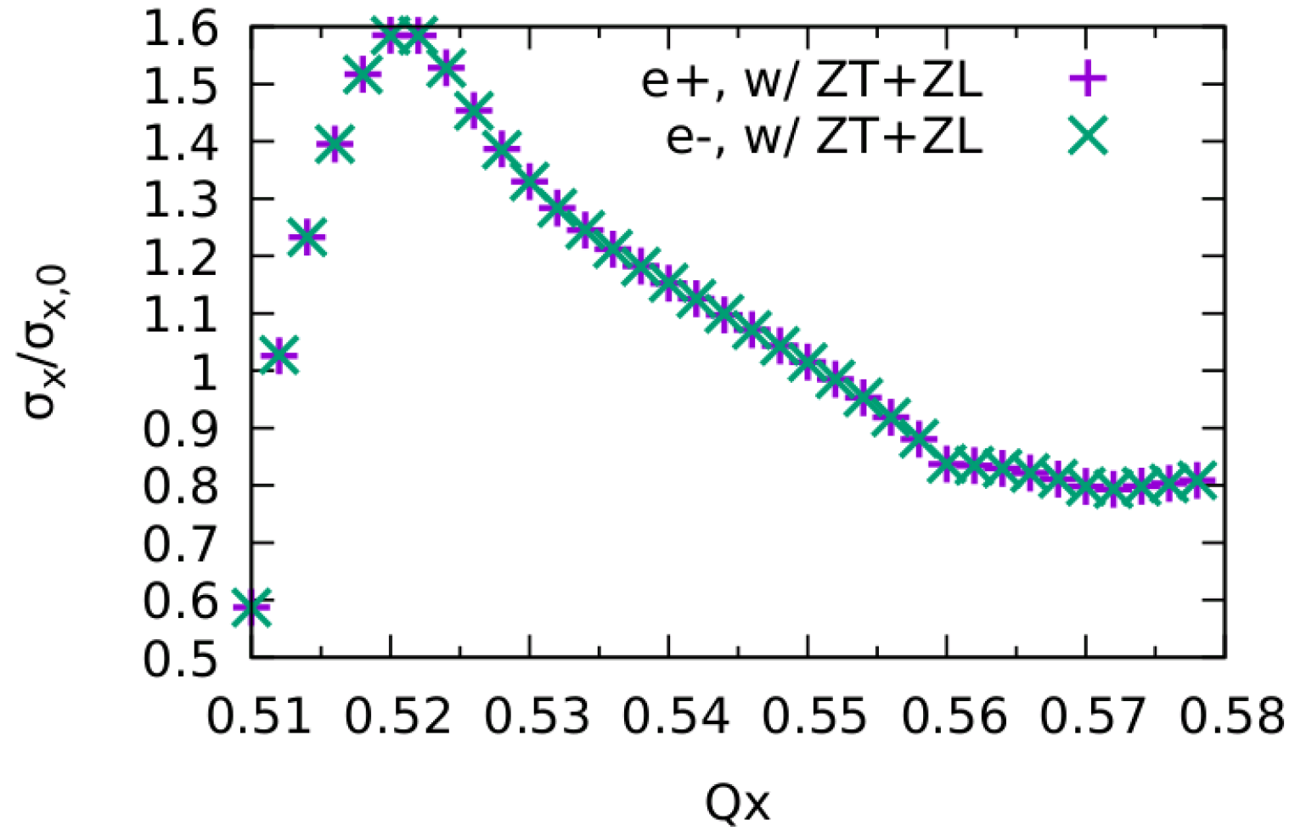
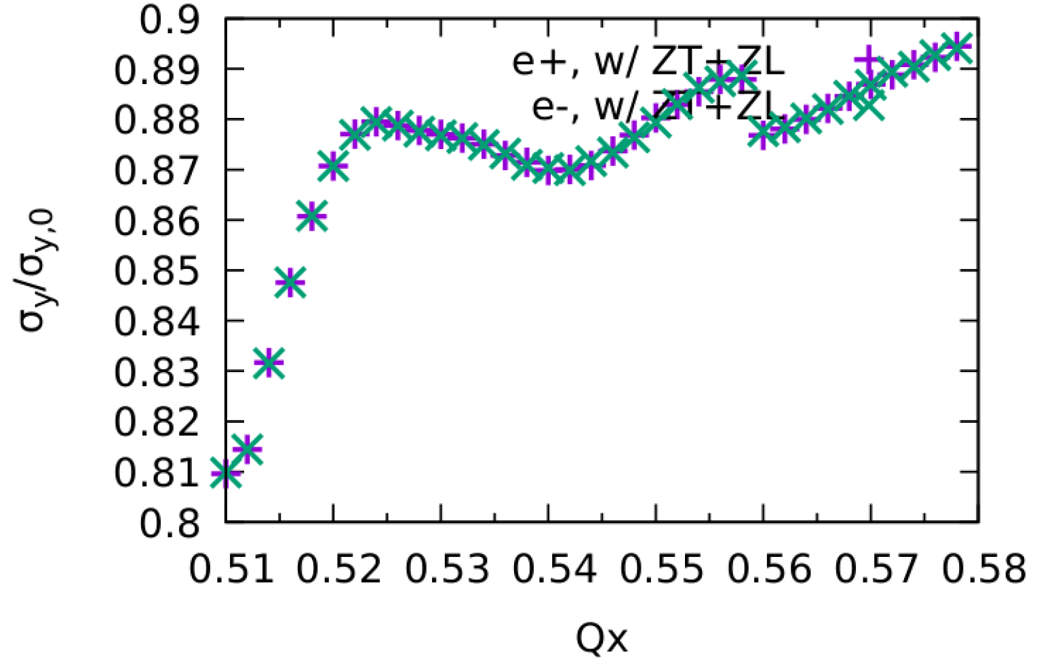
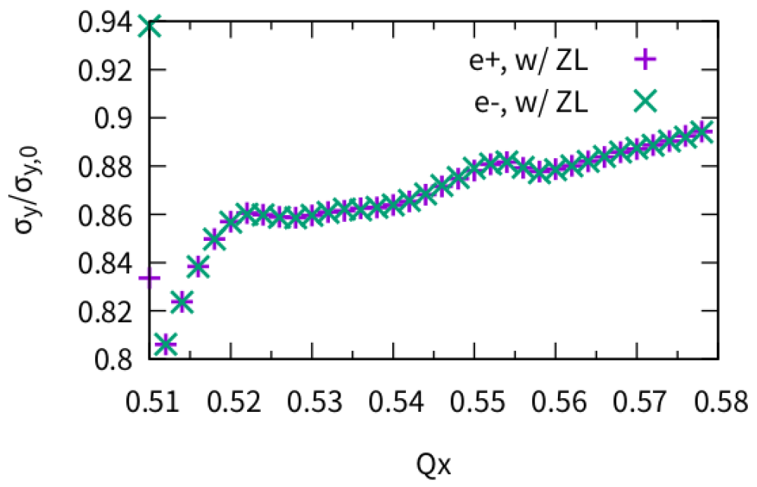
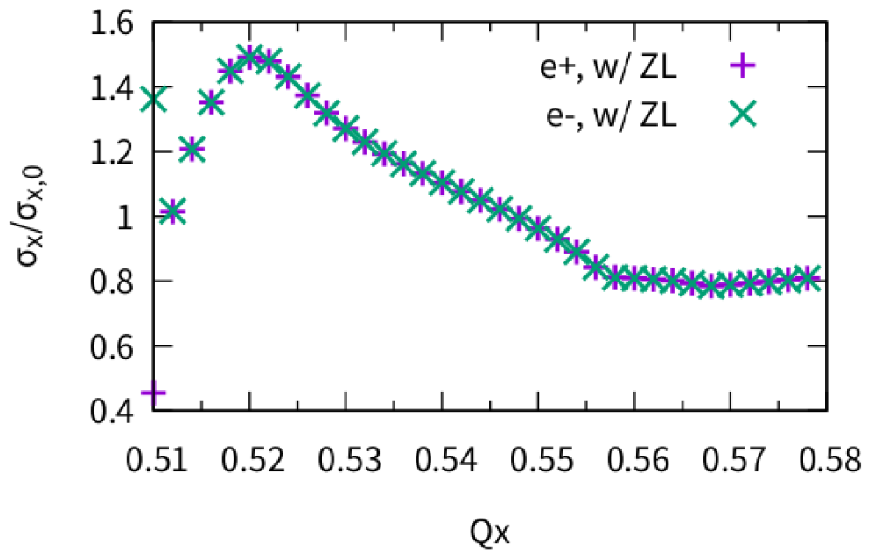
ttbar, w/ZT (2022)
Piwinski Angle: 1.2
No clear effect from transverse impedance.
Optimized Qx~0.570

Slide 5
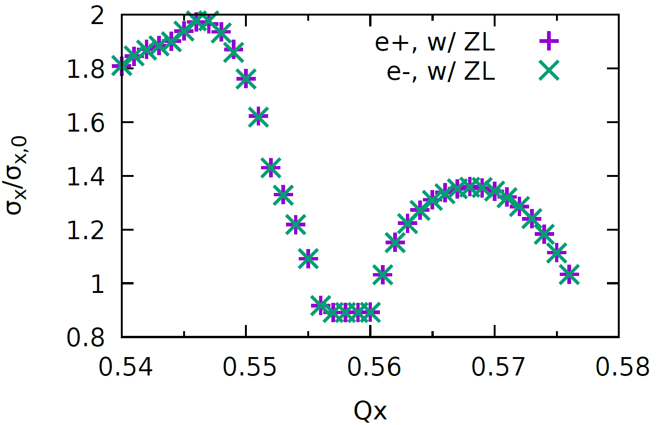
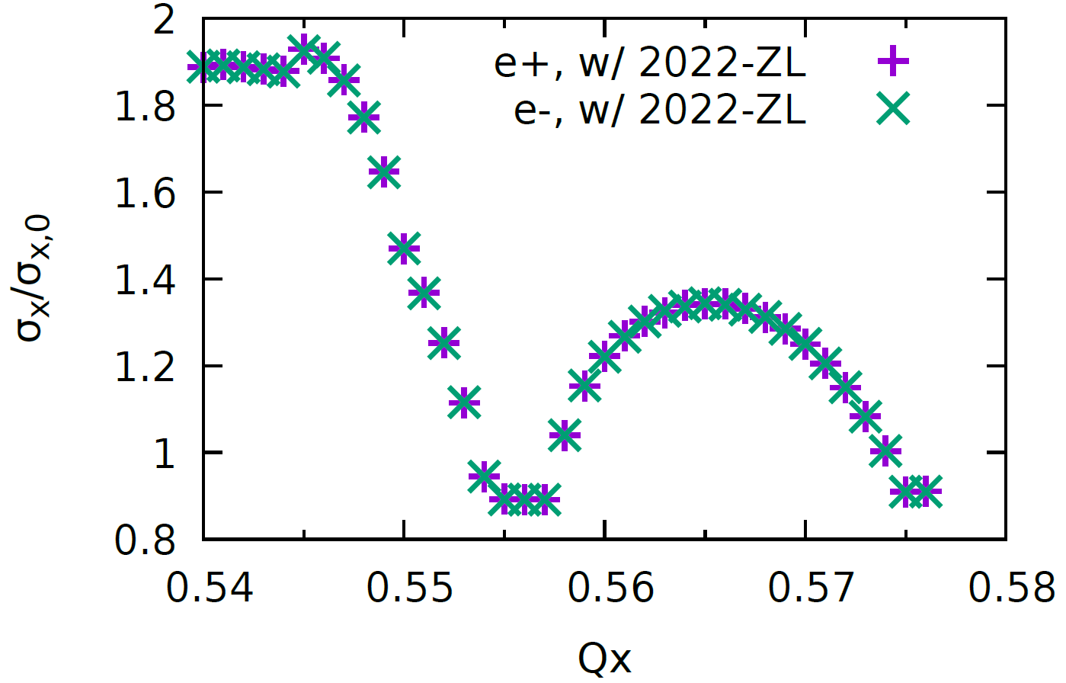
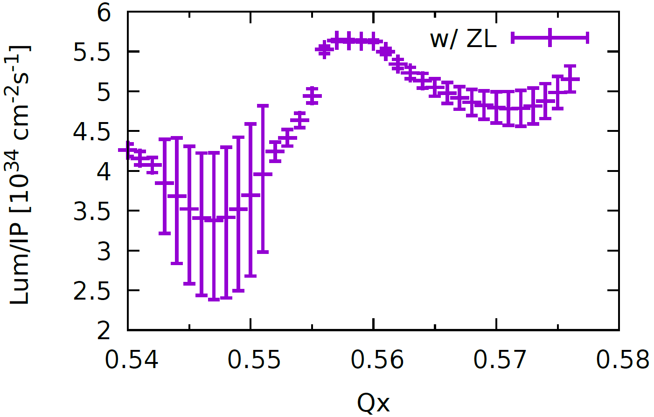
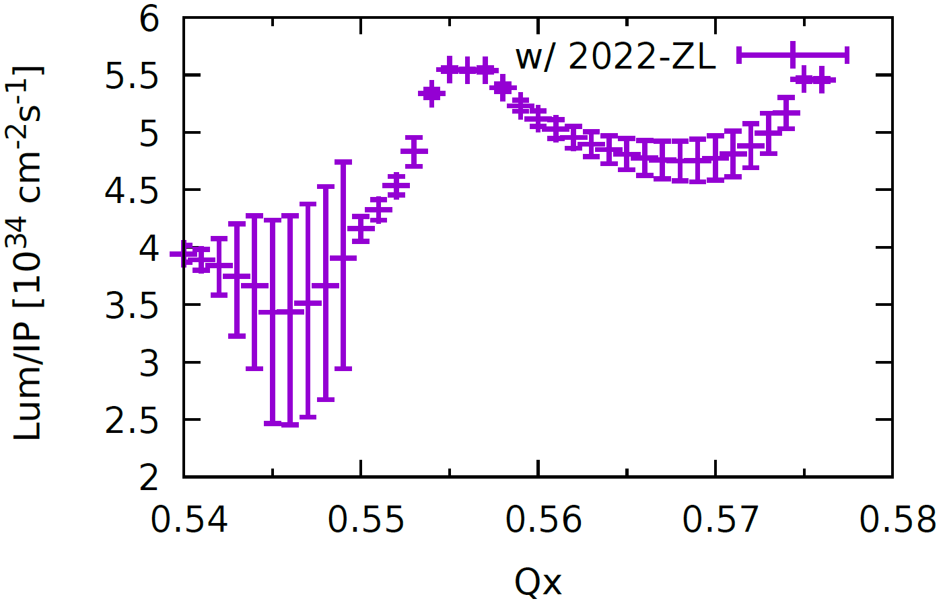


Higgs: $σ_{x} \& Lum$ versus Horizontal tune
$β_{x}^{∗}$ = 0.33 m, Np = 14e10
Stable tune area is too limited
CDR Impedance
2022
Piwinski Angle: 6

Slide 6
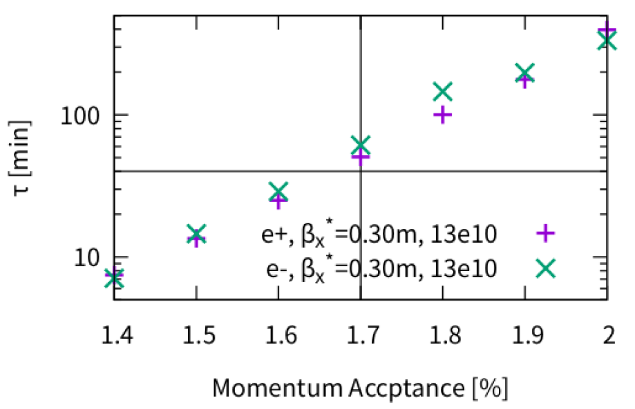
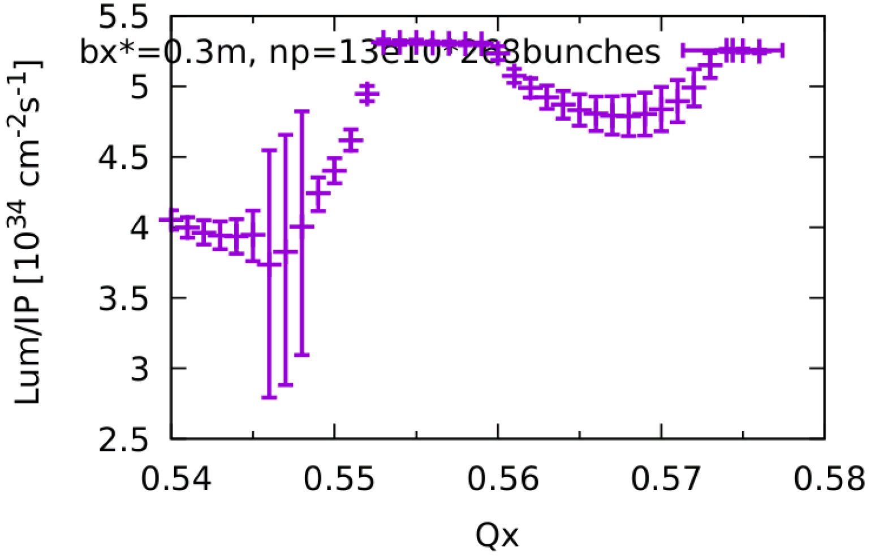
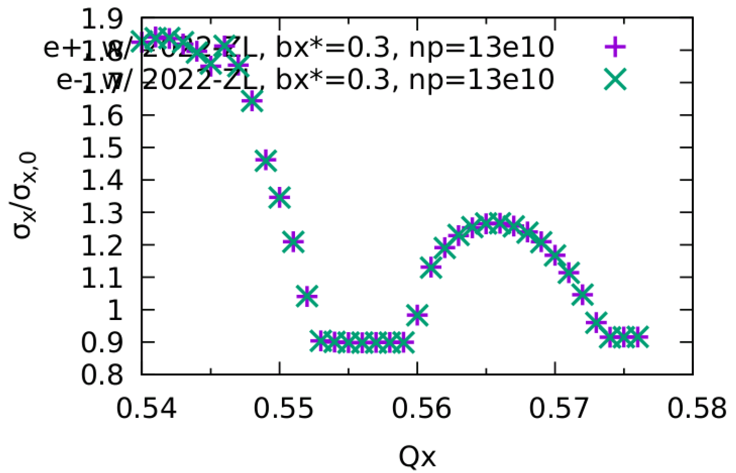
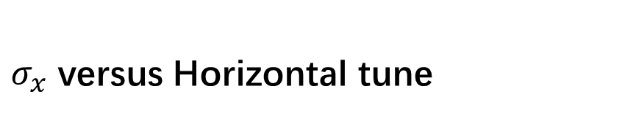


Higgs: $β_{x}^{∗}$=0.3 m, Np=13e10
Old: $β_{x}^{∗}$ = 0.33 m, Np = 14e10
Width of stable tune area: 0.006
Lum ~ 5e34
Beamstrahlung Liftime ~ 50min with MA=1.7%
Luminosity
$σ_{x}$ versus Horizontal tune

Slide 7
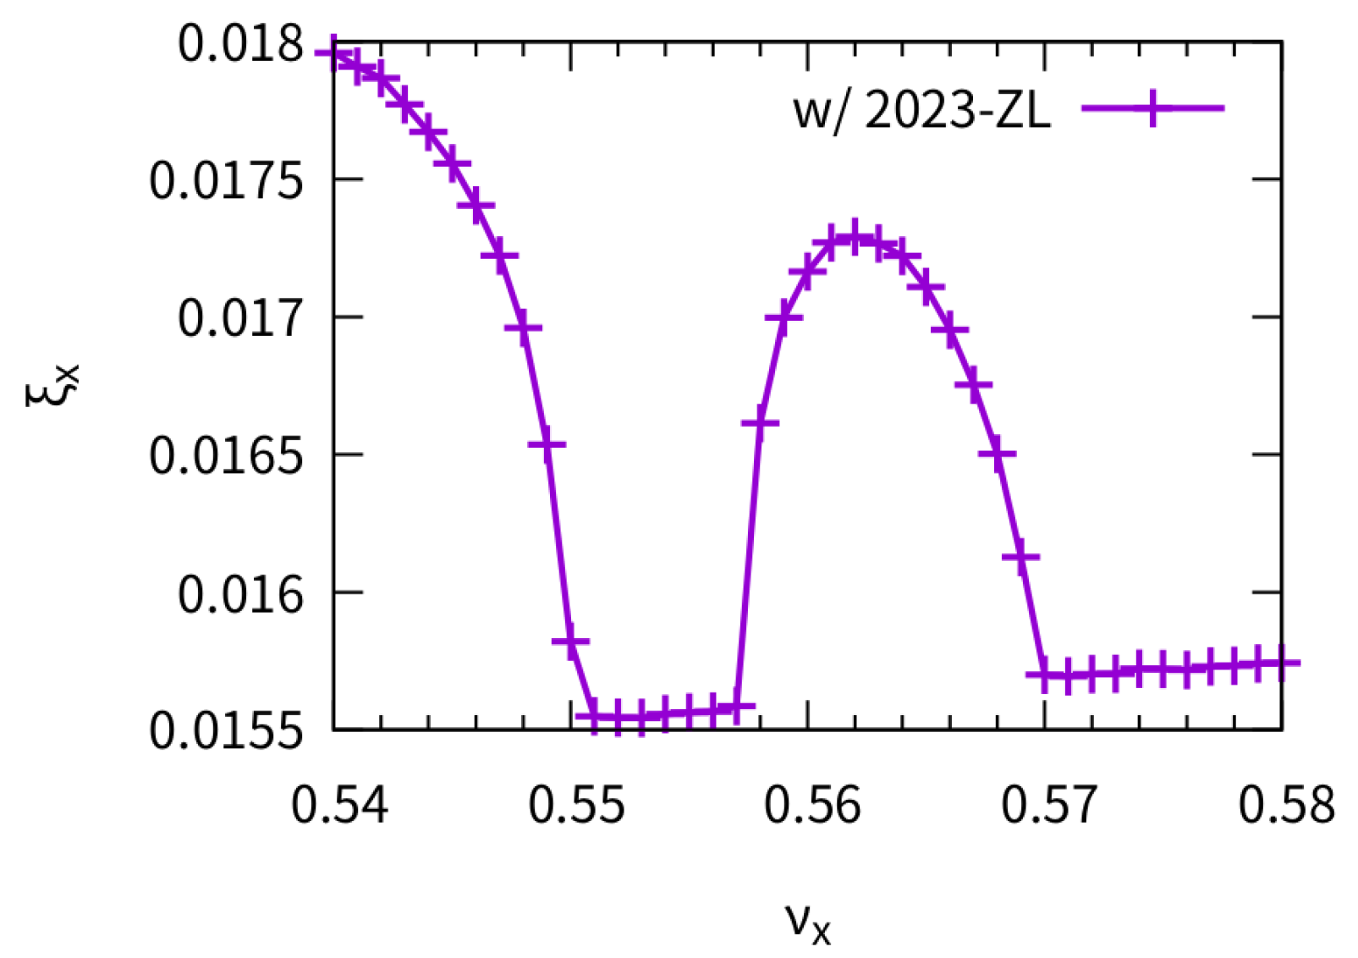
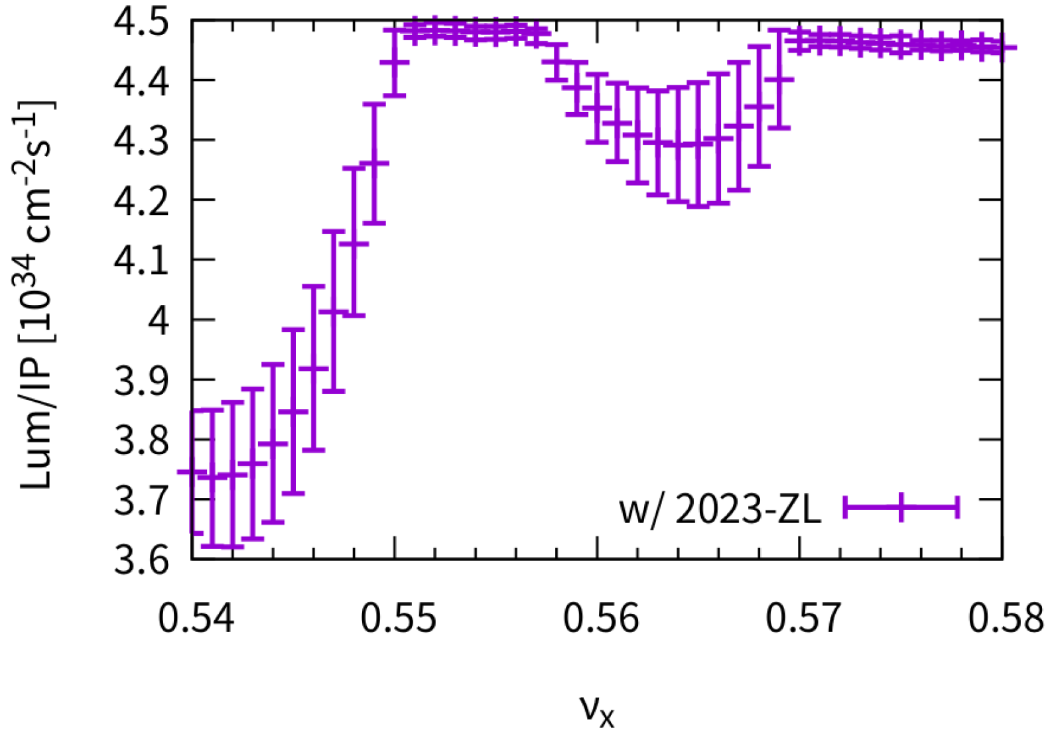
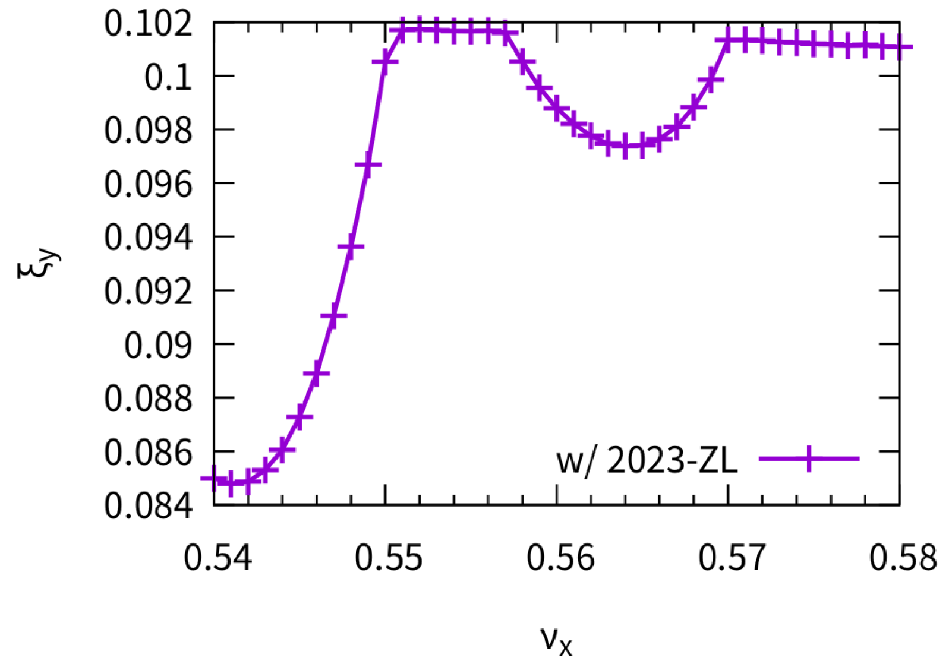
Higgs: 2023-ZL smooth approximation instead of local RF cavity
No qualitive difference from 2022-ZL

Slide 8
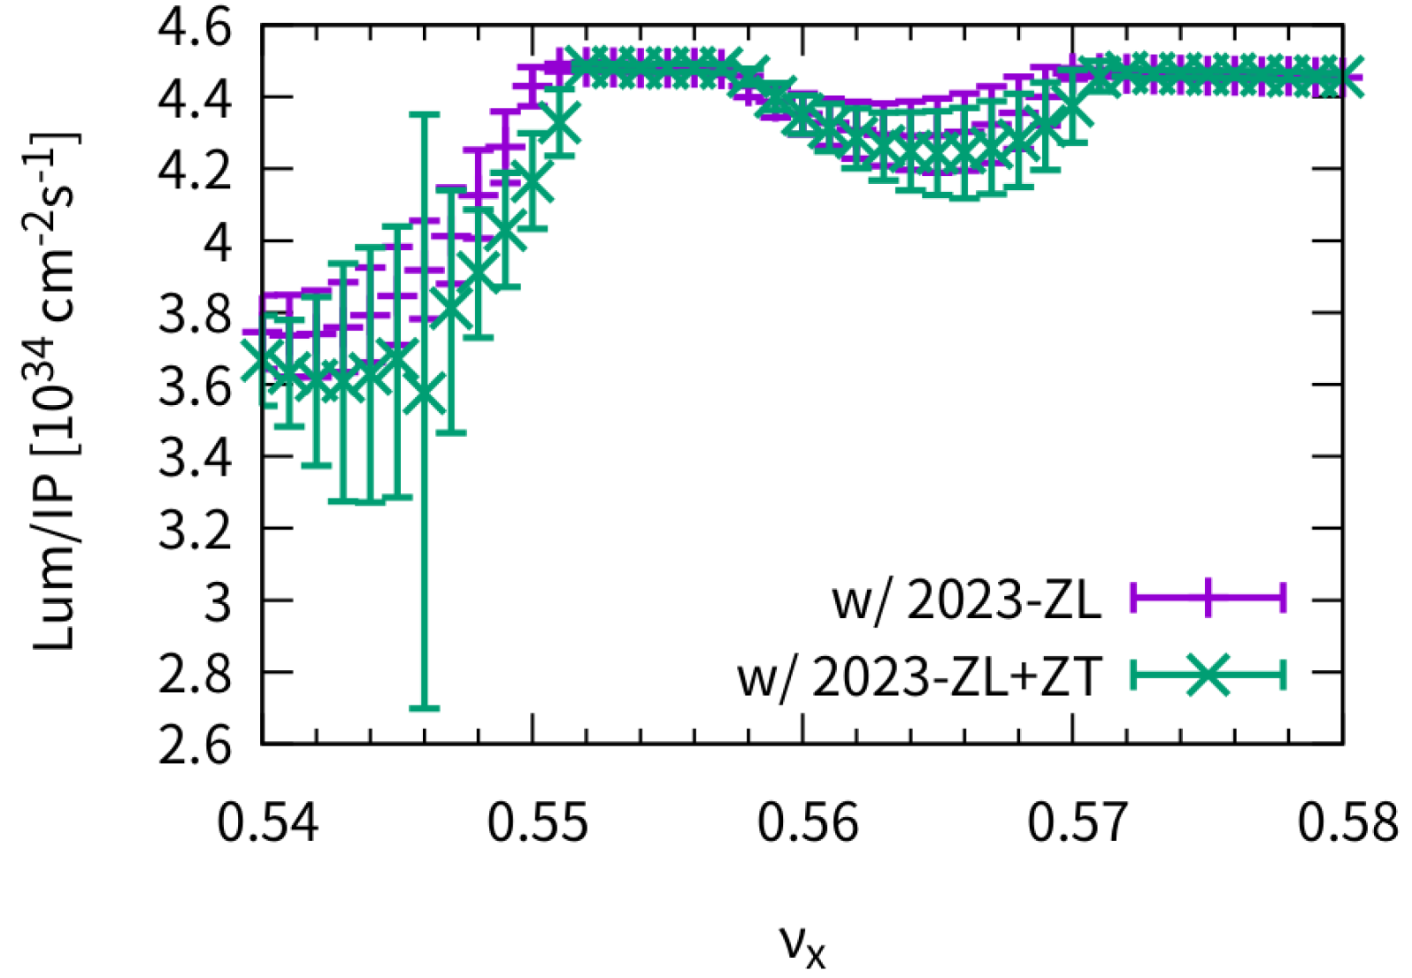
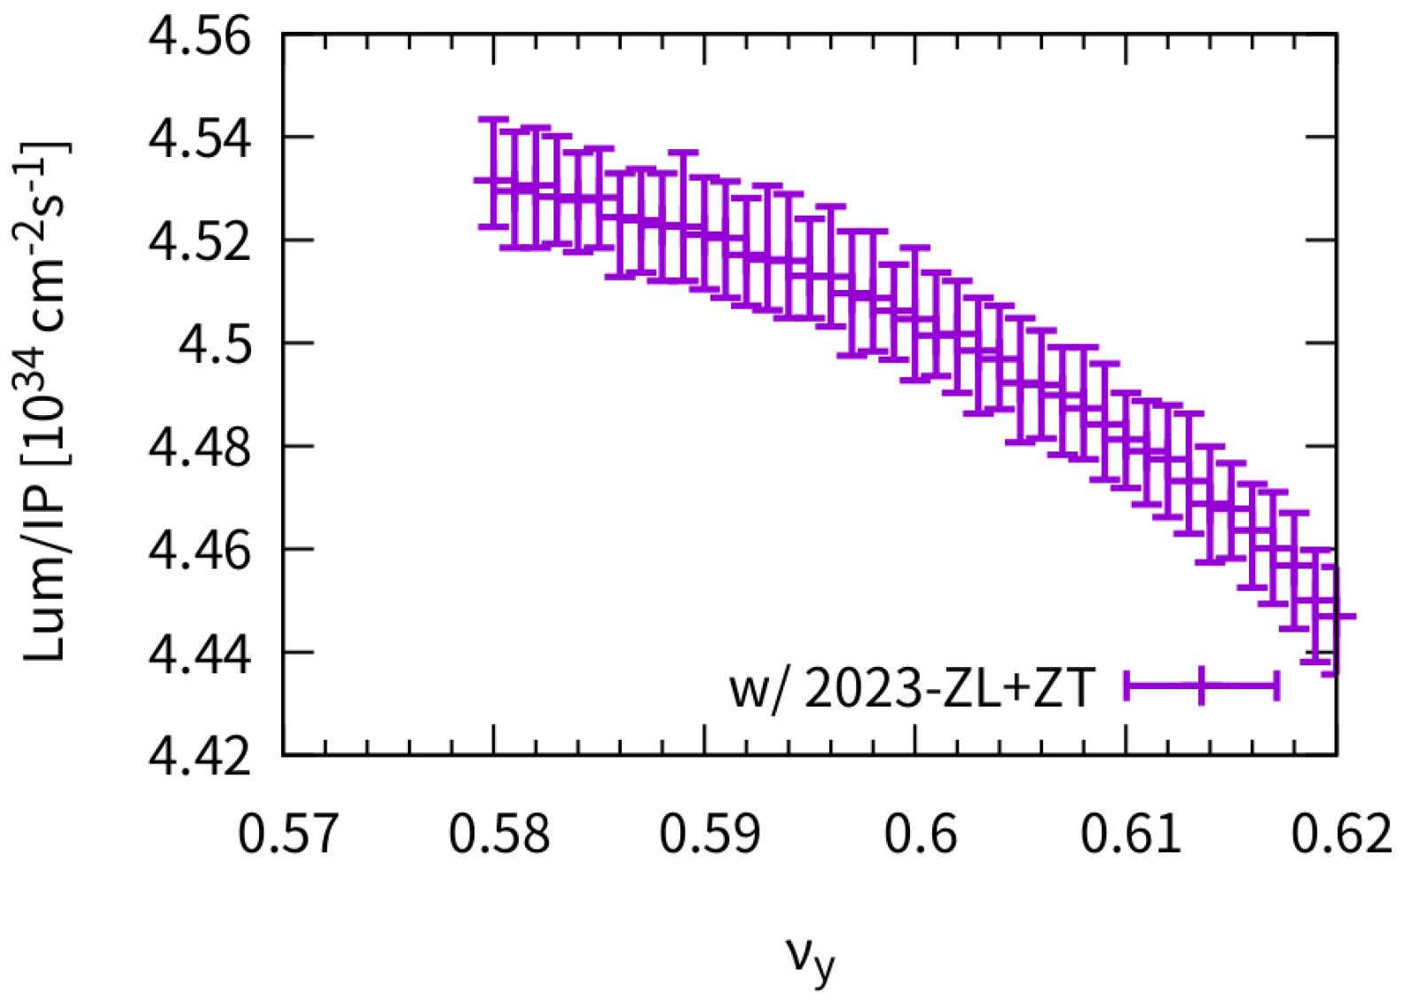
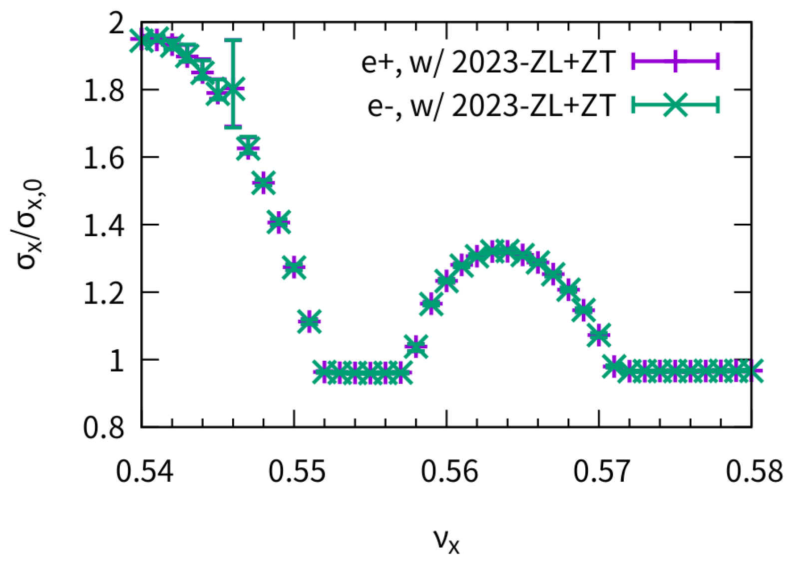
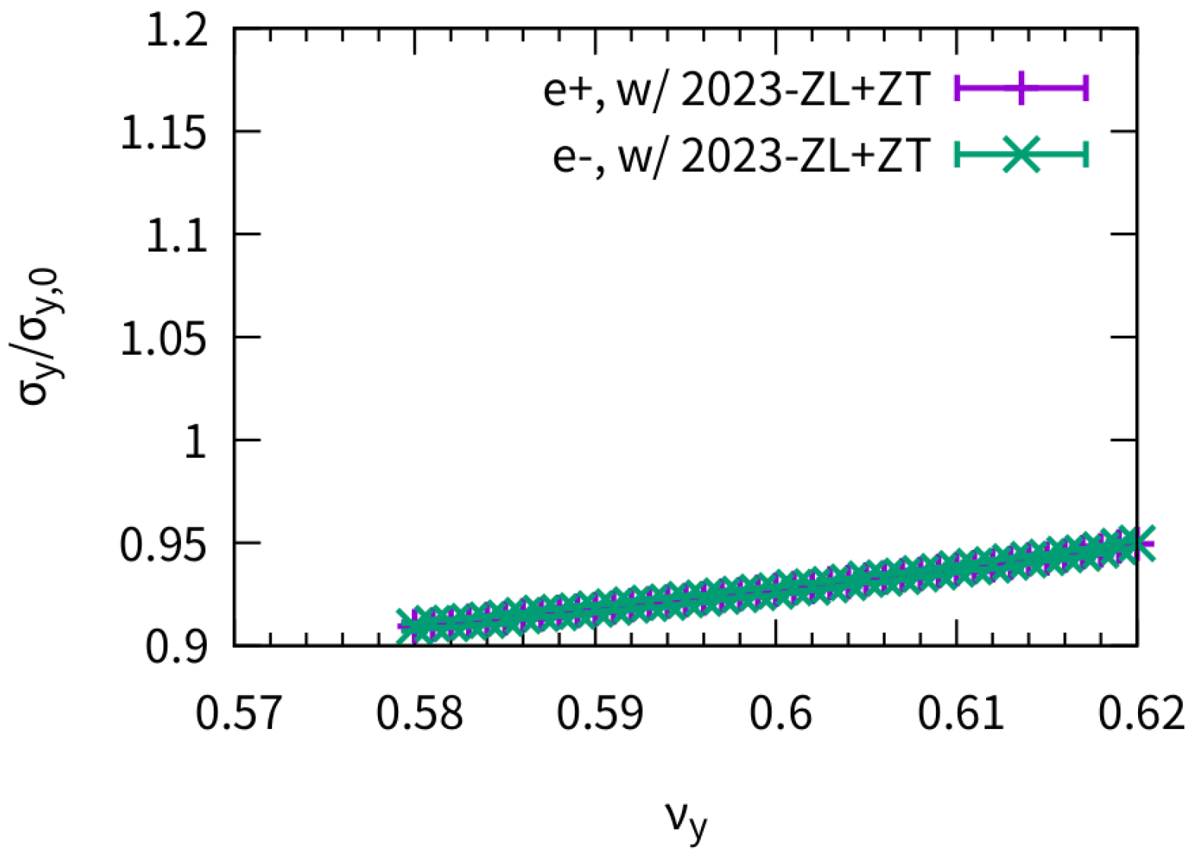
Higgs: 2023-ZT
Tune scan in both horizontal and vertical direction
Transverse impedance does not bring clear effect for collision

Slide 9
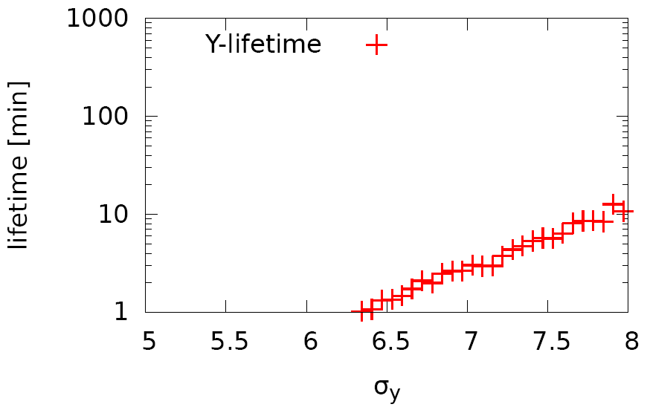
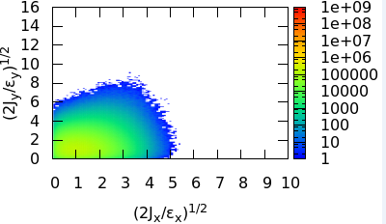
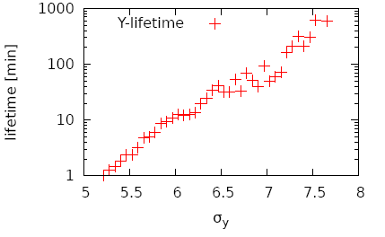
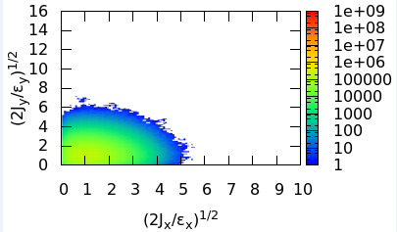
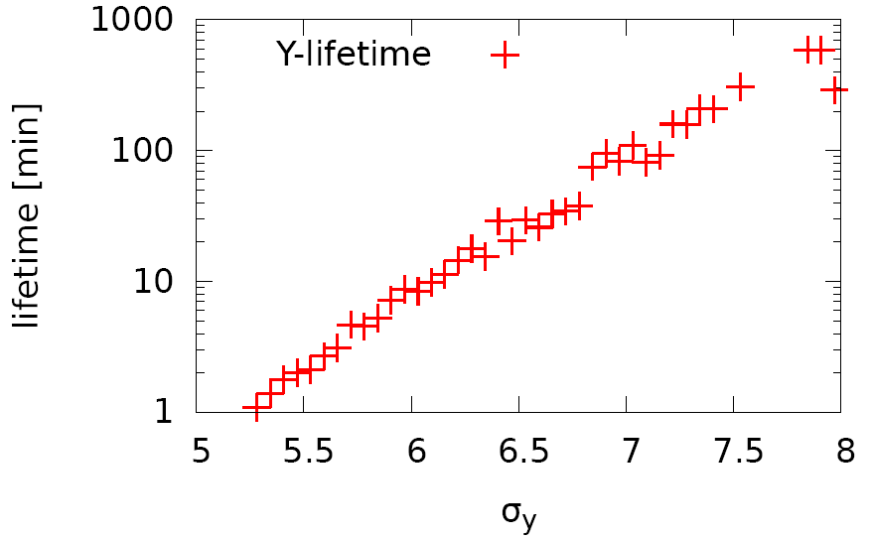
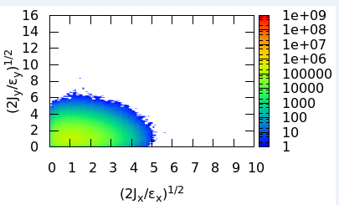
Higgs: Lifetime and equilibrium distribtuion
Realistic lattice w/o beam-beam
Huiping Geng and Yiwei Wang
50k turns
w/o beambeam
@IP
@Injection point
@RF section

Slide 10
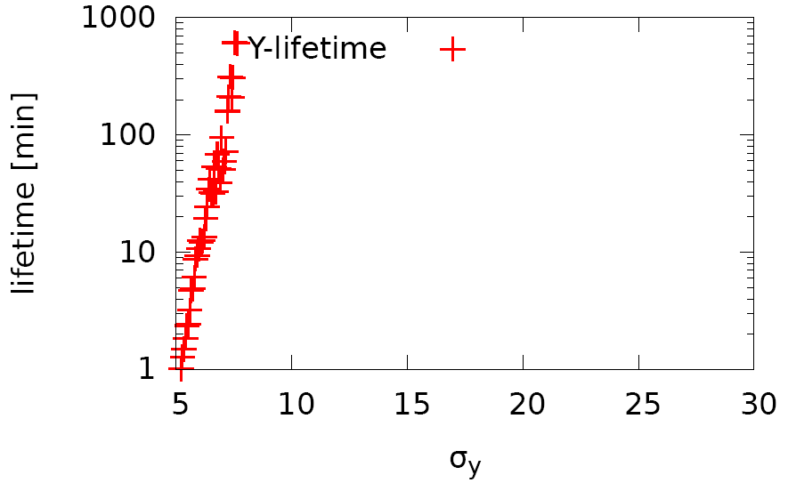
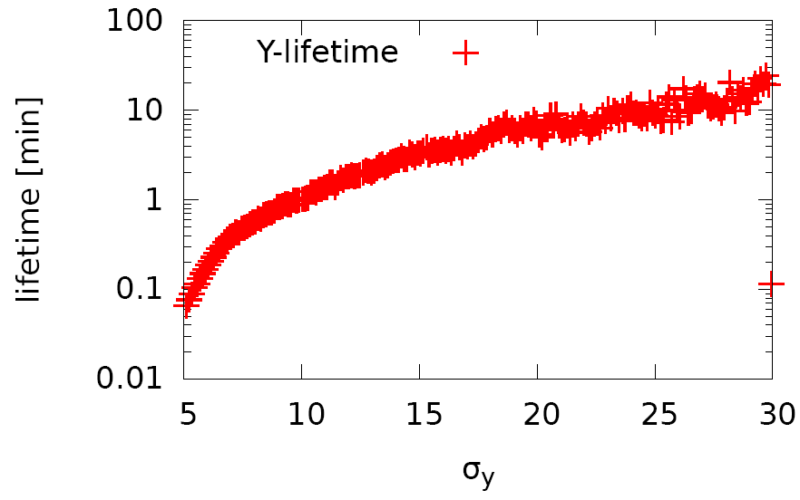
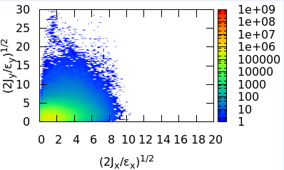
Higgs: Lifetime w/ and w/o beambeam
Realistic lattice w/o and w/ beam-beam
Huiping Geng and Yiwei Wang
50k turns, 1k macro-particles @injection point
w/o bb
w/ bb
Survival particles:
1000
Survival particles:
861

Slide 11
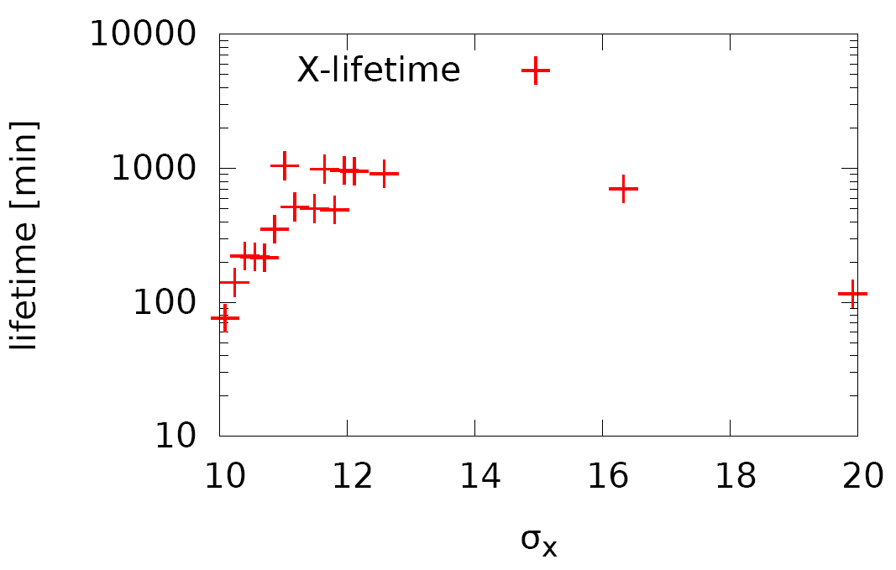
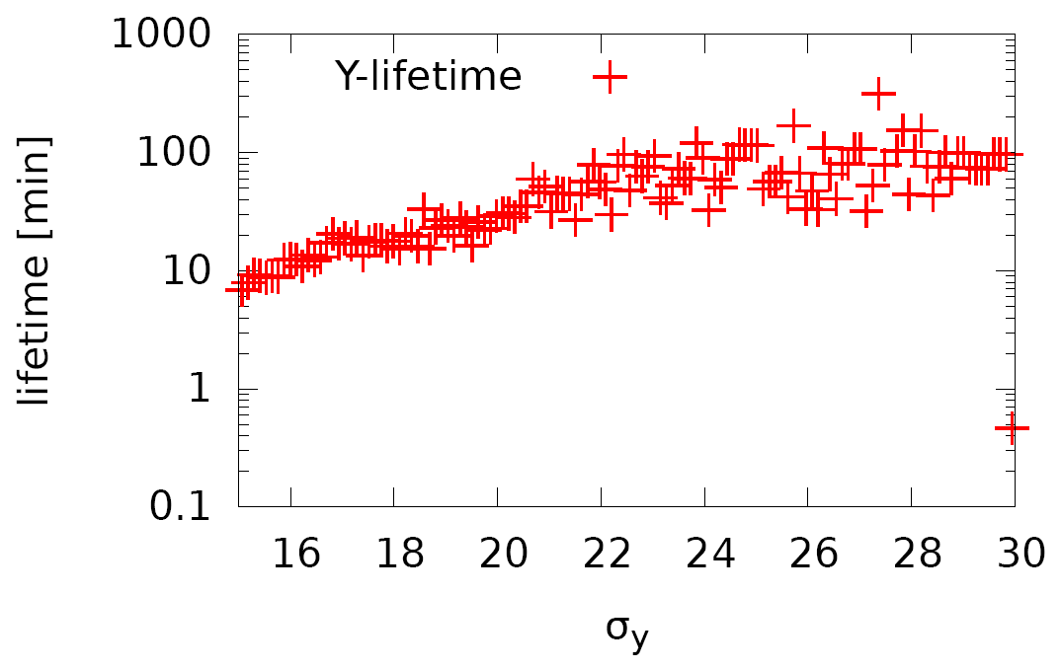
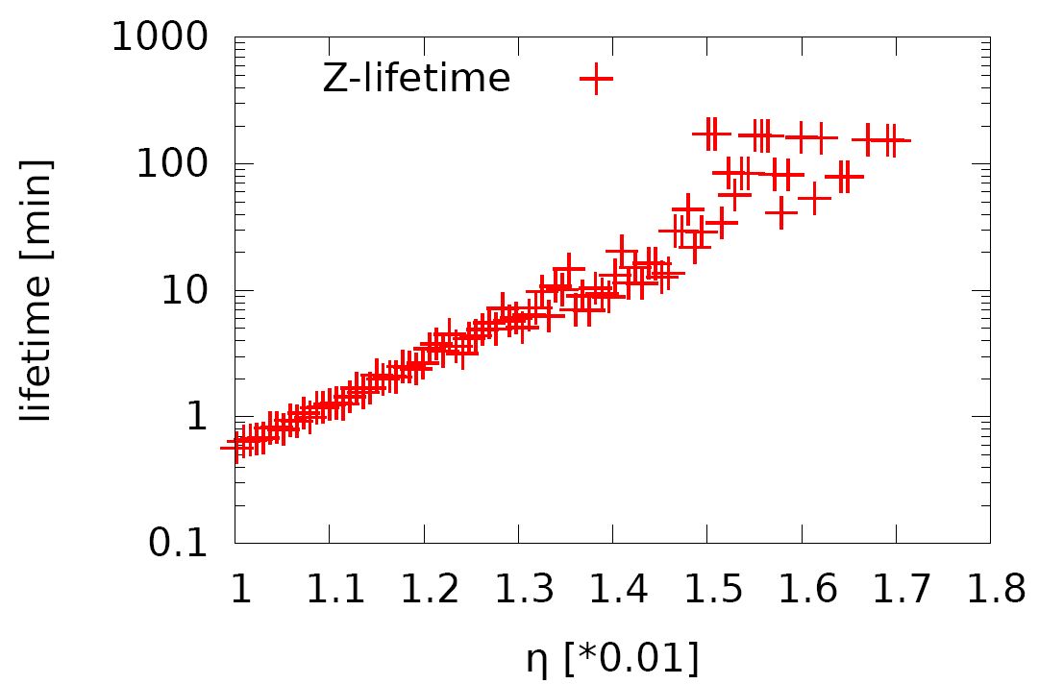
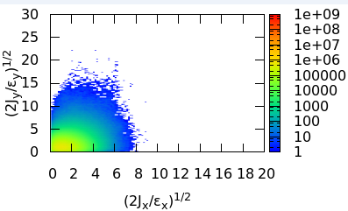
Higgs: Lifetime optimization
Realistic lattice w/ beam-beam
Huiping Geng and Yiwei Wang
NIMA 959 (2020) 163517
Diffusion Map Analysis
50k turns, 1k macro-particles @injection point
32 families of sextupoles in Arc
Survival particles:
962

Slide 12
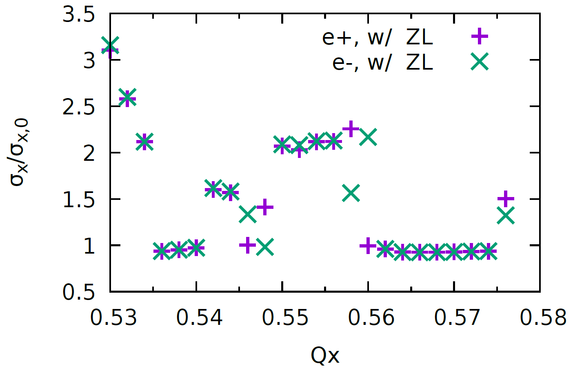
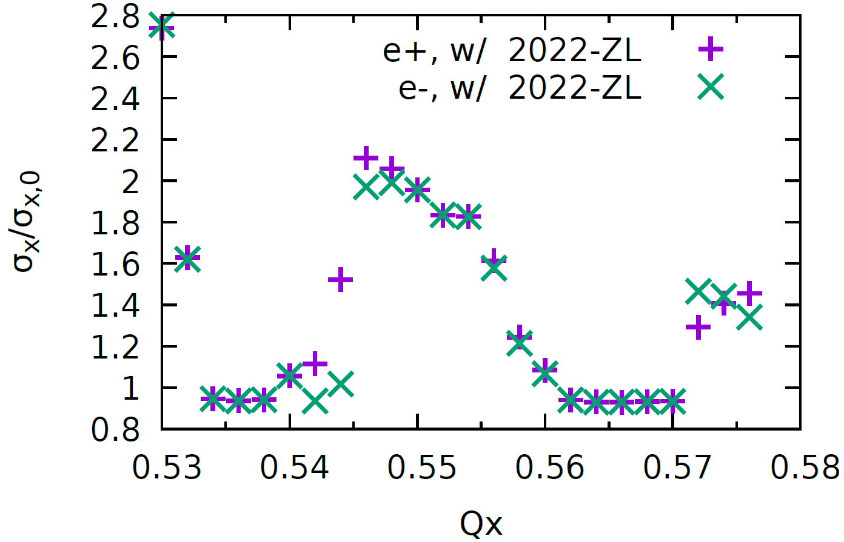
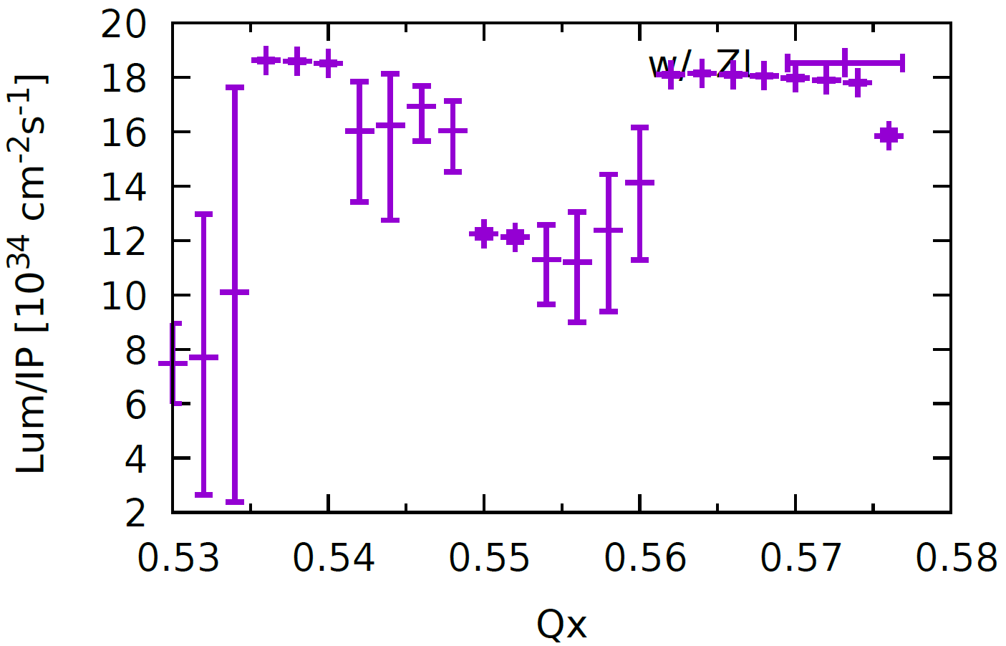
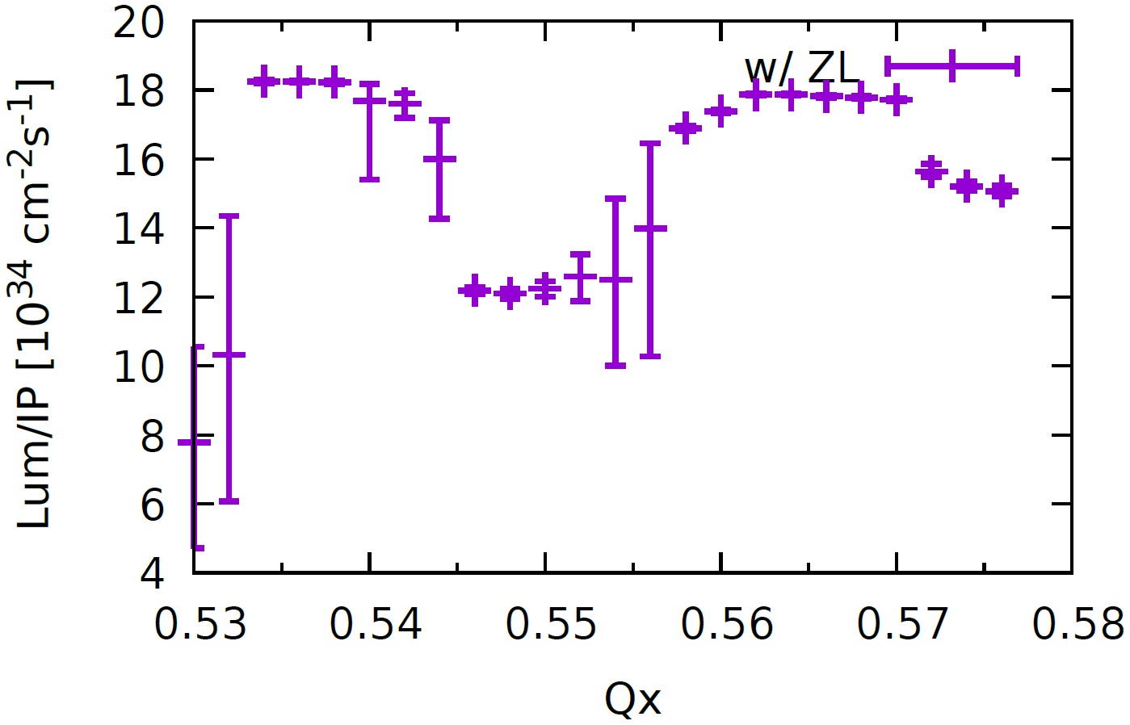
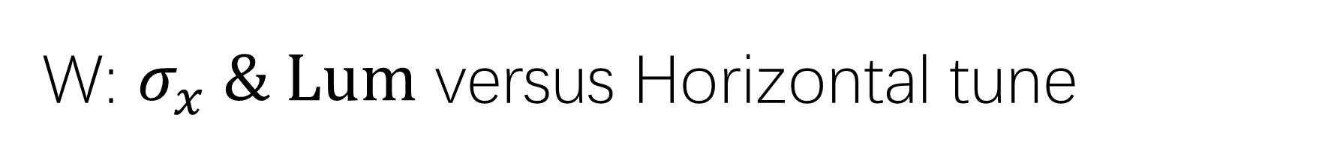
W: $σ_{x} \& Lum$ versus Horizontal tune
With stronger ZL, Stable tune area is still large enough
CDR Impedance
2022 Impedance
Piwinski Angle: 6

Slide 13
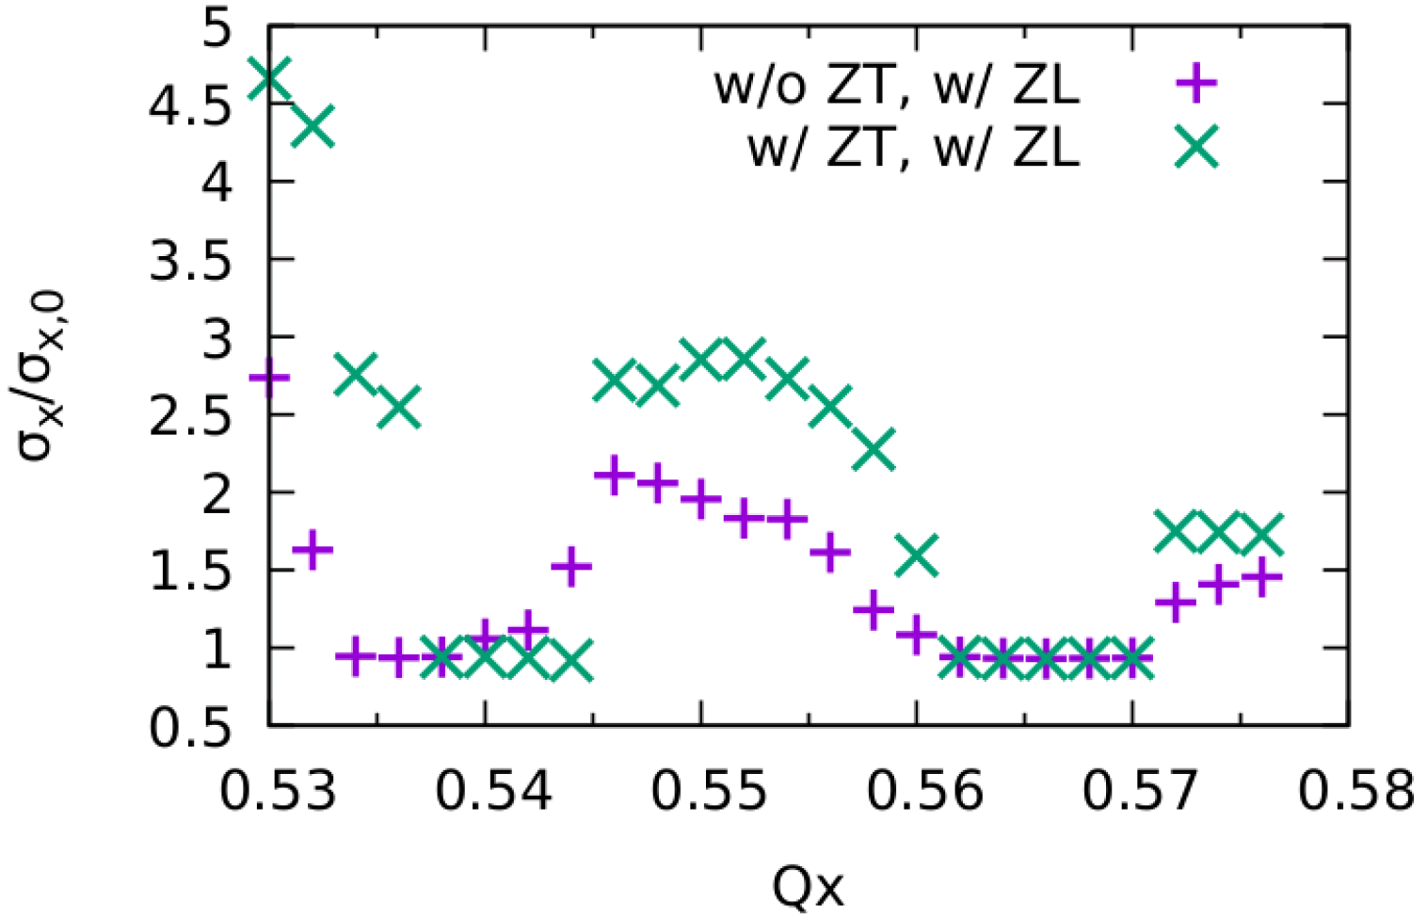
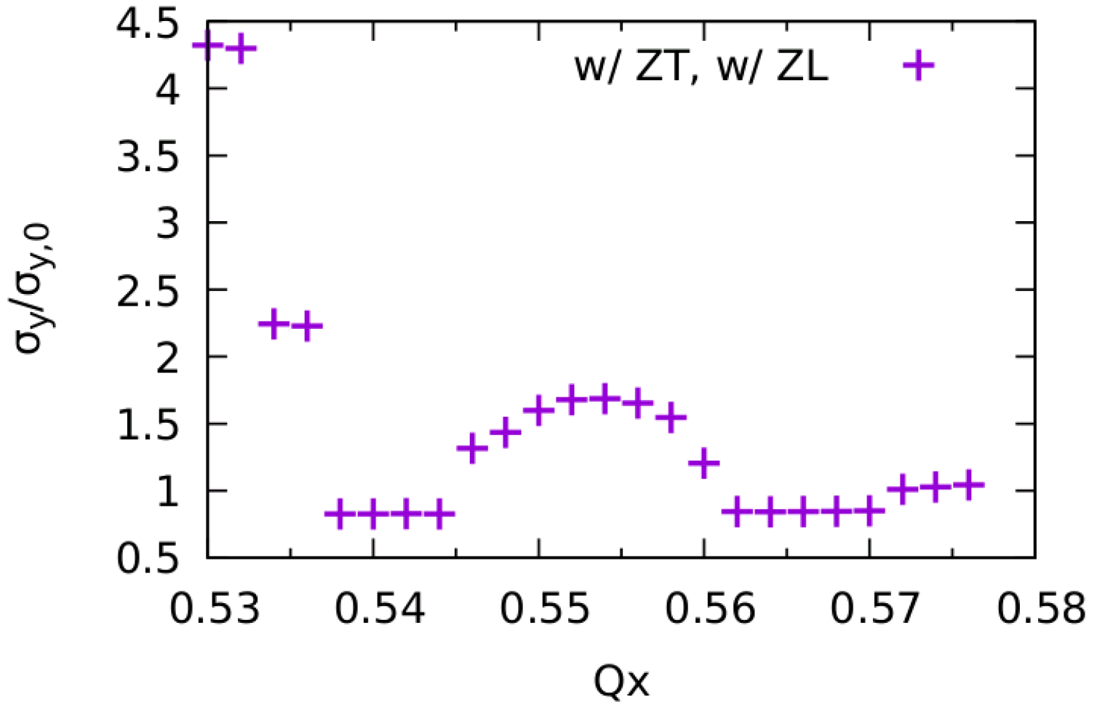
W, w/ ZT (2022)
Only X-Z instability
stable region is large enough (ZT applied 1 kick)

Slide 14
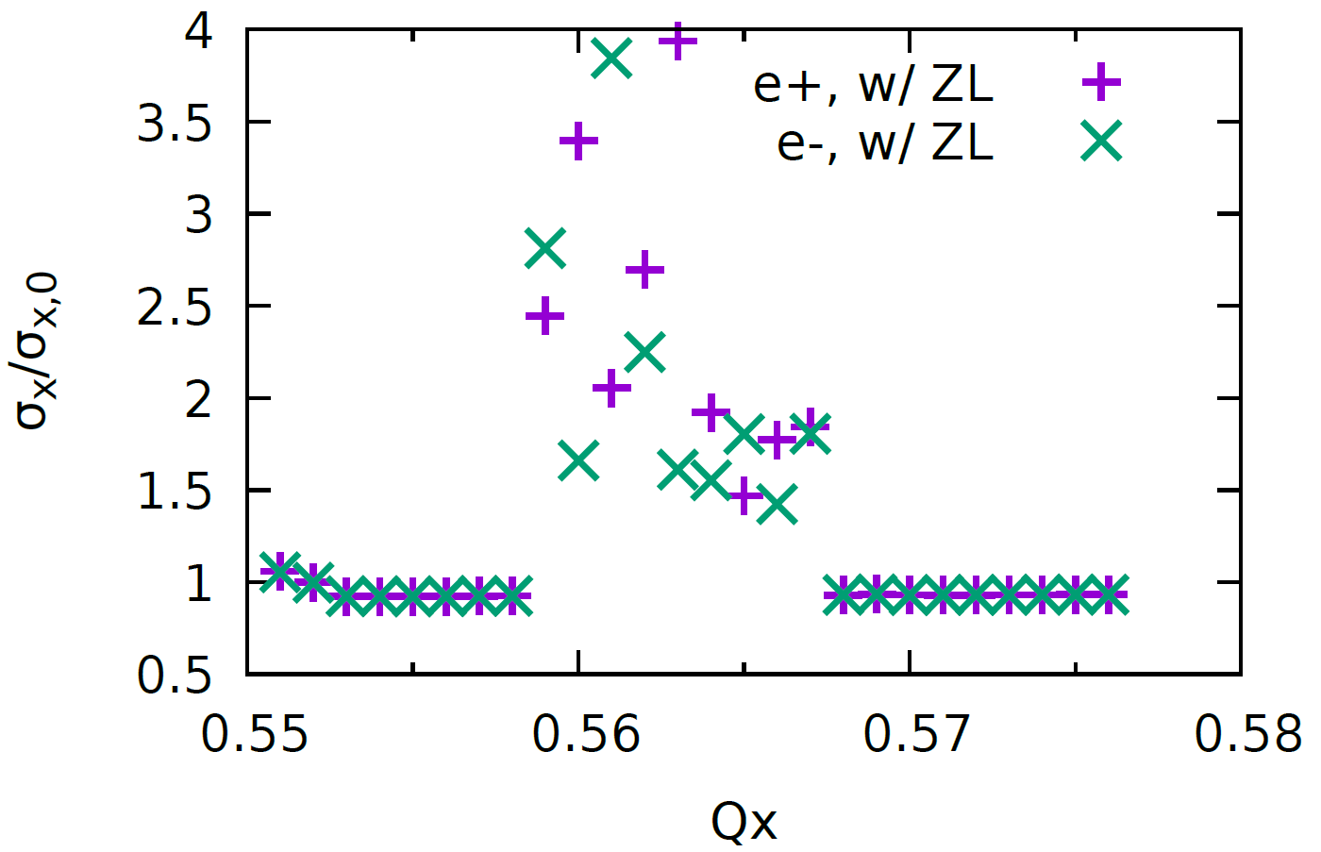
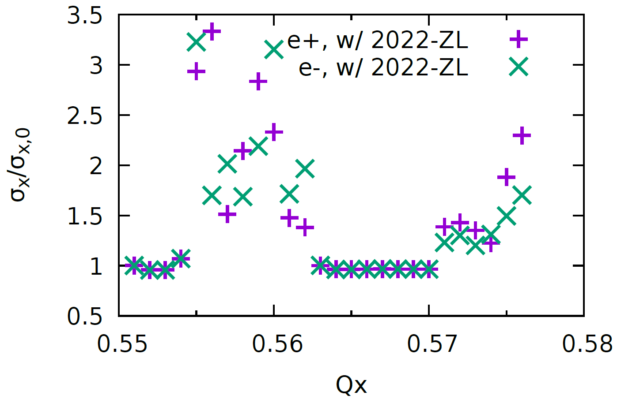
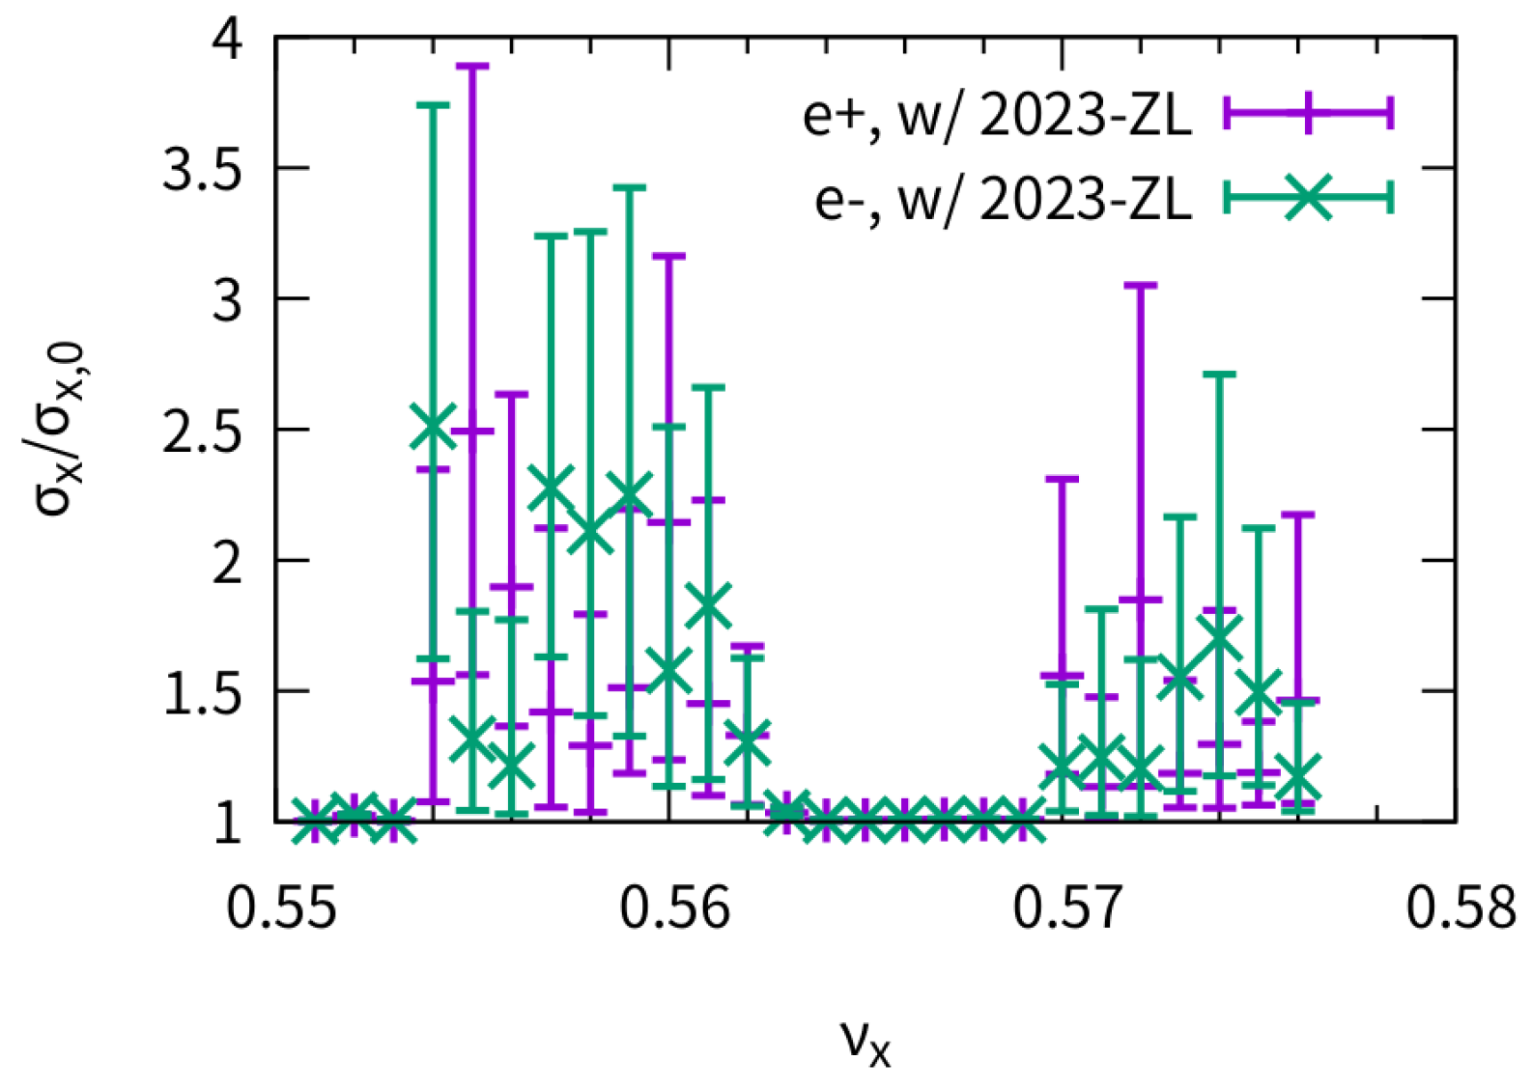
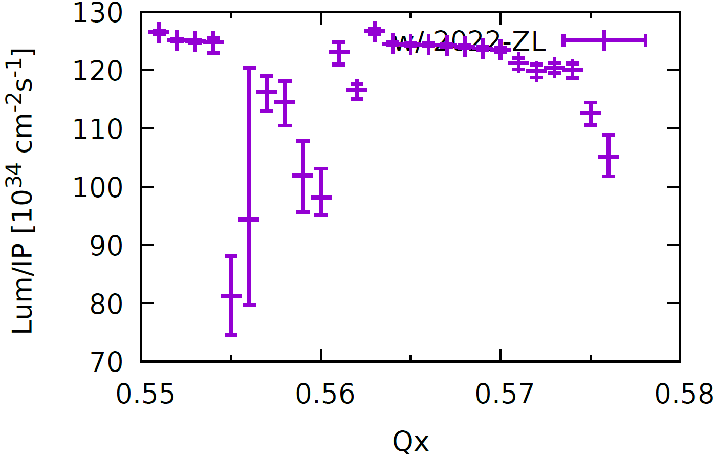
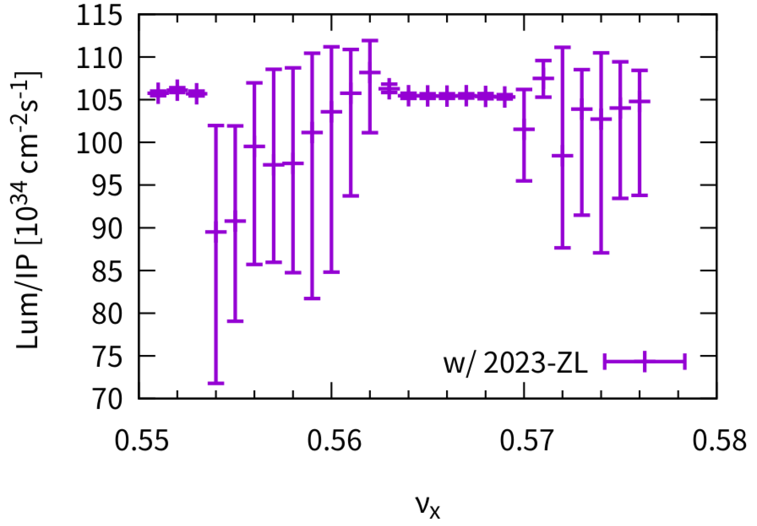
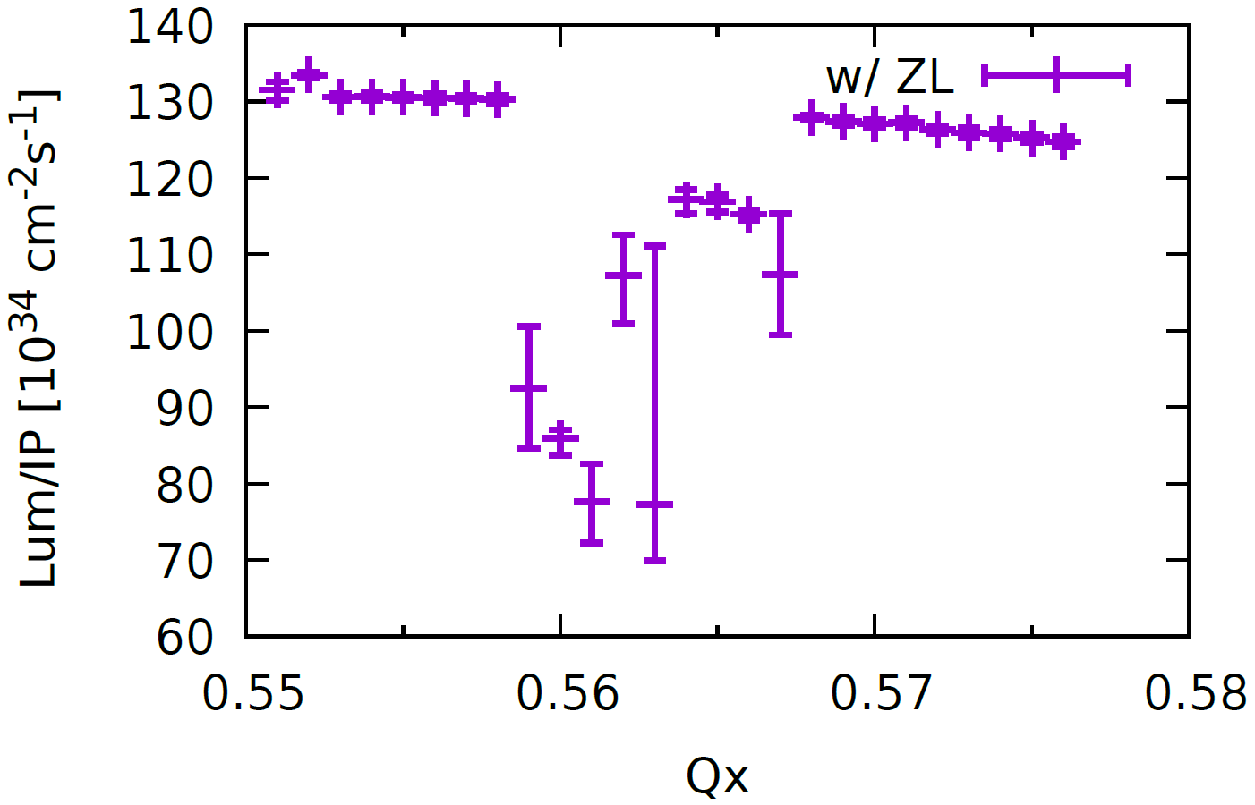
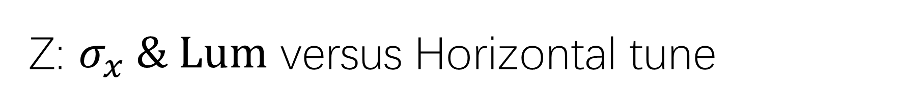
Z: $σ_{x} \& Lum$ versus Horizontal tune
Only ZL
Piwinski Angle: 24
Stable tune area is still large enough, even squeezed.
CDR Impedance
2022 Impedance
2023 Impedance

Slide 15
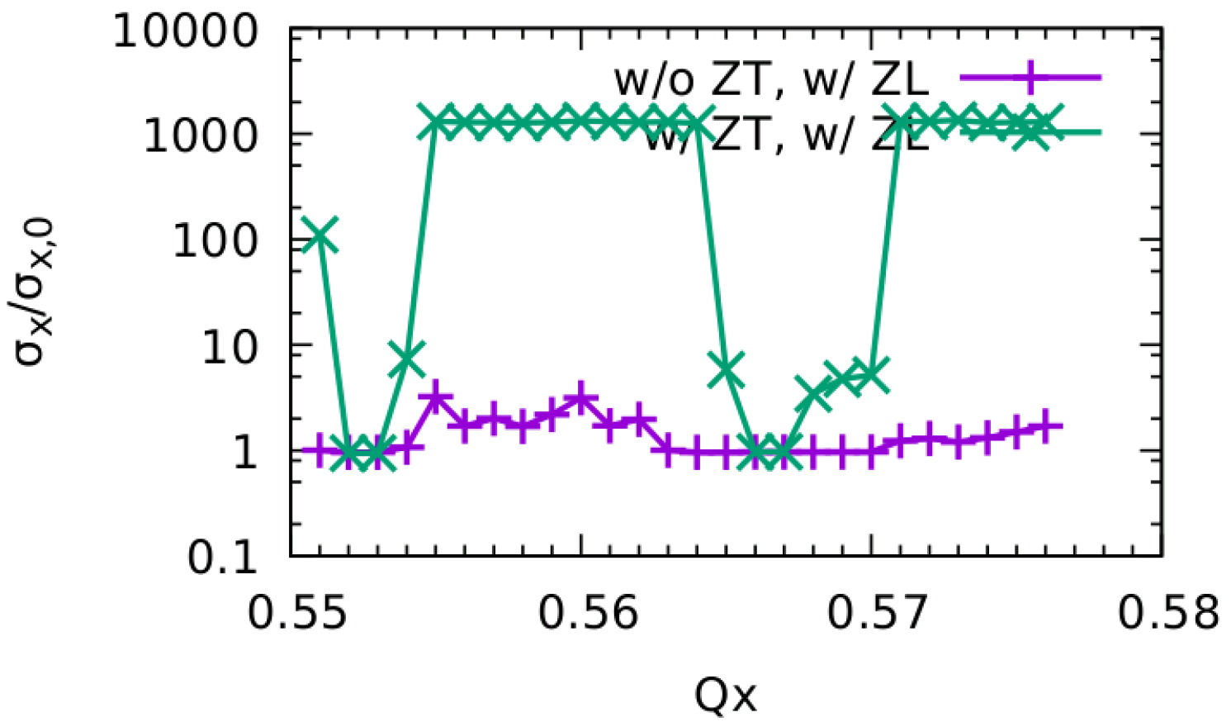

Z, w/ ZT (2022)
No stable working points
There exist very strong blowup in both X/Y direction

Slide 16


CEPC Only Zx(+ZL) 2022
Stable tune area is large enough (w/ZT)
Simulation and analysis agrees qualitatively.
Courtesy of Chuntao Lin and Na Wang
Simulation
Analysis, ZT kick applied at IP
Kick number of wake field affect the result
In horizontal direction, smooth distributed impedance nearly does not squeeze the stable tune area serious
A very local impedance may squeeze the stable area.
In horizontal direction, considering ZX
the instability growth rate is faster,
unstable tune area increases

Slide 17





CEPC Only Zx(+ZL) 2022
@ Qx=0.562
Behavior at unstable working point
It has been simulated that w/o BS (but keep same bunch length), the TMCI-like instability would not appear.
X-Z instability is first excited
Bunch length is shorter
X-TMCI-like instability is then excited
Y is blowup due to stronger beam-beam interaction

Slide 18


CEPC Only Zy(+ZL) 2022
Qx=0.567
No stable working point (w/Zy)
Simulation and analysis agrees qualitatively.
Courtesy of Chuntao Lin and Na Wang
Simulation
Analysis, ZT kick applied at IP
  pure beam-beam is unstable due to ignorance of strong nonlinearity ?
  It is also found enhance of instability when considering ZY
Kick number of wake field affect the result
No stable tune area

Slide 19





CEPC Only Zy(+ZL) 2022
Qx=0.567
Behavior at unstable working point
It has been simulated that w/o BS (but keep same bunch length), the X-Z instability would not appear.
Y-TMCI-like instability is first excited
Bunch length is shorter
X-Z instability is excited
Stronger Y blowup due to strong beam-beam

Slide 20



Head-tail behavior
Y. Zhang, N. Wang,
K. Ohmi, D. Zhou, T. Ishibashi,
C. Lin, submitted to prab
$σ$ mode dominate

Slide 21


Effect of Vertical Chromaticity (Lum & $σ_{y}$)
Y. Zhang, N. Wang,
K. Ohmi, D. Zhou, T. Ishibashi,
C. Lin, submitted to prab
Qy’~10 could help suppress the strong TMCI-like instability induced by BB+ZT
ZX+ZY+ZL (2022), Qx=0.567

Slide 22




Effect of different vertical tune (Qy+=0.610)
Qy Difference > 0.01 could help suppress instability with Qy’=5
Y. Zhang, N. Wang,
K. Ohmi, D. Zhou, T. Ishibashi,
C. Lin, submitted to prab
Thanks: K. Oide, K. Ohmi
Qy’=0
Qy’=5

Slide 23




Different Horizontal tune
Asymmetric
Symmetric
Qx+=0.567

Slide 24




Beam-Beam cross-wake force
Y. Zhang, N. Wang,
K. Ohmi, D. Zhou, T. Ishibashi,
C. Lin, submitted to prab
‘-’ for $σ$ mode beam-beam cross-wake force, which is same sign as ring wake ; ‘+’ for $π$ mode
Ring impedance : 2022

Slide 25



Analysis of vertical coherent instability
Y. Zhang, N. Wang,
K. Ohmi, D. Zhou, T. Ishibashi,
C. Lin, submitted to prab
Dipole/Quadrupole beam-beam force is considered
$σ$ mode is more unstable, which is similar to that in horizontal direction
$σ$ mode instability is enhanced by ring wakefields.
$π$ mode is more or less weakened by ring wakefields

Slide 26


Some analysis results of mitigation method
Y. Zhang, N. Wang,
K. Ohmi, D. Zhou, T. Ishibashi,
C. Lin, submitted to prab

Slide 27



Z: More challenging: 30MW->50MW bunch population: 14e10->21e10
Single Bunch TMCI threshold ~ 21e10 considering beamstrahlung length without beam-beam interaction
Qx’=5 does not help
Qx’=5 + diffnux does not help
Qx’=10 help suppress the instability
2022 impedance
Only ZX, Qx’=0, Symmetrical

Slide 28


TMCI –THRESHOD: 2022 VS 2023 impedance
2022-ZT
+ beamstrahlung length and energy spread @14e10
(with ZL)
2023-ZT
+ beamstrahlung length and energy spread @14e10 (with ZL)
TMCI threshold: 21e10
TMCI threshold: 15e10

Slide 29




Could expected strong feedback system help? (Off-collision)
Thanks: M. Zobov, M. Migliorati
PRAB 24, 041003 (2021)
$$ν_{s}=0.0176$$
A simplified resistive damper is used:
It is fountd stronger damper reduce the TMCI threshold.
$$Δp_{i}=−2d_{p}p_{i}$$
Dp=0.1, threshold ~ 12e10.
Dp=0.01, threshold ~ 15e10.
Dp=0, threshold ~ 15e10.

Slide 30





Resistive feedback + Qx’=5 (off collision)
Threshold increase with the damper strength
Dp=0.01, threshold~10e10
Dp=0.02, threshold~13e10
Dp=0.03, threshold~17e10
Dp=0.05, threshold~30e10
Dp=0.04, threshold~30e10

Slide 31


ZX+ZL, resistive feedback dp=5e-2 (Qx’=5)
Np=14e10, 30MW (stable)

Slide 32


ZY+ZL, resistive feedback dp=5e-2
Np=14e10, Qy’=10 is stable, Qy’=5 unstable

Slide 33


resistive feedback dp=5e-2, np=21e10
Stable!
Qx’=5, Zx+ZL
Qy’=10, Zy+ZL

Slide 34
Summary & Outlook
It is important to consider both ZL+ZT at CEPC
The transverse impedance does not bring harmful effect for ttbar/Higgs/W
Combined effect of beam-beam interaction and transverse impedance may induce strong head-tail instability in vertical direction at Z mode
The chromaticity and asymmetrical tunes could help mitigate the instability induced by beam-beam with impedance
With newest impedance, 30MW(np=14e10) could not work. Strong damper+Chromaticiy may help, however strong feedback is challenging and complicated (future work)

