Slide 1
Klystrons and RF Power Sources for CEPC
Zusheng Zhou（周祖圣）
On behalf of CEPC RF power source team
Feb.15, 2023

Slide 2
Outline
Klystron
  Design consideration
  R&D Status
    1st prototype
    2nd (HE klystron) conditioning
    3rd (MBK) design and fabrication progress
    C&S band klystron design
CEPC RF power sources
Summary

Slide 3
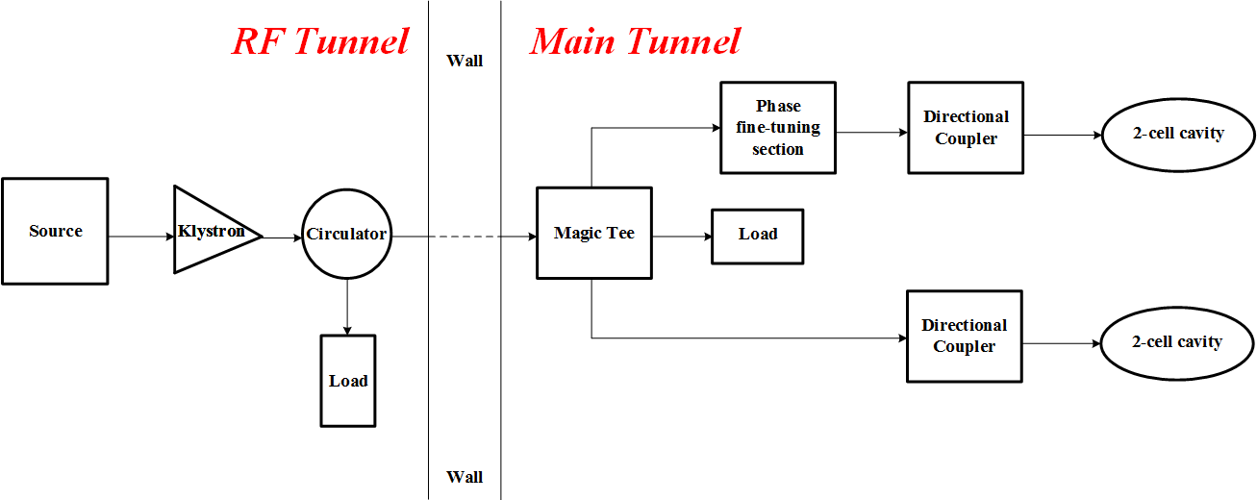
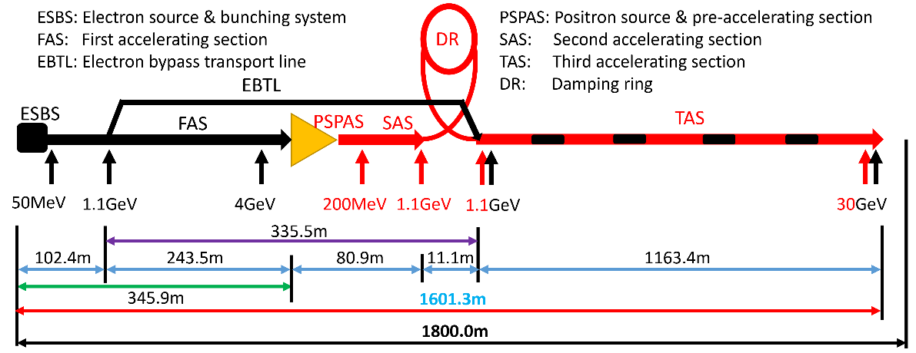
Design consideration
P band klystron for CEPC Collider
Parameters | Value
Freq.(MHz) | 650
Klystron QTY. | 120
Klystron power(kW) | 800
1 to 2 SC cavity
C&S band klystron for CEPC Linac
Parameters | S | C
Freq.(MHz) | 2860 | 5720
Klystron QTY. | 33 | 236
Klystron power(MW) | 80 | 50
RF structure distribution | 1-to-2&1-to-4 | 1-to-2

Slide 4
R&D Status

Slide 5
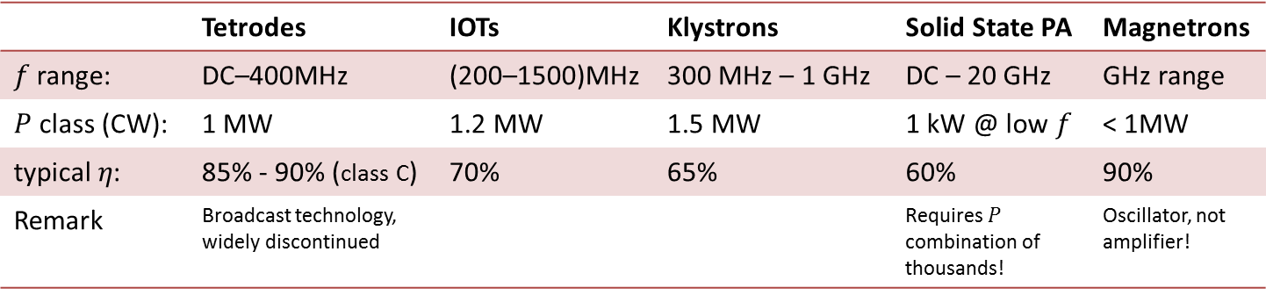
RF Power source choice
The Collider beam power is more than 60 MW. The increase in efficiency of RF power sources is considered a high priority issue.
RF power sources - efficiencies
 | Tetrodes | IOTs | Klystrons | SSA | Magnetrons
 | DC–400MHz | (200–1500)MHz | 300 MHz – 1 GHz | DC – 20 GHz | GHz range
 | 1 MW | 1.2 MW | 1.5 MW |  | < 1MW
 | 85% - 90% (class C) | 70% | 65% | 60% | 90%
Remark | Broadcast technology, widely discontinued |  |  |  | Oscillator, not amplifier!
High power klystrons are the more attractive choice because of their high eﬃciency, low cost and more stable than IOT and SSA for CEPC collider.

Slide 6
System overall efficiency
CEPC Collider SRF Wall Plug Efficiency
Wall to PSM power supply/modulator | 95%
Modulator to klystron | 96%
Klystron to waveguide | 75%
Waveguide to coupler | 95%
Coupler to cavity | ~100%
Cavity to beam | ~100%
Overall efficiency | ~65%
The critical factor is klystron efficiency
Much higher efficiency, less energy consumption.

Slide 7
Cost consumption
Efficiency impact on operation cost (Only considering operation efficiency of klystrons)
CEPC at 800 RMB/MWh and 6000 hours/year
Save Money
84M RMB
1 year
65 M RMB
Excessive electricity bill, M RMB
NOW
1st tube
62%
COMING
2nd tube
75%
Efficiency, %
FUTURE
MBK
80%

Slide 8
R&D strategy and plan (2016 to 2021)
3 or more klystron prototypes
2016 | 2017 | 2018 | 2019 | 2020 | 2021
2022
2023
Prototypes
Step1
1st
Step2
2nd
Step3
3rd
more
Efficiency: 60%
70%
80%

Slide 9
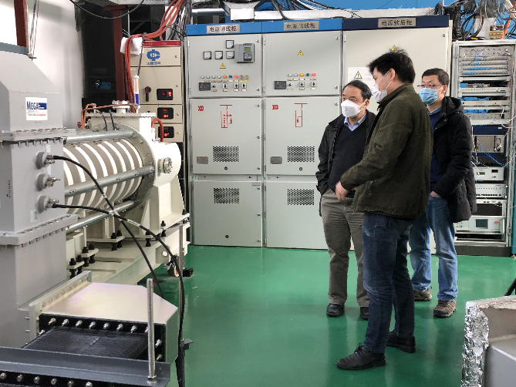
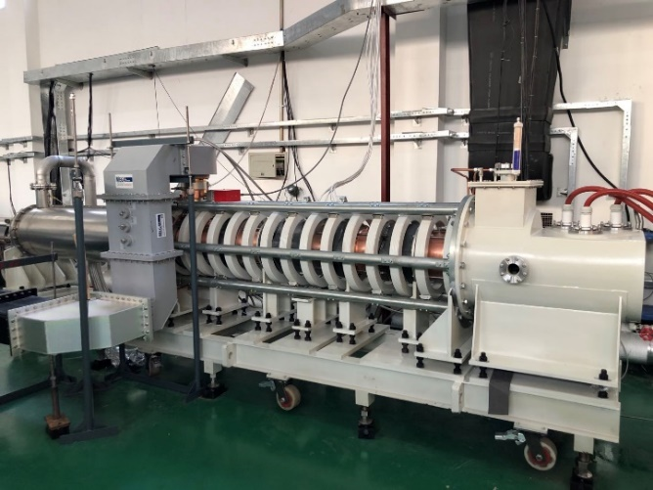
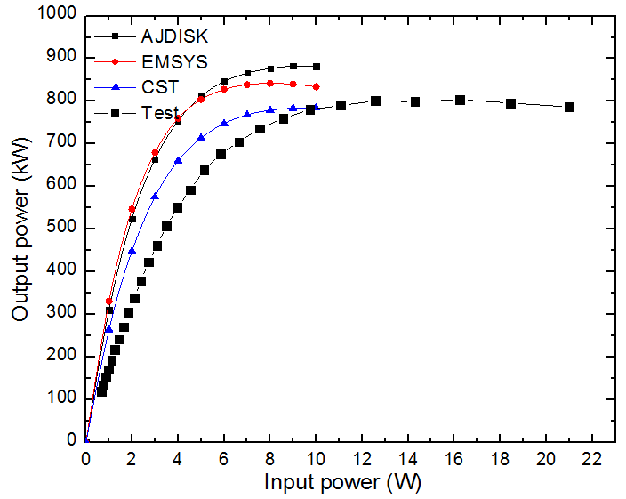
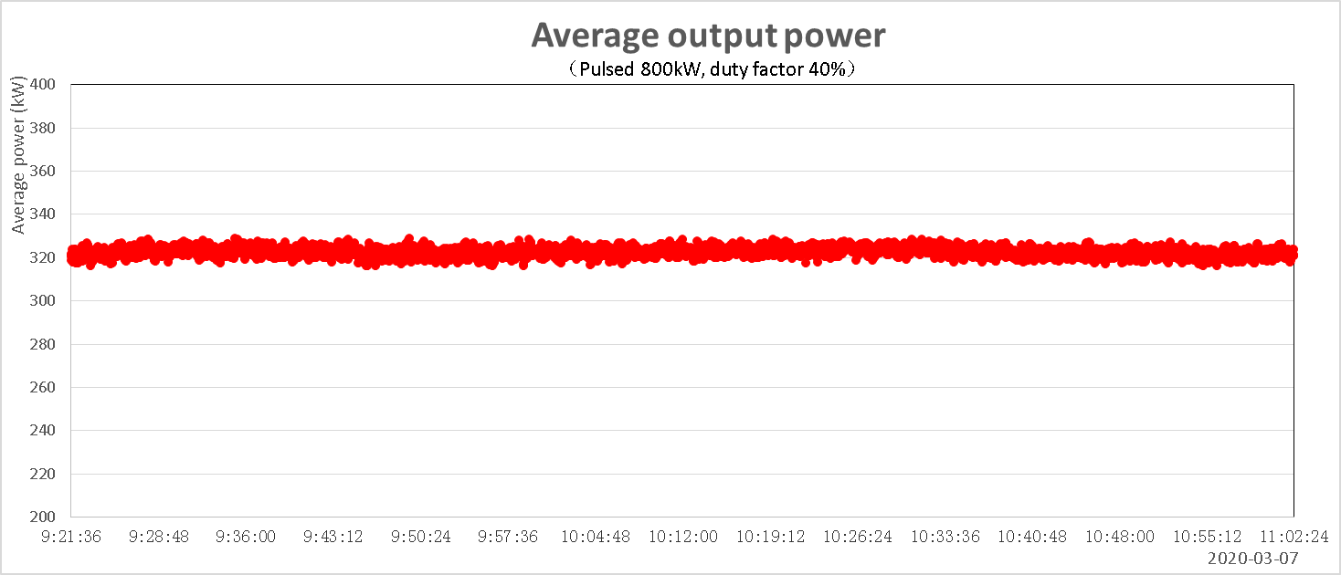
1st prototype high power test results
  700kW CW and 800kW pulsed power with 62% efficiency
Parameters | Design | Test
Operating frequency (MHz) | 650 | 650
Beam Voltage (kV) | 81.5 | 80
Beam Perveance (μA/V^{3/2}) | 0.65 | 0.7
Efficiency(%) | 65 | 62
Saturation Gain(dB) | ≥45 | 47
Output power(kW) | 800 | 800
1 dB Bandwidth(MHz) | ≥1 | 1.8
High power test stand
Pulsed 800kW

Slide 10
HE Klystron Milestone
Jan., 2021: Klystron manufacture started
Jul., 2021: Parts fabrication completed
Nov., 2021: Gun processing and klystron baking out
Dec., 2021: Klystron delivered to IHEP
Mar., 2022: Klystron conditioning started
  Cold high voltage conditioning
  Cathode activation
  High voltage conditioning
  RF Conditioning(Pulsed and CW)
Jul., 2022: CW 630kW/Eff. 70.5%

Slide 11
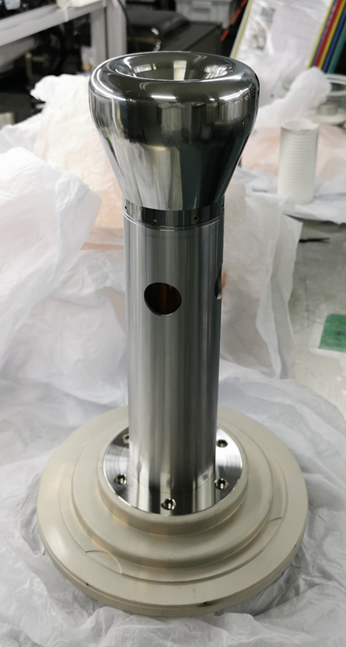
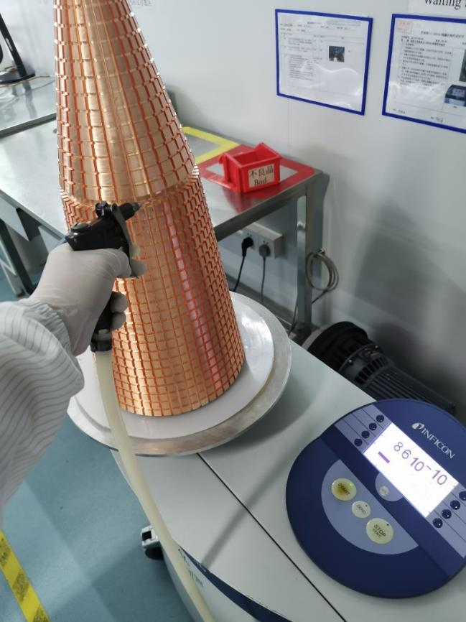
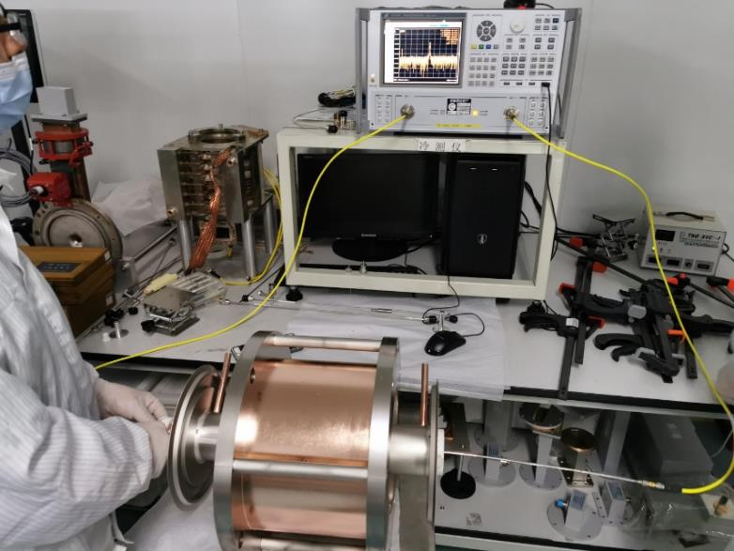
Fabrication processing
Electron gun
Cold test
Collector body

Slide 12
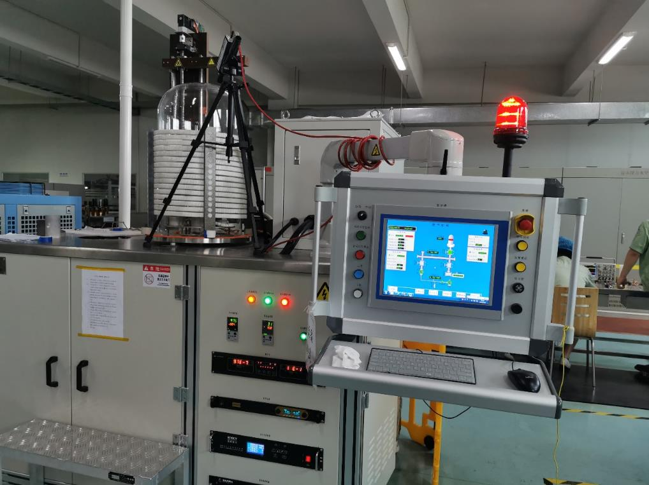
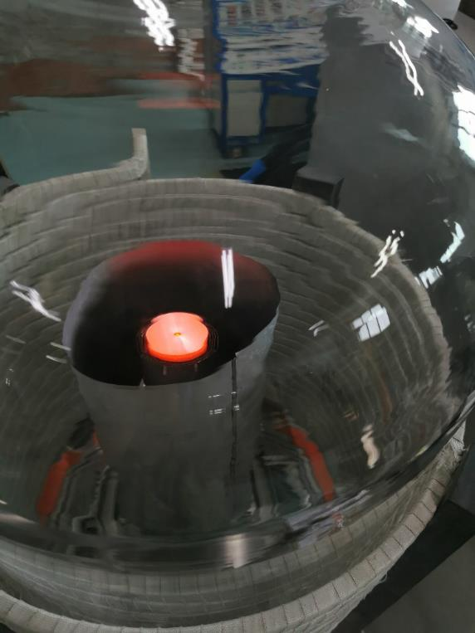
Electron gun processing
Cathode Temp. 975 degree C @Fil. 27V/6A

Slide 13
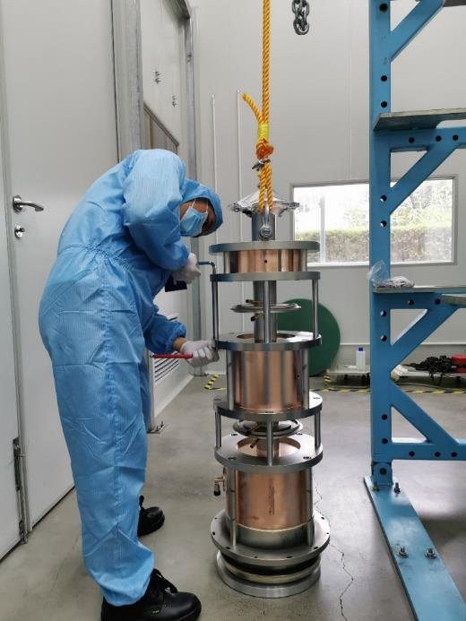
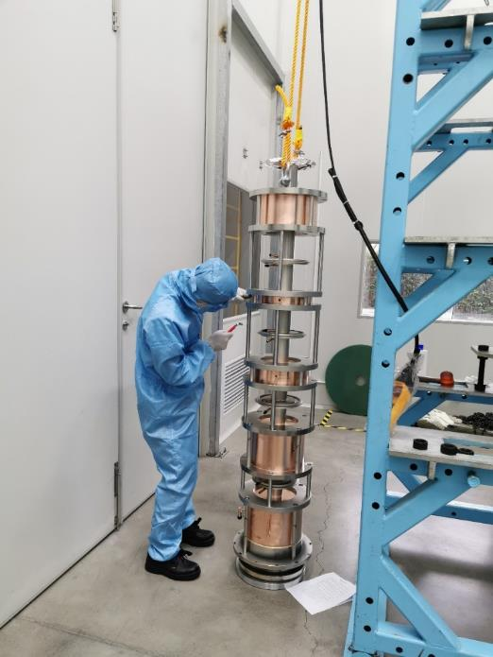
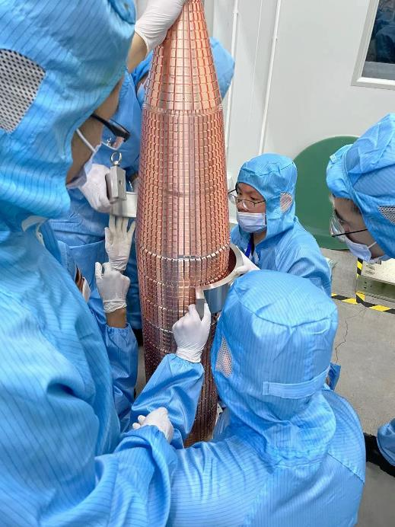
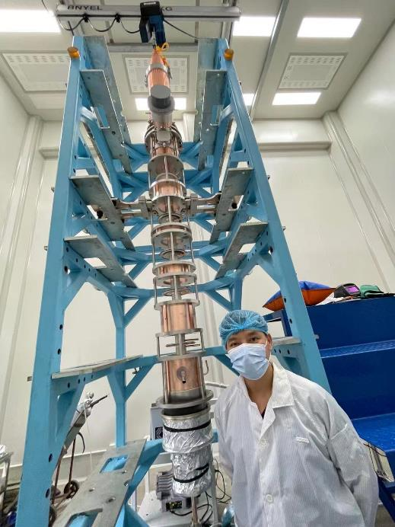
Klystron final assembly
Klystron final assembly

Slide 14
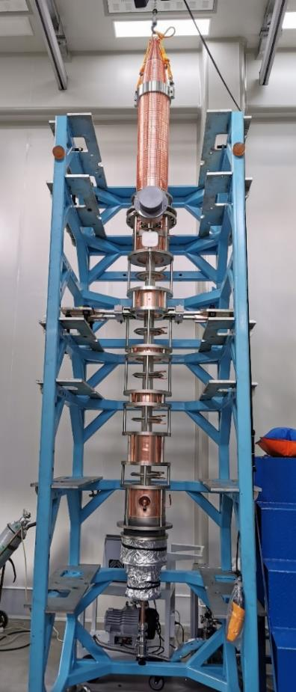
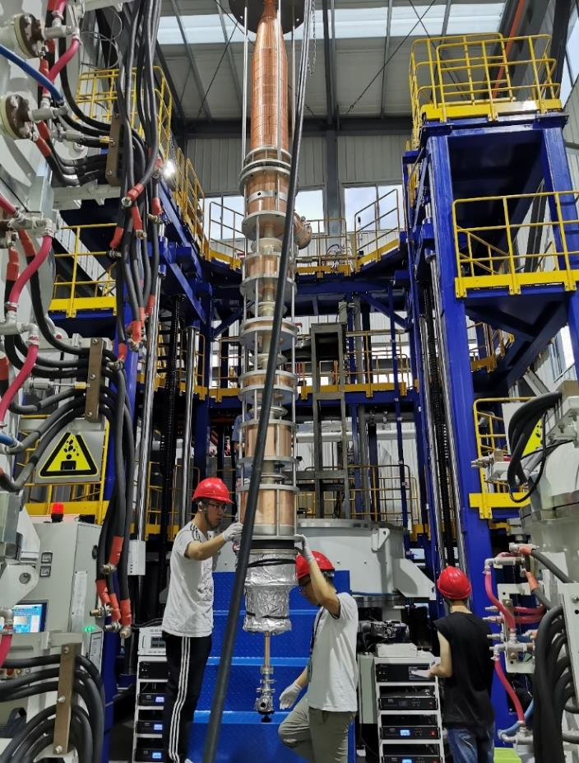
Klystron baking out

Slide 15
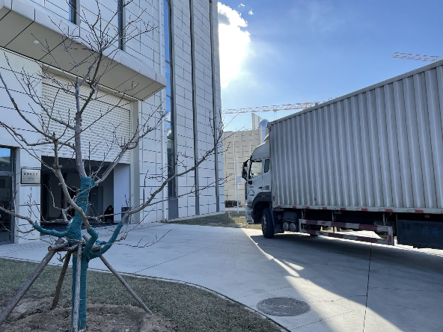
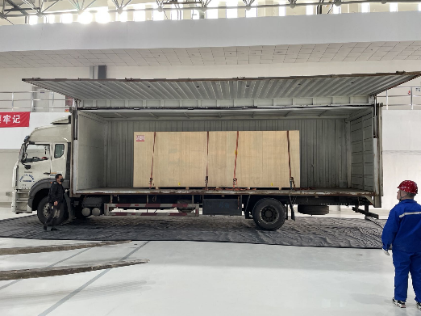
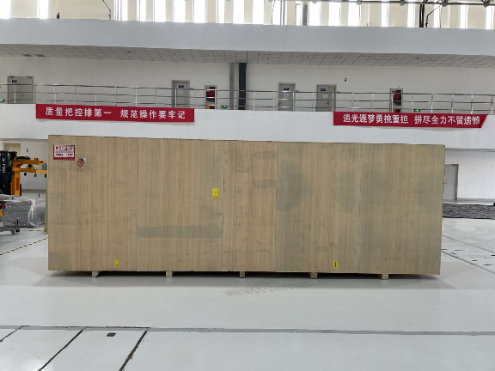
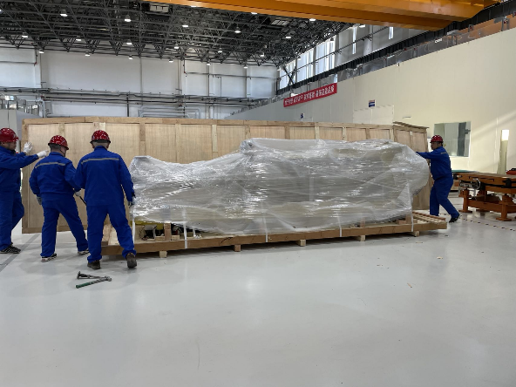
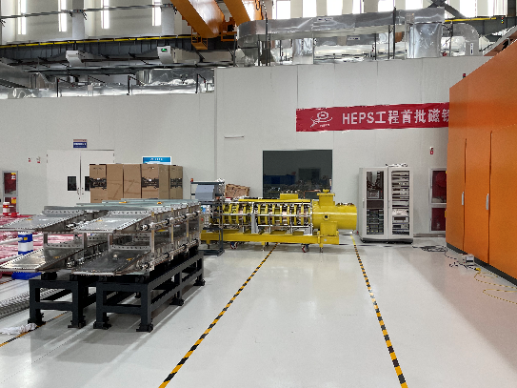
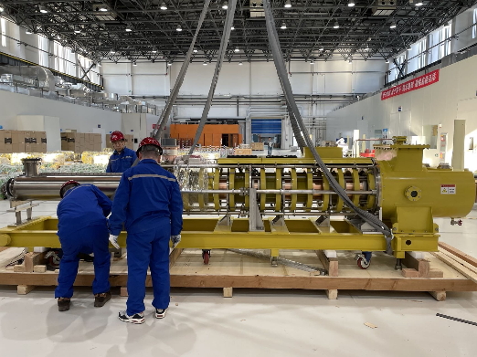
High power test preparation
Klystron is in place in IHEP PAPS site

Slide 16
High power conditioning
On Jul.5, 2022
CW power: 630kW
Eff. : 70.5%

Slide 17
MBK design and fabrication status

Slide 18
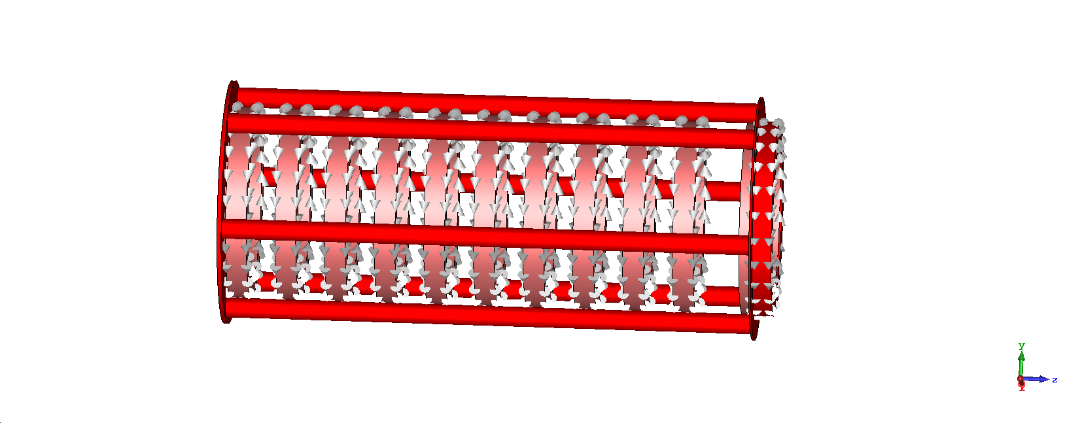
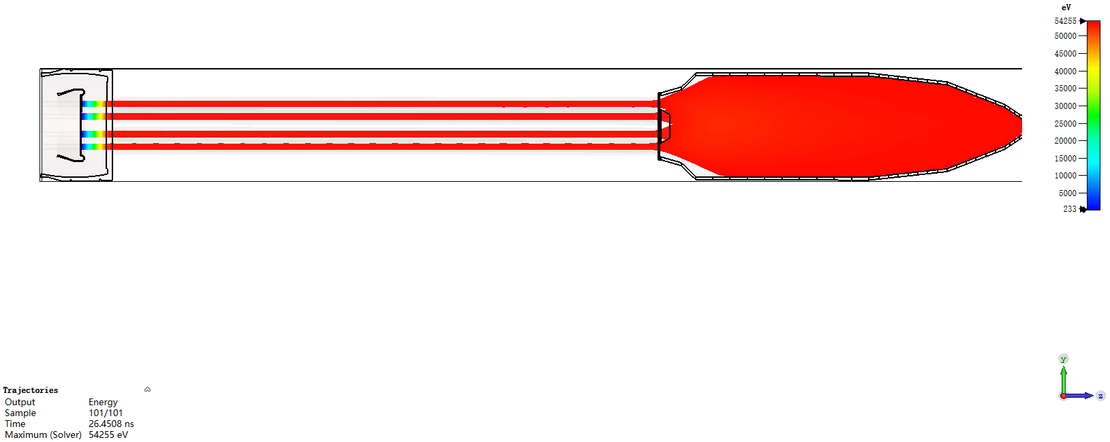
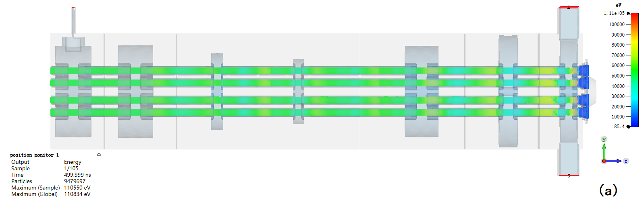
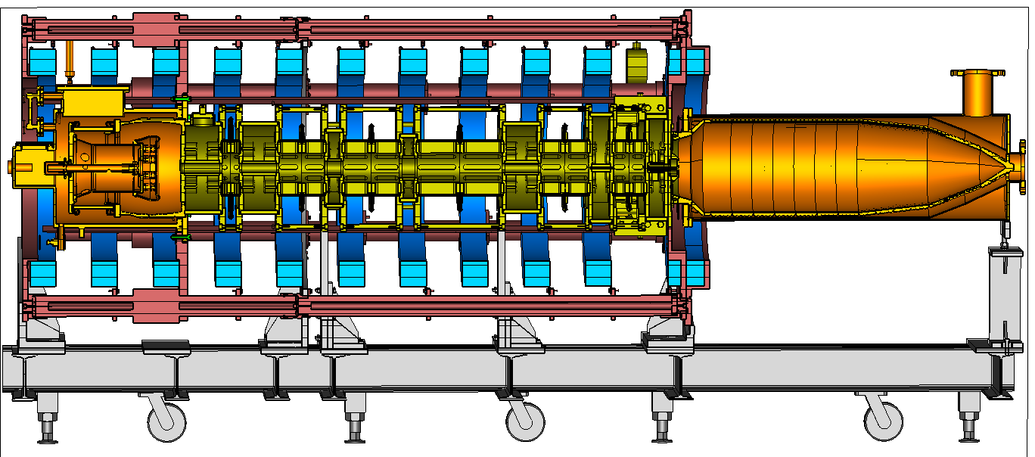
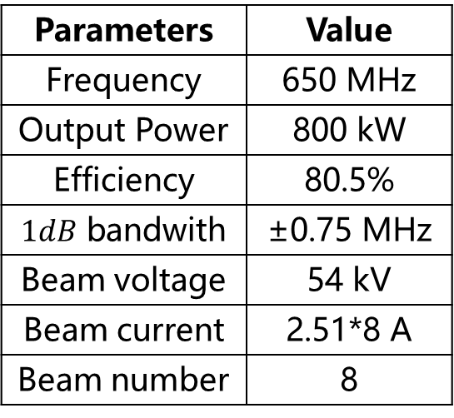
MBK physical and mechanical design
Final physical and mechanical design was completed at the end of 2021.
Parameters | Value
Frequency | 650 MHz
Output Power | 800 kW
Efficiency | 80.5%
$1dB$ bandwith | ±0.75 MHz
Beam voltage | 54 kV
Beam current | 2.51*8 A
Beam number | 8

Slide 19
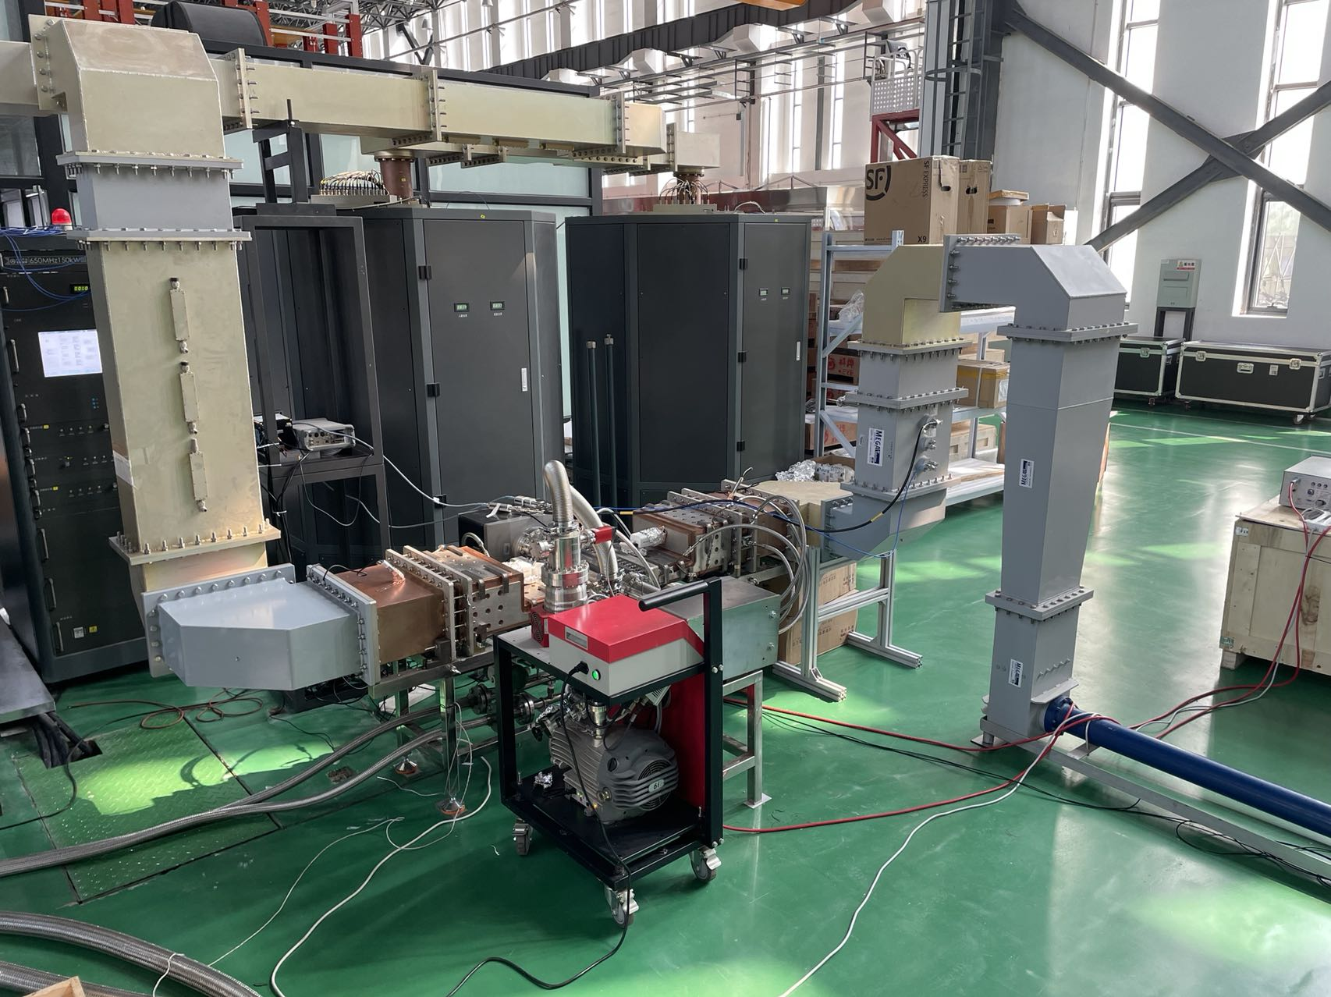
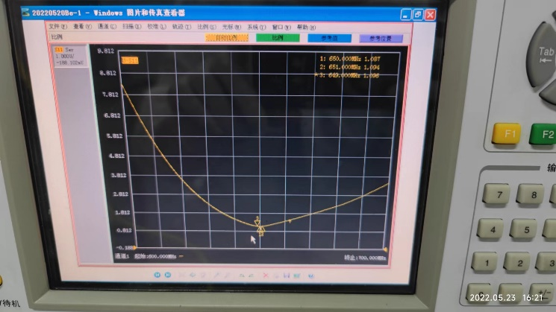
MBK Fabrication Status
Fabrication of two types of output window prototype is completed.
The high power conditioning was been processed with solid state amplifier at PAPS site.
Test result | Alumina | Beryllium oxide
VSWR@651MHz | 1.048 | 1.089
VSWR@650MHz | 1.034 | 1.084
VSWR@649MHz | 1.052 | 1.096
  High power conditioning site

Slide 20
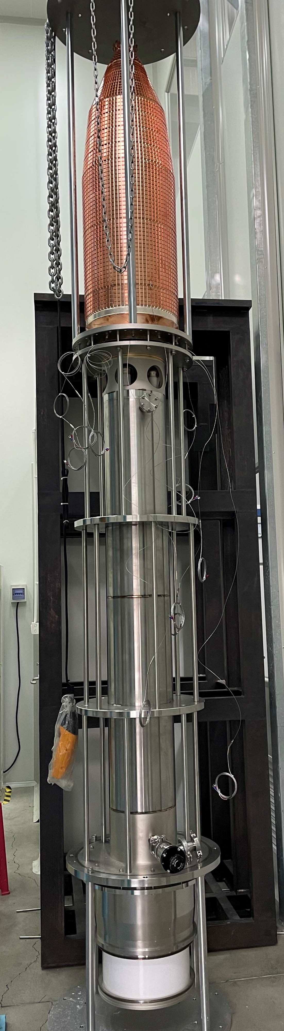
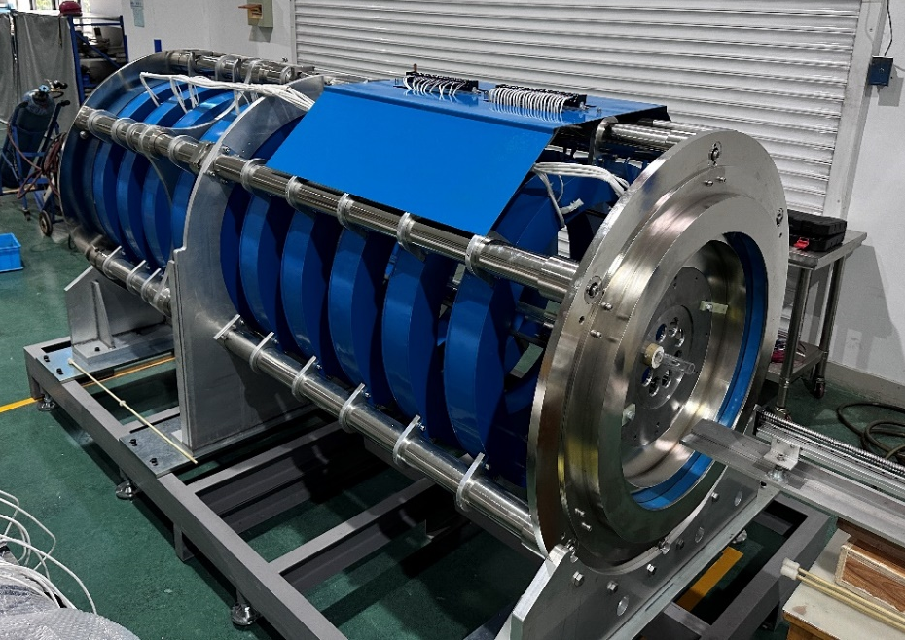
MBK Fabrication Status
The experimental cavity is completely manufactured with mechanical tuning device.
Fabrication of MBK beam tester is completed(including electron gun, collector, focusing coil) and will be delivered to IHEP for high power test on next month.
MBK Coils and field value
MBK beam tester

Slide 21
C band and S band klystron
Type | QTY | Freq.(MHz) | Structure type
S-band klystron | 33 | 2860 | 1 1-to-1，standard-bunch 3 1-to-2，standard acc. structure. 8 1-to-2，large aperture acc. structure 21 1-to-4, standard acc. structure.
C-band klystron | 236 | 5720 | 1-to-2，standard acc. structure.

Slide 22
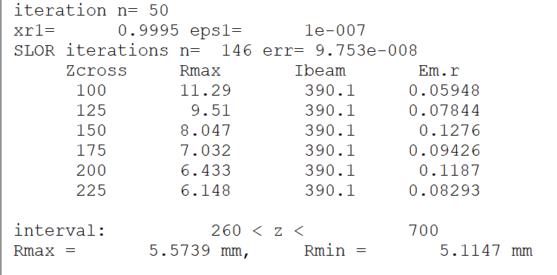
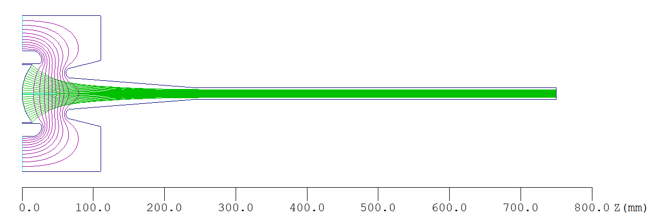
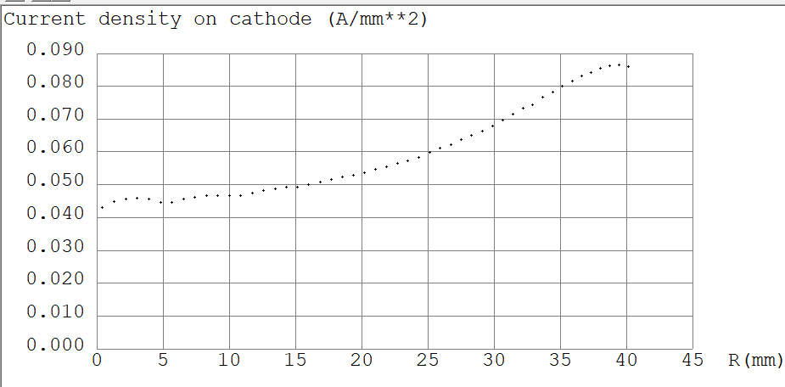
80 MW C-Band(5720 MHz) klystron
Beam optics design simulation
Beam Current
Emax@ FE = 0.1864E+05 V/mm
Emax @Anode = 0.1546E+05 V/mm
Beam Trajectories
Beam Current = 390 A
Beam Voltage = 410 kV
Perveance = 1.49 µP
Cathode Loading
Average = 6.5 A/cm^2
8.5 A/cm^2
4.4 A/cm^2
% Ripple rate < 4.2%
Cathode uniformity 1.9 : 1

Slide 23
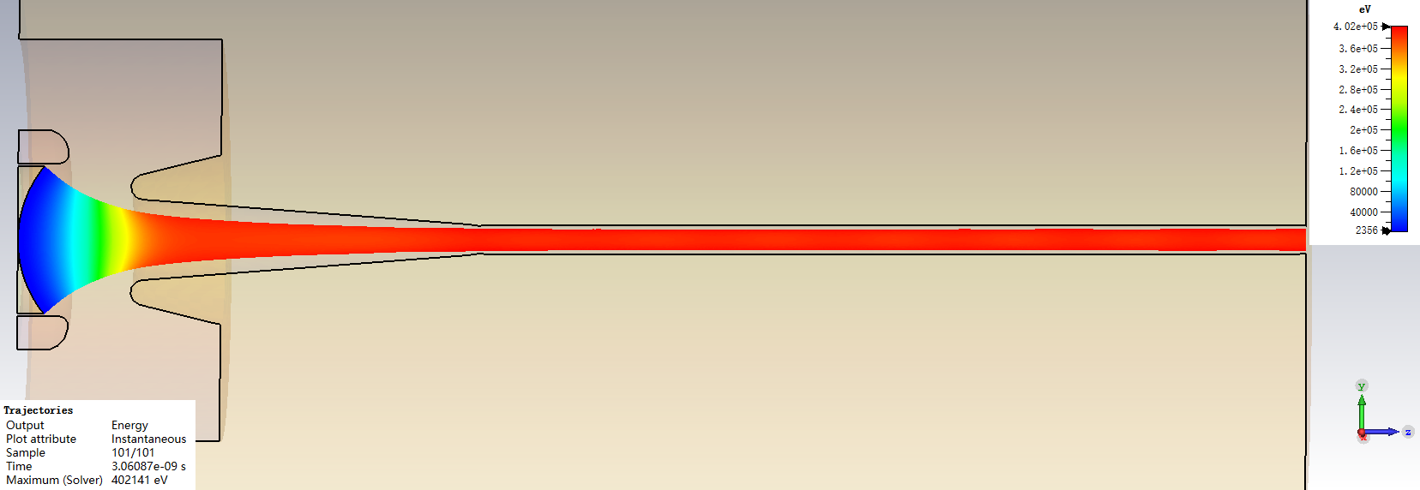
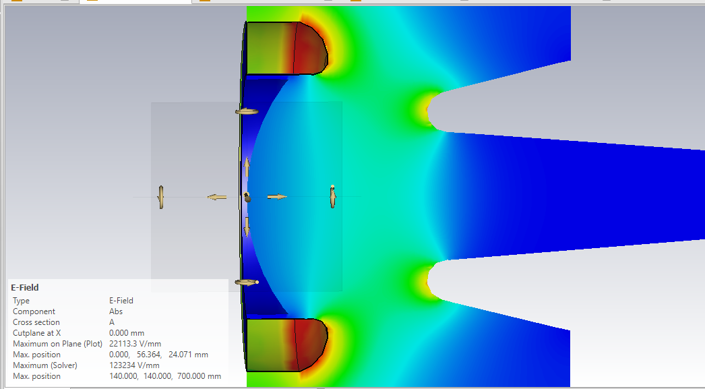
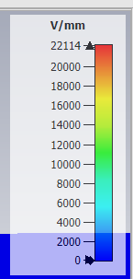
GUN simulation result in CST
Beam trajectories
Surface Gradient

Slide 24
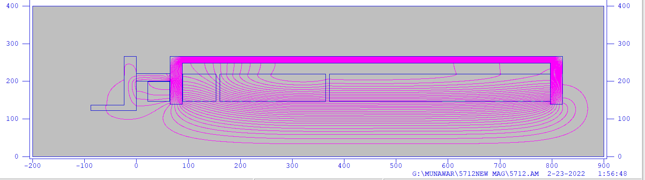
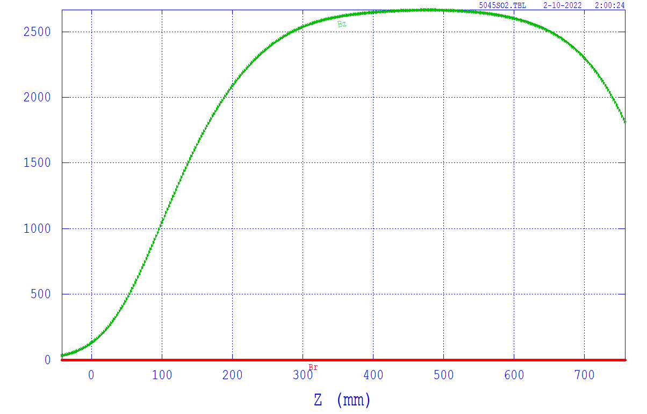
Solenoid Design
Pole Pieces
Reverse Coil
Focusing Coils
Magnetic Field at the Tube Body = 2540G
Magnetic Field at the Cathode = 32.67 G

Slide 25
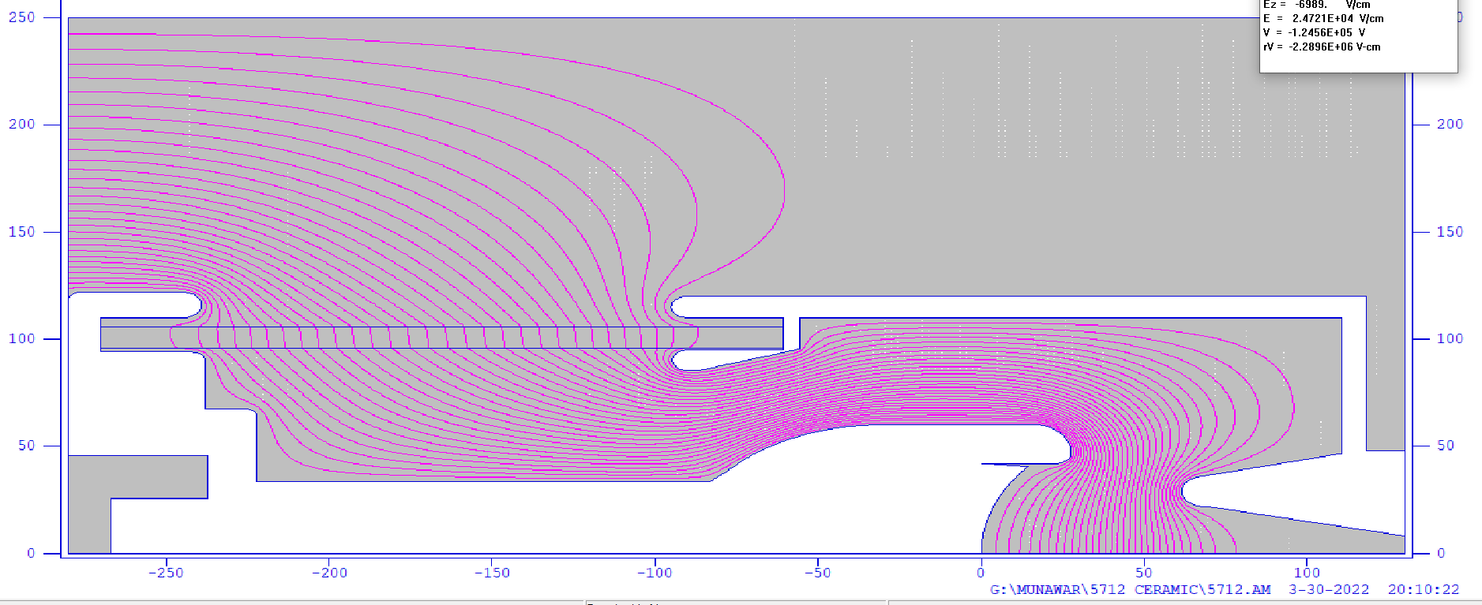
Surface gradient at beam optic & ceramic
@upper ceramic; 106.000 -92.2877 4.4685E+04
4.47 kV/mm
21.84 kV/mm
@ FE 59.9832 18.0268 2.1844E+05
18.39 kV/mm
@anode; 30.6698, 61.6178, 1.8394E+05
@lower ceramic; 96.0000, -96.7931, 2.9319E+04
@ corona 85.803, -91.8242, 1.5702E+05

Slide 26
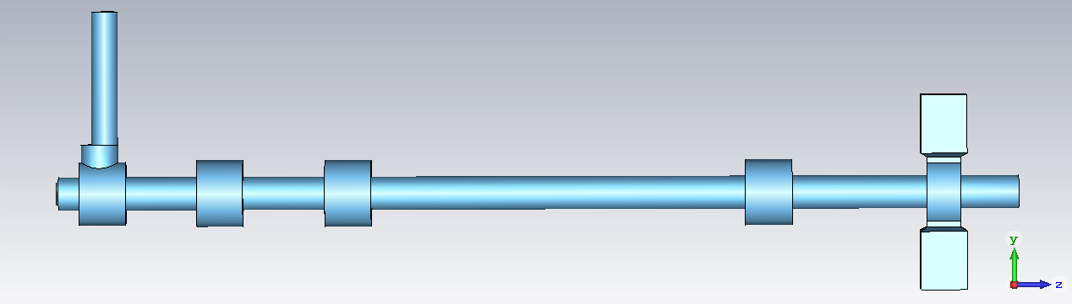
Beam dynamic simulation of C band klystron
Parameters | Value
Frequency | 5720 MHz
Output Power | 80MW
Efficiency | 45%
Beam voltage | 420 kV
Beam current | 403 A
Beam number | 1

Slide 27
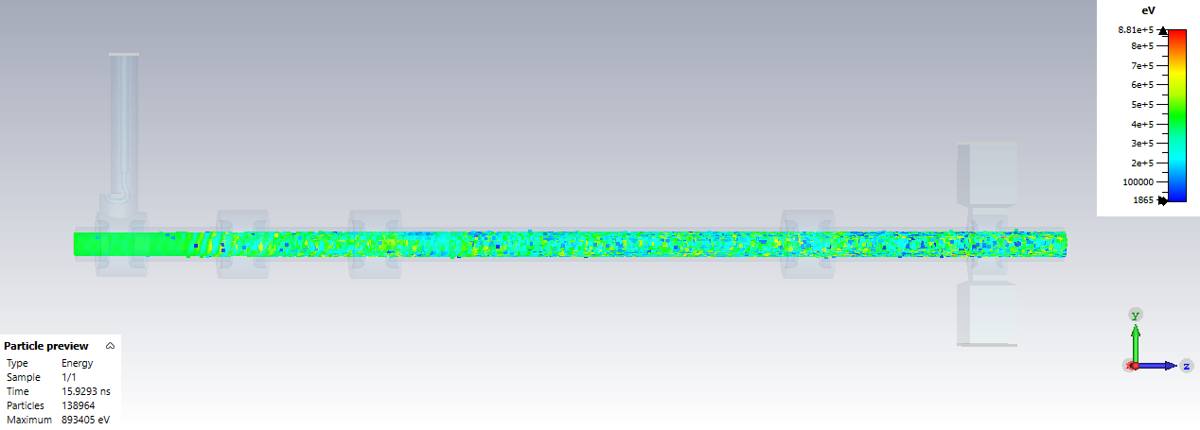
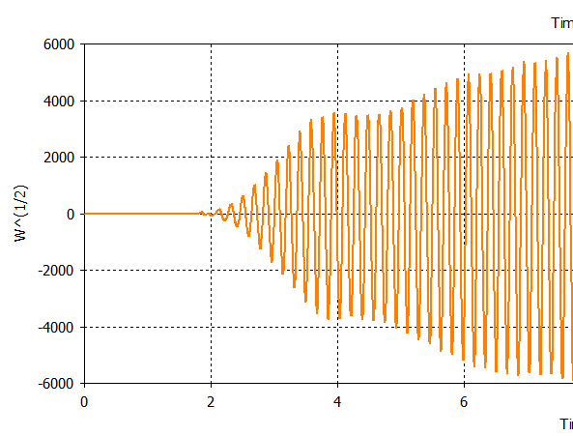
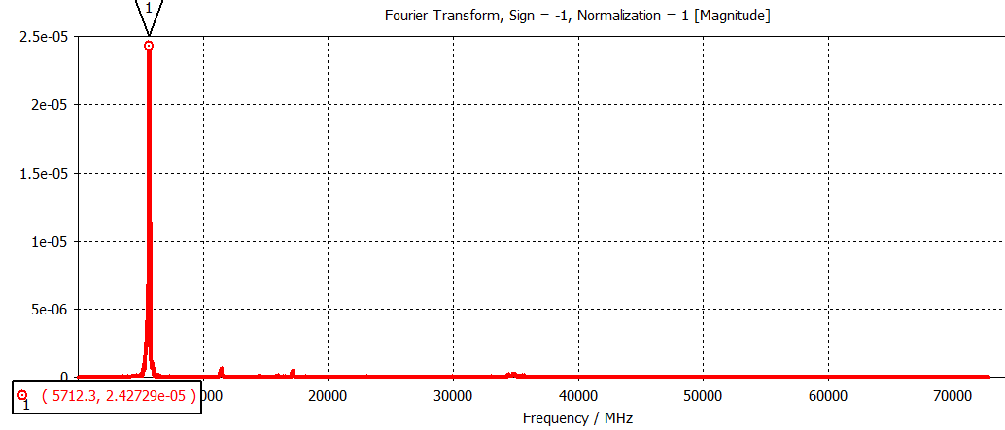
Beam dynamic simulation of C band klystron
Optimization in progres

Slide 28
S Band klystron parameters
The RF power source system of CEPC LINAC includes 33 sets of pulsed klystron operating at a frequency of 2860MHz. The power of these klystron are excepted to be 80MW.
Parameters | Value
Operating frequency | 2860MHz
Output power | 80MW
RF pulsed width | 4μS
Beam voltage | 350kV
Beam current | 414A
Beam μperveance | 2.0
Efficiency | 55%

Slide 29
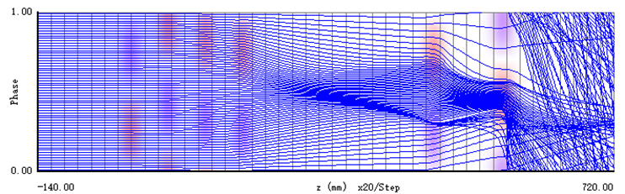
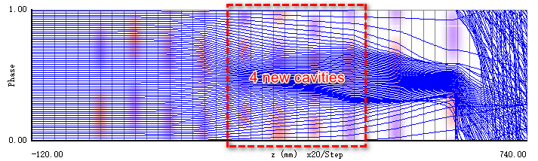
Efficiency improvement
The 1-D code AJDISK is suitable for the preliminary optimization of the interaction section parameters. Based on AJDISK, a 1-D automatic optimization code via NSGA-II was developed at IHEP.
The 1-D efficiency is about 64%.

Slide 30
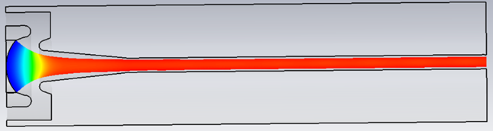
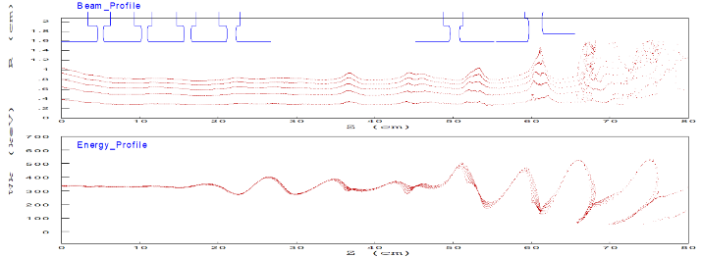
Efficiency improvement
The parameters obtained from AJDISK was checked by 2-D code EMSYS and 3D code CST.
Parameters | DGUN | CST
Beam μperveance | 1.978 | 1.997
Beam maximum radius | 8.54mm | 8.64mm
Beam minimum radius | 7.93mm | 8.02mm
Beam ripple | 3.7% | 3.6%
30

Slide 31
RF power sources

Slide 32

Collider transmission system

Slide 33


Collider infrastructure
Collider Power Source Gallery
High voltage power supply are placed on the ground.
For space savings, transmission system in part are placed in RF tunnel.

Slide 34
Booster RF power source
Design consideration
1.3 GHz/25kW SSA Specifications
The Booster RF system consists of 1.3 GHz superconducting RF cavities. There are 12 cryo-modules for Higgs operation, each containing eight 9-cell superconducting cavities.
These cavities need 96 set 25kW power sources.
SSA, their capabilities extend from a few kW to several hundred kW, reasonable efficiency (~50%), high gain, and modular design provide high reliability.
So the SSA has been chosen for the Booster RF power source system.
Parameters | Values
Frequency | 1.3 GHz
Power | 25 kW
Gain | ≥65 dB
Bandwidth (1dB) | ≥ 1 MHz
Amplitude stability | ≤0.1% RMS
Phase stability | ≤0.1°RMS
Phase Variation | ≤10°
Harmonic | < -30 dBc
Spurious | < -60 dBc
Efficiency at 25kW | ≥45%
MTBF | ≥30000 h
Redundancy | 1 power module failure

Slide 35

Booster SSA cabinet
2120mm(H)×1326mm(W)×1300mm(L)

Slide 36


Booster SSA parts
1:2 power divider
6:1 power combiner

Slide 37



Booster RF transmission

Slide 38
Damping ring RF power source
There are 2 RF stations, RF power is 650MHz/90kW/station.
650MHz/90kW SSA Specifications
Parameters | Values
Frequency | 650MHz
Power | 90 kW
Gain | ≥65 dB
Bandwidth (1dB) | ≥ 1 MHz
Amplitude stability | ≤0.1% RMS
Phase stability | ≤0.1°RMS
Phase Variation | ≤10°
Harmonic | < -30 dBc
Spurious | < -60 dBc

Slide 39


Damping ring SSA cabinet
3210mm(H)×3220mm(W)×1800mm(L)

Slide 40


Damping ring SSA key components
1:4 power divider
60kW 1:2 power divider

Slide 41




Damping ring SSA key components
30kW 2:1 power combiner
60kW 2:1 power combiner
2 port directional coupler
4 port directional coupler

Slide 42
Summary
HE klystron is being developed, efficiency of 60% and 70% has been achieved, 80% efficiency is expected to be reached by the end of this year.
Development of S and C band 80MW klystron for CEPC Linac is also in progress.
Design of RF power distribution system for collider, booster, damping ring and Linac is showed.
SSA mechanical design for booster and damping ring is also showed.

Slide 43
Thanks for your attention!

