Slide 1

HEPS injector linac developments
Reporter: Jingru Zhang
On behalf of HEPS linac group
Institute of High Energy Physics, CAS

Slide 2
Outline
1
HEPS layout & linac design
2
HEPS linac key technologies development
3
CEPC Linac layout
4
Summary

Slide 3
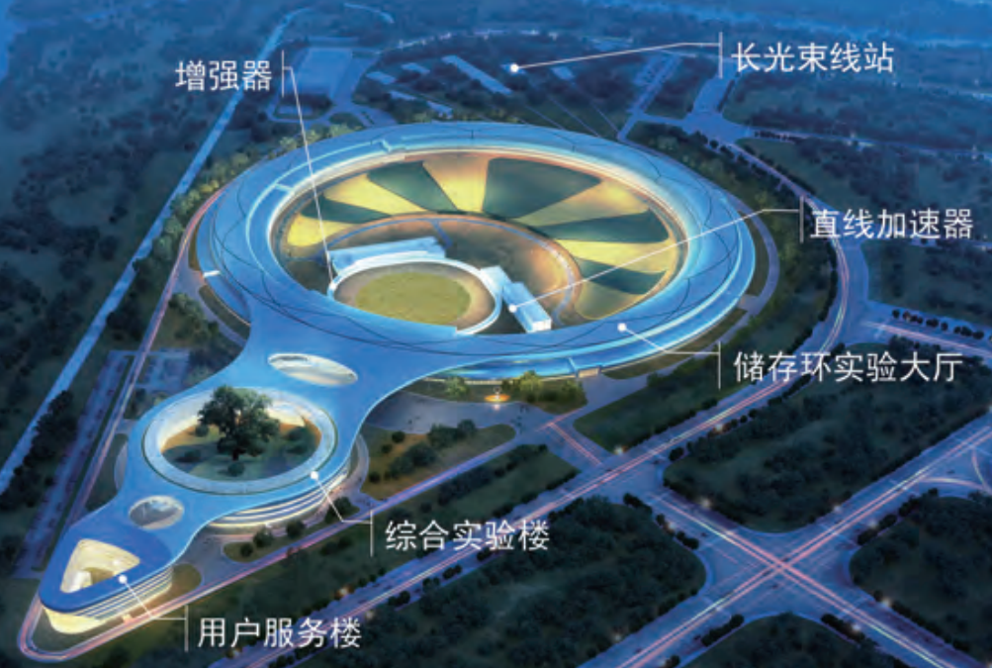
HEPS layout & linac design
High Energy Photon Source (HEPS)
  It is a fourth-generation synchrotron light source with an ultrahigh brightness and under construction in Huairou district Beijing, China
  The accelerator is comprised of a 6-GeV storage ring, a full energy booster, a 500 MeV linac
  From the gun to vacuum gate valve in the end of linac, the total length is about 48.8m
Booster
LINAC
storage ring

Slide 4
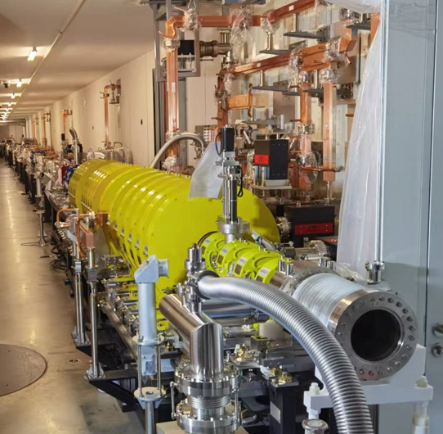
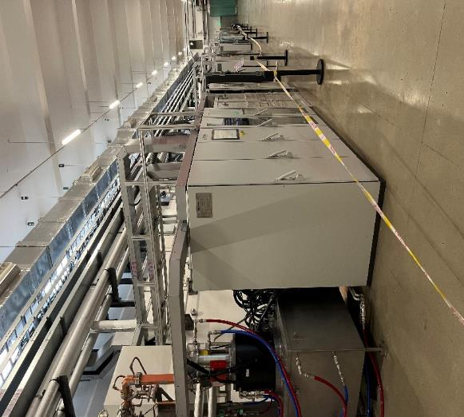
HEPS layout & linac design
HEPS linac has been installed in the tunnel and completed high power practice
Beam commissioning will be carried out after the environmental protection certificate is approved
HEPS linac tunnel
HEPS linac equipment hall

Slide 5
HEPS layout & linac design
The HEPS is an S-band normal conducting linear accelerator with energy of 500MeV
The maximum designed bunch charge is 10 nC
  As light source injector in the world, the HEPS Linac has the highest bunch charge
  Bunch charge is same as the collider injector for positron source
Design requirement
Parameter | Unit | V3.0
RF frequency | MHz | 2998.8
Energy | MeV | 500
Max. Repetition frequency | Hz | 50
Pulse charge | nC | 7.0
Number of bunches per pulse | - | 1 or 3
Bunch length (rms) | ps | ~5
Energy spread (rms) | % | 0.5
Emittance (rms) | nm·rad | 70

Slide 6
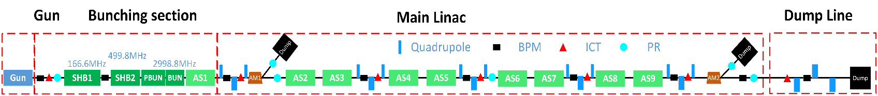
HEPS layout & linac design
Layout
  Thermal-cathode electron gun
  Bunching system
    2 SHB, PBUN, BUN, AS1
    Solenoid for focusing
  Main Linac
    8 accelerating structure (4 klystron)
    5 triplet focusing structure
    2 energy analysis transport lines
    3 beam dump
  Beam diagnostics
    8 BPM, 6 ICT, 6 PR

Slide 7
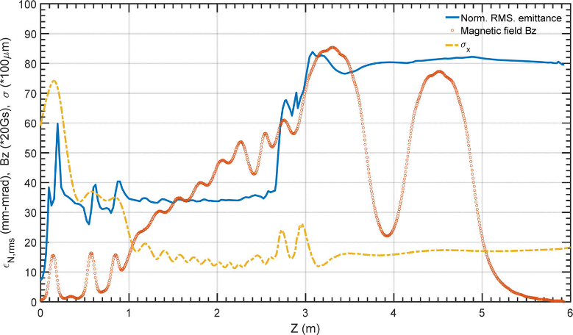
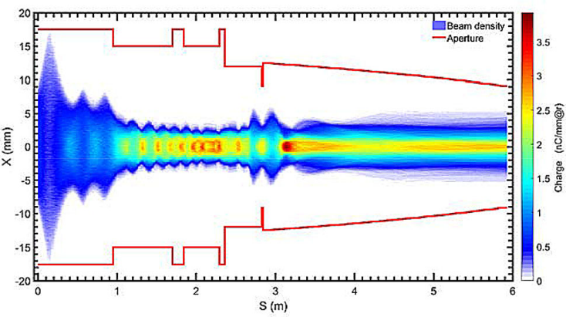
HEPS layout & linac design
Bunching section transmission efficiency is about 97%
Norm. RMS. Emittance is 80nm.rad@10nC

Slide 8
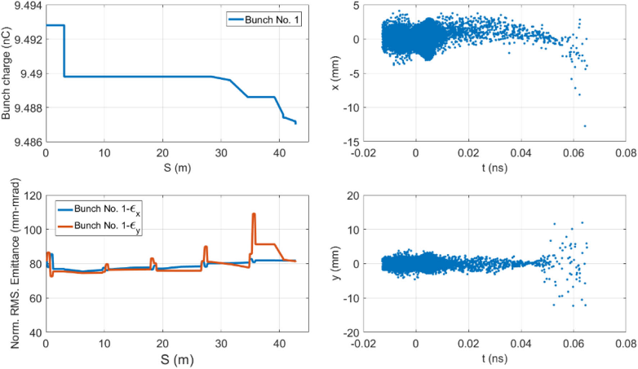
HEPS layout & linac design
Total transmission efficiency is about 95%
Norm. RMS. Emittance is 80mm-mrad@10nC

Slide 9
HEPS layout & linac design
2020, the design of the HEPS Linac was finalized
2021.7, the commissioning schedule was proposed
2021.9, the simulation of beam commissioning was completed
2022.3, high-level applications (HLA) of the HEPS Linac for beam commissioning was finished, based on a new architecture platform Pyapas
2022.3, the tunnel installation was started
2022.4, the magnetic field measurement and analysis was completed
2022.5, the lattice for commissioning based on beam measurement of electron gun and field measurement of magnet and cavity
2022.7, the installation was completed
2022.8, system joint debugging was completed; the test and upgrade of the HLA was completed
2022.9, high power conditioning of RF units and power supplies was completed and beam commissioning preparation is ready
Now, We are waiting for environmental protection certificate about radiation protection

Slide 10
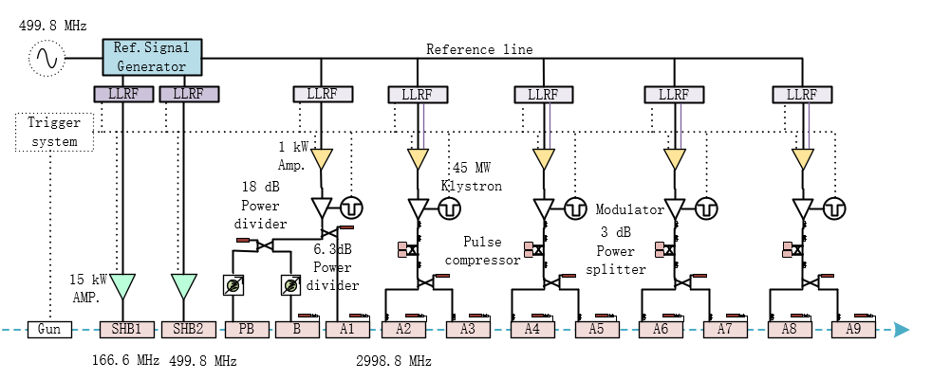
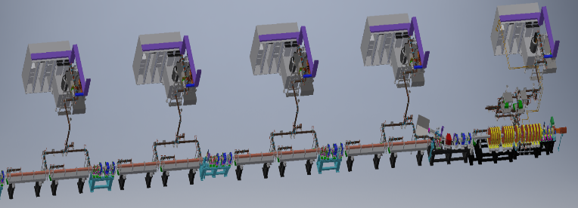
HEPS linac key technologies development
The signal source frequency is 499.8MHz
The SHBs use 15kW solid state amplifier with deferent frequency
The first klystron power feed to PB 、B and the first accelerating structure using power divider. Before the PB & B, Phase-shift attenuator is used to adjust the phase and amplitude to PB & B
The other four klystron power feed to two accelerating structures with pulse compressor
K1
K3
K2
K5
K4

Slide 11
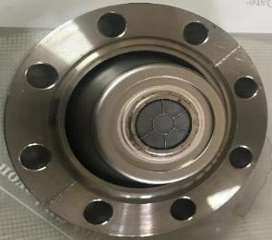
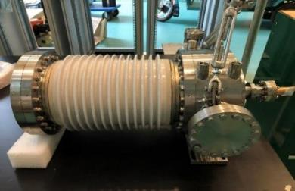
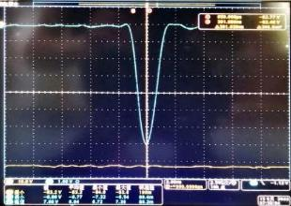
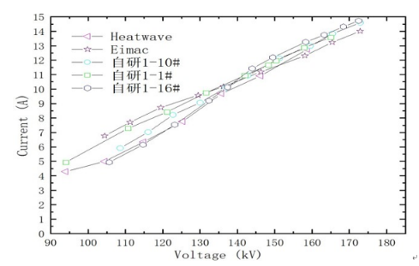
Electron gun
Traditional thermionic triode gun
Cathode-grid assembly was produced in China company
Peak emission current is 14A with 1ns FWHM when grid bias is 100V and pulser voltage is 950V
Parameter | Unit | Value | Measurement result
Type |  | Thermionic Triode Gun | Thermionic Triode Gun
Beam Current (max.) | A | ＞10 | 14
High Voltage of Anode | kV | 120 ~ 200 | 165
Bias Voltage of Grid | V | 0 ~ -200 | -100
Pulse duration | ns | 1 | 1
Electron gun for HEPS
The cathode emission capacity

Slide 12
Bunching system
Requirements of bunching system
  There are solenoid coils outside the two SHBs and hope the electromagnetic field improve rapidly, so there are requirements for mechanical dimensions
  The cavity voltage of SHB1, SHB2, PB, B is 100, 120, 100, 1200 kV respectively
Parameters | value |  |  |  | unit
 | SHB1 | SHB2 | PB | B
Frequency | 166.6 | 499.8 | 2998.8 | 2998.8 | MHz
Type | SW | SW | SW | TW | -
Max. cavity voltage | 100 | 120 | 100 | 1200 | kV
Pulse repetition | 50 | 50 | 50 | 50 | Hz
Drift tube aperture | 30 | 30 | 24 | 24 | mm
Longitudinal mechanical length | 750 | 450 | 243.5 | 235 | mm
Short drift tube length | ≤120 | ≤120 | - | - | mm
RF parameters
Mechanical dimensions

Slide 13
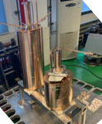
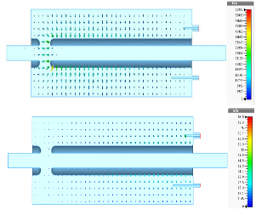
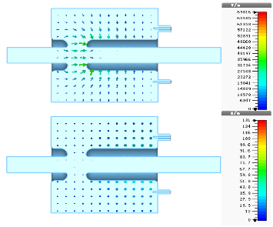
SHBs
Cavity type： Capacitance loaded coaxial line resonator
Material ： Oxygen free copper
Parameters | SHB1 | SHB2 | Unit
Frequency | 166.6 | 499.8 | MHz
Shunt impedance | 1.52 | 2.68 | MΩ
Q₀ | 8813 | 13135 | -
Esmax@100kV | 6.44 | 7.36 | MV/m
Kilpatrick factor | 0.47 | 0.35 | -
Transit time factor | 0.997 | 0.971 | -
SHB1
SHBs for HEPS
Cold test result（SHB1）
  VSWR： 1.03
  Q₀=8038（Theoretical value with coupler and tuner: 8083, 99.4% ）
Cold test result (SHB2)
  VSWR： 1.02
  Q₀=12076（Theoretical value with coupler and tuner: 12100，99.8%）
SHB2
Electromagnetic field

Slide 14
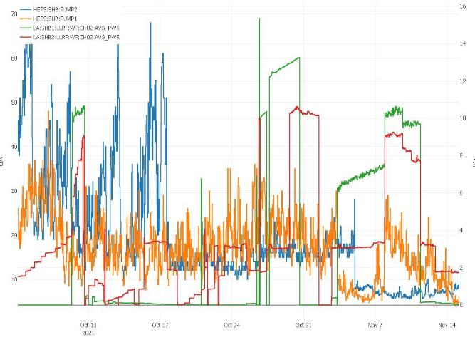
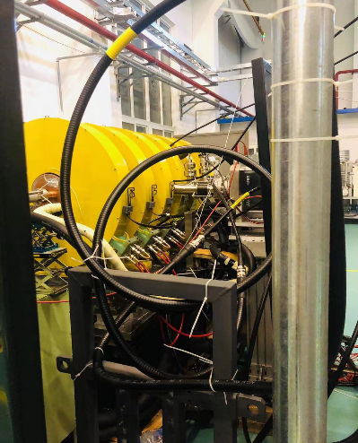
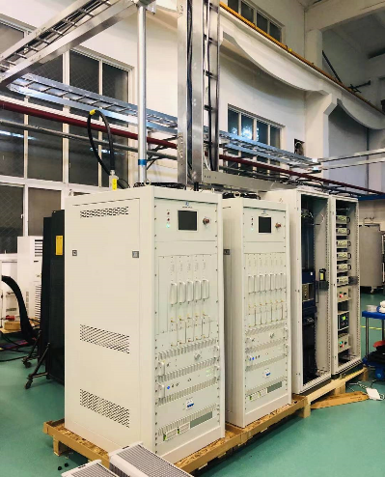
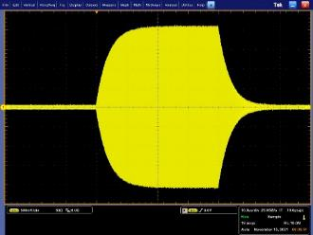
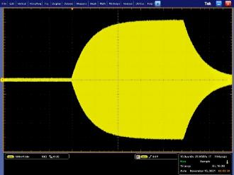
SHBs
High power test
  46 days (2021.9.30-2021.11.15)
  The waveform is stable
High power test facility
15kW SSA

Slide 15
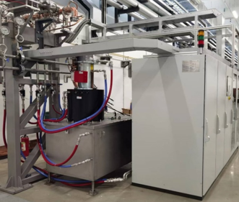
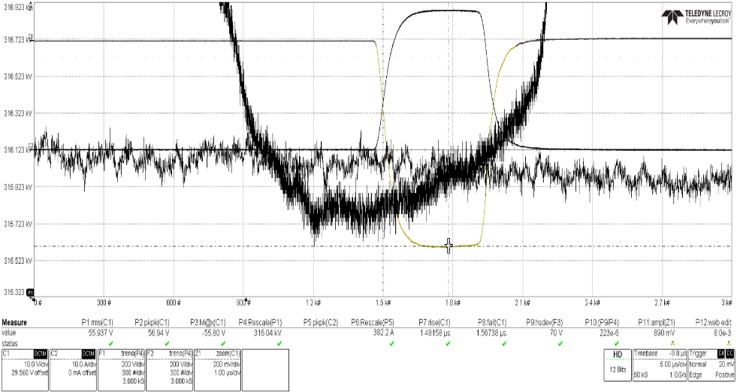
Power source
Modulator&klystron
  SSMs (solid-state modulator) are researched and developed by IHEP,
  Klystrons are E37302A tube products of CANON, 50MW
  All SSMs and klystrons were completed RF commissioning
  Amplitude stability error of SSM is about 200 ppm standard deviation with 3000 pulses

Slide 16
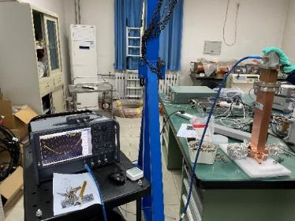
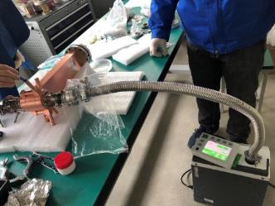
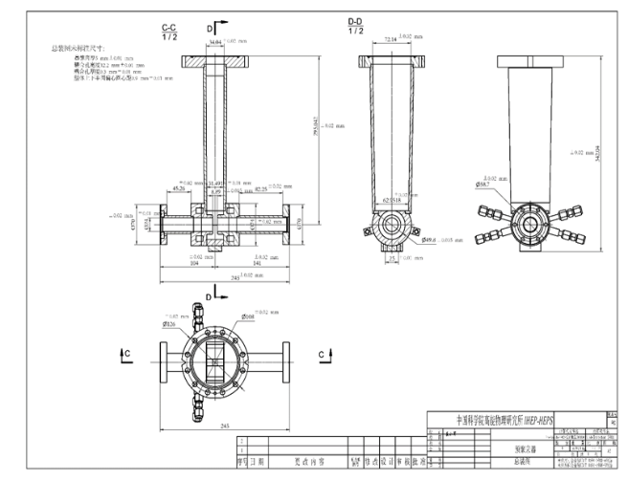
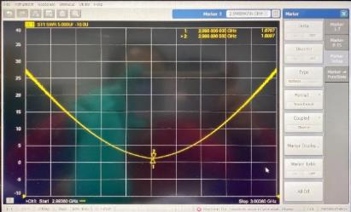
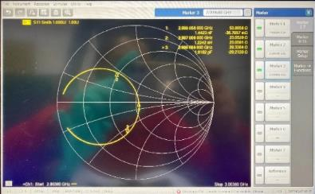
Prebuncher
One cavity, waveguide magnetic coupling
The main body of the cylinder is made of stainless steel, which reduces Q₀ and temperature sensitivity
  VSWR: 1.08
  Q₀: 1600

Slide 17
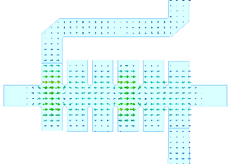
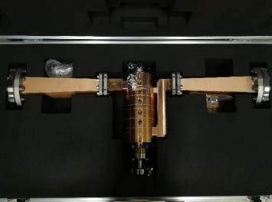
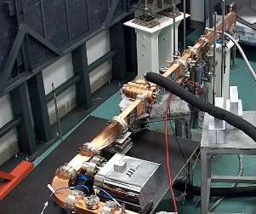
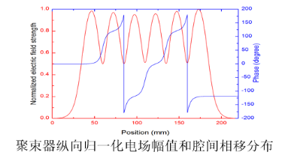
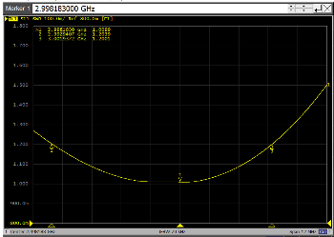
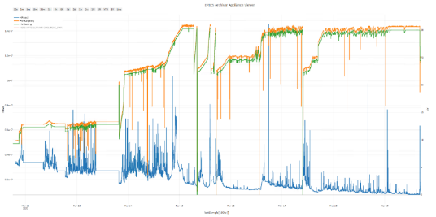
Buncher
Traveling wave constant impedance disk loaded waveguide accelerating structure, including 6 cavities, β=0.75
The output coupler design needs to consider the diameter size of solenoid coil S2
The high power test from 2022.3.11 to 3.20. Lasted 9 days
  High power goal: 2uS/10MW（1uS、1.5uS，2uS）
parameters | value | unit
Frequency | 2998.8 | MHz
Mode | 2π/3 | -
Cavity number | 6 | -
β | 0.75 | -
v_{g} | 0.0193 | -
α | 0.147 | Np/m
Rs | 33.2 | MΩ/m
Q₀ | 11083 | -
VSWR | 1.01 | -
Input power | 8 | MW
Type | TW | -
Buncher for HEPS

Slide 18
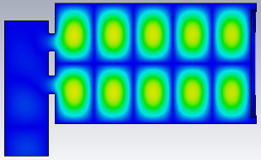
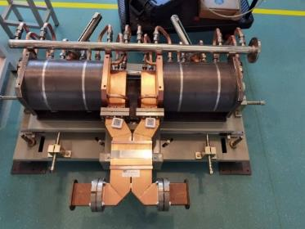
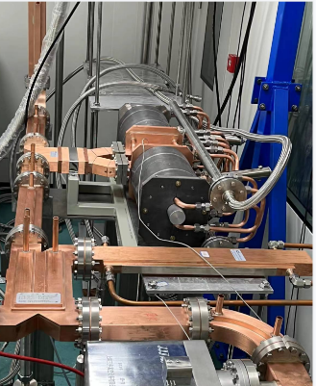
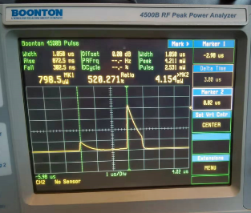
Pulse compressor
The working mode is TE₀₁₅
Two-hole narrow-wall coupled SLED type is adopted
The energy contribution will be 1.6 times compared to the situation without the pulse compressor
Before installation, all the 4 compressors have been practiced in the high power test bench
It is about 10 days need to the input power of 40 MW
腔内电场分布TE_{0,1,5}
Item | Designed value | Measured value
Frequency | 2998.8 MHz | 2998.8MHz
Mode | TE_{0,1,5} | TE_{0,1,5}
Unloaded quality factor | 100,000±5,000 | 99980
Coupling coefficient | ~5 | 4.6
Insertion loss | ≤0.2 dB | 0.19dB
Frequency tuning range | ＞±500 kHz | ＞±500 kHz
VSWR | ＜1.1 | 1.09
Peak power gain | 7dB | 7.16dB
High power test

Slide 19
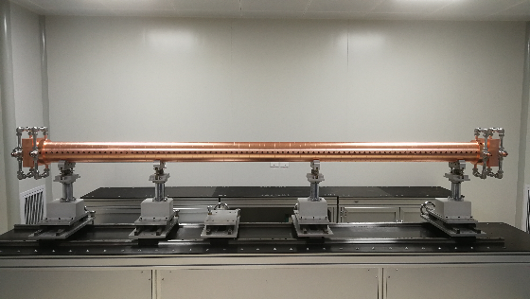
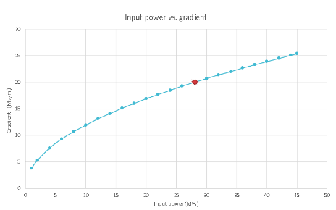
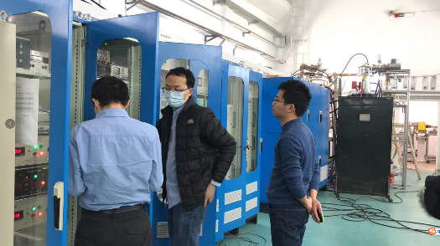
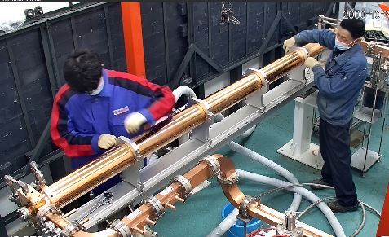
Accelerating structure
The total number of Accelerating structures is 9
All of them have high power test and to the gradient 20MV/m
Parameters | Designed value | Measured value | Unit
Frequency | 2998.8 | 2998.8 | MHz
Cavity mode | 2π/3 | 2π/3 | rad
Cells | 88+2 | 88+2 | -
Length | ~3.1 | 3.101 | m
Phase advance per cell | 120±1 | 120＜±1 | deg
Filling time | ~0.74 | 0.767 | us
Shunt impedance | 64.9～72.6 | - | （MΩ/m）
Attenuation factor | 0.46 | 0.5 | NP
Group velocity (v_{g}/c) | 1.9~0.87 | - | %

Slide 20
Accelerating structure
High power test duration on the test bench
  This statistics includes the equipment failure time
  It takes a long time to AS1 and AS2 because of the waveguides and loads are all new one

Slide 21
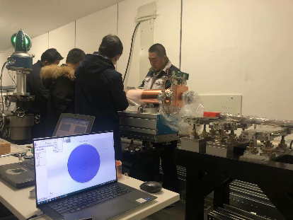
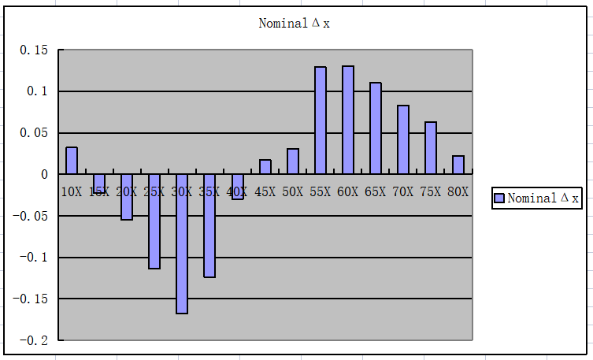
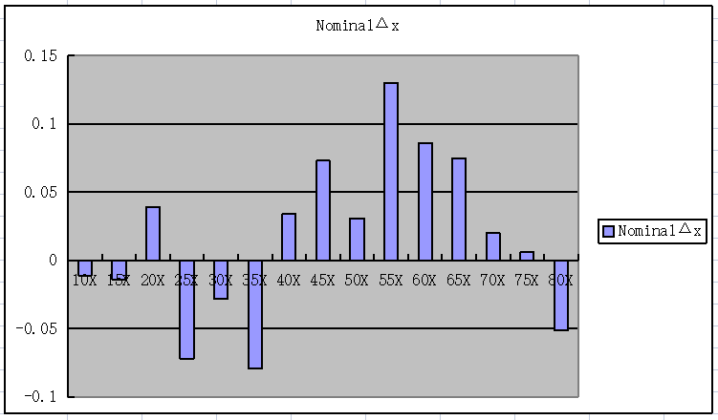
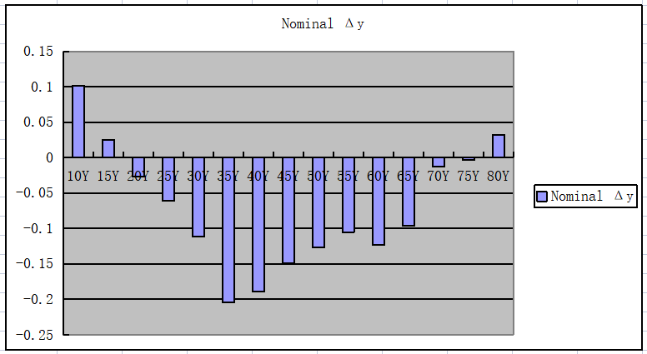
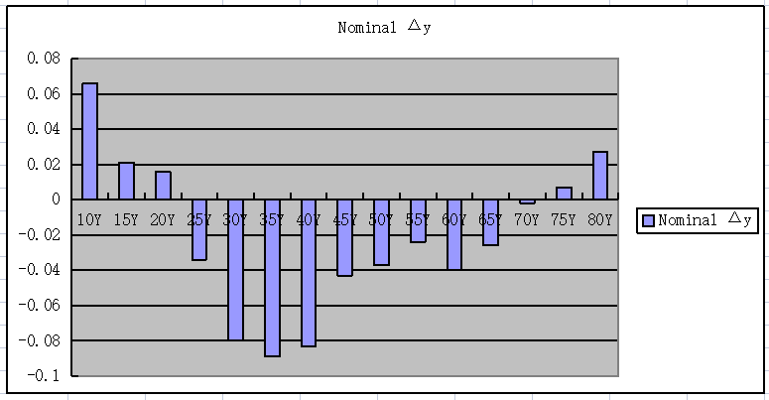
Accelerating structure
Straightness adjustment
  Required straightness ± 0.15mm
  After installation on the linac bracket
  Using laser tracker to adjust the straightness of the 3 meters long structure
After

Slide 22
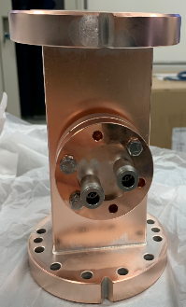
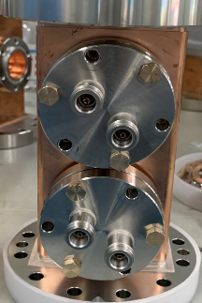
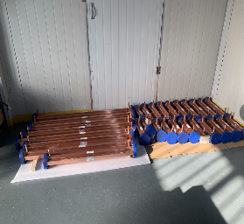




Waveguide components
Directional coupler
  Beth hole type
  The inverted T-shaped coupling piece is easy to process and adjust, and can obtain high directivity
    Coupling: -60±0.5dB
    Directivity: ~40dB
Straight waveguide
Bent waveguide
3dB power hybrid
  Test results
    Coupling ：-3.06dB，-3.10dB
    VSWR：1.03
    Isolation ：-46.7dB
    Balance ：90.03°
Extraction waveguide
Dummy loads

Slide 23





LLRF
The digital LLRF has been adopted
It consists of a 2U MTCA.4 chassis, a MCH, an AMC computer board, a Struck SIS8300-KU card and a Struck DWC8VM1 rear transition-module with supporting clock/local oscillator (LO)/reference generation RF circuits
These board have been designed by our team number
Local oscillator signal generator
  (Generate 2973.8MHz LO signal and 99.98MHz clock signal for LLRF system from 2998.8MHz reference)
Down converter RTM
(For accelerating tube)
Direct-sampling RTM （for SHB cavities）
AMC IO board (used as timing and interlock signal interface )

Slide 24




LLRF
The requirement of the phase stability
  0.5° (RMS) for SHB cavities
  0.3° (RMS) for accelerating structures
System phase stability test (24 hours) is 0.05°(RMS) in lab
Phase stability test (0.5 hour) in Heps linac equipment hall
  SHB1: 0.023°(RMS)
  Accelerating structure (K3): 0.042° (RMS)

Slide 25

CEPC 30GeV linac
  The CEPC linac has upgrade from 10 GeV (CDR) to 30 GeV(TDR)
  Electron source: thermal cathode electron gun
  Positron source: Conventional scheme (fixed target with tungsten@15 mm thickness)
  1.1GeV damping ring with two 5 cell normal conducting cavities
S-band Linac: FAS: 4GeV + PSPAS: 200MeV + SAS: 1.1GeV
C-band Linac: TAS：1.1GeV→30GeV
Vertical electron by-pass transport line (EBTL): 1.2 m separation
Parameter | Symbol | Unit | Design value
Energy | E | GeV | 30
Repetition rate | f_{rep} | Hz | 100
Number of bunches per pulse |  |  | 1 or 2
Bunch charge |  | nC | 1.5
Energy spread | σ_{E} |  | 1.5×10⁻³
Emittance | ε_{r} | nm | 6.5
Electron energy at target |  | GeV | 4
Electron bunch charge at target |  | nC | 10
Tunnel length | L | m | 1800

Slide 26




CEPC 30GeV linac
RF distribution of the CEPC 30 GeV linac
  S-band
    80 MW klystron, the number of S-band Acc. Structure is 93, big hole s-band structure after the positron source is 16. the number of pulse compressor is 33
  C-band
    50 MW klystron, C-band structures: 470, pulse compressor 235
Parameter | Unit | S-band |  | C-band
Frequency | MHz | 2860 |  | 5720
Length | m | 3.1 | 2.0 | 1.8
Cavity mode |  | 2π/3 |  | 3π/4
Aperture | mm | 19~26 | 25 | 12~16
Gradient | MV/m | 22/27 | 22 | 40~45
Cells (include coupler cells) |  | 86 | 55 | 89
Number of Acc. Stru. |  | 91 | 16 | 470
Number of Klystron |  | 33 |  | 236
Klystron Power | MW | 80 |  | 50
S-band
C-band

Slide 27




S-band accelerating structure
R&D of 3 meters long S-band accelerating structure for CEPC
The average gradient has reached 33 MV/m at high power test bench (with SLED)
Frequency: （MHz） | 2860
No. of Cells | 84+2*0.5
Phase advance | 2π/3
Total length(m) | 3.1
Length of cell : d (mm) | 34.988
Disk thickness: t (mm) | 5.5
Shunt impedance : Rs (MΩ/m) | 60.3~67.8
Quality factor | 15465~15373
Group velocity: Vg/c (%) | 2% ~ 0.94%
Filling time : t_{f} (ns) | 784
Attenuation factor : τ (Np) | 0.46
High power test bench
Modulator and klystron
The input power with SLED

Slide 28




C-band accelerating structure
The R&D of C-band accelerating structure at IHEP
  The beam dynamics of linac based on this design. Finished in May 2018 with the support of fund
  Constant gradient, 3π/4 mode, 1.8 meters long
    Round cavity
    Racetrack magnetic coupling
Frequency: f（MHz） | 5720
No. of Cells | 87+2*0.5
Phase advance | 3π/4
Total length | 1.8m
Length of cell : d (@20°C) | 19.675mm
Disk thickness: t | 4.5mm
Average aperture: 2a (@20°C) | 14.8mm
Average diameter : 2b (@20°C) | 45.7mm
Shunt impedance : Rs (MΩ/m) | 66.0 ~ 75.7
Quality factor : Q | 11232~11359
Group velocity: Vg/c (%) | 2.8% ~ 1.4%
Filling time : t_{f} (ns) | 271
Attenuation factor : τ | 0.432
The deformation caused by temperature variation
Cavity

Slide 29
Summary
HEPS linac is a 500MeV S-band normal conducting pre-injector
Before installation, accelerating structure, pulse compressor, loads etc. have been high power tested
Now linac have been installed and finished high power practice at Huairou Science City and waiting for Commissioning
The CEPC linac baseline design is changed from 10 to 30 GeV S+C-band AS in TDR phase
The HEPS linac key technology can be used in CEPC linac, such as gun, normal conducting accelerating structure, pulse compressor, SSM，LLRF……

Slide 30
Thank you for your attention!

Slide 31


