Slide 1
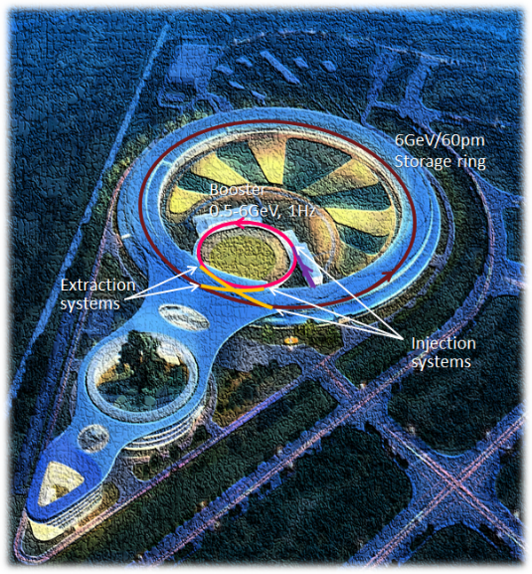
HEPS Injection/extraction hardware development
IAS Program on High Energy Physics 2023
February 12 – 16, 2023, Hongkong
Jinhui Chen, Zhe Duan, Lei Wang, Lihua Huo , Yuwen Wu, Hua Shi, Guanwen Wang, Xiaolei Shi, Peng Liu, Guanjian Wu, Xinzhe Zhai
Injection group，IHEP
2023-2-14

Slide 2
Outline
1
Overview of HEPS Inj./Ext. systems
2
Lambertson magnets
3
Slotted-pipe kicker system for BST
4
Strip-line kicker system for SR
5
Summary

Slide 3
Overview of the HEPS injection and extraction systems

Slide 4

High Energy Photon Source
HEPS is a typical 4th generation light source on green field in Huairou Beijing, China.
Officially approved in Dec. 2017, the construction was scheduled to start at the end of 2018, and completed in 2024. The whole project will be finished in mid-2025 after commissioning.
A R&D program for HEPS called HEPS-TF was started in 2016, and was completed in Sept. 2018 in order to solve some key technical issues, including some injection and extraction technologies.
So far, the Linac has been ready to commission , the booster tunnel installation has been completed, the SR tunnel installation has been started.

Slide 5
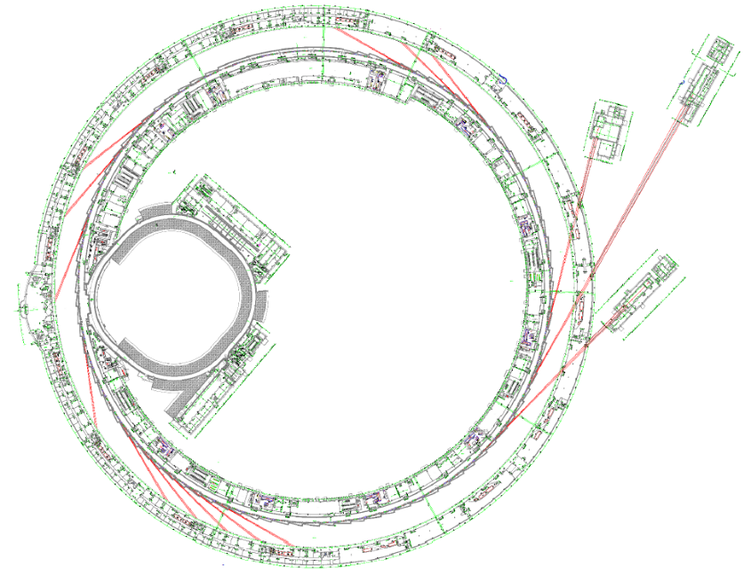
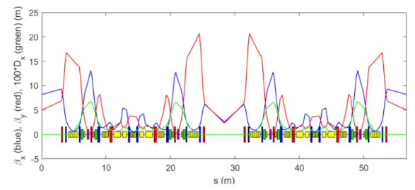
Introduction of HEPS accelerator
The HEPS accelerator complex consists of a Linac, several transport lines, a booster ring and storage rings.
Linac: 0.5Gev/50Hz
Booster: 0.5GeV~6GeV/454.1m/1Hz
Storage ring: 6GeV/ 1360.4m, 34.8pm natural emittance
Storage ring
  48 hybrid-7BA cells, w/ BLGs and ABs
  interleaved high-β and low-β straight sections of 6 m
Booster
Linac

Slide 6
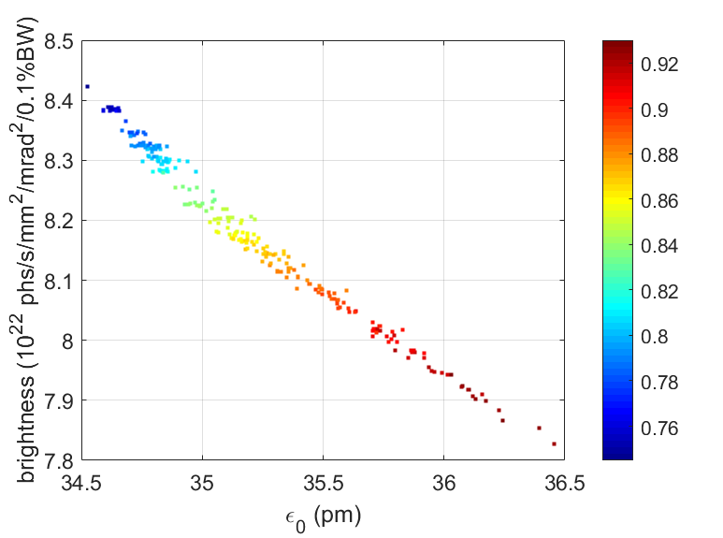
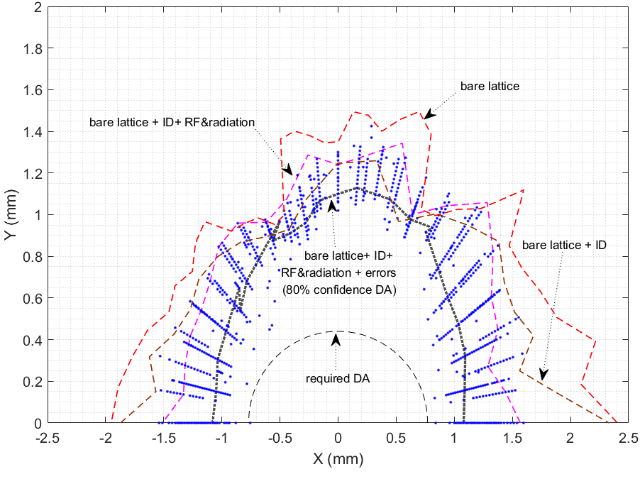
Top-up injection scheme for HEPS
HEPS SR is a typical Low Emittance Ring (LER) with the MBA lattice. In order to achieve higher brightness, the Dynamic Aperture (DA) large enough for traditional off-axis injection is hard to reach at the same time.
HEPS SR top-up injection scheme:
  On-axis swap-out injection using the booster as an accumulator ring is the baseline scheme
  Reserve possibility for on-axis longitudinal injection with dual active RF system, which frequency is 166MHz and 500MHz.
*Zhe Duan
Color: DA area

Slide 7
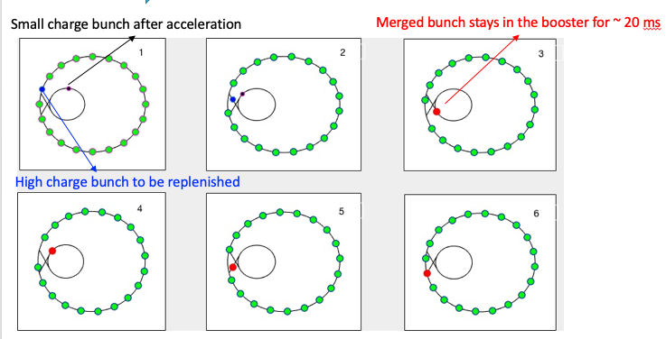
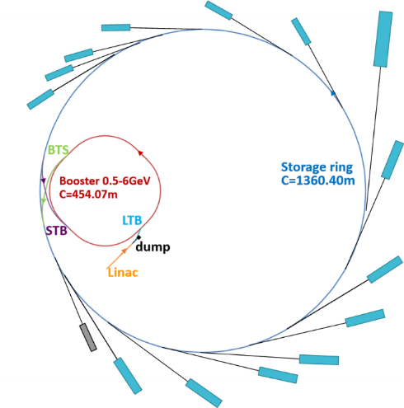
High-energy accumulation in the booster
Major challenge of swap-out injection: a full charge injector
  Full charge bunch prepared in an AR, injected into and accelerated in the booster (APS-U)
  Bunch recycling w/ a dedicated AR between BR and SR (ALS-U)
  Bunch recycling w/ booster serving as a full energy AR (HEPS) [1,2]
FODO cell, 16nm, up to 5nC
500MeV, up to 7nC
[1] Z. Duan, et al., IPAC’18, THPMF052
[2] Y. Jiao et al., J. Synch. Radiat., 25 (2018)1611

Slide 8
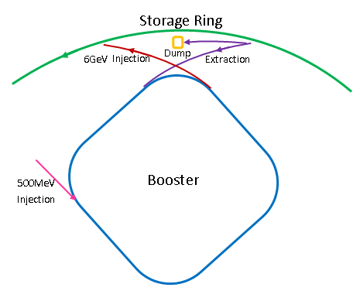
HEPS Injection & Extraction systems
The injection and extraction system of HEPS consists of 5 sub-systems.
BTS: SR 6GeV injection system
STB: SR 6GeV extraction system
(Bunch by bunch/on-axis swap out injection)
STB: Booster 6GeV injection system
(Pulsed local bumped injection by 2 kickers )
BTS: Booster 6GeV extraction system
(Bunch by bunch/fast extraction assisted by 4 slow bumpers)
LTB: Booster 0.5GeV injection system
(Bunch by bunch/one turn/on-axis injection )

Slide 9
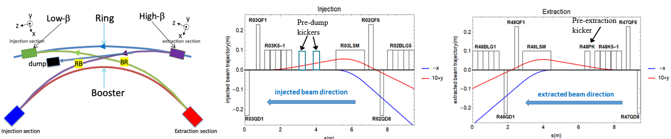
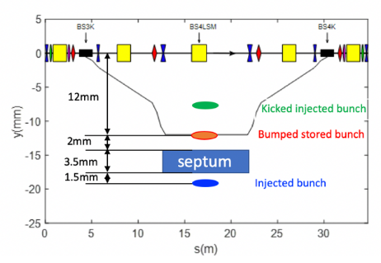
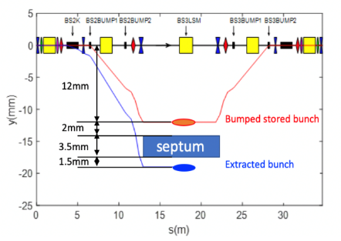
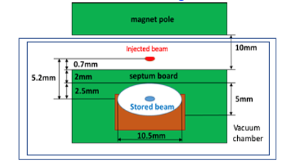
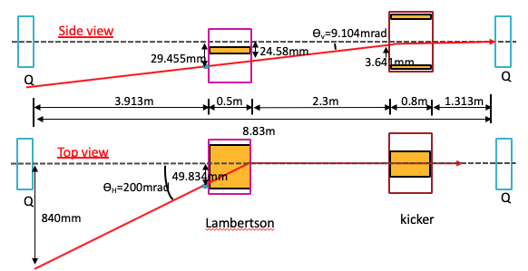
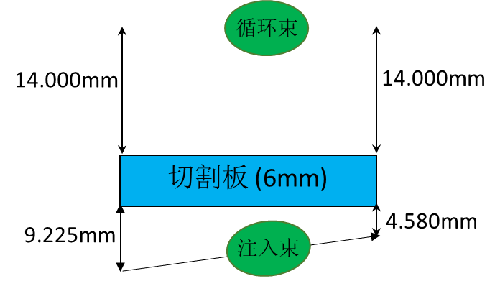
The layout of the injection & extraction sub-systems
6 GeV extraction
6 GeV injection
Stored beam
Septum（6mm）
injected beam

Slide 10
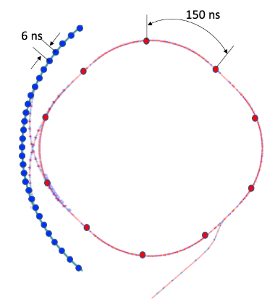
Hardware challenges of injection system
SR injection and extraction system
  2 straight sections of 6 meter to accommodate injection and extraction system for 6 GeV beam manipulation.
  Fast kicker system: 300mm long strip-line kicker groups and super fast pulser of 10ns bottom width (3%-3%)，±15kV peak into 50ohm.
  Thin septum: Lambertson magnet of 2mm thickness septum
BST injection and extraction system
  kicker system: slotted-pipe kicker and fast pulser of 300ns(at least 600ns) bottom width (10%-10%)，2.8kA peak into 0.7μH to inject 10 (at least 5) bunches into the BST ring in a cycling period.
  Thin septum: Lambertson magnet of 3.5mm thickness septum
  Slow bumper: half-sine wave of 1ms bottom width(only for extraction subsystem)
RF=166MHz
6ns
6ns
10ns
4ns
On-axis swap-out injection
On-axis long. injection
Kicker electrical pulse

Slide 11
Lambertson magnets

Slide 12
Typical requirements for HEPS LSM
Parameters2 | Unit | BST1-LSM | BST3/BST4-LSM | R48/R03-LSM
Quantity | - | 1 | 2 | 2
Energy | GeV | 0.5 | 6 | 6
Deflection angle | mrad | 200 | 79.945 | 79.95
Insertion length | m | 0.5 | 1.6 | 1.6
Magnetic field strength for injected/extracted beam | T | 0.7 | 1 | 1
Min. Septum thickness（including septum board, wall of beam pipes, installation gap) | mm | ≤6 | ≤3.5 | ≤2
Field uniformity | - | <±0.05% | <±0.05% | <±0.1%
Leakage field | - | ≤1×10⁻³ | ≤1×10⁻³ | ≤0.002T·m
Clearance of stored beam at lambertson（H×V） （refer to stored beam orbit） | mm | 10×10 | 22×28 | 8×5
Clearance of inj.&ext. beam at lambertson（H×V）（refer to inj.&ext. beam orbit） | mm | 22×28 | 10×3 | 6×1.4
Physical aperture of stored beam vacuum chamber | mm | 28×28 | 28×28 | 10.5x5
In-air
Half in vacuum

Slide 13
Lambertson Magnet Design Considerations
In order to decrease the septum thickness, 2 novel structures of magnet were proposed:
  half-in-vacuum (for 2mm septum)
  embedded thin-wall vacuum chamber (for 3.5mm septum)
Magnet pole
Wall of stored beam pipe
+
Wall of injected beam pipe
+
Iron septum
+
installation margins
Installation margin
Septum
thickness
Injected bunch
=
Yoke
Stored bunch
Magnet pole
Installation margin
Injected bunch
SS
Half in-vacuum
Installation margin
Yoke
Magnet pole
Stored bunch
Installation margin
Injected bunch
SS
Iron or
VP(FeCoV，1J22)
Yoke
Traditional LSM
Stored bunch
in-air

Slide 14
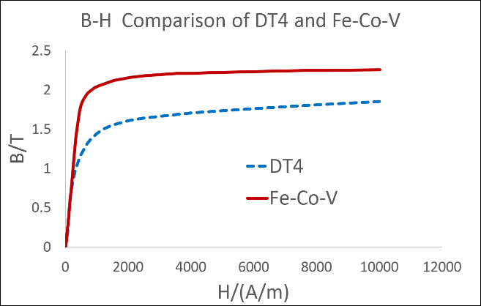
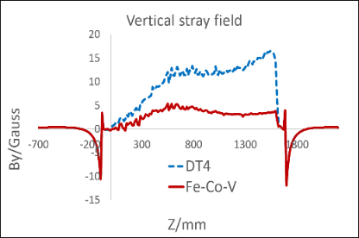
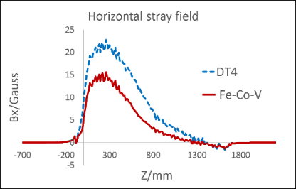
Lambertson Magnet Design Considerations
In order to decrease the absolute values of leakage field with thinner septum, Vanadium Permendur (FeCoV： iron50% cobalt 48% vanadium 2%, domestic brand 1J22 ） is adopted for septum board.
    Higher Bs (Saturation magnetic density)
    Higher μr(Relative permeability)

Slide 15
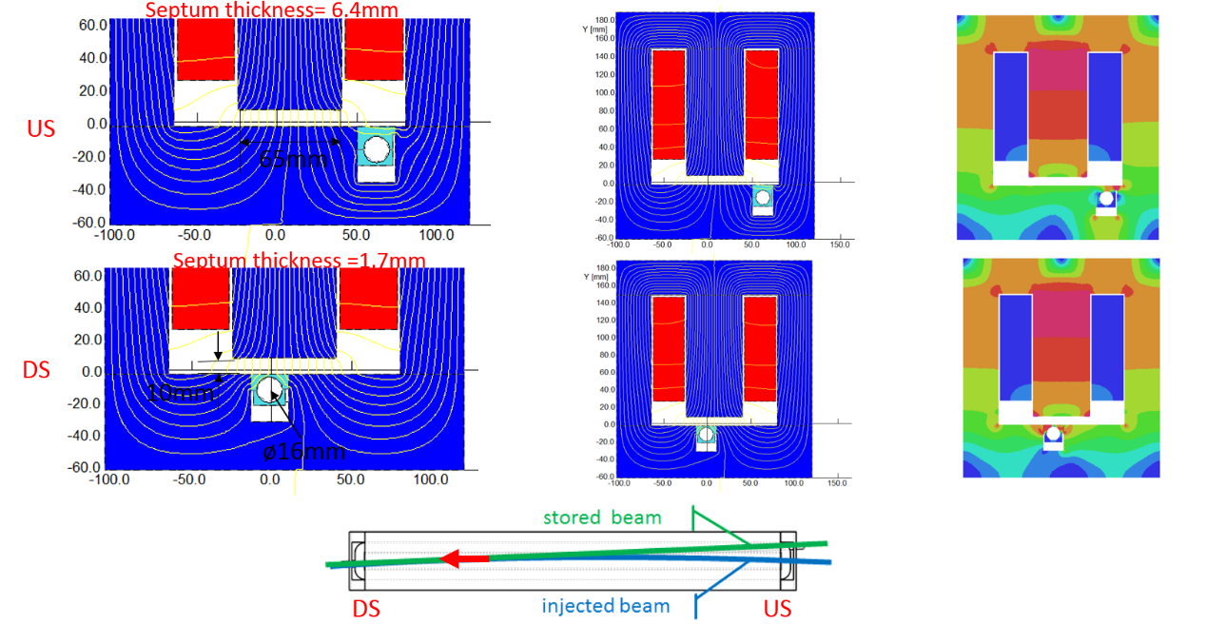
Lambertson Magnet Design Considerations
In order to decrease the integrate leakage field, the upstream end of the stored beam chamber is located under the side leg of the yoke to create a leakage field that is opposite in sign.

Slide 16
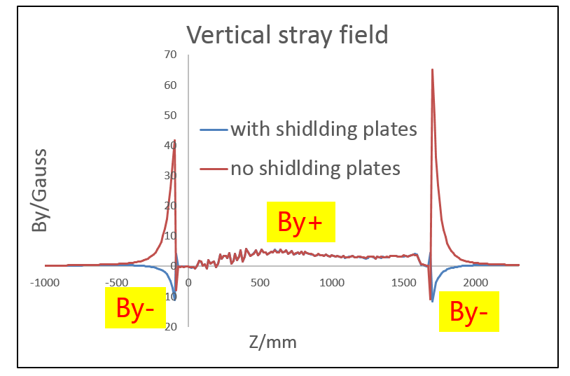
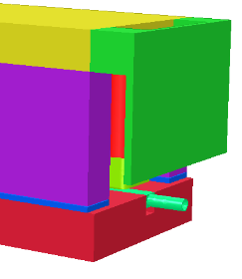
Lambertson Magnet Design Considerations
In order to further reduce the integrate leakage field, the transition part and shielding plate design at the end of Lambertson magnet also plays an important role. With the shield plate, the leakage field in the opposite direction to the main field will be generated at the end of the magnet to cancel the leakage field in the body of magnet.

Slide 17
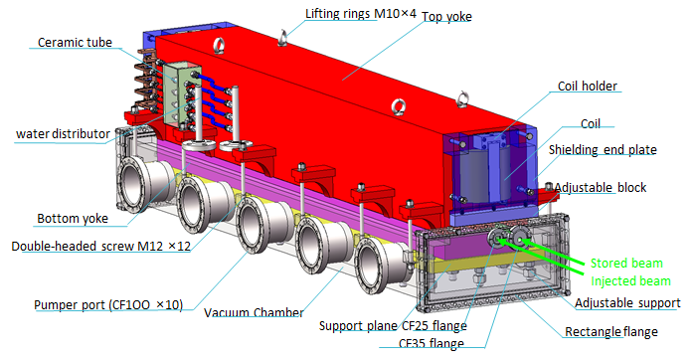
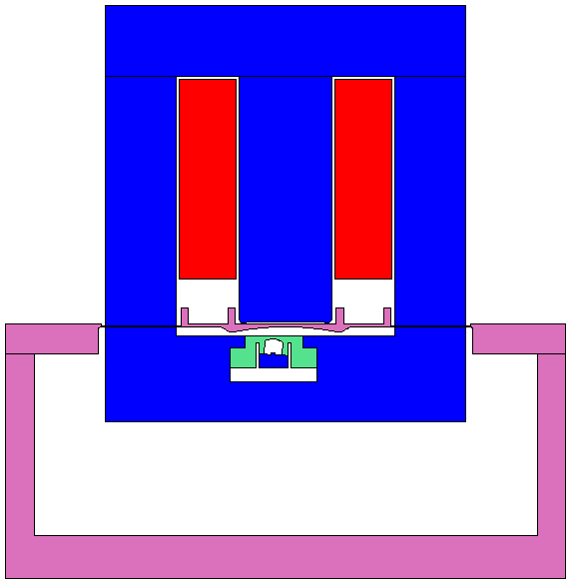
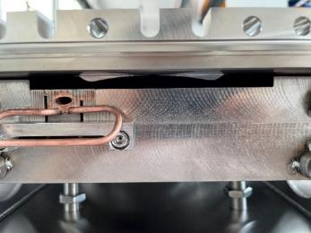
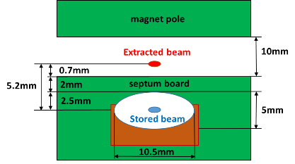
Half in-vacuum LSM R&D for HEPS SR
Full size prototype engineering design
FeCoV
2mm
DT4
Cu

Slide 18
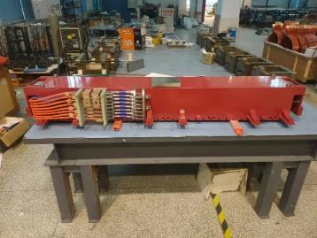
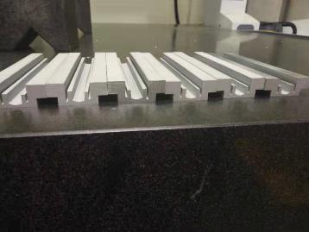
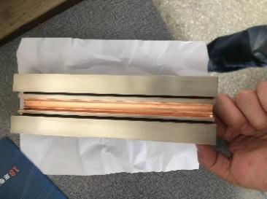
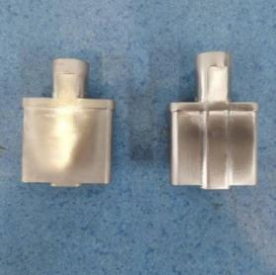
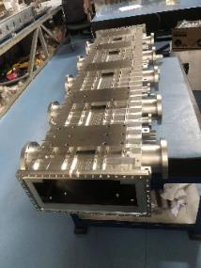
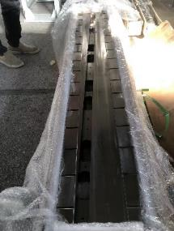
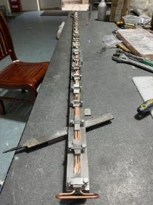
Half in-vacuum LSM R&D for HEPS SR
Full size prototype:
  Started in 2021
  All the mechanical component processing was completed before June 2022.
  The biggest challenge is magnetic shielding block machining because the VP is hard and brittle. Although it can be segmented processing by EDM, but annealing deformation is hard to control.
1J22 Magnetic shielding block
Transition part
Upper iorn yoke
1J22 with cu coating
DT4 with Ni coating
Vacuum chamber
DT4 Yoke
Half cu Beam pipe

Slide 19
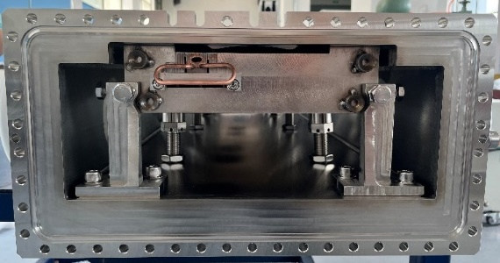
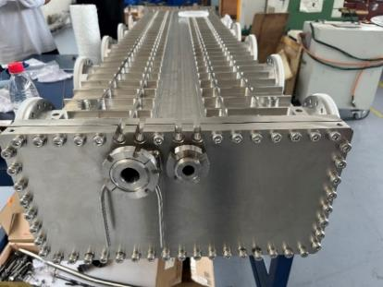
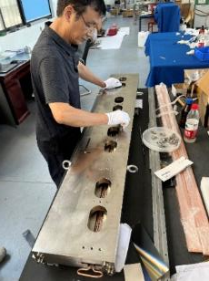
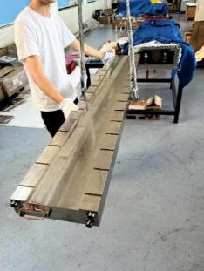
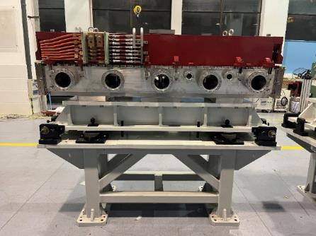
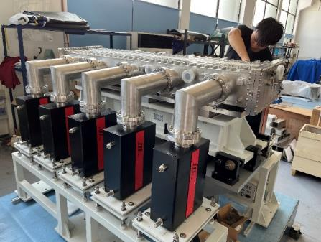
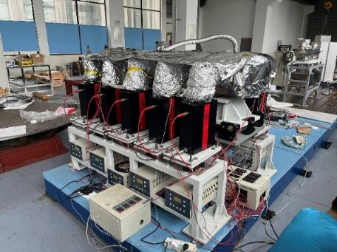
Half in-vacuum LSM prototype for HEPS
  Final assembling and vacuum testing was completed in July 2022.
  Vacuum pressure: 5.0×10⁻⁸pa（vacuum chamber）, 2.2×10⁻⁷pa（Transition section）

Slide 20
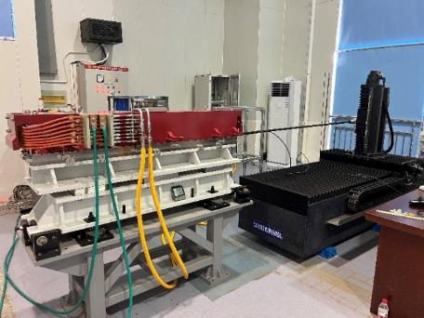
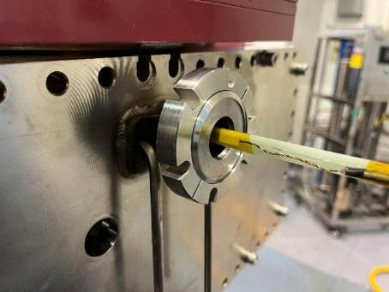
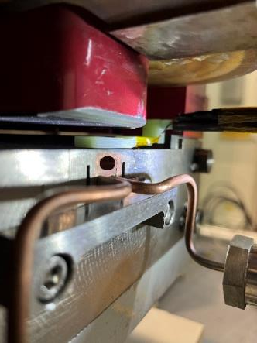
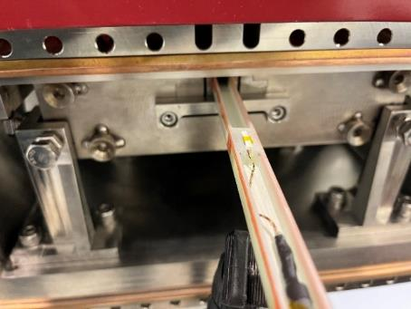
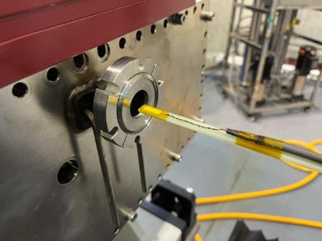
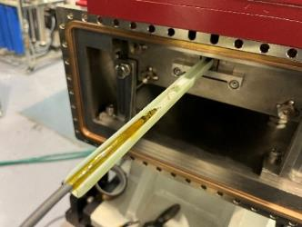
Half in-vacuum LSM prototype for HEPS
  Magnetic field measurement by Hall probe measurement system was finished successfully in Jan. 2023.

Slide 21
Main field distribution measurement
All magnetic field performance of the prototype can meet the requirements of physics.
  Horizontal field distribution in range x=±6mm : 7.22E-04 (<±0.1%) @ 175A

Slide 22
Main field distribution measurement
  vertical field distribution in range 1.2mm<y<4mm：3.85E-04 (<±0.1%) @ 175A
*Y=0 plane is surface of bottom polar

Slide 23
Integral leakage field measurement
Vertical integral leakage field
  w/o transition part：integral vertical leakage filed=3.25E-03(53431Gauss·mm )，not meet requirement
  With transition part：integral vertical leakage filed=4.3E-04 (-6997Gauss·mm)， meet requirement
Central section
Central section
Outlet section
Entry section

Slide 24
Integral leakage field measurement
Horizontal integral leakage field
  w/o transition part：integral horizontal leakage filed=8.75E-04(14402Gauss·mm )，meet requirement
  With transition part：integral horizontal leakage filed=8.19E-04 (13464Gauss·mm)， meet requirement
Central section
Entry section
Outlet section

Slide 25
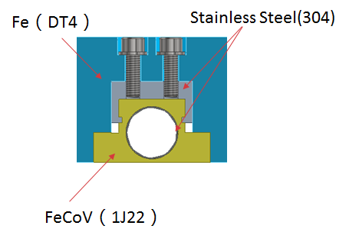
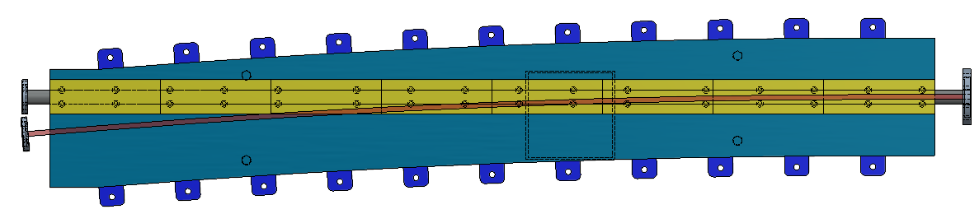
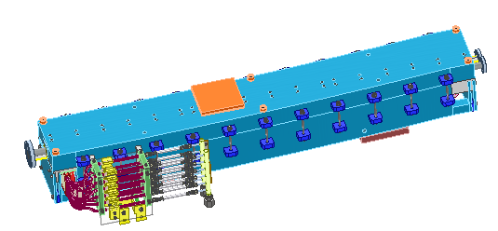
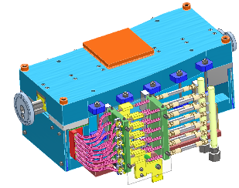
In-air LSM R&D for HEPS BST
Feature：magnet is located in the air; total septum thickness=3.5mm， Length=1.6m
Because FeCoV（1J22，Co50）is hard to machine, the magnetic shielding blocks must segmented processing by EDM . And that, the embedded thin wall SST vacuum chamber for stored beam is needed.

Slide 26
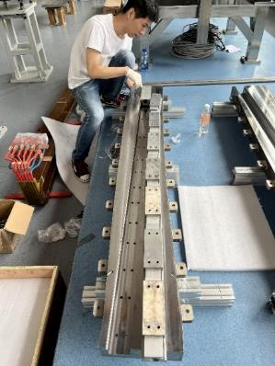






In-air LSM R&D for HEPS BST
  The process of prototypes being assembled
  The process of prototypes hall probe measurement
(BS1LSM)
(BS3LSM)

Slide 27



In-air LSM R&D for HEPS BST
Field measurement result shows that The gap at the joint of magnetic poles has a great influence on the leakage field and the main field distribution.
After repair，the BS1LSM and BS3LSM have pass the second time magnetic field measurement
BS1LSM
BS3LSM

Slide 28






In-air LSM R&D for HEPS BST
BS1LSM:vertical main field distribution is improved from ±0.19% to ±0.0468%
BS3LSM:horizontal main field distribution is improved from ±0.0732% to ±0.0278%
BST high energy extraction LSM (BS3LSM)

Slide 29



In-air LSM R&D for HEPS BST
BS1LSM has been installed into the booster tunnel.
BS3LSM is ready to been installed.
BS1LSM
BS3LSM
stored beam
Injected beam from LINA

Slide 30
Slotted-pipe kicker system for the Booster

Slide 31
Parameters of kicker system in BST
parameter | LE-injection | HE-type I | HE-type II | HE-type III | Unit
name | BS1K | BS2K | BS3K | BS4K | -
Quantity | 1 | 1 | 1 | 1 | -
Magnetic effective length | 0.8000 | 1.4000 | 1.4000 | 1.4000 | m
Deflect direction | Vertical | Vertical | Vertical | Vertical | -
Deflect angle | 9.10 | 1.02 | 1.75 | 1.75 | mrad
Magnetic strength | 0.020 | 0.015 | 0.025 | 0.025 | T
Clearance region(H×V) | 22×28 | 30×28 | 30×28 | 30×28 | mm
Good field region(H×V) | [-6,6]×[-8,8] | [-6,6]×[-4,3] | [-6,6]×[-5,4] | [-6,6]×[-4,3] | mm
Field uniformity in good field region | x=±4,y =±5，better than±1%; x=±6,y =±8，better than±2.5% | ±1% | ±2% | ±1% | -
Repetition rate | 50 | 50 | 50 | 50 | Hz
Amplitude repeatability | ±0.5% | ±0.5% | ±0.5% | ±0.5% | -
Pulse jitter | ≤5 | ≤5 | ≤5 | ≤5 | ns
Bottom width of half sine pulse | < 300（at least 600） | <300（at least 600） | <1000 | <1000 | ns
Exciting current | 2160 | 1630 | 2715 | 2715 | A
Inductance of kicker | 265+200 | 460+200 | 460+200 | 460+200 | nH

Slide 32





Engineering design of the slotted-pipe kicker completed
Features：the kicker outer body is machined by EDM; One end of the busses are connected to outer body which is on ground potential level. So need a bipolar pulsed power supply. Totally 10 HV RF 50Ω cables are connected to the other end of the busses by the feedthroughs.
Cooling water pipe
Outer body (316L)
H×V=36×36mm
HV feedthrough
-
+
Busses (FOC)
insulation support (ceramic)
To vacuum pump

Slide 33







Prototype kicker for HEPS BST
  the kicker prototype passed the vacuum assembling test and the magnetic field measurement have completed. The field distribution performance meet the requirements.

Slide 34




Kicker magnets installation
All 4 kicker magnets for the booster injection & extraction have been installed into the booster tunnel.

Slide 35




Solid-state fast kicker pulser R&D
Scheme: 20-stage inductive adder based on SiC-MOSFETs.
The co-axial transformer is configured as bipolar output.
The pulser is located outside tunnel and 10 50 Ω cables with length more than 30m are applied to connect with kicker.
Matching terminal resistor is 10Ω.
20-stage inductive adder

Slide 36








Pulser prototype for HEPS
Progress：Single stage and double stages full power test has been completed（1400V into 0.5Ω）
Mass production and test
Final version

Slide 37



Pulser prototype for HEPS
Latest Progress：18-stage inductive adder was tested（DC HV=800V, output pulse voltage is 14.2kV into 10Ω）.
Due to the existence of parasitic inductance outside the adder, a reverse voltage spike with high amplitude will be induced at the tail of the pulse when MOSFET is turned off, which must be suppressed by the reverse peak absorption circuit composed of high-speed diodes, Otherwise, MOSFET overvoltage breakdown will be caused.

Slide 38
Strip-line kicker system for the Storage ring

Slide 39
Parameters of kicker system for SR
Parameters | Unit | injection |  | extraction
Name |  | R03K1~5 |  | R48K1~5 | R48PK
Straight section length | m | 6.086 |  | 6.086
Total kick angle | mrad | 1.6108 |  |  | 0.2~0.075
Kick direction | - | Vertical |  |  | Horizontal
Length of Strip-line kicker electrode | mm | 300 |  |  | 300
Gap between two electrodes | mm | 8 |  |  | 16
Quantity of Strip-line kicker | - | 5 | 5 |  | 1
Longitudinal space between strip-line kicker electrode | mm | 6 |  |  | -
Good field region | mm | x=±1.1，y= (-0.85, 2.1) |  |  | x=±0.5，y±0.4
Integral field uniformity | - | <±1% |  |  | <±1%
Odd mode impedance | Ω | 50±1 |  |  | 50±1
Even mode impedance | Ω | <65 |  |  | <65
Amplitude of electrical pulse（into 50Ω） | kV | ±15 |  |  | ±7.5
Bottom width of electrical pulse（3%-3%） | ns | <4 * |  | <10 | <10
FWHM(50%-50%) | ns | >2 * |  | >4 | >4
Electrical Pulse Amplitude Stability | - | <2% (RMS) |  |  | <2% (RMS)
Repetition rate（CW） | Hz | 50 |  |  | 50
Time jitter between electrical pulse and timing clock | ps | <200 |  |  | <200
Time jitter between channels (bipolar) | ps | <100 |  |  | <100

Slide 40



Strip-line kicker scheme
Following APS-U type strip-line kicker
  “D” shaped blades are used to improve field-uniformity in the good field region.
  An ellipse outer body with vanes geometry is adopted to ease common-mode impedance-matching
  Tapered end sections for matching impedance to the feed-throughs.
APS-U
vane
blade
out body
tapered end
HEPS 2D Model
HEPS strip-line kicker prototype 2D model
The strip-line blades are decided by:
  a, b - axes of the center ellipse
  gap=5mm – ½ distance between blades
  blade=3mm – thickness of blades
The outer body half shell consists of 2 half ellipses that defined by:
  Center half: Xc, a0, b0
  Outer half: Xc, a00, b0
New parameter:
  vane (>=<b)- ½ distance between Vanes

Slide 41




Prototype I: 750mm-long Strip-line Kicker
Commercial
Feedthrough
750mm
End cover
Beryllium copper braid
Outer body
blade
Beryllium copper braid
Coaxial Connector
Silver seal
Holder for assembling
to Vacuum pump

Slide 42




Prototype kicker completed in 2018
750mm
Vacuum leak test
after brazing
Feed through
End cover
D shape blades
Ion pump
kicker
Cooling water tube
Kicker transmission characteristics test result
Outer body
Pusle voltage=18kV
FWHM=1.92ns
Vacuum =2E-9~2E-8Torr
Kicker HV test reult：
Kicker electrical pulse：
Rise time（10%-90%）<641ps，
Fall time（90%-10%）<1.5ns。
pluse edge slowing down due to kicker insertion：
rise time (10%-90%)≈86.6ps,
Fall time (90%-10%) ≈ 35ps。
Kicker HV test bench
HV pulser

Slide 43



Limit longitudinal installation space
The HEPS prefers shorter strip-line kicker(300mm-long) to reduce difficulty of fast pulser, specially for longitudinal injection
5 sets of shorter kickers and a Lambertson magnet must be installed in 6m of straight section
The separated kicker structure is not fit for the shorter kicker for HEPS because of limited longitudinal space.
A new compact design have to be considered.
750mm
100mm
3300mm

Slide 44

Prototype II: 300mm-long Strip-line Kicker
New kicker structure with 5 cascaded kickers in a single vacuum chamber was proposed.
The longitudinal gap between adjacent kicker blades is <6mm.
The outer body is split into 4ps(1.2m long) which made by CNC machining from FOC.
300mm-long strip-line blades without taper end are also made by CNC machining from FOC.
The coaxial bend transition parts connected blades and HV RF feedthroughs is the key point.

Slide 45








The strip-line kicker prototype completed in 2019
Feature：5 sets of 300mm strip-line kicker in a single module
L. Wang, J.H. Chen, A 300mm long prototype strip-line kicker for the HEPS injection system, IPAC2019
TDR measurement
HV pulse testing at ± 20kV
No.1
No.2
No.3
No.4
No.5
300mm long kicker:
Pulse voltage: ±20kV into 50Ω
Tr(10%-90%)=670.7ps
Tf(90%-10%)=1.4ns
FWHM=1.9ns
Keysight E5071C VNA

Slide 46








Progress of final kicker production for HEPS
The all mechanical machining have been completed
vacuum chamber
eletrodes
outbody
Component made in SST
Support board
HV RF feedthrough
first module has been assembled and passed the vacuum commissioning.

Slide 47


10ns-fast puler R&D
Features：
Drift Step Recovery Diode(DSRD) ^{[4]}: Opening in sub-ns
Chips from the Chinese vender are available (i _{p}≥300A/ V_{p}=10kV)
A 6-stage inductive adder designed as DSRD pumper circuit for 15kV:
  avoid isolated switch driver and HV components(capacitors, switches <1kV)
  need much fewer components compared to an inductive adder pulser
K005
16 MOSFETs per stage
8 DSRDs(4 parallel, 2 series) switching 600A into 50 Ω;
0.3m long PFL(TL1) for p_{w}=3ns
DSRDs circuit with 6-stage inductive adder driven

Slide 48










The 10ns fast pulser prototype R&D completed in 2018
To reduce residual voltage：
DSRD array: 4 in parallel and 2 in series
Saturable inductor: 2 NiZn ferrite cores
±18kV pulsers installed in 19 inch cabinet
PFL=0.3m
Vpeak=17kV,
FWHM=5ns,
T_{r}(10-90%)<2.6ns,
T_{f}(90-10%)<3.2ns,
Bottom width(3%-3%)<10ns
Time jitter<100ps(RMS)
4ns
DSRD array
DSRD assembling
（2×4=8pcs）
Saturable inductor
（2 DN200L ferrite cores）
J.H. Chen, Strip-line kicker and fast pulser R&D for the HEPS on-axis injection system, NIMA 920(2019)1-6

Slide 49



New pumper R&D based on commercial SiC MOSFET
    The commercial RF-MOSFET(IXZ631DF12N100) applied in pusler prototype being in “End of Life” status
    Alternative power semiconductor SWITCH：SiC MOSFET C2M0045170D （CREE）with higher Vds and Id, but slower switching speed.
    New prototype based on SiC MOSFET was developed. A Non-linear transmission line is introduced to sharpen the pulse. The best result is the bottom width(3%-3%) of pulse is less than 10ns, the peak large than 15kV into 50ohm.

Slide 50
Summary
The HEPS accelerators includes 3 injection systems and 2 extraction systems, which were designed to realize on-axis swap-out top-up injection in the storage ring with small DA.
The injection and extraction hardware R&D activities for HEPS was initial from 2016, HEPS-TF project.
2 kinds of Lambertson magnet with thin septum are developed respectively for the storage ring and booster. The half-in-vacuum Lambertson magnet prototype has been completed and the in-air one was installed into the HEPS booster tunnel.
The slotted-pipe kickers were developed successfully and also installed into the into the HEPS booster tunnel. The solid-state pulser with 300ns bottom width are still under R&D.
2 kind of strip-line kicker prototype were developed for the HEPS on-axis swap-out injection successfully. The final devices have been in assembling and vacuum commissioning phase. The fast pulsers based on DSRD with a 10 ns pulse width (3%-3%) was developed successfully. And a new prototype with alternative SiC MOSFET pumping circuit is in commissioning phase.

Slide 51

Thank you for attentions

