Slide 1
  Magnet Power Supply Development
  for HEPS
  Bin Chen ( IHEP, CAS )
  IAS Program on High Energy Physics 2023, Hong Kong

Slide 2
Content
  Introduction
  Design scheme
  Design and development
  Summary

Slide 3
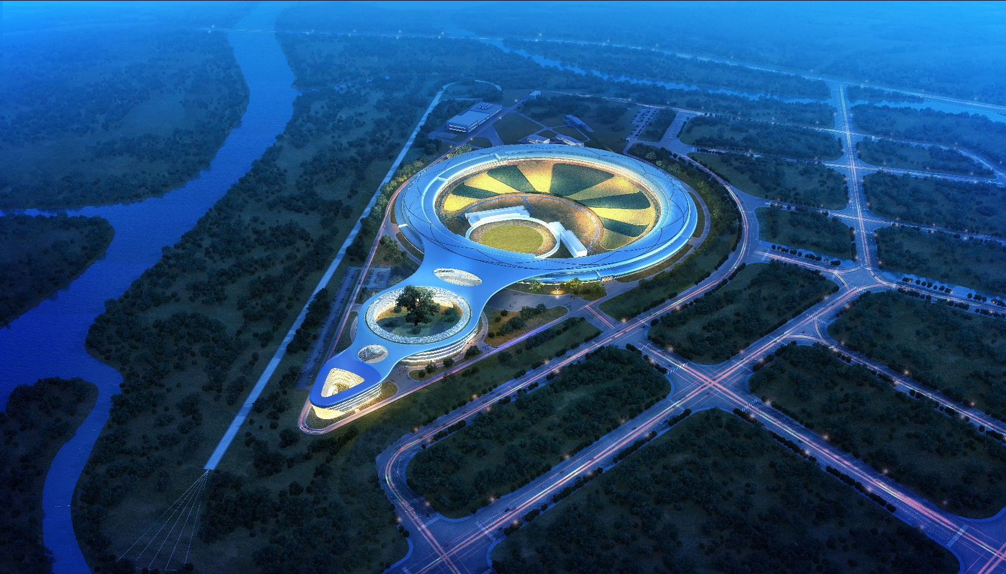
Introduction
  Overview of HEPS
    High Energy Photo Source (HEPS) is the fourth generation of Synchrotron radiation source.
    Energy：6GeV
    Emittance：60 pm rad （ultra-low）

Slide 4
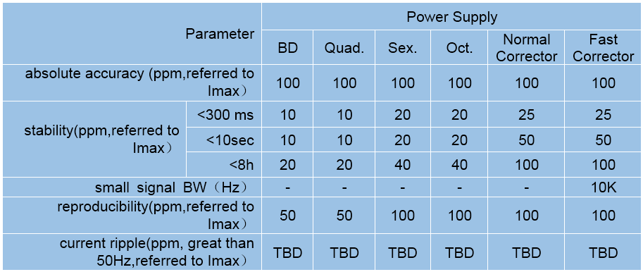
Introduction
  Overview of Magnet Power Supply in HEPS
    HEPS requires more than 2400 power supplies with either unipolar or bipolar DC output currents, and about 100 power supplies with 1Hz dynamic current output.
    BLG: longitudinal gradient dipole, based on permanent magnets, no PS needed
    The power supply performance requirements are much more stringent.
    The output current stability of main power supply in storage ring is required to be better than10ppm.
    The bipolar power supplies for the fast correction magnets are required to have a wide bandwidth of 10kHz.

Slide 5
Design scheme
  Based on the requirements from physicists and magnet designers:
    mostly power supplies are with current around 200A;
    powering optimization with magnet designers, e.g., decreasing the current for BD, and increasing the current for sextupole and octupole, and minor adjustments for quadrupole to promise the current level for each ps as close as possible;
    same power module with 200A; PS supplied individual magnet is based on single module; and PS supplied serial-connected magnets is based on multi-modules in series/parallel.
    all power supplies is based on switching-mode topology with high efficiency, reduced size and weight, easy interface to digital controller, and higher order voltage ripple components with less influence on magnet current.
    all are digital-controlled with self-designed Digital Power Supply Control Module (DPSCM).
    all power supplies is mounted self-designed DCCT (two scales, 300A DCCT for main magnet PS, and 20A DCCT for corrector PS).

Slide 6
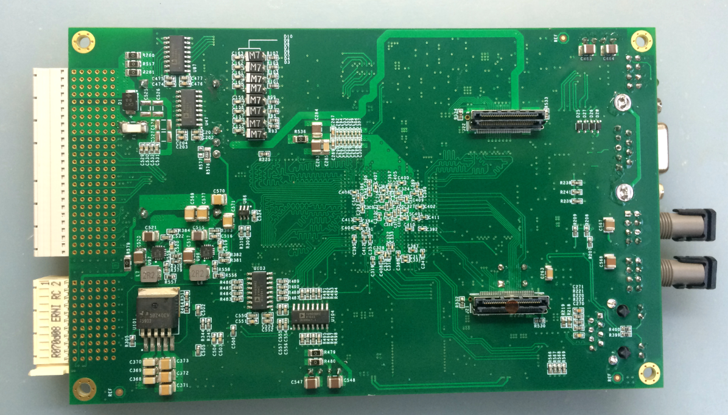
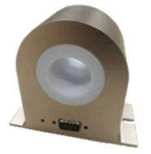
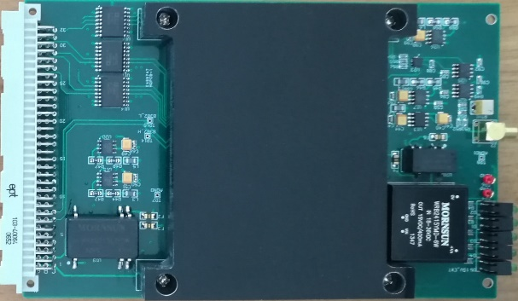
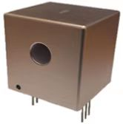
Design scheme
  The digital control power supplies are split in three independent parts
    A power part acting as a voltage source or a current source, which is suitable for industrial design and production
    Current transducers DCCT（Commercial Product or Self-design)
    Self-designed digital electronics control module, which performs the current regulation, diagnostics, monitoring and local/remote service . It’s standardized for all types of power supply
    Key components that affect the current performance of power supply: DPSCM and DCCT
Functional diagram
DPSCM- Main board and ADC board
Self-design DCCT

Slide 7
Design scheme
  Interfacing with the power part
    Fully digital: the preferred solution for corrector ps; digital PWMs will be interfaced between the DPSCM and the power part.
    Digital current loop + other analog loops: open the field to more power supply producers who build quality products but may not have the experience in 10 ppm current control; open the field to any vendors who are good at a certain kind of topology; fast analog voltage loop up to 10kHz bandwidth with -30dB@300Hz, suppressing voltage ripples as much as possible; Resolution of PWM is not the limitation of high precision current regulation any more.

Slide 8
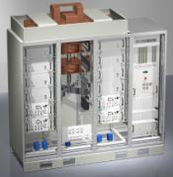
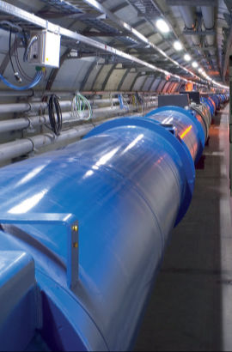
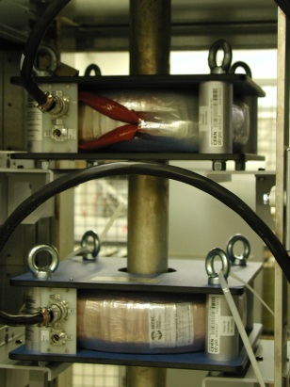
Design scheme
  SMPS
Digital Current loop:
promise current with high precision
Voltage loop:
ensuring low voltage ripple
I
B
Iref
Vref
+
e_{I}
Reg.
V
DAC
G(s)
-
e_{V}
F(z)
I_{measured}

Slide 9
Design and development
  Booster power supply
  10ppm high precision power supply
  Fast corrector power supply
  Digital Power Supply Control Module (DPSCM).
  DCCT

Slide 10
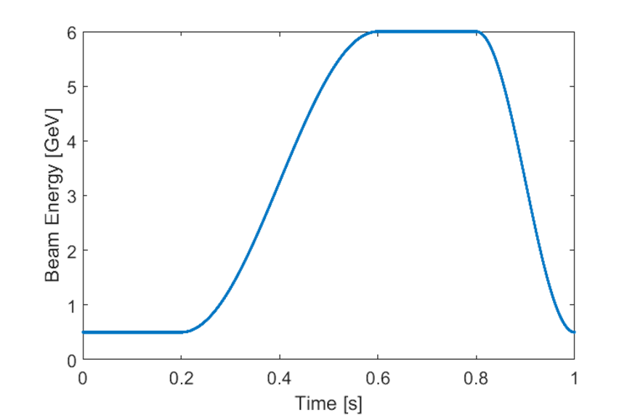
Design and development
  Booster power supply
    Repetition frequency above 10Hz: White type resonant power system (J-PARC, CSNS), energy fluctuations in the process of operation is stored by the resonant network.
    Repetition frequency below 10Hz: forced oscillation power supply (NSLS-II, SOLEIL, SSRF, HEPS). The power supply must have energy storage capacity to reduce the impact on the grid.
    The booster power supply belongs to the two quadrant regulation current source, working in quadrant Ⅰ, IV. In the current rise phase, the power supply outputs energy, the magnet consumes and stores energy, in the current fall phase, the magnet releases energy and consumes energy.
    Key technical issue: dynamic tracking accuracy.
 | CEPC | HEPS
Output Rating | 520A/890V | 900A/900V
Stability | 500ppm | 300ppm
Repetitive frequency | 0.08Hz | 1Hz
Stability | 500ppm | 500ppm
tracking error | 0.1% | 0.09%
The magnetic field cycle waveform for HEPS booster

Slide 11
Design and development
  Booster Power Supply - topology
    AC-DC-AC structure
    Front stage rectifier circuit: diode rectifier + Booster.
    Output stage is the two-quadrant chopper,
    A power control circuit is used to reduce the fluctuation of input power

Slide 12
Design and development
  Booster Power Supply - topology
    Mature Multi – module series technology is adopted for high voltage output

Slide 13
Design and development
  Booster Power Supply-topology
    Output control and multi phase-shifting PWM generator circuit be used to increase the cut-off frequency of power supply

Slide 14
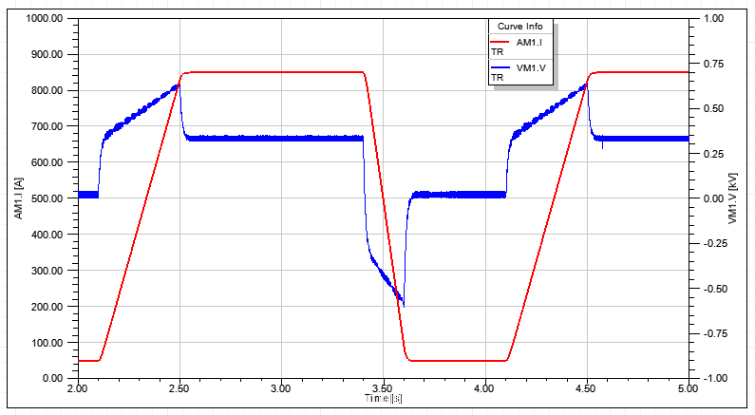
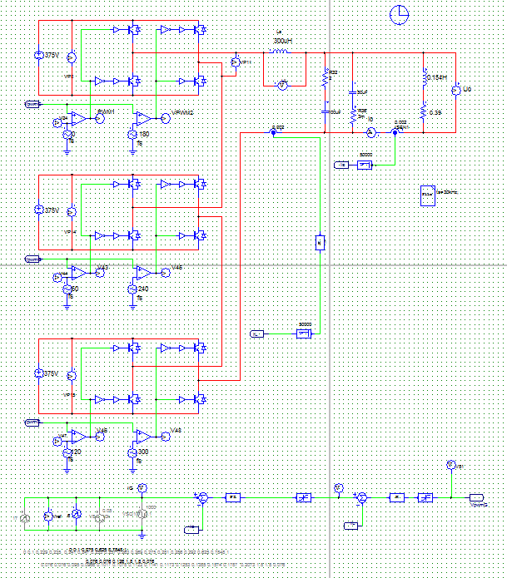
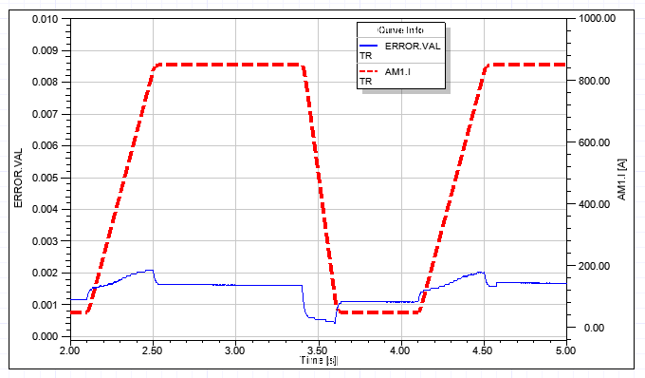
Design and development
  Booster Power Supply - topology
    Simulation
output stage simulation circuit
output current and tracking error waveform

Slide 15
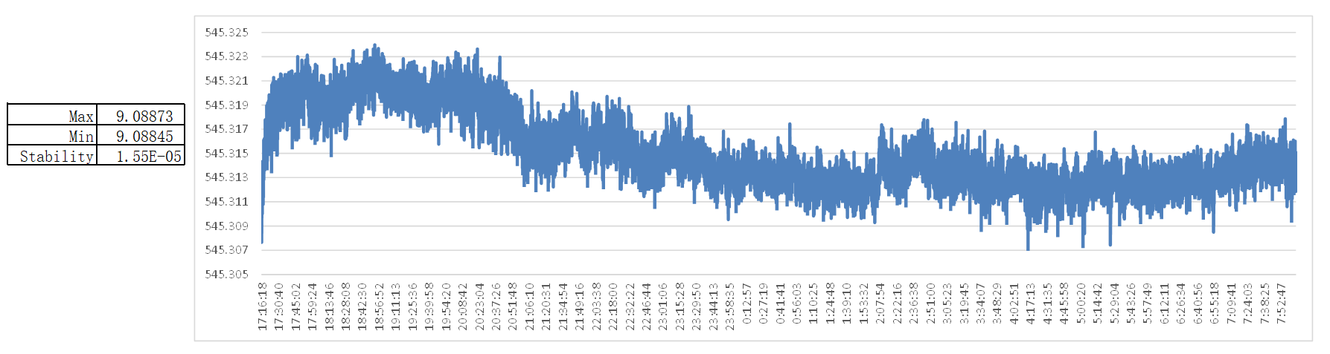
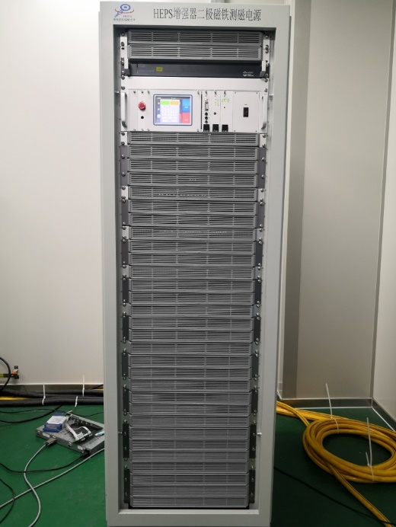
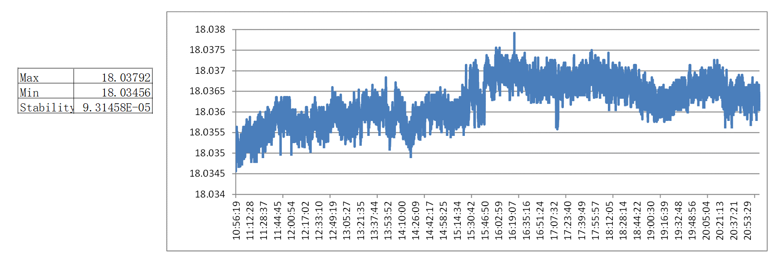
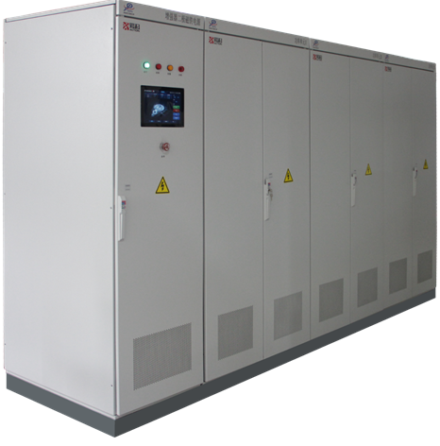
Design and development
  Booster Power Supply - prototype
the stability meets the requirements
Prototype for HEPS magnet Measuring
Current tracking waveform
the formal power supply of HEPS booster magnet

Slide 16
Design and development
  10ppm high precision power supply – parameter
  topology
    Three-phase uncontrolled rectifier + single H-bridge inverter
    The type of the H-bridge switch tube: IGBT or MOSFET

Slide 17
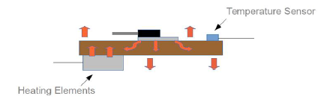
Design and development
  10ppm high precision power supply - Closed-loop control
    In order to reduce voltage ripple, it is recommended to adopt three - loop control structure
    Outer loop: digital current loop
    Middle loop: voltage loop
    Inner loop: peak current loop of primary side of high-frequency transformer
    The peak current loop is used to improve the dynamic response of power supply and restrain the fluctuation of the grid
    In order to reduce temperature drift, the burden resistance of current type DCCT and ADC in digital controller have given special considerations
    burden resistance : customized by company
    ADC circuit: uses a constant temperature control circuit

Slide 18
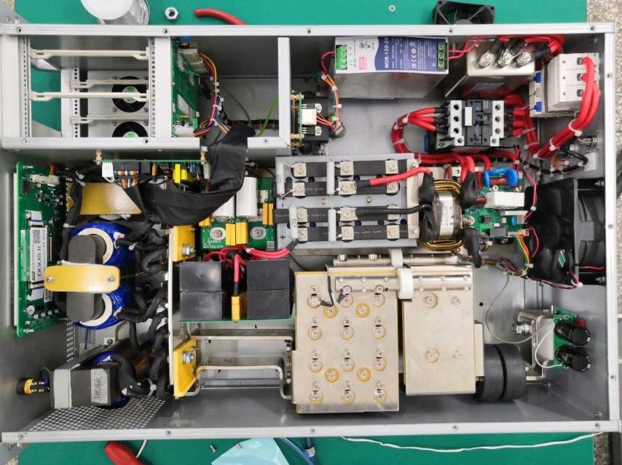
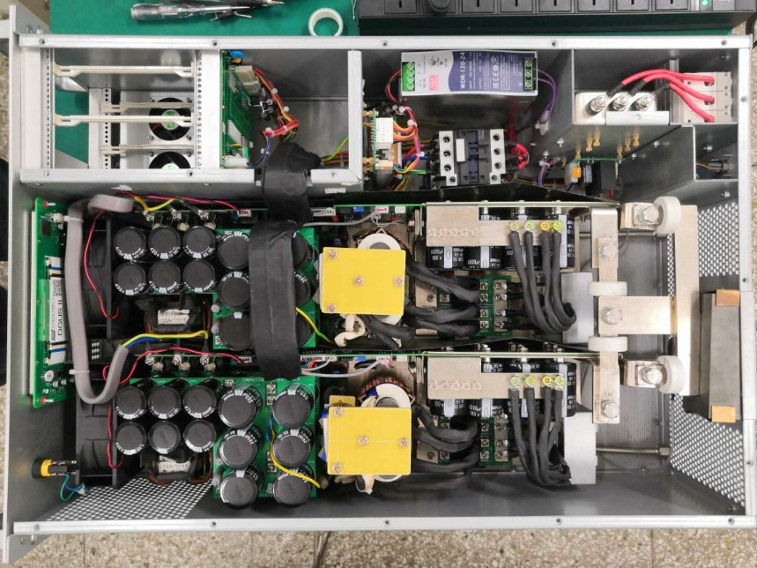
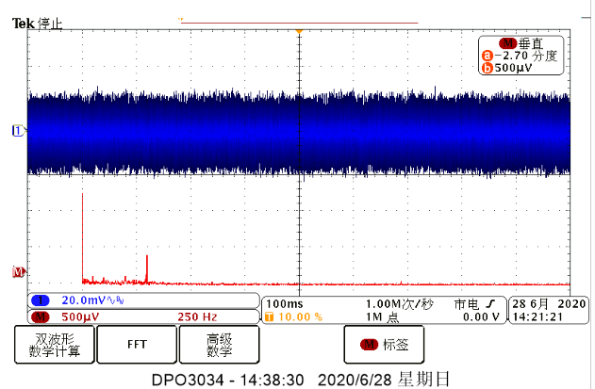
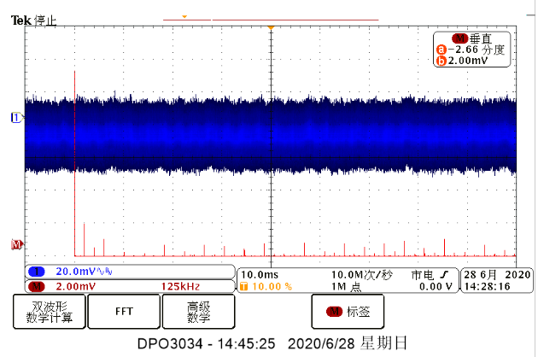
Design and development
  10ppm high precision power supply - prototype
IGBT scheme
Dual-module MOSFET scheme

Slide 19
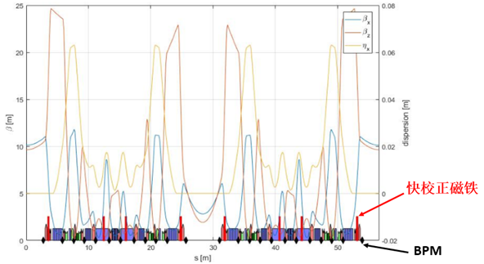
Design and development
  Fast corrector power supply
    Fast corrector power supply is the execution unit of fast orbit feedback (FOFB) system
    Fast dynamic response and high precision
名称 | 值
电源数量（台） | 384 + （48/2）
磁铁电感mH | 13
电源规格 | 18A/80V
负载电阻（mΩ） | 75
小信号-3dB带宽（kHz） | 10
阶跃响应时间（us） | ≤75
输出电流纹波（ppm） | 20
输出电流分辨率（bit） | 18
输出电流稳定度（ppm） | 50

Slide 20
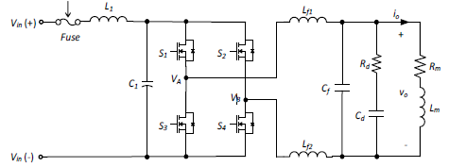
Design and development
  Fast corrector - Topology
    For fast corrector PS: switching-mode as the preferred solution
    Switching-mode ps design: 100kHz for each POWER MOSFET; and 50kHz cut-off freq. for output LC filter.
    greatly reduce the size of output filter
H-Bridge
DC/DC Converter
LC filter
The freq. of output voltage before LC filter
is two times of PWM frequency.

Slide 21
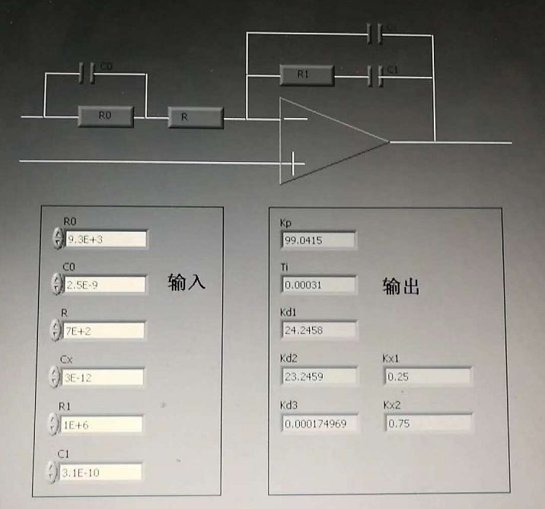
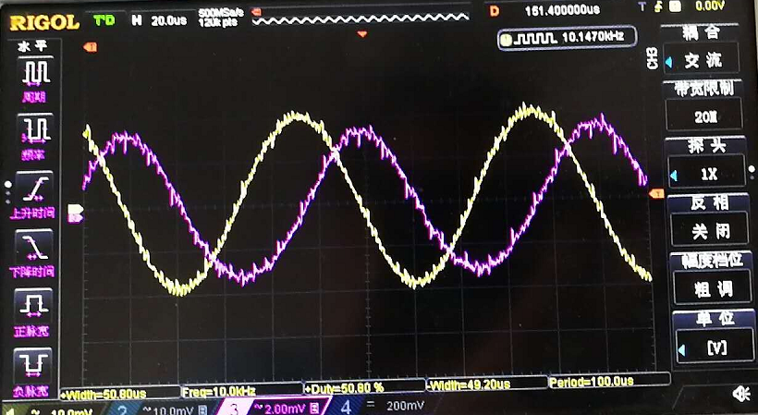
Design and development
  Fast corrector - Topology
    Adding a phase-lead compensator to the PI controller to increase the bandwidth of the closed-loop control system.
    It is difficult to achieve the 10kHz bandwidth and low current ripple at the same time.
    Based on SM: with multi-level control strategy to increase the equivalent switching freq. and decrease the voltage ripple.

Slide 22
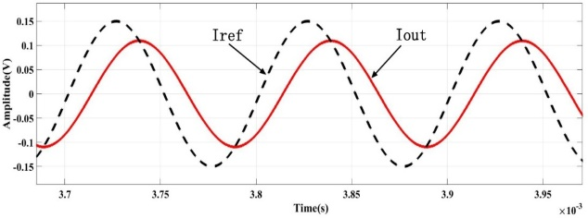
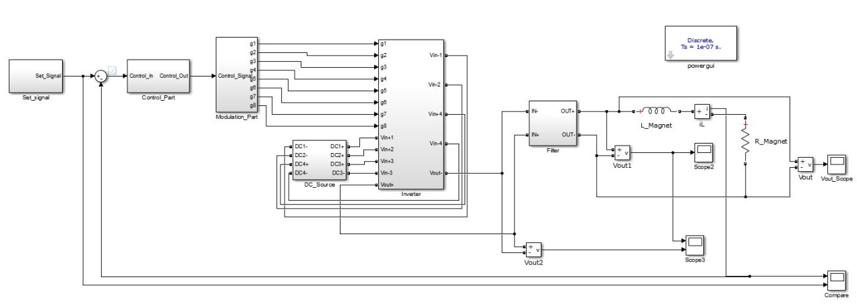
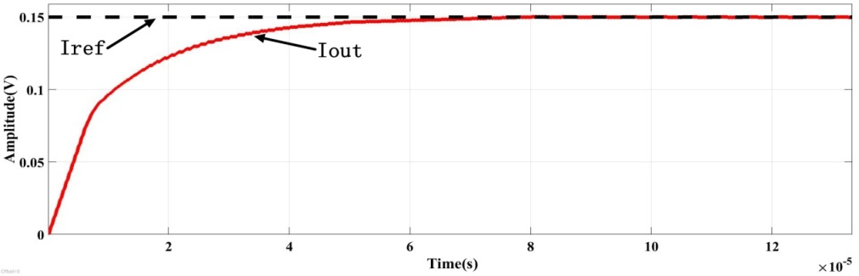
Design and development
  Fast corrector - Simulation
    Bandwidth: 0.15A@10kHz sinusoidal current output, amplitude attenuation -2.8dB, phase delay 39.5°
    Step response: 0→0.15A step current output, response time 62us

Slide 23
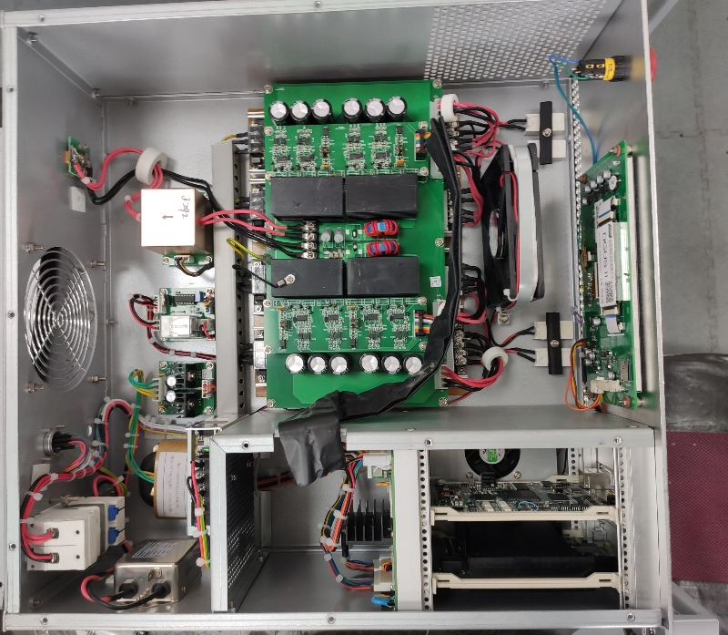
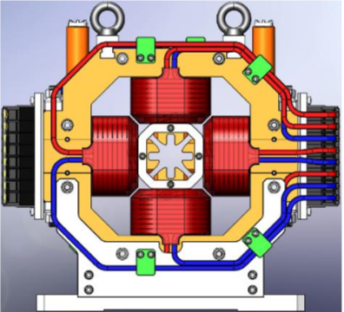
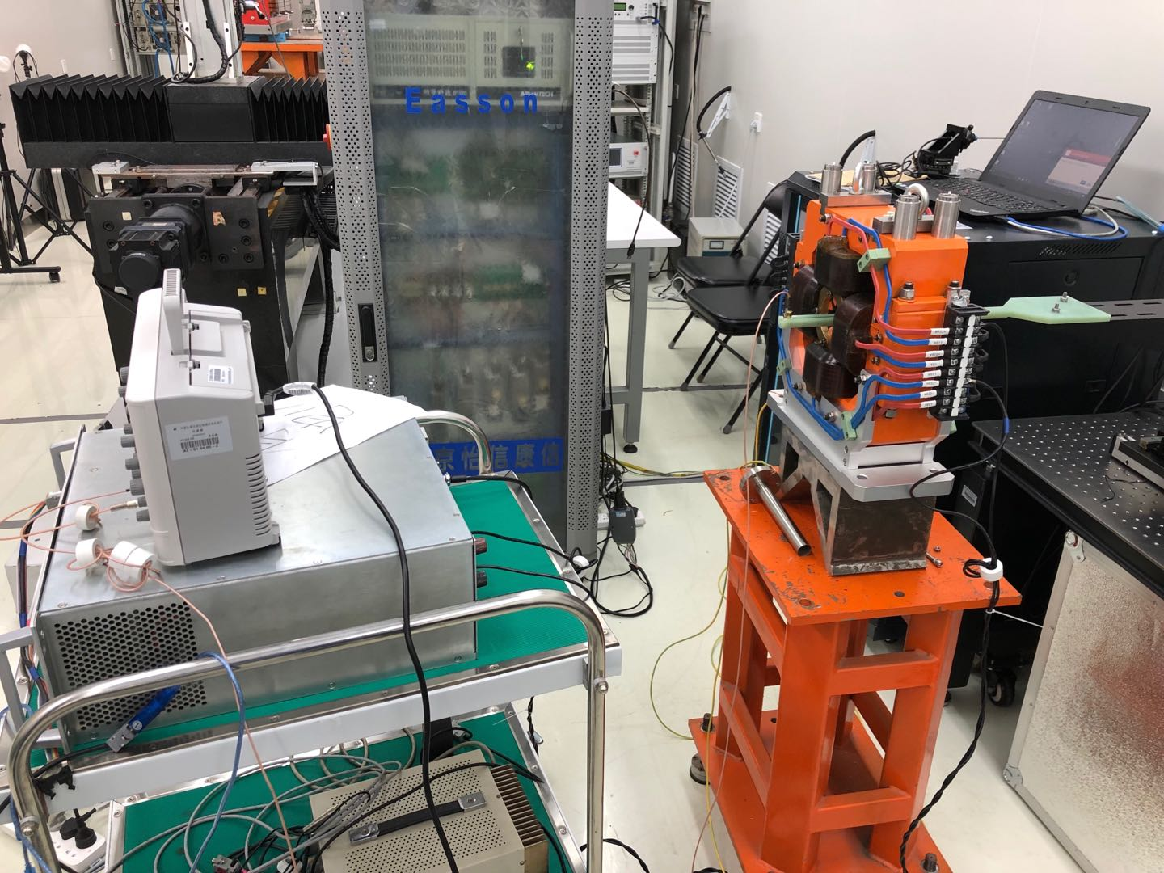
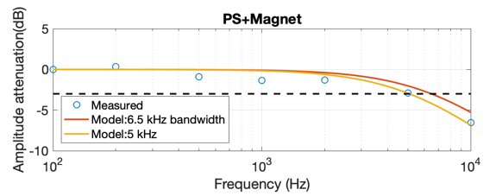
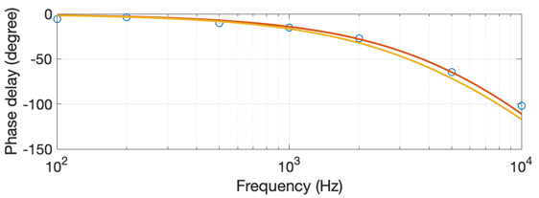
Design and development
  Fast corrector - prototype

Slide 24
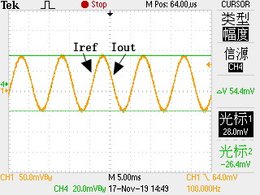
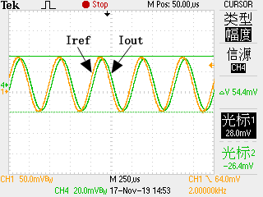
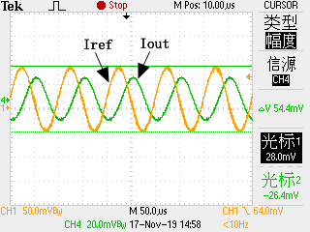
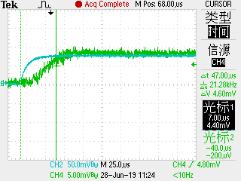
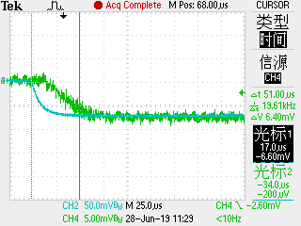
Design and development
  Fast corrector - prototype
电流给定 | 幅值衰减 （dB） | 相位延迟 （°）
0.16 A@ 100 Hz | -0.08 | 0.7
0.16 A@ 2 kHz | -0.36 | 36
0.16 A@ 5 kHz | -1.2 | 72
0.16 A@ 10 kHz | -2.7 | 105
0.16A@100Hz
0.16A@2kHz
0.16A@10kHz
阶跃电流给定（A） | 系统响应时间（μS）
0→0.08 | 53
0→0.16 | 62
3→3.08 | 57
3→3.16 | 64
13.16→13 | 63
13.08→13 | 52
3.16→3 | 62
3.08→3 | 52
0.16→0 | 62
0.08→0 | 50
3→3.08A Step
3.08→3A Step

Slide 25
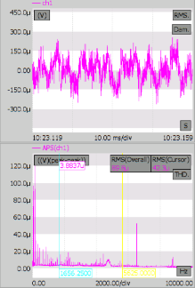
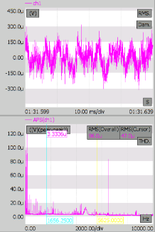
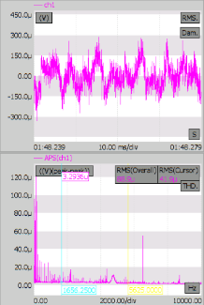
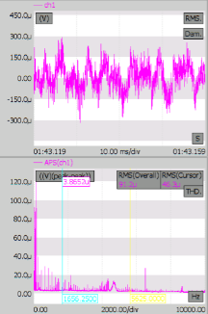
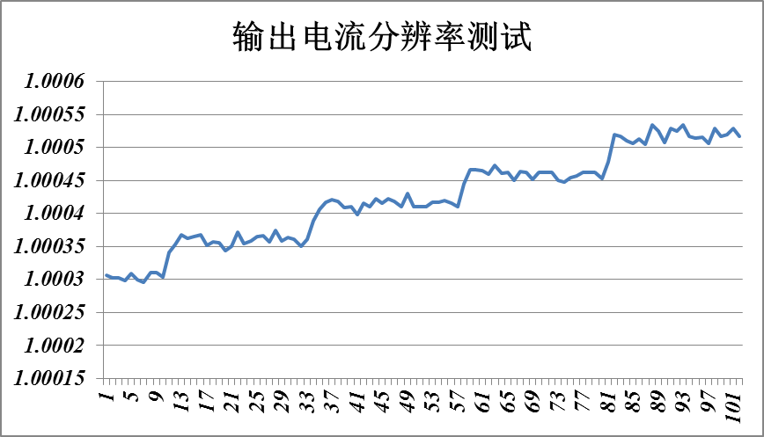
Design and development
  Fast corrector - prototype
电流给定（A） | FFT RMS（μV） | 电流纹波（ppm）
1 | 89.8 | 17.96
5 | 99.3 | 19.86
10 | 95.9 | 19.18
15 | 96 | 19.2
-1 | 88.9 | 17.78
-5 | 98.2 | 19.64
-10 | 92.2 | 18.44
-15 | 91.2 | 18.24
1A DC
15A DC
-1A DC
-15A DC
Output current resolution ：18bit

Slide 26
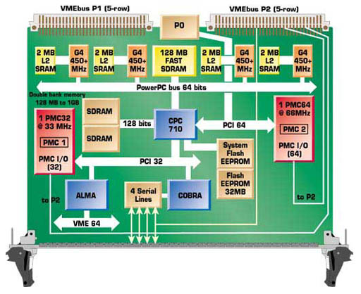
Design and development
  Digital Power Supply Control Module (DPSCM)
    SOPC FPGA： System On a Programmable Chip
    All algorithms and peripherals control entirely implemented in one FPGA
I/O
CPU
Flash
SDRAM
I/O
I/O
I/O
I/O
DSP
I/O
FPGA
FPGA
CPU
DSP
Solution: Replace External Devices
with Programmable Logic

Slide 27
Design and development
  Digital Power Supply Control Module (DPSCM)
    DPSCM-MB: PID + modern
  control theory
    high precision ADC board
  DPSCM-AD: temp control
    the voltage source
  interfacing board DPSC-DA
    the diagnostic board
    DPSCM_MDA

Slide 28
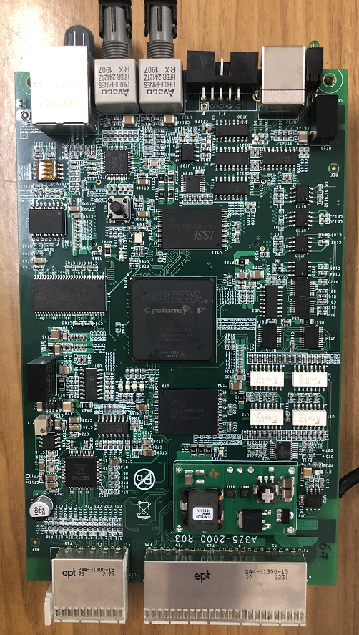
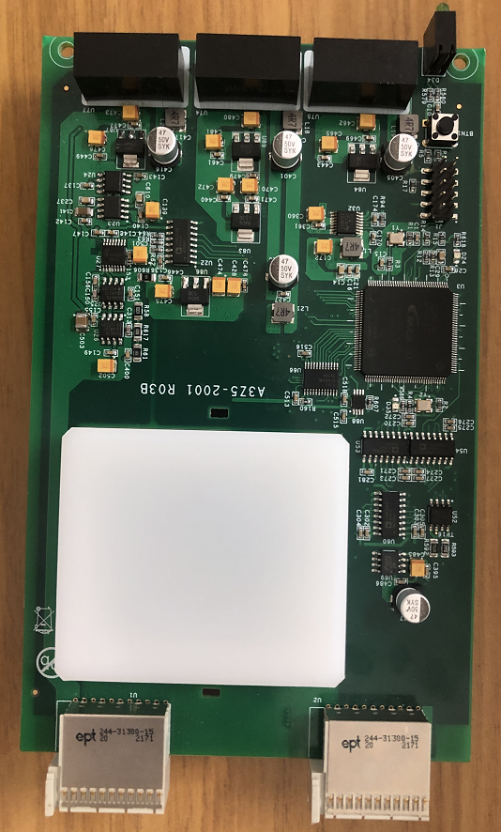
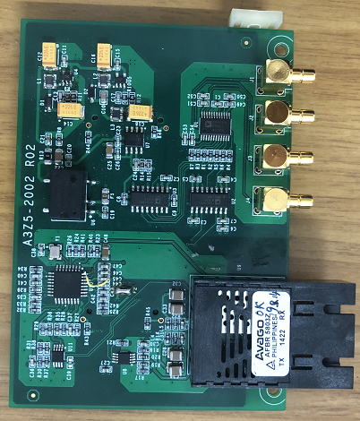
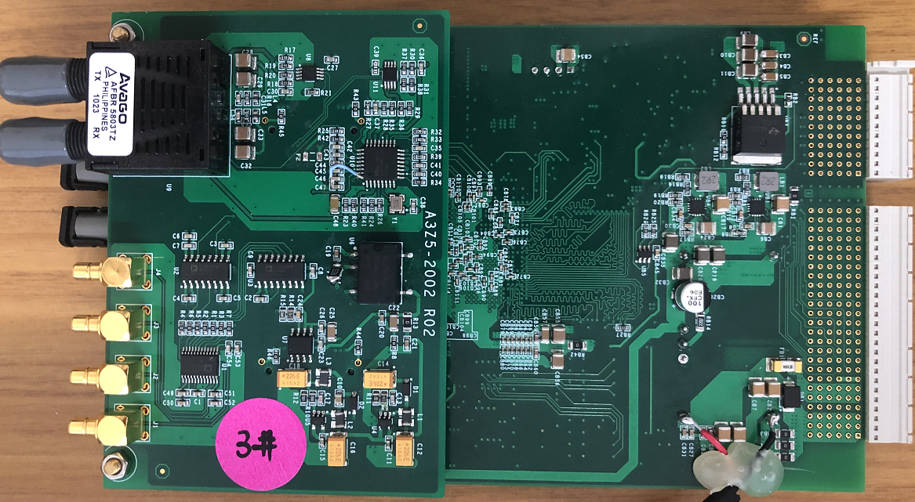
Design and development
  Digital Power Supply Control Module (DPSCM)
    Hardware

Slide 29
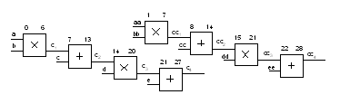

Design and development
  Digital Power Supply Control Module (DPSCM)
    Software
    Balance between resources and speed of the digital controller is realized by using module time-sharing multiplexing and pipeline design
Modular time-sharing multiplexing
Pipeline design

Slide 30


Design and development
  Digital Power Supply Control Module (DPSCM) :
    Test platform ( Closed-loop test system based on simulated load )
    The controller underwent long time off-line testing before being installed into the power supply

Slide 31







Design and development
  DCCT
    Used at accelerators for magnet current measurement
    high stability, high linearity, high resolution and low temperature drift.
    Self-designed 300A and 20A DCCT, based on zero-flux principe.
    Key issue is to solve the problem of production technology
可靠性、抗干扰性、稳定性等性能得到极大改善
第I版 （HEPS-TF）
第II版
第III版（HEPS）
带宽
分辨率
线性度
噪声

Slide 32








Design and development
  Current transducers– 20A prototype
    On the basis of the 300A: calculation of magnetic circuit parameters, improvement of circuit noise, structure design.
    20A-DCCT was successfully developed
    Resolution ≤0.5ppm (10uA), linearity ≤1.5ppm, noise ≤1ppm (maximum noise point)

Slide 33




Design and development
  Current transducers– 300A prototype test
    In order to ensure the reliability and stability of the self-made DCCT, long-term performance tests have been carried out in different HEPS power sources
    HEPS 10ppm high precision power supply, stability is better than 8ppm

Slide 34
Summary
  Three types of power supply: booster dynamic power supply, high precision power supply, fast corrector power supply
  Two key components: DCCT and digital controller
  All power supplies and devices have been developed and applied in HEPS
  The technological design of power system will determine the reliability of power supply system operation in the future
  Quality control of so large number of power supplies is very challenging.

Slide 35
Thank You!

