Slide 1
Magnet Development in HEPS
Wen Kang, Fusan Chen
IHEP
IAS Program on High Energy Physics
2023-02-14

Slide 2
Contents
Introduction of HEPS
The total magnets for HEPS accelerators
The magnets for the linac and transport lines
The magnets for the booster
The magnets for the storage ring
Summary

Slide 3
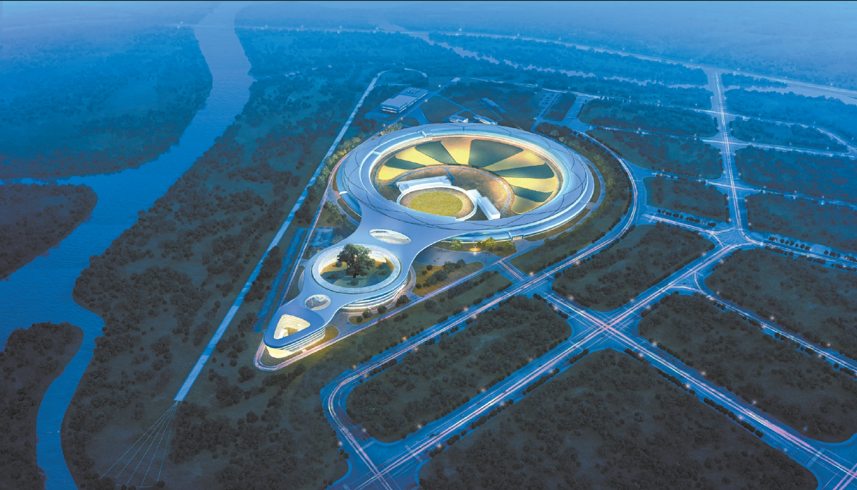
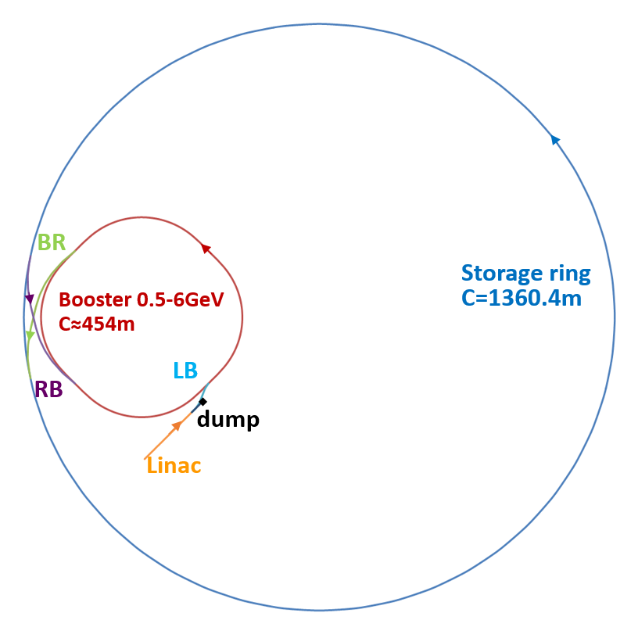
Introduction of HEPS
The High Energy Photon Source (HEPS) is an on-construction light source of the fourth generation in Huairou, Beijing, China.
Its accelerators consist of an ultra-low emittance storage ring and a full energy injector. The injector is comprised of a 500 MeV linac, a 500 MeV to 6GeV booster synchrotron and transport lines connecting the machines.

Slide 4
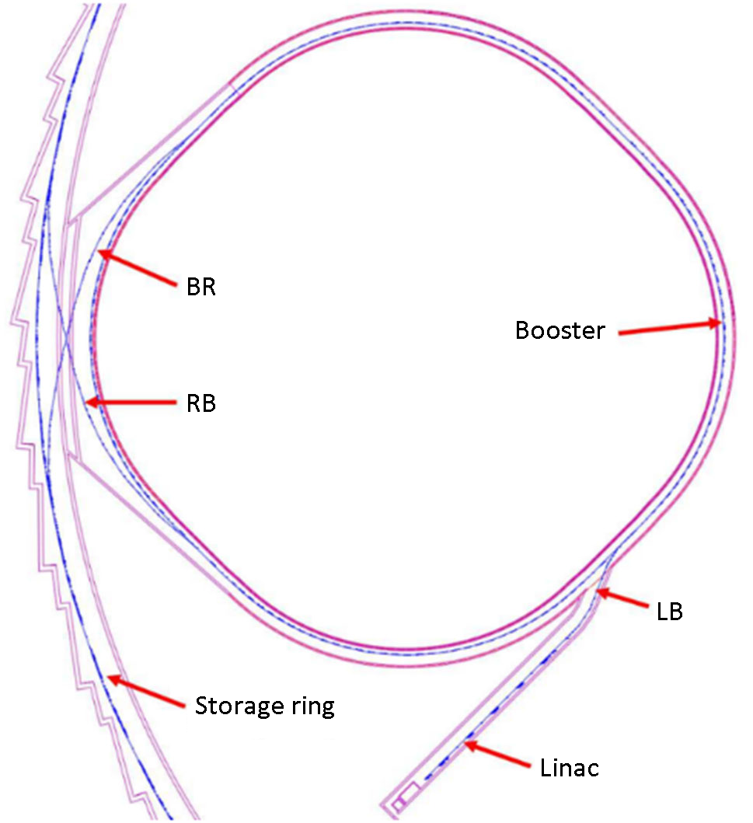
The total magnets of HEPS accelerators
There are 2389 magnets in the HEPS accelerators, 1776 for the storage ring, 436 for the booster, 54 for linac and 122 for transport lines.
Magnets for HE TL: 92
Magnets for SR: 1776
Magnets for Booster: 436
Magnets for LE TL: 30
Magnets for Linac: 54

Slide 5
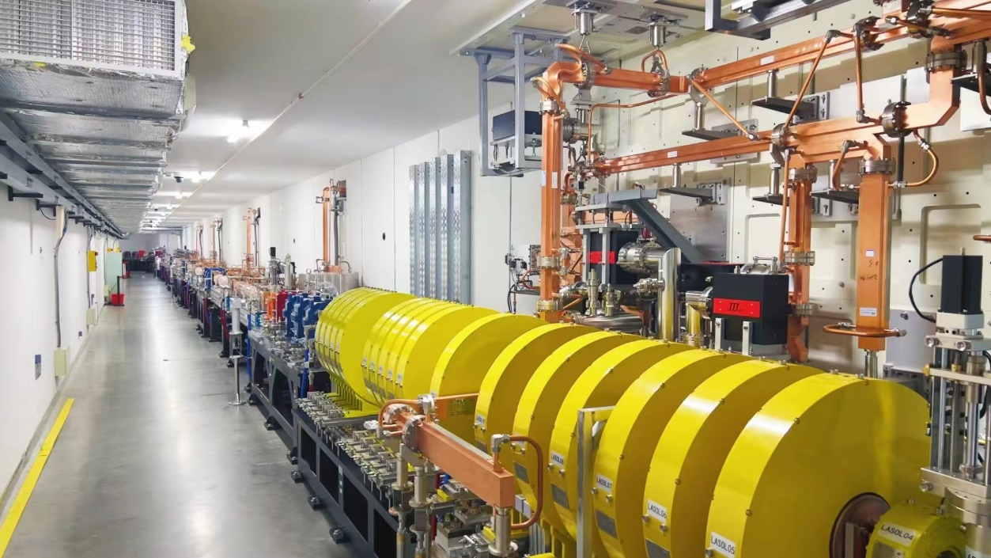
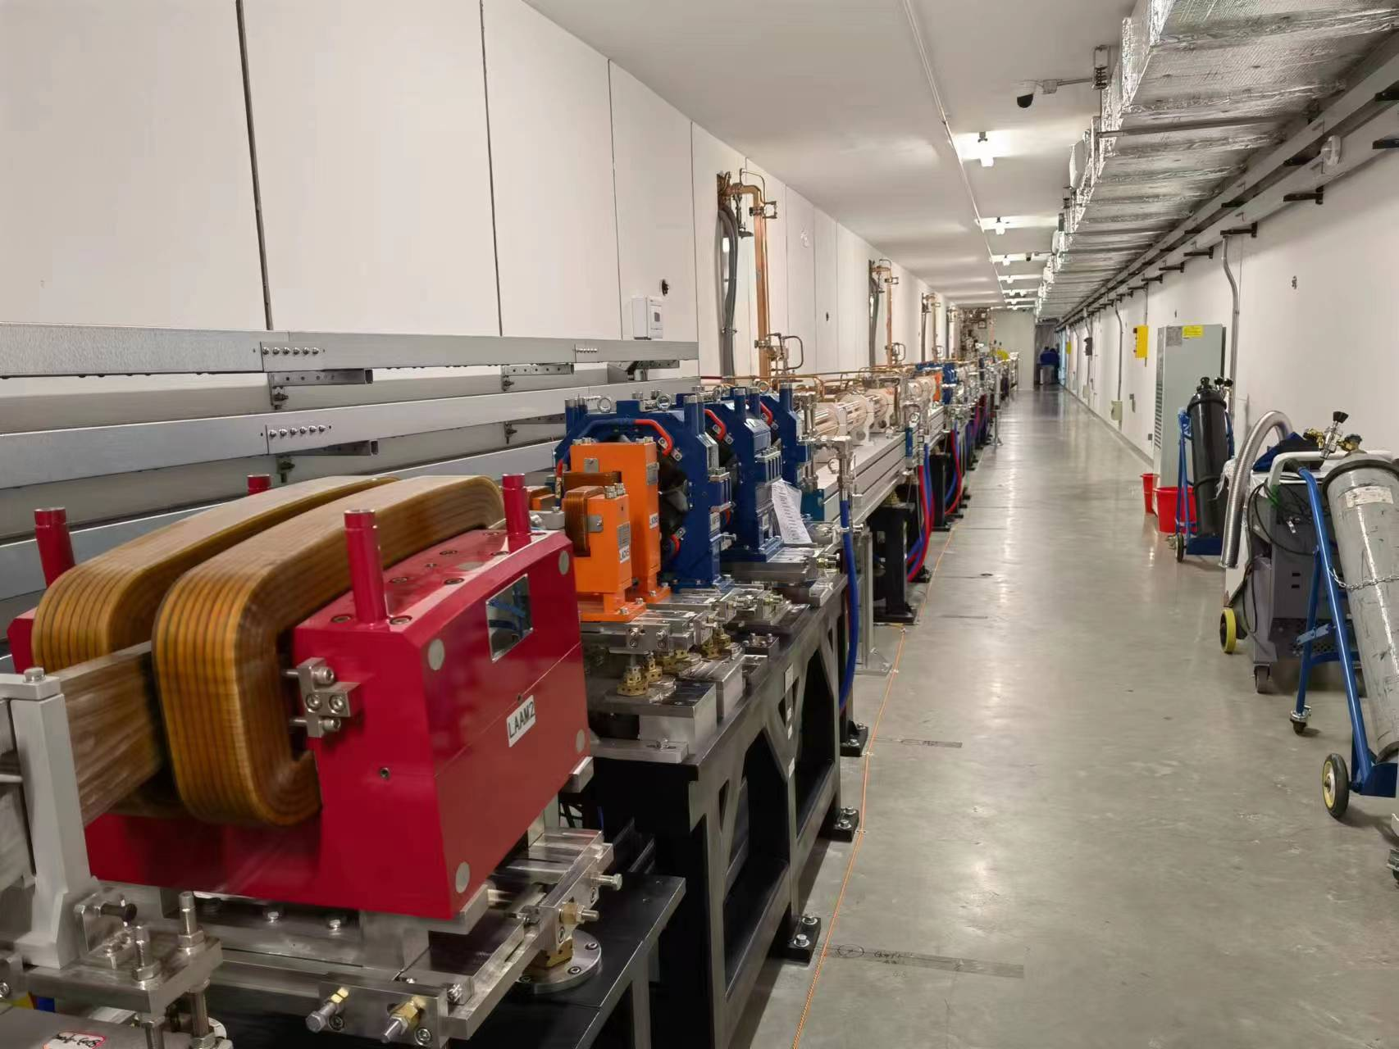
The magnets for the linac and transport lines
Since all magnets for the HEPS linac and transport lines are DC magnets, for economic considerations, some magnets are made by solid iron and some are made by silicon steel laminations.
The coils of the most magnets are wound by solid wires without water cooling due to the relatively low working field.
By the end of May in last year, all the magnets for linac and LE transport line were installed in the tunnel.

Slide 6
The magnets for the linac and transport lines
The main parameters of the magnets for the HEPS linac and transport lines are listed in the tables.

Slide 7
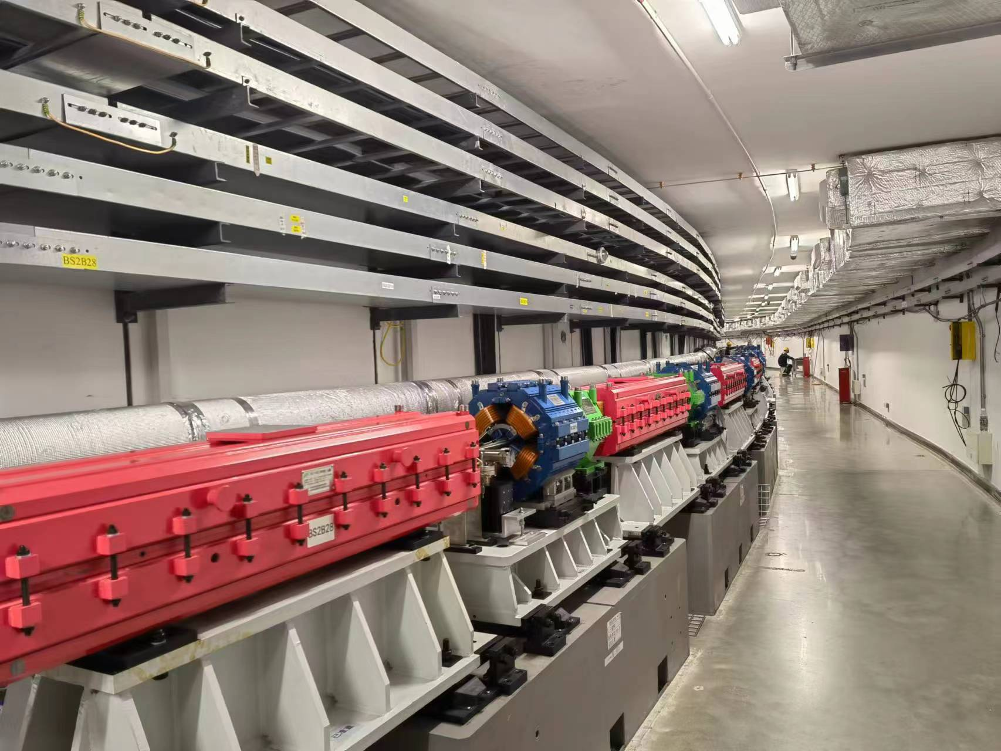
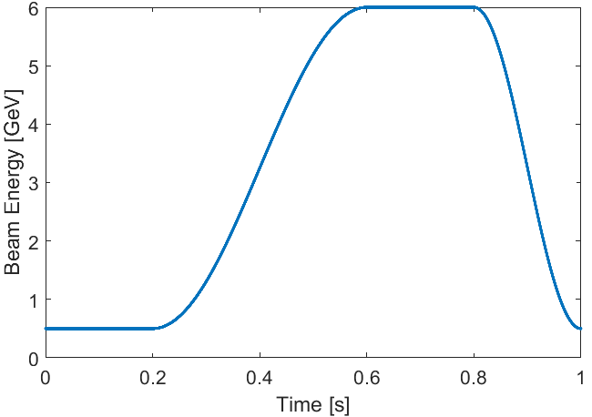
The magnets for the booster
The HEPS booster is a 1Hz synchrotron which accelerate the electron beam from 500MeV to 6GeV, the typical waveform of the beam energy is shown below.
It has 128 dipoles, 148 quadrupoles, 68 sextupoles and 92 correctors, the field of all these magnets will synchronously change with the beam energy.
The aperture of the dipoles is 34mm whereas that of the quadrupoles, sextupoles and correctors is 40mm. The field errors of all magnets is required to be less than 5E-4.
By the end of 2022, all the magnets for the booster were produced, measured and installed in the tunnel.

Slide 8
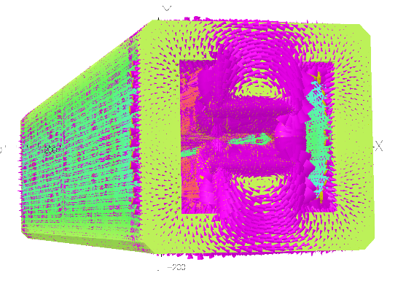
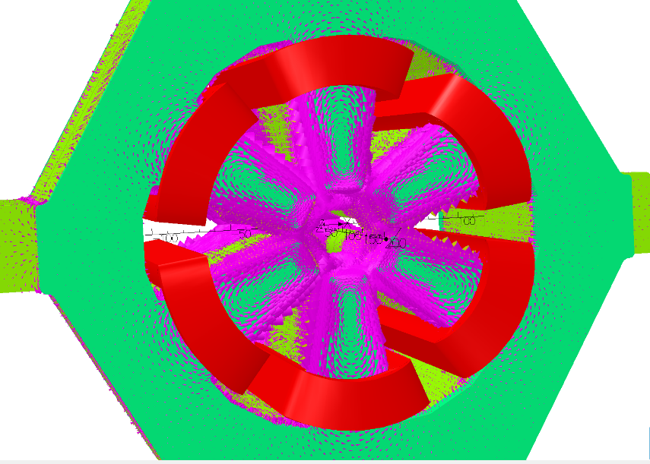
The magnets for the booster
Since the magnets for the booster are dynamic magnets, some special issues should be carefully considered when the magnets are designed and produced.
  Eddy current will be induced in the metal components such as the cores, end plates and coils of the magnets, which will produce extra field errors and cause the field waveform deformation.
  To reduce the eddy current effect, the cores of the magnets for the booster will be stacked by the laminations with thickness of 0.5mm, the end plates of the cores will be produced by stainless steel with low conductivity.

Slide 9
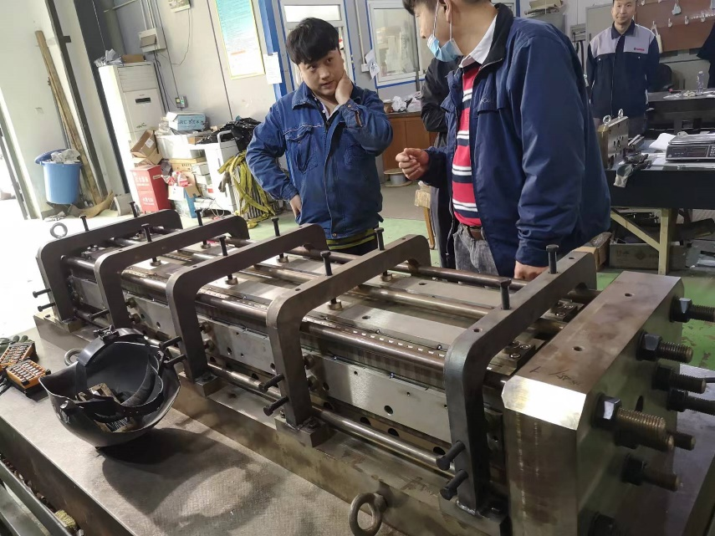
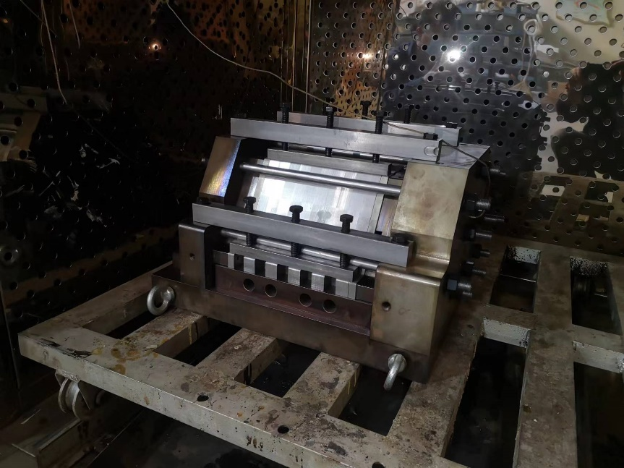
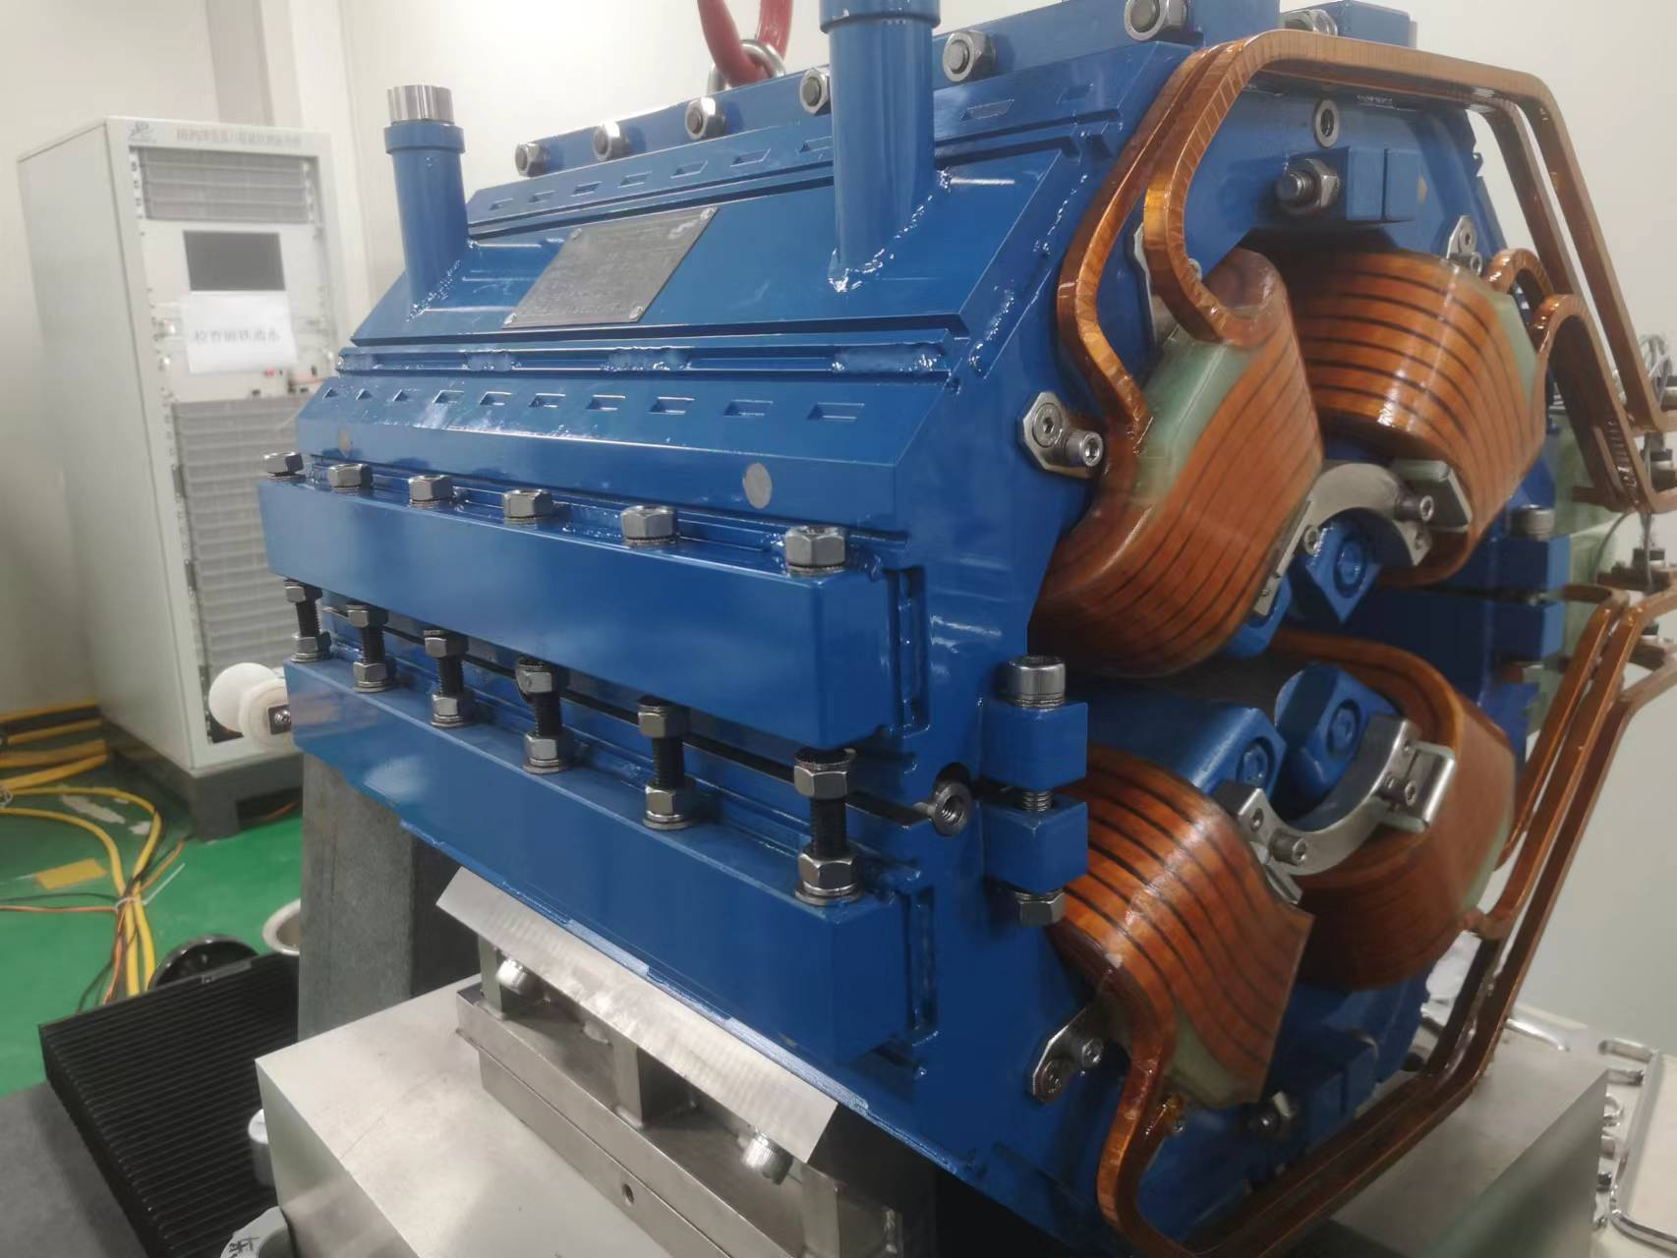
The magnets for the booster
The changed field will produce the changed forces, which will lead to the vibration of the cores and coils.
To reduce the vibration and ensure the stability, the laminations of the magnet are adhered together by the epoxy resin, the anti-loosening bolts and washers are used to fix the components of the magnets.
The torque wrenches are used to tighten all the bolts as uniformly and firmly as possible.

Slide 10
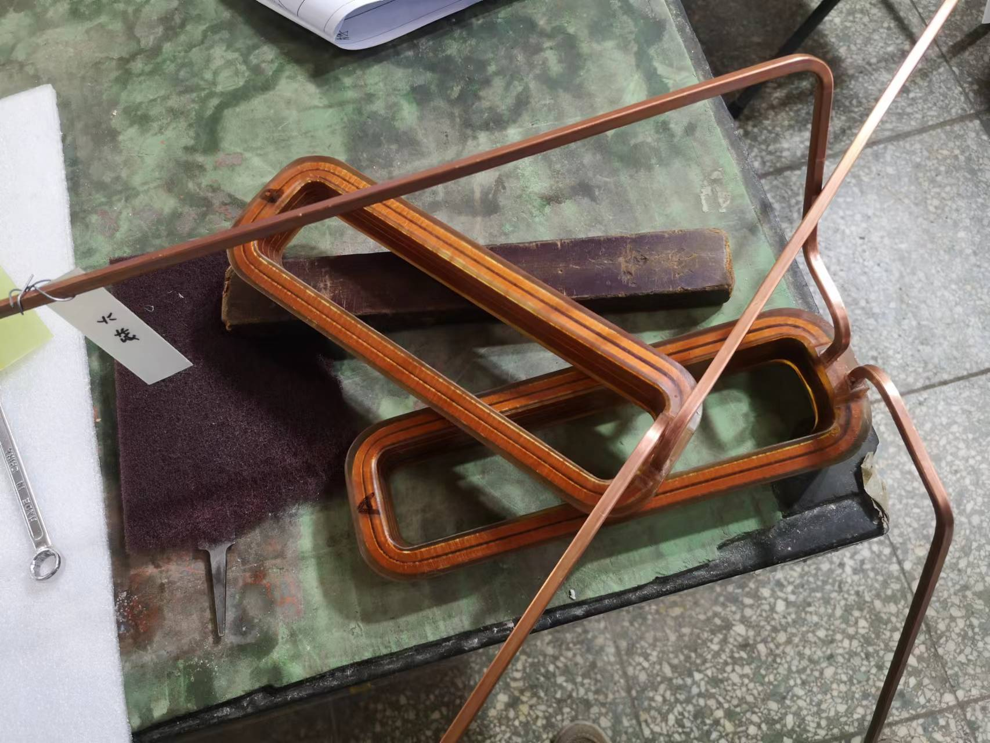
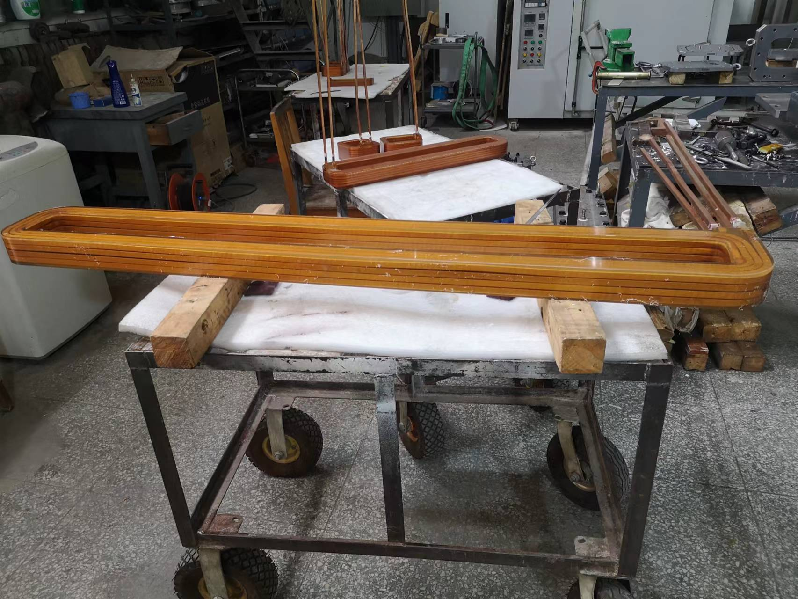
The magnets for the booster
Because each family of the magnets is powered in serious, high voltage will be induced in the ends of the magnet coils when the field changes.
To reduce the high voltage, the coils have to be designed with small turns and low inductance. The insulation degree between the coils and cores of the magnets has to be designed as high as possible.

Slide 11
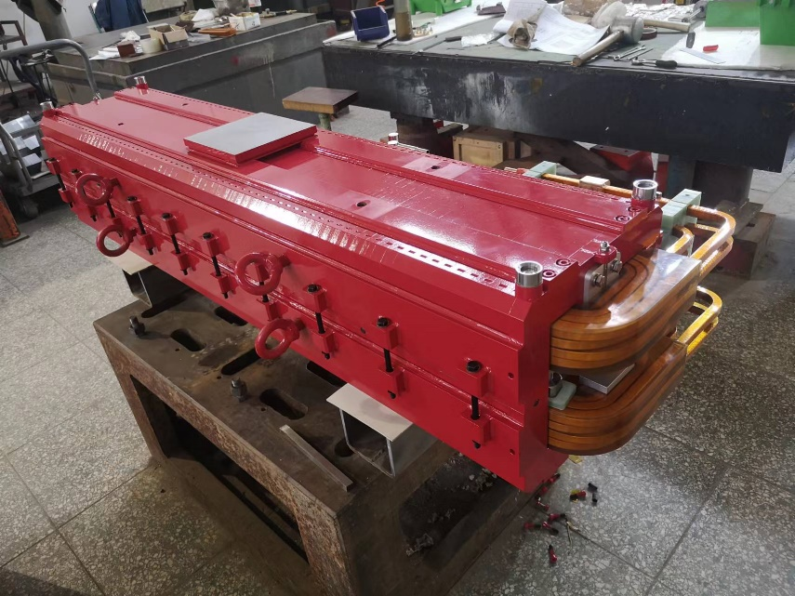
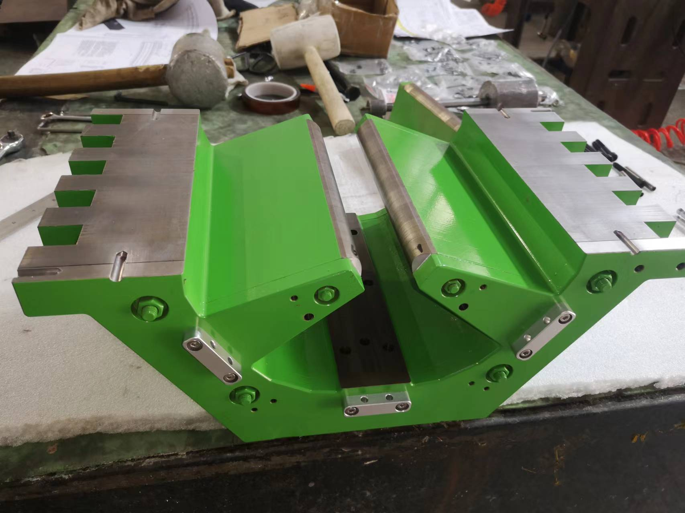
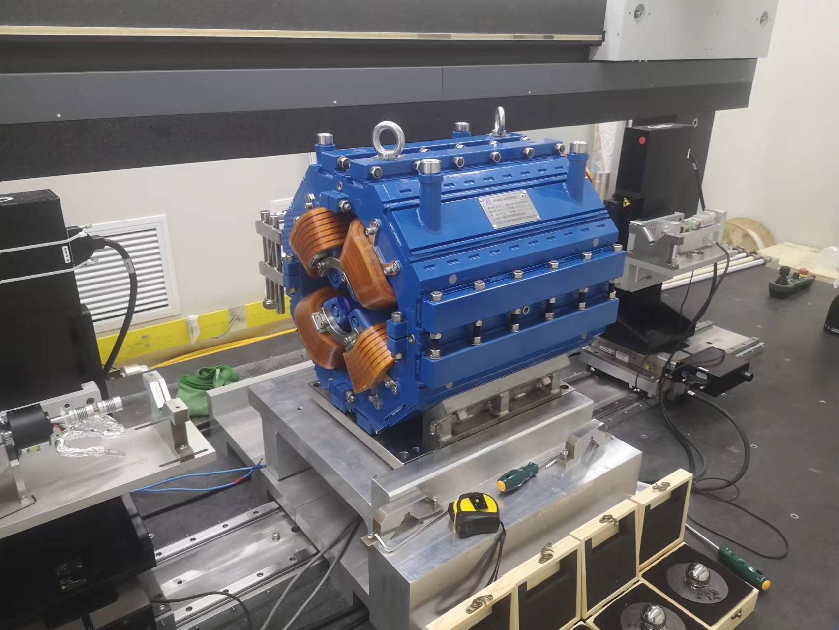
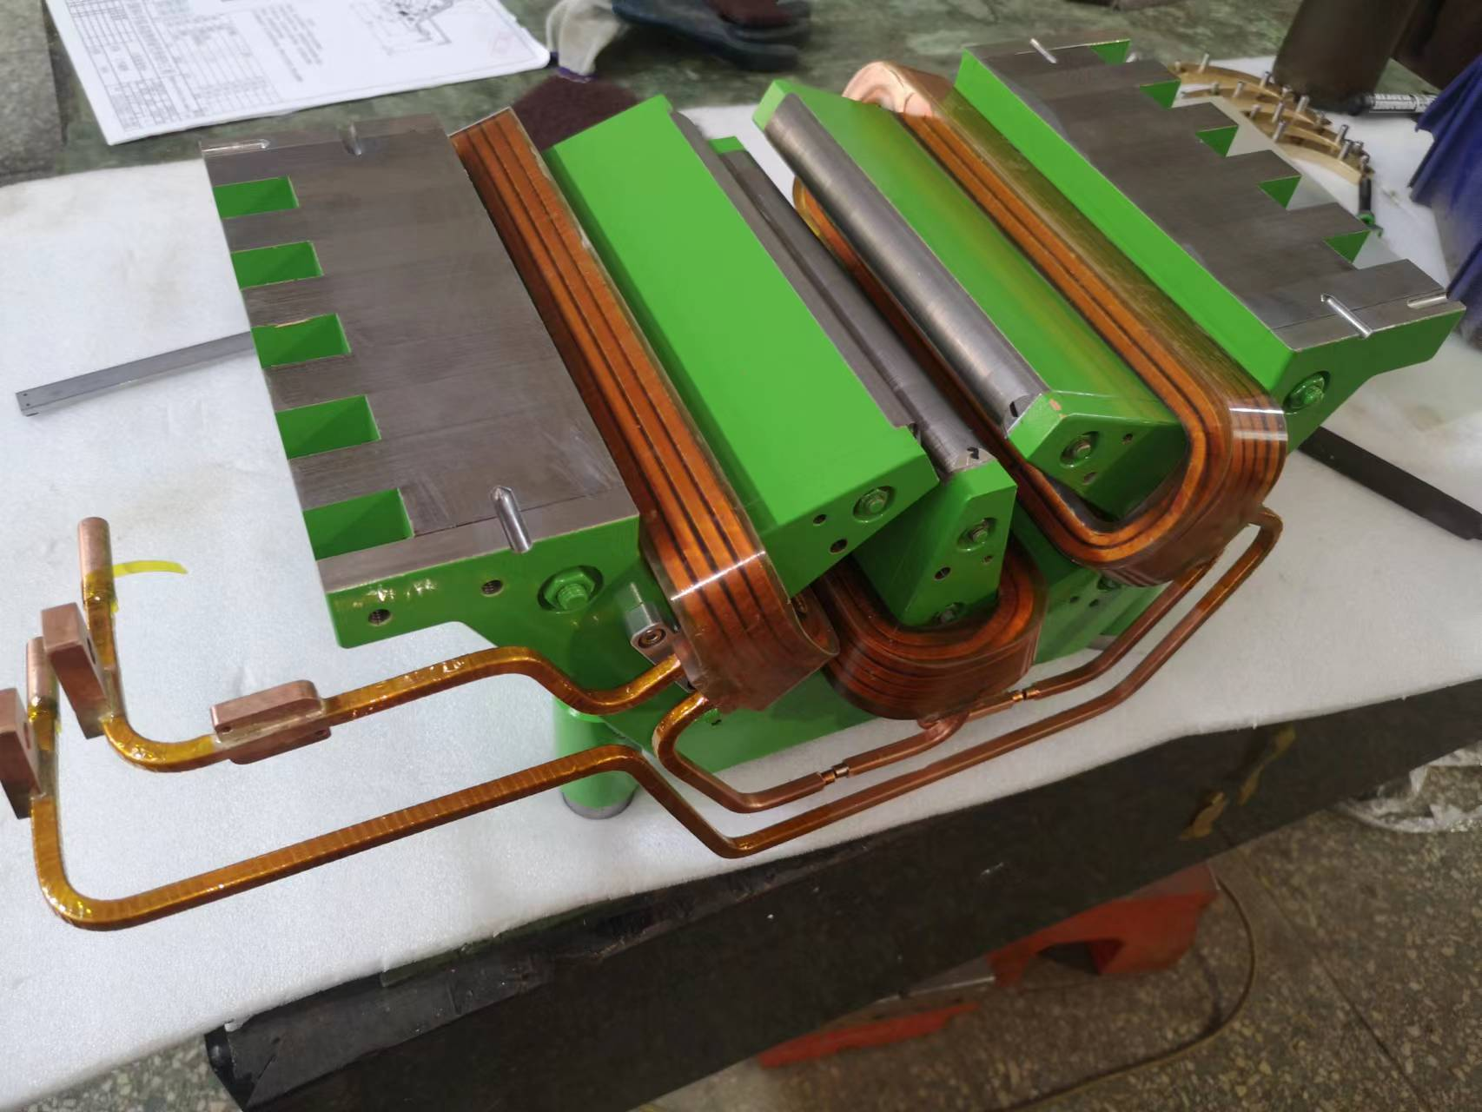
The magnets for the booster
To install the coils, the dipole magnet can be split into upper and lower yokes, the quadrupole magnet can be split into four quarter yokes, the sextupole magnet can be split into upper and lower yokes meanwhile the upper and lower poles can be moved away.
All the coils are wound by hollow copper conductors, which have 12 turns for the dipole magnet, 14 turns for the quadrupole magnet and 8 turns for the sextupole magnet.

Slide 12
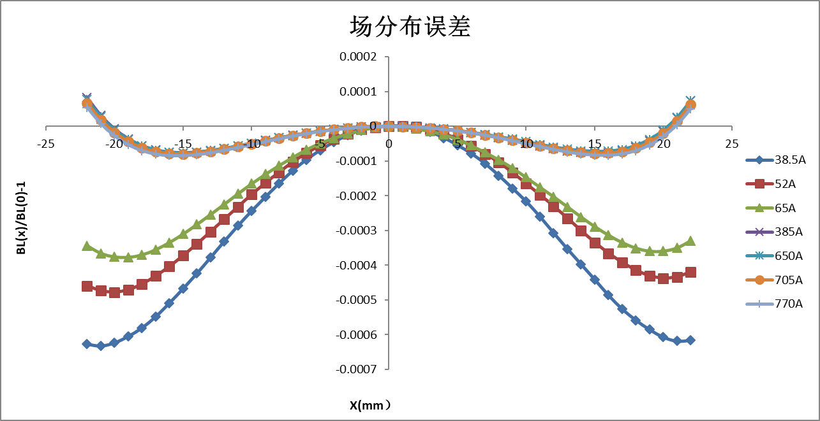
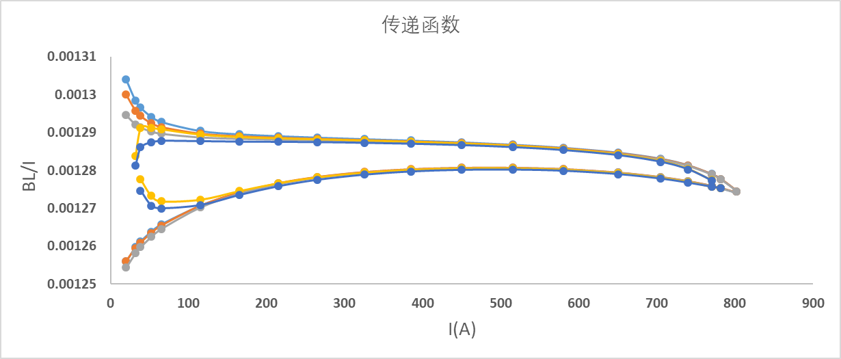
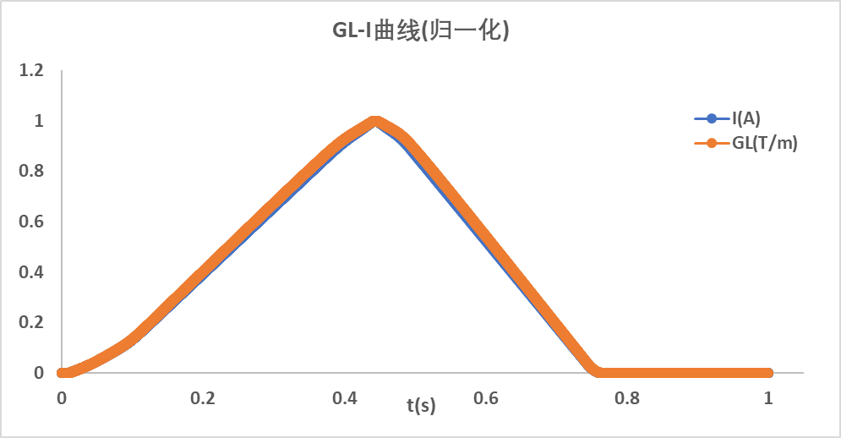
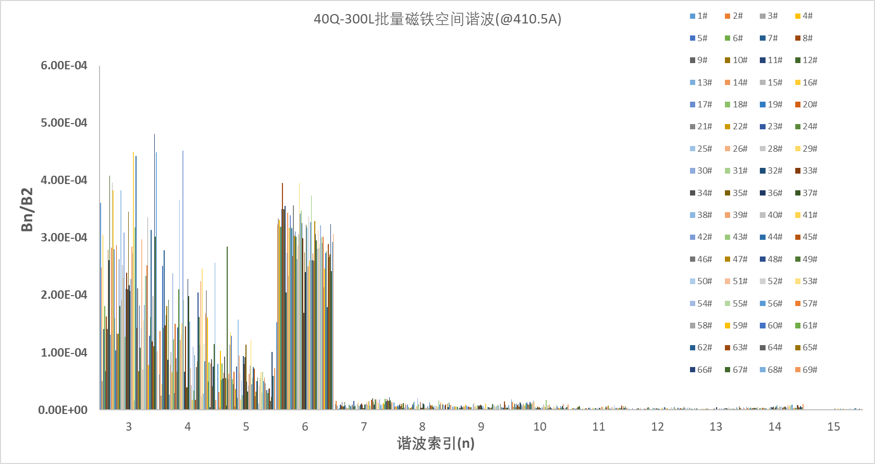
The magnets for the booster
The magnetic field measured results of some magnets for the booster.
Field distribution curves of the dipoles
Transfer functions of the dipoles
Field and current waveforms of the qradrupoles
Field harmonic errors of the quadrupoles

Slide 13
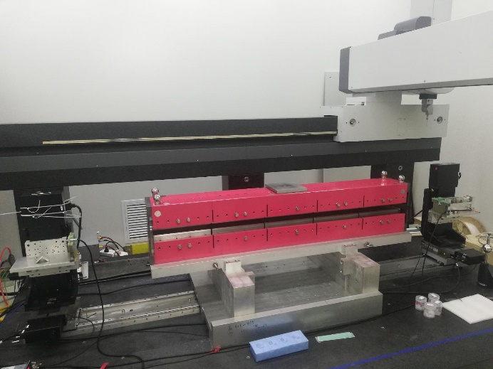
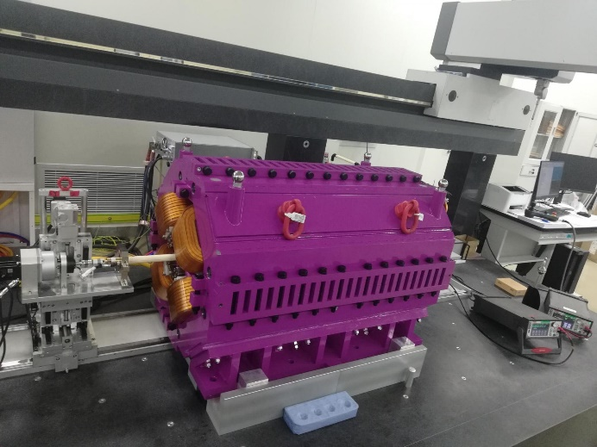
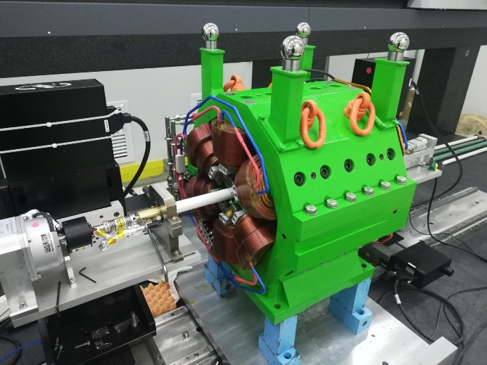
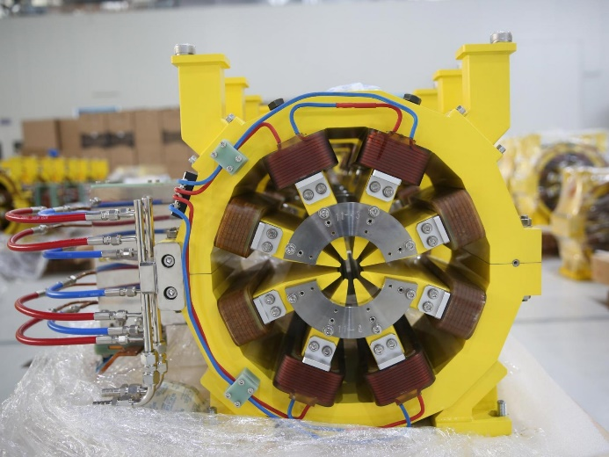
The magnets for the storage ring
The storage ring has 48 super-periods. Each super-period has 5 bending magnets combined with longitudinal gradients (BLG), 6 dipole and quadrupole combined magnets(BD/ABF), 14 quadrupole magnets(QF/QD), 6 sextupole magnets(SF/SD), 2 octupole magnets(OCT) and 4 fast correcting magnets(FC).

Slide 14
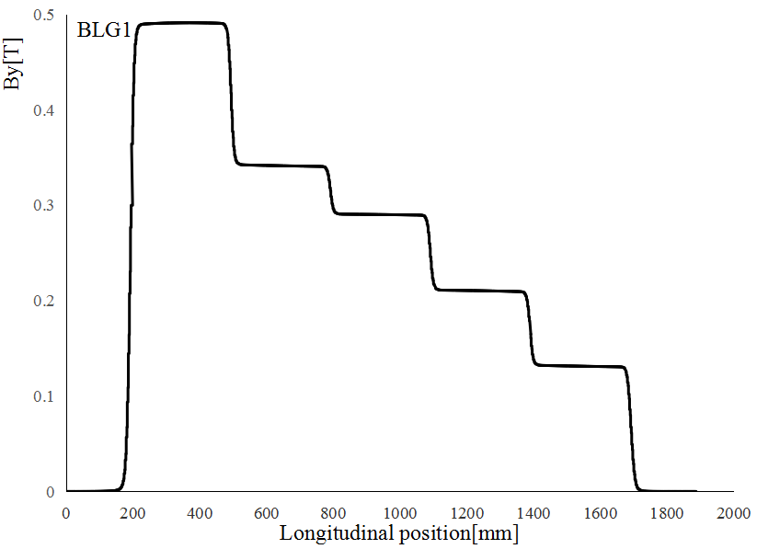
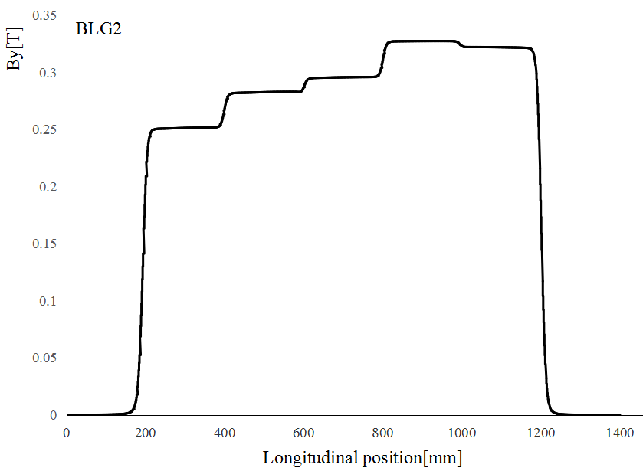
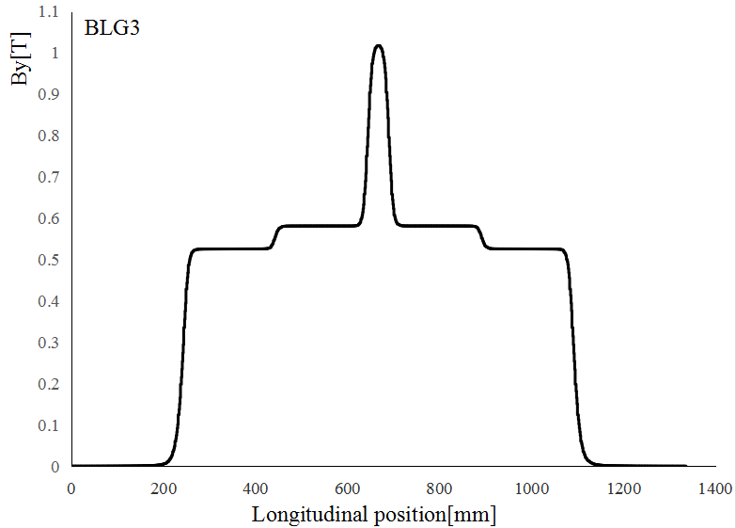
The dipole magnets for the storage ring
(Q. Li)
To reduce the emittance of the electron beam, the dipole magnets of the storage ring are the bending magnets combined with longitudinal gradients (BLGs) .
There are five BLGs in one period, the field distributions along the longitudinal direction of BLG1, BLG2, BLG3 are shown below. The field distributions of BLG4, BLG5 is symmetrical about the center of period with BLG1, BLG2.

Slide 15
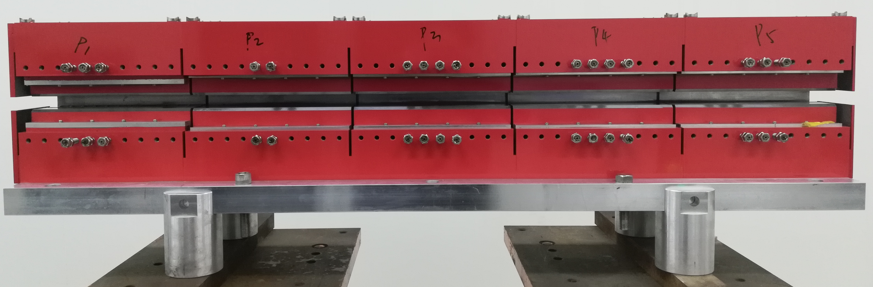
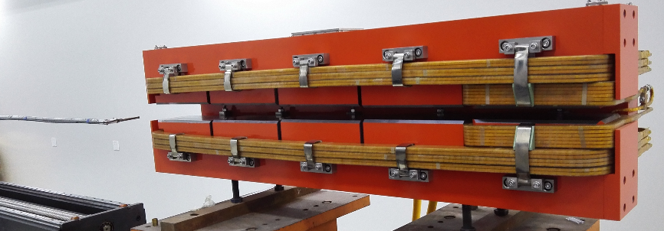
The dipole magnets for the storage ring
In the R&D stage of the HEPS, two types of BLGs were designed and developed, one was the magnet excited by current, another was the permanent magnet. All the measured specifications of the both magnets were satisfied with the requirements.
Due to the compact structure, long-term field stability, good temperature stability and no electricity power loss, the permanent magnet was chosen as the final design of the BLGs.

Slide 16
The dipole magnets for the storage ring
The permanent dipole magnets are combined by five modules in longitudinal direction, which are mainly composed of iron poles, iron yokes, magnet blocks(Sm2Co17), adjustable iron bars, temperature compensation shunt sheets(FeNi alloy) and field shielding plates.
The permanent material of Sm2Co17 is chosen to excite the field since it has a relatively lower temperature dependence factor.

Slide 17
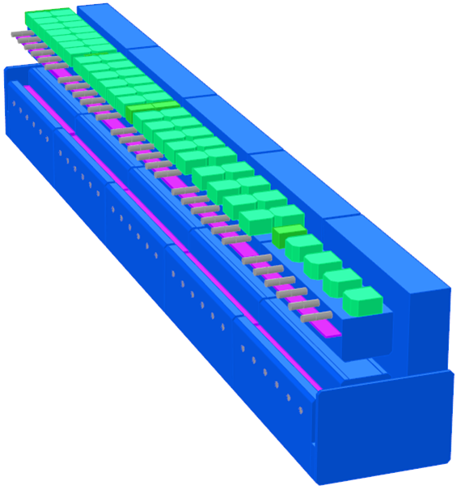
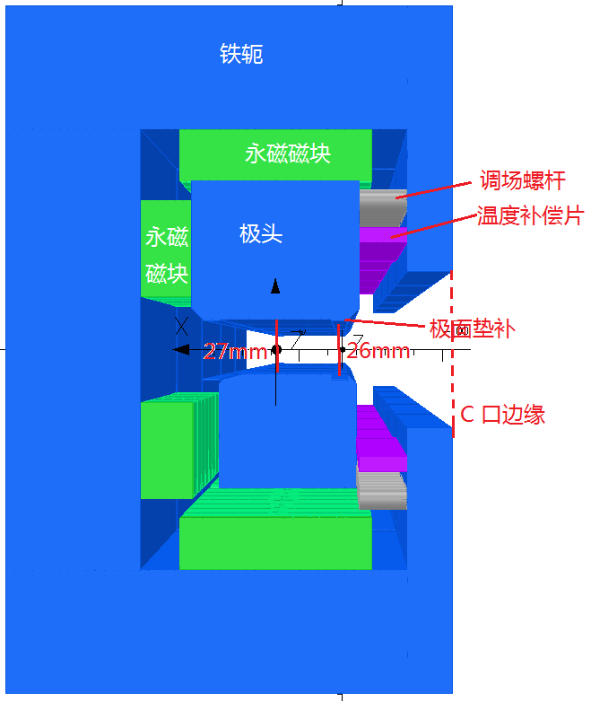
The dipole magnets for the storage ring
By using the different numbers of the magnet blocks, each module can have a different field value and a longitudinal gradient field can be realized.
By using the adjustable iron bars, the field of each module can be precisely adjusted to fit the ideal values.
By using the temperature compensation shunt sheets, the temperature dependence of magnet blocks can be weakened.

Slide 18
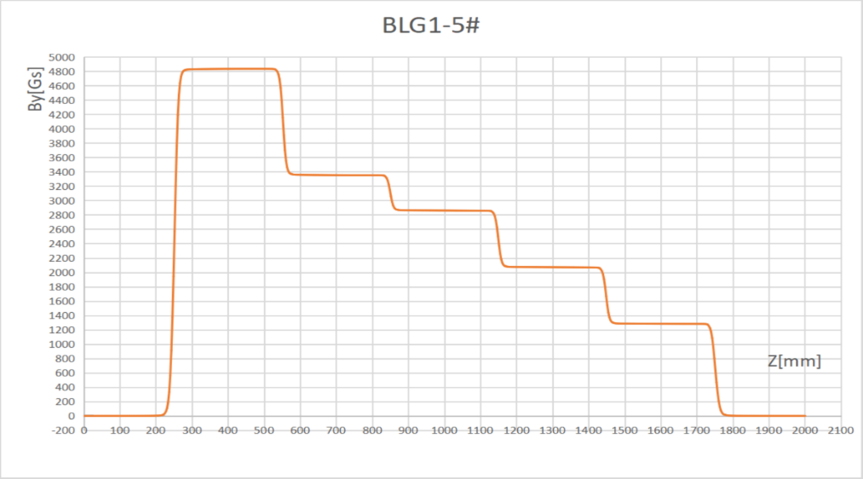
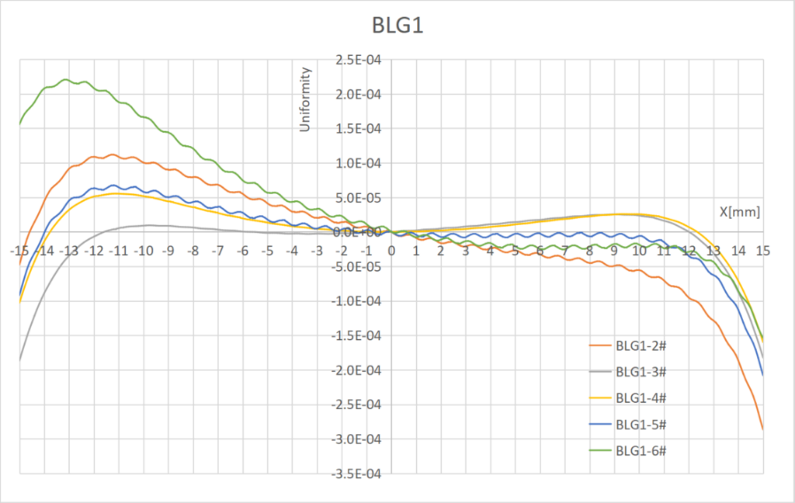
The dipole magnets for the storage ring
The hall probe measurement system is used to map the field along the central line in the gap, the long coil measurement system is used to measure distribution of the integral field .

Slide 19
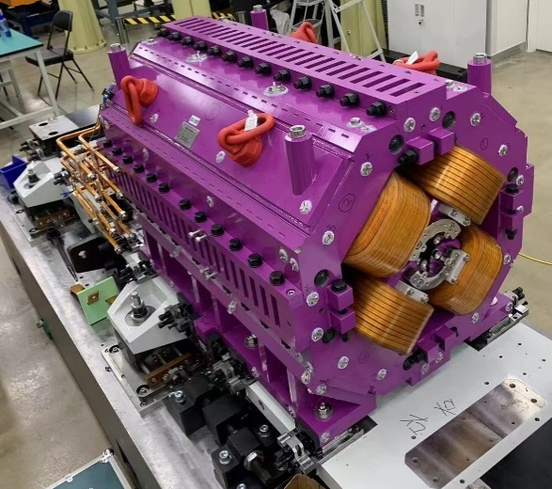
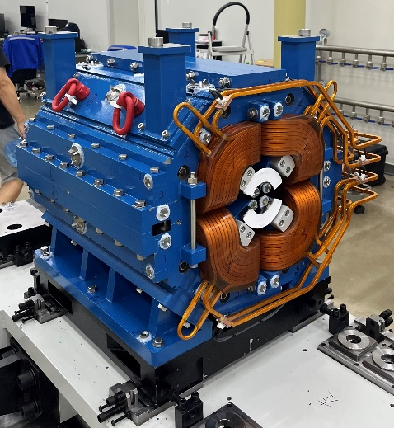
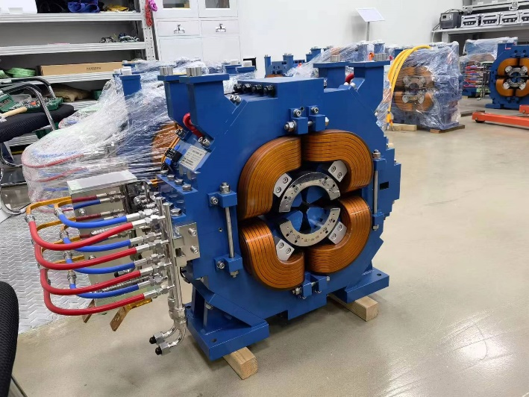
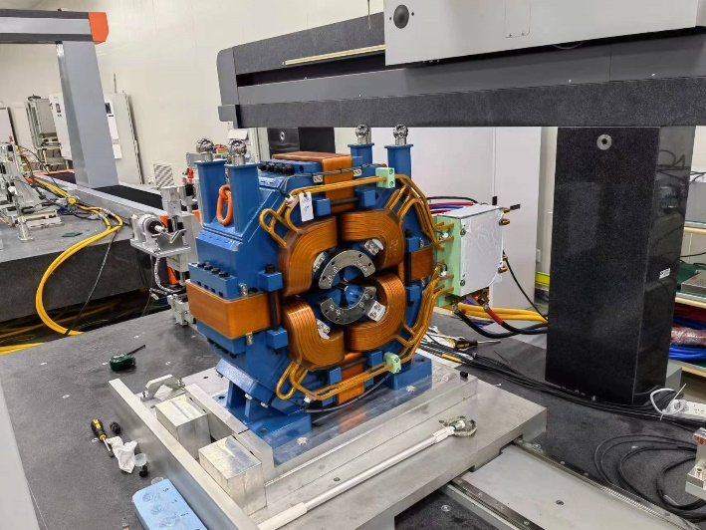
The quadrupole magnets for the storage ring
(Y. S. Zhu)
There are 960 quadrupole magnets in the HEPS storage ring, some of them are used as the dipole and quadrupole combined magnets (BD/ABF) by offset installation from beam central orbit.
The max gradient and aperture of the most quadrupole magnets are 80T/m and 26mm, which are key factors to achieve ultra-low emittance of the storage ring. But they make the magnets to work at the saturation region of the BH curves.
The harmonic errors of all quadrupole magnets are required to be less than 4E-4 within the GFR.

Slide 20
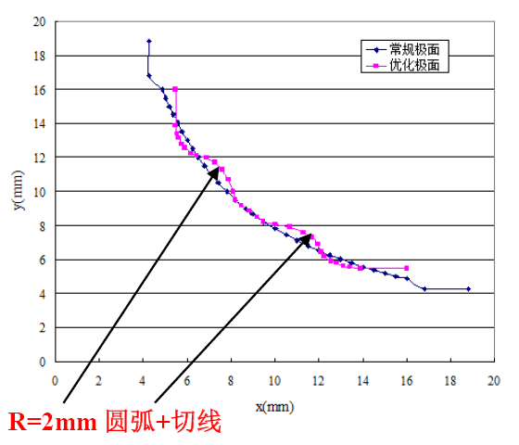
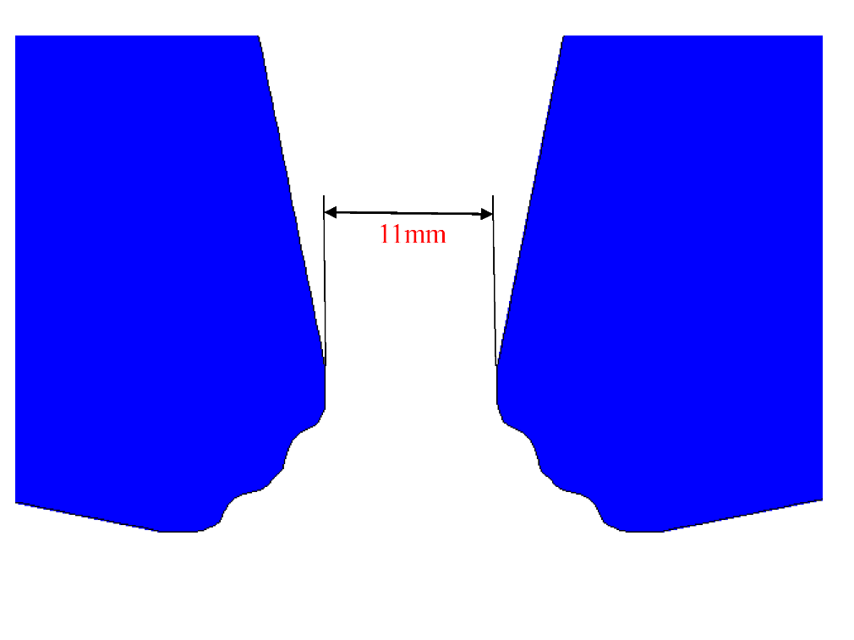
The quadrupole magnets for the storage ring
The gap between poles is required to be less than 11mm, which makes the conventional hyperbola pole face not to meet the requirement of the field quality. So a special pole face shape was proposed and adopted to the quadrupole magnets.
After several iterations of optimization, the simulated harmonic errors of the quadrupole magnets are suppressed to 0.5E-4.

Slide 21
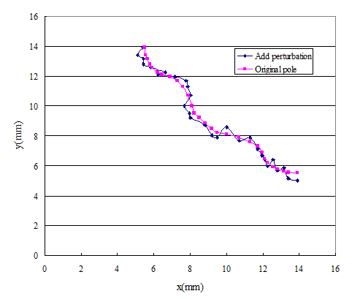

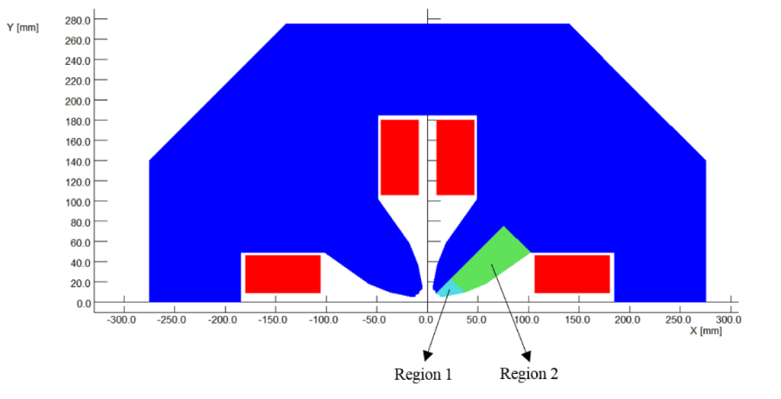
The quadrupole magnets for the storage ring
The perturbations of the pole shape and position as well as the core material are simulated and studied, then the tolerances of the pole production are proposed.
The mechanical tolerance of the pole shape and position are required to be less than 0.02mm, the difference of the material in a single pole is required to be less than 3%.
21

Slide 22
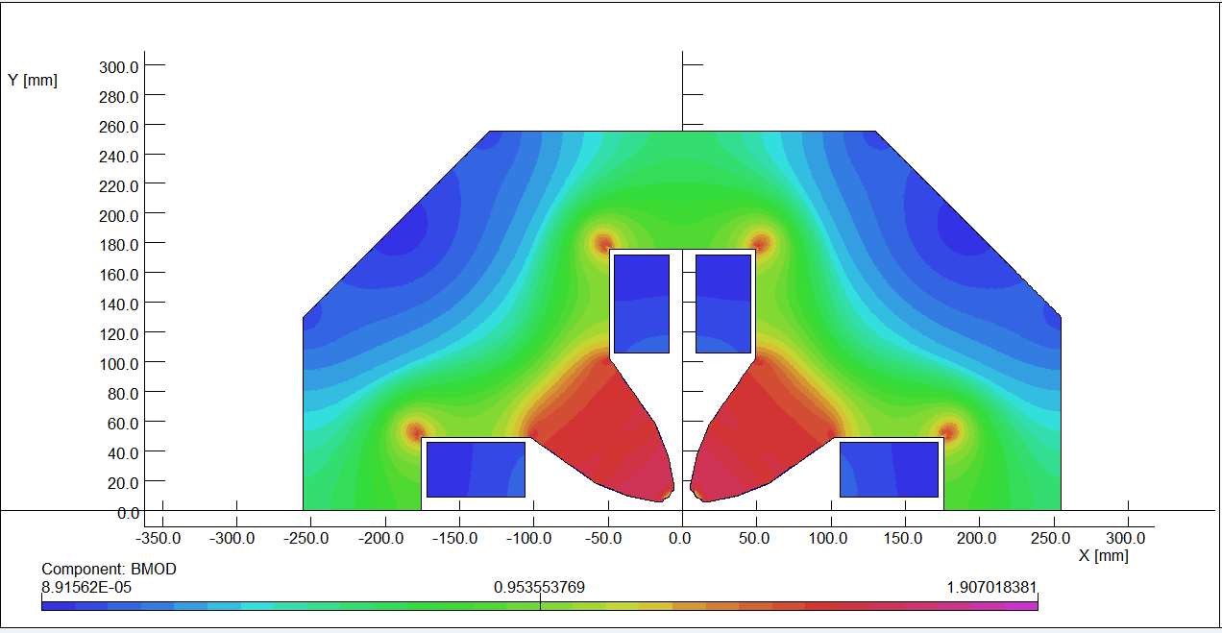
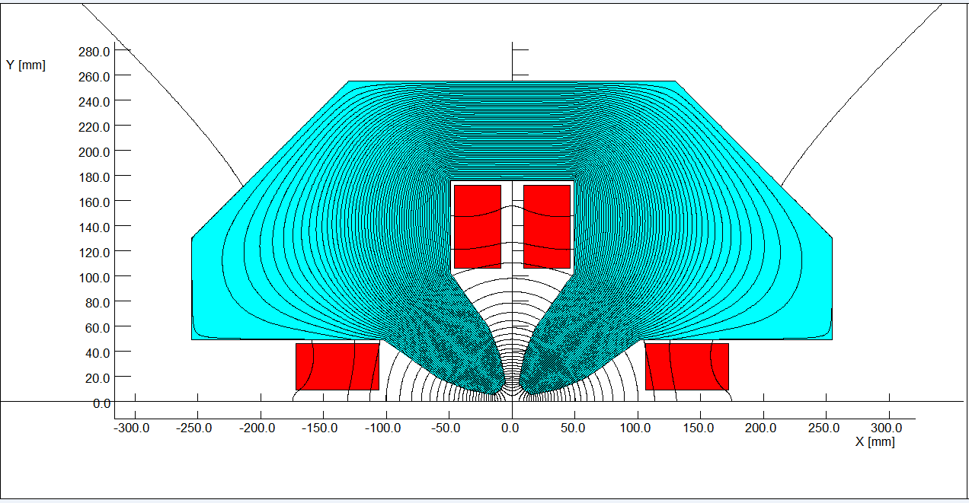
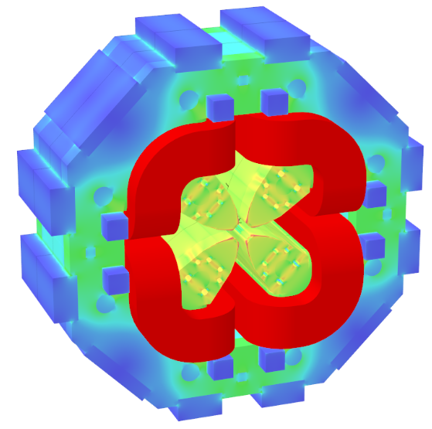
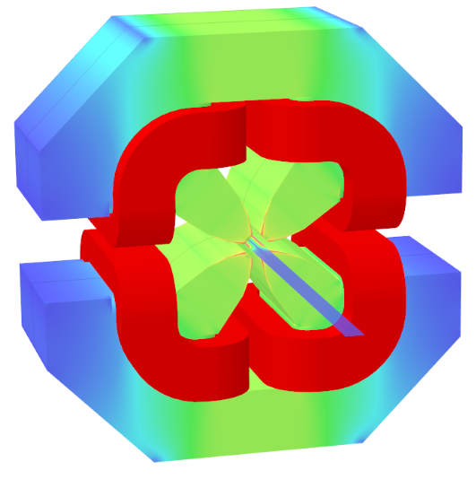
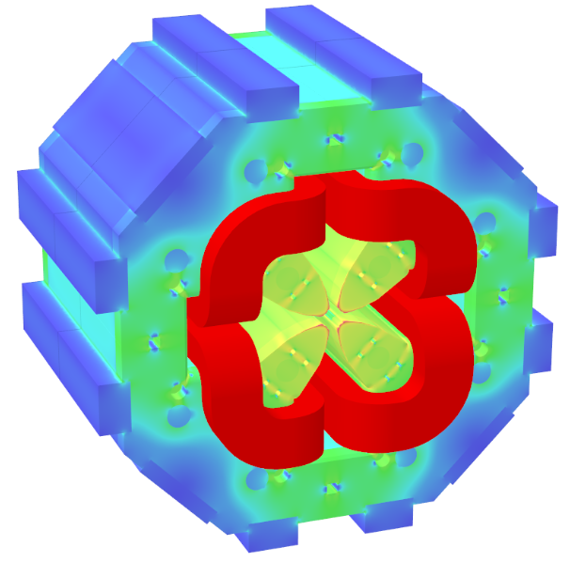
The quadrupole magnets for the storage ring
Detailed 2D and 3D magnetic field calculations are carried out for each type of quadrupole magnets. Simulation results meet the requirements.

Slide 23
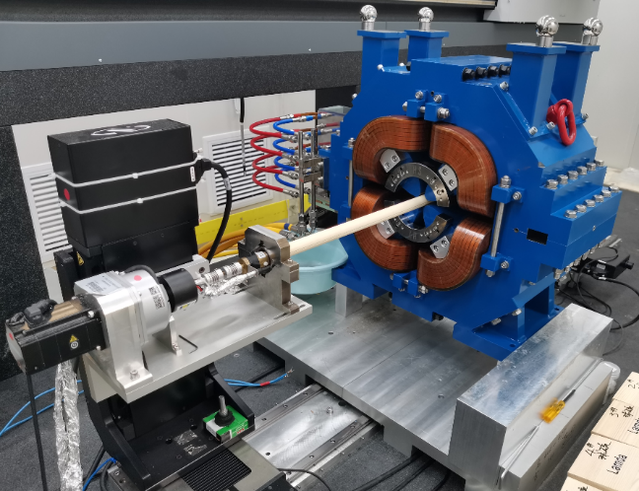
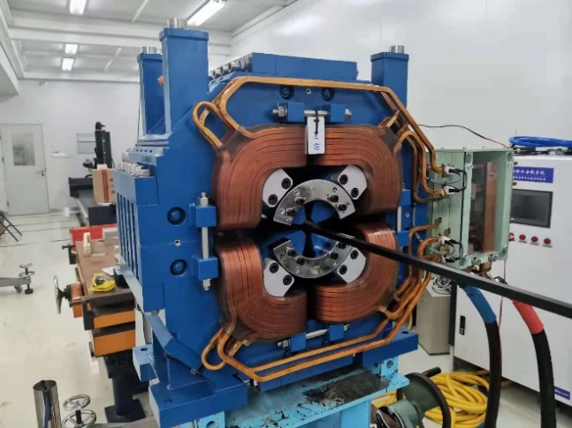
The quadrupole magnets for the storage ring
The hall probe measurement system is used to map the field in the aperture, the rotating coil measurement system is used to measure the harmonic errors and integral field.
The results show that the most magnets work at non-linear region of BH curve and the harmonic errors of the magnets are less than 4E-4.

Slide 24



The other magnets for the storage ring
The storage ring has 288 sextupole magnets and 96 octupole magnets, which are designed and produced by the conventional technologies. The cores of the magnets are made by solid steel, the coils are wound by hollow copper conductors.
There are also 192 fast correctors. To reduce eddy current effect, the cores of the magnets are stacked by the steel laminations with the thickness of 0.15mm.

Slide 25
Summary
The HEPS has three accelerators (Linac, Booster and Storage ring), which have totally 2389 magnets
The magnets for linac and transport lines are DC magnets, which are designed and produced by conventional technologies.
The magnets for the booster are dynamic magnets, some special technologies related to eddy current and vibration are developed when the magnets are designed and produced.
The magnets for the storage ring are high field, high precision magnets, which are firstly designed and produced in China. It is a challenge to us because the field quality is very sensitive to the mechanical tolerance and performance of the material due to high working field.
Most of the technologies developed in HEPS magnets can be used to design and produce CEPC magnets in future.

Slide 26
Thank you for your attention.

