Slide 1
Vacuum System Development of HEPS
Yongsheng Ma
On behalf of vacuum system
Ping He, Haiyi Dong, Hong Song, Binglin Deng, Qi Li, Dizhou Guo, Fei Sun, Qi Yang, Yucheng Yang, Tianfeng Liu, Baiqi Liu, Xujian Wang, Xiaohua Peng, Tao Huang, Pilong Tian
Pengcheng Wang, Jiaming Liu, Xiaoyang Sun, Bangle zhu
2023-2-14

Slide 2
Contents
1
Preview of HEPS vacuum system
2
Linac Vacuum，Transport Lines Vacuum
3
Booster Vacuum
4
Storage ring Vacuum
5
Summary

Slide 3
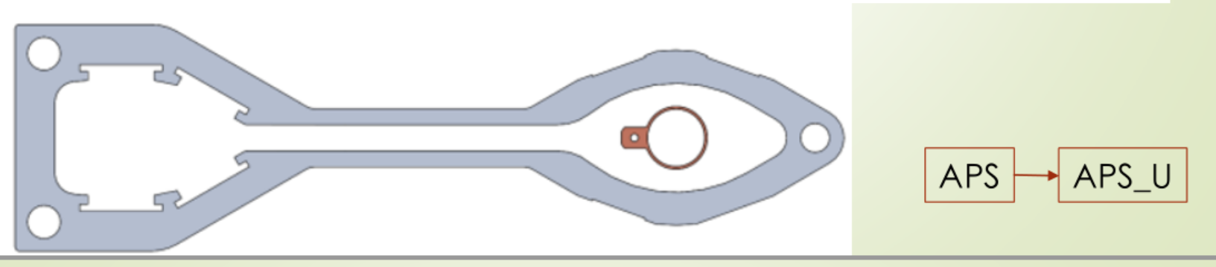
1 Preview of HEPS vacuum system
Haiyi Dong
High Energy Photon Source
Booster
Linac
Storage ring
Storage ring vacuum chamber changes to much smaller from 3th Generation To 4th Generation
3th Generation
4th Generation
Notes:
Vacuum of Booster 、storage ring, MDI are all considered and under technical design. Conventional technical such as ion pump /extruded copper pipes will be used in CEPC. There is no especial issue exceed our control, except to balance the impedance and gas absorb ability of NEG film

Slide 4
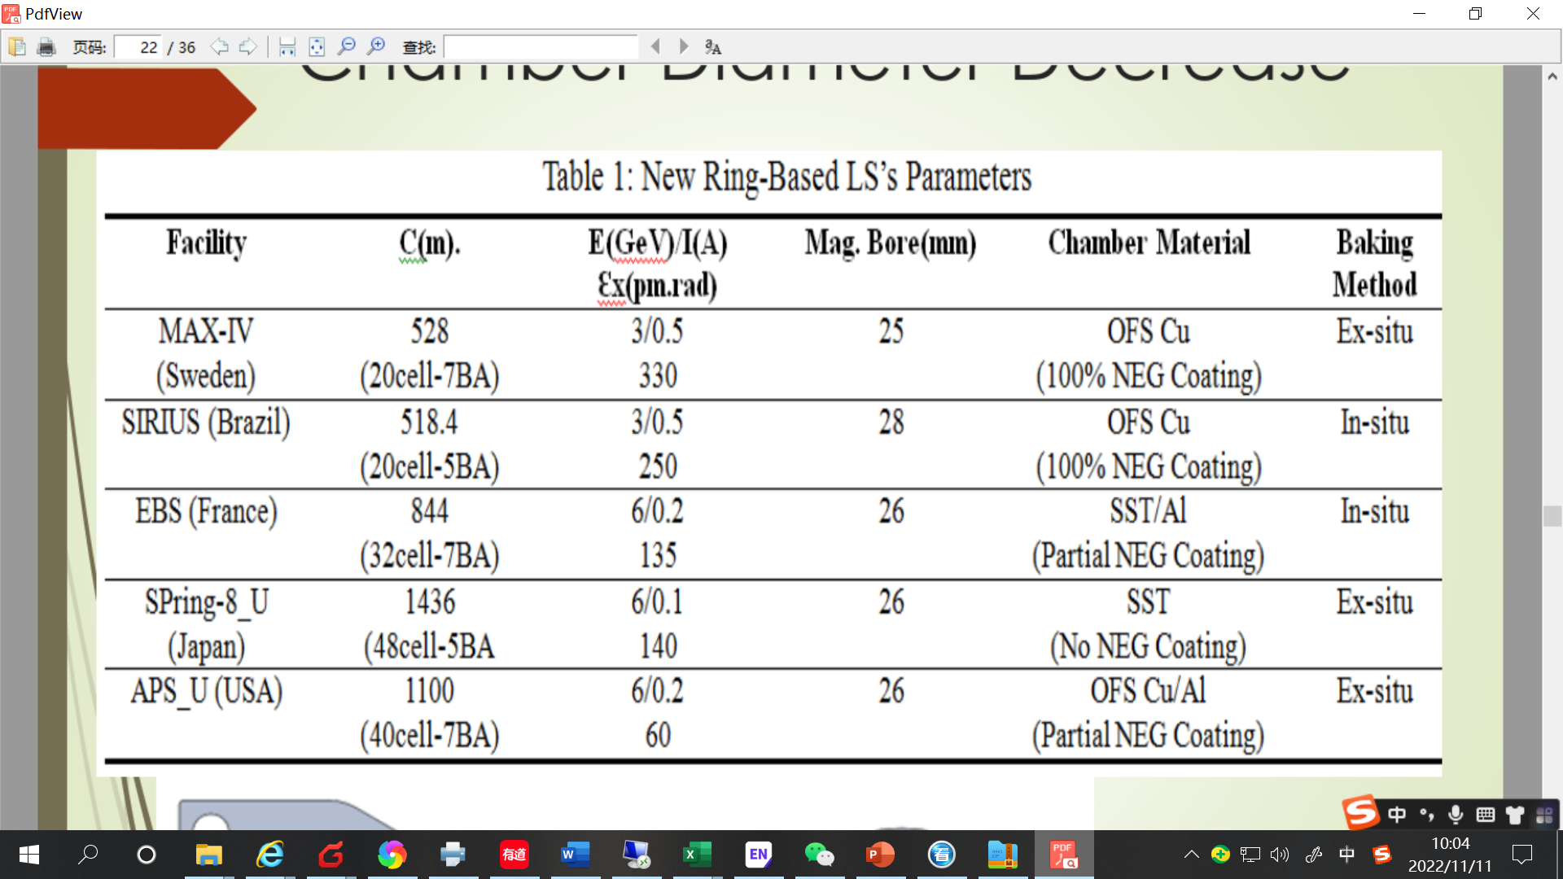
1 Preview of HEPS vacuum system
Haiyi Dong
 | Energy | Material | Cross Section/mm | Length/m | Dynamic pressure /Torr
LINAC | 500 MeV | Stainless steel, copper | Φ30 | 49 | Acc <2×10⁻⁷ E-gun<2×10⁻⁸
Booster | 500 MeV to 6 GeV | Stainless steel | 36×30 (H×V) ellipse / thickness of 0.7mm | 454 | <3×10⁻⁸
Storage Ring | 6 GeV | Extruded copper, S.S, NEG film | φ22/thickness of 1mm | 1360.4 | <3×10⁻⁹
LTB | 500 MeV | Stainless steel | φ30/thickness of 1mm | 25 | <1×10⁻⁷
BTS(STB) | 6 GeV | Stainless steel | φ26/thickness of 1mm | 105 | <1×10⁻⁷
HEPS | 1346 （48cell-7BA） | 6/0.2 35 ^{[1]} | 26 | CrZrCu （Partial NEG coating） | In-situ
Notes:
Vacuum of Booster 、storage ring, MDI are all considered and under technical design. Conventional technical such as ion pump /extruded copper pipes will be used in CEPC. There is no especial issue exceed our control, except to balance the impedance and gas absorb ability of NEG film

Slide 5
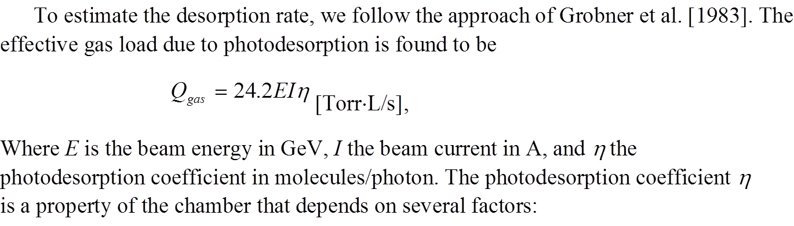
1 SR power and gas load
 | E | I | ρ | Psr | PL | PSD | q _{th} | Q _{gas} | Q _{LSR}
 | Gev | A | m | MW | W/m | molecules/photon | Torr·L/s·cm² | Torr·L/s | Torr·L/s·m
Booster | 6 | 0.015 | 28.52 | 60.32 | 336.8 | 2.00E-06 | 1.0E-11 | 4.36E-06 | 2.43E-08
Storage ring | 6 | 0.2 | 53 | 432.82 | 1300.4 | 2.00E-06 | 2.5E-12 | 5.81E-05 | 1.74E-07

Slide 6
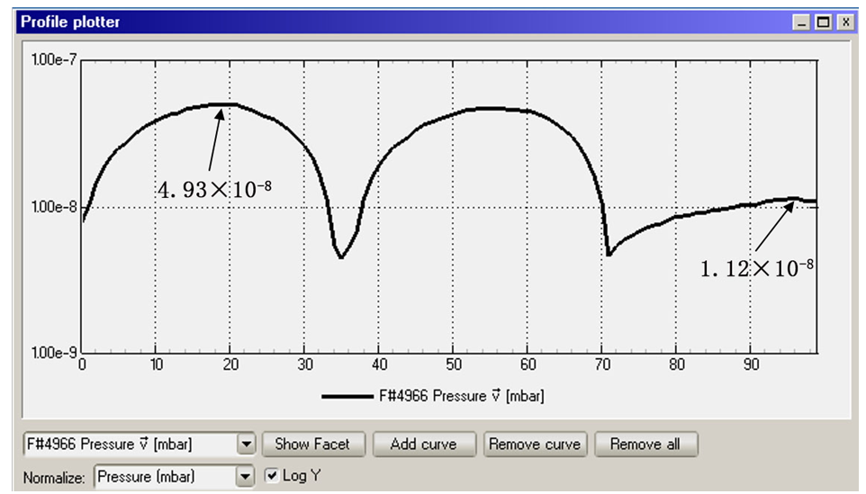
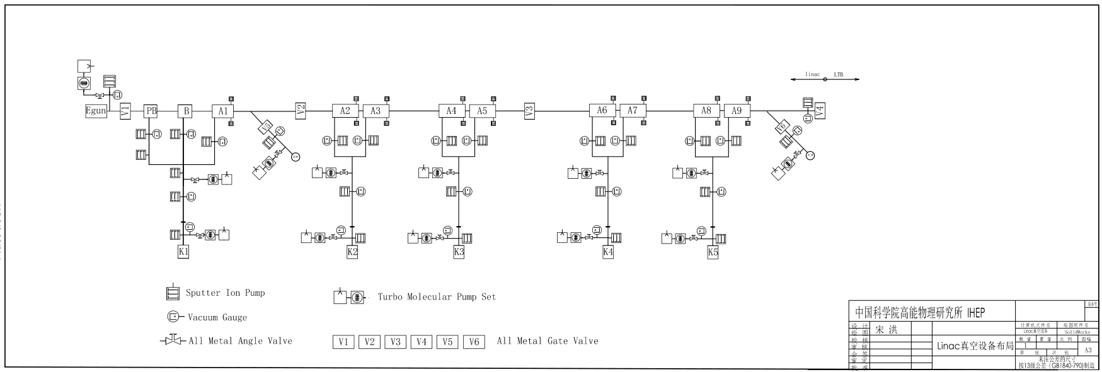
2 Layout of Linac vacuum system
Hong Song
Section | Static pressure /Torr | Dynamic pressure /Torr
E-gun | <1×10⁻⁹ | <2×10⁻⁸
Buncher | <5×10⁻⁸ | <2×10⁻⁷
Accelerating structure | <5×10⁻⁸ | <2×10⁻⁷
AM | <5×10⁻⁸ | <5×10⁻⁷
Waveguide | <5×10⁻⁸ | <5×10⁻⁷
The Linac vacuum system with a length of 49m is divided into 6 sections. it consists of electron gun, bunching system, accelerating structures and Analyzer Magnet sections.
Sputter ion pumps: 45; Vacuum gauges: 25; Gate valves: 6
Most of the components are made of oxygen-free copper .
The thermal outgassing rate is 1×10⁻¹¹ Torr·l/s·cm².
Notes:
conventional technology

Slide 7
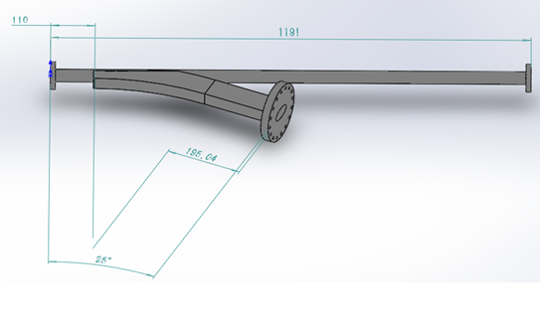
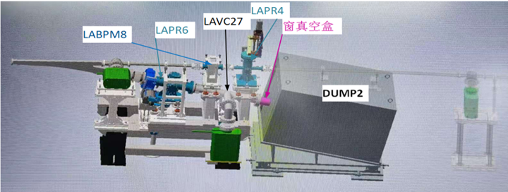
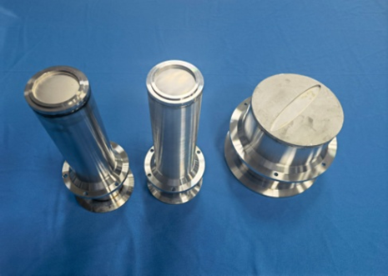
Dump chambers and membrane windows for Linac
The elliptical Ti thin membrane window of 170×10 mm with a thickness of 0.1 mm was welded on the s. s. plate with a diameter of 183 mm and a thickness of 5mm.
membrane windows
Inner cross section of ellipse in 60 × 30 mm
Outer cross section of rectangle in 62 × 32 mm
Membrane windows
The thickness of Ti window is 0.1mm
Deformation test under vacuum: elliptical window is 0.4mm, circle window is 2.3mm;
ultimate vacuum<5 ×10⁻⁸Pa。
Notes:
材料的选择→加工工艺→样件试制→检漏→变形测量→极限真空测试
对0.1mm厚的钛膜进行电子束焊和钎焊试验；
钛窗真空下变形实验，椭圆窗0.4mm，圆窗2.3mm，打压1MPa未发现有漏；
极限真空小于5 ×10⁻⁸Pa。

Slide 8
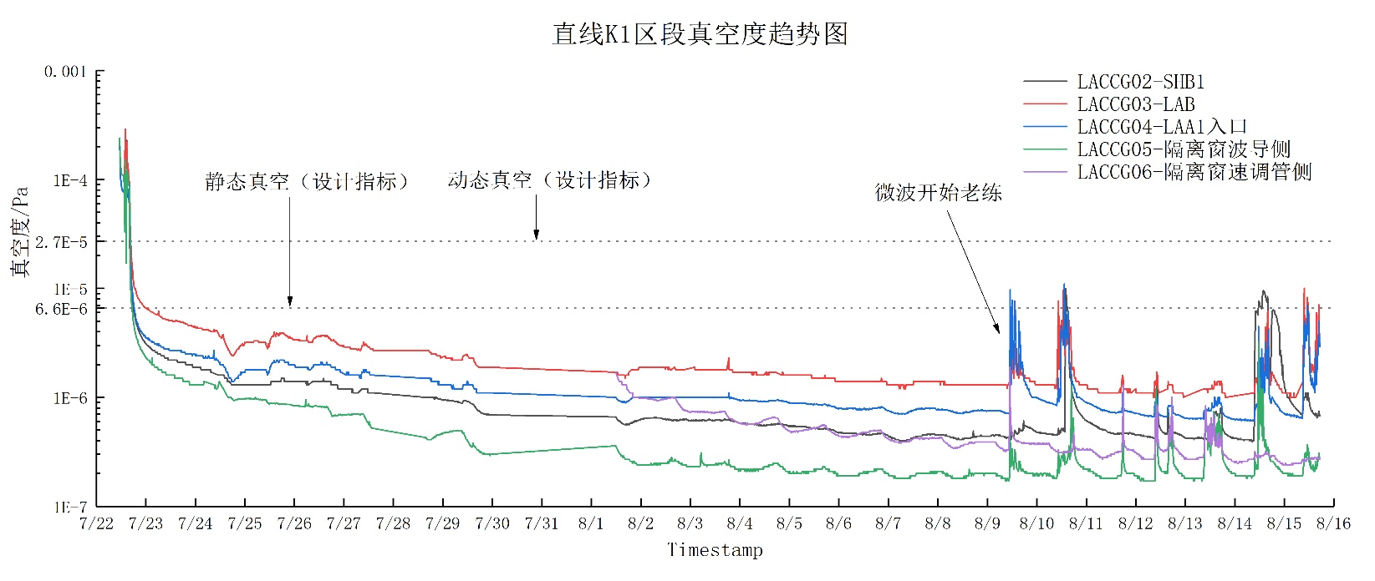
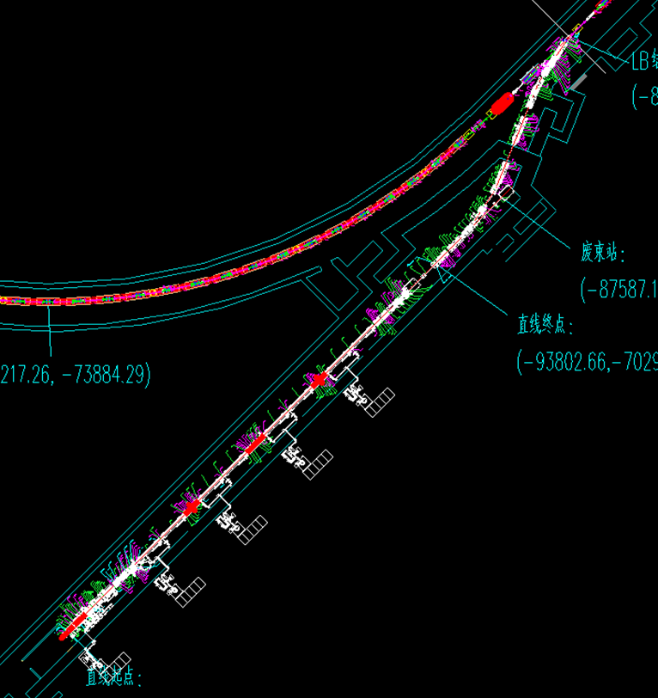
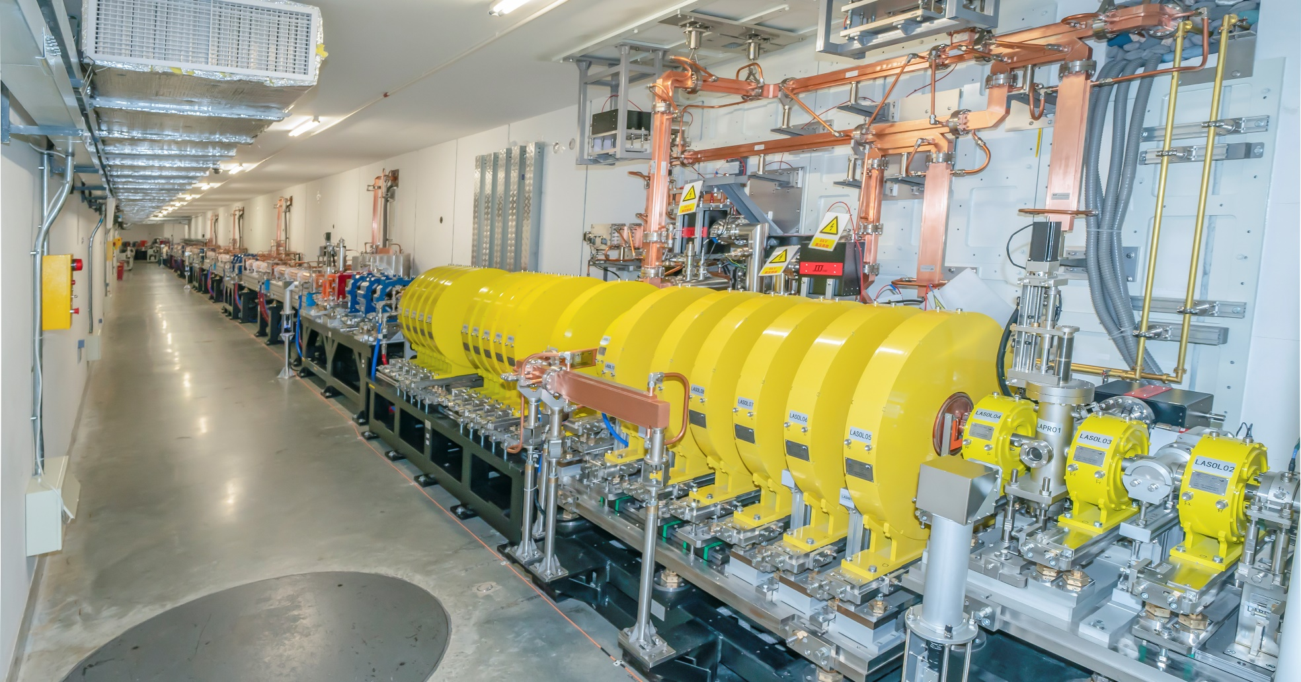
2 Status of Linac
K1 section vacuum curve vs date
The installation of all devices of Linac has been finished by July 2022,
The static pressure reached its design value .
Static pressure
Dynamic pressure
Microwave conditioning
Vacuum/Pa
Notes:
直线和低能输运线通过8个区段阀分成8个真空区段，其中有电子枪、聚束单元、加速结构、分析磁铁节等；
真空盒和波纹管材料为不锈钢，共103件；
离子泵共有60台，冷阴极真空规30个。

Slide 9
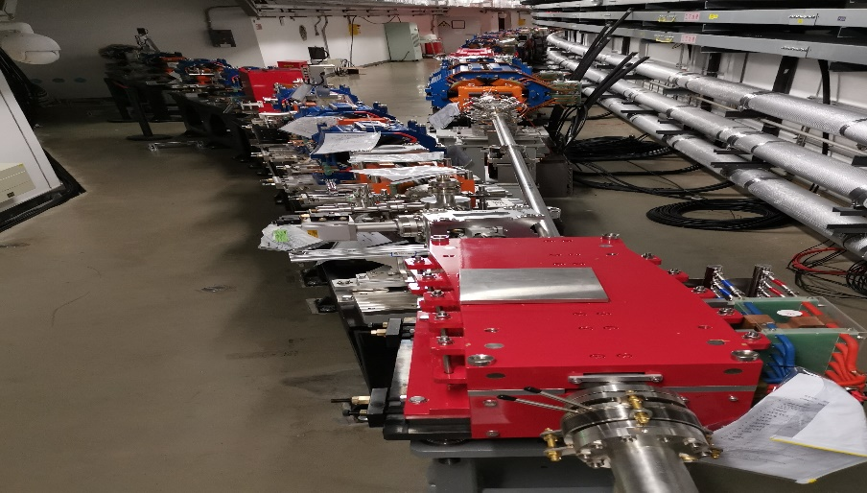
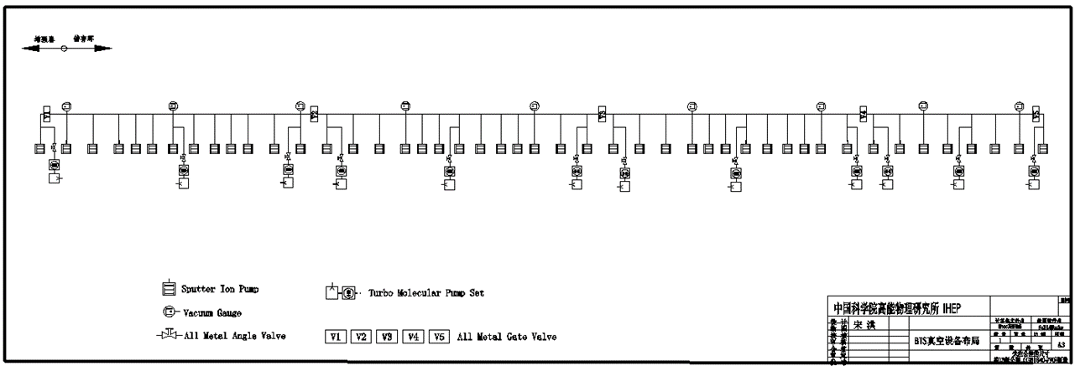
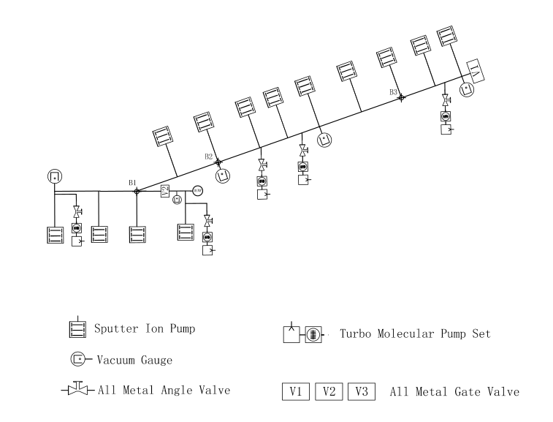
2 Introduction of transportation lines
There are three beam transport lines. One is used to transfer 500MeV electrons from linac to the booster (LTB), the other two lines are used to transfer 6GeV electrons from booster to storage ring (BTS), and storage ring to booster (STB).
Thermal outgassing rate is 1×10⁻¹⁰ Torr·l/(s·cm⁻²). The dynamic vacuum pressure < 1×10⁻⁷ Torr.
Section | Length/m | Average pressure /Torr | Maximum pressure /Torr | The distance of SIP
LTB | 25 | 2.3 × 10⁻⁸ | 3.3×10⁻⁸ | 2.5m
BTS(STB) | 105 | 2.7 × 10⁻⁸ | 4.7×10⁻⁸ | 1.8m
LTB Line
LTB vacuum layout
BTR(RTB) vacuum layout
Notes:
高能输运线（BR&RB)由2条约105m长的传输线和1条约18m长的废束线组成；
每条线真空分为5个区段，共有离子泵54台、冷规15个、闸板阀6台；
BR线真空盒126根、RB线129根、DUMP线12根，波纹管共计124件；

Slide 10
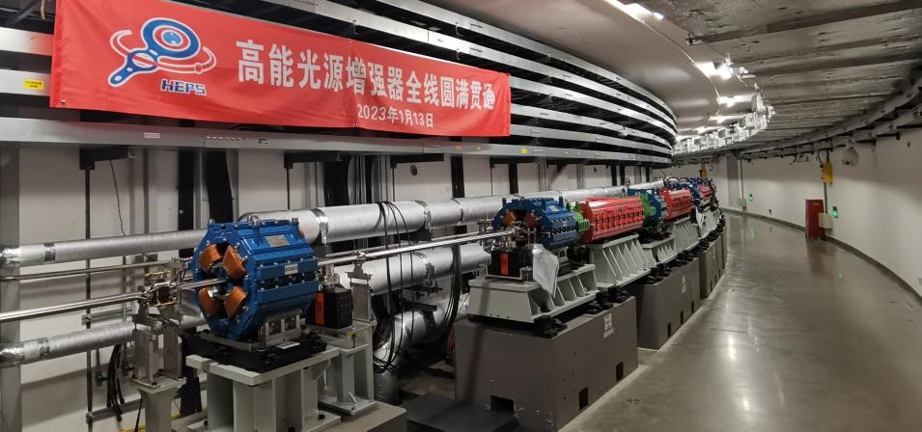
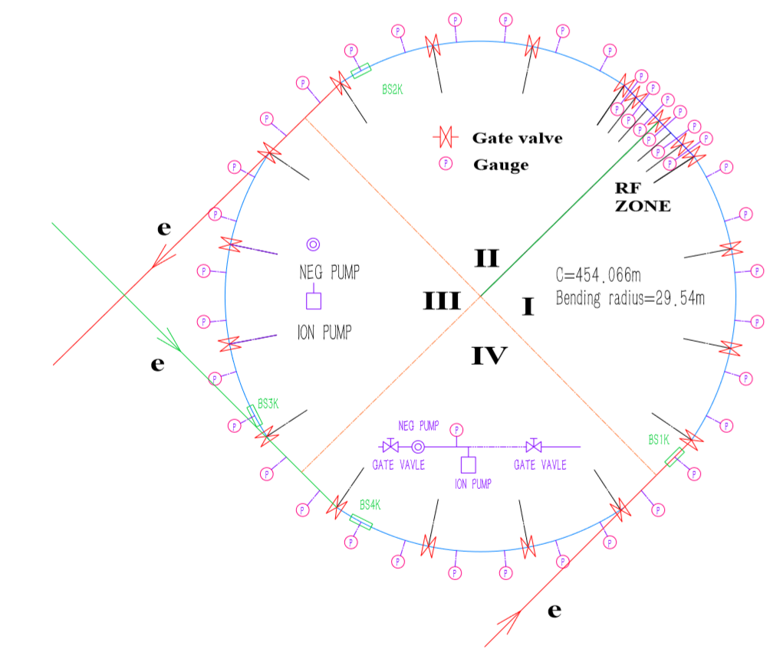
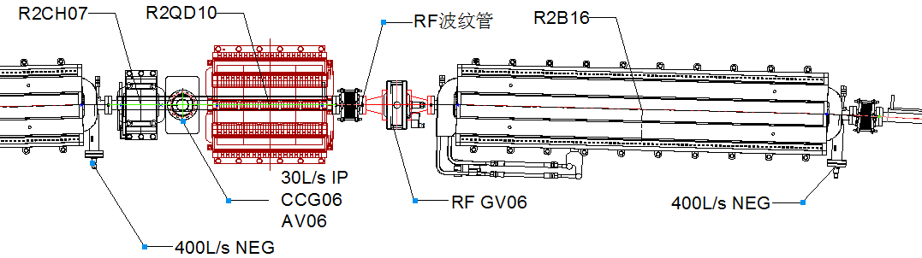
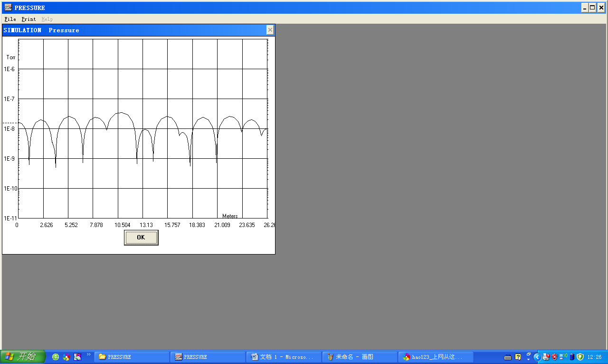
3 Booster vacuum system
Pengcheng Wang
The vacuum system is divided into 19 sections , 12 sections for the arc regions, 7 sections for the straight and RF regions. Each section has 2 rough pumping valves.The system is first pumped to 10⁻⁷ Torr by oil-free TMPs. The ion pumps and NEG pumps will be used as maintain pumps. Average pressure is 1.59×10⁻⁸ Torr
schematic diagram
Item | Ion pump | NEG pump | Gate valve | Vacuum gauge | RGA | RF-shield Bellows
Quantity | 140 | 84 | 19 | 38 | 16 | 152
Specification | 30 L/s | 400 L/s | All metal | CCG |  | Double fingers
Notes:
通过带RF屏蔽的全金属闸板阀把增强器分成16个区段，同时每个高频腔两端配有阀门，共需28个阀门，其中包括低能注入区、高能引出区和回注区、高频腔区等；
总计407根真空盒，包括83种规格；
真空获得设备为干泵、分子泵、离子泵和吸气剂泵；
真空测量为冷阴极真空计和残余气体分析仪。
schematic diagram

Slide 11
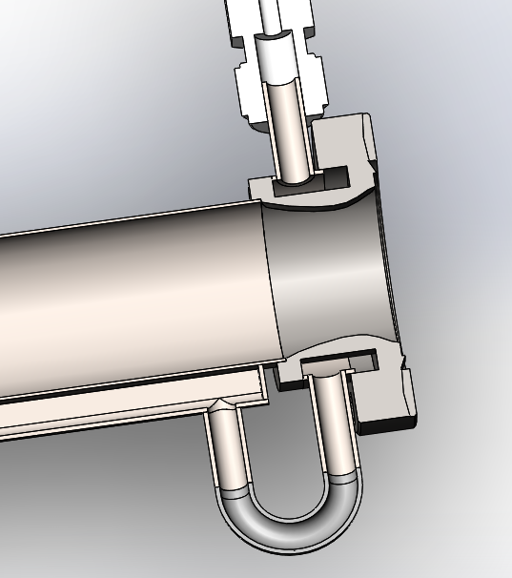
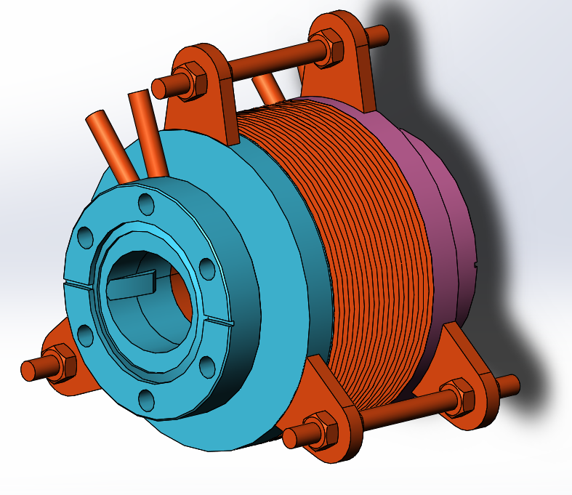
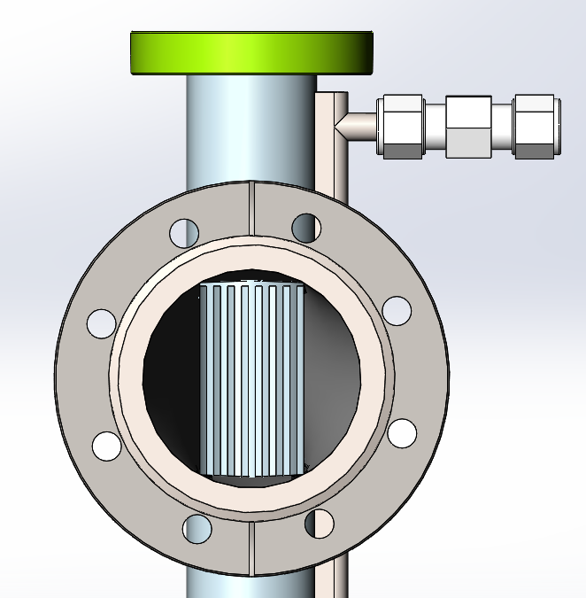
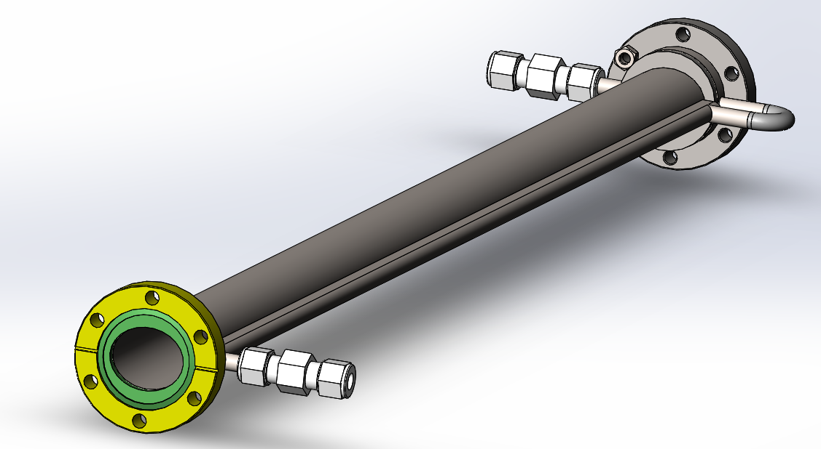
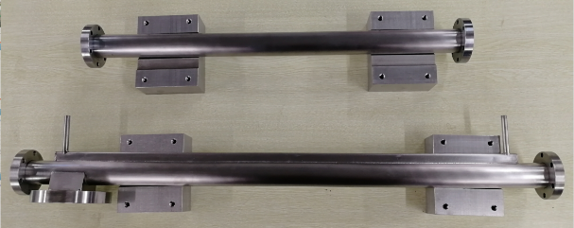
3 Booster vacuum requirements
Jiaming Liu
The in-line absorbers are used to prevent SR photons from falling on the bellows, BPM etc.
In order to reduce the eddy current effect during the quick cycle of the magnets, the vacuum chambers will be made of thin-walled stainless steel. The inner surface of the vacuum chambers should be as smooth as possible to reduce the impedance.
A cross-section of 36mm×30mm (H×V) ellipse with wall thickness of 0.7mm, length of 1.62m, bending radius of 28.52m. Permeability ≤1.02.
The peak SR power of the booster reaches 0.34 kW/m, and the average power is about 1/4 of the peak power.
Notes:
椭圆真空盒壁厚0.7mm, 磁导率≤1.02, 垂直度≤0.1mm, 直线度≤0.2mm；
技术路线：冷拨薄壁椭圆管+激光焊接+工装保证尺寸+钳工整形；
A seamless stainless steel tube is drawn and extruded into an ellipse, and then bent into the required angle.
The magnetic permeability of stainless steel chambers is less than 1.02.
Mechanical sizes meet the requirements.
Ultimate pressure of 1.8×10⁻⁹ Torr was reached with a 30L/s ion pump.

Slide 12
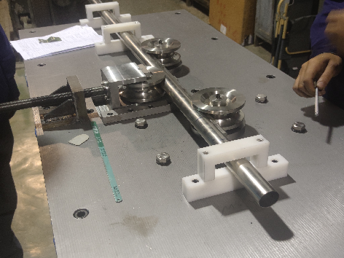
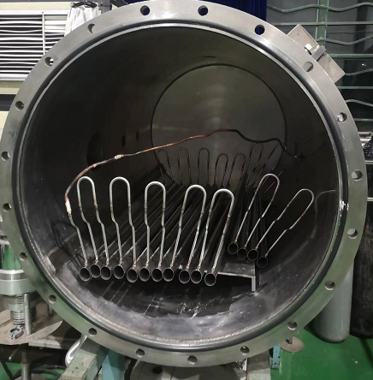
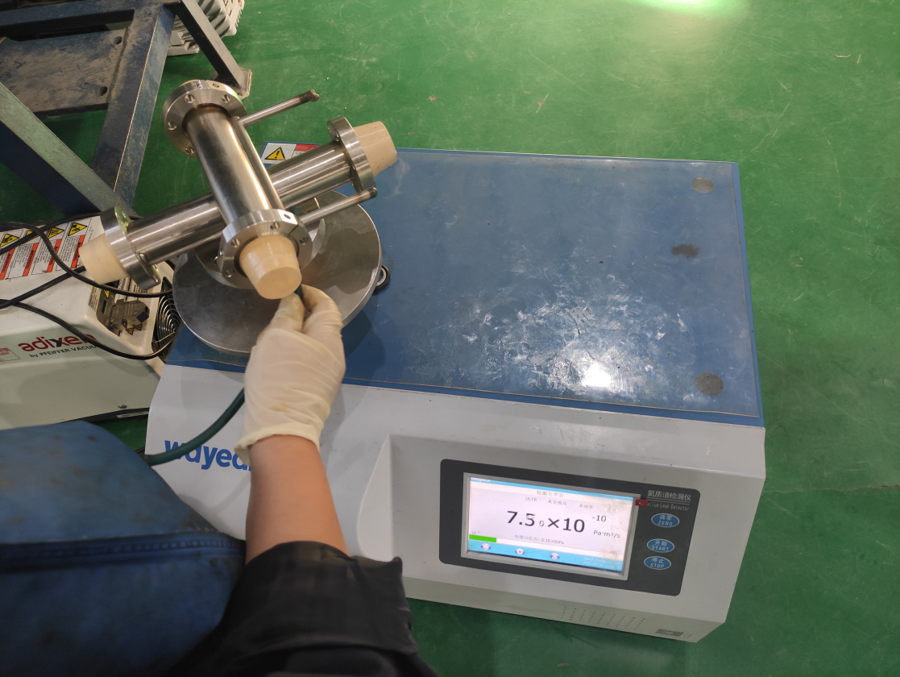
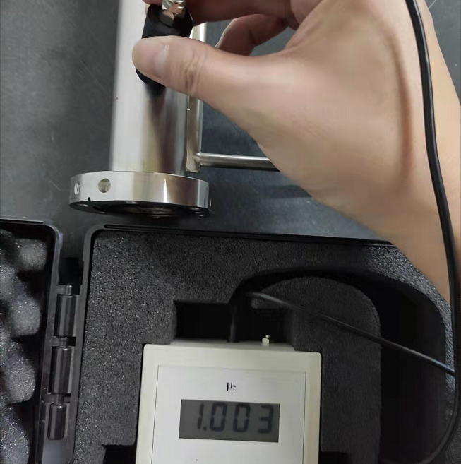
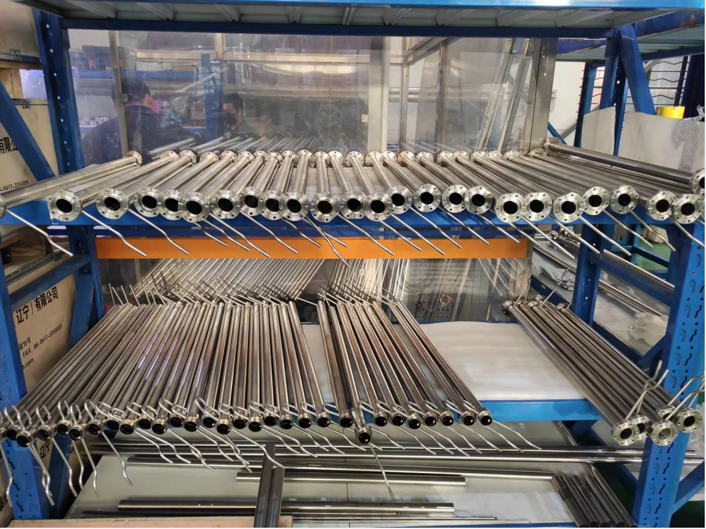
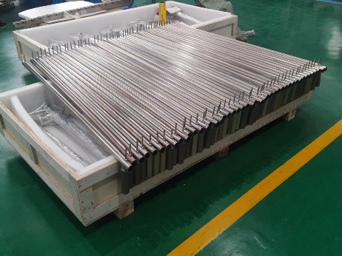
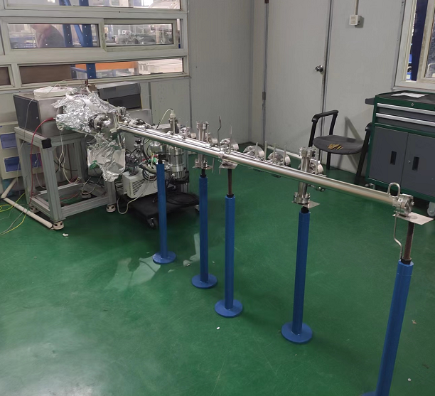
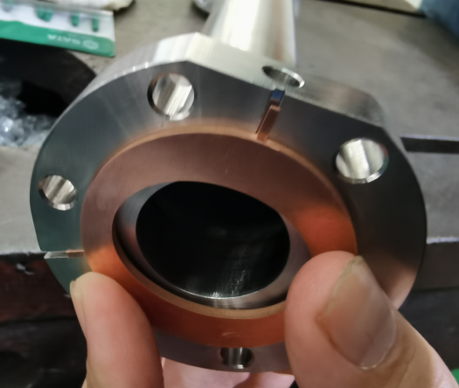
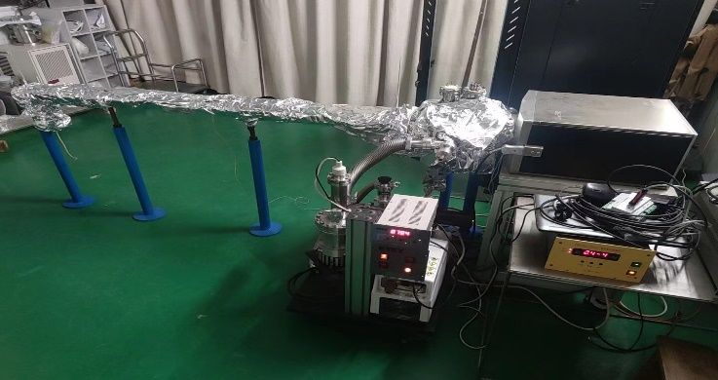
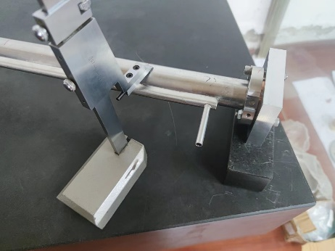
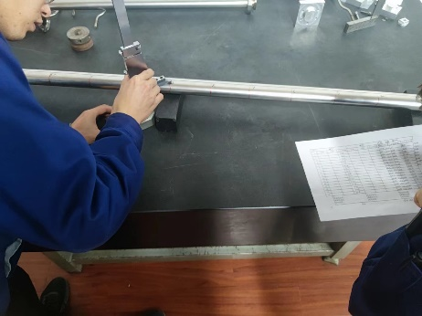
3 Processes of vacuum chamber produce

Slide 13
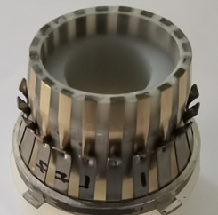
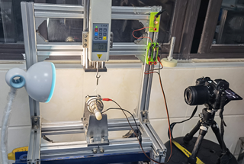
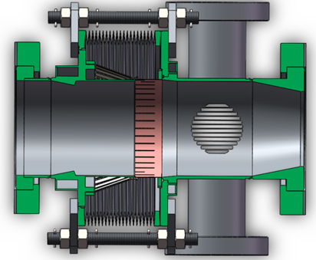
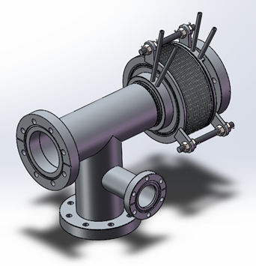
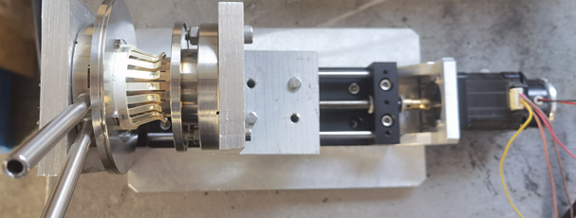
3 RF shielding bellows of booster
Jiaming Liu
Total length | Expansion | Contraction | Ellipse cross section | Contact pressure | Maximum radial offset
70-100mm | 5mm | 10mm | 36mm×30mm | 125±25g | 2mm
Mask is designed on the upstream of RF bellows to absorb the SR
The all RF bellows of HEPS is produced by domestic company in China

Slide 14
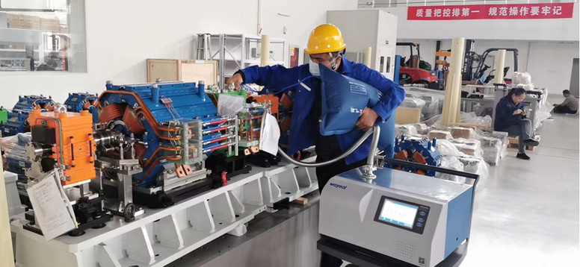
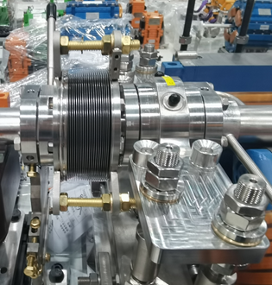
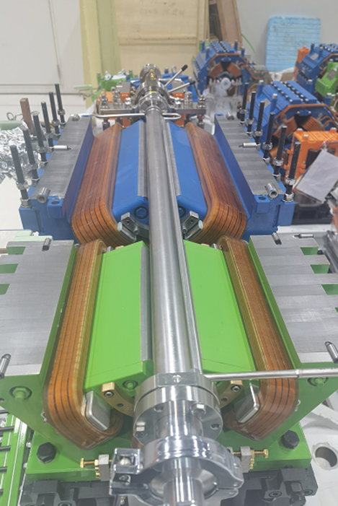
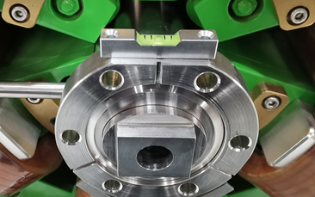
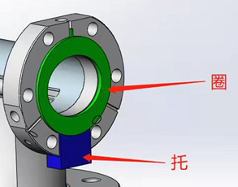


3 Booster vacuum components pre-installation at PAPS
Jiaming Liu xiaoyang Sun, Bangle Zhu
Sealing ring
Chamber adjustment
support-Auxiliary tooling
Notes:
To speed up installation progress and reduce errors,

Slide 15
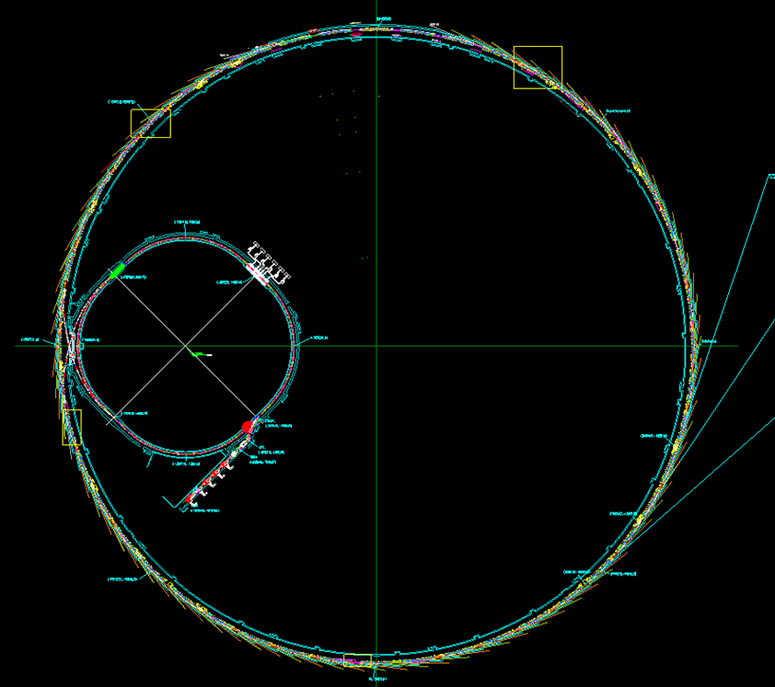
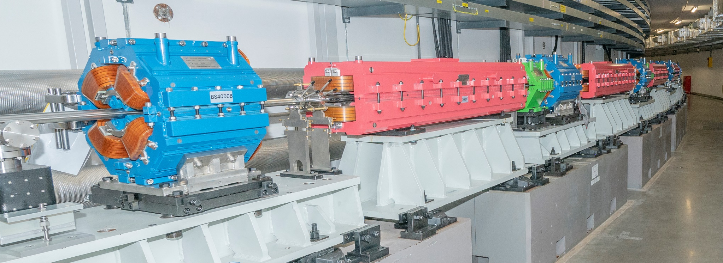
3 Status of Booster
The installation of all devices of booster has been finished so far.
The last chamber of vacuum system have been installed by 23th Jan 2023, which is before Chinese New Year. The vacuum will be pumped down after cables are connected.
Notes:
直线和低能输运线通过8个区段阀分成8个真空区段，其中有电子枪、聚束单元、加速结构、分析磁铁节等；
真空盒和波纹管材料为不锈钢，共103件；
离子泵共有60台，冷阴极真空规30个。

Slide 16
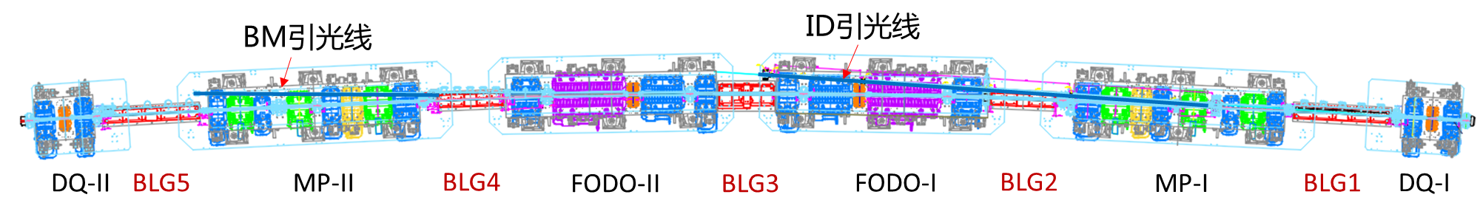
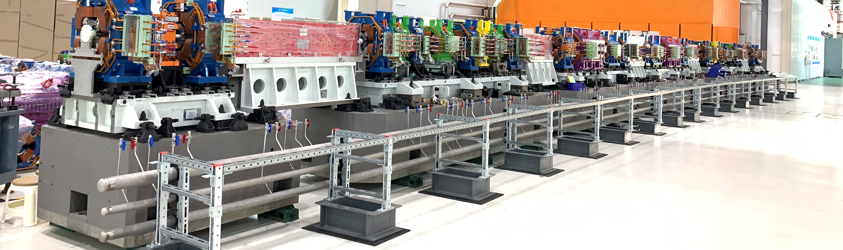
4. Storage ring Vacuum
Haiyi Dong
The Circumference of HEPS storage ring is 1360.4 m, and 24 double 7BA units are applied in an achromatic Lattice design.
The long linear section is located at the beginning of the 48 standard units and is mainly used for mounting insertions, injection and extraction devices, RF and other equipment. RF shielding all-metal gate valves are installed on the two ends of the long linear section, which are divided into about 96 vacuum sections.
Each standard arc unit includes 18 vacuum chambers, the most of those will be NEG coating, and 14 RF shielded bellows, 4 photon absorbers, ion pumps, NEG pumps, vacuum gauges and valves.
BM Light extraction line
ID Light extraction line
R46 even arc unit
Notes:
HEPS储存环周长1360.4 m，采用24个双7BA单元消色散Lattice设计；
在48个标准单元中长直线节位于开始，并且主要用来安装插入件、注入引出、高频等设备。在长直线节的二端安装RF屏蔽全金属闸板阀，共分成约96个真空区段；
每个标准弧区单元包括18根真空盒、14套RF屏蔽波纹管、4个光子吸收器，还有离子泵、吸气剂泵、真空规和阀门等

Slide 17
4. Storage ring Vacuum requirements
A vacuum in the lower than 1×10⁻⁹ Torr is required when a beam is circulating in the storage ring. It can be shown that the beam lifetime would exceed 100 h if only losses due to Interactions between beam and gas.
Good beam lifetime must be achieved soon after the initial startup with a stored beam.
The system must be capable of quick recovery after the sections are vented for maintenance.
The chamber wall is designed as smooth as possible to minimize the electromagnetic fields induced by the beam.
Sufficient cooling to safely dissipate the heat load associated with both synchrotron radiation and higher-order-mode (HOM) losses.
Capability to shield outer ring components from synchrotron radiation.

Slide 18
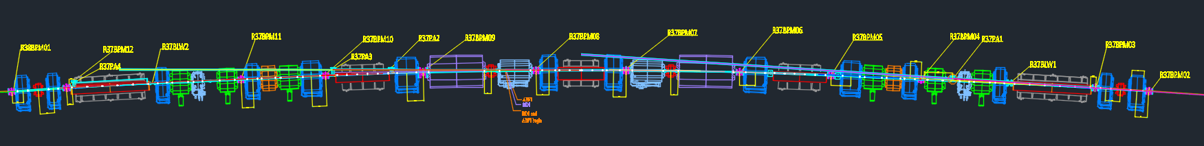
4. Distribution of SR power on the Storage Ring vacuum components
ABS: Photon Absorber Yellow
MSK: Mask Brown
VC: Vacuum Chamber Blue

Slide 19
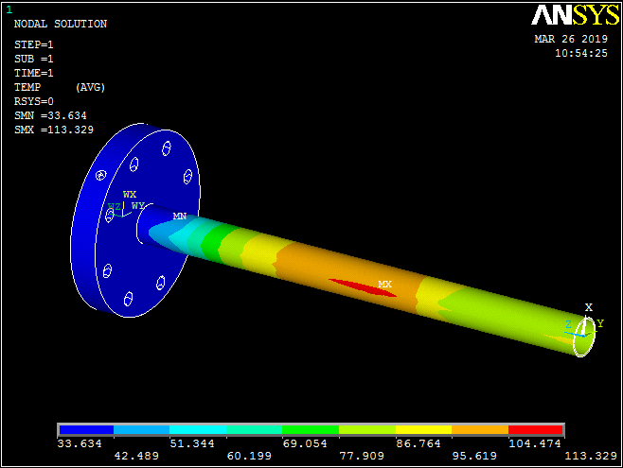

4. FEA of the mask of a highest power density
Dizhou Guo
Positions | Power（Ｗ） | Length (mm) | Height (mm) | Area (mm²) | Power density（W/mm²）
Ｉ | 297.92 | 101.24 | 0.2 | 20.25 | 14.71
ＩＩ | 839.11 | 164.77 | 0.2 | 33 | 25.46
ＩＩＩ | 129.6 | 19.18 | 0.2 | 3.84 | 33.79
ＩＶ | 14.93 | 2.8 | 0.14 | 0.39 | 38.07
Ｖ | 8.6 | 3 | 0.14 | 0.42 | 20.47
SR Mask with a slope length of 300 mm (total of I To V) to reduce power density.
The part of mask in the magnet is cooled by water-cooled pipes and the outer part by water-cooled jackets.
As the total power does not decrease, the maximum temperature is still high.
Max. Temp 113℃
Max. Stress 22 MPa

Slide 20

4. Pumping system & vacuum distribution
The circumference of the storage ring is divided into about 96 sectors by means of the RF all metal gate valves, which allow all vacuum work such as pumping down from atmosphere pressure, leak detecting, bakeout, and vacuum interlock protection, to be done in sections of manageable length and volume.
Roughing down to approximately 10⁻⁷ Torr will be achieved by the oil free turbo-molecular pump group.
The main pumping is achieved with Non Evaporable Getter(NEG)-coated chambers, the ion pumps will be used to maintain pressure and pump off CH₄ and noble gases.
CPMU, IVU and RF cavities will be pumped down by NEG pumps and ion pumps.
1~14: ion sputtering pump
Pressure profile of a standard arc section @ 6GeV，200mA
Thermal outgassing rate: 2.5×10⁻¹² mbar·L/s·cm²
Photo desorption rate: 1.95×10⁻⁶ moleculars/photon
Pumping speeds: Ion pump 30 L/s;
NEG film sticking factor H2 is 0.007, CO is 0.07

Slide 21



4. Vacuum chambers requirements
Cu-Cr-Zr (C18150) is chosen as the chambers material because of its higher thermal conductivity and higher resistance to softening due to the NEG activation temperature of 200 C°.
Stainless steel (Inconel) material is used for fast corrector chambers and some chambers with ion pumps.
The vacuum chambers have a 22 mm inside diameter with 1 mm wall thickness. The clearance between the chambers and the magnets poles is 1 mm (include 0.4mm heating tape).
Distributed cooling channels are welded to the chambers to safely dissipate the SR power.
All the chambers are produced with tight mechanical tolerances to avoid any interference with the magnet poles and coils.
Sheathed heating wires
MSK
Cooling jacket
Notes:
真空盒的设计既要考虑到束流清晰区和全环阻抗预算的要求，又要满足真空度的要求及磁铁孔径的限制，同时还要控制好同步辐射功率的分布；
快校正子真空盒采用低电导率的Inconel材料，壁厚0.5mm，用来减小涡流效应；
真空盒内壁应逐渐过渡(坡度比≤ 1/10, 台阶≤ 0.1mm)，以减小束流阻抗和高次模损失；同时需要冷却水管分散同步光功率。

Slide 22
Vacuum chambers of a 7BA cell
Number | Related magnets | Shape | Material | Length (mm) | Bending (°) | Flange types
VC1 | QF1-FC1-QD1 | φ24*1 | C18150/Inconel625 | 956.9 |  | Various
VC2 | BLG1 | Antechamber (part) | 316LN (coating Cu) | 1604.4 | 1.2372 | CF63
VC3 | QD2-SD1-ABF1 | Antechamber/φ24*1 | C18150 (Cu-Cr-Zr) | 1155.3 | 0.0768 | CF63/CF25
VC4 | SF1 | φ24*1 | C18150 | 496.8 |  | CF25/CF63
VC5 | QF2-OCT1-SD2-QD3 | φ24*1 | C18150 | 1667.8 |  | CF63
VC6 | BLG2-QF3 | φ24*1 | C18150 | 1697.8 | 0.8375 | CF63
VC7 | BD1 | φ24*1 | C18150 | 1196.9 | 1.3671 | CF63/CF25
VC8 | FC2 | φ24*1 | Inconel625 | 221.3 |  | CF25/CF25
VC9 | ABF2 | φ24*1 | C18150 | 715.2 | 0.2756 | CF25/CF63
VC10 | QD4-BLG3-QD5 | φ24*1 | C18150 | 1666.7 | 1.3863 | CF63
VC11 | ABF3 | Antechamber | C18150 | 705.2 | 0.3081 | CF63
VC12 | FC3 | Antechamber | Inconel625 | 221.3 |  | CF63
VC13 | BD2 | Antechamber | C18150 | 1168 | 1.3675 | CF63/CF160
VC14 | BLG4-QF4 | Antechamber (part) | 316LN (coating Cu) | 1808.4 | 0.8142 | CF160/CF63
VC15 | QD6-SD3-OCT2-QF5 | φ24*1 | C18150 | 1555.8 |  | CF63
VC16 | SF2-ABF4-SD4-QD7 | φ24*1 | C18150 | 1647.1 | 0.1178 | CF63/CF25
VC17 | BLG5 | Antechamber (part) | 316LN (coating Cu) | 1589.1 | 1.288 | CF25/CF63
VC18 | QD8-FC4-QF6 | Antechamber/φ24*1 | C18150/Inconel625 | 967.8 |  | Various
Notes:
Cu-Cr-Zr (C18150) will be chosen as the main chambers material. Inconel material will be used for fast corrector chambers.
Stainless steel will be adopted for the BLG chambers and coated with copper inside.

Slide 23








Vacuum chamber design of VC14 (BLG4+QF4)
Dizhou Guo
ABS2 & ABS3
Pump ports
curved
Integrated spacers to reduce stress and strain
Upper / lower half parts
fabricated by NC machine
Elliptical cross-section with mask to avoid stainless steel material from exposure to synchrotron radiation light.
QF4 profile
BLG4 profile
Cooling water pipe
Notes:
纵向梯度二极铁(BLG1/4/5)真空盒和VC04多通真空盒采用316LN不锈钢材料，主要目的是根据不锈钢容易加工和焊接的特点制造成多接口的结构，以便在真空盒上可利用的空间安装真空泵、真空规和光子吸收器等；

Slide 24



Vacuum chamber design of VC14 (BLG4+QF4)
Dizhou Guo
QF4 profile
VC14 consisted by BLG4, QF4, mask, tapered pipe, antechamber, pump ports
Cu film of 20 μm coated on the beam pipe of S.S, Permeability ≤1.02
Laser welding, electron beam welding, argon arc welding are employed
Notes:
真空盒由BLG4段、QF4段、档块、变径管、法兰等组成；
整个真空盒焊接包括激光焊、电子束焊，氩弧焊三种方式；
束流管道内表面镀铜20μm，真空盒磁导率小于1.02；
主体激光焊完成后进行检漏，再精加工上下面；
组焊、尺寸检测、真空调试。

Slide 25


Insertion vacuum chamber
Lei zhang
SR power
Mango Wiggler vacuum chamber is made by extruded CuCrZr (C18150). The length is 2.4m, inner diameter is 8mm
NEG coating, and no cooling pipe, due to low power of SR.
Mango Wiggler upstream mask vacuum chamber is is made by extruded CuCrZr (C18150). ). The length is 0.17m, inner diameter is varies from 7.8mm to 22mm.
SR power si 3W/mm²，NEG coating and water colling is applied.
Notes:
Aluminum vacuum tube (Al-6061) is thermally extruded.

Slide 26


Insertion vacuum chamber
Lei zhang
IAU vacuum chamber is made by extruded Al6061, the length is 5.4m, elliptical beam aperture 7.4×22.
IAU vacuum chamber
2mm
APPLE Knot is the same as IAU vacuum chamber, which is made by extruded Al6061, the length is 5.4m, elliptical beam aperture 7.4×22.
1.5mm
22mm
7.4mm
12.4mm
APPLE Knot vacuum chamber

Slide 27





RF shielding bellows of storage ring
Xujian Wang
Vacuum bellow modules are needed to compensate the mechanical misalignments of the vacuum chambers during installation and to absorb their thermal expansion during the bake-out. In order to reduce the beam impedance during operation with beams these modules are equipped with RF bridges to carry the image current.[1]
BPM and RF shielding bellow are constructed into a whole to save space.
ID-BLW01RF
BPM09
BPM-III
BPM08
[1]IPAC2015-WEPHA005
Notes:
Along the 27 Km of LHC beam pipe, various types of vacuum bellow modules are needed to compensate the mechanical misalignments of the vacuum chambers during installation and to absorb their thermal expansion during the bake-out. In order to reduce the beam impedance during operation with beams these modules are equipped with RF bridges to carry the image current. They are usually made out of a copper tube insert at one side and Cu-Be RF fingers at the other end of the module. A spring is used to keep the contact between the RF fingers and the tube insert. The geometry and the choice of this spring become critical to ensure a good electrical contact.【1】
The electrical contact between the RF fingers and the tube insert depends on the geometry of both parts as well as on a spring, which assures the force to keep the contact [2] [3].
[1]IPAC2015-WEPHA005
[2] E. Metral et al., “Lessons learnt and mitigation measures for the CERN LHC equipment with RF fingers”, TUPWA042, IPAC’13, Shanghai, China.
[3] R. Veness et al., “Design aspects of the RF contacts for the
LHC beam PAC’01, Chicago, USA.

Slide 28

Photon absorber Vs position of magnet
Qi Li
ABF4
ABF3
ABF2
ABF1
ABSR2
ABSR1
ABS5
ABS4
ABS3
ABS2
ABS1
BLG5
BLG4
BD2
BLG3
BD1
BLG2
BLG1
About 41~48% of the synchrotron radiation power generated by the bending magnet is deposited on the photon absorber (ABS).
Four photon absorbers were set up in the arc area of each unit, three of which were located at the exit of synchrotron radiation to extract the beam lines.
Absorbers bear high power density synchronous light deposition, requiring good machining and installation accuracy.
Notes:
弯转磁铁产生的同步辐射功率约有41~48%集中沉积到光子吸收器(ABS)上；
每个单元弧区设置了4个光子吸收器，其中3个位于同步辐射光引出岔口，用于引出光束线；
吸收器承担高功率密度的同步光沉积，需要好的加工和安装精度。

Slide 29









Photon absorber models
Qi Li

Slide 30




Photon absorber prototypes
Qi Li
1 GlidCop-AL15 and SS316L flange brazing in a vacuum furnace.
2 GlidCop-AL15 and SS316L flange brazing in a hydrogen furnace.
3 and 4 CuCrZr copper Integrating flange (no brazing).
1
2
3
4

Slide 31




Photon absorber prototypes
Qi Li
ABS4
ABS5
ABSR

Slide 32









NEG coating of vacuum chamber
Yongsheng Ma, Fei Sun, Tao Huang
There are 1007 and the total length of 1239m vacuum chambers will be NEG coating, include 22mm round chambers, Antechambers and racetrack.
Qty 1007
Length1239
8×22
D22+7×18
D22+7×38
15×32
Antehchamber
Racetrack chamber
D22+7×45
Notes:
在国内属首次批量化应用，同时由于真空盒延期使得镀膜工期非常紧张。NEG镀膜工艺复杂，要求高，同时HEPS真空盒种类多，数量庞大。批量镀膜的主要挑战性是既要保障质量又要保障进度。我们已通过大量的试验与测试，确保工艺与设备的稳定性，同时设备24小时满负荷运行，最大程度保障质量与进度。

Slide 33



Specification of NEG coating
Yongsheng Ma, Fei Sun, Tao Huang
Specification of NEG coating
Specification | Design value | attained
Pumping speed of H2 L/s.cm² | 0.5 | 0.72
Activation temperature ℃ | ≤180 | 160
Capacity of CO mbar·L/s·cm² | >1.0 ×10⁻⁵ | 1.8 ×10⁻⁵
Thermal degassing Torr·L/s/cm² | ≤2.5×10^{－12} | ≤2.5×10^{－13}
Ti
Cathode
V
Zr

Slide 34



Massive NEG coating
Yongsheng Ma, Fei Sun, Tao Huang
The coating device A: Vacuum chambers are connected in parallel to 6 groups, each group of vacuum chambers length should be lower than 3.5m, outer diameter is about 0.47m;
The coating device B: Antechamber are connected in parallel to 4 groups, each group of vacuum chambers length should be lower than 1.5m, due to its discharge difficulty.
Two setups of NEG coating have been built for vacuum pipes of HEPS at IHEP Lab. And a lot of test vacuum pipes have been coated, which shows that NEG film has good adhesion and thickness distribution.
A：Circle, racetrack
B：Antechamber
Dust-free room
Notes:
圆形真空盒镀膜装置并联6组，每组真空盒长约3.5m，吊装长度约5m，外径约0.47m；
前室形真空盒镀膜装置并联4组，每组真空盒长约1.5m；

Slide 35

Results of massive NEG coating
Yongsheng Ma, Fei Sun, Tao Huang
The discharge of antechamber is very difficult due to its height is only 7mm , the whole antechamber which length is 1200mm has been NEG coated by last year.
The life times of NEG coating activation exceeded 21@225℃.
The stability of massive NEG coating is very important due to time limit for storage ring installation.

Slide 36







4 Bakeout experiments for NEG film activation
Baiqi Liu
Polyimide aluminized film Heaters (260℃) with a thickness of about 0.4mm were tested.
For 260 ℃ baking temperature, if the gap between vacuum chamber and magnet pole increase from 0.5mm to 1mm, the rising temperature could reduce from 36.6 ℃ to 17.5 ℃.
Strip Heater will be employed in most vacuum chamber heating, due to its easier to be installation and reliability. The temperature variation is 30℃.
Antechamber heat
Film Heater + Strip Heater
Polyimide aluminized film Heater test
Magnet temperature rise test

Slide 37





Tests of low impedance gaskets
Preload force /N | 4
Leakage rate/mbar.L/s | ＜1E-10
Baking temperature/℃ | 250
Baking time/h | 24
Repeated Baking times | 6
Repeat installation times | 4
Impedance measurement
Several experiments indicate the contact fingers have a good contact with flange surface.
Copper gasket with contact fingers
Notes:
Several experiments indicate that the contact fingers have a good contact with flange surface.

Slide 38
8. Summary
The installation of all devices of Linac has been finished by July 2022, the static pressure has reached its design specifications.
The membrane Ti windows have been applied in the dumps of linac.
The installation and leak detection of the booster vacuum system have been completed and will be pumped down.
Mass production of key equipment of storage ring will be soon finished.
The vacuum chambers with the amount of 1007 and the total length of 1239m will be NEG-coated, which include the circle chambers of 22mm in diameter, Antechambers with a slit height of 7mm and racetrack chambers, many works need to be done.
The installation of the storage ring devices began on 1th Feb 2023, it will take about one year to be finished.
Notes:
介绍了HEPS真空系统设计要求，同步光功率和气载以及压强分布计算方法；
描述了注入器真空设备布局以及主要的真空部件；
说明了储存环真空关键设备的设计和样机研制进展；
真空设备批量采购和加工将在明年初开始；
真空系统的设计应该与加速器的其他硬件系统同时进行，以便从开始就可以获得一个全局的优化设计；
真空部件在安装前都要进行严格的测试，以保证系统的可靠性，避免由于单个部件的问题影响整个工程的进度。

