Slide 1
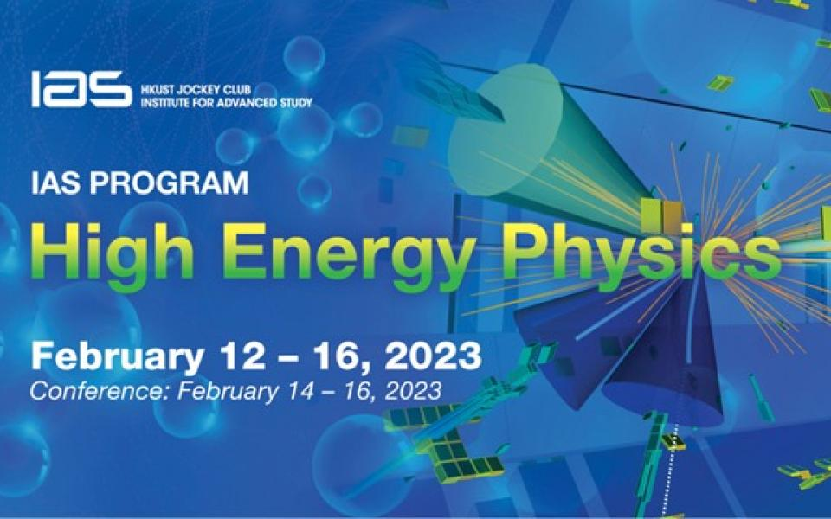
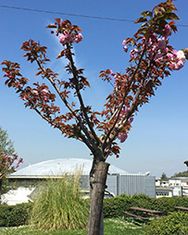

Electron Positron Collider Power Consumption & Performance Considerations
Frank Zimmermann, CERN
HKUST IAS HEP2023, 14 February 2023
Thanks to B. List, S. Belomestnykh, V. Shiltsev, J. Gao, A. Faus-Golfe, M. Biagini, M. Boscolo, R. Rimmer, T. Satogata, M. Koratzinos, E. Nanni, P. Raimondi, T. Raubenheimer, J. Seeman, V.N. Litvinenko, K. Oide
eeFACT’22

Slide 2
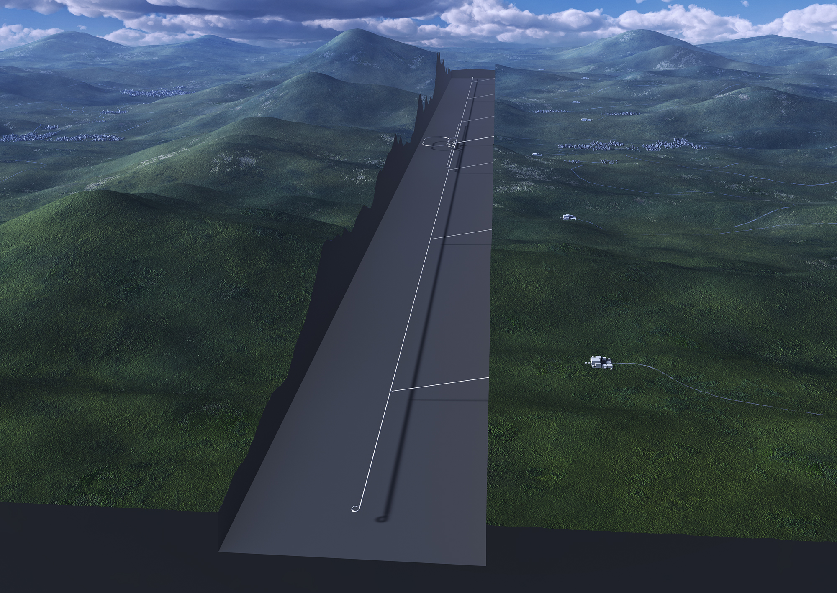


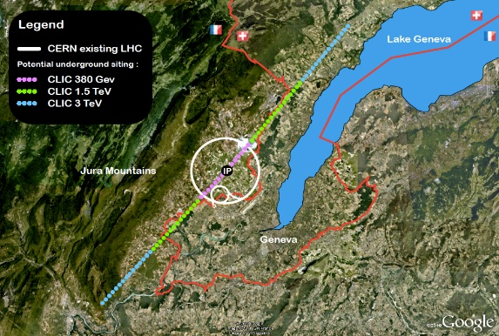
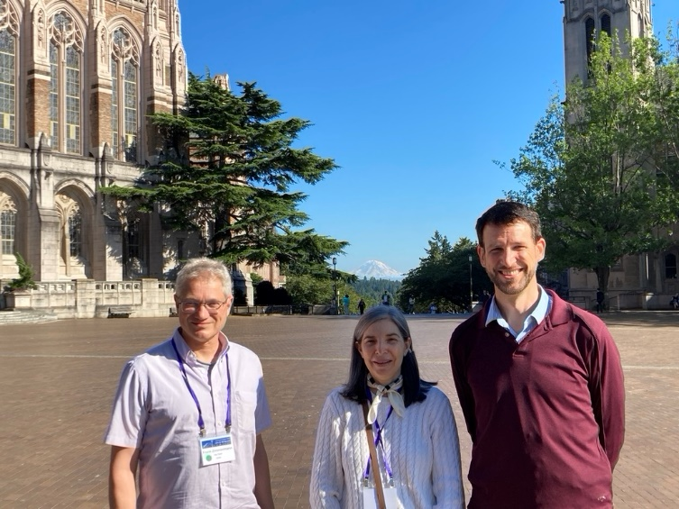


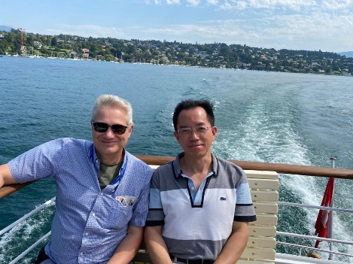
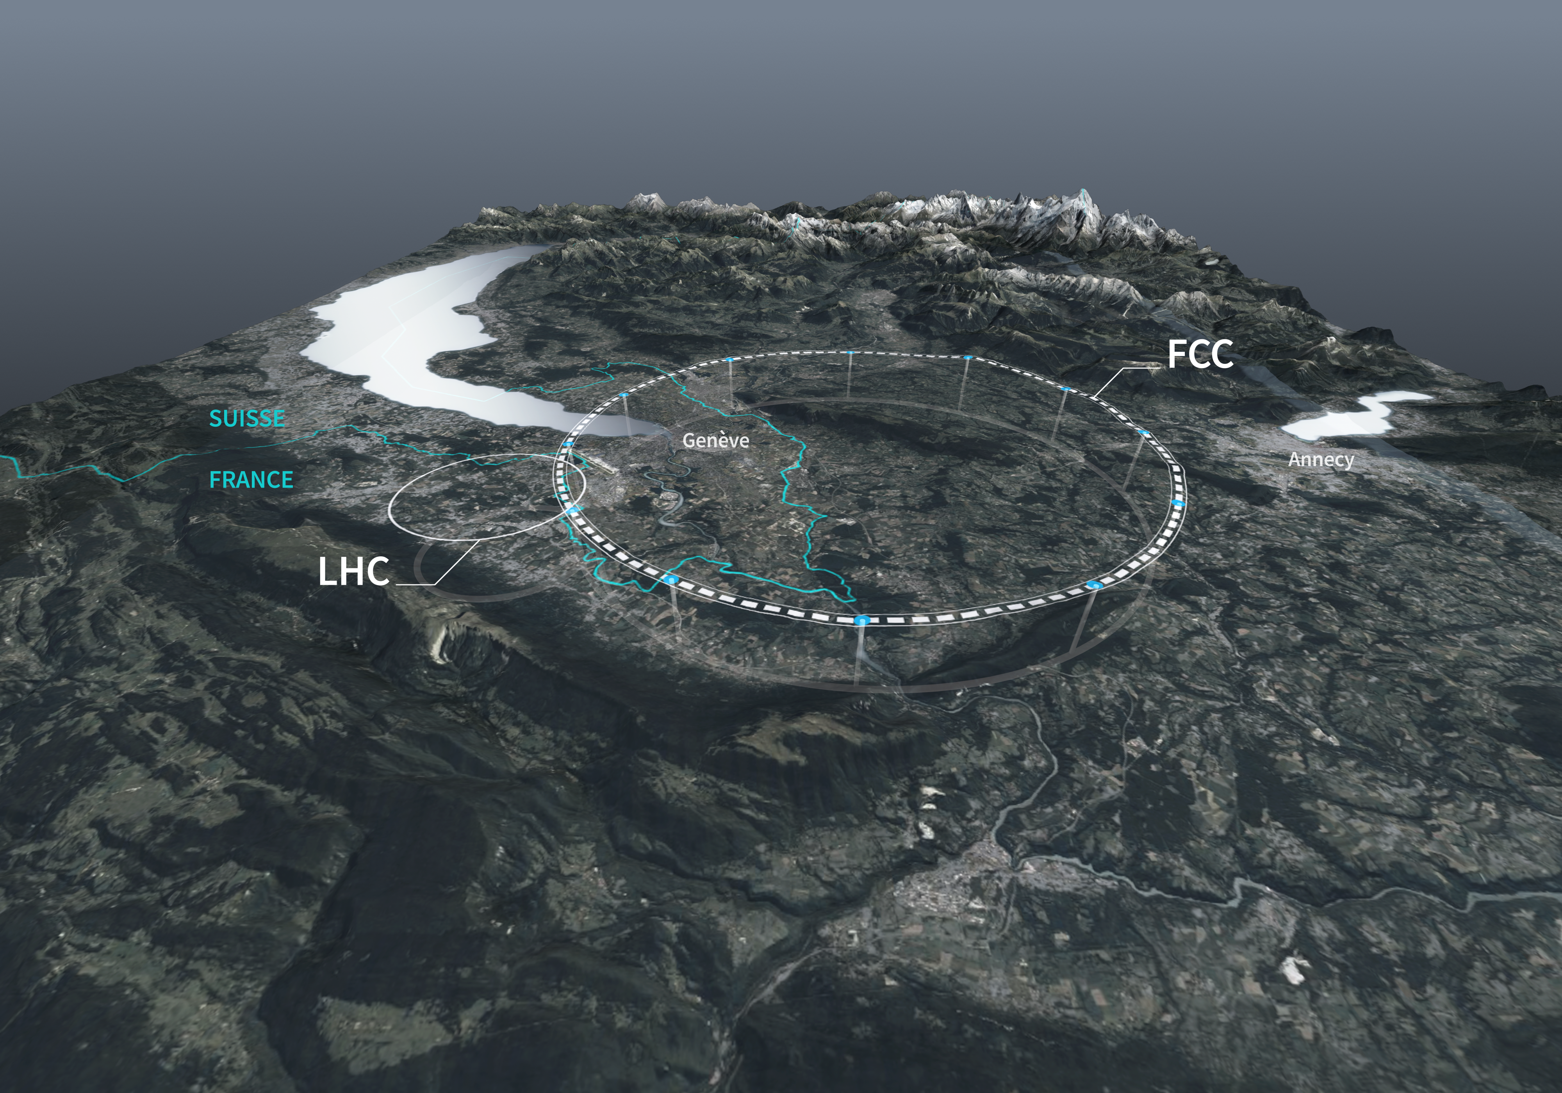
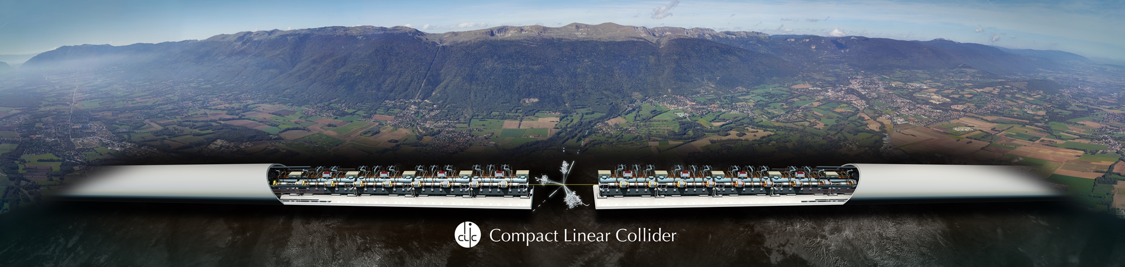
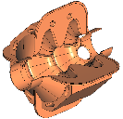
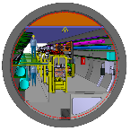

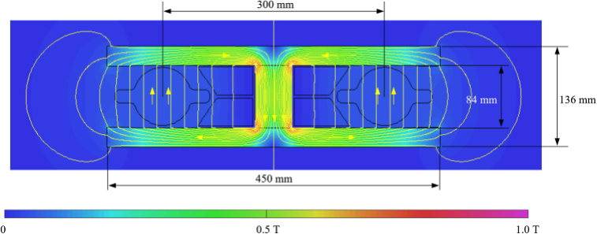

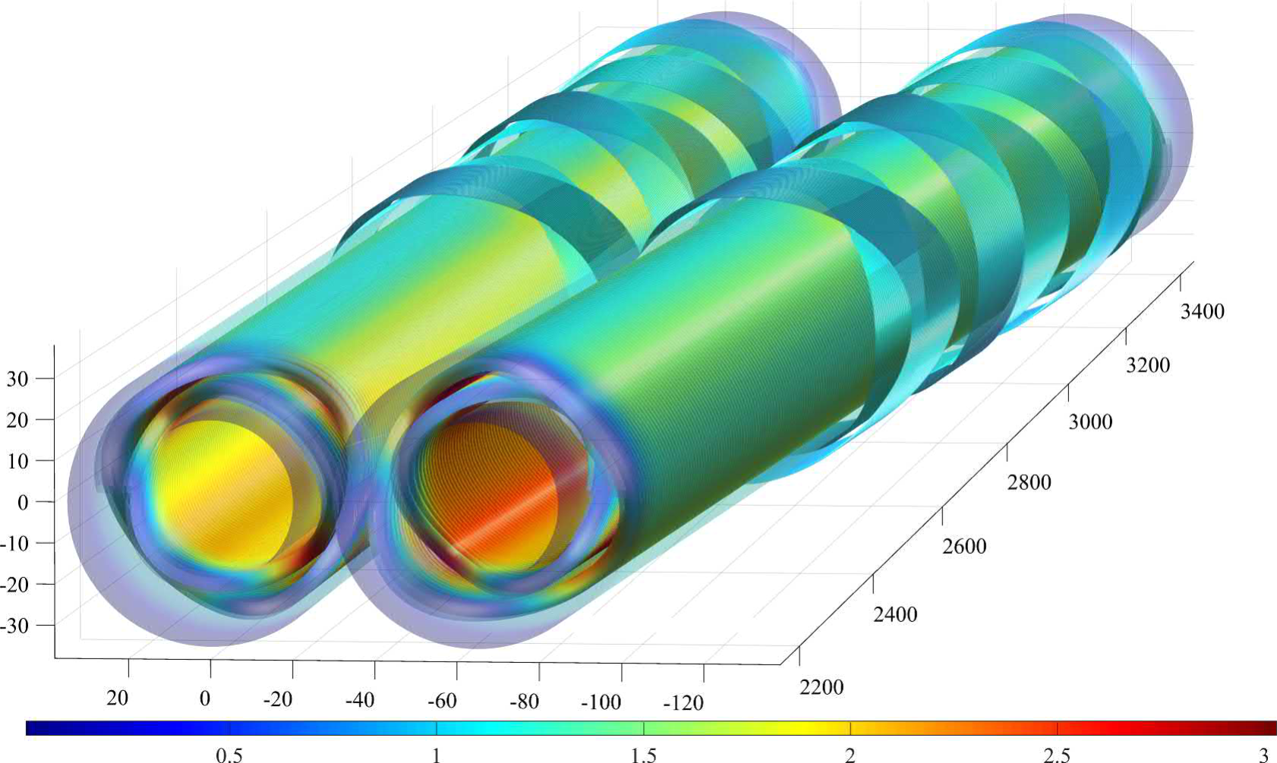
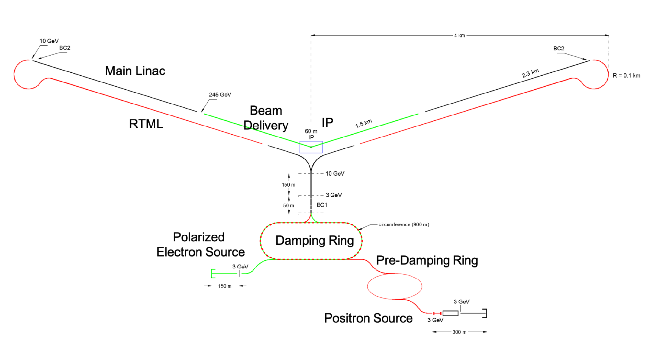
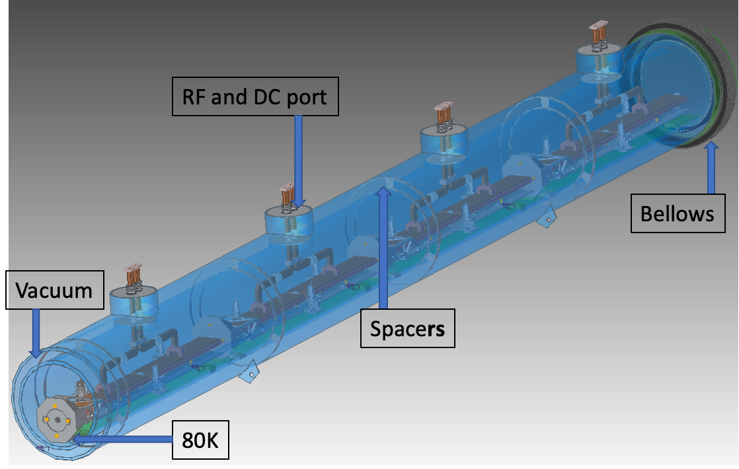
Co-Conveners
AF03:
EW/Higgs Facilities
report: https://arxiv.org/abs/2209.05827
Georg Hoffstaetter
Qing Qin
Angeles Faus-Golfe
Frank Zimmermann
Notes:
Summary of the EW-Higgs factory papers received in the AF03 and the resulting discussion these last week, compiled by Qing Qin in the distance, Frank Zimmermann, Georg Hoffstaeter and myself.

Slide 3
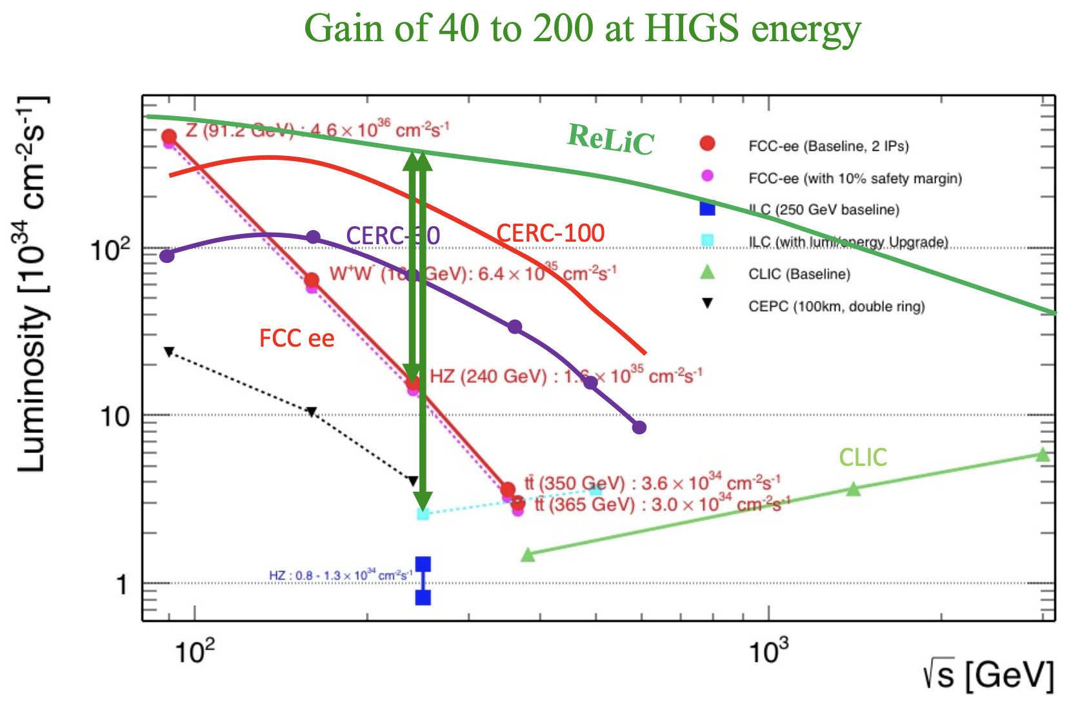
RELIC
V. Litvinenko

Slide 4
During the Snowmass Community Summer Study in Seattle, questions arose on the feasibility of power and luminosity numbers communicated for various collider proposals.
The Accelerator Frontier Implementation Task Force (ITF) had received many inputs on various collider concepts. The ITF specifically mentioned that they had not reviewed luminosity and power consumption projections (i.e., the ITF used proponents’ numbers of luminosity and power).
The following ICFA Workshop eeFACT’22, organized at Frascati in September 2022, was charged with helping the broader accelerator and HEP community by taking a look at the luminosity and power consumption projections for various e⁺e⁻ Higgs factories and providing an “expert comparative evaluation” for them.
Given the strength of the cohort of anticipated participants, such “independent” evaluation was expected to be very helpful.
A special session was set up during eeFACT’22, where representatives from all major proposals were invited to present and discuss their respective numbers and the underlying assumptions.
This effort resulted in a dedicated paper, FRXAS0101, submitted to the proceedings of eeFACT’22.
Key points are reported here.

Slide 5
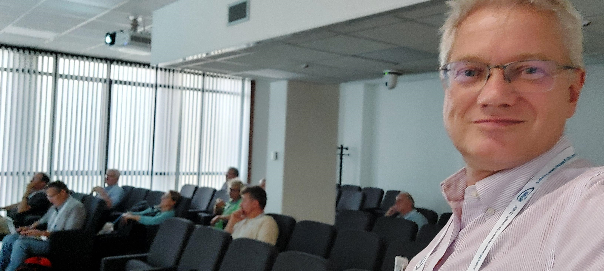
eeFACT22 extension as mandated by Snowmass
task from the Snowmass process to
“take a look at the luminosity and power consumption projections for various ee-Factories & provide expert comparative evaluation for them.”
special session on Thursday evening
and Friday morning
thanks to Marica Biagini, Vladimir Shiltsev, Tor Raubenheimer, Mike Koratzinos, Jie Gao, Angeles Faus-Golfe, …

Slide 6
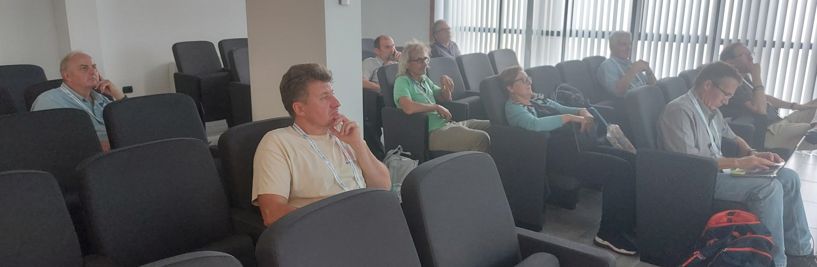
Agenda of the special eeFACT’22 session
Thursday afternoon/evening, 15 Sept. 2022
Talks from the US
Vladimir Litvinenko, CERC and ReLiC
Emilio Nanni, C³
Sergey Belomestnykh, HELEN
Friday, 16 Sept. 2022
Talks from Europe and Asia
Jie Gao, CEPC
Frank Zimmermann, FCC-ee
Steinar Stapnes, CLIC
Benno List, ILC

Slide 7
survey table
Beam energy [GeV]
Average beam current [A or mA]
SR power [MW]
---
Collider cryo power [MW]
Collider RF power [MW]
Collider magnet power [MW]
Cooling & ventilation power [MW]
General services power [MW]
Injector cryo power [MW]
Injector RF power [MW]
Injector magnet power [MW]
Pre-injector power (where applicable) ] [MW]
Detector power (if included) [MW]
Data center power (if included) [MW]
--
Total power [MW]
---
Effective physics time per year for integrated luminosity [10^7 s]
every project provided this input

Slide 8
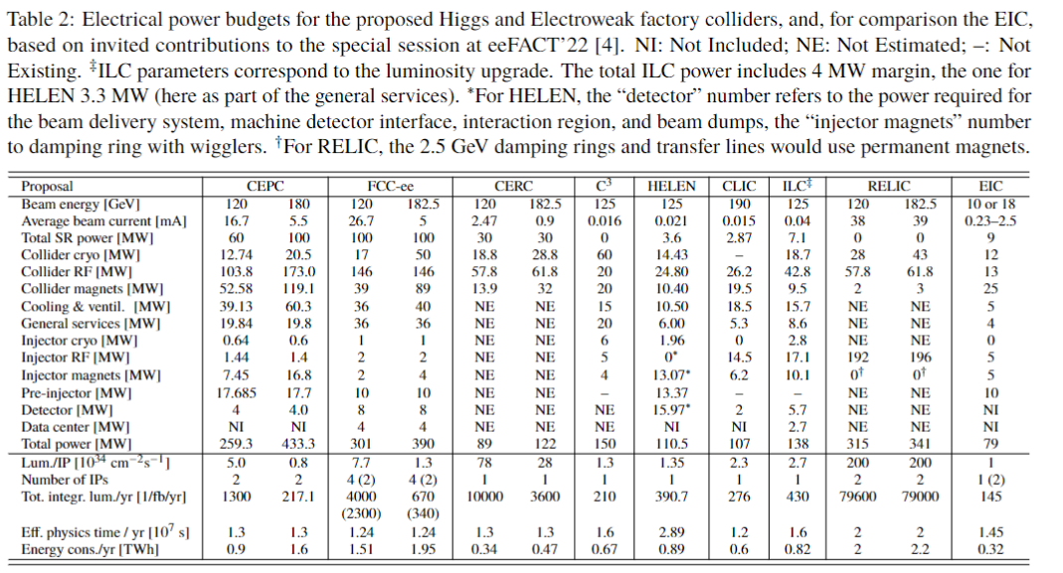

Slide 9
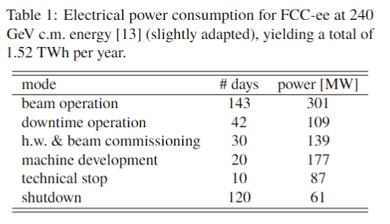
Annual power consumption in TWh numbers does not look fully consistent across various machines.
As an example, for the FCC-ee, the annual power consumption is higher than the product of instantaneous power and effective physics time, since power needs during annual hardware commissioning, beam commissioning, operational down times, technical stops, machine development periods and shutdowns are also taken into account [J.-P. Burnet], as sketched in the following Table.

Slide 10
Static Heat Loads
Concerning static heat loads, the best values from LCLS-II cryomodules are reported to be 5 times larger than those which had been assumed for the ILC. Based on operational experience, the 2-K static heat load per 8-cavity cryomodule is expected to be about 11 W for LCLS-II-HE, which is about two times higher than the value of 6 W estimated for LCLS-II in 2014, and an order of magnitude higher than the static heat load per cryomodule of 1.32 W at 2 K, which had been predicted for the ILC in 2017.
LCLS-II may still have some cryogenic issues to resolve.
A more appropriate comparison is with the European E-XFEL. For this E-XFEL, a static heat load of 6.1 W was measured per linac cryomodule. Consequently, in the latest ILC estimates, a static heat load of 6 W per cryomodule is assumed, consistent with actual E-XFEL experience.

Slide 11
Cryoplant Efficiency
The cryoplant efficiencies at various existing facilities, like LHC, JLAB, and SLAC can be compared with the target efficiency for future projects. The LHC cryoplant efficiency at 1.9 K is 900 W/W (that is the number of Watt at room temperature required for removing one Watt at 1.9 K). For a proposed 8 GeV SC proton linac at Fermilab a cryo efficiency at 2 K of 790 W/W is considered. The ILC will further improve the 2-K cryoplant efficiency to 700 W/W.
Collision Spot Size
The difference of the vertical spot size observed at the KEK/ATF-2 facility from expected value, especially at nominal 𝛽∗_{𝑥} , and its dependence on bunch intensity, resembles earlier findings at the SLC and at the FFTB. The present ATF-2 optics is much relaxed compared with the design, which should greatly lower the optical aberrations. The ATF-2 would offer an opportunity to characterize the higher-order aberrations with beam and to compare them with model predictions.

Slide 12
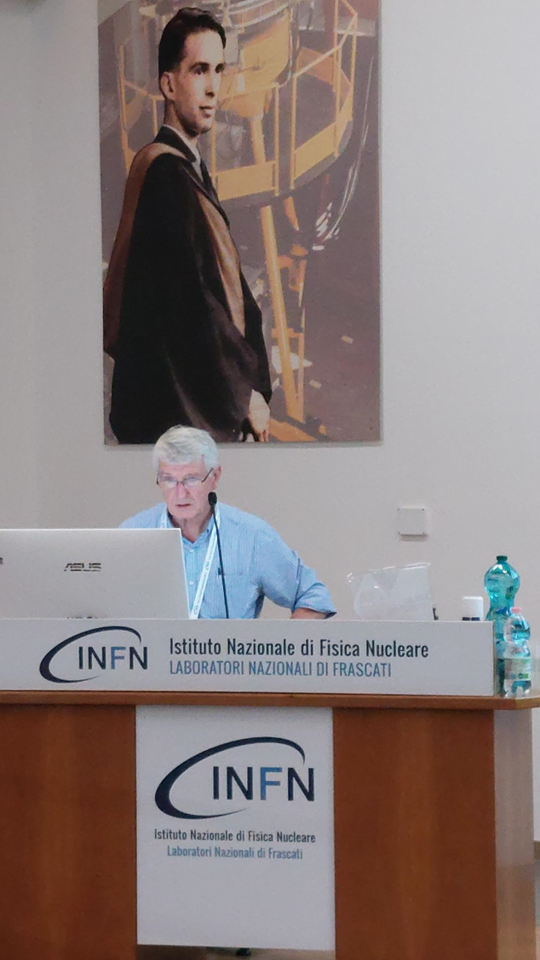
Positron Needs
Traditional linear colliders lose all particles after 1 collision
For circular colliders and ERL based colliders,
unavoidable losses occur due to radiative Bhabha scattering and beamstrahlung
Radiative Bhabha scattering:
simulation program BBBREM and formalism developed by Burkhardt and Kleiss for LEP, includes cut-off on momentum transfer related to average distance between beam particles
other treatment by Kotkin and Serbo with cutoff related to transverse beam size
exact theory and numbers to be revised
either way, cross section depends on IP parameters
J. Seeman reviewed project e⁺ rates compiled by ITF

Slide 13
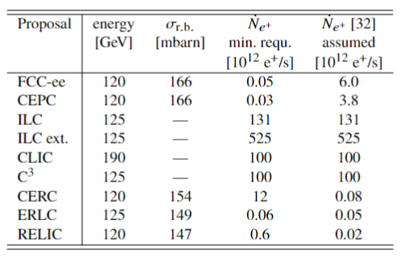
Cross section for particle loss due to radiative Bhabha scattering, 𝜎_{r.b.}, as computed by BBBREM considering an energy acceptance of 2% and a cut-off based on the Burkhardt-Kleiss parameter d, the resulting minimum positron production rates required for different circular and ERL based colliders (“min. requ.”), compared with project assumptions compiled for Snowmass’21 (“assumed”). In case of linear colliders without particle recovery, like ILC and CLIC, the required (“min. requ.”) positron rate directly follows from bunch charge and bunch collision rate.
FCC-ee and CEPC: significant margins thanks to the fact that the maximum injector production rate is specified for the more demanding running on the Z pole
For RELIC, loss rate due to radiative Bhabha scattering a ~25x higher than production rate hitherto assumed; for CERC the loss rate is 100x higher than production rate → injector designs may need to be modified
respective cross sections still need to be validated, and possibly updated, before definite conclusions can be drawn

Slide 14
Predicting Performance
More mature projects (ILC, CLIC, FCC-ee, CEPC) have fairly established and reviewed performance figures backed by detailed simulations, although of course all projects are working towards increasing performance.
The newer projects (e.g., RELIC, CERC) do not yet have reviewed performance figures, neither detailed simulations demonstrating how to achieve them.
Past experience with the SLC, which after ten years of operation reached about half of its nominal luminosity, present-day struggles with obtaining the SuperKEKB design luminosity, and, on the other hand, actual luminosities exceeding design values at previous machines like LEP, PEP-II and KEKB, highlight the importance of a fair and thorough evaluation of the luminosity risks and of the luminosity potentials.
The corresponding work needs to be continued !

Slide 15
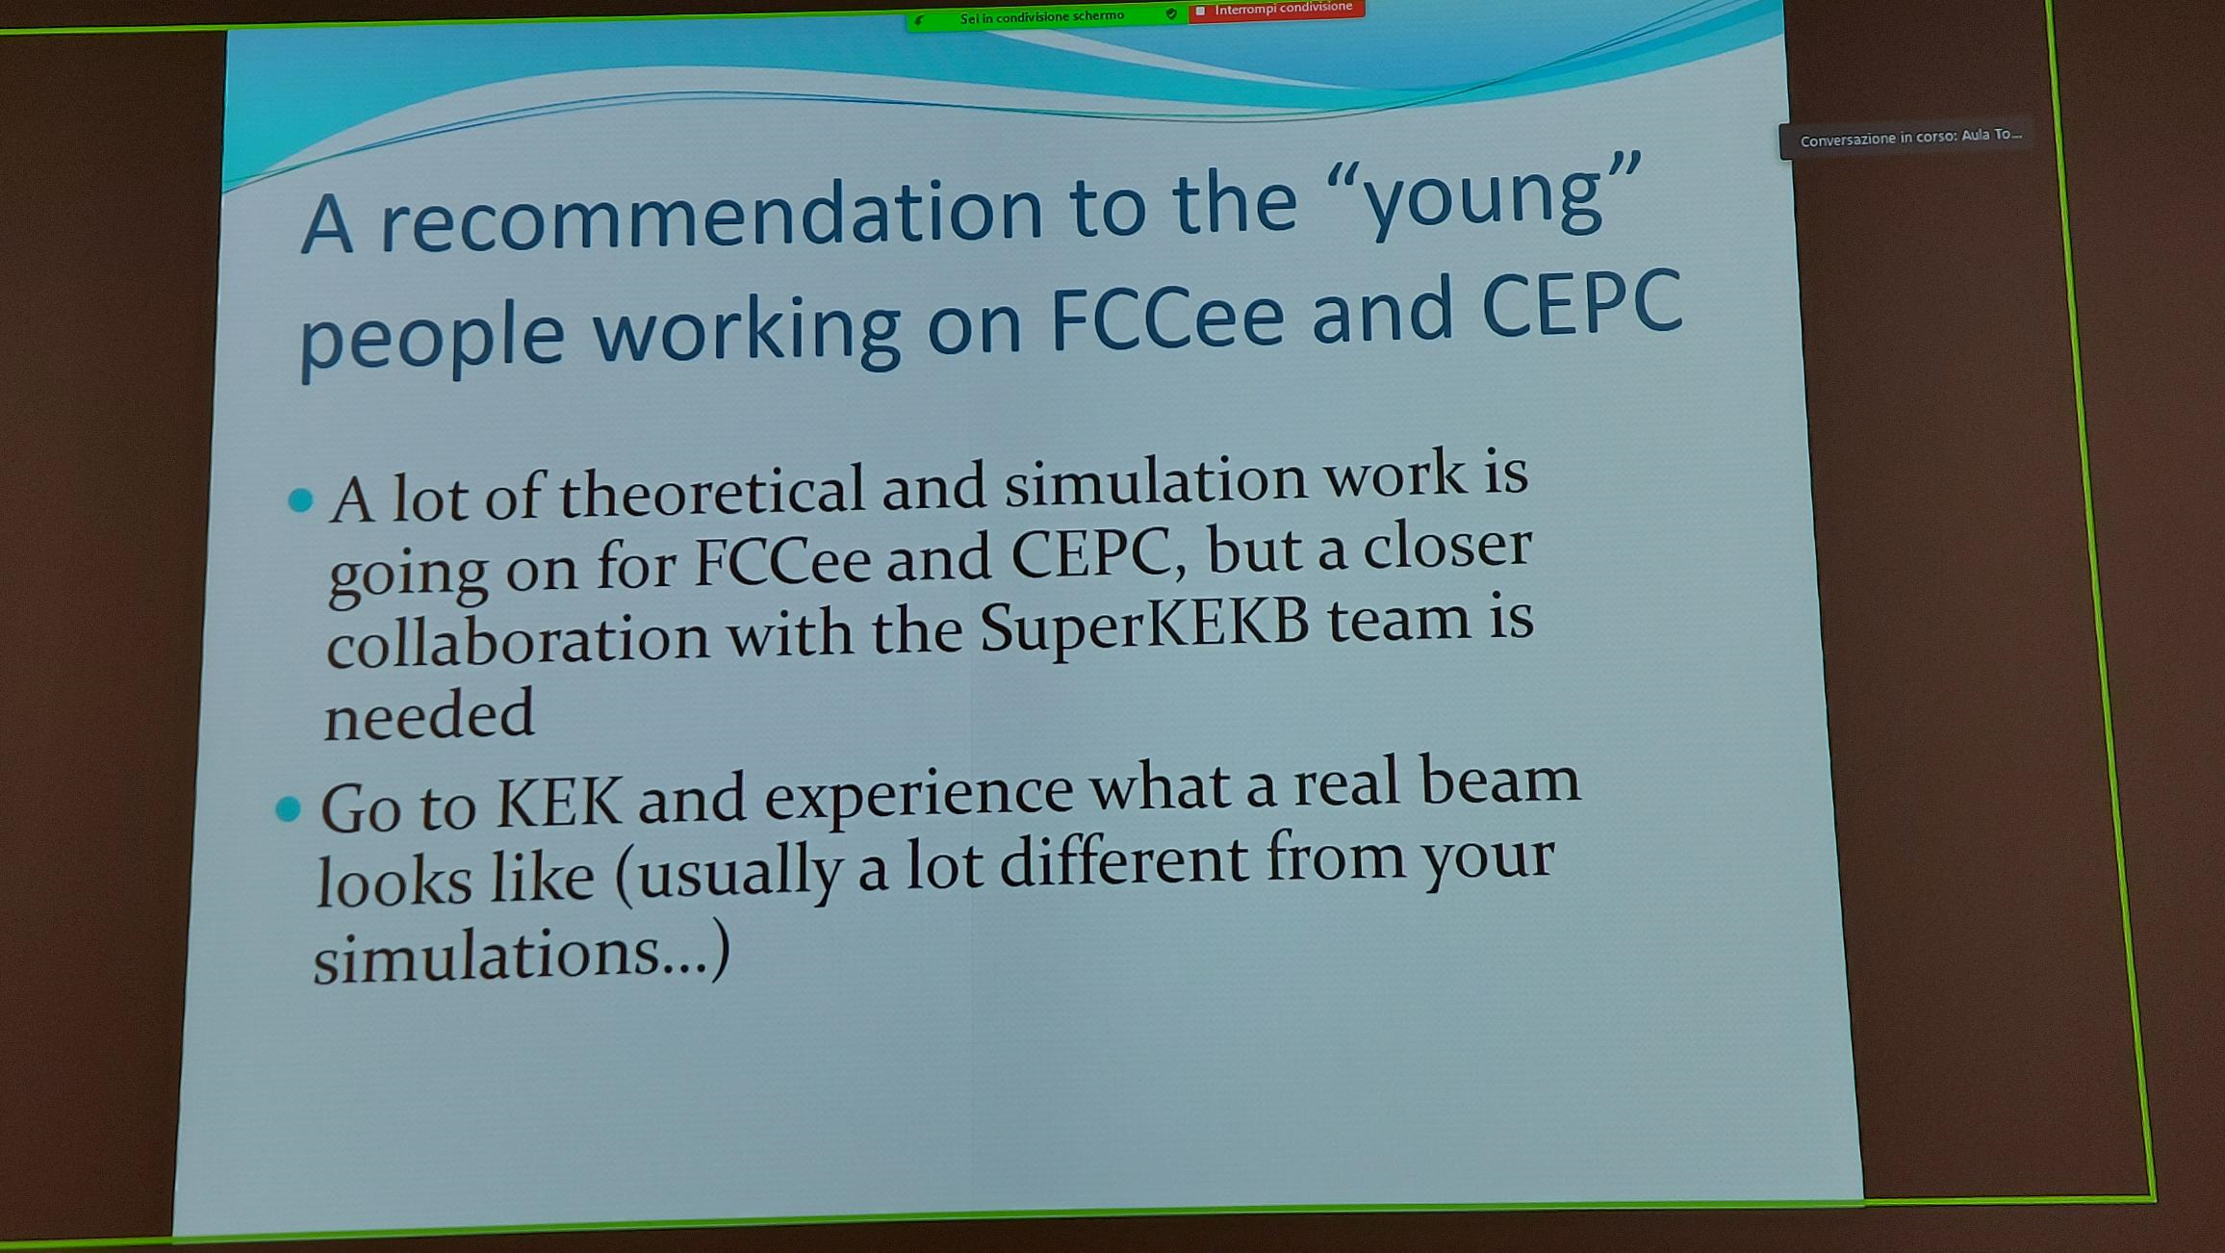
M. Biagini, eeFACT’22

