Slide 1
Status of SuperKEKB Accelerators
Makoto Tobiyama（KEK Accelerator Laboratory） for SuperKEKB Accelerator Team

Slide 2
Recent operation

Slide 4
Especially on 2022b runs
Strongly required to get higher “peak” luminosity for the 10-years evaluation process of MEXT.
  Decided to skip various machine studies to understand machine.
  Could not repair damaged collimator heads.
  Needed to skip the regular maintenance.
  Received very good report from the MEXT committee to strongly support the project.
Due to crazily rising electricity costs, we had no choice but to discontinue operation and enter LS1.
  The rising of electricity costs is continuing– we are doing our best to reduce the standby power after stopping the operation of 2022b.
    (Almost) stop the water pumps.
    Stop the air conditioning of the power supply buildings and the arc section of the tunnel.
    Tuning off the lights of the tunnel in the night.
    25Hz operation of Linac.

Slide 5
Achieved up to now..
Peak luminosity : 4.65 x 10³⁴ cm⁻²s⁻¹ (4.71 x 10³⁴ cm⁻²s⁻¹ w/o Belle II data taking)
Integrated luminosity : 424 fb⁻¹ (491 fb⁻¹)
Peak currents : 1.46 A (LER) / 1.14 A (HER), 2346 bunches (2-bucket spacing)
βy*: 1 mm (0.8 mm) << bunch length ~6 mm -> proof of the nano-beam scheme
Crab waist scheme has been applied (80 % in the LER, 40 % in the HER).
  luminosity improvement
Beam-Beam parameter : 0.035 at 0.7 mA (0.045 at 1.1 mA for small number of bunches)
Bunch-by-bunch FB tuning (gain, noise reduction) in the HER ->luminosity improvements
Bunch-by-bunch FB tuning (number of taps) in the LER ->suppress single bunch blowup, luminosity improvements
Chromatic X-Y coupling correction with rotatable sextupoles in the LER ->luminosity improvements

Slide 6
Long-term drift of QCS magnetic field (beta-beat) <-reduced by new QCS initialization procedure
Orbit deviation due to IP knob tuning (beta-beat) <- suppressed with QCS corrector (ZHQC2RP)
Increase of positron charge for the LER injection : 3 nC at the end of e+ beam transport line
2-bunch injection for the LER and HER ->improve injection efficiency
Adjustment of injection orbit in the HER (septum, kicker) ->improve injection efficiency (not enough)
Reduce leakage orbit from injection kickers <- reduced by additional inductance for the coils

Slide 7
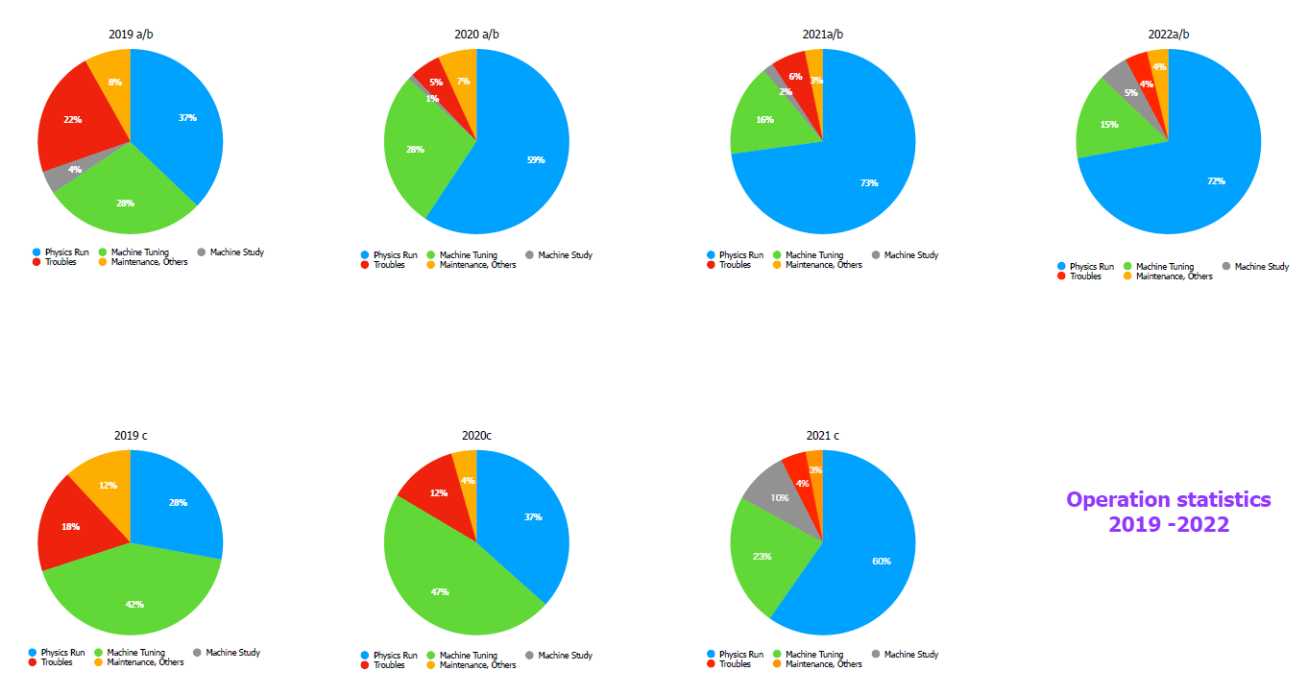
Operation Statistics

Slide 8
Machine parameters

Slide 9
Challenges to improve luminosity
Sudden beam loss and damage to the vertical beam collimators
  Damaged collimator(s) increases transverse impedance, which makes the threshold of TMCI much lower.
  Not easy to increase the bunch current.
Beam blowup in the LER
  Some (or most) of the sources might be coming from the higher transverse beam impedance.
IR Optics (βy*) modulation due to stored current (HER)
  Beam-line deformation, especially around the strong sextuplole magnets.
Shorter beam lifetime, especially in LER
Injection efficiency and stability of the injector
  Emittance growth coming from beam transport line
  Injection background

Slide 10
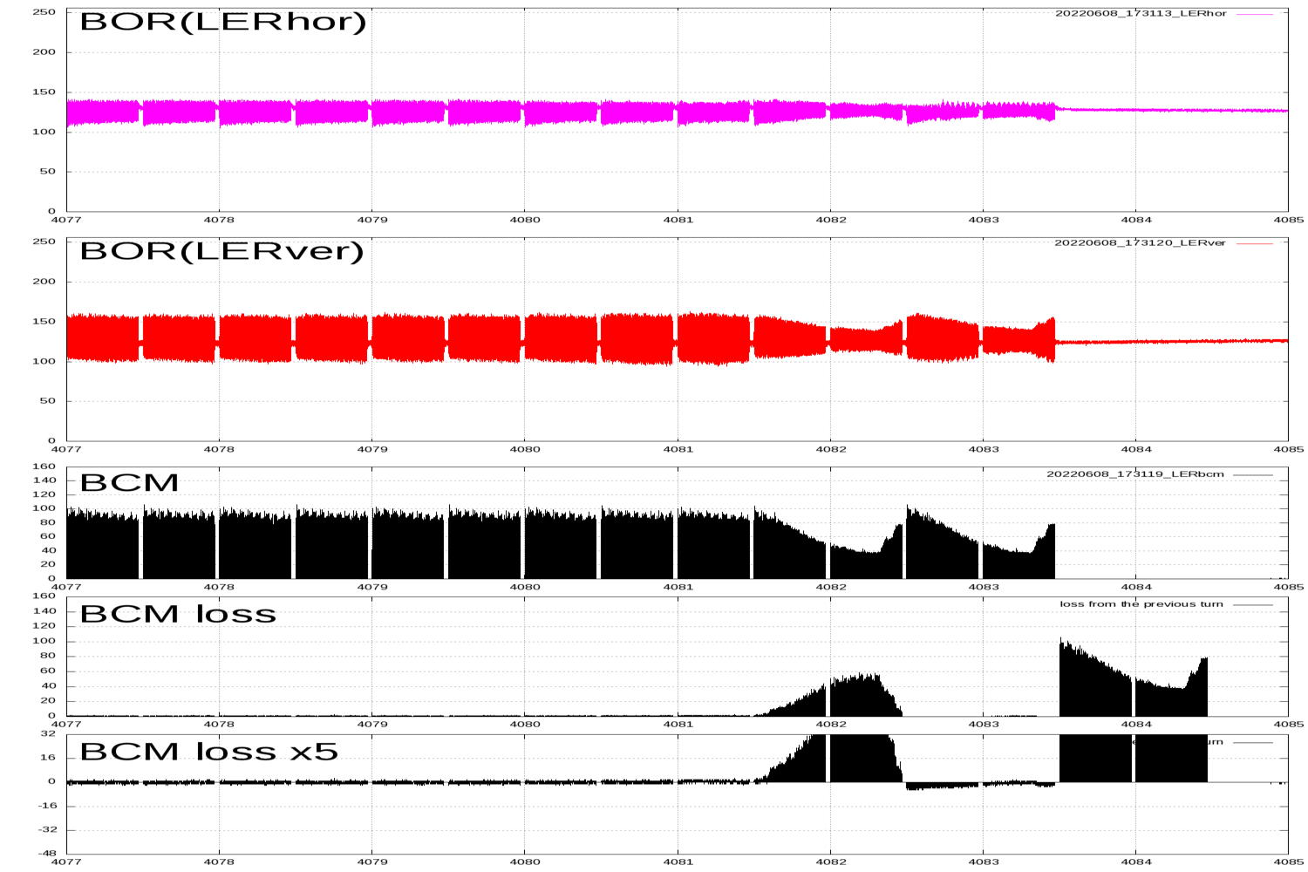
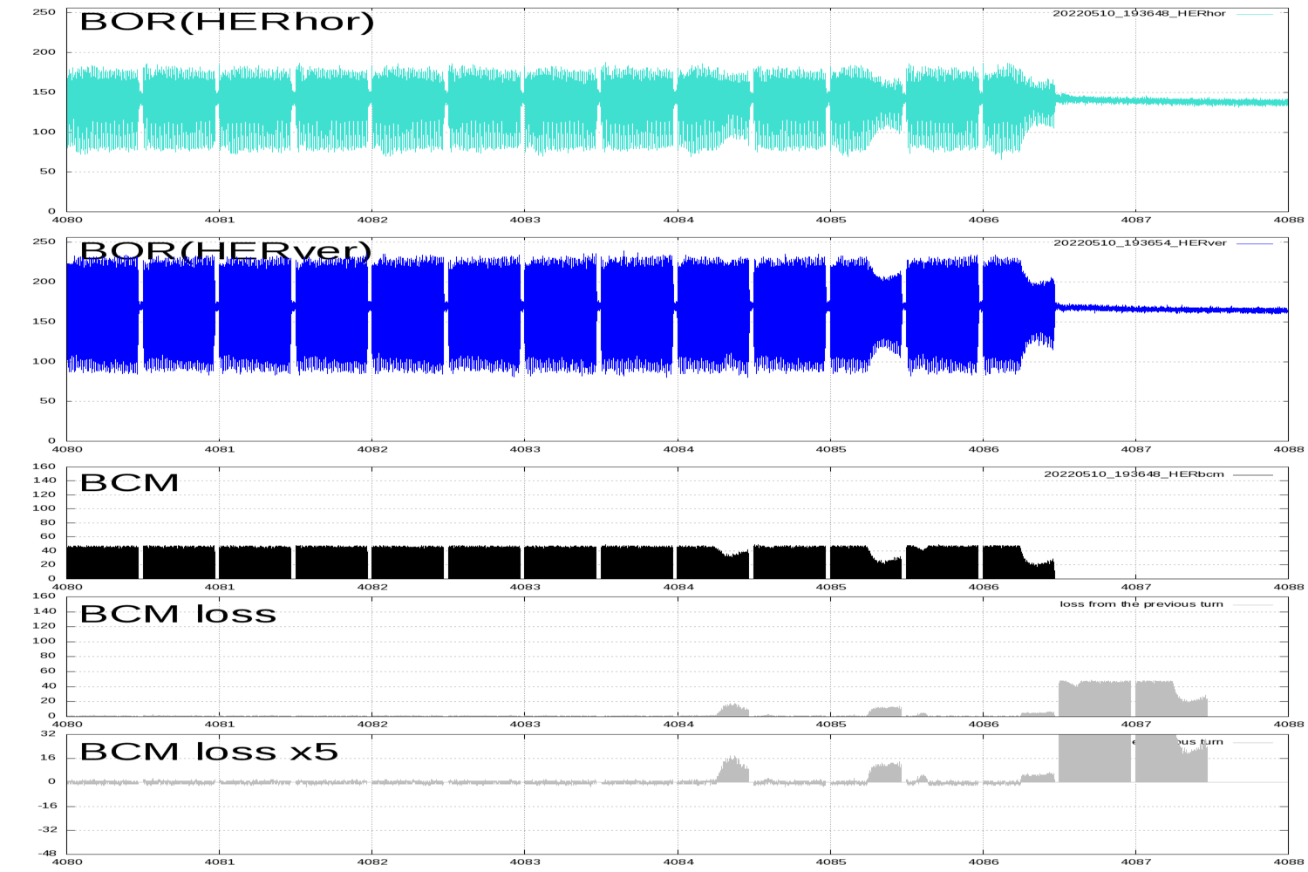
Sudden beam loss
Without growing the transverse motion, some part of bunches drops within 1-2 turns.
  Occurs in both LER and HER, but the damage in LER is much greater (QCS quench, vertical collimator damage, etc)
  After damaging the collimator heads, many unwanted side-effects happen.
    Much larger background.
    Larger transverse beam impedance.
Several discussions on ITF-sudden beam loss subgroup.

Slide 12
Fireball hypothesis

Slide 13
Beam(bunch) current

Slide 14
Beam blowup in LER
Bunch current dependent– TMCI related.
  With the increase of the bunch current, the synchro-betatron sideband (νy+νs) appears (and will finally merge).
  Also coupled with the side-effect of transverse BxB feedback system.
    Large phase shift coming from the many-tap filter (10 tap FIR) reduced the gain margin of the system, finally excited dipole oscillation at the sideband.
    By reducing the number of FIR taps (10 ->4), the phase shift in the digital filter was mitigated and the dipole oscillation at the sideband was suppressed.

Slide 15
The threshold seems depend on the aperture of vertical collimators (transverse impedance), selection of vertical tune, vertical chromaticity, BxB FB settings + damage of the head of vertical collimator.
With the severe damage of the heads of the vertical collimator, the transverse impedance has been increased and the threshold had dropped less than 0.8mA/bunch.
Non-linear collimator should help to reduce the transverse impedance.

Slide 16
IR Optics (βy*) modulation due to stored current (HER)

Slide 19
Long Shutdown 1

Slide 20
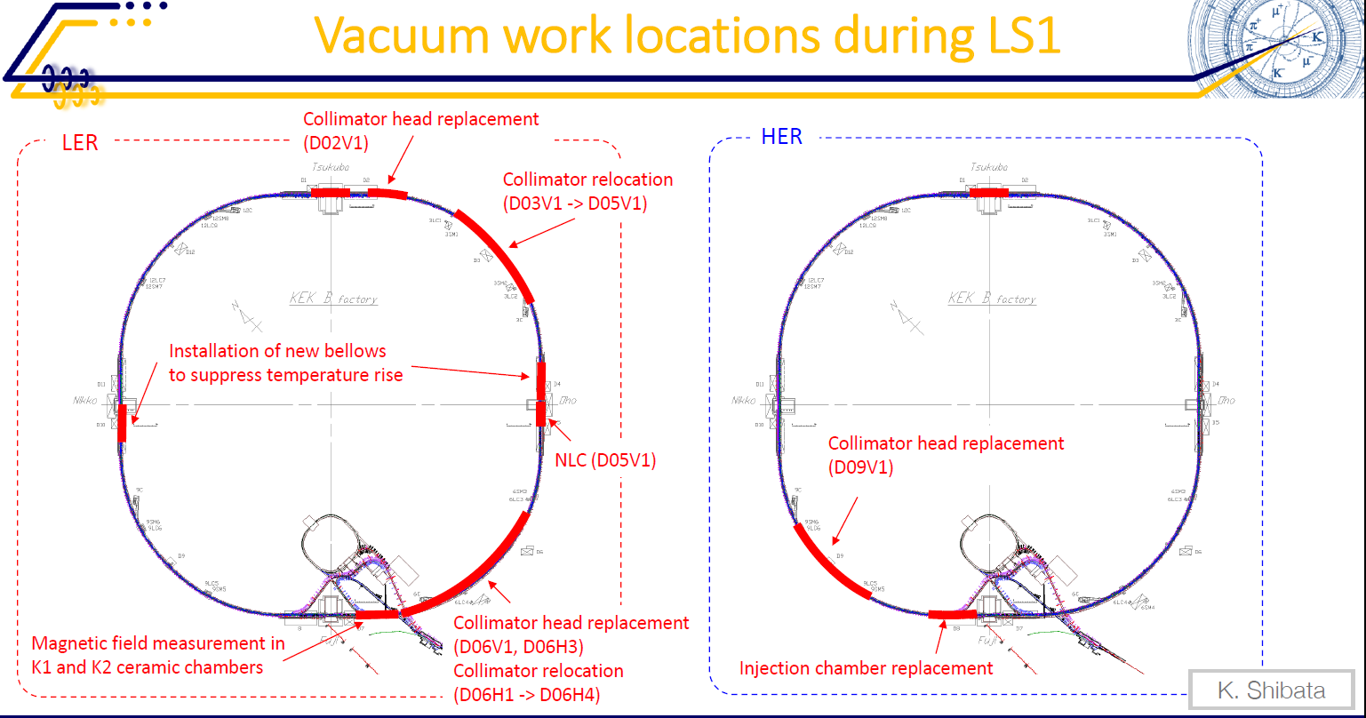

Slide 21
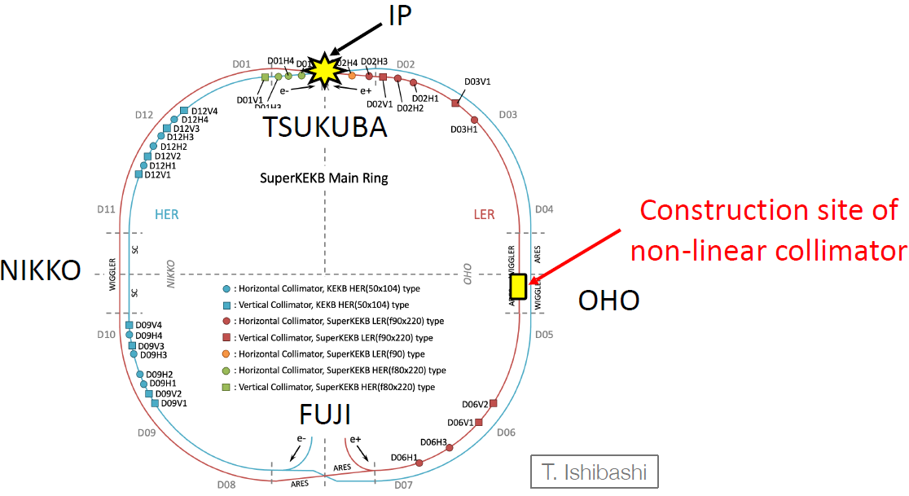
Non-linear collimator

Slide 22
HER injection line physical aperture

Slide 23
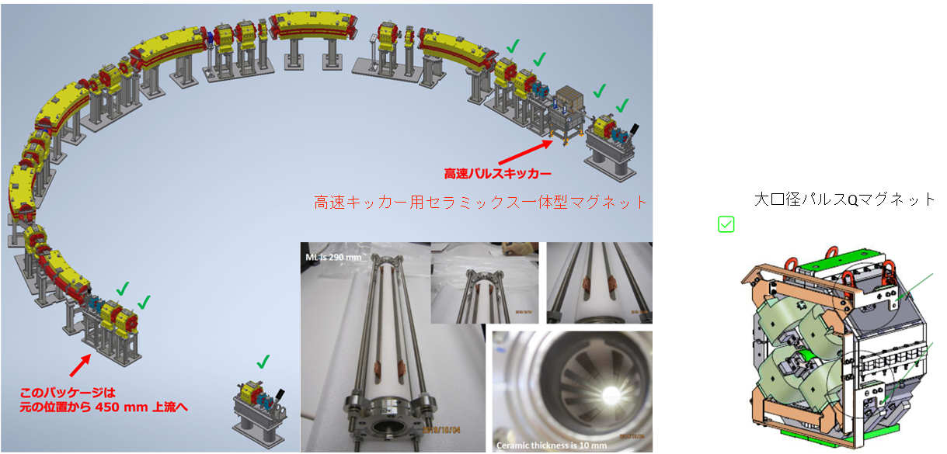
(LS1) upgrade for Injector
Fast pulse magnets will be installed at the J-arc and the sector 5 to control the orbit of two bunches independently.
Large aperture pulse Q will be installed at the end point of J-arc to optically match the e- and e+ (primary high charge e-) beam independently.
Install 4 sets of large aperture pulse Q magnets around 1-2 sectors to make optical matching for both high energy e- and low-energy e+ beams and to reduce the emittance growth consequently.

Slide 24
Design study for LS2 upgrade
We are revisiting the investigation of IR (including QCS) section to achieve much higher luminosity.
Beam optics study with possible QCS design.
QCS group are starting considering magnet re-design.
Vacuum group and QCS group are working for the possible mechanical design.
Re-fabricate QC1Ps and anti solenoids to fit near position to IP??

Slide 25
Summary
Peak luminosity of 4.7x10³⁴cm⁻²s⁻¹ has been achieved
Demonstrated stable operation over 1A in the LER (with smaller bunch current less than 0.7mA/bunch)
Sudden beam loss is serious challenge to increase luminosity and beam current, up to now.
Many other challenges:
  Beam blowup in LER
  Beam line deformation with HER beam current
  Shorter beam lifetime; both dynamic aperture and physical aperture (beam collimators), need to clarify the effect of crab waist.
  Injection efficiency, long-term stability of the injector.
Several upgrade items during long shutdown 1.
Re-starting design study for LS2 upgrade.
International Task Force for SuperKEKB upgrade
  Beam Tuning, Collective Effect, Beam Injection, Sudden Beam Loss, IR Upgrade subgroups are actively on-going.

Slide 26
QCS-R cryostat leak hunting
QCS-R and L have been retreated.
  Leak check on QCS-R cryostat has been made

