Slide 1
T-Calorimetry
Goals and tools
I. Laktineh
IAS workshop, January 2022

Slide 2
Disclaimer
Timing in calorimetry is still in its childhood. For the time being there is no large calorimeter with precise time measurement and thus there is no proof that all the ideas presented in this talk will be materialized in the near future.
The talk is a personal review using several works and presentations from other authors. My interpretation may differ from their so I apologize in advance if I misinterpret their thoughts.

Slide 3
Outline
Timing in Calorimetry
Goals
  PID
  Pileup mitigation
  Cleaning&PFA
  Energy construction
Tools
  Detectors
  Electronics
Conclusion

Slide 4
Goals

Slide 5
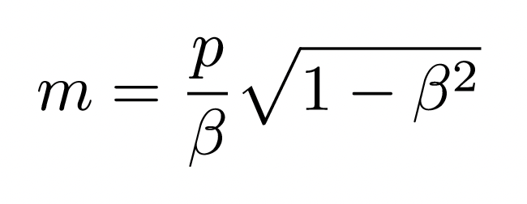
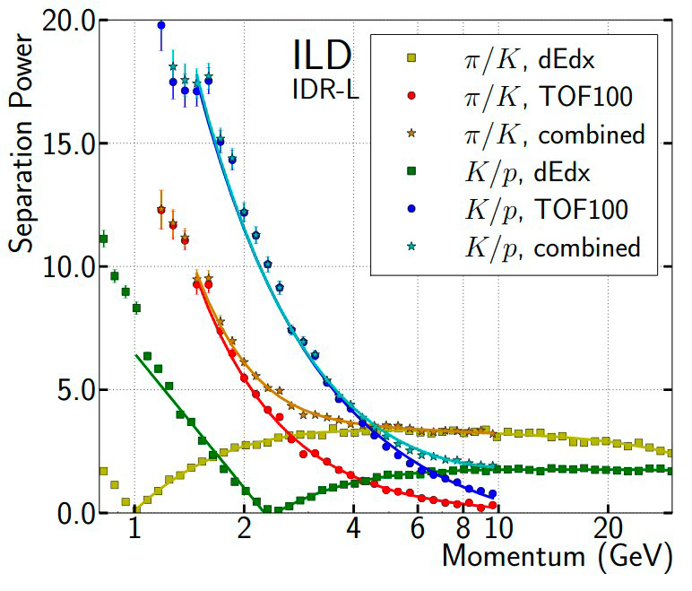
Particle Identification
PiD is important for many topics
Heavy Flavor &Higgs (B and D reconstruction), CP measurement (Jet Charge)..
To identify particles, the usual tool is : dE/dX from detectors like TPC
ToF is another important tool.
Dedicated ToF detectors (MRPC/Alice, MTD/CMS, HGTD/ATLAS) bring precious information for charged particles but not for all neutral particles
Calorimeters equipped with high-precision time
detectors could help for both. However:
Limited momentum range < 10 GeV/c
Limited number of detectors able to
provide excellent time precision

Slide 6
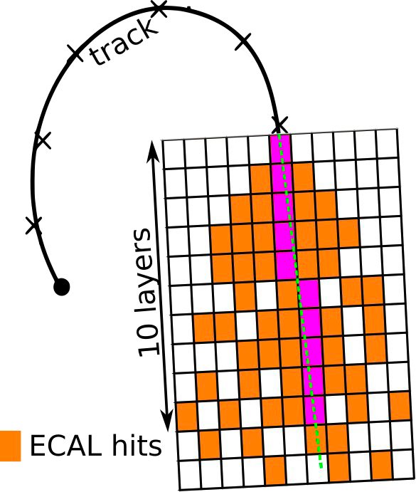
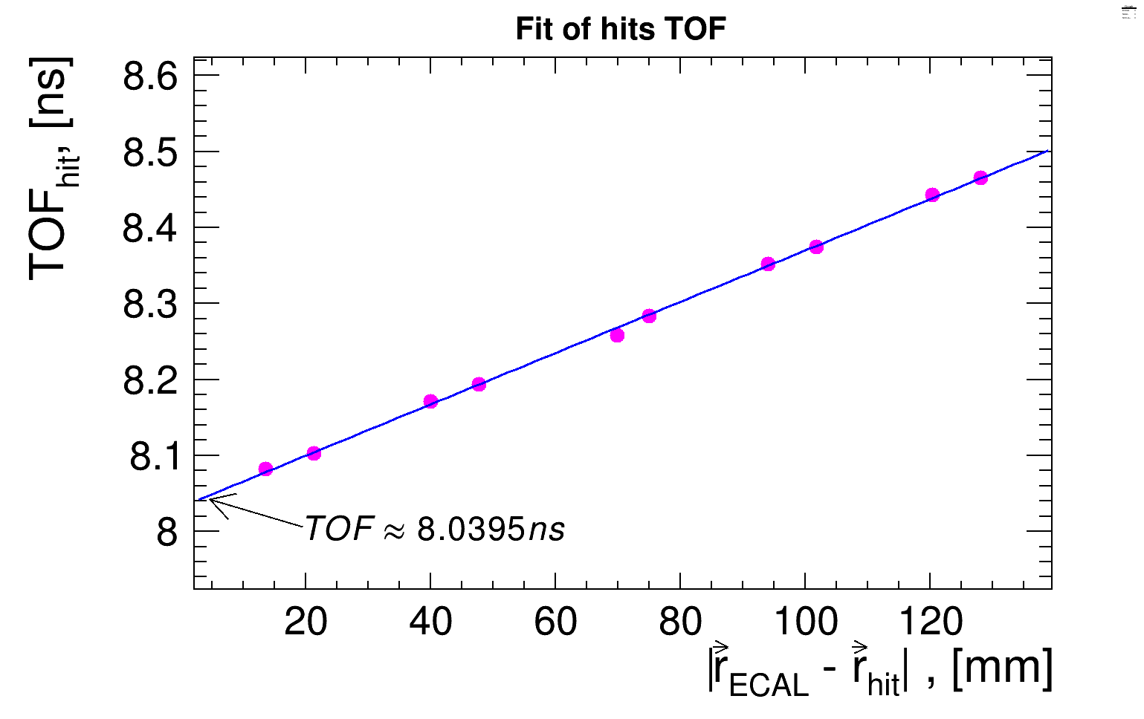
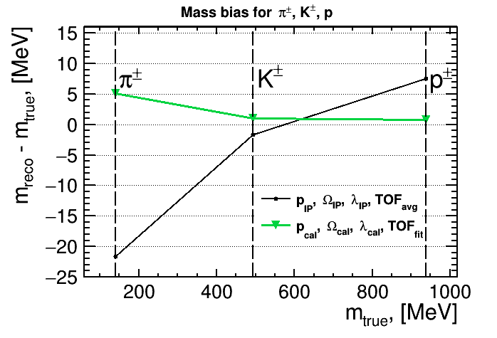
Particle Identification
In case of charged particles :
P is taken from the tracker at the ECAL entrance and β from ToF
To estimate the ToF in a granular calorimeter like the ILD ECAL in the case of charged particles several methods can be used:
Using time of the closest hit to the track
Using time of the fastest hit
Using the average time of hits along the track extrapolation in a few layers in case of longitudinally segmented ECAL (ToF_{Avg})
Using the time information of the hits of the first layers to determine the time at entrance of the ECAL (ToF_{Fit})
B. Dudard et al

Slide 7
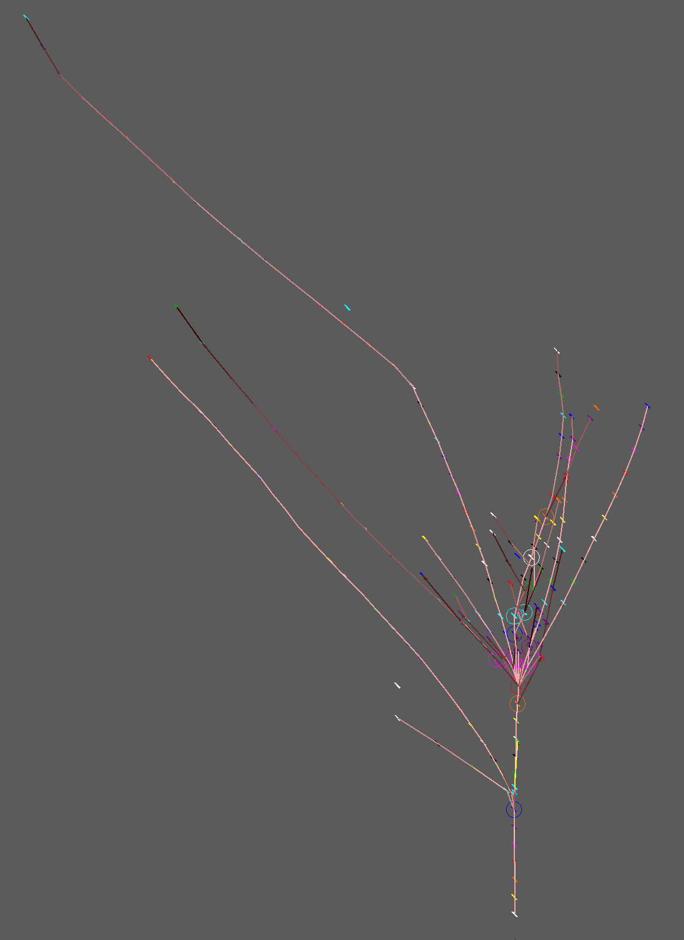
Particle Identification
Another approach that can be applied in very high granular calorimeters is to estimate β of track segments within a shower as well as the energy loss to identify the nature of the particle and then its momentum.
β could be known up to 10% according to a simulation
study on hadronic showers in ILD SiW ECAL
To achieve this, a time resolution better than the
Calorimeter longitudinal segmentation is needed.
In case of
ILD ECAL (6.5 mm → 20 ps) hard to achieve for the moment
ILD HCAL (30 mm → 100 ps) rather possible
The measurement of β and energy loss of the different
particles within a shower as well as the shape could be
exploited to determine the nature of the incoming particles
H. Videau et al.
The darkness reflects the slowing down

Slide 8
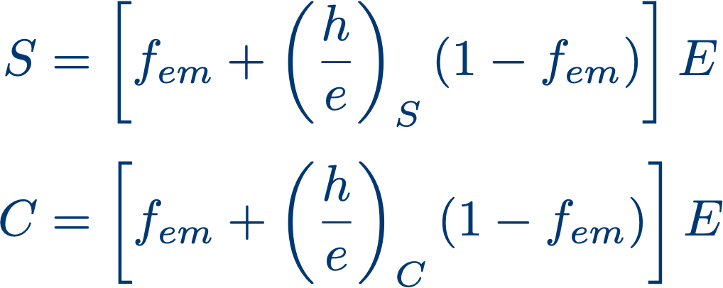
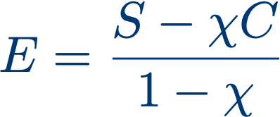
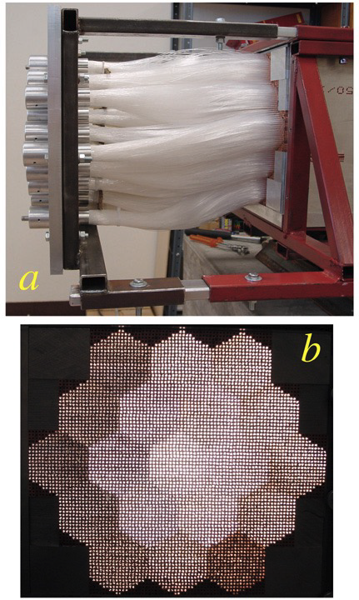
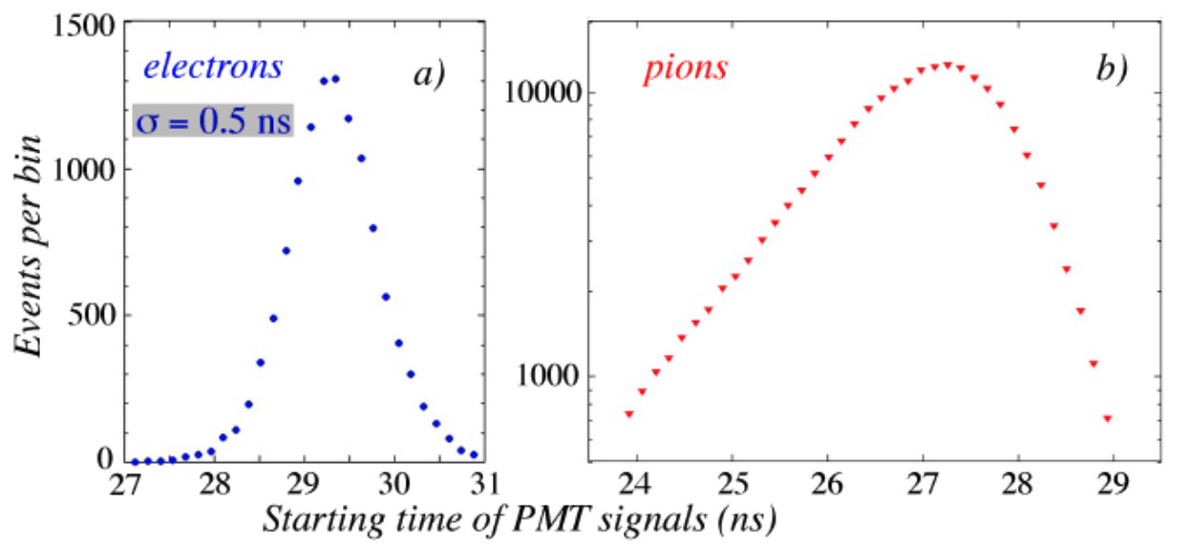
Particle Identification
Time information is also very useful in other technologies than the
one based on high granularity.
In Dual Readout technologies one can use precise time information
to discriminate electrons against pions since the showers associated
to those particles start on average in different depths of the calorimeter.
This with the shape information are efficient tools for PiD.
S. Lee, M. Livan, R. Wigmans, , Rev. Mod. Phys. 90 (2018) 025002

Slide 9
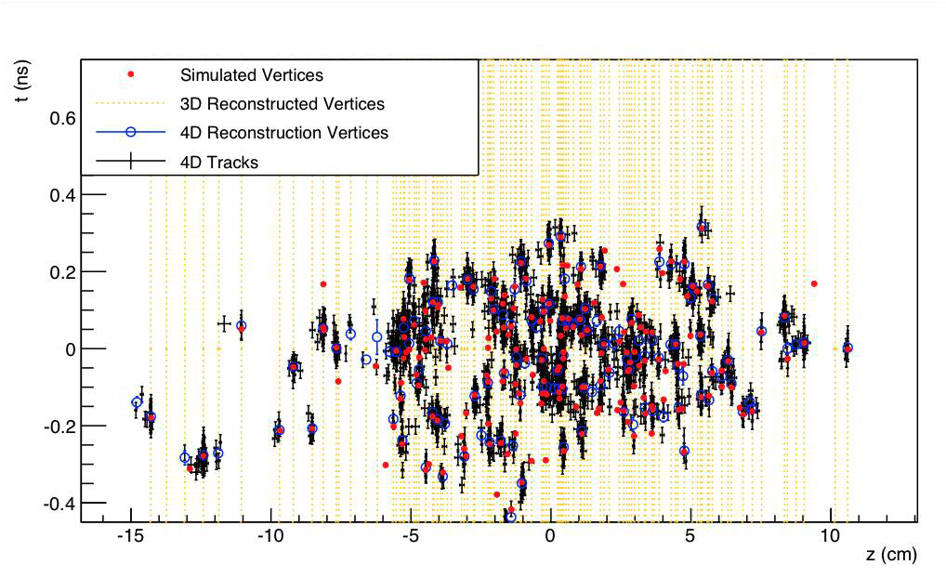
Pile Up Mitigation
Pileup 200
σ_{t}= 30 ps
A precise time measurement is a key tool in mitigating pileup

Slide 10
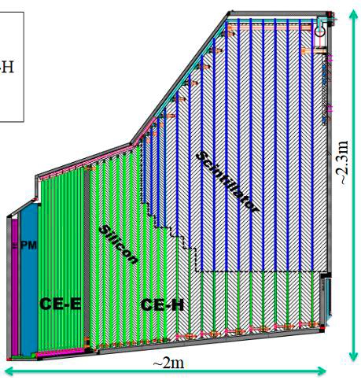
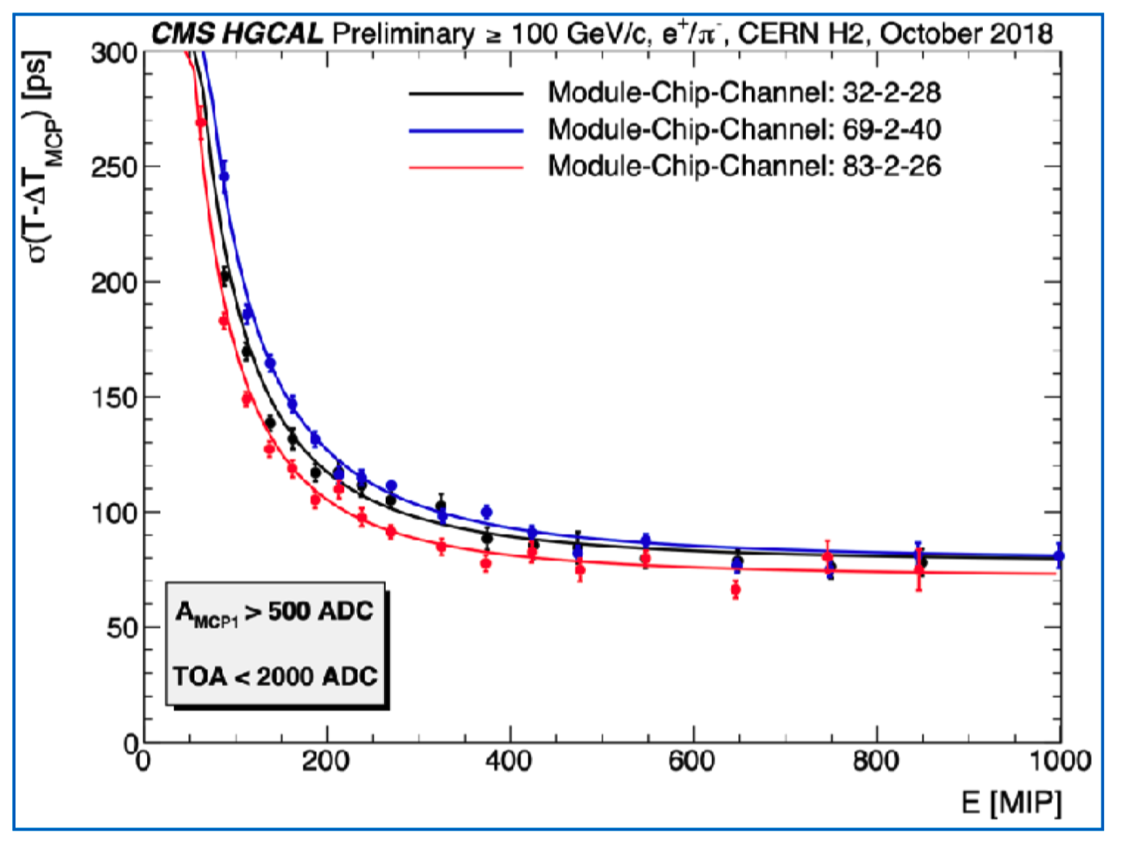
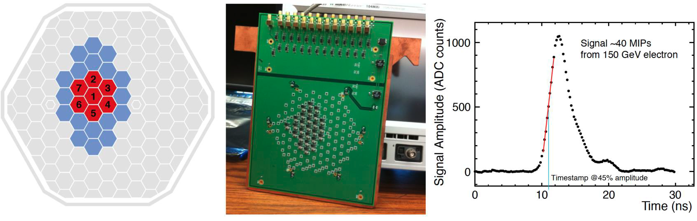
Pile Up Mitigation
CMS HGCAL will be the first large calorimeter to provide precise time information useful for pileup
mitigation. This is possible thanks to the use of Silicon sensors.
Courtesy: D. Barney and T. Quast

Slide 11
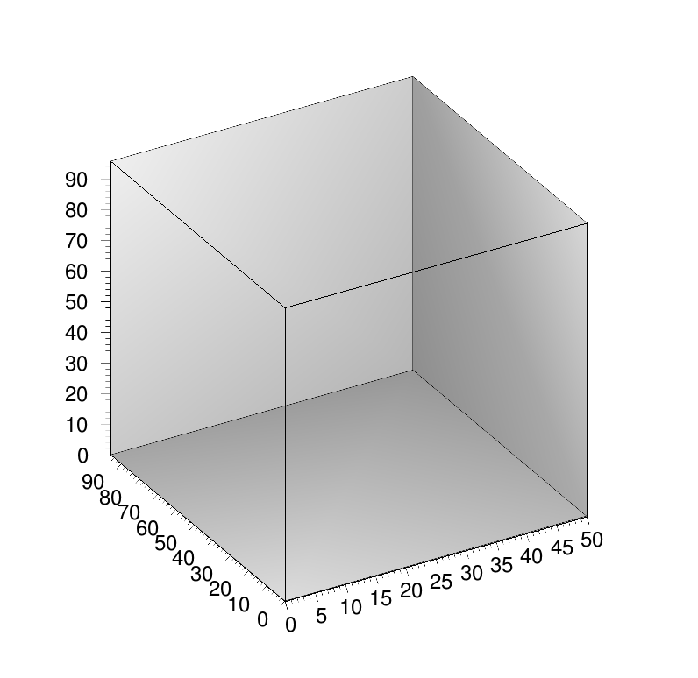
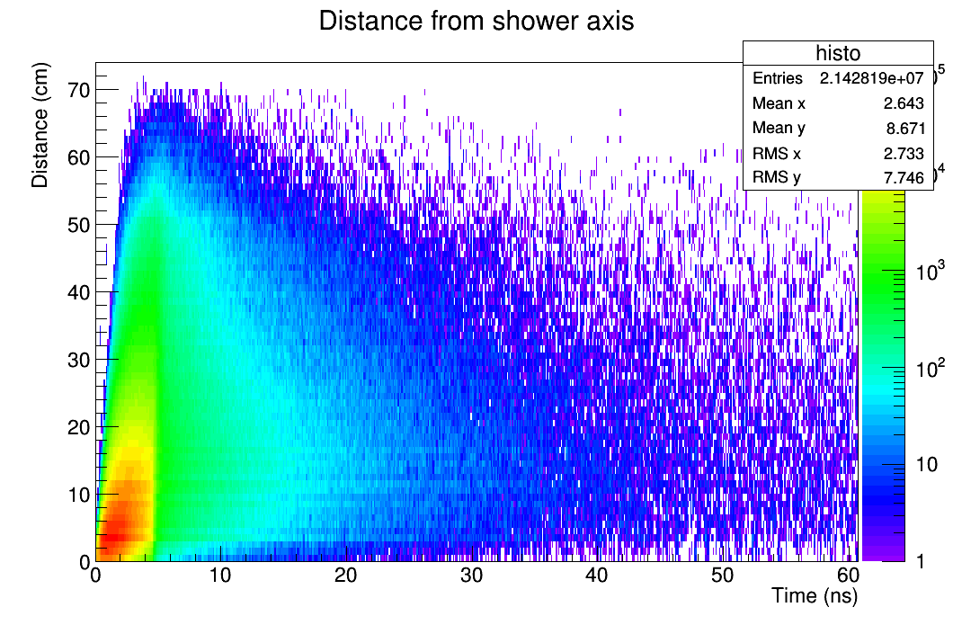
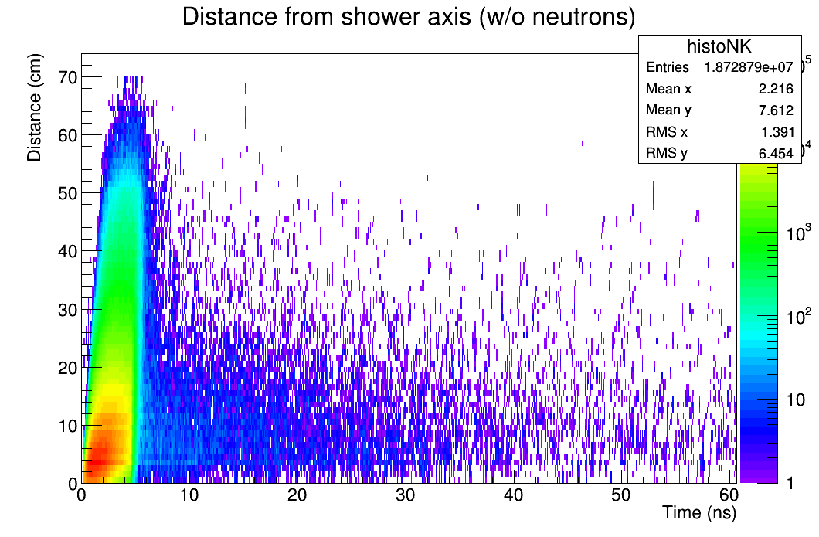
Cleaning and shower separation
Hadronic showers feature many neutrons and many of them are delayed ones and can :
1- fake the energy measurement (fluctuations)
2- complicate nearby showers separation when PFA is used
Timing can then tag the hits produced by the neutrons.
SDHCAL simulation

Slide 12
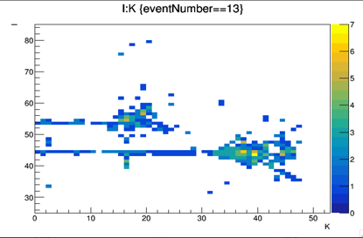
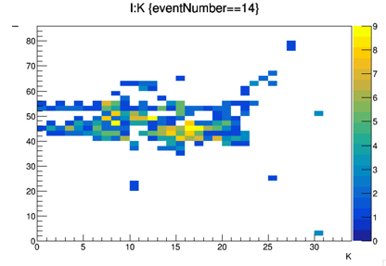
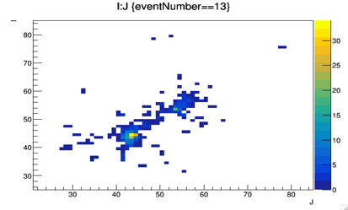
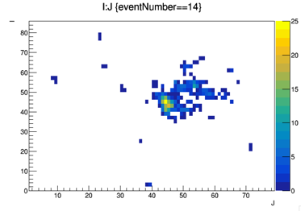
Cleaning and shower separation
Time information can also help to separate close by showers and reduce the confusion for a better PFA application. Example: pi-(20 GeV), K-(10 GeV) separated by appox. 15 cm.
EASY
DIFFICULT
SDHCAL simulation

Slide 13
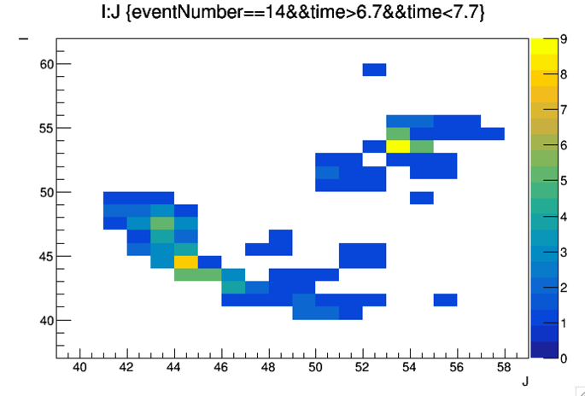
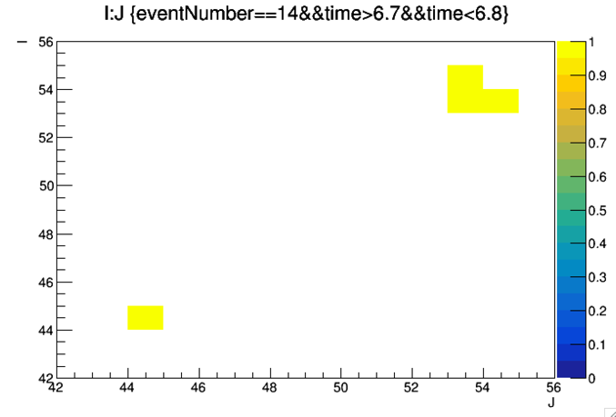
Cleaning and shower separation
Having precise time measurement allows to know how many showers and then the construction of shower by basing the algorithms of construction on the found “skeletons”
Shower projection on transversal plan
SDHCAL simulation

Slide 14
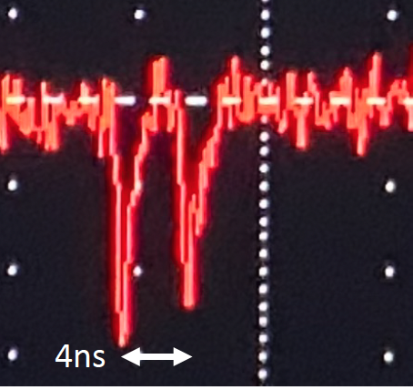
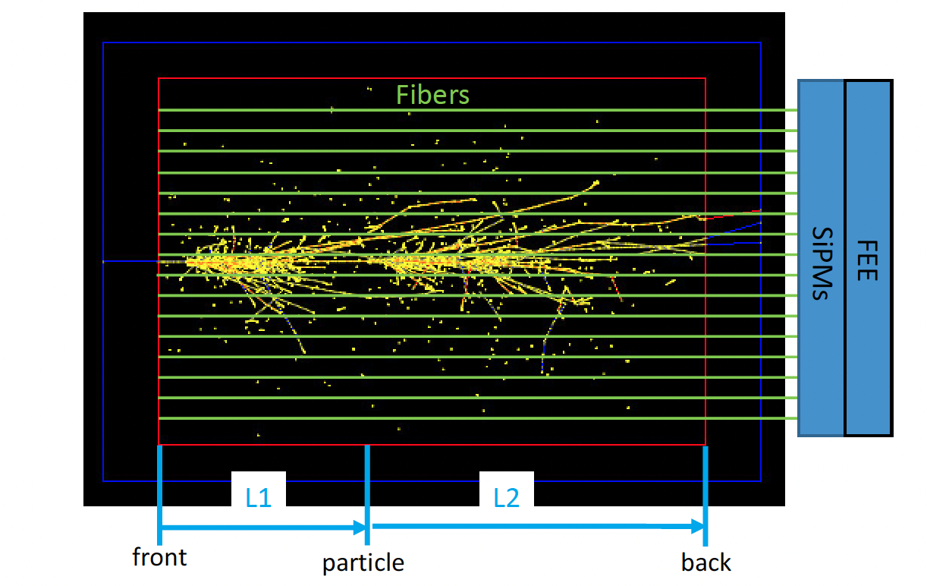
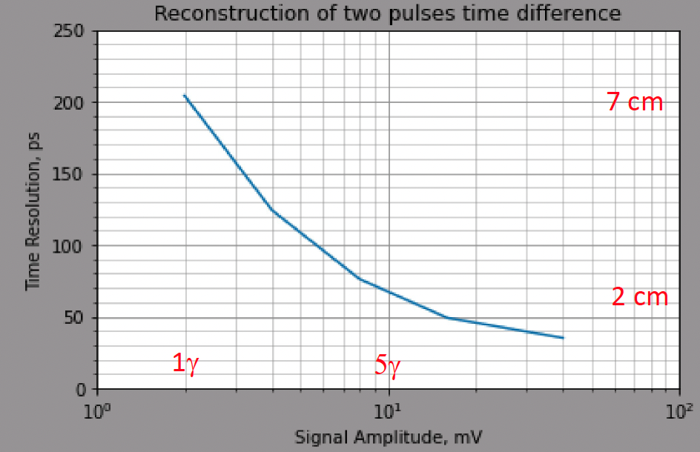
Longitudinal Granularity
With good time resolution, longitudinal segmentation could be replaced by the signal time
arrival measurement and then Neural Network techniques can be used to extract position information based on the signal shape collected by fibers and read out by Photodetectors+Fast timing electronics
Signal Time = L1/c + L2/kc,
c = velocity of particle
kc = velocity of light in fiber (k~0.6)
Courtesy S. Kunori

Slide 15
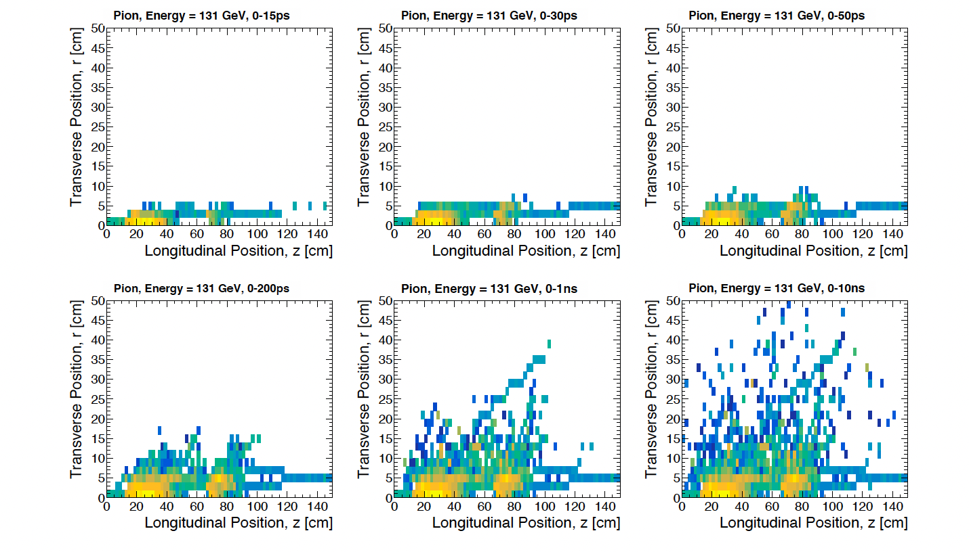
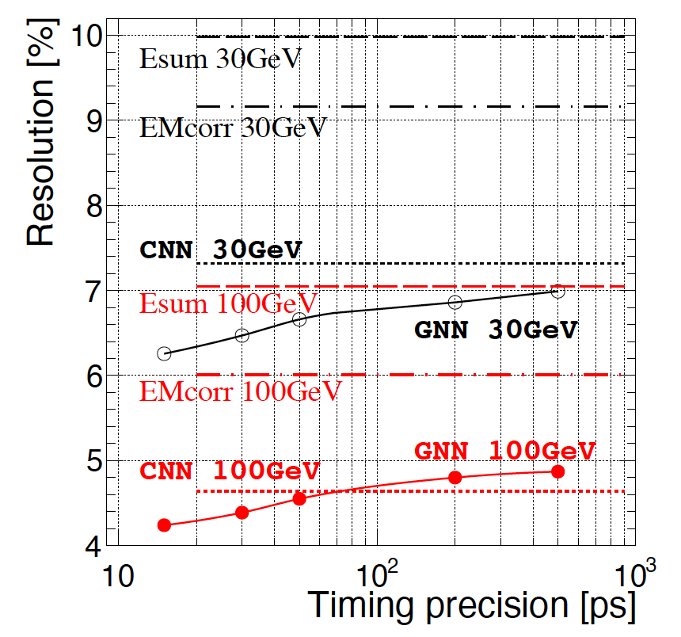
Energy Measurement
Simulation of electrons and hadrons in 3D calorimeter made of Uranium as absorber and 3 mm Silicon as active medium and
Using GNN with time information improves energy reconstruction
Esum: standardd
EMcorr
DR-based
CNN
uses the shape in addition
GNN
uses shape and timing
arXiv:2107.10207v3

Slide 16
Detectors &Electronics

Slide 17
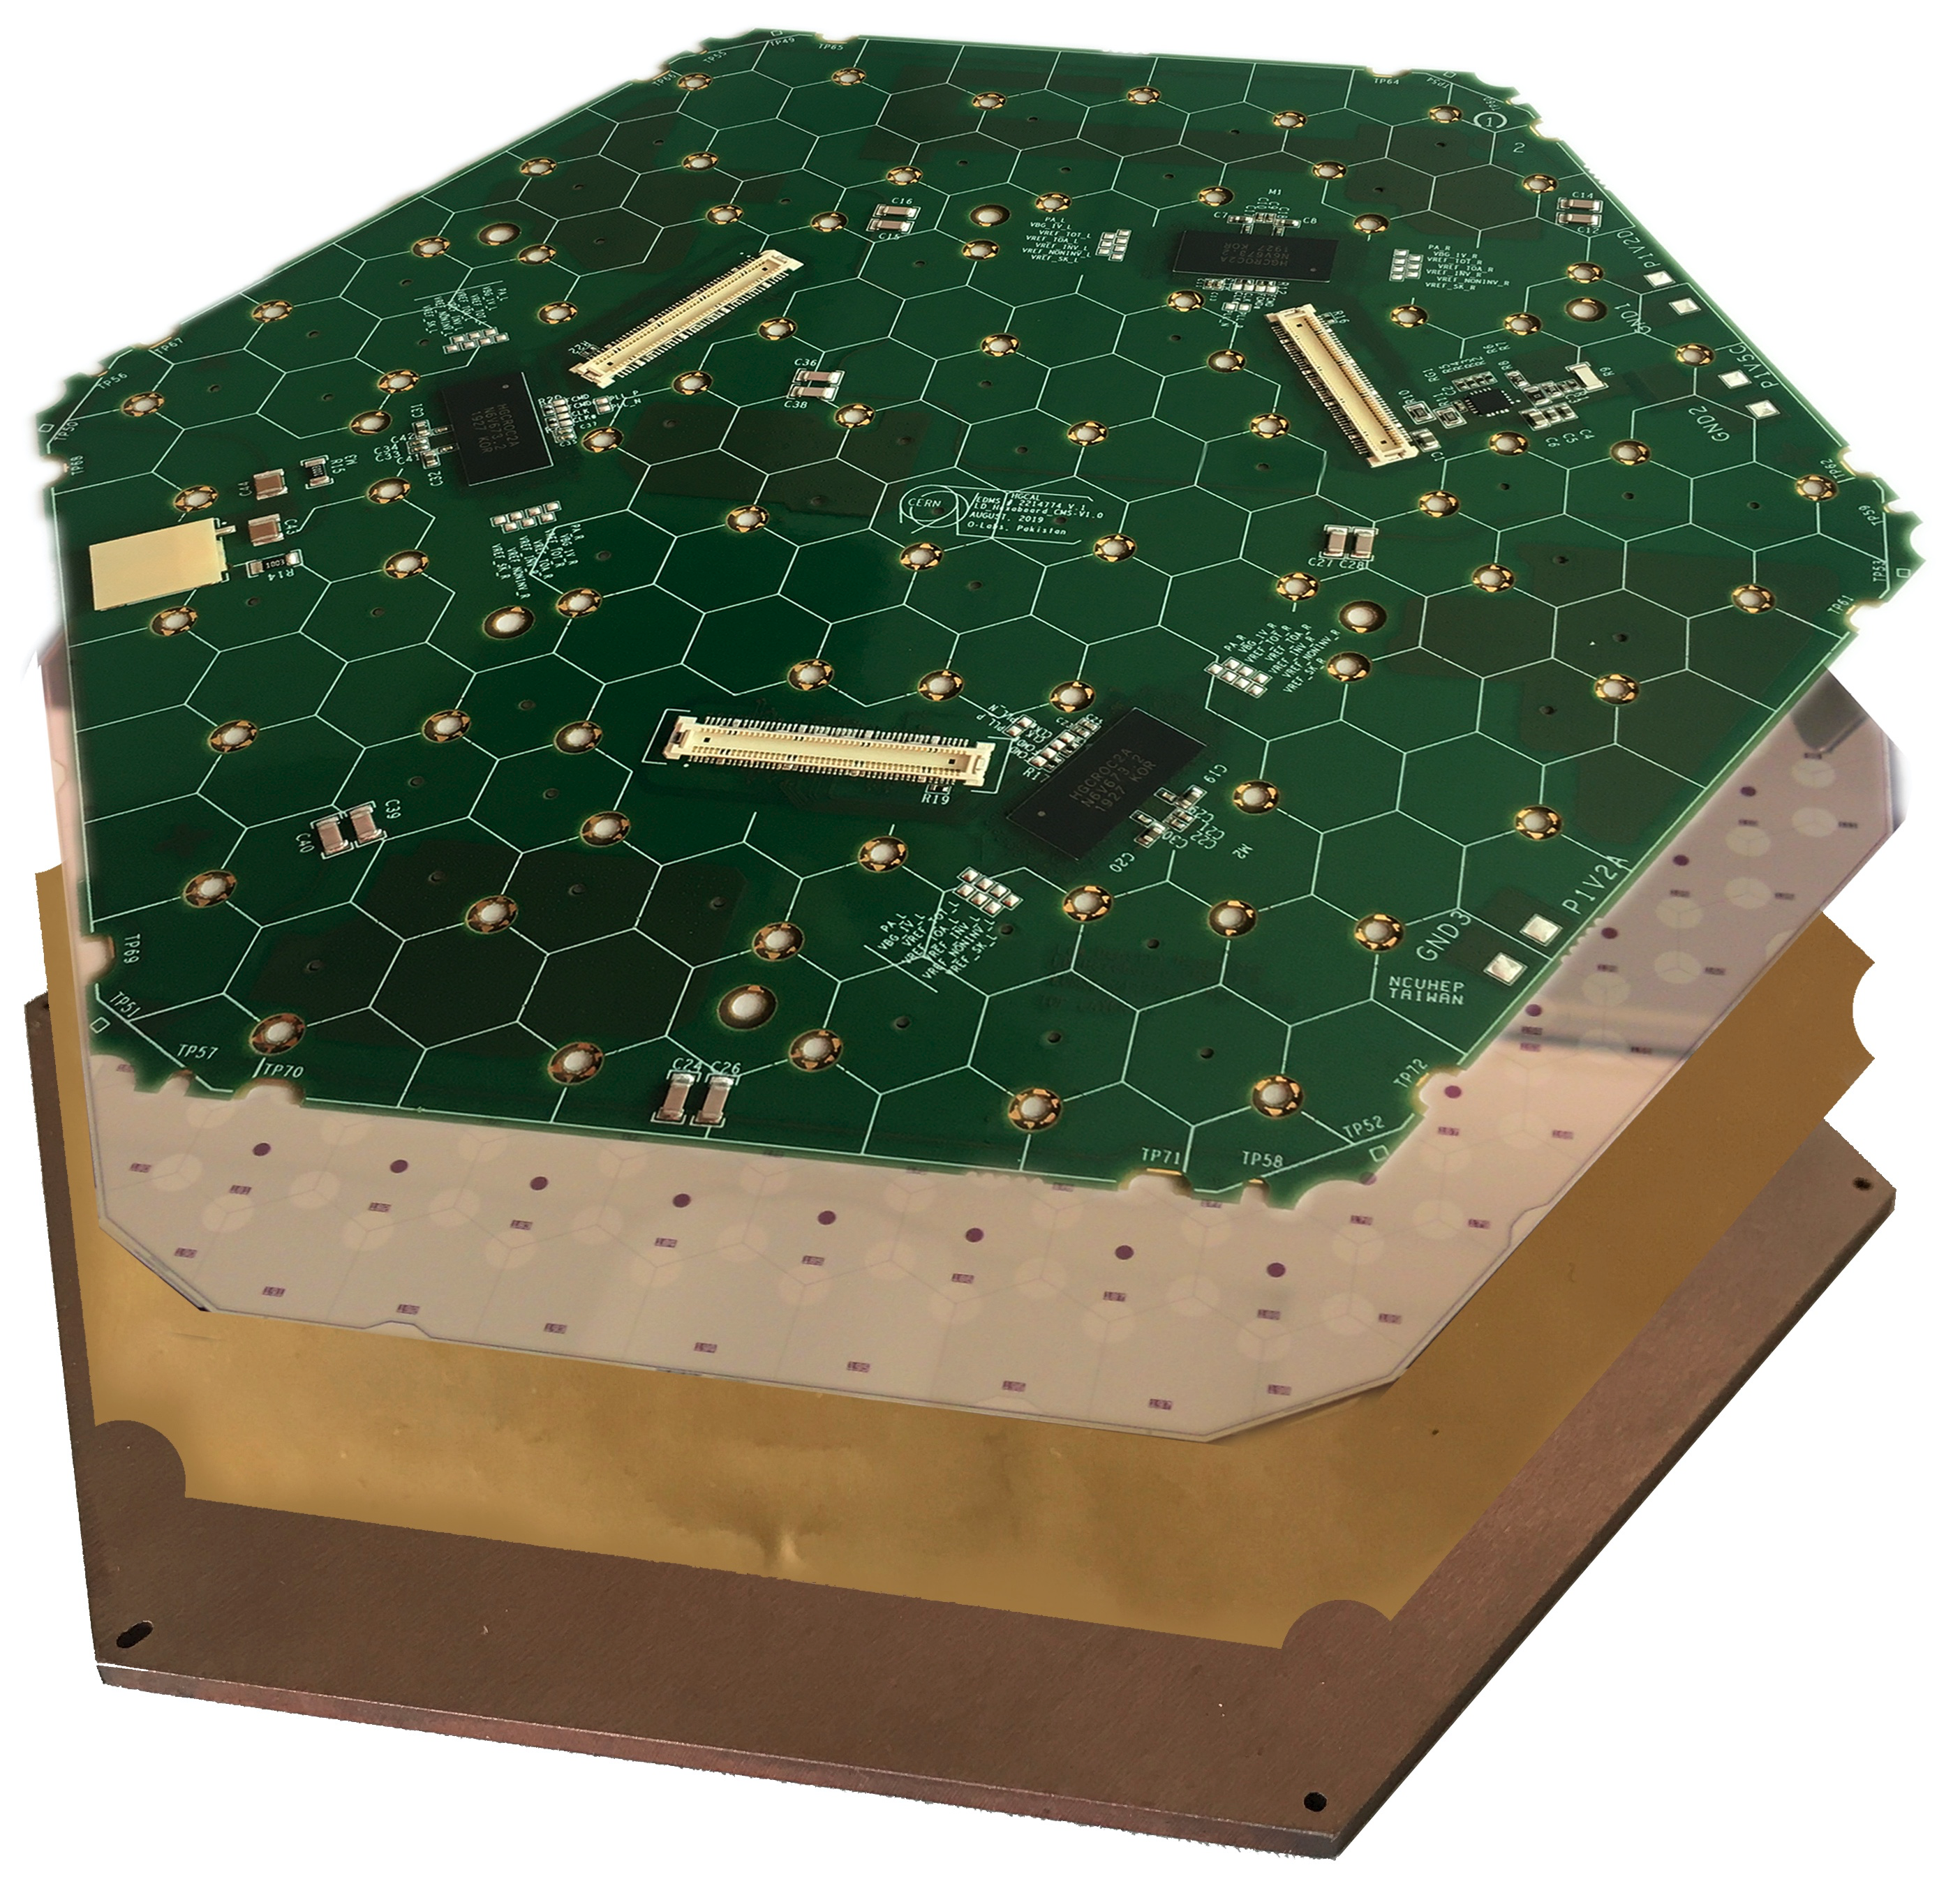
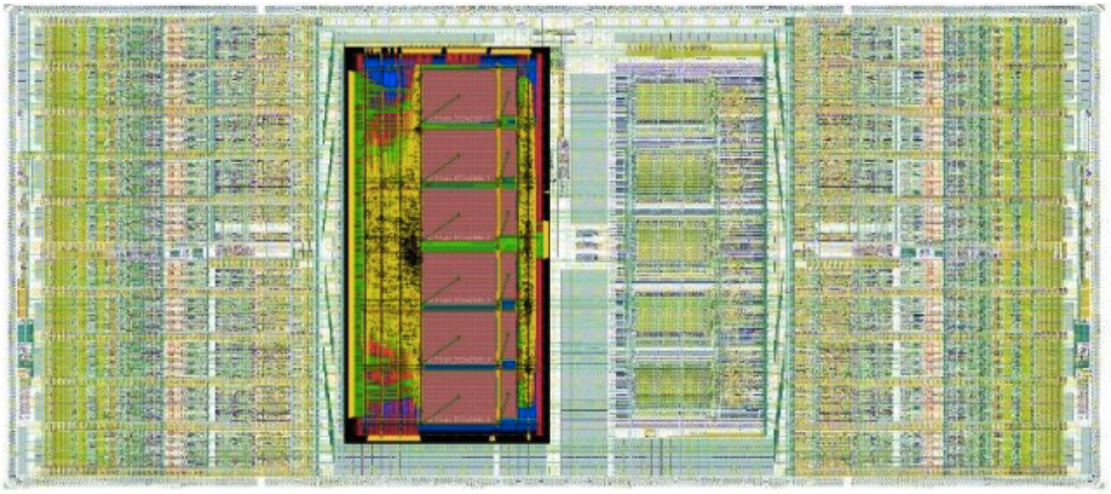
Silicon-based
CMS HGCAL will be the first calorimeter using this
technology at large scale. CALICE physical prototype was a proof of concept.
CMS Silicon modules
Sandwich of PCB, sensor, biasing/insulation layer and baseplate for rigidity/cooling.
• Wire-bonding from PCB onto the silicon.
• CE-E: Cu W baseplates act as absorbers.
• CE-H: PCB baseplates (good thermal
properties and cheaper).
Silicon thickness (120, 200, 300 µm) depending on the rate
Low noise (<2500e)
High dynamic range (0.2fC -10pC).
Timing information tens of picoseconds Radiation tolerant.
Consumption <20mW per channel (cooling limitation).
Zero-suppression of data to transmit to DAQ.
HGROC

Slide 18
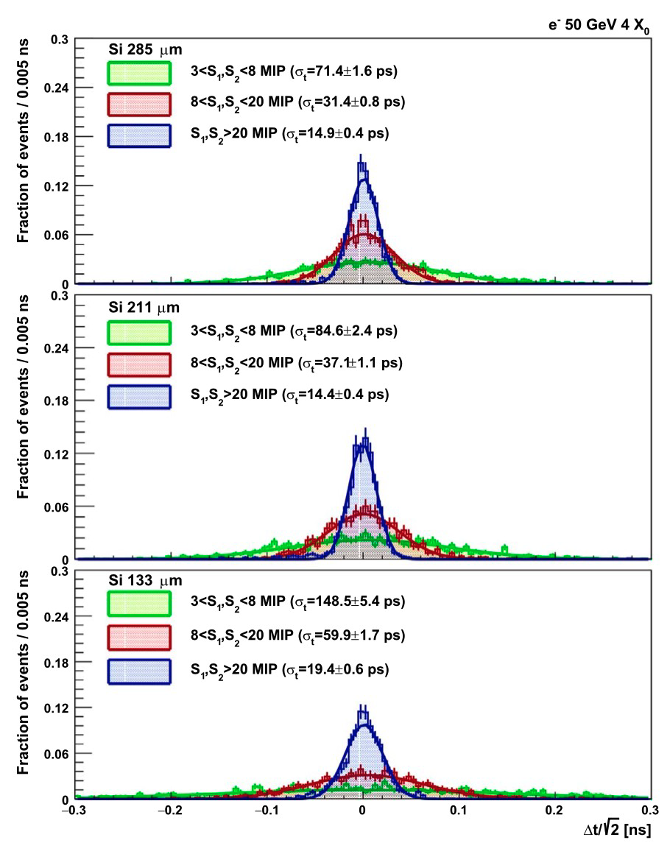
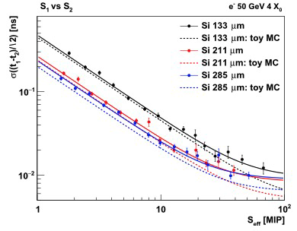
Silicon-based
Silicon-based calorimeter could be optimized to improve on timing performance
wafer thickness is an important aspect:
The thicker the wafer the better the time resolution
N. Akchurin, V. Ciriolo, E. Currás, J. Damgov, M. Fernández, C. Gallrapp, L. Gray, A. Junkes, M. Mannelli, K. H. Martin Kwok, P. Meridiani, M. Moll, S. Nourbakhsh, S.
Pigazzini, C. Scharf, P. Silva, G. Steinbrueck, T. T. de Fatis, and I. Vila, On the Timing Performance of Thin Planar Silicon Sensors, Nuclear Instruments and Methods in
Physics Research Section A: Accelerators, Spectrometers, Detectors and Associated Equipment 859, 31 (2017).

Slide 19
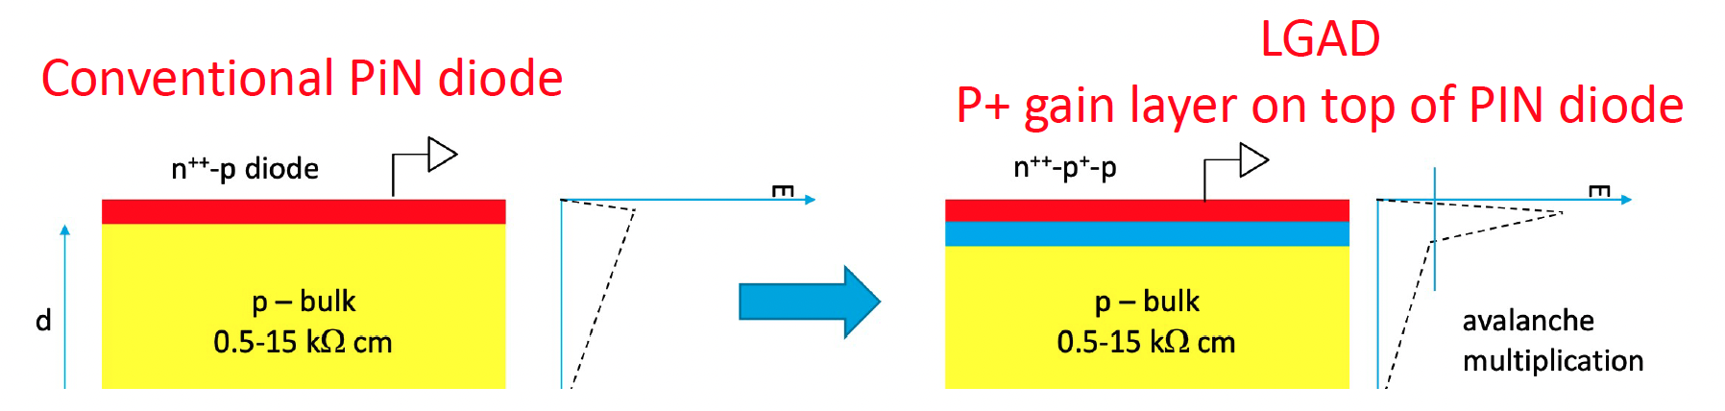
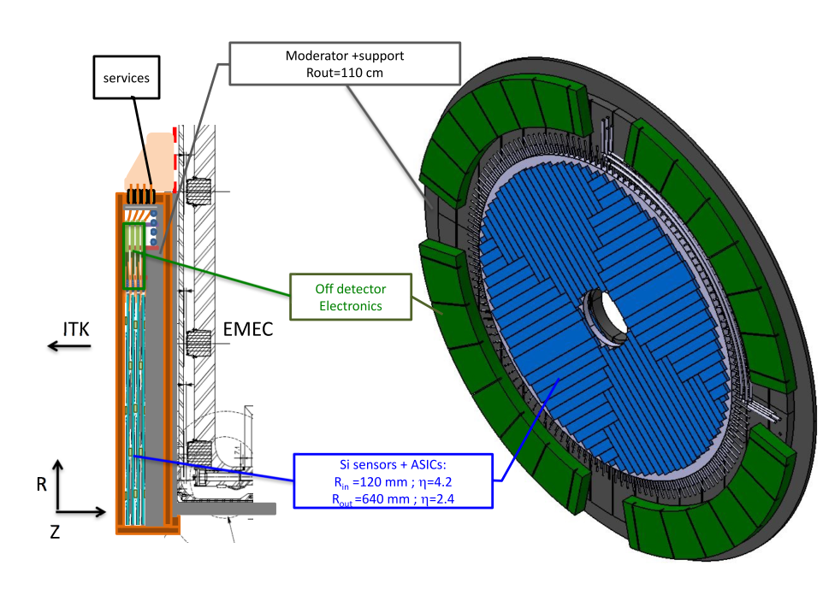
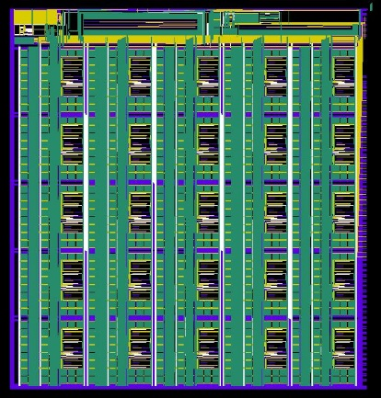
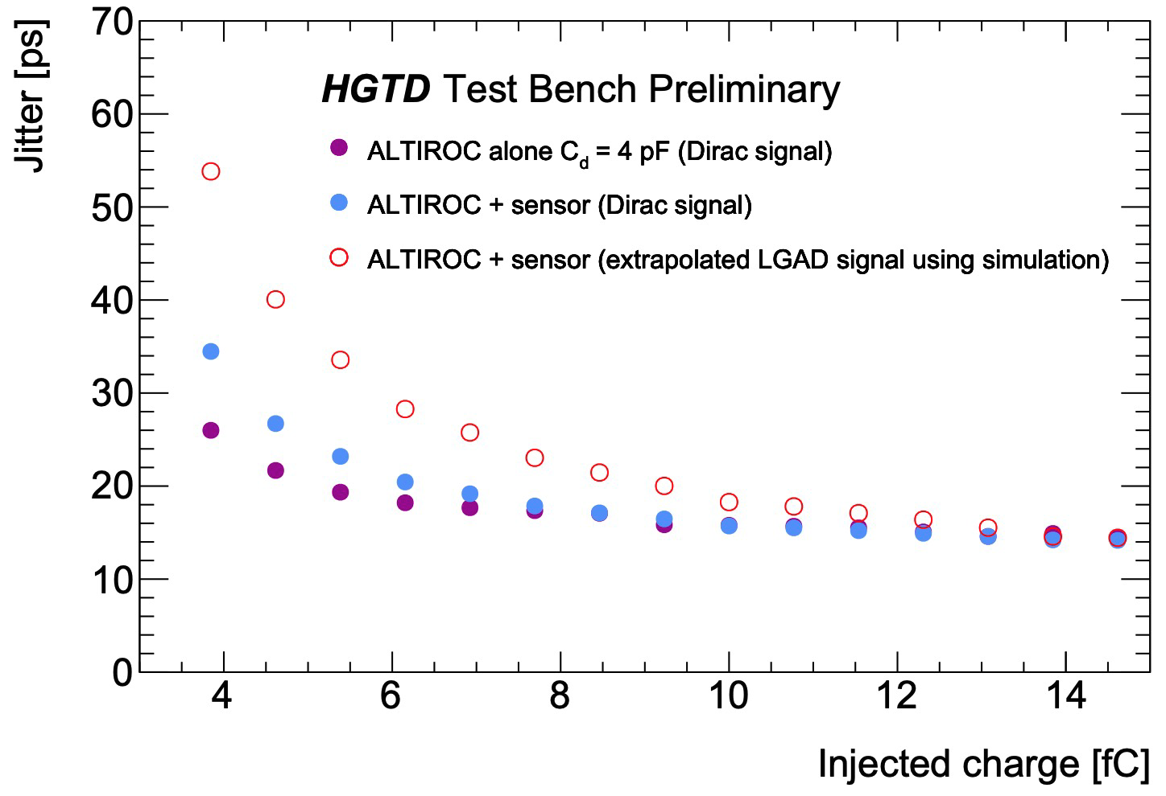
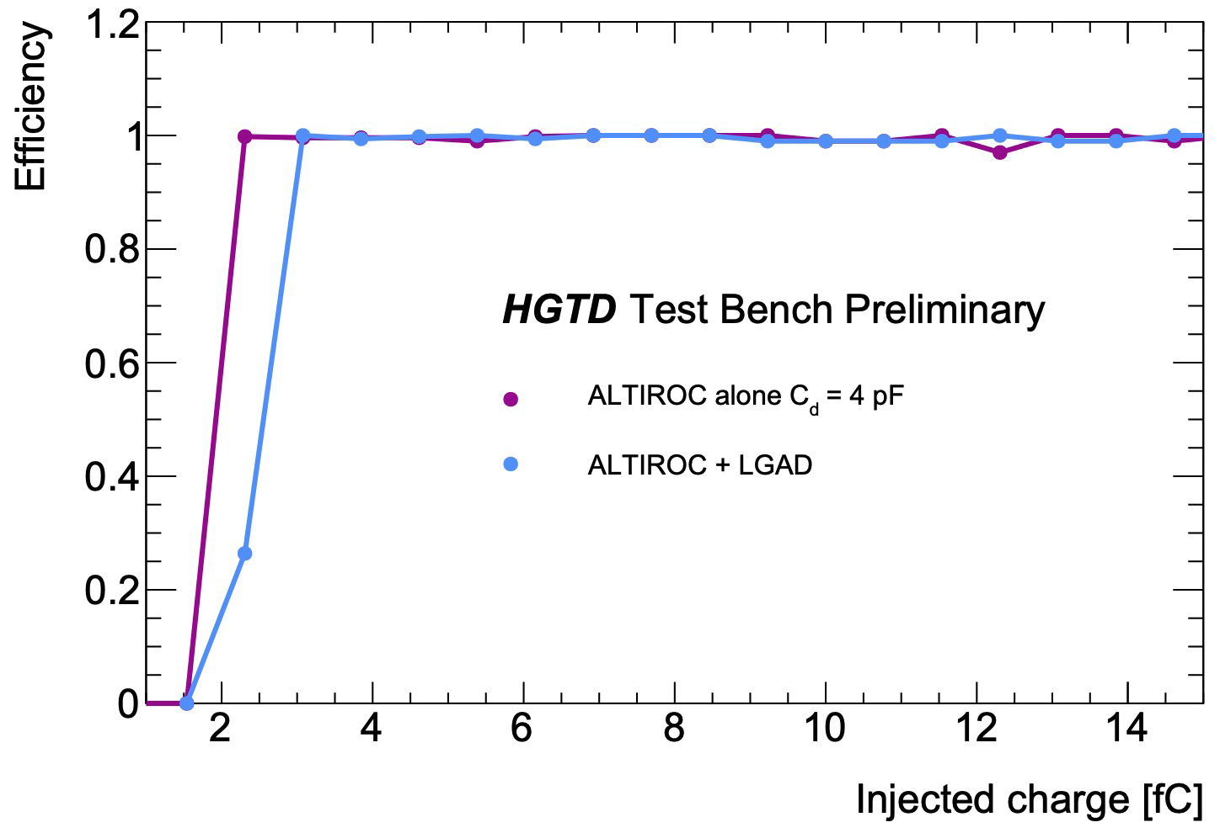
LGAD-based
Multiplication takes place in a limited space reducing the time spread
ATLAS HGTD
Is the first large detector to
use this very promising technology
LGAD sensors will be read out thanks to
ALTIROC:
TSMC 130 nm, 225 channels
Targeted time performance: 20 ps
MTD ( EndCaps of CMS) will also use the same technology
ALTIROC
HGTD
~15ps jitter @ 15fC, better than
70ps jitter@ 4fC
and excellent efficiency
Courtesy Z. Liang

Slide 20
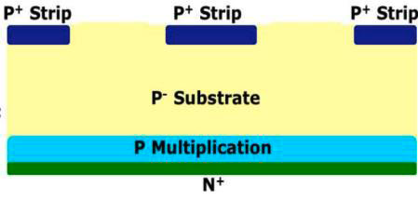
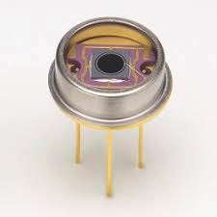
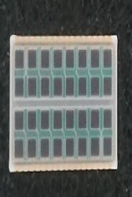
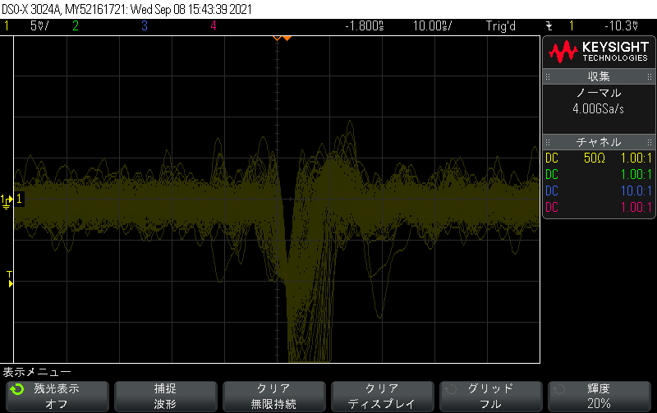
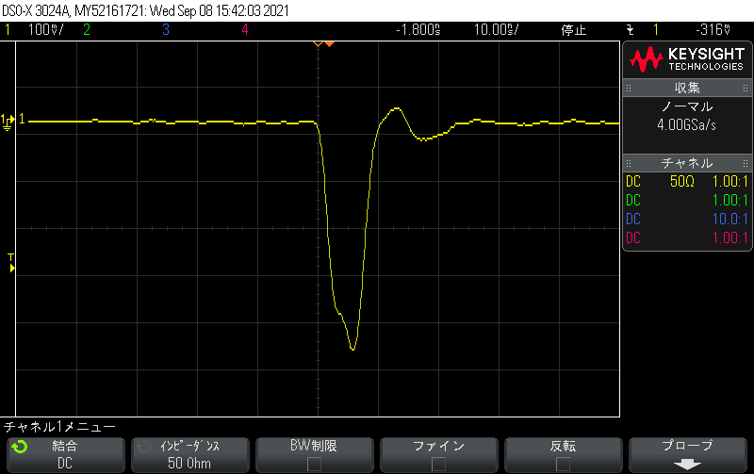
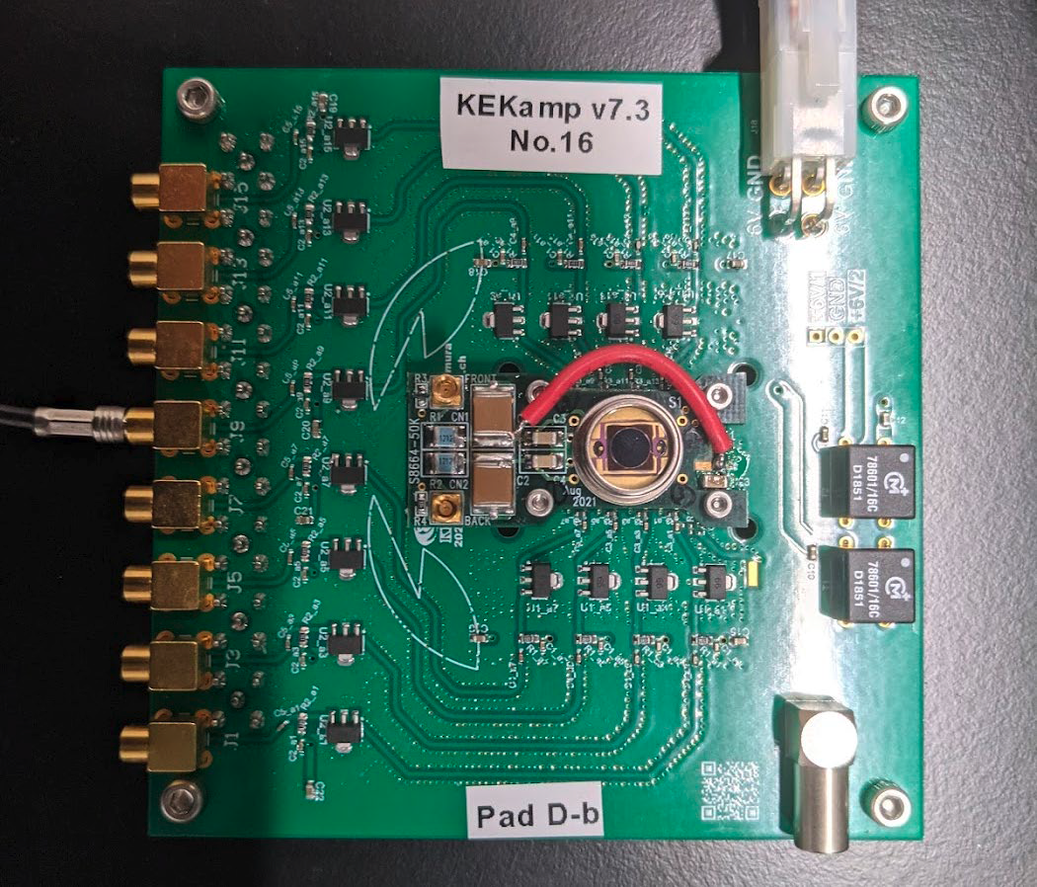
LGAD-based
Inverse type (Single Sided) presents → Better flatness & thinner active area`
Courtesy T. Suehara
Single cell
Multi cell
CALICE collaboration has started a new development to investigate the possibility to replace the silicon-based ECAL by a LGAD-based one
Figure of Electronics merit T_{r}/(S/N)
Pulse height ~500 mV, rise time ~ 2 ns
Noise ~ 2 mV (sigma)
LGAD amplifier
Gain (100) & 3 GHz
Expected jitter 10 ps

Slide 21
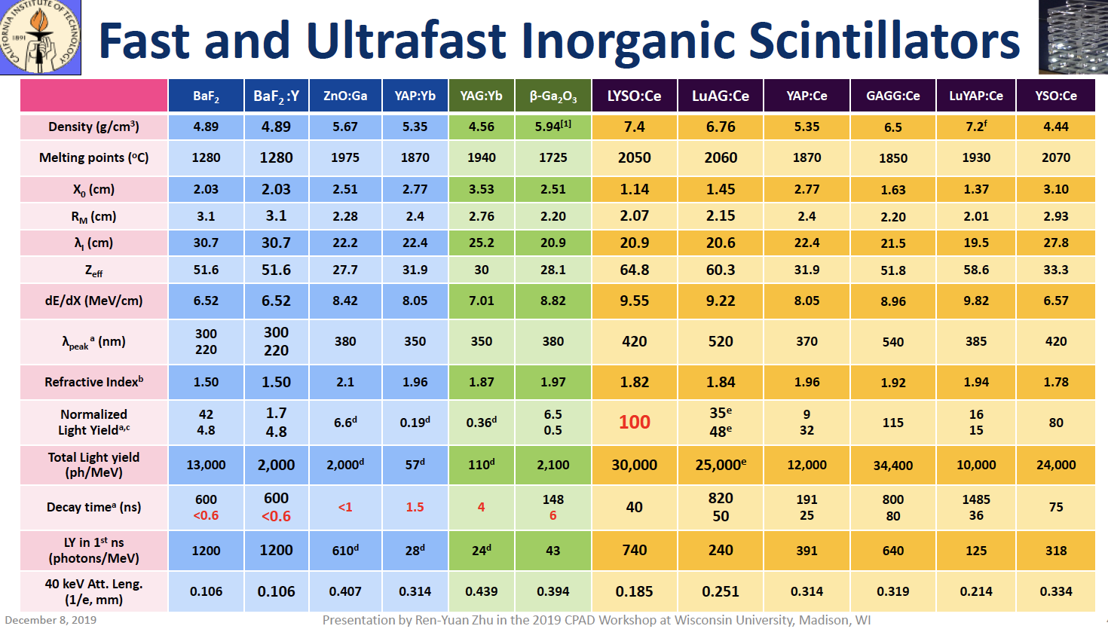
Scintillator/Crystal-based
Using scintillation materials with fast response that are read out by fast photo-detectors adds to the
excellent energy resolution, a timing information that can help not only to mitigate pileup but also to improve on the energy resolution.
Inorganic materials seem to perform better than others but big efforts are made to find new materials or revisit old ones

Slide 22
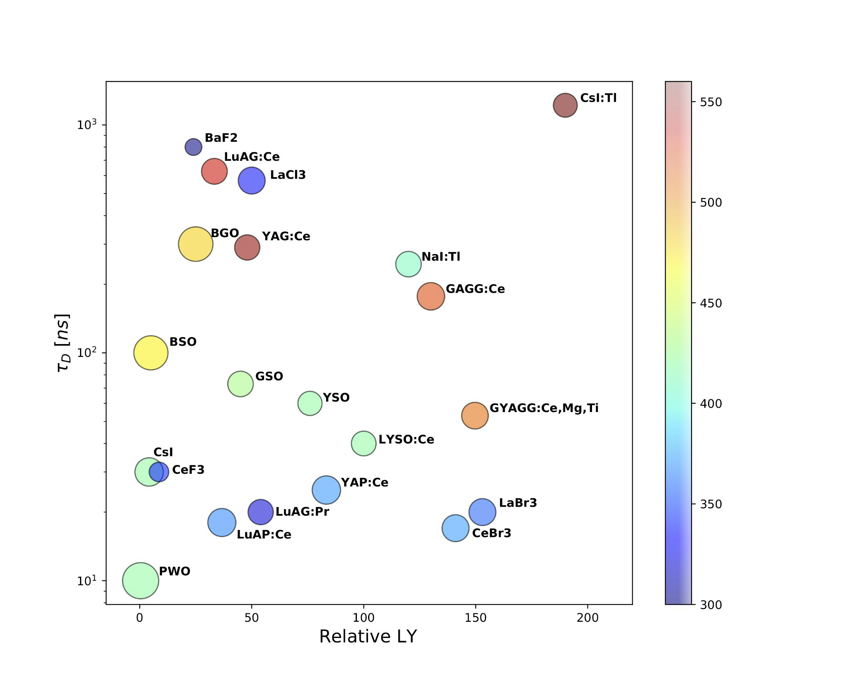
Scintillator/Crystal-based
Using scintillation materials with fast response that are read out by fast photo-detectors adds to the
excellent energy resolution, a timing information that can help not only to mitigate pileup but also to improve on the energy resolution.
Inorganic materials seem to perform better than others but big efforts are made to find new materials or revisit old ones

Slide 23
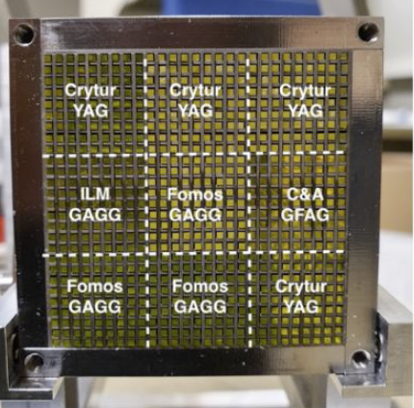
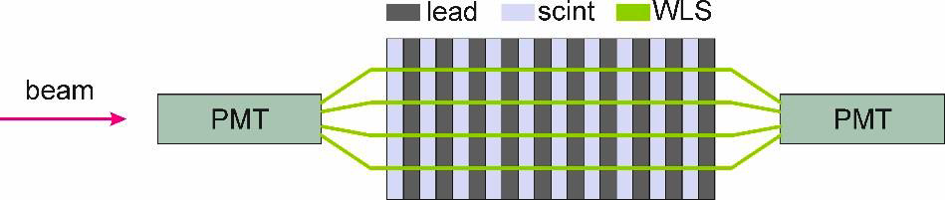
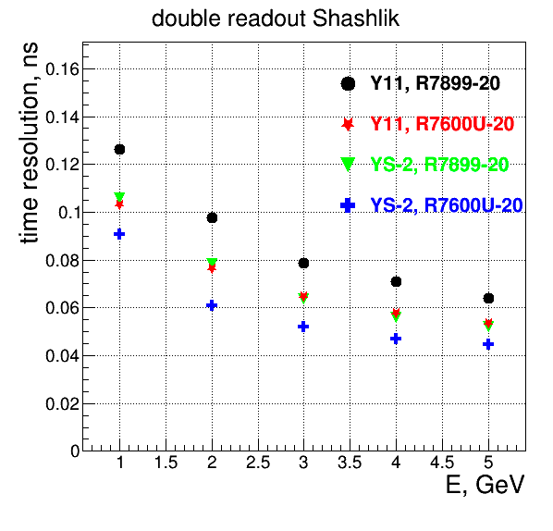
Scintillator/Crystal-based
LHCB ECAL upgrade
Shashlik structure is proposed for the LHCB ECAL upgrade aiming at time resolution of few tens of ps
Scint
Several Scintillators are
Being studied:
-YAG
-GAGG
-GFAG
Photodetector
Use better PMT (small transit time spread and transit time uniformity over the photocathode)
•R7899-20 (TTS ≈ 1-2 ns)
•R7600U-20 (TTS ≈ 0.35 ns)
WLS fibers
•Use WLS fibers with shorter decay time
•Y11 decay time ≈ 7 ns
•Research work is ongoing in KURARAY aiming to
develop faster WLS fibers with good light yield
•New KURARAY WLS: YS-2 (≈ 2.7 ns)
Courtesy of A.Schopper

Slide 24
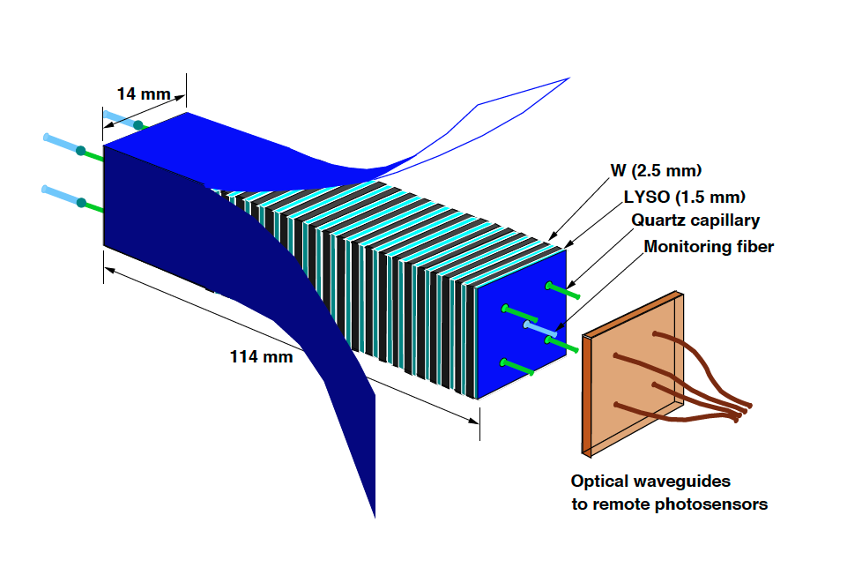
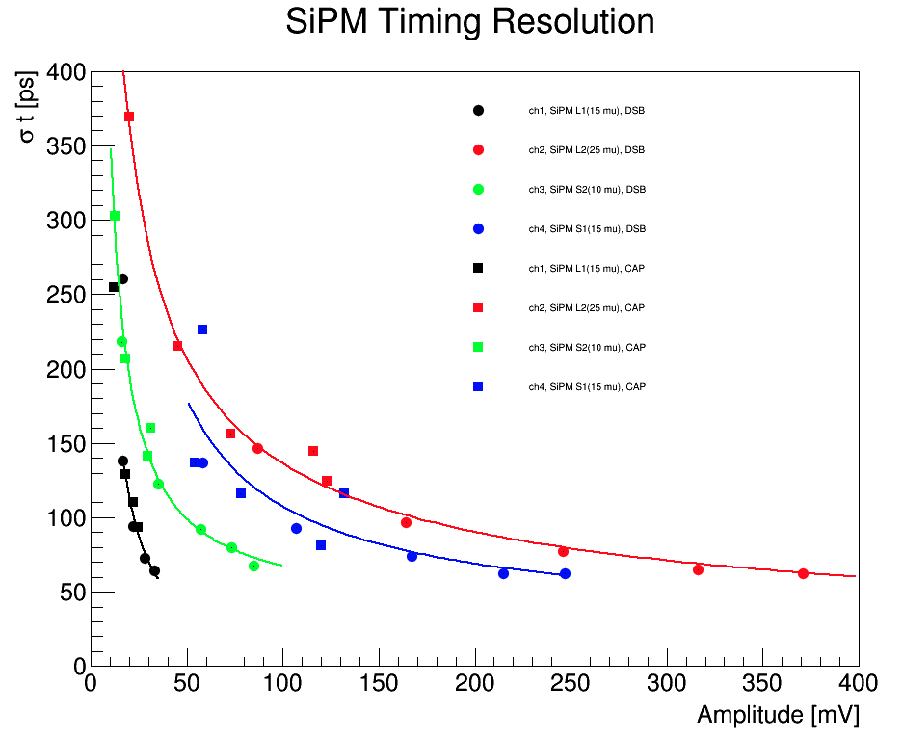
Scintillator/Crystal-based
RADiCAL concept is also a compact shashlik-like concept aiming at excellent energy resolution and excellent timing in harsh conditions (FCChh)
Courtesy R. Rushti
LYSO/W module, single channel time resolution with SiPM
readout. Waveshifter readout was either DSB1 WLS dye in a
multiclad optical fiber (dots) or DSB1 WLS in a liquid-filled
capillary (squares). Fermilab Test Beam, A. Bornheim et al.

Slide 25



Scintillator/Crystal-based
Time information is one of the main features
1. Positioning of WLS filaments at
Shower Max for timing studies.
2. Incorporation of dual readout for
both scintillation and Cerenkov
measurement – including for timing
with quartz rods and the WLS
capillary structures which are
predominantly quartz material.
Simulation
Simulation
GEANT4 simulation of the time resolution
expected from Shower Max, using LYSO
and DSB1 filament. Electrons of 50 GeV
Shower profile at Max.
Courtesy R. Rushti

Slide 26




Scintillator/Crystal-based
CALICE AHCAL uses 3cm X 3cm tiles
read out by SiPM
SiPM used in AHCAL
S13360-1350
●Historical reference to compare with previous measurements
●Breakdown voltage = 51.76V
●S14160-1315
●Best representative of SiPMs in HGCAL: Hamamatsu S14160 series will be used
●Breakdown voltage = 38.31V
SiPM are fast timing but need appropriate scintillation media and adequate readout electronics.
For AHCAL proposed for ILC moderate time measurement is needed to eliminate delayed neutrons (> few ns)
Courtesy M. Kroen
Single channel resolution
1.1/√2 = 0.78ns

Slide 27





Scintillator/Crystal-based
Array of LYSO crystals (CMS MTD)
SiPM is becoming an important piece of the
scintillator/crystal detectors/calorimeters
Associated to fast Scintillator/crystals
it can provide excellent time resolution
Time resolution of ~30 ps for single MIPs with
single LYSO layer is expected from MTD (CMS, Barrel)
Efforts to go for small pixels < (10 µm) are to be carefully
followed since the smaller the pixel the better the faster
the time response.
Developments of the so-called Nano crystals (such as
Perovskite sensitizer, CsPbBr3) that feature sub-nanosecond scintillation
with good LY as well as colloidal quantum dot technology
are ongoing and could lead to a breakthrough
In addition, revisiting known material (doping) to better
distribute scintillation in favor f fast component→ PWO-III
MTD Barrel
30 ps time
resolution
Courtesy
M. Lucchini
Courtesy of M.Korjik
and G.Tamulaitis

Slide 28





Gaseous Calorimeters
SDHCAL concept is being transformed into T-SDHCAL
RPC are replaced by MRPC (much faster)
Semi-digital electronics (HARDROC) is replaced by
low-time jitter PETIROC ( > 20 ps @Q> 300 fC)
The hope is to reach time resolution better than
100 ps/mip over all the surface.
Advantage of the gaseous detector option is its low cost and limited dead zone

Slide 29



Askaryan Calorimeter
In dense media about 10-20% of the electromagnetic shower is formed of negative particles that
are concentrated in the front of the shower. They produce a coherent microwave Cherenkov.
This emission provides an excellent estimator of the energy and the time of the shower
Courtesy R. Preschelt
This phenomenon, already used in neutrino astrophysics detection, could be used in HEP calorimeters since the Cherenkov emission can provide a very precise time measurement

Slide 30






A small prototype was built:
Courtesy R. Preschelt
Standard WR51 (12.6mm x 6.3mm) copper waveguides
loaded with alumina bars (Al2O3) are used.
Askaryan (microwave Cherenkov) from a shower moving
through the waveguide is coupled into the TE10 mode (5-8 GHz)
and propagates to each end.
The ns-scale pulse is amplified with low-noise amplifiers (LNAs)
and sample with high-bandwidth digitizers.
The measured waveform is a direct measurement of the shower
energy via the coupled Askaryan emission and provides a precise
time of arrival!

Slide 31





Electronics For time measurement
Role of electronics of time precision:
A few ASICS as examples
Courtesy Ch. De la Taille

Slide 32
TDC
Several TDC (either on ASICS or FPGA) are now able to provide time resolution lower than 10 ps
ASICs present more stability and less power consumption
SAMPIC (Waveform digitizer) -> 3.5 ps
AARDVVARC V3 (waveform digitiser) -> 4-6 ps
PicoTDC (PLL) → 1.5-3 ps
Of course, for large systems the synchronization of all the electronics is challenging but systems like White Rabbit + Local distribution system (lpGBT) can achieve excellent time precision.

Slide 33
Conclusion
Time measurement in future calorimeters can add precise information so to
Mitigate pileup
Identify particles
Apply PFA more efficiently
Improve on energy reconstruction
New algorithms including the time information is being developed. First estimations from the simulation are very encouraging
-Only fast time detectors will survive this evolution toward 5D calorimeters. several technologies exist and being adapted.
-Excellent and time precision electronic readout systems have been developed
-The challenge will soon become to ensure that all the components of the calorimeters are able to preserve the excellent time precision of the detectors and their electronics and this requires huge engineering efforts.

