Slide 1


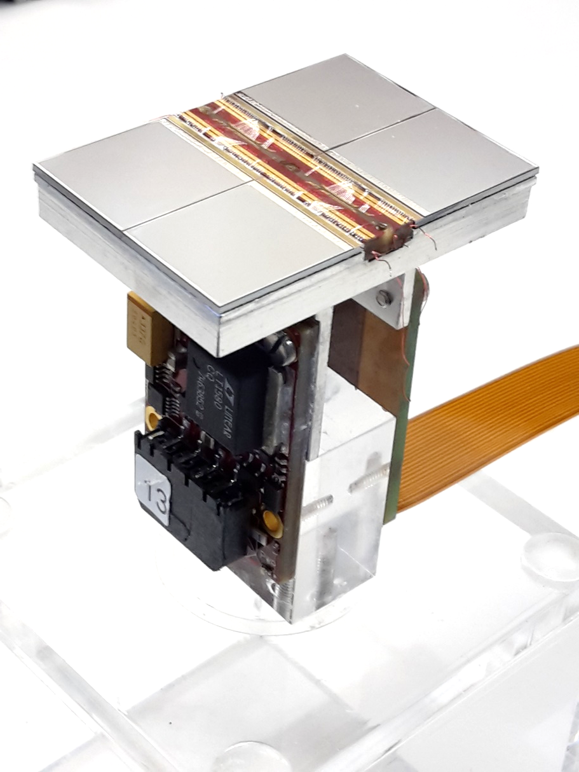


Pixelated Time Projection Chamber Tracker Detector Technology
Yevgen Bilevych, Klaus Desch, Harry van der Graaf, Fred Hartjes, Jochen Kaminski, Peter Kluit, Naomi van der Kolk,
Cornelis Ligtenberg,
Gerhard Raven, and
Jan Timmermans
IAS HEP Hong Kong 2022

Slide 2
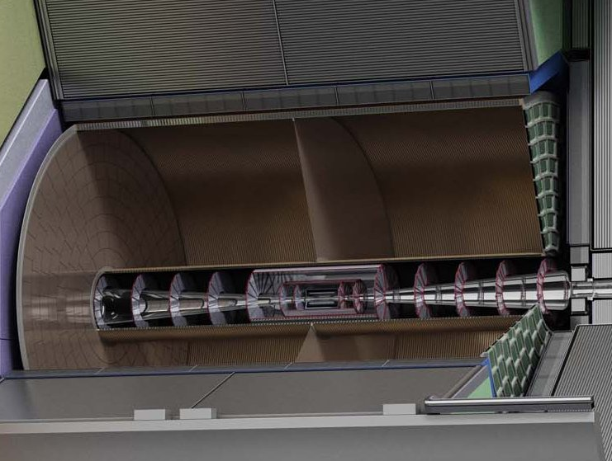
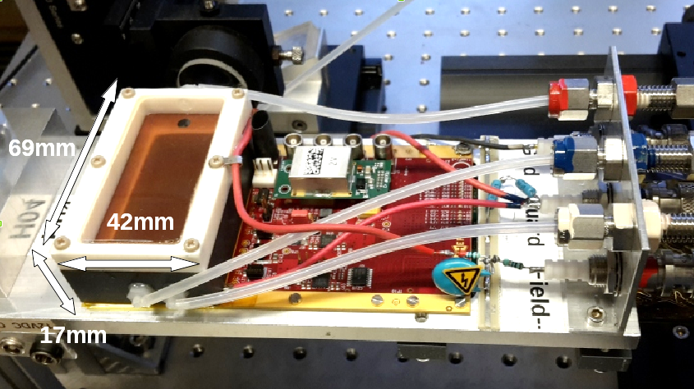
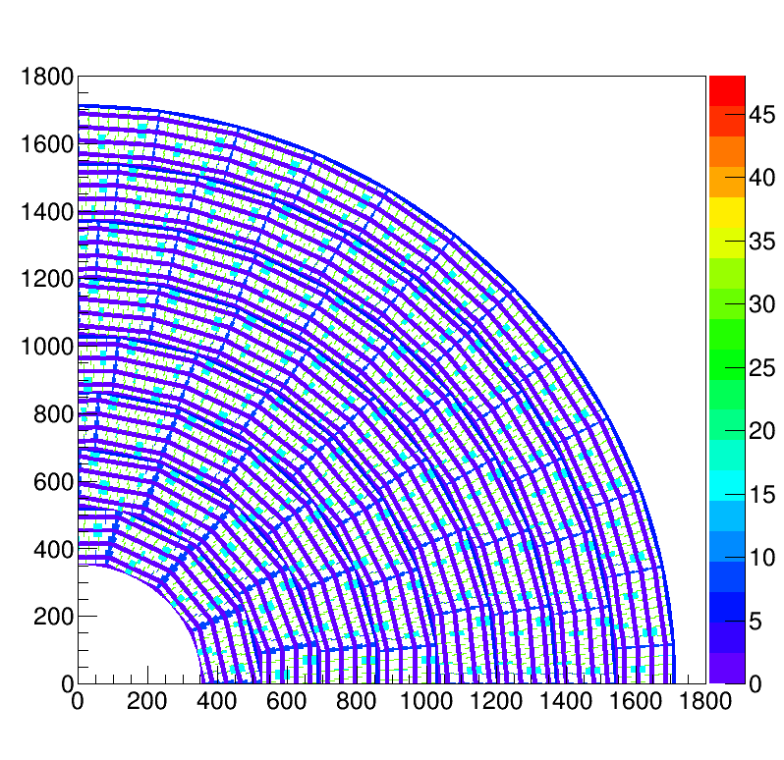
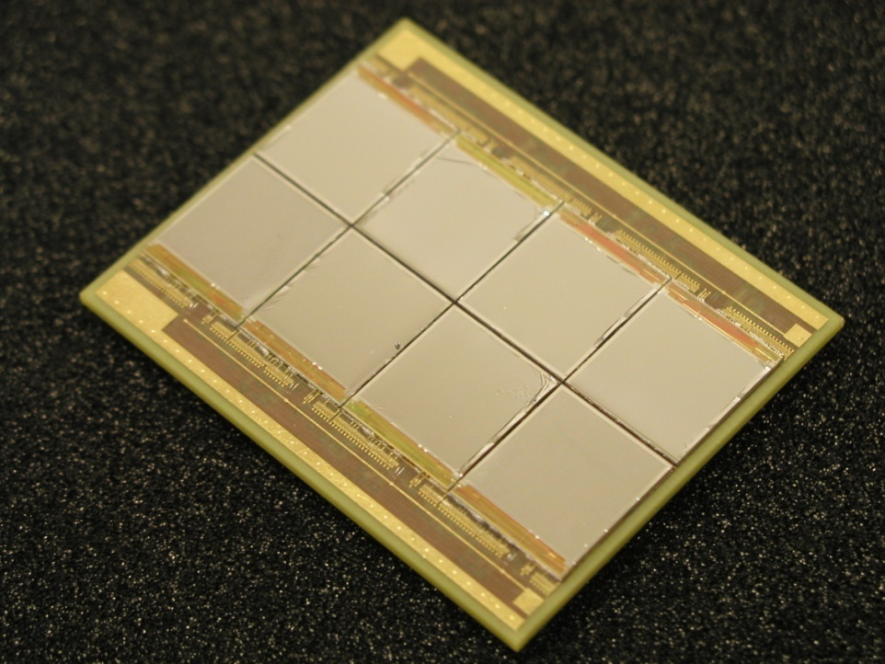
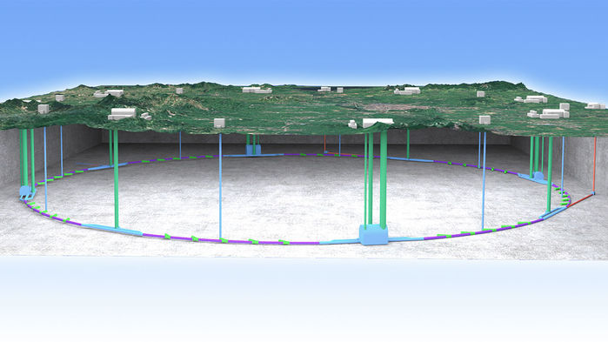
Pixel TPC
(Octopuce)
(TimePix1) TPX3 chip Quad Module TPC plane
(2007-14) 2017 2018 2019
Picture IHEP

Slide 3
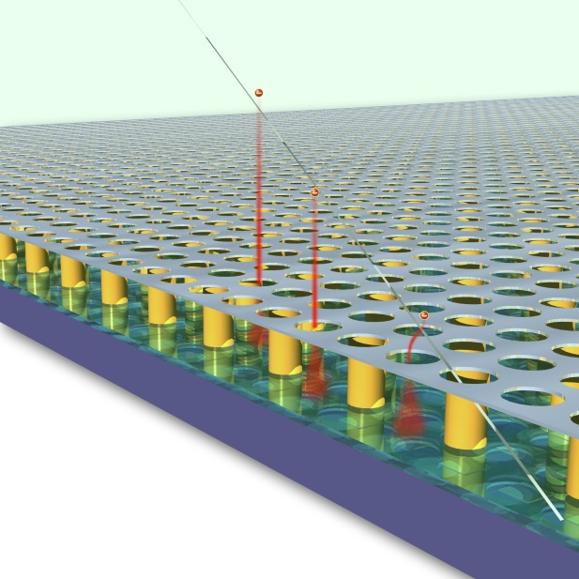
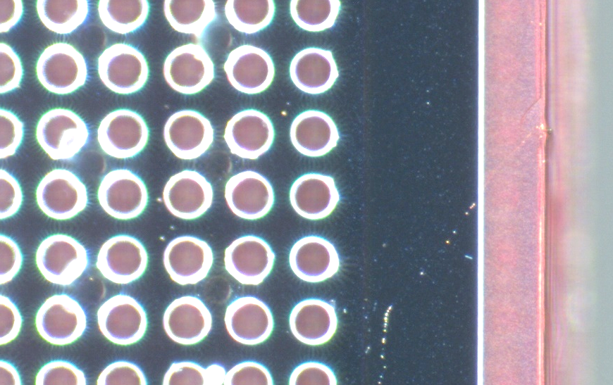
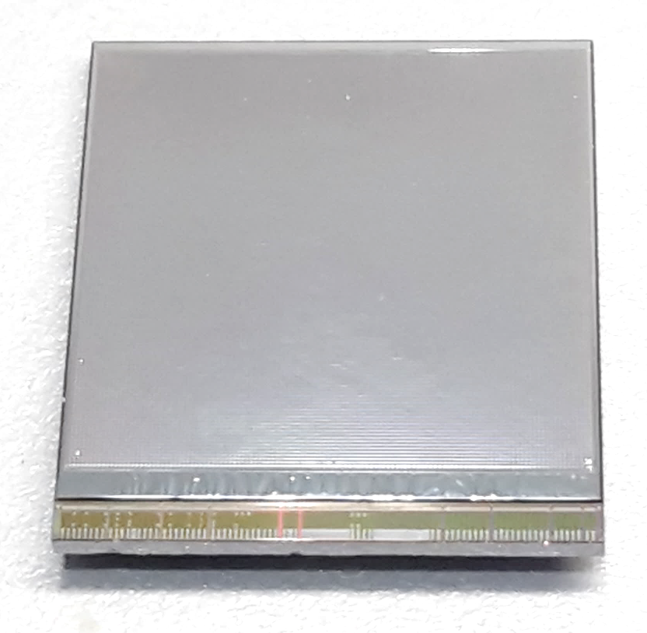
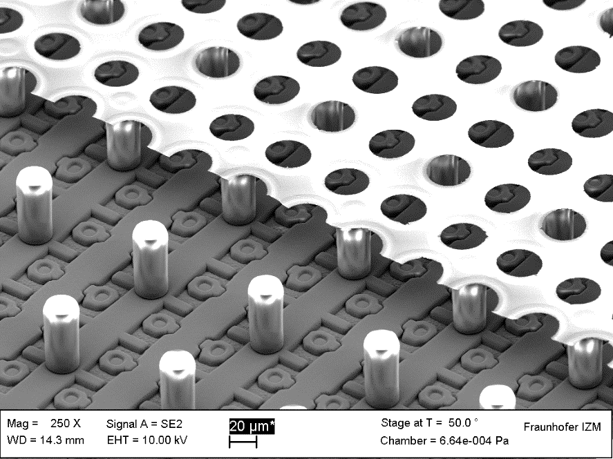
GridPix technology
Pixel chip with integrated Grid (Micromegas-like)
InGrid post-processed @ IZM
Grid set at negative voltage (300 – 600 V) to provide gas amplification
Very small pixel size (55 µm)
detecting individual electrons
dyke
55 µm
Aluminium grid (1 µm thick)
35 µm wide holes, 55 µm pitch
Supported by SU8 pillars 50 µm high
Grid surrounded by SU8 dyke (150 µm wide solid strip) for mechanical and HV stability
50 µm

Slide 4
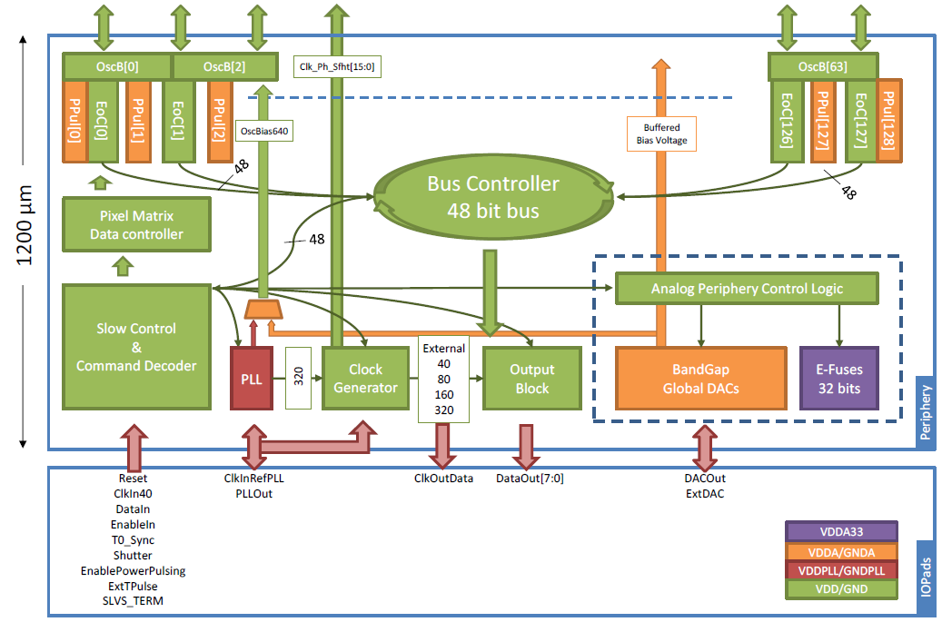
Pixel chip: TimePix3
256 x 256 pixels
55 x 55 µm pitch
14.1 x 14.1 mm sensitive area
TDC with 640 MHz clock (1.64 ns)
Used in the data driven mode
  Each hit consists of the pixel address and time stamp of arrival time (ToA)
  Time over threshold (ToT) is added to register the signal amplitude
  compensation for time walk
  Trigger (for t₀) added to the data stream as an additional time stamp
Power consumption
  ~1 A @ 2 V (2W) depending on hit rate
  good cooling is important
Sensitive area
14.1 mm
2+3 mm

Slide 5
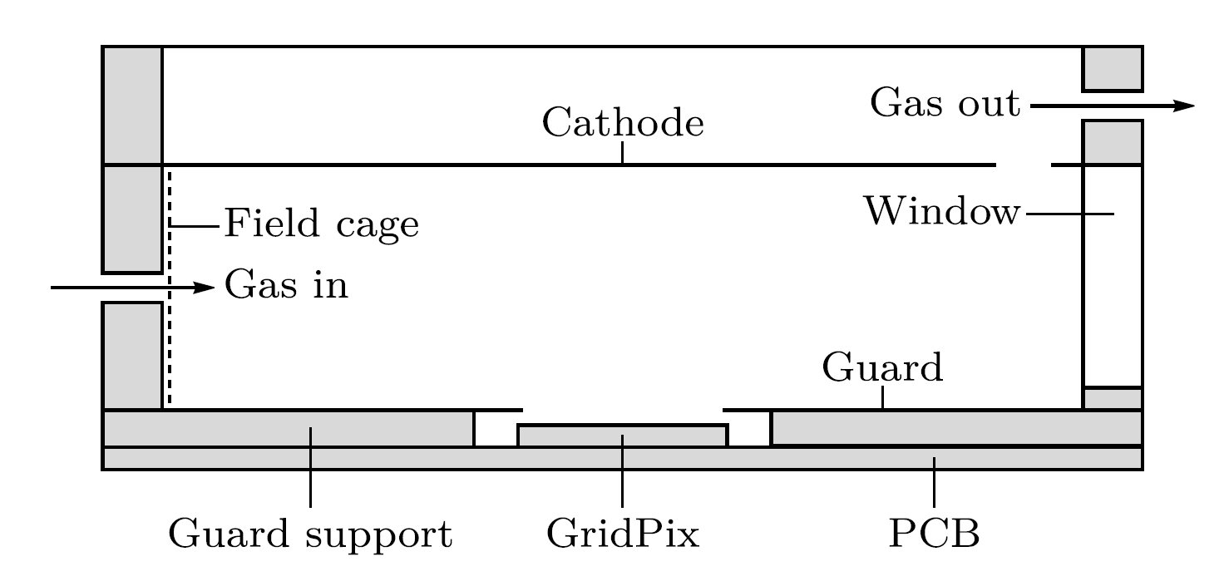
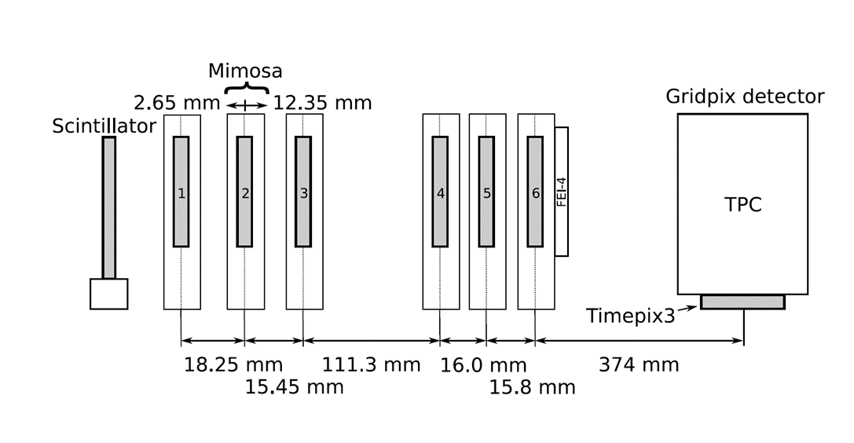

Single chip test in test beam Bonn (June 2017)
ELSA: 2.5 GeV electrons
Tracks referenced by Mimosa telescope
Gas: Ar/CF₄/iC₄H₁₀ 95/3/2 (T2K)
Electrons: ~100 e/cm
E_{d} = 280 V/cm, V_{grid} = -350 V
--------- Mimosa telescope ---------
Detector with guard and field shaper
@Bonn
Published paper on 2017 testbeam: https://doi.org/10.1016/j.nima.2018.08.012

Slide 6
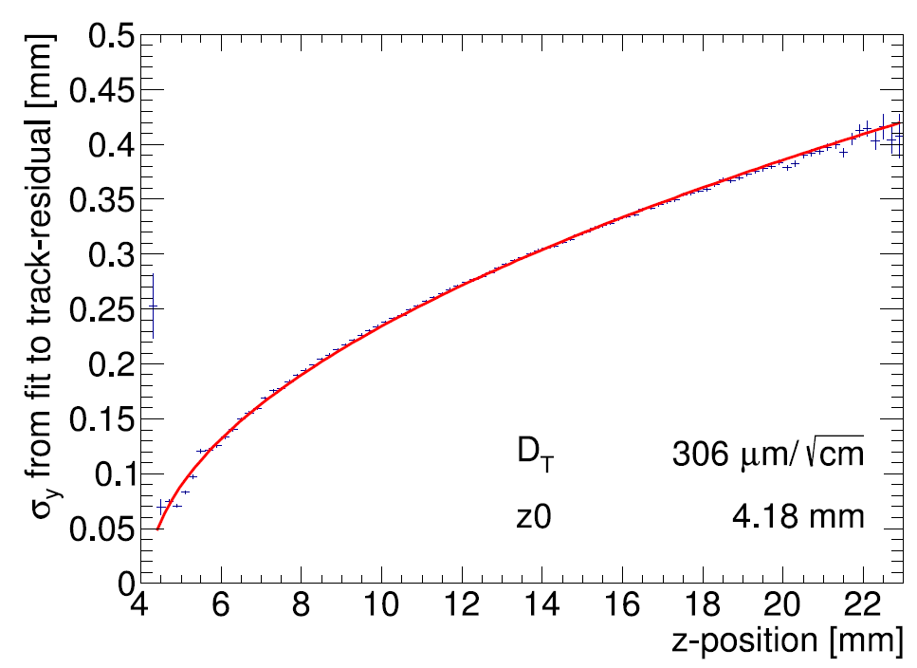
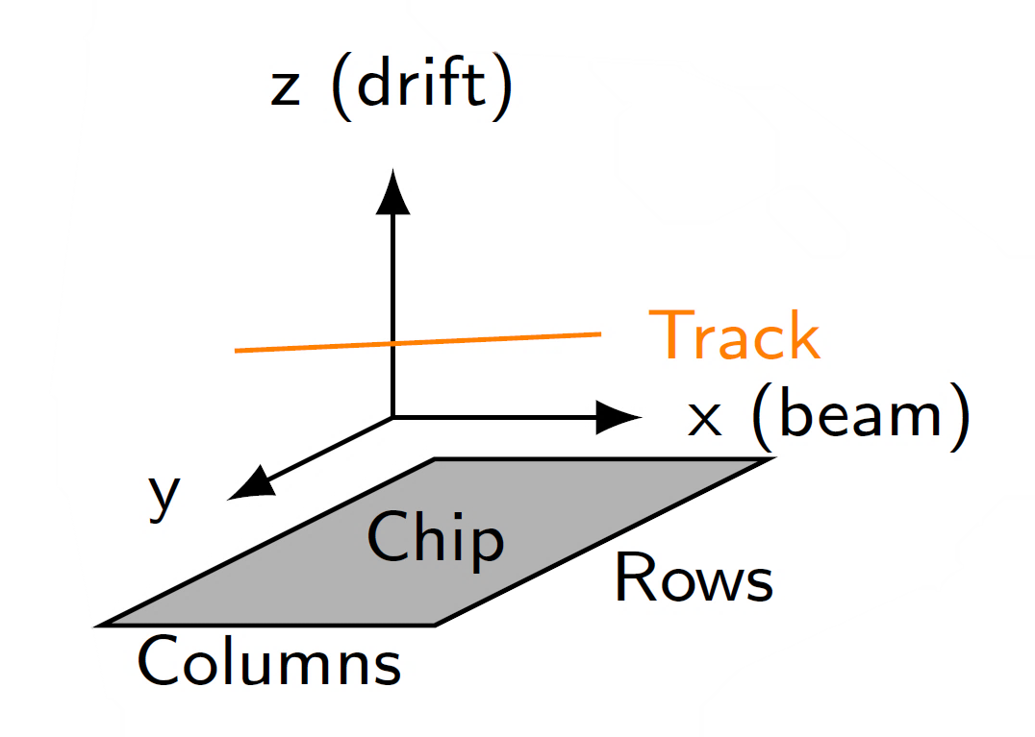
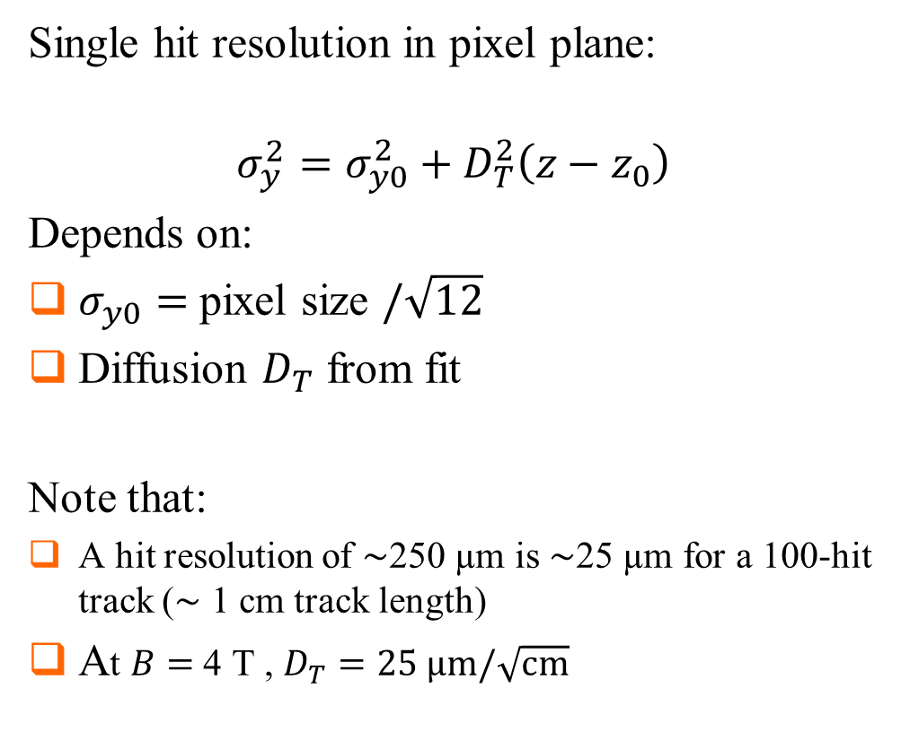
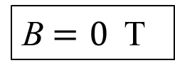
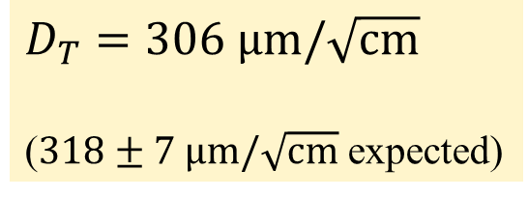
Single hit resolution in transverse direction
Single hit resolution in pixel plane:
$$σ_{y}^{2}=σ_{y0}^{2}+D_{T}^{2}\left(z−z_{0}\right)$$
Depends on:
$σ_{y0}=$ pixel size $/\sqrt{12}$
Diffusion $D_{T}$ from fit
Note that:
A hit resolution of $\sim$250 µm is $\sim$25 µm for a 100-hit track ($\sim$ 1 cm track length)
At $B=$ 4 T , $D_{T}=25 \text{μm}/\sqrt{\text{cm}}$
B$=0$ T
$D_{T}=306 \text{μm}/\sqrt{\text{cm}}$
($318±7 \text{μm}/\sqrt{\text{cm}}$ expected)

Slide 7
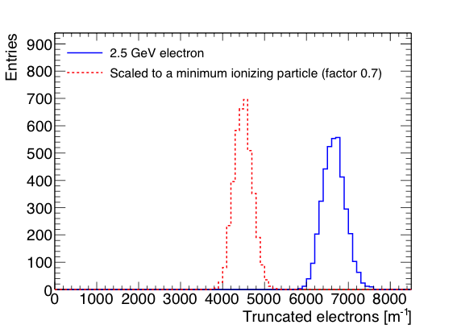
Pixel dE/dx performance
dE/dx resolution with truncated mean
  From the single chip tracks; 1 m long tracks are made;
  nr of electrons counted in slices of 20 pixel and reject 10% highest slices
  Distances along track are scaled by 1/0.7 to get an estimation for the dE/dx of a MIP
  Resolution is 4.1% for a 2.5 GeV electron and 4.9% for a MIP
Separation S = (N_{e} − N_{MIP})/σ_{e}
8σ MIP-e separation for a 1 meter track
A pixel readout can in principle within the resolution (diffusion) separate primary from secondary clusters. dE/dx can be measured by cluster counting and performance separation enhanced.

Slide 8
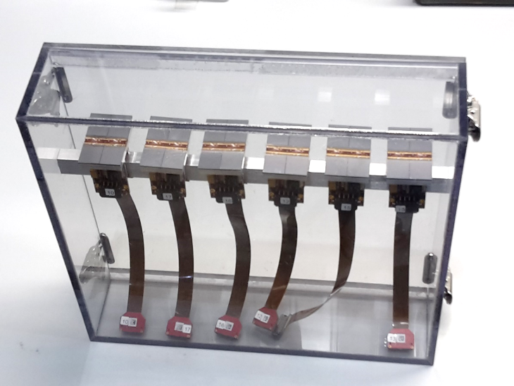
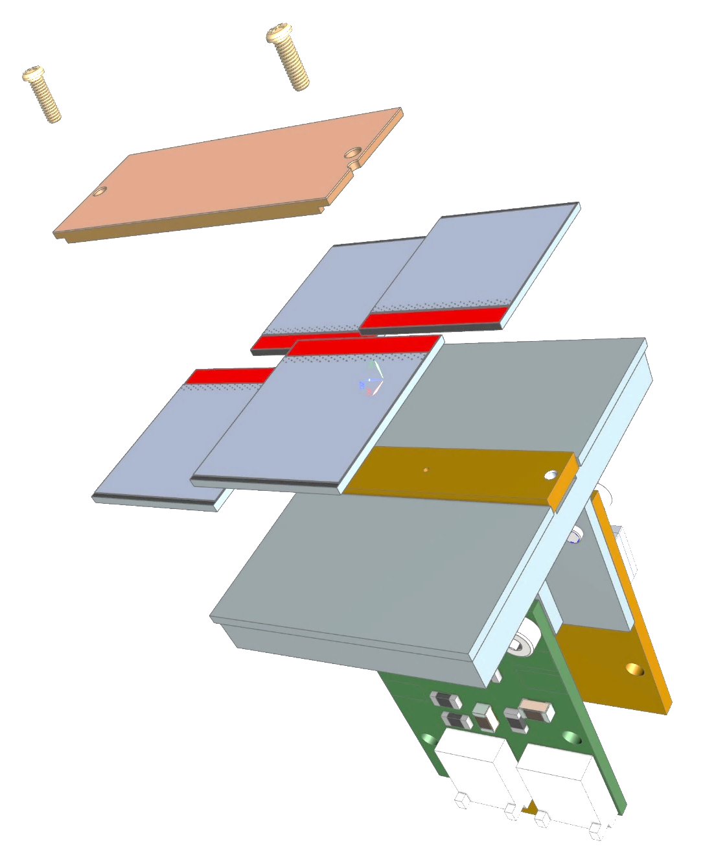
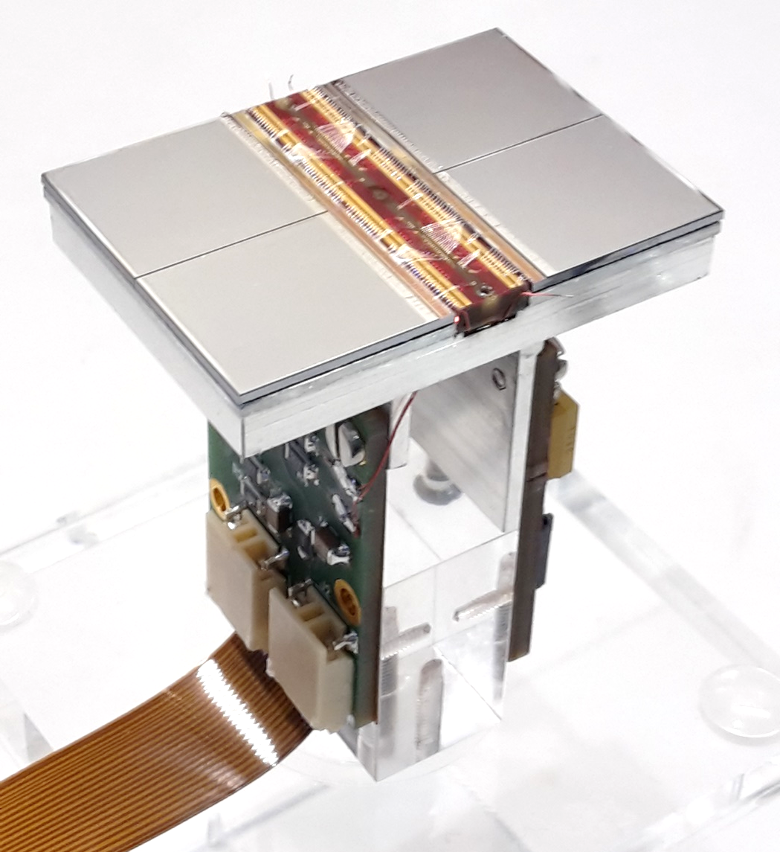
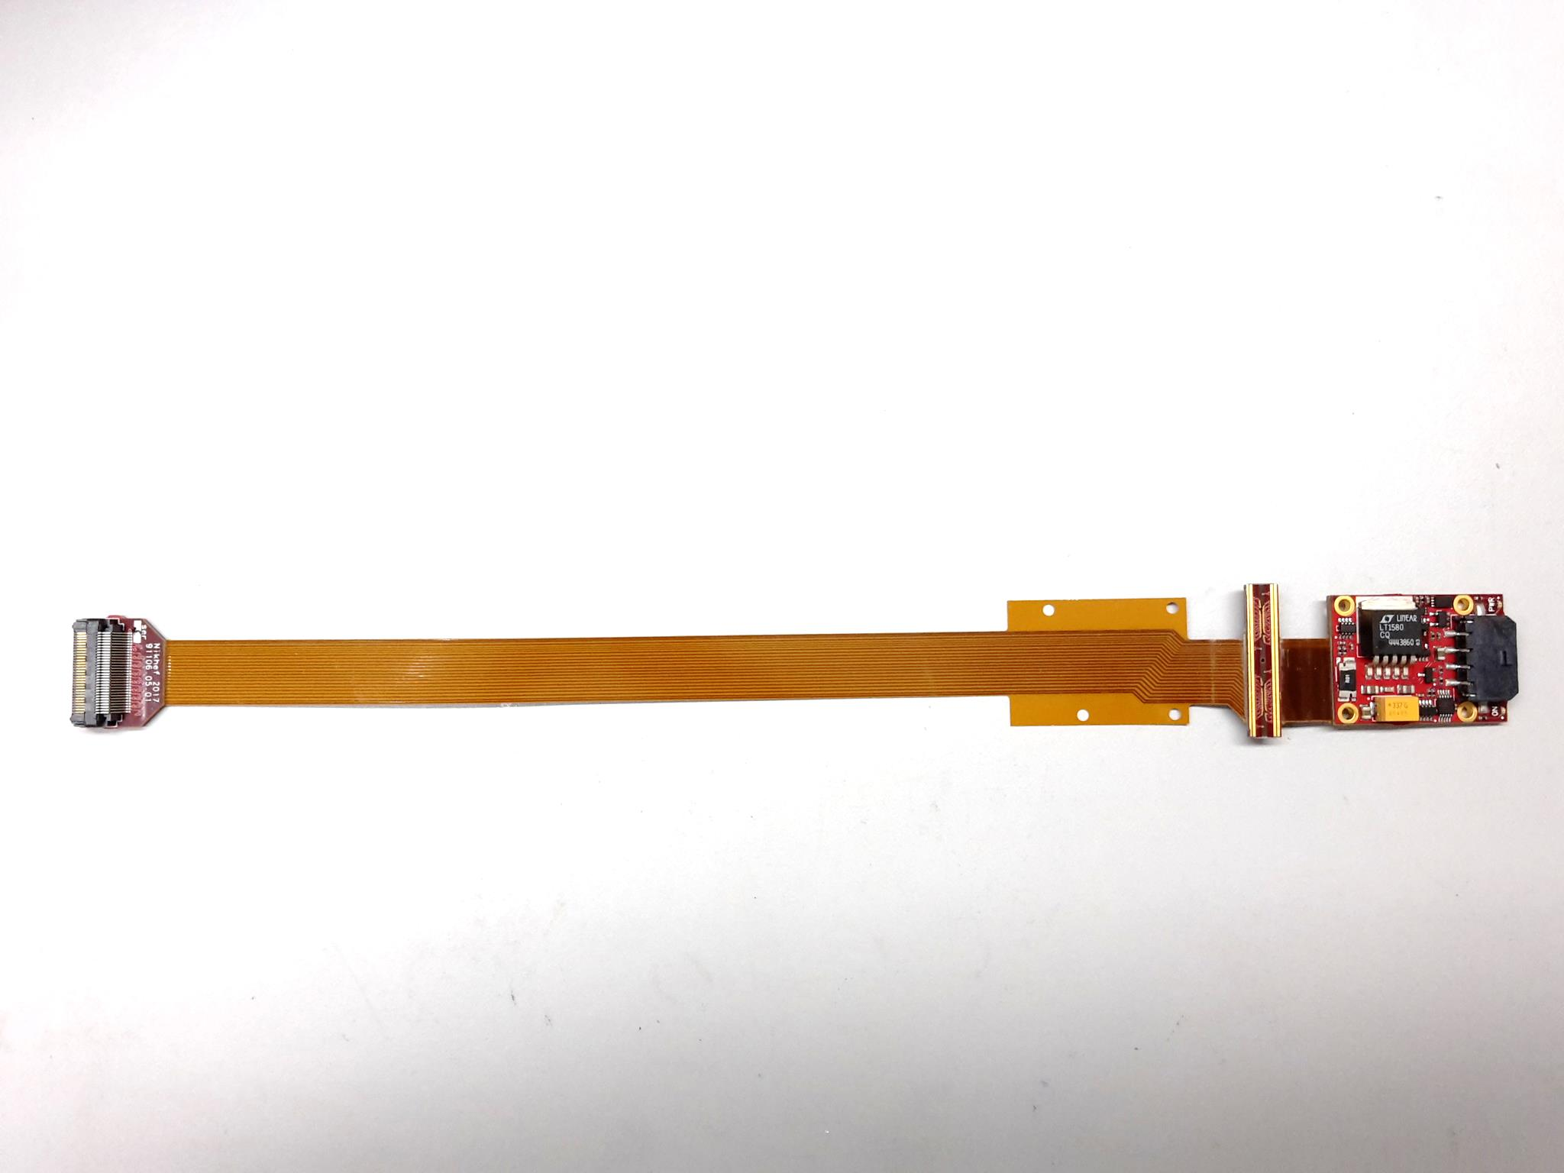
QUAD design and realization
Four-TimePix3 chips
All services (signal IO, LV power) are located under the detection surface
The area for connections was squeezed to the minimum
Very high precision 10 μm mounting of the chips and guard
QUAD has a sensitive area of 68.9%
DAQ by SPIDR
39.6 x 28.38 mm
series of QUADs
Guard
TPX3
TPX3
TPX3
TPX3
COld
CArrier

Slide 9
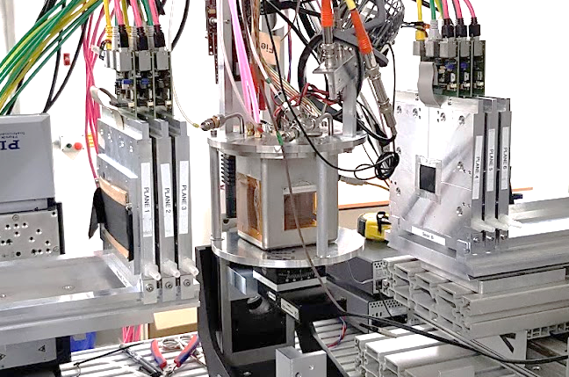
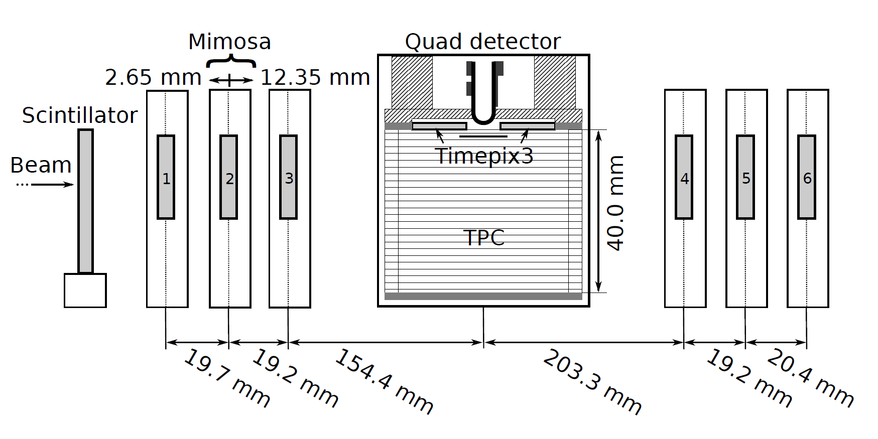
QUAD test beam in Bonn (October 2018)
ELSA: 2.5 GeV electrons
Tracks referenced by Mimosa telescope
QUAD sandwiched between Mimosa planes
  Largely improved track definition
  6 planes with 18.4 μm × 18.4 μm sized pixels
Gas: Ar/CF₄/iC₄H₁₀ 95/3/2 (T2K)
E_{d} = 400 V/cm, V_{grid} = -330 V
Typical beam height above the chip: ~1 cm
Published NIMA https://doi.org/10.1016/j.nima.2019.163331
@Bonn
Field cage

Slide 10
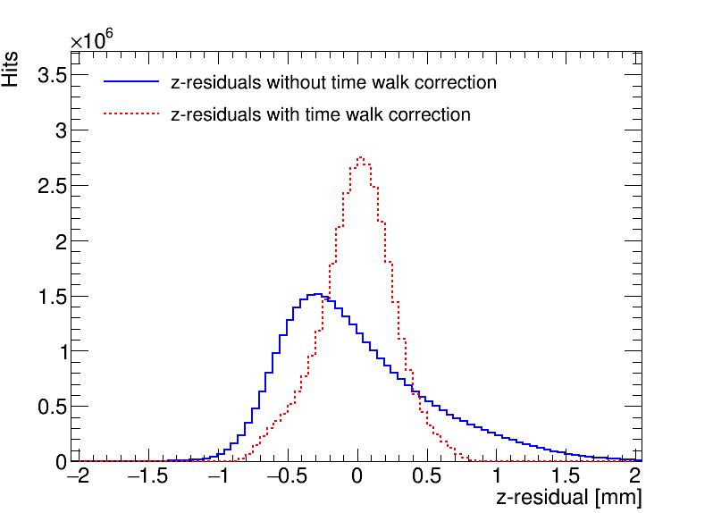
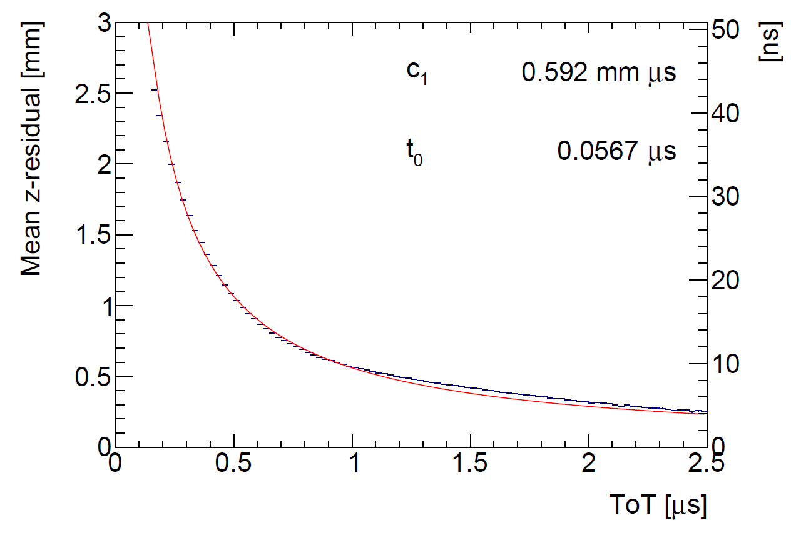
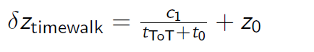
QUAD time walk results
Time walk correction works well
Applied for all analysis results

Slide 11
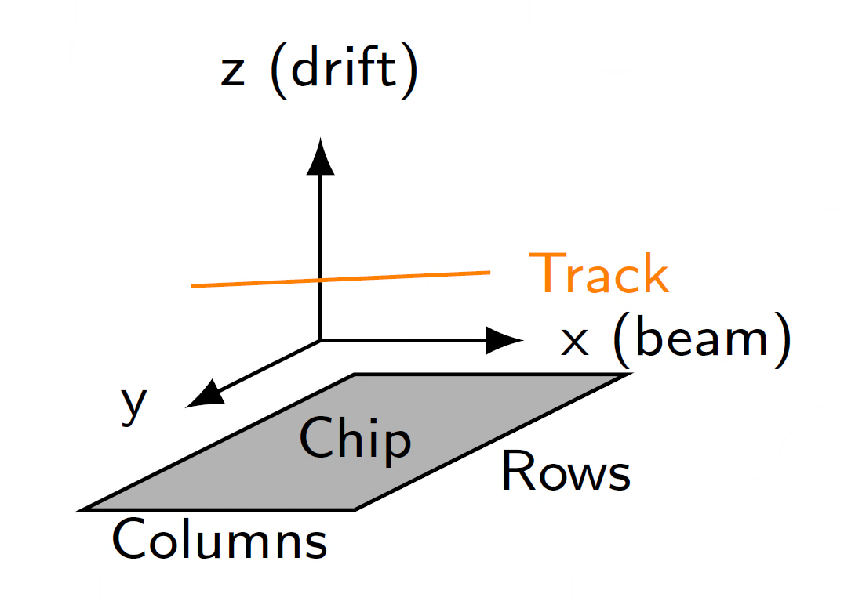
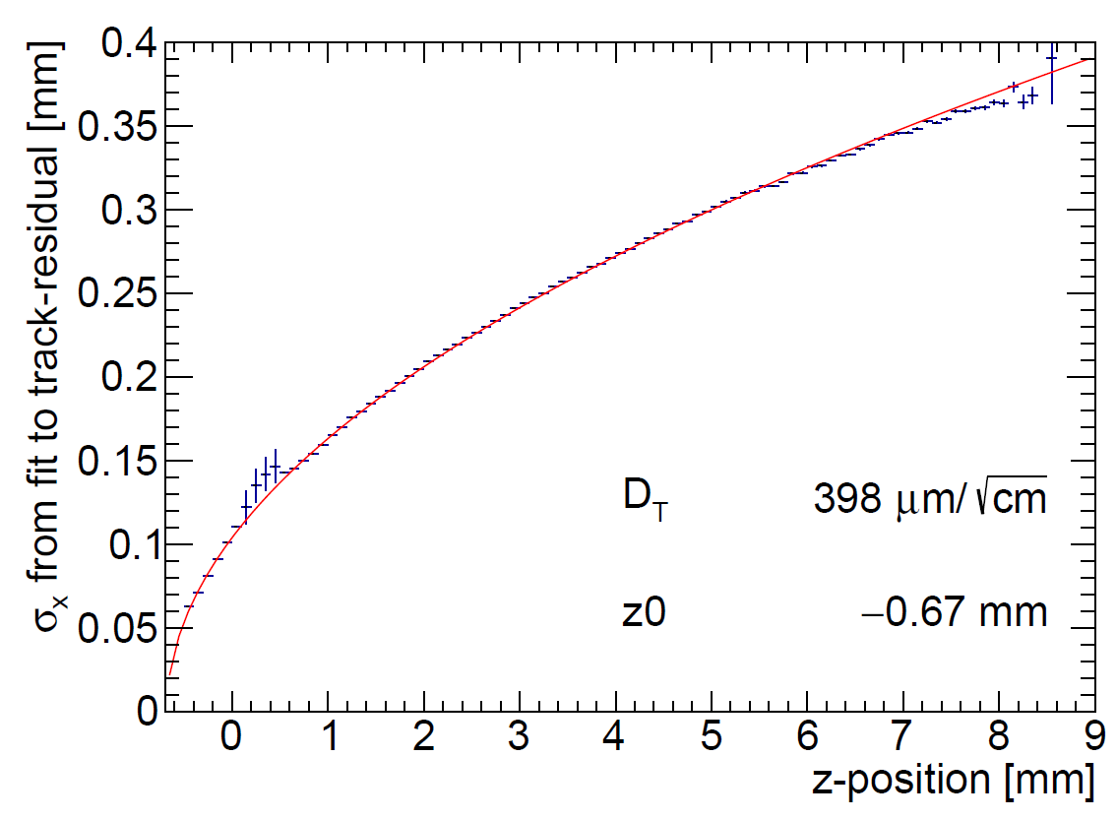
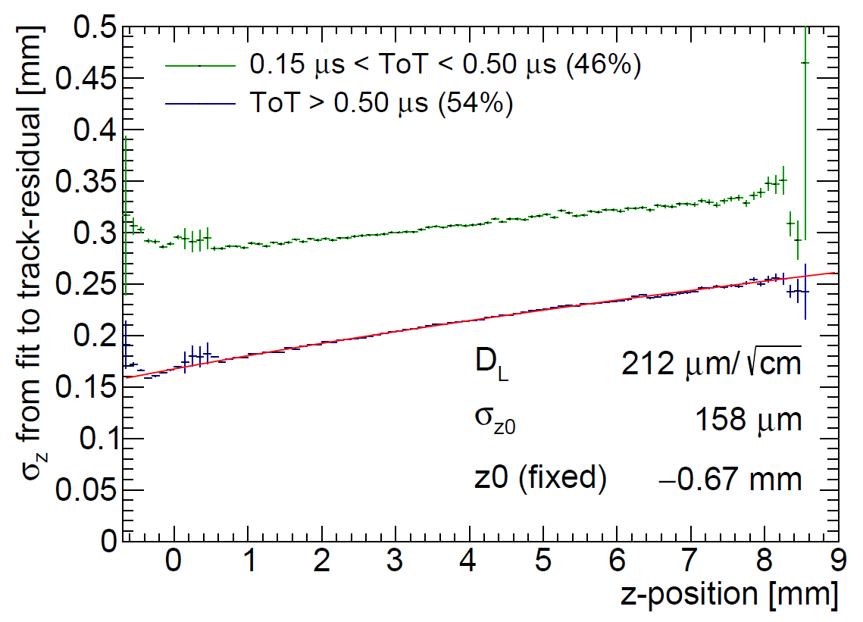
QUAD single hit resolution
Transverse
Longitudinal
D_{T} = 398 μm/√cm
D_{L} = 212 μm/√cm
The D_{T} value is rather high due to an error in the gas mixing (too low CF4)

Slide 12
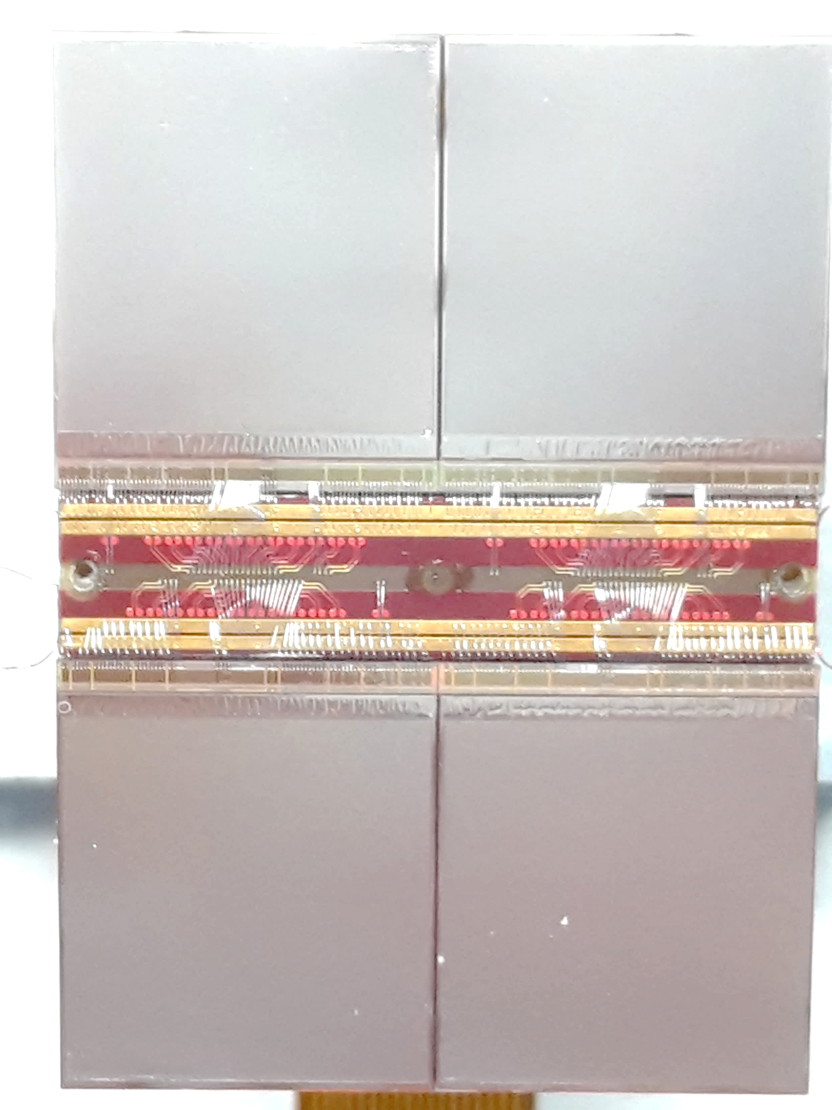
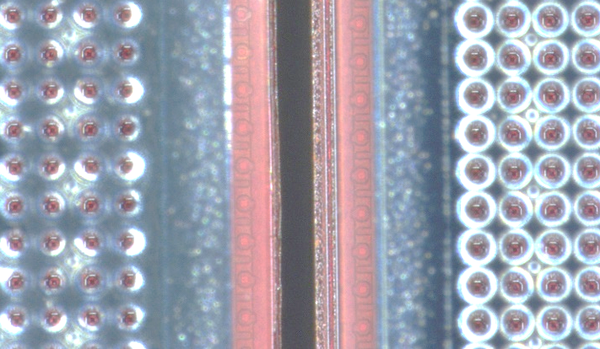
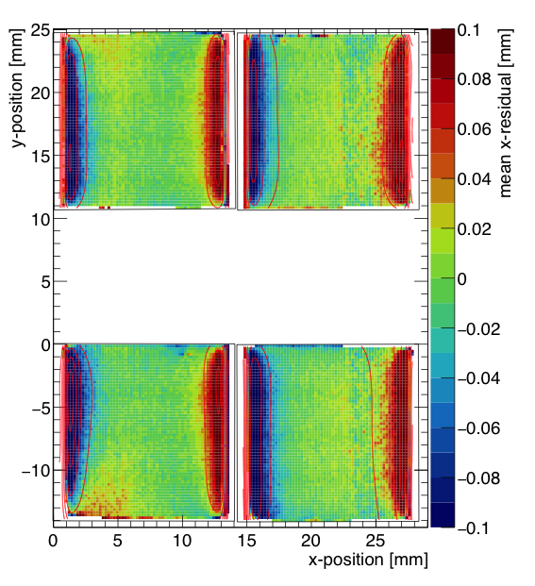
QUAD edge deformations (XY)
Small deformations due to
  Dead zone between chips
  Grounded region between chips
Are corrected by:
  fitted correction function
  adding proper guard wire electrode
Grounded region

Slide 13
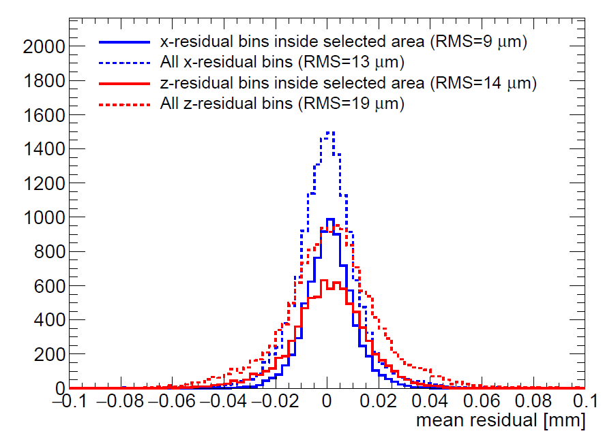
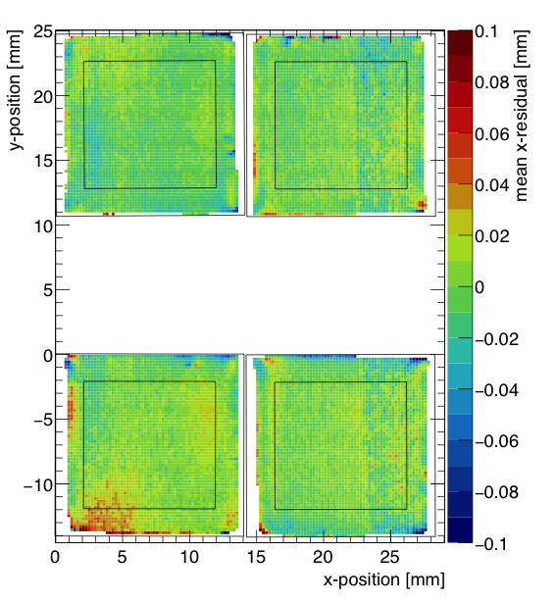
QUAD deformations in transverse plane (XY)
After applying fitted edge corrections
RMS of the mean residuals are 13 μm over the whole QUAD
XY

Slide 14
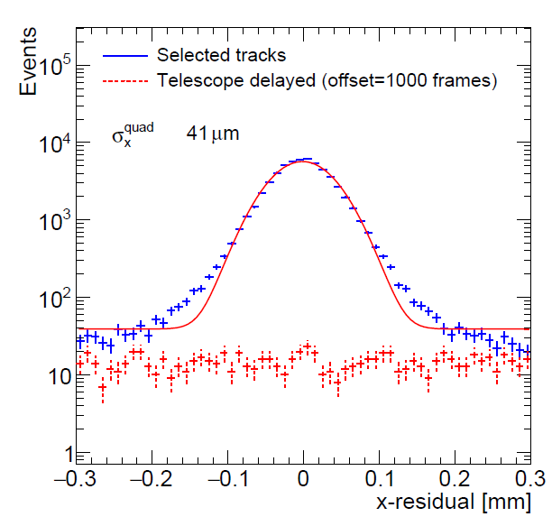
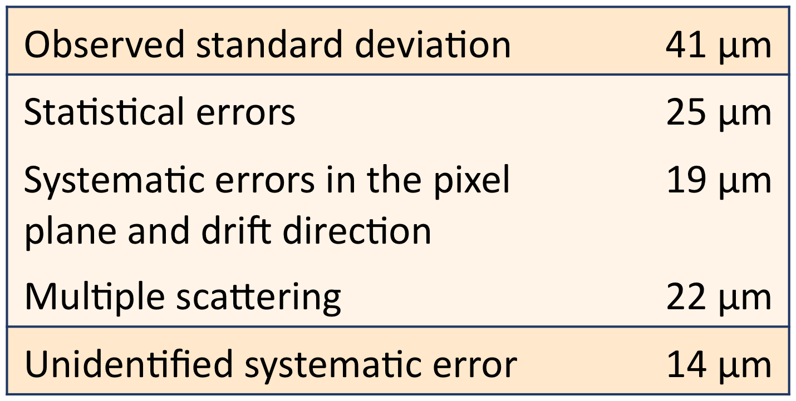
Combined resolution (XY) of a QUAD
Below a breakdown of the uncertainties and sources is given
The observed resolution can be understood if an additional contribution of 14 μm is added
XY

Slide 15
Next: QUAD as a building block
8-QUAD module with field cage
in red guard wires

Slide 16
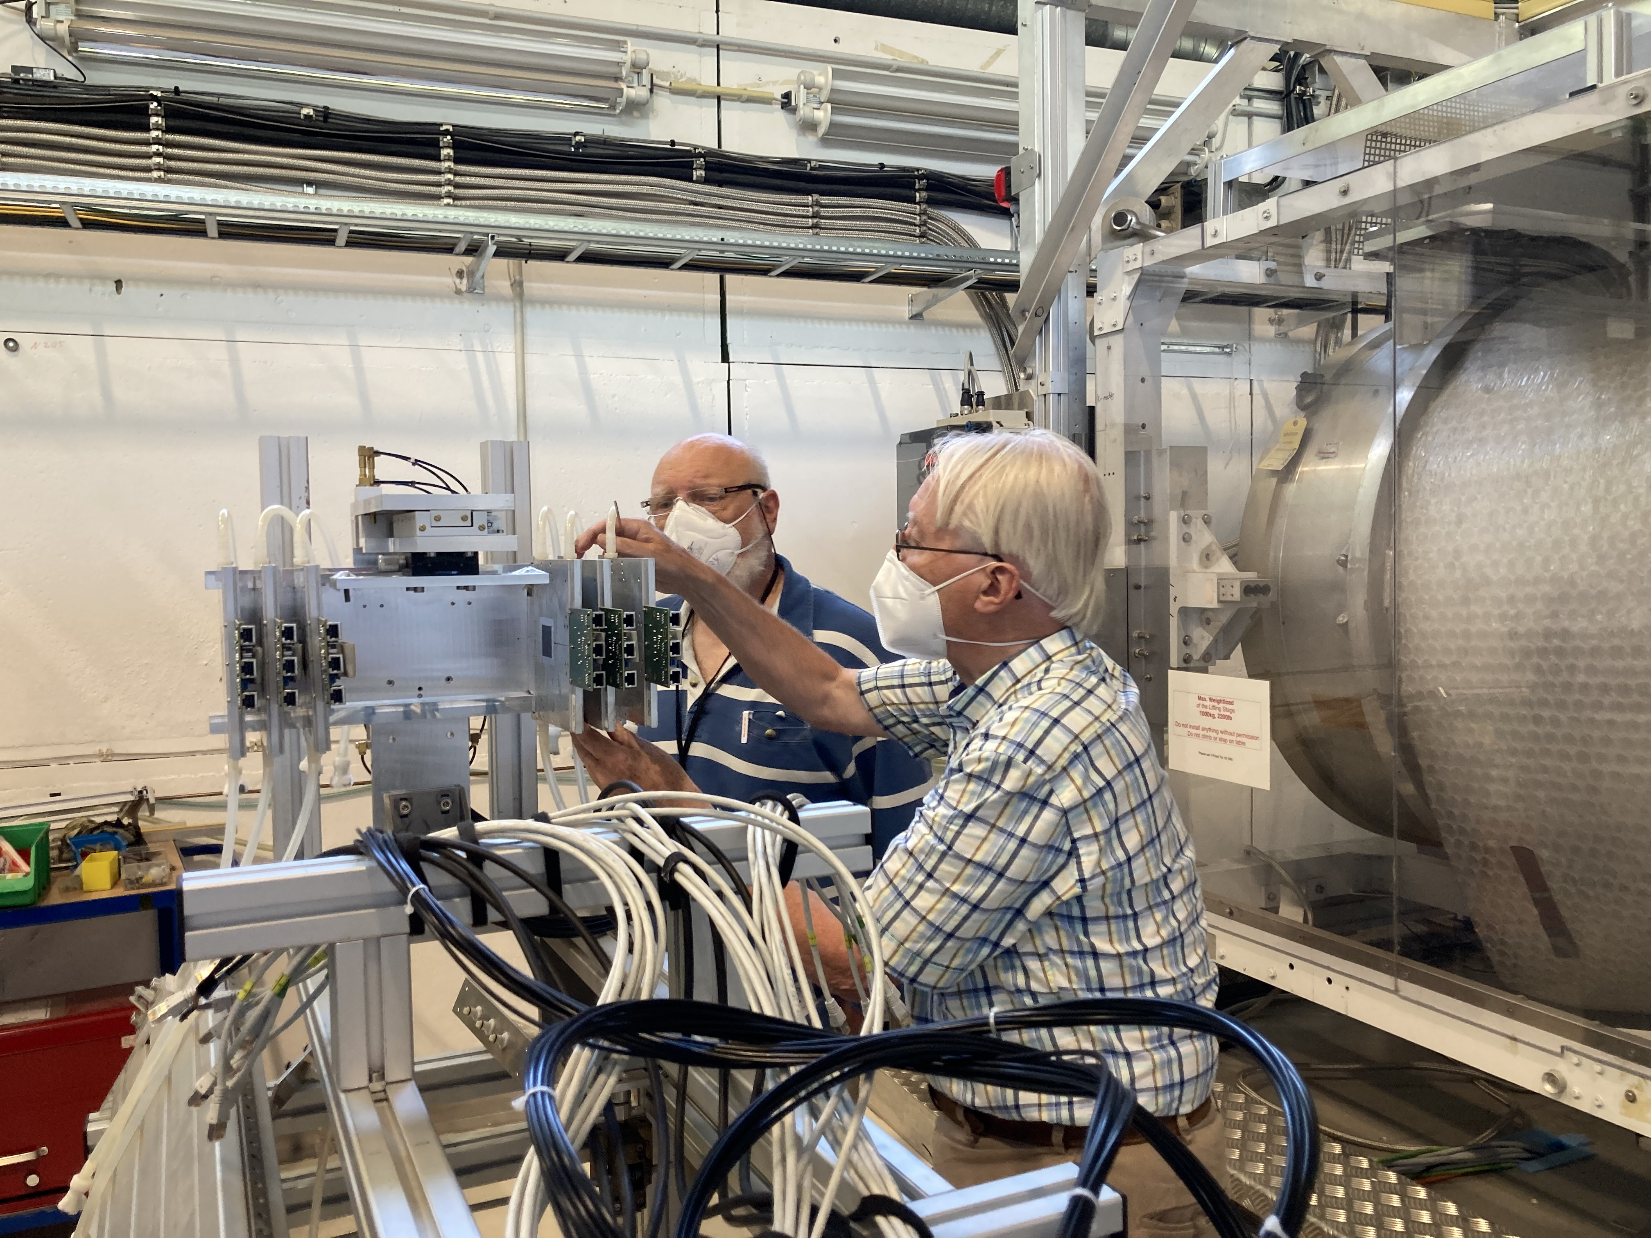
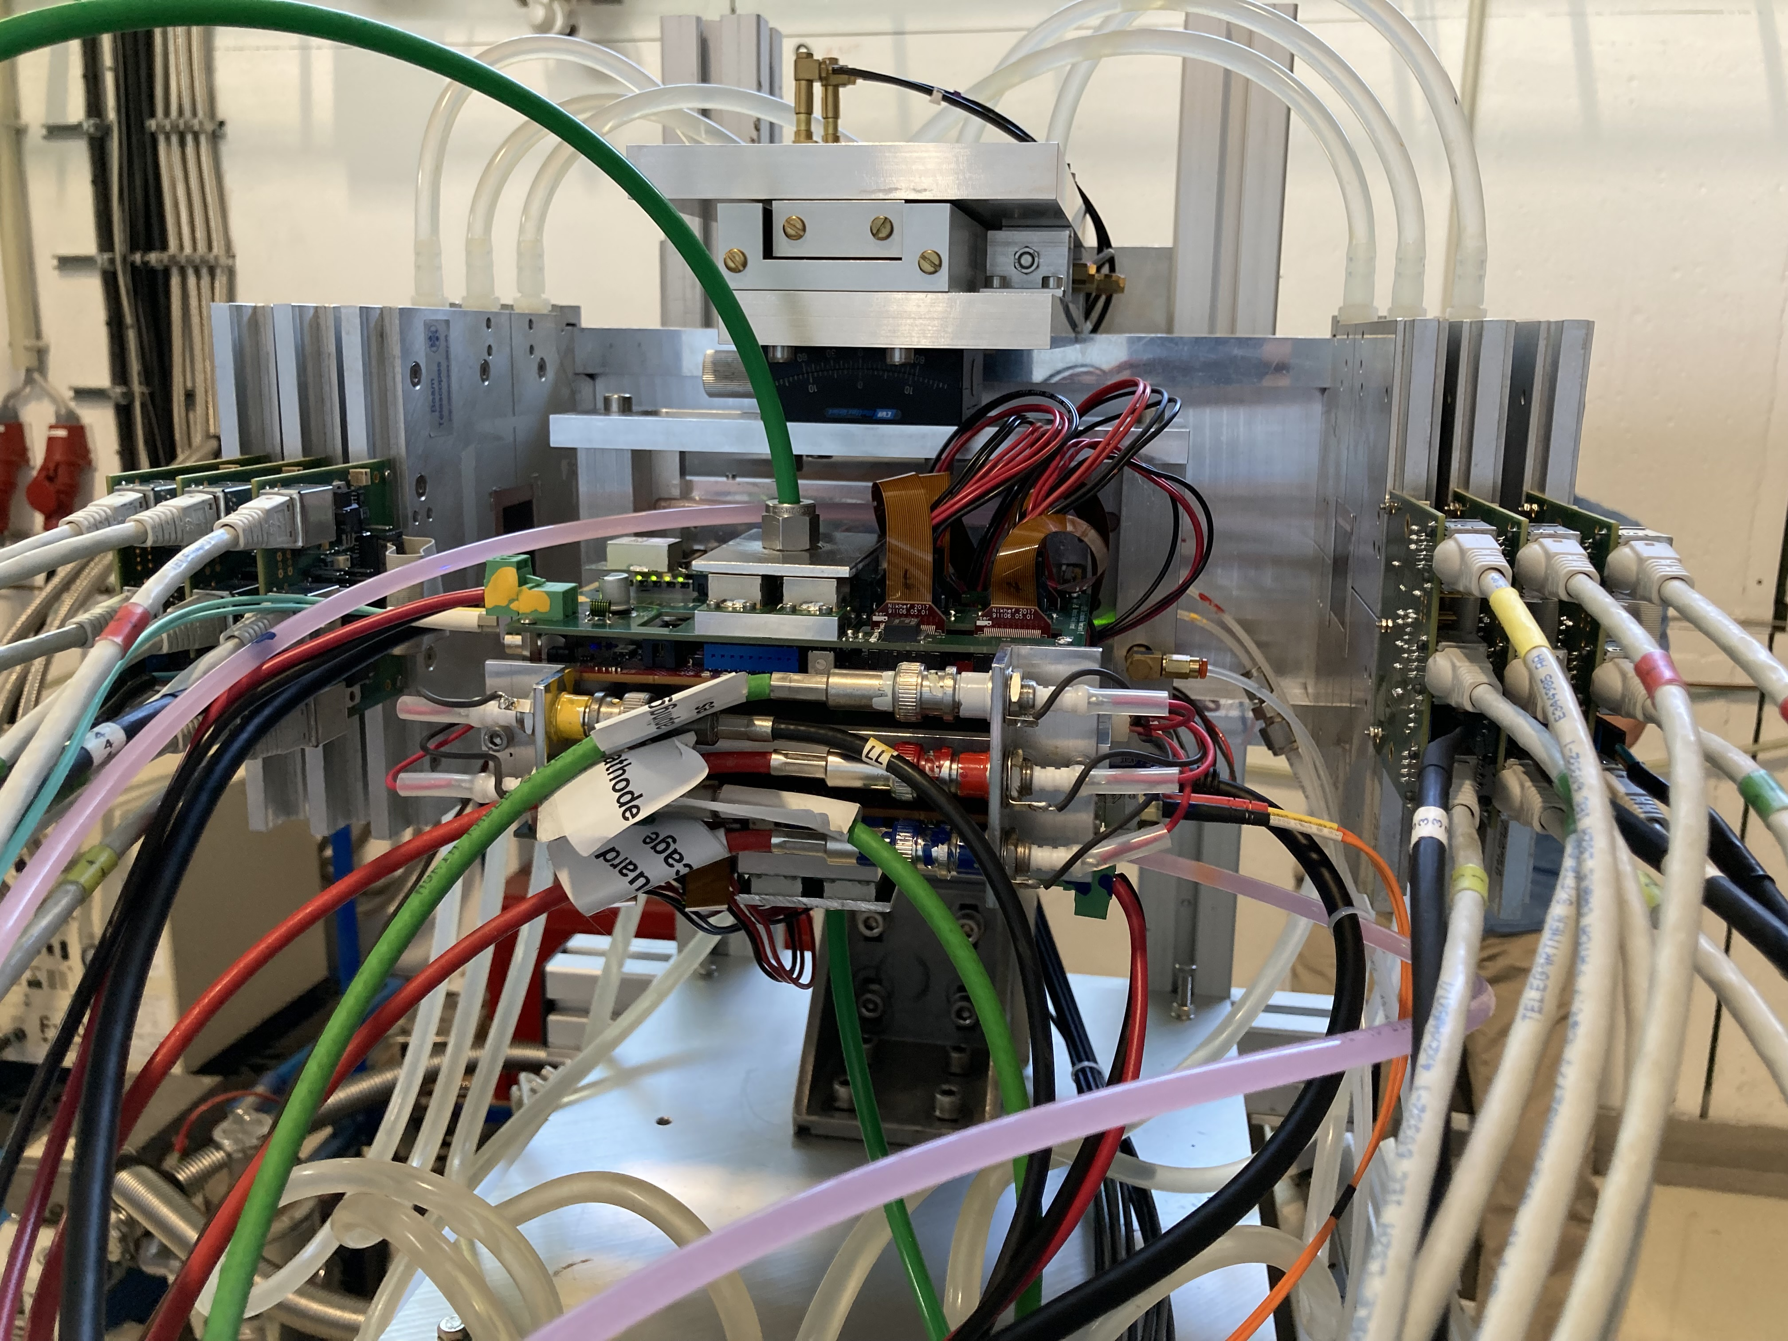
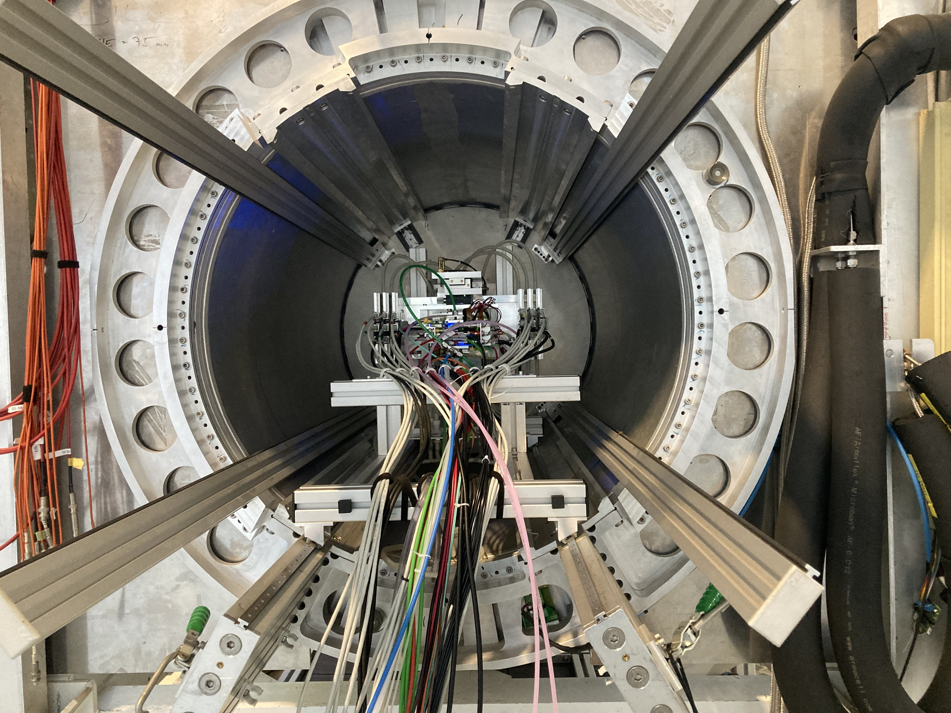
DESY testbeam June 2021
Mounting the 8 quad module between the silicon planes
sliding it into the 1 T PCMAG solenoid

Slide 17
DESY testbeam June 2021

Slide 18
DESY testbeam June 2021

Slide 19
DESY testbeam Module Analysis
Preliminary
Track 1050 hits
χ²_{xy} = 912/1048
χ²_{z} = 1740/1048
(no asymmetric tail (z time slewing) or outlier removal applied yet)

Slide 20
DESY testbeam Module Analysis
Run 6916 B=0 T p =6 GeV
σ_{xy} =250 μm and σ_{z} =425 μm 1M hits
Preliminary
<mean> 6.4 mm

Slide 21
DESY testbeam Module Analysis
Run 6916 B=0 T p =6 GeV
Preliminary
Tracking precision:
position 9 μm (xy) 13 μm (z)
angle 0.19 mrad (dx/dy) 0.51 mrad
module tracklength = 157.96 mm
Note that in a B field because of the reduced diffusion the tracking precision will improve substantially
1060 selected tracks
Impressive 900 hits / track

Slide 22
DESY testbeam data analysis
High statistics data taken with different B fields
The Silicon telescope has been aligned and gives excellent track predictions
A beautiful data set and we look forward to study further the performance (resolutions and deformations)
Opportunity to exploit pixel TPC high precision tracking and particle identification with dE/dx using single electrons

Slide 23
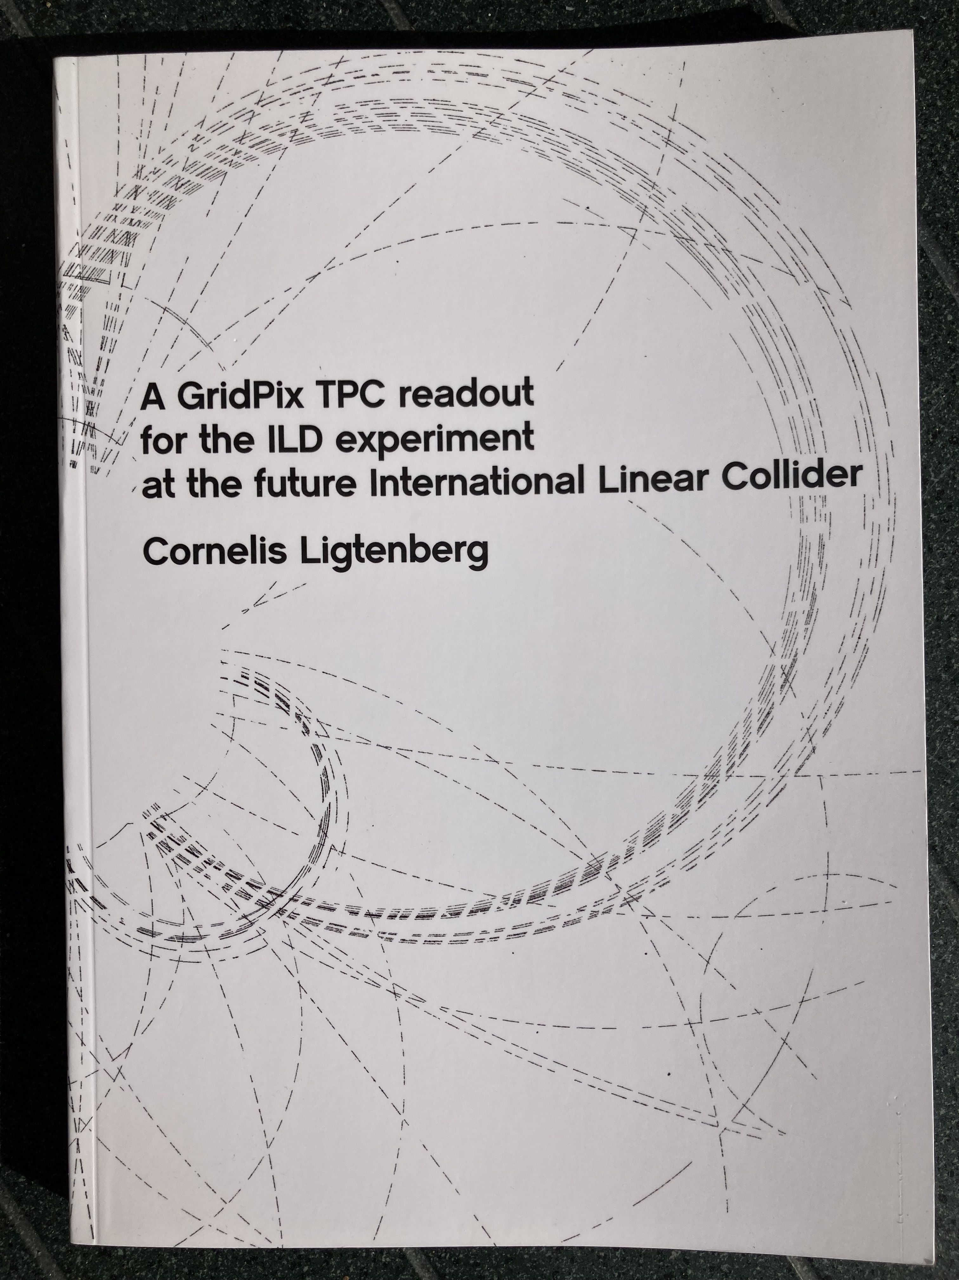
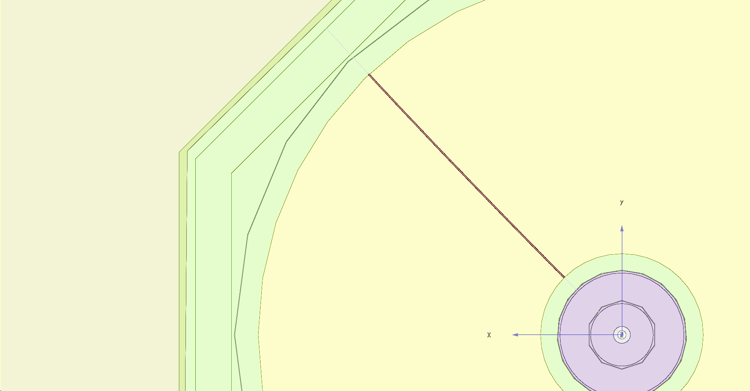
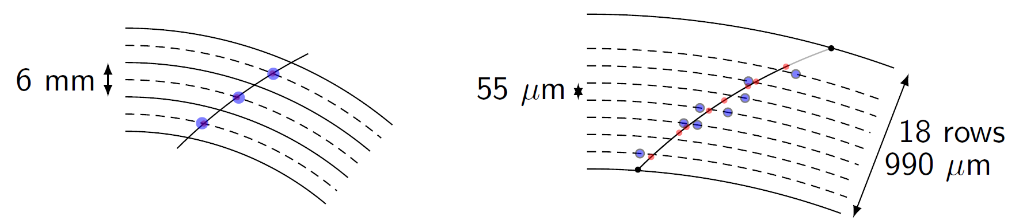
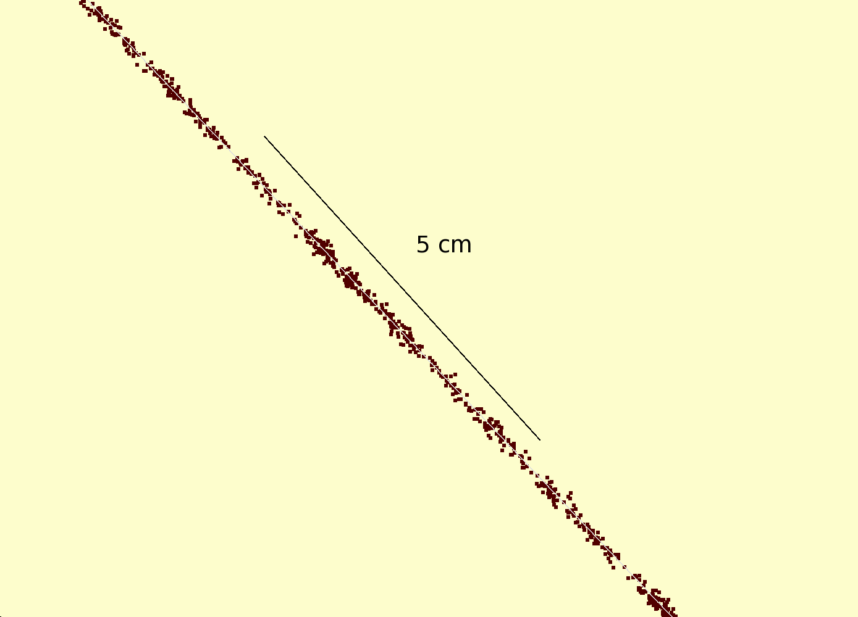
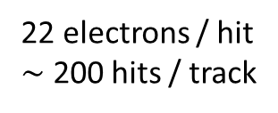
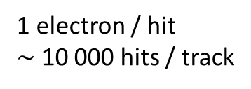
Simulation of ILD TPC with pixel readout
To study the performance of a large pixelized TPC, the pixel readout was implemented in the full ILD DD4HEP (Geant4) simulation
Changed the existing TPC pad readout to a pixel readout
Adapted Kalman filter track reconstruction to pixels
PhD Kees Ligtenberg
https://www.nikhef.nl/pub/services/biblio/theses_pdf/thesis_C_Ligtenberg.pdf
pixels
pads
50 GeV muon track with
pixel readout

Slide 24
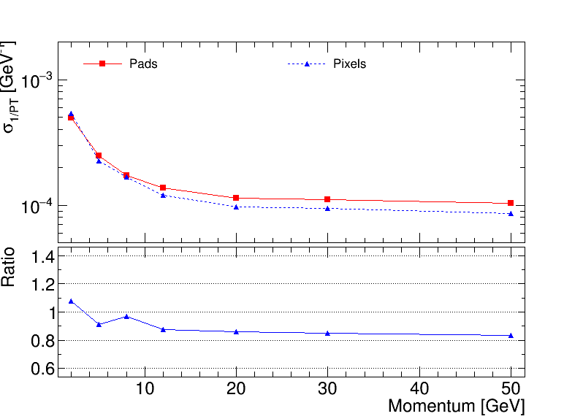
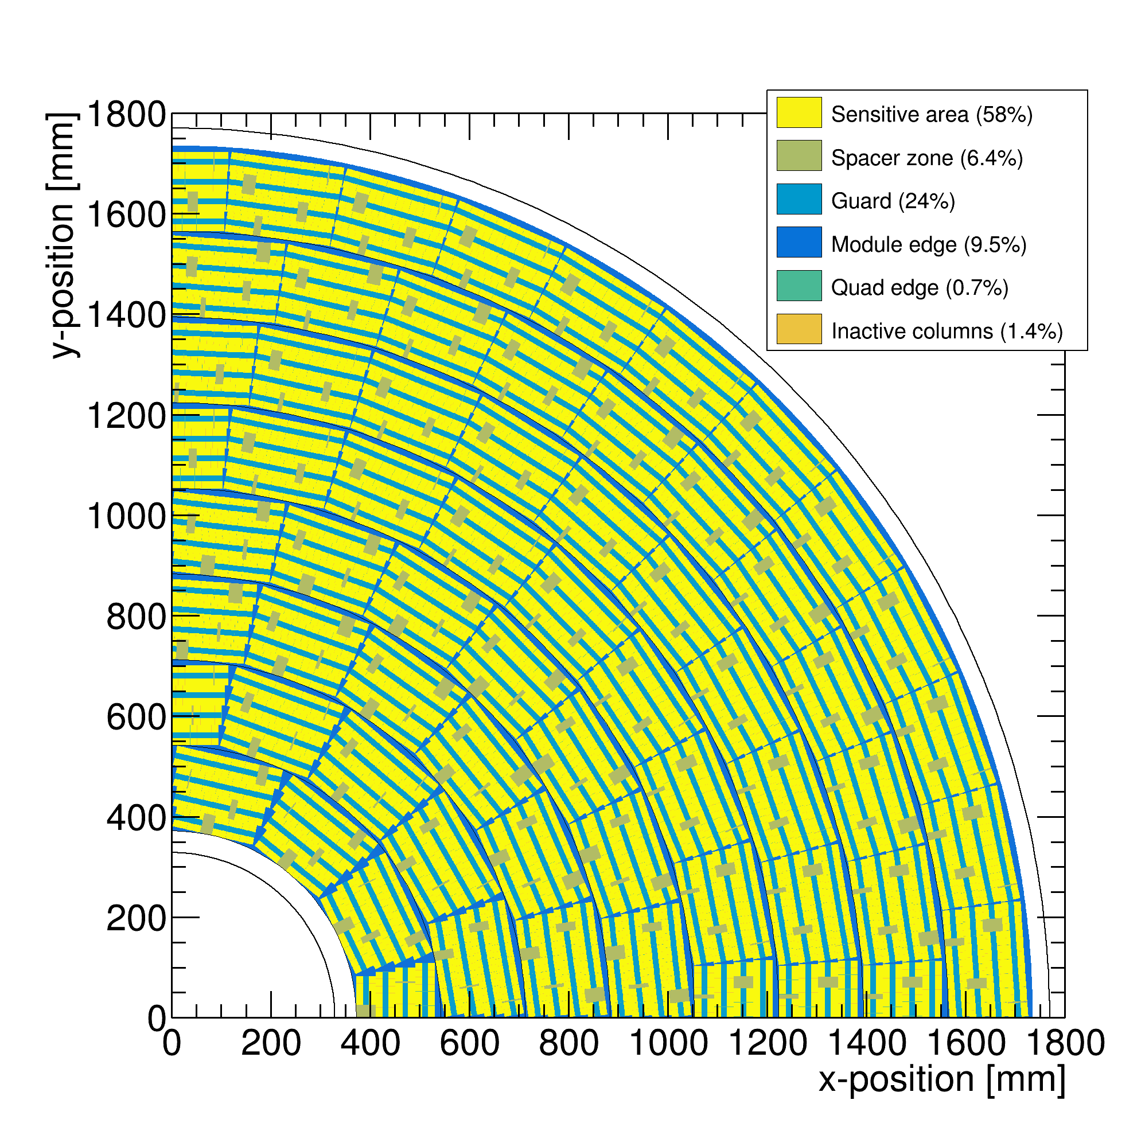
Performance of a GridPix TPC at ILC
From full simulation the momentum resolution can be determined
Momentum resolution is about 15% better for the pixels with realistic coverage (with the quads arranged in modules 59%) and deltas.

Slide 25
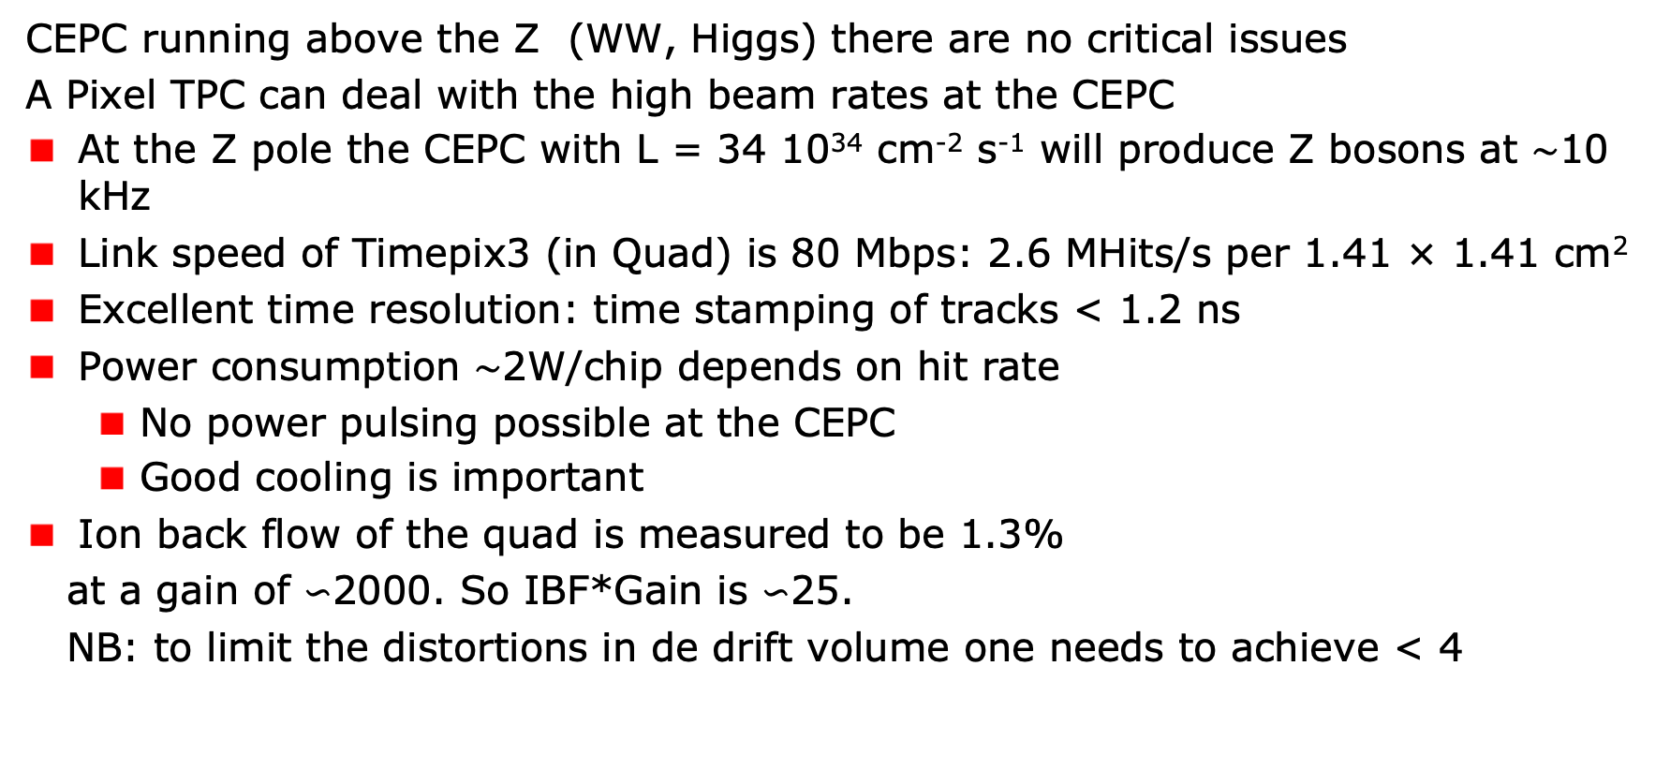
A Pixel TPC at the CEPC?
CEPC running above the Z (WW, Higgs) there are no critical issues
A Pixel TPC can deal with the high beam rates at the CEPC
At the Z pole the CEPC with L = 34 10³⁴ cm⁻² s⁻¹ will produce Z bosons at $\sim$10 kHz
Link speed of Timepix3 (in Quad) is 80 Mbps: 2.6 MHits/s per 1.41 × 1.41 cm²
Excellent time resolution: time stamping of tracks < 1.2 ns
Power consumption $\sim$2W/chip depends on hit rate
  No power pulsing possible at the CEPC
  Good cooling is important
Ion back flow of the quad is measured to be 1.3%
at a gain of $∽$2000. So IBF*Gain is $∽$25.
NB: to limit the distortions in de drift volume one needs to achieve < 4
Picture IHEP
LCWS 2019 Sendai talk Huirong Qi

Slide 26


Reducing the Ion back flow in a (Pixel) TPC
The Ion back flow can be reduced – while running at the Z:
By installing a gating device and closing the gate after a trigger.
E.g.the Gating GEM as developed in the contect of the ILD experiment
Can one apply gating in Z collisions?
High luminosity CEPC L = 32-50 10³⁴ cm⁻²s⁻¹. Time between Z interactions 120-60 μs TPC drift takes 30 μs. So events are separated in the TPC; gating is possible.
Gate length of 20-60 μs would stop the ions in triggered mode.
Problem is that the gating will lead to dead time and a data taking efficiency at high luminosities of $∽$85%-65% (for a 20 μs gate length).
LCWS19 presentation ILD gating GEM by Yumi Aoki (KEK)

Slide 27
Reducing the Ion back flow in a Pixel TPC
The Ion back flow can be reduced by adding a second grid to the device.
It is important that the holes of the grids are aligned. The Ion back flow is a function of the geometry and electric fields. Detailed simulations – validated by data - have been presented in LCTPC WP #326.
With a hole size of 25 μm an IBF of 3 10⁻⁴ can be achieved and the value for IBF*Gain (2000) would be 0.6. Well below the specifications.
Ion backflow | Hole 30 μm | Hole 25 μm | Hole 20 μm
Top grid | 2.2% | 1.2% | 0.7%
GridPix | 5.5% | 2.8% | 1.7%
Total | 12 10⁻⁴ | 3 10⁻⁴ | 1 10⁻⁴
transparancy | 100% | 99.4% | 91.7%
We plan to test this idea

Slide 28
Conclusions
A single chip GridPix detector was reliably operated in a test beam in 2017
  Single electron detection => the resolution is primarily limited by diffusion
  Systematic uncertainties are low: < 10 µm in the pixel xy plane
  dE/dx resolution for a 1 m track is 4.1%
  A Quad detector was designed and the results from the 2018 test beam presented
  Small edge deformations at the boundary between two chips are observed
    added guard wires to the module to obtain a homogeneous field
    After correcting the edges, deformations in the transverse plane shown to be < 15 µm
An 8-Quad module has been designed with guard wires
  Deformations in the transverse plane for one quad are shown to be < 15 µm
Test beam data taken at DESY in 2021: first results on precision tracking presented
A pixel TPC has become a realistic viable option for experiments
  High precision tracking in the transverse and longitudinal planes, dE/dx by electron and cluster counting, excellent two track resolution, digital readout that can deal with high rates
  A double grid will allow to reduce the Ion back flow distortions substantially

Slide 29
(Backup) Test beam summary
First preliminary results of the 8 Quad Module in the DESY test beam in June 2021 have been presented
The run 6916 B=0 T with p=6 GeV has been analysed
The Mimosa telescope has been aligned using the corryvrecan software and tracks fitted with the GBL package
The 8 quad module data is decoded and matched to the tracks
The single electron resolution is:
  σ_{xy} =250 μm and σ_{z} =425 μm (mean drift distance of 6.4 mm)
In total 1060 tracks were selected with 900 hits on track
The tracking precision: position 9 μm (xy) 13 μm (z) in angle 0.19 mrad (dx/dy) 0.25 mrad
Note that the module or tracklength is 157.96 mm
This is very promising: more precise results can be extracted

Slide 30

QUAD deformations in drift plane (Z)
After applying fitted edge corrections
RMS of the mean residuals are 19 μm over the whole QUAD
XY

Slide 31

8-quad module deformations laser measurements
One of the quads inside the 8-quad modules has been measured using laser tracks
No edge corrections are applied
The result is encouraging; the guard wires that run over the quad edges define a homogeneous field
The RMS in the large rectangular area (near the edges) is only 14 μm
Current plan is to do a test beam at DESY and Bonn as soon as all 8-quads can be read out simultaneously
Preliminary

