Slide 1
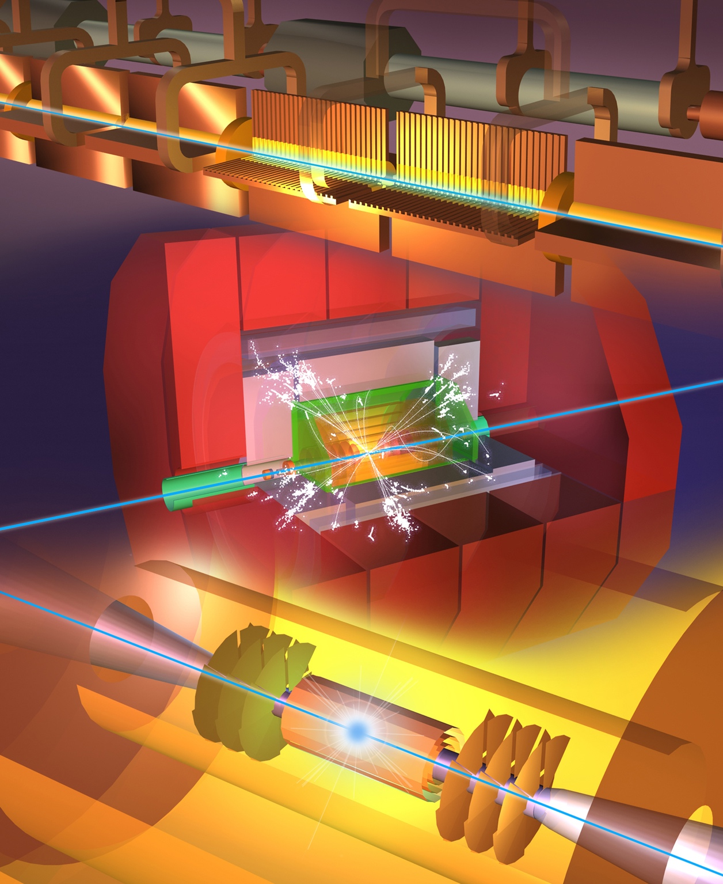
Steinar Stapnes
on behalf of CLIC
The Compact Linear Collider (CLIC)
Outline
A CLIC project overview
CLIC at 380 GeV
Multi-TeV studies
Summary
IAS HK
Jan 18th, 2022

Slide 2
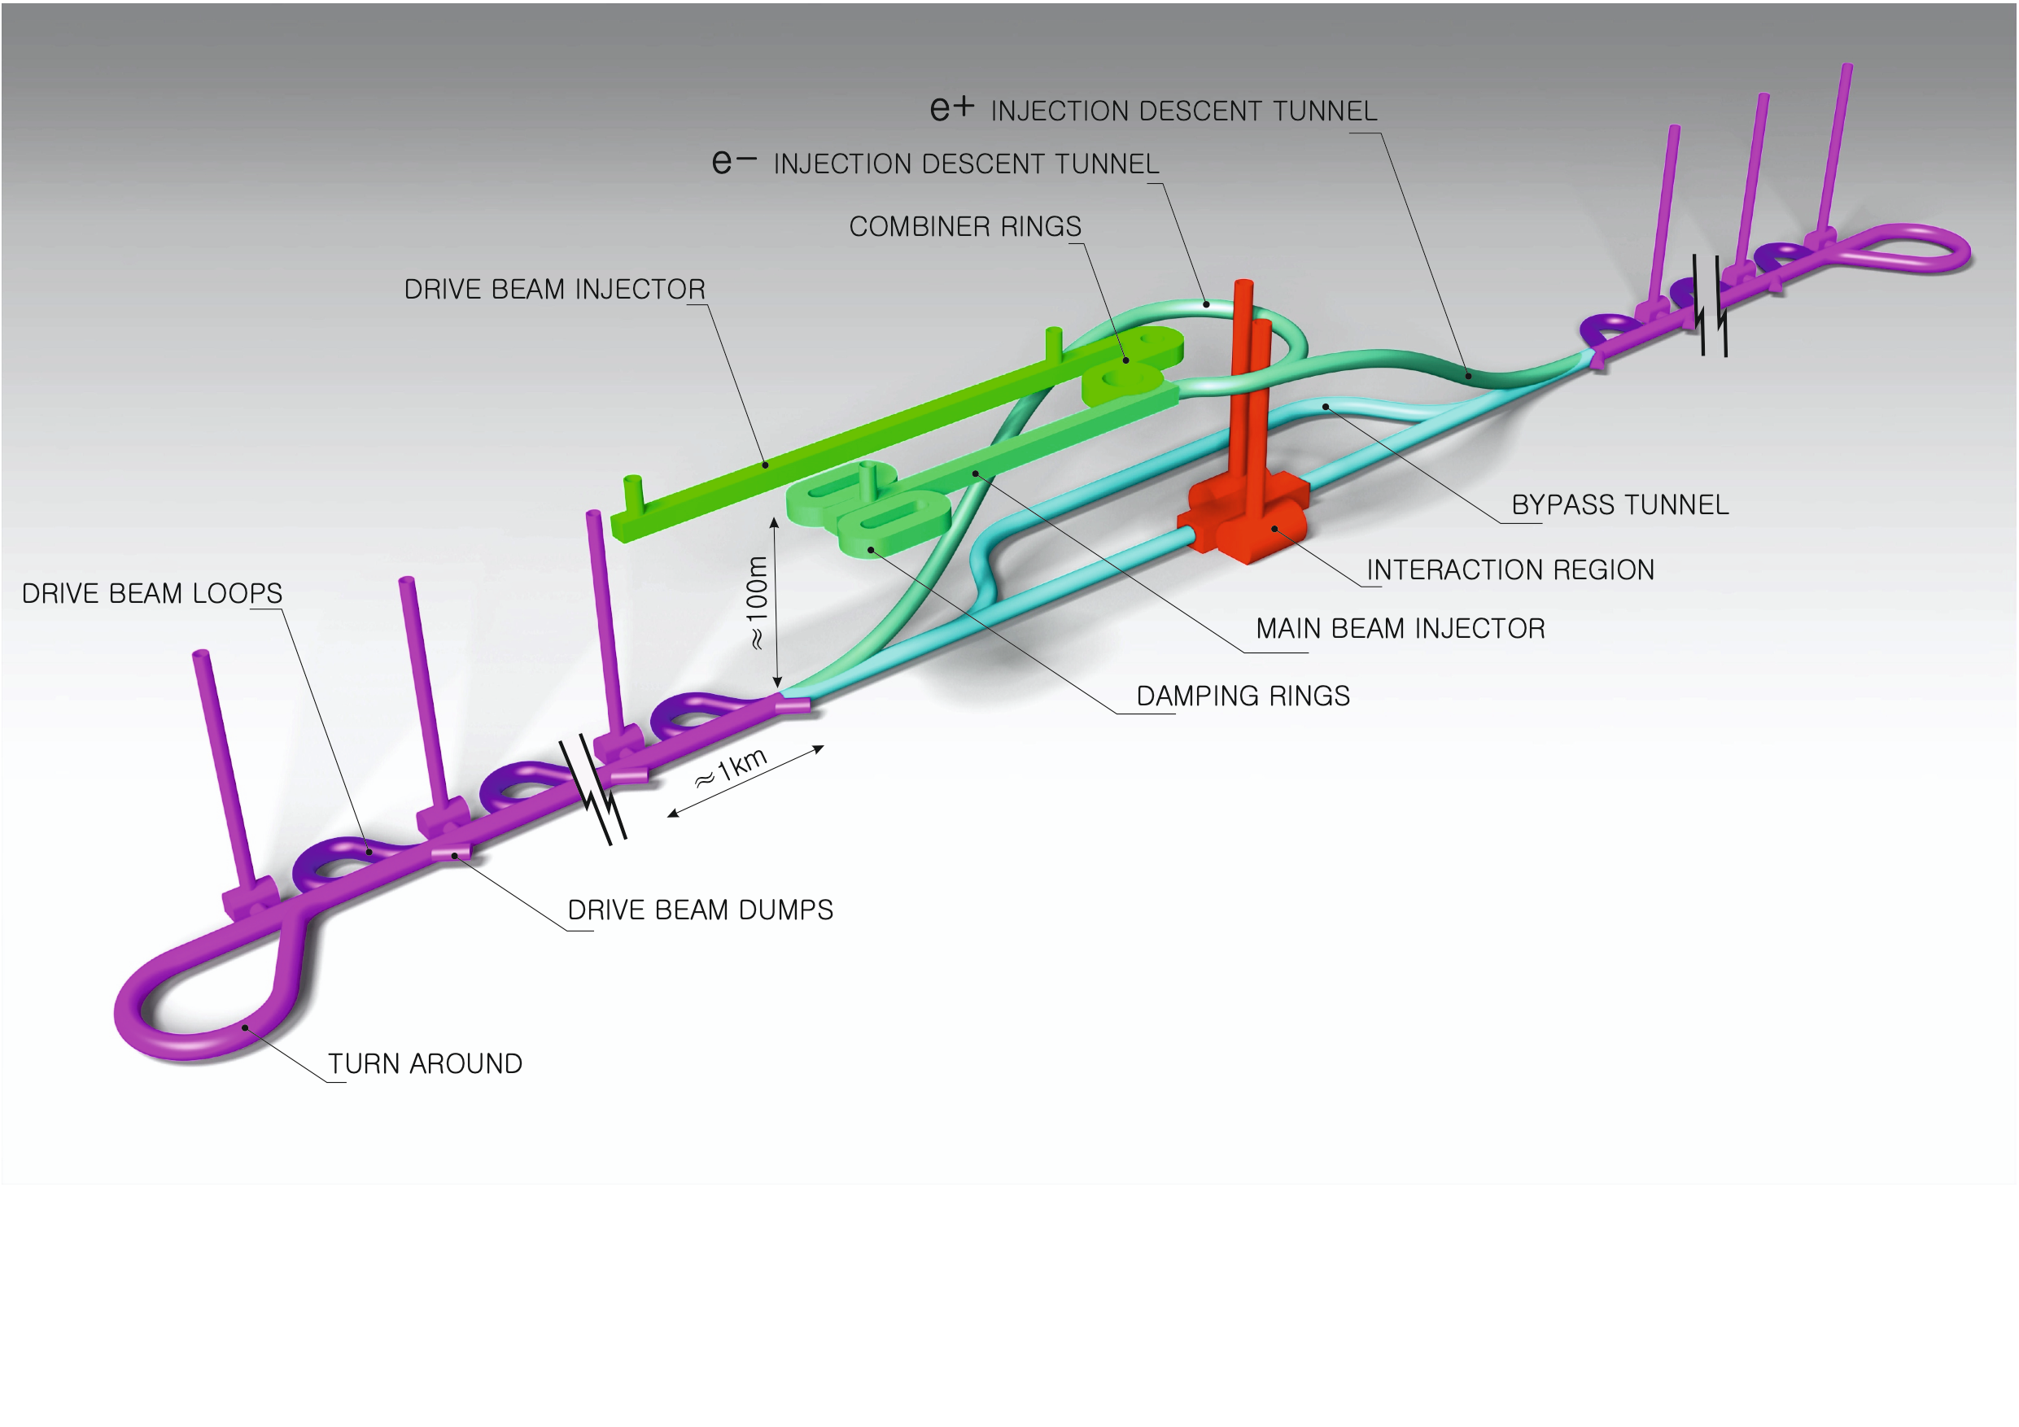
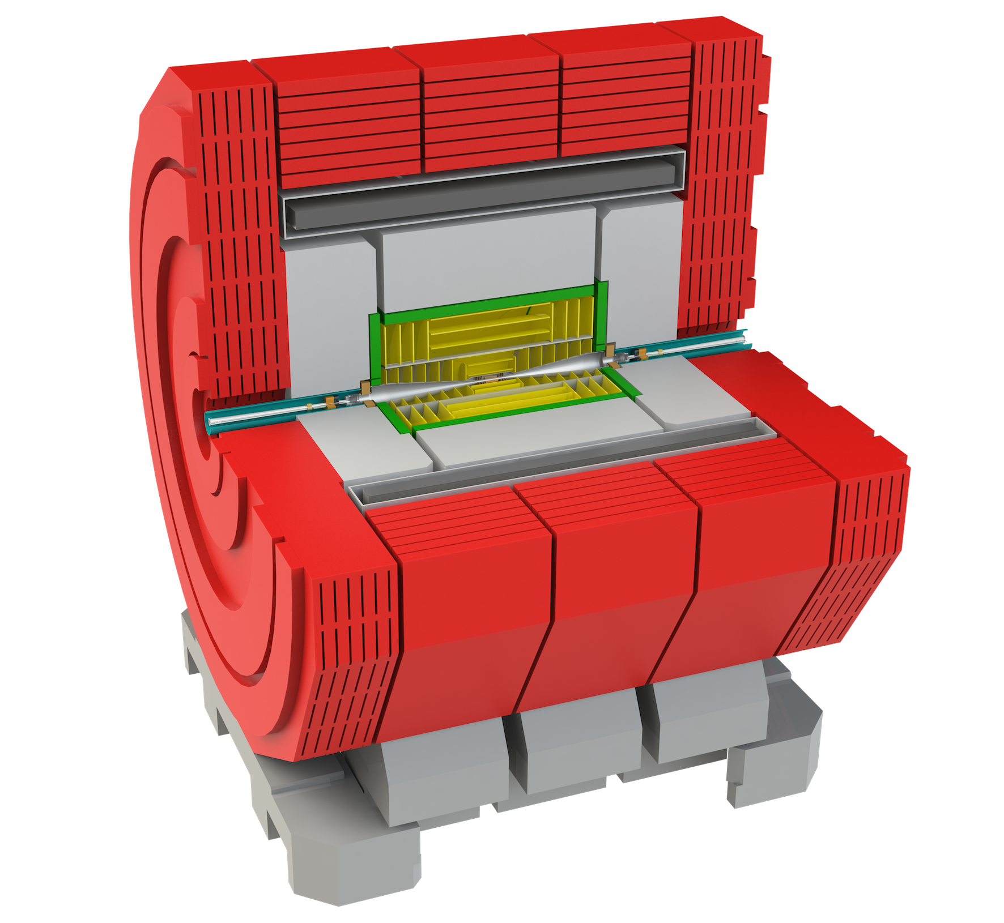
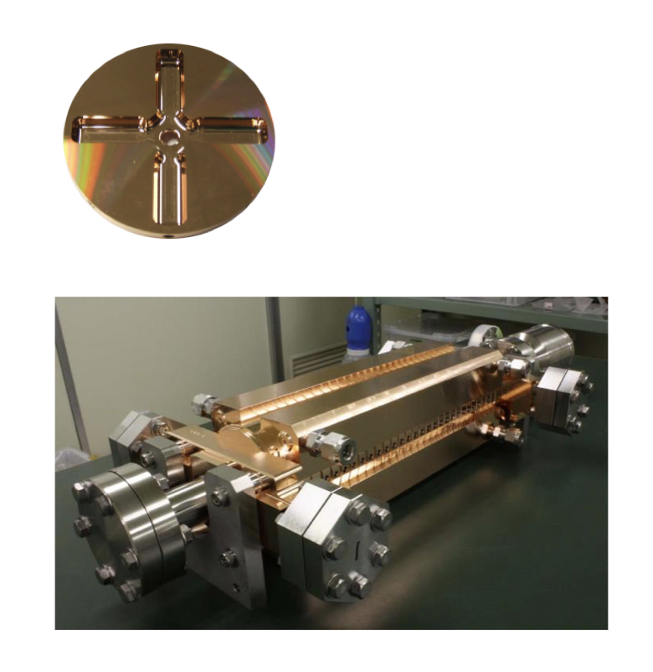
The Compact Linear Collider (CLIC)
  Timeline: Electron-positron linear collider at CERN for the era beyond HL-LHC
  Compact: Novel and unique two-beam accelerating technique with high-gradient room temperature RF cavities (~20’500 structures at 380 GeV), ~11km in its initial phase
  Expandable: Staged programme with collision energies from 380 GeV (Higgs/top) up to 3 TeV (Energy Frontier)
  CDR in 2012 with focus on 3 TeV. Updated project overview documents in 2018 (Project Implementation Plan) with focus 380 GeV for Higgs and top.
  Cost: 5.9 BCHF for 380 GeV (stable wrt 2012)
  Power: 168 MW at 380 GeV (reduced wrt 2012),
  corresponding to 60% of CERN’s energy consumption today
  Comprehensive Detector and Physics studies
Accelerating structure prototype for CLIC:
12 GHz (L~25 cm)

Slide 3
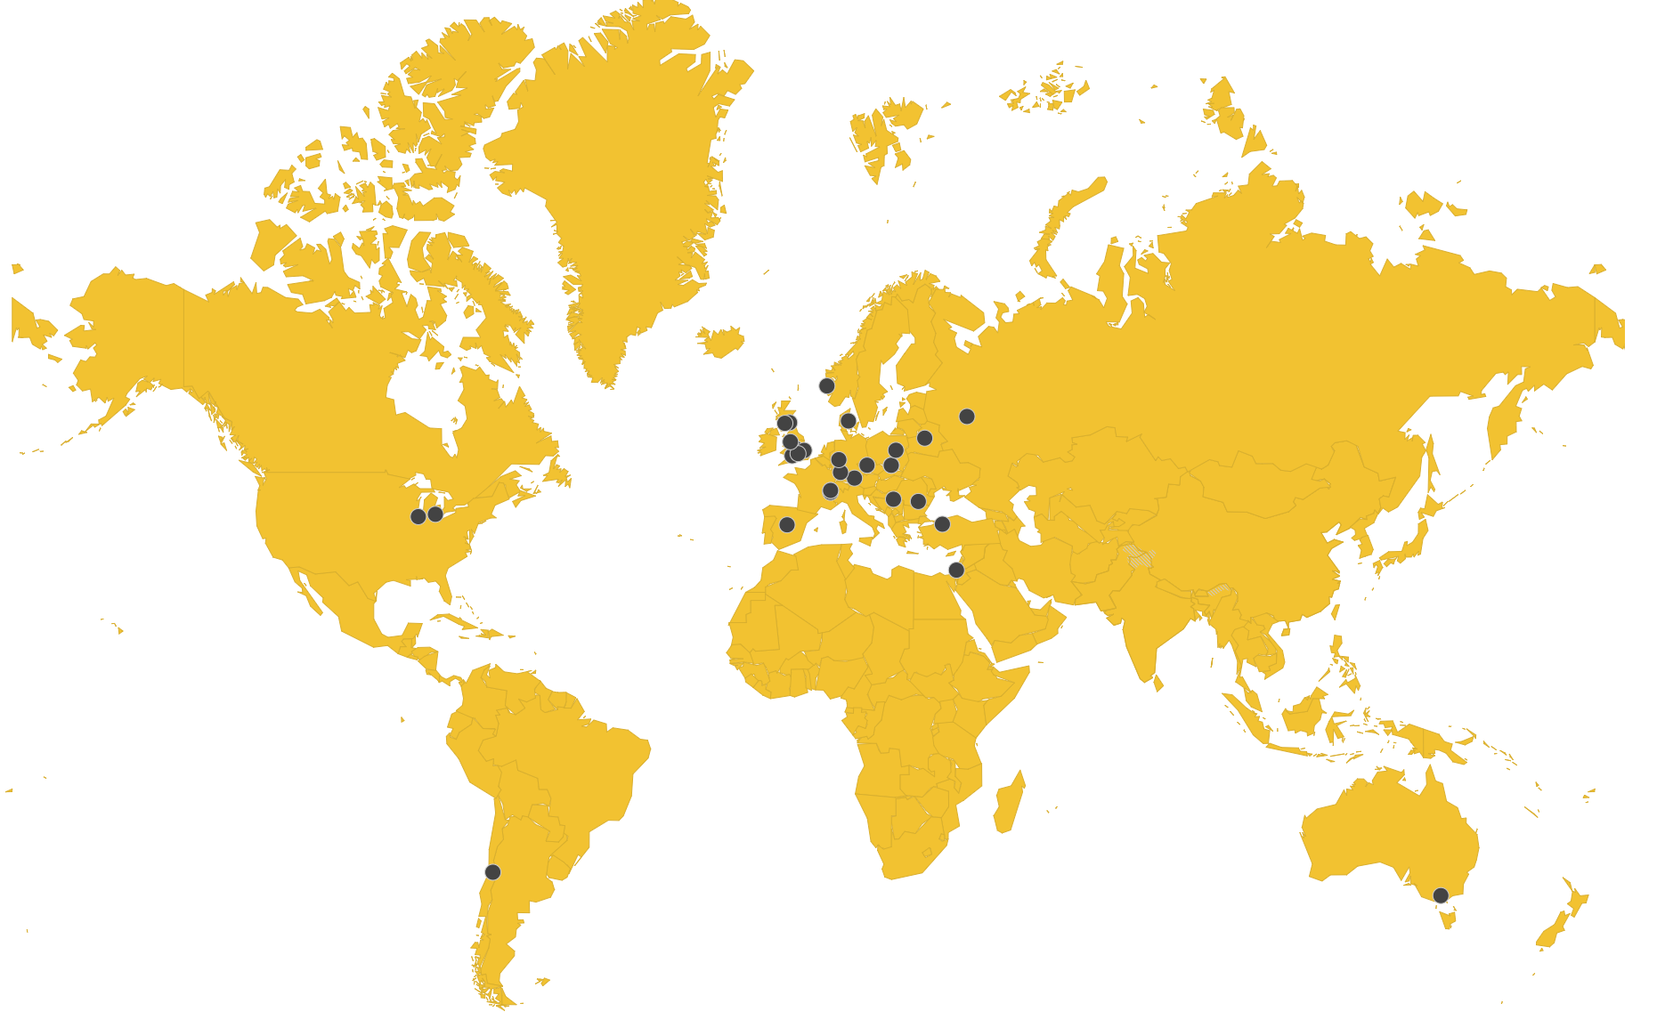
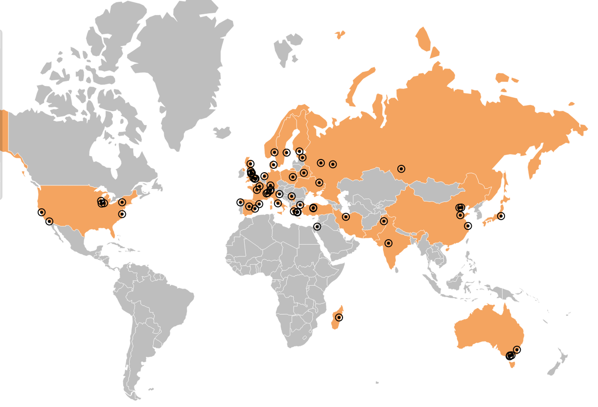
Collaborations
CLIC accelerator
  ~50 institutes from 28 countries*
  CLIC accelerator studies
  CLIC accelerator design and development
  Construction and operation of CLIC Test Facility, CTF3
CLIC detector and physics (CLICdp)
  30 institutes from 18 countries
  Physics prospects & simulations studies
  Detector optimisation + R&D for CLIC
+ strong participation in the CALICE and FCAL Collaborations and in AIDA-2020/AIDAinnova
*Canada missing on map
Notes:
Chec AIDA – Canada missing

Slide 4
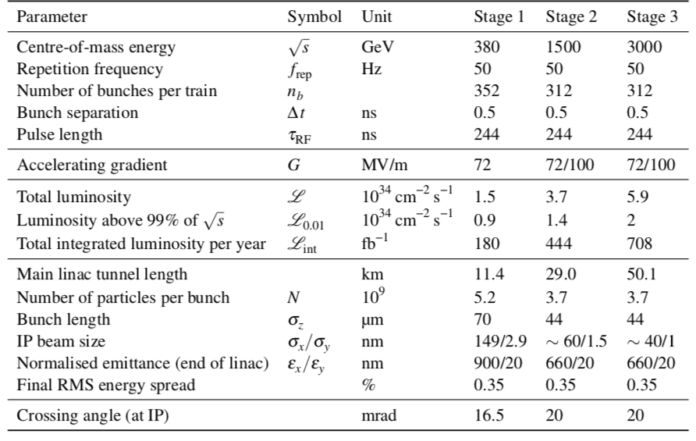
CLIC parameters

Slide 5
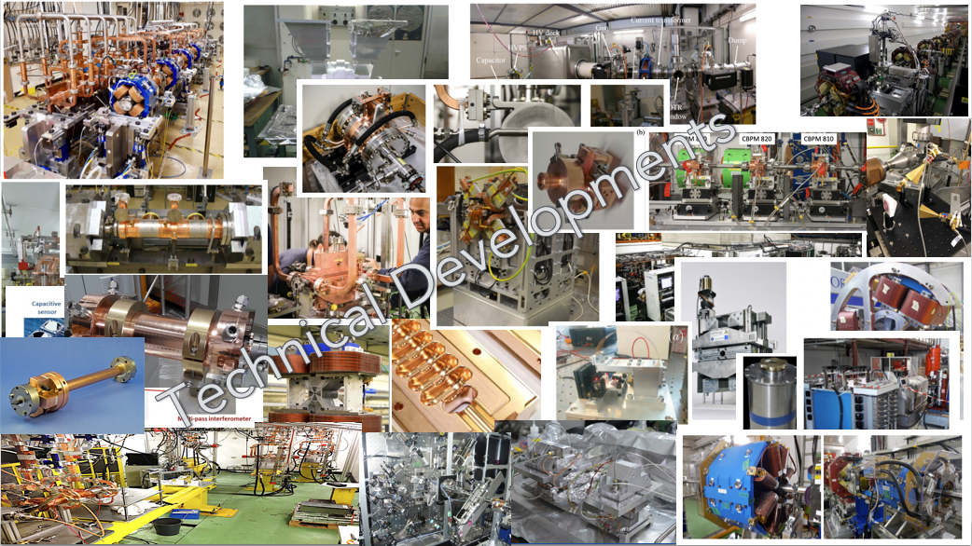
CLIC is a mature design/study
The CLIC accelerator studies are mature:
Optimised design for cost and power
Many tests in CTF3, FELs, lightsources and test-stands
Technical developments of “all” key elements

Slide 6
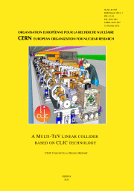
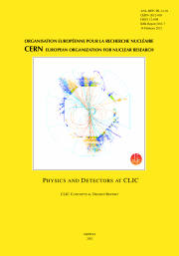
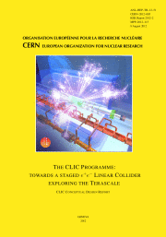
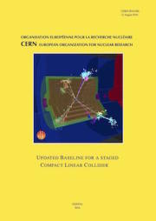
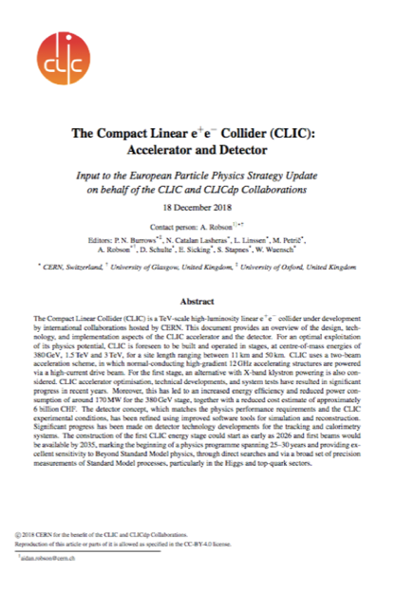
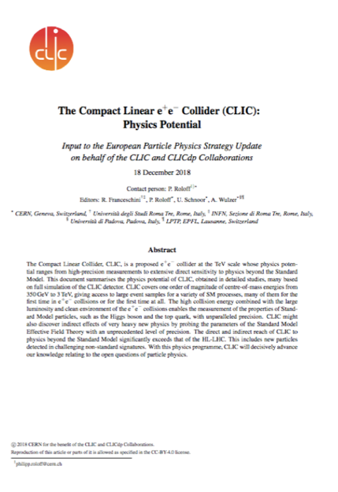
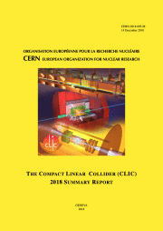
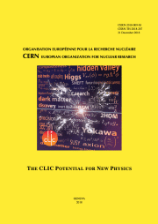
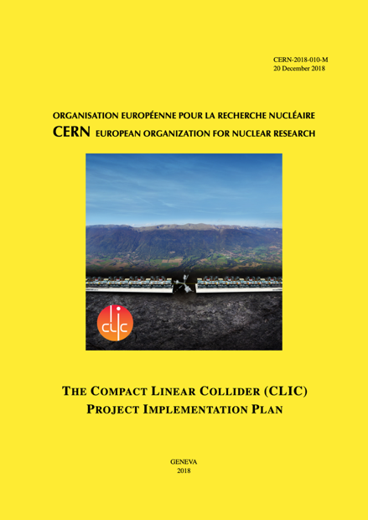
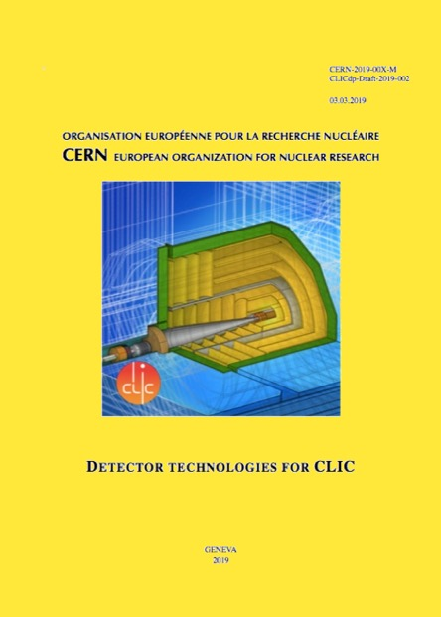
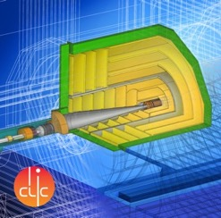
Resources
Available at:
clic.cern/european-strategy
3-volume CDR 2012
Updated Staging Baseline 2016
Two formal submissions to the ESPPU 2018
4 CERN Yellow Reports 2018
Several LoIs have been submitted on behalf of CLIC and CLICdp to the Snowmass process:
The CLIC accelerator study: Link
Beam-dynamics focused on very high energies: Link
The physics potential: Link
The detector: Link
Details about the accelerator, detector R&D, physics studies for Higgs/top and BSM

Slide 7
Updates since 2019
After ESU
  Immediate study of luminosity performance margins, gamma-gamma and Z-pole operation
  Timeline for further studies changed (slower implementation)
  Accelerator
  Resources too limited to move into TDR “proper”
  External projects using X-band technology very important and much increased
  Prioritize R&D type of studies and development of core technologies (will show later)
Physics and Detector:
  Less resources for dedicated CLIC studies, more “Higgs-factory” approach (i.e. CLIC, ILC, FCC-ee, CEPC) and continue linking to detector R&D collaborations

Slide 8
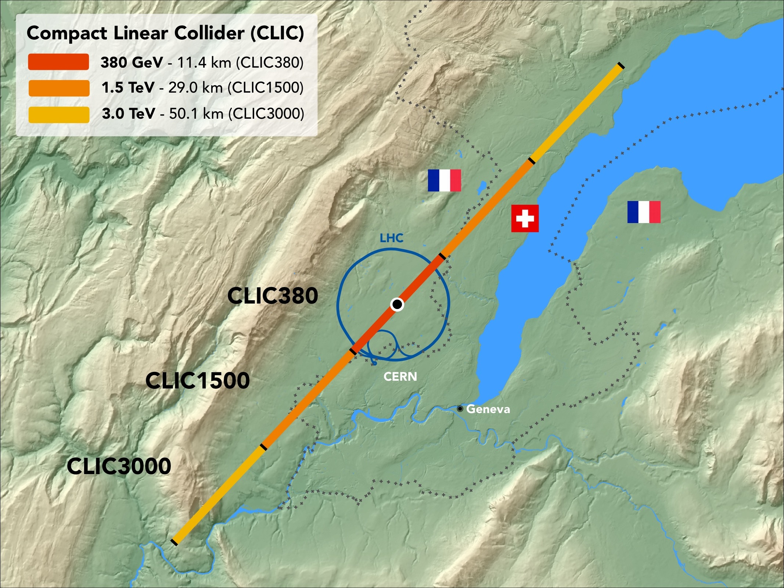
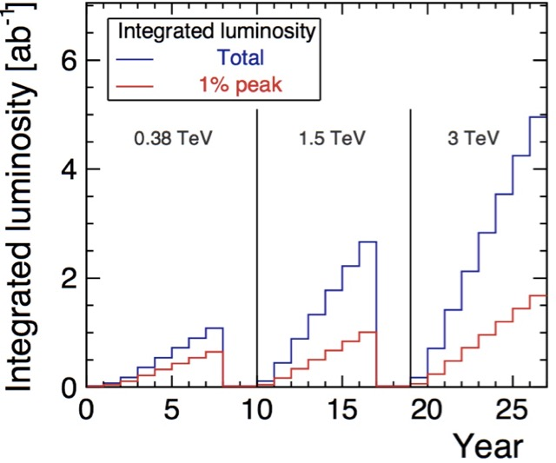
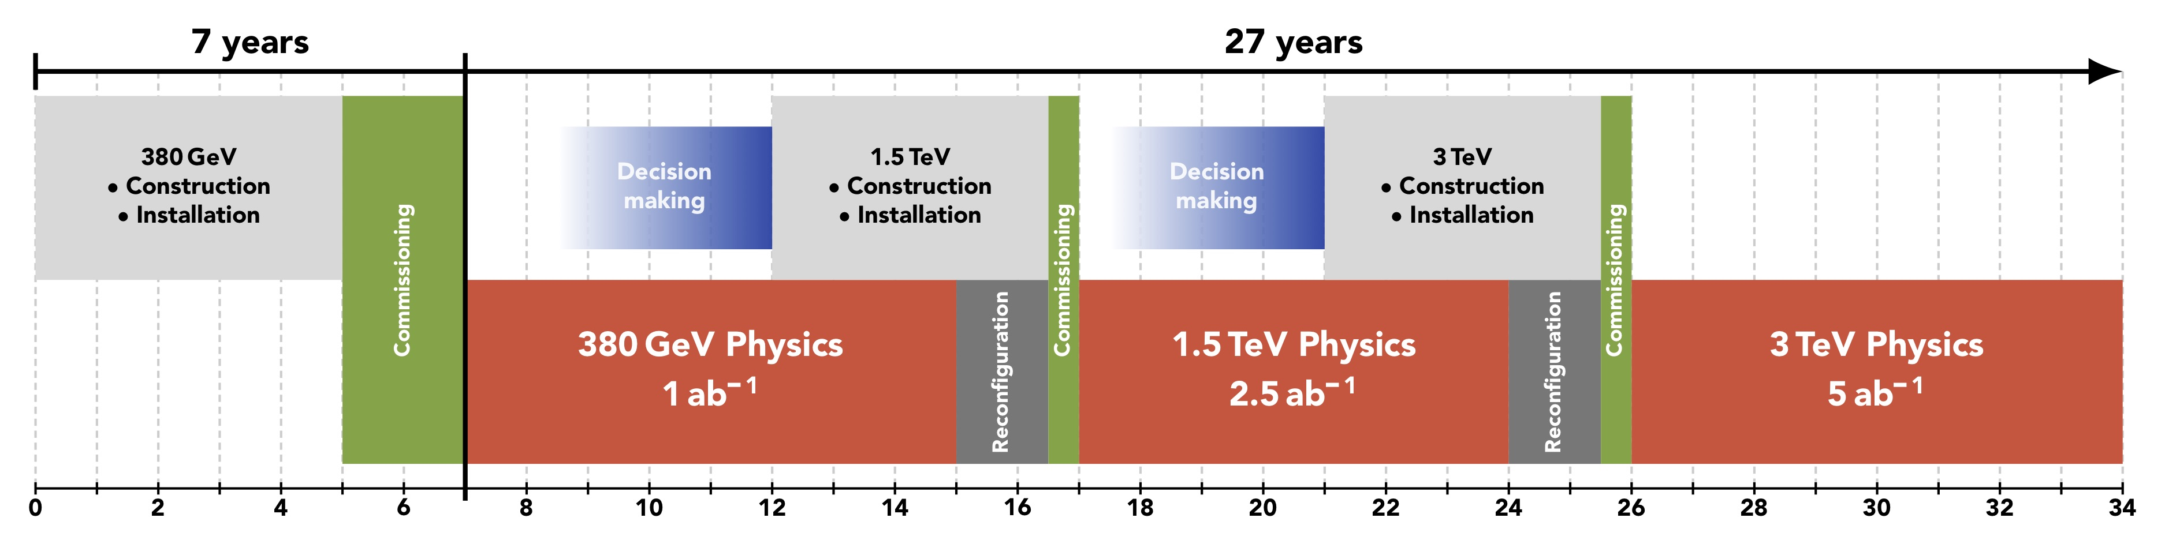
CLIC timeline
Ramp-up and up-time assumptions: arXiv:1810.13022, Bordry et al.
Technology Driven Schedule from start of construction shown above.
A preparation phase of ~5 years is needed before (estimated resource need for this phase is ~4% of overall project costs)

Slide 9
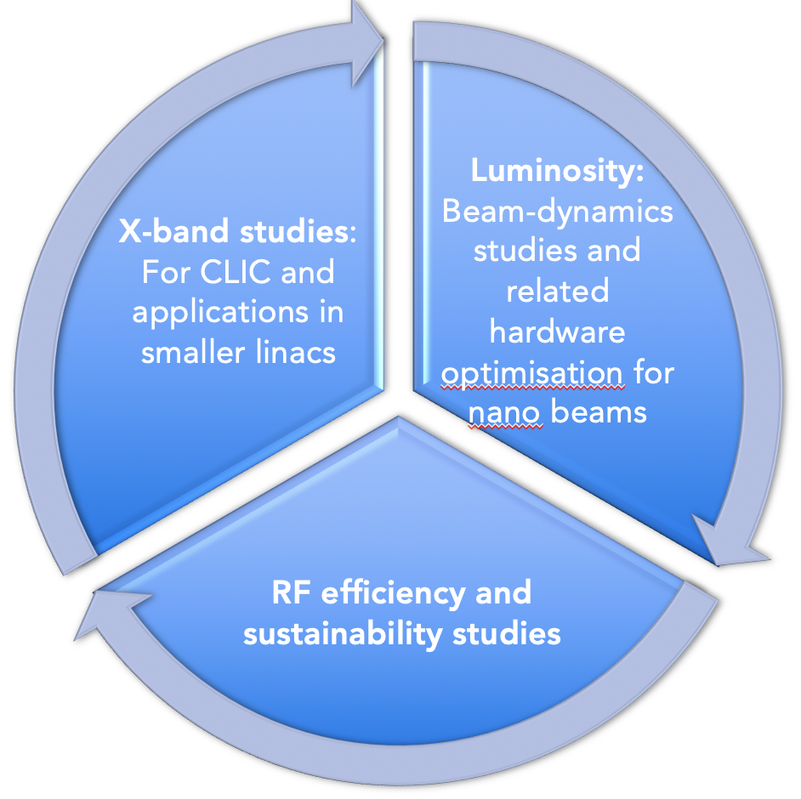
CLIC Project Readiness 2025-26
Project Readiness Report as a step toward a TDR – for next ESPP
Assuming ESPP in 2026, Project Approval ~ 2028, Project (tunnel) construction can start in ~ 2030.
Focusing on:
The X-band technology readiness for the 380 GeV CLIC initial phase
Optimizing the luminosity at 380 GeV
Improving the power efficiency for both the initial phase and at high energies
Goals for these studies by ~2025:
Improved 380 GeV parameters/performance/project plan
Push multi-TeV options/parameters

Slide 10

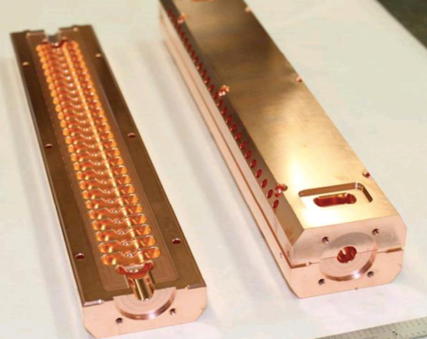
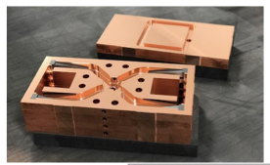
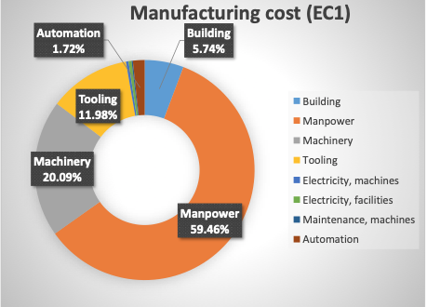
X-band
Industrial questionnaire:
Based on the companies feedback, the preparation phase to the mass production could take about five years. Capacity clearly available.
Structures and components production programme to study designs, operation/conditioning, manufacturing, industry qualification/experience
EU projects: ARIES, I-FAST, new TNA

Slide 11
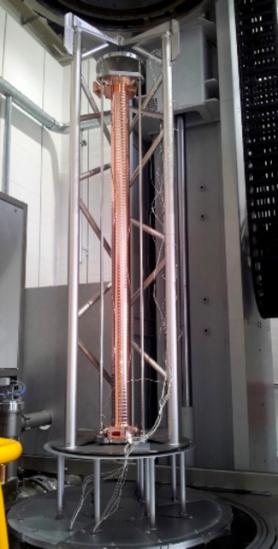
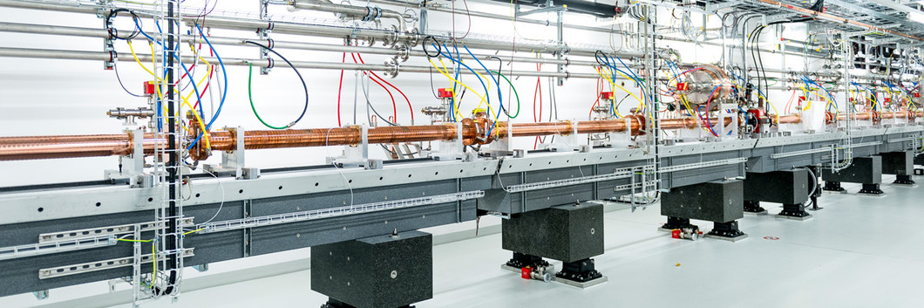
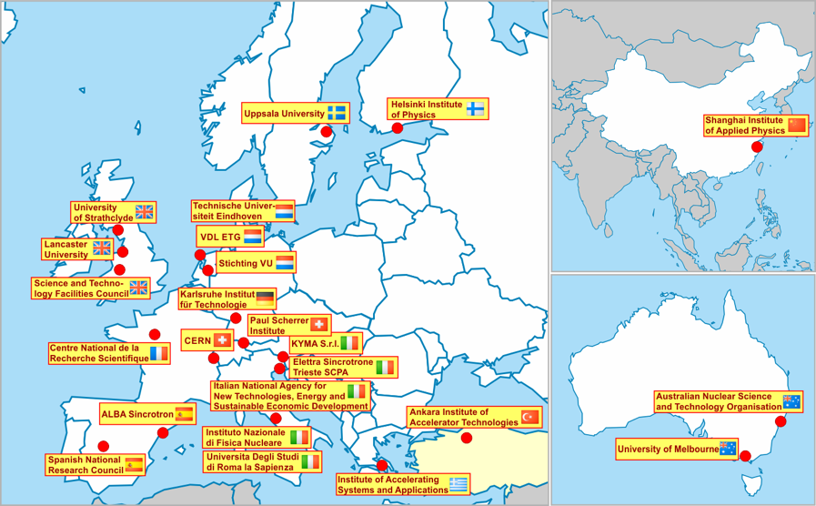
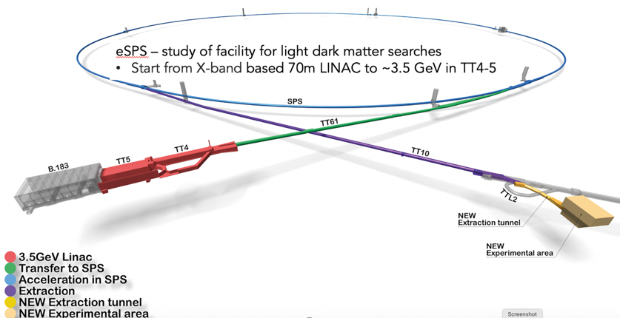
Use in smaller linacs (C and X-band)
SwissFEL: C-band linac
Photo: SwissFEL/PSI
104 x 2 m-long C-band (5.7 GHz) structures (beam up to 6 GeV at 100 Hz)
Similar μm-level tolerance
Length ~ 800 CLIC structures
Being commissioned
X-band structures from PSI perform well
26 academic and industrial partners: http://www.compactlight.eu/Main/HomePage
CompactLight Design Studies 2018-21 (link)
Compact FEL based on X-band technologies
CERN: eSPS study (3.5 GeV X-band linac)

Slide 12
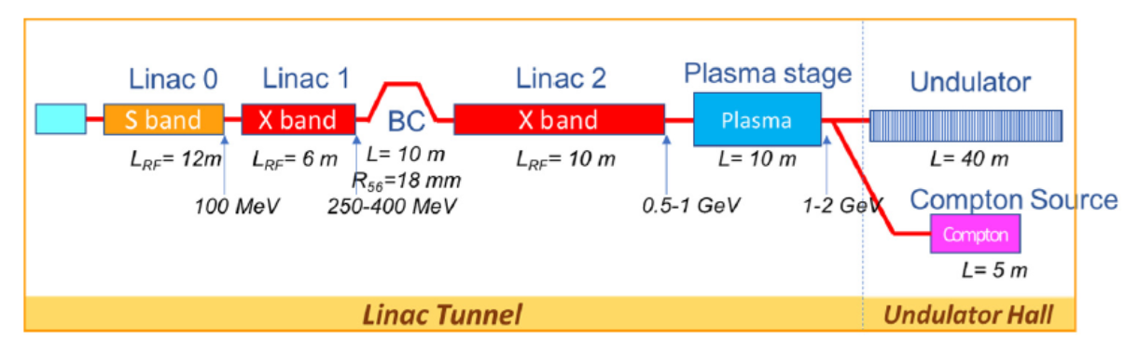
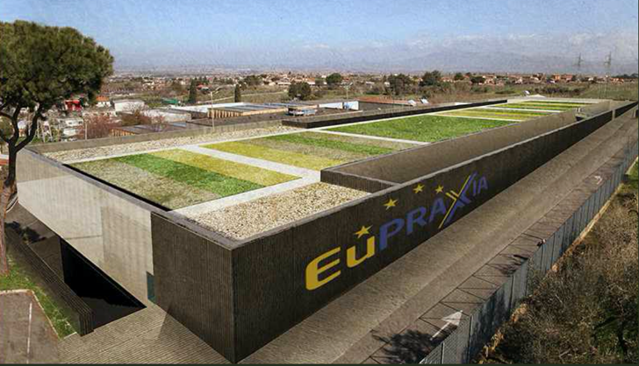
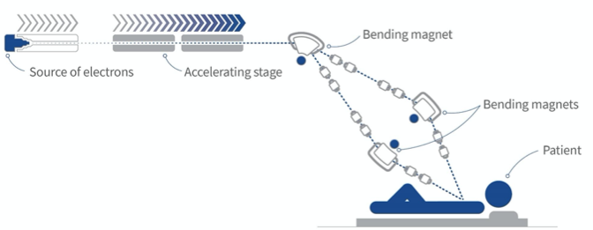
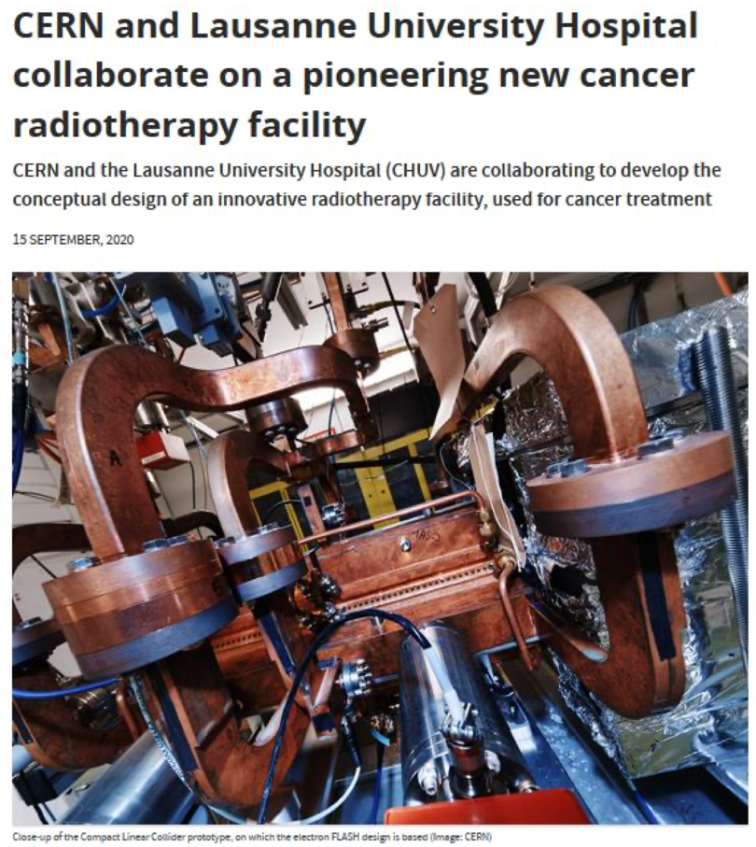
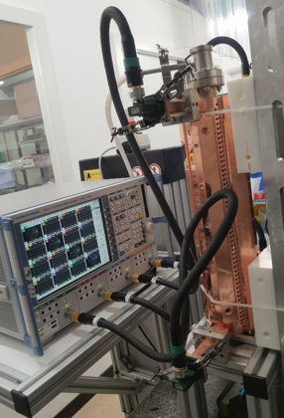
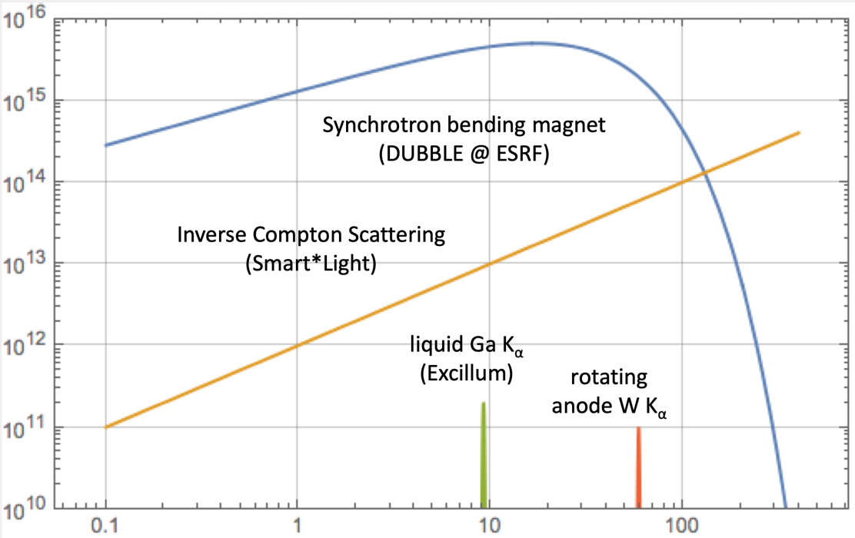
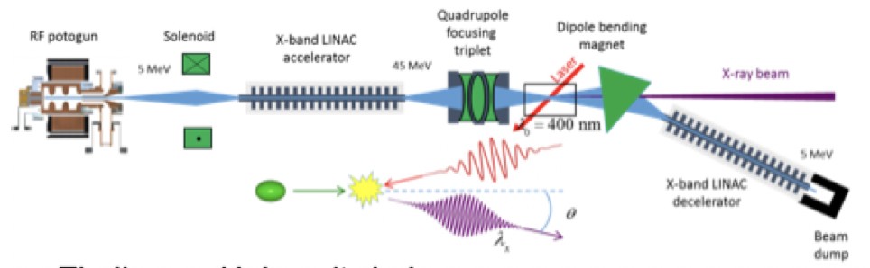
Applications – injector, X-band modules, RF
CompactLight Design Studies 2018-21 (right)
INFN 1 GeV linac
Flash RT, at CHUV
“Design Studies” for ICS
AERES, IFAST and TNA project
Overview at LINK
X-band accelerating modules
Notes:
Size of investments

Slide 13
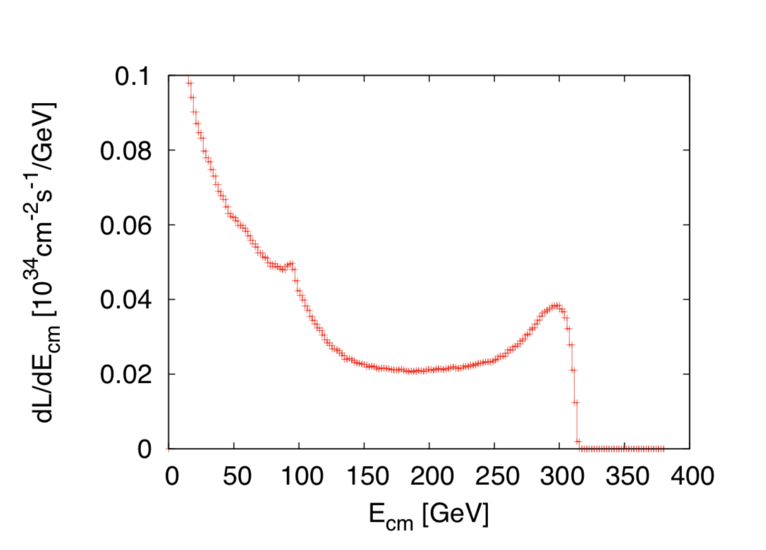
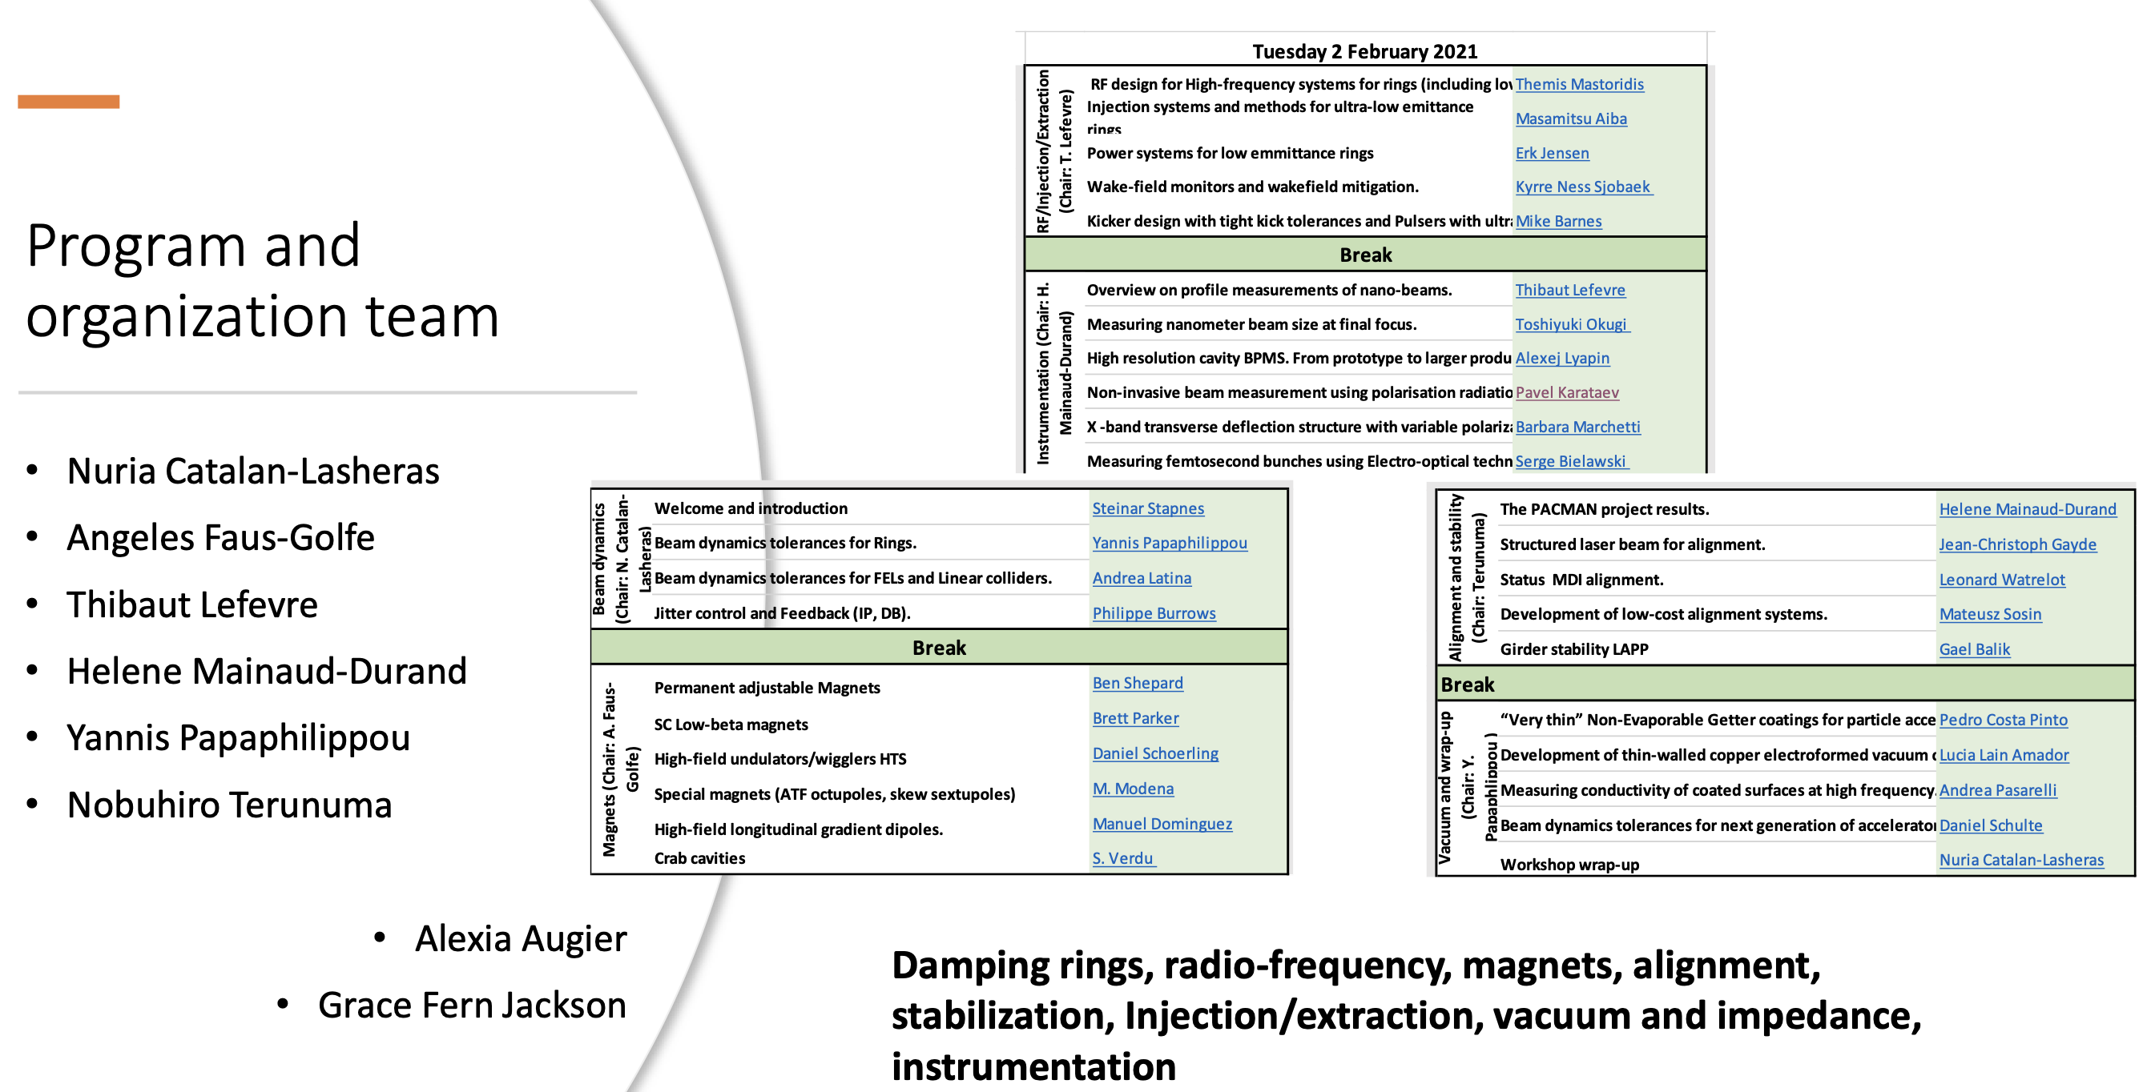
CLIC acc. studies – luminosities
Further work on luminosity performance, possible improvements and margins, operation at the Z-pole and gamma-gamma
    Z pole performance, 2.3x10³² – 0.4x10³⁴ cm⁻² s⁻¹
      The latter number when accelerator configured for Z running (e.g. early or end of first stage)
      Gamma – Gamma spectrum (example)
      Luminosity margins and increases
      Baseline includes estimates static and dynamic degradations from damping ring to IP: 1.5 x 10³⁴ cm⁻² s⁻¹, a “perfect” machine will give : 4.3 x 10³⁴ cm⁻² s⁻¹, so significant upside
      In addition: doubling the frequency (50 Hz to 100 Hz) would double the luminosity, at a cost of +50 MW and ~5% cost increase
    CLIC note and paper about these studies
Nanobeam workshop (summary by Nuria Catalan): LINK
Notes:
Is this the last version of this slide, now published

Slide 14
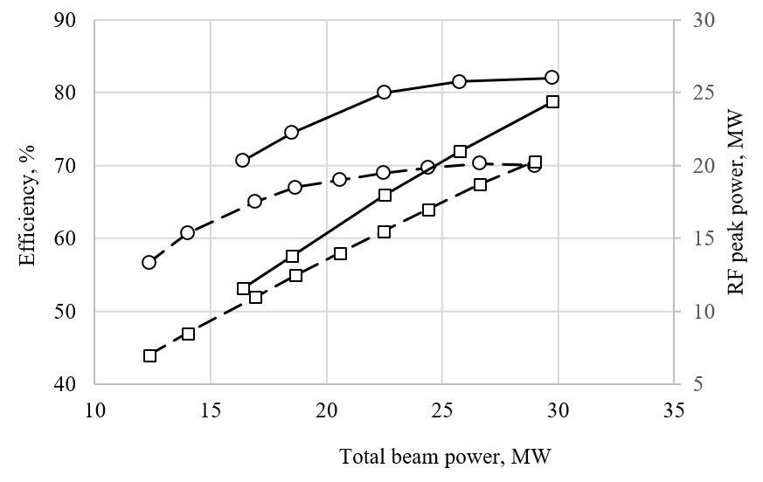
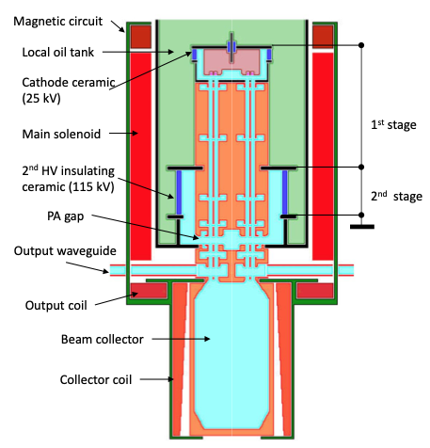
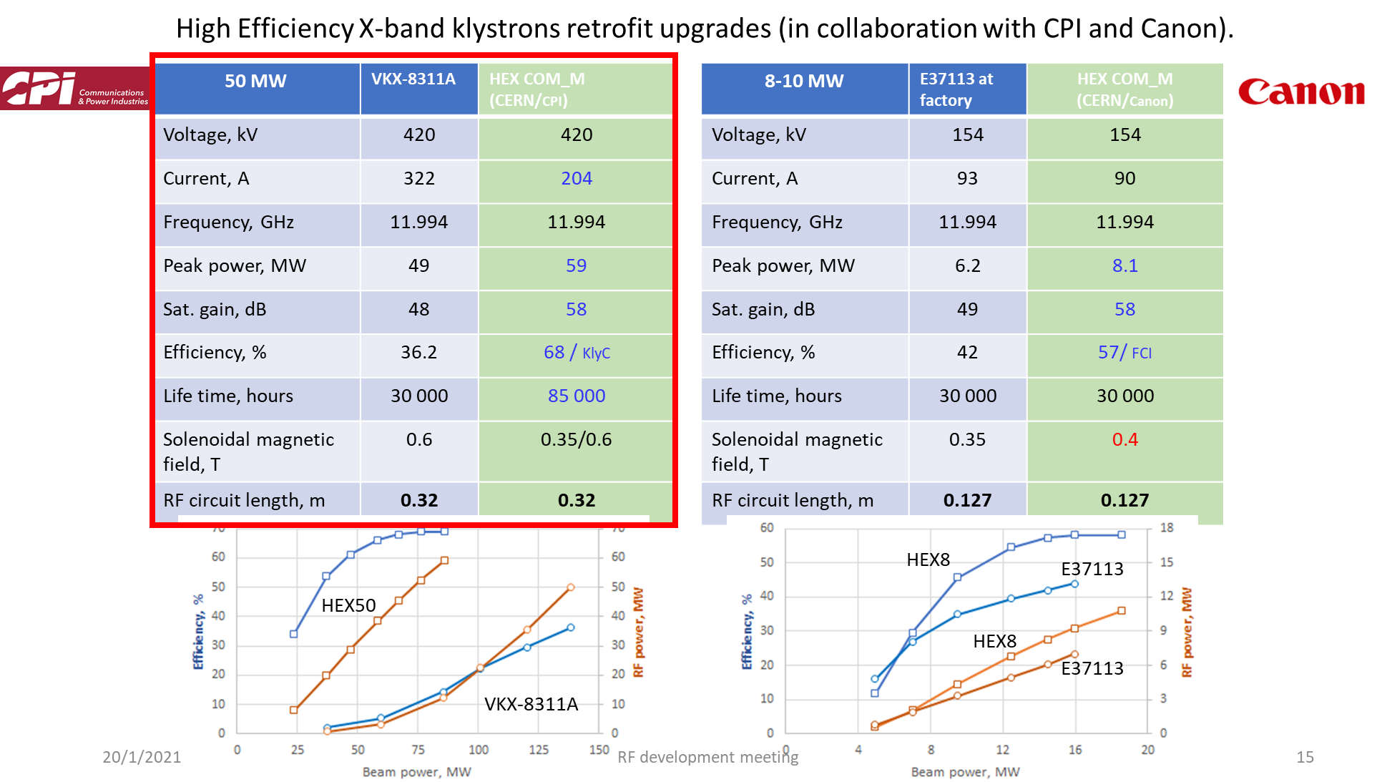
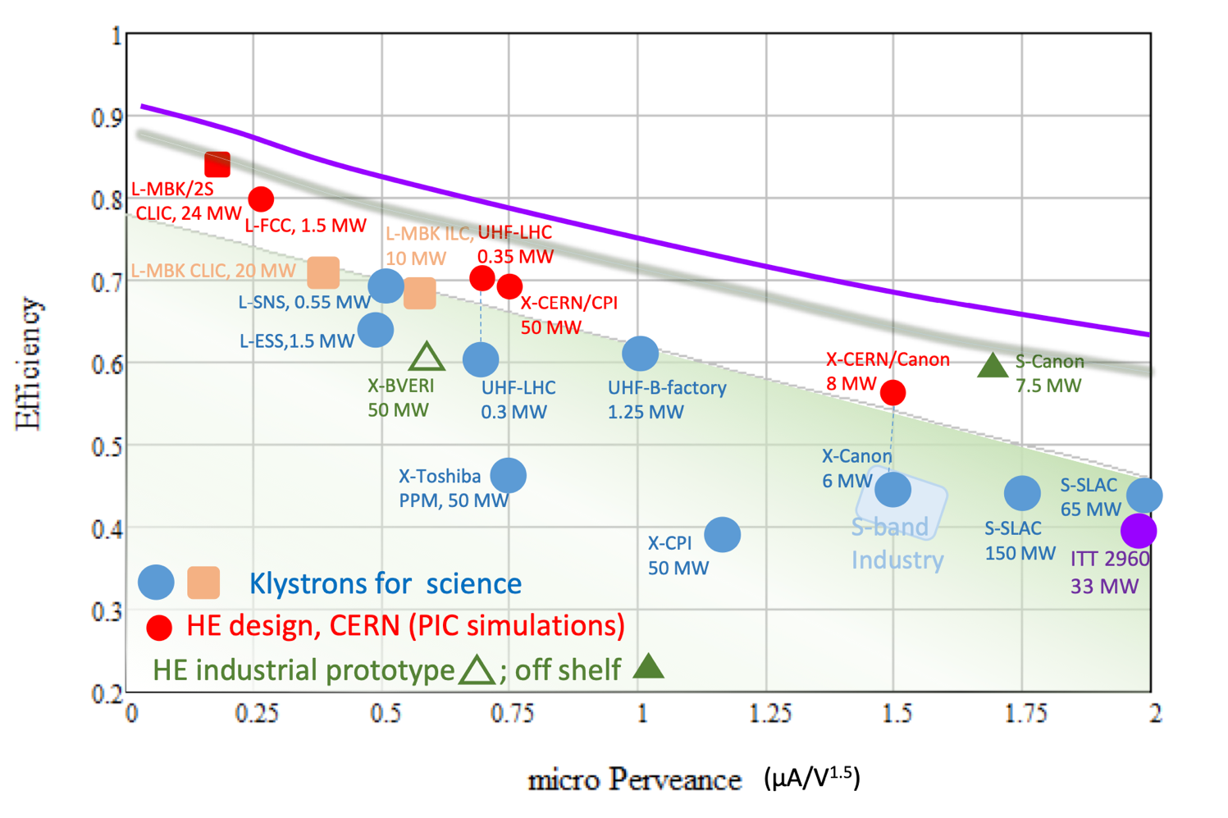
High Eff. Klystrons
L-band, X-band (for applications/collaborators and test-stands
High Efficiency implementations:
New small X-band klystron, ordered
Large with CPI, work with INFN
L-band two stage, design done, prototyping for FCC
Also important, redesign of damping ring RF system (well underway) – no klystron development foreseen
Drivebeam klystron: The klystron efficiency (circles) and the peak RF power (squares) simulated for the CLIC TS MBK (solid lines) and measured for the Canon MBK E37503 (dashed lines) vs total beam power. See more later.
Publication: https://ieeexplore.ieee.org/document/9115885

Slide 15
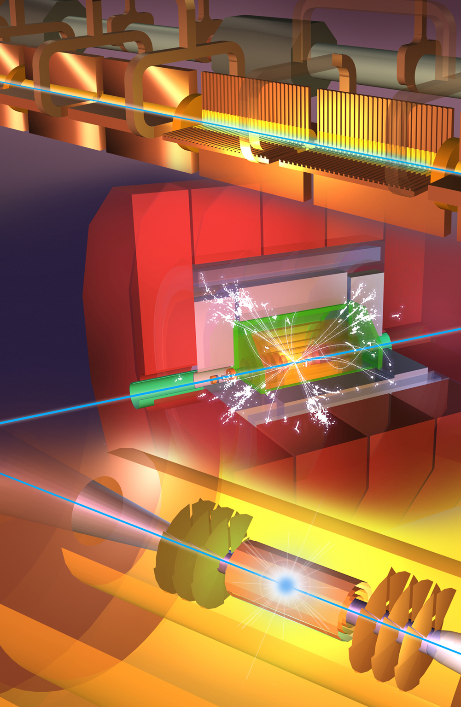
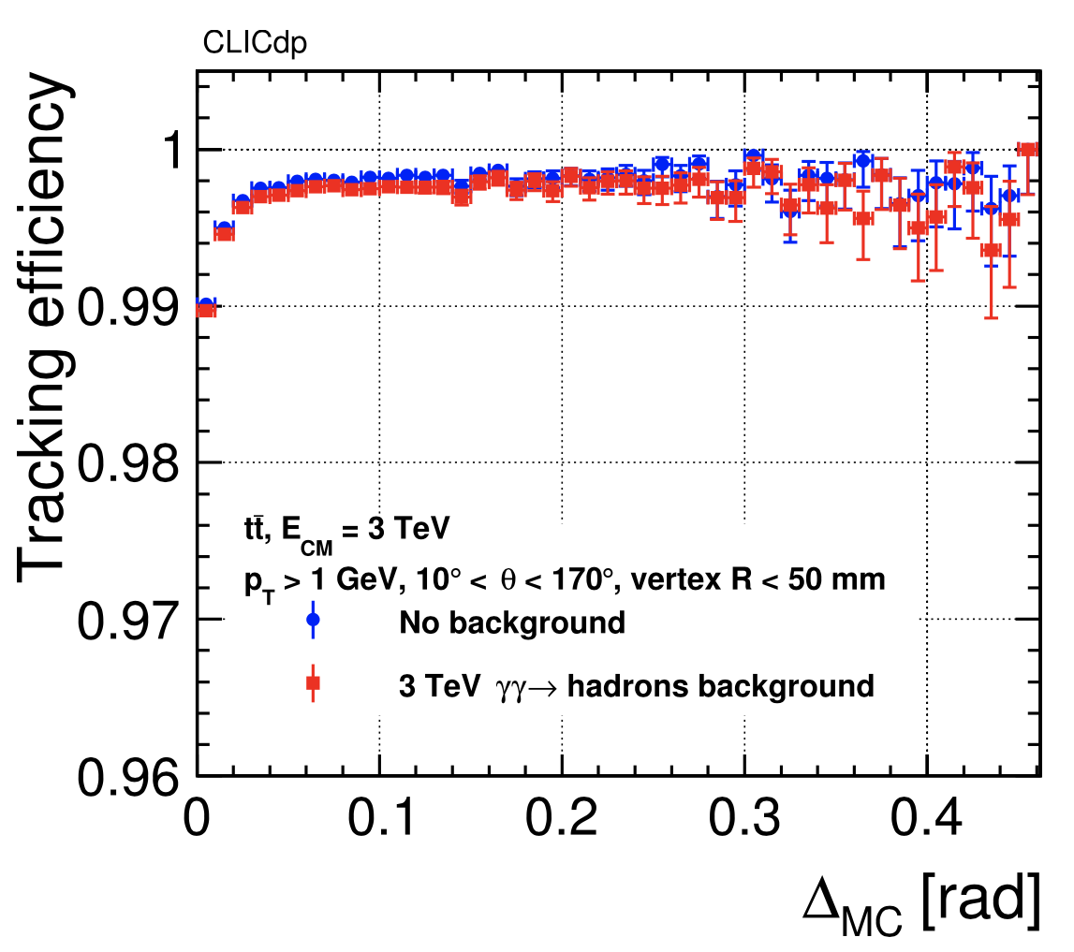
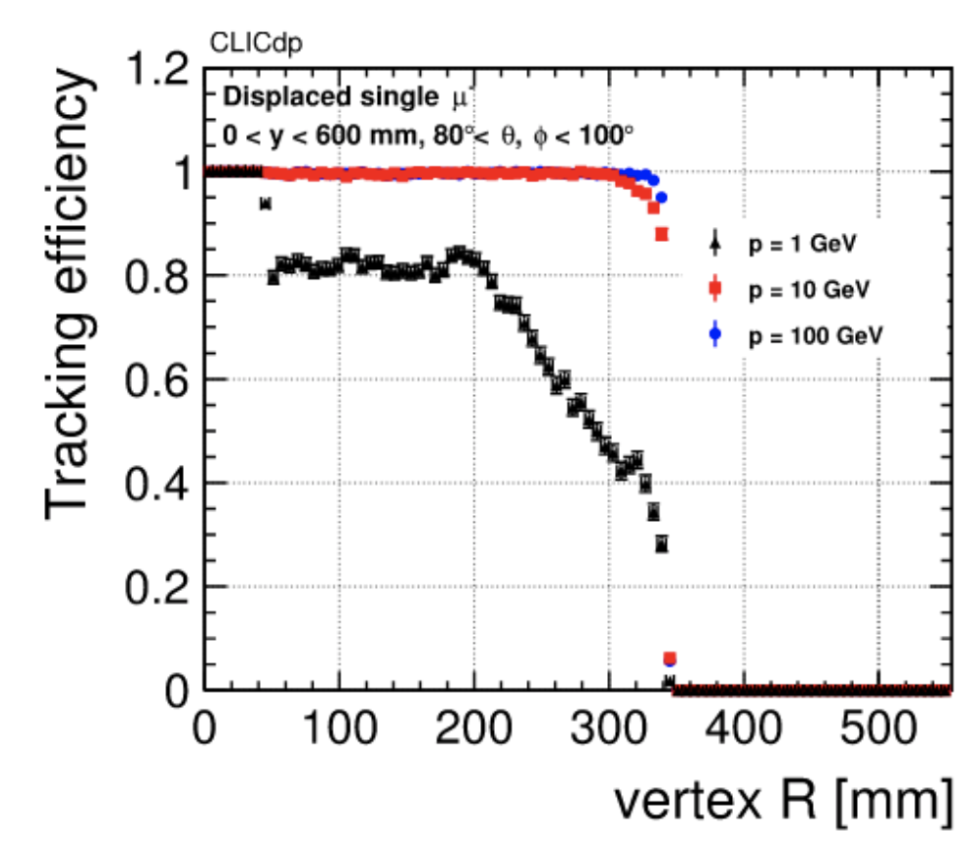
CLIC Detector
CLICdet:
◆ High-performing detector optimized for CLIC beam environment
◆ Full GEANT-based simulation, including beam-induced backgrounds,
available for optimization and physics studies
◆ Mature reconstruction chain allows detailed performance characterisation
– e.g. for tracking: effect of busy environment; displaced track reconstruction
NIM A956 (2020) 163304
Software framework:
◆ Originally in iLCSoft, the simulation/reconstruction is now fully embedded in the Key4HEP ecosystem –> a common target for all future collider options
– existing reconstruction algorithms “wrappered” for the new framework

Slide 16
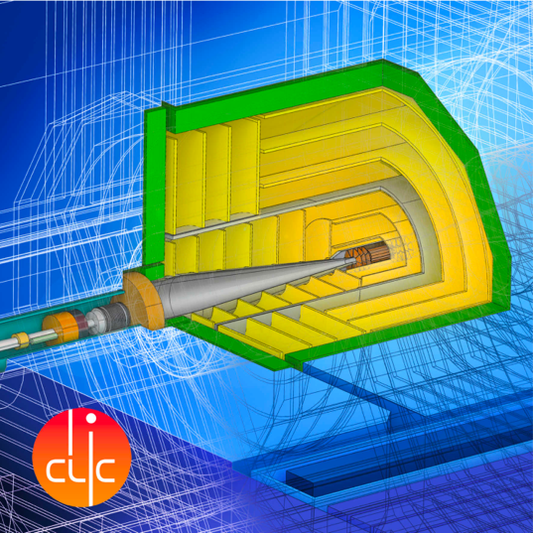
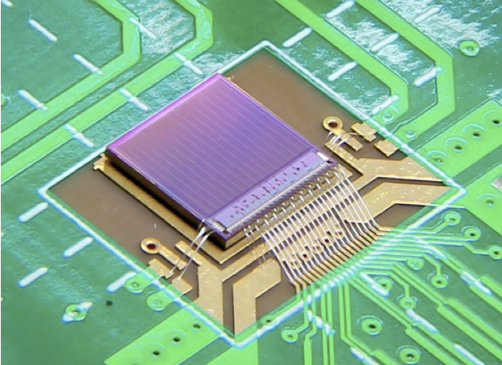
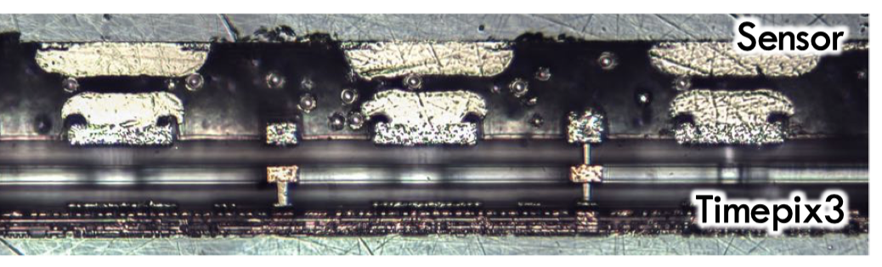
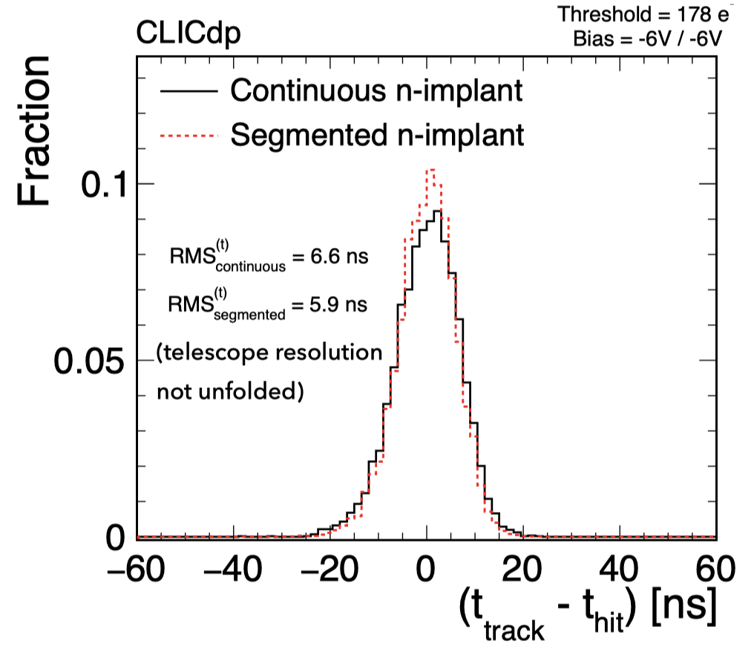
Detector R&D for CLICdet
Calorimeter R&D => within CALICE and FCAL
Silicon vertex/tracker R&D:
Working Group within CLICdp and strong collaboration with DESY + AIDAinnova
Now integrated in the CERN EP detector R&D programme
A few examples:
CLICTD monolithic tracking sensor:
Hybrid assemblies:
Monolithic sensors:
◆ Development of bump bonding process for CLICpix2 hybrid assemblies with 25 μm pitch
https://cds.cern.ch/record/2766510
◆ Exploring sub-nanosecond pixel timing with ATTRACT FASTPIX demonstrator in 180 nm monolithic CMOS
https://agenda.linearcollider.org/event/9211/contributions/49445/
◆ Now performing qualification of modified 65 nm CMOS imaging process for further improved performance
ACF conductor ball
Detailed simulations, Allpix² transient Monte Carlo combined with electrostatic 3D TCAD.
Beam tests at DESY, e.g. 5.8 ns CLICTD time resolution achieved
https://agenda.linearcollider.org/event/9211/contributions/49443/
◆ Successful sensor+ASIC bonding using Anisotropic Conductive Film (ACF), e.g. with CLICpix2, Timepix3 ASICs.
ACF now also used for module integration with monolithic sensors.
https://agenda.linearcollider.org/event/9211/contributions/49469/

Slide 17



Physics Potential recent highlights 1:
Initial energy stage
◆ Ongoing studies on Higgs and top-quark precision physics potential
Higgs coupling sensitivity:
◆ Sensitivities under different integrated luminosity scenarios to complement accelerator luminosity studies
Increased integrated luminosity at 380 GeV
(4ab^{–1})
Baseline: 380 GeV (1ab^{–1}) + 1.5 TeV
Top-quark threshold scan
◆ Optimisation of scan points including beam spectrum; here optimising on mass and Yukawa coupling.
◆ Expected top-quark mass precision of 25MeV can be improved by 25% without losing precision on width or Yukawa.
https://arxiv.org/abs/2103.00522
https://arxiv.org/abs/2001.05278
other sensitivities from Briefing Book https://arxiv.org/abs/1910.11775

Slide 18

Power and Energy
Design Optimisation:
The designs of CLIC, including key performance parameters as accelerating gradients, pulse lengths, bunch-charges and luminosities, have been optimised for cost but also increasingly focussing on reducing power consumption.
Technical Developments:
Technical developments targeting reduced power consumptions at system level high efficiency klystrons, and super conducting and permanents magnets for damping rings and linacs.
Running when energy is cheap:
CLIC is normal conduction, single pass, can change off-on-off quickly, at low power when not pulsed. Specify state-change (off-standby-on) times and power uses for each – see if clever scheduling using low cost periods, can reduce the energy bill
Renewable energy (carbon footprint):
Is it possible to fully supply the annual electricity demand of the CLIC-380 by installing local wind and PV generators (this could be e.g. achieved by 330 MW-peak PV and 220 MW-peak wind generators, at a cost of slightly more than 10% of the CLIC 380 GeV cost)
Power estimate bottom up (concentrating on 380 GeV systems)
Very large reductions since CDR, better estimates of nominal settings, much more optimised drivebeam complex and more efficient klystrons, injectors more optimized, etc
Further savings possible, main target damping ring RF significantly reduced, L-band klystrons (target 110-130 MW)
Energy consumption ~0.8 TWh yearly (target 0.6)
CERN is currently (when) running at 1.2 TWh (~90% in accelerators)

Slide 19



CLIC can easily be extended
  What are the critical elements:
    Physics
    Gradient and power efficiency
    Costs
  Drive beam accelerated to ~2 GeV using conventional klystrons
  Intensity increased using a series of delay loops and combiner rings
  Drive beam decelerated and produces high-RF
  Feed high-RF to the less intense main beam using waveguides
  Extend by extending main linacs, increase drivebeam pulse-length and power, and a second drivebeam to get to 3 TeV

Slide 20



Physics Potential recent highlights 2:
Multi-TeV stages
◆ Ongoing studies on new physics searches
Search for heavy neutrinos
◆ e+e- -> Nν -> qqlν signature allows full reconstruction of N
◆ BDT separates signal from SM; beam backgrounds included.
◆ cross-section limits converted to mass (m_{N}) coupling (V_{IN}) plane
Dark matter using mono-photon signature at 3TeV, e+e- -> XXγ
◆ New study using ratio of electron beam polarisations to reduce systematics
◆ Exclusions for simplified model with mediator Y and DM particle X
◆ For benchmark mediator of 3.5TeV, photon energy spectrum discriminates different DM mediators & allows 1TeV DM particle mass measurement to ~1%
https://arxiv.org/abs/2103.06006
CLIC 3TeV, geY=1
LHC analysis: [1812.08750],
different assumption V_{eN} = V_{mN} ≠ V_{τN} = 0

Slide 21
Pushing the acc. technology – R&D
CLIC core studies:
Normal conducting accelerating structures are limited in gradient by three main effects (setting aside input power):
Field emission
Vacuum arcing (breakdown)
Fatigue due to pulsed surface heating
Studying these processes gives important input into:
RF design – Optimizing structures also coupled with beam dynamics
Technology – Material choice, process optimization
Operation – Conditioning and recovery from breakdown
Designs for CLIC steadily improving, but also RFQ, Muon collider, XFEL, ICS, etc
Important experimental support
Multi-TeV energies:
High gradient, high wall-plug to beam efficiency, nanobeam parameters increasingly demanding

Slide 22



Cost - I
Machine has been re-costed bottom-up in 2017-18
Methods and costings validated at review on 7 November 2018 – similar to LHC, ILC, CLIC CDR
Technical uncertainty and commercial uncertainty estimated

Slide 23

Cost - II
Other cost estimates:
Construction:
From 380 GeV to 1.5 TeV, add 5.1 BCHF (drive-beam RF upgrade and lengthening of ML)
From 1.5 TeV to 3 TeV, add 7.3 BCHF (second drive-beam complex and lengthening of ML)
Labour estimate: ~11500 FTE for the 380 GeV construction
Operation:
116 MCHF (see assumptions in box below)
Energy costs

Slide 24
Summary and thanks
CLIC studies focused on core technologies, X-band and nanobeam, for next ESU, well underway.
Keep focus on both 380 GeV and multi-TeV performance and R&D
Greatly helped by studies of smaller linacs and systems using X-band technology
Detector and physics studies continue at lower pace, also in many areas integrated or connected with ”Higgs-factory” studies, and wider Detector R&D efforts
Thanks to many CLIC accelerator colleagues for slides and input, and the CLICdp slides in particular compiled by Aidan Robson

