Slide 1
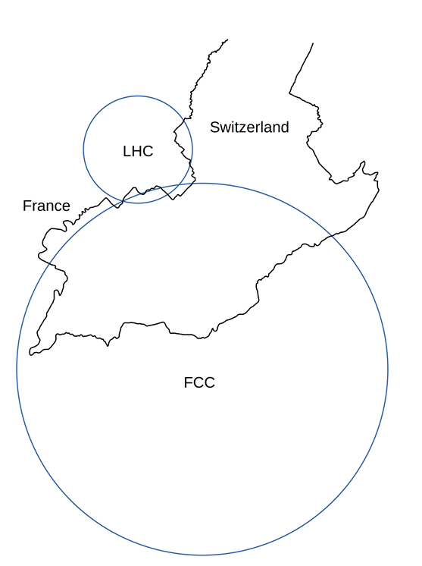









FCC status
HKUST IAS HEP 2022 Conference, Monday 17 January 2022
Frank Zimmermann, CERN
on behalf of the FCC collaboration and FCCIS team -
with help from Michael Benedikt, CERN, Katsunobu Oide, KEK/CERN, and Tor Raubenheimer, SLAC
LHC
PS
SPS
FCC
http://cern.ch/fcc
Work supported by the European Commission under the HORIZON 2020 projects EuroCirCol, grant agreement 654305; EASITrain, grant agreement no. 764879; ARIES, grant agreement 730871, FCCIS, grant agreement 951754, and E-JADE, contract no. 645479
photo: J. Wenninger

Slide 2
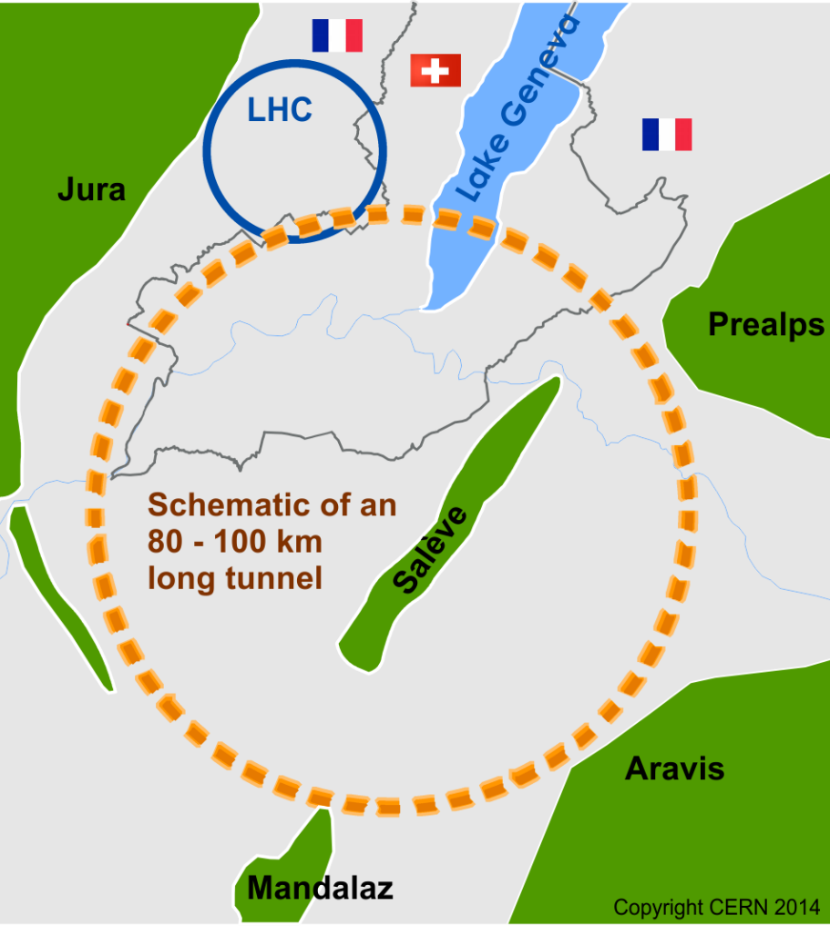
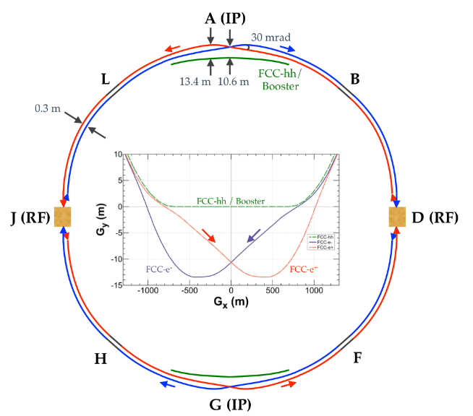
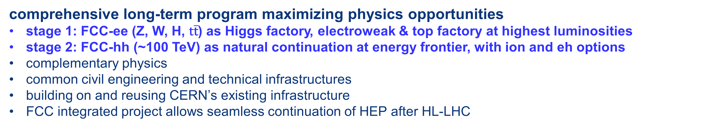
The FCC integrated program
inspired by successful LEP – LHC programs at CERN
comprehensive long-term program maximizing physics opportunities
stage 1: FCC-ee (Z, W, H, $\text{t}\overline{\text{t}}$) as Higgs factory, electroweak & top factory at highest luminosities
stage 2: FCC-hh (~100 TeV) as natural continuation at energy frontier, with ion and eh options
complementary physics
common civil engineering and technical infrastructures
building on and reusing CERN’s existing infrastructure
FCC integrated project allows seamless continuation of HEP after HL-LHC
FCC-ee
FCC-hh

Slide 3

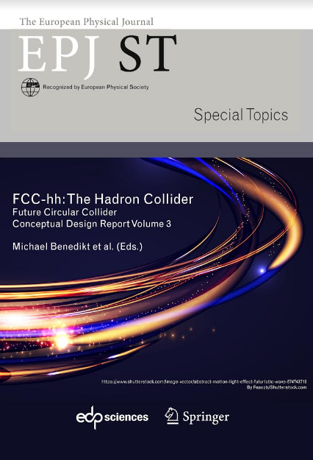
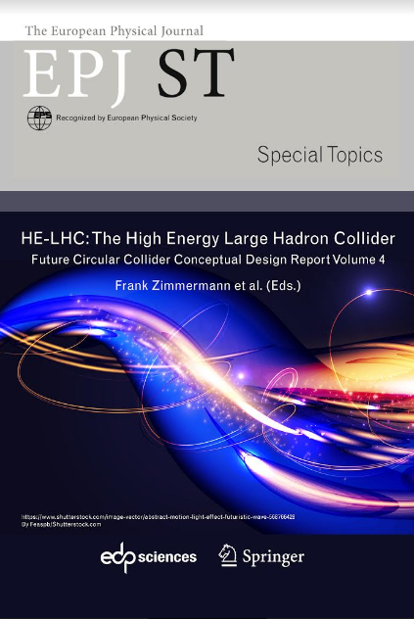
CDR & Study Documentation, end 2018
FCC-Conceptual Design Reports:
  Vol 1 Physics, Vol 2 FCC-ee, Vol 3 FCC-hh, Vol 4 HE-LHC
  CDRs published in European Physical Journal C (Vol 1) and ST (Vol 2 – 4) [Springer]
  EPJ C 79, 6 (2019) 474 , EPJ ST 228, 2 (2019) 261-623 ,
  EPJ ST 228, 4 (2019) 755-1107 , EPJ ST 228, 5 (2019) 1109-1382
EPJ is a merger and continuation of Acta Physica Hungarica, Anales de Fisica, Czechoslovak Journal of Physics, Fizika A, Il Nuovo Cimento, Journal de Physique, Portugaliae Physica and Zeitschrift für Physik. 25 European Physical Societies are represented in EPJ, including the DPG.
Summary documents provided to EPPSU 2019/20
  FCC-integral, FCC-ee, FCC-hh, HE-LHC
  Accessible on http://fcc-cdr.web.cern.ch/
>1350 contributors from > 350 institutes,
a truly global effort as suggested by EPPSU 2013

Slide 4
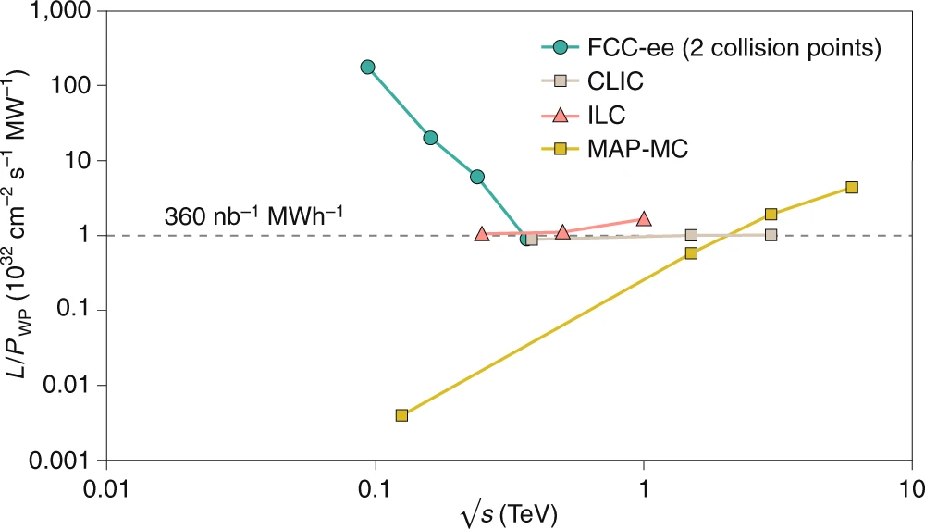
FCC-ee figures of merit
Luminosity vs. capital cost
for the H running, with 5 ab⁻¹ accumulated over 3 years and 10⁶ H produced, the total investment cost (~10 BCHF) corresponds to → 10 kCHF per produced Higgs boson
for the Z running with 150 ab⁻¹ accumulated over 4 years and 5x10¹² Z produced, the total investment cost corresponds to → 10 kCHF per 5×10⁶ Z bosons
This is the number of Z bosons collected by each experiment during the entire LEP programme !
Luminosity vs. electricity consumption
Due to twin-aperture magnets,
thin-film SRF, efficient RF power
sources, top-up injection
Capital cost per luminosity dramatically
decreased compared with LEP !
Highest lumi/power of all H fact proposals
Electricity cost ~200 CHF per Higgs boson
M. Benedikt, A. Blondel, P. Janot, et al., Nature Physics 16, 402-407 (2020), and European Strategy for Particle Physics Preparatory Group, Physics Briefing Book (CERN, 2019)

Slide 5

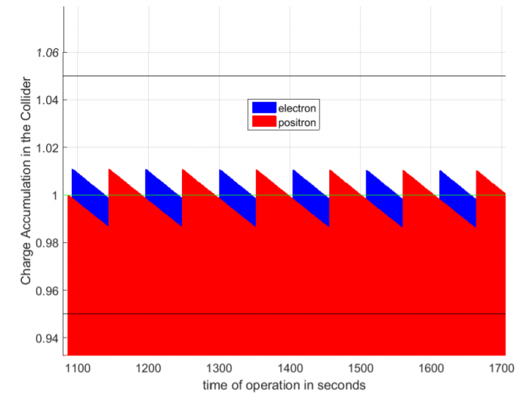
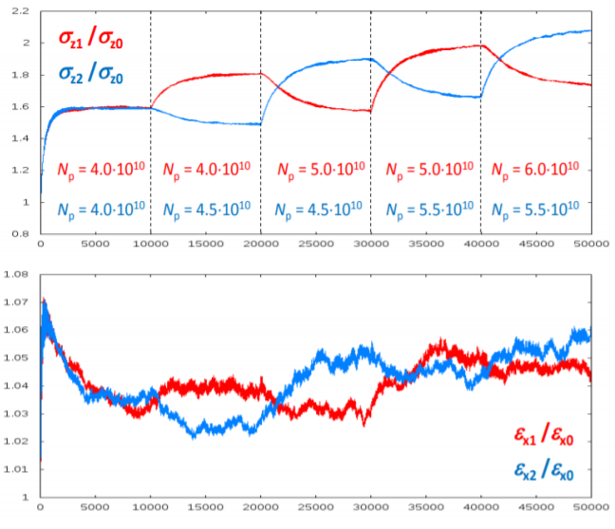
new: “bootstrapping” & top-up injection
injection from zero, alternating between beams to avoid beam-beam flip-flop effect
alternating replenishment of the two colliding beams, keeping beam currents stable within a few per cent
D. Shatilov
S. Ogur
average luminosity ~ peak luminosity

Slide 6

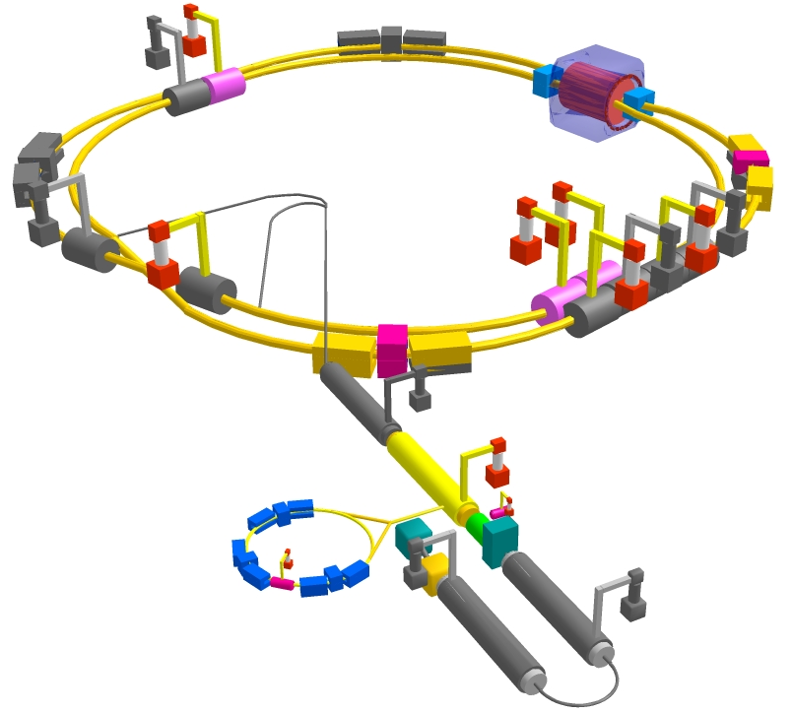
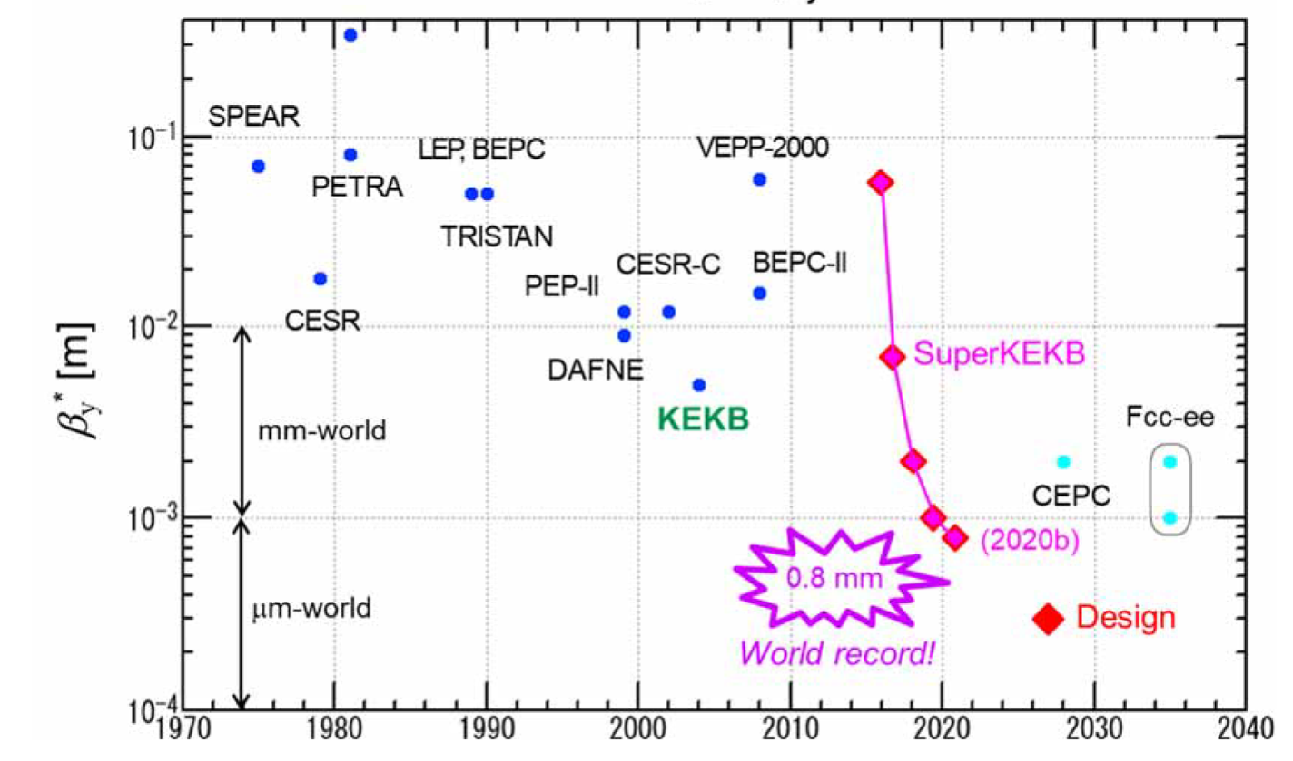
SuperKEKB – “FCC-ee demonstrator”
Double ring e⁺e⁻ collider B-factory at 7(e⁻) & 4(e⁺) GeV; design luminosity $\sim$8 x 10³⁵ cm⁻²s⁻¹; design β_{y}* $\sim$0.3 mm; beam lifetime$\sim$5 min; top-up inj.; $\sim$ 2.5 10¹² e⁺ /s ; under commissioning
Belle 2
M. Tobiyama, K. Oide
SuperKEKB is demonstrating FCC-ee key concepts
β_{y}* = 0.8 mm achieved in both rings – using the
FCC-ee-style “virtual” crab-waist collision scheme
Y. Funakoshi, Y. Ohnishi, K. Oide
new world record L = 3.81 x 10³⁴ cm⁻²s⁻¹ on 23 December ‘21

Slide 7
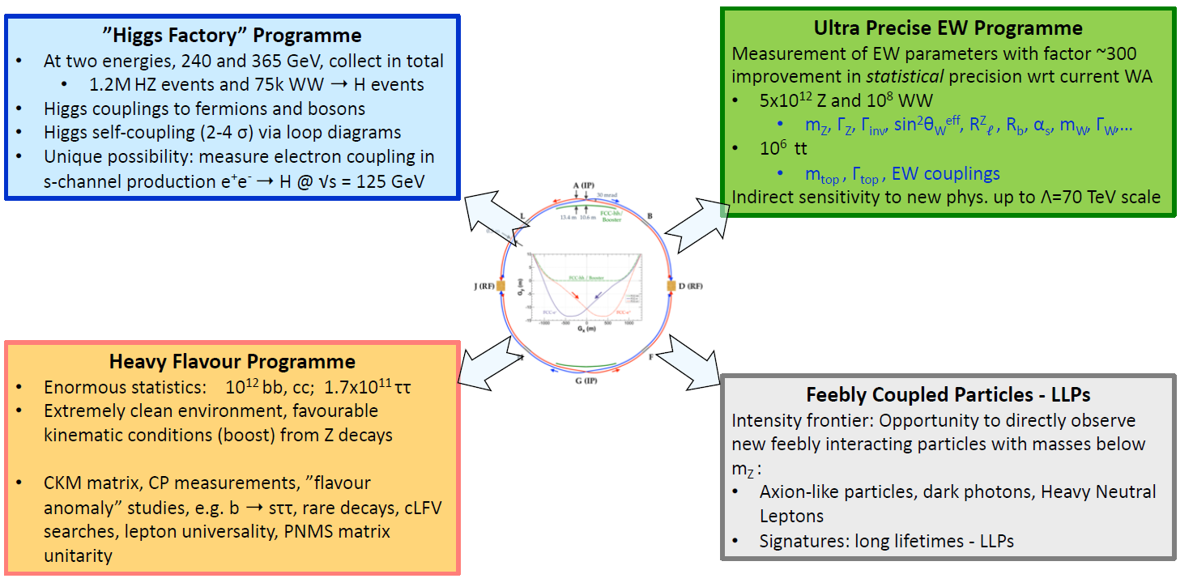
FCC-ee physics programme
M. Dam ECFA R&D road map input
https://indico.cern.ch/event/994685/
& QCD
A .Blondel,
FCC Week 2021

Slide 8
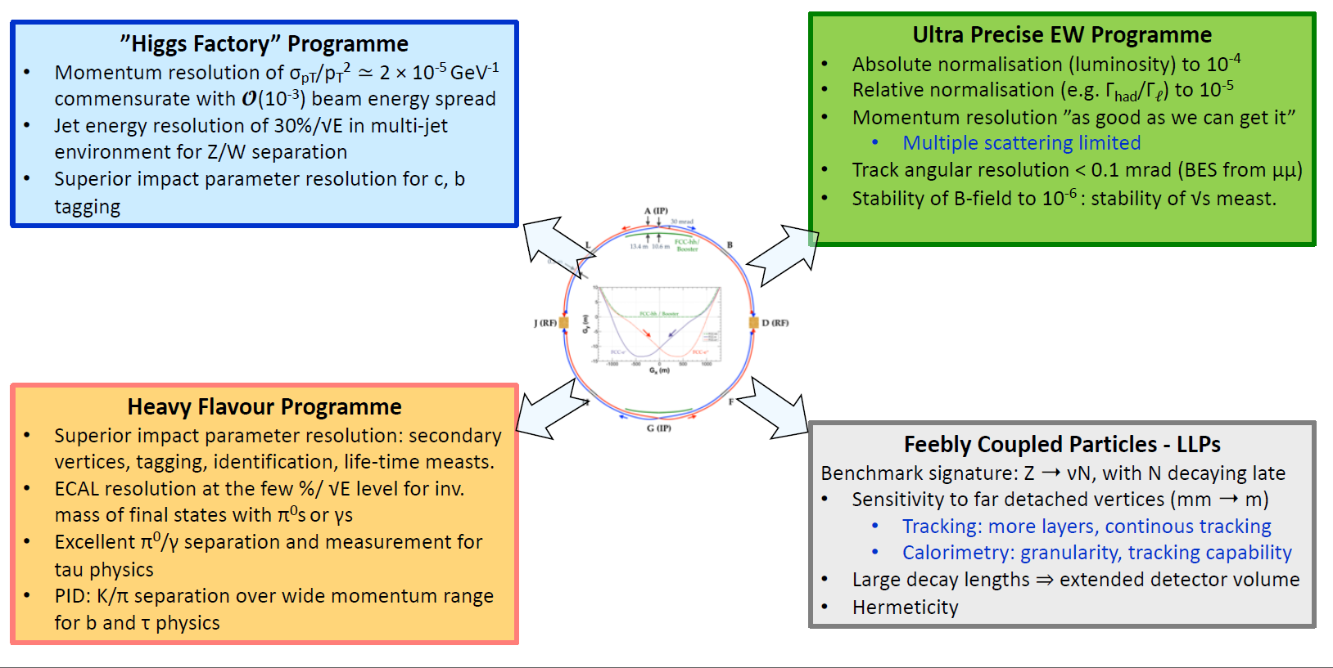
Detector requirements (present status)
M. Dam ECFA R&D road map input
https://indico.cern.ch/event/994685/
A .Blondel,
FCC Week 2021

Slide 9
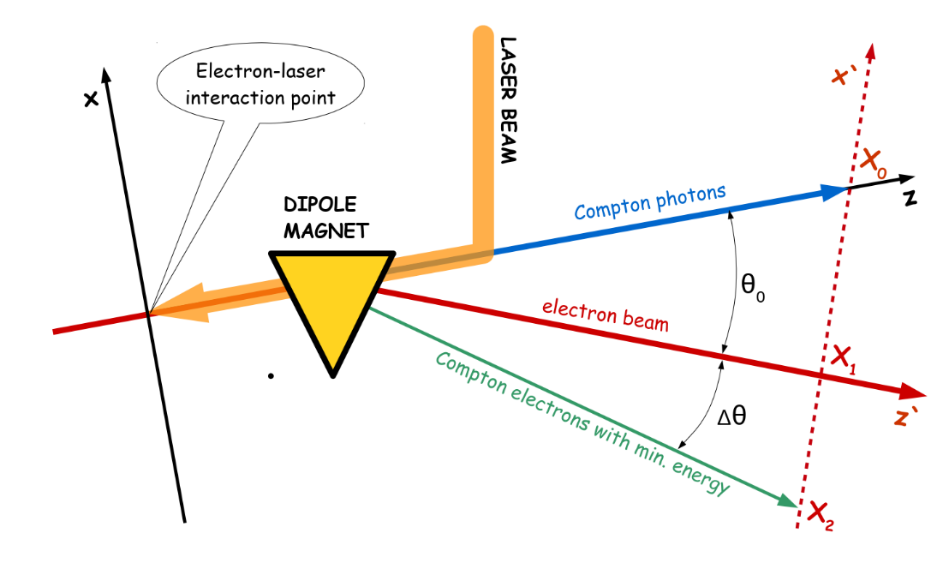
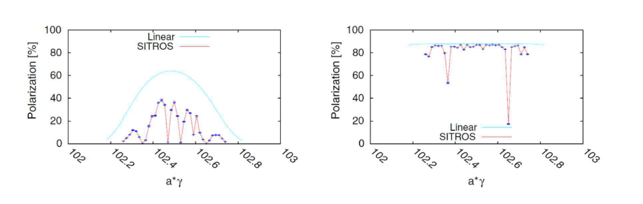
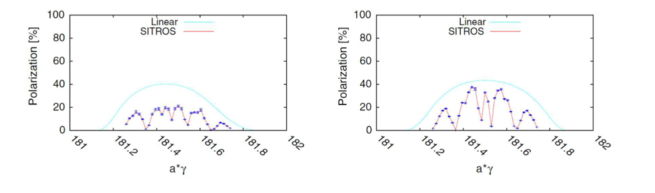
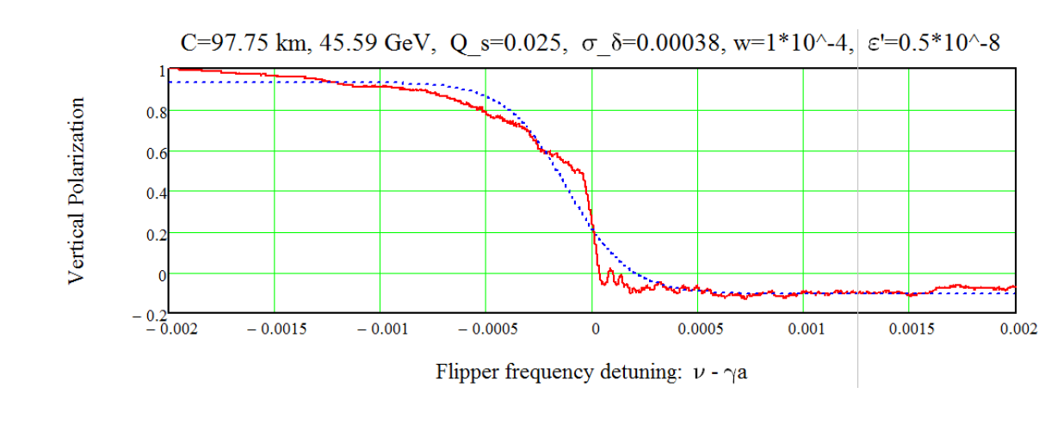
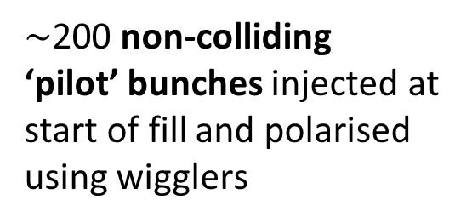
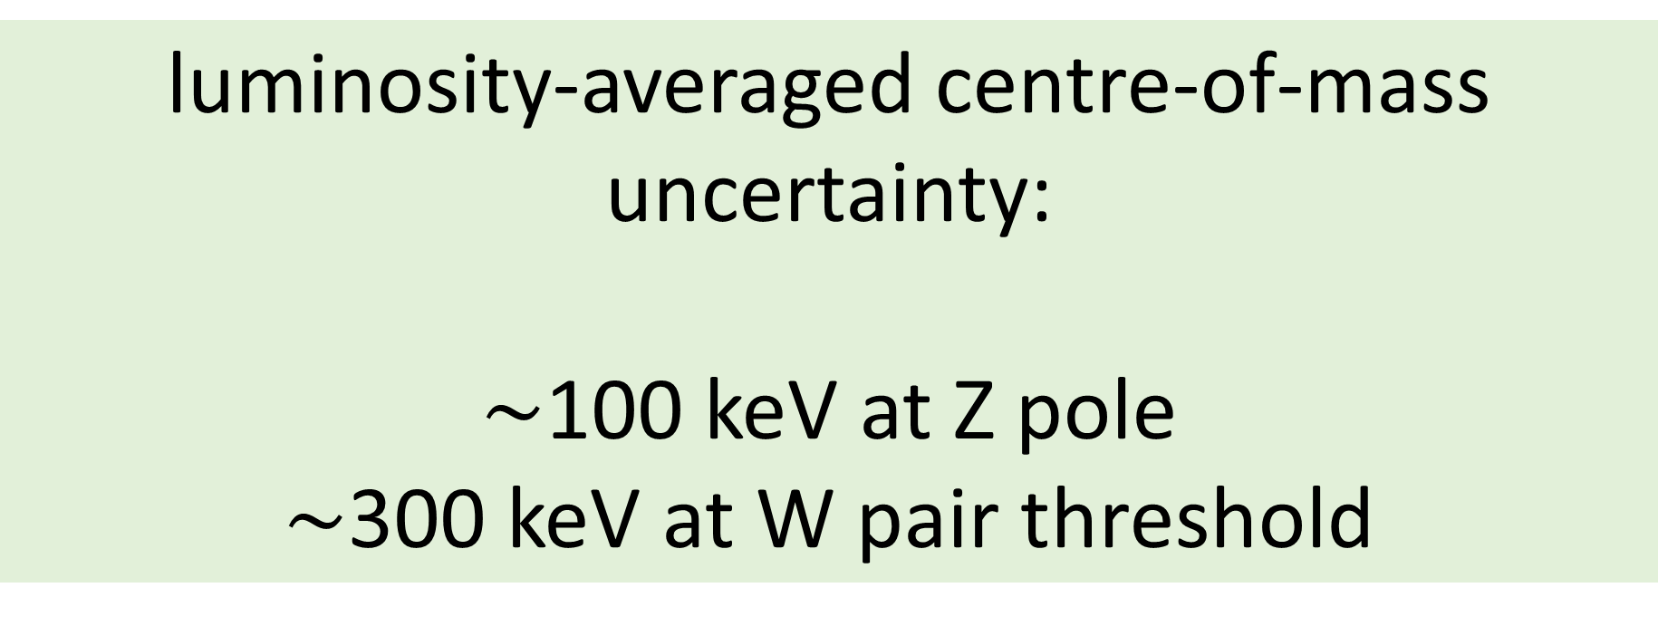
precise energy calibration by res. depolarisation
Z pole with polarisation wigglers
E. Gianfelice-Wendt, Investigation of beam self-polarization in the future e⁺e⁻ circular collider, Phys. Rev. Accel. Beams 19, 101005 (2016).
orbit correction
+ harmonic bumps
Z pole: 8 asymmetric wigglers per beam lower the polarisation rise time to 12 hours allowing a level of 10% (5%) beam polarisation, sufficient for the energy calibration by RDP, to be obtained in 90 (45) minutes.
W pair threshold: spontaneous polarisation with a rise-time of around 10 hours without wigglers.
for Z and W: precise energy calibration at 10⁻⁶ level
WW threshold
RF located in one point ! Largest remaining systematic error:
vertical closed-orbit distortions - at the Z, 300 μm error will induce a possible systematic shift of around 45 keV.
orbit correction
+ harmonic bumps
N. Muchnoi, arXiv:1803.09595 (2018).
$\sim$200 non-colliding
‘pilot’ bunches injected at start of fill and polarised using wigglers
luminosity-averaged centre-of-mass uncertainty:
$\sim$100 keV at Z pole
$\sim$300 keV at W pair threshold
simulated frequency sweep with depolariser
depolarisation
technique used at LEP
A. Blondel, P. Janot, J. Wenninger et al.

Slide 10
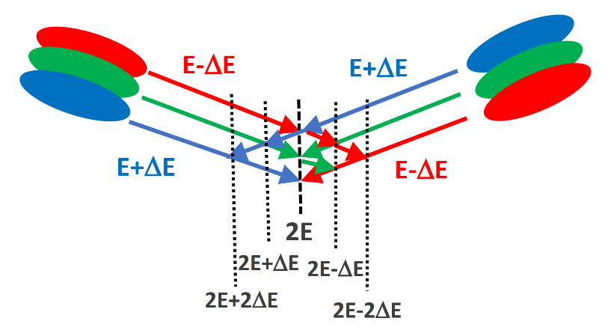
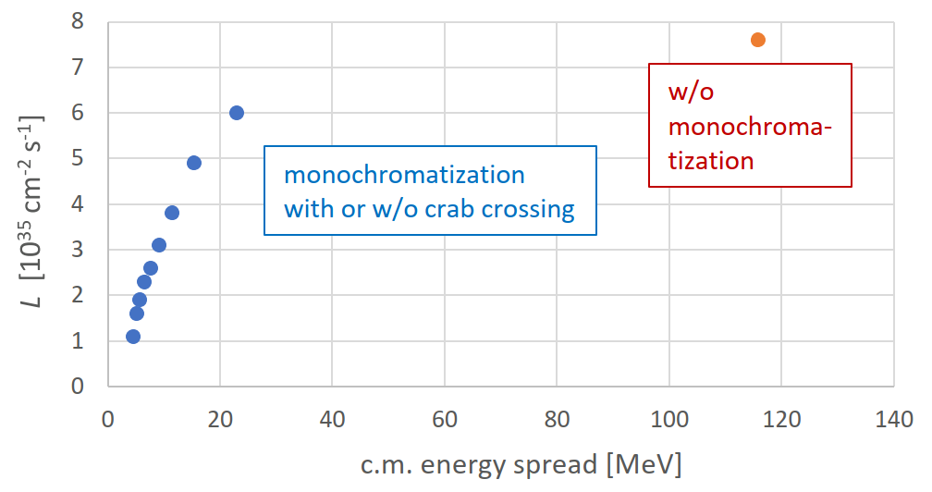
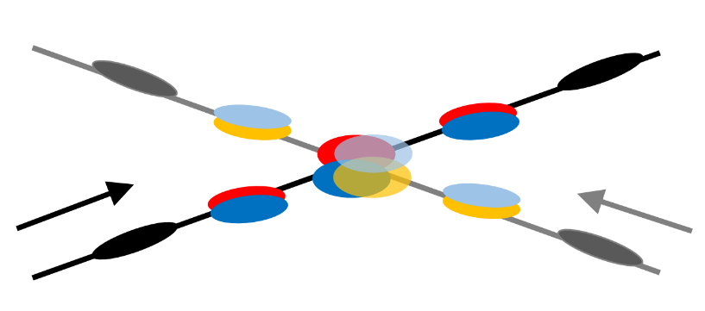
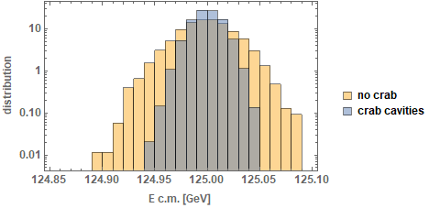
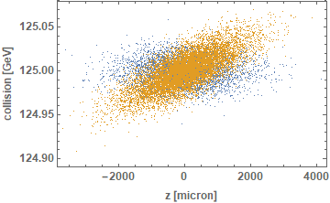
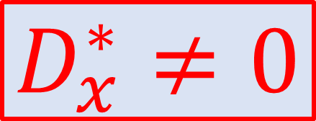
monochromatized direct Higgs production at
125 GeV c.m. to measure e⁻ Yukawa coupling ?
$$D_{x}^{∗}≠0$$
M.A. Valdivia Garcia, A. Faus-Golfe, A. Blondel, F. Zimmermann et al.
w crab cavities
w/o crab cavities
“The challenge of monochromatization”, EPJ+. 2021
including beamstrahlung
integrated resonance scan
a few times higher Higgs production rate thanks to monochromatization
possibly the only available approach to measure the electron Yukawa coupling !

Slide 11
ESPP Update 2020 “High-priority future initiatives”
      An electron-positron Higgs factory is the highest-priority next collider. For the longer term, the European particle physics community has the ambition to operate a proton-proton collider at the highest achievable energy.
      “Europe, together with its international partners, should investigate the technical and financial feasibility of a future hadron collider at CERN with a centre-of-mass energy of at least 100 TeV and with an electron-positron Higgs and electroweak factory as a possible first stage.
      Such a feasibility study of the colliders and related infrastructure should be established as a global endeavour and be completed on the timescale of the next Strategy update..”
→ launch of Future Circular Collider Feasibility Study in summer 2021

Slide 12
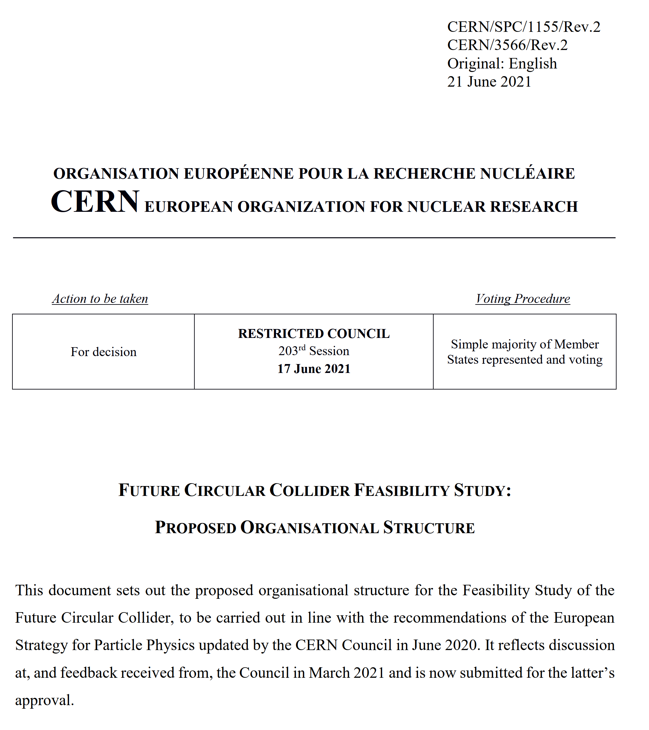
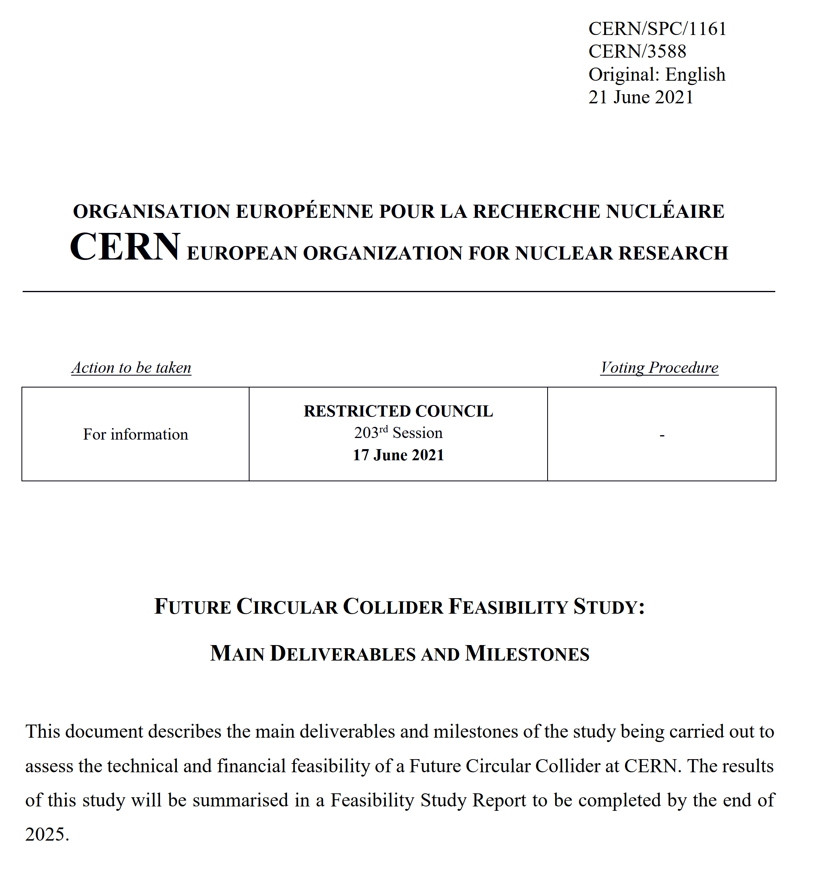
FCC FS Council Documents, June ‘21
Organisational Structure of the FCC Feasibility Study
http://cds.cern.ch/record/2774006/files/English.pdf
Main Deliverables and Timeline of the FCC Feasibility Study
http://cds.cern.ch/record/2774007/files/English.pdf

Slide 13
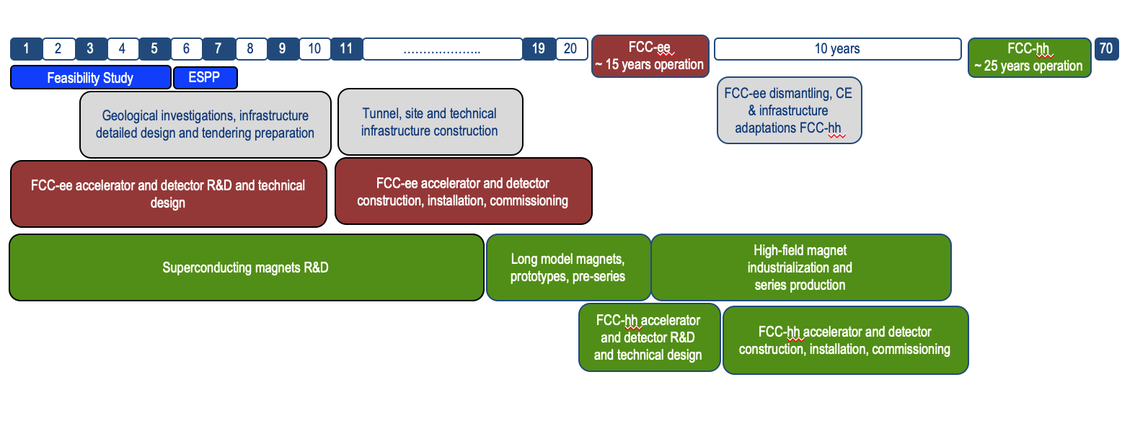
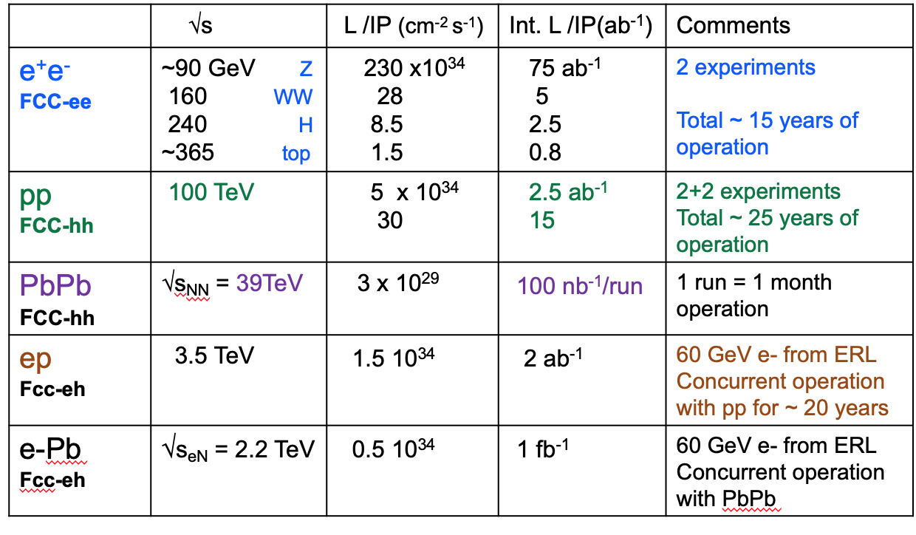
Timeline of the FCC integrated programme
Technical
schedule
2-4 experiments
20-30
Feasibility Study: 2021-2025
If project approved before end of
decade → construction can start
beginning 2030s
FCC-ee operation ~2045-2060
FCC-hh operation 2070-2090++
F. Gianotti

Slide 14
FCC Feasibility Study (2021-205): high-level objectives
demonstration of the geological, technical, environmental and administrative feasibility of the tunnel and surface areas and optimisation of placement and layout of the ring and related infrastructure;
pursuit, together with the Host States, of the preparatory administrative processes required for a potential project approval to identify and remove any showstopper;
optimisation of the design of the colliders and their injector chains, supported by R&D to develop the needed key technologies;
elaboration of a sustainable operational model for the colliders and experiments in terms of human and financial resource needs, as well as environmental aspects and energy efficiency;
development of a consolidated cost estimate, as well as the funding and organisational models needed to enable the project’s technical design completion, implementation and operation;
identification of substantial resources from outside CERN’s budget for the implementation of the first stage of a possible future project (tunnel and FCC-ee);
consolidation of the physics case and detector concepts for both colliders.
Results will be summarised in a Feasibility Study Report to be released at end 2025
F. Gianotti

Slide 15
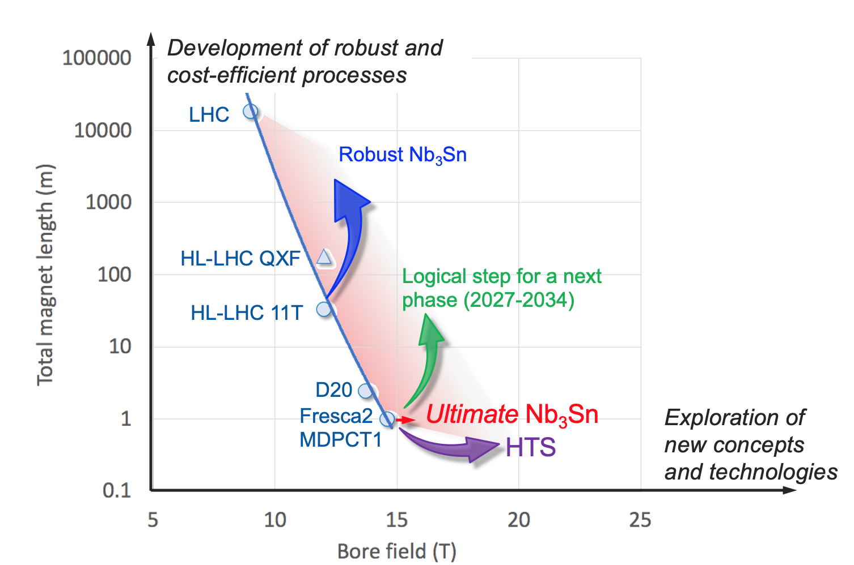
High-field magnets R&D: 1st steps towards FCC-hh
In parallel to FCC studies, HFM development program as long-term separate R&D project
CERN budget for high-field magnets doubled in 2020 Medium-Term Plan (~ 200 MCHF over ten years)
Main R&D activities:
materials: goal is ~16 T for Nb₃Sn, at least ~20 T for HTS inserts
magnet technology: engineering, mechanical robustness, insulating materials, field quality
production of models and prototypes: to demonstrate material, design and engineering choices,
industrialisation and costs
infrastructure and test stations: for tests up to ~ 20 T and 20-50 kA
Detailed deliverables and timescale being defined through Accelerator R&D roadmap under development
L. Bottura, F. Gianotti

Slide 16
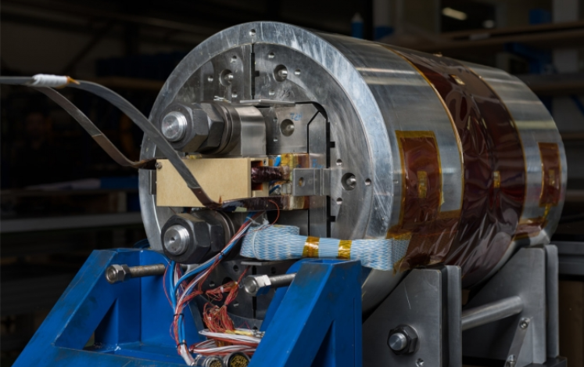
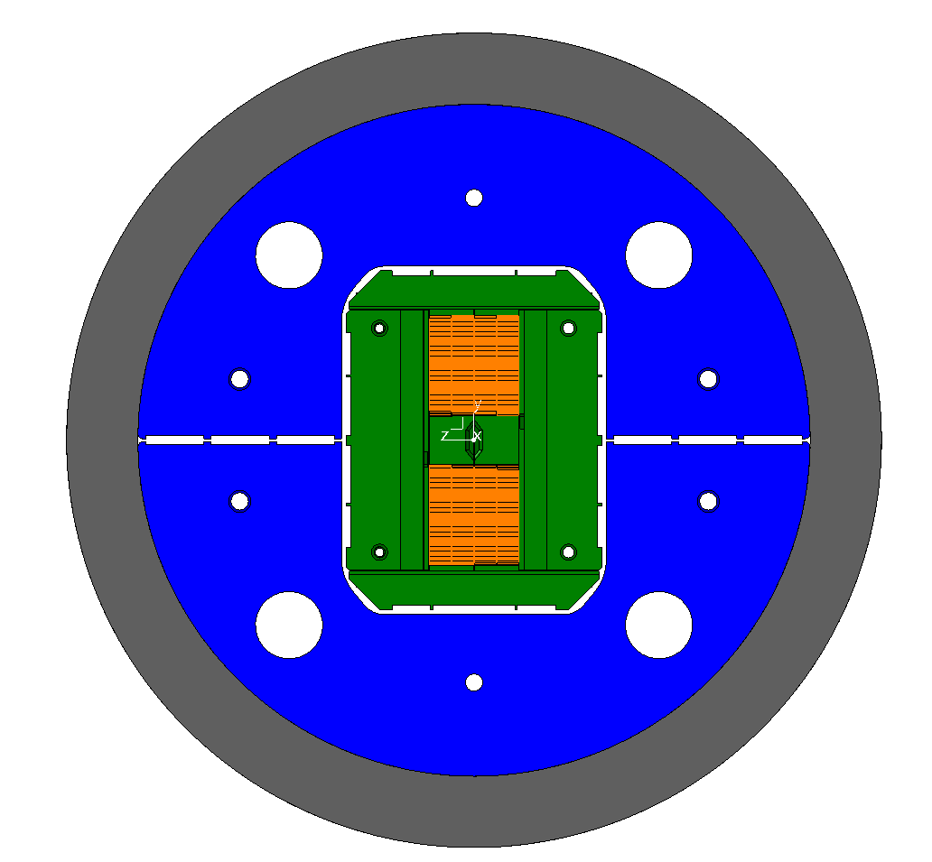
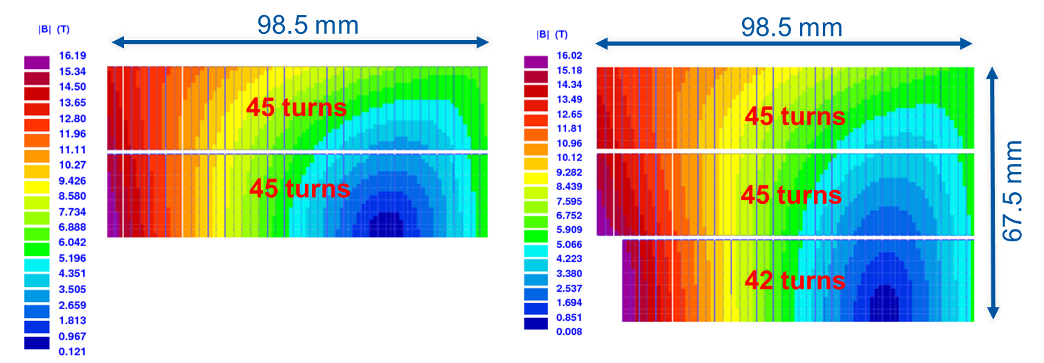
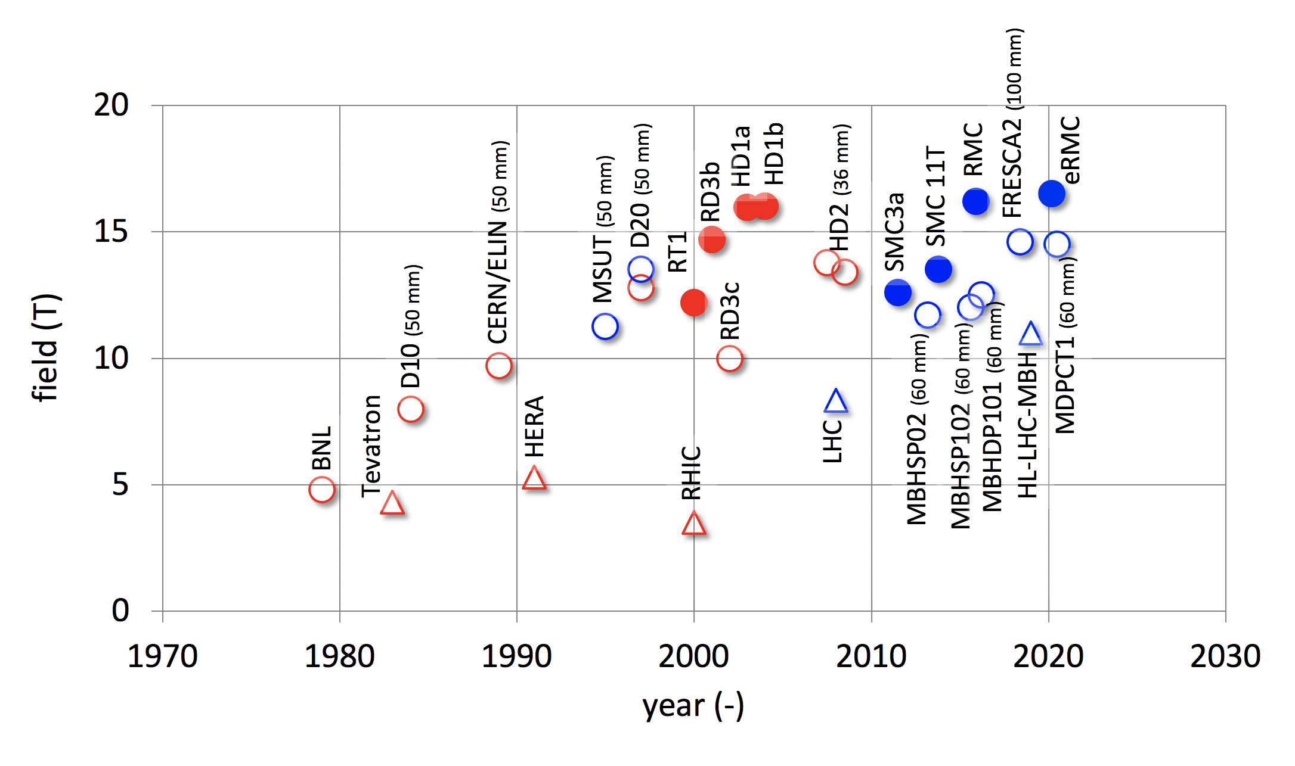
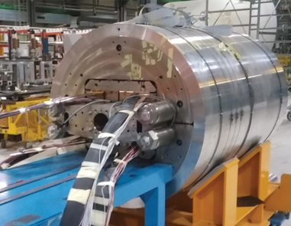
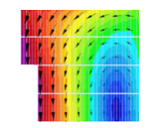
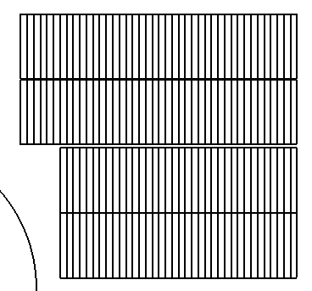
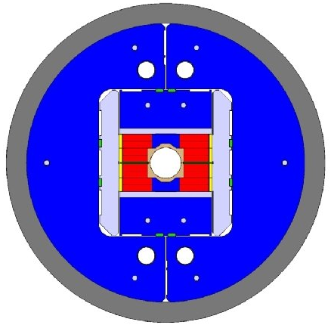
CERN Nb₃Sn progress: FRESCA2 & eRMC
RMC/eRMC (2-decks, no aperture), 16.5 T
Block dipoles
Luca Bottura
FRESCA2 (4-decks, 100 mm), 14.6 T

Slide 17



Feasibility Study Timeline
2021 |  |  |  | 2022 |  |  |  | 2023 |  |  |  | 2024 |  |  |  | 2025
Q1 | Q2 | Q3 | Q4 | Q1 | Q2 | Q3 | Q4 | Q1 | Q2 | Q3 | Q4 | Q1 | Q2 | Q3 | Q4 | Q1 | Q2 | Q3 | Q4
CDR baseline design adaptations for
new implementation scenario
Status reports &
study planning ,
FCC Week & Review : implementation, baseline design, organisation, communication
high-risk areas site investigations, environmental evaluation & impact study with host states
FCCW & mid-term review:
general coherency, CDR cost update
detailed design towards CDR
FCC Week & Review: key technology R&D programs
FS Report
Release FSR
Project cost update

Slide 18
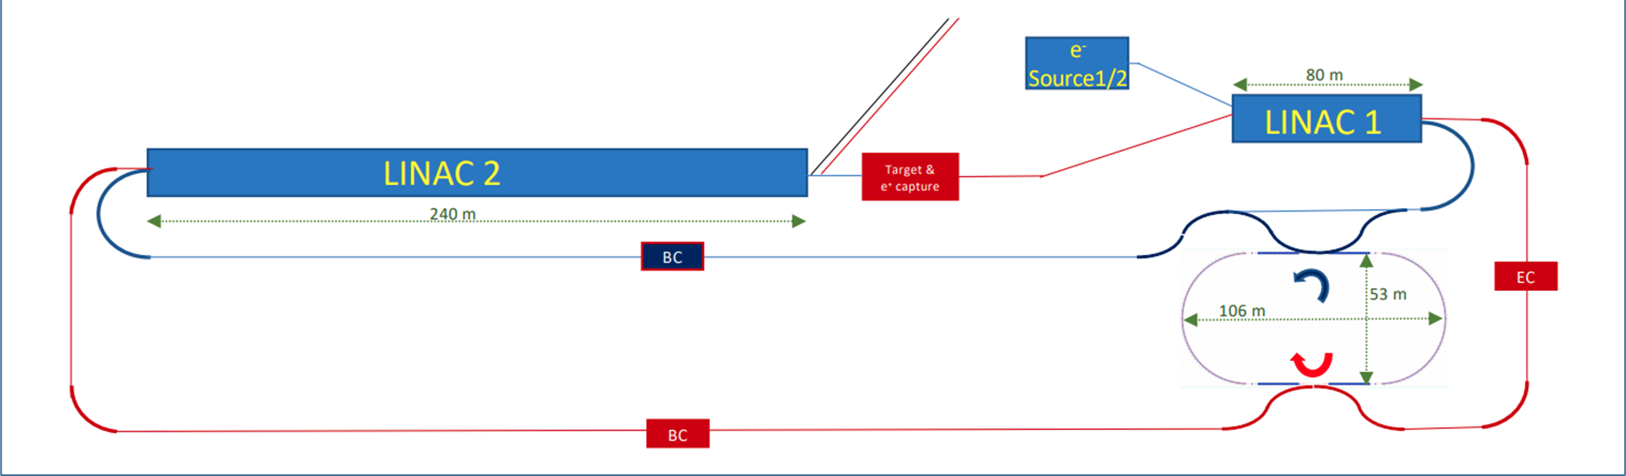
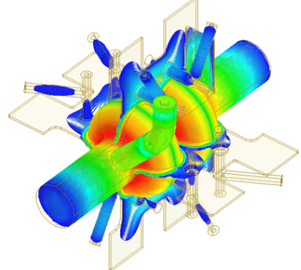
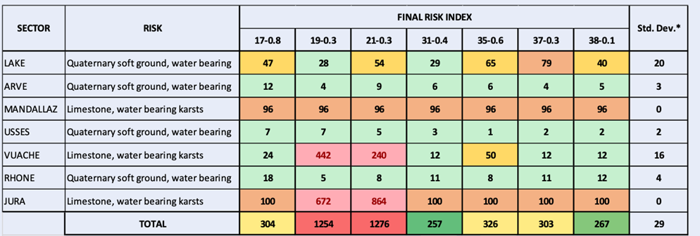
2021: technical reviews on injector, RF, & placement
SRF:
study alternative RF frequency of 600 or 650 MHz (synergies with EIC, JLEIC, PIP-II, CEPC); explore heavily damped cavity concept with slotted waveguides as option for all energies.
FCC-ee injector: new layout (single energy in linac, higher e+ prod. energy) ; linac extension ~20 GeV
Placement:
minimizing the risk → new baseline layout, C=91.1 km;
full 4-superperiodicity & symmetry, compatible with 2 or 4 IPs for FCC-ee

Slide 19
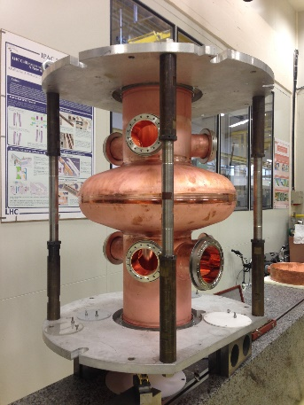
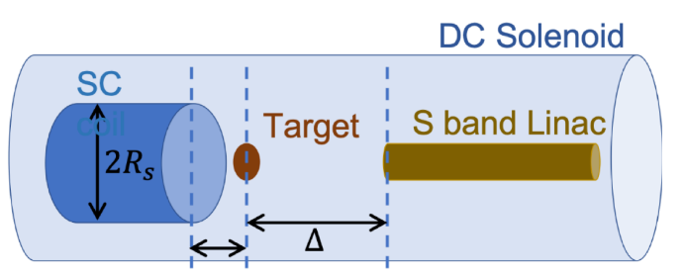
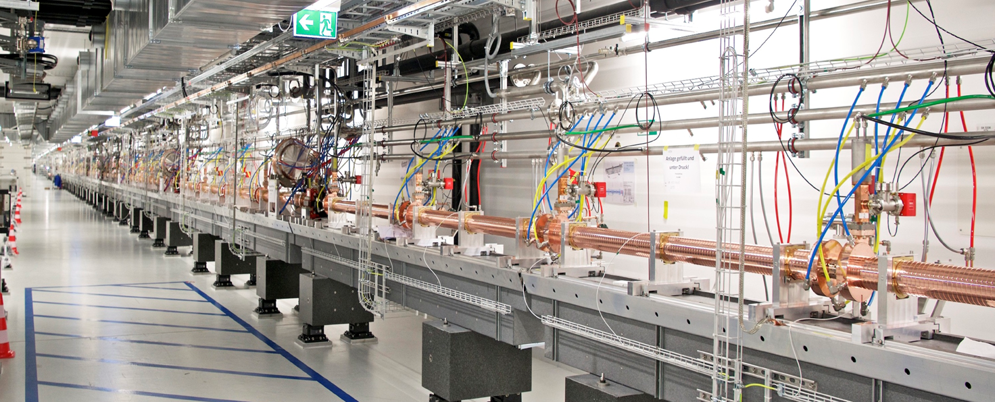
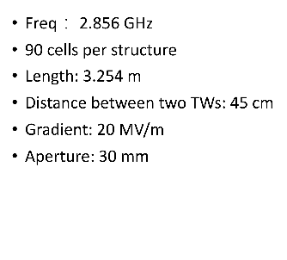
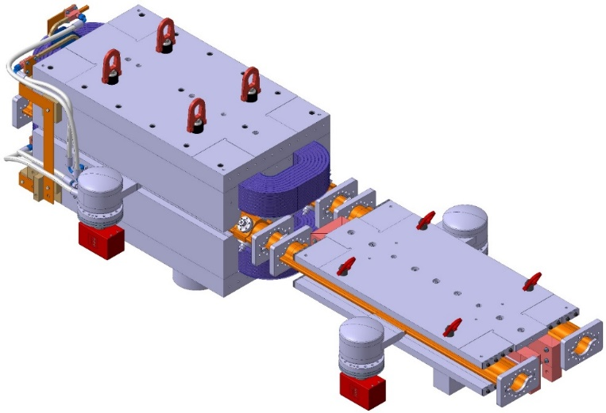
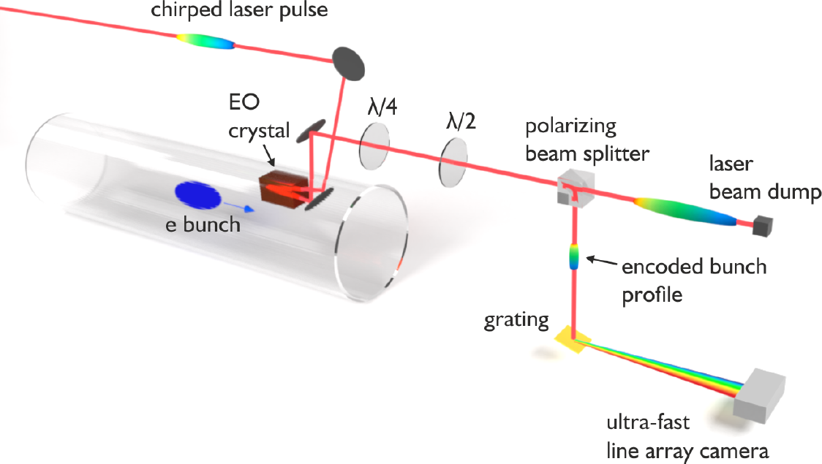
planned FCC-ee prototypes by 2025
400 MHz SRF cryomodule,
+ prototype multi-cell cavities for FCC ZH operation
High-efficiency RF power sources
high-yield positron source
target with DC SC solenoid or flux concentrator
positron capture linac
large aperture S-band linac
beam test of e⁺ source & capture linac at SwissFEL – yield measurement
P. Craievich, H. Braun,
A. Grudiev, I. Chaikovska
SwissFEL linac
strong support from Switzerland via CHART II program 2019 – 2024 for FCC-ee injector, HFM, beam optics, geology and geodesy
FCC-ee arc half-cell mock up
including girder, vacuum system with antechamber + pumps, dipole, quadrupole + sext. magnets, BPMs, cooling + alignment systems, technical infrastructure interfaces.
key beam diagnostics
bunch-by-bunch turn-by-turn longitudinal charge density profiles based on electro-optical spectral decoding (beam tests at KIT/KARA)

Slide 20
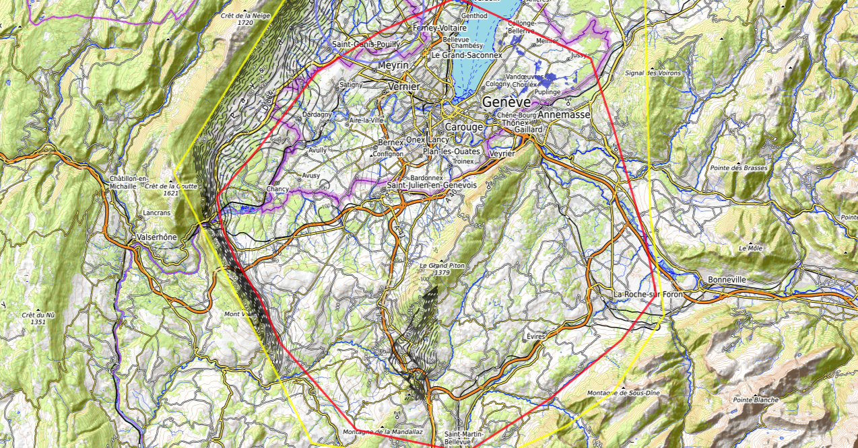
Constraints
Placements studies (i)
J. Gutleber, V. Mertens
Discouraged due
to likely oppositions
Densely urbanized
and agriculture/nature
Strict landscape protection
and re-naturalization areas
Jura limestone
Protected forest
Densely urbanized
and emerging areas
Densely urbanized
Clustered residential
areas and farm areas
Terrain difficult to
access and water
reservoirs
Known water reservoirs and
protected nature in CH
(legal + technical reasons)
Water protection and
natural zones without
developed access
Densely urbanized
and emerging areas
(some spots possible)
Water protection zones,
landscape protection zones,
altitudes
High mountains (900 m)
north of Fillière river valley
Vuache limestone
and faults
Likely major opposition:
local urbanistic planning
for traffic calming &
nature protection
High altitudes
Densely populated

Slide 21
Placements studies (ii)
J. Gutleber, V. Mertens
CERN Prevessin
SPS BA4
LHC Pt8 area
GE public plot in Bellevue
GE public plot in Pallanterie
Target areas
GE public plot in Présinge
Challex area south of D884
Permit north of D884, east of
water bearing layer zone.
Permit entering swiss territory
conntected by access tunnel
CERN
Meyrin site
Selected plots south of
Cranves-Salves
Selected plots south of
Bonne
West of A40 at Arve
Charvonnex, Villy
Between A41,
railroad and
route d’Annecy.
South of A410
Some plots in Contamine
sur Arve
Vulbens south of water
Protection zone until A40
North & south of
A410 at selected
Places to be
analysed
individually
Some plots in Arenthon
North of Roche-s.-Foron,
industrial area and Etaux
Dingy north up to A40,
except water protection
zones
700 m altitude line at
Roche-s.-Foron railroard
Minzier area outside
forests, which are
Inaccessible on mountains
One 3 ha unprotected location
at D2 in Fillière valley
North-east of
Choisy
North of Ollières, few selected locations

Slide 22

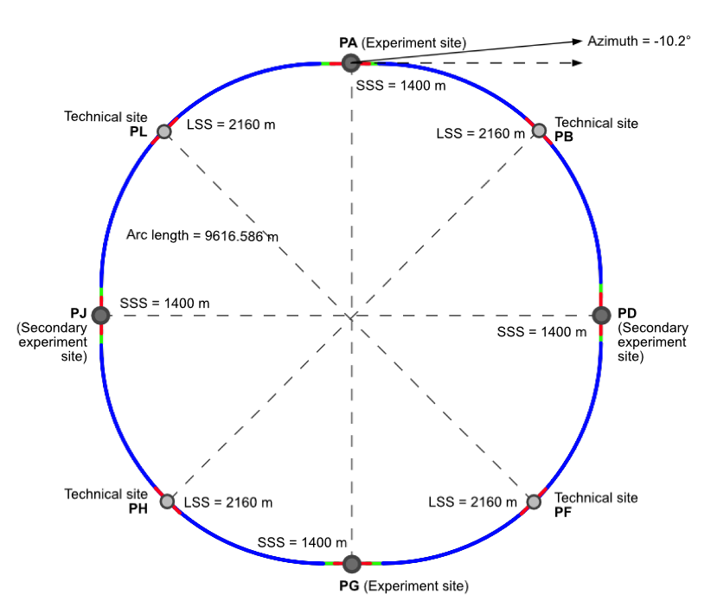
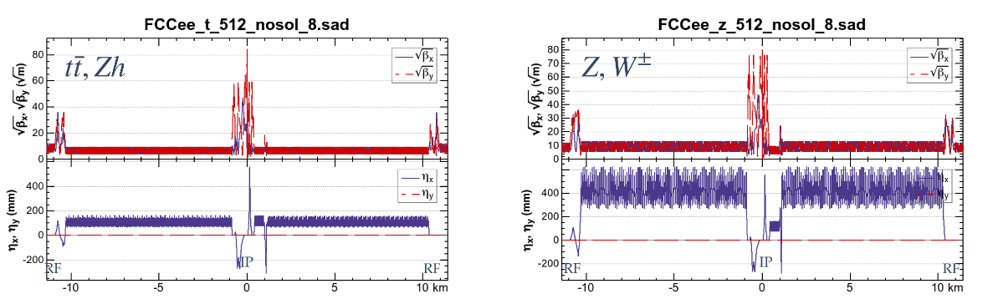
New accelerator layout
8 surface sites
4-fold symmetry
and
4-fold superperiodicity
FCC-ee 2 or 4 Ips
FCC-hh 4 IPs
FCC-ee beam optics for ¼ ring
K. Oide

Slide 23
Plans for on-site activities
1) Surface sites
Visual inspections (non-invasive) as basis for site layout planning and preparation of on site activities (2022).
Initial state analysis (non-invasive) as first step of environmental evaluation process (2022 - 24).
2) Zones for high-risk area geological investigations
Visual inspections (non-invasive) for detailed planning of site investigations (2022).
Environmental impact studies (non-invasive), restricted to site investigations (2022 - 23).
High-risk area investigations (invasive), drillings and seismic investigations (2023 - 25)
3) Surface geodetic reference network
Visual inspections (non-invasive) to identify optimum placement of network pillars (2022).
Installation of network pillars (invasive), restricted to site investigations (2023 - 25).

Slide 24

Plans for high-risk area site investigations
  Jura, Vuache (3 Areas)
  Top of limestone
  Karstification and filling-in at the tunnel depth
  Water pressure
  Lake, Rhône, Arve and Usses Valley (4 Areas)
  Top of the molasse
  Quaternary soft grounds, water bearing layers
  Mandallaz (1 Areas)
  Water pressure at the tunnel level
  Karstification
  Bornes (1 Area)
  High overburden molasse properties
  Thrust zones
  Site investigations planned for mid 2023 – mid 2025:
  ~40-50 drillings, 100 km of seismic lines

Slide 25

3D geological model (i)
  Update of the Molasse database and grid
  New grid generated using >4000 shallow boreholes from Swiss and French public geological database
  data reliability estimates added to the database
  CHART collaboration with University Geneva
Molasse grid
Data points
Deep well
PA 3.1 - 10

Slide 26


3D geological model (ii)
  Update of the Top limestone grid
  Grid updated based on existing faults and seismic interpretation with state-of-the-art gridding algorithms
  Velocity model re-calculated and optimized for the Top Limestone (time to depth conversion of seismic interpretations)
  Seismic and faults re-interpretation including recently acquired seismic data within Geneva Canton
Top Limestone grid
Faults
Deep well
PA 3.1 - 10
Molasse
Key seismic lines re-processing to enhance the visibility of shallow boundaries (Molasse and Top Limestone)
Top Limestone
Seismic line example (18SIG-003)

Slide 27


Geodesy Surface Reference Network
Surface geodetic network needs to be spatially extended
Realization of a coordinate reference frame (CTRF) for georeferencing of site investigation data and as basis for all geospatial works using global navigation satellite system (GNSS) and surveying instruments
GNSS-based monitoring of the geokinematic surface deformations (assure stable main geodetic points, quantify differential displacements which may affect later alignment)
EUREF surface velocity field
(differential displacements)
Faults
(potential discontinuities of displacements)
CTRF uses existing surface points and
8 pillars in vicinity of access shafts, 1 point near centroid
Geomonitoring requires early on
11 network points near faults and tunnel
CHART collaboration with ETH Zürich
Notes:
Two plots on the left: show horizontal and vertical yearly displacement rates. Red vectors = resulting from long term GNSS measurements, data provided by European Reference Frame Velocity Working Group. BLUE vectors = interpolation, but likely not correct because of geological situation (e.g. faults, see 3rd picture). Discontinuities of displacement vector field to be expected. There could be differences of several tenths of mm / year – need to know the displacement rates when tunneling starts and need to know for planning alignment facility details => monitoring required
Plot on the right: red points: proposed new network points to be established soon after site investigation and to be monitored geodetically (campaigns, some points equipped continuously with GNSS receivers) during the feasibility study, possibly even longer. Green points: existing stations (continuously operating GNSS stations) whose GNSS data will be used jointly with data from the red stations.

Slide 28

Mining the Future competition (i)
‘J. Gutleber
Construction of the FCC underground infrastructure would lead to about 9 million m³ of excavated materials, mainly molasse.
The Mining the Future contest organised by the Montanuniversität Leoben and CERN, with the support of the EU-funded H2020 FCCIS project, aims at identifying sustainable reuse solutions for these excavated materials.
Invitation to submit proposals for molasse reuse with TRL 3. Selection of best proposals and invitation to develop towards TRL 4 in competition with ultimate goal of TRL 9 by 2030.
Total duration April 2021 – October 2022.

Slide 29
Mining the Future competition (ii)
‘J. Gutleber
1st phase closed on 31 October 2021: 12 proposals from key players in excavation projects as well as new startup and research institutes, all centered along the Alps (previous experience with similar geology)
An international jury of 9 experts is screening the proposals in view of the second phase
During December 2021, selected candidates are invited to a review and will be asked to outline their original solutions and original content.
Deadline for Phase 2 is 30 June 2022, winning proposals will be announced end July 2022.
An award ceremony in October 2022 at Zentrum am Berg (Austria) in collaboration with CERN.

Slide 30
Next steps related to implementation studies
Accelerator design
Scaling and adaptation of the CDR design (FCC-ee and FCC-hh) to the new layout.
Integration with injector complex (LHC and/or SPS tunnels)
Update of requirements on technical infrastructure for all surface points
Technical infrastructure
Update of system parameters for all surface sites
Scaling of CDR concepts to new parameters
Verification of availability and connections to services
Civil engineering and associated activities:
Adaptation of CE project to 8-site layout, taking specific surface site location into account
Update of construction concept (excavation methods, TBM lowering, etc.) and schedule

Slide 31
Support from CERN Host States
8 Nov 2021: The Préfet de la region Auvergne-Rhone-Alpes was nominated by the French Prime Minister Jean Castex as “interlocuteur unique des autorités Suisses et du CERN” to accompany CERN during the FCC Feasibility Study for all infrastructure related aspects, in concertation with Switzerland and to ensure the compliance with all relevant rules. In particular, the Prime Minister asked the Préfet to establish, by the end of the year 2021, an organization diagram for the management of his mission, as well as a calendar identifying the actions to be taken in order to respond to CERN’s requests, and to report regularly on the progress of the mission and make proposals to allow France to facilitate the execution of the feasibility study.
10 Dec 2021: The Swiss Federal Council announced that it will draw up a federal sectoral plan in order to clarify and facilitate the administrative procedures for spatial planning and to improve planning security for all CERN projects, including the FCC in the event of its implementation. The sectoral plan, which also responds to a request from the Republic and Canton of Geneva, will provide a framework for balancing the objectives of research policy, host-state policy and spatial planning policy.

Slide 32


FCC Feasibility Study - organisational structure
  New structure very similar to the first phase of the FCC Study (2014-2020), leading to the Conceptual Design Report as input to the ESPPU.
  Classical structure common to CERN projects.

Slide 33


Status of Global FCC Collaboration
Increasing international collaboration as a prerequisite for success:
links with science, research & development and high-tech industry will be essential to further advance and prepare the implementation of FCC
147
Institutes
30
Companies
34
Countries
EC
H2020

Slide 34




FCC Physics Workshop 7-11 February 22
Liverpool, UK
number of in-person participants limited to ~160 (first come -- first served)
- registration fee: 300£
- broadcast on zoom
transformed to virtual event

Slide 35

FCC Week 2022
In Paris 30 May to 3 June 2022
We are looking forward
to seeing you there or on zoom!
transformed to hybrid event

Slide 36
FCC – Status and Outlook
Following the European Strategy Update 2020, the organization structure and major milestones and deliverables for the FCC Feasibility Study (FCC FS) were approved by CERN Council in June 2021.
Main activities concern the development of a concrete implementation scenario in collaboration with host state authorities, accompanied by machine optimization, physics studies and technology R&D, performed via global collaboration and supported by the EC H2020 Design Study FCCIS, with the goal to demonstrate feasibility by 2025/26.
Studies related to preferred implementation remain focal point of FCC FS with goal to confirm the new baseline by FCC Week 2022 (June).
New Collaboration Board (guided by an Executive Committee) and Steering Committee have been established.

Slide 37
backup slides
parameters

Slide 38
FCC-ee collider parameters
K. Oide
Parameter [4 IPs, 91.2 km,T_{rev}=0.3 ms] | Z | WW | H (ZH) | ttbar
beam energy [GeV] | 45 | 80 | 120 | 182.5
beam current [mA] | 1400 | 135 | 26.7 | 5.0
number bunches/beam | 8800 | 1120 | 336 | 42
bunch intensity [10¹¹] | 2.76 | 2.29 | 1.51 | 2.26
SR energy loss / turn [GeV] | 0.0391 | 0.37 | 1.869 | 10.0
total RF voltage 400/800 MHz [GV] | 0.120/0 | 1.0/0 | 2.48/0 | 4.0/7.67
long. damping time [turns] | 1170 | 216 | 64.5 | 18.5
horizontal beta* [m] | 0.15 | 0.2 | 0.3 | 1
vertical beta* [mm] | 0.8 | 1 | 1 | 1.6
horizontal geometric emittance [nm] | 0.71 | 2.17 | 0.64 | 1.49
vertical geom. emittance [pm] | 1.42 | 4.34 | 1.29 | 2.98
horizontal rms IP spot size [μm] | 10 | 21 | 14 | 39
vertical rms IP spot size [nm] | 34 | 66 | 36 | 69
beam-beam parameter ξ_{x} / ξ_{y} | 0.004/ .159 | 0.011/0.111 | 0.0187/0.129 | 0.096/0.138
rms bunch length with SR / BS [mm] | 4.32 / 15.2 | 3.55 / 7.02 | 2.5 / 4.45 | 1.67 / 2.54
luminosity per IP [10³⁴ cm⁻²s⁻¹] | 181 | 17.3 | 7.2 | 1.25
total integrated luminosity / year [ab⁻¹/yr] | 86 | 8 | 3.4 | 0.6
beam lifetime rad Bhabha / BS [min] | 19 / ? | 20 / ? | 10 / 19 | 12 / 46
preliminary – example parameters
for present layout & with 4 IPs

Slide 39
FCC-hh (pp) collider parameters
parameter | FCC-hh |  | HL-LHC | LHC
collision energy cms [TeV] | 100 |  | 14 | 14
dipole field [T] | 16 |  | 8.33 | 8.33
circumference [km] | 97.75 |  | 26.7 | 26.7
beam current [A] | 0.5 |  | 1.1 | 0.58
bunch intensity [10¹¹] | 1 | 1 | 2.2 | 1.15
bunch spacing [ns] | 25 | 25 | 25 | 25
synchr. rad. power / ring [kW] | 2400 |  | 7.3 | 3.6
SR power / length [W/m/ap.] | 28.4 |  | 0.33 | 0.17
long. emit. damping time [h] | 0.54 |  | 12.9 | 12.9
beta* [m] | 1.1 | 0.3 | 0.15 (min.) | 0.55
normalized emittance [mm] | 2.2 |  | 2.5 | 3.75
peak luminosity [10³⁴ cm⁻²s⁻¹] | 5 | 30 | 5 (lev.) | 1
events/bunch crossing | 170 | 1000 | 132 | 27
stored energy/beam [GJ] | 8.4 |  | 0.7 | 0.36

