Slide 1



Plasma Colliders
Carl Schroeder
BELLA Center, Berkeley Lab
HKUST IAS Program on High Energy Physics:
Mini-Workshop on Accelerator - Key Beam Physics and Technologies Issues for Colliders
Friday, 14 January 2022
Work supported by the U.S. DOE, Office of Science, Office of High Energy Physics, under Contract No. DE-AC02-05CH11231

Slide 2
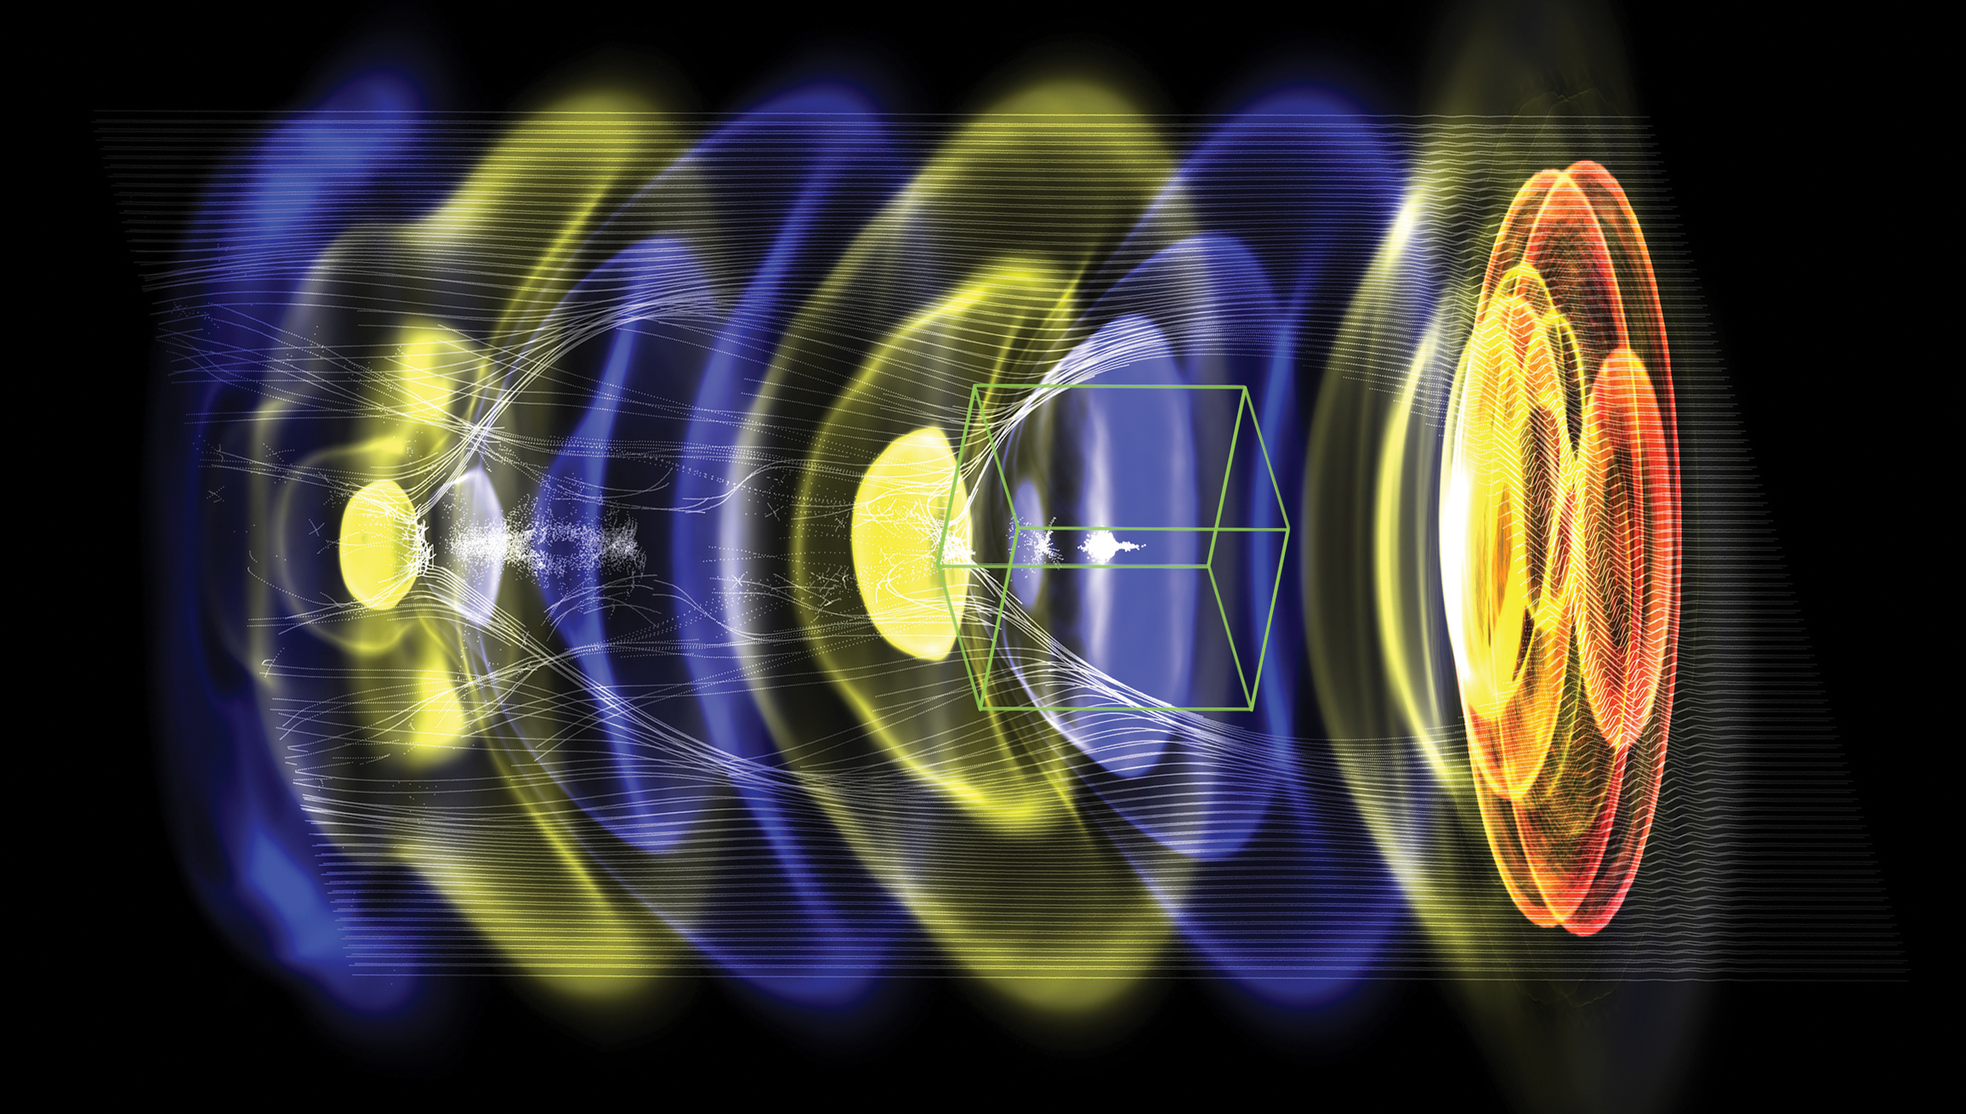
Outline
  Introduction to plasma accelerators
  Energy reach of a plasma-based collider
      Power requirements
  Experimental progress
      Laser-driven plasma accelerators
      Beam-driven plasma accelerators
      Light-source applications
  Key accelerator R&D challenges
  Laser-technology requirements and R&D
  R&D goals for next 5-10 years
WarpX
Example: a laser or particle beam (red) drives a density wave (blue to yellow) in plasma, accelerating electrons (white) with fields of order 10 GeV/m
2

Slide 3
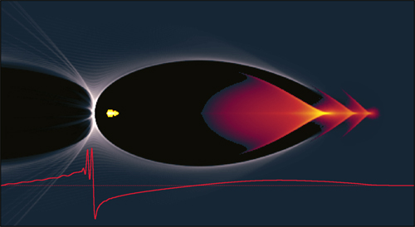
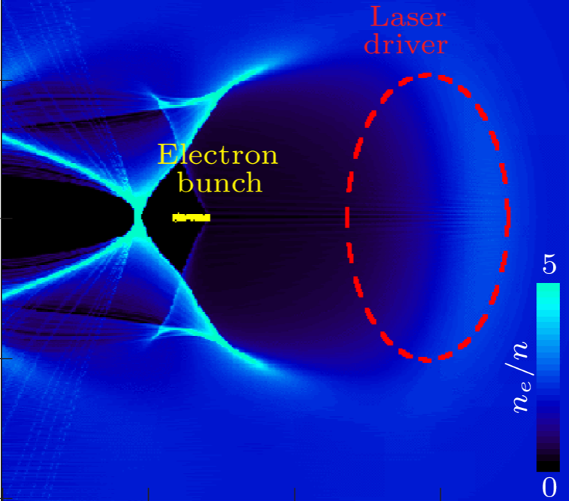
Plasma accelerators driven by intense particle beams
or lasers achieve ultra-high accelerating gradients
Plasma wave (wakefield) driven by space charge of particle beam or ponderomotive force of laser
Focusing and acceleration provided by plasma wave
Characteristic size of the electric field: (e.g., 10–100 GV/m for 10¹⁶–10¹⁹ cm⁻³)
Beam-driven plasma wakefield accelerator (PWFA):
Laser-driven plasma wakefield accelerator (LWFA):
J. Osterhoff, DESY
C. Benedetti, LBNL
particle beam
beam driver
Ultra-short bunches accelerated: 𝛔_{z} < λ_{p} (e.g., λ_{p} ~ 100um for 10¹⁷ cm⁻³)
~ plasma wavelength, λ_{p}
3

Slide 4
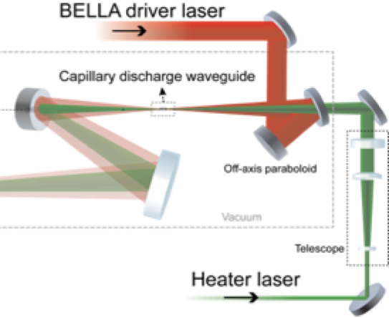
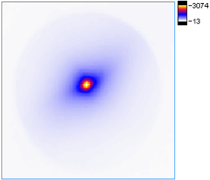
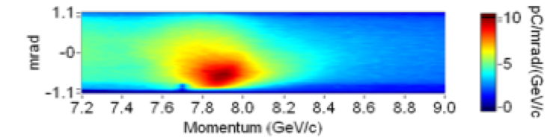
Laser-driven plasma accelerator state-of-the-art:
multi-GeV accelerator (8 GeV in 20 cm)
  Single stage multi-GeV acceleration: 8 GeV in 20 cm (40 GV/m)
A. Gonsalves et al. PRL (2019)
PW (40 J, 40 fs)
divergence:
150 mrad
Laser-heater-assisted discharge-capillary plasma waveguide
2019 (LBNL)
  Key technology: plasma channel creation for guiding at low density (3x10¹⁷ cm⁻³) – discharge capillary + laser heater
  New technologies emerging: hydrodynamic optical-field-ionized plasma channels
  1 Hz repetition rate
  Reproducibility limited by laser fluctuations (at ~100 Hz)
Energy gain (GeV) in LWFA stage
2014 (LBNL)
2013 (GIST)
2013 (TPW)
2006 (LBNL)
plasma density (x10¹⁸ cm⁻³)
4

Slide 5
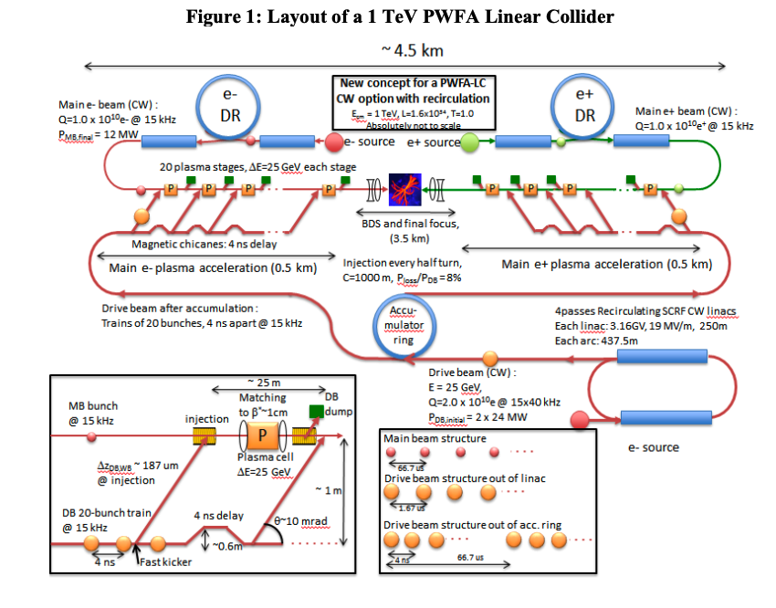
Plasma-based collider: staged plasma accelerators
with >1 GV/m geometric gradients (>TeV/km)
Preliminary designs (not conceptual design studies ) to outline a plasma collider and used to guide R&D
Beam-driven plasma accelerators (PWFA)
Laser-driven plasma accelerators (LWFA)
Leemans & Esarey Phys. Today (2009)
E. Adli et al., arXiv:1308.1145 (2013)
C. Schroeder et al., NIMA (2016)
Operating plasma density: 2x10¹⁶ cm⁻³
25 GeV/stage
Geometric gradient: 1 GV/m
Operating plasma density: 1x10¹⁷ cm⁻³
5 GeV/stage
Geometric gradient: 2.3 GV/m
5

Slide 6
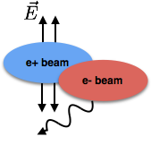
Ultra-short bunches yield power savings
Beam parameters constrained by IP interaction; beam charge limited by beamstrahlung
Future linear colliders (> 1TeV) will operate in high-field beamstrahlung regime
  Mean beam field strength in beam rest frame large compared to Schwinger field
  If local constant field approximation holds (bunch durations > rad. formation length), then average fractional energy loss:
P. Chen, K. Yokoya (1995)
In plasma accel., bunch charge and length (optimized for efficiency) not independent and depends on density choice:
Plasma accelerators operate with short bunches (~10 um)
Short beams save power:
Schroeder et al., PR ST-AB (2010)
Plasma accelerators produce short beams and short beams save power by reducing beamstrahlung
6

Slide 7
Experimental R&D: Staging of LWFAs
  Proof-of-principle staging of laser-driven plasma wakefield accelerators (LWFAs)
Compact driver coupling using a plasma mirror
Steinke et al. Nature (2016)
Plasma lens focusing of beam
  Proof-of-principle experiment demonstrate 100 MeV energy gain
    Poor capture efficiency, beam-quality preservation
  Multi-GeV (5 GeV + 5 GeV) staging experiments are planned / commissioning underway at Berkeley Lab (BELLA PW 2nd beamline)
    Goal: near-100% capture efficiency, quality preservation
7

Slide 8
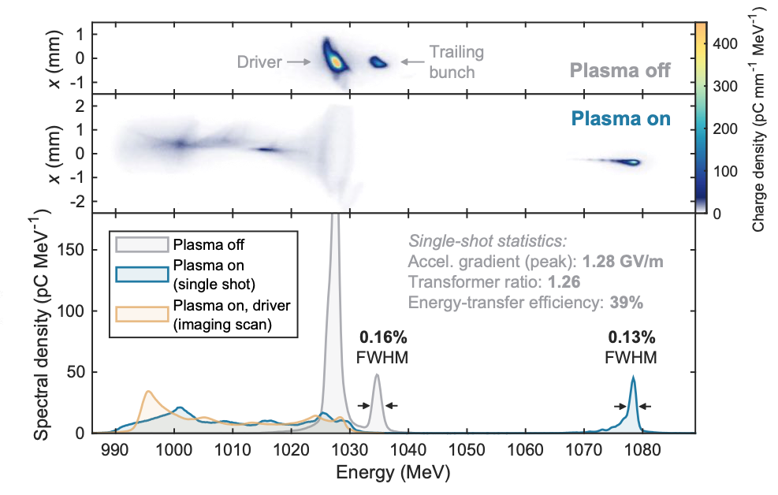
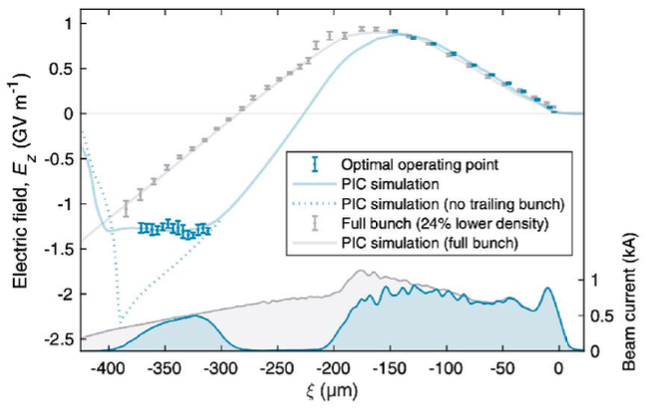
Experimental R&D:
Demonstration of optimized beam loading in PWFA
  Optimized beam loading enables uniform, efficient acceleration in beam-driven plasma wakefield accelerator (PWFA)
C. Lindstrøm et al. PRL (2021)
S. Schröder et al. Nature Comm. (2020)
  Drive & accelerated beam experiments at FlashForward, DESY (Germany)
    Beam-loading = wake of trailing beam destructively interferes with driver wake (extracting energy)
    Accelerating field flattening: energy spread ~0.2%
    Energy transfer efficiency: wake to beam = 42%
8

Slide 9
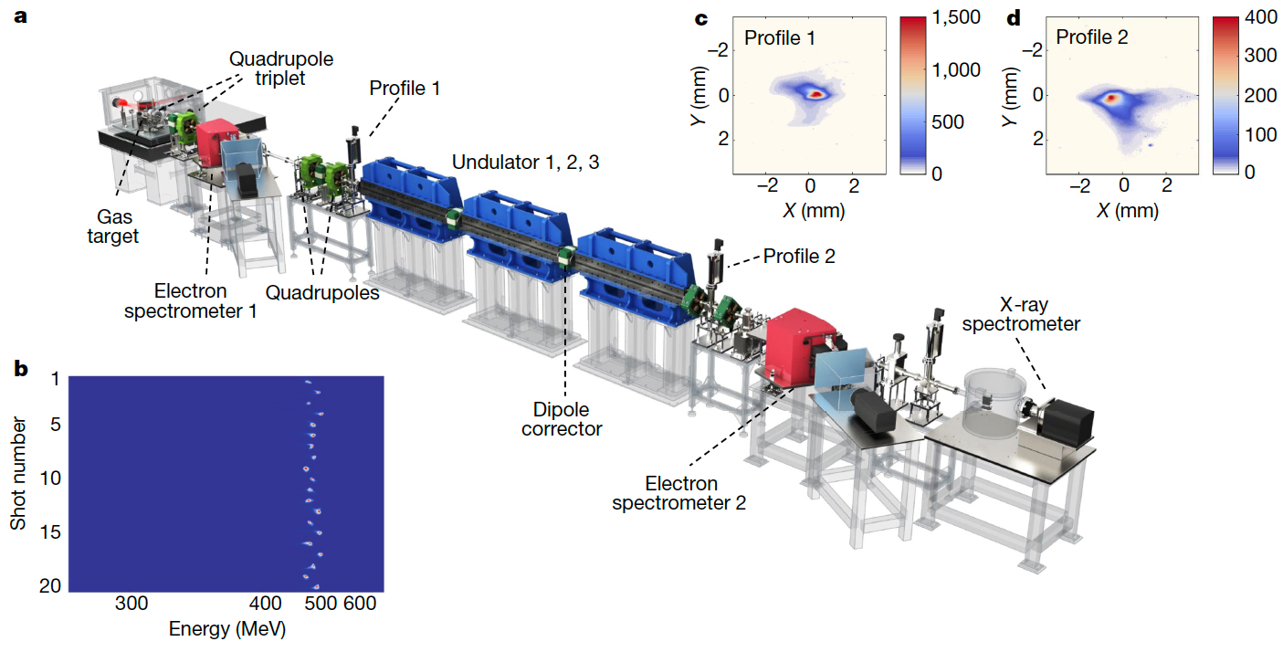
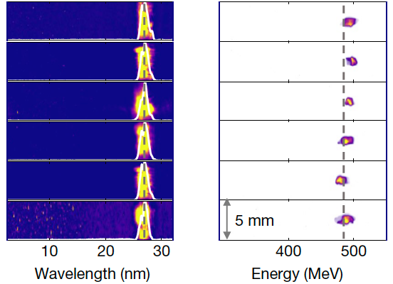
Plasma accelerator driven photon sources
  Plasma-accelerator based photon sources naturally are on the R&D path to a collider
    First lasing of FEL using laser plasma wakefield accelerator (LWFA) at 27 nm at SIOM (Shanghai, China)
Wentao Wang, Ke Feng, et al., “Free-electron lasing at 27 nanometres based on a laser wakefield accelerator” Nature 595, 516 (2021)
    LWFA: 200 TW used to generate 490 MeV e-beams
    0.5% energy spread, ~0.5 um emittance
    Radiation up to 150 nJ / pulse (100-fold gain)
    First lasing of FEL (830nm) using beam-driven plasma accelerator (PWFA) reported at SPARC_LAB (INFN, Italy)
9

Slide 10
Key R&D challenges for plasma accelerators
Beam matching/coupling between stages
  Strong focusing forces in plasma: β~ 0.01 - 0.1 m
  Finite energy spread (<1%)
Alignment
  Small structures (~10-100 um) place severe (~nm) alignment tolerances
Potential plasma-based sources of beam quality degradation
  Transverse stability in strongly beam-loaded regime
  Scattering (with background ions)
  Betatron radiation in strong plasma focusing fields
Robust e+ acceleration configuration
  Proposed configurations (hollow plasma channels, plasma columns) require experimental demos
Laser technology development
  Coherent combining of fiber lasers or Tm:YLF lasers
  kW average power systems feasible today (kHz rep rate enables laser stability)
10

Slide 11
Transverse stability – hosing leads to emittance growth
Ion motion mitigates instability growth
Strong beam loading (for efficiency) associated with transverse wakefield induced instability (hosing/BBU)
Stability to hosing/BBU achieved via BNS damping:
  Requires large (~10%) energy chirp, owing to strong beam loading
  large chirps have transport challenges
Stability also achieved with head-to-tail density variation
  Naturally created by ion motion
Lebedev et al., PR AB (2017)
Centroid displacement
Normalized emittance
Mehrling et al., PRL (2018)
Stable beams may be efficiently accelerated in plasma accelerators with emittance preservation and without energy spread growth with bunch shaping
Propagation distance
11

Slide 12
Emittance growth by Coulomb scattering in plasma
uniform plasma density
Coulomb scattering of beam on background ions leads to emittance growth
E_{z}/E₀ =0.5
Strong focusing suppress emittance growth
Normalized emittance growth [nm]
Emittance growth weakly dependent on plasma density
Sub-nm normalized emittance growth from scattering with plasma for 10-TeV-class collider
Final beam energy [TeV]
Sub-nm emittances could be achieved at higher energies using near-hollow plasma channels to reduce scattering
Schroeder et al., Phys. Plasmas (2013)
12

Slide 13
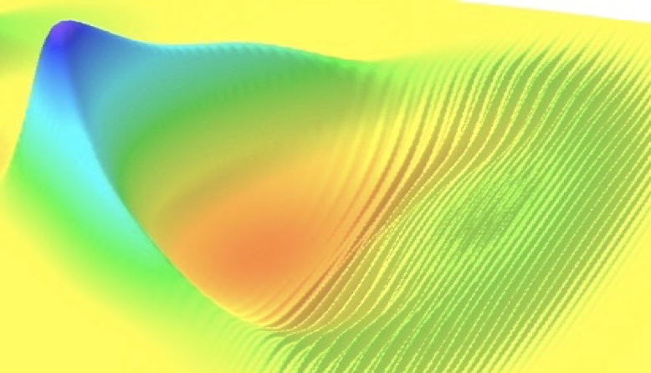
Synchrotron radiation in plasma linacs
n=10¹⁷ cm⁻³
Wiggler/betatron period:
Wiggler strength parameter:
𝜖_{n}=100 nm
𝜖_{n}=10 nm
Energy spread growth linearly proportional to emittance (betatron amplitude)
Assuming focusing from ion cavity:
Relative energy spread
𝜖_{n}=1 nm
Schroeder et al., PRST-AB (2010)
Final beam energy [TeV]
Energy spread induced by synchrotron radiation from plasma betatron motion (assuming low-emittance matched beam) is not a strong limit
13

Slide 14
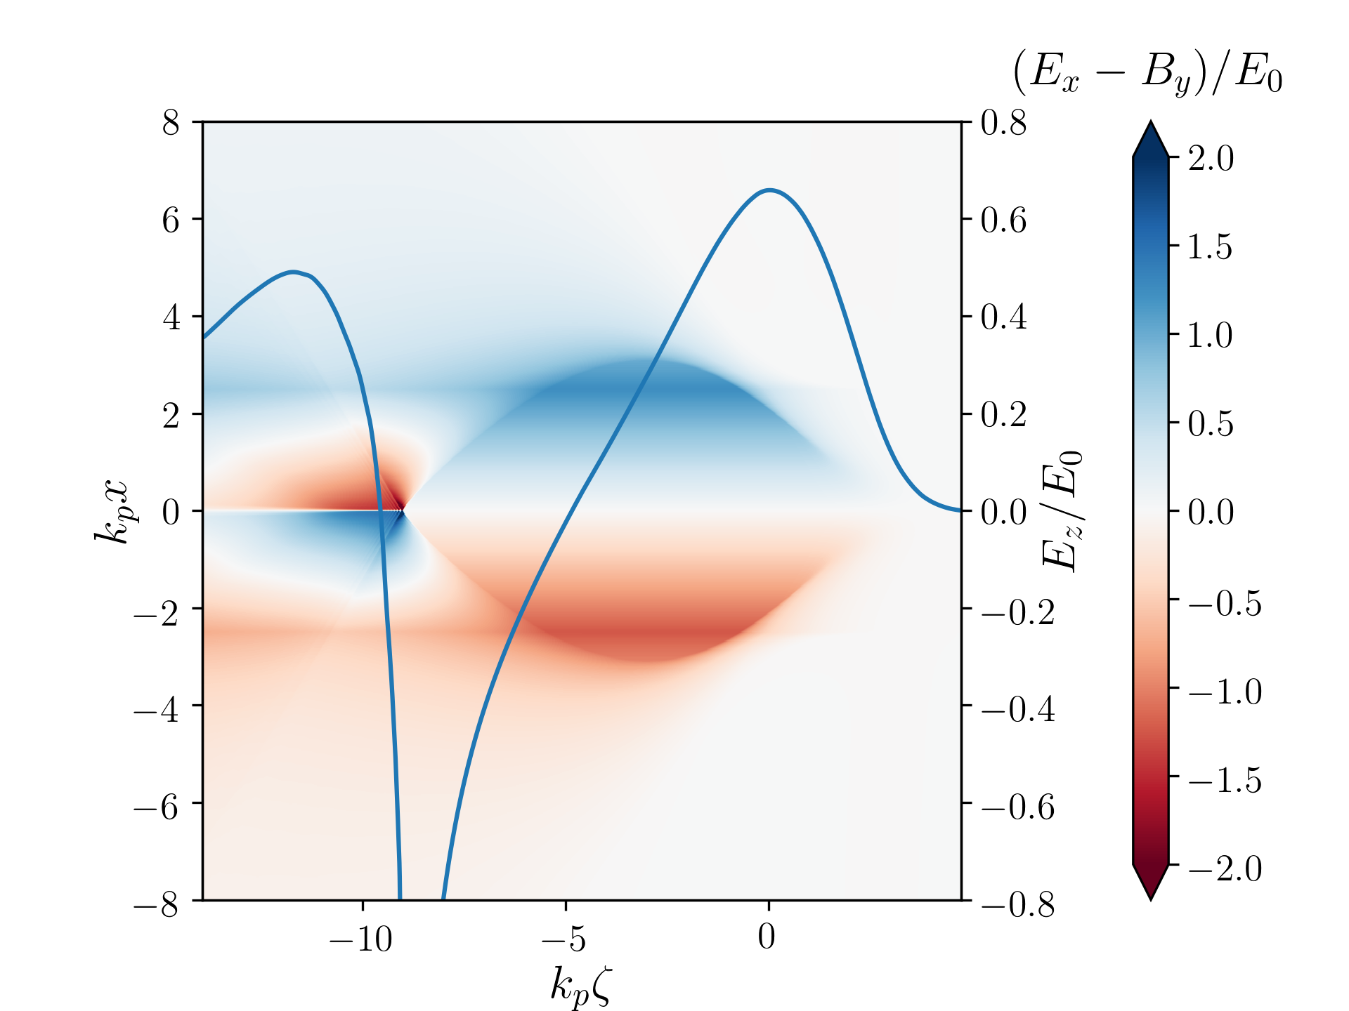
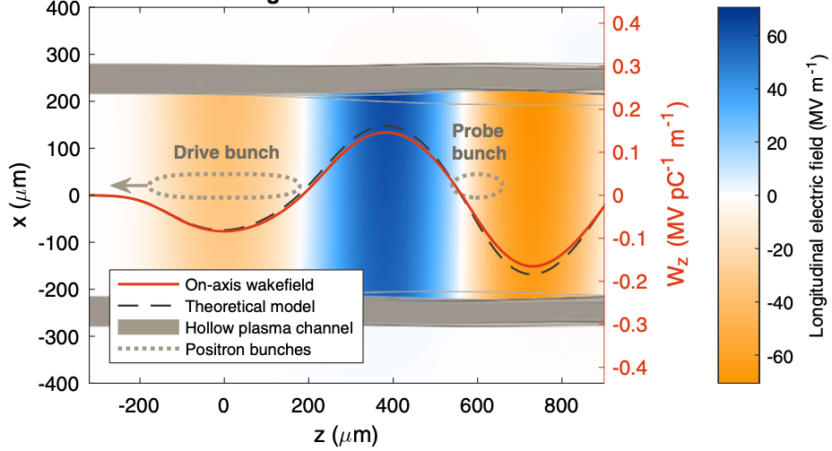
Positron acceleration in plasmas
Hollow plasma channels
Finite plasma columns
S. Dieterichs et al., PRAB (2020)
C. Lindtrøm et al., PRL (2018)
Near-zero density on axis, finite density in channel wall
Severe transverse instabilities; novel damping mechanisms required
Emittance preservation
Transversely stable
Requires experimental tests
Efficiency not comparable to electron beams
S. Gessner et al., Nature Comm. (2016)
C. Schroeder et al., PRL (1999)
S. Dieterichs et al., PRAB (2021)
14

Slide 15

Laser technology requirements for a collider
Laser drivers:
Requires R&D to reach collider parameters:
10 J, 100 fs class, 50 kHz, high wall-to-laser efficiency
Two promising laser architectures:
  Coherent combination of fiber lasers (1 um). R&D at Jena, Michigan, LBNL, LLNL, et al.
      ~60% wall-to-laser efficiency
  Tm:YLF (1.9 micron) – (4x as many LWFA stages). R&D at LLNL
  Peak laser power requirements may be relaxed by excitation using laser pulse trains
High-average power laser drivers
LWFA collider
requirement:
50 kHz
> 40% effic.
1 um
10 pulse train
fiber
Tm:YLF
2µm – 4xstages
T. Zhou et al., Opt. Express (2015)
H. Stark et al. Opt. Lett. (2021)
technically
feasible
today: kHz
average laser power [kW]
fiber
“kBELLA” (kHz, few J)
I. Tamer et al. Opt. Lett. (2021)
HAPLS (ELI)
existing
laser
systems:
few Hz
J. Cowley et al. PRL (2017)
CoReLS (Korea)
BELLA (LBNL)
Facilities needed to demonstrate active-feedback stabilization, develop high-rep-rate LWFA technology (plasma targetry, etc.)
peak laser power [TW]
15

Slide 16
Conclusions / comments
Primary advantages of plasma accelerators:
  High gradient (>GV/m geometric gradient) – compactness
  Short bunches – beamstrahlung reduction, power savings
    Beamstrahlung limits bunch charge, determines power requirements:
Efficiency critical:
  Laser technology R&D required for efficient, high-average, high-peak power lasers
    Coherent combination of fiber lasers shows promising path
  energy recovery (spent laser to photovoltaic; trailing laser pulse used to remove wake energy)
𝛾 𝛾-collider is possible to avoid beam-beam interaction issues & remove need for positrons
  Scattering laser wavelength to avoid e+e- pair creation:
R&D required on auxiliary collider systems compatible with plasma accelerators [e.g., LWFA collider: single bunches (~10 μm), equal bunch spacing, separated by 20 μs]
16

Slide 17
Scientific R&D goals in next 5-10 years
Demonstrate multi-GeV staging of plasma accelerators
    high capture efficiency and beam quality preservation
Demonstrate of robust plasma-based e+ acceleration configuration
Proof-of-principle demonstrations of novel laser technology (coherent combining of fiber lasers or Tm:YLF), showing scaling toward collider applications
    Demonstrate LWFA at kHz (stabilization with active feedback)
    Develop plasma targetry and diagnostics at kHz (and higher)
Develop integrated collider design (injector, cooling, linac, BDS, final focus, etc.)
Develop near- and mid-term applications: (near-term applications are important demonstrations of plasma technology that will advance collider R&D)
    Radiation sources: FEL, Thomson scattering for MeV photons, etc.
    Laser-triggered generation of ultra-high brightness (tens of nm emittance) e-beams
17

