Slide 1
2022 HongKong IAS HEP workshop
CEPC Cryogenic System R&D
Rui Ge / Mei Li
On behalf of CEPC cryogenic system
Jan., 14th, 2022
Notes:
1

Slide 2
OUTLINE
Introduction
Layout of the cryogenic system
Discussion and Comparison on CEPC SRF cryogenic system
Discussion and Comparison on SC magnets cryogenic system
Summary

Slide 3
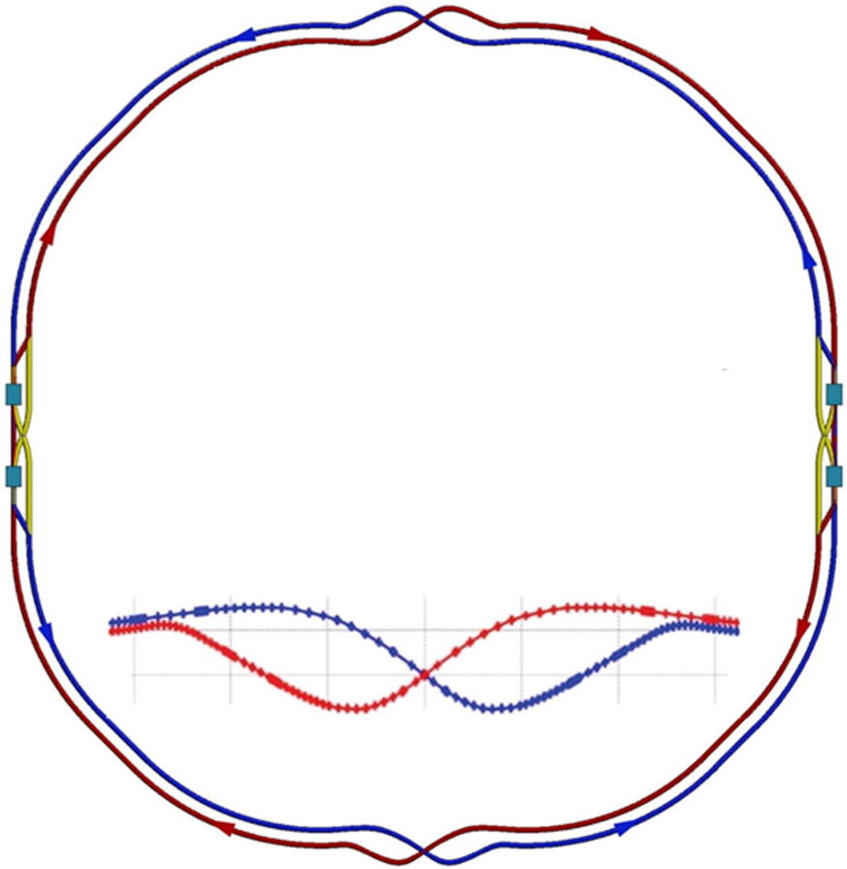
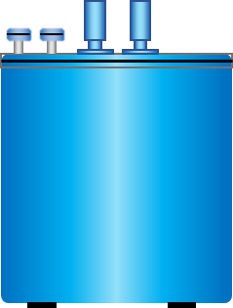
CEPC Cryogenic System Brief Introduction
  Booster ring:
1.3 GHz 9-cell cavities, 96 cavities
12 cryomodules
3 cryomodules/each station
Temperature: 2K
  Collider ring:
650MHz 2-cell cavities, 240 cavities
40 cryomodules
10 cryomodules/each station
Temperature: 2K
  IR magnets:
4 IR magnets, 32 Sextupole magnets, 36 cryomodules
18 cryomodules/each station
Temperature: 4.5K
Detectors:
2 detector magnets
Thermosiphon cooling
主要内容
Layout of CEPC Double Ring
Inj(LSS8)
Ip_cc(LSS1)
Inj(LSS2)
4 Cryo-stations
Refrigeration:4X18 kW@4.5K
Circumference:100km
Cryo-station
RF Station(LSS7)
RF Station(LSS3)
Cryo-station
Estr(LSS6)
Estr(LSS4)
Ip_cc(LSS5)

Slide 4
OUTLINE
Introduction
Layout of the cryogenic system
Discussion and Comparison on CEPC SRF cryogenic system
Discussion and Comparison on SC magnets cryogenic system
Summary

Slide 5
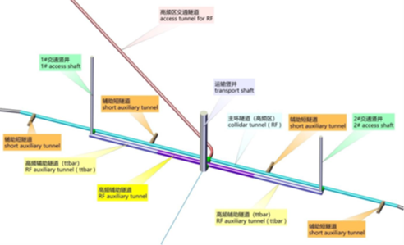
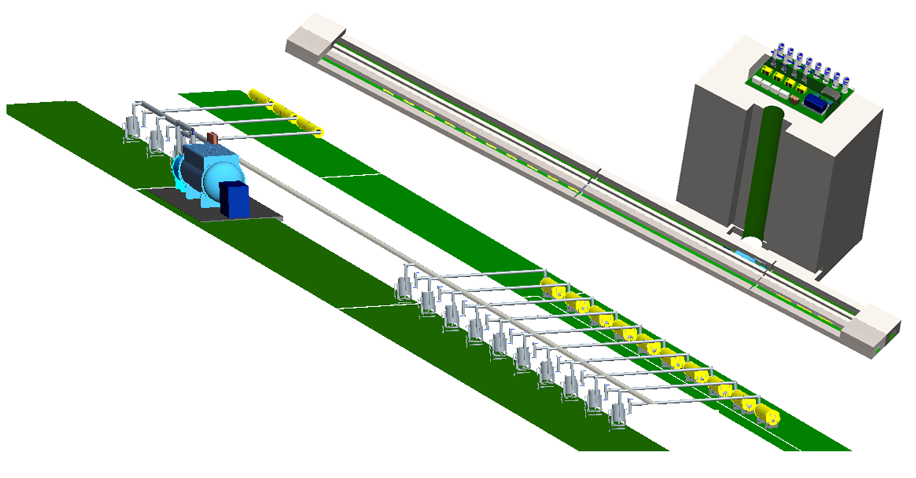
Layout of CEPC cryogenic system
Warm equipment on the ground:
compressor hall, helium gas tanks
Beam tunnel
Gallery tunnel
Shaft
Refrigerator
Cryogenic transfer line
Cold equipment under the ground
2K valve boxes
cryomodules

Slide 6
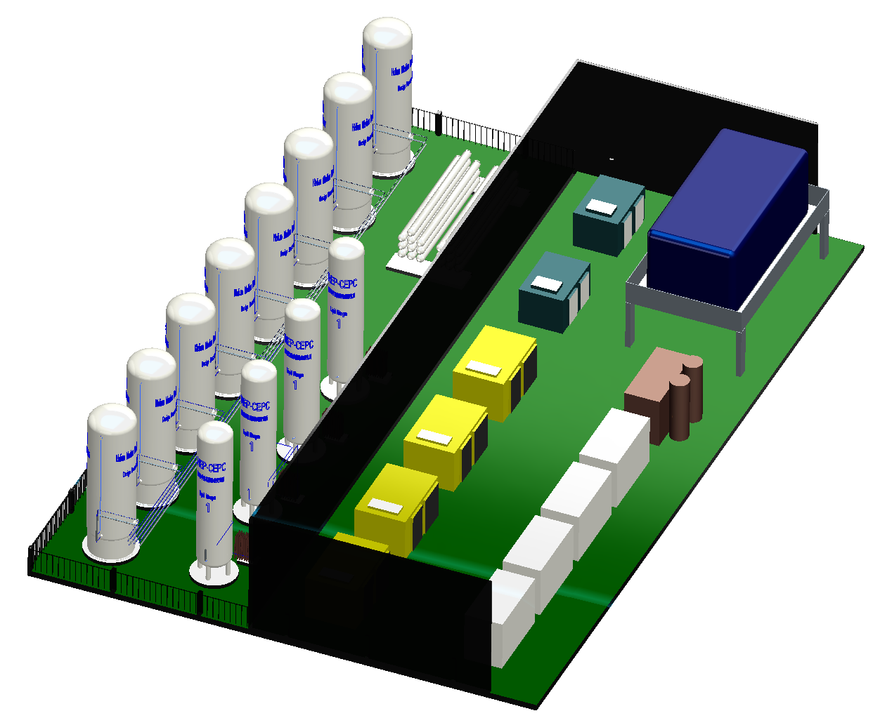
Layout of CEPC cryogenic hall
High pressure helium cylinders
Piston compressors
10*100m³ helium gas
Pressure vessels
Helium gas bag
Helium purifier
Electrical control system
4*50m³ LN₂ Storage Tanks
Recycle screw compressors

Slide 7
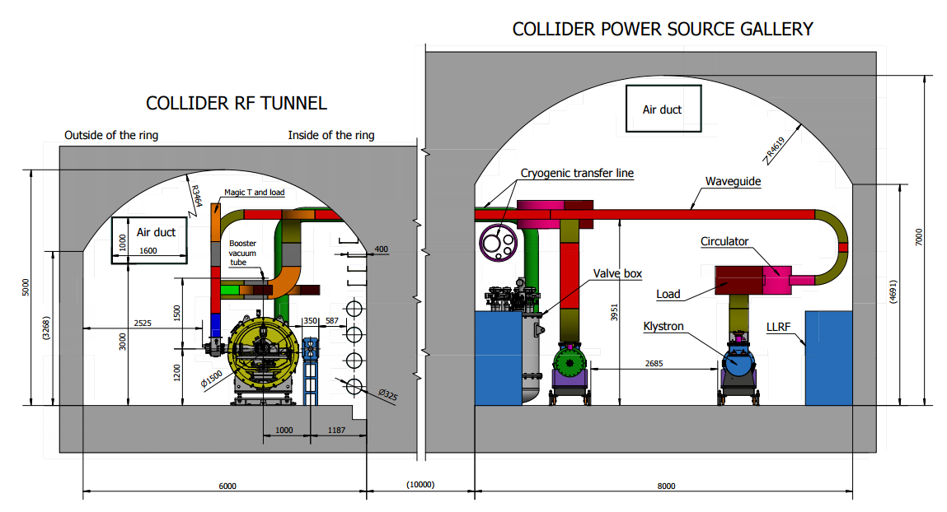
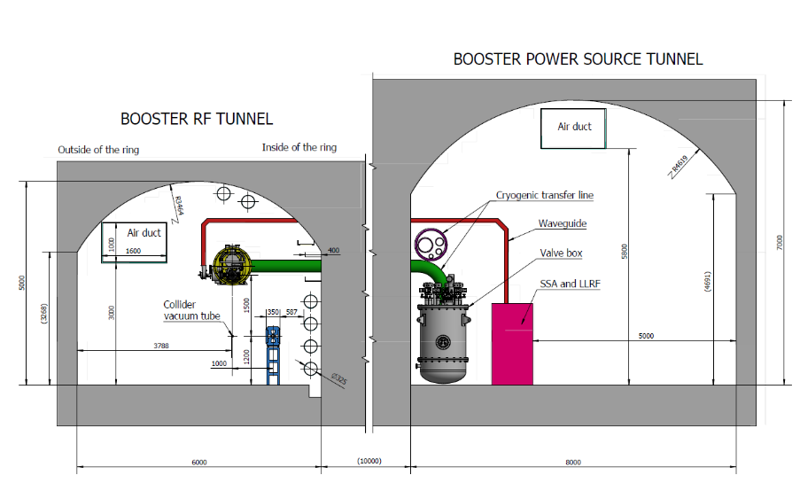
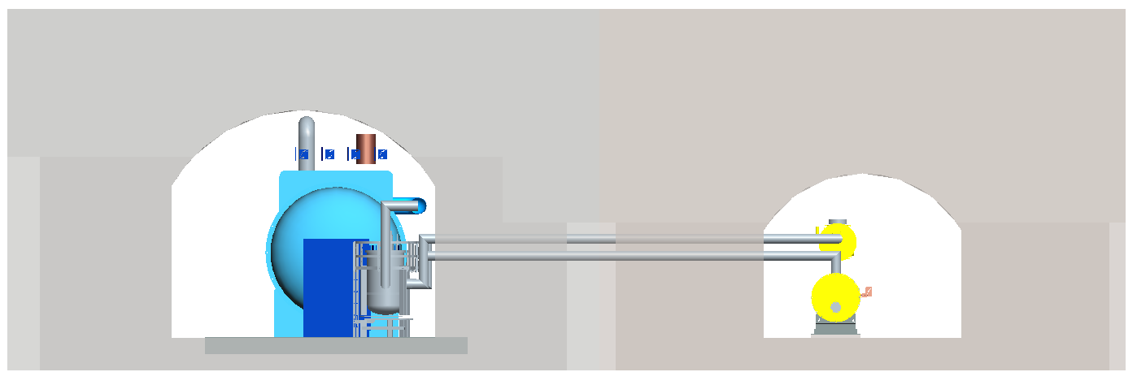
Tunnel Cross section
Gallery Tunnel
Beam Tunnel
Refrigerator
Transfer line
1.3GHz cryomodule
2K valve box
650MHz cryomodule

Slide 8
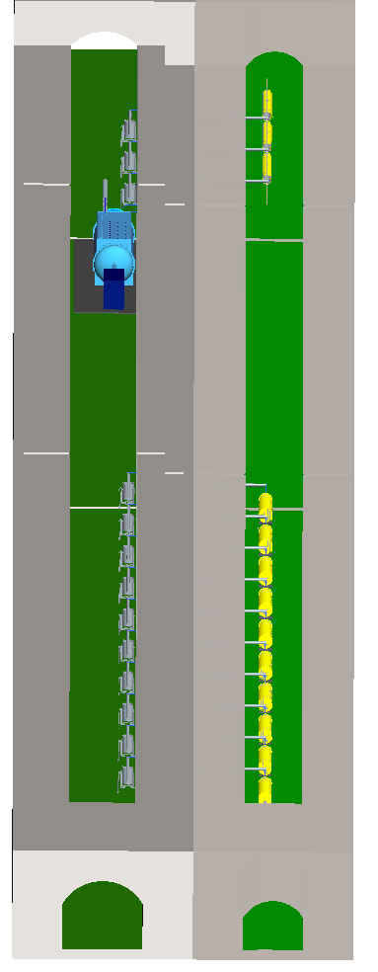
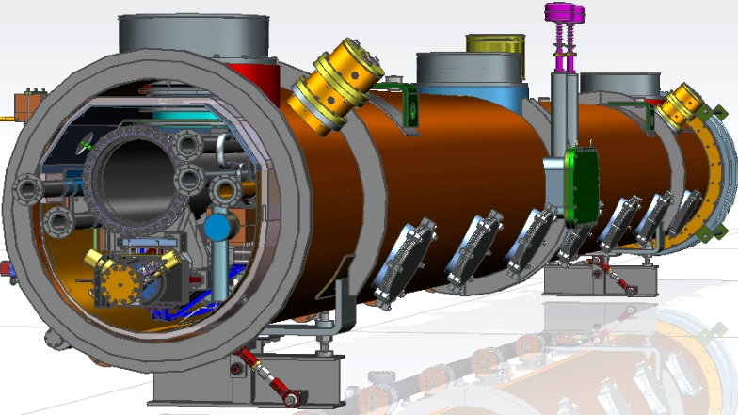
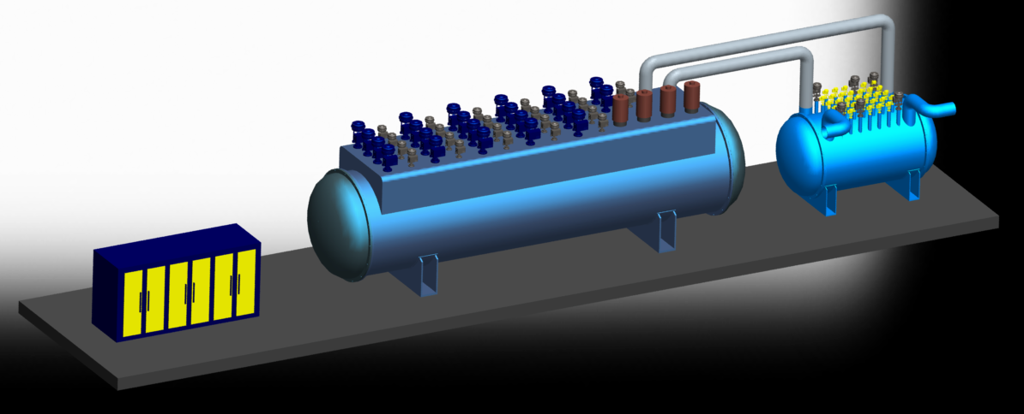
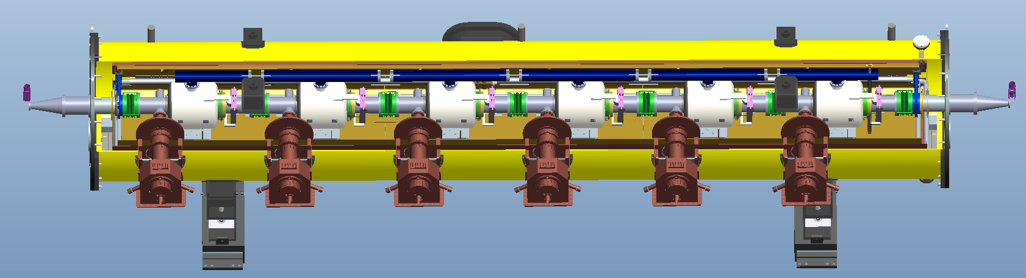
Layout of CEPC cryogenic system
1.3GHz cavity
cryomodule
2K
Valve box
Booster part
Refrigerator
main valve box
2K
Valve box
Collider part
650MHz cavity cryomodule

Slide 9
OUTLINE
Introduction
Layout of the cryogenic system
Discussion and Comparison on CEPC SRF cryogenic system
Discussion and Comparison on SC magnets cryogenic system
Summary

Slide 10
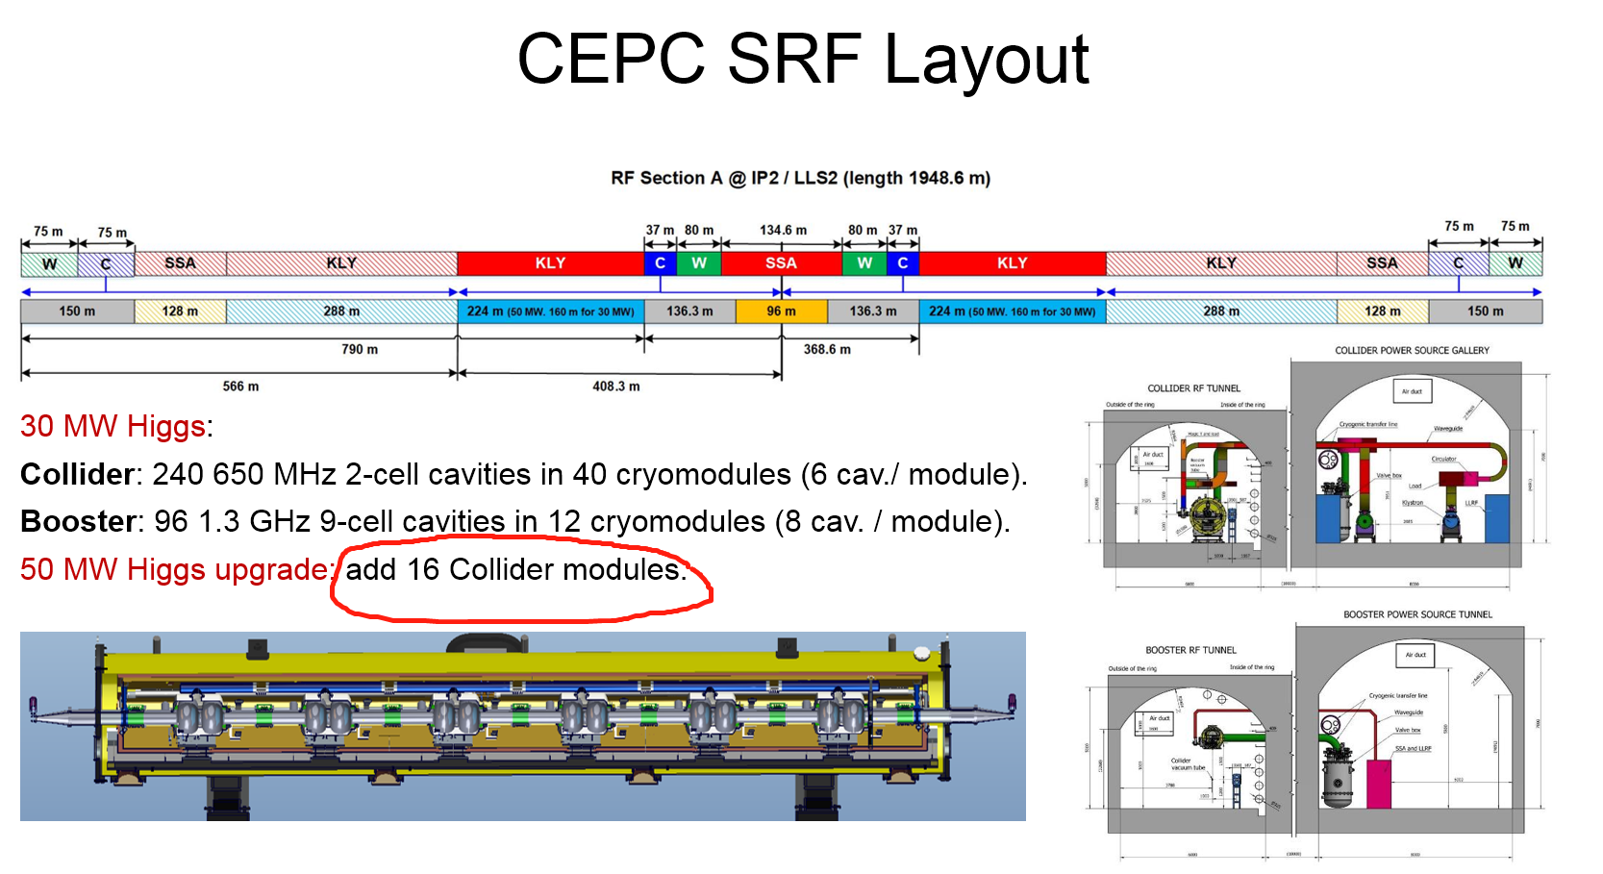
Difference for H50MW and H30MW modes
Multi-transfer lines length: H30 MW 160m → H50MW 224m
56 collider modules

Slide 11
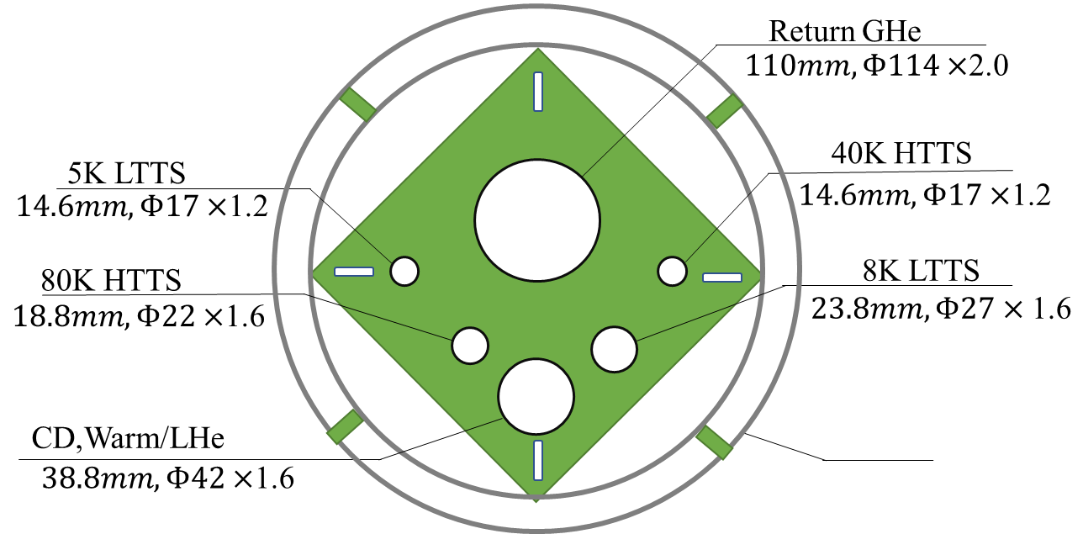
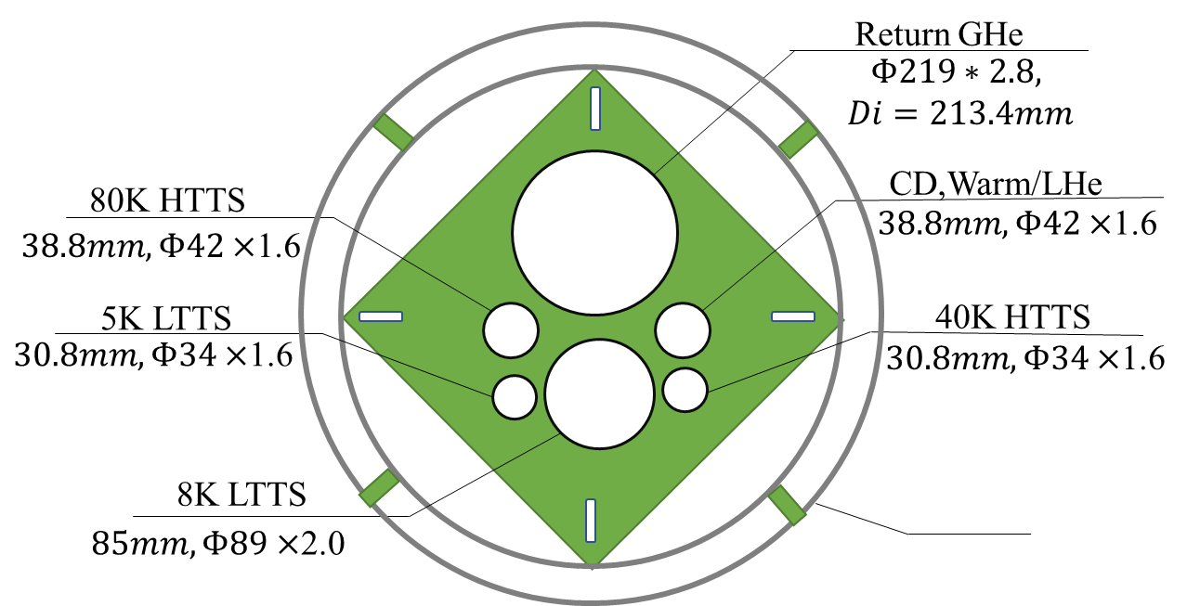
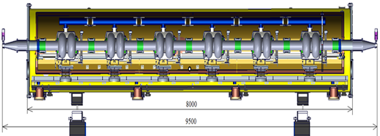
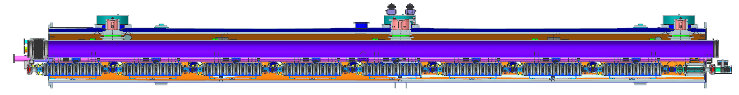
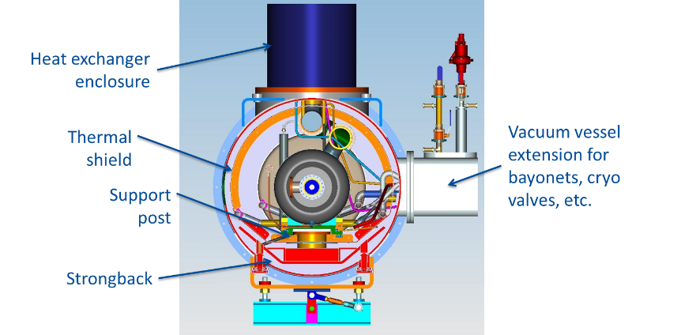
Flow chart of SRF CDR Scheme
24000
50MW
117000
Compressor group
Cold Box
Dewar
Main Distribution
Valve Box
Sub-tunnel
2K valve boxes
224000
80000
14 cryomodules, 6×650MHZ 2-cell cavities each
Collider Ring
3 cryomodules, 8×1.3GHZ 9-cell cavities each
Booster Ring
10
Cryomodules
8000
11000
5000
11000
5000
11000
11000
11000
11000
11000
5000
5000

Slide 12
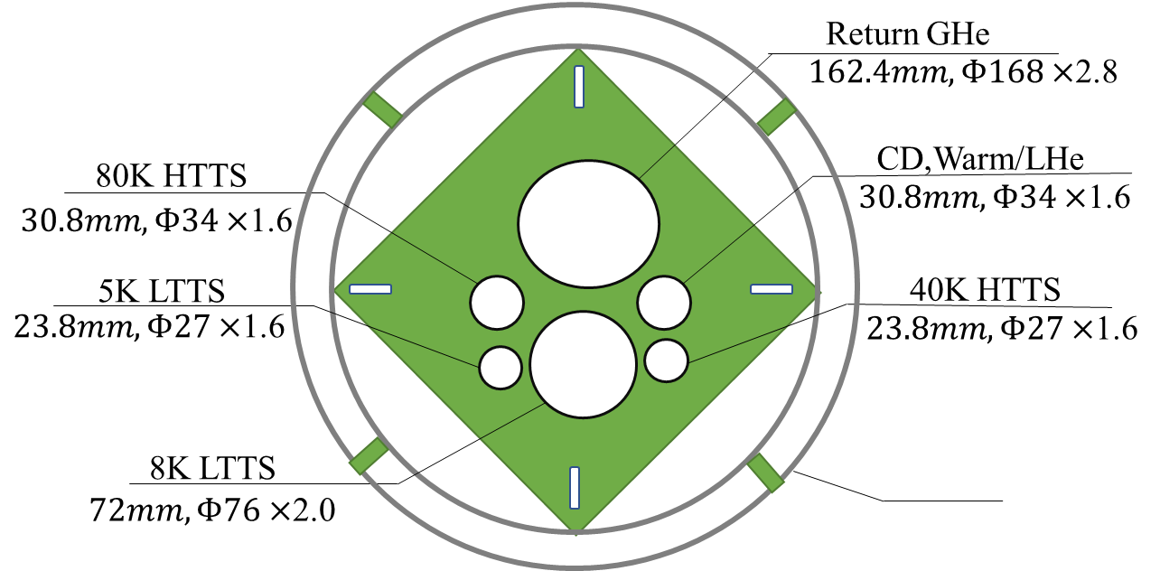
Flow chart of SRF Modif. Scheme
24000
117000
Smaller diameter
Compressor group
Cold Box
Dewar
Main Distribution
Valve Box
14 cryomodules, 6×650MHZ 2-cell cavities each
Collider Ring
3 cryomodules, 8×1.3GHZ 9-cell cavities each
Booster Ring
2K valve boxes
2K valve boxes
10
Cryomodules
11000
5000
11000
5000
11000
11000
11000
8000
11000
11000
5000
5000

Slide 13
Estimated heat loads for SC cavities-CDR Scheme
Higgs Mode 50MW | Unit | Collider |  |  | Booster
 |  | 40-80K | 5-8K | 2K | 40-80K | 5-8K | 2K
Predicted static heat load per cryomodule | W | 300 | 60 | 12 | 140 | 20 | 3
Cavity dynamic heat load per cryomodule | W | 0 | 0 | 153.59 | 0 | 0 | 13.98
HOM dynamic heat load per cryomodule | W | 20 | 12 | 2 | 2 | 1 | 1
Input coupler dynamic heat load per cryomodule | W | 60 | 40 | 6 | 40 | 3 | 0.4
Module dynamic heat load | W | 80 | 52 | 161.59 | 42 | 4 | 15.38
Each Module total heat load | W | 380 | 112 | 173.59 | 182 | 24 | 18.38
Cryomodule number | - | 56 | 56 | 56 | 12 | 12 | 12
EVB heat loss | W | 50 | 10 | 10 | 50 | 10 | 10
EVB number | - | 40 | 40 | 40 | 12 | 12 | 12
MDVB heat loss | W | 50 | 30 | 30 | 50 | 30 | 5
MDVB number | - | 4 | 4 | 4 | 4 | 4 | 4
Total cryogenic transfer line length | m | 1924 | 1924 | 1924 | 536 | 536 | 536
cryogenic transfer line heat loss per meter | W/m | 2 | 0.5 | 0.3 | 2 | 0.5 | 0.3
Total cryogenic transfer line heat loss | W | 3848 | 962 | 577.2 | 1072 | 268 | 160.8
Total heat load | kW | 27.328 | 7.754 | 10.81824 | 4.056 | 0.796 | 0.52136
Total predicted mass flow | g/s | 82.42 | 152.26 | 373.72 | 13.34 | 12.73 | 18.324
Overall net cryogenic capacity multiplier |  | 1.54 | 1.54 | 1.54 | 1.54 | 1.54 | 1.54
4.5K equiv. heat load with multiplier | kW | 3.16 | 10.80 | 53.32 | 0.47 | 1.11 | 2.58
4.5K equiv. heat load with multiplier | kW | 67.29 |  |  | 4.15
Total 4.5K equiv. heat load with multiplier | kW | 71.44
Total:2460m
Four individual refrigerators (4 × 18kW@4.5K) will be employed for the CEPC cavity cryogenic system.

Slide 14
Estimated heat loads for SC cavities-Modif. Scheme
Higgs Mode 50MW | Unit | Collider |  |  | Booster
 |  | 40-80K | 5-8K | 2K | 40-80K | 5-8K | 2K
Predicted static heat load per cryomodule | W | 300 | 60 | 12 | 140 | 20 | 3
Cavity dynamic heat load per cryomodule | W | 0 | 0 | 153.59 | 0 | 0 | 13.98
HOM dynamic heat load per cryomodule | W | 20 | 12 | 2 | 2 | 1 | 1
Input coupler dynamic heat load per cryomodule | W | 60 | 40 | 6 | 40 | 3 | 0.4
Module dynamic heat load | W | 80 | 52 | 161.59 | 42 | 4 | 15.38
Each Module total heat load | W | 380 | 112 | 173.59 | 182 | 24 | 18.38
Cryomodule number | - | 56 | 56 | 56 | 12 | 12 | 12
EVB heat loss | W | 50 | 10 | 10 | 50 | 10 | 10
EVB number | - | 40 | 40 | 40 | 12 | 12 | 12
MDVB heat loss | W | 50 | 30 | 30 | 50 | 30 | 5
MDVB number | - | 4 | 4 | 4 | 4 | 4 | 4
Total cryogenic transfer line length | m | 728 | 728 | 728 | 136 | 136 | 136
cryogenic transfer line heat loss per meter | W/m | 2 | 0.5 | 0.3 | 2 | 0.5 | 0.3
Total cryogenic transfer line heat loss | W | 1456 | 364 | 218.4 | 272 | 68 | 40.8
Total heat load | kW | 24.936 | 7.156 | 10.45944 | 3.256 | 0.596 | 0.40136
Total predicted mass flow | g/s | 82.42 | 152.26 | 373.72 | 13.34 | 12.73 | 18.324
Overall net cryogenic capacity multiplier |  | 1.54 | 1.54 | 1.54 | 1.54 | 1.54 | 1.54
4.5K equiv. heat load with multiplier | kW | 2.89 | 9.97 | 51.56 | 0.37 | 0.83 | 1.98
4.5K equiv. heat load with multiplier | kW | 64.41 |  |  | 3.19
Total 4.5K equiv. heat load with multiplier | kW | 67.60
Total:2460m
Total:864m
4 × 16.85 kW
Can reduce 4.04kW heat load compared scheme1
Four individual refrigerators (4 × 18kW@4.5K) will be employed for the CEPC cavity cryogenic system.

Slide 15
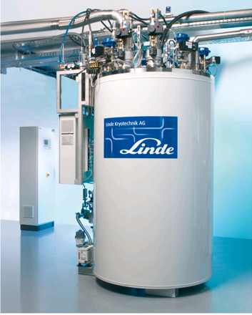
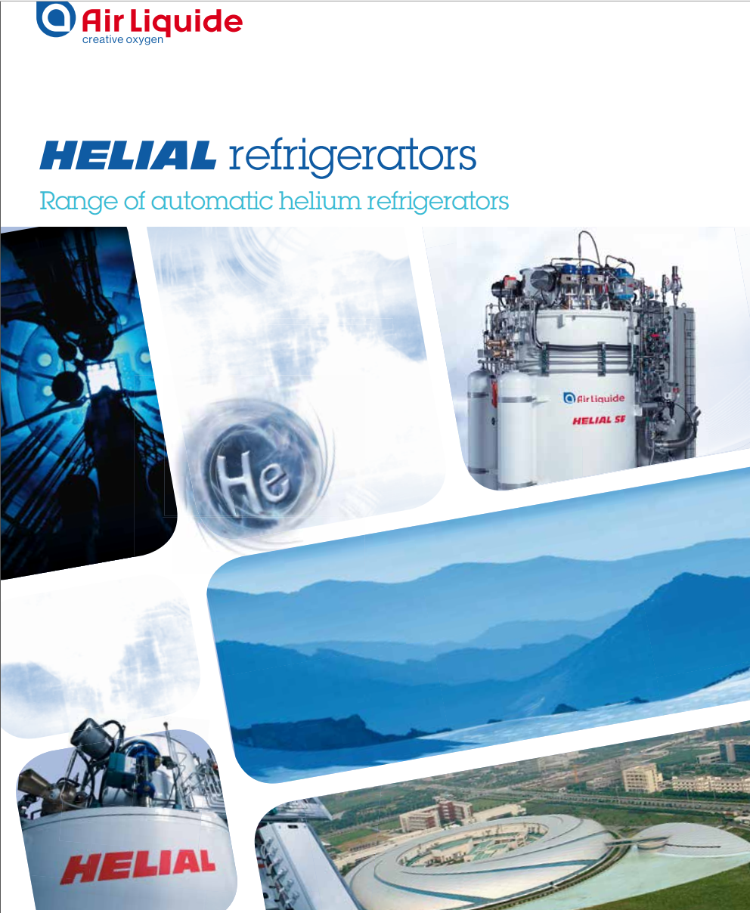
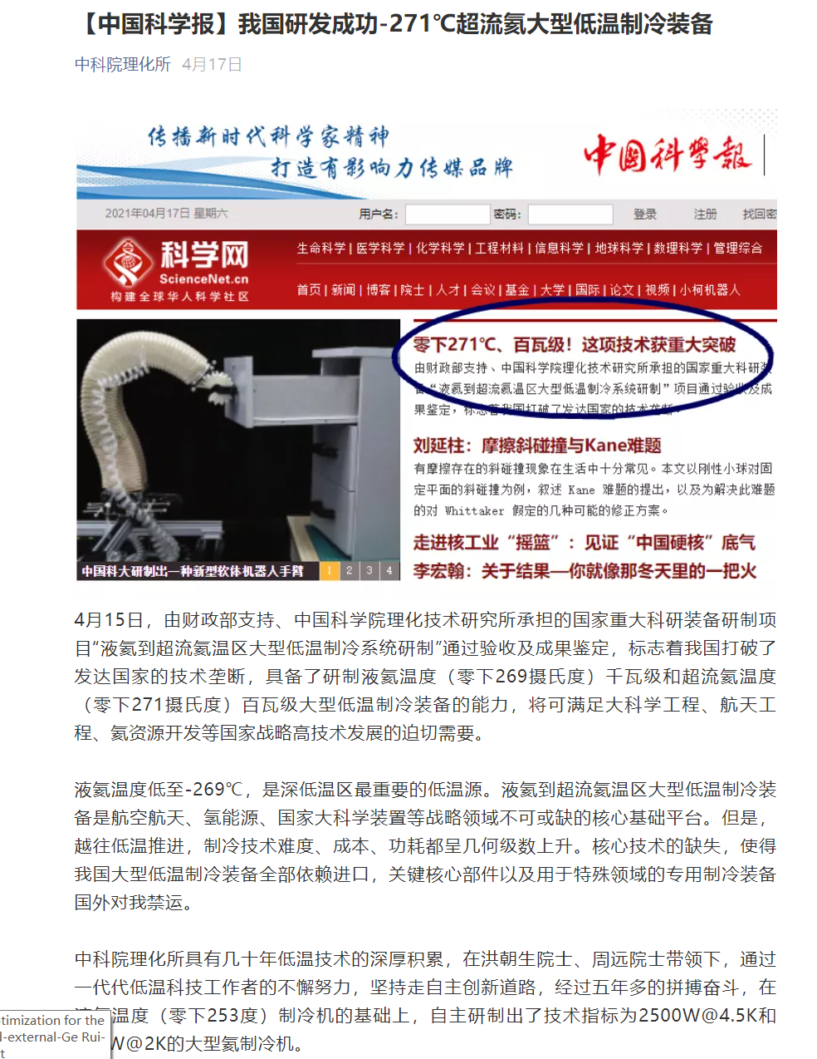
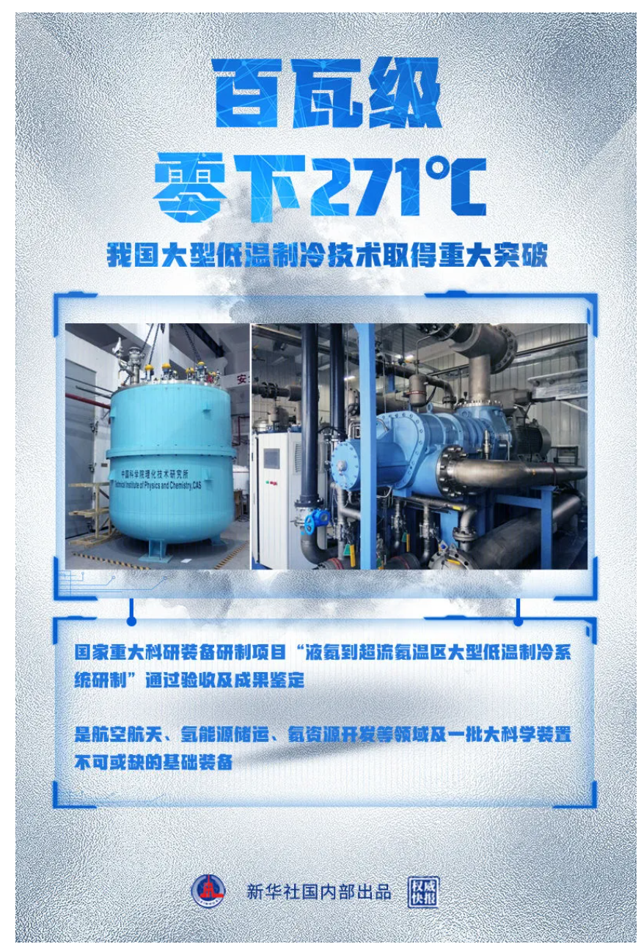
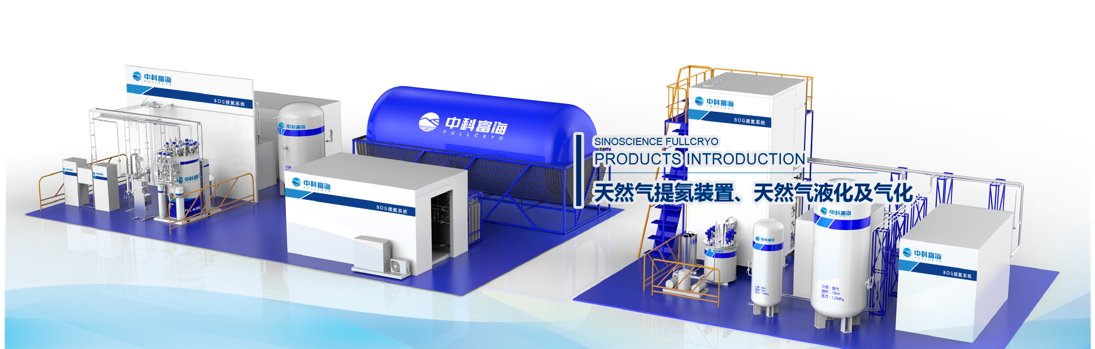

Large Helium Refrigerator Market Research
Foreign refrigerator / liquefiers, features: mature and stable industry chain, wide range of users
Linde refrigerator / liquefier series
BEPCII: 2*500W@4.5K（IHEP）
PAPS: 2.5kW@4.5K（IHEP）
HEPS: 2.0kW@4.5K+150L/h（IHEP）
Air Liquide refrigerator/liquefier series
ADS injector I: 1kW@4.5K or 100W@2K
Domestic refrigerator / liquefier
Institute of physics and Chemistry, CAS (FULL CRYO) has: 2kW@20K，10kW@20K, etc.; 2.5KW@4.5K or 500W@2K Has been successfully developed; 10kW@4.5K has planned
Institute of Plasma Physics, CAS: existing 500W@4.5K or 150L / h, 2.2kW@4.5K , planned 5kW@4.5K
https://mp.weixin.qq.com/s/mNQJin9pgKc9wkowtQA4PA
https://mp.weixin.qq.com/s/Twz8Kk4AUwkvB456RWeuqQ

Slide 16
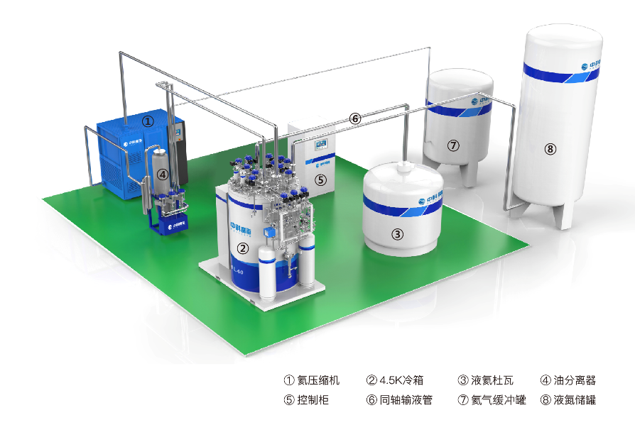
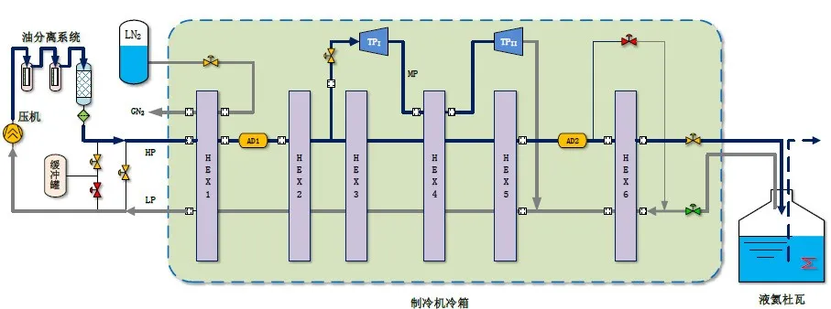
National refrigerator company status research
中科富海制冷机关于万瓦级大型氦制冷机的研制情况：
Development status of 10kW@4.5K or 18kW@4.5K (CEPC) large helium refrigerator of FULL CRYO company:
先导专项已立项，科技部重大专项都有相关工作部署，预计三年将开发出10kW@4.5K大型制冷机，为cepc做好充分准备;
The pilot project has been approved, and the major projects of the Ministry of science and technology have relevant work deployment, which is expected to be developed in three years 10kW@4.5K Large refrigerator, fully prepared for CEPC.
2.5kW@4.5K已经通过验收，是理化所的工作成果;
2.5kW@4.5K or 500W@2K refrigerator has passed the acceptance this year, and it is the work achievement of the Institute of physics and chemistry.
10kW也是理化所牵头联合富海公司共同研制开发的下一代产品。
10kW@4.5K large helium refrigerator is also the next generation product jointly developed by the Institute of physics and chemistry (TIPC, CAS) and FULL CRYO company.

Slide 17
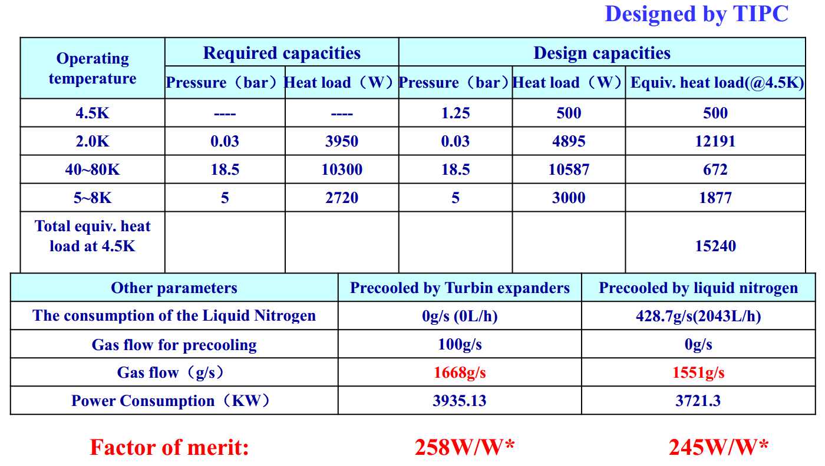
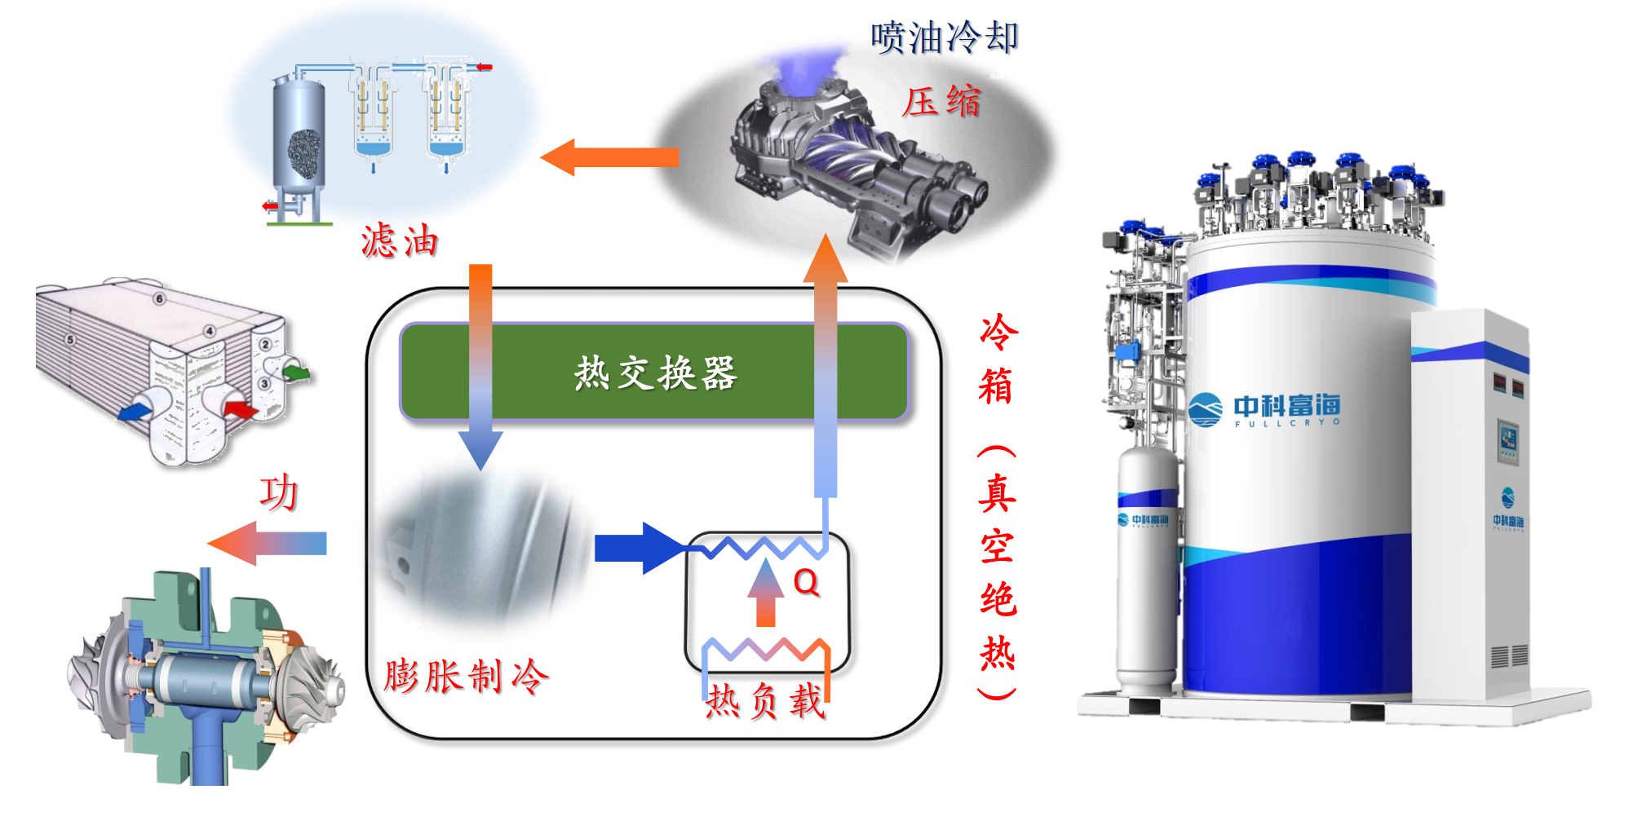
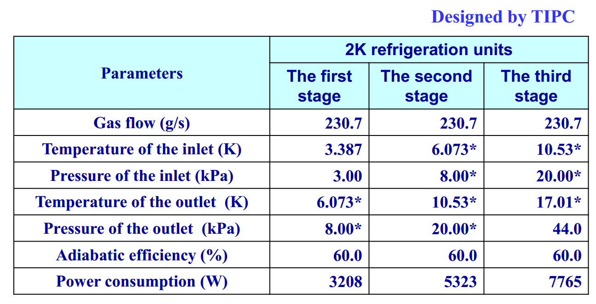
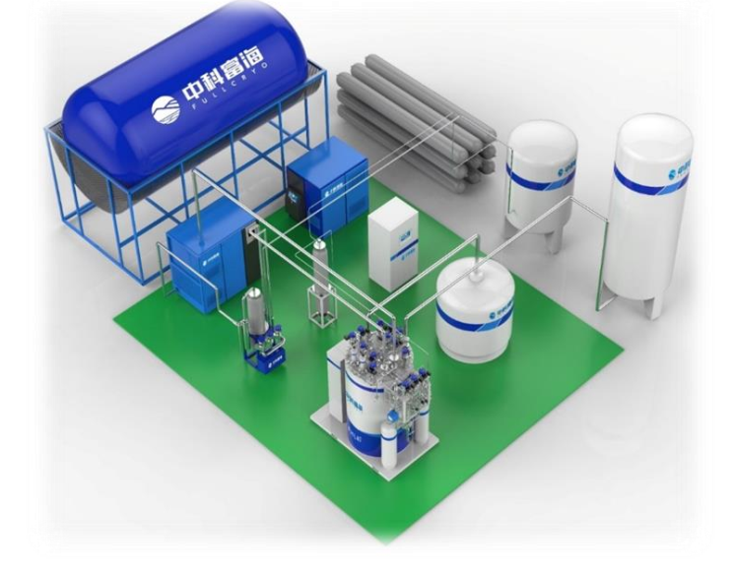
The main specification of large refrigerator
Cold compressor

Slide 18
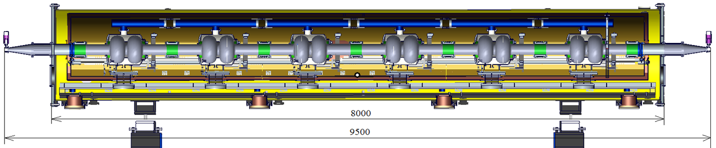
Cryomodule for 650MHz 2-cell cavities
Including six 2-cell 650 MHz superconducting cavities, six high power couplers, six mechanical tuners and two HOM absorbers
Cryomodule performance |  | Specification
Number of leakage | He →insulation | 0
 | He →beam pipe | 0
 | Insulation →coupler | 0
 | Insulation →beam pipe | 0
 | Coupler →beam pipe | 0
Alignment x/y inside (Cavities) |  | ±0.5mm
Alignment z inside |  | within 2 mm
Coupler antenna design z |  | within 2 mm
Six 2-cell Cavities Cryomodule
Overall length(flange to flange, m) | 8.0
Diameter of Vacuum vessel ,m | 1.3
Beamline height from floor, m | 1.5
Cryo-system working temperature, K | 2
Number of 200-POST | 6

Slide 19
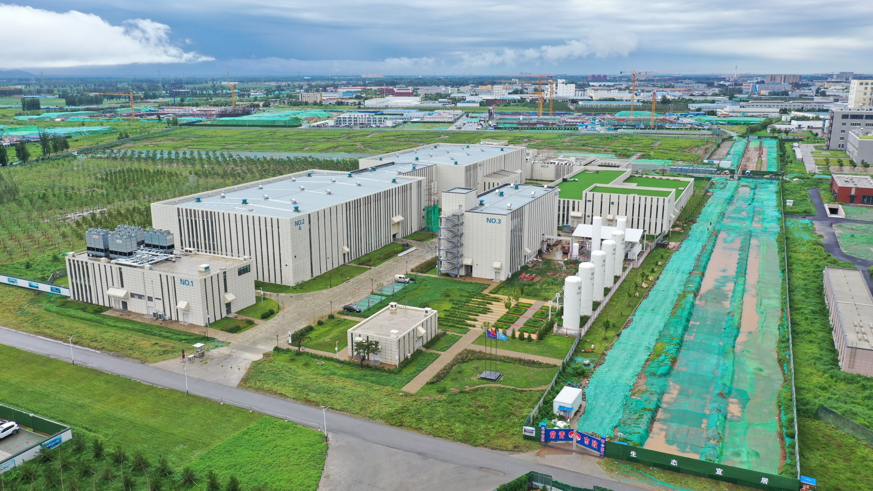
Magnet building
Beam test building
X-ray building
SRF building
Cryogenic building

Slide 20
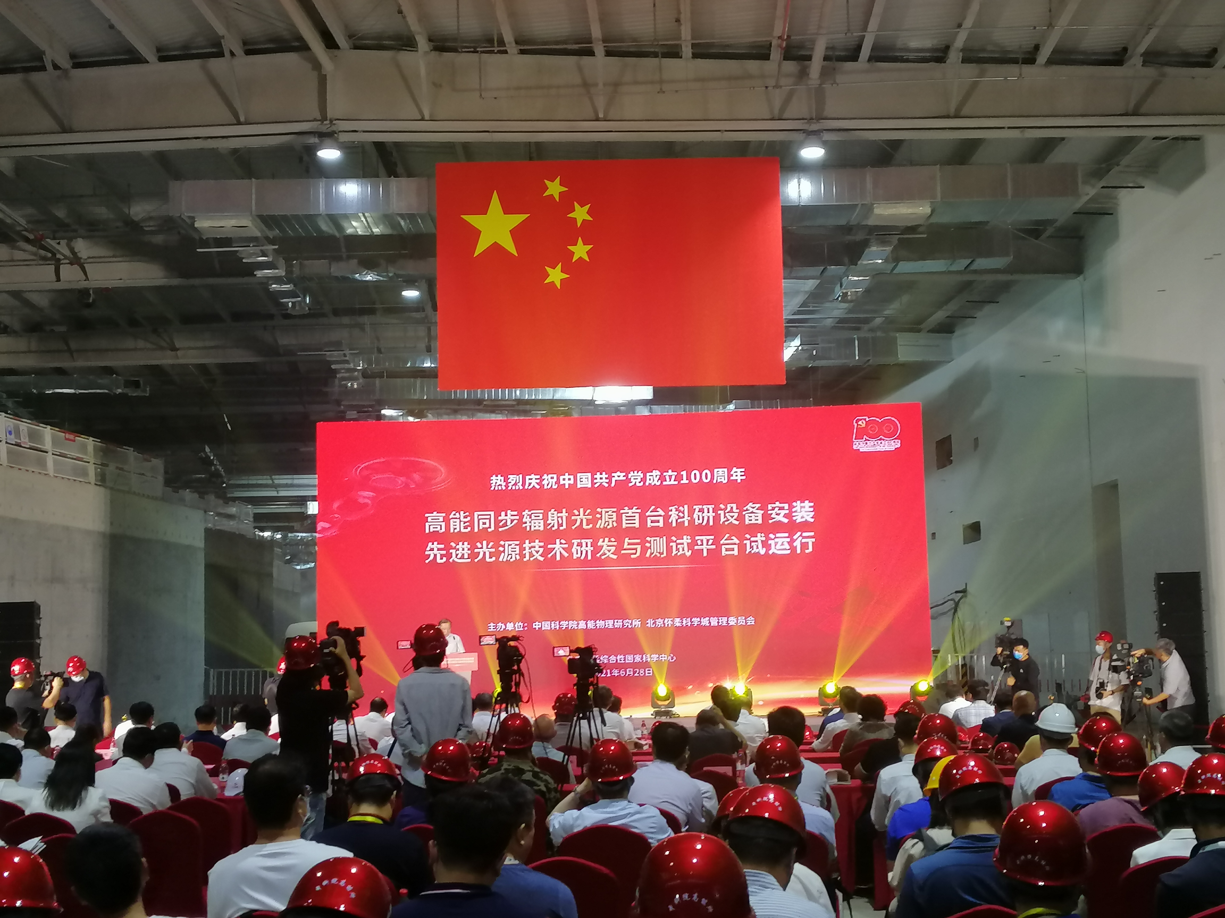

Slide 21
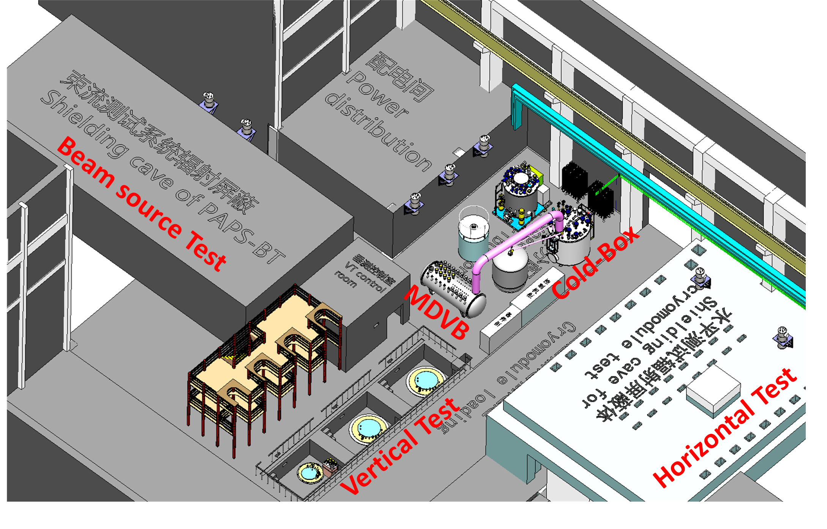

Slide 22
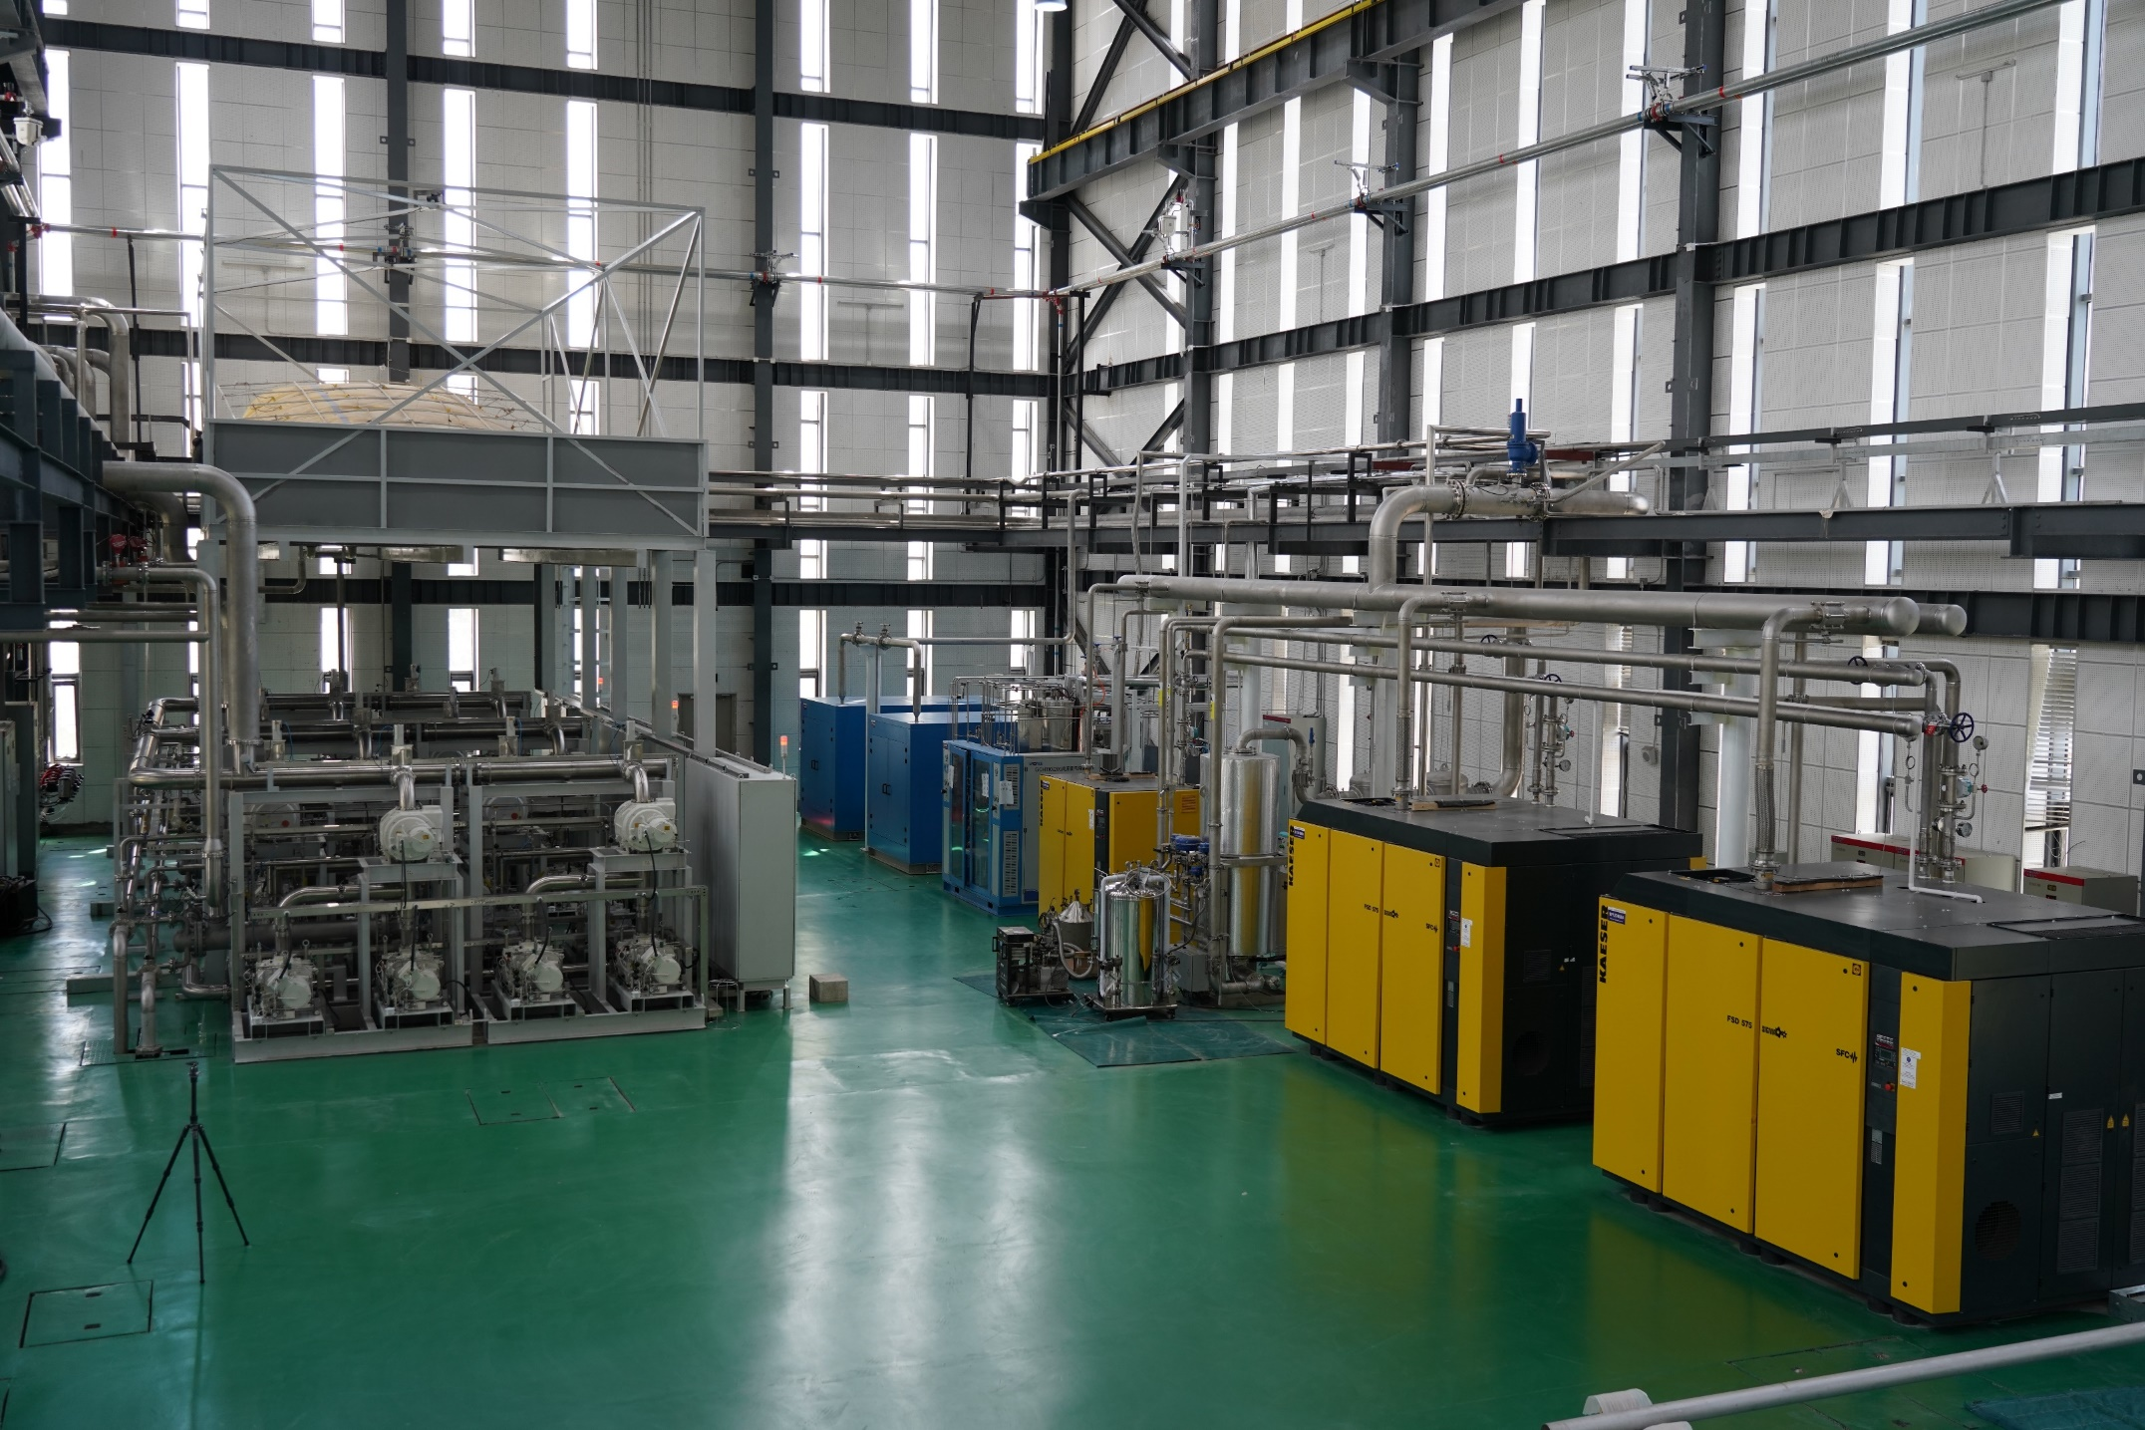
PAPS cryogenic hall

Slide 23
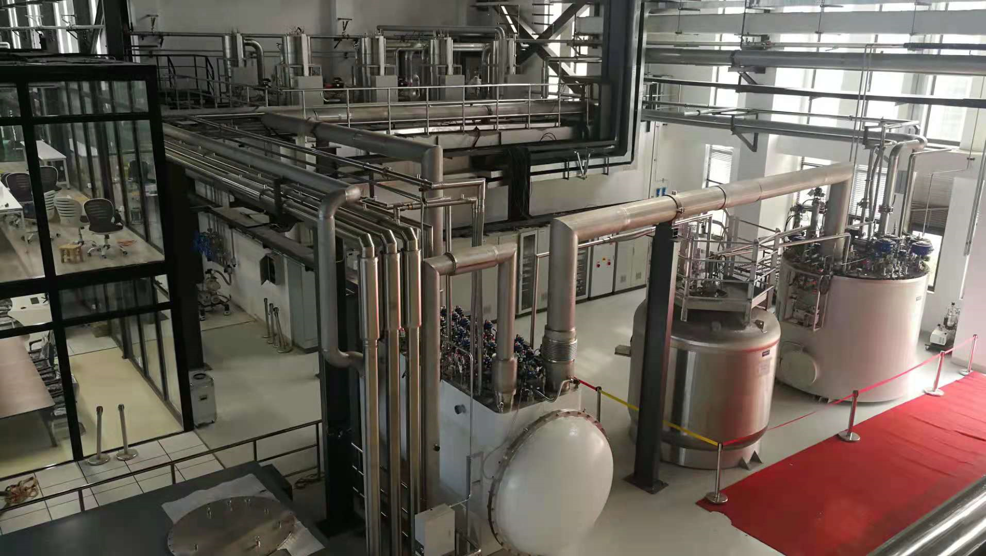
PAPS RF hall

Slide 24
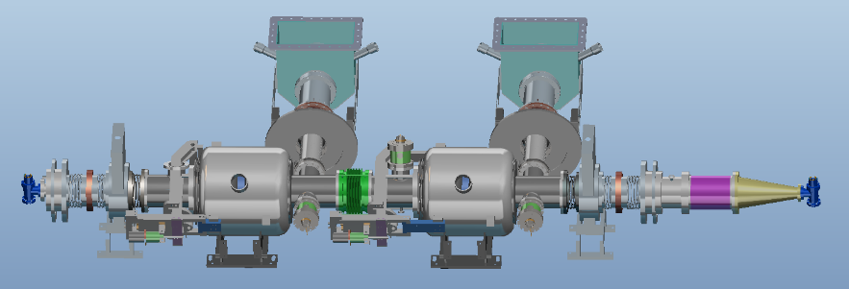
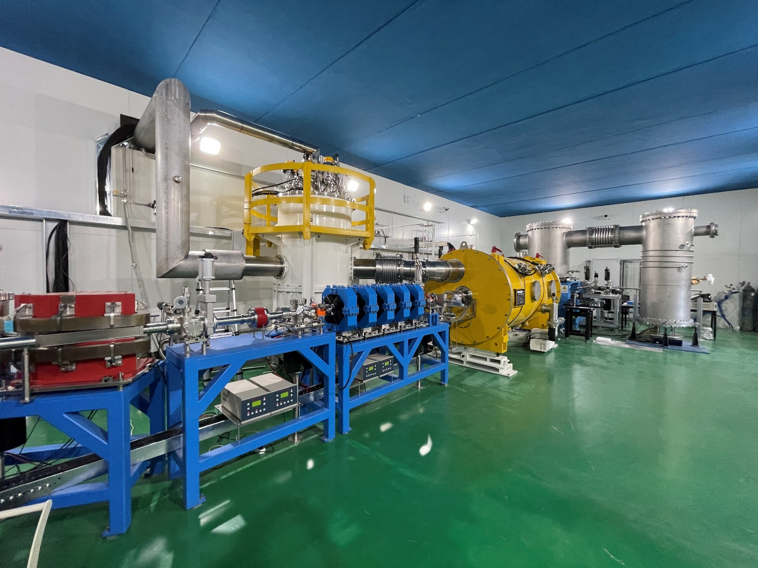
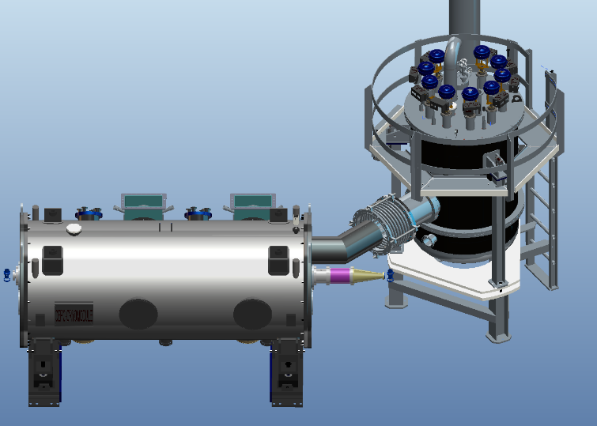
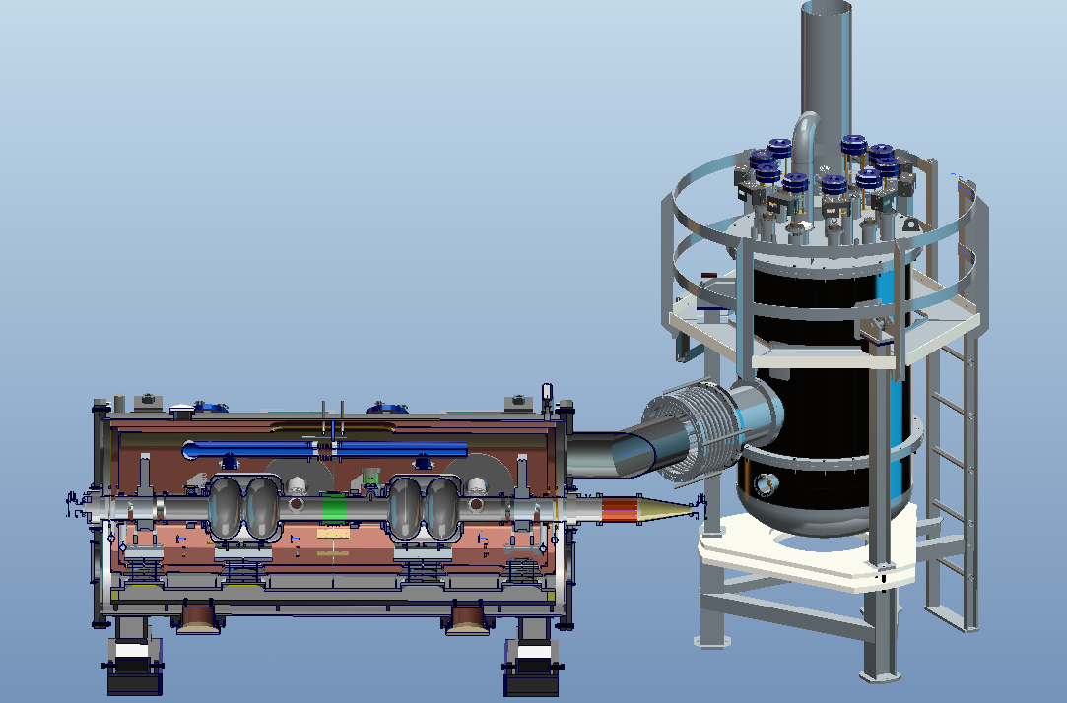
Cryomodule for 650MHz 2-cell cavities
A test cryomodule with two 2-cell 650 MHz superconducting cavities has been operated in the PAPS system this year.

Slide 25
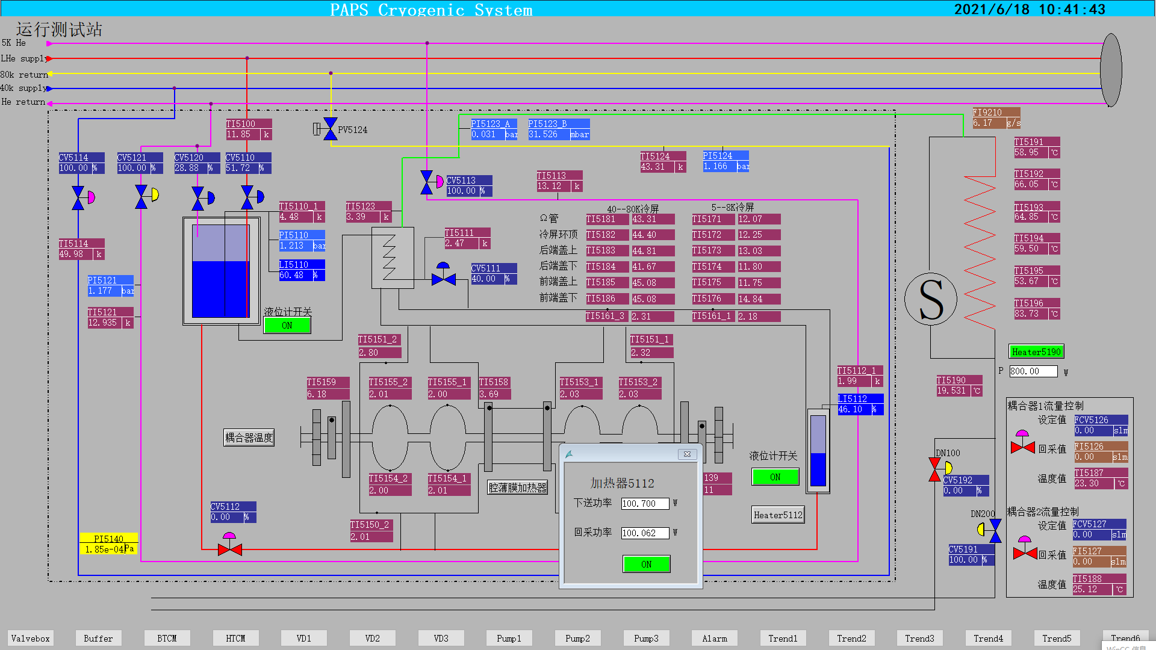
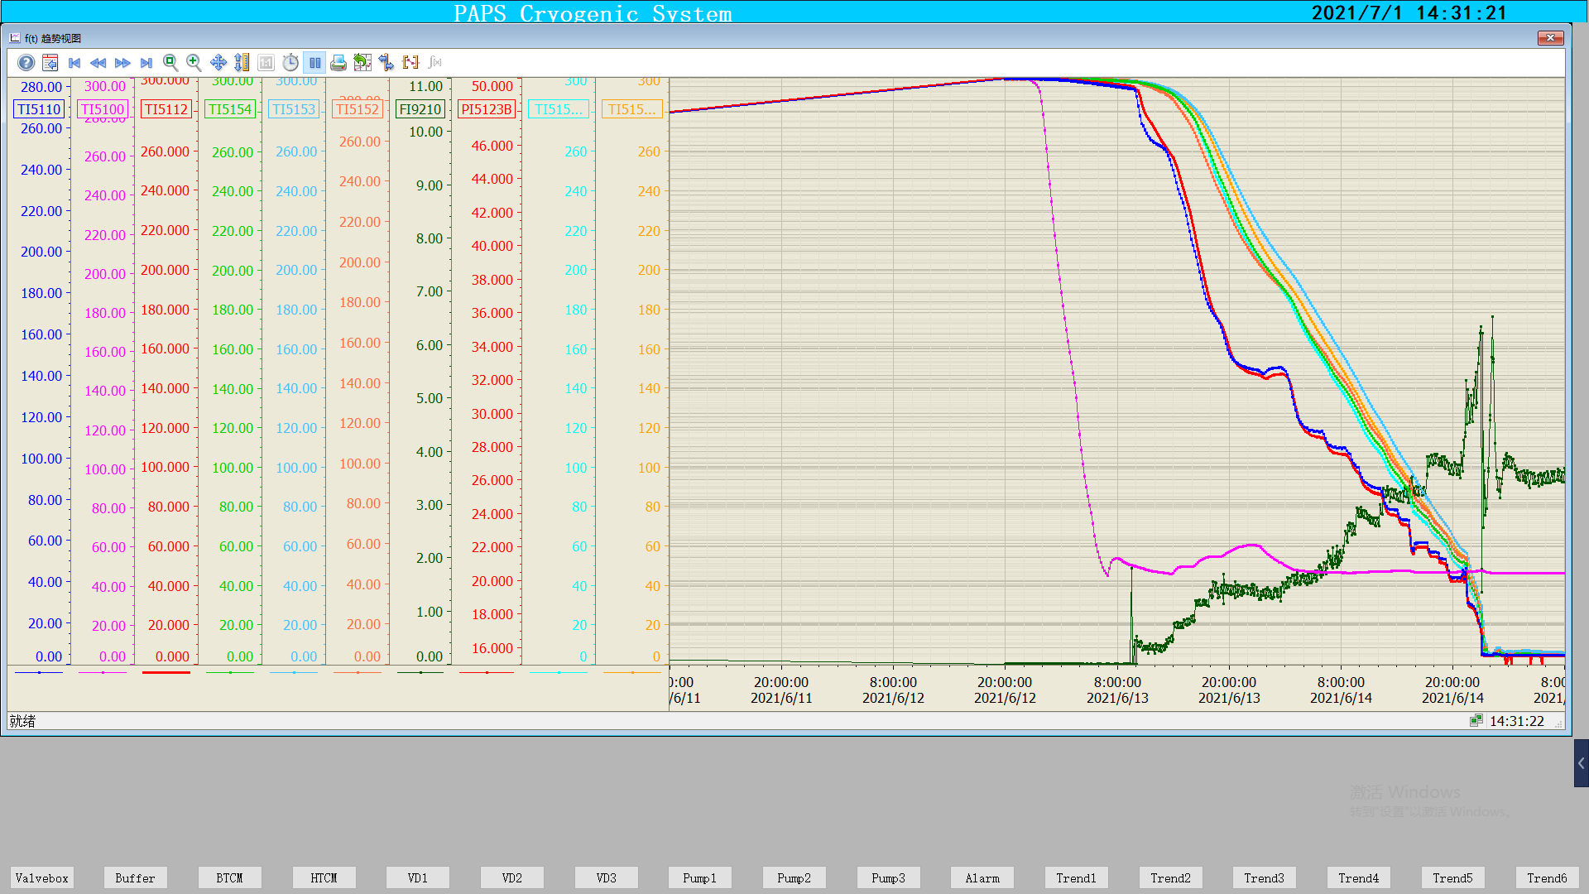
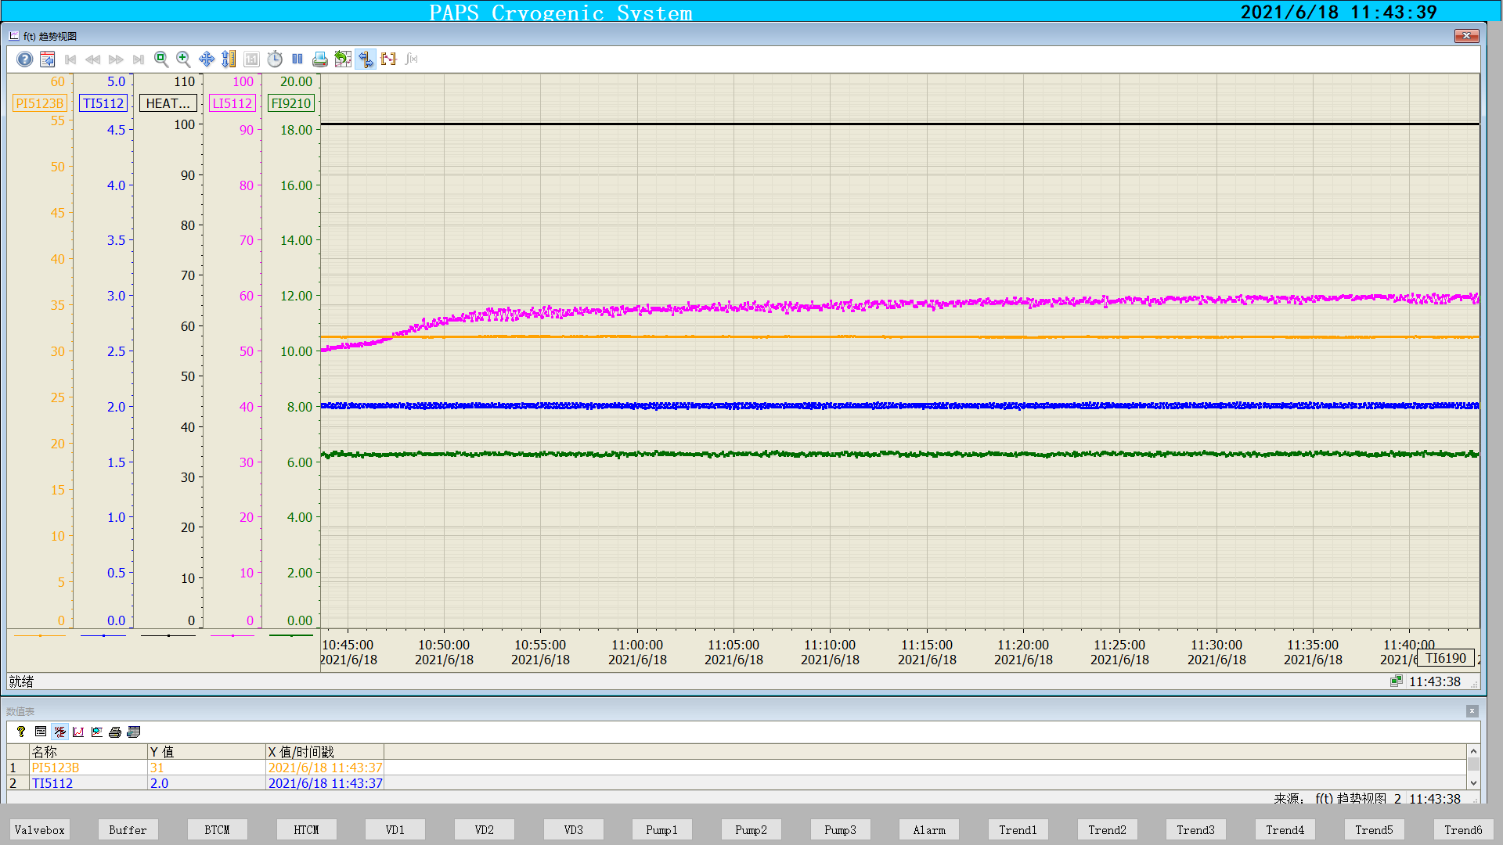
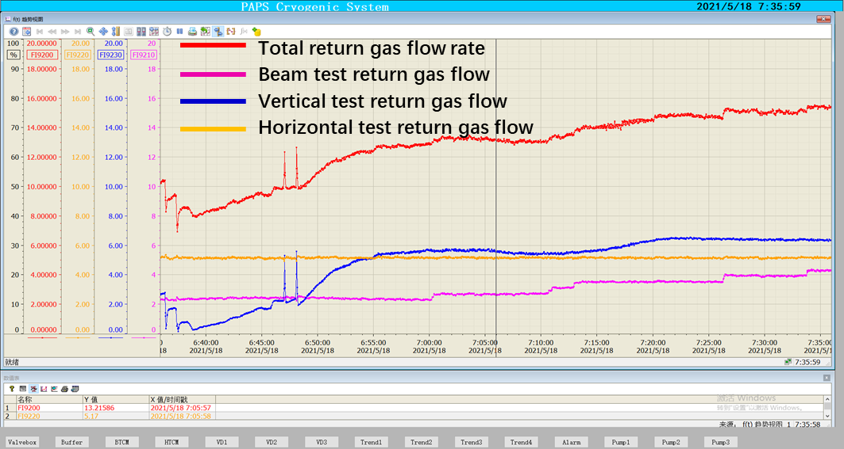
Operation test for 650MHz 2-cell cavities
BTCM cooldown
BTCM: 100.7W@2K
Level
Temperature
Pressure
Mass flow
Pressure 31mbar±10Pa
Temperature 2K±0.02K
BTCM 2K stable operation
Total dynamic heat load 300W@2K return gas flow rate

Slide 26

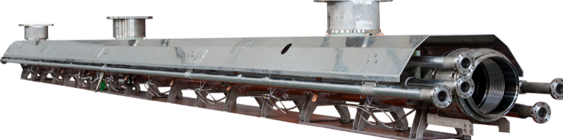
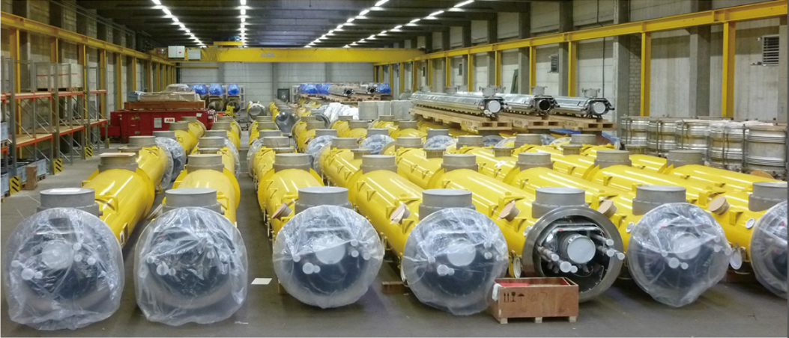
Cryomodule for 1.3GHz 9-cell cavities
Design Goals:
Low heat loss
Fast cool down
XFEL / LCLS-II type Cryomodule for High Q Cavity
Cryogenic Group in IHEP has manufactured 58 1.3GHz 9-cell Cryomodules for EXFEL cooperated with local companies.
It’s a good foundation for the optimization design for the CEPC cryomodules.

Slide 27
RF detailed Process calculation
0.15W/m single loop transfer line heat loss
Scheme1
Scheme2
Collider: after modified, Smaller diameter

Slide 28
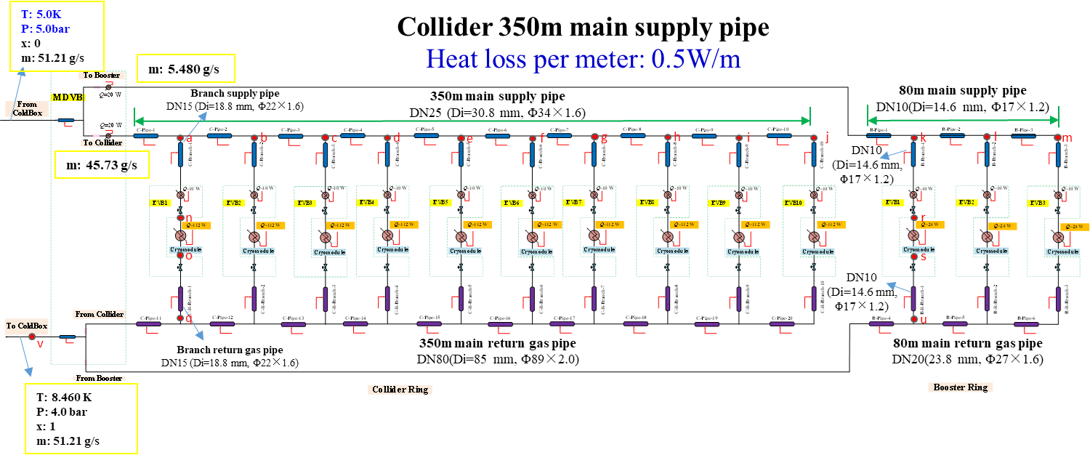
5K~8K TS calculation
Total main supply pipe length is 430 meters, and the heat loss per meter is 0.5 W.
The mass flow of liquid helium needs to be provided by the refrigerator is no less than 51.21 g/s .
Main supply pipe sizes: collider- Di=30.8 mm, Booster-Di=14.6 mm.
Main return gas pipe sizes: collider- Di=85 mm, Booster-Di=23.8 mm.
Branch supply pipe sizes: collider- Di=18.8 mm, Booster-Di=14.6 mm.
Branch return gas pipe sizes: collider- Di=18.8 mm, Booster-Di=14.6 mm.

Slide 29
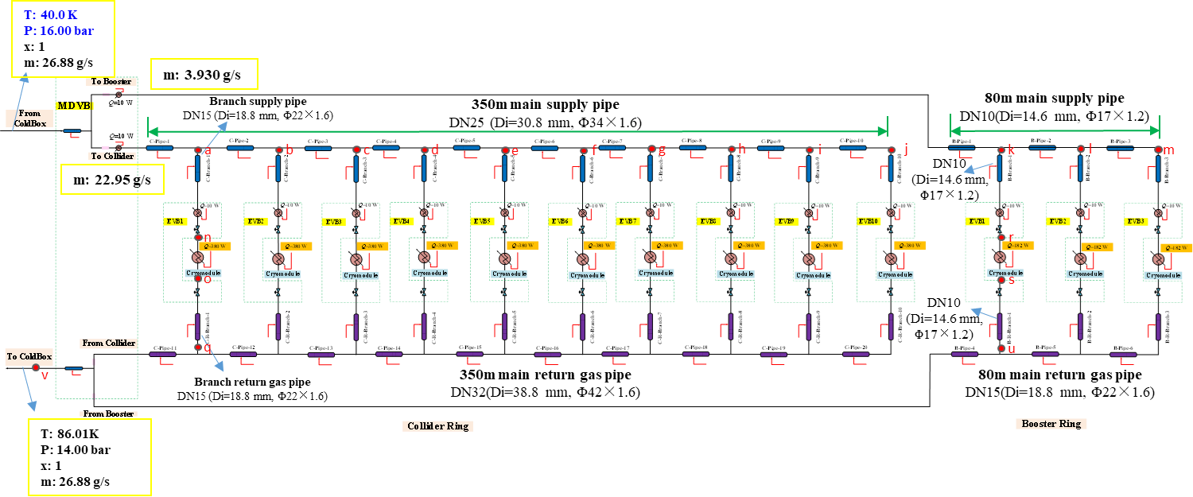
40K~80K TS calculation
Collider 350m main supply pipe
Heat loss per meter: 2.0 W/m
Total main supply pipe length is 430 meters, and the heat loss per meter is 2.0 W.
The mass flow of liquid helium needs to be provided by the refrigerator is no less than 26.88 g/s .
Main supply pipe sizes: collider- Di=30.8 mm, Booster-Di=14.6 mm.
Main return gas pipe sizes: collider- Di=38.8 mm, Booster-Di=18.8 mm.
Branch supply pipe sizes: collider- Di=18.8 mm, Booster-Di=14.6 mm.
Branch return gas pipe sizes: collider- Di=18.8 mm, Booster-Di=14.6 mm.

Slide 30
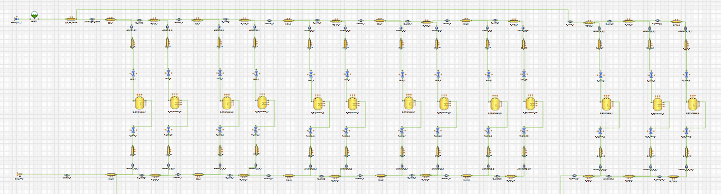
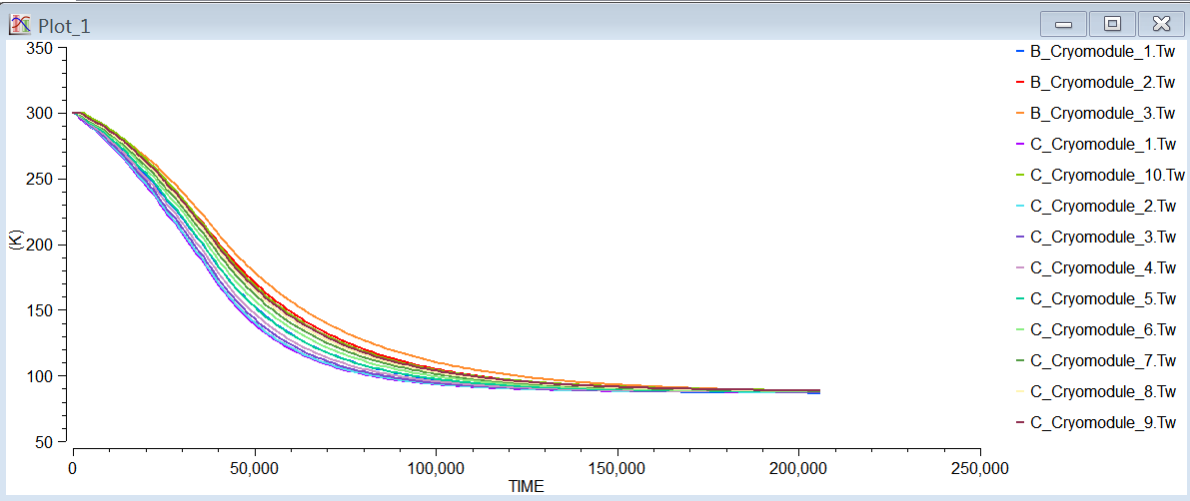
Unsteady-state simulation for the RF cavity cooldown
From refrigerator
SRF cavity
to refrigerator
Cool-down stage I: The cool-down process of the SRF cavity is from 300K to 100K, and the total cooldown time is 120000 second (33h).
The time for Cooldown is 120000 second.

Slide 31












Unsteady-state simulation for the RF cavity cooldown
The cooling rate of the superconducting cavity needs to be strictly controlled, and a three-dimensional flow field non-stationary numerical simulation of the cooling process of the 650 2-cell superconducting cavity is performed.
A certain simulation basis is laid for the subsequent automatic cooling.
a) 260K b) 220K c) 180K
d) 140K e) 100K f) 60K
g) 40K h) 20K
Non-stationary analysis of superconducting cavity cooling process
Global velocity distribution

Slide 32
Summary of CEPC RF cryogenic system design
接下来，超导腔侧还需要确定以下事情：
Next, the following things still need to be determined on the superconducting chamber side.
进行低温系统更为详细的流程计算和优化，以回气△P=0.4kPa压降为条件进行管径优化；
More detailed process calculations and optimization of the cryogenic system, optimization of the tube diameter in terms of return gas ΔP = 0.4 kPa pressure drop.
恒温器结构设计优化（接口尺寸、走向等），恒温器之间常温磁铁的结构确认，与高频组、磁铁组一起协商对接方案
Cryostat structure design optimization (interface size, orientation, etc.), the structure of the room temperature magnet between the cryostat needs to be confirmed with RF group, magnet group .
高性能的多通道低温传输管线的设计与测试研究
Design and testing study of high performance multi-channel cryogenic transfer lines.
多通道低温管线真空隔断的优化设计
Optimization of the design of vacuum isolation for multi-channel cryogenic pipeline
……

Slide 33
OUTLINE
Introduction
Layout of the cryogenic system
Discussion and Comparison on CEPC SRF cryogenic system
Discussion and Comparison on SC magnets cryogenic system
Summary

Slide 34





SC magnets cryogenic system overview
LTS Solenoid
LTS Solenoid ：
Solenoid located outside calorimeter
Inner diameter 7.2 m, length 7.4 m
Central field：3 T
Superconductor：NbTi
Operation temperature：4.2 K
IDEA detector
HTS Solenoid
HTS Solenoid ：
Solenoid located inside calorimeter/less material
Inner diameter 4 m, length 6 m
Central field：2 T
Superconductor：YBCO
Operation temperature：20 K
From Zhu Ying-shun
Zhu Zian，Wang Meifen

Slide 35
Estimated heat loads for SC IR magnets
 |  | 4.5K main loop |  |  | Thermal Shielding 40~80K
Name | Unit | No. | Heat load for each | Heat load | Heat load for each | Heat load
IR SC sextupole magnet | W | 32 | 10 | 320 | 68 | 2176
Valve Box of IR SC sextupole magnet | W | 32 | 20 | 640 | 20 | 640
Current lead of IR SC sextupole magnet | g/s | 32 | 0.1 | 3.2 | 0.1 | 3.2
IR SC magnet | W | 4 | 30 | 120 | 180 | 720
Valve Box of IR SC magnet | W | 4 | 30 | 120 | 30 | 120
Current lead of IR SC magnet | g/s | 4 | 0.5 | 2 | 0.5 | 2
Main distribution valve box | W | 4 | 50 | 100 | 50 | 200
Cryogenic transfer-line | W | 4000 | 0.3 | 1200 | 2 | 8000
Total equiv. heat load @4.5K | W | 14356
Total equiv. heat load @4.5K | W | 14356W+10.4g/s
Total equiv. heat load @4.5K | W | 14478
Total equiv. heat load @4.5K with multiplier 1.5 | W | 21717
Cooling capacity of refrigerator@4.5K | W | 2 | 12kW@4.5K | 24kW@4.5K
Installed power (COP 300W/1W) | MW
 |  | 4.5K main loop |  |  | Thermal Shielding 40~80K
Name | Unit | No. | Heat load for each | Heat load | No. | Heat load for each | Heat load
IR SC sextupole magnet | W | 32 | 10 | 320
Valve Box of IR SC sextupole magnet | W | 32 | 20 | 640
Current lead heat load of IR SC sextupole magnet | W | 32 | —— | ——
IR SC magnet | W | 4 | 30 | 120
Valve Box of IR SC magnet | W | 4 | 30 | 120
Current lead of IR SC magnet | g/s | 4 | 0.5 | 2
Main distribution valve box | W | 4 | 50 | 100
Cryogenic transfer-line | W | 4000 | 0.3 | 1200 | 3424 | 1.5 | 5136
Total heat load @4.5K | W |  |  | 2500 |  |  | 5136
Total heat load @4.5K | W |  |  | 2500W+2g/s |  |  | 5136
Total heat load @4.5K | W |  |  | 2523.45 |  |  | 5136
Coefficient |  |  |  | 1 |  |  | 0.05
Total heat load @4.5K | W |  |  | 2523.45 |  |  | 256.8
Total equiv. heat load @4.5K | W | 2780.25
Total equiv. heat load @4.5K with multiplier 1.5 | W | 4170
Cooling capacity of refrigerator@4.5K | W | 2 | 4kW@4.5K | 8kW@4.5K
Two individual refrigerators (2 x 4kW@4.5K) will be employed for the CEPC SC magnets cryogenic system.

Slide 36


Heat loads and layout for detector magnet
Zhu Zian，Wang Meifen
layout for detector magnet
Refrigerator selection
Liquefaction | 430L/h
Refrigeration | 2×1.5kW@4.5K
Liquefaction/Refrigeration | 1kW@4.5K & 150L/h

Slide 37

SC magnets cryogenic system
2 IPs in CEPC Interaction Region, there are 4 QD0 magnets, 4 QF1 magnets, 4 anti-solenoids and 32 sexupole magnets.
Plant A. Large refrigerator
Plant B. GM refrigerator
Refrigeration:
2.5kW@4.5K
The GM refrigerator’s vibration is unacceptable, besides the electricity power consumption is very high.
The maintenance of the GM refrigerator is very difficult, and failure rate is many times that of a single large refrigerator.
Compressor takes up space and produces vibration and noise in tunnel.

Slide 38


Power consumption comparison
SC magnet:
10W heat load of each SC magnet
1.5W@4.2K GM refrigerator, needs 8 sets of GM refrigerators/each SC magnet, total 16*8=128 sets
power consumption 7.2kW/each GM refrigerator
16 SC magnets power consumption: 16*8*7.2=921kW
If adopts a large refrigerator, power consumption ~800kW
Therefore, the small GM refrigerator scheme has no advantage in the power consumption aspect.
Considering the operation stability and power consumption of the system, the large refrigerator scheme is selected.

Slide 39


Flow scheme of Traditional SC magnets
cryogenic system
Compressor group
Cold Box
Dewar
Main Distribution
Valve Box
Valve Box
Detector
SM
SM
SM
SM
SM
SM
SM
SM
QD0,QF1, and anti-solenoid
QD0,QF1, and anti-solenoid
to another Detector
SM
SM
SM
SM
SM
SM
SM
SM
1.5kW@4.5K

Slide 40


Flow scheme of Modified SC magnets
cryogenic system
J. Gao
The requirement for IR sextupole magnets is updated.
The magnet bore and pole field is reduced.
Conventional sextupole magnet technology can be used (FeCoV pole). Max strength 3886T/m² is achieved with bore aperture 42 mm. Max current < 200A.
IR sextupoles have been changed from SC magnets to normal conducting ones and cryogenic system for sextupoles can be eliminated.
Y.W. Wang

Slide 41

Flow Chart for CEPC MDI Cryostat (one site)

Slide 42


Mechanical Design of CEPC MDI Cryostat
The total weight of cryostat is about 2.5 T
IP
反抵螺线管
QD0
冷屏
QF1
Beam pipe

Slide 43

Vacuum chamber---temperature field
1
2
3
4
5
Calculation conditions: the outermost layer is set as convective boundary condition, the surface that the support structure contacts with the helium pool is set as 5K, and the surface that contacts with the cold screen is set as 60K
Support numbers
convective heat transfer coefficient | 1 | 2 | 3 | 4 | 5
5W m^-2 K^-1 | 268.97 K | 268.98 K | 270.52 K | 282.76 K | 283.32 K
8W m^-2 K^-1 | 273.14 K | 273.14 K | 274.09 K | 285.34 K | 286.65 K

Slide 44




Vacuum chamber---stress analysis
最大变形0.1mm@外压1Bar
最大变形0.15mm@内压1.2Bar
最大应力69.343MPa@外压1Bar
最大应力125.73MPa@内压1.2Bar

Slide 45
Summary of CEPC SC magnets cyogenic system
接下来，超导磁体侧还需要确定以下事情：
Next, the following things still need to be determined on the superconducting magnet side.
需跟进磁铁机械设计，方案确定后可进行更为详细的低温系统设计
Need to follow up on the progress of multiple technology routes for the magnets, and more detailed design of the cryogenic system can be done after the program is determined.
超导磁铁低温恒温器进行更为详细的结构设计，以及针对低温恒温器进行多维度的流动传热仿真计算，分析流场进而指导优化结构设计，形成闭环设计思路。
More detailed structural design of the superconducting magnet cryostat, as well as multi-dimensional flow and heat transfer simulation calculations for the cryostat, analyze the flow field and then guide the optimization of the structural design to form a closed-loop design idea.
.......

Slide 46
Summary
Previous CDR and TDR works have laid a good foundation for the further design.
For the CEPC cryogenic system TDR design, relevant aspects have been considered , including process scheme, layout, and key equipment design.
Several key technologies (JT heat exchanger platform/cryo-circulating pump/multi-channel Transfer line test platform/Virtual system establishment and automatic control strategy research) are introduced.
Further TDR design is going on. Now it‘s just at the stage of scheme comparison, and there is still a long way to complete the whole TDR design. In the later time, the project team members need to work together to greatly push forward the work, and complete the TDR design on time.

Slide 47
Thanks for Your Attention！

