Slide 1


CEPC booster and damping ring
Dou Wang (IHEP)
on behalf of CEPC AP group
Mini-workshop on Accelerator Physics, IAS Program on High Energy Physics 2022.

Slide 2
outline
Design status for CEPC booster
Design status for CEPC positron damping ring
Summary

Slide 3
outline
Design status for CEPC booster
Design status for CEPC positron damping ring
Summary

Slide 4
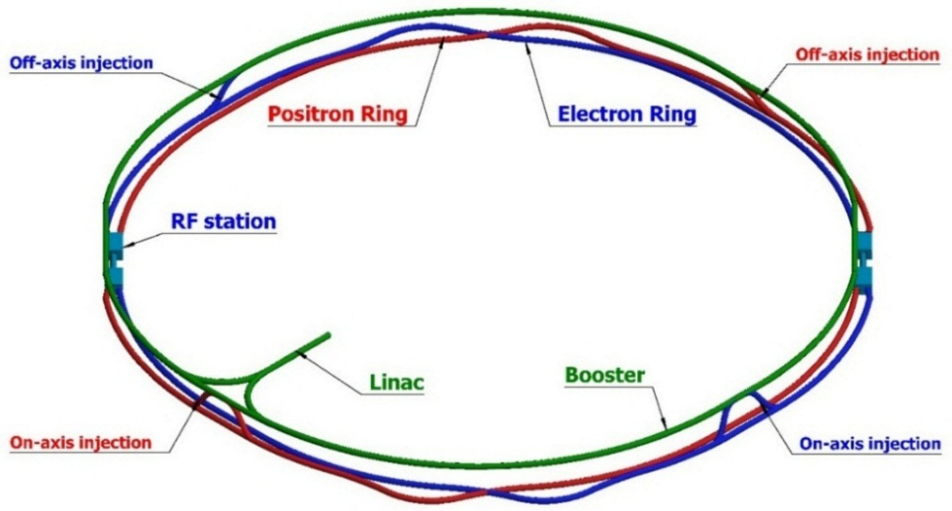
CEPC injector chain
20→180GeV
20GeV
100km
Injection energy: 20GeV
20 GeV linac provides electron and positron beams for booster.
Top up injection for collider ring ~ 3% current decay
Booster is in the same tunnel as collider ring, above the collider ring, bypass in IR.
Budget for transfer efficiency 90%: 92% for booster + 99% for transport lines.
Beam current threshold in booster is limited by RF system.
Feedback systems (Transverse & longitudinal) are need to damp the instability at low energy.

Slide 5
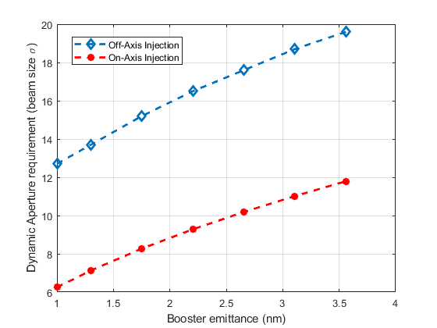
Requirement update for booster
Collider ring | Higgs (CDR) | Higgs (TDR)
Number of IPs | 2 | 2
Energy (GeV) | 120 | 120
Circumference (km) | 100 | 100
SR loss/turn (GeV) | 1.73 | 1.8
Half crossing angle (mrad) | 16.5
Piwinski angle | 3.48 | 4.30
N_{e}/bunch (10¹⁰) | 15.0 | 14.5
Bunch number | 242 | 240
Beam current (mA) | 17.4 | 16.7
SR power /beam (MW) | 30 | 30
Bending radius (km) | 10.7 | 10.2
Momentum compaction (10⁻⁶) | 11.1 | 7.1
β_{IP} x/y (m) | 0.36/0.0015 | 0.33/0.001
Emittance x/y (nm) | 1.21/0.0024 | 0.64/0.0013
Transverse σ_{IP} (um) | 20.9/0.06 | 15.0/0.037
ξ_{x}/ξ_{y}/IP | 0.018/0.109 | 0.021/0.115
V_{RF} (GV) | 2.17 | 2.20
f _{RF} (MHz) (harmonic) | 650 (217500)
Nature bunch length σ_{z} (mm) | 2.72 | 2.3
Bunch length σ_{z} (mm) | 4.4 | 3.9
Energy spread (%) (SR/BS) | 0.1/0.134 | 0.1/0.17
Energy acceptance requirement (%) | 1.35 | 1.7
Energy acceptance by RF (%) | 2.06 | 2.3
Lifetime due to beamstrahlung (min) | 80 | 40
Lifetime (min) | 25 | 20
F (hour glass) | 0.89 | 0.88
L_{max}/IP (10³⁴cm⁻²s⁻¹) | 2.93 | 5.0
Horizontal DA requirement of collider ring due to injection
X. H. Cui
Booster emittance @120 GeV <1.7nm (3.6nm in CDR)

Slide 6
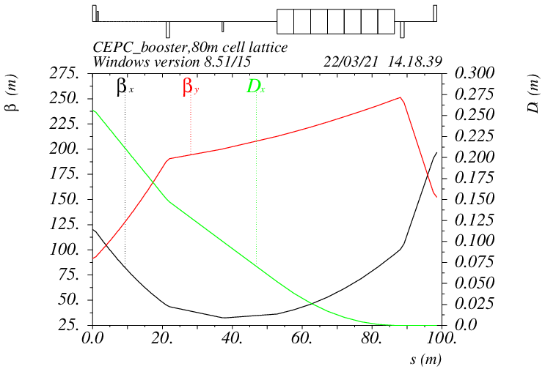
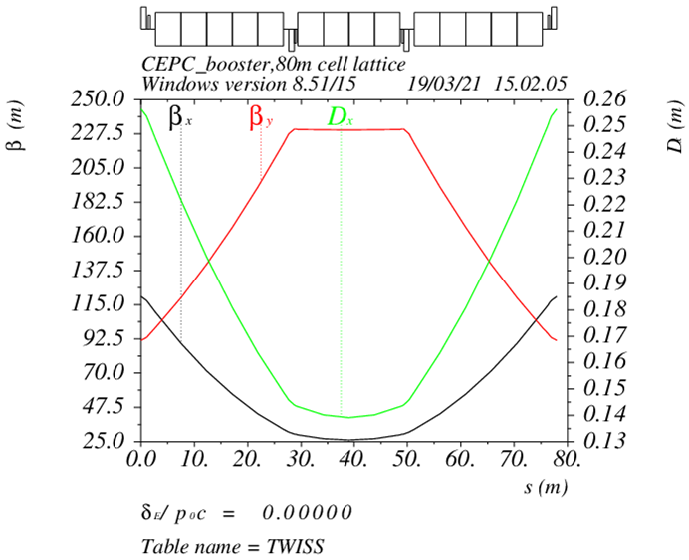
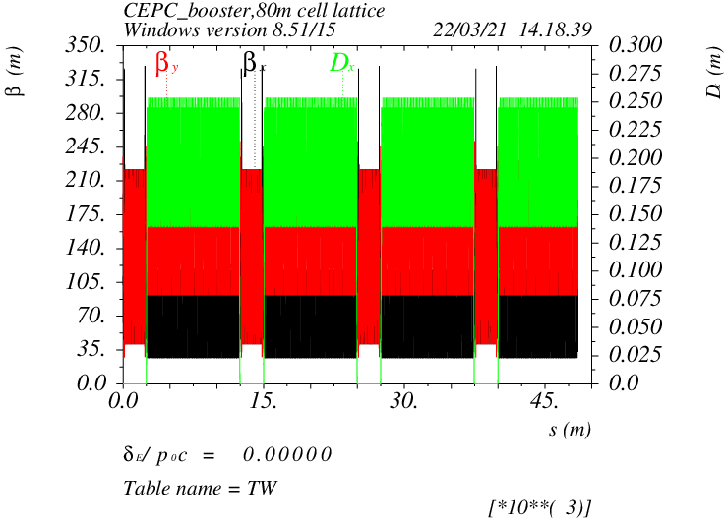
Booster TDR optics
D. Wang, C. H. Yu, Y. M. Peng…
TME like structure (cell length=80m)
Interleave sextupole scheme
Emittance@120GeV=1.26nm
Overall idea: uniform distribution for the Q
Combined magnet (B+S) scheme possible
Dispersion sup.
Arc cell
Half ring

Slide 7
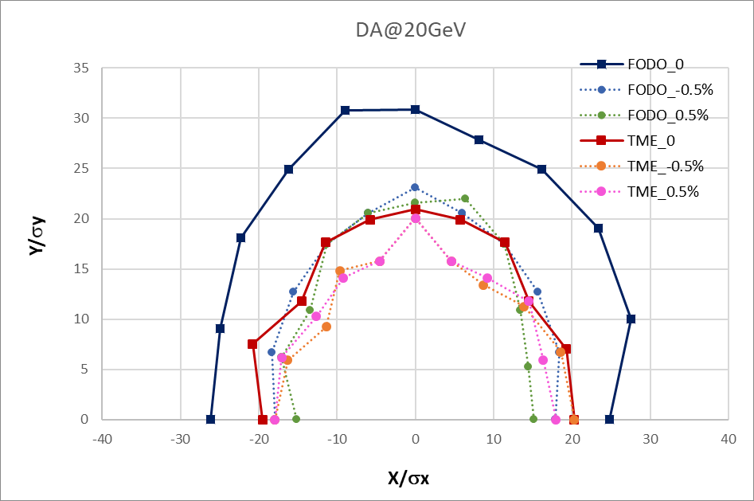
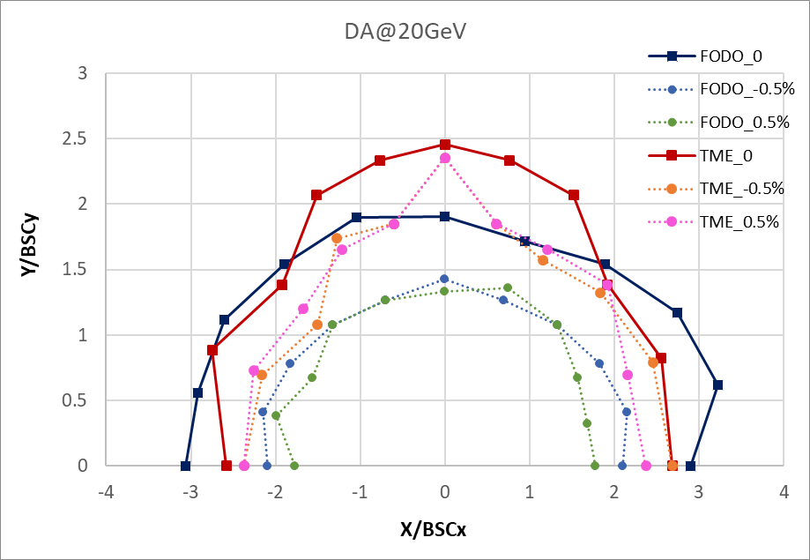
DA results @ 20GeV
Booster energy: 20GeV~180GeV
20GeV: BSC_{xy}=(4σ_{xy}+5mm)*2
Inj. emittance from Linac:10nm
Energy spread from Linac: 0.16%

Slide 8
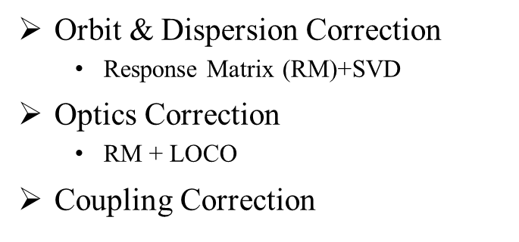
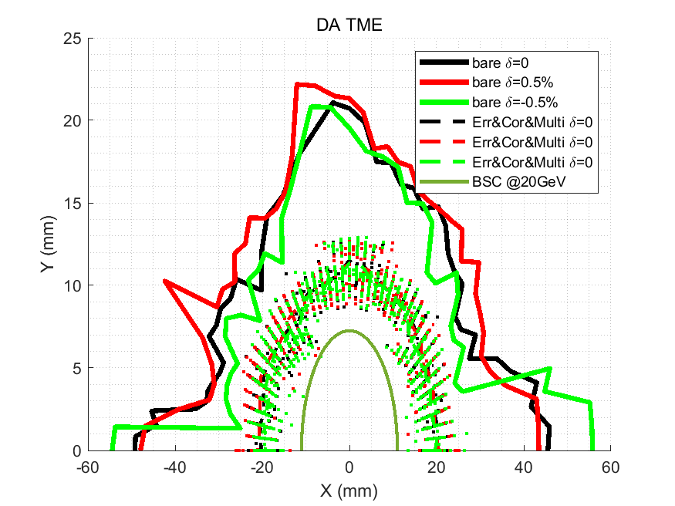
DA results with errors and correction
D. H. Ji
 | Dipole | Quadrupole | Sextupole
Transverse shift X/Y (μm) | 100 | 100 | -
Longitudinal shift Z (μm) | 100 | 150 | -
Tilt about X/Y (mrad) | 0.2 | 0.2 | -
Tilt about Z (mrad) | 0.1 | 0.2 | -
Nominal field | 1e-3 | 2e-4 | 3e-4
 | Accuracy (m) | Tilt (mrad) | Gain | Offset w/ BBA(mm)
BPM(10Hz) | 1e-7 | 10 | 5% | 30e-3
(100 seeds)
(93 seeds)
Relax multipole errors
(93 seeds)
dipole | quadrupole
B1/B0 ≤ (2→3)×10⁻⁴
B2/B0 ≤ (3→5)×10⁻⁴ | B2/B1 ≤ 3×10⁻⁴
B3/B0 ≤ 2×10⁻⁵ | B3/B1 ≤ (1→2)×10⁻⁴
B4/B0 ≤ 8×10⁻⁵ | B4/B1 ≤ 1×10⁻⁴
B5/B0 ≤ 2×10⁻⁵ | B5/B1 ≤ 1×10⁻⁴
B6/B0 ≤ 8×10⁻⁵ | B6/B1 ≤ 5×10⁻⁵
B7/B0 ≤ 2×10⁻⁵ | B7/B1 ≤ 5×10⁻⁵
B8/B0 ≤ 8×10⁻⁵ | B8/B1 ≤ 5×10⁻⁵
B9/B0 ≤ 2×10⁻⁵ | B9/B1 ≤ 5×10⁻⁵
B10/B0 ≤ 8×10⁻⁵ | B10/B1 ≤ 5×10⁻⁵

Slide 9
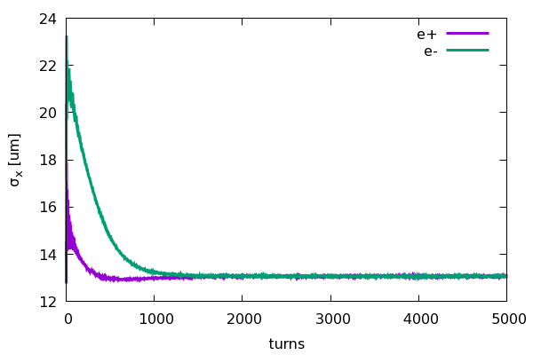
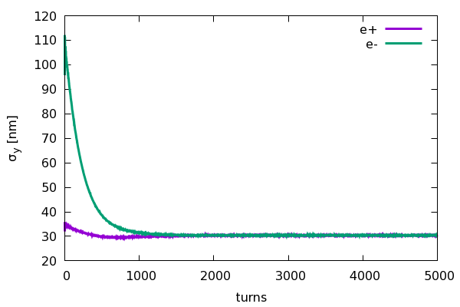
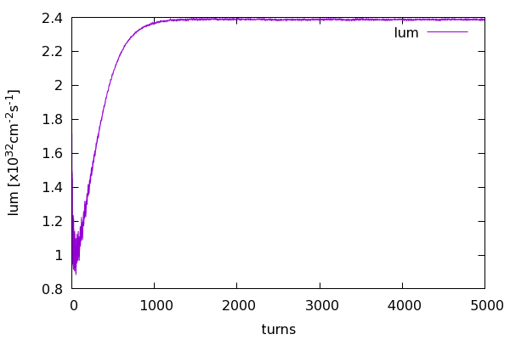
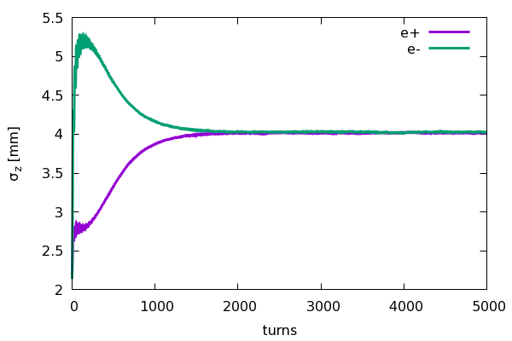
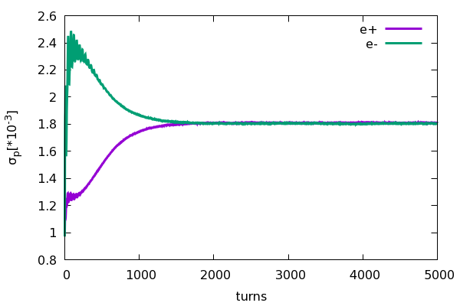
Beam beam instability for on-axis injection
Yuan Zhang
Collision stability check for on-axis injection scheme at 120GeV
e- (Ne=14×10¹⁰)
e+ (Ne=14×10¹⁰)
• Emittance X = 1.26nm
• Energy spread = 0.1%
• Bunch length=2.1mm
• Coupling=1.0%
• Emittance X = 0.68nm
• Energy spread = 0.1%
• Bunch length=2.25mm
• Coupling=0.2%

Slide 10
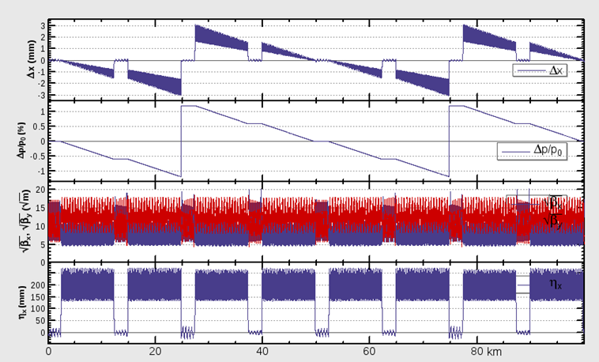
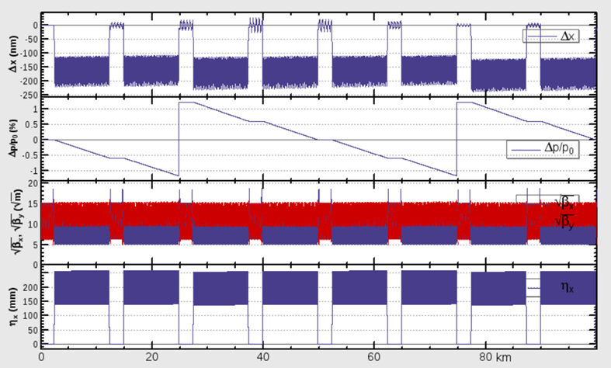
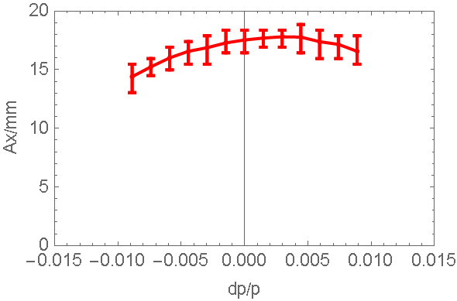
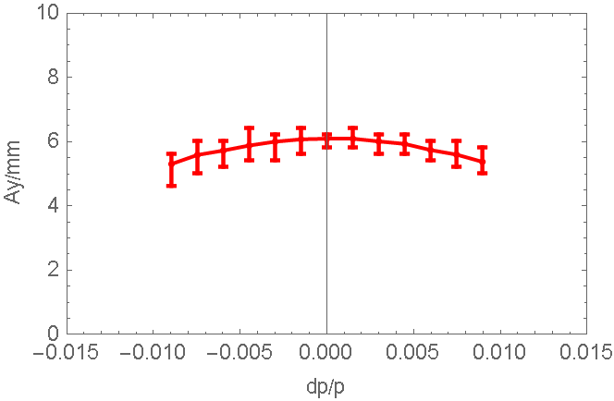
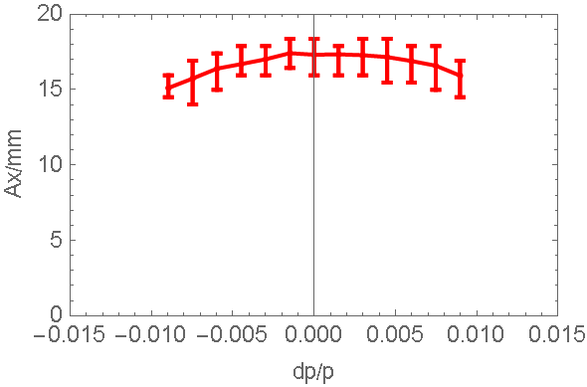
SR & Sawtooth effect@180GeV
D. Wang, D. H. Ji
2 RF stations
Maximum sawtooth orbit: 3 mm
Energy deviation: 1.1%
Emittance growth: ~2.9%
DA reduction due to strong SR
Combined effects of sawtooth and magnets’ errors will be studied:
Taper dipoles in 8 sections
No need to taper the quad and sext
Orbit (optics) correction
W/O taper
W taper
DA tracking (50 seeds, 100 turns)
DA > requirement (injection)
- DA_X=5σx+3mm=7.0mm
- DA_Y=39σy+3mm=4.3mm
Sawtooth orbit was corrected by tapering
No DA reduction due to sawtooth orbit

Slide 11
Dipole reproducibility requirement@20GeV
Increase/decrease the strength of all the dipoles by the same amount.
Evaluate the influence: working point, closed orbit, DA, energy acceptance
Working point should not pass through the lower order resonance
Small shrink for dynamic aperture
Reproducibility requirement for dipoles: ~0.04%
Stability requirement for power supply: ~0.01%
Dipole field error tolerance slightly loser than FODO.
 | original | +0.01% | -0.01% | +0.03% | -0.03% | +0.05% | -0.05%
nux | 321.271 | 321.234 | 321.308 | 321.158 | 321.383 | 321.084 | 321.458
nuy | 117.193 | 117.166 | 117.220 | 117.112 | 117.274 | 117.058 | 117.328
Δx (um) | 0 | -26 | 26 | -77 | 77 | -130 | 130
DA (%) | 100 | 95 | 100 | 97 | 95 | 97 | 95

Slide 12

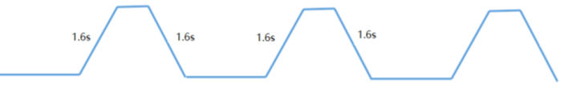
Booster ramping scheme
Dou Wang, Xiaohao Cui
0.037s
tt
7.3s
7.3s
0.37s+7.3s+0.037s+7.3s=15.0s
1 cycles/beam
0.37s
0.24s
5s damping
Higgs
4.5s
4.5s
4.5s
4.5s
1 cycles/beam
2.4s
off-axis
2.4s
on-axis
2.4s+4.5s+5.0s+4.5s=16.4s
1.23s
W
2.7s
2.7s
1 cycles/beam
12.3s+2.7s+1.23s+2.7s=18.9s
12.3s
0.048s
Z
(19.2s+1.6s+0.048s+1.6s)*3=67.34s
19.2s
19.2s
3 cycles/beam (top up)
19.2s

Slide 13
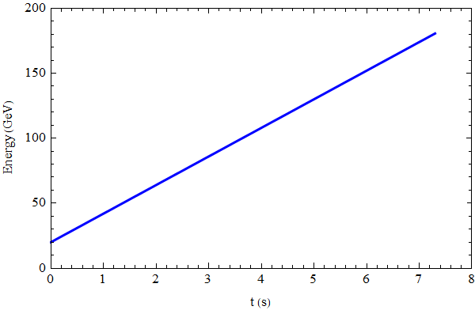
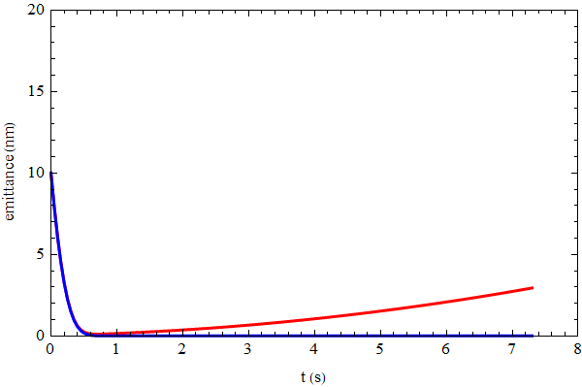
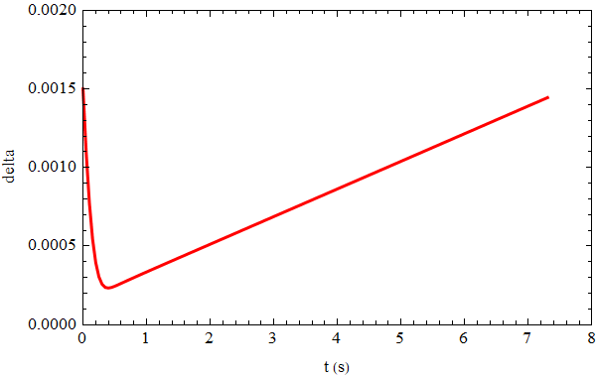
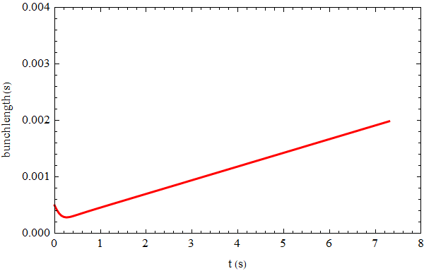
Beam parameter evolution
Injection emittance: 10nm @20GeV
5s damping time (CDR) for Z can be canceled.
emittance
energy
energy spread
bunch length

Slide 14
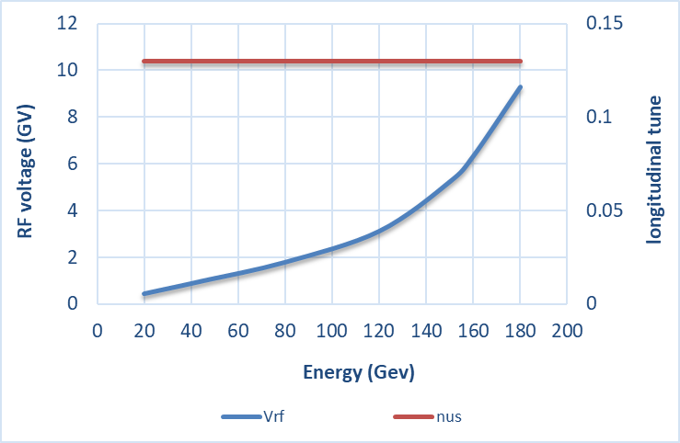
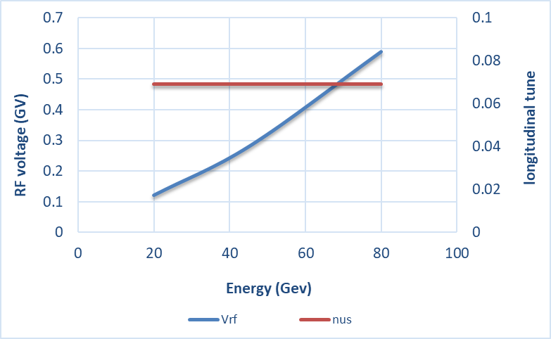
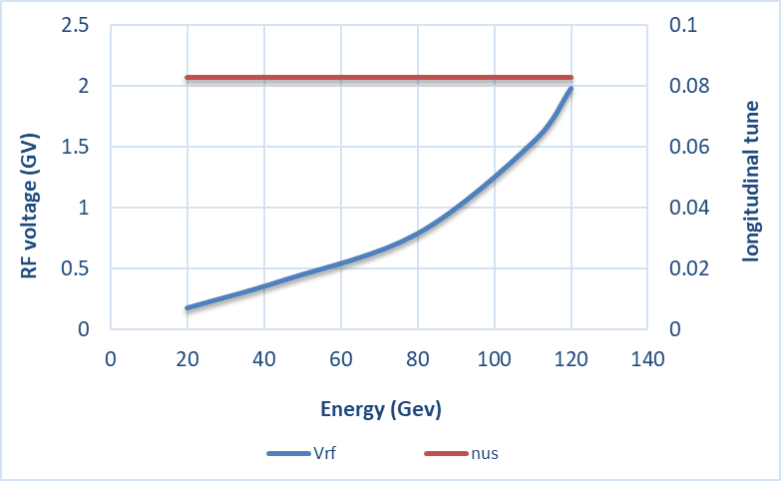
RF ramping curve
Different RF ramping curve for each energy mode
νs for tt: 0.13
νs for Higgs: 0.087
νs for W & Z: 0.069
tt
Max RF voltage @tt determined by longitudinal quantum lifetime.
η_{RF}: ~ 9 ×δ
VRF (180GeV)=9.3GV
Higgs
W &Z

Slide 15
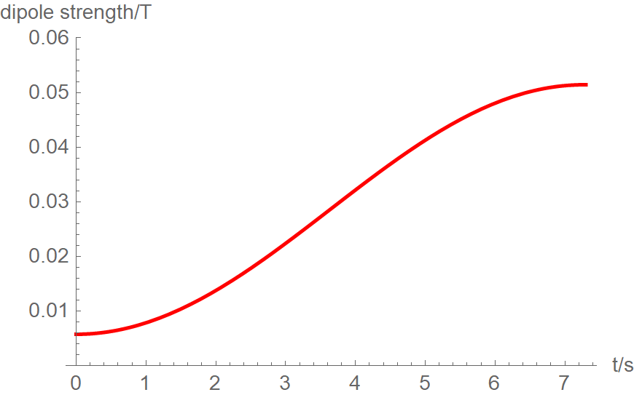
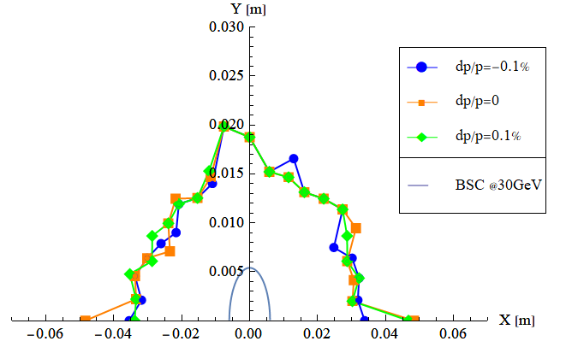
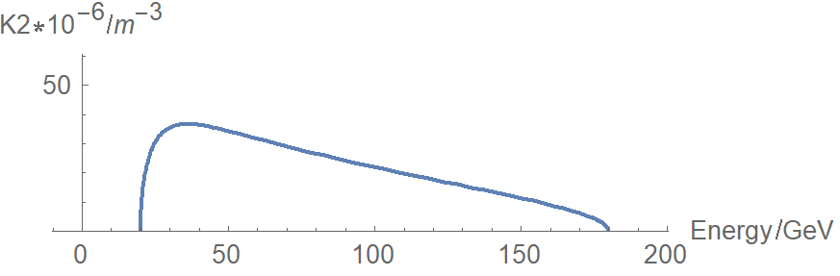
Eddy current effect for TME
Dedicated ramping curve to control the maximum K2.
Al beam pipe (round shape)
- inner diameter: 55mm, thickness: 2mm
Dynamic chromaticity correction can not used.
- Sextupole field is attached to dipole
Analytical estimation for eddy effect*
K2 reaches max at 30GeV.
Max K2=0.000037 (m⁻³)
*Yuan Chen et al., Analytical expression development for eddy ﬁeld and the beam dynamics eﬀect on the CEPC booster, IJMPA, Vol. 36, No. 22 (2021) 2142010

Slide 16
Booster TDR parameters
Injection energy: 10GeV → 20GeV
Max energy: 120GeV → 180GeV
Lower emittance ─ new lattice (TME)
Extraction
Injection
*Diameter of beam pipe is 55mm for re-injection with high single bunch current @120GeV.

Slide 17
outline
Design status for CEPC booster
Design status for CEPC positron damping ring
Summary

Slide 18
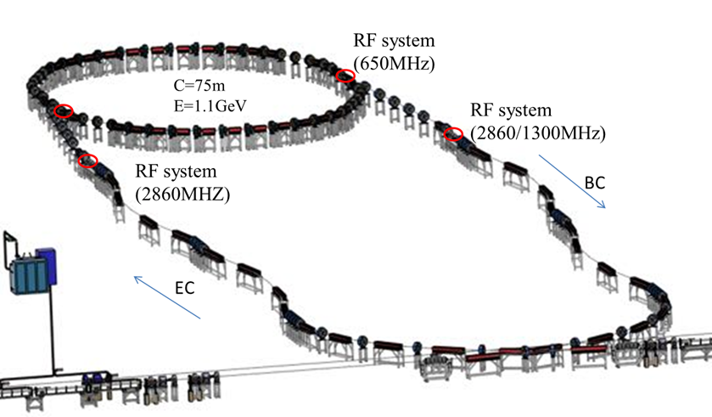
Damping ring layout (CDR)
Linac repetition: 100Hz
Only for positron beam
Storage time: 20 ms
Emittance (norm.): 2500→ 530 mm.mrad
e +

Slide 19
Requirements update for the Damping ring
Cai Meng
Emittance
  High luminosity of Higgs (lower emittance collider → lower emittance booster)
    Lower emittance Linac:10nm@20GeV → Norm. RMS emittance is 392mm⋅mrad
    DR emittance requirement: < 200mm⋅mrad
      Keep the margin for emittance growth
        -- high bunch charge
        -- C-band accelerating structure
      Could use C-band accelerating structure just after the Damping Ring (@1.1GeV)
Damping time
100Hz Linac & two-train scheme/200Hz Linac→ storage time: 20ms
Requirement for damping time: <13ms
Bunch length
  RMS bunch length after DR <1mm
    -- a bunch length compressor was introduced after the DR for electron and positron beam

Slide 20
Comparison of damping ring design requirement
lower emittance collider → lower emittance booster → lower emittance linac
 | CDR | TDR | remark
Energy (GeV) | 1.1 | 1.1
Inj. Emittance (mm⋅mrad) | 2500 | 2500
Ext. emittance (mm⋅mrad) | 530 | <200 | 1) Linac lower emittance: 10nm@20GeV, 2)use C band acc. structure as early as possible
Storage time (ms) | 20 | 20
Damping time (ms) | 15 | <13 | 1) Smaller ext. emittance with same storage time
Circumference (m) | 75 | ~150 | 1) Smaller nature emittance for DR

Slide 21
DR parameters
Damping with reversed bending magnet
4 (max. 8)-bunch storage, storage time:20 (40) ms
Emittance: 2500→ 166/123 (97/59) mm.mrad
Flexibility for extr. emittance
 | DR V3.0
Energy (Gev) | 1.1
Circumference (m) | 147
Number of trains | 2 (4)
Number of bunches/trian | 2
Total current (mA) | 12.4 (24.8)
Bending radius (m) | 2.87
Dipole strength B₀ (T) | 1.28
U₀ (kev/turn) | 94.6
Damping time x/y/z (ms) | 11.4/11.4/5.7
Phase/cell (degree) | 60/60 | 75/75
Momentum compaction | 0.013 | 0.0075
Storage time (ms) | 20 (40)
δ₀ (%) | 0.056
ε₀ (mm.mrad) | 94.4 | 56.7
injection σ_{z} (mm) | 5 | 5
Extract σ_{z} (mm) | 4.9 | 4.2
ε_{inj} (mm.mrad) | 2500 | 2500
ε_{ext x/y} (mm.mrad) | 166(97)/75(3) | 123(59)/68 (2)
δ_{inj} /δ_{ext} (%) | 0.22 /0.056 | 0.22 /0.056
Energy acceptance by RF(%) | 1.6 | 1.8
f_{RF} (MHz) | 650
V_{RF} (MV) | 2.0 | 1.5
Longitudinal tune | 0.0346 | 0.0224

Slide 22
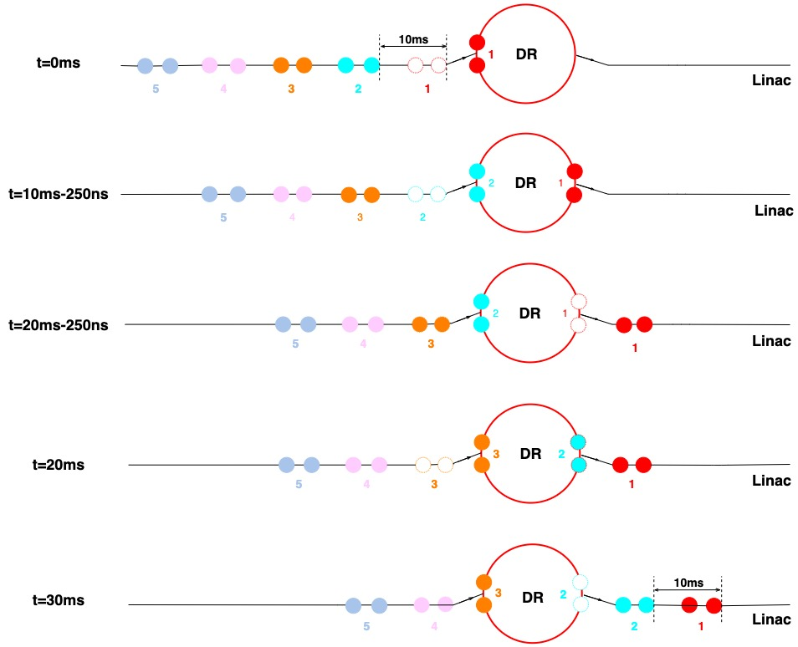
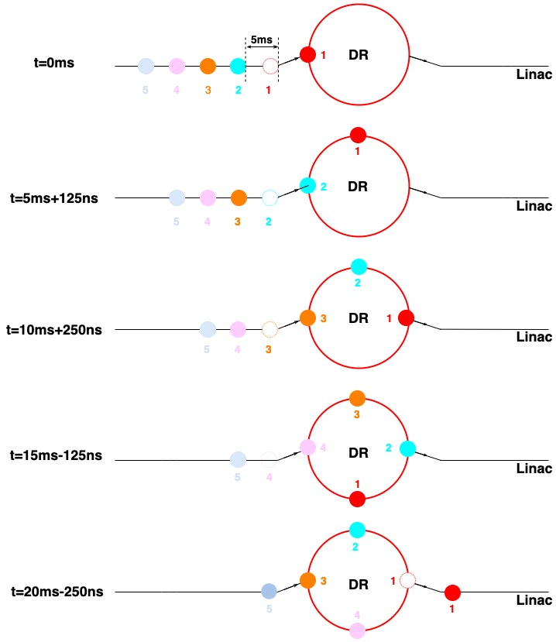
DR time structure
Meng Li, Gang Li, Ge Lei
Double bunch (Inj./Ext.: two by two)
200Hz (Inj./Ext.: bunch by bunch)

Slide 23
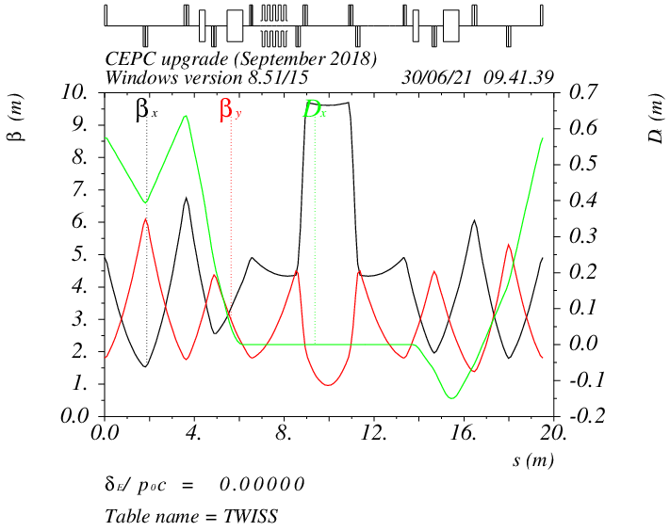
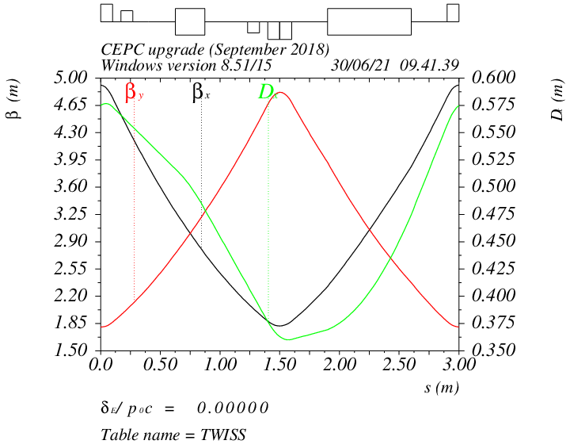
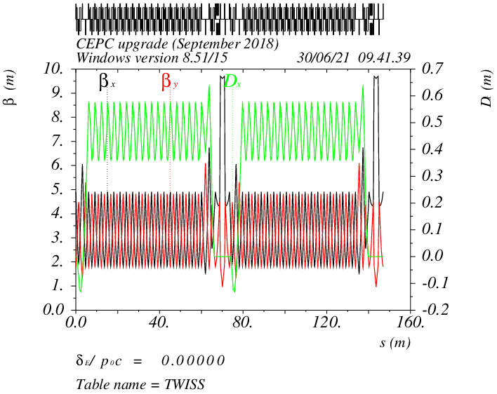
DR optics
Phase/cell: 60°/60° ~ 75°/75° FODO (adjustable)
Interleave sextupole scheme
2 sex. families
Straight
B=1.28T
Arc

Slide 24
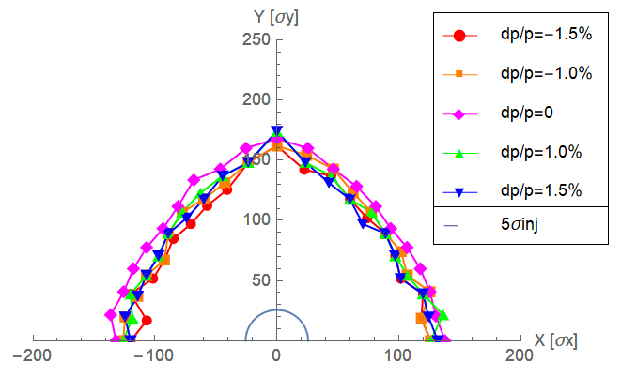
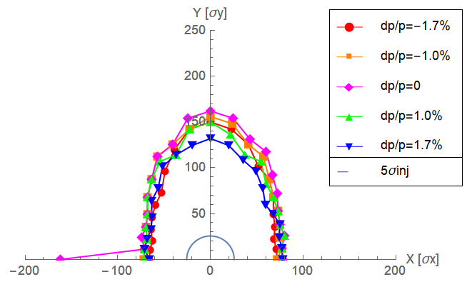
DR DA results
Large trans. acceptance→ inj. efficiency
DA > 5 inj. beam size (ε_{inj}=2500mm.mrad)
Energy acceptance ≥ 1.6%
Phase/cell: 60°/60°
Phase/cell: 75°/75°

Slide 25
Transverse Mode Coupling Instability
Yudong Liu
The threshold for the TMCI is estimated by following analytical formula
Here,ν_{s} is he synchtron tune, β_{y} is the,betraon function and κ_{y} is the transvers kicker factor which is decided by impedance and bunch length.
parameters | Phase/cell: 60°/60° | Phase/cell: 75°/75°
Energy | 1.1Gev | 1.1Gev
circumference | 147 | 147
Beta tune | 7.70/ 8.54 | 9.28 /10.11
Bunch length | 6.7mm/4.9mm | 6.7mm/4.2mm
Bunch number | 4 （2 train） | 4（2 train）
synchtron tune | 0.0346 | 0.0224
Bunch current (mA) | 3.1 | 3.1
Bunch current threshold(mA) | 11.02/9.4 | 8.44/6.6
* Circular Al pipe with 30mm inner diameter

Slide 26
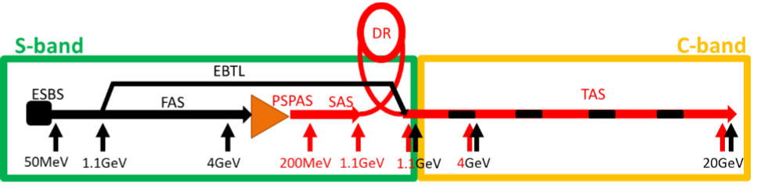
Transport lines between DR and Linac
Dou Wang, Xiaohao Cui
Linac→DR | EC
E₀ (Gev) | 1.1
δ₀ (%) | 0.7
σ_{z0} (mm) | 1.5
f_{RF} (MHz) | 2860
V_{RF} (MV) | 29.0
Length of acc. Structure (m) | 1.08
φ_{RF} (degree) | 88
R₅₆ (m) | -0.626
E_{f} (Gev) | 1.1
δ_{f} (%) | 0.22
σ_{zf} (mm) | 5
DR→Linac | BC
E₀ (Gev) | 1.1
δ₀ (%) | 0.056
σ_{z0} (mm) | 4.9
f_{RF} (MHz) | 2860
V_{RF} (MV) | 20.6
Length of acc. Structure (m) | 0.76
φ_{RF} (degree) | 89.7
R₅₆ (m) | -0.893
E_{f} (Gev) | 1.1
δ_{f} (%) | 0.55
σ_{zf} (mm) | 0.5

Slide 27
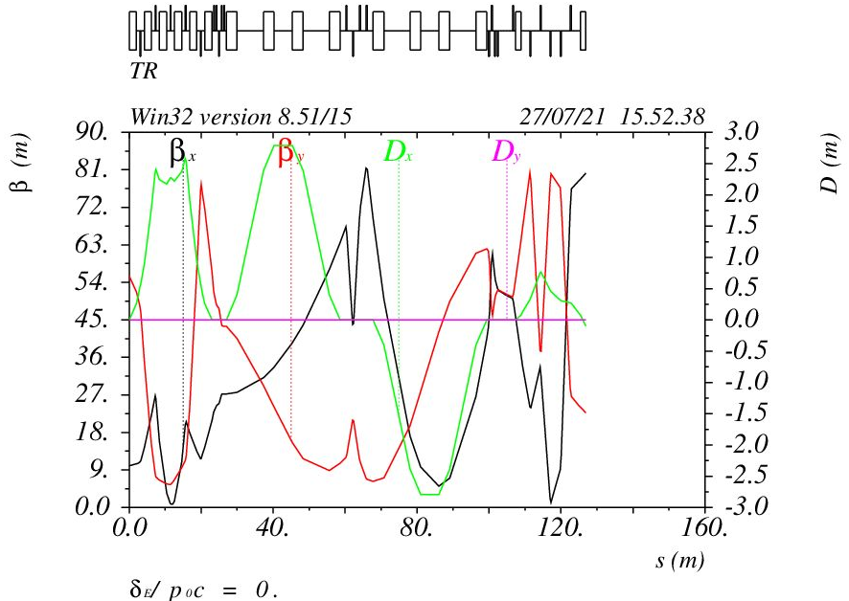
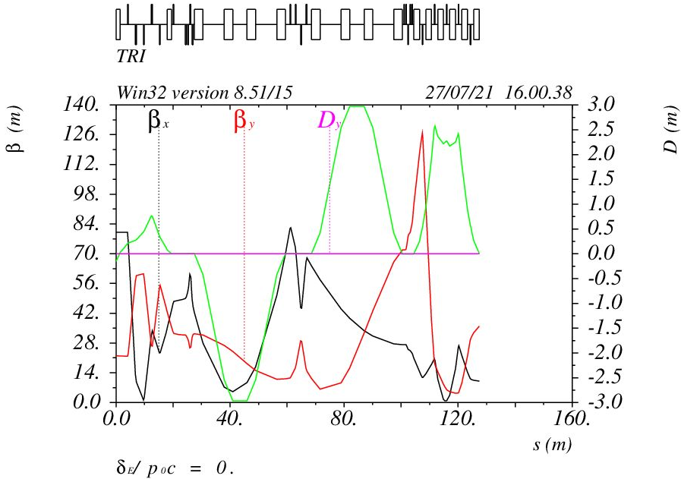
Optics for the transport lines
Xiaohao Cui
Linac→DR
DR→Linac

Slide 28
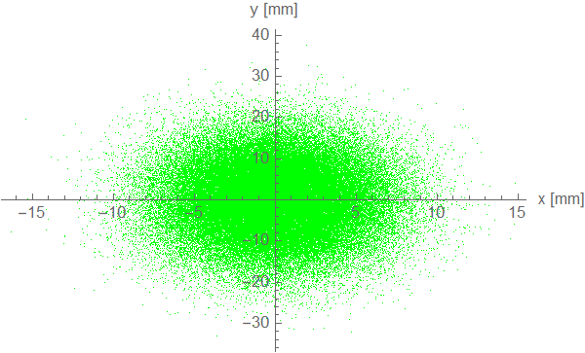
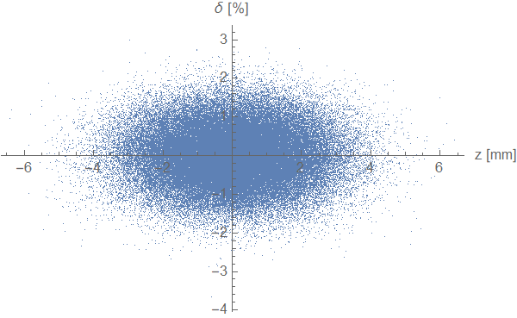
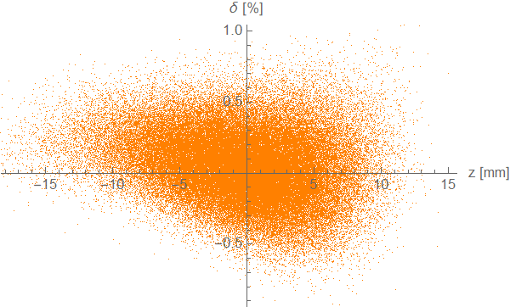
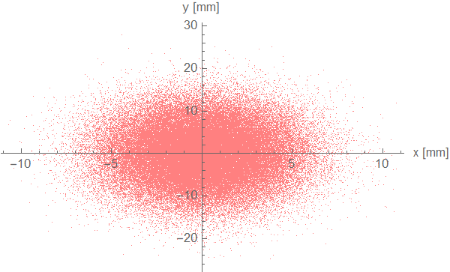
Particle tracking from Linac to DR
Particle number: 100000 (Gauss bunch)
Inj emittance: 2500mm.mrad
σ₀ =1.5mm
δ₀ =0.7%
Before ECS
After ECS

Slide 29
Summary
Booster energy range is enlarged in TDR. (10GeV/120GeV → 20GeV/180GeV)
Update booster design with smaller emittance in TDR─ support for CEPC high lum. scheme
TME structure with combined magnets (B+S)
DA with error effects fulfill the requirements
Booster parameters update ─ consistent with CEPC TDR parameters at 4 energy
Damping ring update is the requirement of higher luminosity goal for TDR.
Circumference: 150m, energy: 1.1GeV
Reversed bending, extracted emittance=59~166 mm⋅mrad (adjustable)
Damping time: 15ms (CDR) → 11ms (new)
Transport lines similar as CDR with energy compression and bunch compression

Slide 30
Back up

Slide 31
Optics parameter comparison
D. H. Ji, W. Kang
Lattice | FODO 0 （CDR） | FODO | TME (combine magnets)
Emittance X (nm) @120GeV | 3.57 | 1.29 | 1.26
Momentum compaction (×10⁻⁵) | 2.44 | 1.18 | 1.12
Tunes | [263.201/261.219] | [353.180/353.280] | [321.271/117.193]
Quad amount | 2110 | 2816 | 3458
Quad Strength (K1L rms） | 0.0383 | 0.0407 | 0.0259
Sext amount | 512 | 896 | 0
Sexts Strength (K2L rms) | 0.179 | 0.4091 | 0.0492
H Corrector | 1053 | 1408 | 1218
V Corrector | 1054 | 1408 | 2240
BPM | 2108 | 2816 | 3458
Magnets’ cost of TME is lower than FODO
TME is less sensitive to the errors
No independent sextupole for TME
Quadrupole strength of TME is lower
Lower strength for quadrupoles and sextupoles

Slide 32
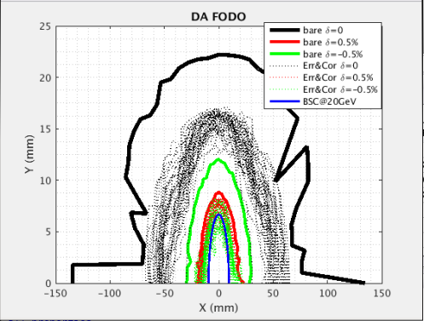
DA results with errors and correction-FODO
D. H. Ji
 | Dipole | Quadrupole | Sextupole
Transverse shift X/Y (μm) | 100 | 100 | 100
Longitudinal shift Z (μm) | 100 | 150 | 100
Tilt about X/Y (mrad) | 0.2 | 0.2 | 0.2
Tilt about Z (mrad) | 0.1 | 0.2 | 0.2
Nominal field | 1e-3 | 2e-4 | 3e-4
 | Accuracy (m) | Tilt (mrad) | Gain | Offset w/ BBA(mm)
BPM(10Hz) | 1e-7 | 10 | 5% | 30e-3
Almost impossible to obtain the initial closed orbit naturally
  Start from sextupole off
Orbit correction (COD)(60 Seeds)
  Response matrix method(RM)
  SVD method
  Dispersion corrected
Optics correction(60 Seeds)
  Response matrix method
  LOCO code
  Dispersion corrected

Slide 33
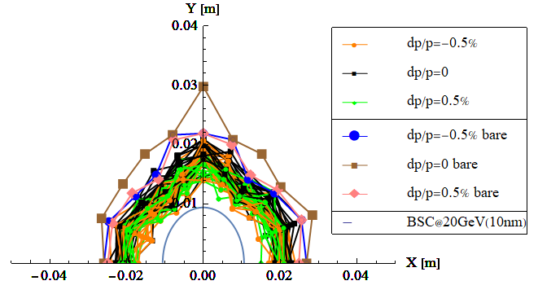
Multipole errors @ 20GeV-TME
dipole | quadrupole
B1/B0 ≤ 2×10⁻⁴
B2/B0 ≤ 3×10⁻⁴ | B2/B1 ≤ 3×10⁻⁴
B3/B0 ≤ 2×10⁻⁵ | B3/B1 ≤ 1×10⁻⁴
B4/B0 ≤ 8×10⁻⁵ | B4/B1 ≤ 1×10⁻⁴
B5/B0 ≤ 2×10⁻⁵ | B5/B1 ≤ 1×10⁻⁴
B6/B0 ≤ 8×10⁻⁵ | B6/B1 ≤ 5×10⁻⁵
B7/B0 ≤ 2×10⁻⁵ | B7/B1 ≤ 5×10⁻⁵
B8/B0 ≤ 8×10⁻⁵ | B8/B1 ≤ 5×10⁻⁵
B9/B0 ≤ 2×10⁻⁵ | B9/B1 ≤ 5×10⁻⁵
B10/B0 ≤ 8×10⁻⁵ | B10/B1 ≤ 5×10⁻⁵
Multipole errors only

Slide 34
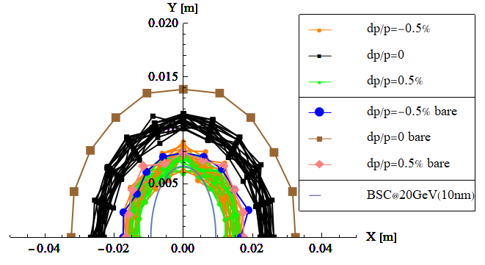
Multipole errors @ 20GeV-FODO
dipole | quadrupole | sextupole
B1/B0 ≤ 2×10⁻⁴
B2/B0 ≤ 3×10⁻⁴ | B2/B1 ≤ 3×10⁻⁴
B3/B0 ≤ 2×10⁻⁵ | B3/B1 ≤ 1×10⁻⁴ | B3/B2≤ 1×10⁻³
B4/B0 ≤ 8×10⁻⁵ | B4/B1 ≤ 1×10⁻⁴ | B4/B2 ≤ 3×10⁻⁴
B5/B0 ≤ 2×10⁻⁵ | B5/B1 ≤ 1×10⁻⁴ | B5/B2 ≤ 1×10⁻³
B6/B0 ≤ 8×10⁻⁵ | B6/B1 ≤ 5×10⁻⁵ | B6/B2 ≤ 3×10⁻⁴
B7/B0 ≤ 2×10⁻⁵ | B7/B1 ≤ 5×10⁻⁵ | B7/B2 ≤ 1×10⁻³
B8/B0 ≤ 8×10⁻⁵ | B8/B1 ≤ 5×10⁻⁵ | B8/B2 ≤ 3×10⁻⁴
B9/B0 ≤ 2×10⁻⁵ | B9/B1 ≤ 5×10⁻⁵ | B9/B2 ≤ 1×10⁻³
B10/B0 ≤ 8×10⁻⁵ | B10/B1 ≤ 5×10⁻⁵ | B10/B2 ≤ 3×10⁻⁴
FODO

Slide 35
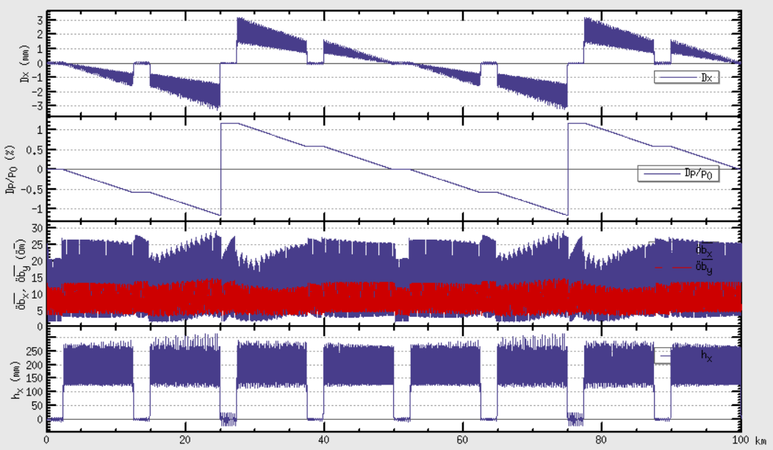
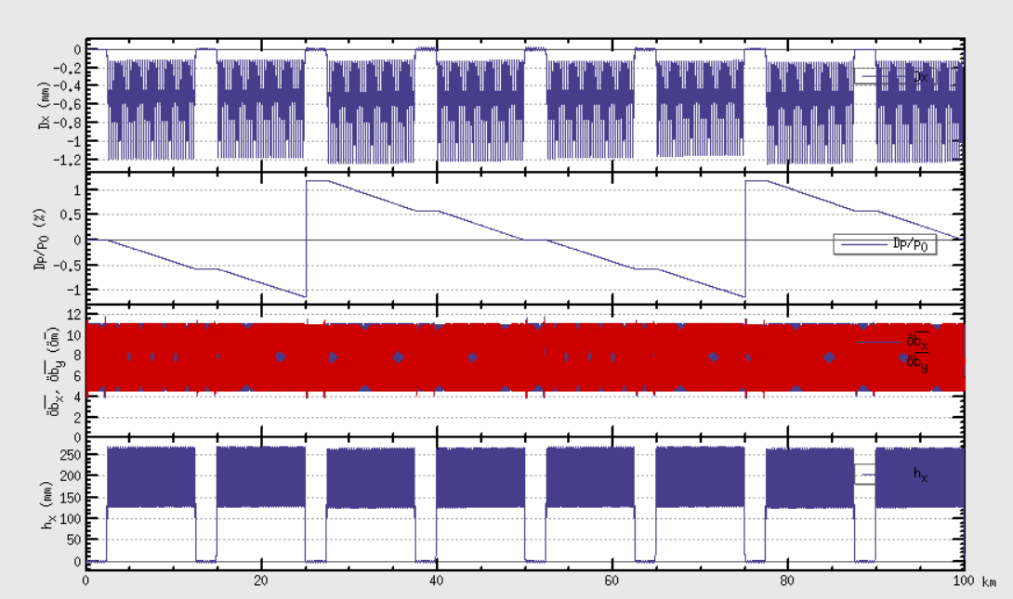




SR & Sawtooth effect@180GeV-FODO
D. Wang, D. H. Ji
2 RF stations
Maximum sawtooth orbit: 3 mm
Energy deviation: 1.1%
Emittance growth: ~210%
DA reduction due to strong SR
Optics distortion due to sawtooth orbit is serious.
Magnets tapering is essential.
Taper dipoles one by one
need to taper the quad & sext
W/O taper
W taper
DA tracking (50 seeds, 100 turns)
DA < requirement (injection)
- DA_X=5σx+3mm=6.0mm
- DA_Y=39σy+3mm=4.2mm
Sawtooth orbit was corrected by tapering
DA reduction due to sawtooth orbit

Slide 36


DA@20GeV
BSC_{xy}=(4σ_{xy}+5mm)*2
FODO
TME

Slide 37


DA@45GeV
BSC_{xy}=(4σ_{xy}+5mm)*2
Off axis injection to collider
FODO
TME

Slide 38


DA@80GeV
BSC_{xy}=(5σ_{xy}+3mm)*2
Off axis injection to collider
FODO
TME

Slide 39


DA@120GeV
BSC_{x}=(5σ_{x}+3mm)*2
BSC_{y}=(39σ_{y}+3mm)*2 (on axis-injection scheme for collider)
FODO
TME

Slide 40

DA@180GeV
BSC_{xy}=(5σ_{xy}+3mm)*2
Off axis injection to collider
FODO
TME

Slide 41
DA@180GeV (after tapering)
BSC_{x}=(5σ_{x}+3mm)*2=7mm*2
BSC_{y}=(5σ_{y}+3mm)*2=4mm*2
Off axis injection to collider
FODO
TME

Slide 42

Z mode injection (top-up)
Meng Li

Slide 43

Z mode injection (full injection)
Meng Li

