Slide 1
Status of CEPC Control system
Presented by Gang Li
On behalf of Control Group, IHEP
Jane. 13th-19th, 2022
Mini-workshop on Accelerator Physics on CEPC, Hong Kong

Slide 2
Outline
Performance and Scope of the CEPC control system
Requirement information of controlled devices
The challenge and characteristic of CEPC
Potential international collaborations
Summary

Slide 3
Performance of the Control System
5bility+RT
  Stability
  Availability
  Flexibility
  Scalability
  Reliability
  Real Time

Slide 4
Scope of the Control System
Global control
  Control Platform
  Center Control System: computers, servers, database, etc
  Network System
  Timing System
  Post Mortem System
  Machine Protection System
  Video system
Local control
  Power Supply Control System
  Vacuum Control System
  Temperature Monitoring System
  Linac Control System
Integration of subsystems
  LLRF, Cryogenic system, Injection/Extraction system etc.
Interface to other system
  Detector(Experimental physics), beamline and conventional facility

Slide 5
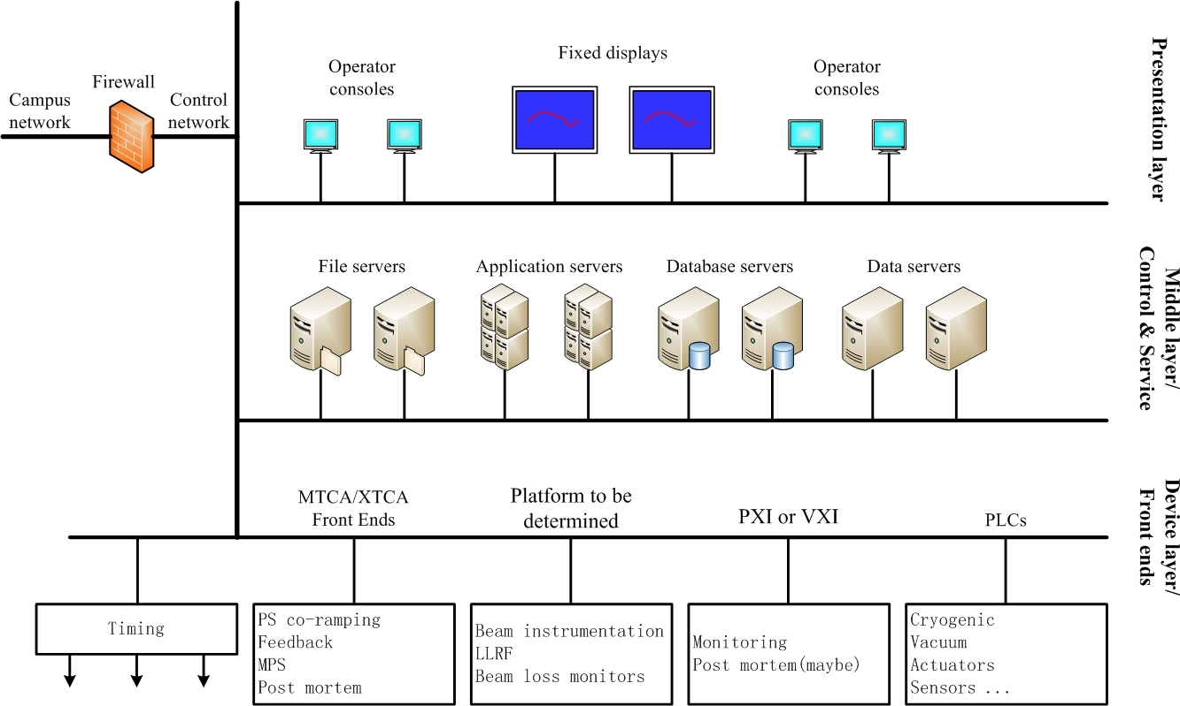
Control System and sub-system
Overall hardware architecture of the control system

Slide 6
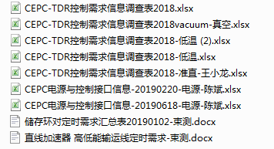
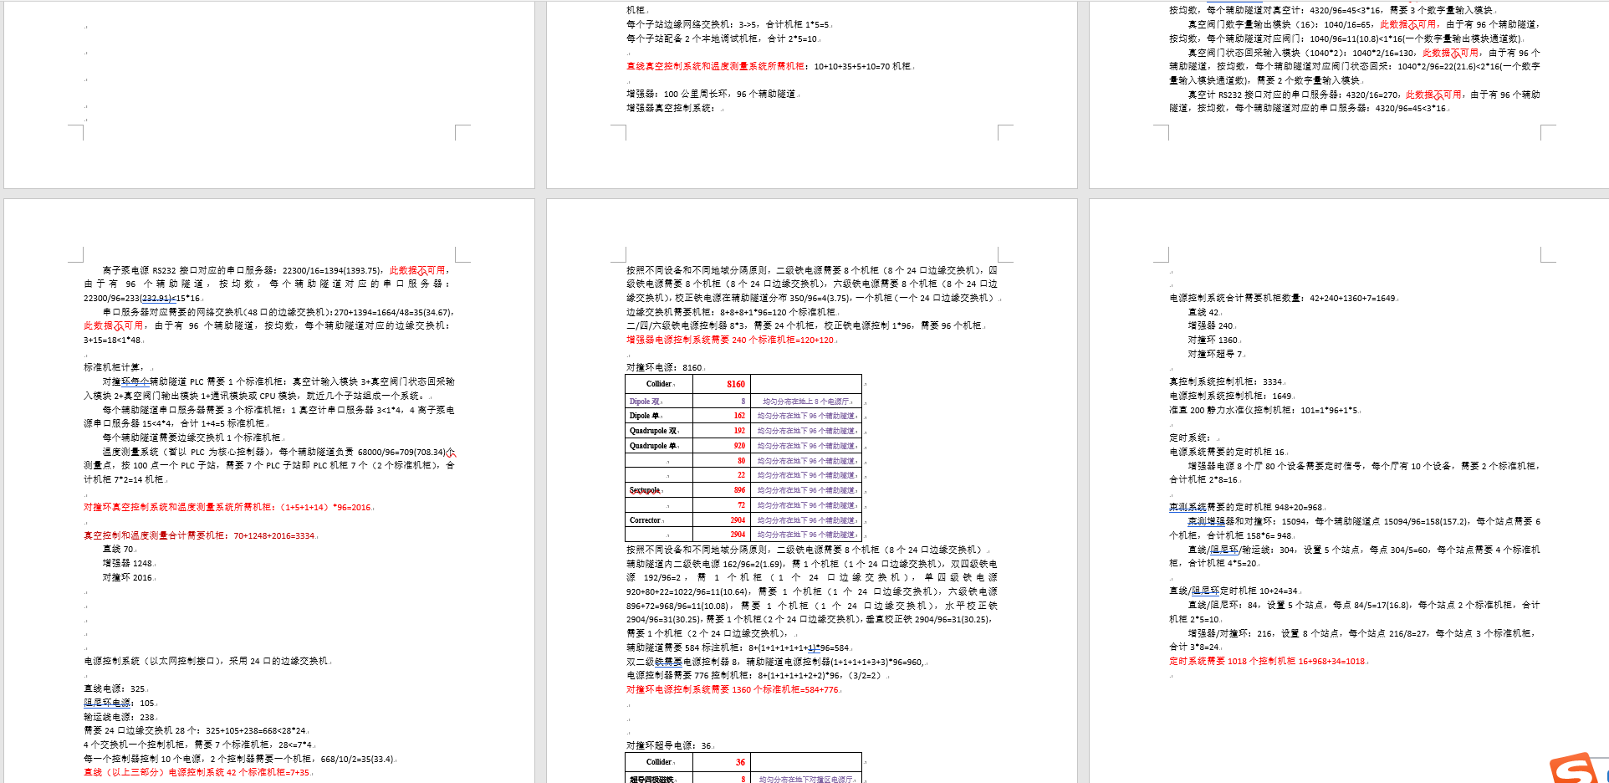
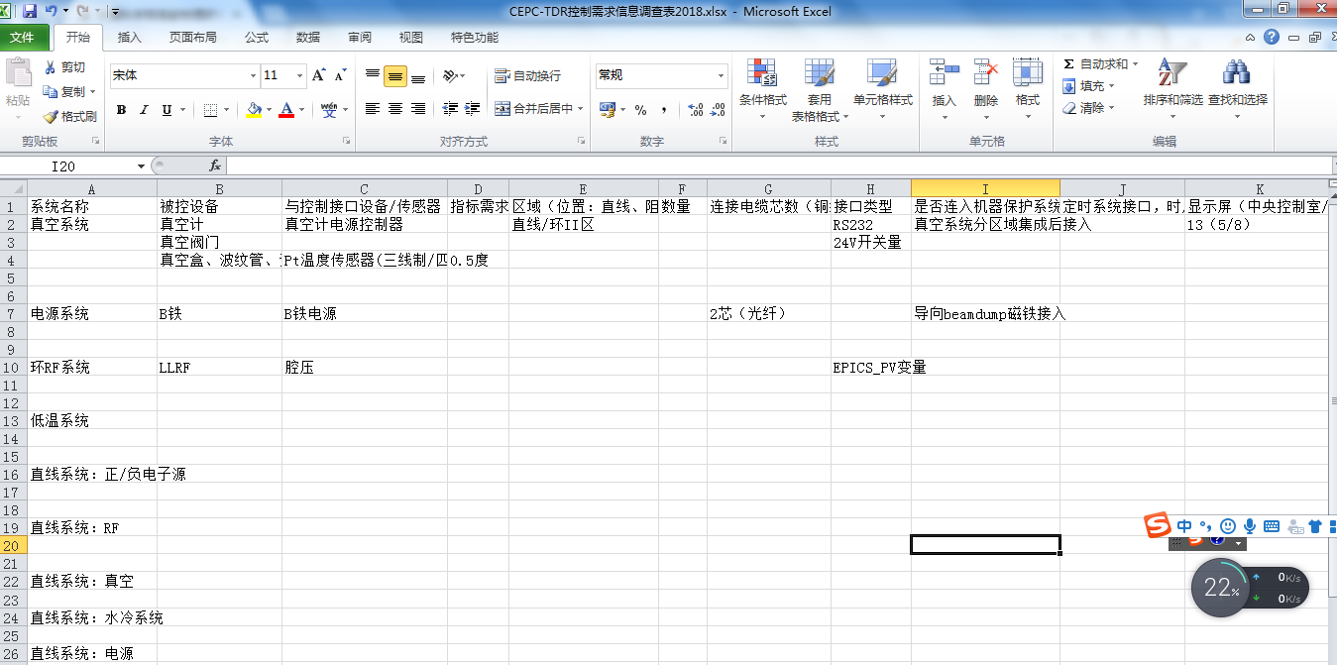
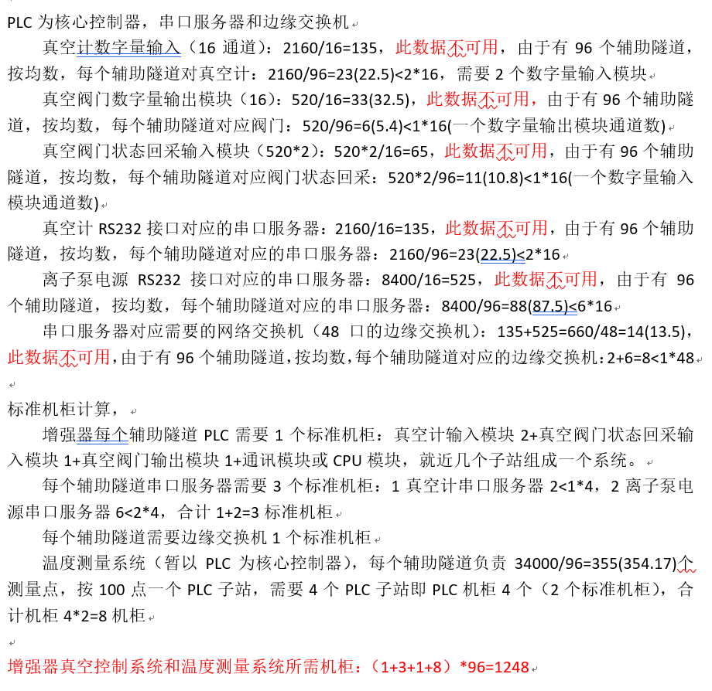
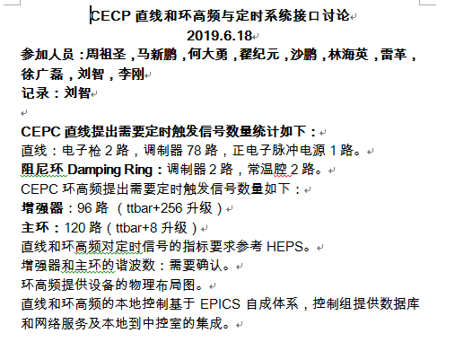
Requirement information of controlled devices

Slide 7



Control Platform
Software Platform: EPICS
  Open source, free SCADA/DCS, toolkits
Hardware Platform
  Standardization, Modularity and Commercial products
  Workstation and servers
  ATCA/uTCA (High Availability)
  PLC
  Fieldbus：Serial device servers and so on
  Motion controller/Driver
  etc.

Slide 8
The challenge and characteristic of CEPC CS
Super scale
  Linac: 1.2/1.4km
  Ring: 100km
A large number of Controlled Equipments
  Discrete distributed in the Linac and Ring
Quantity of PVs
  millions of PVs

Slide 9
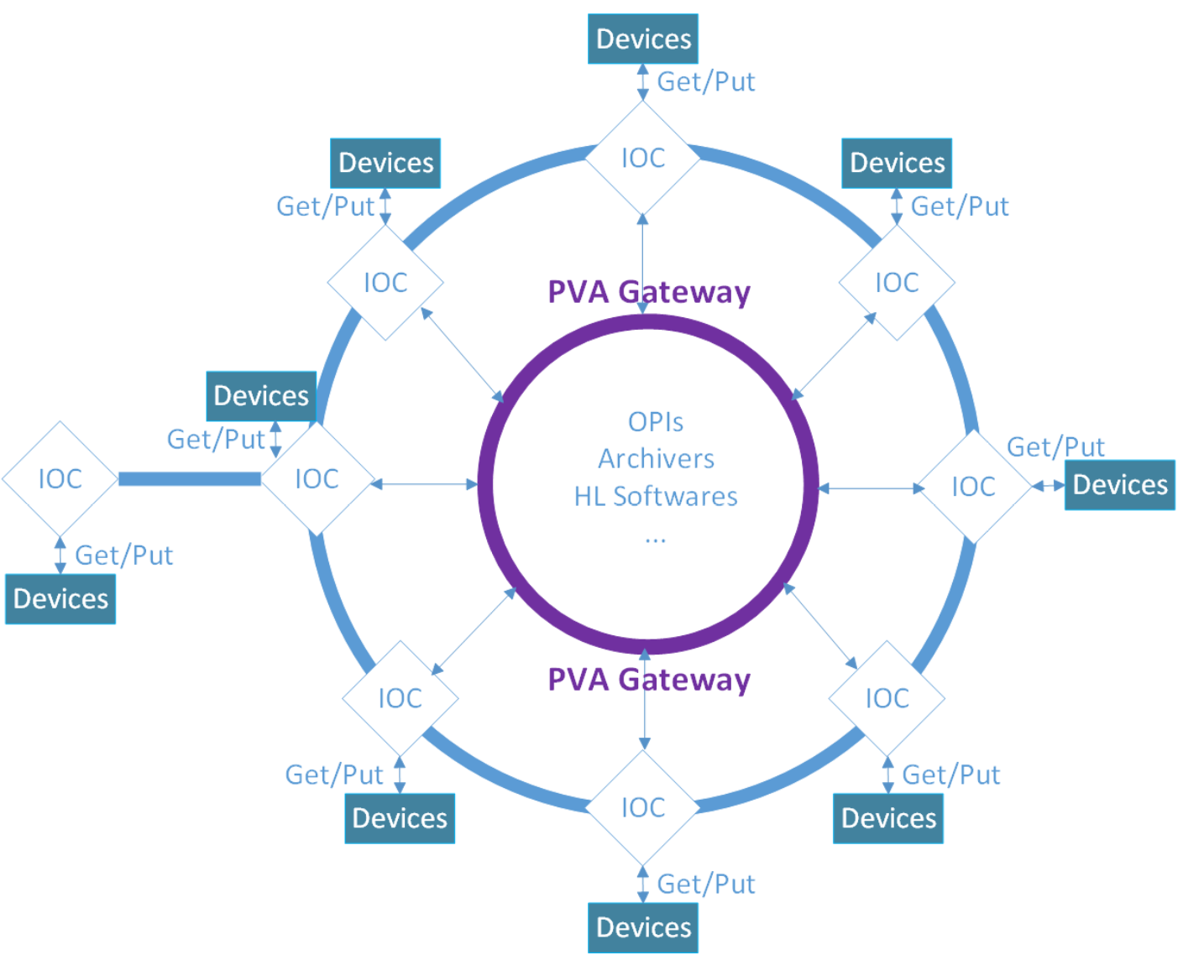
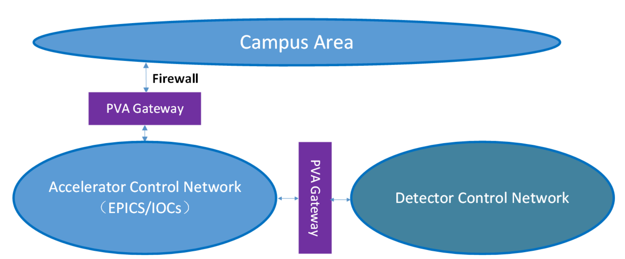
The challenge and characteristic of CEPC CS
General design of CEPC control system and subsystem
  PV Gataway：
    Reduce the resource load on IOCs
    Access control restrictions to requests from the clients
Timing/MPS/PPS

Slide 10
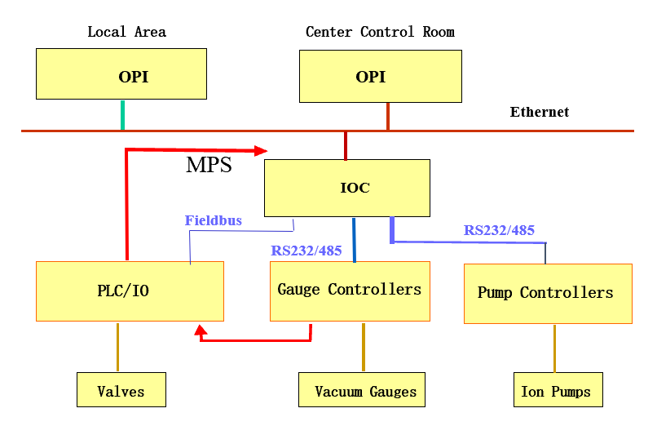
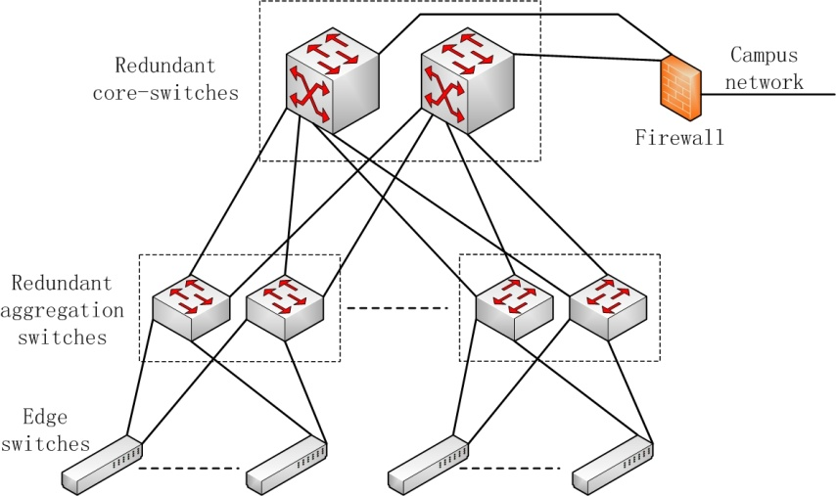
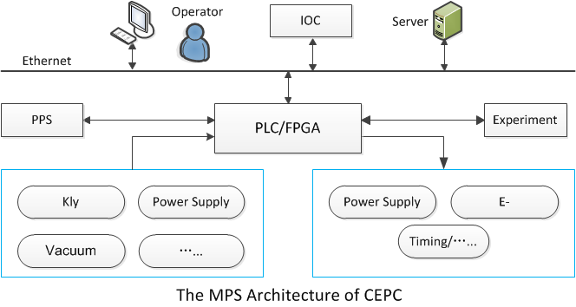
The challenge and characteristic of CEPC CS
General design of CEPC control system and subsystem
  Such as… …
  Not going to introduce them in detail

Slide 11
The challenge and characteristic of CEPC CS
Potential bottlenecks
  Data rate/traffic in the network(low latency switch)
    Cut-through
    Store-and-Forward
  Travel time/response time(between GUI and IOCs/controlled devices)
    200us(40Km, c*2/3)
  Faulty recovery(Distance between stations: dozens of km)
    High Availability (Redundant IOCs)->Reduce maintenance time
  Database and Management of the control system
    Database
    Apps and Wechat
    etc

Slide 12
Potential international collaborations
Be member of EPICS Council
  EPICS Council organization was founded in 2016
  Prioritize major EPICS upgrade projects for Base and Extensions to guide resource allocation decisions at investing facilities
  Develop a roadmap for future EPICS Core and Extensions development to facilitate planning for all EPICS sites. The roadmap will be developed using technical input from the chairs of relevant working groups (currently EPICS Core Working Group and CS-Studio Working Group)
  Provide support to control system managers in promoting EPICS development efforts to their organization leadership
  Select semi-annual EPICS Collaboration Meeting sites and dates
  Ensure that EPICS continues to be an open collaboration and that contributions are open-source
Join in work group(Core, CSS and Python)
  GUI will be updated every 5~10 years
  etc

Slide 13
Potential international collaborations
EVG/EVR Timing System
  Trigger
  RF reference
  Precise timestamping
EVG/EVR：Broadcast
Site：APS、SLS，BEPCII，CSNS，SSRF，etc
Distance: a few Km
Support
  Commercial products (Micro-Research Finland)
  EVG/EVR of SSRF
  Homemade I/O and delay board
White Rabbit Timing System
  Precise timestamping
  Trigger
  RF reference
Master/Slave: Bi-directionality
Site：CERN、GSI、ESRF、Spring-8、 SHINE、LHAASO、German Stock Exchange，etc
Distance: less than 10Km
Support
  OpenHareware+Commercial products
  V.S

Slide 14
Potential international collaborations
Database based on the user’s requirement
Parameter Database Naming Convention Database
Magnet Database Equipment Database
Lattice and Model Database Management of File
Log and trouble tracking Alignment Database
Management of Cable and device Alarm database
Configuration of Security database MPS and interlock database
Etc..
More and more Database will be designed with the progress of the Project

Slide 15
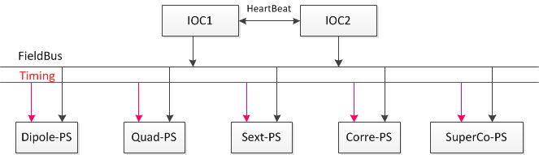
Potential international collaborations
Redundant IOCs

Slide 16

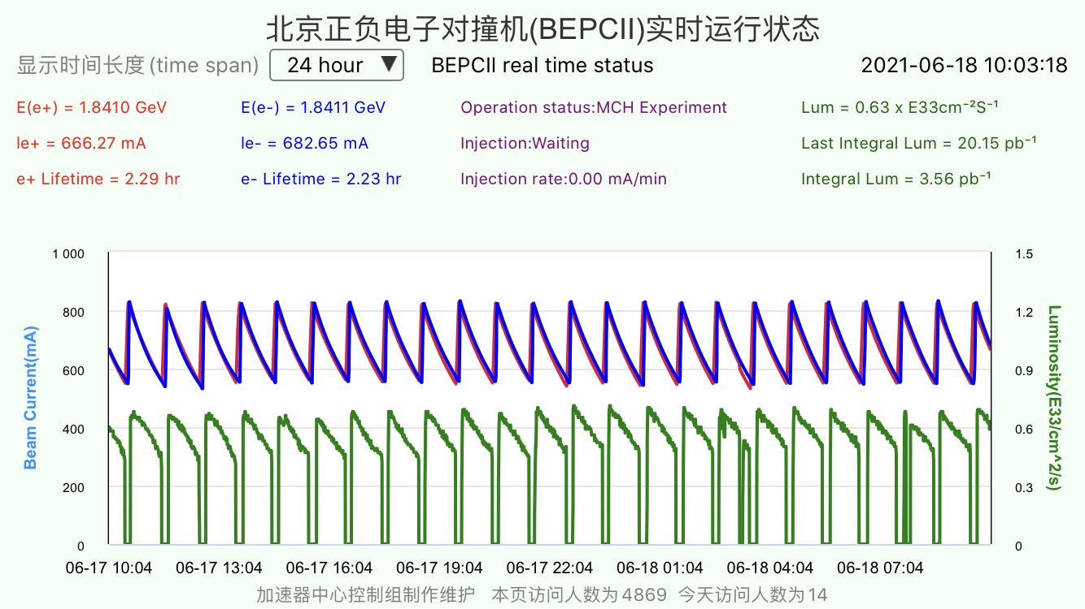
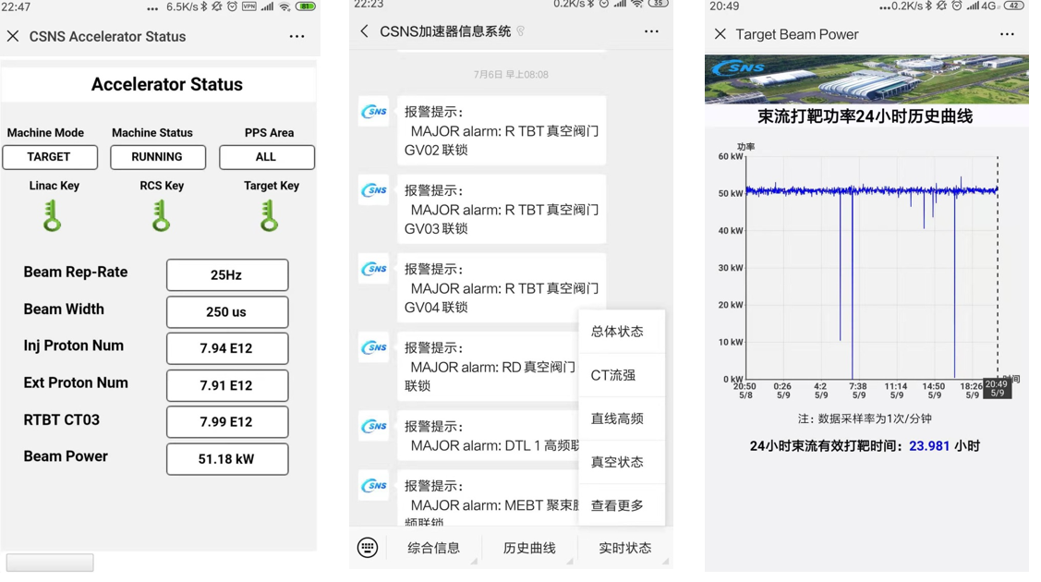
Potential international collaborations
Apps and Wechat （iOS and Android）

Slide 17
Summary
More detailed requirements should be further clarified, with the progress of CEPC TDR
EPICS：Cooperate closely with EPICS community and company
New technique: IoT/AI/machine learning in control system
Thanks a lot!

