Slide 1
SuperKEKB control system and operation
Hiroshi Kaji (KEK)

Slide 2
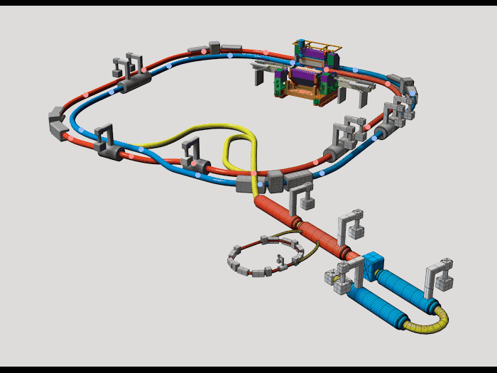
The SuperKEKB collider
Electron-Positron Collider
C.M.S. Energy: √s = 10.58 GeV
Luminosity: L = 8 x 10³⁵ cm^{– 2}s^{–1} (Luminosity Frontier Machine)
Main Rings
 | Electron | Positron
Energy (GeV) | 7 | 4
Current (A) | 3.6 | 2.6
Positron Damping Ring
Large difference from KEKB
- 20 times smaller vertical beam size at IP
- twice larger beam current
- Damping Ring for position injection
Injector Linac

Slide 3
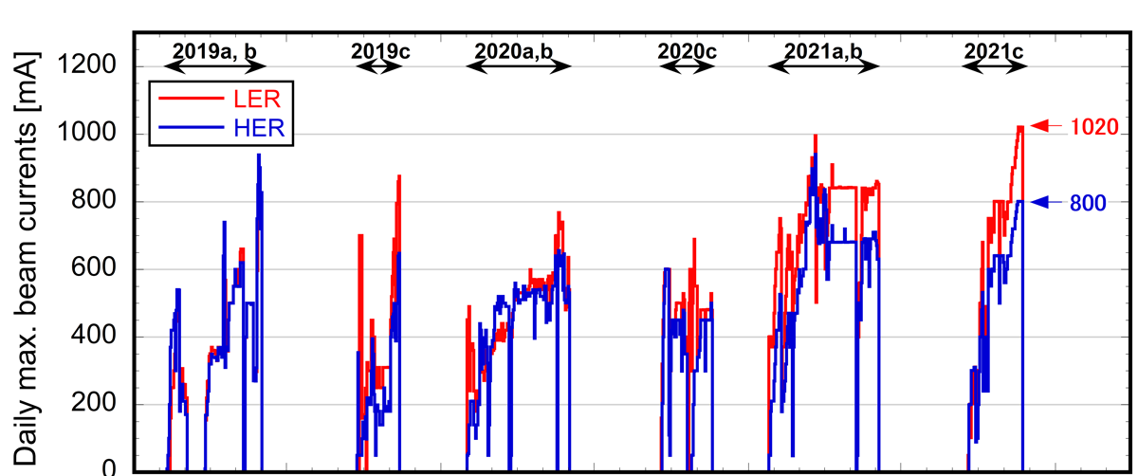
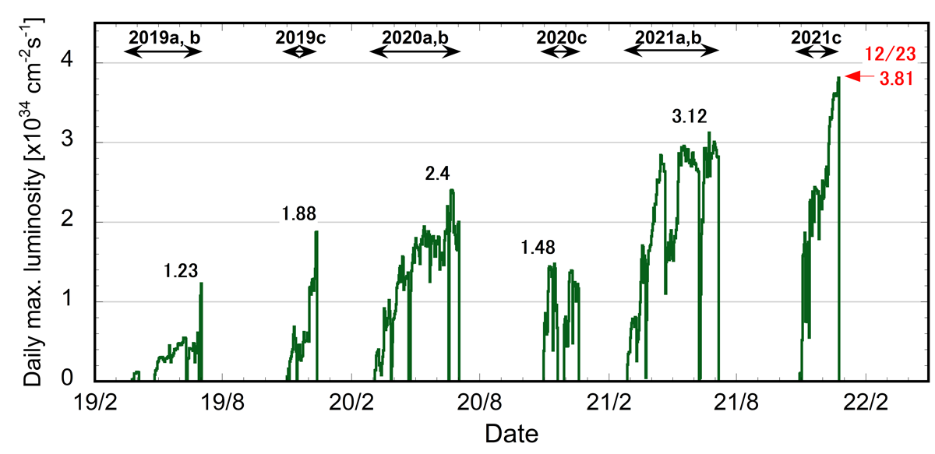
Operation Summary in Phase III
Operation Current is increased gradually.
β_{y}* = 3mm
β_{y}* = 1mm
New world record of the luminosity, 2.4x10³⁴ cm^{–2}s^{–1},
is made on June 21, 2021.
It became 3.81x10³⁴ cm^{–2} s^{–1} in the end of 2021.
Crab waist
Ohnishi, et al. “SuperKEKB operation using crab waist collision scheme”, Eur. Phys. J. Plus 136, 1023 (2021).

Slide 4
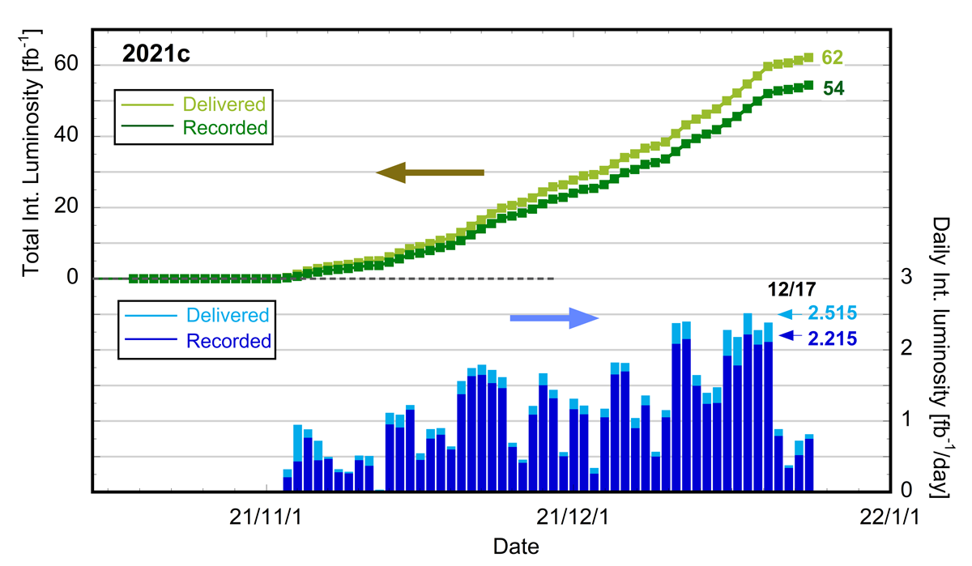
Integrated Luminosity in the last run period
The 2021 autumn run was fruitful.
The smooth operation gave us the large integrated luminosity.
In the end of last year, everyday we collected more than 2000 pb^{–1} (2x10³⁹ cm^{–2}) data.

Slide 5
Control Group in Machine Operation
Injection Control System
The system is designed and developed by the MR control group.
- Top-up operation
- DR operation
- Bucket Selection and Bunch Current equalizing
- Monitoring the Injection condition
Beam Abort Analysis
- Time sort
- Database development (requested and discussed)
Beam Permission system
- Machine Protection System
- Beam Gate system

Slide 6
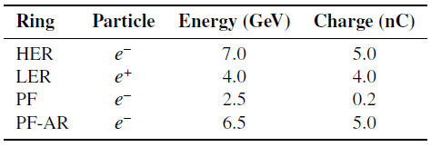
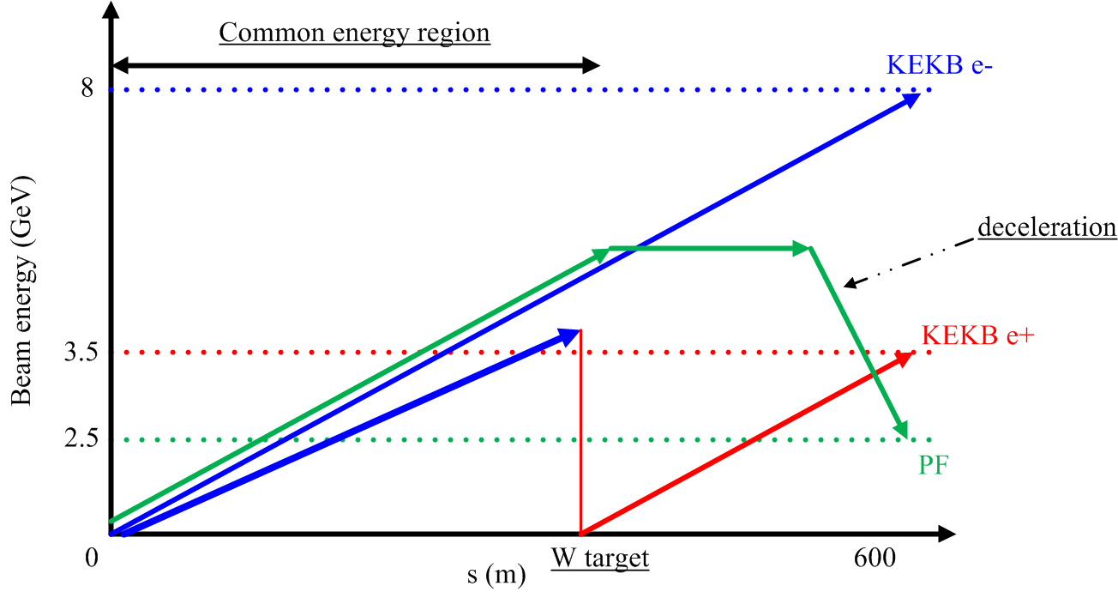
Top up operation
Injector linac carries out the top-up filling operation for 4 independent rings
- electrons and positrons for Main Rings (HER and LER)
- the other two kinds of electrons to the light sources
One beamline produces and transfers the four kinds of beam-pulses.
RF phases must be modulated to realize the different beam energies for the four rings, respectively.
Pulse Q-magnet must be operated with different parameters.
The number of parameters that must be changed is more than 150.

Slide 7
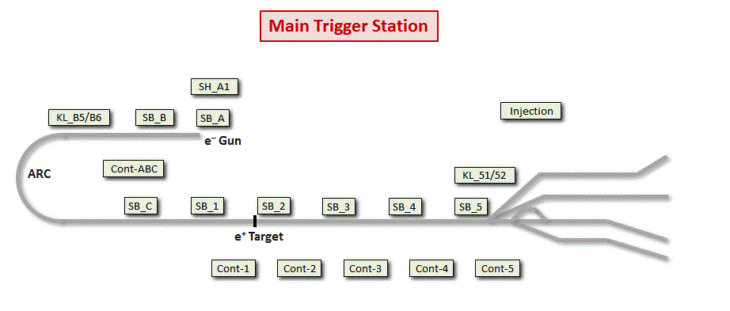
Pulse-to-Pulse Modulation
To carry out the top-up filling operation for 4 independent rings
- More than 150 parameters of beamline hardware are switched in 50Hz.
- Even though the hardware components are distantly installed along the beamline, the parameters must be switched synchronously.
It is controlled at Main Timing Station via the dedicated optical network.
The system is based on Event Timing System that are utilized also for the trigger delivery.

Slide 8
Injection with Damping Ring
The damping ring (DR) operation for the positron injection is started since 2018. Injection scheme becomes heavily complicated.
The required damping time, “at least 40 ms”, is longer than the LINAC pulse period of 20 ms.
The difference of RF frequencies, like 2856MHz (LINAC) and 509MHz (MR/DR), requires extremely complicated timing management.
Successfully operated since 2018
e⁻ Gun
ARC
e⁺ BT (SuperKEKB: 4GeV, 4nC)
e⁺ Target
e– BT (SuperKEKB: 7GeV, 5nC)

Slide 9
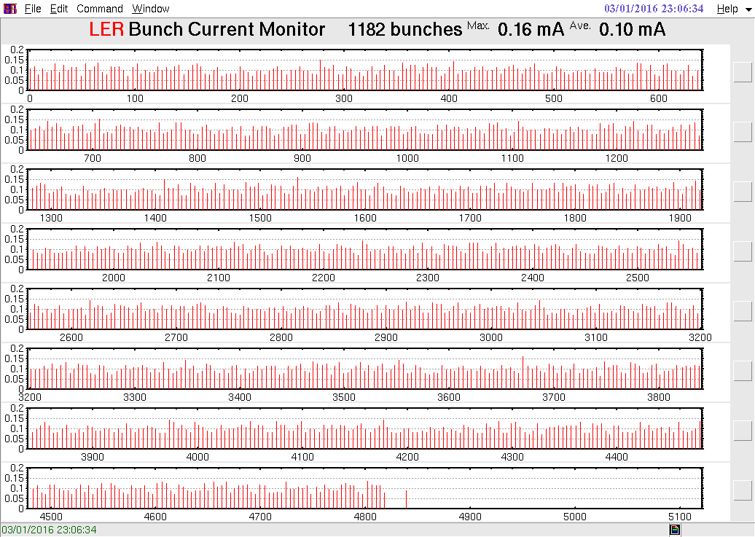
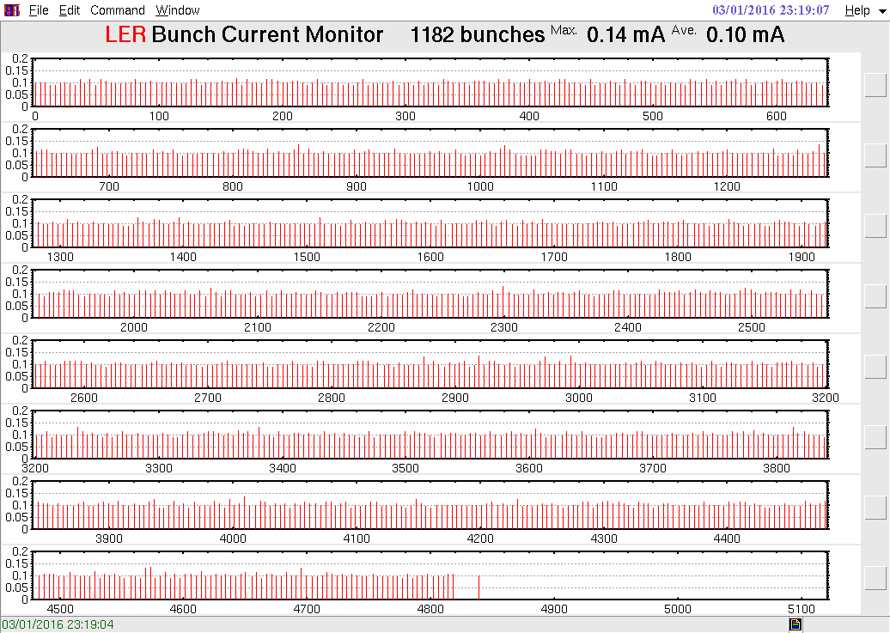
Bucket Selection system
The most important task is to equalize the bunch current at Main Rings.
- select the RF-bucket with the lowest beam current to the next injection.
- The decision must be made in 50Hz.
Turn BCE “ON” with following bunch current
13 minutes after ...
H. Kaji et al., “Bucket Selection System for SuperKEKB”, in Proc. of 12th Annual Meeting of PASJ, Tsuruga, Japan (2015).
H. Kaji, “Bucket Selection of the SuperKEKB Phase-3 Operation” in Proc. of 15th Annual Meeting of PASJ, Nagaoka, Japan (2018).

Slide 10
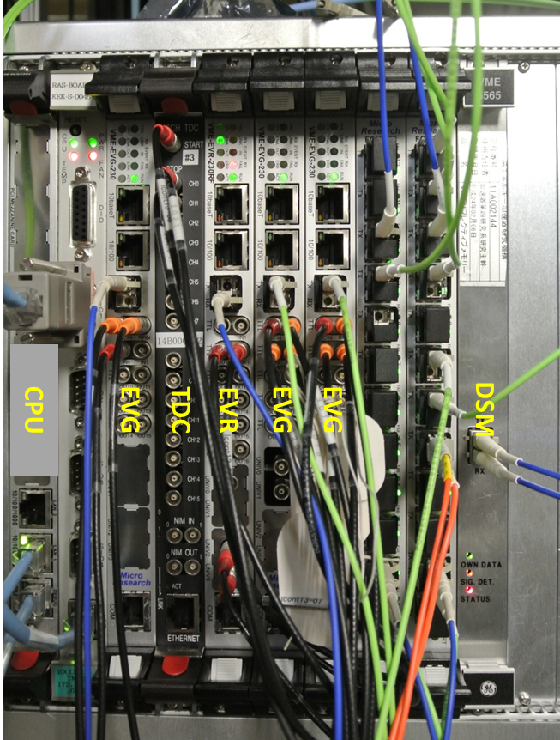
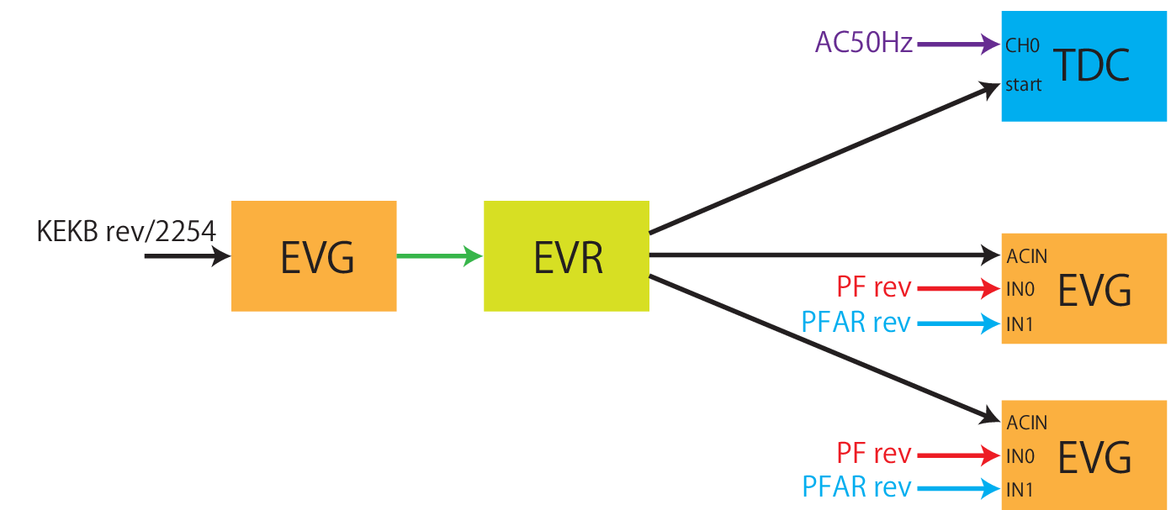
Hardware for Injection Control
The control system with two kinds of optical network manages the injection control
- Event Timing System: timing-trigger delivery, pulse-to-pulse modulation
- Distributed shared memory: Bucket Selection
LINAC 1st half
LINAC 2nd half
Timing adjustment for Bucket Selection
Distributed Shared Memory
Injector linac (LINAC)
Main Ring
SM network
D7 Sub-control Building
Distributed Shared Memory
Distributed Shared Memory
Central Control Building
H. Kaji, “Injection Control System for the SuperKEKB Phase-2 Operation” in Proc. of 15th Annual Meeting of PASJ, Nagaoka, Japan (2018).

Slide 11
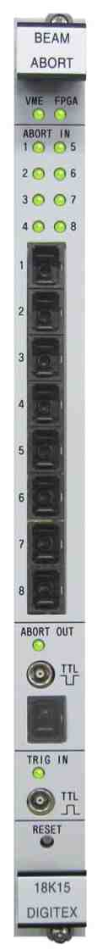
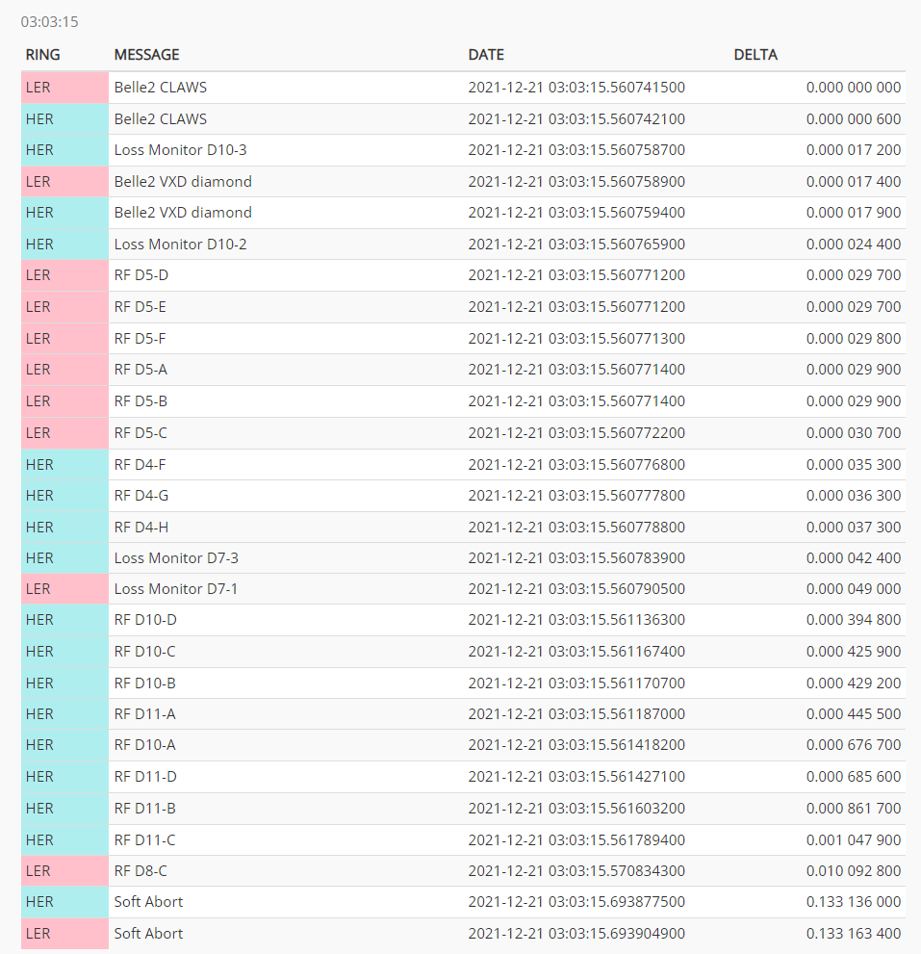
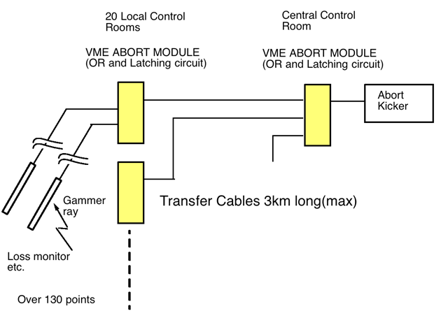
Abort request and Analysis
The beam-abort requests from main ring hardware are collected and transferred by Abort Trigger System.
Besides, it makes the time series of abort requests with accuracy of <10μs.
⇒ It is utilized for investigate the source of the beam anomaly.
11 Sub-control Buildings
Central Control Building
The abort analysis part will be replaced by the White Rabbit system
S. Sasaki et al., “Upgrade of Abort Trigger System for SuperKEKB”, in Proc. ICALEPCS’15, Melbourne, Australia (2015).
H. Kaji et al., “Time Synchronization for distant IOCs of the SuperKEKB Accelerators”, in Proc. IPAC’17, Copenhagen, Denmark (2017).

Slide 12
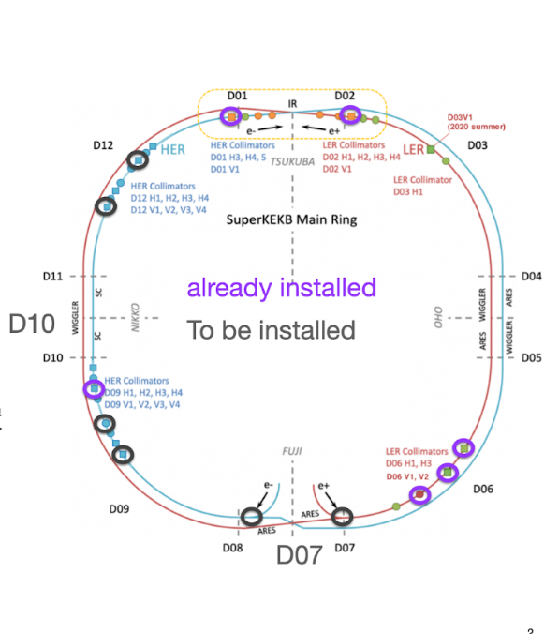
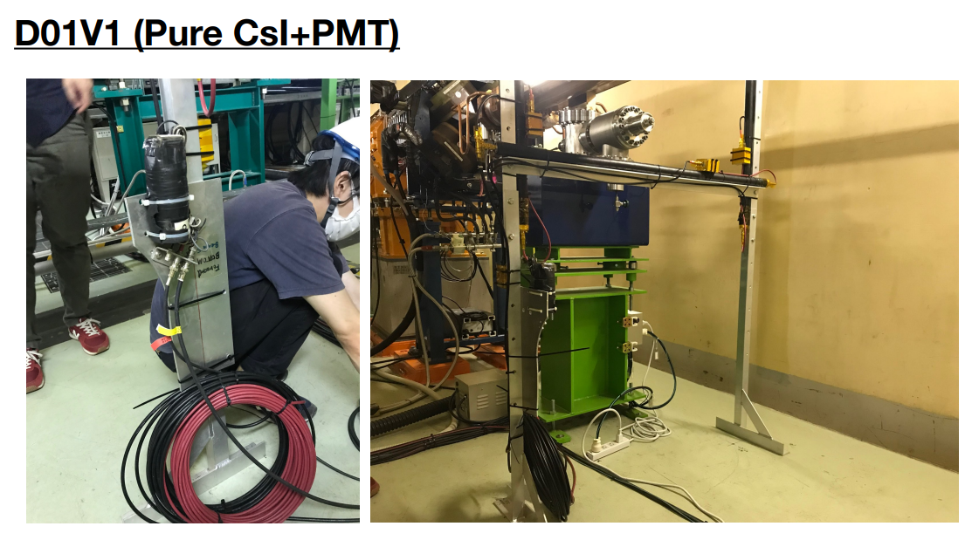
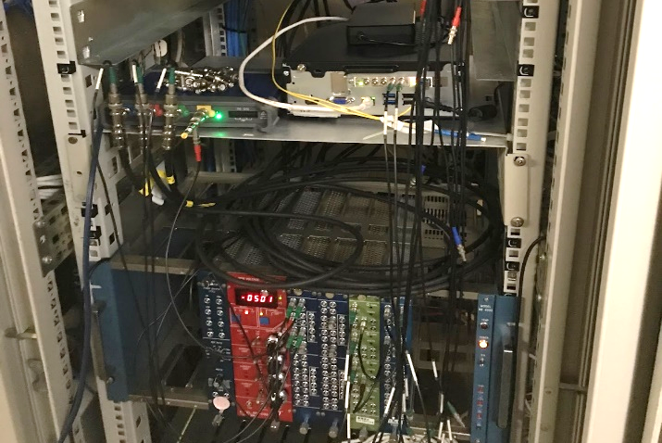
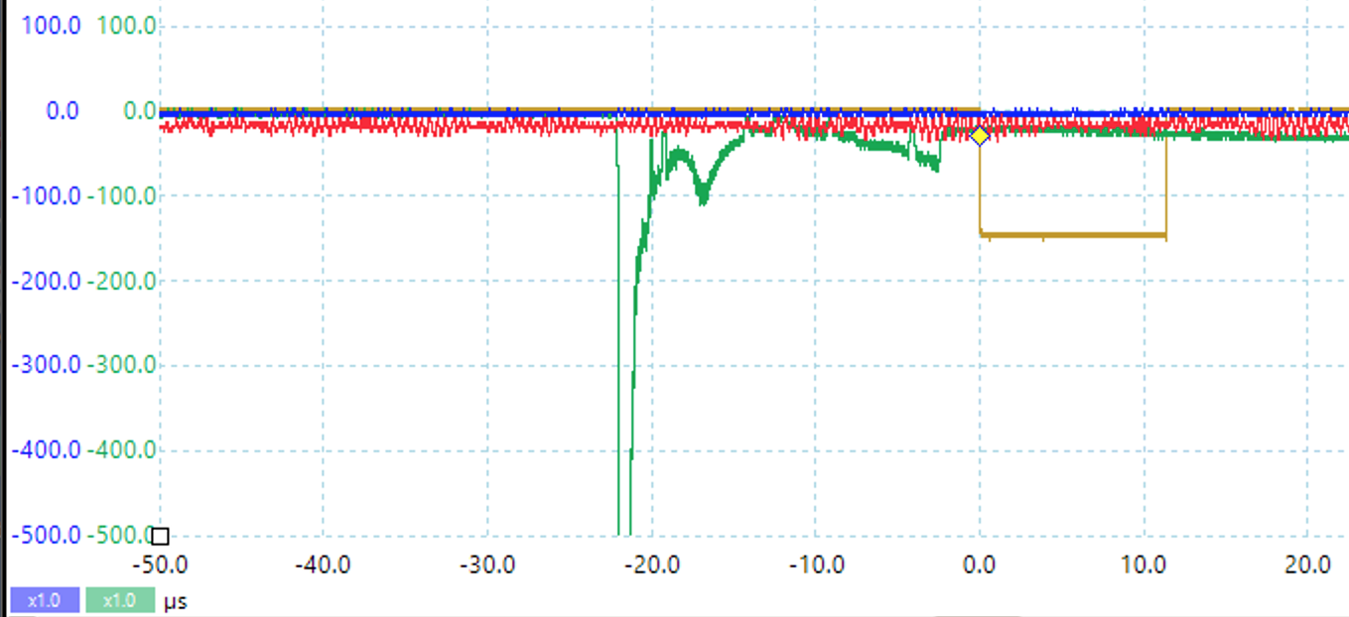
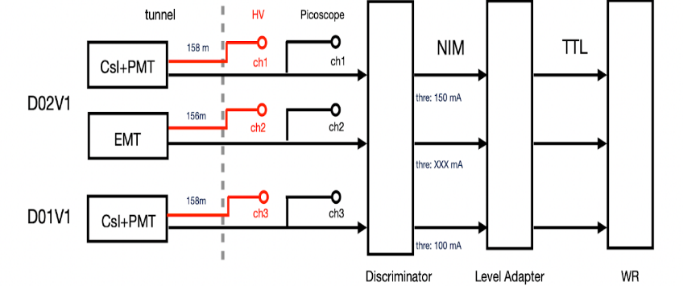
Fast loss monitor and White Rabbit
This is on-going project by the collaboration of machine and detector teams.
We investigate the source of the large beam loss with
- loss monitor that has the precise time-resolution: CsI pure crystal scintillator
- distributed TDC based on the state-of-art timing system: White Rabbit
WR node
Scope
Beam-loss at D01V1 on 6:24pm Nov 18th, 2021
①
②③
④
① 18:24:08.737868456 #3612
② 18:24:08.737870448 #4626
③ 18:24:08.737870728 #4769
④ 18:24:08.737873400 #1008
Time-resolution:
a few ns
<1ns
8 ns
Time-resolution of the entire system is fairly smaller to give us the beam-loss position.
We can know which bucket causes the loss in where.
We start operation at two stations in 2021 Autumn. More stations will be installed this year.

Slide 13
Typical Tasks for Control Group
Develop and maintain the ICT infrastructure
- work station servers
- network
Framework of the control system
- EPICS control system
- Standard design of IOC
- middle layer services (archiver, alarm, ...)
- monitoring system for above
H. Kaji, et al., “Control System of SuperKEKB”, in Proc. ICALEPCS 2019, New York, USA (2019).

Slide 14
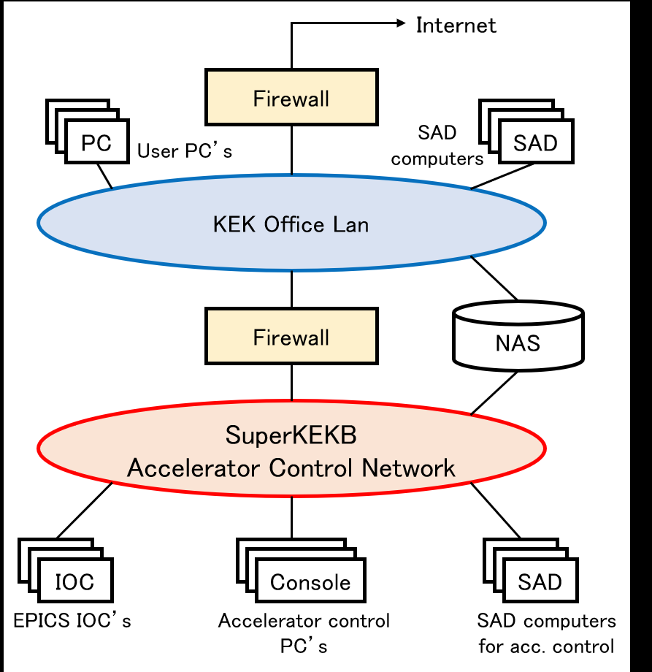
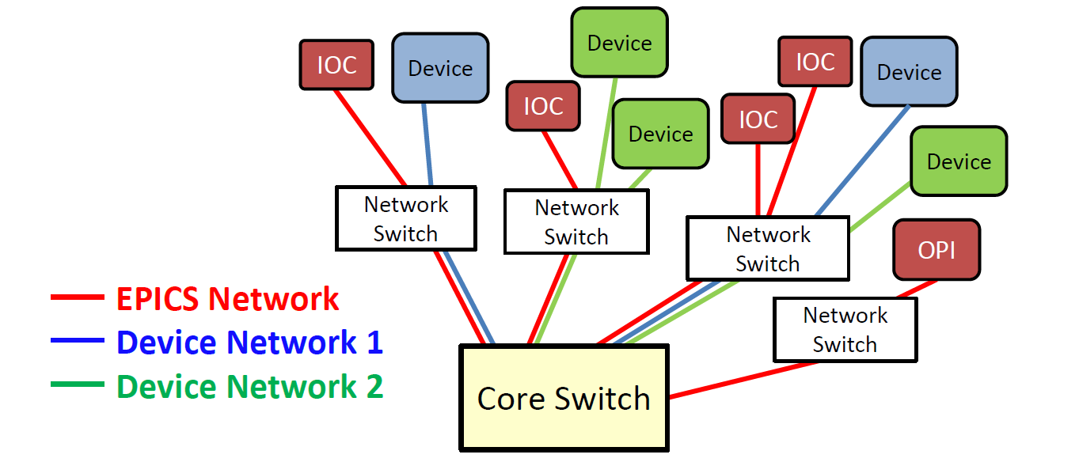
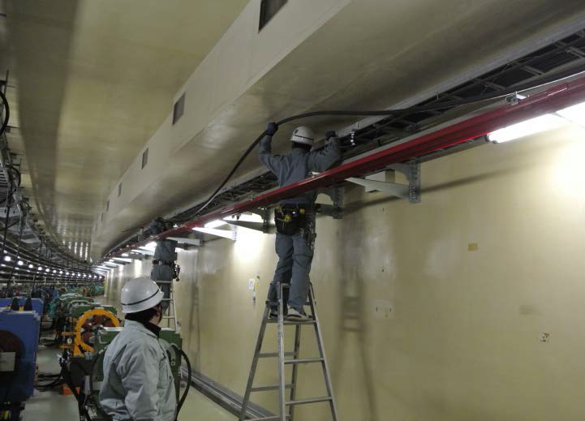
Accelerator Control Network
The control system is developed on the dedicated network which is separated from the KEK office network with the fire-wall.
Configuration
2 core switch at Central Control Building
40 edge switch at every Sub-Control Building
Redundant network based on Virtual Switching System
- Set of 10GbE and 1GbE-backup
- Partially, 1GbE and 1GbE, link aggregation
Leaky Coaxial cables in the entire accelerator tunnel
VLAN segmentation
EPICS VLAN + three Hardware VLAN
(for protecting the hardware from the large EPICS broadcast)
― EPICS VLAN
― Device1 VLAN
― Device2 VLAN
M. Iwasaki et al., “Design and Status of the SuperKEKB Accelerator Control Network System”, in Proc. ICALEPCS’13, San Francisco, USA (2013)

Slide 15
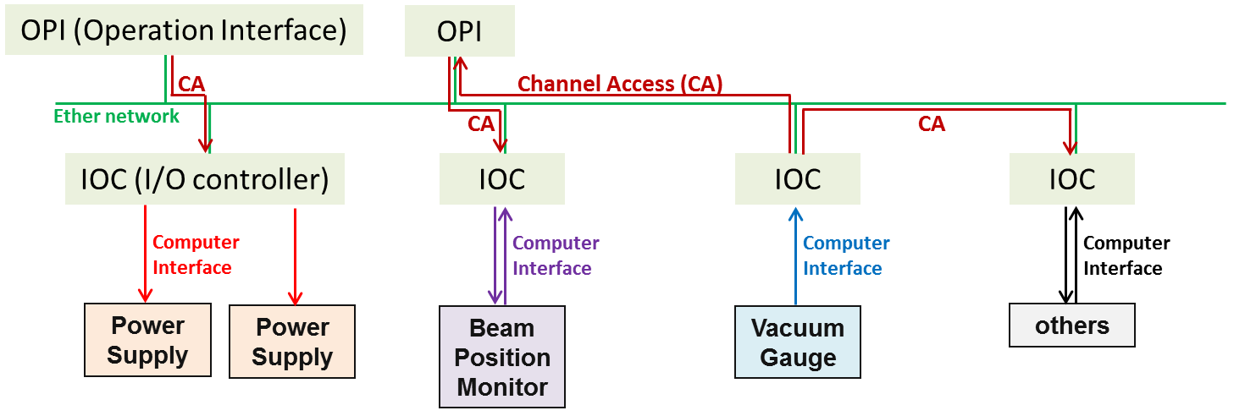
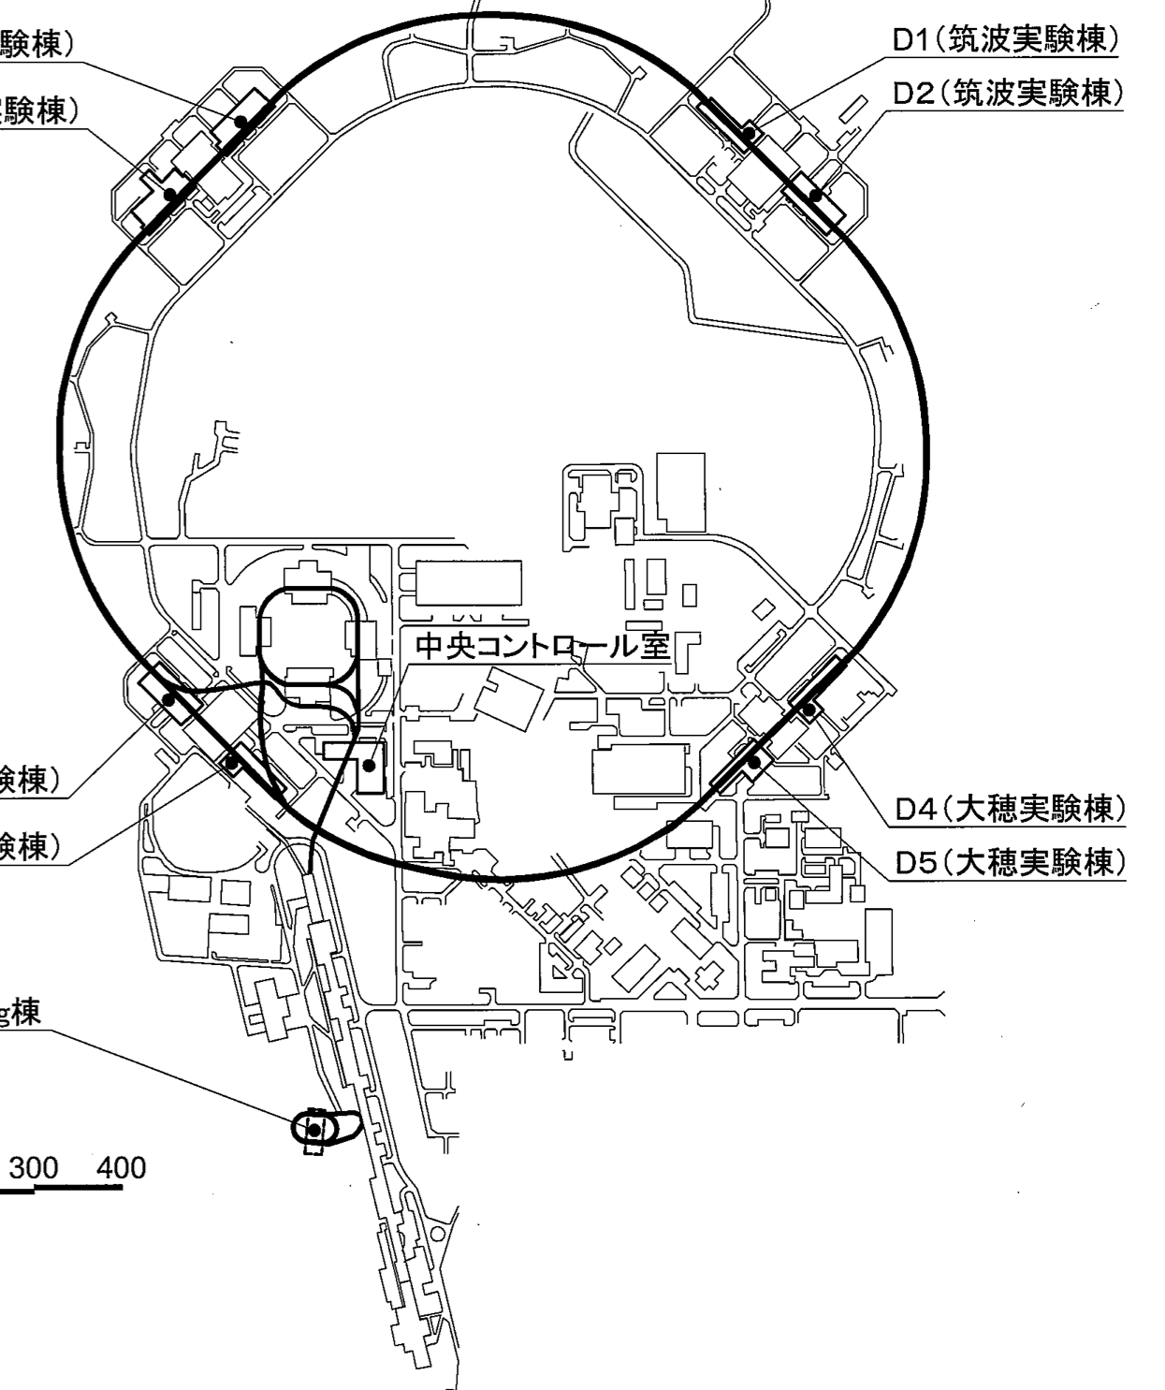
EPICS Control System
The 10000 components installed belonging to ~3km beamline are operated with the distributed control system based on EPICS.
Central
Control
Building
There are ~200 Input/Output Controllers (IOCs) installed on the 26 sub-control buildings.
The servers and operator consoles are installed on the Central Control Building and most of Operator Interfaces (OPIs) are running here.
They are connected via the dedicated network system.
26 sub-control buildings
The control system is working properly since 2016 and we are steadily improving it with the increased requests from the operation.

Slide 16
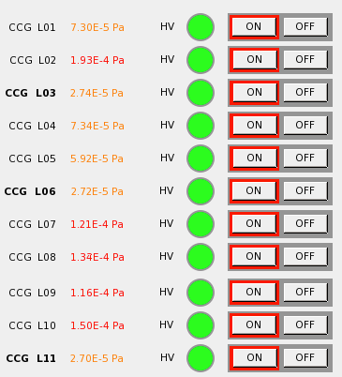
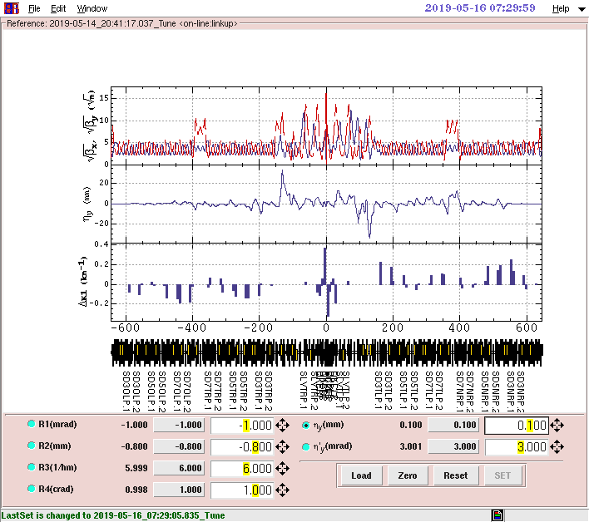
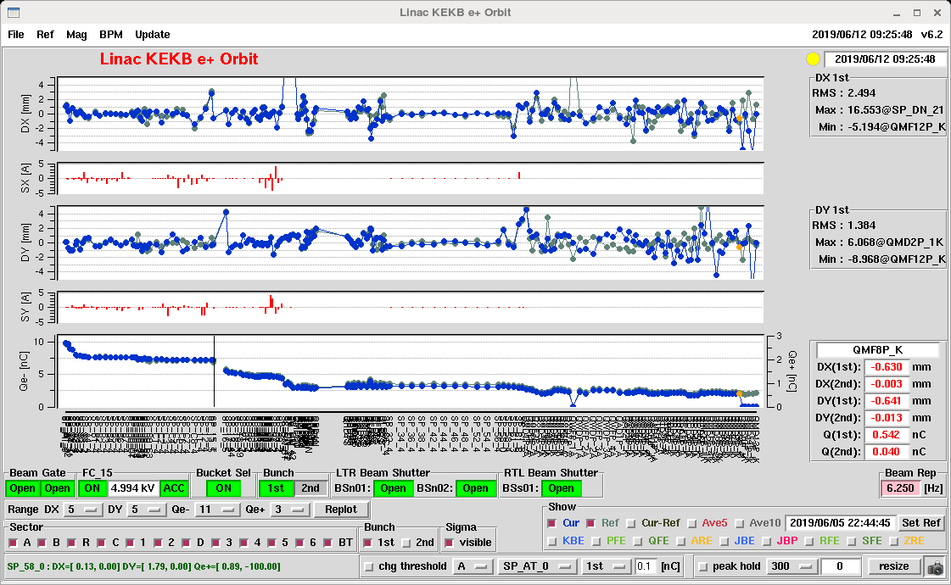
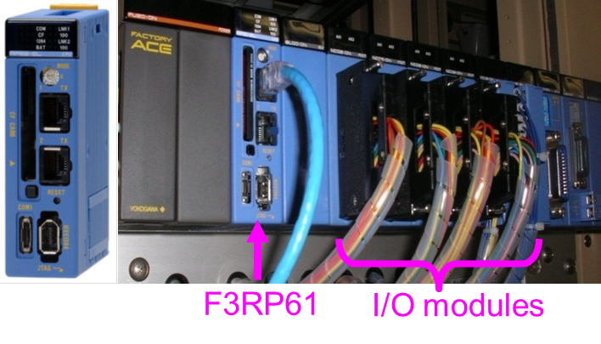
IOC and OPI
IOC (Input/Output Controller)
OPI (Operator Interface)
VME platform 98 IOCs
- CPU: mostly MVME5500,
MVME4100 and MVME6100
(EPICS v3.14.8-v3.14.12)
- OS: VxWorks (real-time OS)
- High-spec. and robust system
PLC platform 95 IOCs
- CPU: F3RP61 (EPICS v3.14.8-v3.14.12)
F3RP71 (EPICS v3.15.6)
- OS: Linux
- Small size, Low price, low power consumption
Others
- cPCI Event Receiver IOC
- microTCA for LLRF
- Software IOC as the middle layer system
SAD and Python scripts
- Tk toolkit for GUI
- Channel Access functions
- Optics calculation, tracking, ...
Control System Studio (CSS)
- All-in-one application for accelerator control
J.-I. Odagiri, et al, “Integration of PLC with EPICS IOC for SuperKEKB Control System”, in Proc. ICALEPCS’13, San Francisco, USA (2013)

Slide 17
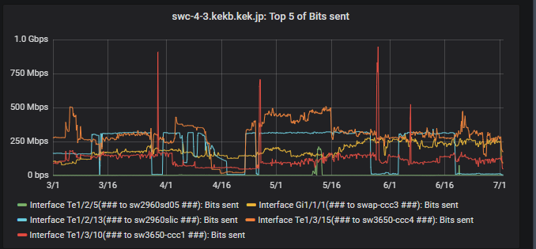
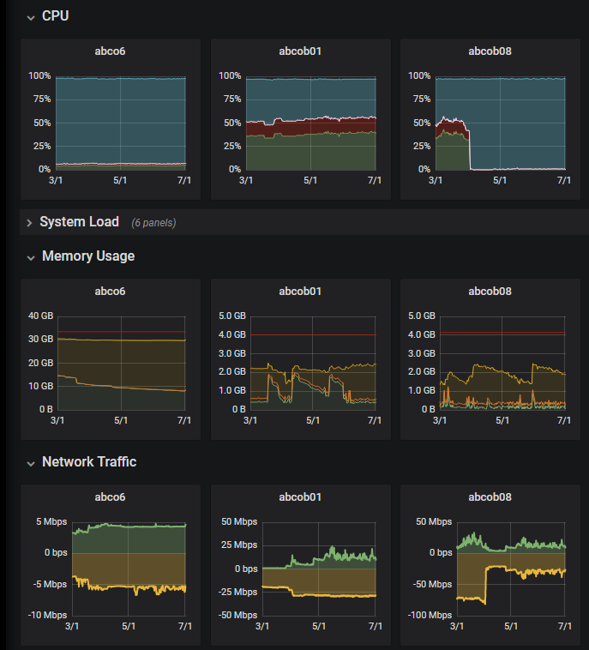
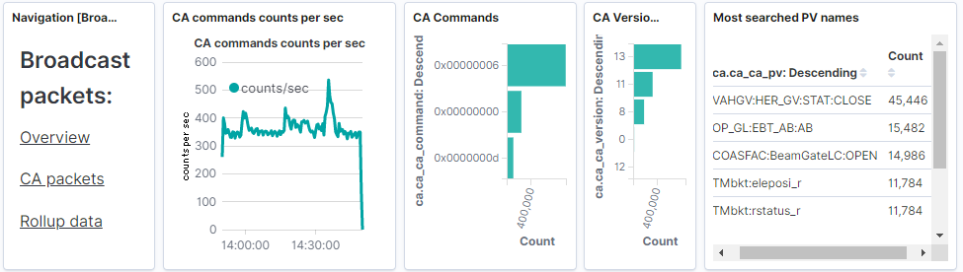
Monitoring System
The monitoring system is economically developed with open-source software.
The status of the control system can be checked from everywhere via web-browser.
Followings are visualized with Grafana.
Network Monitoring
The status of network switches, servers, and IOCs are collected with Zabbix.
We originally developed and integrated the functions to collect the pvAccess of EPICS7. It enables us to collect the various fields information of PV such as the severity, time, ...
Network Monitoring
Server Monitoring
Elastic stack is utilized to monitor the following log messages. The results are shown with Kibana.
Server Monitoring
The “ps”, “caSnooper”, “casw” commands are periodically implemented and their logs are recorded with Elasticsearch.
The broadcast of the EPICS system is monitored with Wireshark which includes the cashark plugin.
IOC Monitoring
S. Sasaki et al., “Monitoring System for IT Infrastructure and EPICS Control System at SuperKEKB”, in proc. ICALEPCS’19, NY, USA (2019).

Slide 18
Conclusion
SuperKEKB has been operated since 2016.
- The phase-3 operation is ongoing.
- The world’s largest luminosity record is broken continuously.
The control group takes care of the important part of the SuperKEKB operation
- Injection Control
- Beam abort request system
- Beam permission system
There are many other tasks for control group.
- Maintenance of ICT infrastructure
- Provision of standard IOC and OPI for the EPICS control system
- their monitoring system

