Slide 1


CEPC Collider Ring and Booster Magnets R&D
Mei Yang, Wen Kang, Fusan Chen, Xianjing Sun
Jan. 14,2022
HKUST IAS Mini Workshop of Accelerator (HEP 2022)
Jan. 13-19, 2022, online Hongkong

Slide 2
Outline
CEPC Booster dipole magnet R&D
  Manufacturing status of full-scale CT coil dipole magnet
  Development of the field measurement system
  Design of the full-scale iron-core dipole magnet
CEPC Collider magnets R&D
  Development of dual aperture dipole magnet
  Optimization of dual aperture quadrupole magnet
  Design of sextupole magnet
Summary and next plan

Slide 3
Outline
CEPC Booster dipole magnet R&D
  Manufacturing status of full-scale CT coil dipole magnet
  Development of the field measurement system
  Design of the full-scale iron-core dipole magnet
CEPC Collider magnets R&D
  Development of dual aperture dipole magnet
  Optimization of dual aperture quadrupole magnet
  Design of sextupole magnet
Summary and next plan

Slide 4
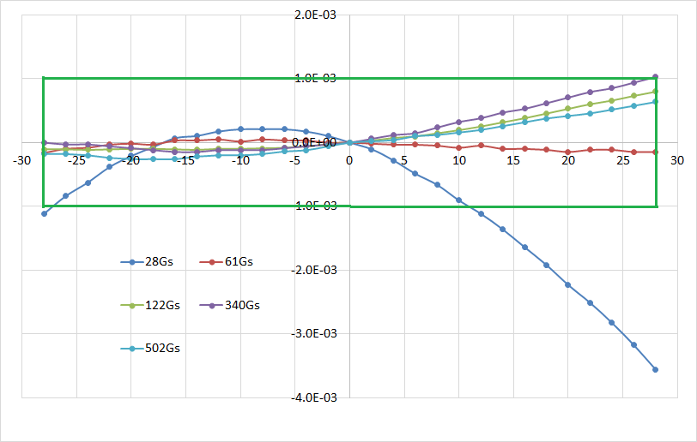
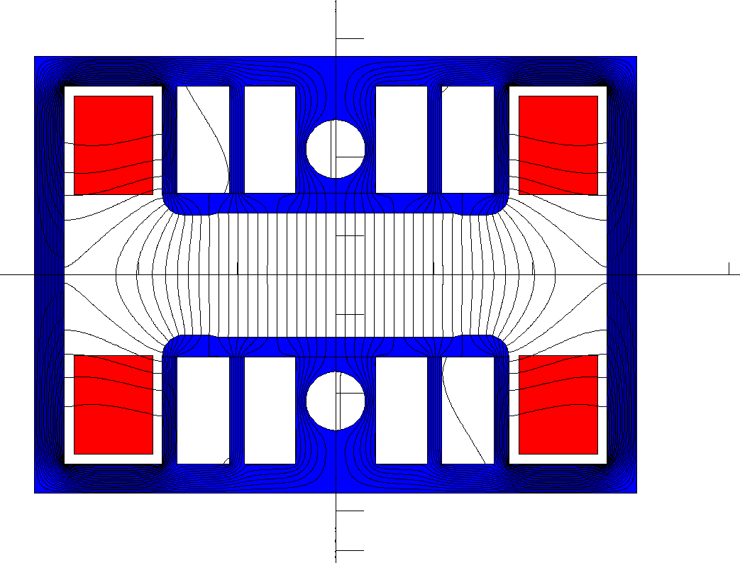
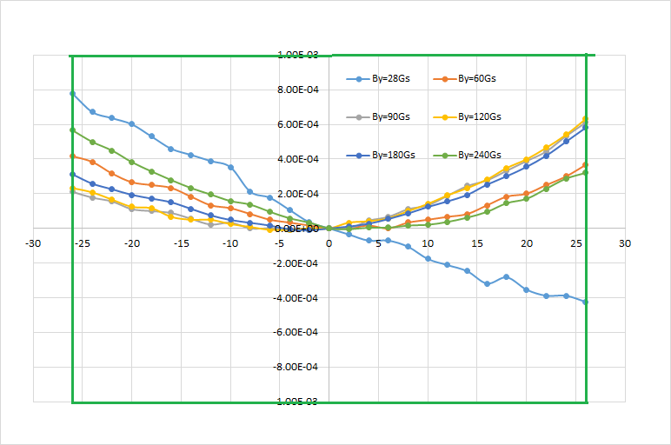
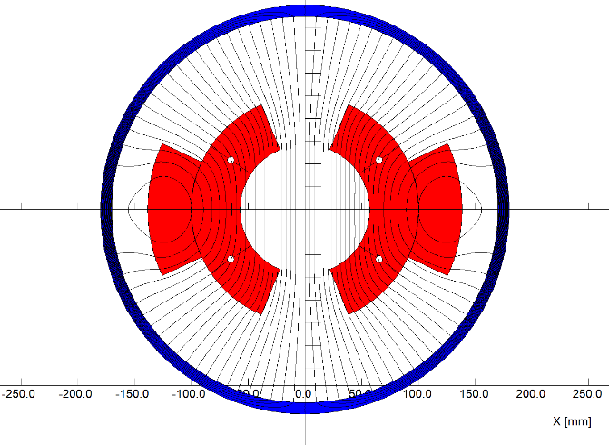
Specifications and subscale prototype magnets
Main specifications of CEPCB dipole magnets
 | BST-63B
Quantity | 16320
Minimum field (Gs) | 28
Maximum field (Gs) | 338@120GeV/500@180GeV
Gap (mm) | 63
Magnetic Length (mm) | 4700
Good field region (mm) | 55
Field uniformity | 0.1%
Field reproducibility | 0.05%
Iron type
Two subscale prototype magnets:(1m)
Iron dominated:
CT type (coil dominated):
CT coil type

Slide 5
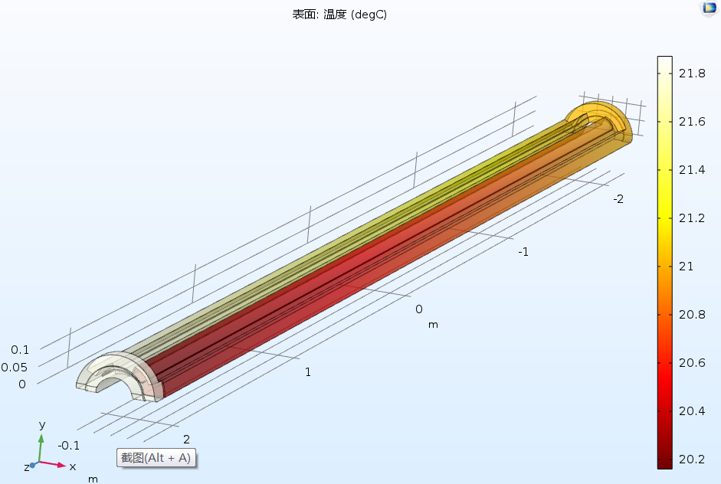
Status of the full-scale prototype CT coil dipole magnet
On the base of the subscale prototype CT dipole magnet, the mechanical design of a full scale prototype CT dipole magnet was finished. The production of the magnet on the way.
The total length of the magnet including the shielding tube is 5.1m.
The coil conductors will be made from pure aluminum, the size tolerance less than 0.05mm, the position tolerance less than 0.1mm.

Slide 6
Status of the full-scale prototype CT coil dipole magnet
Each conductor is 5m long, it is initially designed to be fabricated from a long aluminum bar, which will need large machining facility, so the cost will be very high.

Slide 7
Status of the full-scale prototype CT coil dipole magnet
To reduce the production cost, the 5 m long conductor is considered to be divided into 2 parts for convenient fabrication and then assembled together, the touch surface of two conductors will be coated with the silver film to reduce the contact resistance.

Slide 8
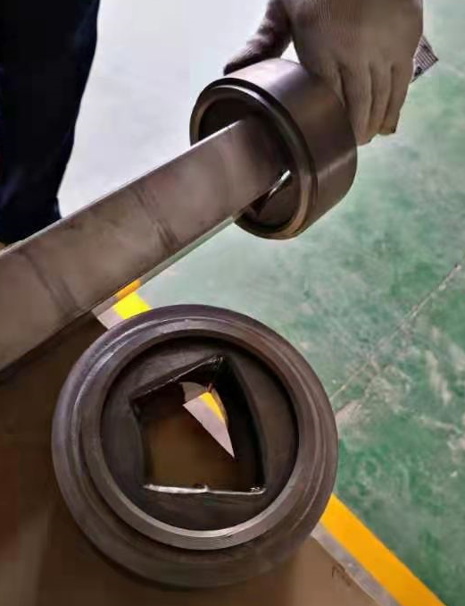
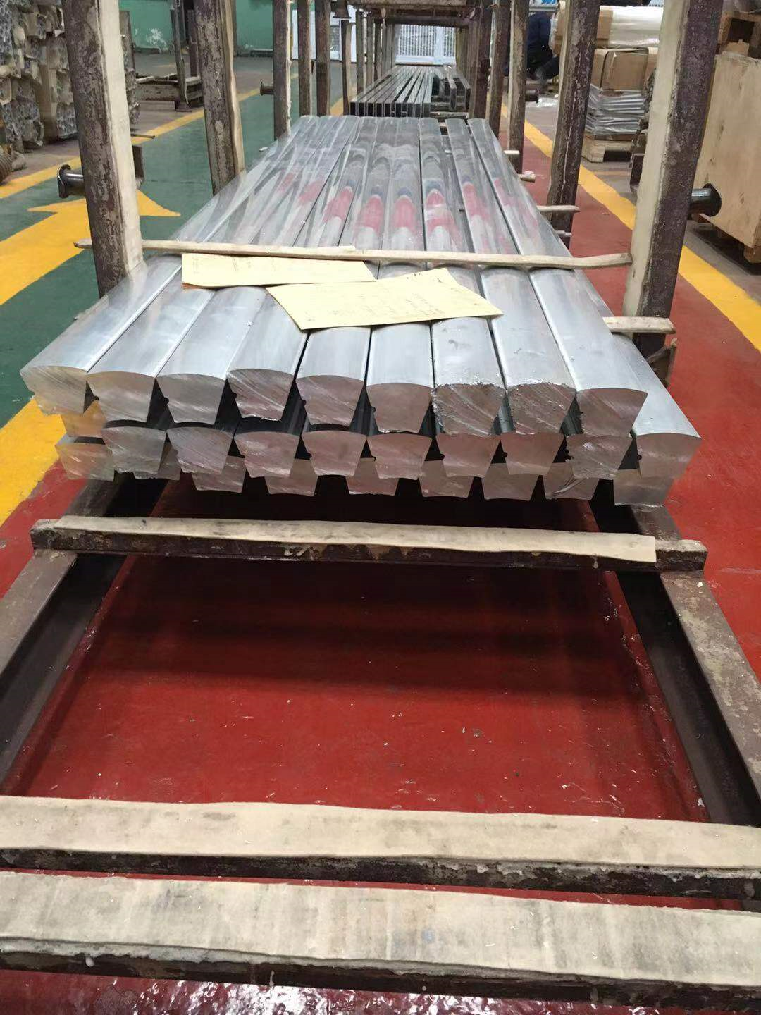
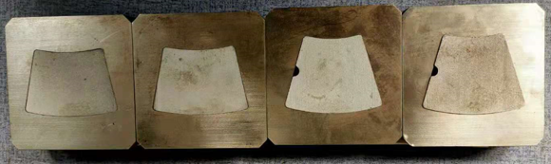
Status of the full-scale prototype CT coil dipole magnet
To reduce the production cost further, we decided to change the procedures of manufacture, instead of the direct fabrication, the conductors were precisely extruded and forged. The mechanical test results showed that the tolerances of the short samples were satisfied with the requirements.

Slide 9
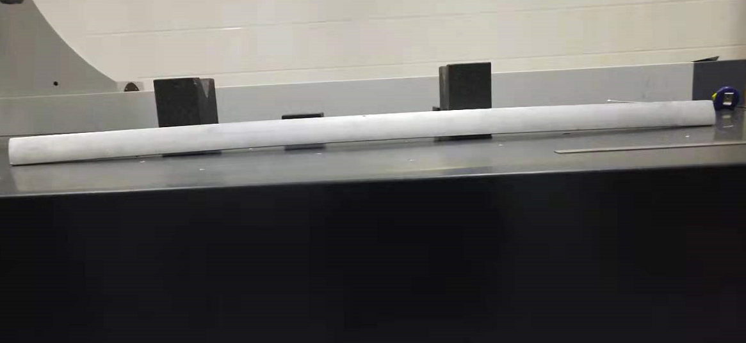
Status of the full-scale prototype CT coil dipole magnet
However, in the extrusion process of the 3m long conductors, the deformation along the conductors was serious although the tolerance of the cross section was good, so the Keye company decided to produce a device to reduce the deformation of the conductors.

Slide 10
Status of the full-scale prototype CT coil dipole magnet
After the coil conductors are produced and assembled together, they will be put into the shielding tube, which can be opened into upper and lower parts.

Slide 11
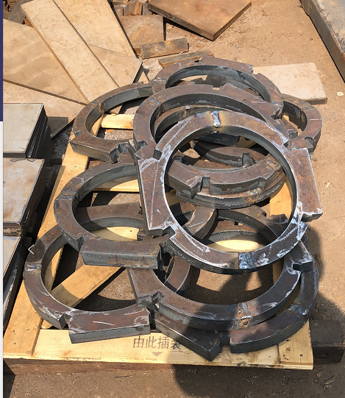
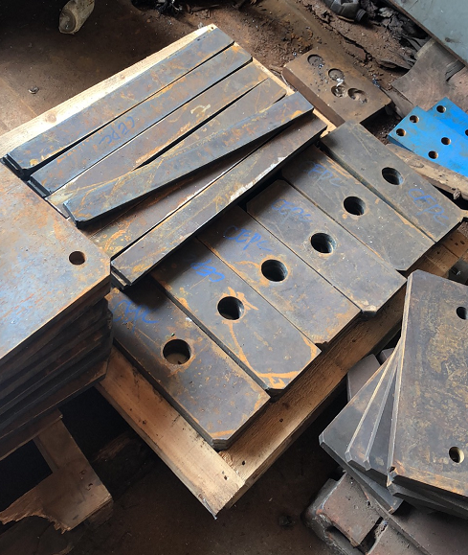
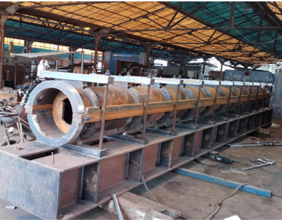
Status of the full-scale prototype CT coil dipole magnet
At present, the production of the shielding tube is on the way.

Slide 12
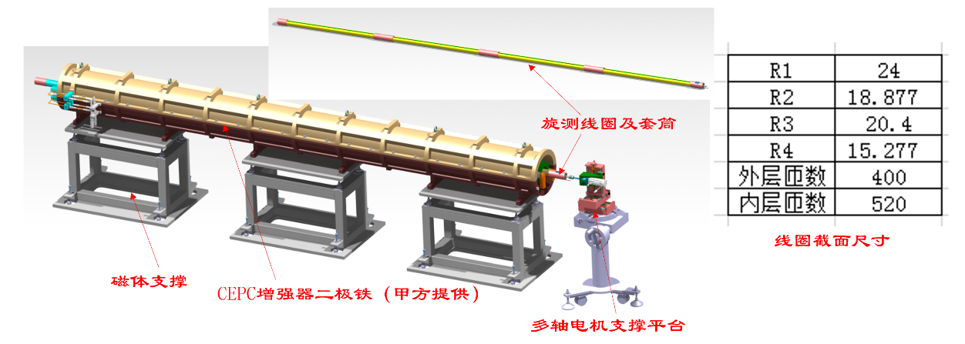
Status of the field measurement system
1、Long coil
2、Motor and Driver
3、Encoder
4、Motor control
5、Signal acquisition device

Slide 13
Status of the field measurement system
The structure of the long rotating coil
The total length of the coil is 5.6m, which is installed in a supporting tube.
Since it is very difficult to manufacture a 5.6m long rotating coil, so the long coil will be assembled with 4 sub-coils. Each sub-coil is 1130 mm long.

Slide 14
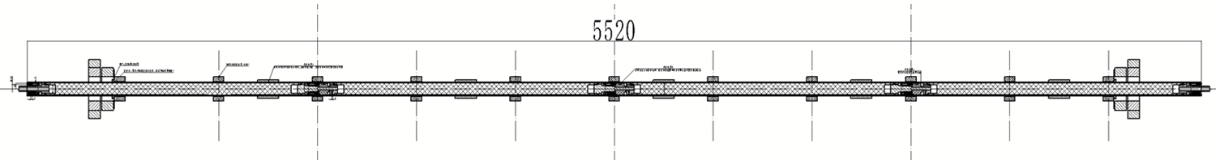
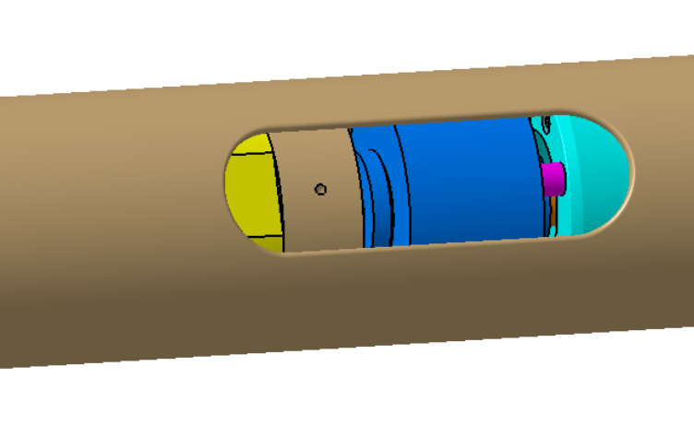
Status of the field measurement system
The field of the magnet in different longitudinal positions can be measured by the 4 sub-coils respectively, and the field of the whole magnet can be measured by connecting the signals in series.

Slide 15
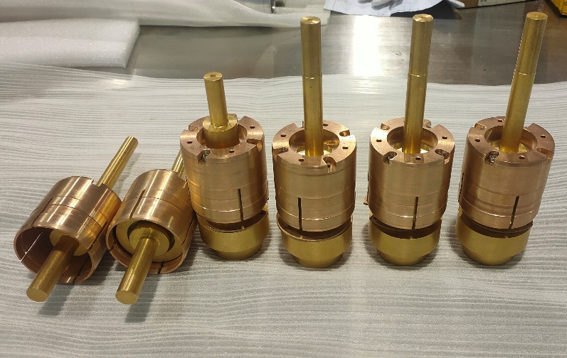
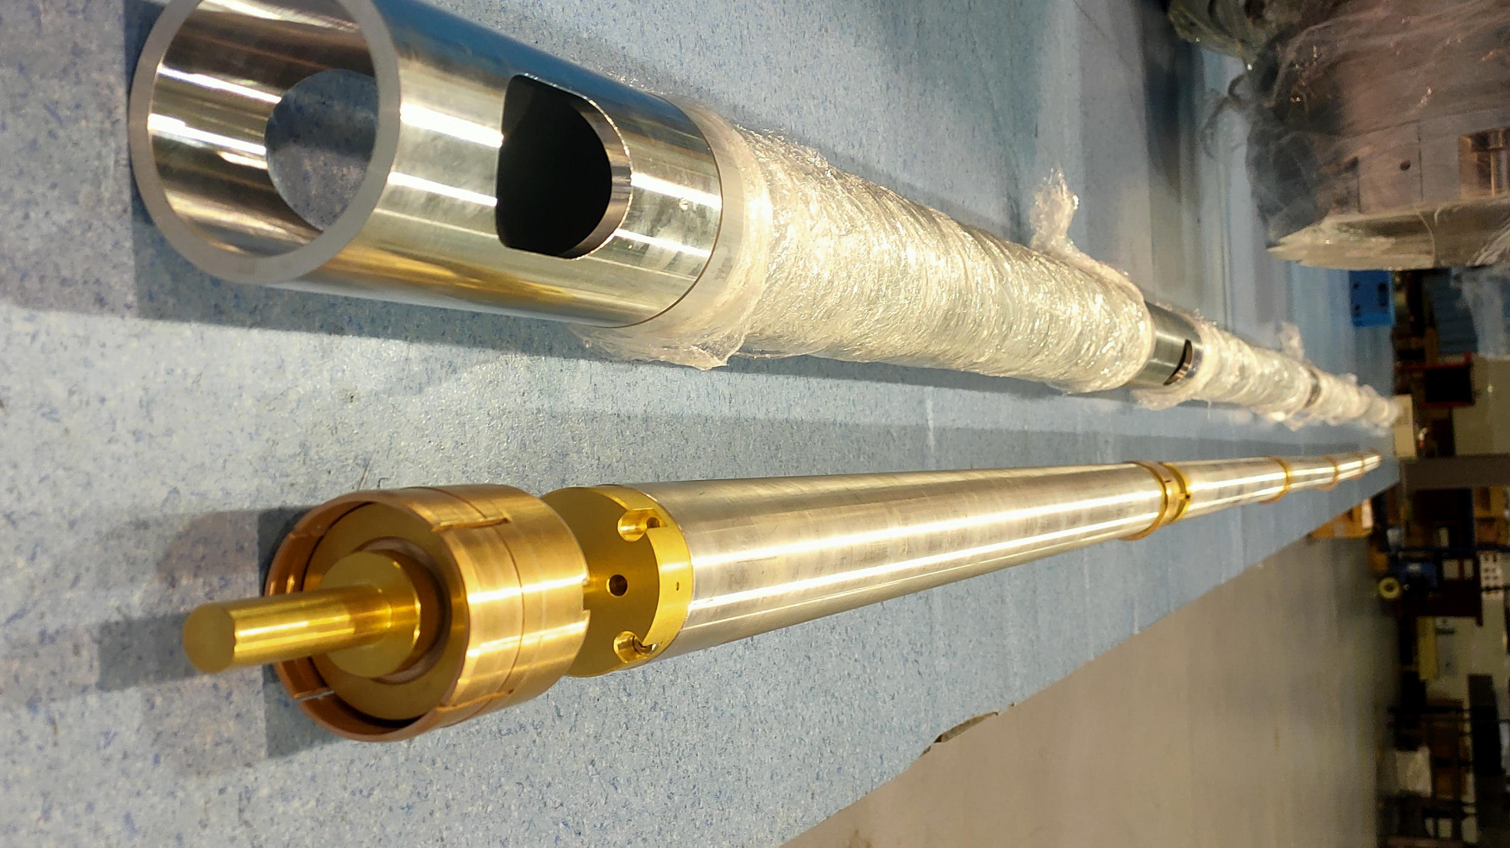
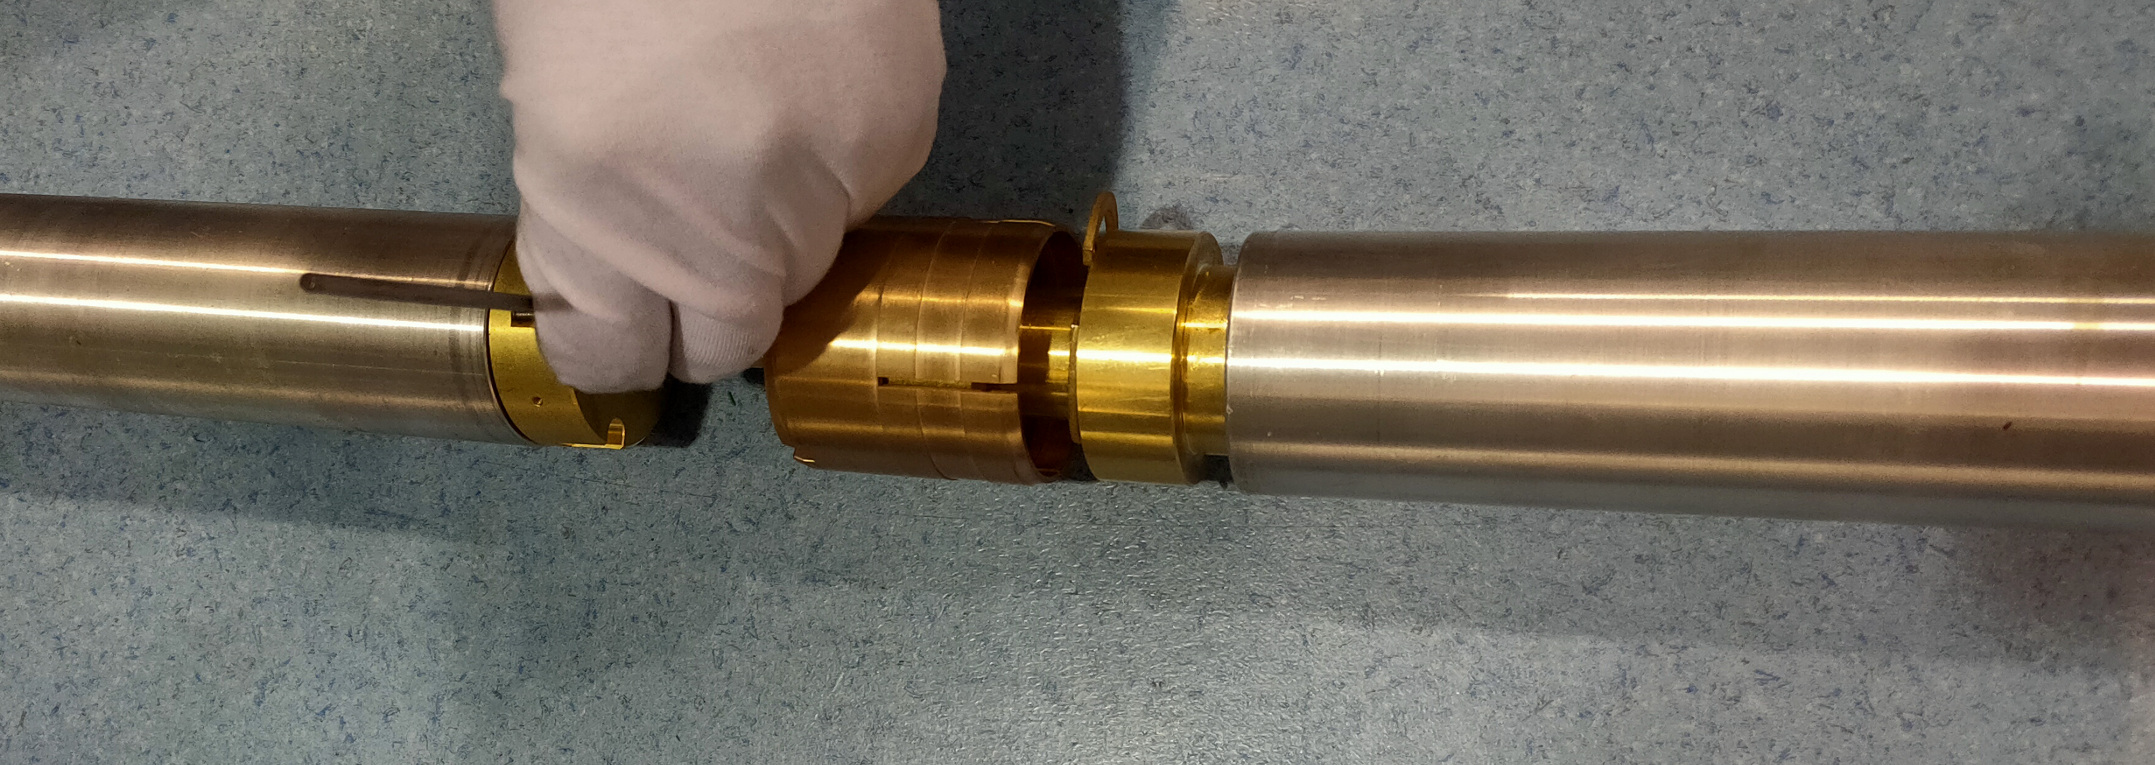
Status of the field measurement system
To test and verify the connection structures of the 4 sub-coils, the samples of the coil frames and connectors were produced. In the process of assembling, it is found that the tolerance of some components are not reasonable, the samples of the sub-coils could not be assembled together. So the design of the components was modified and the new ones will be produced.

Slide 16
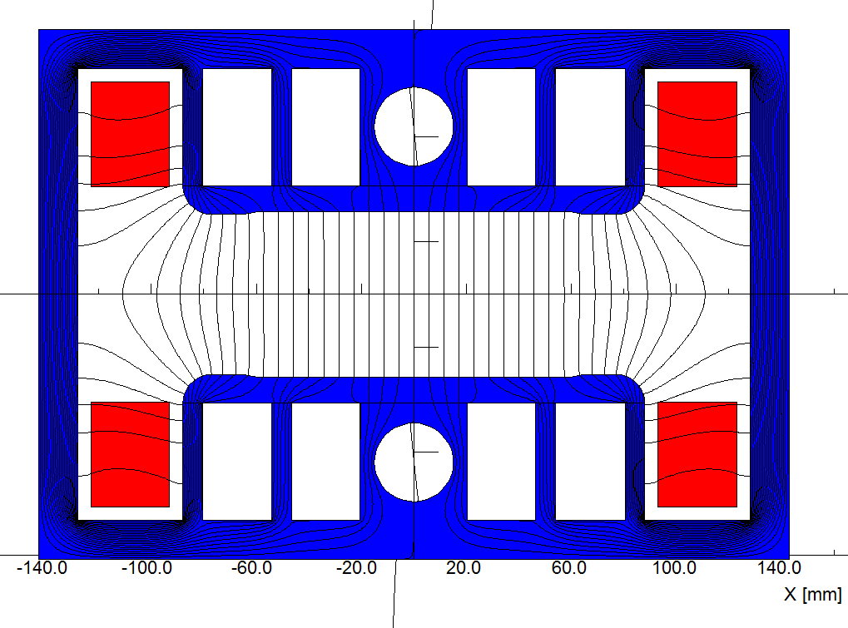
Design of the full scale iron core dipole magnet
As said in previous, the field uniformity of the iron-core dipole magnet could not meet the requirement of 28Gs@10GeV, but it could meet the requirement if the min. working field increases to 56Gs@20GeV.
The key advantages of the iron-core dipole magnet are low production cost and low electricity power loss. So in CEPC Day of May, the director made a big decision to increase the injection energy from 10GeV to 20GeV, the iron-core dipole magnet became the baseline design for the CEPC booster.

Slide 17
Design of the full scale iron core dipole magnet
The key design points of the full-scale iron-core dipole magnet.
To reduce the influence of earth field, a closed H-type core frame was chosen;
To reduce the influence of remnant field, the oriented low carbon silicon steel laminations with low remnant field was used to stack the cores of the magnet.
To reduce the cost and weight of the magnet, the technology of core dilution was adopted, the material of aluminum was used to produce the coils.

Slide 18
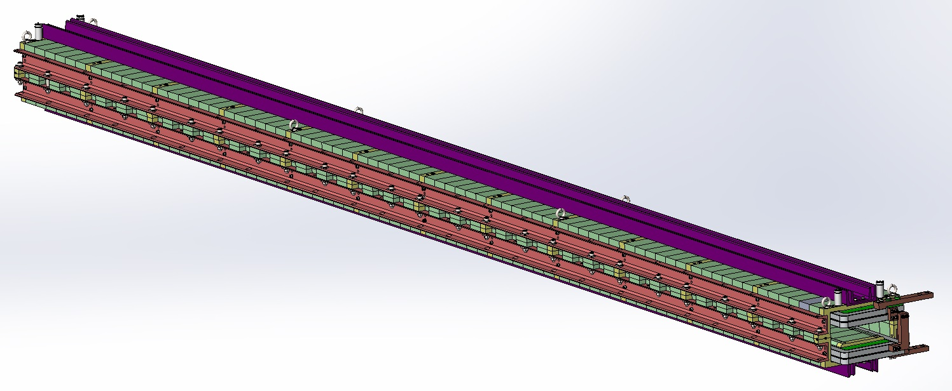
Design of the full scale iron core dipole magnet
Compared with the sub-scale prototype magnet, the length of the full-scale iron-core dipole magnet is 4.7m, such long iron-core dipole magnet with high precision has never been produced in China.

Slide 19
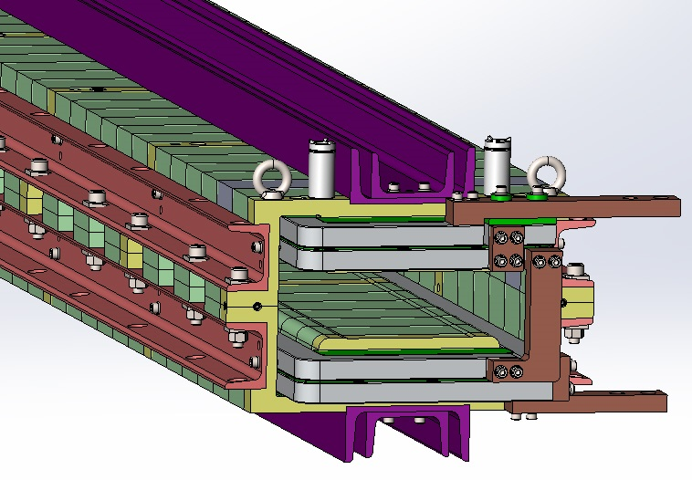
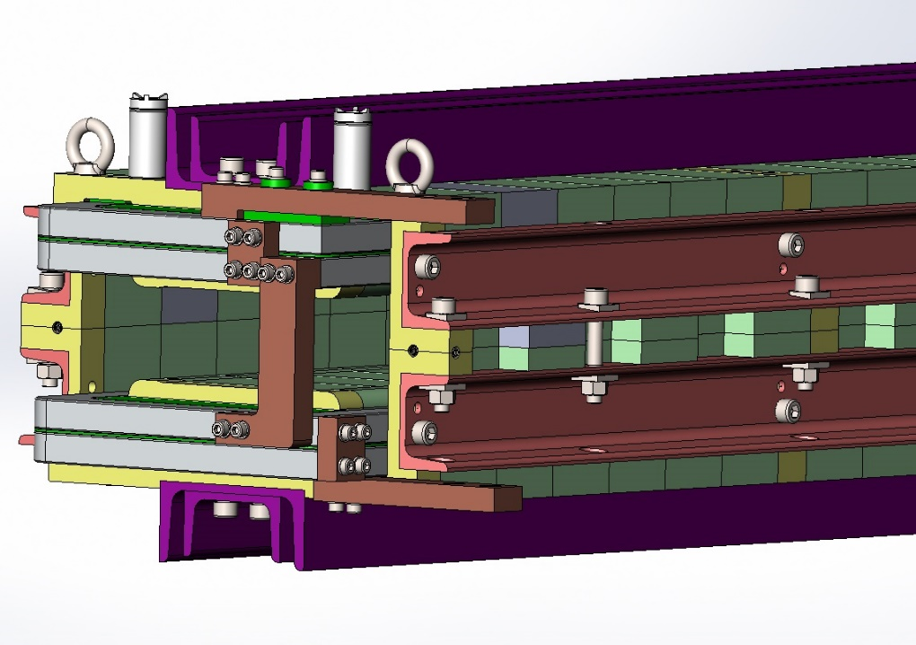
Design of the full scale iron core dipole magnet
The key design considerations of the full-scale iron-core dipole magnet
To increase the strength of the iron-core as high as possible.
To decrease the production cost as low as possible.
So all the metal bars around the iron-cores that pull the laminations together will be made by U-steel which has high strength and low cost, instead of solid steel.

Slide 20
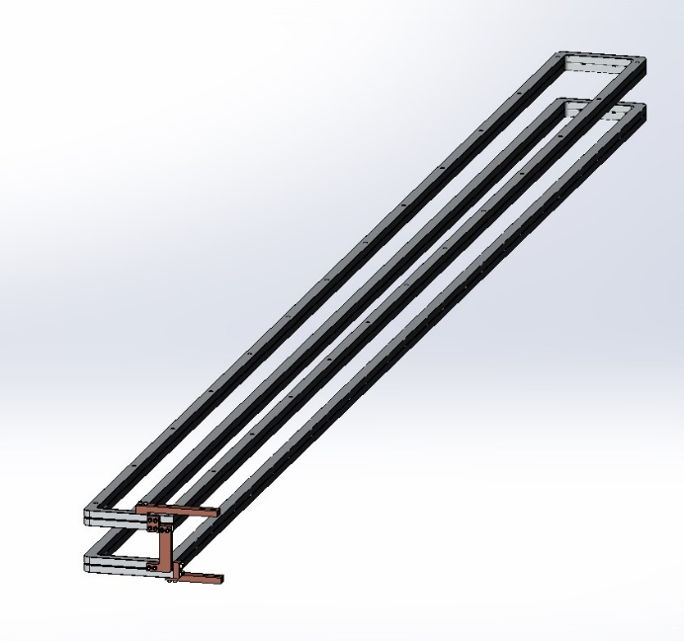
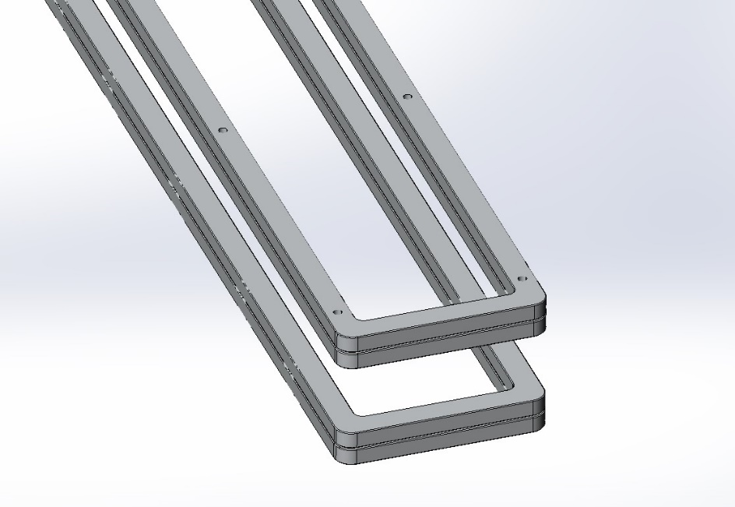
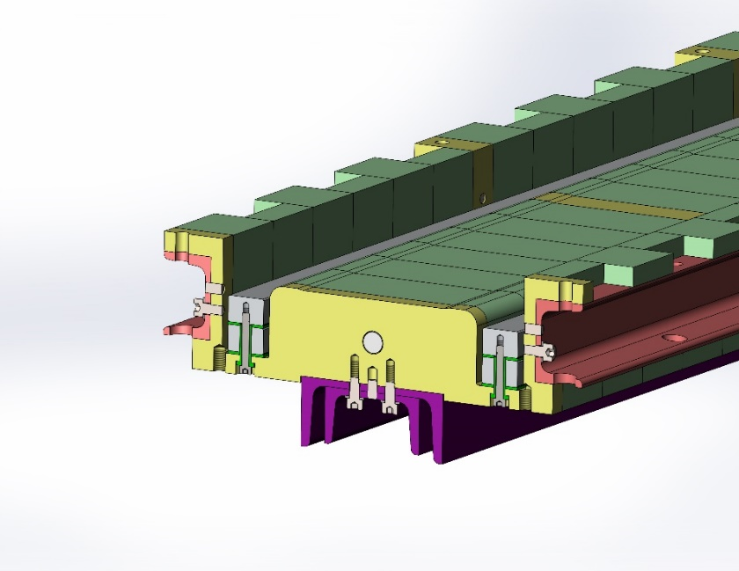
Design of the full scale iron core dipole magnet
For the design of the coils, in order to reduce the cost,
The coils have only two turns without water cooling, so each turn of the coils can directly produced by the aluminum bars.
Unlike the conventional vacuum epoxy casting, the insulation either between the turns or between coil and iron-core will be simply made by G10 plates.
By using some kind of special structure, the coils can be simply fixed on the iron cores.

Slide 21
Design of the full scale iron core dipole magnet
 | Iron-core | CT
Field uniformity@10GeV | 3.5E-3 | 5E-4
Field uniformity@20GeV | 5E-4 | 3E-4
Field reproducibility | <5E-4 | <5E-4
Max. power loss (W)@180GeV | 546 | 2935
Max. power loss (W)@120GeV | 245 | 1272
Magnet weight (ton) | 1.4 | 1.5
Cost per magnet (10kRMB)/MP | 15 | 25
Cost of all magnets (BRMB)/MP | 2.448 | 4.08

Slide 22
Outline
Progress on CEPC Booster dipole magnet
  Manufacturing status of full-scale CT coil dipole magnet
  Development of the field measurement system
  Design of the full-scale iron-core dipole magnet
Progress on CEPC Collider magnets
  Development of dual aperture dipole(DAD) magnet
  Optimization of dual aperture quadrupole(DAQ) magnet
  Design of sextupole magnet
Summary and next plan

Slide 23
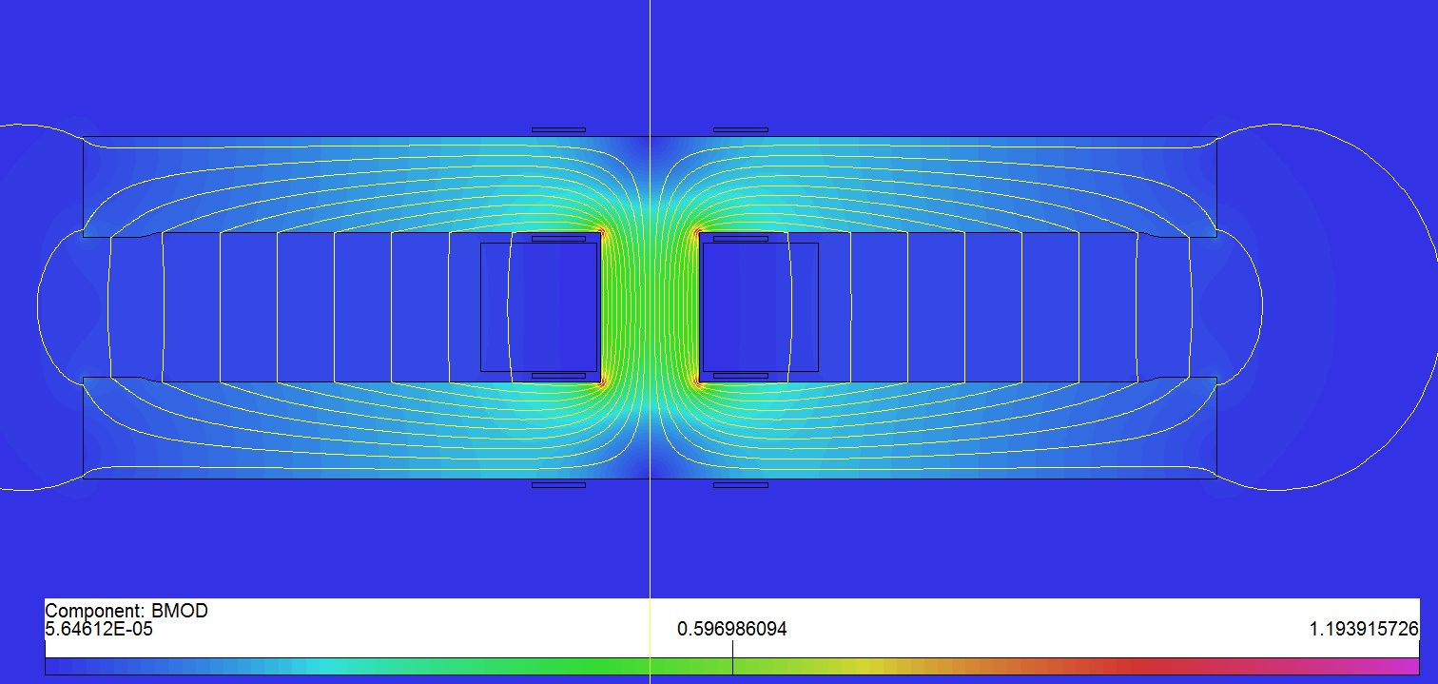
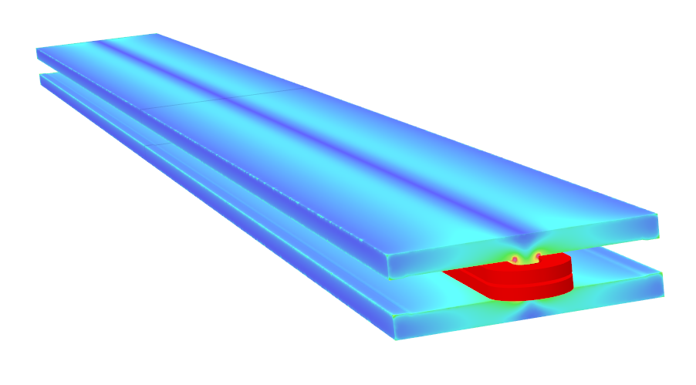
Progress on the collider dual aperture dipole magnet
Long dual aperture dipole（DAD）magnet design
  As the magnetic length is up to 28.7m, the 5.7m pure dipole model will be built to check the field quality, mechanical strength and deformation.
  Basic parameters
  Design considerations
    Beam center separation is 350mm;
    Solid iron with DT4;
    Two turns of aluminum busbars with cooling hole;
    Silvered contact face to reduce contact resistance.
Item | Value
Center field (Gs) | 141.6@45.5GeV，373@120GeV，568@182.5GeV
Gap (mm) | 66
Magnetic Length (m) | 5.737
Good field region (mm) | ±13.5
Field harmonics | <0.05%
Field adjustability | ±1.5%
Field difference between two apertures | <0.5%

Slide 24
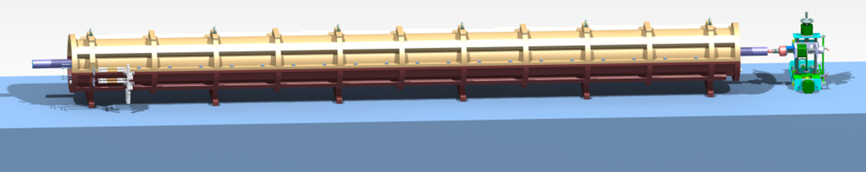
Progress on the Collider DAD magnet
The mechanical design of the long DAD has been completed.
The magnetic field will be measured by a rotating coil measurement system
  Shared with Booster dipole magnet.

Slide 25
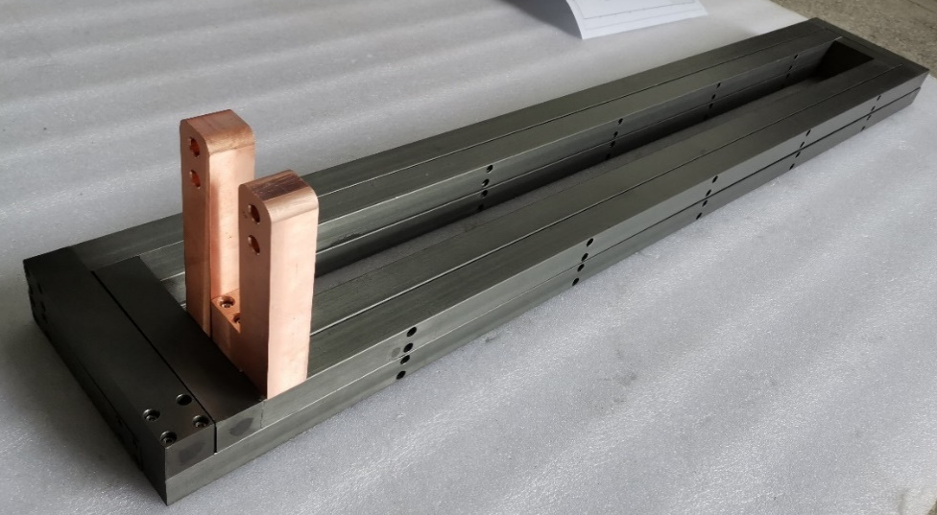
Progress on the Collider DAD magnet
Research on coil’s radiation protection and insulation
  Aluminum strip: 4 turns;
  Cross section:30*27mm,D10mm;
  Water channel sealed by sealing ring;
Hard anodized insulation test results
  Water drop test: passed.（Δp=0.88Mpa，keep 30min)
  Turn by turn insulation test: failed
  High voltage test：failed.
Anodic Oxidation

Slide 26
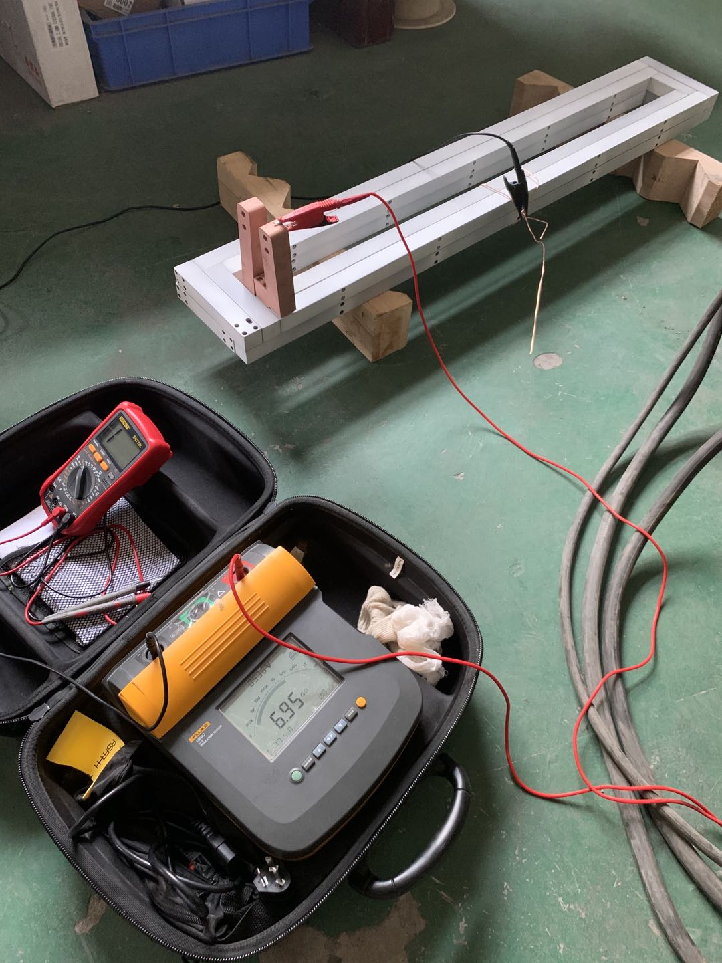
Progress on the Collider DAD magnet
Ceramic coating insulation test results
  Water drop test: passed（1Mpa~0.12Mpa，keep 30min)
  Turn by turn insulation test: passed.
  High voltage test：passed.
  Resistance: much larger than design.
The insulating coating lead to poor contact of the contact surface, the oxidation corrosion of silver plating.
Surface treatment required.
  The final resistance is 0.66 mΩ, still larger than the simulated one（0.47 mΩ）.
Ceramic Coating

Slide 27
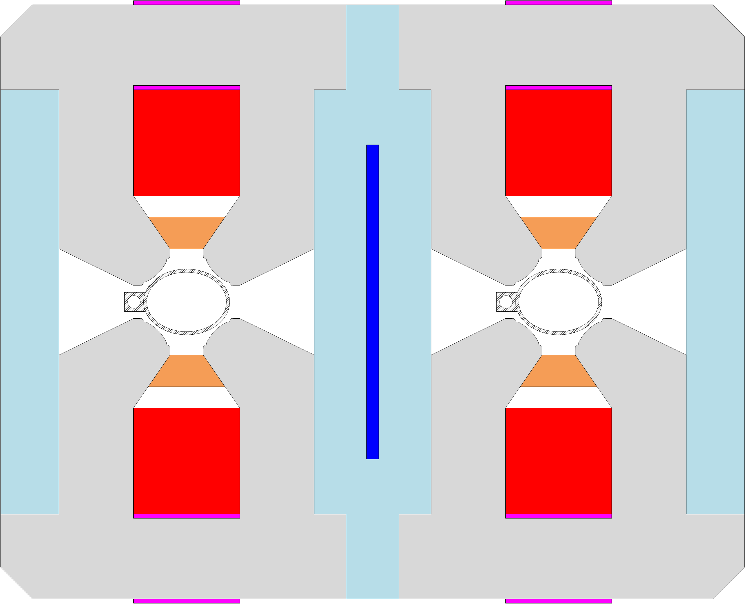
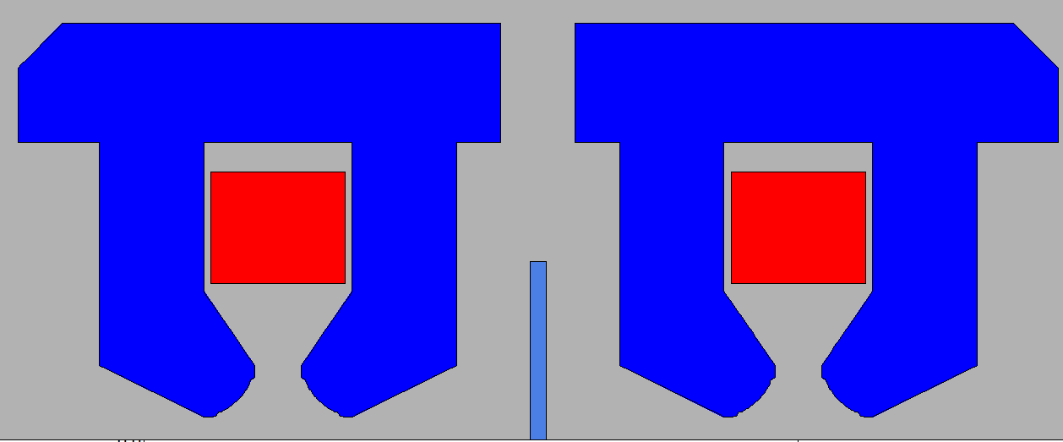
  Optimization of DAQ magnet
Basic parameters of DAQ (dual aperture quadrupole)
  Aperture：76mm
  Beam separation is 350mm
  Gradient range: 3.20T/m@45.5GeV~12.8T/m@182.5GeV
  Trim coil:+-1.5%
  Good field region: 5×10⁻⁴@Rref=12.2mm
First F/D prototype features:
  DT4 compensation sheet at yoke center.
  Trim coils are the same with main coils.
  Hollow water cooled aluminum conductor.
  The field in DT4 sheet saturation resulted harmonic changes in the b1 and b3, large cross talk between the two apertures.

Slide 28
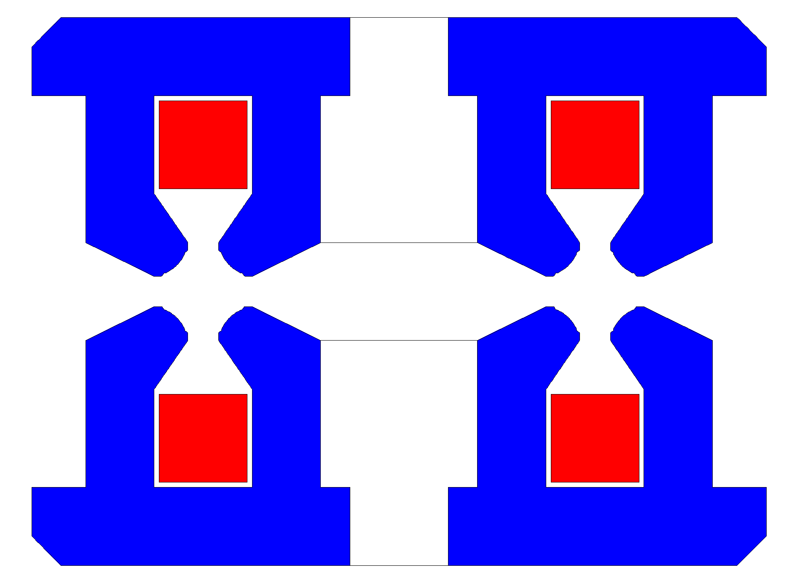
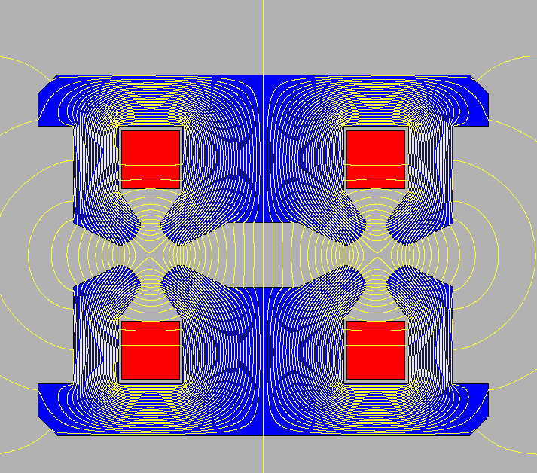
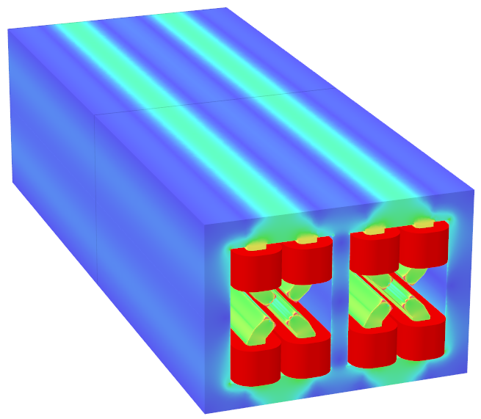
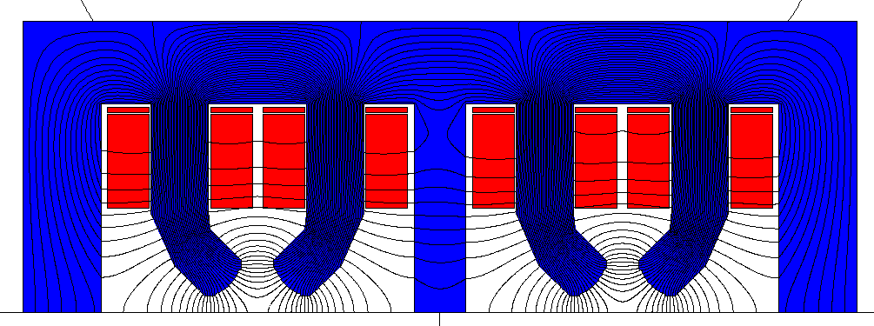
Optimization of DAQ magnet
Cross talk effect solving attempt:
  Different shim at the pole face;
  Pole shift; Pole rotate;
  Beam separation change:
Backup scheme: F/F polarity
  8 main coils, large power supply.
  No cross talk effect.
 | d350 |  | d400 |  | d500
 | Ap1 | Ap2 | Ap1 | Ap2 | Ap1 | Ap2
b1 | -2359.19 | 2359.21 | -1685.94 | 1685.94 | -1624.30 | 1624.31
b3 | -191.13 | 191.13 | -136.59 | 136.59 | -131.59 | 131.59
b5 | -2.58 | 2.58 | -1.85 | 1.85 | -1.78 | 1.78

Slide 29
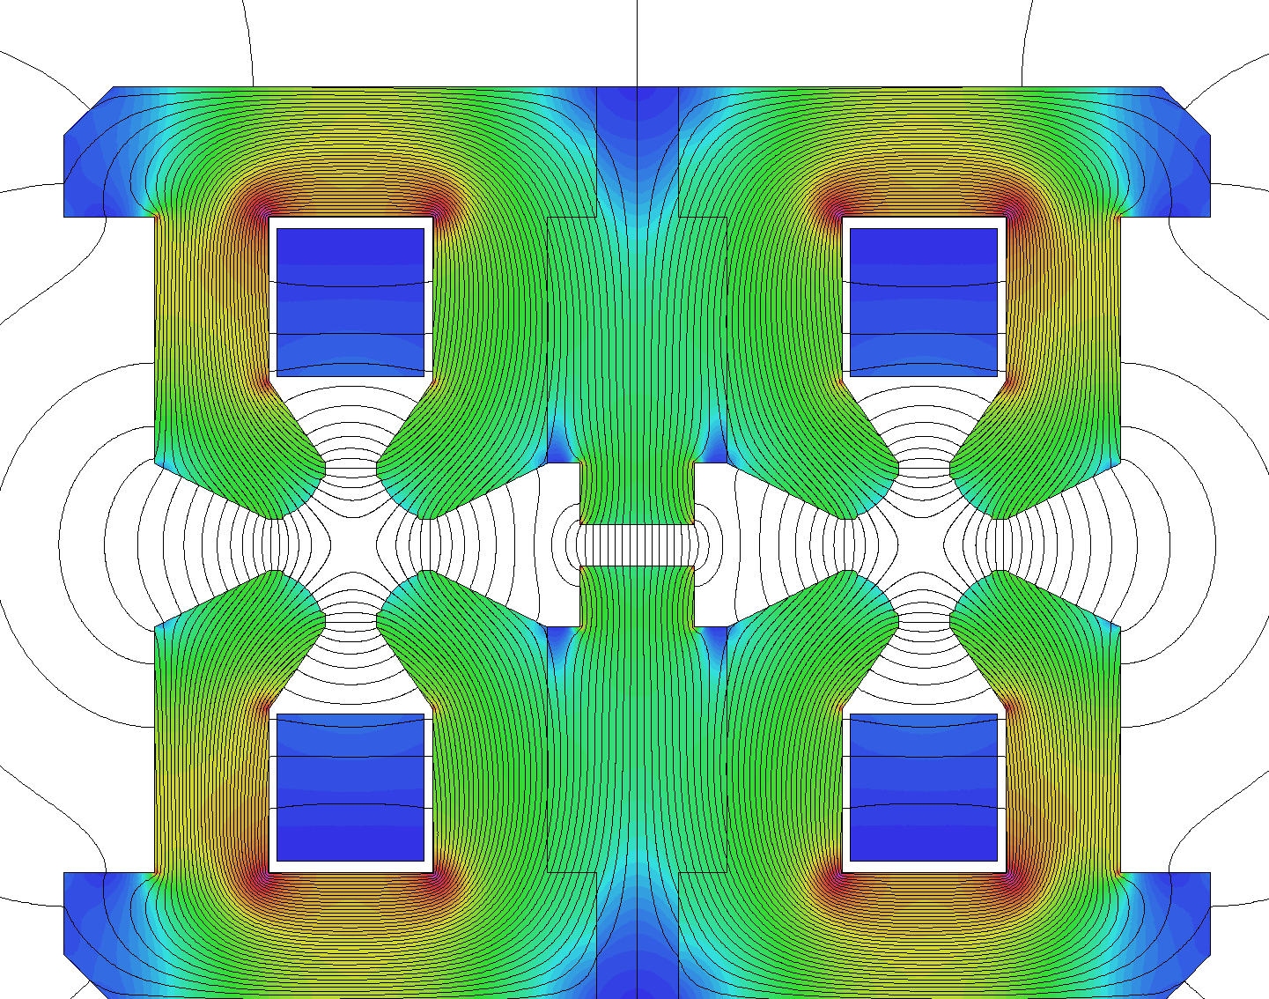
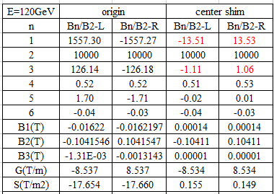
Optimization of DAQ magnet
New design of F/D prototype
  Shim at yoke center
  The iron not saturated and the b1 and b3 component changes along with energies can be neglected.
Original
Center shim

Slide 30
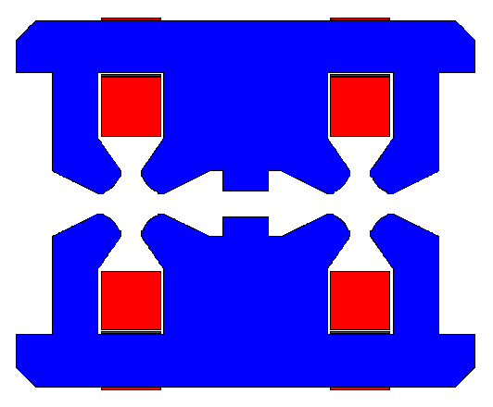
Progress on the Collider DAQ magnet
Trim coil design：to adjust the field at two apertures independently.
  Counteract energy sawtooth effect.
  Eliminate the dispersion of magnetic field.
Optimization target:
  Produce local field strength in one aperture.
  Never affect the other aperture.
Layout 1: trim coil on the yoke.
  Without trim coil, from Z to TT, b1 varies about 5 units.
  1.5% trim coil: b1 varies about 260 units, b3 varies 20 units.

Slide 31
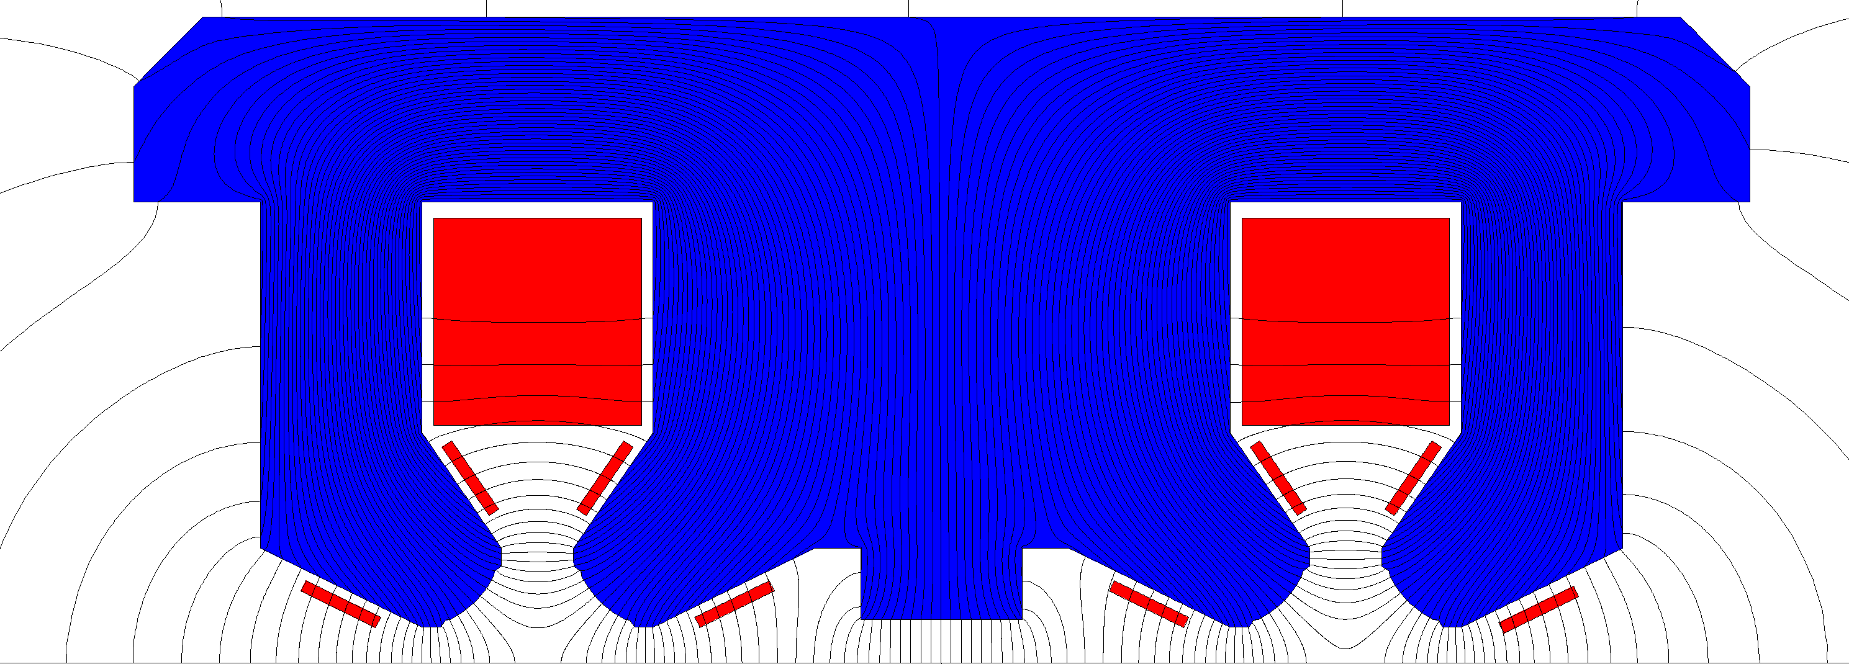
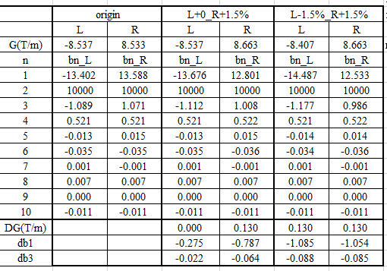
Progress on the Collider DAQ magnet
Layout 2: chosen.
  1.5% trim coil : harmonic variations are accepted at different energies.
Layout 2: trim coil

Slide 32
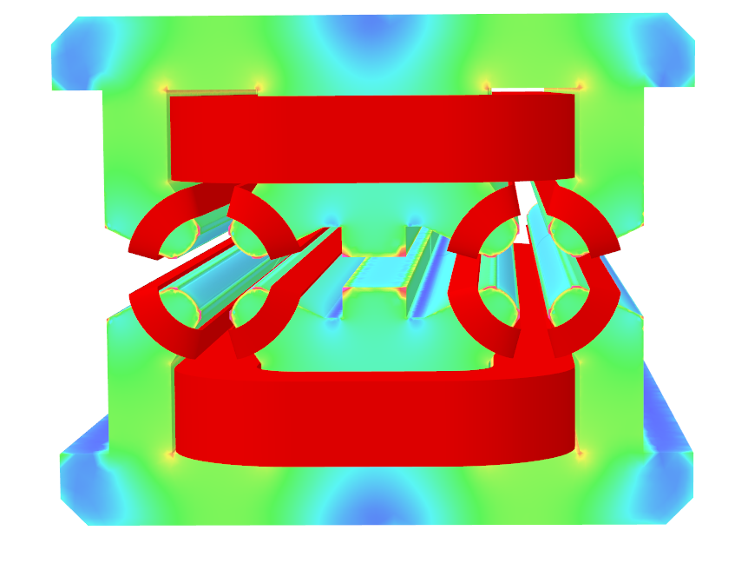
Progress on the Collider DAQ magnet
3D simulation with trim coils
  The harmonics change a little.
Trimcoil | 45GeV |  | 120GeV |  | 182.5GeV |  | change
 | AP_L | AP_R | AP_L | AP_R | AP_L | AP_R
G(T/m) | -3.18 | 3.28 | -8.39 | 8.64 | -12.68 | 13.05
b3 | 9.63 | -9.53 | 9.64 | -9.72 | 10.52 | -11.58 | -2.1
b4 | 0.53 | 0.41 | 0.54 | 0.42 | 0.56 | 0.43
b5 | 0.11 | -0.12 | 0.11 | -0.12 | 0.12 | -0.14
b6 | -0.34 | -0.31 | -0.35 | -0.31 | -0.36 | -0.33
x0(mm) | 0.2937 | -0.2834 | 0.2936 | -0.2807 | 0.2841 | -0.2560 | 0.03
Beam sep |  | -0.5770 |  | -0.5743 |  | -0.5401 | 0.04

Slide 33
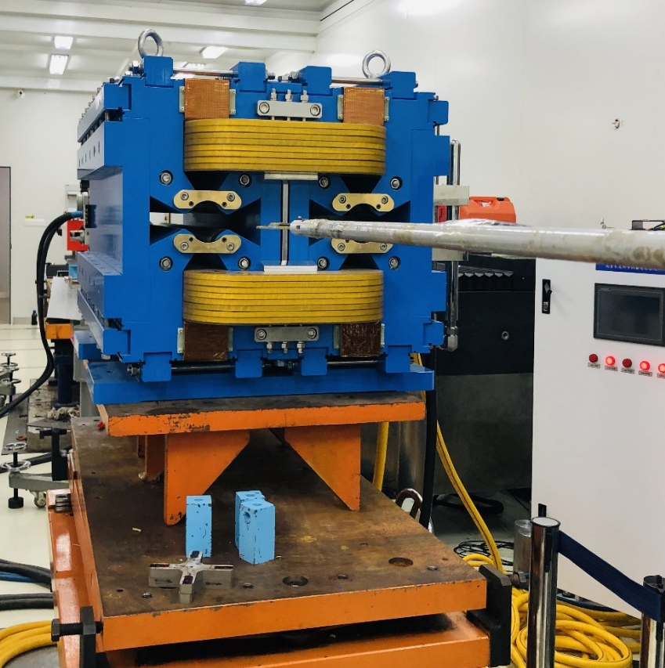
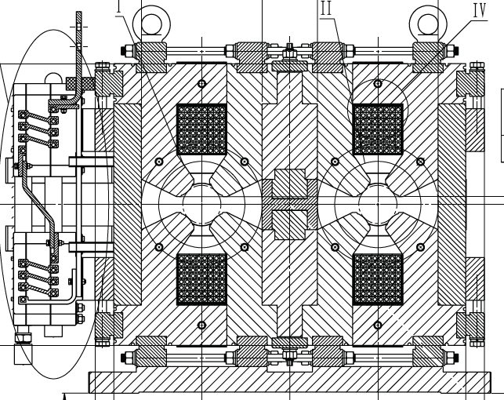
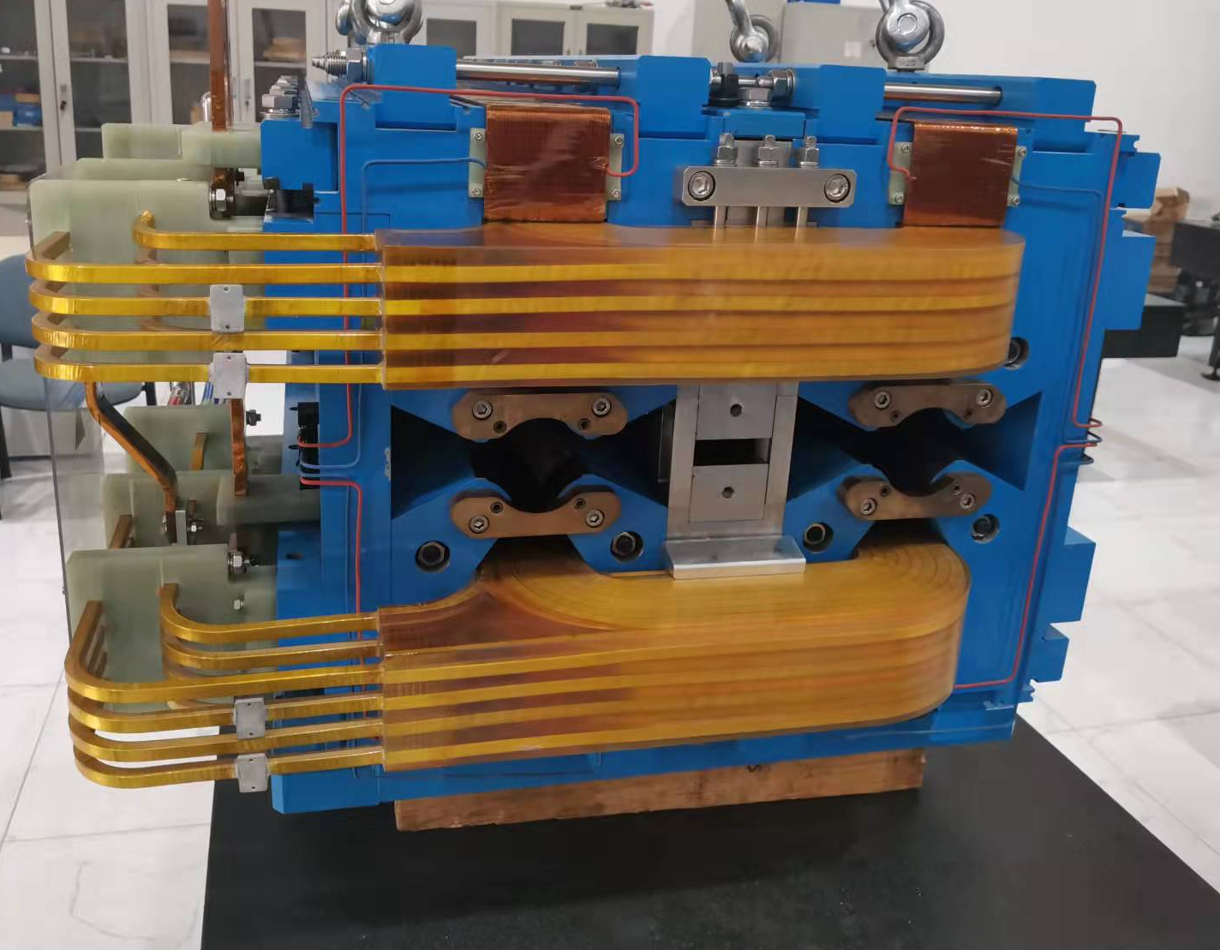
Progress on the Collider DAQ magnet
Modification of the dual aperture quadrupole magnet
  The new simulation of the 1m magnet is been checked.
  The mechanical modification is completed.The field measurement is under development.

Slide 34
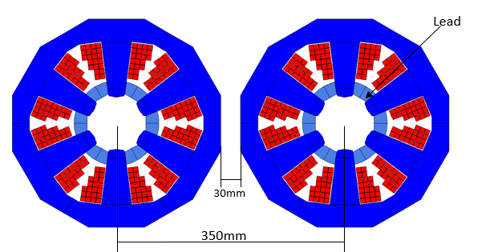
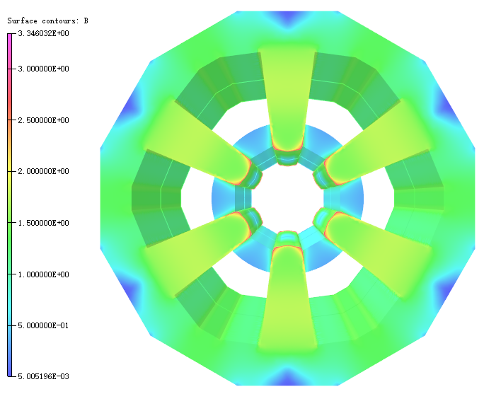
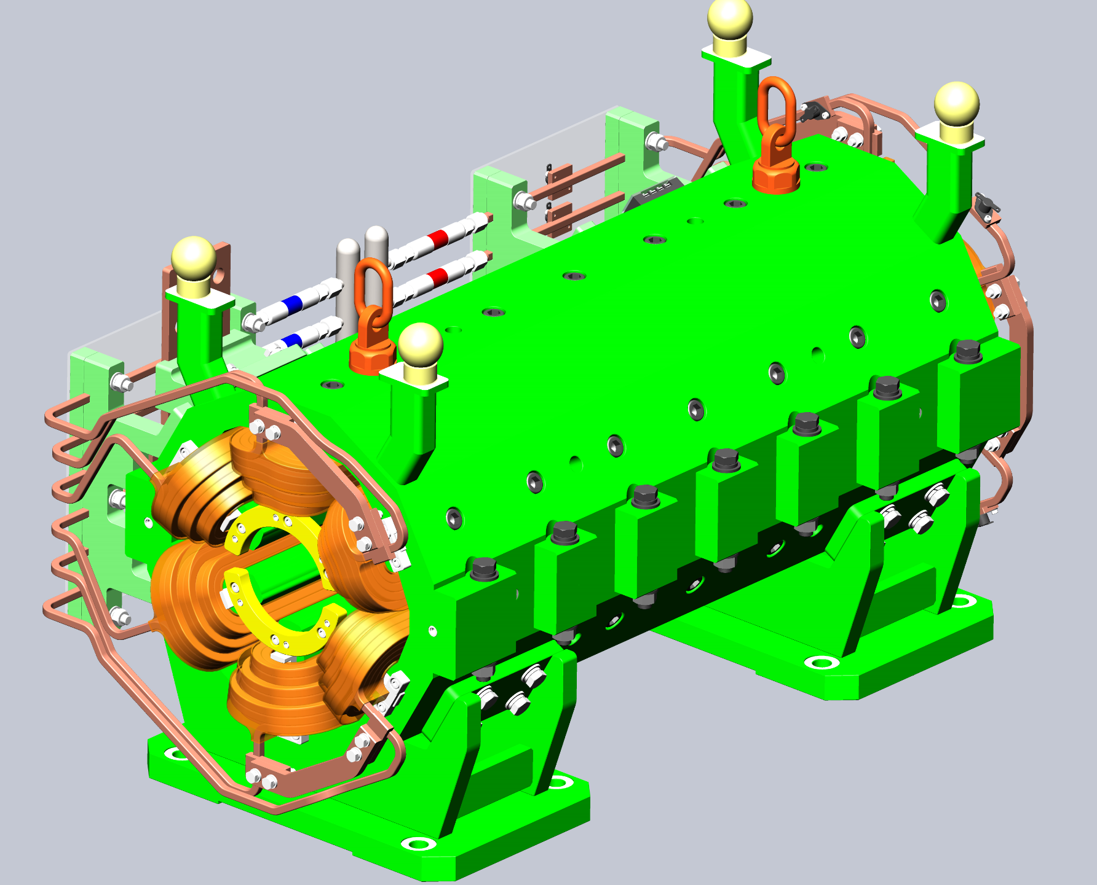
Design of sextupole magnet
Basic design
  Wedge-shaped magnetic poles are used to reduce magnetic pole saturation and improve excitation efficiency
  Further optimization to the position of the lead block and the arrangement of coil wires to reserve space for magnet assembly.
  Mechanical design is in progress, the mechanical strength should be checked.

Slide 35
Summary and next plan
For CEPC Booster dipole magnet:
  CT coil dipole can meet the physical requirements at 28Gs, both the coil and iron-core magnets can meet the requirements above 56Gs when the energy is at 20GeV.
  CT coil dipole is under production and the rotating coil measurement system is being development.
  The iron core magnet is chosen for CEPC booster as the injection energy is increases to 20GeV. The full scale magnet is under mechanical design.
For CEPC Collider Magnet:
  Long DAD is under production.
  The radiation protection and contact surface treatment experiment of the water-cooled aluminum rod is in progress.
  New compensated scheme for F/D DAQ has been finished. The modification of the prototype is undergone and will be measured. Further optimization is still on.
  The single aperture sextupole magnet is in mechanical design.

Slide 36
Thank you very much!

