Slide 1
On polarization and energy calibration in e+e- colliders
Sergei Nikitin
BINP, Novosibirsk
Accelerator Mini-Workshop at IAS Program on HEP , Hong Kong 2022
13.01.2022

Slide 2
Let me recall
some moments in the history of radiation polarization,
methods for measuring polarization and
peculiarities of its use for calibrating particle energy;
give examples from world experience,
some theses on polarization issues in new projects;
tell about some polarization experiments at VEPP-4M

Slide 3
Early milestones
1963. A.A. Sokolov, I.M. Ternov. Discovery of radiative polarization in theory
1963. Discovery of Touschek effect in Orsay (France) at AdA created in INFN (Frascati).
1968. V.N. Baier, V.A. Khose (INP, Novosibirsk). Touschek scattering and then (1969) Compton
scattering of circularly polarized optical photons proposed for measuring polarization.
1970. First observation of radiative polarization at VEPP-2M, 625 MeV (INP, Novosibirsk).
First application of Resonant Depolarization (at external resonance). Touschek detector used.
1970. First observation of radiative polarization at ACO, 536 MeV in Orsay (France).
Touschek detector used. Enforced depolarization at betatron-frequency-sideband resonances.
With article on motion of spin in storage ring with arbitrary field and polarization direction
(DAN USSR) the series of fundamental works by Ya.S. Derbenev and A.M. Kondratenko began.
1975. Resonant Depolarization proposed to measure beam energy (INP, Novosibirsk).
Used to measure φ-meson mass.
1975. First measurement of polarization using laser polarimeter (SPEAR 2.4 GeV at SLAC).
1983. First observation of spin dependence of SR intensity and its application to measure
polarization (VEPP-4 at 5 GeV, INP, Novosibirsk).
1994. First production of longitudinal polarization in high energy electron storage ring
HERA 27.5 GeV; spin rotators with transverse magnetic fields used

Slide 4
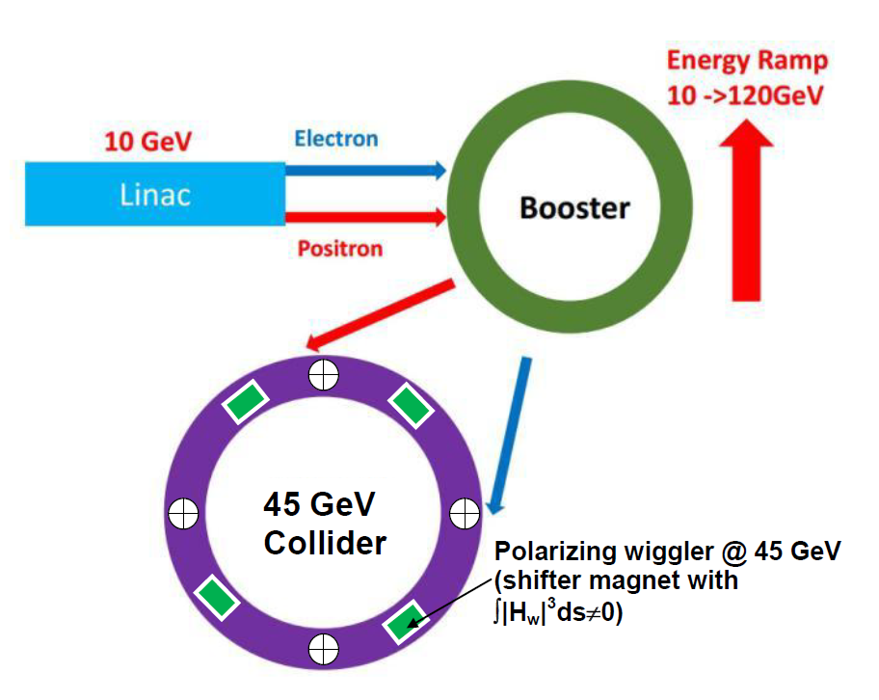
Sokolov-Ternov polarization time
Long-known tool:
special wigglers
amplify polarizing
effect of storage ring field!
 | Energy [GeV] | S-T time [h]
VEPP-3 | 1.85 | 0.55
VEPP-4M | 1.85 | 70
VEPP-4M | 4.73 | 0.65
LEP | 45 | 5
CEPC | 45 | 265
FCCee | 45 | 250
CEPC | 80 | 15
CEPC

Slide 5
Special wigglers to speed up polarization at CEPC
Shifter magnet
While using laser polarimeter for RD technique it is enough to ensure polarization degree about of 10% achived in a few hours with shifter magnets
Calculated for a variant of the CEPC-Z magnetic structure

Slide 6
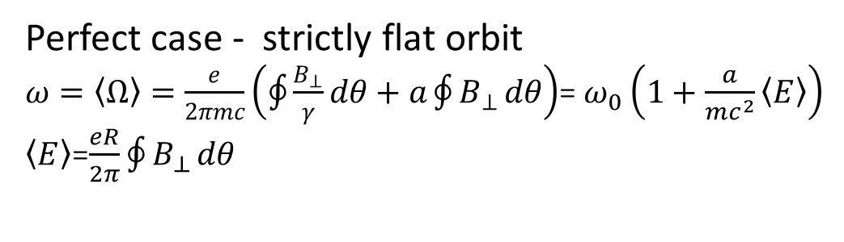
Perfect relation of spin tune and particle energy for RD
No horizontal and longitudinal magnetic fields as well as vertical electric fields
Perfect case - strictly flat orbit
$ω=\left\langle Ω\right\rangle =\frac{e}{2πmc}\left(\oint{\frac{B_{⊥}}{γ}}dθ+a\oint{B_{⊥}}dθ\right)$= $ω_{0}\left(1+\frac{a}{mc^{2}}\left\langle E\right\rangle \right)$
$\left\langle E\right\rangle$=$\frac{eR}{2π}\oint{B_{⊥}}dθ$
To determine the absolute beam energy in a storage ring with a flat orbit it is enough to measure a ratio between the spin frequency (νω₀) and the revolution one (ω₀) given by the RF frequency. The relative accuracy is limited by the uncertainty in the fundamental constant values and equals to 6.1⋅ 10⁻⁹.

Slide 7
Radiative polarization in real storage ring
Derbenev-Kondratenko theory
“Shake” of precession axis n due to quantum fluctuations→ “non-resonant” spin diffusion growing nearby spin resonances, main depolarization factor in storage rings as long as spin tune spread is much less than distance to closest dangerous resonances

Slide 8
Depolarization factor with synchrotron modulation
G=P/P₀=P/0.92

Slide 9
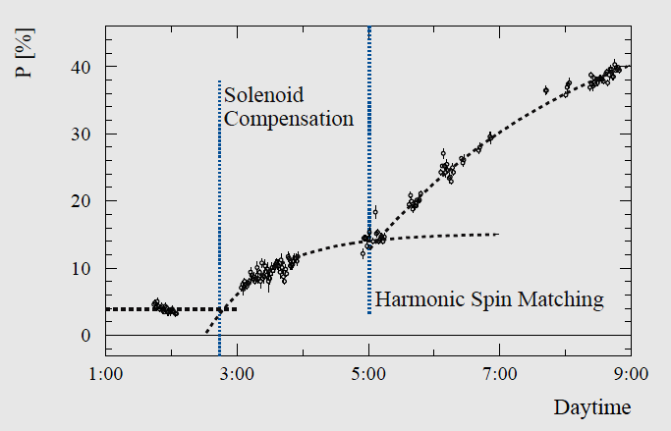
Expectations vs observation: LEP experience
45 GeV LEP polarization benefited from Spin Matching techniques
Polarization (%)
It is important to reduce the resonant harmonic amplitudes in orbit distortions down to level |w_{k}| ≤10⁻³ using special orbit bumps or global correction. There was positive experience of LEP team: polarization
was improved to more than 35 % with average around 50% using Harmonic Spin Matching technique
(R. Assmann , A.Blondel et.al., CERN SL/94-62 (AP)

Slide 10
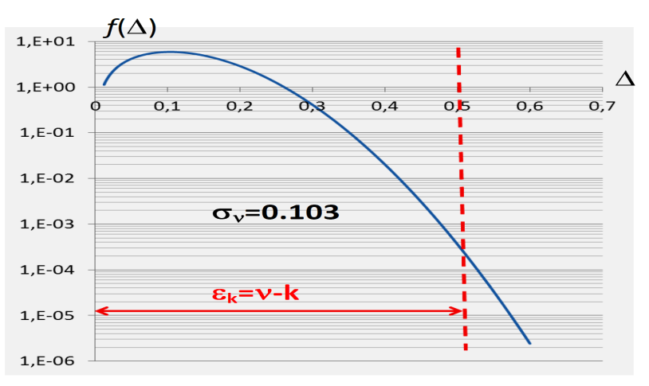
Resonant diffusion of polarization due to large spin tune spread
It was not so relevant in electron-positron rings
of previous generations.
Modulation amplitude distribution
S. Nikitin, “Polarization issues in circular electron–positron super-colliders”,
Int. J. Mod. Phys. A, vol. 35, no. 15n16, p. 2041001, 2020.
Resonant diffusion due to large instant spin tune spread (σ_{ν}∼0.1 in wiggler mode or at higher energy) should be considered in framework of model basing on radiative excitation and damping. For particle falling into tail of distribution function, amplitude of spin tune modulation by synchrotron oscillations can sporadically overlap distance to closest spin integer resonances (ε_{k}≈0.5). As result, there are accidentally recurring fast intersections of those resonances…
CEPC –Z
wiggler mode
Calculation: large spin tune spread σ_{ν}∼ 0.1 can be noticeable depolarizing factor!

Slide 11
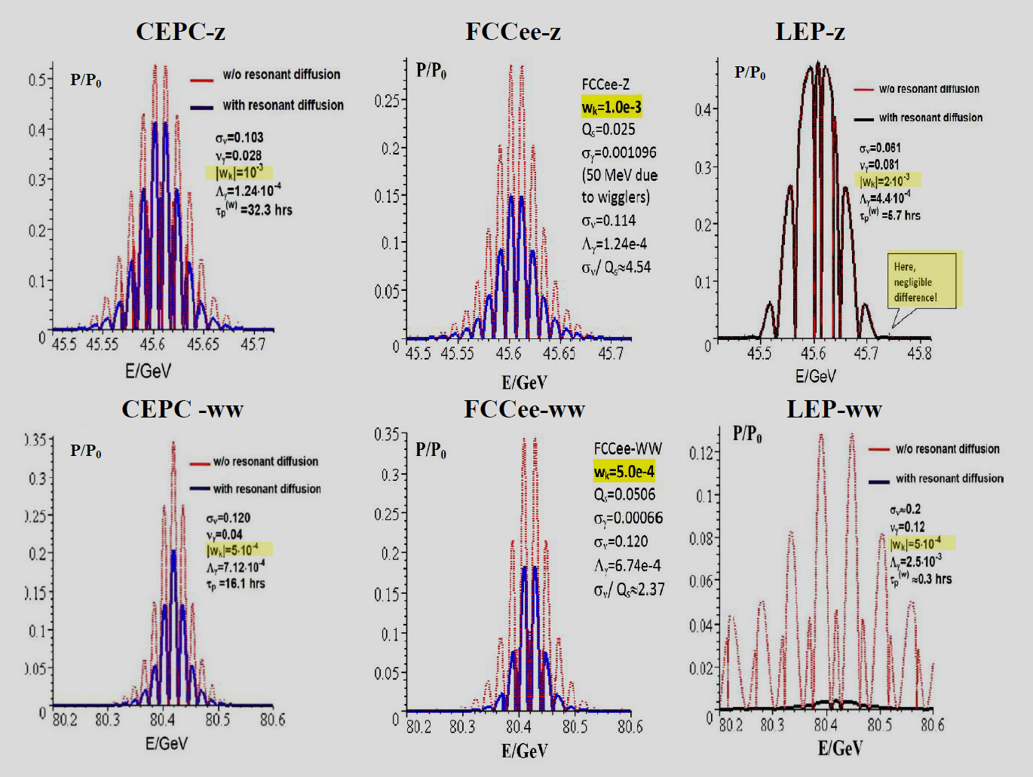
Combined effect of non-resonant and resonant diffusions
S. Nikitin, “Polarization issues in circular electron–positron super-colliders,”
Int. J. Mod. Phys. A, vol. 35, no. 15n16, p. 2041001, 2020.
LEP1 45 GeV
σ_{ν}≈0.061
CEPC 45 GeV
σ_{ν}≈0.103
wiggler on
Resonant diffusion
is nothing!
LEP2 80 GeV
σ_{ν}≈0.2
CEPC 80 GeV
σ_{ν}≈0.12
wiggler off
Resonant diffusion
could win all!
Note, the attempts to get a polarization at 80 GeV LEP failed!
Spin tune spread in CEPC, FCCee at 80 GeV is about 2 times smaller than that in LEP. Calculation: there is chance to obtain relevant polarization in 80 GeV CEPC , FCCee if dangerous spin harmonics in CO distortions are suppressed to level of 5e-4 and below

Slide 12
Methods to measure beam polarization in e+e- storage rings
Polarimeter based on Intra-Beam Scattering (IBS)
VEPP-2, ACO, VEPP-2M, VEPP-4, VEPP-4M …
Compton polarimeters:
Laser polarimeter (supposed for CEPC, FCCee)
SPEAR (1976), DESY, VEPP-4, LEP
Scattering of SR by an opposed beam
VEPP-4 (1982)
Spin Light based polarimeter (interesting, in my opinion, to consider for CEPC, FCCee)
VEPP-4 (1983)
Møller polarimeter based on internal polarized target
VEPP-3 (2003)

Slide 13
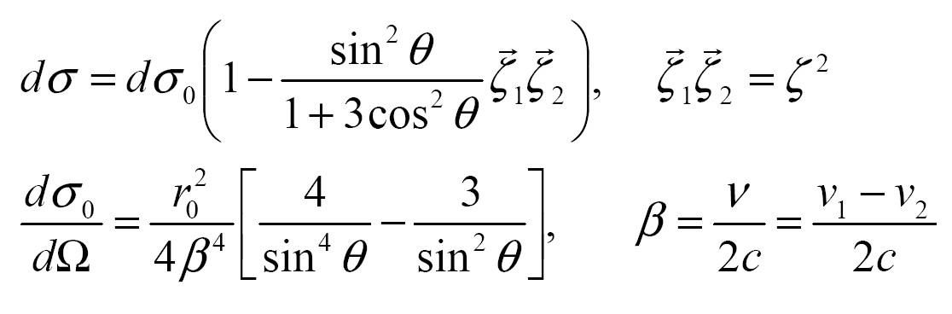
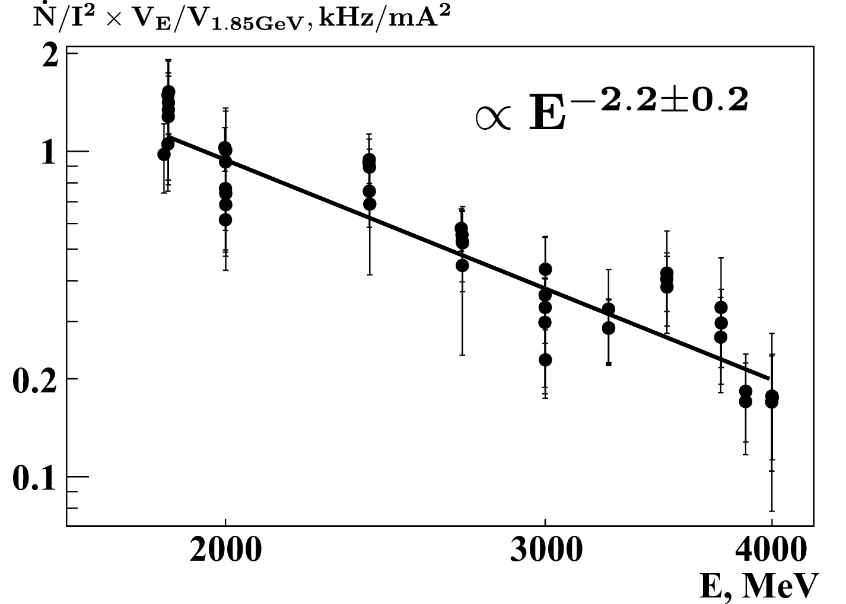
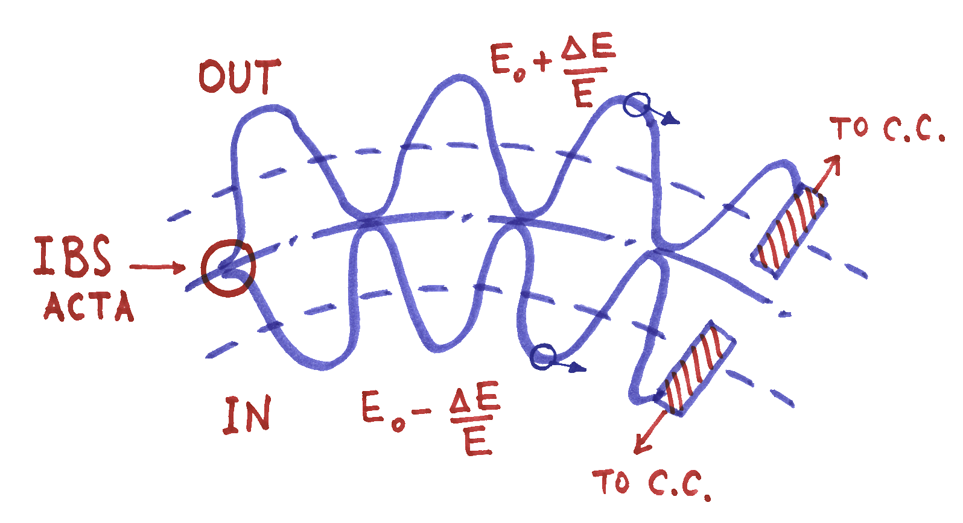
Basics of Touschek polarimeter
IBS cross section decreases with polarization (ζ≠0)
1. IBS electron count rate normalized on beam volume and on squared current vs VEPP-4M beam energy
Schematic diagram of Touschek particles detecting
S. A. Nikitin and I. B. Nikolaev, JETP, vol. 115, no. 1, pp. 36–47, 2012
S. A. Nikitin and I. B. Nikolaev, “Calculation of the intensity of Touschek electrons in the VEPP-4M storage ring,” Journal of Experimental and Theoretical Physics, vol. 115, no. 1, pp. 36–47, 2012
Theory: ∝ E ⁻³
Possible sources of discrepancy:
-inhomogeneity of experimental
conditions with changing energy;
-uncertainty of effective beam
angular spread definition
2. Polarization effect in count rate of Touschek
particles decreases with energy as ∝ 1/E⁴
If IBS dominates over “Gas-Beam” one can use a sum of
the counter rates instead of their logical production
Touschek polarimeter in use for RD at VEPP-4M works very well at E_{beam} <2 GeV but will be rather not effective at E_{beam} > 4 GeV because of considerable decrease of effect and counting rate with energy

Slide 14
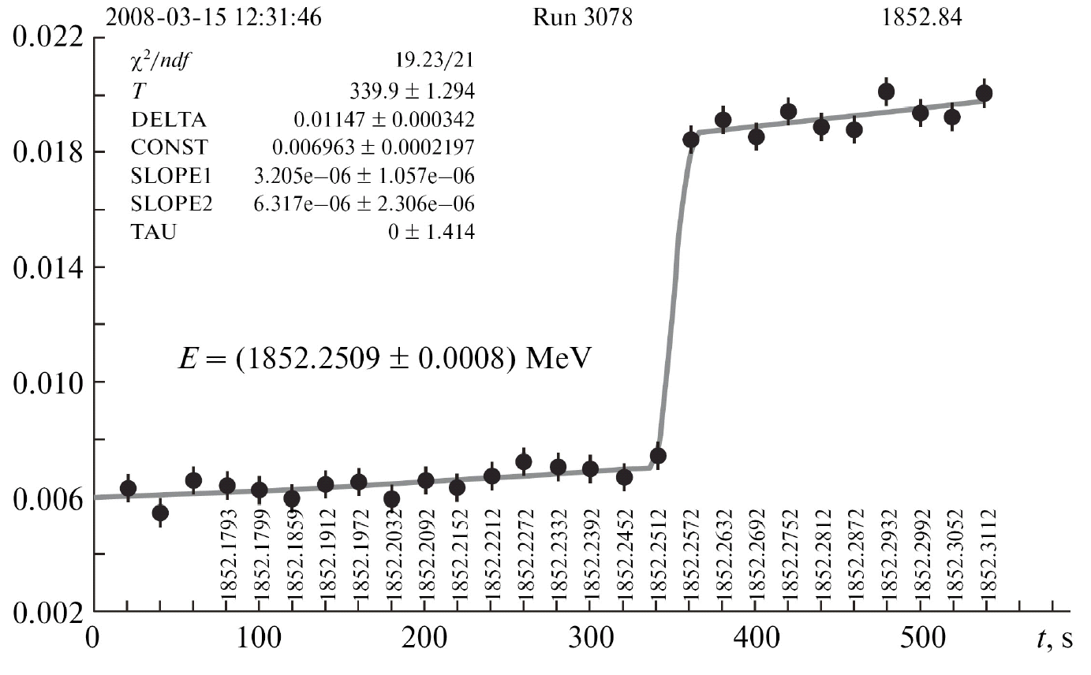
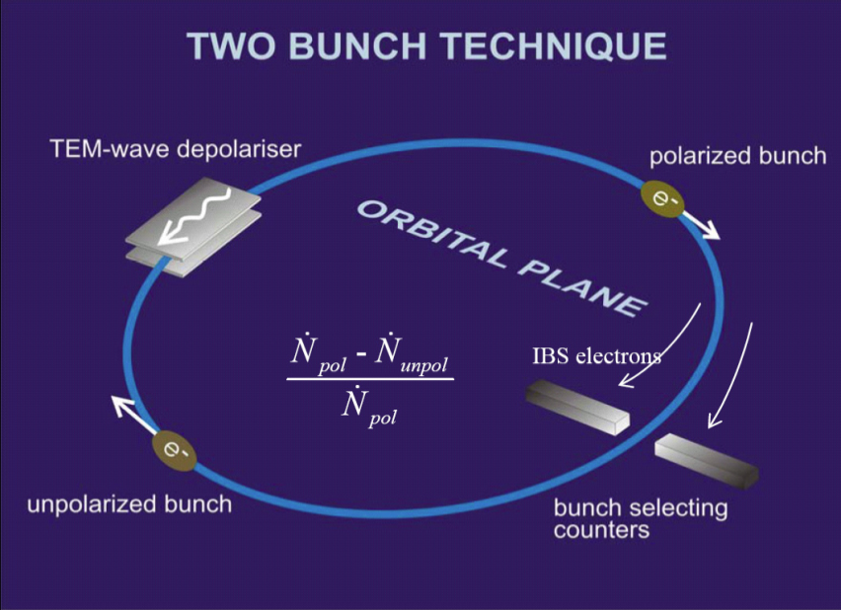

RD energy calibration using Touschek polarimeter at VEPP-4M
Depolarization Jump
Scanning the depolarizer frequency
In the special “fine scan” mode, we achieve a record resolution of 10⁻⁹

Slide 15
Spin response factor of kicker-depolarizer
Introduced in: Y. S. Derbenev, A. M. Kondratenko, and A. N. Skrinsky, Part. Accel., vol. 9, p. 247, 1979.
CEPC structure on 07.11.2017
ν_{x}=355.103
ν_{y}=355.215
E=45. 387 GeV (Z peak)
ν=103
Factor |F^{ν} | can enhance or weaken significantly the direct action of the depolarizer, depending on the azimuth of its placement and the energy. Energy dependence of spin response of three different kicker-depolarizers at VEPP-4M placed at different azimuths. A special experiment at 1495 MeV revealed that the beam could be depolarized by depolarizer #1, not by depolarizer #3, all other factors being equal.
The spin response function is used to estimate the depolarizing effect of quantum fluctuations due to corresponding transverse perturbations of the guide field. Calculation of |F^{ν} | allows choose the optimal place for the kicker depolarizer (providing a strong effect on the spin with a weak perturbation in orbital motion).

Slide 16
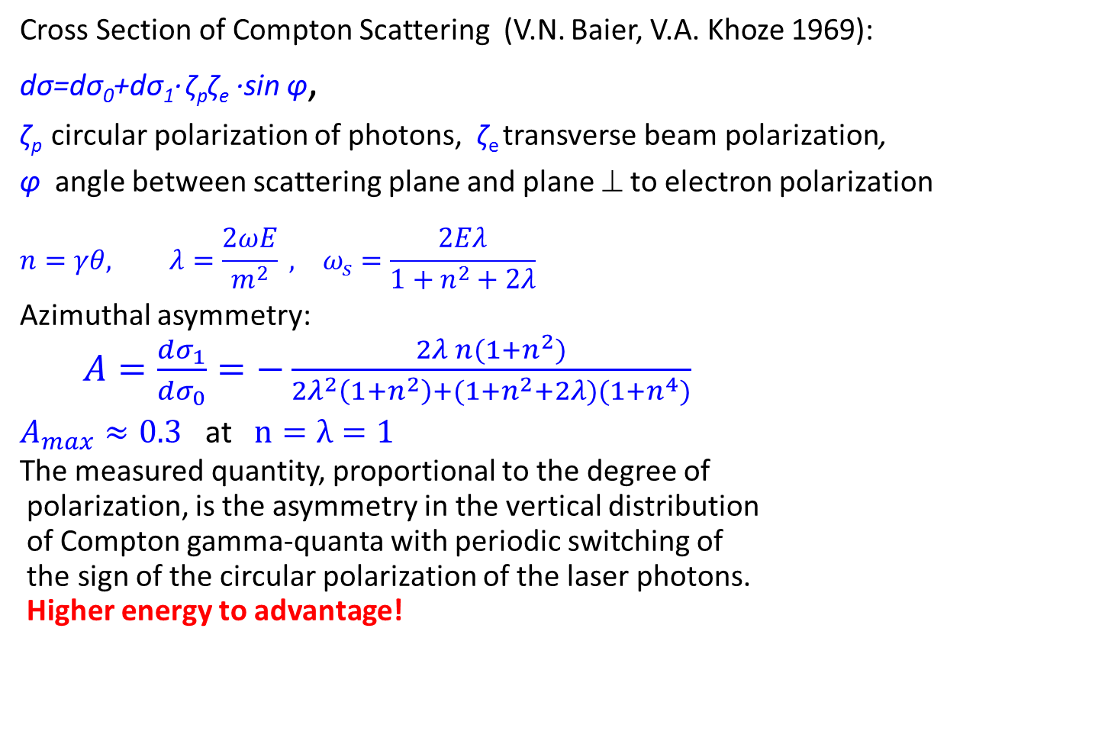
Laser polarimeter
Cross Section of Compton Scattering (V.N. Baier, V.A. Khoze 1969):
dσ=dσ₀+dσ₁· ζ_{p}ζ_{e} ·sin φ,
ζ_{p} circular polarization of photons, ζ_{e} transverse beam polarization,
φ angle between scattering plane and plane ⊥ to electron polarization
$${n=γθ, λ=\frac{2ωE}{m^{2}} , }_{}ω_{s}=\frac{2Eλ}{1+n^{2}+2λ}$$
Azimuthal asymmetry:
  $A=\frac{dσ_{1}}{dσ_{0}}=−\frac{2λ n(1+n^{2})}{2λ^{2}\left(1+n^{2}\right)+(1+n^{2}+2λ)(1+n^{4})}$
$A_{max}≈0.3$ at $n=λ=1$
The measured quantity, proportional to the degree of
polarization, is the asymmetry in the vertical distribution
of Compton gamma-quanta with periodic switching of
the sign of the circular polarization of the laser photons.
Higher energy to advantage!
Polarization build-up measured at SPEAR
Schematic diagram at SLAC
SPEAR, VEPP-4, DORIS, PETRA, TRISTAN, CESR, HERA, LEP ….

Slide 17
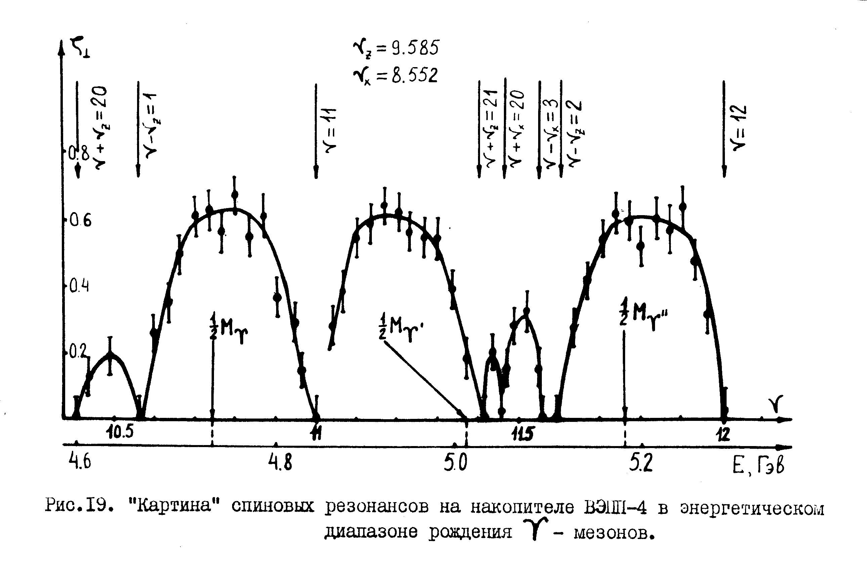
Polarization at VEPP-4 in the region of Upsilon family (early 80s)
Υ
Υ’
Υ’’
ν=γa
E, GeV
Measurements performed using the laser polarimeter. Prior to these measurements, the coupling correction system was modified to more than double the degree of polarization at the Υ resonance energy.

Slide 18
Spin dependence of SR intensity

Slide 19
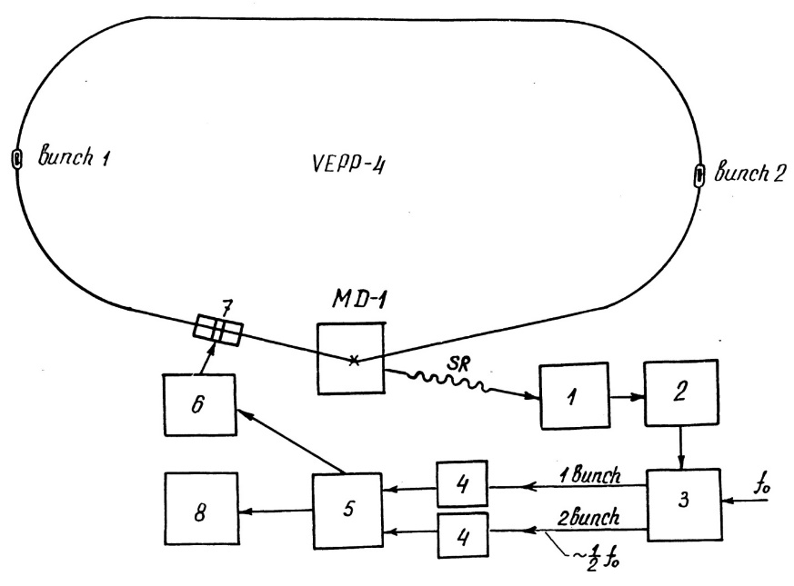
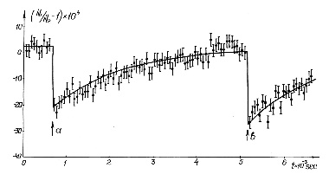
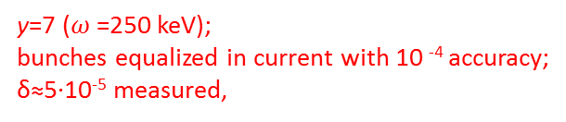
First observation of Spin Light (VEPP-4, 1983)
selective depolarizer
S. A. Belomestnykh et al., Nucl. Instrum. Meth., vol. A227, pp. 173–181, 1984
y=7 ($ω$=250 keV);
bunches equalized in current with 10 ⁻⁴ accuracy;
δ≈5·10⁻⁵ measured,
The quantum effect ~ 10⁻⁴ has been
measured, in fact, based on the classical concept of a particle as an elementary magnet. Thus, a positive answer was given to previously considered controversial (N. Bohr)
issue, highlighted in a 1930 article by
W. Pauli, about the possibility of setting up experiments on the study of the spin properties of free (not bound in an atom) electrons, in particular, when they move in a
macroscopic magnetic field. This is how our result was assessed by I.M. Ternov and V.V. Mikhailin in the book “Synchrotron Radiation. Theory and experiment ", 1988.
E=4.98 GeV
ζ=74%
e+
e+
amplitude spectrum
H=2 Tesla shifter
scintillator discriminator
counter
current source
monitor computer counters selector
Effect grows with increase in magnetic field, particle energy and energy of registered gamma quanta!

Slide 20
Mass measurement experiments with RD
φ OLYA, VEPP-2M, 1978
K± EMUL, VEPP-2M, 1979
J/Psi, Psi’ OLYA, VEPP-4, 1980
Υ MD-1, VEPP-4, 1982; CUSB, CESR, 1984
Υ’ MD-1, VEPP-4, 1982; ARGUS, DORIS, 1984
Υ’’ MD-1, VEPP-4, 1983-1984
Z ALEPH etc., LEP, 1991
J/Psi, Psi’ KEDR, VEPP-4M, 2003
t KEDR, VEPP-4M, 2007
Particle Mass Accuracy Top List
Particle | Δm/m, ppm
n p e μ π± J/ψ ψ′ π ⁰ | 0.04 0.04 0.04 0.09 2.5 3.5 3.9 4.5

Slide 21
Issues on mass measurement accuracy
Groups of error sources
mean energy value determination basing on measured spin frequency
energy stability in time domains between energy calibrations
determination of produced particles energy in a Center-of-Mass system basing on energy of one of colliding beams measured with RD
Methods of accounting
- correction of measurement data
- declaration of uncertainty
Sources of errors
radial orbit distortions (non-stability of currents in magnet coils, temperature variations, geomagnetic storms, solar and lunar daily geomagnetic variations…)
violation of simple energy-spin tune relation (random perturbations of vertical orbit, weak longitudinal magnetic fields, vertical orbit bumps at sections with bend magnets… and the like)
azimuthal dependence of beam energy due to radiation losses
effect of beam parameters in IP (momentum spread, inaccurate colliding beam convergence, parasitic vertical dispersion, FF chromaticity, beam potential…)
In red: issues concerning RD method

Slide 22
Example with imperfect “spin tune- energy” relation
Vertical distortions and torsions of closed orbit
Thomas-BMT equation “works” in full form:
Direct proportionality relation “energy-spin tune measured with RD” violated:
Spin tune shift measured at incorrect compensation of KEDR detector field:
Minimization
by adjusting field
of anti-solenoids:
betatron coupling
(~1% in AS current);
systematic error with RD in absolute energy
(down to ~1 keV)

Slide 23
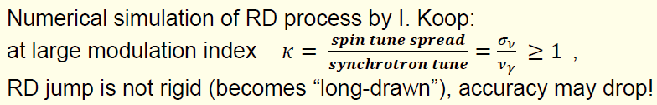
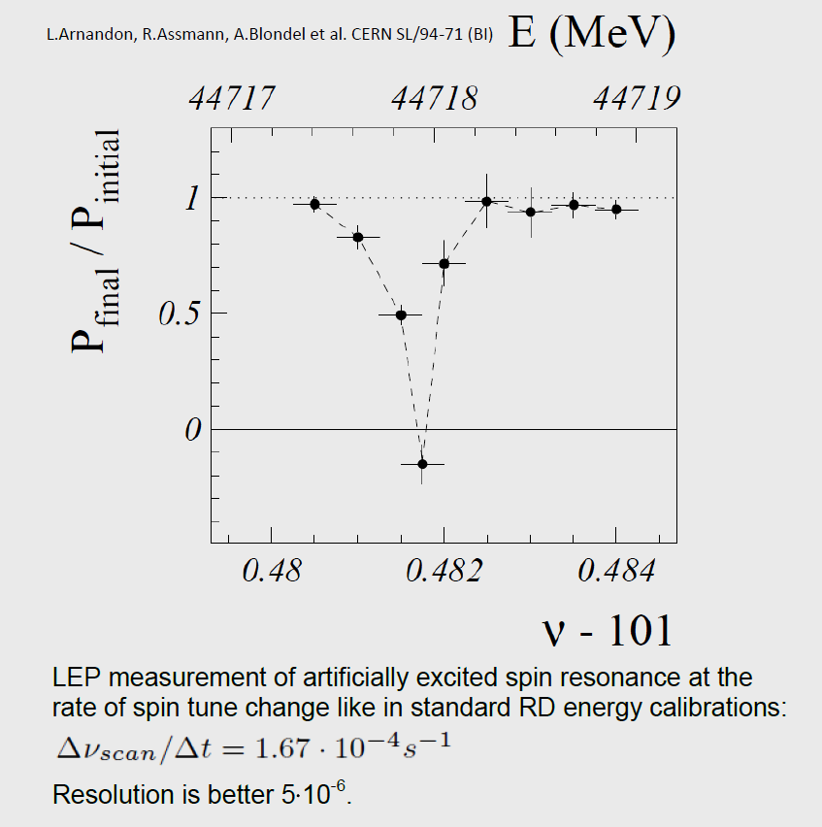
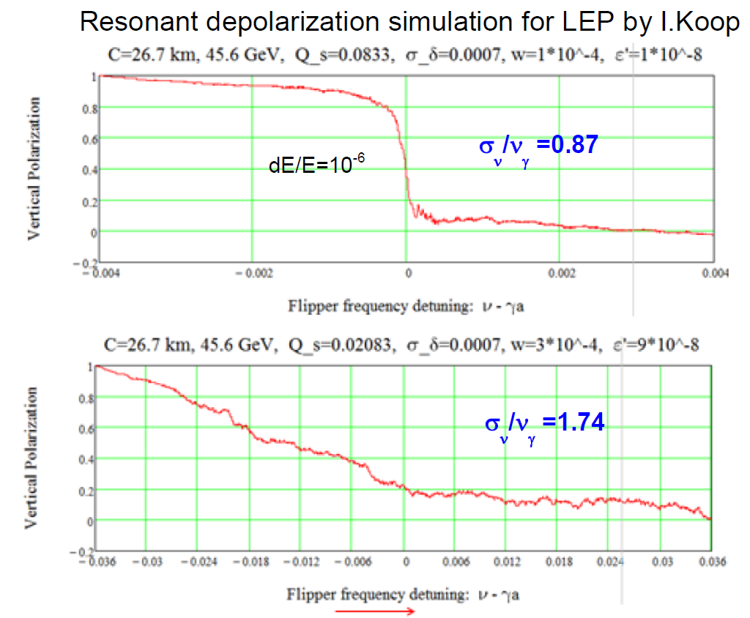
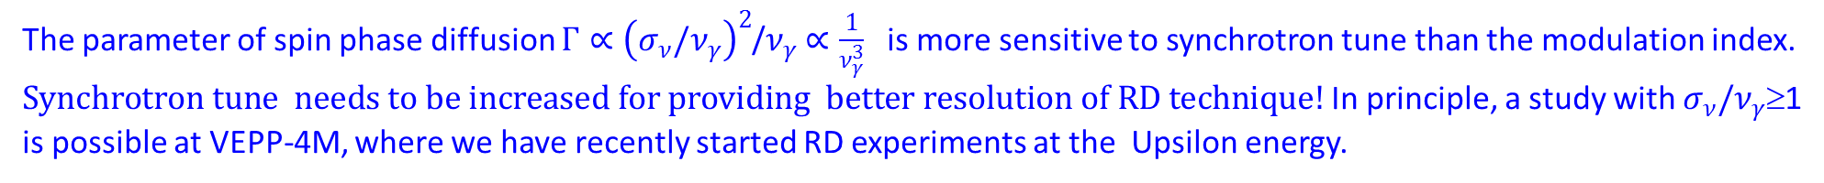
Issue of large modulation index in RD technique
LEP
σ_{ν}/ν_{γ} =0.73
Γ=0.054
Γ=0.054
S.Nikitin, Talk at IAS Program on HEP, Jan. 2018
Close to reality
Collider | E, GeV | σ_{ν} | ν_{γ} | τ_{p} , min | f₀ , kHz | σ_{ν}/ν_{γ} | Γ | Resolution
VEPP-4M | 1.85 4.73 | 0.0015 0.0098 | ~0.01 ~0.01 | 4200 45 | 820 | 0.15 ≥1 | 5e-5 ∼0.01 | 1e-9 ?
LEP | 45.6 | 0.061 | 0.083 | 300 | 11 | 0.73 | 0.054 | 5e-6
FCCee | 45.6 80 | 0.039 0.119 | 0.025 0.051 | 15000 900 | 3 | 1.56 2.35 | 0.155 0.708 | ? ?
CEPC | 45.6 80 | 0.039 0.120 | 0.028 0.04 | 15900 957 | 3 | 1.39 3.0 | 0.104 1.84 | ? ?
σ_{ν}/ν_{γ}=3.48
Γ=3.45
Model example with
synchrotron tune 4 times less
The parameter of spin phase diffusion $Γ∝{\left(σ_{ν}/ν_{γ}\right)}^{2}$/$ν_{γ}$ $∝\frac{1}{ν_{γ}^{3}}$ is more sensitive to synchrotron tune than the modulation index. $Synchrotron tune needs to be increased for providing better resolution of RD technique!$In principle, a study with $σ_{ν}/ν_{γ}$≥1 is possible at VEPP-4M, where we have recently started RD experiments at the Upsilon energy.

Slide 24
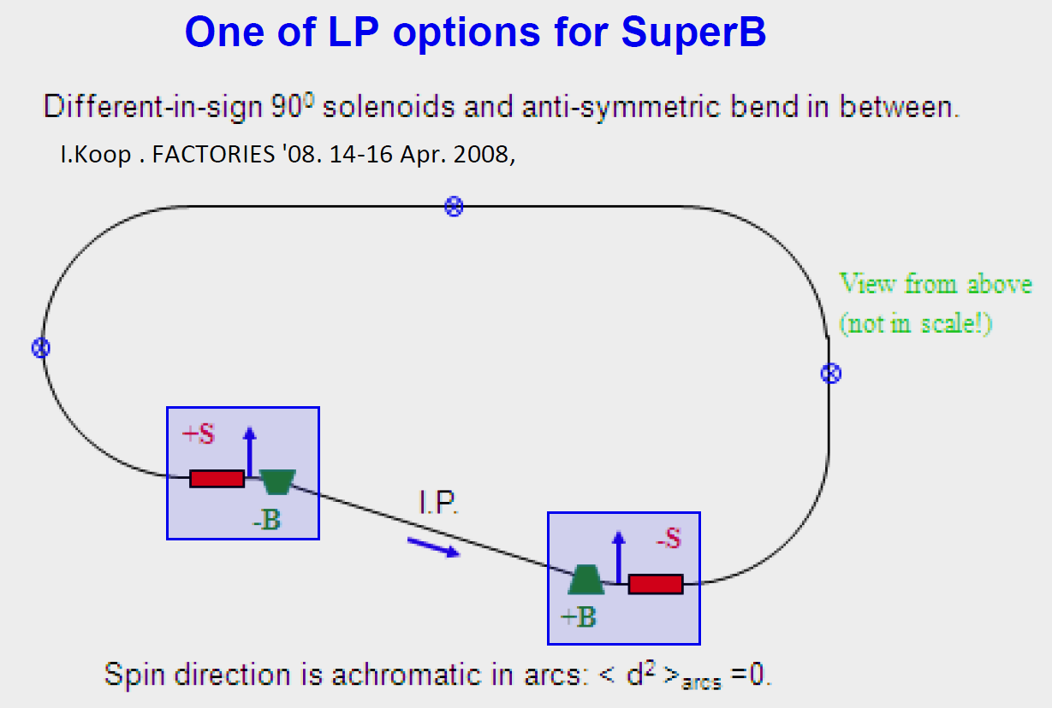
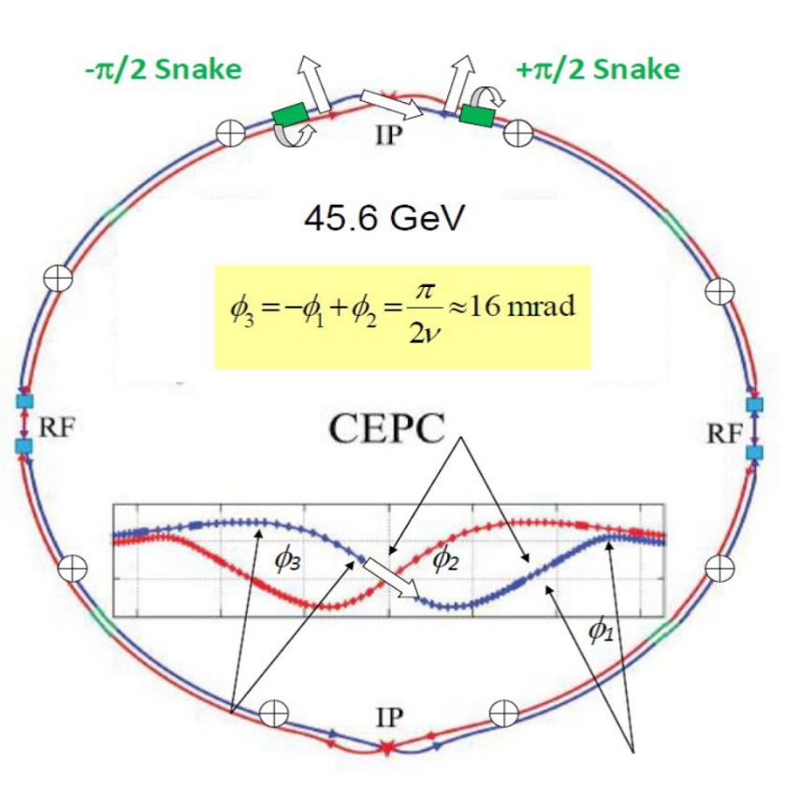
Longitudinal polarization with minimization of spin-orbit coupling
e.g. H||L≈8T×30 m solenoid-based snake
CEPC-Z case can be analogue due
to successful
сombination
of parameters!
Ideal case:
n direction is achromatic in arcs: d_{arc} =γdn/dγ + d_{beta} ≈ γdn/dγ=0
Antisymmetric rotator insert system: solenoids S± rotate spin by ±π/2
Bends B±= ±π/2ν rotate by ±π/2 (bends to left and to right of IP)).
Contributions to spin chromaticity from left and right parts of rotator system cancel each other. Thus, depolarization effect of SR in arcs is mainly suppressed (only not so large contribution from excited betatron oscillations is retained)
S-shaped form of orbit in CEPC/FCCee helps to do it at Z-peak!
Wagging orbit in the CEPC interaction region with bending angles close to optimal ones (half crossing angle=15 mrad) allows us to consider respective spin kinematic design basing on solenoid inserts
S.Nikitin, Talk at IAS Program on HEP, Jan. 2018, Hong Kong; IJMP A, Vol. 34 No. 13n14, 1940004 (2019)
Radiative relaxation time τ_{r} of polarization in order of magnitude can be comparable with S-T time τ_{p}=260 hrs and much larger than luminosity beam life time. In top-on mode, time-average degree of longitudinal polarization will be closed to polarization degree of beam injected from booster!

Slide 25
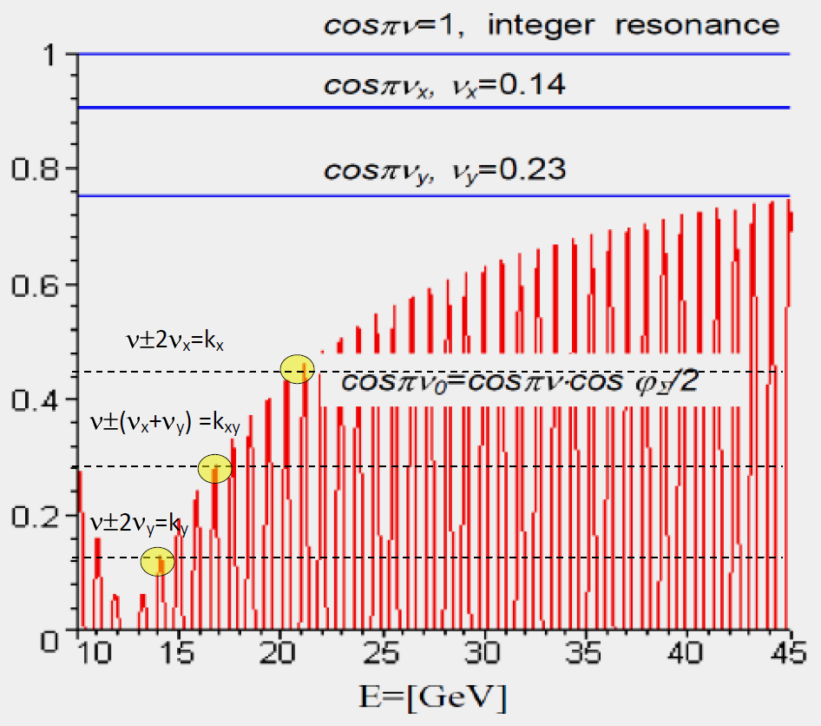
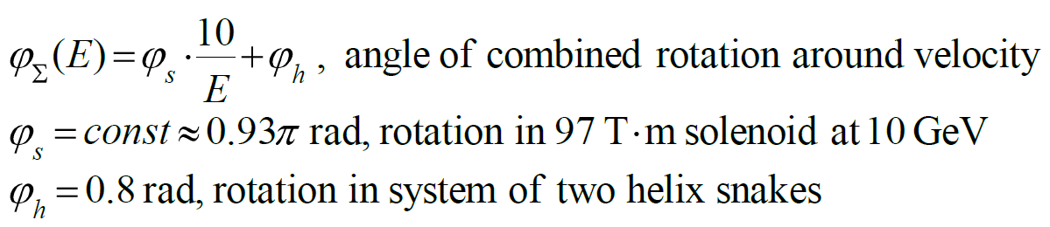
Scheme to avoid all main spin resonances in CEPC booster to issue on how to accelerate polarized beam in booster
S. Nikitin. IJMP A, Vol. 34 No. 13n14, 1940004 (2019)
Combined Partial Siberian Snake of
two helix snakes + solenoid with field=const
number
of turns
radiation
loss factor
At marked points , the rate of crossing the spin-betatron resonances related to quadratic nonlinearities
drops sharply. Here, apparently, one needs to apply a method of fast jump in betatron tunes .

Slide 26
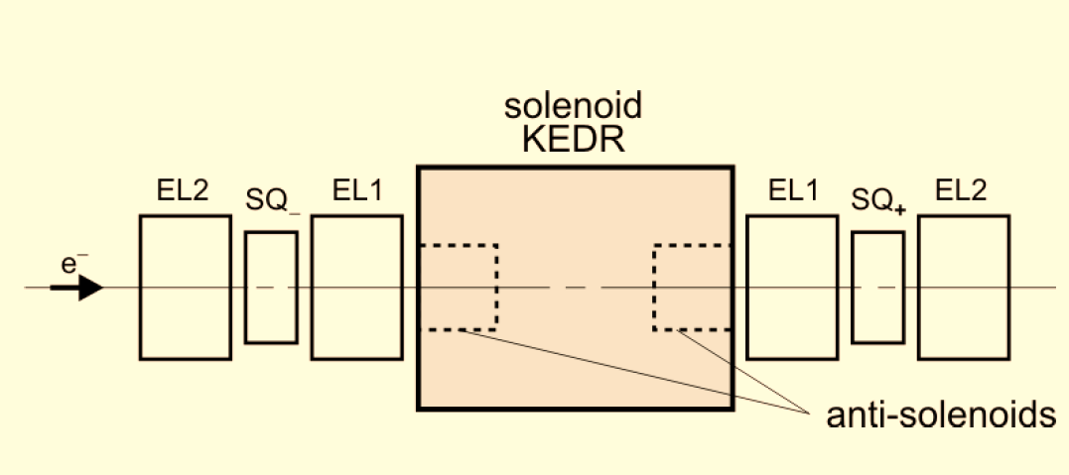
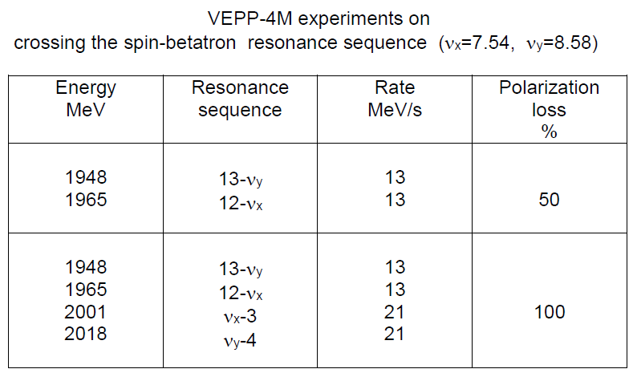
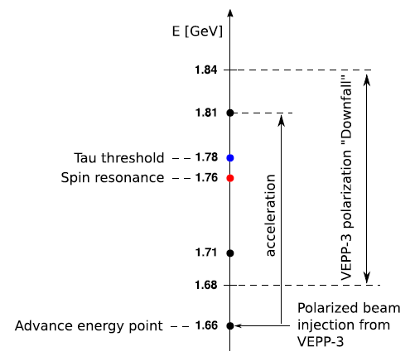
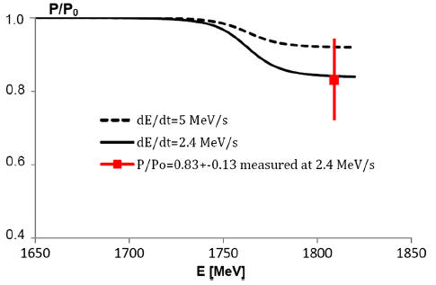
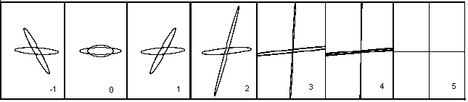
Crossing integer spin resonance using Partial Siberian snake at VEPP-4M
A.K. Barladyan et al., DOI:10.1103/PRAB 22.112604
Why study crossing spin resonances?
Alternative way to obtain polarization in future circular lepton colliders –
via acceleration of polarized beams in booster
Unique way leading to possibility of obtaining longitudinal polarization
Unlike proton machines, this technique in e+e- rings has been much lesser
studied (specificity is complication associated with depolarization due to
synchrotron radiation)
normal
modes
skew quads for decoupling
spin rotation angle in KEDR
anti-solenoids off
ν=4
Evolution
of polarization
under acceleration with
various rates
calc.
We have successfully performed an experiment on the adiabatic crossing of an integer spin resonance, using the longitudinal field of the KEDR detector as a partial Siberian snake (with the anti-solenoids turned off).

Slide 27
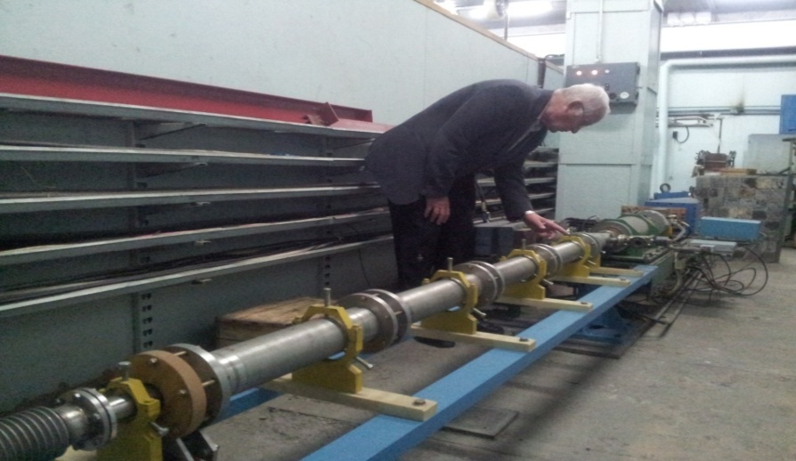
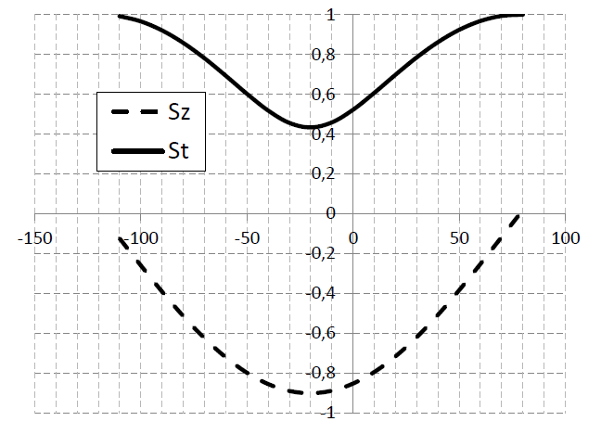
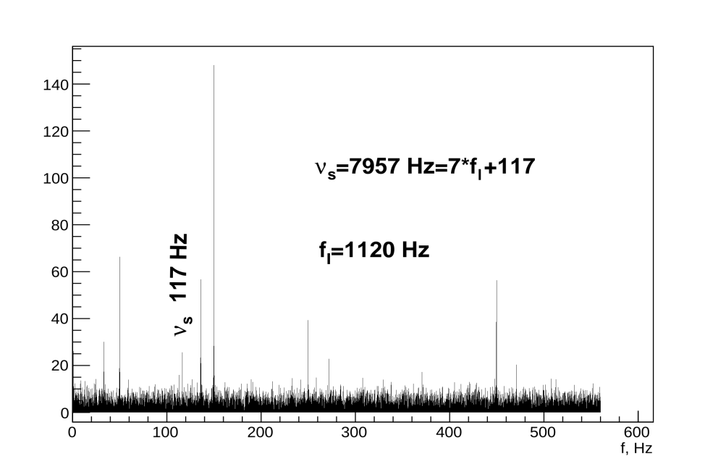
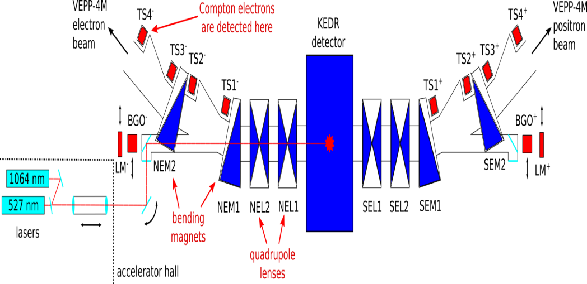
“Pulsar” - Fan Polarization test at VEPP-4M (2015)
V. Kaminskiy, V. A. Kiselev, E.B. Levichev, S.A. Nikitin, I.B. Nikolaev, A. N. Zhuravlev
Concept by I.Koop for FCCee beam energy measurement at injection (HF2014):
injection of polarized bunches into the collider rings with the horizontal spin orientation and measuring turn by turn the free precession frequency using longitudinal Compton polarimeter and detecting scattered electrons instead of CBS gamma- quanta.
ϕ=90°
“Fan Polarization”
ψ opening angle
Pulse solenoid in VEPP-3-VEPP-4M beam line
horizontal projection
χ°
angle of spin
rotatIon In solenoid
L=2 m, ∅50 mm, 300 turns, Hmax=2.5 Т,
Umax=3 kV, Imax=12 kA
vertical projection
Compton electron counting rate 1-2 kHz
Measurement time 130 s
Normalization by laser power
Discrete Fourier analysis:
50 Hz harmonics
Betatron frequencies
Synchrotron frequency
No spin precession frequency in spectrum
was observed!
Spectrum of Compton electron intensity
Synchrotron tune
Laser repetition
We intend to repeat the experiment by significantly reducing <H’’>, a zero harmonic of the quadratic nonlinearity of the VEPP-4M field. According to preliminary analysis, it is the reason for the rapid diffusion of the fan opening angle.

Slide 28
Siberian Snake at VEPP-4M - back to old 1981 proposal
S.A. Nikitin, E.L. Saldin,
Preprint INP 81-19, 1981
IP
VEPP-4M
VEPP-3
Pulse solenoid
for spin matching
e⁺
πν
e⁻
SC π-solenoid
Siberian Snake (SS) insert with decoupling:
Two 145 cm × 71.7 kG solenoids (1.98 GeV)
Five 20 cm×(up to 3 kG/cm) quads
(1 normal +4 skew)
Insert length=532 cm
(in the project for VEPP-4)
Polarization
life time
after
injection
Now, the project "Siberian snake" at VEPP-4M is under consideration in the form close to that which was proposed in 1981
for VEPP-4. The implementation of the project would make it possible to investigate the features of the radiative kinetics
of longitudinal polarization (LP) with the Siberian Snake. They have not yet been sufficiently studied experimentally.
This is important since three Siberian Snakes are supposed to be used in the BINP Super С-Tau factory project.

Slide 29
Thanks for attention!

