Slide 1

CEPC collective instabilities studies
Na Wang, Yudong Liu, Yuan Zhang, Yuting Wang, Haisheng Xu
1/14/2022
IAS mini-workshop on Accelerator Physics, Jan. 13-14, 2022

Slide 2
Outlines
Impedance updates
Single bunch instabilities
Transverse resistive wall instability
Beam ion effects
Electron cloud effects

Slide 3
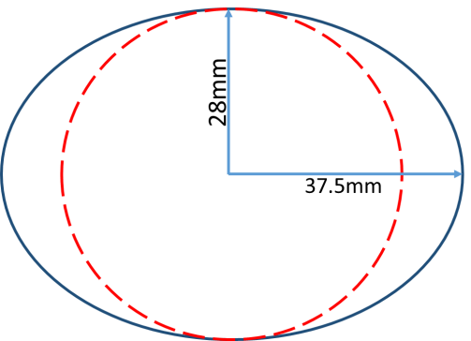
Impedance updates
Impedance model is updated regarding the change of the chamber cross section (elliptical→circular), as well as more impedance contributors included.
  Main impedance contributions are considered.
  Possible large contributors, including Inj./ext. elements, feedback kickers, absorbers, masks/collimators around the ring, are not included yet.
Element | Number | Element | Number
Resistive wall | / | BPMs | 1808
RF cavities | 60 | IR Collimators | 16
Flanges | 37714 | Electro separators | 20
Bellows | 15949 | IP chambers | 2
Gate valves | 500 | ES Transitions | 40
Vacuum pumps | 5316 | IP Transitions | 8

Slide 4
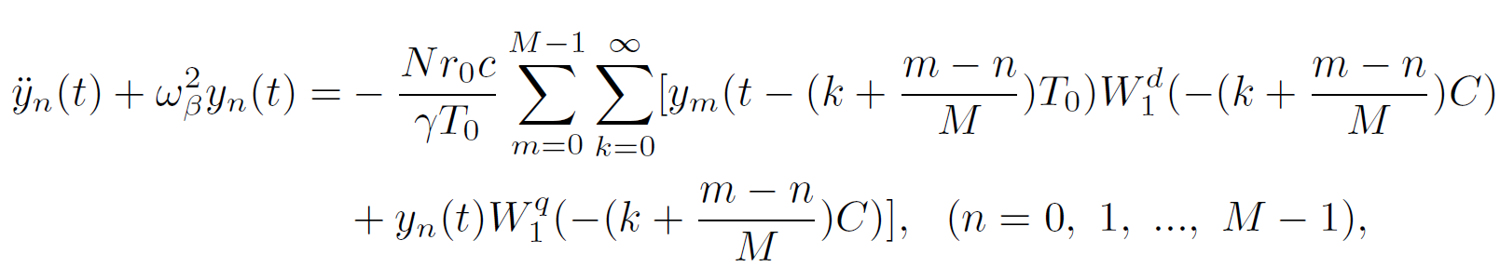
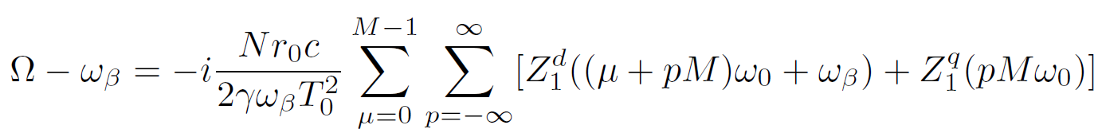
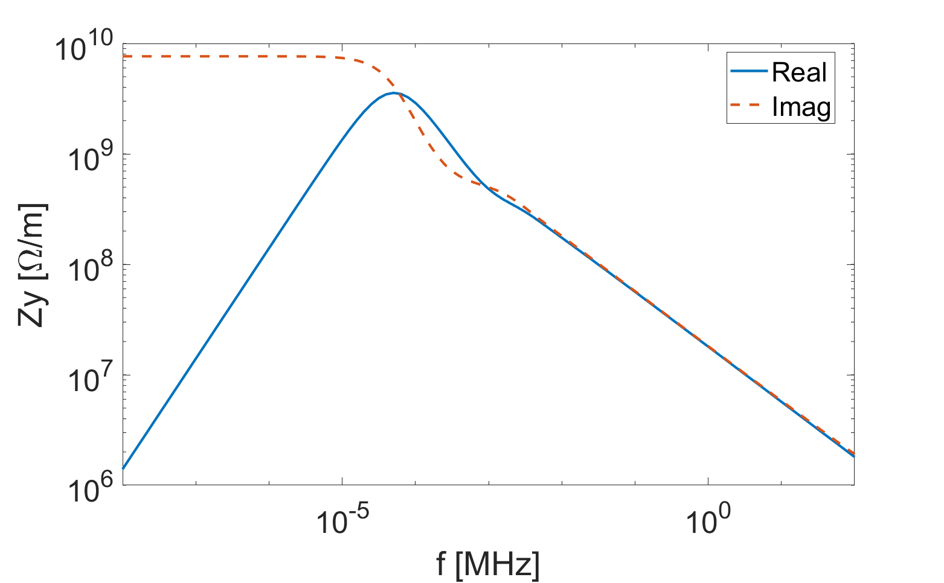
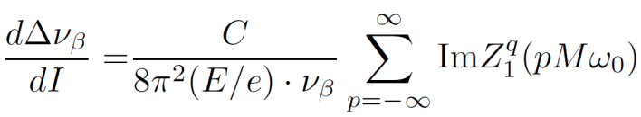
Changes on Resistive Wall
Yuting Wang
Incoherent tune shift due to the quadrupolar impedance is derived from beam oscillation equations.
0.1Hz
[ν_{y}]⋅f_{rev}
Incoherent tune slope:
DC value of the quadrupolar impedance dominates

Slide 5
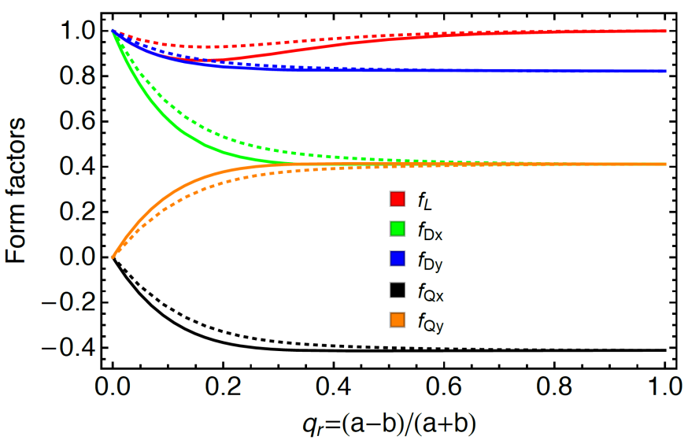
Changes on Resistive Wall
Yuting Wang
Resistive wall impedance
  Form factor – Ratio of elliptical and circular chamber (infinite thick wall)
  RW_ Elliptical multilayer= Form factor * RW_Circular multilayer (σ, μ, dt)
With frequency decreases, the skin depth increases and the background material outside the beam pipe should be considered.
Two impedance models:
Model A: Vacuum outside the chamber
3mm Cu + Vacuum (Infinite)
Model B: Magnet outside the chamber
3mm Cu + 100mm Magnet (μ=100) + Vacuum (Infinite)
Solid lines: Based on Lutman’s method
Dashed lines: Yokoya form factor

Slide 6
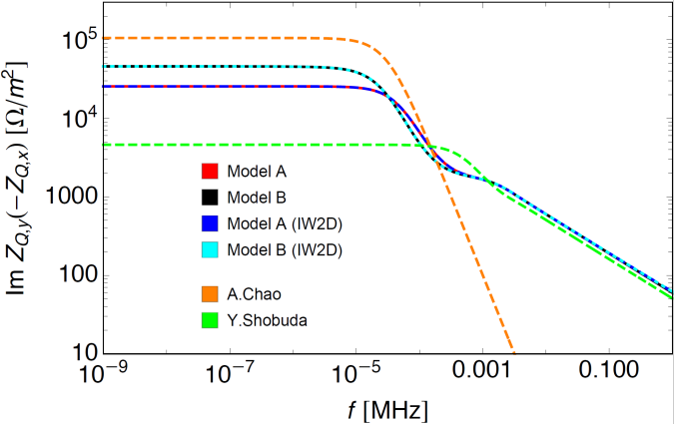
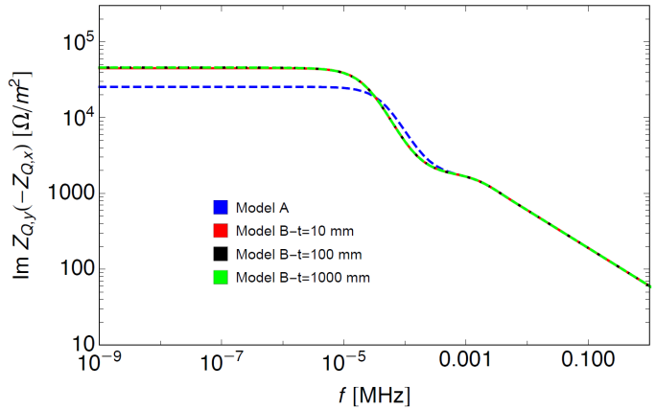
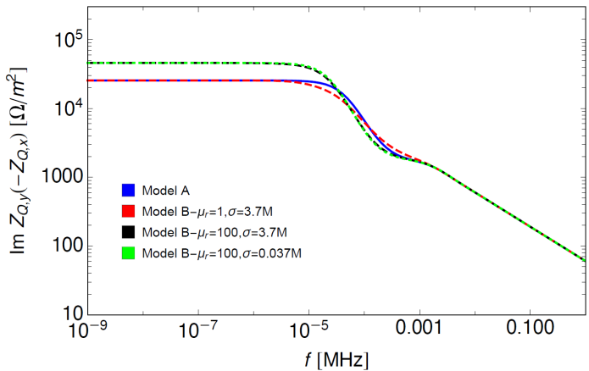
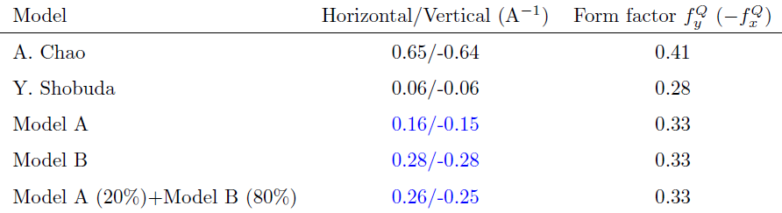
Changes on Resistive Wall
Yuting Wang
Model A: Vacuum outside the chamber
Model B: Magnet outside the chamber
Dependence on the thickness of the magnets
Dependence on the permeability and conductivity of the magnets
Consider that 80% of the collider is surrounded by the magnets, the tune shifts are 0.26/-0.25 (A⁻¹)
Main different among different methods can be explained by the impedance model and the form factors used.
For circular chamber, unsymmetrical magnets (e.g. dipoles) can also generate incoherent tune shift.
[1]
[2]
[1] PRST-AB, 5, 111001 (2002), [2] PRE 66, 056501 (2002)

Slide 7
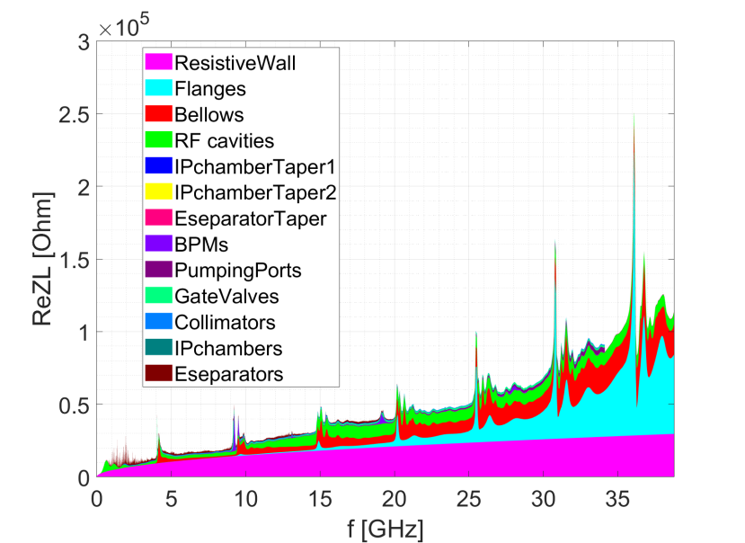
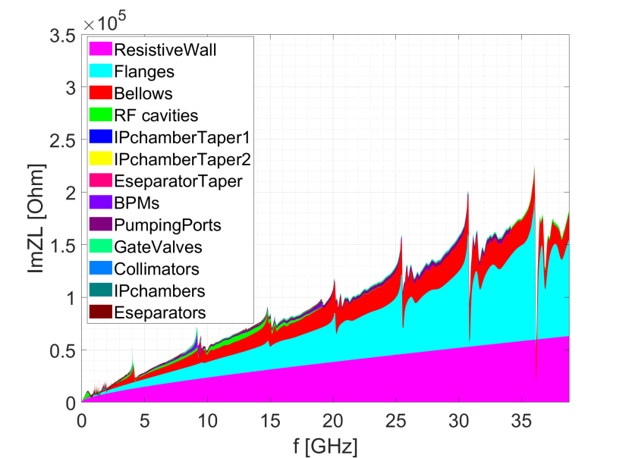
Ring longitudinal impedance
Broadband impedances are mainly contributed by: resistive wall, flanges, bellows, RF cavities.
Narrowband impedances need to be further checked.

Slide 8
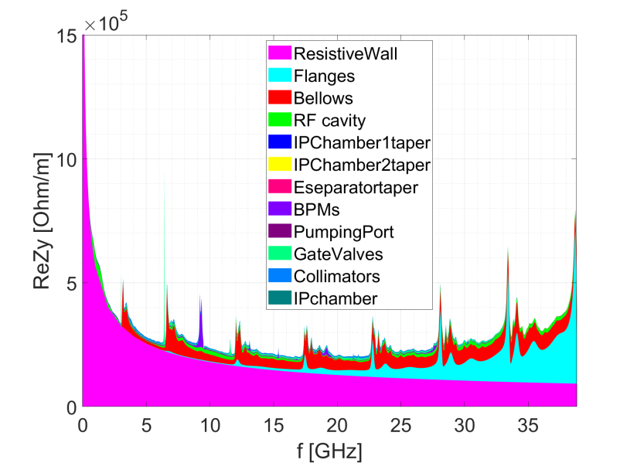
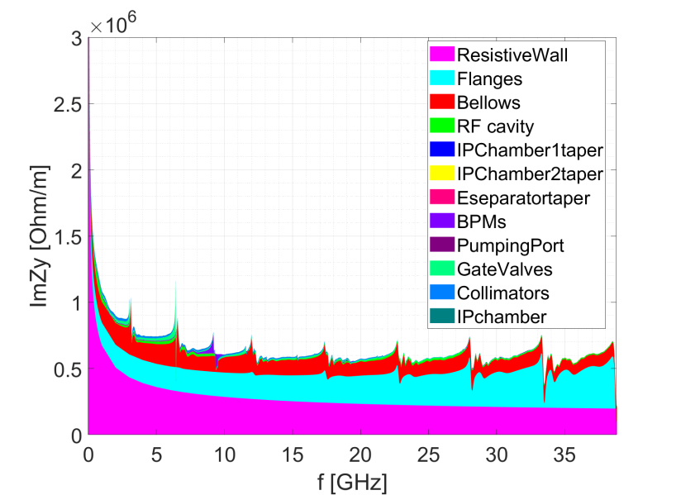
Ring transverse impedance
Broadband impedances are mainly contributed by: resistive wall, flanges, bellows.
Narrowband impedances need to be further checked.

Slide 9
Impedance budget @σ_{z}=3mm
Components | Number | Z||/n, mΩ | k_{loss}, V/pC | ky, kV/pC/m
Resistive wall | - | 6.2 | 363.7 | 11.3
RF cavities | 60 | 0.5 | 101.2 | 0.5
Flanges | 37714 | 5.2 | 37.3 | 5.2
BPMs | 1808 | 0.04 | 9.5 | 0.2
Bellows | 15949 | 2.9 | 87.4 | 3.9
Gate Valves | 500 | 0.2 | 14.5 | 0.4
Pumping ports | 5316 | 0.3 | 2.3 | 0.2
Collimators | 16 | 0.04 | 23.4 | 0.6
IP chambers | 2 | 0.004 | 0.3 | 0.05
Electro-separators | 20 | -0.1 | 34.5 | 0.1
Taper transitions | 48 | 0.04 | 2.5 | 0.09
Total |  | 15.3 | 676.6 | 22.5
CDR Total |  | 11.4 | 786.8 | 20.2
Longitudinal and transverse broadband impedances are dominated by the RW, flanges and bellows.
The loss factor is mainly contributed by the resistive wall, RF cavities and bellows.
Compare to the CDR budget, we have larger Z/n and k_{y}, but smaller k_{loss}.

Slide 10
Collective instabilities
Instability issues for high luminosity Z are investigated.
  High beam current and bunch intensity
  Low momentum compaction
  Short natural bunch length
  Slow radiation damping
  Large circumference (ω₀↓, RW↑)
Key instability issues
  Single bunch effects
  Transverse resistive wall instability
  Electron cloud effect
  Beam ion instability
Parameter [unit] | Z-High Lumi
Beam energy [GeV] | 45.5
L_{max}/IP (10³⁴cm⁻²s⁻¹) | 105.5
Emittance (H/V) [nm] | 0.27/0.00135
Beam current [mA] | 839.9
Bunch number | 11520
Bunch Population [10¹⁰] | 15.2
Momentum compaction [10⁻⁵] | 1.43
Natural bunch length σ_{z} (mm) | 2.75
Natural energy spread | 3.78×10⁻⁴
Betatron tune ν_{x}/ν_{y} | 319.10/317.22
Synchrotron tune | 0.032
Radiation damping [ms] | 849.5/849.5/425.0

Slide 11
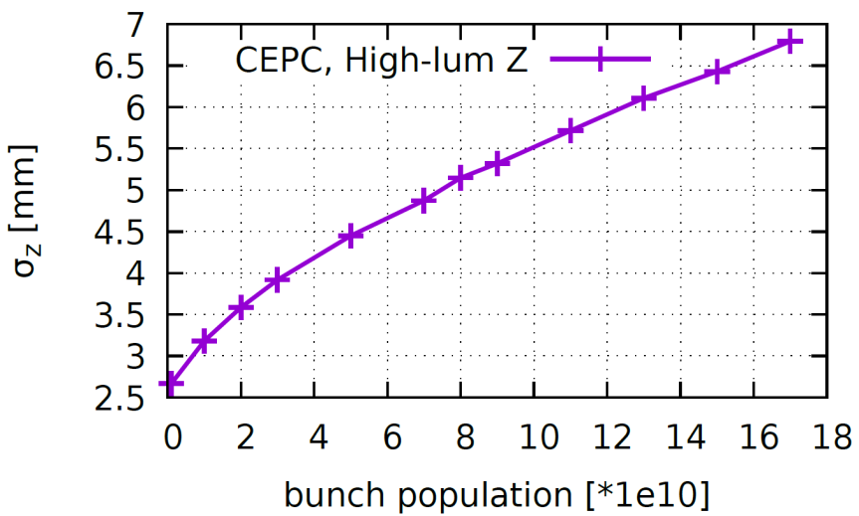
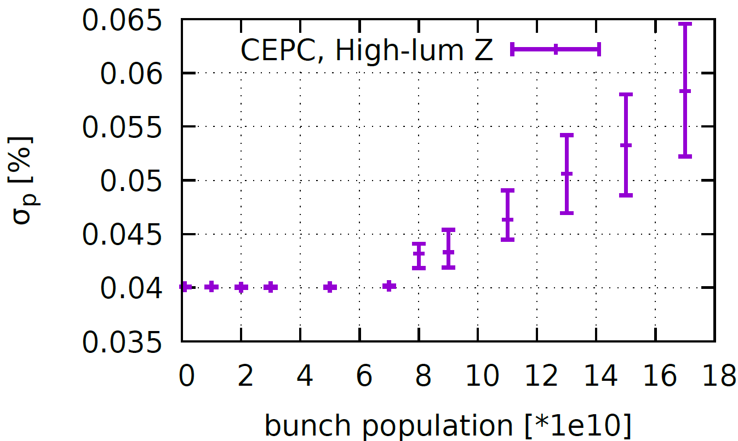
MWI instability & bunch lengthening
Yuan Zhang
Rarely induce beam losses, but may reduce the luminosity due to the deformed beam distribution and increasing of the beam energy spread.
The instability threshold is about half of the design bunch intensity.
σ_{l} with ZL [mm] (σ_{l}/σ_{l0}-1) | 6.5 (140%)
σ_{e}/σ_{e0}-1 | 35%
Design
Design

Slide 12
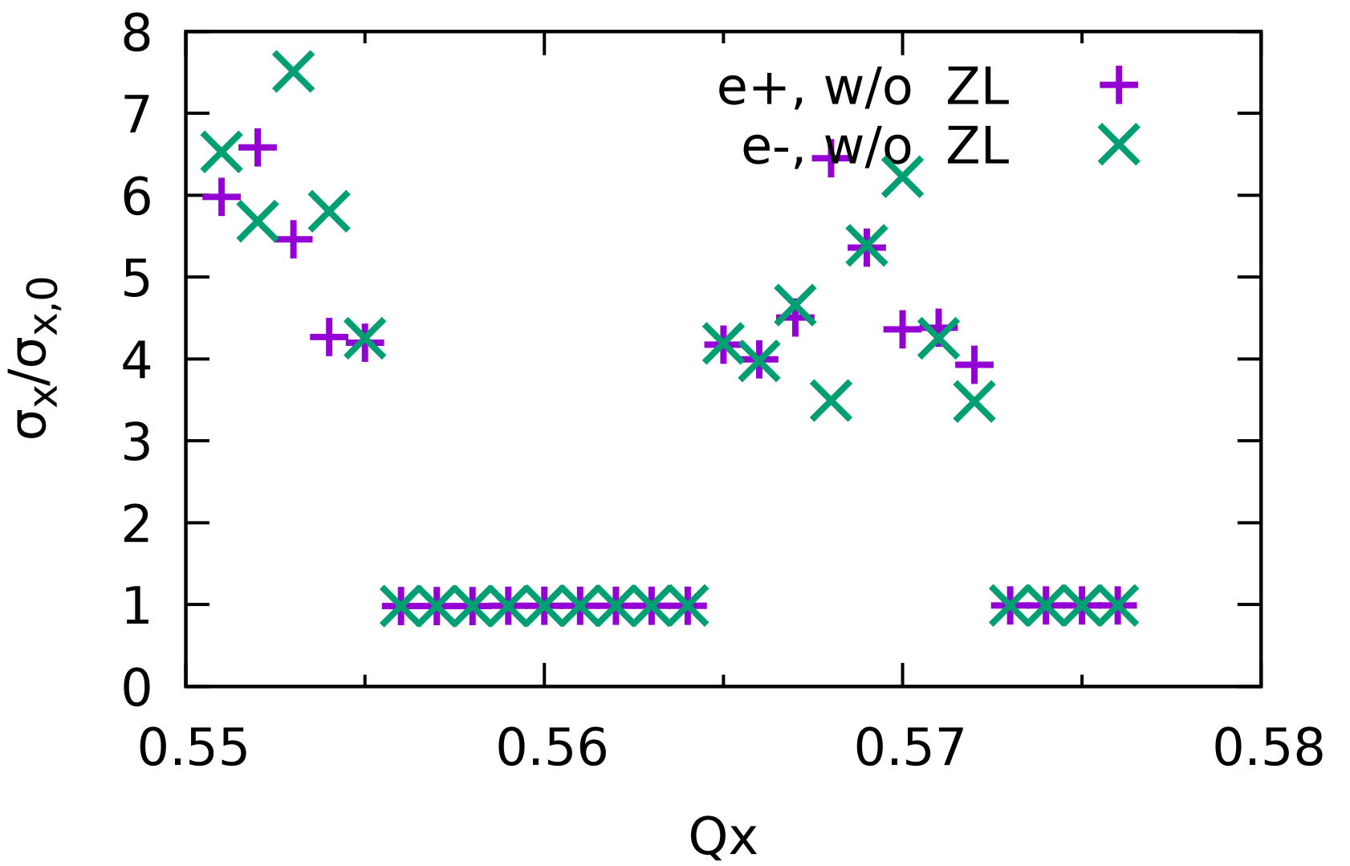
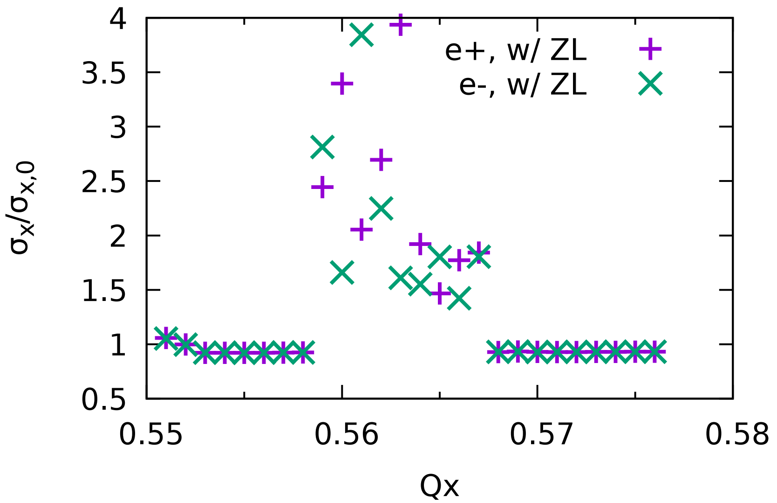
Influence of impedance on beam-beam
Yuan Zhang
Less stable region obtained with longitudinal impedance included in the beam-beam simulation consistently.
The beam-beam interaction gets more unstable with longitudinal impedance due to the X-Z coupling.
CDR impedance is used in these plots
W/O ZL
W/ ZL
The stable region shrunk and shifted

Slide 13
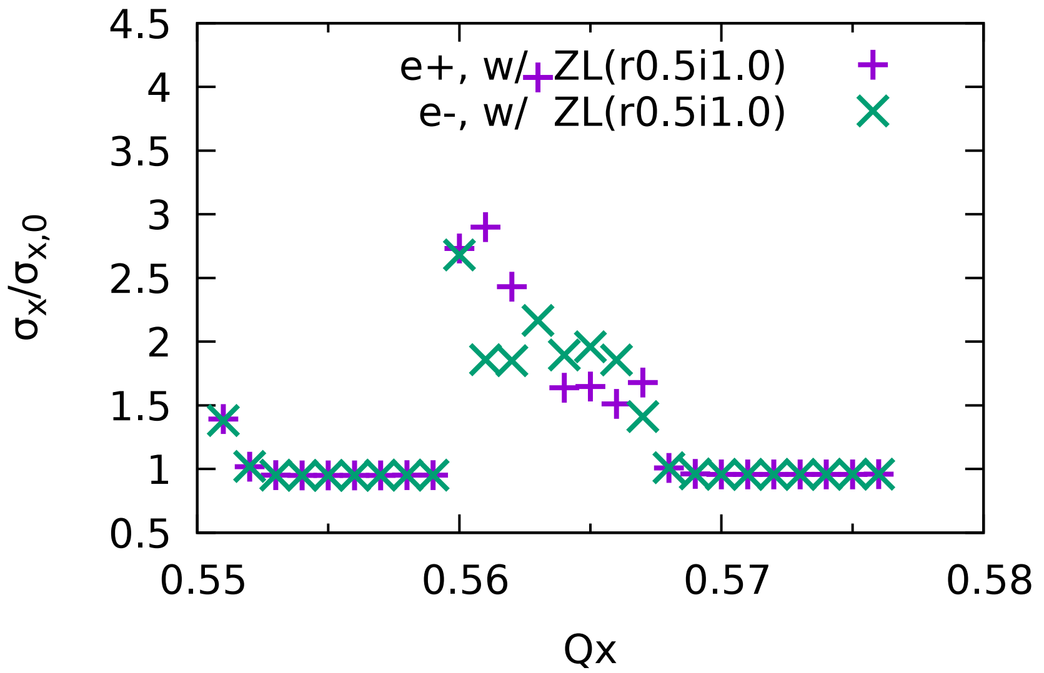
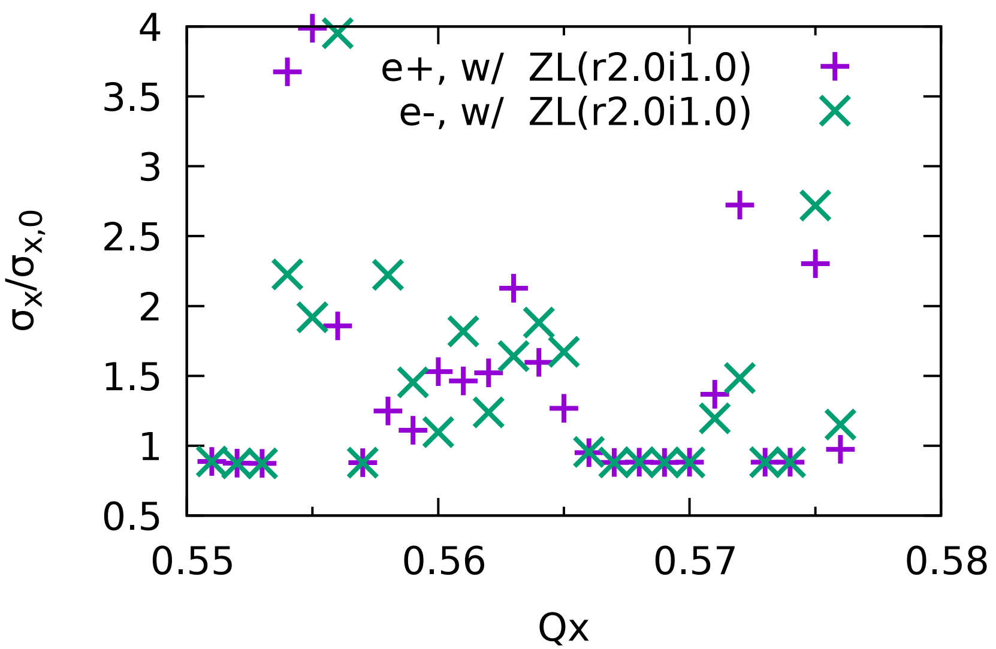
Influence of impedance on beam-beam
Yuan Zhang
With the real/imaginary longitudinal impedance roughly multiplied by a factor, the influence of the impedance on the beam-beam interaction is further investigated.
ReZL (0.5→1→2), ImZL (1)
CDR impedance is used in these plots
Distinct influence shown with the real part of the impedance increased by a factor of 2
Locations of the stable regions are mainly fixed.

Slide 14
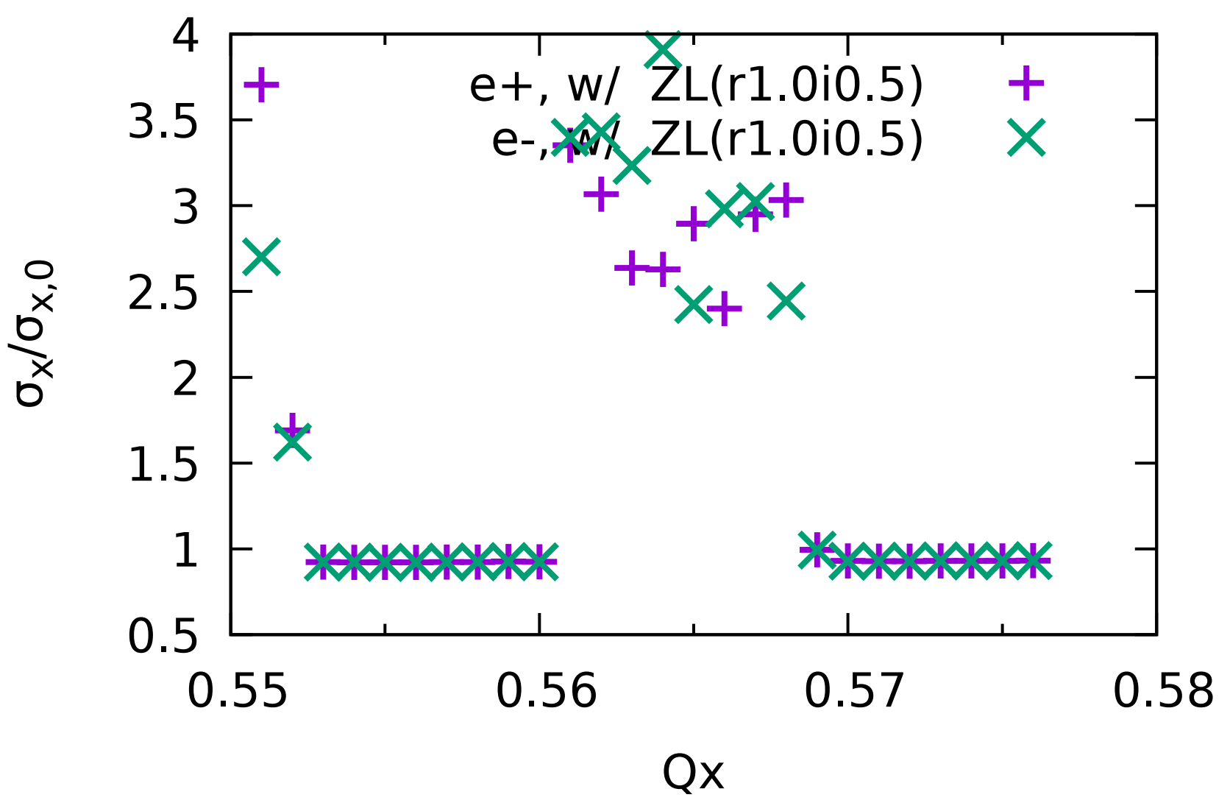
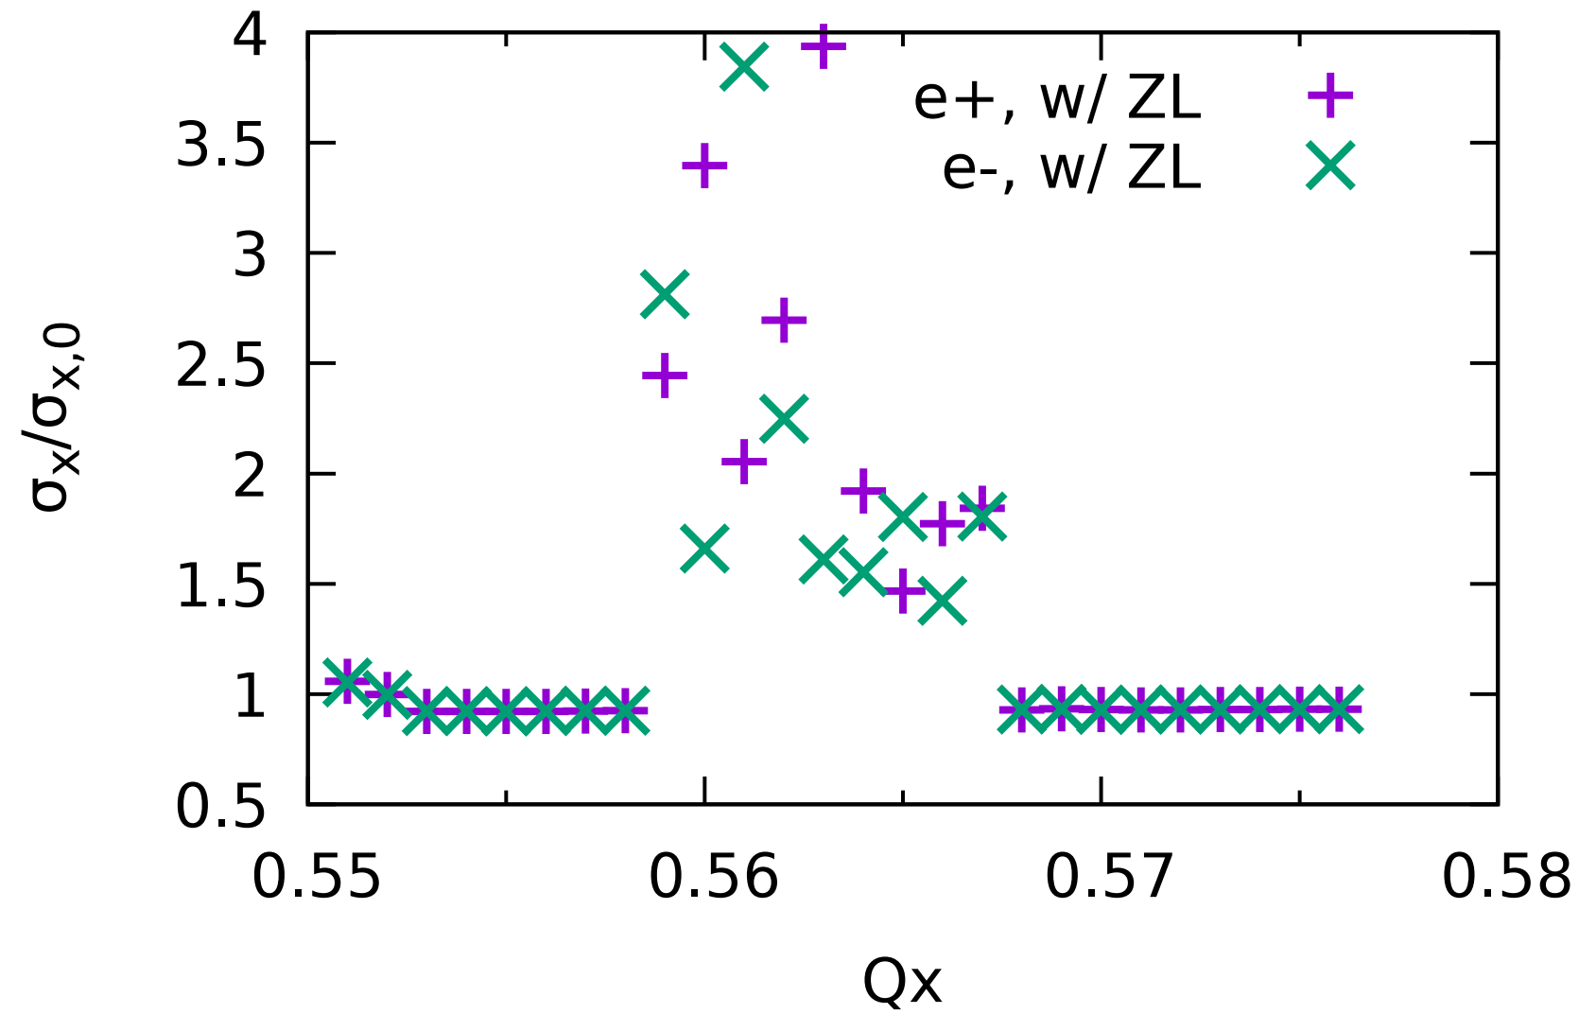
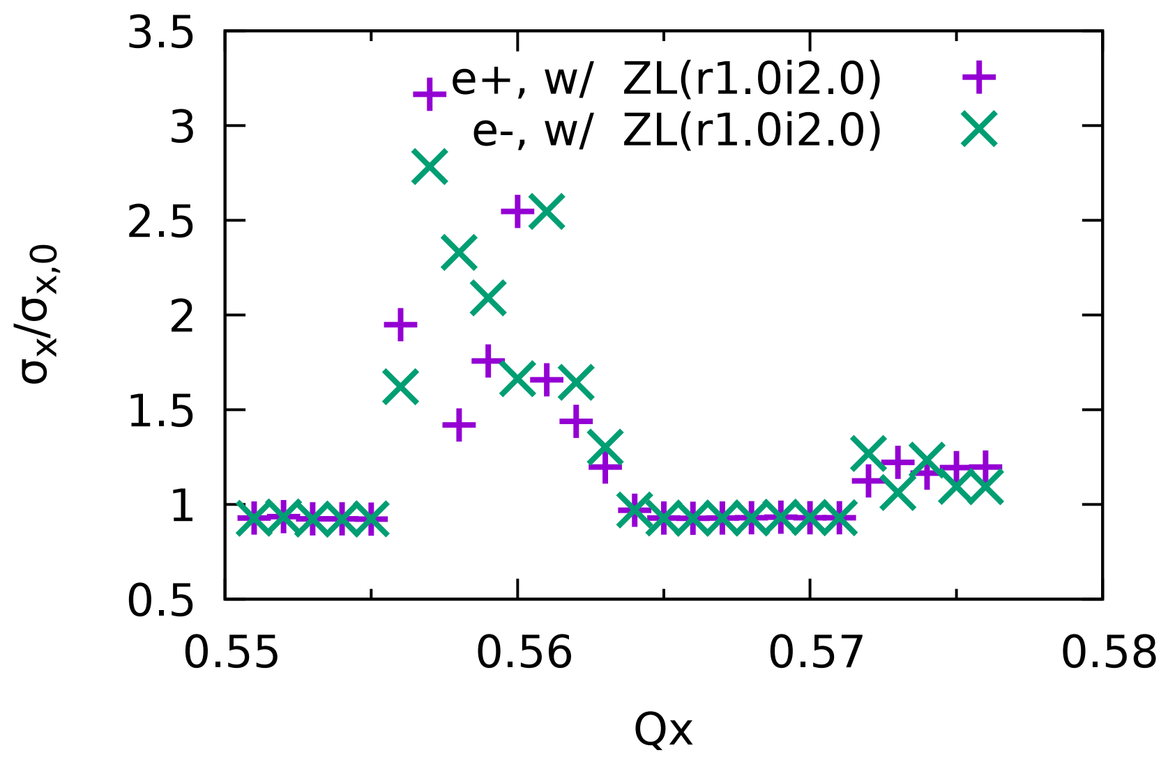
Influence of impedance on beam-beam
Yuan Zhang
ReZL (1), ImZL (0.5→1→2)
CDR impedance is used in these plots
Reasonable large stable region even with the imaginary part of the impedance increased by a factor of 2, only with shift of the stable region.
⇒ To optimize the impedance to mitigate this effect, the real part of impedance should be well controlled, while the imaginary part can be more relaxed (NEG coating may not be necessarily less than 1μm).

Slide 15
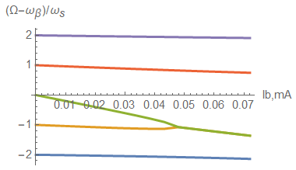
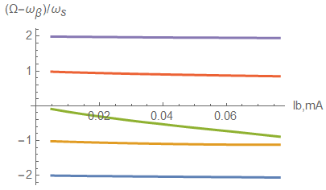
Transverse mode coupling instability
Fast instability, normally with beam losses.
The instability threshold extends from 45μA to 85uA when considering bunch lengthening due to the longitudinal impedance.
The instability will be further detuned when considering the bunch lengthening due to the beamstrahlung.
W/O ZL
W/ ZL
Design
Design

Slide 16
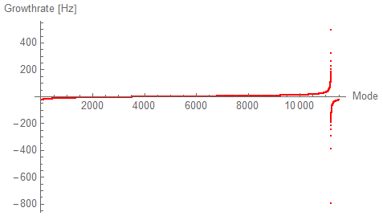
Transverse resistive wall instability
The coupled bunch instability can be driven by the resonance at zero frequency of the transverse resistive wall impedance.
An efficient bunch by bunch feedback damping of ~3 turns is required.
  Multiple of feedback systems around the ring
  Single mode damping specially for the RW is under consideration
  A positive chromaticity tends to provide some extra damping
 | Z-High Lumi
Instability growth time [ms] | 2.0 (~6 turns)
Radiation damping [ms] | 840
Bunch by bunch feedback [ms] | 1.0 (~3 turns)
Growth of the most dangerous mode vs. damping factors

Slide 17
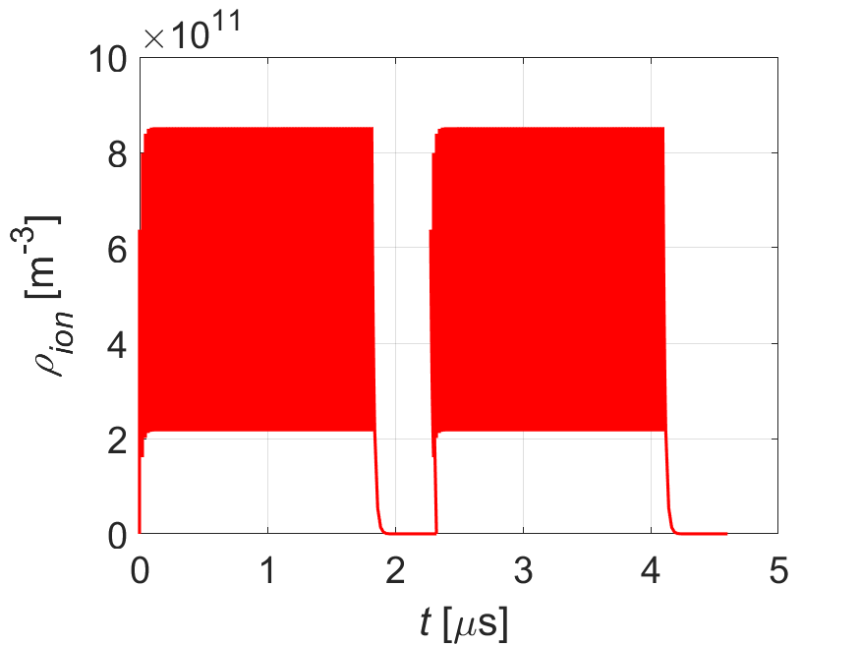
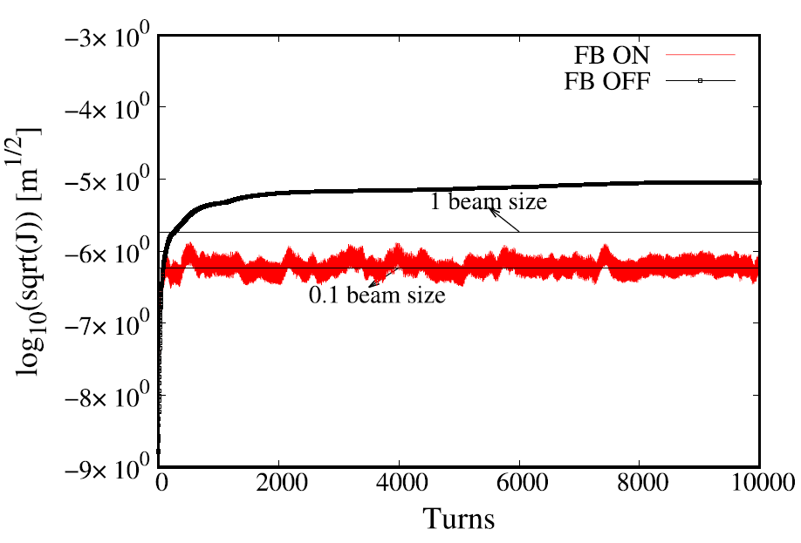
Beam ion effects
Induce emittance blow-up and a positive tune shift along the bunch train.
Filling pattern: {Ntrain=144, Bunch spacing=23ns, Gap=492ns}
Beam size increase due to the beam ion interaction are foreseen.
Parameters | Z-30MW
L_{sep}ω_{ion}/c₀ | 0.8
ρ_{ion,ave}[m⁻³] | 4.3E11
τ_{e} [ms] | 0.1
τ_{H} [ms] | 4.0
Δν_{y} | 0.016
PRAB, 23, 074401 (2020)
Build-up of ions along the bunch train
Bunch by bunch feedback can be effective on damping this effect

Slide 18
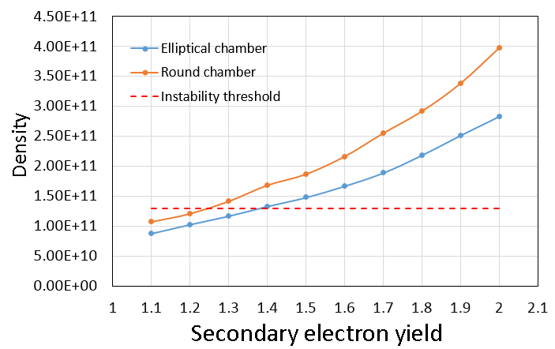
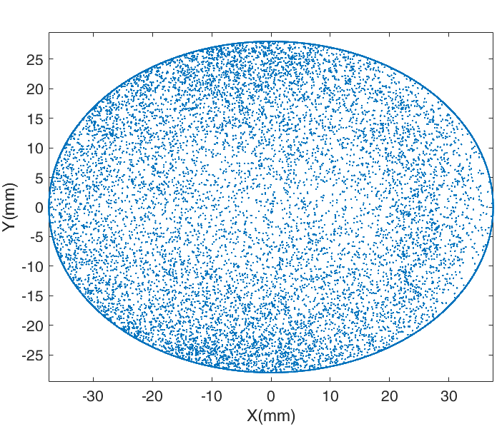
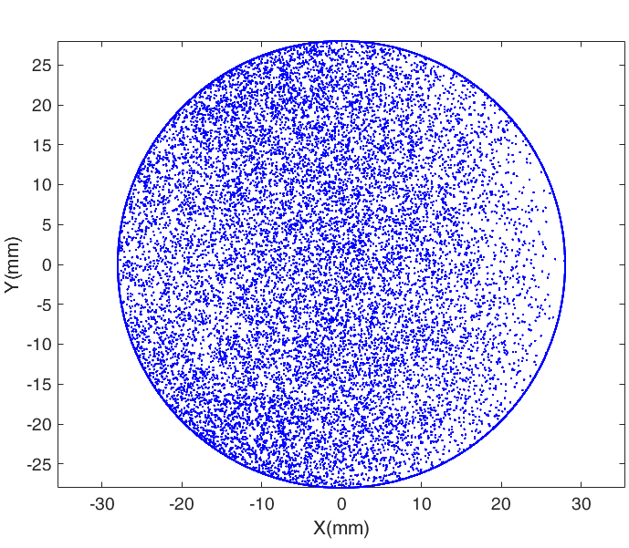
Electron cloud effects
Yudong Liu
The electron density is increased due to the change of the chamber cross section. The SEY needs to be reduced to <1.2 by introducing NEG coating.
More detailed simulations as well as evaluation of its induced heating are under going.
Elliptical chamber: SEY<1.3
Round chamber: SEY<1.2

Slide 19
Summary
Impedance model is updated regarding the change of the chamber cross section (elliptical→circular), as well as more impedance contributors included
Key instability issues for high luminosity Z are investigated:
  Coupling of the longitudinal impedance and the beam beam effects results in reduce of the stable beam-beam interaction region, the real part of the impedance should be well controlled.
  TMCI is OK considering bunch lengthening induced by longitudinal impedance.
  Resistive wall instability needs an efficient feedback damping of ~3 turns
  Ecloud requires an SEY of less than 1.2 or adding antechambers.
  Beam size increase due to the beam ion effect are foreseen ⇒ feedback system is needed to damp this effect.

Slide 20
Thank you for your attention!

