Slide 1
CEPC mechanics design
Haijing Wang
IAS Mini-workshop: Accelerator Physics - Key Beam Physics and Technologies Issues for Colliders
1.13-1.14, 2022

Slide 2
Outline
Magnet supports
MDI mechanics
Collimators and machine protection scheme
Summary

Slide 3
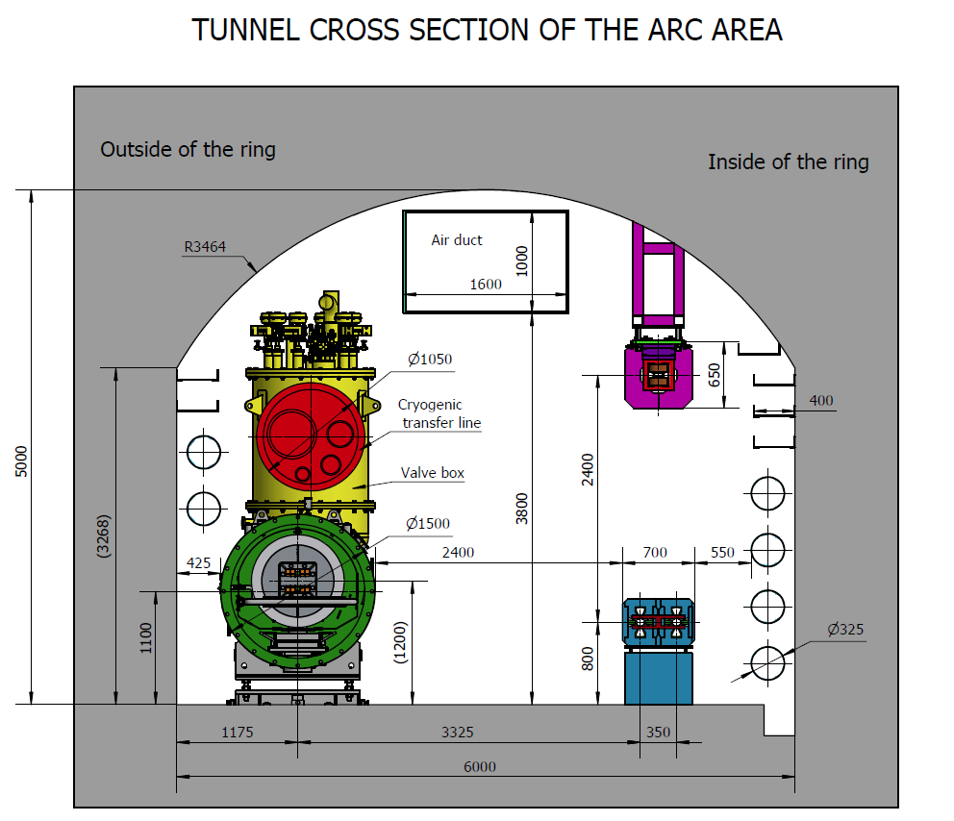
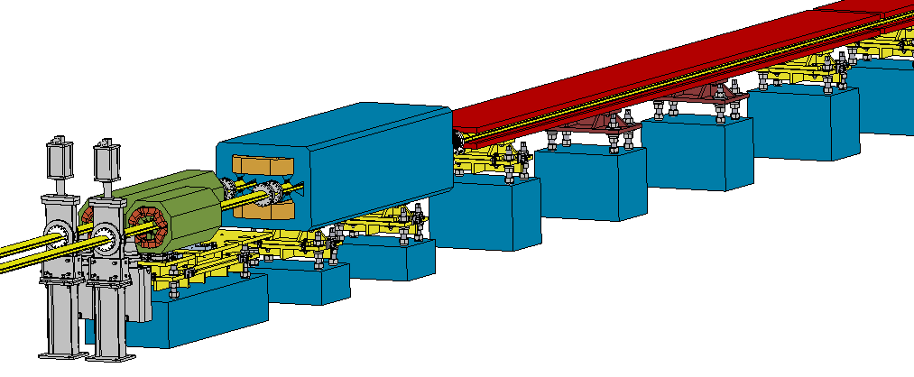
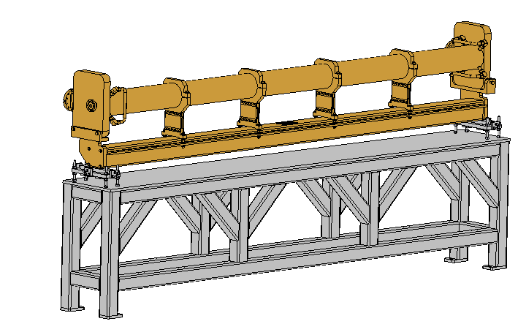
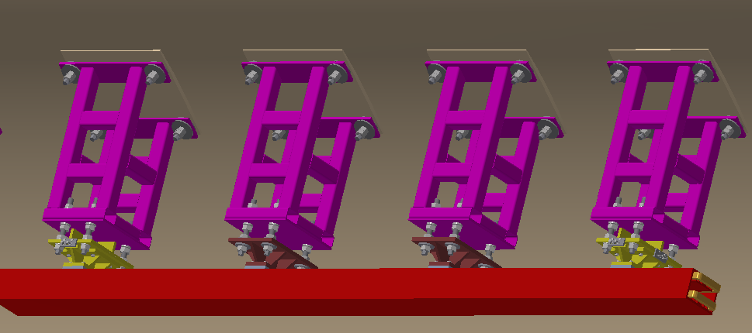
Magnet supports
Over 80% of the length is covered by magnets of about 138 types.
Adjustment Ranges of magnets
X | ≥±20 mm | Δθx | ≥±10 mrad
Y | ≥±30 mm | Δθy | ≥±10 mrad
Z | ≥±20 mm | Δθz | ≥±10 mrad
Booster
Collider

Slide 4
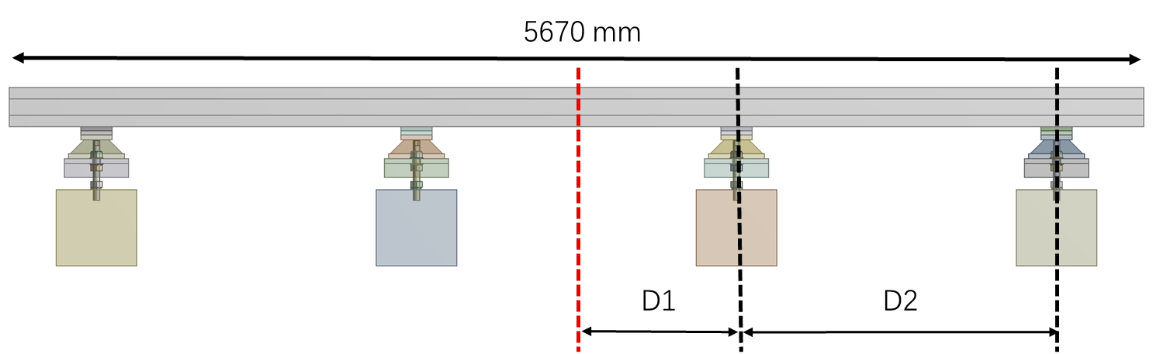
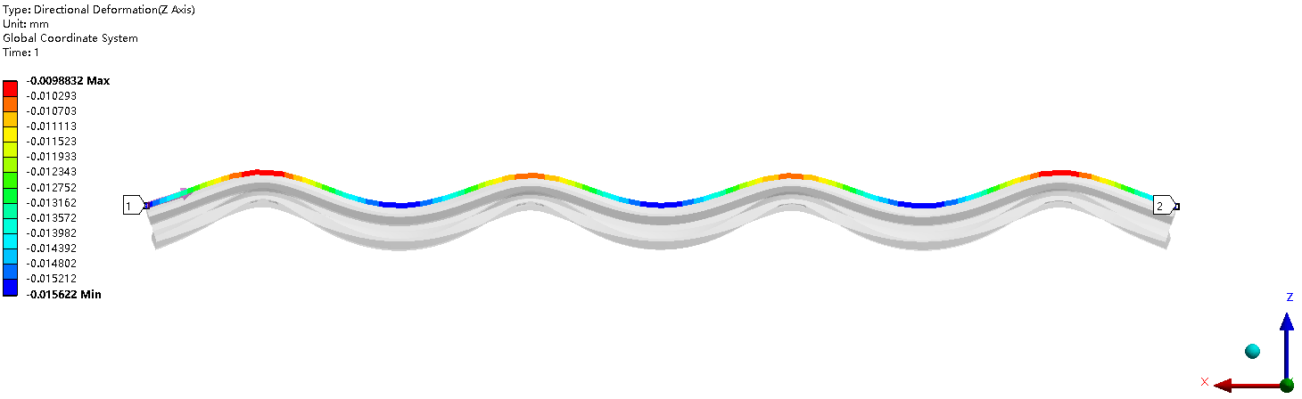
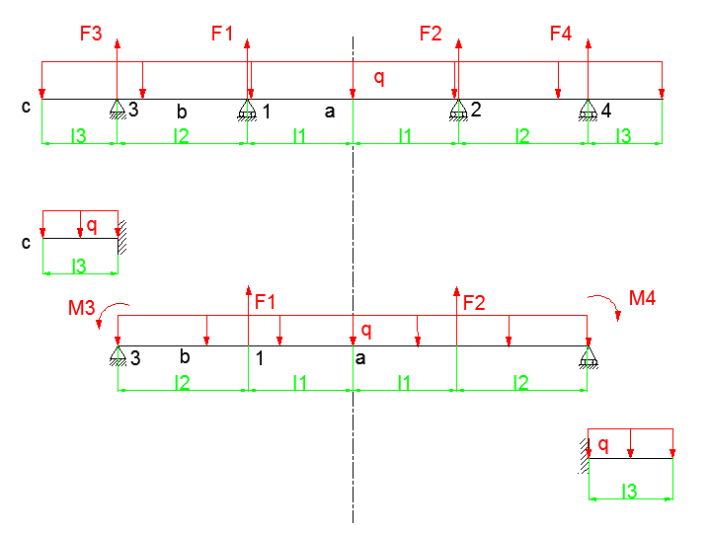
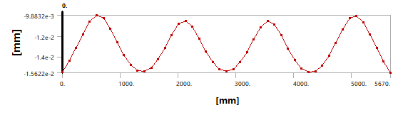
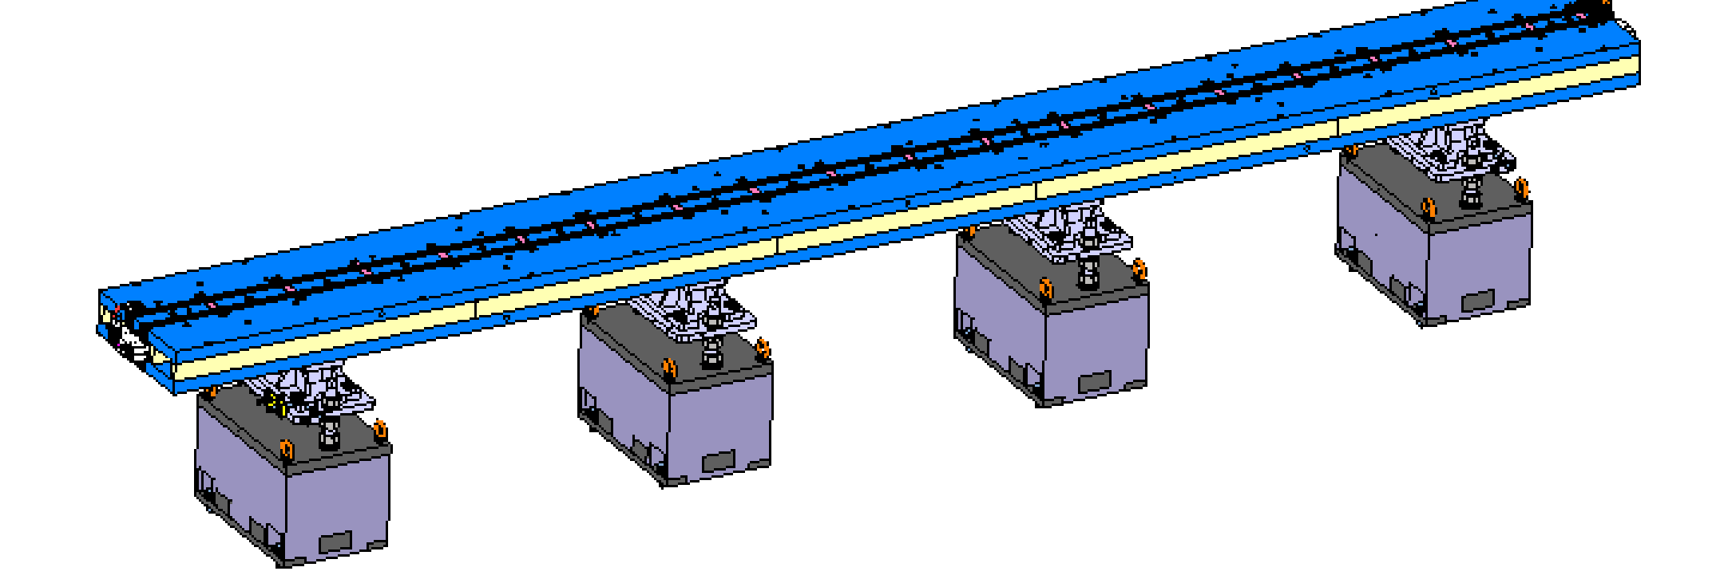
Magnet supports
Optimization for dipole supports
No. of supports | Max. deformation (um)
3 | 19
4 | 7
5 | 5
Methods:
  Theoretical derivation
  Deformation optimization
Tools:
  Matlab
  Workbench-Response surface
  Inventor

Slide 5
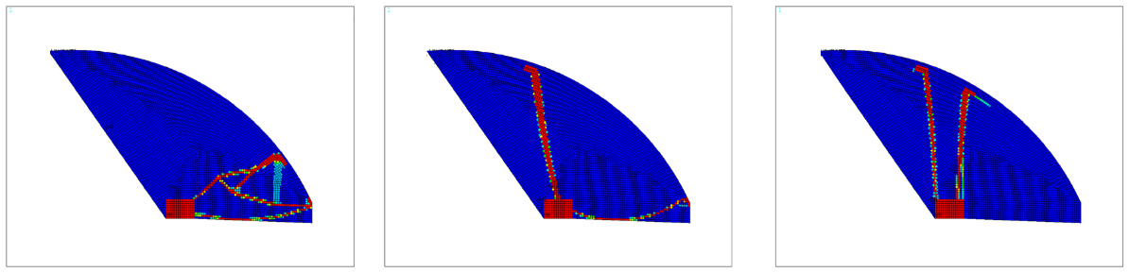
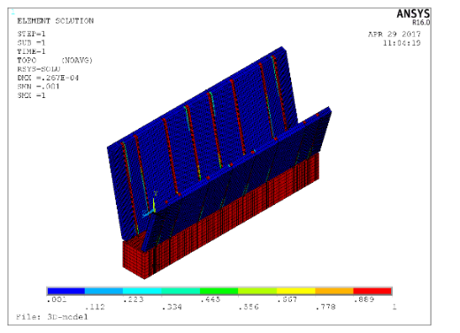
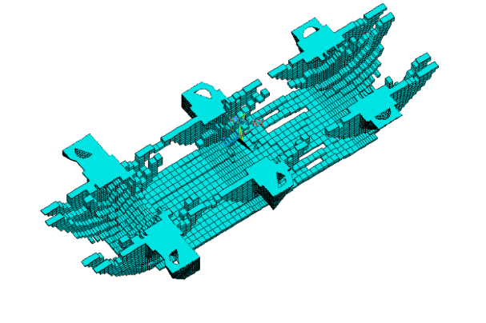
Magnet supports
Optimization for dipole supports in Booster
Methods:
  Theoretical derivation
  Deformation optimization
  Topology optimization
Tools:
  Matlab
  Workbench-Response surface
  ANSYS APDL
  Inventor
Topology optimization was first used in girder design by our team on HEPS-TF

Slide 6
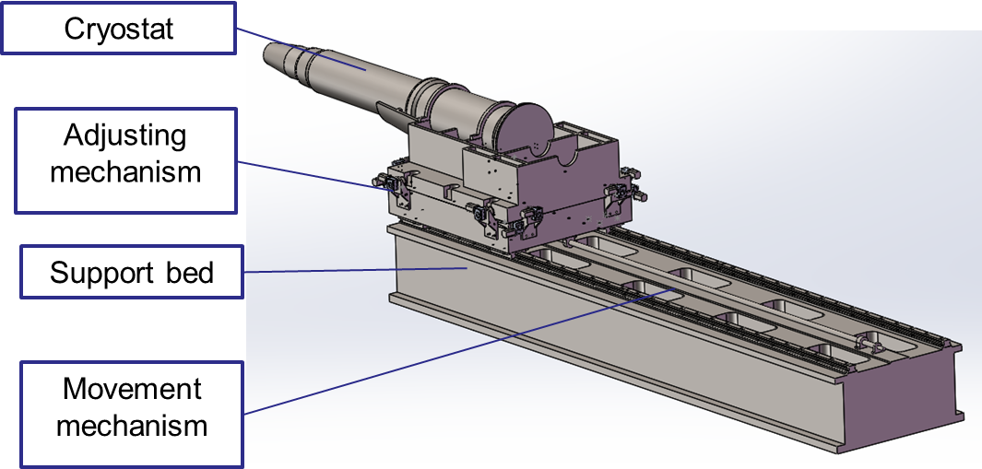
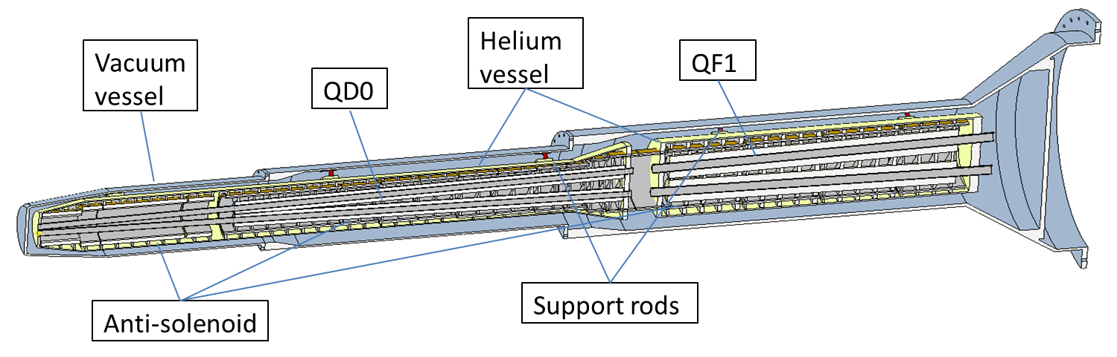
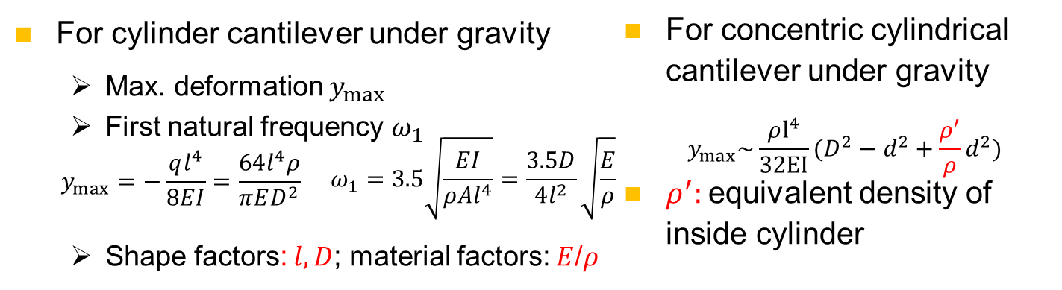
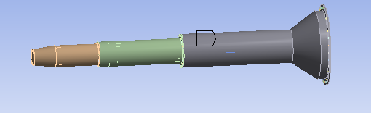
Magnet supports
Optimization for SC magnet supports
Methods:
  Theoretical derivation
  Deformation optimization
  Stability optimization
  Material optimization
Tools:
  Matlab
  Workbench
  Inventor
Fz1
Fz2
Fz3
G

Slide 7
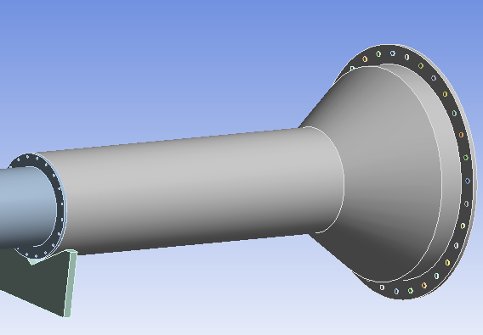
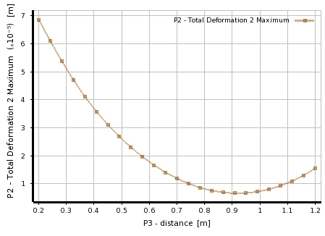
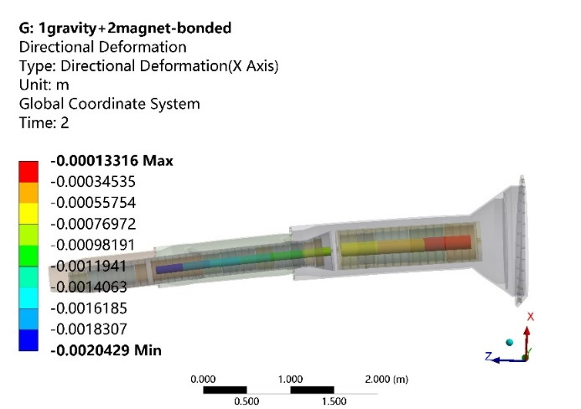
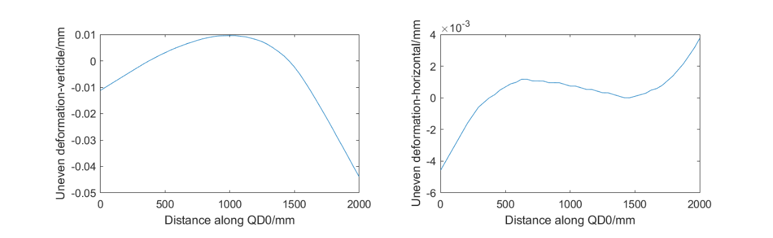
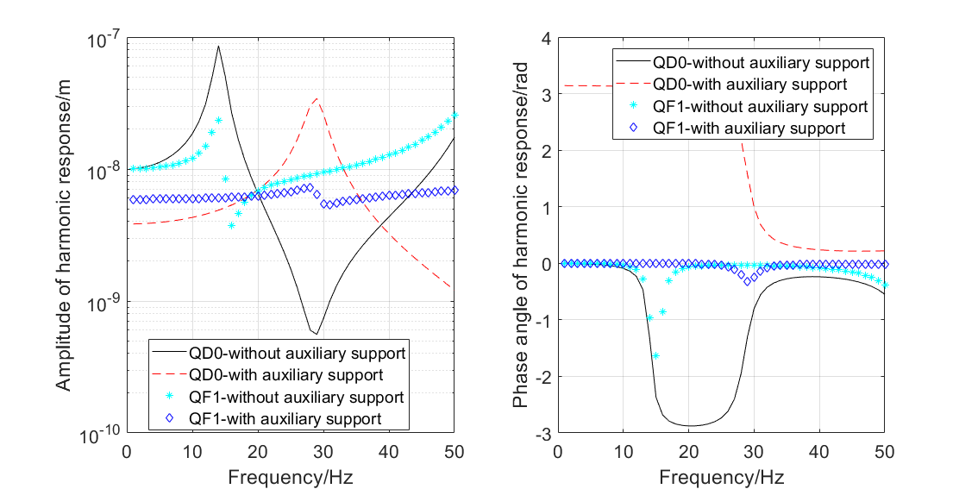
Magnet supports
Optimization for SC magnet supports
Methods:
  Theoretical derivation
  Deformation optimization
  Stability optimization
  Material optimization
Tools:
  Matlab
  Workbench
  Inventor

Slide 8
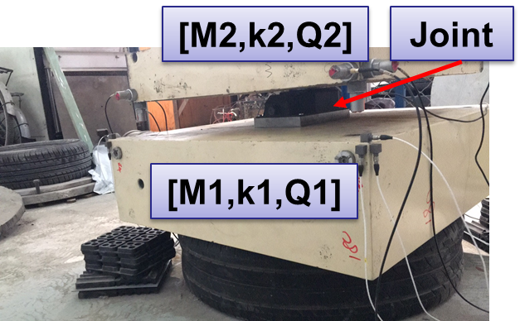
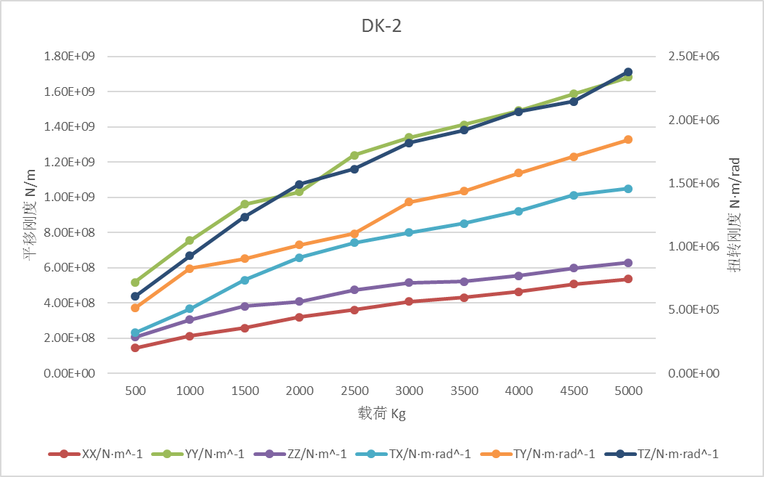
Magnet supports
Stiffness study for adjusting joints: very important for stability evaluation
A new method used in HEPS
High efficiency
High accuracy
Simple
载荷KG | XX/% | YY/% | ZZ/% | TX/% | TY/% | TZ/%
500 | 1 | 2 | 2 | 19 | 1 | 2
1000 | 3 | 4 | 0 | 23 | 8 | 6
1500 | 0 | 2 | 3 | 28 | 3 | 8
2000 | 2 | 0 | 5 | 20 | 0 | 5
2500 | 0 | 1 | 2 | 15 | 3 | 5
3000 | 2 | 0 | 5 | 10 | 1 | 6
3500 | 1 | 4 | 6 | 9 | 0 | 3
4000 | 2 | 5 | 9 | 6 | 0 | 2
4500 | 3 | 7 | 8 | 8 | 0 | 1
5000 | 5 | 8 | 10 | 4 | 1 | 0
Methods:
  FEA-based hammering method
Tools:
  ANSYS APDL
  Matlab
  Test devices

Slide 9
Magnet supports
Main parameters obtained in analysis
  Regular dipoles in Collider: 5670 mm long, uneven deformation ＜10um (under gravity )
  QD0: 2000 mm long, uneven deformation ＜30 um (under gravity and Lorentz force in anti-solenoid )
More detailed works are under-going
  Further optimization in SC magnet support
  Common girder design for regular quadrupoles and sextupoles, and optimization

Slide 10
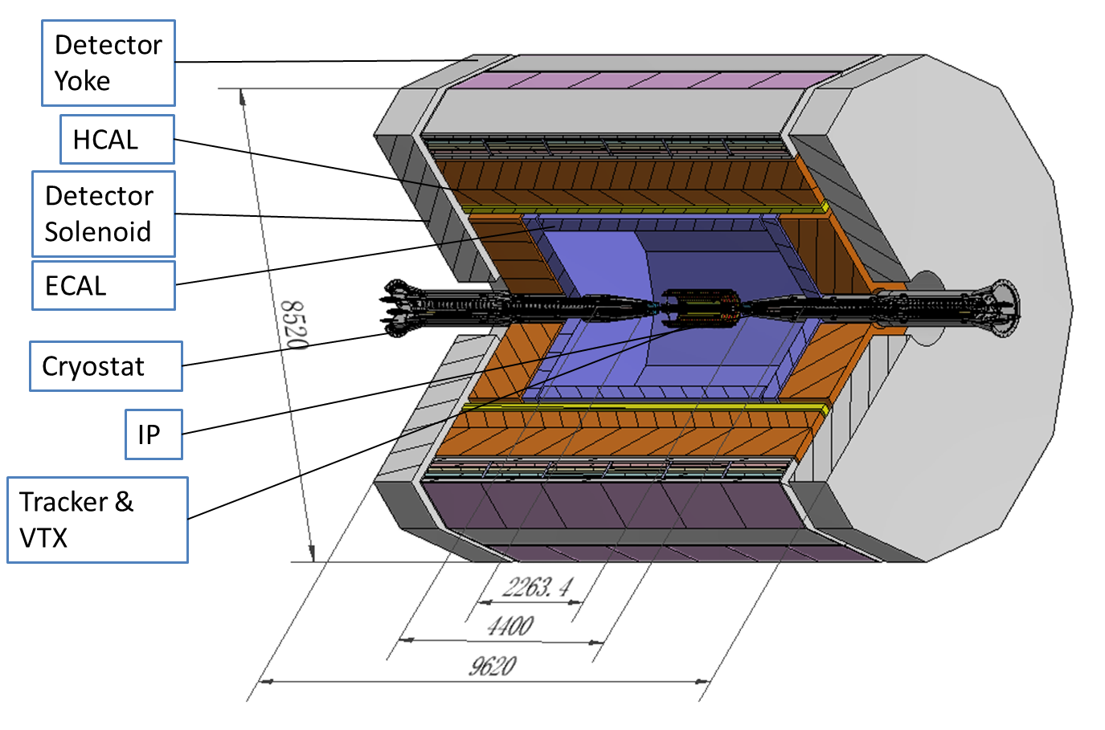
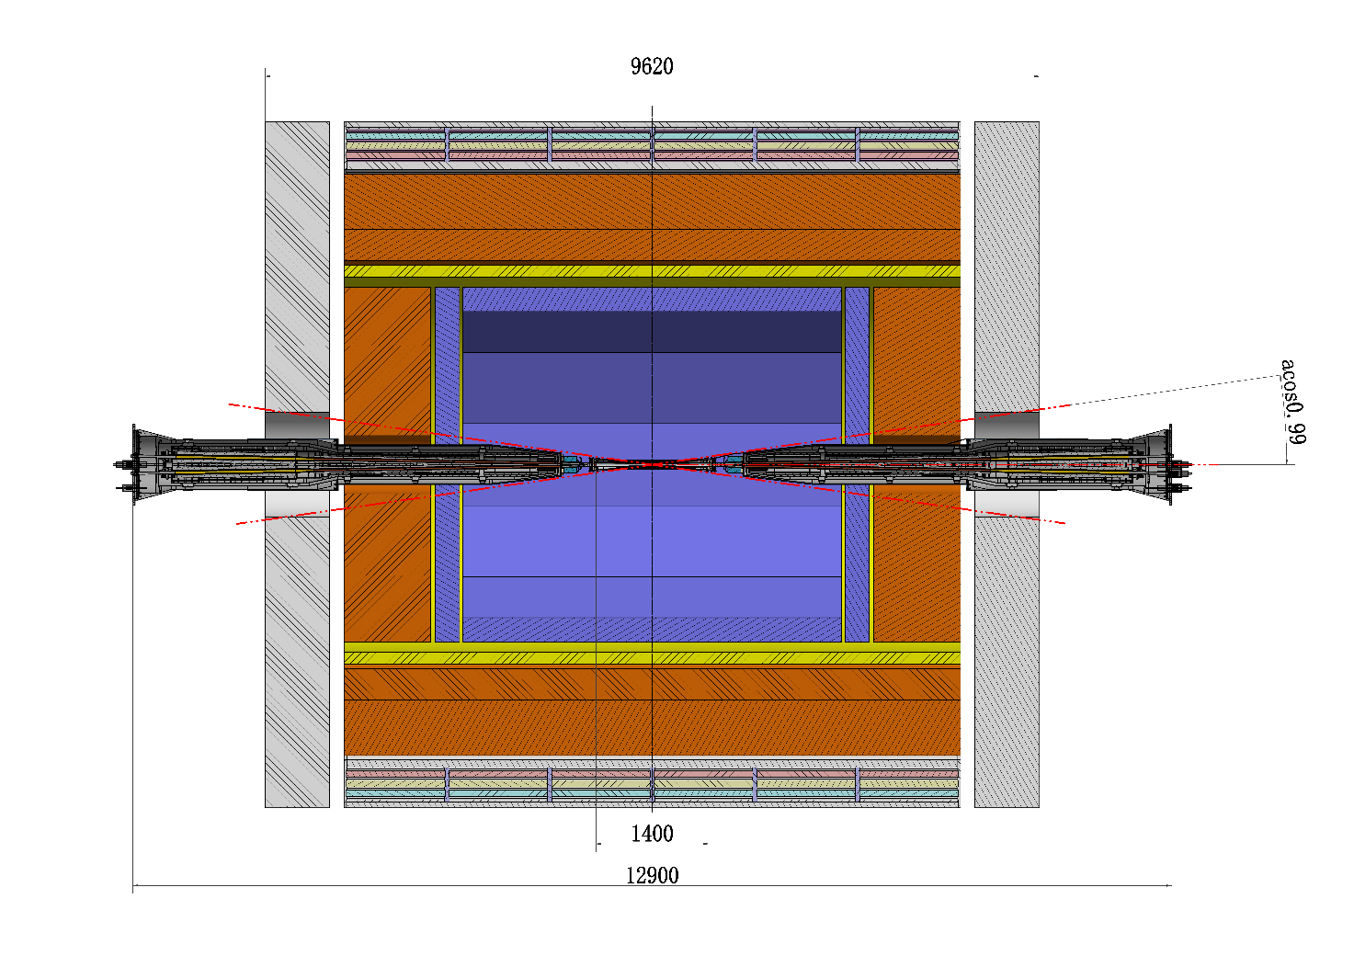
MDI mechanics
MDI layout: Continue to be updated
Detector
Accelerator devices
Accelerator devices
Collaboration from several systems:
  Accelerator: physics, mechanics, SC magnets, vacuum, cryogenic, instruments…
  Detector: physics, mechanics, VTX, Yoke, shielding…

Slide 11
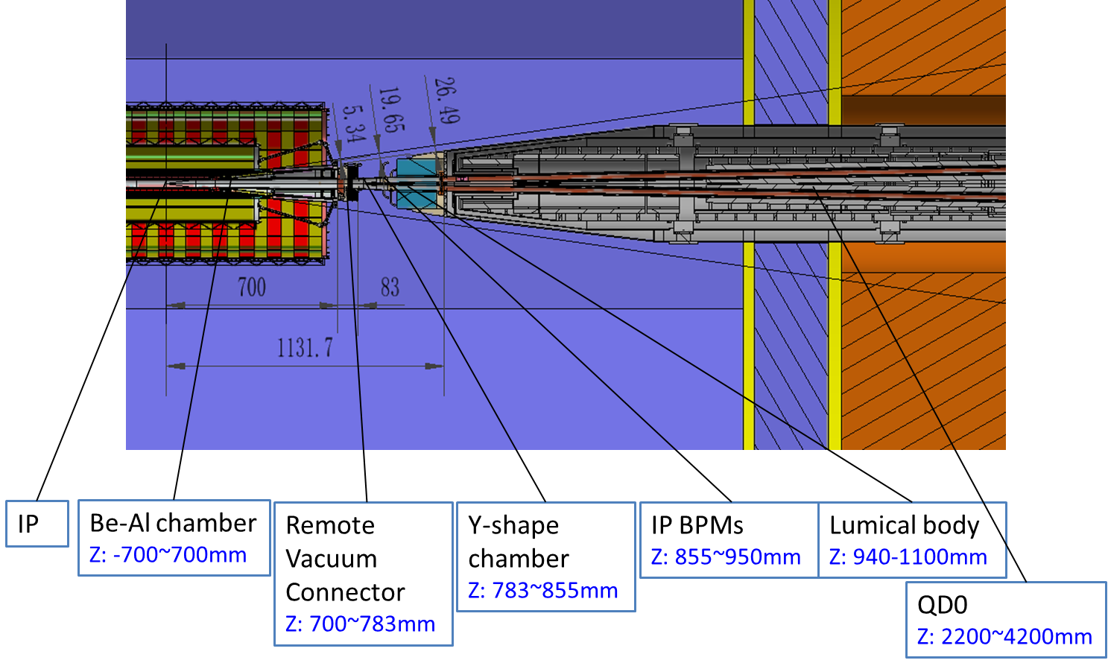
MDI mechanics
MDI layout: Continue to be updated
Tools: Inventor, solidworks…
Phased achievements: a workable layout for CDR

Slide 12
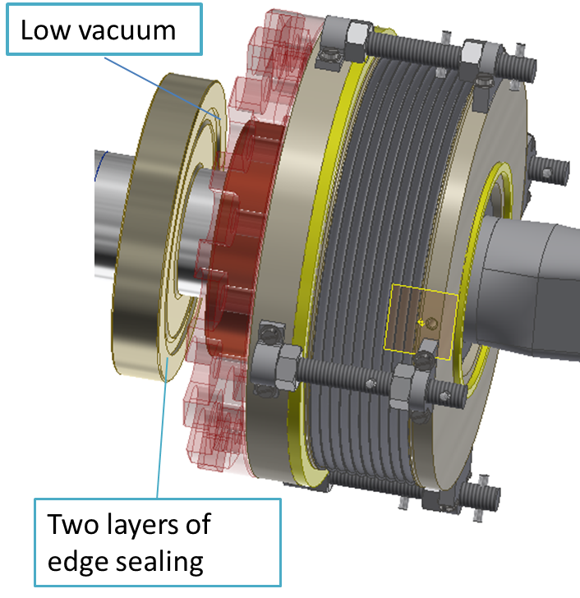
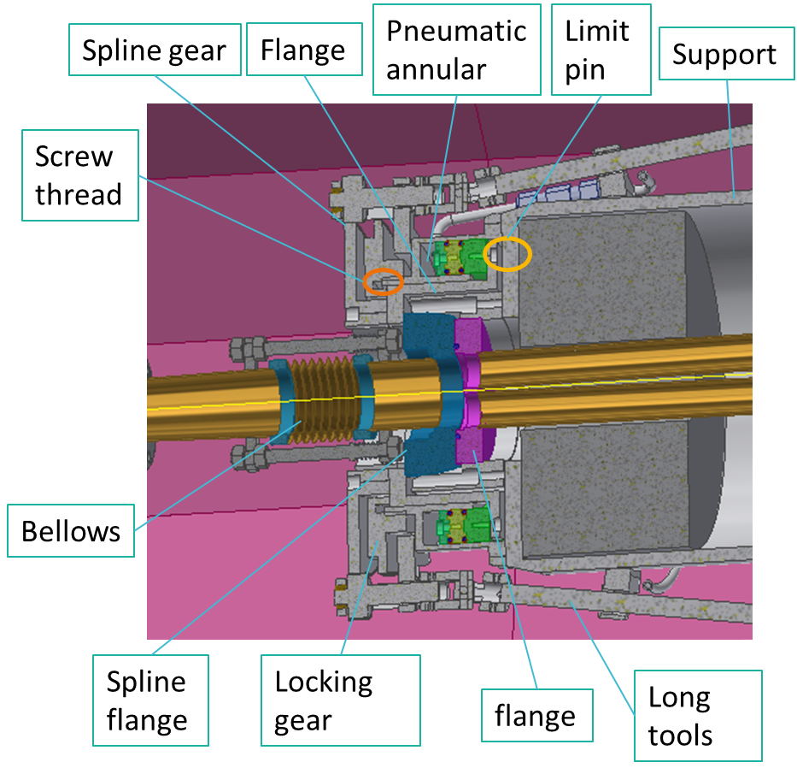
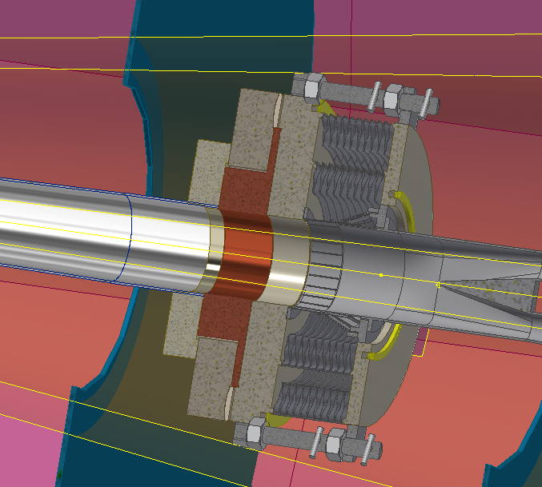
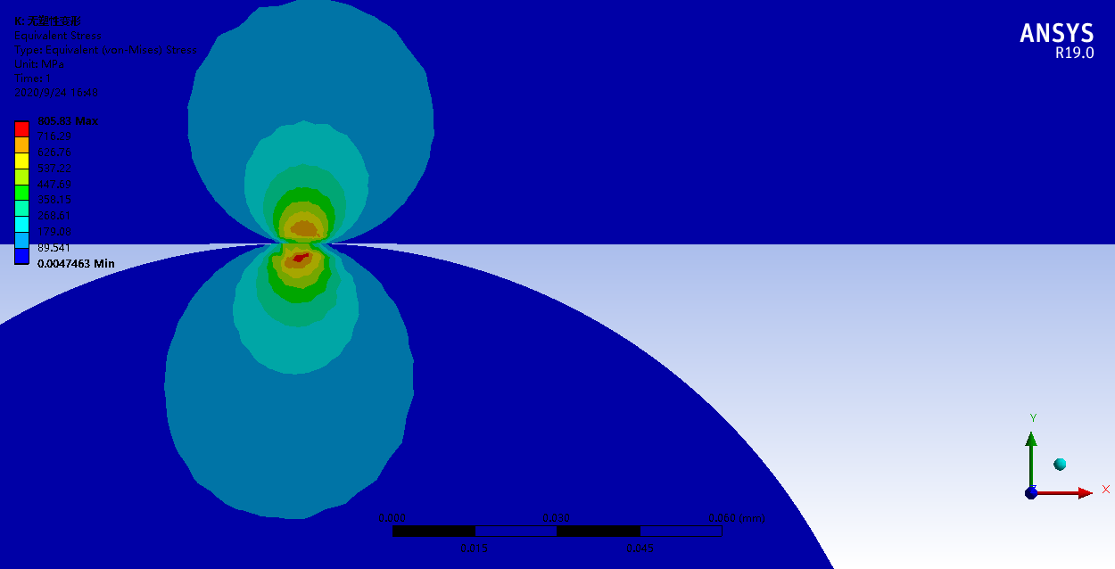
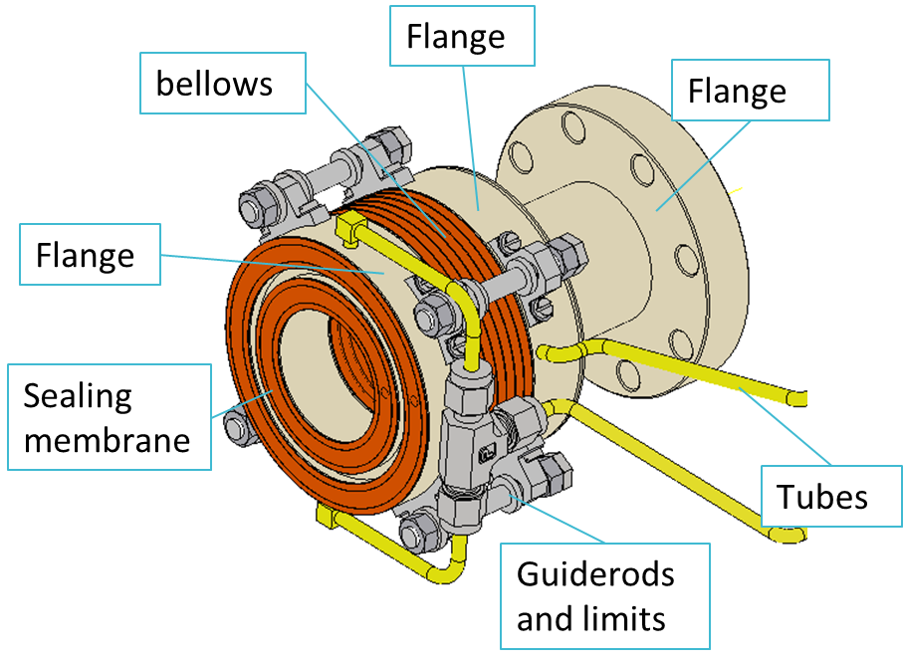
MDI mechanics
Remote vacuum connector
Methods:
  Theoretical derivation
  Two layers of edge sealing
  Space optimization
  FEA
Tools:
  Workbench
  Inventor

Slide 13
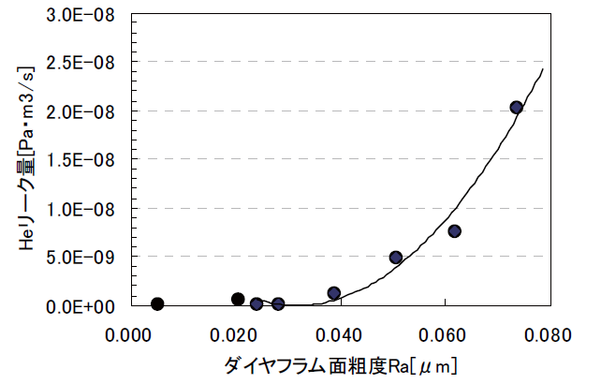
MDI mechanics
Remote vacuum connector
Difficulties:
  Space limitation, leak rate, thermal dissipation…
Sealing methods | Within detection angle | Leak rate estimation | Remarks
RVC | NO |  | Successful used in S-KEKB
Remote chain | Yes |  | Eliminated
Inflatable seal* | Yes |  | Experience from CSNS
Improved inflatable seal | Yes |  | Mainly focused on
Our experience:
    Single-layer → double layer, leak rate can be improved from 1e-6 Pa.m3/s to 8.5e-10 Pa.m3/s.
    Replace membrane sealing by edge sealing

Slide 14
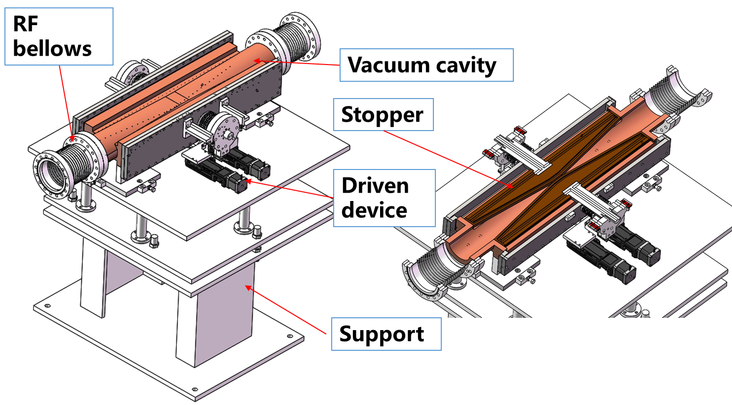
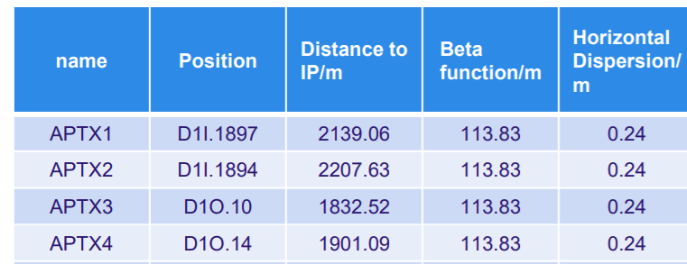
Collimators and machine protection scheme
4 collimators per IP per ring for background decreasing
Horizontal aperture
  4.4 mm~20 mm
Methods:
  FEA
  Thermal deposition analysis
  Impedance analysis
  Kinetic design
Tools:
  ANSYS/Workbench
  Inventor
  Geant4
  CST

Slide 15
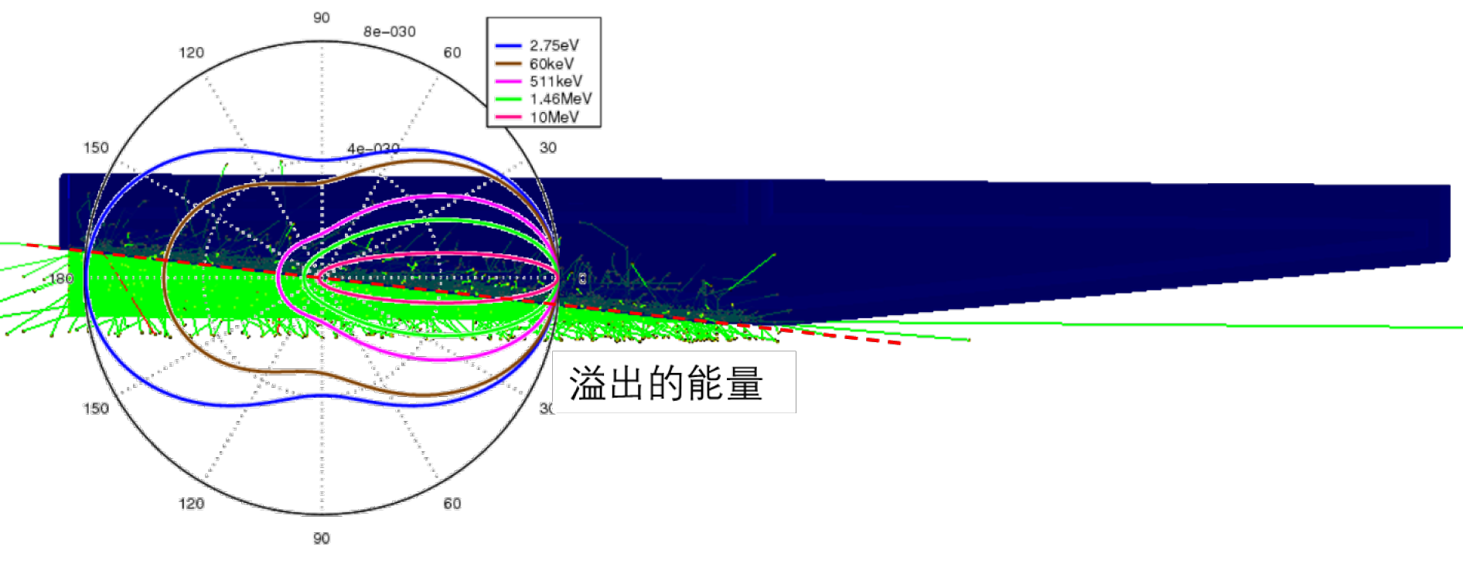
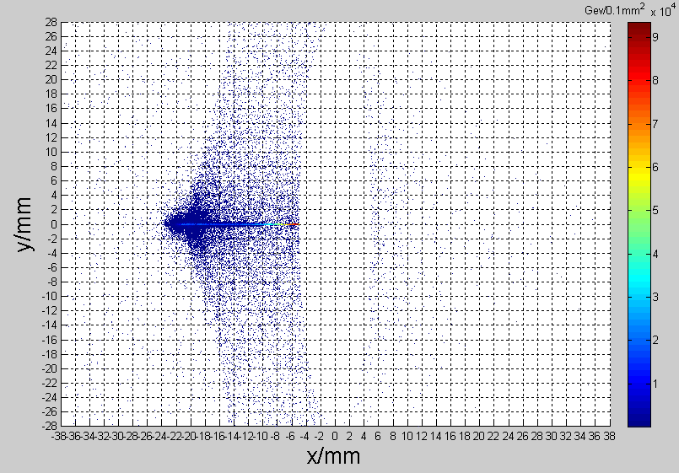
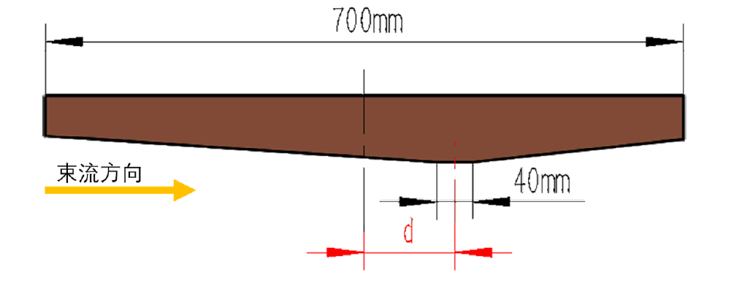
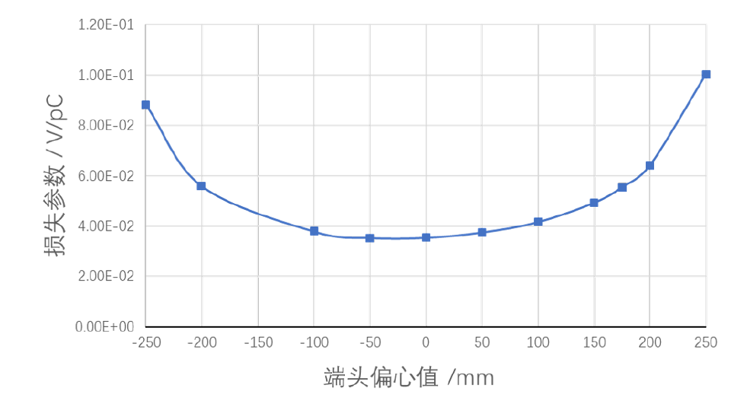
Collimators and machine protection scheme
Particle deposition
  Jaw material: Cu
  Total heat generation: 91.6 W
  Maximum temperature raise by particle-material reaction: 2℃
SR load
  9.3 kW@30 MW, Higgs
  Main power for collimator
Impedance load
  Loss factor can be optimized with tip offset ~ negligible power

Slide 16
Collimators and machine protection scheme
Highest temperature in jaws: 183 ℃
Highest temperature in chamber: 143 ℃

Slide 17
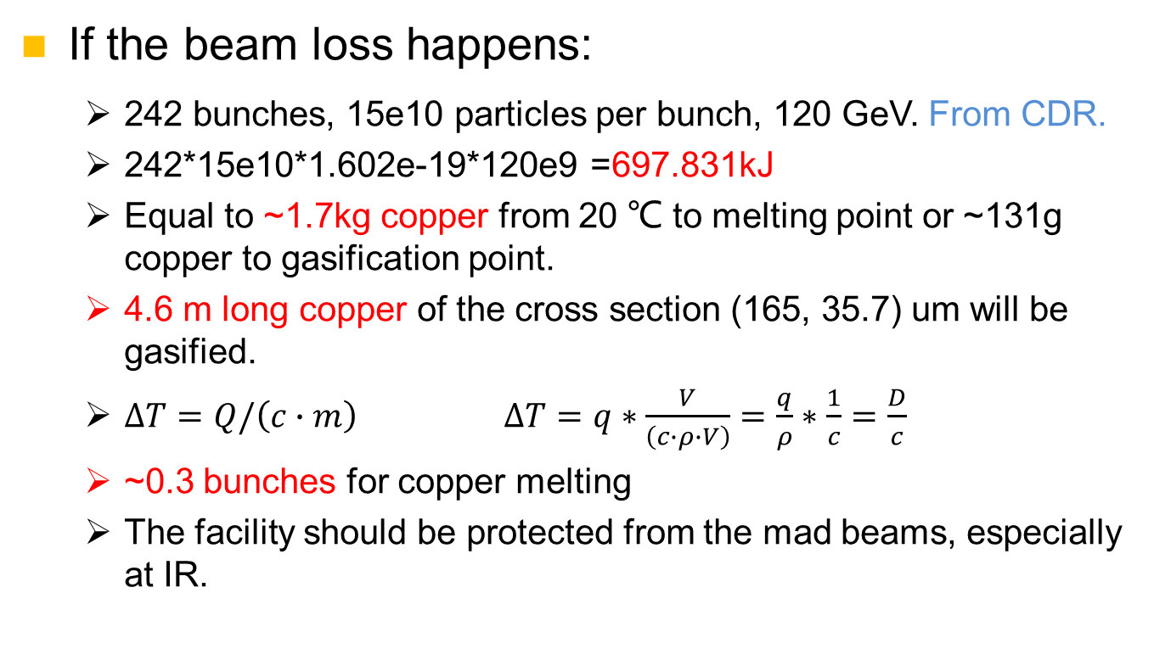
Collimators and machine protection scheme
If the beam loss happens:
  242 bunches, 15e10 particles per bunch, 120 GeV. From CDR.
  242*15e10*1.602e-19*120e9 =697.831kJ
  Equal to ~1.7kg copper from 20 ℃ to melting point or ~131g copper to gasification point.
  4.6 m long copper of the cross section (165, 35.7) um will be gasified.
  $∆T=Q/\left(c∙m\right)$ $∆T=q∗\frac{V}{\left(c∙ρ∙V\right)}=\frac{q}{ρ}∗\frac{1}{c}=\frac{D}{c}$
  ~0.3 bunches for copper melting
  The facility should be protected from the mad beams, especially at IR.
Beam
Target

Slide 18
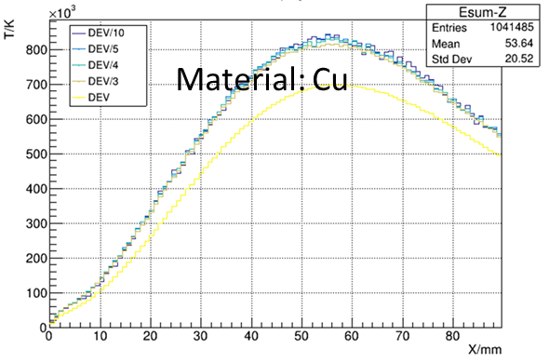
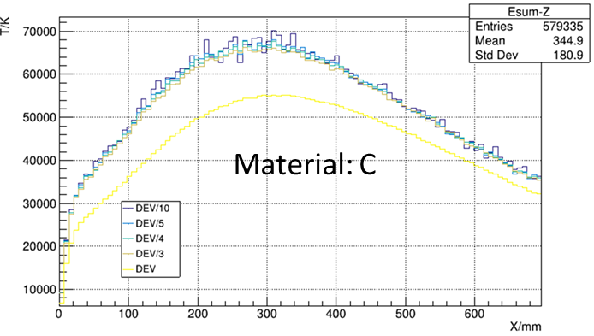
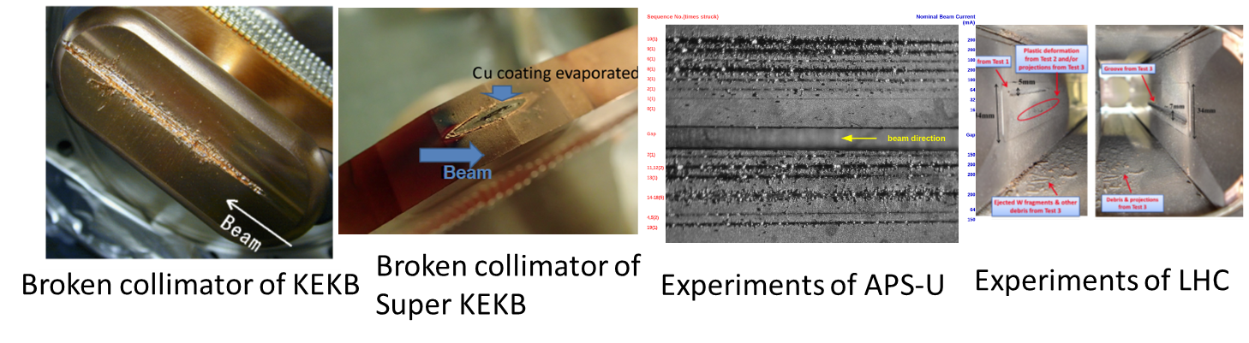
Collimators and machine protection scheme
Beam loss failure of CEPC
  If dipoles have powering failure, The beam will be lost in 1 turn, on collimators or on vacuum chamber. From accelerator physics.
  Beam loss failure on vacuum chamber or magnets should be avoided.

Slide 19
Preliminary design on machine protection
Machine protection—KEKB
  Beam abort system, to avoid direct hit on movable collimators.
  Response time: ~100 us (~10 turns).
Machine protection —Super KEKB
  Deliver the stored beam into a beam dump and prevent spewing beam everywhere in the ring.
  Response time: less than 20 us. (~2 turns)
Machine protection-LHC
  Collimators are used for passive protection. 99.99% of the lost protons were intercepted. 100 collimators.
  Dump delay: 270 us (3 turns)
Abe, Tetsuo, et al. "Achievements of KEKB." Progress of Theoretical and Experimental Physics 2013.3 (2013).
Akai, Kazunori, Kazuro Furukawa, and Haruyo Koiso. "SuperKEKB collider." Nuclear Instruments and Methods in Physics Research Section A: Accelerators, Spectrometers, Detectors and Associated Equipment 907 (2018): 188-199.
Mimashi, Toshihiro, et al. "SuperKEKB beam abort system." Proc. IPAC 14 (2014): 116.
Wenninger, Jörg. "Machine protection and operation for LHC." arXiv preprint arXiv:1608.03113 (2016).

Slide 20
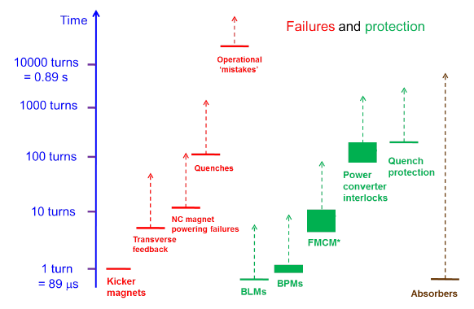
Preliminary design on machine protection
Preliminary scheme
2700 turns
270 turns
Beam abort system, to beam dump
27 turns
2.7 turns
Passive protection
Collimators
Reverse switching solenoids
…
0.27 turns
Picture from: Wenninger, Jörg. "Machine protection and operation for LHC." arXiv preprint arXiv:1608.03113 (2016).

Slide 21
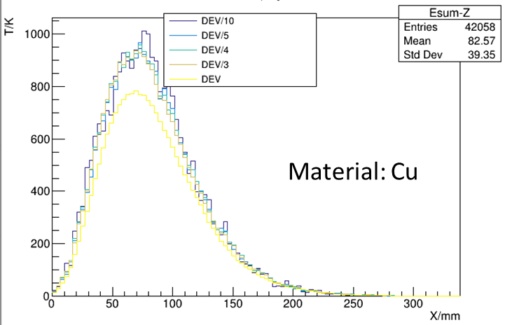
Preliminary design on machine protection
Possible method for passive protection
  By collimators
    Primary collimator: diamond, 1 mm in thickness
    Secondary collimator: graphite, 200 meters after
    The collimators can endure the 242 bunches without melting.
    Collimator distribution and impedances haven’t been studied.
  By reverse switches
    Scale up the beam size three times larger, the copper chamber will not melt.
    Auxiliary solenoids on the vacuum chamber with a reverse switching with dipoles may be used to dilute each bunch.
    Response time and technical flexibility should be studied.
Temperature in 1 mm diamond
Temperature in graphite

Slide 22
Summary
Theoretical derivation, deformation optimization, topology optimization have been adopted in the magnet girder design, more detailed optimization works are on-going.
We have made a workable MDI layout. Some key devices such as remote vacuum connector are designed.
The collimators for background decreasing are designed. The beam loss failure has been considered and preliminary protection scheme with abort system, collimators and reverse switching solenoids are considered.

Slide 23
Thanks for your attention!

