Slide 1
C³ – Cool Copper Collider:
A New Approach
Emilio Nanni
January 13, 2022
HEP 2022

Slide 2
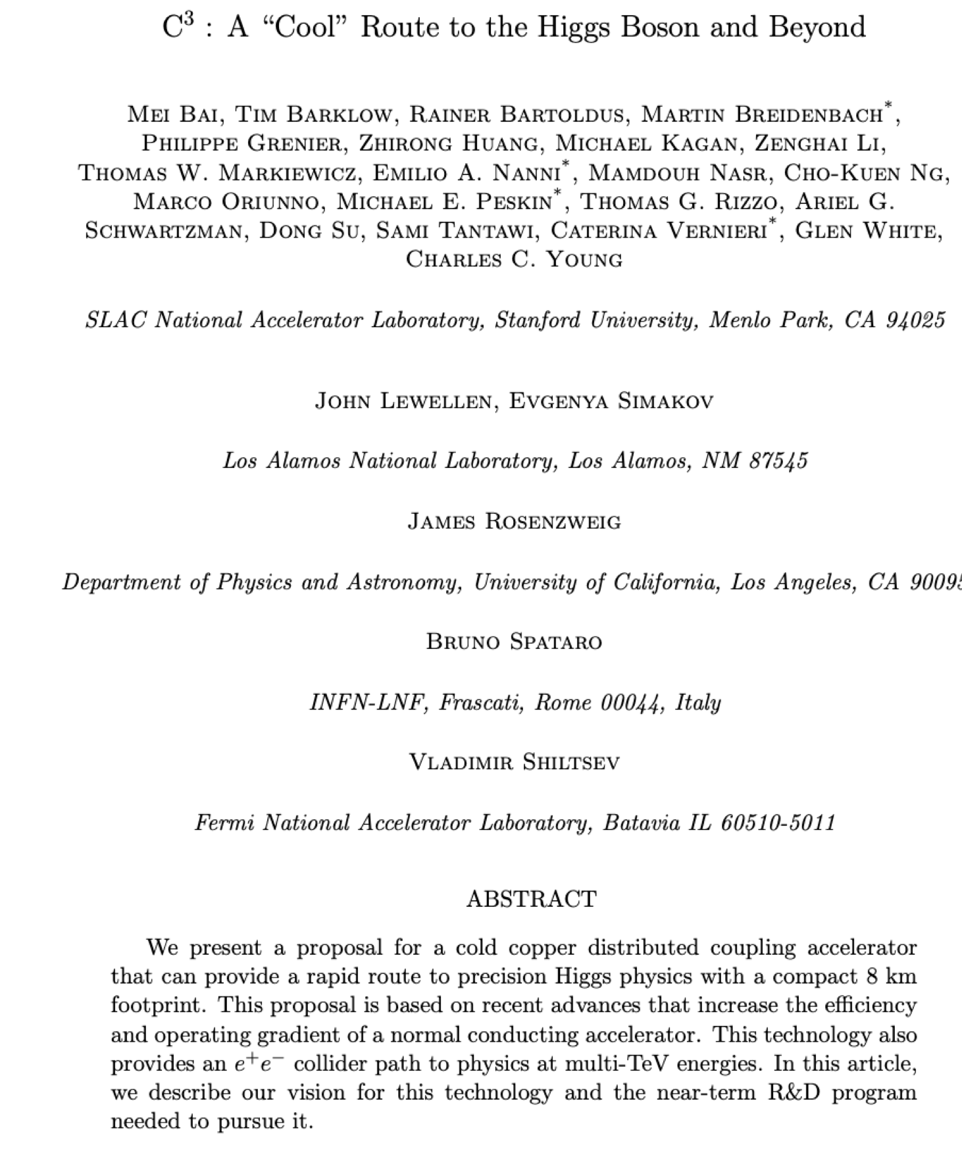
Acknowledgements
More Details See: ArXiv 2110.15800 (2021)
Additional Contributors/Proponents:
Dennis Palmer
Emma Snively
Cici Hanna
Charlotte Whener
Annika Gabriel
Gordon Bowden
Andy Haase
Julian Merrick
Bob Conley
Mitchell Schneider
Radiabeam
Brandon Weatherford

Slide 3
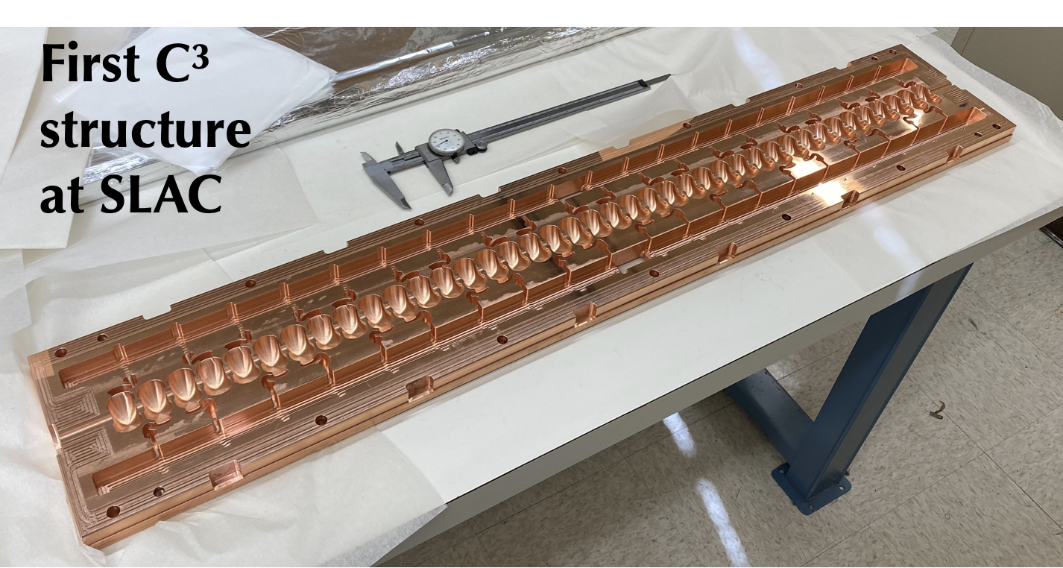
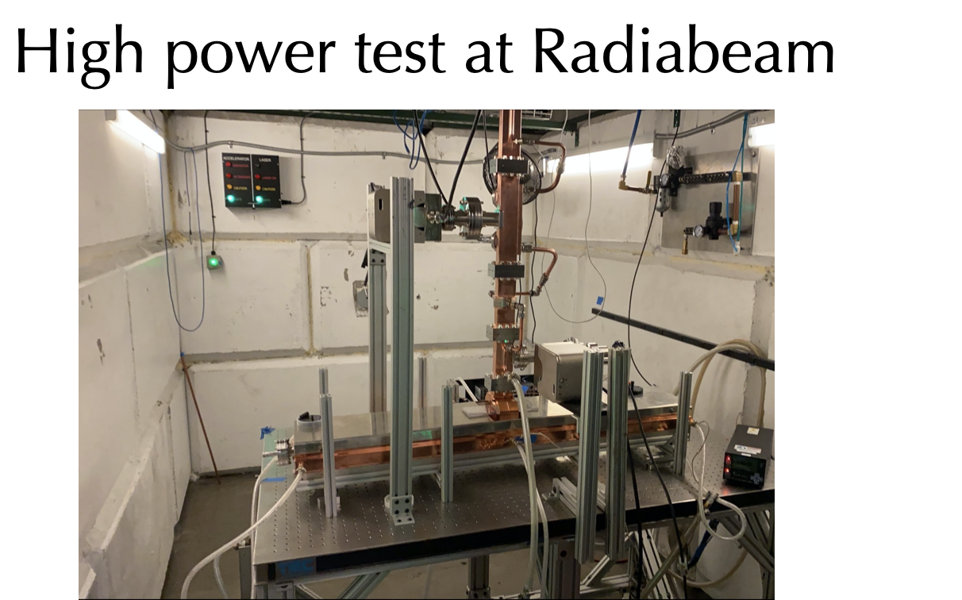
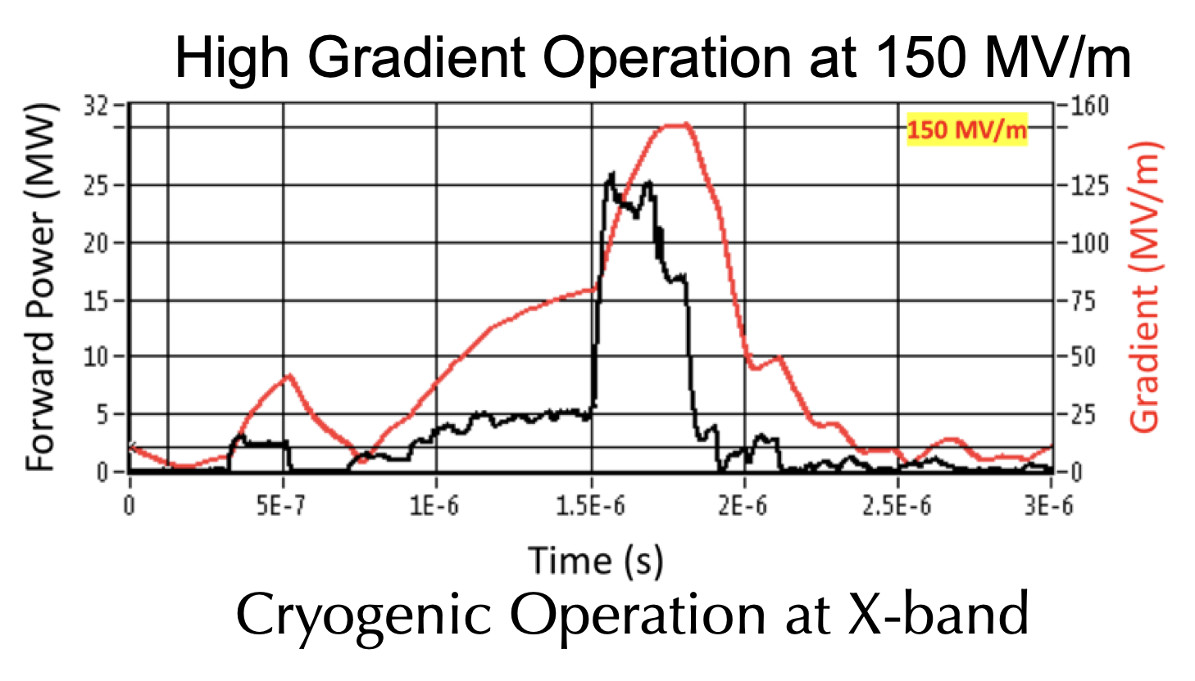
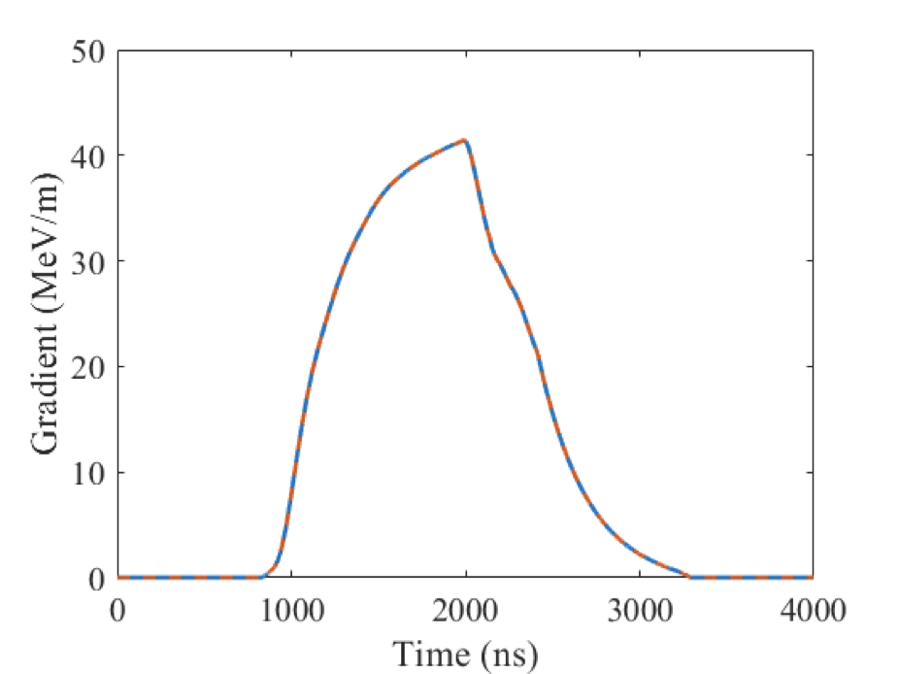
C3 - Cool Copper Collider
C³ is based on a new rf technology
  Dramatically improving efficiency and breakdown rate
Distributed power to each cavity from a common RF manifold
Operation at cryogenic temperatures (LN2 ~80K)
Robust operations at high gradient: 120 MeV/m
Scalable to multi-TeV operation
Confirmed with beam
First 300 K High Power Test Limited Available RF - Next Cryo

Slide 4
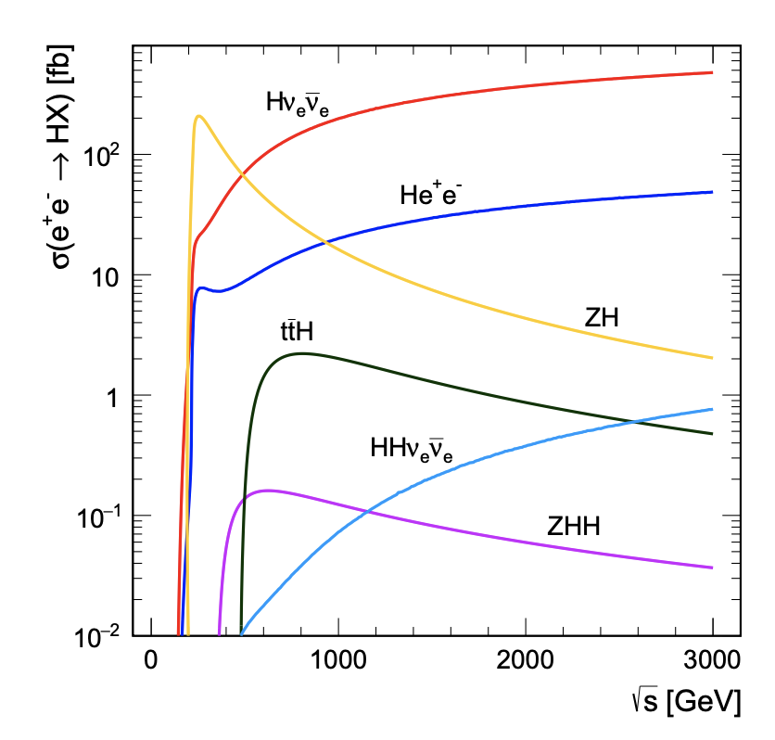
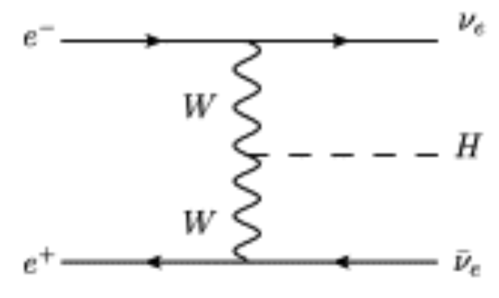
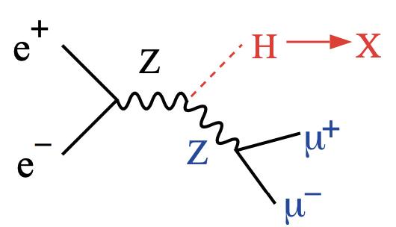
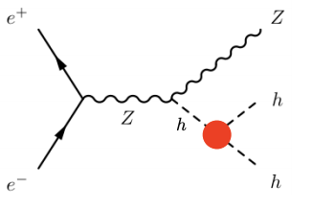
Higgs at e⁺e⁻
ZH is dominant at 250 GeV
Above 500 GeV
  Hvv dominates
  ttH opens up
  HH production accessible with ZHH
C. Vernieri

Slide 5
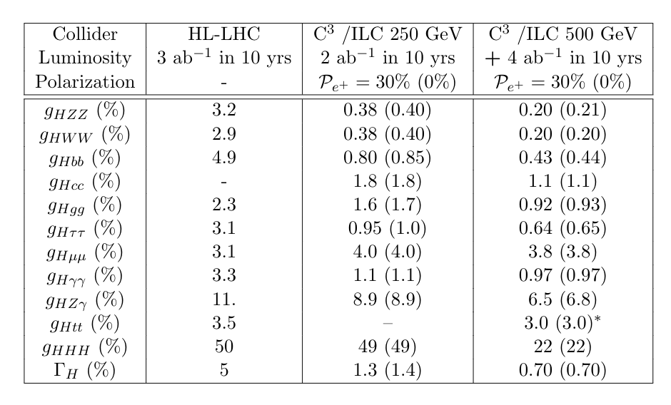
Why 550 GeV?
We propose 250 GeV with a relatively inexpensive upgrade to 550 GeV
An orthogonal dataset at 550 GeV to cross-check a deviation from the SM predictions observed at 250 GeV
From 500 to 550 GeV a factor 2 improvement to the top-Yukawa coupling
O(20%) precision on the Higgs self-coupling would allow to exclude/demonstrate at 5𝜎 models of electroweak baryogenesis

Slide 6
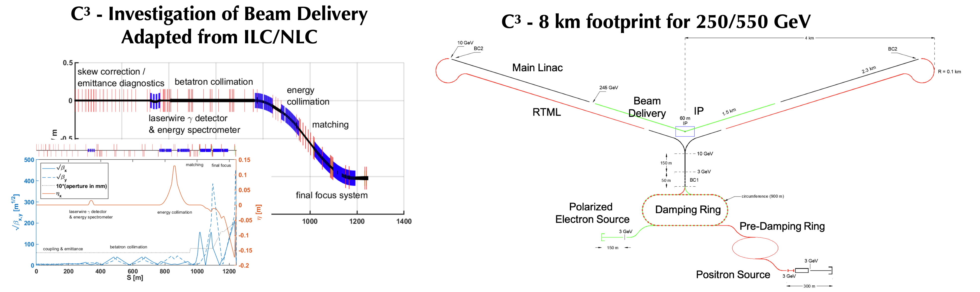
C3 – Accelerator Complex
8 km footprint for 250/550 GeV CoM - > 70/120 MeV/m
  7 km footprint at 155 MeV/m for 550 GeV CoM – present Fermilab site
Large portions of accelerator complex are compatible between LC technologies
  Beam delivery and IP modified from ILC (1.5 km for 550 GeV CoM)
  Damping rings and injectors to be optimized with CLIC as baseline
  Costing studies use LC estimates as inputs

Slide 7
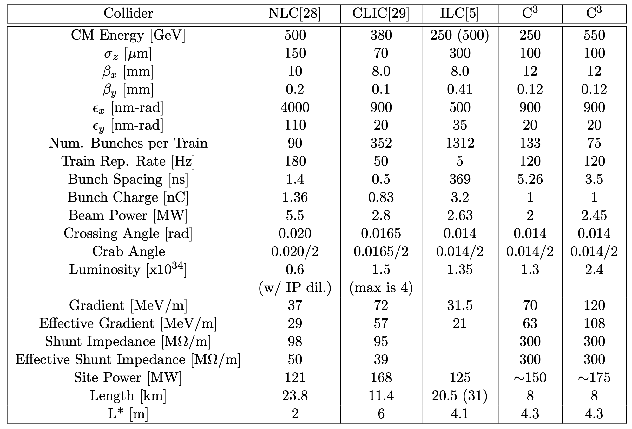
Table of Parameters

Slide 8
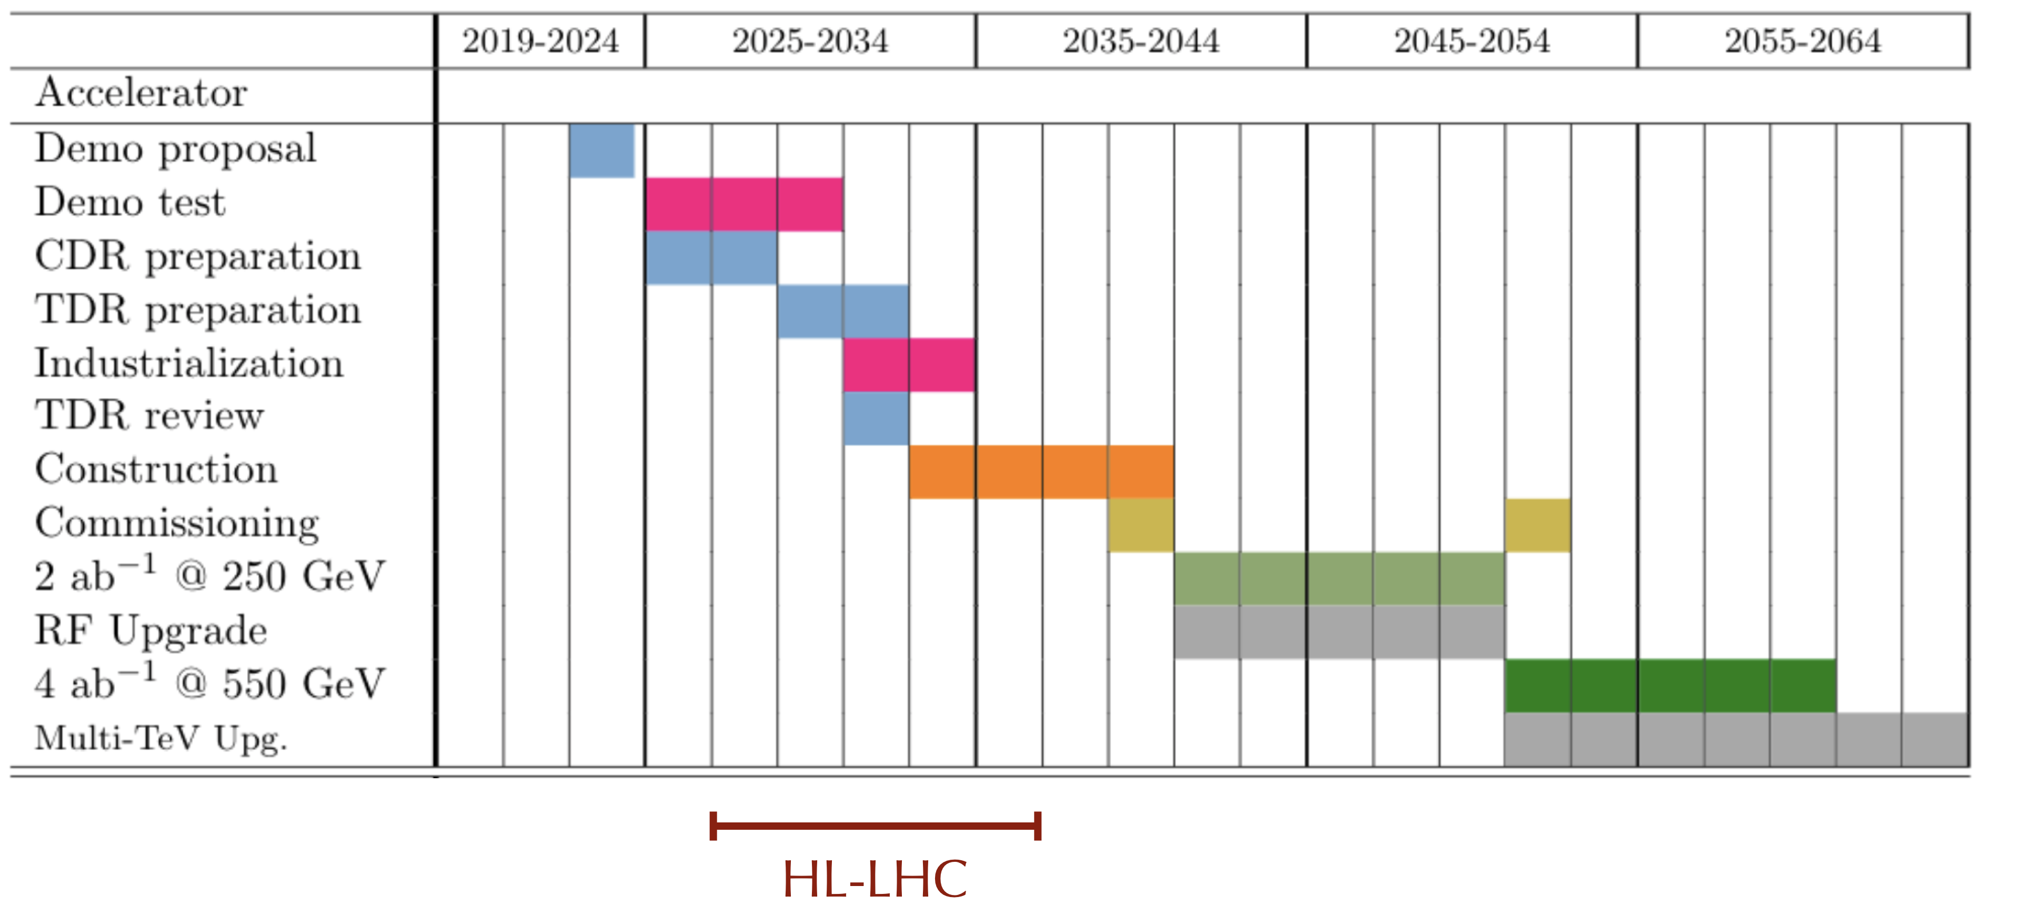
Timeline for C³ 250/550
Technically limited timeline following community engagement through the full Snowmass process to define the parameters of the C³ proposal

Slide 9
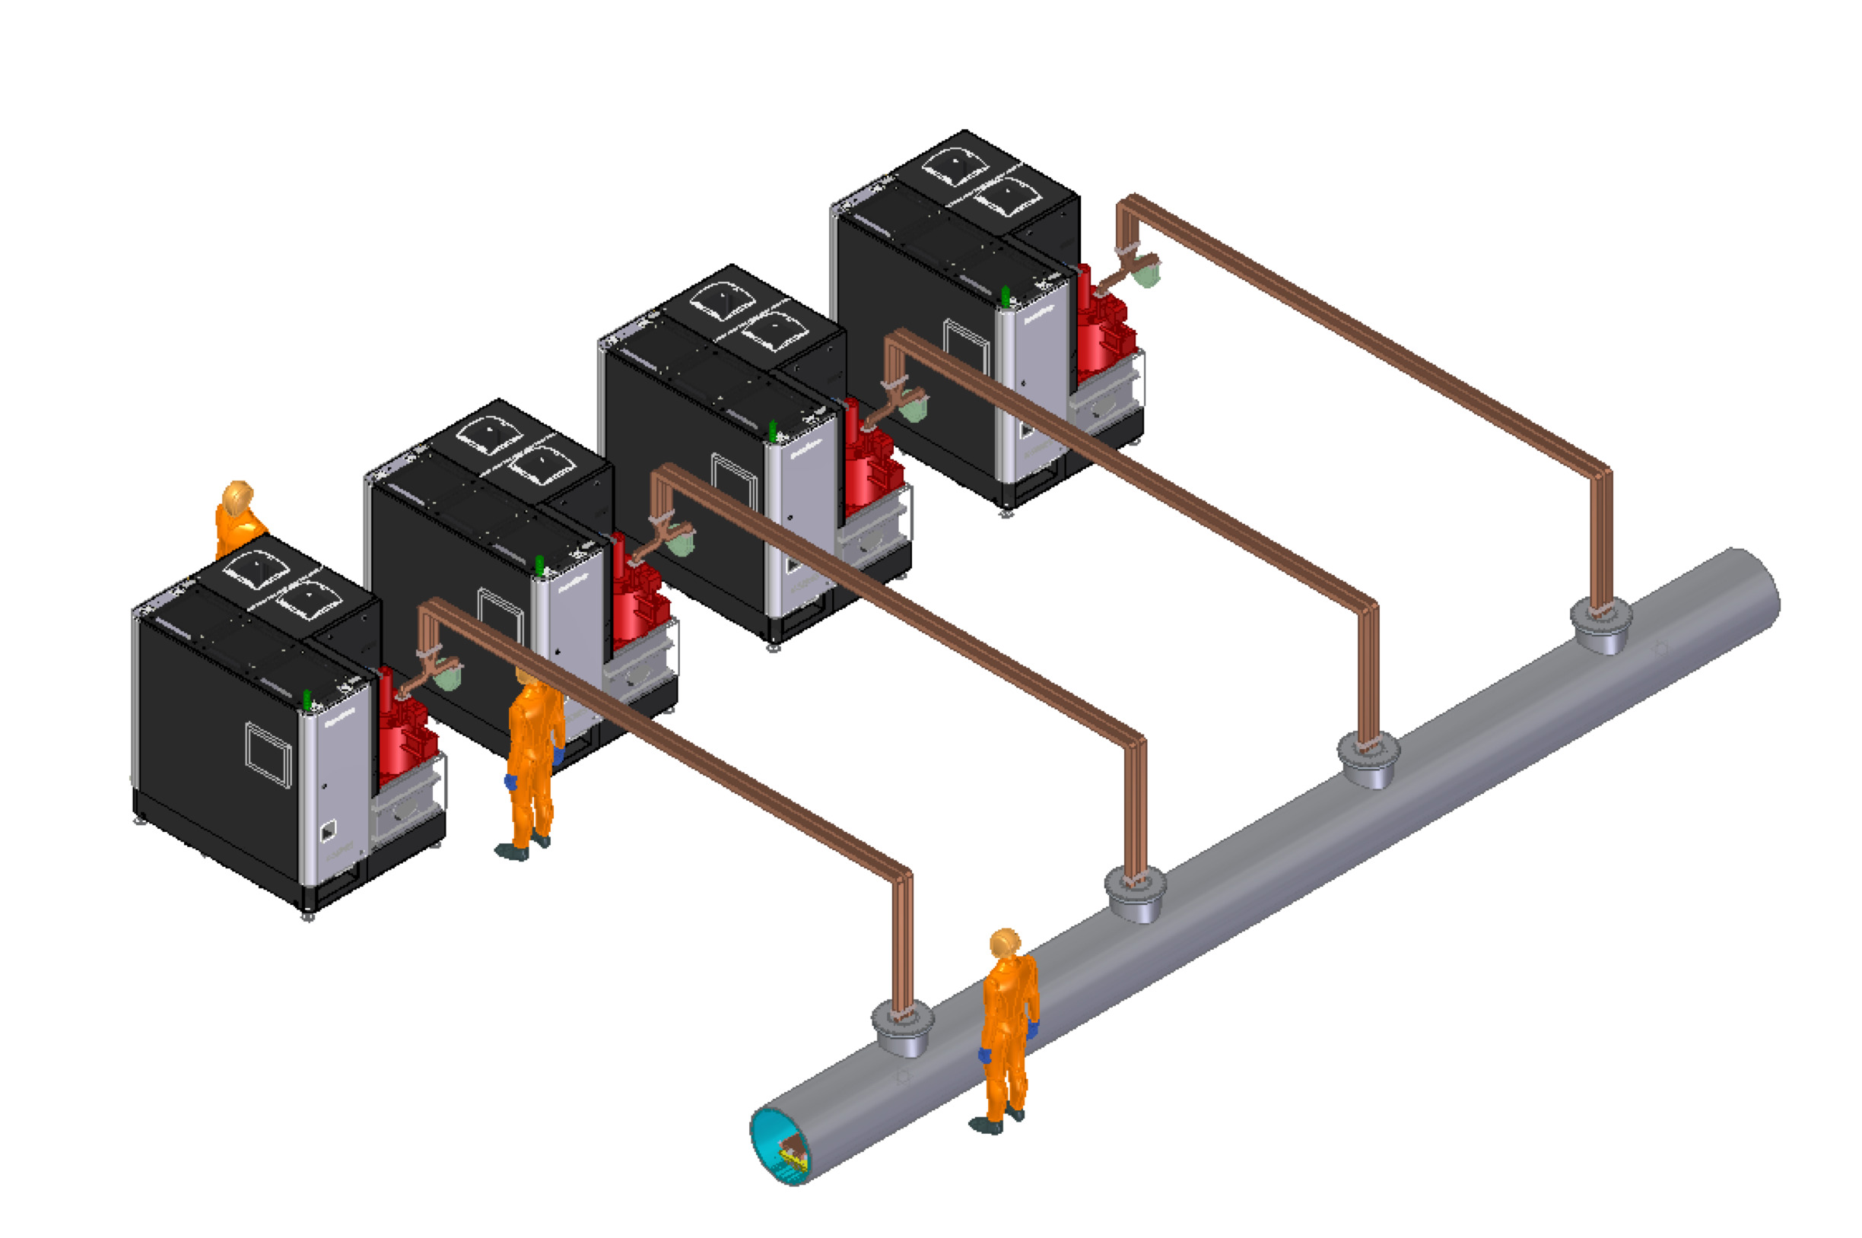
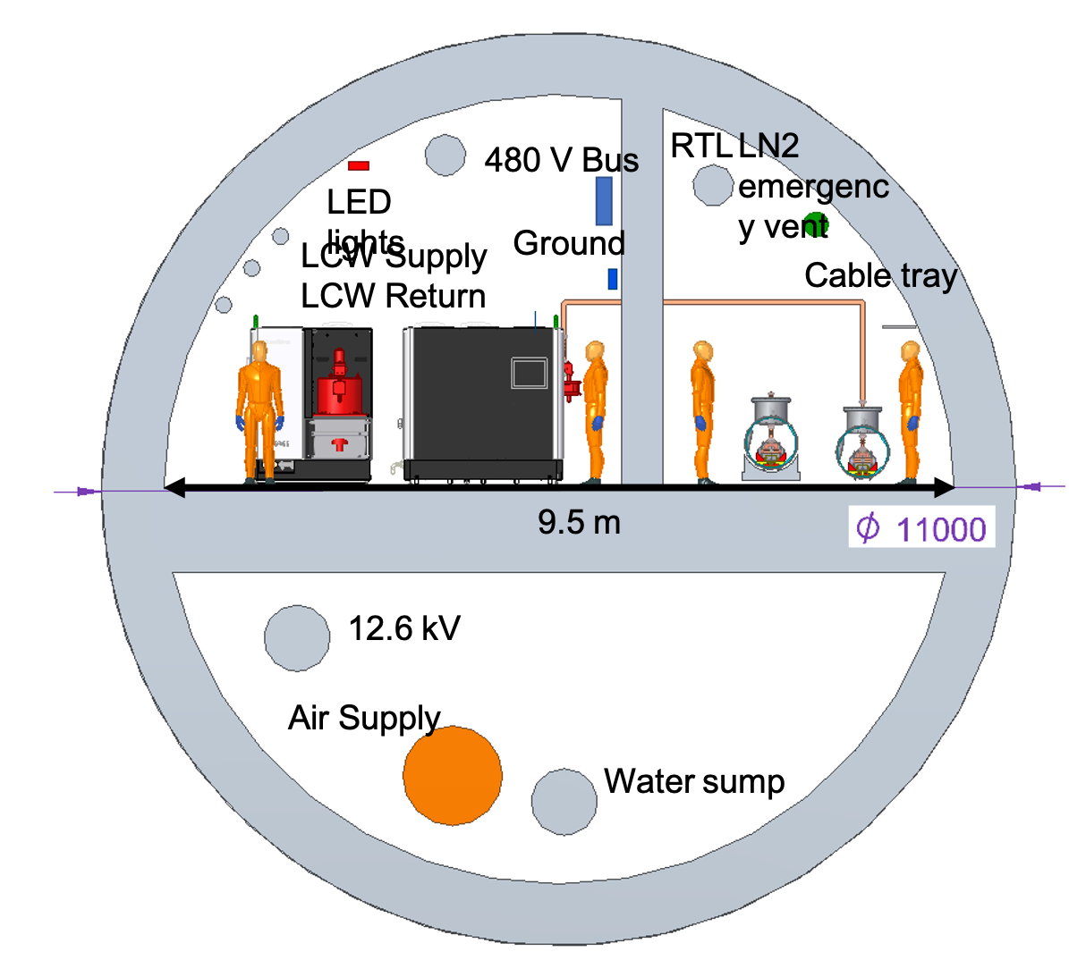
Tunnel Layout for Main Linac 250/550 GeV CoM
Need to optimize tunnel layout – first study looked at 9.5 m inner diameter in order to match ILC costing model
Must minimize diameter to reduce cost and construction time
Surface site (cut/cover) provides interesting alternative – concerns with length of site for future upgrade
Cryomodule unit - 9 m (630 MeV/1 GeV )
Usable Tunnel Width - 9.5 m
(Same tunnel width as ILC)

Slide 10
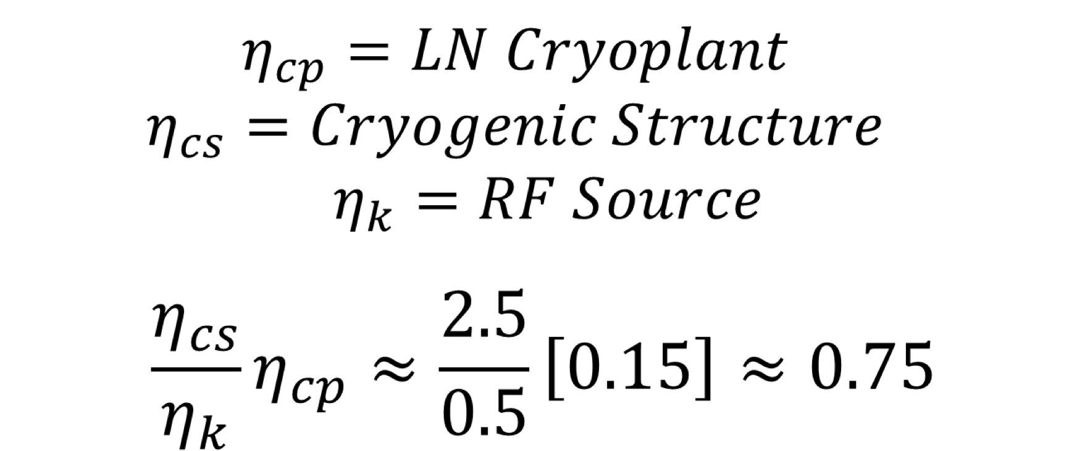
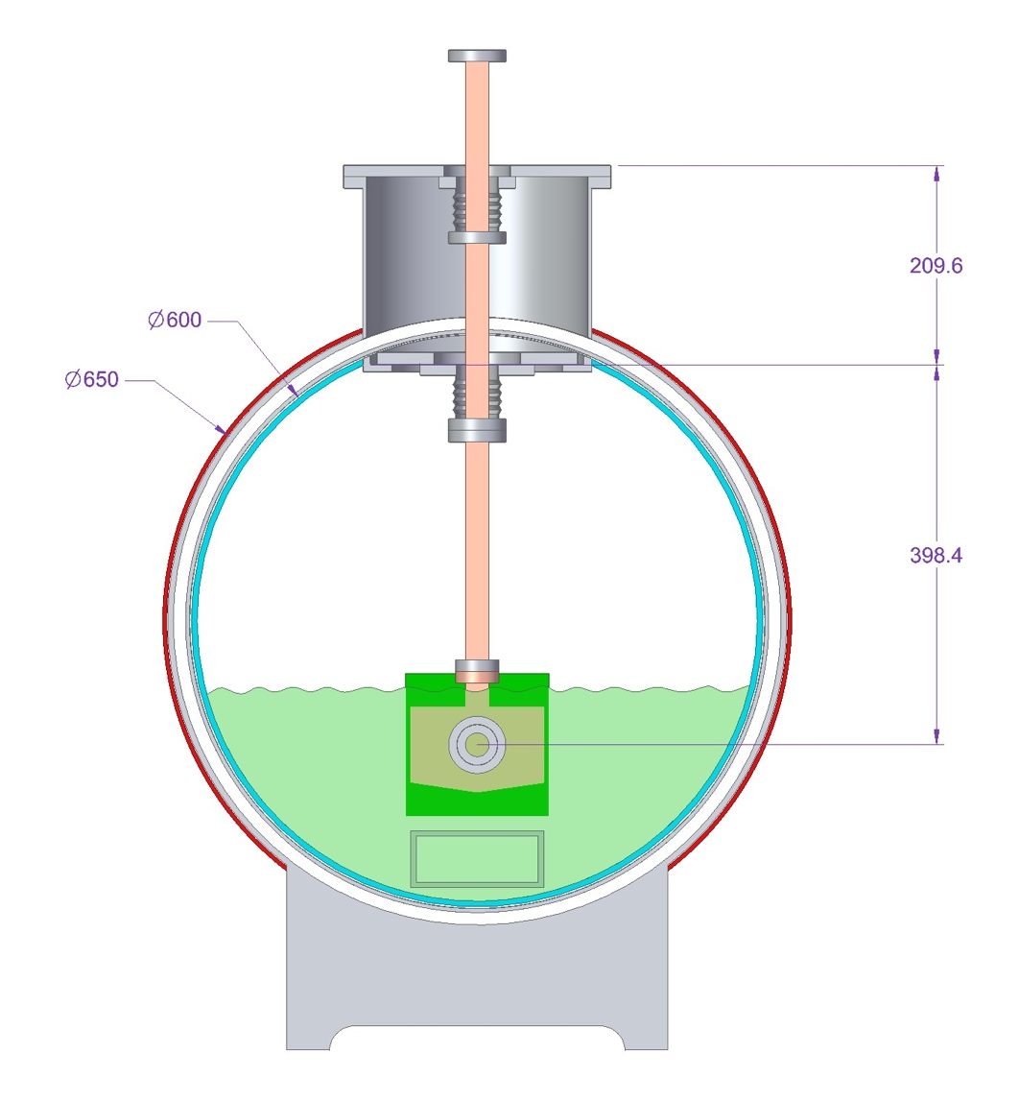
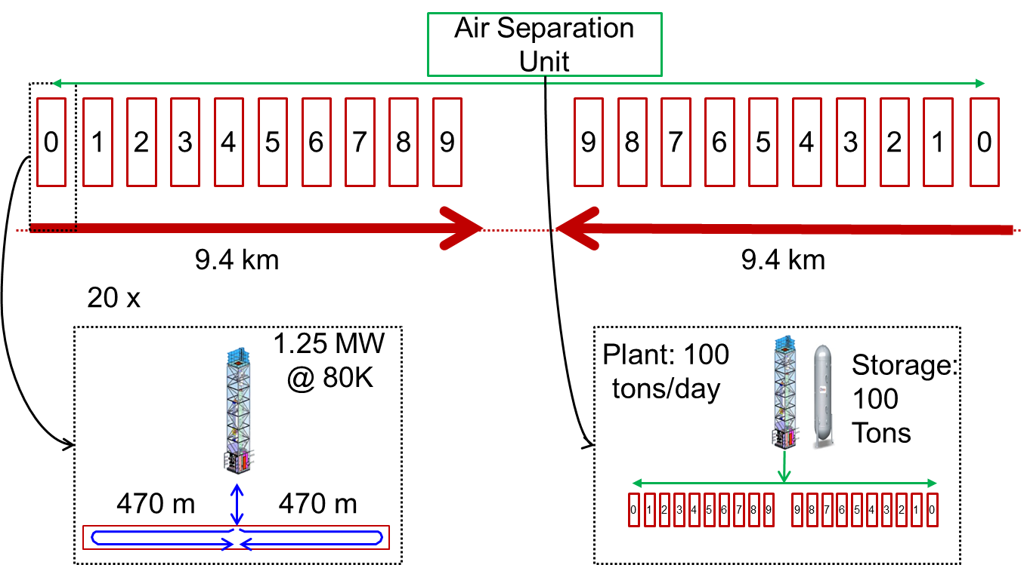
Cryogenics
X-band structure demonstrated full average power over short length (0.25 m)
Cryomodule design developed for cryoplant layout to cool 1.2 MW/km thermal load at 77K
Conservative estimate by Air Liquide
2 TeV CoM Cryogenics
Shared nitrogen supply and return

Slide 11
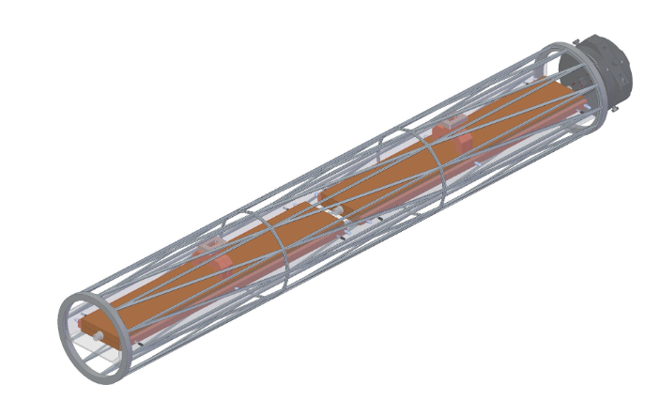
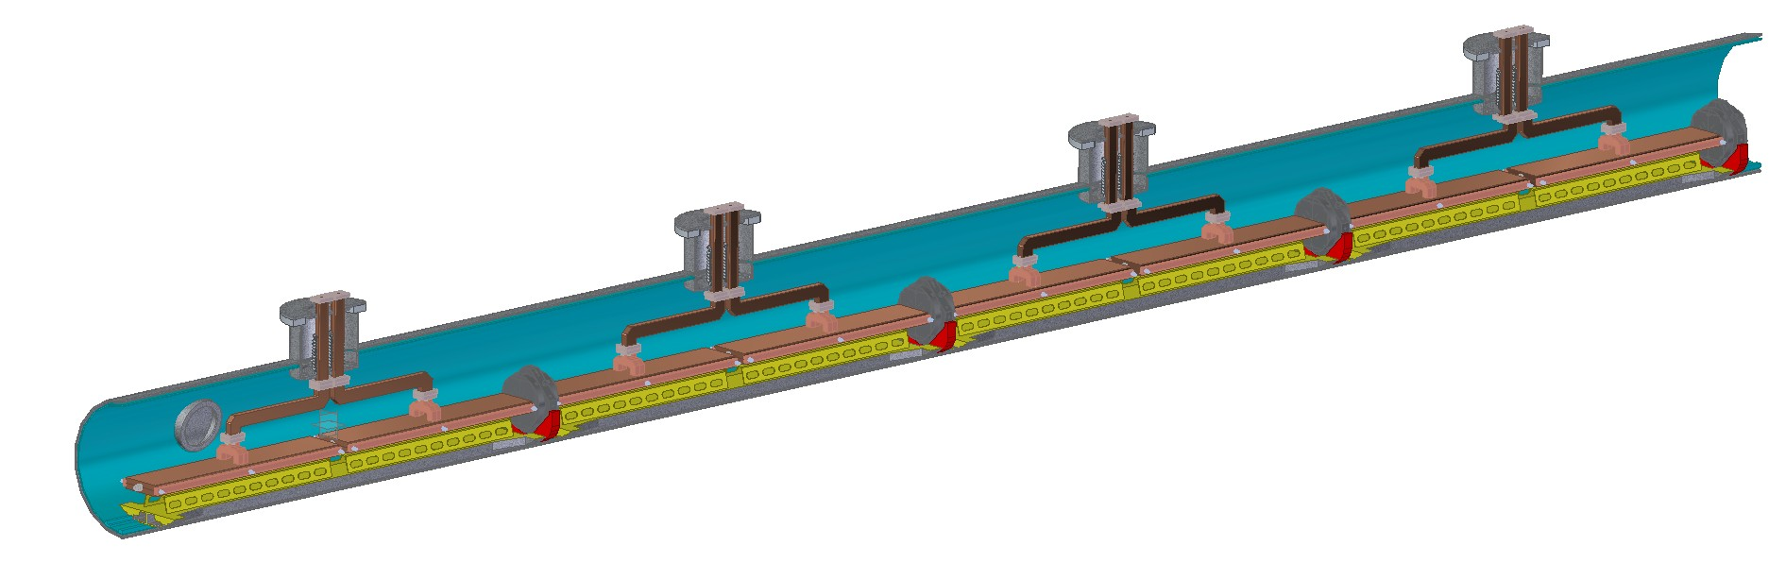
Cryomodule Design and Alignment
Main linac will require 5 micron structure alignment
Combination of mechanical and beam based alignment
Pre-alignment warm, cold alignment by wire, followed by beam based
Mechanical motor runs warm or cold – no motion during power failure
Piezo for active alignment
Investigating support and assembly
1 m Accelerator
~9m Cryomodule (90% fill factor)

Slide 12
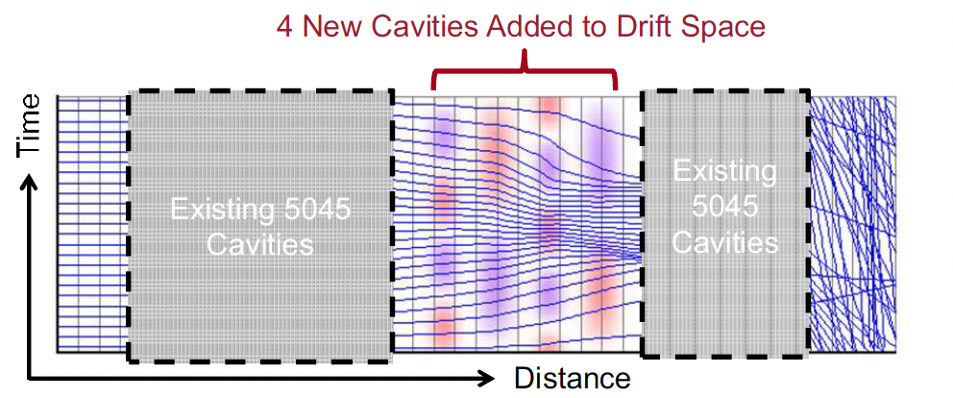
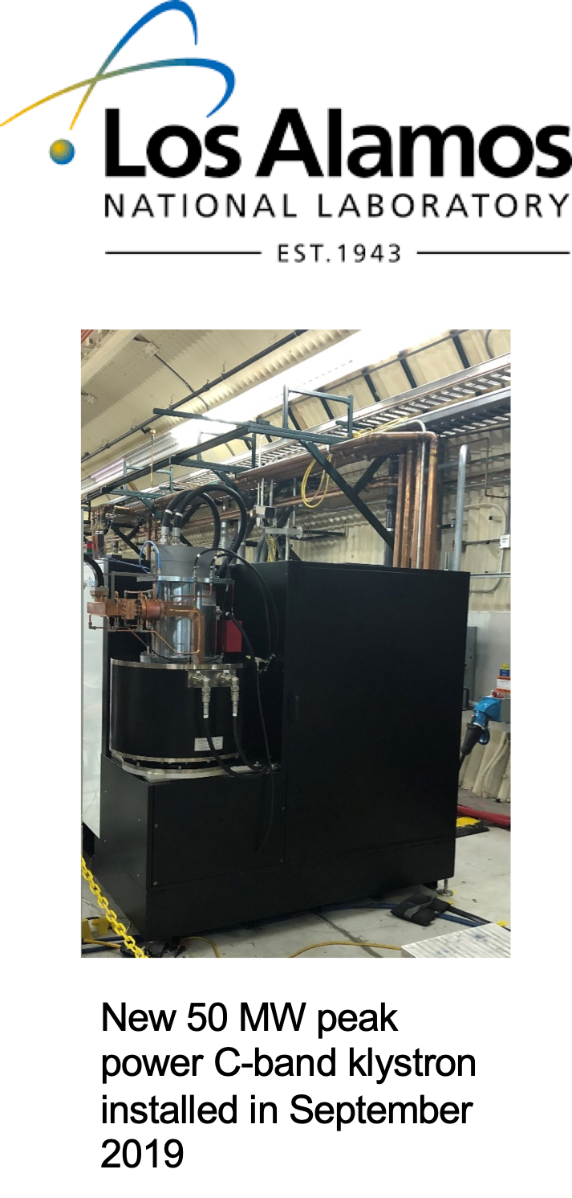
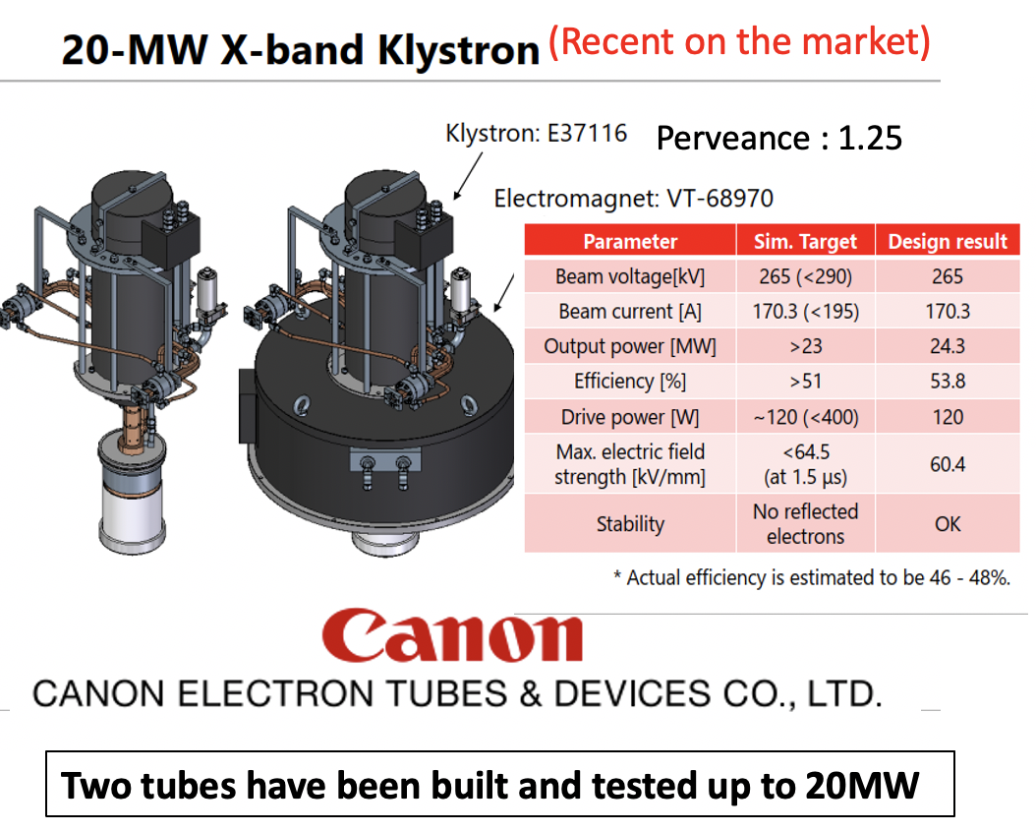
RF Sources Available vs. Near Term Industrial Efforts
RF sources and modulators capable of powering CCC-250 commercially available
Plan to leverage significant developments in performance (HEIKA) of high power rf sources – requires industrialization
SLAC BAC Prototype
S-band Retrofit +10% efficiency, 73 MW
BVEI X-band 50 MW 57%
COM Prototype
Near Term Industry

Slide 13
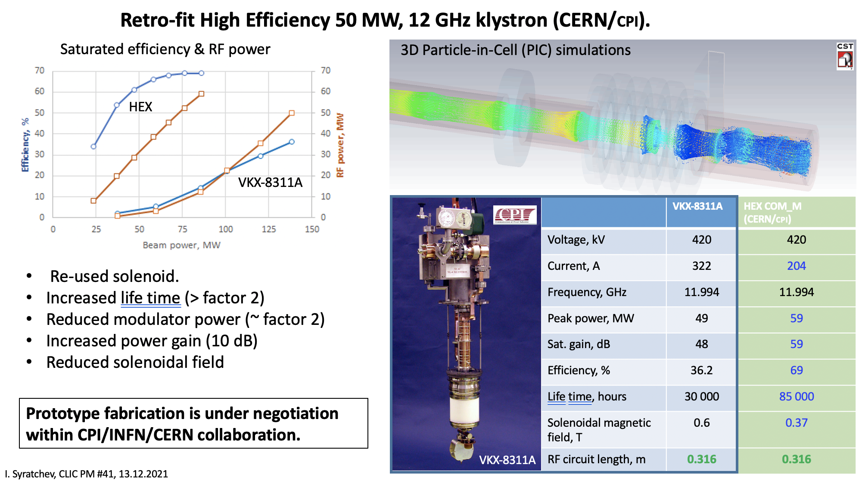
High Efficiency Klystrons
Please See I. Syratchev’s Talk for Many Great Examples from Designs to Prototypes
https://indico.cern.ch/event/1101548/contributions/4635964/attachments/2363439/4034986/CLIC_PM_13_12_2021.pdf

Slide 14
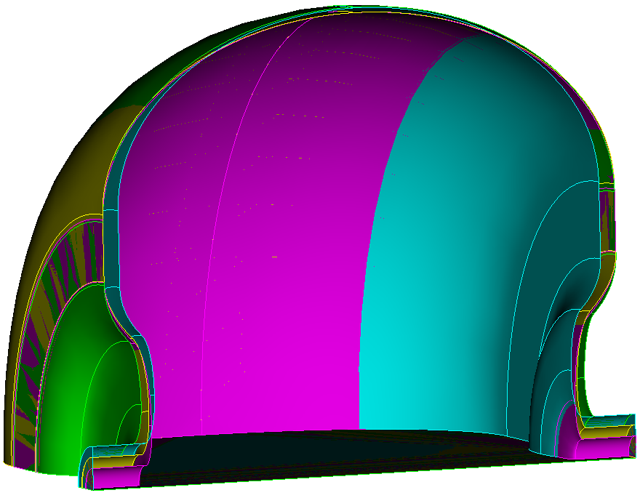
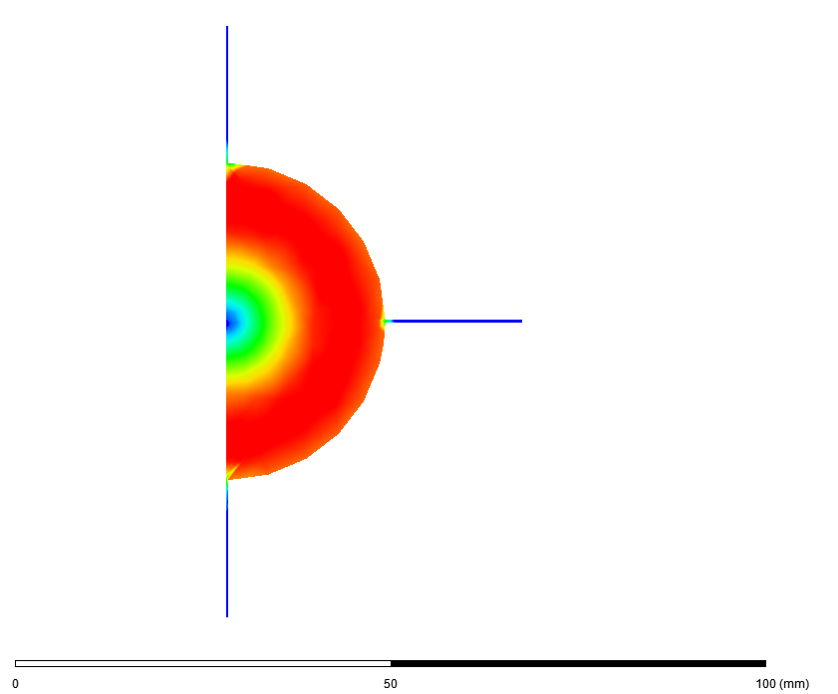
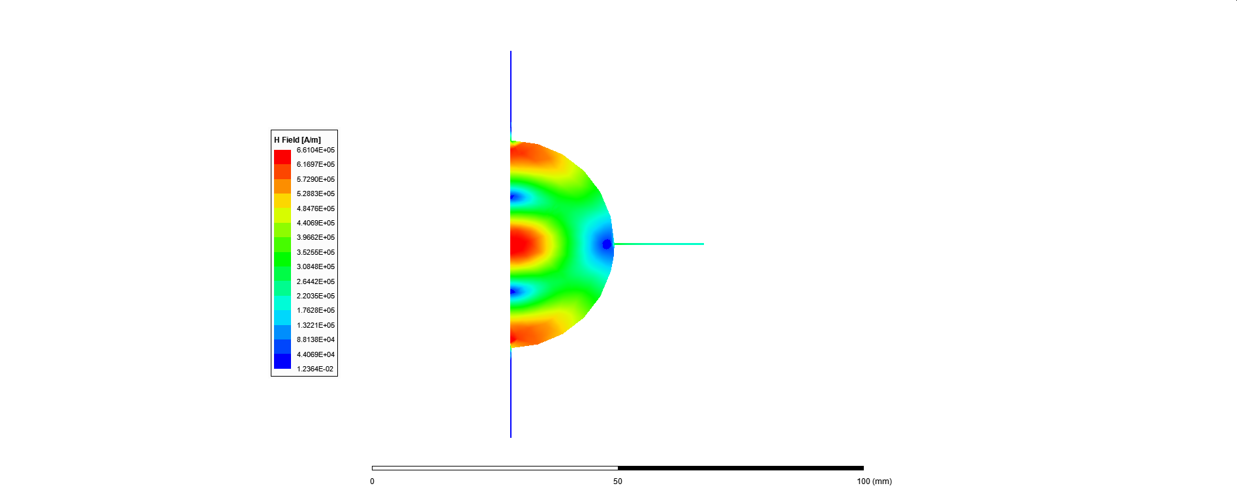
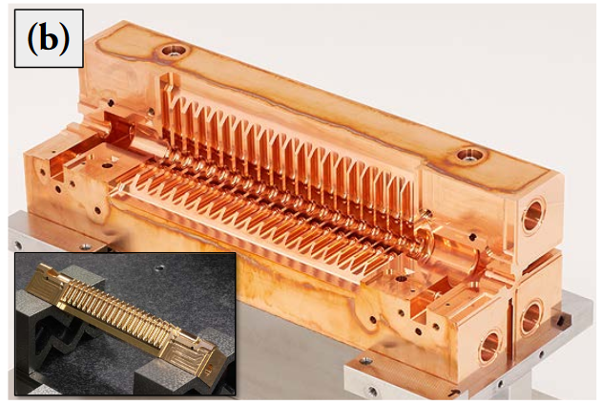

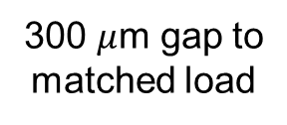
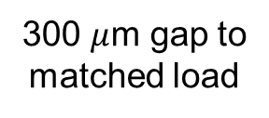
Distributed Coupling Structures Provide Natural Path to Implement Detuning and Damping of Higher Order Modes
Individual cell feeds necessitate adoption of split-block assembly
Perturbation due to joint does not couple to accelerating mode
Exploring gaps in quadrature to damp higher order mode
Design of Detuned Cavities
300 $μ$m gap to
matched load
300 $μ$m gap to
matched load
H-field
Quadrant Structure
Q $≈$ 10³ (vs 4x10⁴)
Accelerating Mode
Dipole
Mode
Abe et al., PASJ, 2017, WEP039

Slide 15
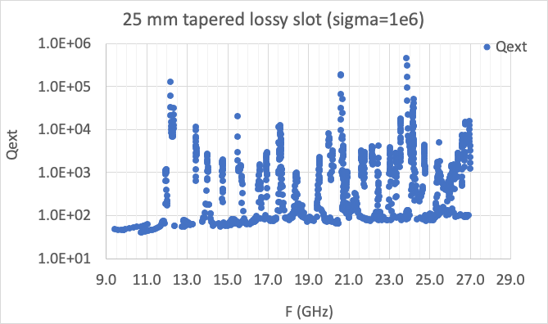
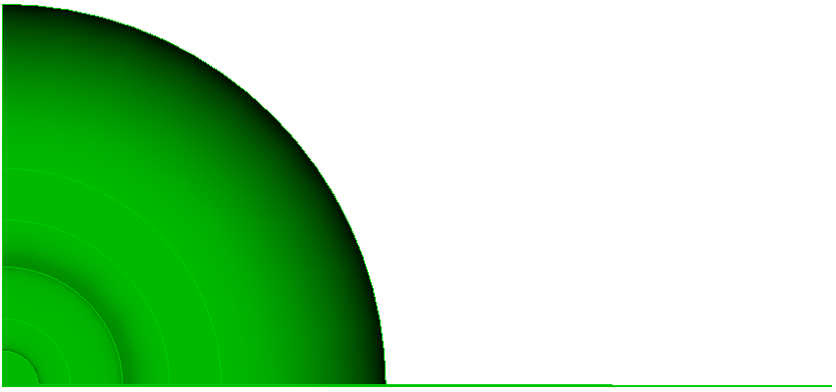
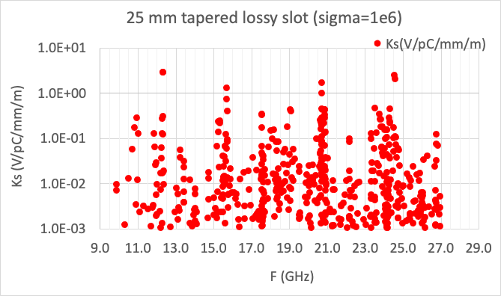
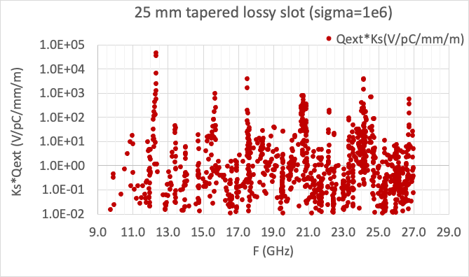
Implementation of Slot Damping
Slot Damping Prototype
Working on NiCr Coating
Need to extend to 40 GHz / Optimize coupling / Modes below 10^4 V/pC/mm/m
NiCr coated damping slots in development
Tapered slot

Slide 16
Demonstration Facility
C³ demonstration facility to advance technology beyond CDR level
Minimum requirement for Demo Facility:
  Demonstrate operation of fully engineered and operational cryomodule
    Simultaneous operations of min. 3 cryomodules
  Demonstrate operation during cryogenic flow equivalent to main linac at full liquid/gas flow rate
  Operation with a multi-bunch photo injector - high charges bunches to induce wakes, tunable delay witness bunch to measure wakes
  Demonstrate full operational gradient 120 MeV/m (and higher > 155 MeV/m) w/ single bunch
    Must understand margins for 120 - targeting power for (155 + margin) 170 MeV/m
    18X 50 MW C-band sources - off the shelf units
  Fully damped-detuned accelerating structure
  Work with industry to develop C-band source unit optimized for installation with main linac
This step is included in our timeline. The cost is O(100 M$).
  This demonstration directly benefits development of compact FELs for photon science.
The other elements needed for a linear collider - the sources, damping rings, and beam delivery system – more advanced from the ILC and CLIC – need C³ specific design
  Our current baseline uses these directly although we will look for further cost-optimizations for the specific needs of the C³

Slide 17
Demonstration Facility R&D Topics
Direct Demonstrator Facility (>=50 m, 120 Hz, 133X 1nC)
  Cryomodule Cryogenics and Beamline Design
  Cryomodule Assembly
  Beam dynamics - lianc, damping rings, bunch compressors
  RF High-brightness photo-injector for demonstrator
  RF High-brightness polarized photo-injector
  DC polarized gun and injector
  Low level rf - Klystron controls and rf signal control
  Raft alignment:
    Warm/cold mechanical/piezoelectric feedback
  High Power RF Distribution (waveguide components, loads)
  End-to-end simulation
Parallel R&D
  Levitated Positron Target - Radiatively cooled
  QD0/QD1
  Advanced RF Source R&D
  RF Distribution (pulse compressor)
  Site Studies
  Error Sensitivity Study
  Polarimetry
Industrialization
  Cryogenics Quads
  Linac Fabrication
  Cryomodule Cryogenics and Beamline Design
  Cryomodule Production
  Klystron
  Modulator
  Tunnel
  Pre-Fab Surface Construction
  Large scale cryogenics

Slide 18
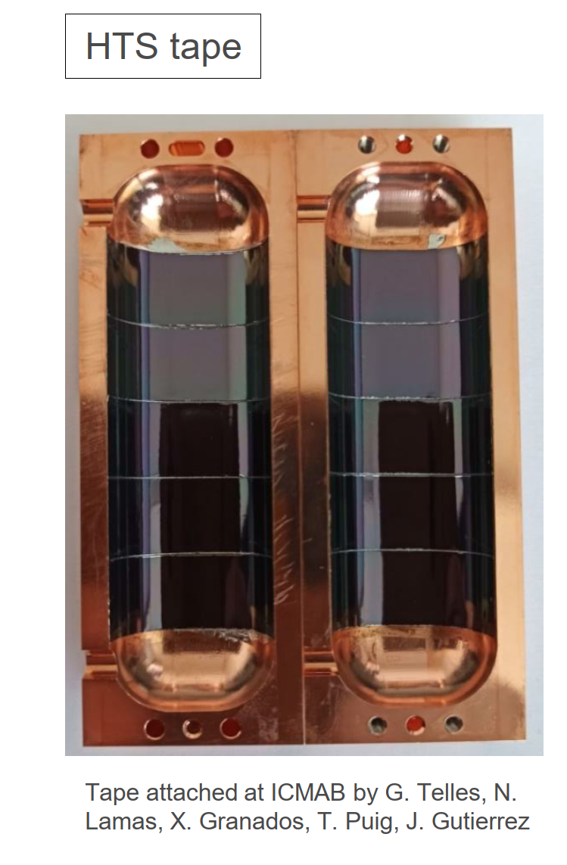
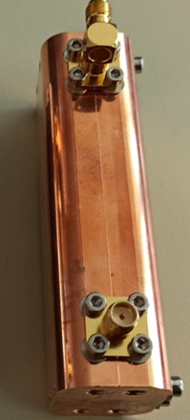
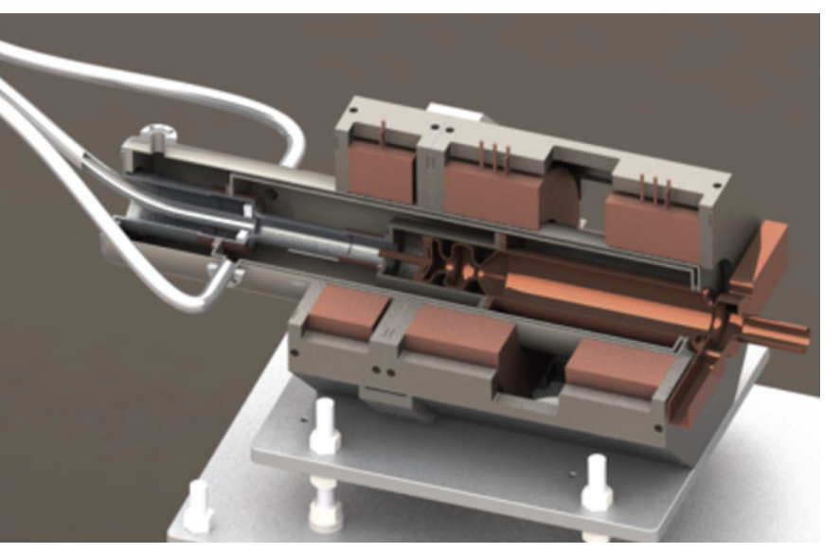
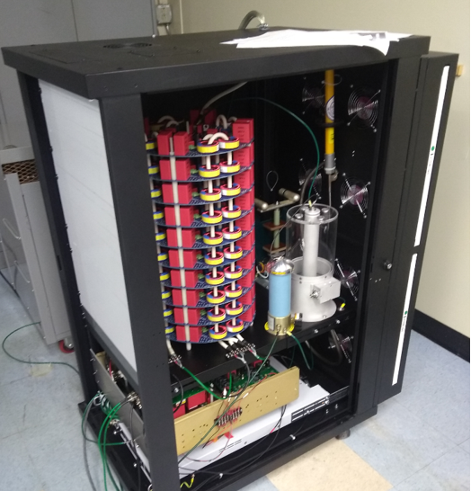
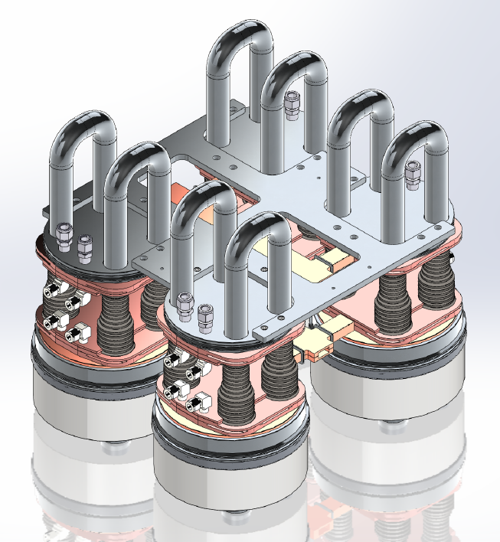
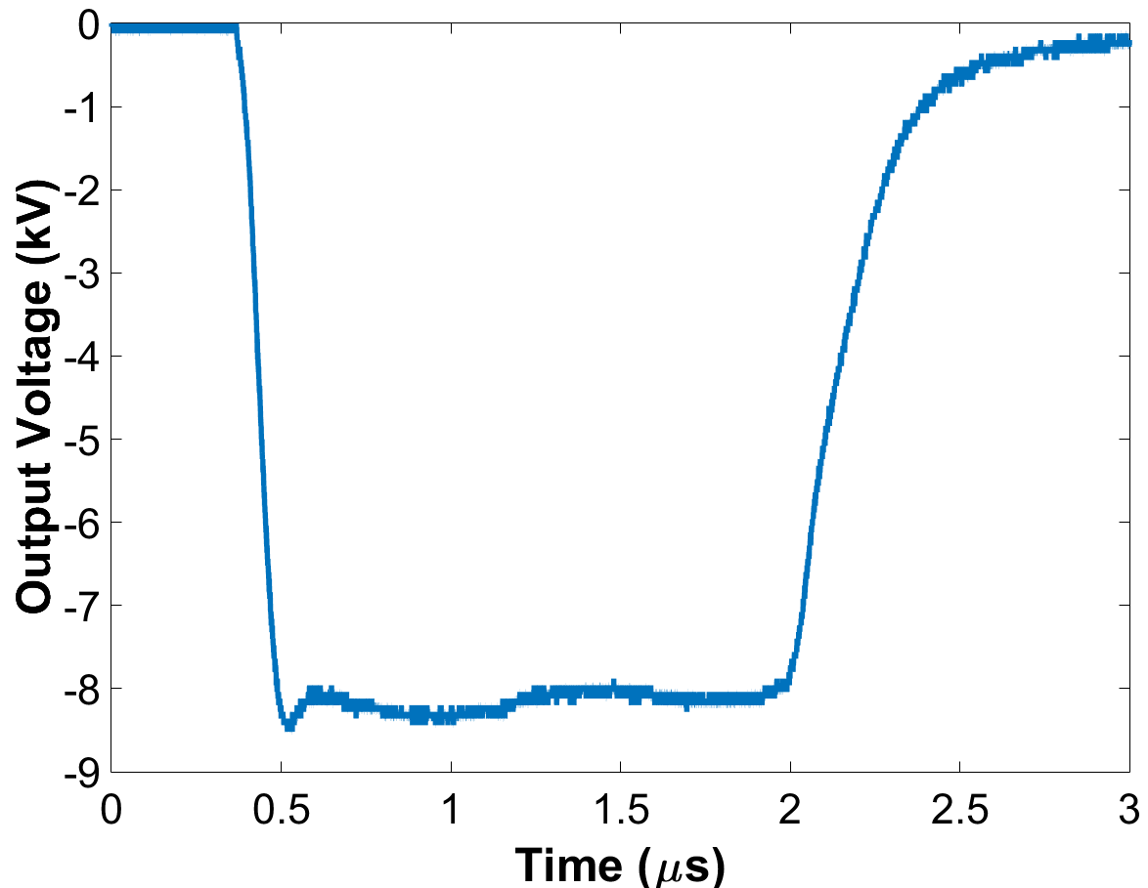
Additional Cost Reduction
High-brightness polarized rf gun to remove one damping ring
Low-voltage massively parallel rf sources – cost driver for the main linac and whole complex at TeV scale
RF pulse compression – achieve nominal gradient faster and reduce thermal load on cryogenics
  High temperature superconductor possible 10X improvement in Q-factor at LN temperature
REBCO Tape Coated Cavity
High Brightness Gun
PRAB 22, 023403 (2019)
Low-cost “Digikey Catalog” Marx Modulator
From: Jessica Golm, Sergio Caltroni, Walter Wuensch
Modular Klystron Array operating at extremely low voltages

Slide 19
Questions?

